Slide 1

Ushicilelo 26.10
Intshayelelo
kwiBitcoin
Isikhokelo sabaqalayo

Slide 2

Kutheni Imali Ibalulekile?
Sisebenzisa imali yonke imihla, kodwa asifane sibuze ukuba isebenza njani.
Notes:
Umthombo: My First Bitcoin, Intshayelelo yeBitcoin, Isikhokelo sabaQalayo, uhlelo 26.10. Ilungiselelwe phantsi kwelayisenisi yeCreative Commons Attribution-ShareAlike 4.0 International; le ngqokelela yezilayidi isebenzisa kwaloo layisenisi. Le ngqokelela yezilayidi sisixhobo sokuncedisa umfundisi-ntsapho xa esenza inkcazo, esisekelwe kwimibuzo emithandathu yesikhokelo. Lungiselelanisani imizekelo, isantya sokufundisa nendlela yokunikezela inkcazo ukuze zihambelane noluntu lwenu, ngoxa nigcina intsingiselo nemiyalezo yokhuseleko. Akukho xesha limiselweyo leseshoni elichaziweyo.

Slide 3

Uninzi lwabantu aluze luziphe
ixesha lokucinga ngemali
Asikokuyirhola, asikokuyichitha, kodwa kukucinga ngokuba iyintoni na nokuba isebenza njani.
Intshayelelo kwiBitcoin · Kutheni Imali Ibalulekile?
Notes:
Qalani ngomfanekiso: wonke umntu osingqongileyo usebenzisa imali ngaphandle kokuzibuza ngayo. Buzani iqela ukuba lagqibela nini ukucinga ngokuba imali ivela phi.

Slide 4

Imibuzo emihlanu yokuqalisa
Kutheni abantu befuna imali?
Yintoni eyenza into ibe yimali?
Ngubani onokudala okanye alawule imali eniyisebenzisayo?
Kutheni imali eniyisebenzisayo inexabiso?
Ngaba imali yenu ithenga umlinganiselo ofanayo wezinto njengangaphambili?
Gcina iimpendulo zenu
Bhalani impendulo emfutshane kumbuzo ngamnye. Niya kubuyela kuzo ekupheleni.
Intshayelelo kwiBitcoin · Kutheni Imali Ibalulekile?
Notes:
Nika abafundi imizuzu embalwa yokubhala. Musani ukucela nabani na ukuba abelane ngeenkcukacha zakhe zemali. Ezi mpendulo ziphinda zivele kwisilayidi samanqaku aphambili esinesihloko esithi “Yintoni Elandelayo?”

Slide 5

Inyaniso okanye uluvo?
Inyaniso: "Eli phepha-mali liyamkelwa ekuhlawuleni irhafu." Oku kunokuqinisekiswa.
Uluvo: "Olu lolona hlobo lwemali lubalaseleyo." Oku kufuna imilinganiselo nobungqina.
Esi sikhokelo senzelwe ukufundisa kuphela. Asiniki ngcebiso ngemali, utyalo-mali, umthetho okanye irhafu, kwaye asinixeleli ukuba nithenge, nithengise okanye nigcine nantoni na.
Intshayelelo kwiBitcoin · Kutheni Imali Ibalulekile?
Notes:
Wugcineni lo mahluko engqondweni kuyo yonke iseshoni. Xa kuvela ibango, zibuzani: singalijonga na ukuba liyinyani, okanye lifuna iinqobo zokuvavanya nobungqina?

Slide 6

Yintoni imali?
Imali sisixhobo sokutshintshiselana.

Slide 7

Ukurhweba ngokutshintshiselana nokungqamana okuphindwe
kabini kweemfuno
Bobabini abantu kufuneka bafune oko omnye anako, ngexesha elinye nangemilinganiselo efanelekileyo.
Intshayelelo kwiBitcoin · Yintoni imali?
Notes:
Sebenzisani umzekelo okwisikhokelo: nilima irayisi kwaye nifuna izihlangu, kodwa umenzi wezihlangu ufuna ioli yokupheka, hayi irayisi. Iingcali zezoqoqosho zikubiza oku ngokuba kukungqamana kabini kweemfuno.

Slide 8
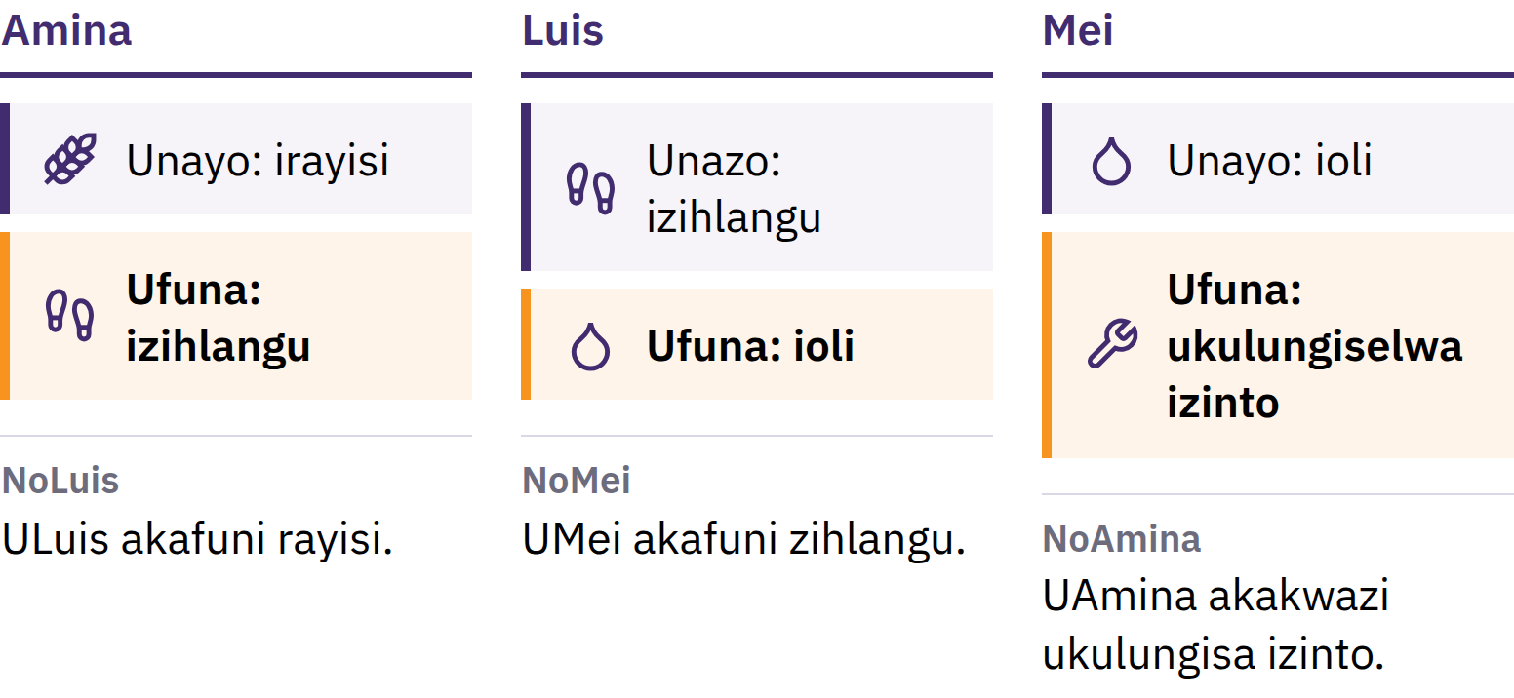
Ukurhweba ngokutshintshiselana nokungqamana okuphindwe
kabini kweemfuno
Abantu bobabini kufuneka bafune oko omnye anako, ngaxeshanye nangobungakanani obufanelekileyo.
Intshayelelo kwiBitcoin · Yintoni imali?
Notes:
Sebenzisani umzekelo okwisikhokelo: nilima irayisi kwaye nifuna izihlangu, kodwa umenzi wezihlangu ufuna ioli yokupheka, hayi irayisi. Iingcali zezoqoqosho zikubiza oku ngokuba kukungqamana kabini kweemfuno.

Slide 9

Imali Sisixhobo Sotshintshiselwano
Akukho mntu ufuna imali ngenxa yayo nje. Iluncedo kuba abanye bayayamkela, belindele ukuba nabanye baya kuyamkela kamva.
Intshayelelo kwiBitcoin · Yintoni imali?
Notes:
Imali eliphepha sisiqwenga nje sephepha. Imali isombulula ingxaki yokunaniselana ngokwahlula ukuthengisa ekuthengeni: nithengisa irayisi yenu komnye umntu nize nithenge izihlangu komnye. Yile nto eyahlula imali ekunaniselaneni.

Slide 10

Izinto Ezintathu Ezenziwa Yimali
Isixhobo sotshintshiselwano: abantu bayasamkela njengentlawulo
Iyunithi yokubala: amaxabiso achazwa ngayo
Isigcini sexabiso: sidlulisela ixabiso ukusuka namhlanje ukuya kwixesha elizayo
Akukho mali igcina ixabiso ngokugqibeleleyo, kodwa ezinye iintlobo zemali ziphulukana namandla okuthenga ngokucothayo kunezinye.
Intshayelelo kwiBitcoin · Yintoni imali?

Slide 11

Ukusuka kumaqokobhe ukuya
ephepheni
Amaqokobhe, ityuwa, amaso, imfuyo, ubhedu, isilivere, igolide
Iintsimbi ezixabisekileyo: zinqabile, zihlala ixesha elide, zamkelwa ngokubanzi
Amabango abhalwe ephepheni anokutshintshwa ngesixa esichaziweyo sesinyithi
Imigangatho yegolide: iyunithi yemali edityaniswe negolide ngokusemthethweni
Imithetho yayisahluka ngokwendawo nangokwexesha.
Intshayelelo kwiBitcoin · Yintoni imali?

Slide 12
Imali ye-fiat
1971: iUnited States yaphelisa ukutshintshiselwa ngokusemthethweni kweedola ngegolide ngoorhulumente bamazwe angaphandle neebhanki ezingoovimba
Namhlanje uninzi lweemali zamazwe yimali yefiat: ikhutshwa phantsi kwegunya likarhulumente, ayinakutshintshiselwa ngegolide okanye nayiphi na enye imveliso yorhwebo
Fiat ligama lesiLatini elithetha ukuthi "makwenziwe", elidla ngokuqondwa njengelithetha ukuthi "ngommiselo"
Yamkelwa kuba abantu, amashishini, iibhanki noorhulumente bayayisebenzisa; imithetho iyenza ibe yimali esemthethweni yokuhlawula kwaye ifuna ukuba isetyenziswe ekuhlawuleni irhafu
Intshayelelo kwiBitcoin · Yintoni imali?

Slide 13

Sasuka kwimali exhaswa yinto
ethile, saya kwimali exhaswa
kukuthembela kumntu othile.
Intshayelelo kwiBitcoin · Yintoni imali?

Slide 14

Yintoni Engalunganga Ngemali Yethu?
Xa abantu besiva igama elithi ukunyuka kwamaxabiso, badla ngokucinga ngamaxabiso anyukayo.

Slide 15
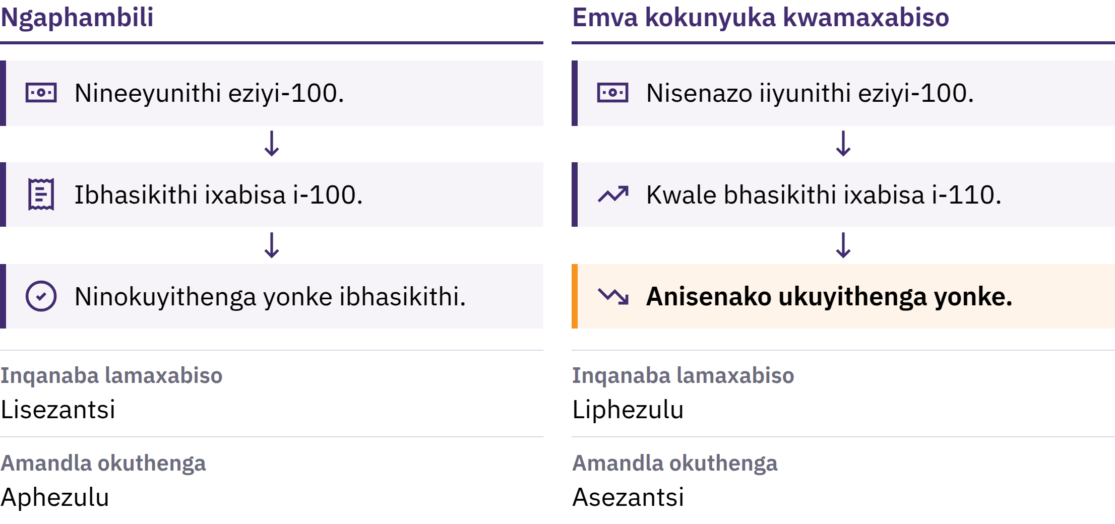
Ukunyuka kwamaxabiso namandla okuthenga
Intshayelelo kwiBitcoin · Yintoni Engalunganga Ngemali Yethu?
Notes:
Ukunyuka kwamaxabiso kukunyuka okuqhubekayo kwinqanaba lamaxabiso ngokubanzi. Elinye icala lako ngamandla okuthenga: ubungakanani bezinto ezinokuthengwa yiyunithi enye yemali. Ukuba ixabiso lebhaskithi yeempahla ezisisiseko linyuka lisuka kwiiyunithi ezili-100 zemali liye kwezili-110, kwaezo yunithi zili-100 azisakwazi ukuthenga yonke loo bhaskithi.

Slide 16

Ukunyuka kwamaxabiso namandla okuthenga
Intshayelelo kwiBitcoin · Yintoni Engalunganga Ngemali Yethu?
Notes:
Ukunyuka kwamaxabiso kukunyuka okuqhubekayo kwinqanaba lamaxabiso ngokubanzi. Elinye icala lako ngamandla okuthenga: ubungakanani bezinto ezinokuthengwa yiyunithi enye yemali. Ukuba ixabiso lebhaskithi yeempahla ezisisiseko linyuka lisuka kwiiyunithi ezili-100 zemali liye kwezili-110, kwaezo yunithi zili-100 azisakwazi ukuthenga yonke loo bhaskithi.

Slide 17

Izizathu Ezininzi, Ukhetho
Olunye
Ukwanda kwemali nekhredithi
Ukuphazamiseka konikezelo notshintsho kwimfuno
Imali ephelelwa lixabiso, iirhafu, iindleko zemveliso
Esinye sezizathu sisiphumo sokhetho, kungekhona ingozi: kwinkqubo yemali yefiat, amaziko ambalwa anokwandisa isixa semali nekhredithi aze atshintshe imithetho yayo.
Intshayelelo kwiBitcoin · Yintoni Engalunganga Ngemali Yethu?
Notes:
Iingcali zezoqoqosho zixoxa ngokuba unobangela ngamnye ubaluleke kangakanani. Gxilani kuloo nobangela mnye osisigqibo kunokuba ube yinto eyenzeka ngengozi.

Slide 18
Ukunqaba neXabiso
I-Mona Lisa yoqobo ixabiseke ngaphezu kwayo nayiphi na ikopi: yiyo kuphela ekhoyo
Ukunqaba kukodwa akudali xabiso, kodwa xa abantu befuna into, ubungakanani bayo obukhoyo bubalulekile
Xa isixa semali esikhoyo sikhula ngokukhawuleza kunesixa sezinto enokuzithenga, iyunithi nganye yayo idla ngokuthenga okuncinane
Intshayelelo kwiBitcoin · Yintoni Engalunganga Ngemali Yethu?

Slide 19
Ukunyuka kwamaxabiso akuchaphazeli wonke umntu
ngokulinganayo
Imali ezinkozo nemali eyongiweyo zinokuphulukana namandla okuthenga
Abanini bee-asethi ezinyuka ngexabiso banokukhuseleka ngokuyinxenye
Imivuzo namaxabiso zihlengahlengiswa ngesantya esingafaniyo
Isixa semali ekwiakhawunti yebhanki sahlukile kwimali ezinkozo eniyiphethe ngesandla: sisithembiso sebhanki sokunihlawula. Eso sithembiso sidla ngokuzalisekiswa, kodwa oko kuxhomekeke ebhankini nakwimigaqo eyilawulayo.
Intshayelelo kwiBitcoin · Yintoni Engalunganga Ngemali Yethu?

Slide 20
Yizamani: Ukuhlola amandla okuthenga
Khethani into enye eqhelekileyo: isonka, ezothutho, okanye imali yokufowuna
Bhalani phantsi ixabiso layo namhlanje
Buzani umntu ukuba yayixabisa malini kwiminyaka eliqela eyadlulayo, nize nijonge ingxelo ethembekileyo ukuba ninako
Ngaba iingeniso zenyuka ngesantya esifanayo? Yintoni enye enokuchaza olu tshintsho?
Intshayelelo kwiBitcoin · Yintoni Engalunganga Ngemali Yethu?
Notes:
Oku kusebenza ngaphandle kwaso nasiphi na isixhobo okanye i-intanethi. Thelekisani iimpendulo kwiqela lonke, nize nikhumbuze abafundi ukuba ixabiso elinye alingomlinganiselo opheleleyo wokunyuka kwamaxabiso.

Slide 21
Imali ye-fiat iyasebenza, kodwa inemingcipheko
Iintlawulo eziluncedo, ikhredithi ebhetyebhetye, izixhobo zokujongana neentlekele
Kodwa ubungakanani bayo obukhoyo nemithetho yayo zinokutshintsha, yaye abantu abayisebenzisayo abanalo kangako ilizwi kwizigqibo
Yiloo nto abantu befuna ezinye iindlela, nesizathu sokuba iBitcoin yadalwa.
Intshayelelo kwiBitcoin · Yintoni Engalunganga Ngemali Yethu?

Slide 22

Yintoni iBitcoin?
Imali yedijithali engalawulwa liziko elinye, enesixa esiqingqiweyo, nenokuthunyelwa ngokuthe ngqo phakathi kwabantu ngaphandle kwemvume yebhanki.

Slide 23
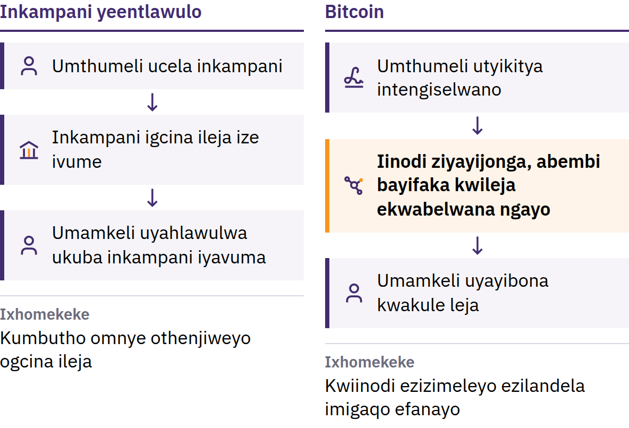
Ingxaki Yokusebenzisa Imali Kabini
31 Oktobha 2008: USatoshi Nakamoto upapasha Bitcoin: Inkqubo Yemali Yombane Yoontanga. Janyuwari 2009: inethiwekhi iyaqala.
Intshayelelo kwiBitcoin · Yintoni iBitcoin?
Notes:
Ngaphambi kweBitcoin, ukuthumela imali kwi-intanethi kwakusoloko kuxhomekeke kumbutho othenjiweyo: ibhanki okanye inkampani yeentlawulo eyayigcina incwadi yeerekhodi, ivume iiakhawunti, yaye inokulibazisa, ithintele okanye irhoxise intlawulo. Kulula ukukopa inkcazelo yedijithali: ukuba ingqekembe yedijithali ibinokusetyenziswa kabini, ibingenakusebenza njengemali. Le yingxaki yokuchitha imali enye kabini. USatoshi Nakamoto ngumntu okanye liqela elisebenzisa elo gama.

Slide 24
Engalawulwa liziko elinye · Unikezelo olunomda · Umntu
kumntu
Ayinaziko lilodwa lolawulo: akukho ofisi engundoqo eyenza iiakhawunti, etshintsha iimali eziseleyo, okanye evumayo ukuba ngubani onokujoyina
Unikezelo olulinganiselweyo: akusayi kuze kubekho i-bitcoin engaphezu kwezigidi ezingama-21
Ukusuka komnye umntu ukuya komnye: thumelani kuye nabani na, naphi na, ngaphandle kokucela imvume kwigunya eliphakathi
Akukho nkampani inokumisa ukusetyenziswa kwe-bitcoin eniyilawulayo ngokwenu. Enye inkalo yaloo nkululeko luxanduva: intengiselwano esemthethweni idla ngokungakwazi ukurhoxiswa, kwaye akukho ziko loncedo lale nethiwekhi.
Intshayelelo kwiBitcoin · Yintoni iBitcoin?
Notes:
Ukunatyiswa kwamagunya akuthethi ukuba wonke umntu unempembelelo elinganayo. Kuthetha ukuba akukho namnye umthathi-nxaxheba onokutshintsha irejista yeentengiselwano okanye imithetho yemali esebenza kubo bonke abantu.

Slide 25
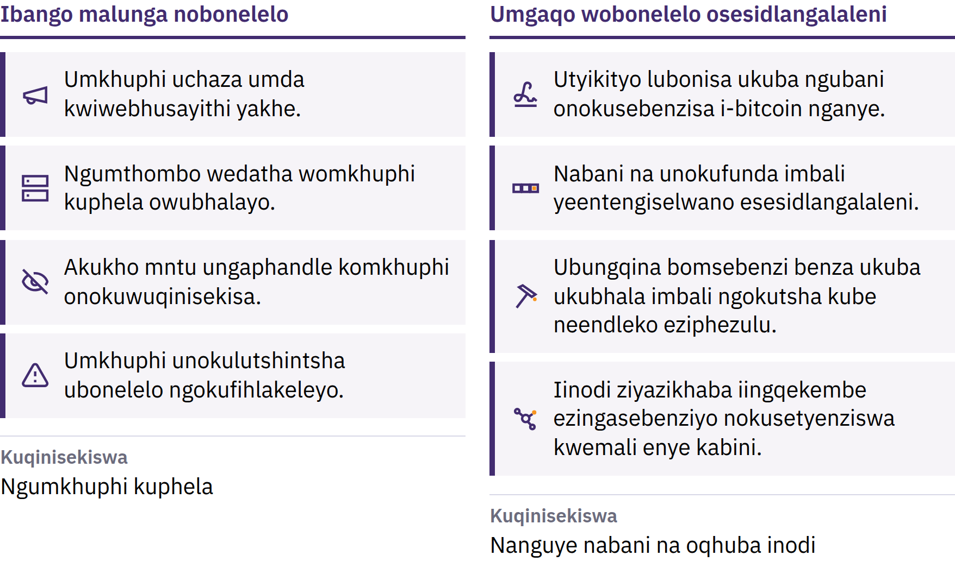
Umda Onokuqinisekiswa Nguye Nabani Na
Intshayelelo kwiBitcoin · Yintoni iBitcoin?
Notes:
Ii-bitcoin ezintsha zikhutshwa ngokweshedyuli kawonke-wonke, yaye iikhompyutha ezizimeleyo ezibizwa ngokuba zii-node ziyayala nayiphi na ibhloko eyaphula loo mgaqo. Lo mda uthembekile kuba nabani na unokuwuqinisekisa. Ayingomthetho wendalo: uhlala usebenza kuba abathathi-nxaxheba beqhubeka bewunyanzelisa. Isixa esilinganiselweyo asiqinisekisi ukuba ixabiso liza kunyuka; ixabiso lixhomekeke kwimfuno nakwisixa esikhoyo.

Slide 26
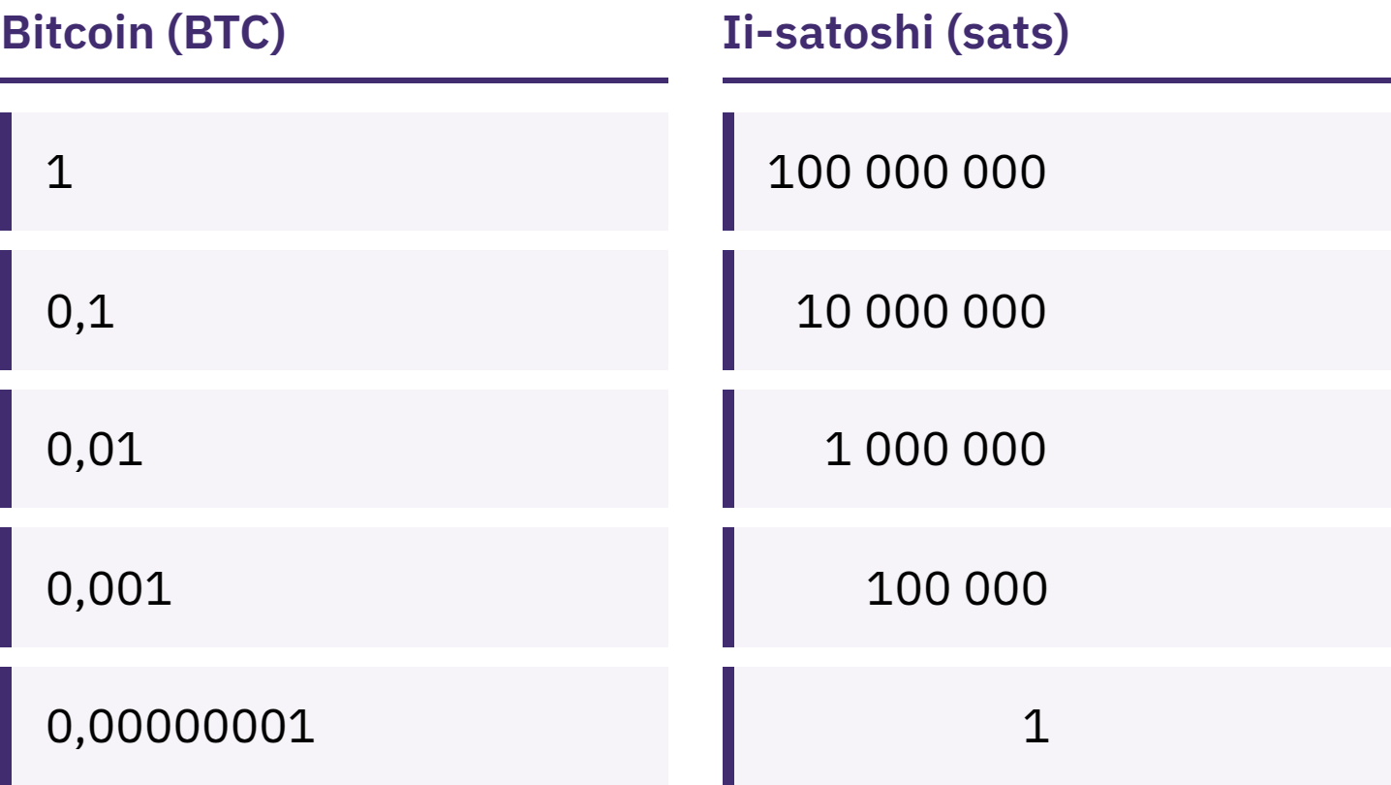
Akuyomfuneko ukuba nibe neBitcoin epheleleyo
I-bitcoin enye yahlulahlulwa ibe ziiyunithi ezincinane eziyi-100 000 000 ezibizwa ngokuba ziisatoshi, okanye iisats.
Intshayelelo kwiBitcoin · Yintoni iBitcoin?
Notes:
Ukuba ne-100 000 sats nokuba ne-0,001 bitcoin kuchaza isixa esifanayo. Lungisani ingcamango ephosakeleyo yokuba i-Bitcoin ayifikeleleki kuba i-bitcoin enye ibiza kakhulu.

Slide 27
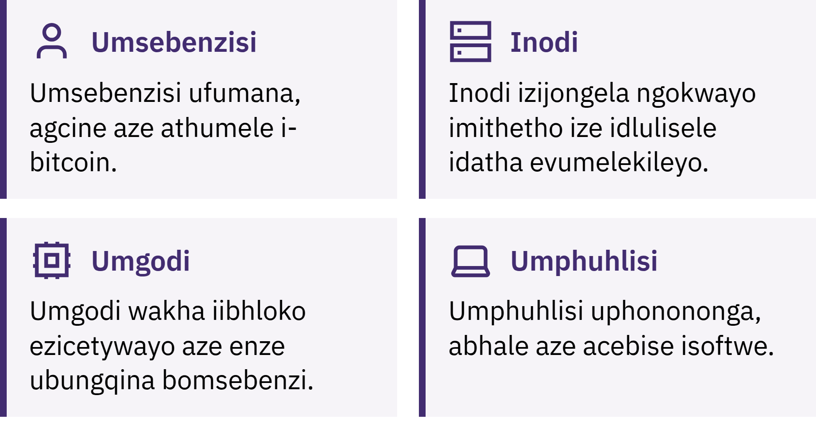
Ngubani ogcina i-Bitcoin isebenza?
Intshayelelo kwiBitcoin · Yintoni iBitcoin?
Notes:
Abasebenzisi bathumela, bamkele baze bagcine i-bitcoin; iindawo zothungelwano zihlola intengiselwano nganye nebhloko nganye ukuqinisekisa ukuba ziyahambelana nemithetho; abembi bakhuphisana ngokongeza ibhloko entsha kwirekhodi malunga nemizuzu elishumi nganye. Loo rekhodi, ikhonkco leebhloko, iyafumaneka esidlangalaleni yaye kubiza kakhulu ukuyibhala ngokutsha. Ingcaciso ngopelo: i-Bitcoin eno-B omkhulu idla ngokuthetha uthungelwano okanye inkqubo; i-bitcoin eno-b omncinane ithetha imali ngokwayo.

Slide 28

Ngubani ogcina i-Bitcoin isebenza?
Intshayelelo kwiBitcoin · Yintoni iBitcoin?
Notes:
Abasebenzisi bathumela, bamkele baze bagcine i-bitcoin; iindawo zothungelwano zihlola intengiselwano nganye nebhloko nganye ukuqinisekisa ukuba ziyahambelana nemithetho; abembi bakhuphisana ngokongeza ibhloko entsha kwirekhodi malunga nemizuzu elishumi nganye. Loo rekhodi, ikhonkco leebhloko, iyafumaneka esidlangalaleni yaye kubiza kakhulu ukuyibhala ngokutsha. Ingcaciso ngopelo: i-Bitcoin eno-B omkhulu idla ngokuthetha uthungelwano okanye inkqubo; i-bitcoin eno-b omncinane ithetha imali ngokwayo.

Slide 29
IBitcoin Ineenzuzo Nezinto Ekufuneka Zincanywe
Ixabiso layo lingatshintsha ngokukhawuleza
Iimpazamo zidla ngokungabi nakulungiseka
Ukwamkelwa kwayo kusanqongophele kwiindawo ezininzi
Ukuyisebenzisa ngokukhuselekileyo kufuna ukufunda okuthile
I-Bitcoin isusa inxalenye yokuthembela kumaziko ize endaweni yayo ifake ukuqinisekiswa noxanduva lomntu ngamnye. Ayiwususi umngcipheko.
Intshayelelo kwiBitcoin · Yintoni iBitcoin?

Slide 30

Niyisebenzisa njani iBitcoin?
Umbuzo wokuqala ngaso nasiphi na isipaji: ngubani olawula izitshixo?

Slide 31
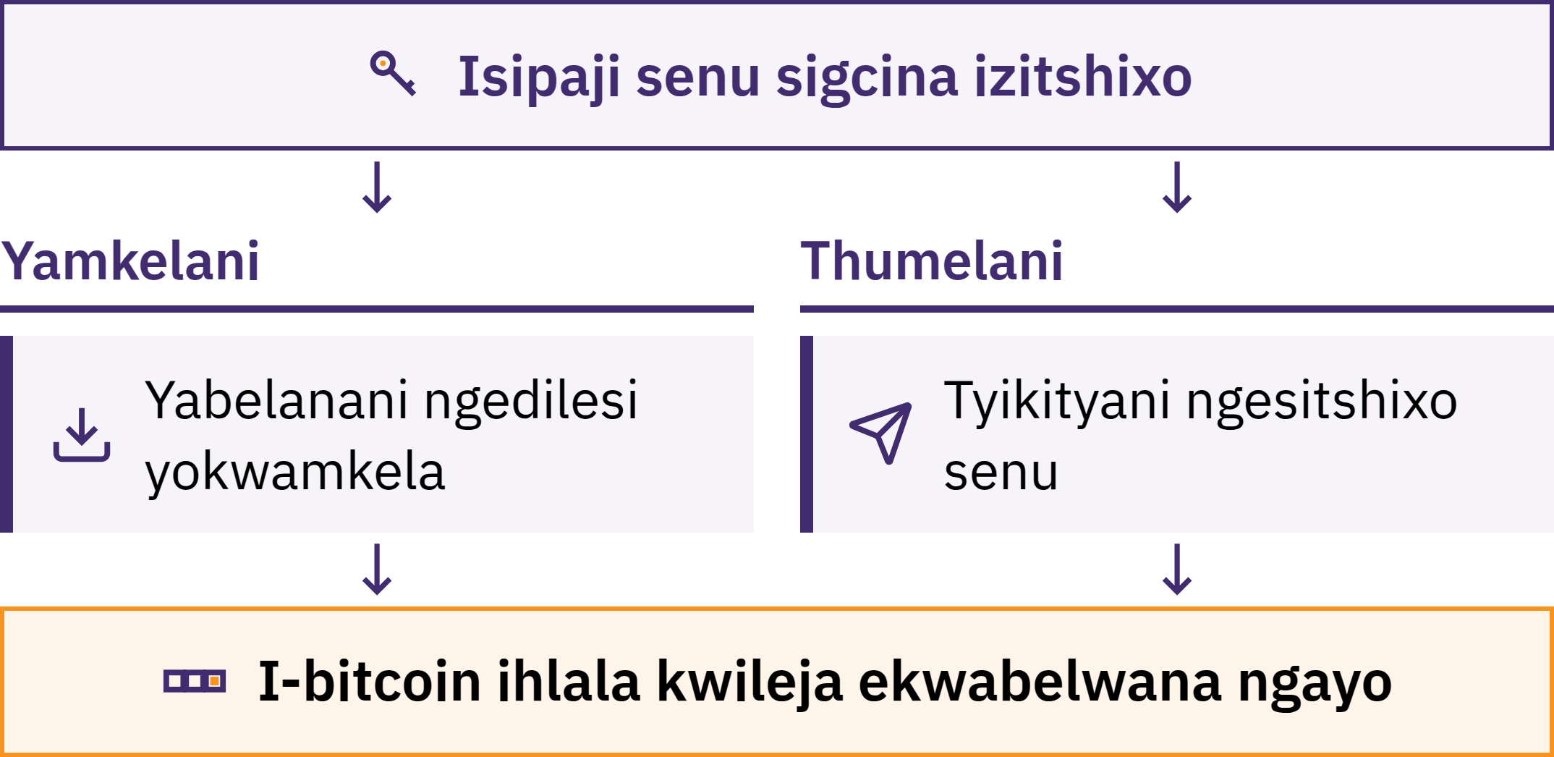
Isipaji Silawula Izitshixo
Intshayelelo kwiBitcoin · Niyisebenzisa njani iBitcoin?
Notes:
Isipaji se-Bitcoin sisixhobo, esidla ngokuba lusetyenziso, esinivumela ukuba nifumane, nijonge, nithumele i-bitcoin. I-bitcoin yenu ayigcinwanga ngaphakathi kwifowuni yenu: irekhodwa kwikhonkco leebhloko. Isipaji silawula izitshixo ezinivumela ukuba ningqine ukuba yeyenu nize nigunyazise intlawulo.

Slide 32
Ngubani Ngokwenene Ophethe iBitcoin Yenu?
Ukuzigcinela: nini abalawula izitshixo
Akukho mntu unokunibuyisela i-bitcoin yenu ukuba nilahlekelwa libinzana lembewu kunye nesixhobo
Ukugcinelwa: inkampani igcina izitshixo, ngendlela efana noko nebhanki
Ibhalansi yenu sisithembiso sayo sokuhlawula; inokumisela imida ekutsaleni imali, imise ukusebenza kweakhawunti, ihlaselwe ngabagqekezi bekhompyutha, okanye ivale
Ukukhetha indlela yokugcina akulovavanyo lokufaneleka kwenu. Okubalulekileyo kukwazi ukuba loluphi uhlobo enilusebenzisayo nokuba nithembele entwenini.
Intshayelelo kwiBitcoin · Niyisebenzisa njani iBitcoin?

Slide 33

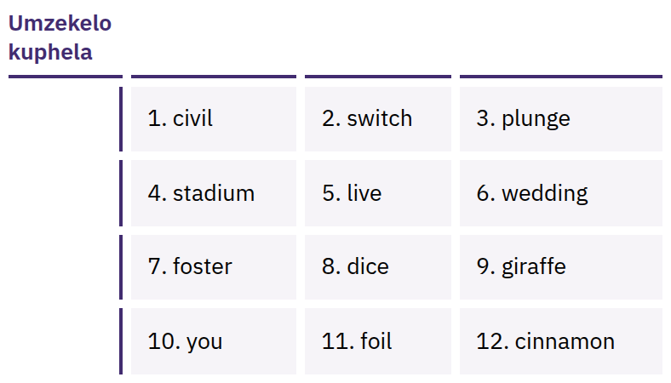
Ibinzana Lenu Lembewu
Linika Ufikelelo Olupheleleyo
Uluhlu lwamagama alandelelanayo, adla ngokuba li-12 okanye angama-24, olunokuphinda luvelise izitshixo zenu. Nabani na onalo unokuthatha i-bitcoin yenu.
Intshayelelo kwiBitcoin · Niyisebenzisa njani iBitcoin?
Notes:
Ibinzana lembewu alilogcino nje kuphela: linika ufikelelo olupheleleyo. Libhaleni ngokuchanekileyo ephepheni xa nisenza isipaji; ligcineni lingekho kwi-intanethi, liyimfihlo, kwaye likwindawo apho lingayi kulahleka okanye lonakale khona. Ningaze nilifote, nilithumele nge-imeyile, niligcine kumanqaku asefini, nilithumele kumyalezo, okanye nilichwetheze kwiwebhusayithi. Amagama abonisiweyo ngumzekelo kuphela; ningaze nibonise okanye niqokelele ibinzana lembewu lokwenene.

Slide 34

Ayizizo izitshixo zenu, ayizizo
iingqekembe zenu.
Intshayelelo kwiBitcoin · Niyisebenzisa njani iBitcoin?

Slide 35

Ngaphambi kokuba nisebenzise
nasiphi na isipaji
Izitshixo: ngubani ozilawulayo, nini okanye yinkampani?
Ukubuyisela: kwenzeka ntoni xa ifowuni yenu ilahleka okanye inkampani inyamalala?
Umthombo: yiwebhusayithi esemthethweni okanye luluhlu olukwivenkile yee-app, hayi ikhonkco enilithunyelelwe ngumntu?
Ikhowudi: yeyomthombo ovulekileyo kwaye igcinwa ihlaziywa rhoqo? (Oku kukodwa akubobungqina bokhuseleko.)
Iindleko: zithini iintlawulo zokuthumela, zokufumana okanye zokutsala imali?
Iintlawulo: zenziwa kwikhonkco leebhloko, nge-Lightning, okanye ngazo zombini?
Intshayelelo kwiBitcoin · Niyisebenzisa njani iBitcoin?
Notes:
I-My First Bitcoin ayicebisi naziphi na izipaji ezithile. Izixhobo, imirhumo nabanini ziyatshintsha, yaye oko kulungele uluntu oluthile kusenokungalulungeli olunye. Ncedani nikhokelele abafundi kumfundisi-ntsapho wasekuhlaleni othembekileyo.

Slide 36
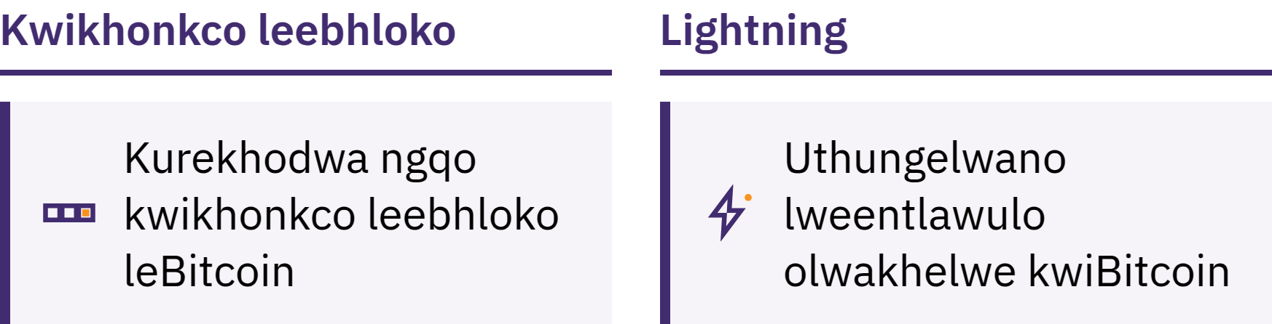
Kwitsheyini kunye ne-Lightning
Kwitsheyini: ibhalwa ngqo kwitsheyini yeebhloko
Lightning: uthungelwano lweentlawulo olwakhelwe phezu kweBitcoin ukwenza iintlawulo ezikhawulezayo, ezincinci nezenziwa rhoqo, njengokuthenga ikofu
Isipaji se-Lightning sinokuba phantsi kolawulo lomntu wesithathu okanye phantsi kolawulo lomnini waso
Intshayelelo kwiBitcoin · Niyisebenzisa njani iBitcoin?

Slide 37
Imithetho Emithathu Ngoxa Nifunda
Fundani kuqala. Musani ukwenza izinto ngenxa yemincili, uloyiko, okanye uxinzelelo.
Qalani ngokuncinci. Zamani izixhobo eningaziqhelanga ngesixa semali eninokukwazi ukumelana nokuphulukana naso.
Musani Ukuthemba, Qinisekisani. Jongani umntu, indlela yokuhlawula, idilesi, nesixa semali.
Yabelanani ngolwazi lokwamkela iintlawulo, ningaze nabelane ngeemfihlo
Idilesi okanye isicelo sentlawulo sinokwabelwana ngaso. Ibinzana lembewu okanye isitshixo sabucala masingaze kwabelwane ngaso. Akukho titshala, nkampani yesipaji, okanye msebenzi wenkxaso osemthethweni oya kuze anicele loo nto.
Intshayelelo kwiBitcoin · Niyisebenzisa njani iBitcoin?

Slide 38

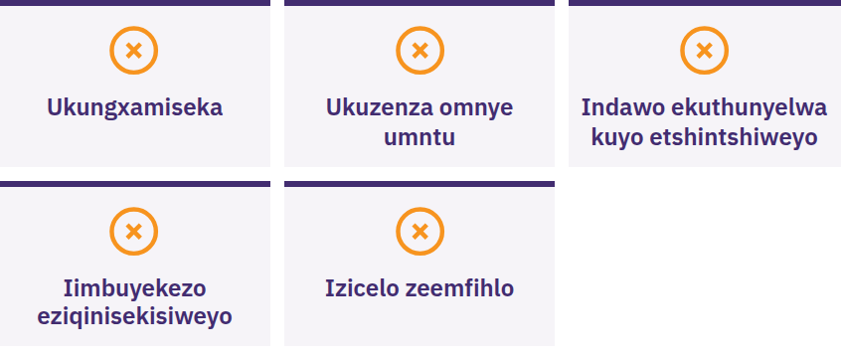
Yimani, Ningabelani Nganto,
Ningathumeli Nto
Yekani ukuba umntu uninyanzela ukuba nikhawuleze okanye nigcine izinto ziyimfihlo, unithembisa inzuzo eqinisekisiweyo, unicela ukuba nithumele i-bitcoin kuqala, okanye ucela ibinzana lenu lembewu. Khanime. Ningabelani nganto. Ningathumeli nto. Emva koko qinisekisani ngomthombo esele niwazi.
Intshayelelo kwiBitcoin · Niyisebenzisa njani iBitcoin?

Slide 39

Yintoni Elandelayo?
Esi sisiqalo nje.

Slide 40
Iingongoma Ezine Eziphambili
Imali ixhomekeke kwimithetho nakwintembeko. Unikezelo lwemali yefiat nemithetho yayo zimiselwa linani elincinane lamaziko.
IBitcoin inemithetho eyahlukileyo. Unikezelo oluselubala, olunomda, olufumaneka kuye nabani na, nolunokuqinisekiswa endaweni yokuthenjwa nje.
Ukhuseleko luza kuqala. Fundani kuqala, qalani kancinci, qinisekisani yonke into, ningaze nabelane nabanye ngebinzana lenu lokubuyisela isipaji.
Esi sisiqalo nje. Inyathelo elinye elilandelayo elikhuselekileyo lanele.
Ithuba lokucamngca
Buyelani kwimibuzo emihlanu esekuqaleni. Beninokuphendula nithini ngoku?
Intshayelelo kwiBitcoin · Yintoni Elandelayo?

Slide 41

IDiploma yeBitcoin
Inyathelo elilandelayo. Iimodyuli zayo ezine zinisa phambili:
Ukuqonda imali
Indlela iBitcoin esebenza ngayo
Ukusebenzisa iBitcoin ngokukhuselekileyo
IBitcoin kuluntu lwenu
Hlalani ninomdla wokwazi, qhubekani nibuza imibuzo, nize nifunde ngakumbi kwiwebhusayithi ethi myfirstbitcoin.org.
Sijonge phambili ekuniboneni kwiqela lethu elilandelayo.
Intshayelelo kwiBitcoin · Yintoni Elandelayo?

Slide 42


