Slide 1

Edition 26.10
Bitcoin
Diploma
Financial Education for the Bitcoin Era

Slide 2

Module 1
Understanding Money
Problem: How do monetary systems work and change?
Notes:
Source: My First Bitcoin, Bitcoin Diploma Student Guide, edition 26.10, Modules 1–4 and introductory learner expectations. Adapted under Creative Commons Attribution-ShareAlike 4.0 International; this deck uses the same license. This deck is an educator-led presentation aid. Adapt examples, activities, pacing, and delivery while preserving curriculum meaning, required competencies, and safety boundaries. No fixed session length is implied.

Slide 3
Knowledge Comes Before Action
Learn first · start small · move slow
No purchase, personal funds, or personal wallet required
No personal device or internet required for completion
Prepared materials, simulations, and offline practice available
This course provides education, not financial, investment, legal, or tax advice. It does not recommend buying, selling, borrowing against, or holding bitcoin, or promise a rising price.
Bitcoin Diploma · Module 1
Notes:
Carry these boundaries through all four modules. Explain the privacy, security, and loss risks before any optional low-stakes live practice.

Slide 4

Don't Trust, Verify
Bitcoin Diploma · Module 1

Slide 5
Discussion and Privacy Expectations
Check evidence; separate facts, opinions, and guarantees
Challenge ideas respectfully; state uncertainty
Keep personal stories and financial information private
No pressure to buy, sell, or disclose holdings
Get permission before recording or sharing anyone's screen, work, or identifying information. Never share real private keys or recovery words.
Bitcoin's price can change sharply. Errors, scams, lost secrets, or custodian failure can cause permanent loss; valid payments are usually difficult or impossible to reverse.
Bitcoin Diploma · Module 1

Slide 6

Opening Questions About Money
Why do people need money?
What makes something money?
Who can create or control the money you use?
Why does your money have value?
Does it buy the same amount as before?
Bitcoin Diploma · Module 1
Notes:
Use the source discussion to distinguish a checkable fact from an opinion that needs criteria and evidence. Do not request personal financial disclosures.

Slide 7
Why Money Exists
Money is an asset people accept because they expect others to accept it later.
Specialization and exchange
Cooperation among strangers
Prices, debts, income, and savings
Value across time and distance
Spot question
What exchange or coordination problem does money help solve?
Bitcoin Diploma · Module 1

Slide 8

Functions of Money
Medium of exchange: payment for goods and services
Unit of account: shared prices and records
Store of value: value across time
One form may serve one function better than another. Every form carries purchasing-power risks.
Bitcoin Diploma · Module 1

Slide 9
Properties of Useful Money
Durability: usable over time
Portability: easy to move or transfer
Divisibility: small and large amounts
Fungibility: interchangeable equal units
Scarcity: limits on supply expansion
Acceptability: willingness to receive it
Verifiability and recognizability: genuine, identifiable units
No form scores perfectly. “Sound money” is a judgment: state criteria and compare consistently.
Think critically
Which properties mattered when you chose one type of money or asset over another?
Bitcoin Diploma · Module 1

Slide 10
Barter and the Double Coincidence of Wants
Direct exchange of goods or services
Both sides must want the other's offer
At the same time, in suitable amounts
Divisibility, spoilage, pricing, and saving difficulties
Money separates selling from buying
Bitcoin Diploma · Module 1
Notes:
Use the source example: Amina has rice and wants shoes; Luis has shoes and wants cooking oil; Mei has cooking oil and wants repair work. Keep the failed direct exchanges distinct from the later money-mediated solution.

Slide 11

Bitcoin Diploma · Module 1

Slide 12

Bitcoin Diploma · Module 1

Slide 13

Scarcity, Value, and Exchange
Scarcity: one use prevents another
Subjective value: needs, preferences, and circumstances
Exchange: both sides prefer what they receive
Opportunity cost: best alternative given up
Time preference: now compared with later
Trade-off: a benefit with a cost
Scarcity alone does not guarantee value; demand matters too.
Bitcoin Diploma · Module 1
Notes:
Use the guide's water-availability example and everyday choices. Urgent needs can reasonably increase preference for the present.

Slide 14
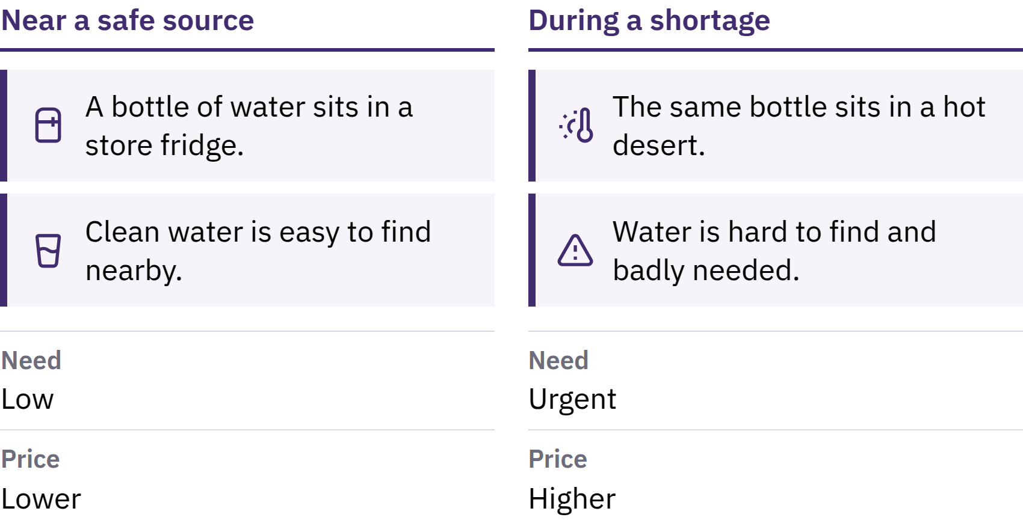

Slide 15

Opportunity Cost
Bitcoin Diploma · Module 1

Slide 16
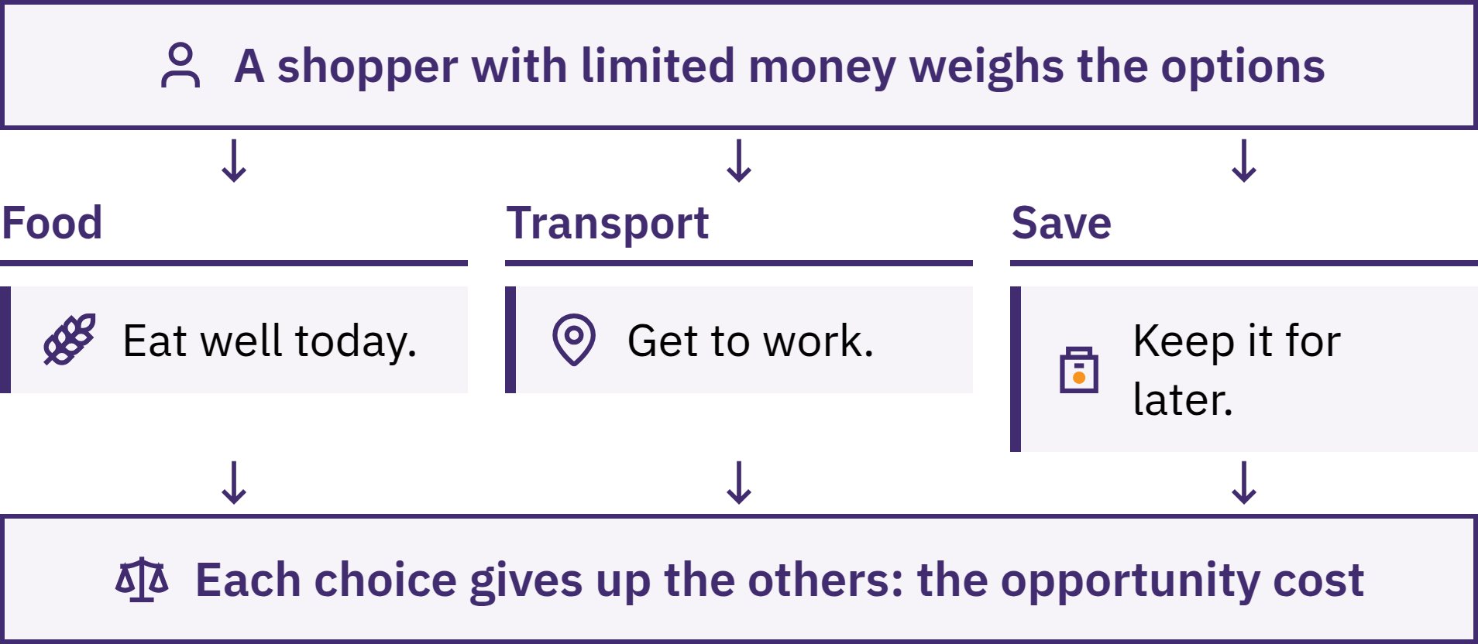

Slide 17
From Barter to Digital Money
Direct exchange, gifts, obligations, and debt records
Commodity money: goods with other uses
Standard coins: recognition; possible debasement
Representative paper: redeemable claims; issuer trust
Banks and government money: institutional promises
Digital payments: instructions changing records
Different forms coexisted; societies did not follow one identical sequence. Convenience often brought dependence on issuers and intermediaries.
Bitcoin Diploma · Module 1
Notes:
Explain the gold standard and its varied redemption rules within representative paper. A card or phone sends instructions; it does not contain money. A normal bank deposit is the bank's obligation to its customer.

Slide 18
Fiat Money
Fiat money is government-authorized currency that is not redeemable for a fixed amount of a commodity such as gold.
Central bank: base money, policy, settlement
Commercial banks: deposits, payments, loans
Government: taxes, spending, laws
People and businesses: work, prices, exchange
Shared acceptance and network effects
Convenient payments and flexible credit bring institutional dependence. Supply, access, and rules can change; legal-tender rules vary by jurisdiction.
Bitcoin Diploma · Module 1

Slide 19
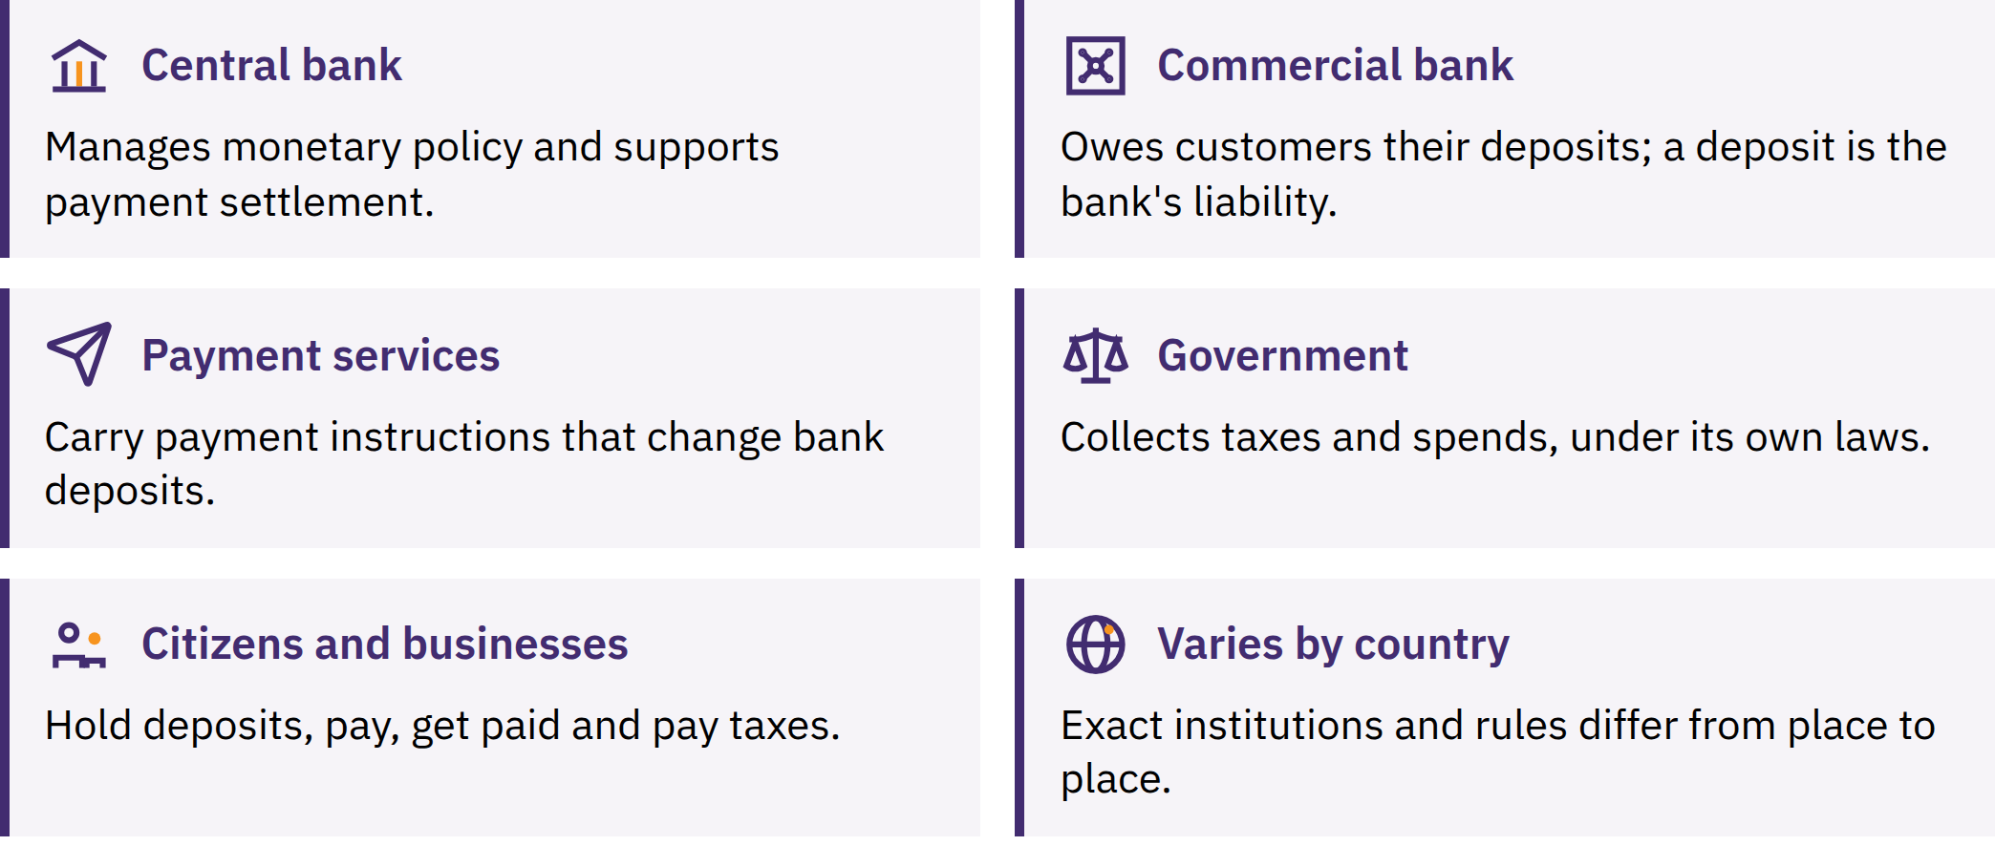

Slide 20

Examine a Local Payment
Choose an ordinary payment, or use an invented scenario.
What is being paid for? Which currency is the unit of account?
Why does the recipient accept it?
Which institutions, records, or rules support it?
What becomes harder if acceptance or trust breaks down?
Bitcoin Diploma · Module 1

Slide 21
Fractional Reserve Banking
Bank deposits: promises to pay
Only part held as immediately accessible reserves
A loan usually creates new deposit money
Principal repayment reduces deposit money
Capital, liquidity, credit risk, funding, regulation, and demand constrain lending
Liquidity risk: too little available for withdrawals today.
Solvency risk: assets worth less than obligations.
Bank runs can strain access. Insurance and central-bank lending can reduce panic, but coverage and rules vary; protection cannot remove every risk.
Bitcoin Diploma · Module 1
Notes:
Banks earn interest and fees while covering costs and losses. Do not imply that all banks are about to fail or that lending is unconstrained. Distinguish a bank's promise from direct possession of the settlement asset.

Slide 22
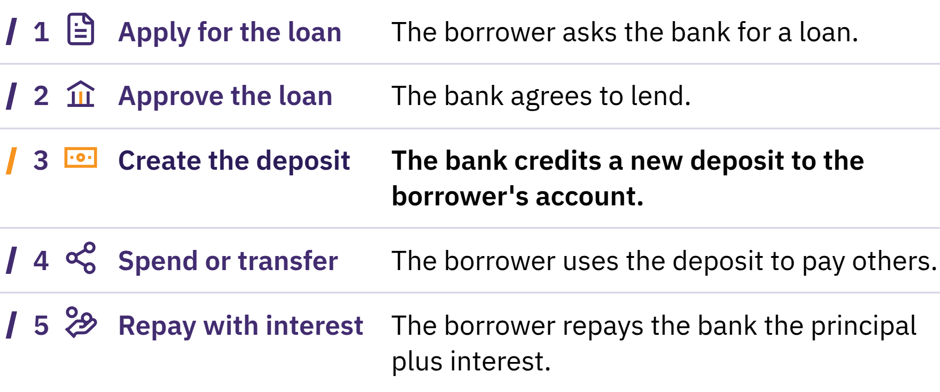

Slide 23
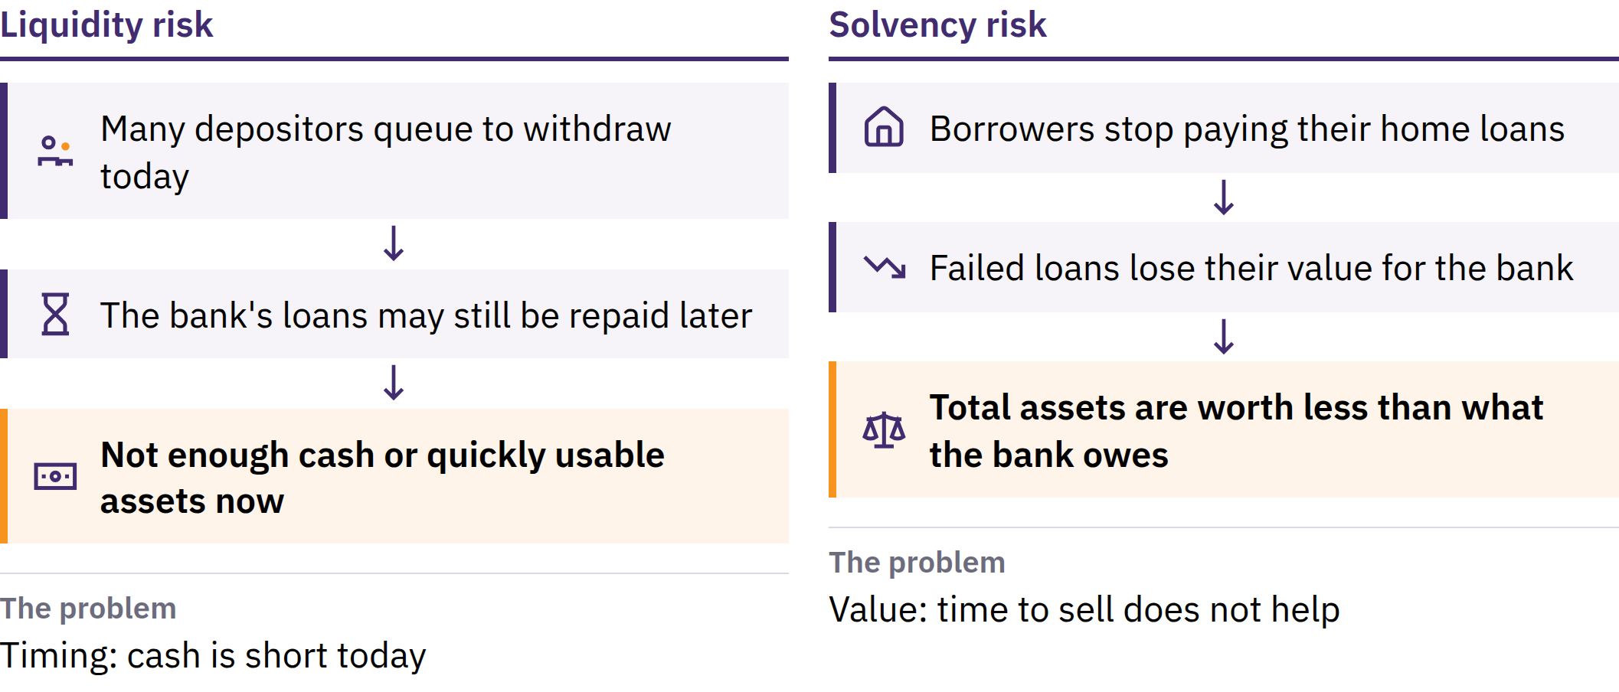

Slide 24

Bitcoin Diploma · Module 1

Slide 25

Inflation and Purchasing
Power
Price inflation: sustained rise in the general price level
Purchasing power: what a unit of money buys
Same basket: 100 → 110 currency units
Unchanged income or savings: less purchasing power
Money and credit expansion can contribute, alongside supply, demand, currency, tax, regulation, and costs. One rising price is not the whole inflation measure.
Bitcoin Diploma · Module 1

Slide 26
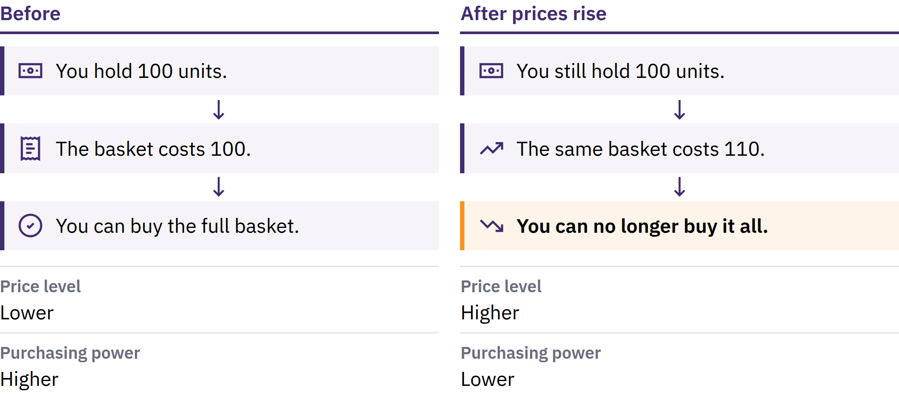

Slide 27
Compare Purchasing Power Locally
Choose an ordinary item; record today's price.
Compare with a past price; check a reliable record if possible.
Did income change at the same rate? What else changed?
Compare with an official inflation measure and its basket.
Effects differ for cash holders, asset owners, borrowers, and lenders; wages and prices adjust at different speeds. Your spending may differ from the measured basket.
A changed basket or method is not automatically manipulation; check the explanation and document the change.
Bitcoin Diploma · Module 1

Slide 28
The US Dollar as Reserve Currency
Reserve currency: held for international payments
World wars: shifts in economic and financial strength
1944: Bretton Woods; currencies linked to dollar, dollar to gold
1971: official dollar–gold convertibility ended
Established trade, economic scale, and deep financial markets
Reserve-currency shares can change; central banks also hold other currencies.
Bitcoin Diploma · Module 1

Slide 29
Alternatives for Saving and Holding Value
Precious metals: physical possession; storage and verification costs
Real estate: useful asset; high entry cost, upkeep, low portability
Stocks: productive ownership; business, market, and custody risks
Other options: foreign currency, bonds, businesses, tools, education
An asset does not automatically perform every money function. No asset guarantees purchasing power in every situation.
Taxes can change costs and benefits; rules vary and change. This course provides no tax advice.
Bitcoin Diploma · Module 1

Slide 30
Central Bank Digital Currencies (CBDCs)
A CBDC is digital fiat money issued as a central-bank liability: a claim owed to its holder.
Different from cash and commercial-bank deposits
Possible settlement or access benefits
Possible monitoring, restrictions, and identity links
Central issuance and monetary policy remain
Designs differ. Digital does not automatically mean decentralized, scarce, private, or independently verifiable.
Check
Who issues it, who can use it, what data are collected, and who can block payments or change rules? What happens offline, and what legal protections exist?
Bitcoin Diploma · Module 1

Slide 31
Review: How Can Money Break?
Key takeaways
Money coordinates exchange, prices, and value across time
Functions and properties support comparison
Convenience brings trade-offs in trust, control, and access
Supply, banking risks, and inflation affect people differently
Alternatives and CBDCs also require careful evaluation
What makes your money useful, and which rules depend on institutions you trust?
A moment to reflect
What is one question you now ask about money that you did not ask before?
Bitcoin Diploma · Module 1

Slide 32

Module 2
How Bitcoin Works
Solution: Why was Bitcoin created, and how does it respond?

Slide 33

Why Bitcoin Was Created
Digital payments already existed
Central ledger keepers: permission, data, fees, and failure risks
Copyable data: the double-spend problem
Bitcoin: shared payment history without a central ledger keeper
Bitcoin reduces central trust in issuance and settlement; it does not remove all trust or risk.
Bitcoin: network and protocol · bitcoin: asset · BTC: amount abbreviation
Bitcoin Diploma · Module 2

Slide 34
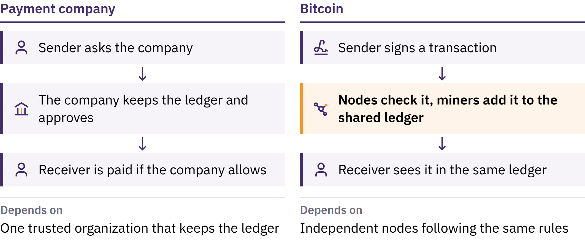

Slide 35
The Search for Digital and Decentralized Money
Cypherpunks: privacy and freedom through cryptography
Encryption: protects message privacy
Digital signatures: prove authorization without revealing a secret key
Goal: no single issuer, server, or administrator
Earlier pieces of the puzzle
DigiCash: private payments; central-company dependence
Hashcash: computational cost against abuse
Bit Gold, b-money, RPoW: scarce-value proposals and experiments
BitTorrent: peer-to-peer information sharing, not money
Bitcoin Diploma · Module 2

Slide 36

Early Digital Money and
Double Spending
Double spending is an attempt to send the same digital unit to two recipients.
Central database: one trusted decision maker
Bitcoin: peer-to-peer broadcast and signatures
Miners: blocks and proof of work
Nodes: independent verification
Shared record: valid history with the most accumulated work
Bitcoin Diploma · Module 2
Notes:
Keep the five-part response connected. Earlier proposals supplied pieces; avoid implying that each was a complete decentralized currency.

Slide 37
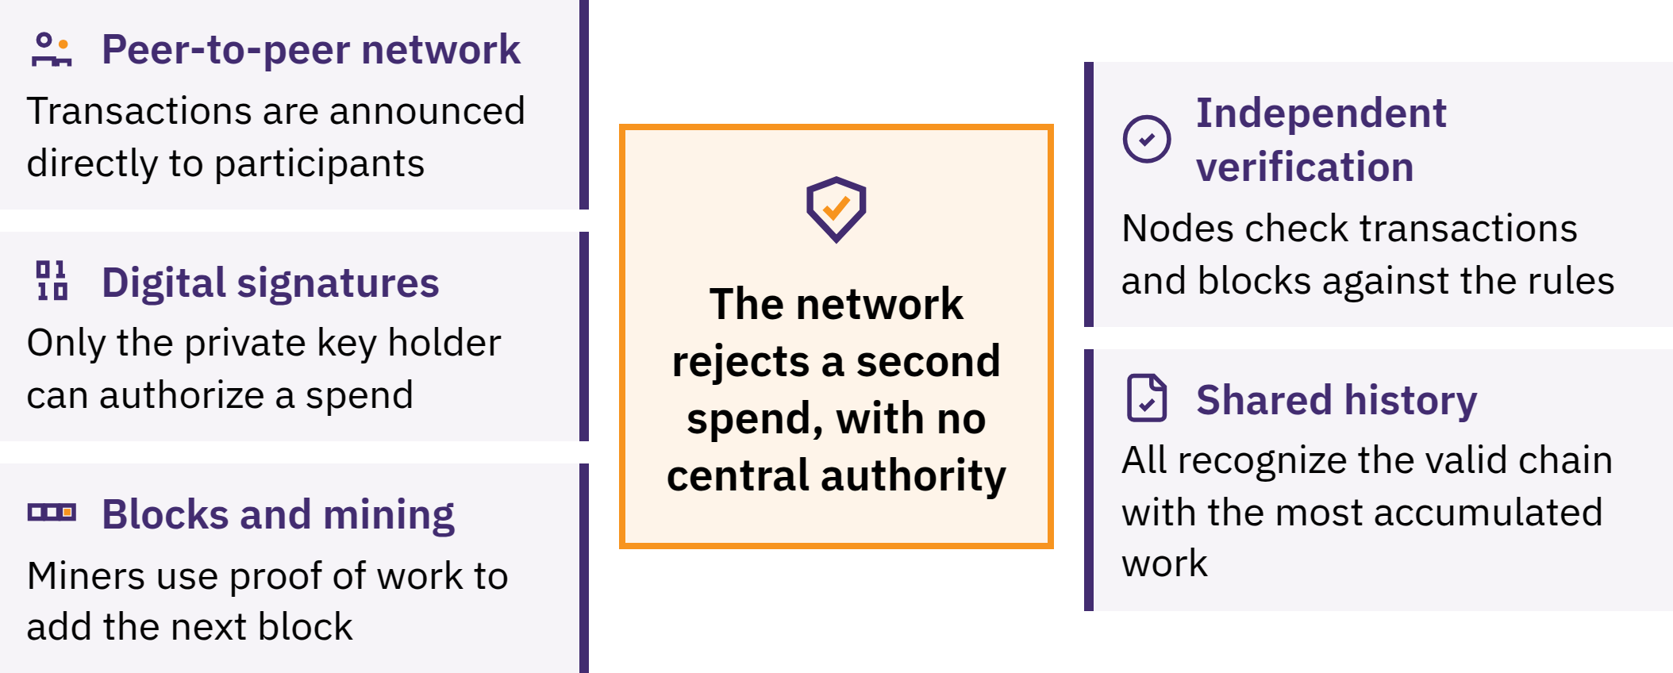

Slide 38

Digital Scarcity and Verifiable
Supply
Valid units distinguished from invalid copies
Double spends rejected
Public transaction history and signatures
Proof of work and independent rule checks
Supply limit tied to decentralization and verification
A written supply claim is not enough: who can verify it, and who could change it?
Bitcoin Diploma · Module 2

Slide 39
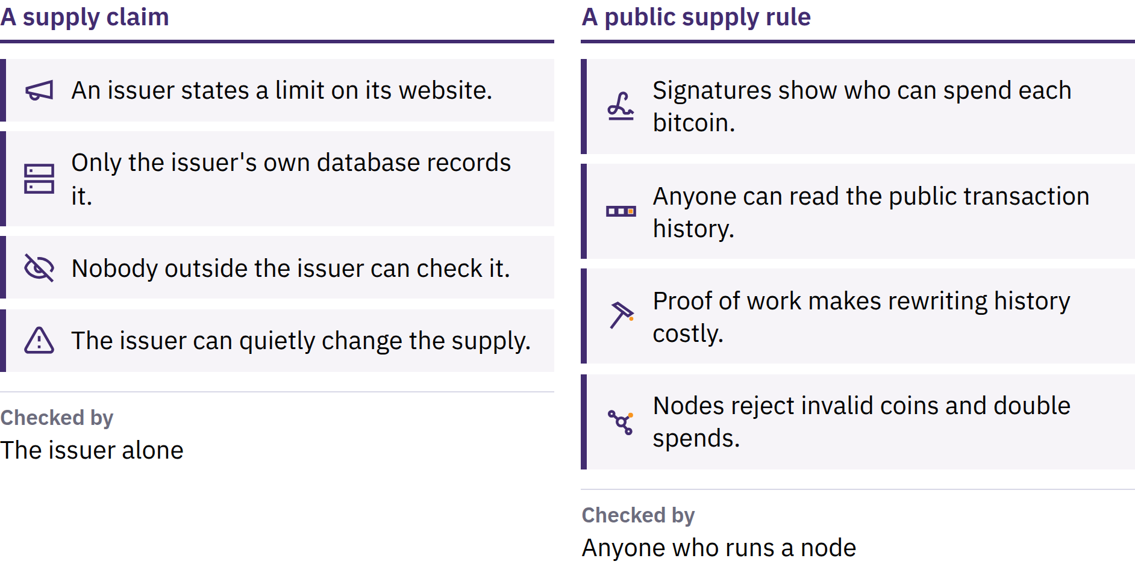

Slide 40
The Blockchain: Bitcoin’s Public Ledger
Replicated public transaction record
Linked blocks; independently checked copies
Valid chain with the most accumulated proof of work
About one new block every ten minutes, on average
Rewriting history requires redoing work and catching up. It is costly, not literally impossible; temporary competing histories and reorganizations can occur.
Bitcoin Diploma · Module 2

Slide 41

Decentralization
Open-source software and open protocol participation
Independent nodes verify; miners propose blocks
Rule changes depend on voluntary adoption
No single participant can change rules for everyone
Influence and resources are unequal; large services can create dependence. Coordination can be slower, and the network has no central support desk.
Bitcoin Diploma · Module 2

Slide 42
Digital Signatures and Peer-to-Peer Transfer
Wallet uses a private key to sign
Network verifies without learning the key
Signed transaction broadcast through participants
No central Bitcoin operator approves membership or payment
Anyone obtaining a private key can usually spend the funds. Losing access can mean permanent loss.
Intermediary services remain optional; choosing one adds its custody rules and risks. A valid payment to the wrong address usually cannot be reversed.
Bitcoin Diploma · Module 2

Slide 43
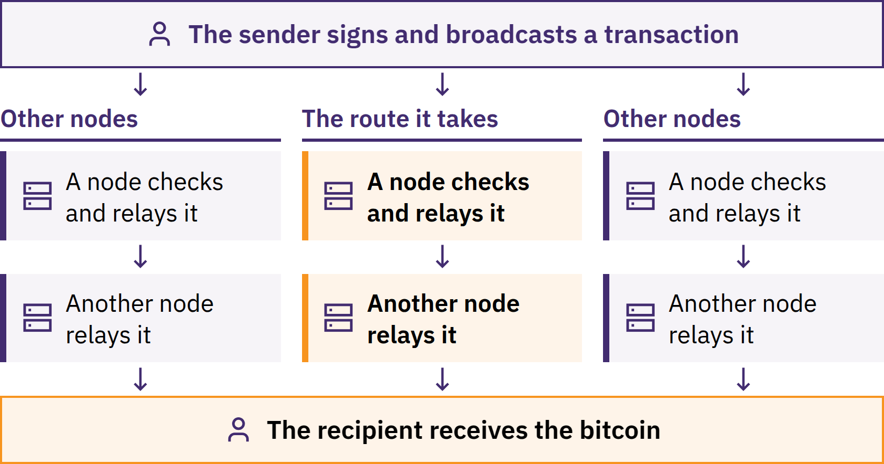

Slide 44
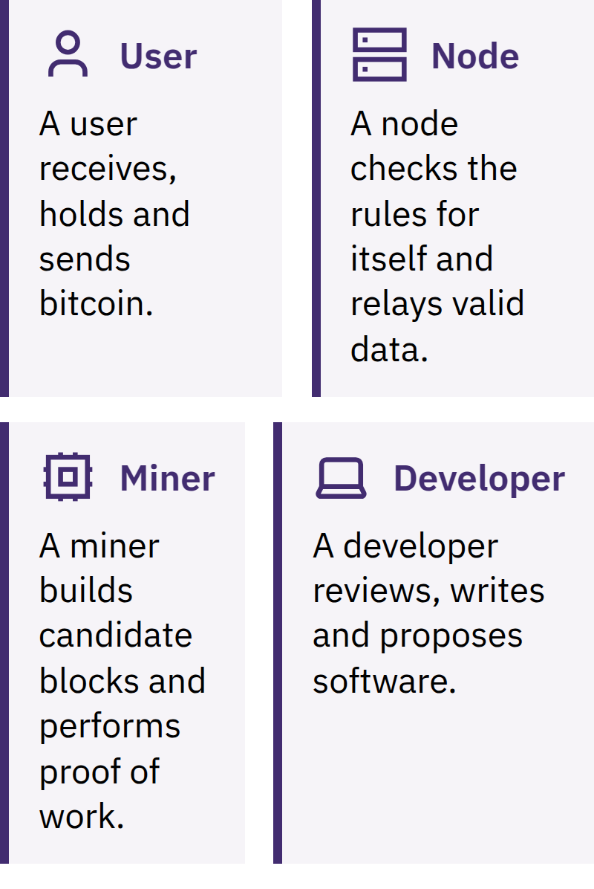

Bitcoin Diploma · Module 2

Slide 45
Users, Nodes, Miners, and Developers
Miners cannot make invalid blocks acceptable to honest nodes. Developers cannot force software adoption. One person may perform several roles.
Spot question
Why does a node verify transactions? Name one rule it checks.
Bitcoin Diploma · Module 2

Slide 46

Proof of Work
Candidate block → repeated hashing → valid result
Costly computation and energy; quick verification
Valid block broadcast and checked by nodes
Target adjusts toward ten-minute average blocks
Accumulated work makes rewriting costly
Mining secures transaction ordering; it does not solve outside equations. Evaluate energy source, use, security benefit, and alternatives.
Bitcoin Diploma · Module 2

Slide 47
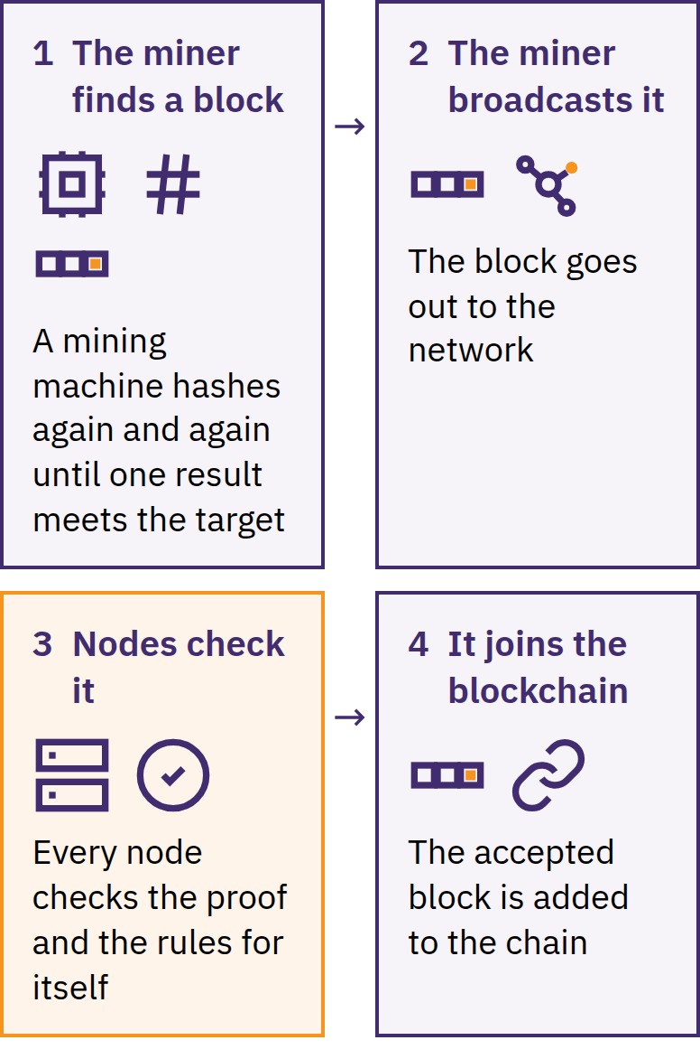

Bitcoin Diploma · Module 2

Slide 48

Finite Supply
Maximum: 21 million BTC under the public rules
New issuance: block subsidy
Halving: every 210,000 blocks, roughly four years
Subsidy: 50 → 25 → 12.5 → 6.25 → 3.125 BTC
Fees are separate from new issuance
Nodes reject excess issuance; the limit holds while participants enforce it. Limited supply does not guarantee a rising price.
Bitcoin Diploma · Module 2
Notes:
Some bitcoin may be inaccessible or unavailable for sale.

Slide 49
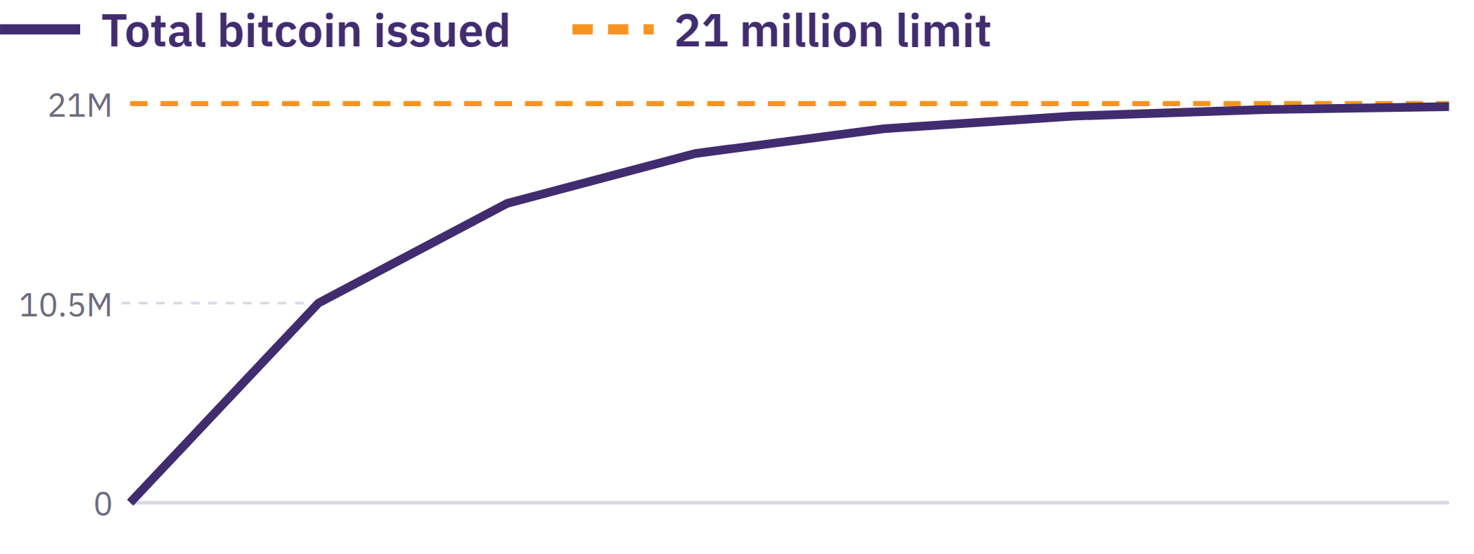

Slide 50
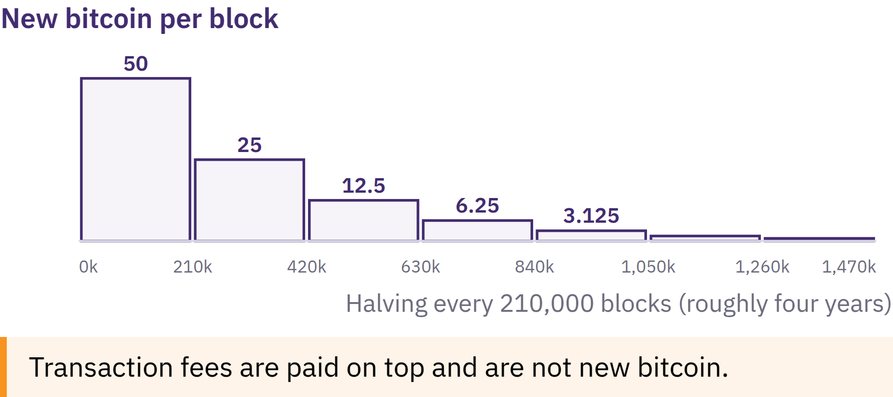

Slide 51

Satoshis and Unit Bias
1 BTC = 100,000,000 sats
0.001 BTC = 100,000 sats
1 sat = 0.00000001 BTC
A whole bitcoin is not required
Unit bias: a low price per whole unit does not prove better value. Compare the supply share, value involved, and risks.
Show your understanding
How many sats are in 0.01 BTC? Why can someone use less than a whole bitcoin?
Bitcoin Diploma · Module 2
Notes:
Let learners work out the conversion; no visible answer key.

Slide 52
Bitcoin as Sound Digital Money
Durable ledger; access depends on keys
Portable and divisible; transfer needs communications
Public scarcity and verifiable rules
Fungibility can be affected by how services treat public history
Acceptance varies by place
Three functions
Store of value: predictable supply; volatile price
Medium of exchange: direct transfer; varying fees and acceptance
Unit of account: BTC or sats; many goods priced in fiat
“Sound money” depends on stated criteria. Compare alternatives using the same standards.
Bitcoin Diploma · Module 2

Slide 53
Bitcoin, Stablecoins, and Other Crypto-Assets
Bitcoin: public issuance rules; no central issuer
Stablecoins: target a reference value; reserves, mechanisms, or redemption claims
Other crypto-assets: differing networks, issuance, control, and purposes
A fork's shared code history does not give it Bitcoin's network or security
Compare: issuance control, independent verification, key control, and counterparties.
This comparison clarifies Bitcoin; it does not recommend acquiring, trading, or promoting any asset.
Bitcoin Diploma · Module 2

Slide 54
Different Designs, Different Risks
Bitcoin: volatility, key loss, payment finality, fees, public records
Stablecoins: depegging, reserves, redemption, freezes, and counterparties
Other crypto-assets: rule changes, concentrated influence, bugs, hacks, and bridges
Services: custody, failure, access, and legal risks across categories
A familiar ticker, stable-looking price, or polished app does not prove safety. Tokens do not automatically confer company ownership, income, or redemption rights.
Bitcoin Diploma · Module 2

Slide 55
Learning Is Not Trading or Promotion
Explain, question, compare, and verify
Speculation: price risk, platform risk, and pressure
Promotion: possible conflicts of interest
No instruction to buy, sell, or hold
Local-value check
Separate market price, local acceptance, and personal preference or bias.
Bitcoin Diploma · Module 2

Slide 56
Bitcoin Origin Timeline
Satoshi Nakamoto is a pseudonym; the creator or creators remain unknown. Others continued the open-source network without a permanent central leader.
Evaluate the design and operation as well as its origin story.
Bitcoin Diploma · Module 2

Slide 57
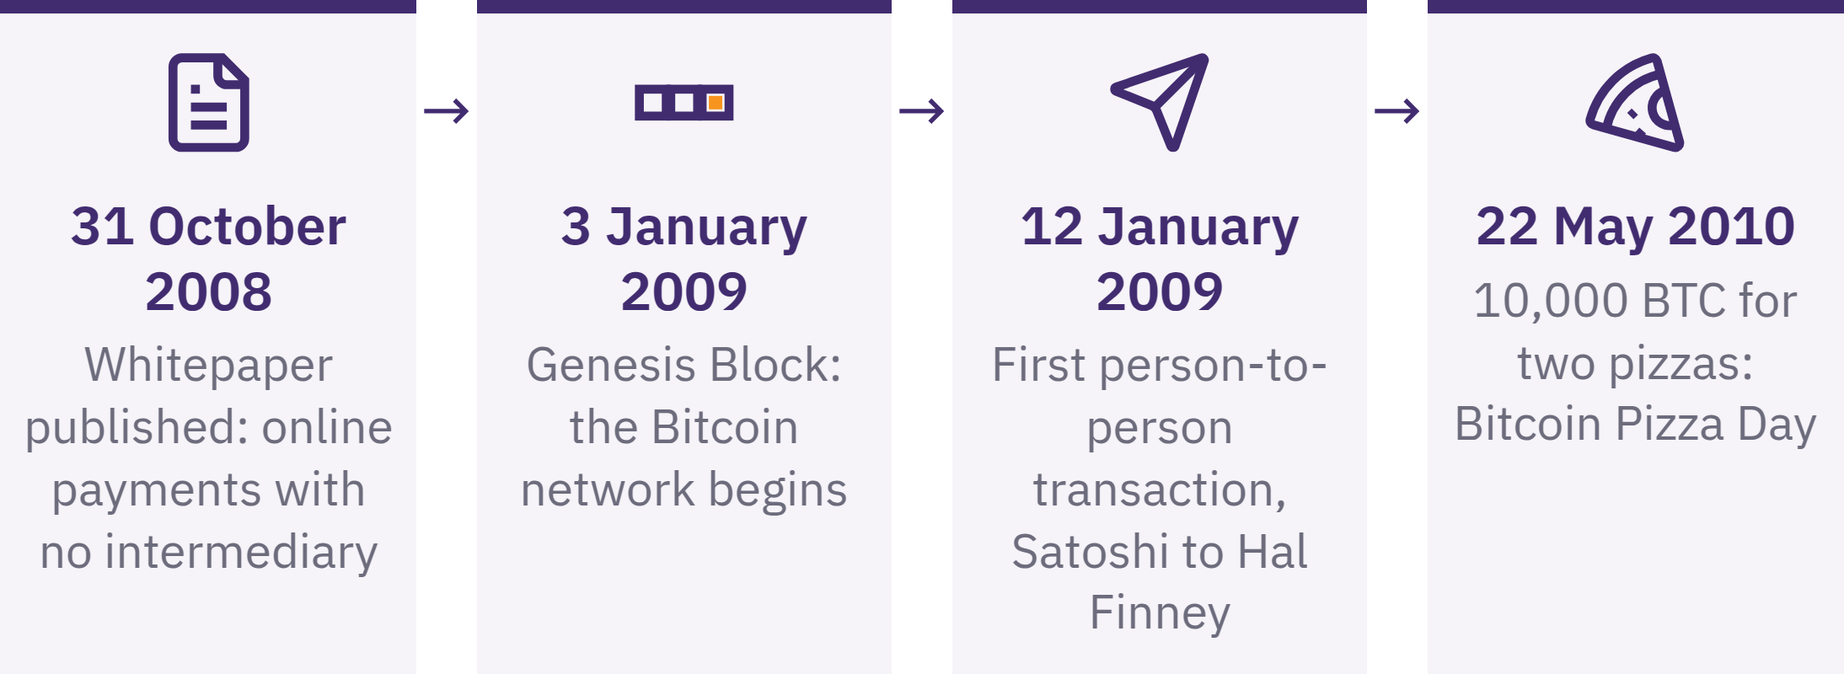

Slide 58
Empowerment, Risk, and Responsibility
Direct control through keys
Public rules and independent verification
Global peer-to-peer transfer
Backups, payment checks, and recovery planning
Volatility, public records, fees, and limited acceptance
No company can restore a lost seed phrase. Ask for help before moving meaningful funds, without revealing secrets.
Personal responsibility can include education, peer review, procedures, and small tests.
Bitcoin Diploma · Module 2

Slide 59
Review: How Does Bitcoin Address Monetary Flaws?
Key takeaways
Changing supply → public issuance rules; users enforce them
Central payment permission → peer-to-peer transfer; errors hard to reverse
Central ledger → shared verification; public-record privacy risks
Institutional access → key control; backup responsibility
Transaction ordering → proof of work; equipment and energy costs
A moment to reflect
Which part of Bitcoin's design would you explain differently now, and why?
Bitcoin Diploma · Module 2
Notes:
Key thought: Does Bitcoin have value to you? Does its current price represent its value?

Slide 60

Module 3
Using Bitcoin Safely
Action: How do I take responsibility for using and securing Bitcoin?

Slide 61
Safe First Actions
Share receiving information; never secrets
Pause before approving a send
Keep mistakes small; ask for help
Use prepared, empty, simulated, or approved low-stakes materials
No purchase, personal funds, or personal wallet is required. Live practice adds privacy, security, and loss risks; a no-funds alternative is available.
Bitcoin Diploma · Module 3
Notes:
Prepare the receive-screen check, send-and-verify check, and recovery-readiness or scam-response practice. Explain each environment's limits before use.

Slide 62
Wallets
A Bitcoin wallet manages the keys and information needed to receive and authorize transactions; bitcoin remains recorded on the shared ledger.
Who controls the keys?
How is access recovered?
Which payment methods are supported?
Source, maintenance, compatibility, privacy, cost, and support
Open-source code supports inspection; it does not prove that a wallet is safe or suitable.
Training wallets must not secure meaningful funds. A later personal wallet needs a new private setup and new recovery information.
Bitcoin Diploma · Module 3

Slide 63
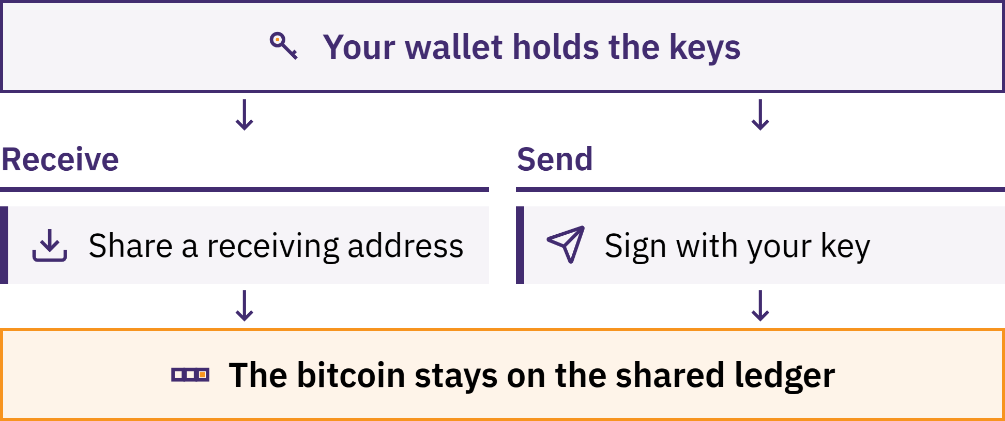

Slide 64
Addresses
Public receiving information for on-chain payment
Obtain from the intended wallet's receive screen
Scan or copy; compare with the trusted screen afterward
Confirm recipient, network, and payment method
On-chain address and Lightning invoice: different requests
Malware can replace copied destinations. Familiar appearance is not enough. Fresh addresses reduce easy links between payments; they do not make payments anonymous.
Bitcoin Diploma · Module 3

Slide 65
Keys
Private key: secret information used to authorize spending
Public key: verifies signatures without revealing the private key
Address: receiving information derived from public-key information
Wallets normally manage many keys automatically
Never share private keys, seed phrases, passwords, or recovery codes. No legitimate educator, support worker, wallet company, exchange employee, or developer needs them.
Try it
Sort prepared examples into receiving information, secrets, and public information that becomes sensitive when linked to a person.
Bitcoin Diploma · Module 3

Slide 66
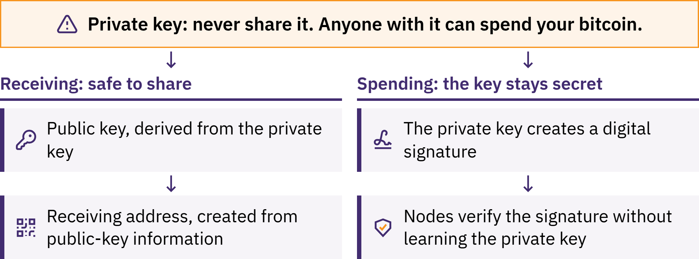

Slide 67

Seed Phrases
A seed phrase is an ordered list of words that many wallets use to recover their private keys.
Often 12 or 24 words; designs differ
Exact spelling and order
Official backup instructions; private, offline storage
Protect against loss, damage, cameras, and other observers
Bitcoin Diploma · Module 3
Notes:
Never photograph, cloud-store, email, message, or enter a real seed phrase into a website or ordinary form. It can provide full access to funds.
Additional passphrases, multiple keys, and advanced backup schemes belong to Advanced Learning. Do not introduce complexity learners cannot explain or recover from.
If it may have been seen, copied, entered online, or stored on an untrusted device, treat it as compromised. Seek help without revealing it; use a new trusted recovery process.

Slide 68
Custodial and Non-Custodial Use
Custodial: service controls keys and account recovery
Displayed balance: service's promise to provide bitcoin
Self-custodial: user controls keys and backup
Direct control brings error and recovery responsibility
A public blockchain cannot prove what a service owes a particular customer. Self-custody can still involve software, hardware, server, and network dependencies.
Try it
Compare two prepared descriptions: who controls keys, who restores access, and what risk needs checking?
Bitcoin Diploma · Module 3

Slide 69

Bitcoin Diploma · Module 3

Slide 70
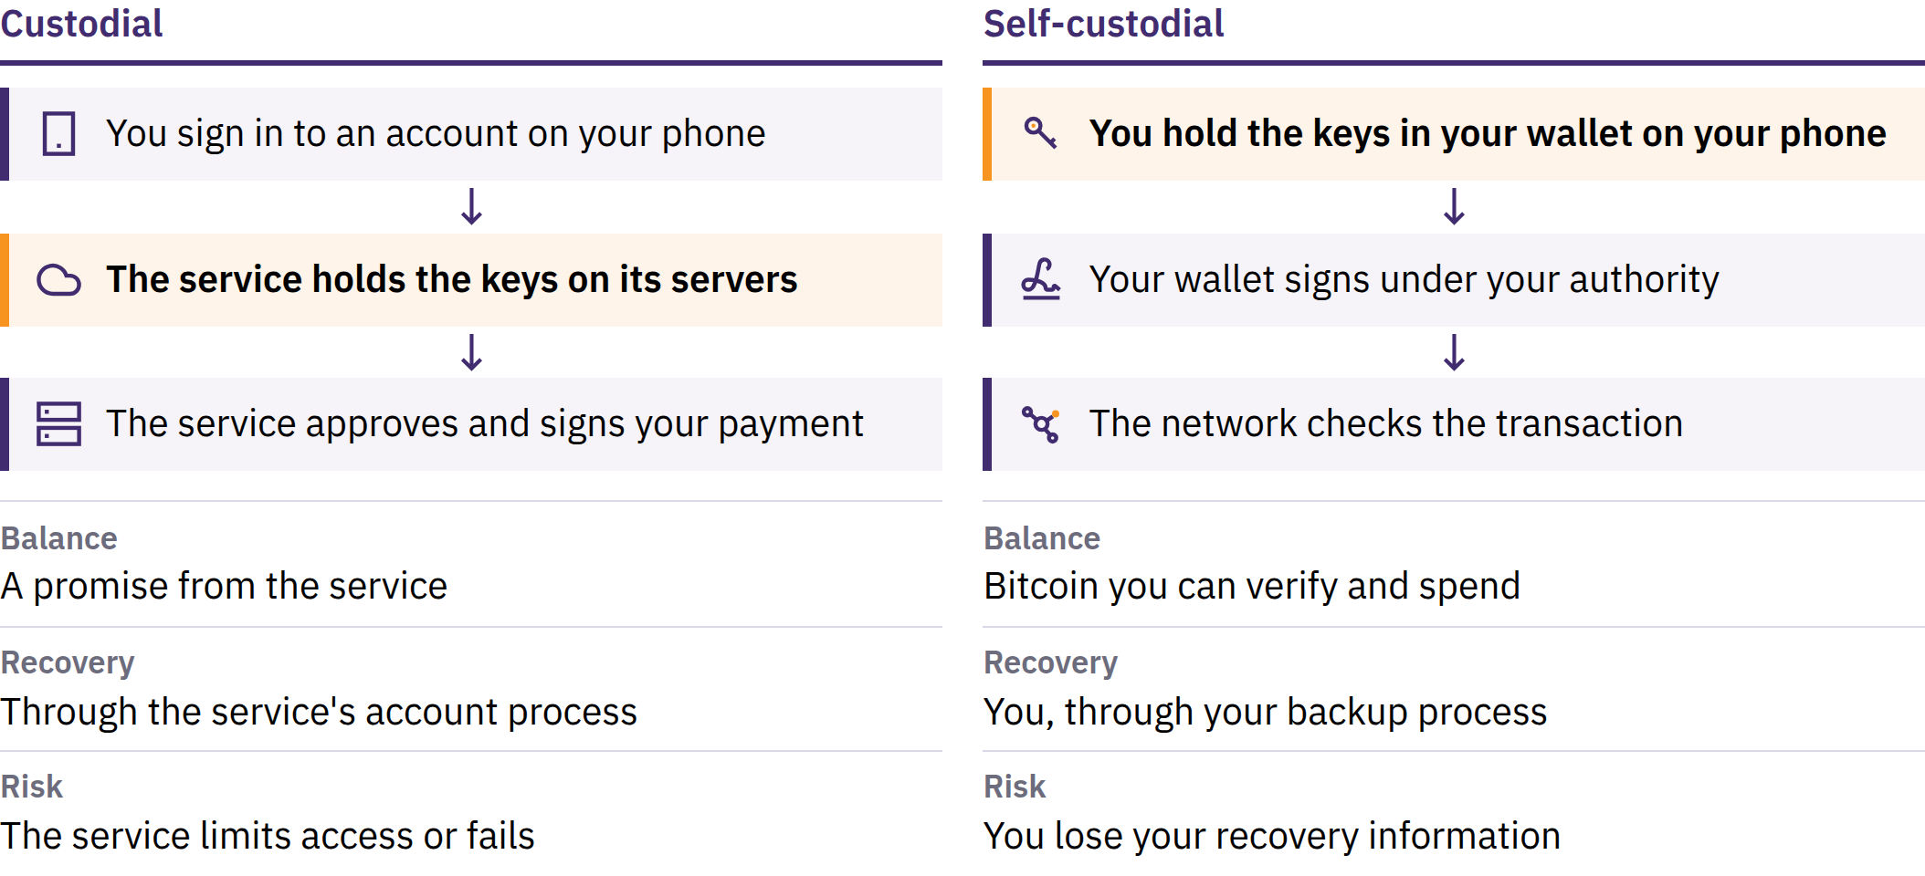

Slide 71

Hot and Cold Wallets
Hot: keys on an internet-connected device; convenient, greater exposure
Cold: signing keys isolated from an internet-connected general-purpose device
Hardware wallet: dedicated key-protection and signing device
Custody and recovery: separate questions
A hardware wallet can support cold storage; the terms are not interchangeable. Devices and backups still need protection.
Bitcoin Diploma · Module 3
Notes:
Use the source fictional small-payment and less-frequent-payment comparison. Keep choices hypothetical; do not select tools or amounts for learners' personal funds.

Slide 72
Wallet Recovery and Seed Phrase Testing
Use only prepared, empty, or simulated materials. Never expose real recovery words; never use a classroom wallet for meaningful funds later.
Bitcoin Diploma · Module 3
Notes:
Observe the process without viewing recovery words. A later personal setup requires new, privately generated recovery information.

Slide 73
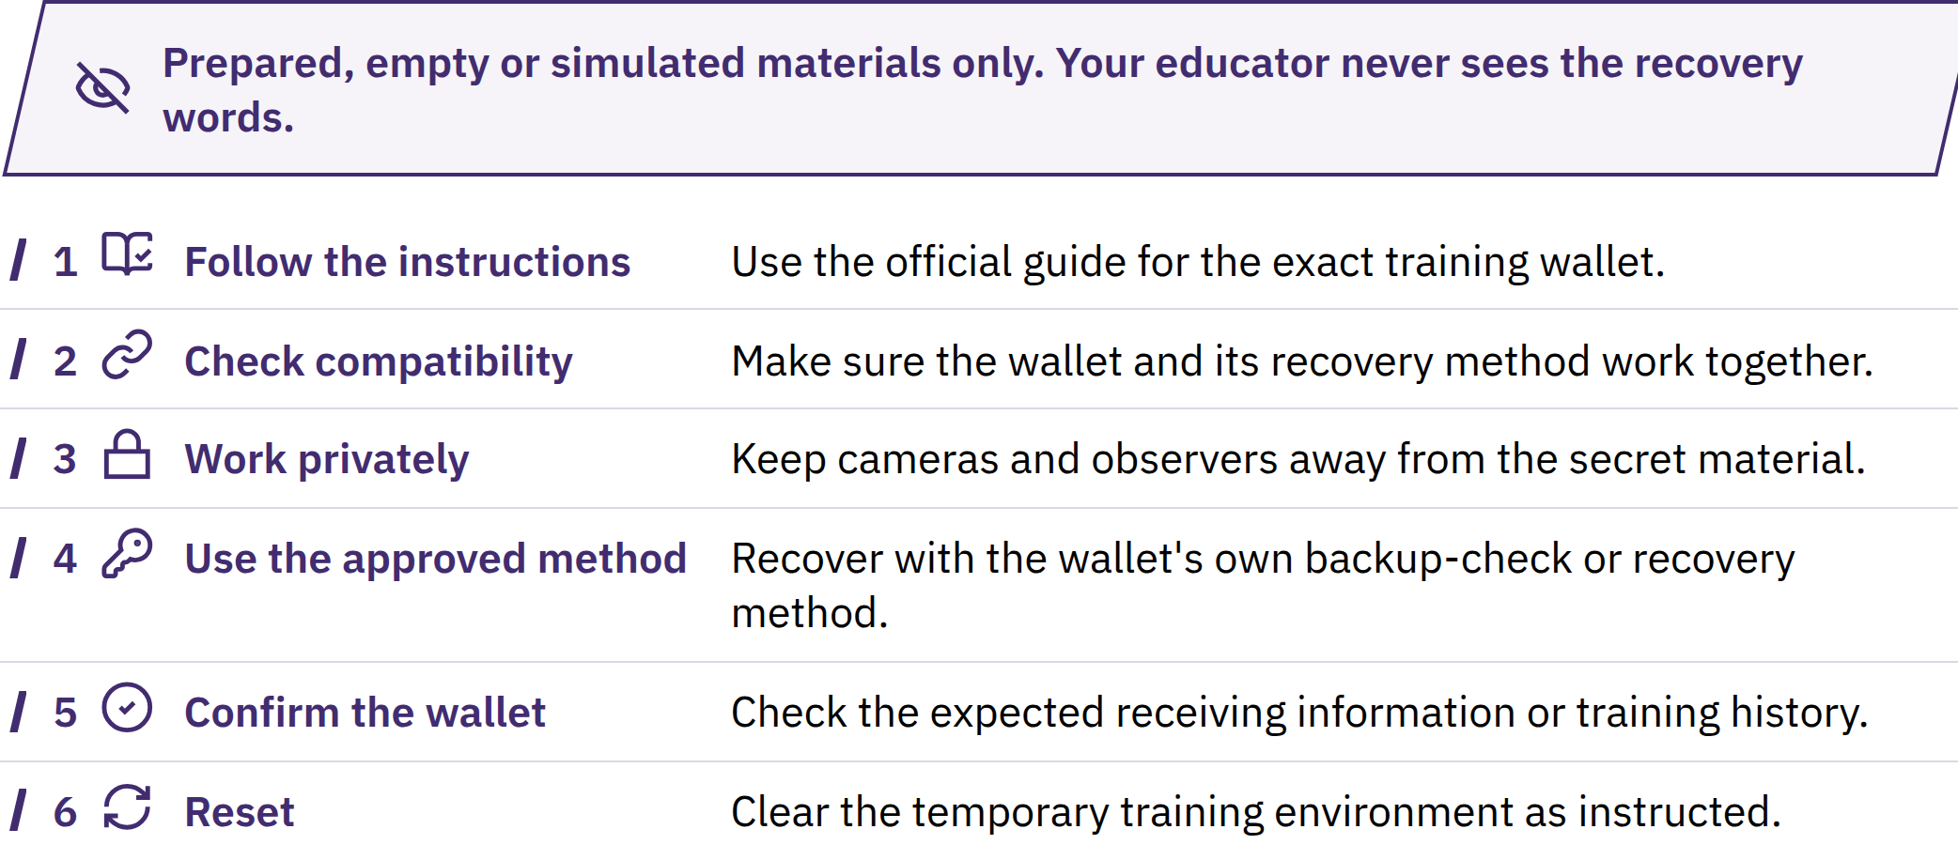

Slide 74
Receiving Bitcoin
Practice 1: receive safely
Open the prepared wallet; choose Receive.
Identify on-chain or Lightning.
Share only public receiving information.
Check any requested amount with the sender.
Check the amount and status in your own wallet.
A sender's message or screenshot is not proof. Pending is different from confirmed; confirmations cannot repair a wrong address or scam.
Bitcoin Diploma · Module 3

Slide 75

Sending Bitcoin
Practice 2: pause and check before sending
Approve only when every check matches. If details change, urgency appears, or anyone requests secrets, stop and verify independently. A valid send is difficult or impossible to reverse.
Bitcoin Diploma · Module 3

Slide 76
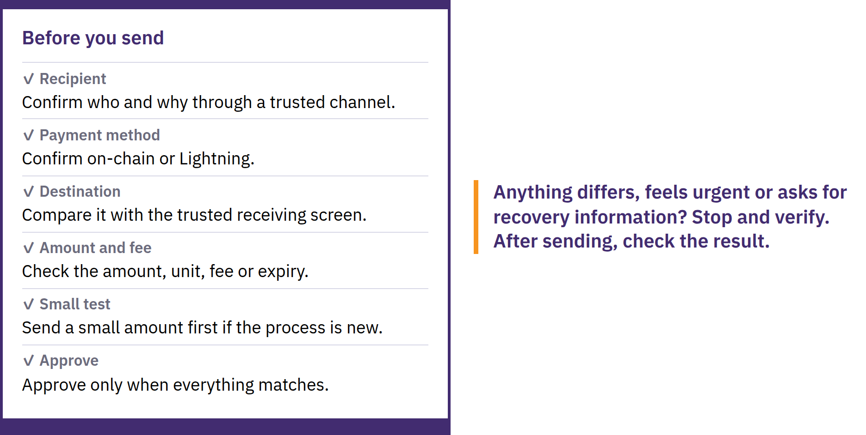

Slide 77
Verification and Irreversible Transactions
Txid: identifier for an on-chain transaction
Explorer: interface to public transaction data
Check network, destination, amount, fee, status, and confirmations
Broadcast → pending → included in a block → later confirmations
An explorer cannot prove identity, honesty, or payment purpose. There is no universal confirmation count for every payment.
Use prepared examples; do not search a learner's personal address or transaction. Searches can reveal your interest to the explorer operator.
Bitcoin Diploma · Module 3
Notes:
On-chain fees depend mainly on transaction data and block-space demand, not simply the amount sent. Read the final estimate; timing and fees can change.

Slide 78
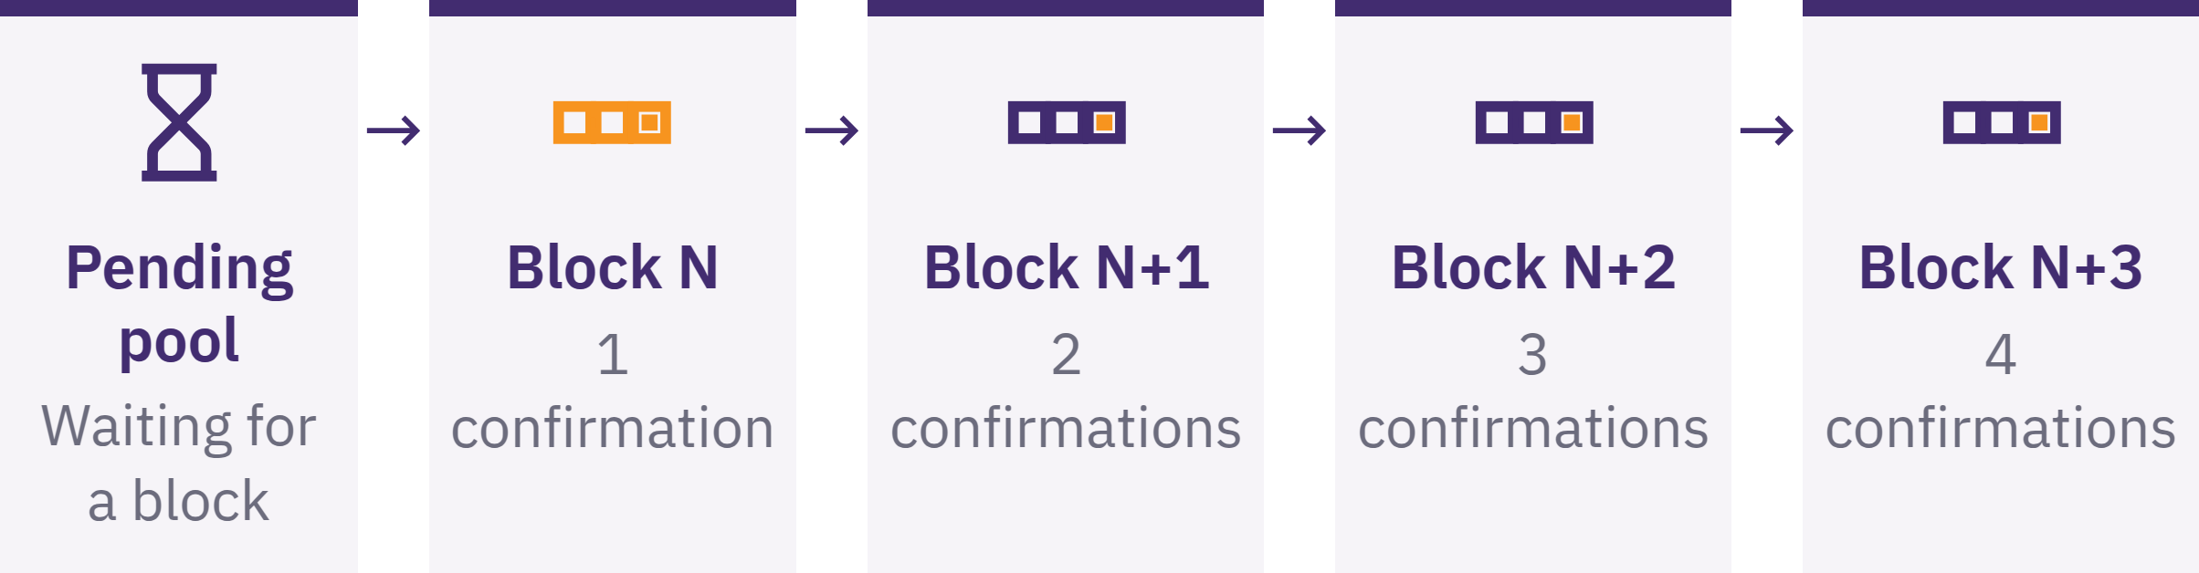

Slide 79

Safety Checklist
Practice 3: spot a risk and stop safely
Pause. Share nothing. Send nothing. Close the channel. Verify independently. Ask for help without revealing secrets.
Try it
Identify a prepared message's warning sign, possible loss, and first safe action.
Bitcoin Diploma · Module 3
Notes:
Reach official sites, app listings, and contacts independently. Check publisher and domain; be cautious with ads, messages, and look-alike sites. Never borrow money to experiment.

Slide 80
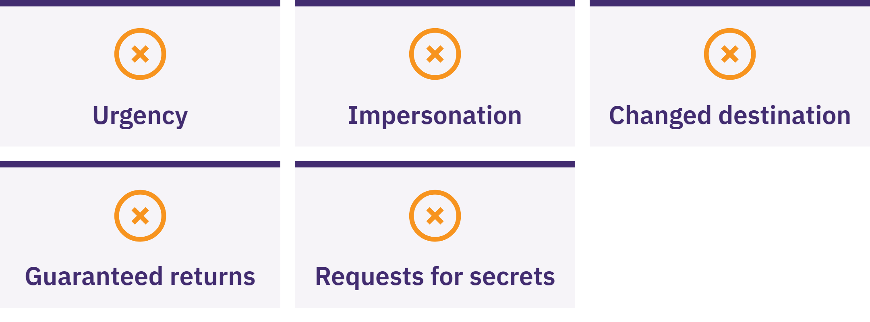

Slide 81

Acquiring and Exchanging
Bitcoin
Awareness, not financial advice
Compare total price and spread, service and withdrawal fees, key control, identity data, settlement, and current local rules.
No route or provider is automatically best. KYC means identity checks: possible compliance or recovery benefits, with identity–payment data risks.
Bitcoin Diploma · Module 3

Slide 82
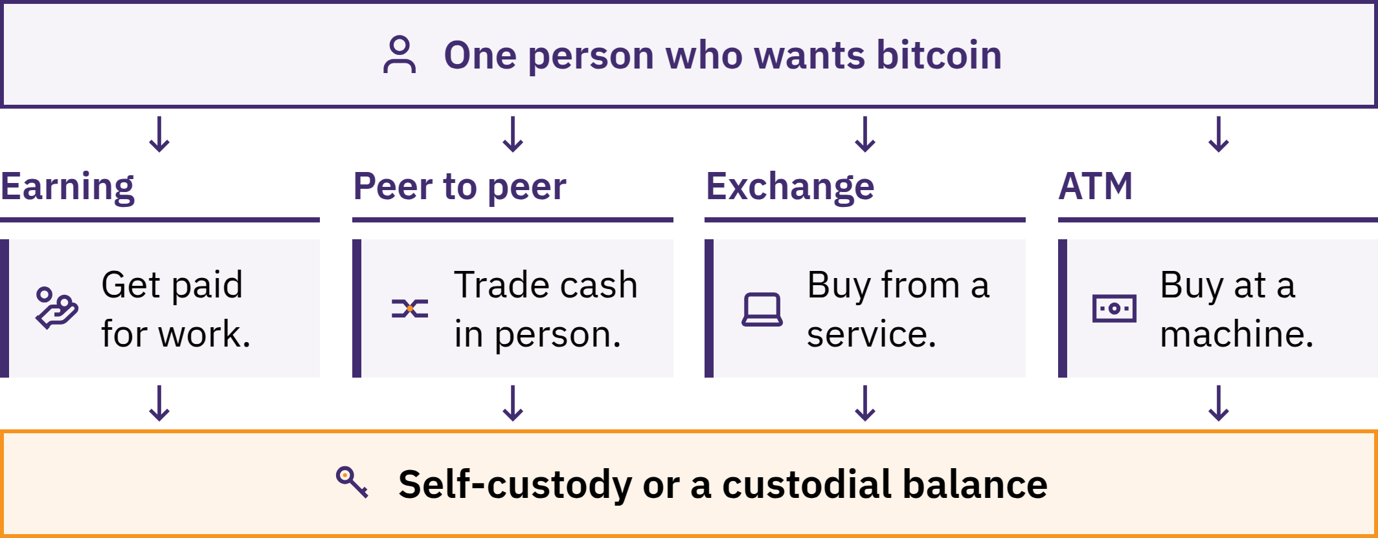

Slide 83
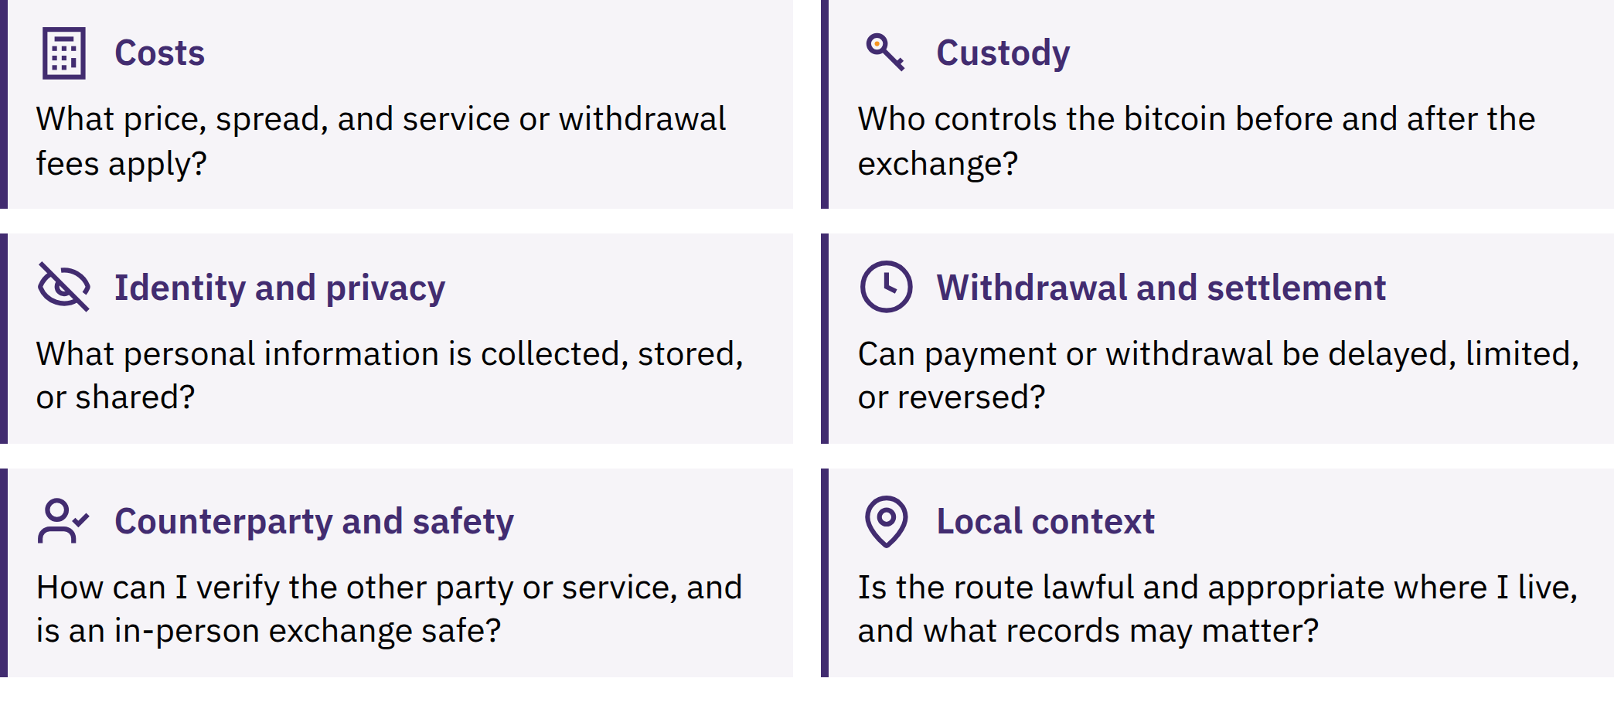

Slide 84
On-Chain and Lightning Payments
On-chain: blockchain record; confirmations
Lightning: Bitcoin payment network; usually quick success or failure
Different receiving requests, fees, limits, and failure points
Match the request to the wallet's supported payment method
Either path can involve custody or service dependence
Lightning is not a separate coin. A Lightning wallet can be custodial or self-custodial; fast payment does not prove suitability for larger balances.
Some apps support both paths with added fees or dependencies. Detailed channels, routing, and liquidity belong to Advanced Learning.
Bitcoin Diploma · Module 3

Slide 85
Supported Practice
Open and navigate the prepared wallet
Complete the approved first-access pathway
Locate and check public receiving information
Receive or safely simulate receipt; check status
Complete or simulate a receive/send flow
Show recovery readiness without exposing secrets
Use the agreed training environment. Pause on a mismatch; ask for support and more practice when needed.
Bitcoin Diploma · Module 3
Notes:
Source anchor: Practical competency check observed by an educator. C6 requires direct observation of both wallet/receipt and recovery-readiness tasks. Simulations, prepared materials, physical models, and no-funds alternatives are valid. Give feedback and another opportunity when needed. Keep rubrics and assessment administration off screen.

Slide 86
Review: What Does Self-Custody Responsibility Mean?
Key takeaways
Wallet manages access; keys authorize spending
Share receiving information; keep secrets offline and private
Identify custody, recovery, and device risks
Verify before approval; check the result yourself
Stop under pressure; keep learning mistakes small
A friend sends a request while unfamiliar support demands immediate action. What could you check before doing anything?
A moment to reflect
Which safety check will you pause to make before acting?
Bitcoin Diploma · Module 3

Slide 87

Module 4
Bitcoin in Your Community
Connect: How do the problem, solution, and safe action connect to this community?
Notes:
Module 4 is required and educator-curated. Select the locally relevant Bitcoin-as-money task and use the following prompts as adaptable options, not a requirement to demonstrate every tool or scenario. Verify current tools, local rules, infrastructure, and support. Preserve required competencies and Module 3 safety standards; do not invent local providers or details.

Slide 88
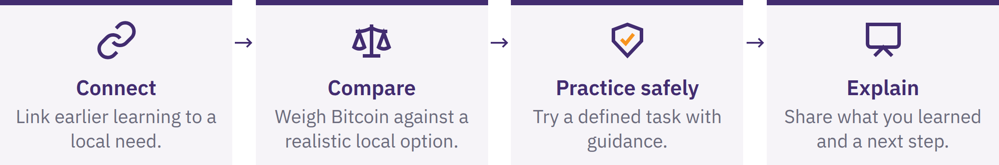
Your Local Module 4
Record your local focus: problem or opportunity, alternative, safe scenario, main benefit and risk, and safe next step.
You are not expected to adopt Bitcoin or conclude it is best. Local examples do not prove that a method works everywhere.
Bitcoin Diploma · Module 4

Slide 89
Workshops and Demonstrations
Presentation: observe the process and risks
Practice: follow with safe training materials
Production: complete a task or explain a decision independently
Before practice: checked tools, clear recovery and failure plans, known risks, and a clear stopping point.
No pressure to install software or disclose financial data. An offline or no-funds alternative is available. Any live amount must be small enough that total loss remains a lesson, not a crisis.
Bitcoin Diploma · Module 4
Notes:
Choose the relevant source task: custody comparison, receive-screen check, payment-path comparison, prepared transaction check, route-cost comparison, scam response, merchant/donation flow, or resource verification. Seek local expertise when needed.

Slide 90
Local Bitcoin Tools and Resources
Purpose and realistic alternative
Key control and recovery
Genuine publisher, domain, or app listing
Open-source status, review, and maintenance
Privacy, total cost, compatibility, and support
Current local rules and restrictions
Record the tool/version, check date, custody, main use, benefit, risk, recovery method, and alternative.
Named tools are dated learning examples, not endorsements or promises of safety, availability, low cost, or suitability. Check them again before real use.
Bitcoin Diploma · Module 4

Slide 91
Lightning Payments
Invoice: request for a specific payment; may include amount and expiry
Lightning address: provider-supported routing identifier, often email-like
Check custody, funding route, backup, fees, and limits
Identify failure handling and recipient confirmation
A Lightning address is not an email account; it depends on its supporting provider or domain. Check the final request before approving.
A successful small payment does not prove safety for larger balances.
Bitcoin Diploma · Module 4

Slide 92
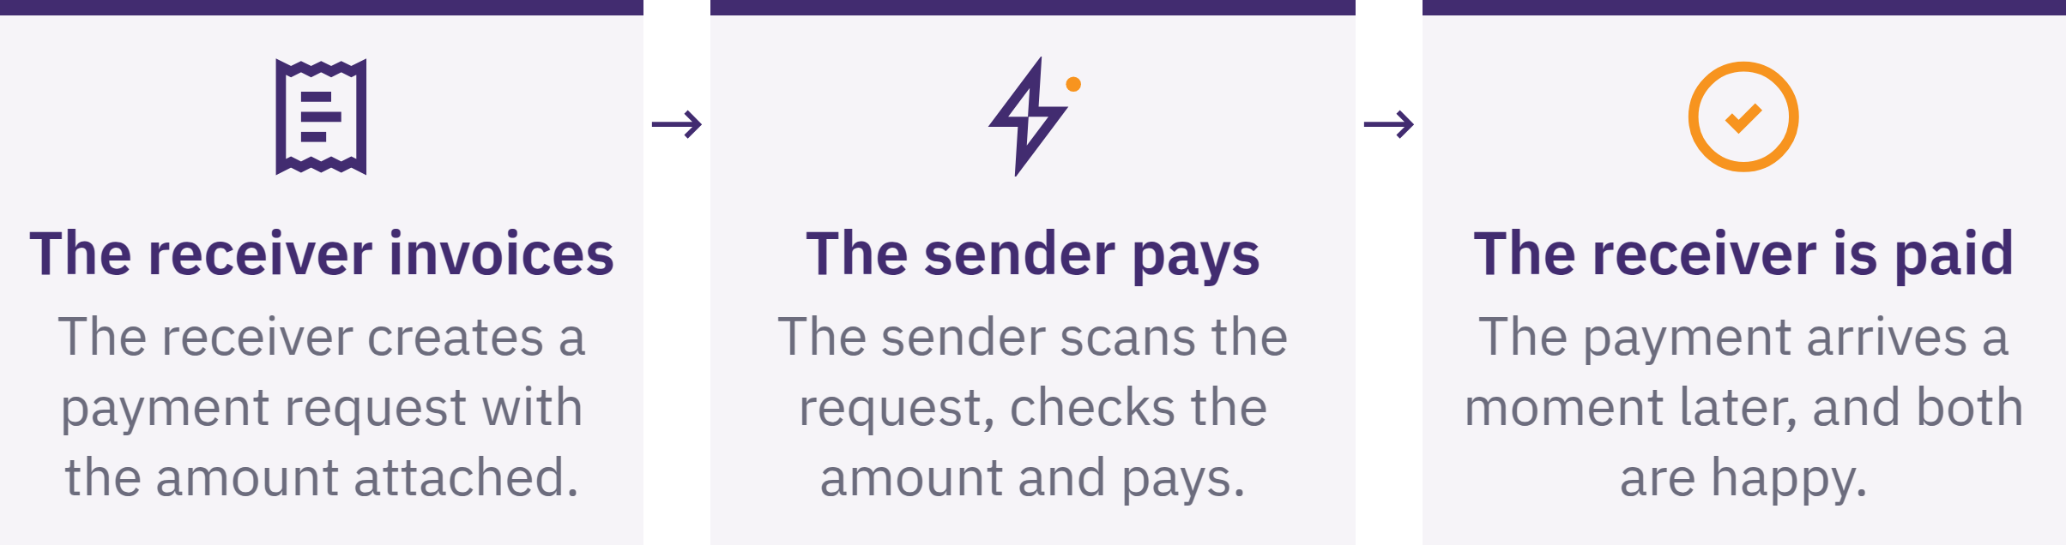

Slide 93
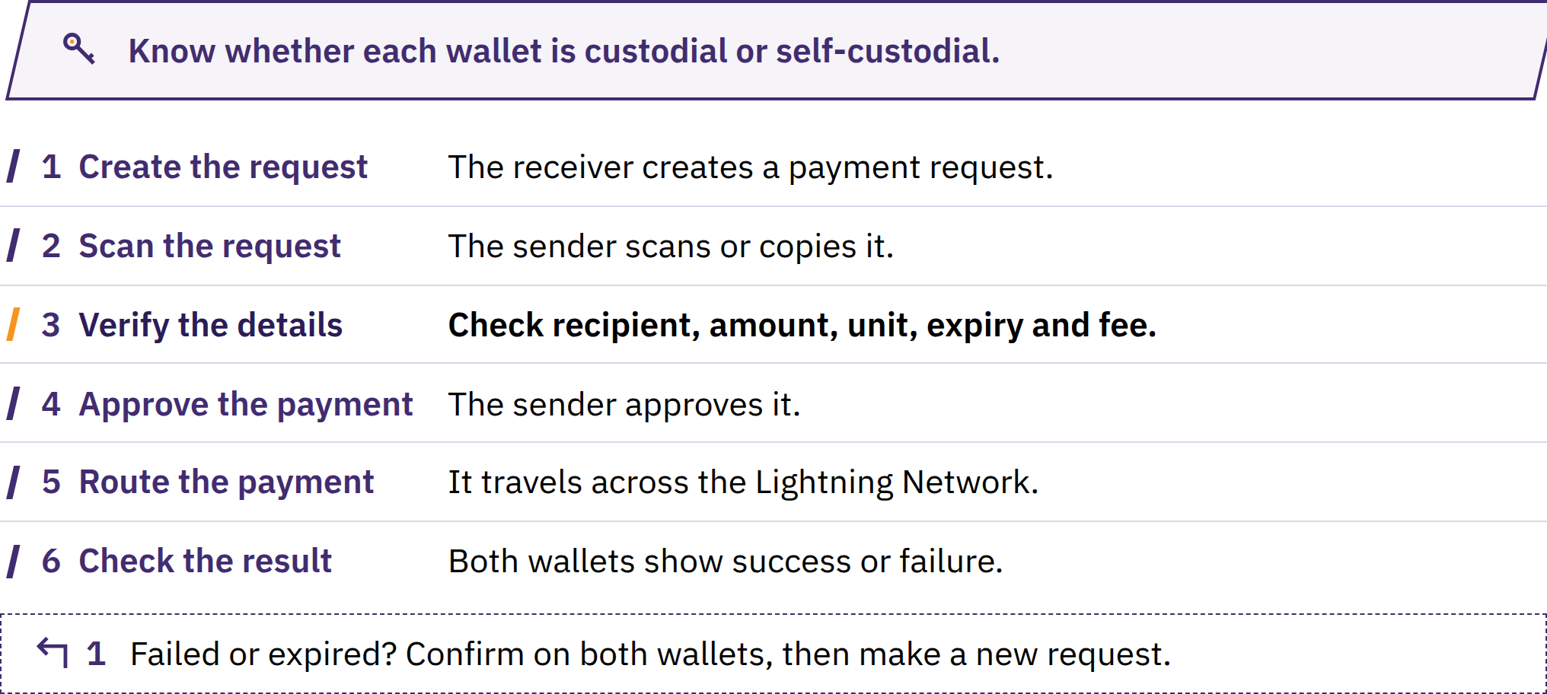

Slide 94
Guided Lightning Payment
Receiver creates the correct request.
Sender scans or copies it.
Check recipient, amount, unit, fee, and any expiry.
Approve only when details match.
Both sides check the result in their own wallets.
Explain custody and failure risks.
Use prepared or approved low-stakes practice. Stop if the outcome differs from the plan; verify before further action.
Bitcoin Diploma · Module 4

Slide 95
Daily-Life Bitcoin Use
Earning: pricing, timing, volatility, records, and custody
Saving: future use; price can fall sharply
Receiving and sending: correct request, settlement, route, and fees
Spending: exchange rate, merchant policy, and tax effects
Pricing and accounting: BTC/sats; fiat records may still be needed
Donating: verify the real recipient's request
What problem is addressed? Is Bitcoin better than the available alternative here? What new risk or responsibility appears?
Bitcoin Diploma · Module 4

Slide 96

Local Spending and Receiving
A small purchase
Which path fits a small, quick payment?
Who requests; who checks amount and unit?
What if “sent” and “received” disagree?
Payment for work
Price unit, rate timing, who pays fees?
Custody, records, safe management?
Bitcoin Diploma · Module 4
Notes:
Use a low-value item or a simulation. Explain the complete flow before approving payment.
Select or adapt the guide's scenarios to the local task. Keep prompts learner-facing and avoid treating hypothetical acceptance as an actual local merchant listing.

Slide 97
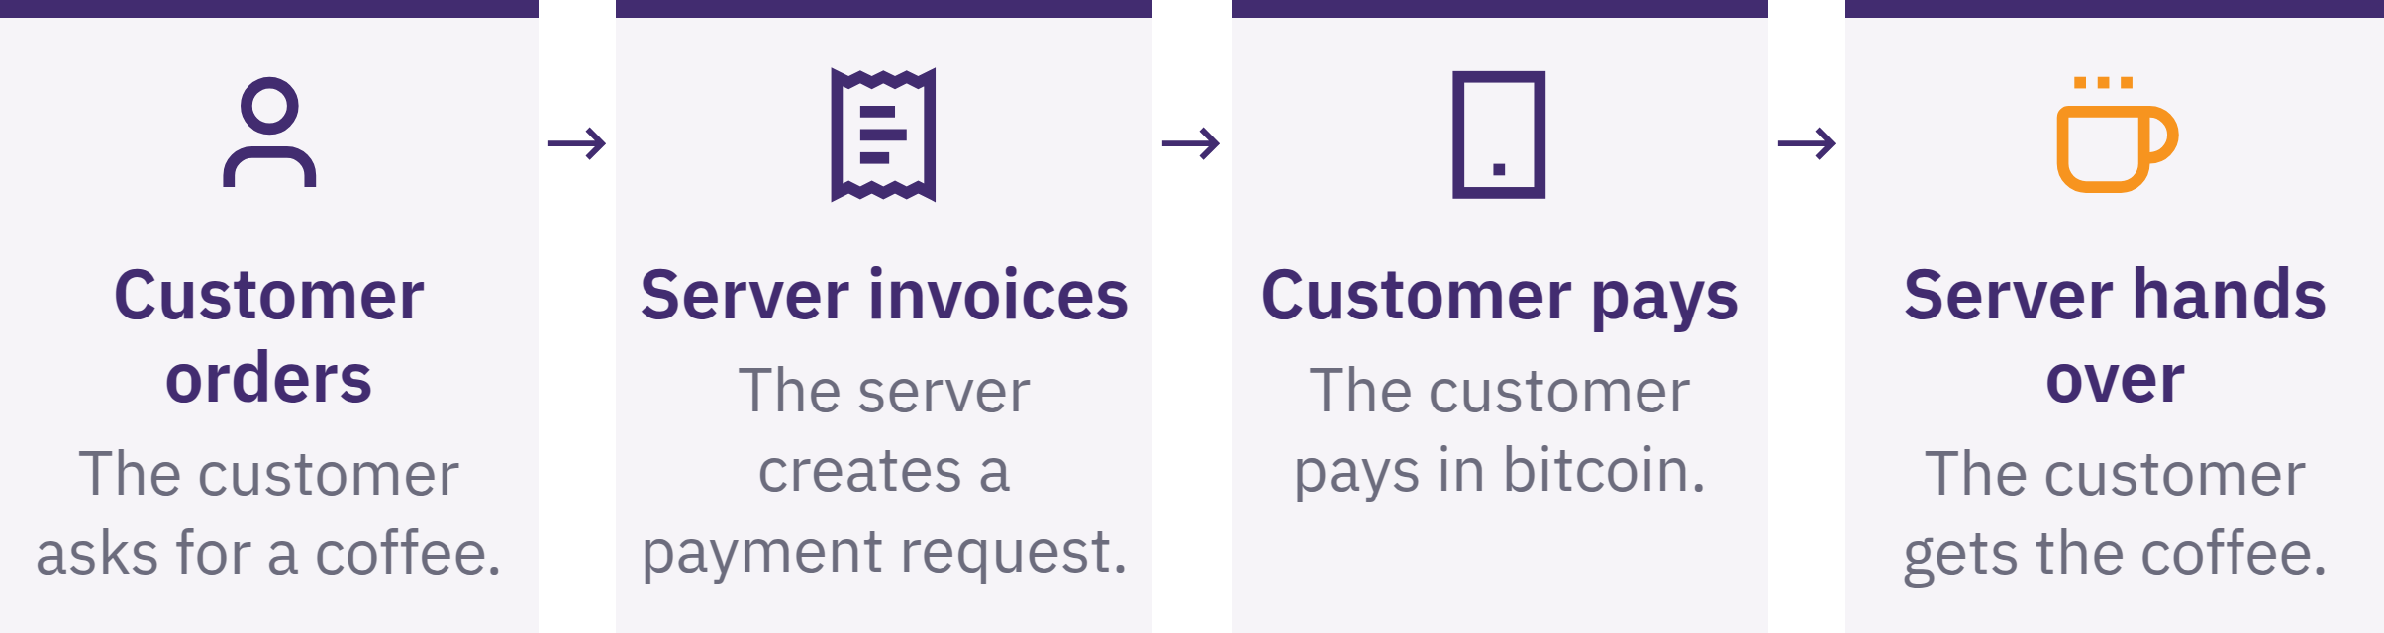

Slide 98
Local Transfers, Refunds, and Donations
Family transfer: compare the complete route, total cost, delays, custody, and what the recipient wants
Refund: verify the customer's request; use a fresh refund address; agree fees and records
Community donation: verify the request; identify key/backup control and payment path
Balance transparency with donor privacy; check required records
Bitcoin Diploma · Module 4
Notes:
Use whichever source scenario supports the selected local task. A refund is a new payment, not a reversal of the original on-chain transaction.

Slide 99
Local On-Ramp and Off-Ramp Pathways
On-ramp: local money, work, or assets → bitcoin
Off-ramp: bitcoin → local money, goods, or services
Compare two local routes with an existing non-Bitcoin option
Total received, time, custody, privacy, reversal risk, and failure points
Check withdrawal to keys you control; an internal balance may remain a claim
For in-person exchange, use an appropriate public location, avoid unnecessary cash, bring a trusted person where suitable, verify payment before leaving, and follow local law. Do not reveal holdings or storage details.
Bitcoin Diploma · Module 4
Notes:
Source pathways include work, direct exchange, brokers, ATMs, merchants, conversion services, and circular economies. Use current verified local facts or a clearly fictional scenario.

Slide 100
KYC and No-KYC Trade-Offs
KYC: identity checks; possible banking access, limits, compliance, or recovery benefits
Data risk: lasting identity–payment links, breaches, misuse, or restrictions
No-KYC: potentially less identity collection
Possible higher prices, lower liquidity, less support, fraud, or legal restrictions
Neither label is automatically best. Do not break local law or face physical danger in pursuit of privacy; seek qualified current local guidance when unclear.
Bitcoin Diploma · Module 4
Notes:
Compare data retention, on-chain links, counterparties, fraud protection, limits, fees, and dispute handling.

Slide 101
Circular Economies
A Bitcoin circular economy connects people who voluntarily earn, spend, save, and exchange bitcoin within a community.
Workers → customers → merchants → suppliers
Where does value circulate or convert to fiat?
Who provides education and technical support?
What happens if connectivity fails?
Who carries custody and price risks?
Adoption numbers alone do not prove usefulness. Weak demand, tools, education, or security can break the loop; avoid dependence on giveaways or one organizer processing every payment.
Bitcoin Diploma · Module 4

Slide 102

Bitcoin Diploma · Module 4

Slide 103
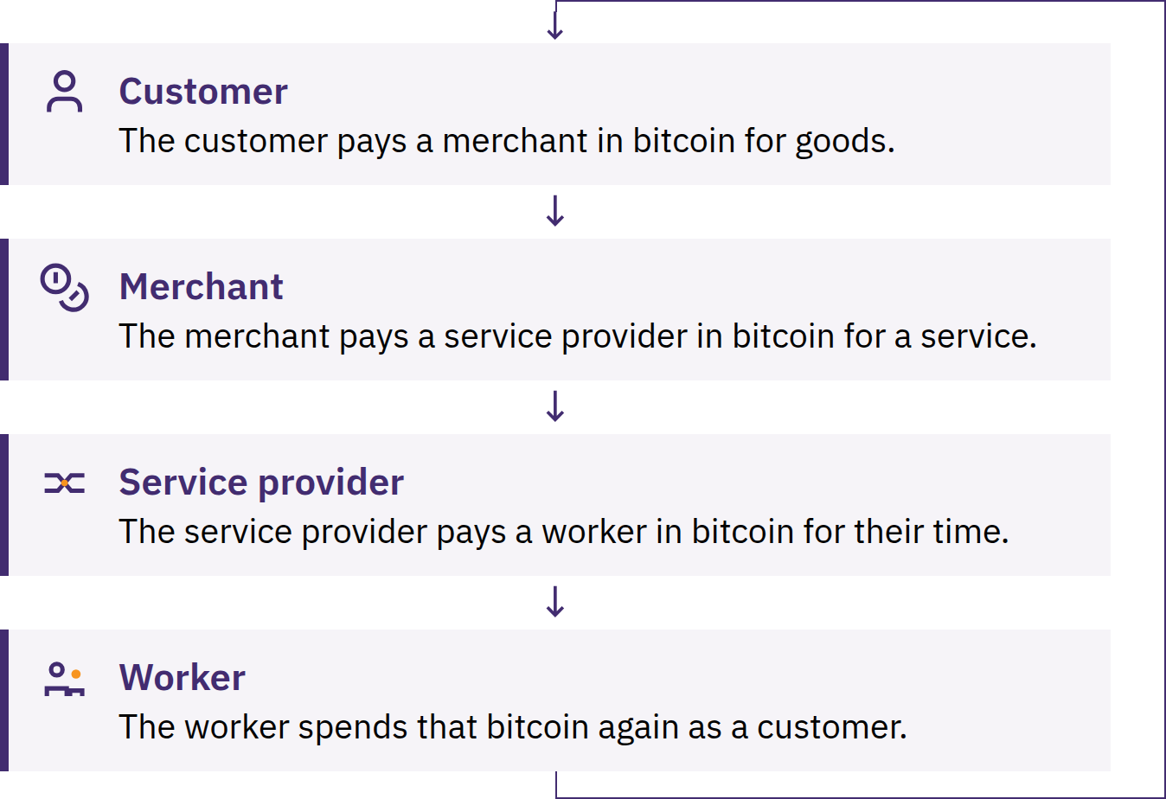

Slide 104
Merchant or Community Use Cases
Pricing unit and payment method
Key control, staff access, device security, and backups
Confirmation, receipts, refunds, and mistakes
Conversion, records, taxes, and support
Plan for wallet or network failure
One organizer holding shared funds is a custodian and a point of trust. Shared funds need transparent rules, records, access controls, and legal review where appropriate.
Bitcoin Diploma · Module 4
Notes:
Define success by the problem solved, not the transaction count.

Slide 105

Local Resource Maps and Community Discovery
Find merchants, educators, meetups, and community resources
Check the date; confirm independently
Bring an alternative way to pay or participate
Community membership is not proof of trustworthiness
Never reveal recovery words, balances, home addresses, or security arrangements at a meetup. Be cautious with investment management, private-exchange offers, urgent help, and guaranteed returns.
Bitcoin Diploma · Module 4

Slide 106
Review: Connect This to Your Community
Complete individually, then compare reasoning with your group.
What local need and money function were involved?
What realistic alternative did you compare?
On-chain, Lightning, or both? Who controlled keys?
Strongest benefit, most serious risk, and possible failure?
How did law, infrastructure, language, or culture affect the result?
What evidence supports a responsible next step, if any?
Bitcoin Diploma · Module 4
Notes:
Observe the educator-selected local Bitcoin-as-money task and the learner's explanation of purpose, alternative, trade-offs, possible failure, and next step. Keep scoring, rubrics, and assessment administration off screen.

Slide 107
Key Takeaways and a Moment to Reflect
Start with a local need and a realistic alternative
Observe, practice safely, then explain or demonstrate
Verify tools, custody, costs, privacy, and current local rules
Confirm payment method and result; plan for failure
Useful community participation is voluntary and protects people
A moment to reflect
What question would you ask before deciding whether a Bitcoin path fits a local need?
Bitcoin Diploma · Module 4

Slide 108


