Slide 1

Ntintim 26.10
Bitcoin
Ho Nnianim
Ɔhyɛasefoɔ Akwankyerɛ

Slide 2

Adɛn Nti Na Sika Ho Hia?
Yɛde sika di dwuma da biara, nanso yɛntaa mmisa sɛdeɛ ɛyɛ adwuma.
Notes:
Farebaeɛ: My First Bitcoin, Bitcoin Ho Nnianim, Akwankyerɛ Ma Wɔn a Wɔrehyɛ Aseɛ, deɛ ɛto so 26.10. Wɔayɛ mu nsakraeɛ wɔ Creative Commons Attribution-ShareAlike 4.0 International tumi krataa no ase; saa slaid ahodoɔ yi nso de saa tumi krataa korɔ no ara na ɛyɛ adwuma. Saa slaid ahodoɔ yi yɛ nkyerɛkyerɛ boafoɔ a ɔkyerɛkyerɛfoɔ na ɔde di dwuma, na egyina nsɛmmisa nsia a ɛwɔ akwankyerɛ no mu no so. Momma nhwɛsoɔ, nkyerɛkyerɛ no ahoɔhare ne ɔkwan a mode ma no mfata mo mpɔtam hɔfoɔ, nanso monkora nteaseɛ no ne ahobanbɔ ho nkra no so. Ɛnkyerɛ sɛ wɔahyɛ bere tenten pɔtee bi ama nkyerɛkyerɛ no.

Slide 3

Nnipa Dodow No Ara Ntɔ Wɔn
Bo Ase Nnwene Sika Ho Da
Ɛnyɛ sɛ yɛreyɛ adwuma de anya no anaa yɛresɛe no, na mmom yɛredwene deɛ ɛyɛ ne sɛdeɛ ɛyɛ adwuma ho.
Bitcoin Ho Nnianim · Adɛn Nti Na Sika Ho Hia?
Notes:
Momfa mfonini no mfi ase: obiara a ɔwɔ yɛn ho hyia de sika di dwuma a ɔmmisa ho asɛm. Mommisa kuw no bere a etwa to a wɔdwenee baabi a sika fi ba ho.

Slide 4

Nsɛmmisa Num a Yɛde Bɛhyɛ Ase
Adɛn nti na nnipa hia sika?
Dɛn na ɛma biribi yɛ sika?
Hwan na ɔtumi yɛ sika a mode di dwuma no anaa ɔdi so?
Adɛn nti na sika a mode di dwuma no wɔ boɔ?
Mo sika tumi tɔ nneɛma dodow koro no ara sɛ kane no anaa?
Monkora mo mmuaeɛ no so
Montwerɛ asɛmmisa biara ho mmuaeɛ tiawa. Mobɛsan ahwɛ mu wɔ awieeɛ no.
Bitcoin Ho Nnianim · Adɛn Nti Na Sika Ho Hia?
Notes:
Momma asuafoɔ no simma kakra na wɔntwerɛ. Mommisa obiara sɛ ɔnka n’ankasa sikasɛm ho nsɛm nkyerɛ. Wɔbɛsan de mmuaeɛ yi aba wɔ “Ɛdeɛn na ɛdi hɔ?” slide a ɛka adesua no mu nsɛntitire ho asɛm no so.

Slide 5

Nokwasɛm anaa Adwene?
Nokwasɛm: "Wɔgye saa krataa sika yi de tua ɛtoɔ." Wobetumi ahwɛ sɛ ɛyɛ nokorɛ anaa.
Adwene: "Yei ne sika a ɛyɛ papa pa ara." Ɛhia gyinapɛn ne adanseɛ.
Saa akwankyerɛ yi yɛ adesua nko ara ho. Ɛmma sikasɛm, sikatoɔ, mmara anaa ɛtoɔ ho afotuo, na ɛnka nkyerɛ mo sɛ montɔ, montɔn anaa monkora biribiara so.
Bitcoin Ho Nnianim · Adɛn Nti Na Sika Ho Hia?
Notes:
Momma nsonsonoeɛ yi nna adi wɔ adesua yi nyinaa mu. Sɛ obi ka asɛm bi a, mommisa sɛ: yɛbɛtumi ahwɛ sɛ ɛyɛ nokorɛ, anaa ɛhia gyinapɛn ne adanseɛ?

Slide 6

Sika Ne Dɛn?
Sika yɛ adwinnadeɛ a wɔde sesa nneɛma.

Slide 7

Nneɛma Sesa ne Afanu no Ahiadeɛ a Ɛhyia
Ɛsɛ sɛ nnipa baanu no mu biara pɛ nea ɔfoforo no wɔ, wɔ berɛ koro no ara mu ne dodow a ɛfata mu.
Bitcoin Ho Nnianim · Sika Ne Dɛn?
Notes:
Momfa akwankyerɛ nhoma no mu nhwɛsoɔ no nni dwuma: modua ɛmo na mohia mpaboa, nanso nea ɔyɛ mpaboa no pɛ aduannoa ngo, na ɛnyɛ ɛmo. Sikasɛm ho animdefoɔ frɛ wei ahiadeɛ mmienu a ɛhyia.

Slide 8
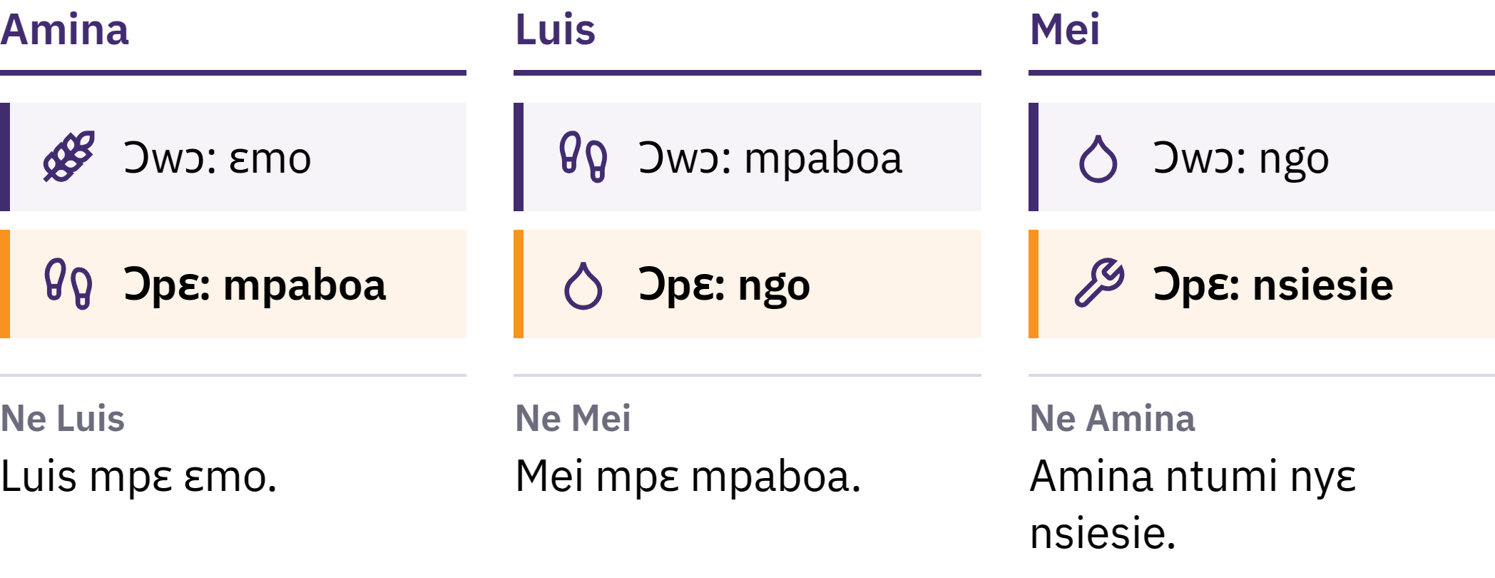
Nneɛma Sesa ne Afanu no Ahiadeɛ a Ɛhyia
Ɛsɛ sɛ nnipa baanu no mu biara pɛ deɛ ɔfoforɔ no wɔ, wɔ berɛ korɔ no ara mu ne dodow a ɛfata mu.
Bitcoin Ho Nnianim · Sika Ne Dɛn?
Notes:
Momfa akwankyerɛ nhoma no mu nhwɛsoɔ no nni dwuma: modua ɛmo na mohia mpaboa, nanso nea ɔyɛ mpaboa no pɛ aduannoa ngo, na ɛnyɛ ɛmo. Sikasɛm ho animdefoɔ frɛ wei ahiadeɛ mmienu a ɛhyia.

Slide 9

Sika Yɛ Nsesaeɛ Ho Adwinnadeɛ
Obiara mpɛ sika sɛ ɔbɛnya sika kɛkɛ. Ɛho wɔ mfasoɔ ɛfiri sɛ afoforɔ gye tom, na wɔhwɛ kwan sɛ afoforɔ nso bɛgye atom akyiri yi.
Bitcoin Ho Nnianim · Sika Ne Dɛn?
Notes:
Sika krataa yɛ krataa bi kɛkɛ. Sika di ade a wɔde sesa ade ho haw ho dwuma denam adetɔn ne adetɔ a ɛma ɛtetew mu no so: motɔn mo ɛmo ma obi, na motɔ mpaboa fi obi foforɔ hɔ. Eyi na ɛma sika yɛ soronko wɔ ade a wɔde sesa ade ho.

Slide 10

Nneɛma Mmiɛnsa a Sika Yɛ
Nsesayɛ adeɛ: nkurɔfoɔ gye tom sɛ adeɛ a wɔde tua ka
Akontaabu susudeɛ: wɔde kyerɛ nneɛma boɔ
Boɔ akoraeɛ: ɛde boɔ firi ɛnnɛ kɔ daakye
Sika biara ntumi nkora boɔ so pɛpɛɛpɛ, nanso tumi a sika ahodoɔ bi wɔ de tɔ nneɛma no so te brɛoo sene afoforɔ deɛ.
Bitcoin Ho Nnianim · Sika Ne Dɛn?

Slide 11

Efi Sedie So Kɔ Krataa So
Ɛpo mu nkoradeɛ, nkyene, nhene, mmoa a wɔyɛn wɔn, kɔbere, dwetɛ, sika kɔkɔɔ
Nnadeɛ a ɛsom bo: ɛho yɛ na, ɛkyɛ, wɔgye tom wɔ mmeaeɛ pii
Nkrataa a wɔtumi de kɔgye dadeɛ dodorɔ bi a wɔakyerɛ
Sika kɔkɔɔ gyinapɛn: sika susudua a mmara de abɔ sika kɔkɔɔ ho
Na ɛsono baabiara ne berɛ biara mmara.
Bitcoin Ho Nnianim · Sika Ne Dɛn?

Slide 12
Aban Mmara Sika
1971: United States gyaee nhyehyɛeɛ a ɛma amannɔne aban ne wɔn sikakorabea titire tumi de dɔla sesa sikakɔkɔɔ wɔ aban kwan so no
Ɛnnɛ, aman mu sika dodow no ara yɛ fiat sika: wɔde ba wɔ aban tumi ase, na wɔrentumi mfa nsesa sikakɔkɔɔ anaa aguadeɛ foforɔ biara
Fiat yɛ Latin asɛmfua a ɛkyerɛ "ma wɔnyɛ no saa", na wɔtaa te aseɛ sɛ "ɛnam ɔhyɛ so"
Wɔgye tom ɛfiri sɛ nnipa, nnwuma, sikakorabea ne aban de di dwuma; mmara ma ɛyɛ sika a wɔgye tom de tua ka na ɛhwehwɛ sɛ wɔde tua ɛtoɔ
Bitcoin Ho Nnianim · Sika Ne Dɛn?

Slide 13

Yɛfirii sika a biribi taa akyi so kɔɔ
sika a ahotosoɔ a yɛwɔ wɔ obi mu
taa akyi so.
Bitcoin Ho Nnianim · Sika Ne Dɛn?

Slide 14

Dɛn Na Ɛhaw Yɛn Sika?
Sɛ nkurɔfoɔ te asɛmfua nneɛma boɔ mmasoɔ a, wɔtaa dwene nneɛma boɔ a ɛrekɔ soro ho.

Slide 15
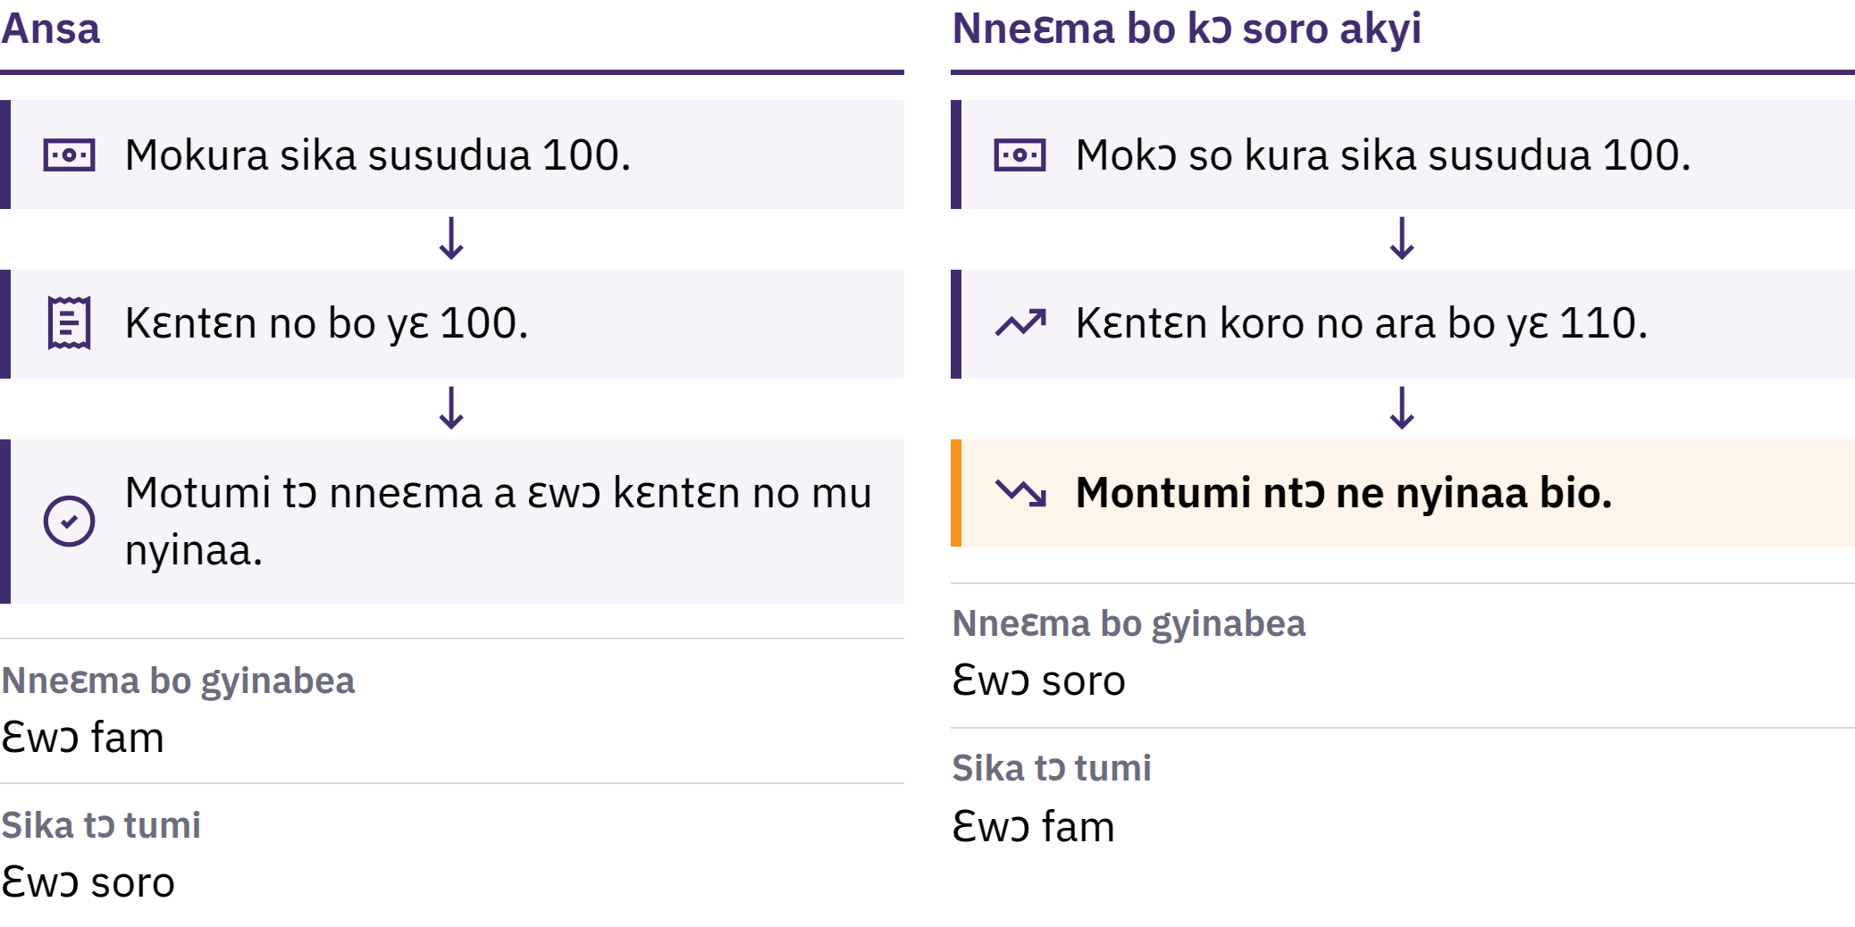
Nneɛma Boɔ a Ɛkɔ Soro ne Adetɔ Tumi
Bitcoin Ho Nnianim · Dɛn Na Ɛhaw Yɛn Sika?
Notes:
Nneɛma boɔ kɔsorɔ yɛ nneɛma boɔ nyinaa a ɛkɔ soro na ɛtoa so saa. N’afa foforɔ ne adetɔ tumi: nneɛma dodoɔ a sika susudua baako bɛtumi atɔ. Sɛ nneɛma atitire a ɛwɔ kɛntɛn bi mu boɔ kɔ soro firi sika susudua 100 kɔ 110 a, saa sika susudua 100 no ara rentumi ntɔ nneɛma a ɛwɔ kɛntɛn no mu nyinaa bio.

Slide 16

Nneɛma Boɔ a Ɛkɔ Soro ne Adetɔ Tumi
Bitcoin Ho Nnianim · Dɛn Na Ɛhaw Yɛn Sika?
Notes:
Nneɛma boɔ kɔsorɔ yɛ nneɛma boɔ nyinaa a ɛkɔ soro na ɛtoa so saa. N’afa foforɔ ne adetɔ tumi: nneɛma dodoɔ a sika susudua baako bɛtumi atɔ. Sɛ nneɛma atitire a ɛwɔ kɛntɛn bi mu boɔ kɔ soro firi sika susudua 100 kɔ 110 a, saa sika susudua 100 no ara rentumi ntɔ nneɛma a ɛwɔ kɛntɛn no mu nyinaa bio.

Slide 17

Nnyinasoɔ Pii, Ɔpaw Baako
Sika ne bosea dodoɔ a ɛkɔ soro
Nneɛma a wɔde ma no mu ntwitwiram ne nneɛma a nkurɔfoɔ hwehwɛ no mu nsakraeɛ
Sika a ɛsom bo so retew, ɛtoɔ, nneɛma a wɔyɛ ho ka
Adeɛ baako a ɛde ba no yɛ gyinaeɛ a wɔsi, na ɛnyɛ biribi a ɛba kwa: wɔ fiat sika nhyehyɛeɛ mu no, ahyehyɛdeɛ kakraa bi tumi ma sika ne bosea dodoɔ kɔ soro na wɔsesa nhyehyɛeɛ no mmara.
Bitcoin Ho Nnianim · Dɛn Na Ɛhaw Yɛn Sika?
Notes:
Sikasɛm ho animdefoɔ gye akyinnye fa sɛnea nneɛma a ɛde eyi ba no mu biara ho hia no ho. Momma mo adwene nsi adeɛ baako a ɛfiri gyinaesi mu, na ɛnyɛ biribi a ɛbaeɛ kwa no so.

Slide 18
Ahoyɛna ne Boɔ
Mona Lisa mfonini ankasa no boɔ sen biara a wɔayɛ no sɛso: ɛno nko ara na ɛwɔ hɔ
Ɛnyɛ adeɛ ho a ɛyɛ na nko ara na ɛma ɛnya boɔ, nanso sɛ nkurɔfoɔ pɛ adeɛ bi a, ɛho hia sɛ wɔhwɛ dodoɔ a ɛwɔ hɔ
Sɛ sika dodoɔ kɔ soro ntɛmntɛm sen nneɛma a wɔde bɛtumi atɔ a, sika no mu baako biara taa tumi tɔ nneɛma kakra sen dada
Bitcoin Ho Nnianim · Dɛn Na Ɛhaw Yɛn Sika?

Slide 19
Nneɛma Boɔ Nkɔanim Nnya Obiara So Nkɛntɛnsoɔ Pɛ
Sika a ɛwɔ nsam ne sika a wɔakora no tumi a ɛde tɔ nneɛma betumi so ate
Wɔn a wɔwɔ agyapadeɛ a ne bo kɔ soro no betumi anya ahobammɔ bi
Akatua ne nneɛma bo nsakraeɛ mma ntɛmntɛm pɛ
Sika a ɛwɔ mo sikakorabea akonta mu yɛ soronko wɔ sika a ɛhyɛ mo nsam ho: ɛyɛ sikakorabea no bɔhyɛ sɛ ɛbɛtua mo sika no. Mpɛn pii no, wɔdi saa bɔhyɛ no so, nanso ɛgyina sikakorabea no ne mmara a ɛkyerɛ sɛdeɛ ɛyɛ adwuma no so.
Bitcoin Ho Nnianim · Dɛn Na Ɛhaw Yɛn Sika?

Slide 20
Sɔ Hwɛ: Adetɔ Tumi mu Nhwehwɛmu
Mompaw daa asetena mu adeɛ baako: paanoo, akwantuo, anaa telefon so sika
Montwerɛ ɛnnɛ ne boɔ nto hɔ
Mommisa obi sɛ na ne boɔ yɛ sɛn mfeɛ bi a atwam no, na sɛ motumi a, monhwɛ ɛho kyerɛwtohɔ a mobɛtumi de mo ho ato so
Sika a nkurɔfoɔ nya no kɔɔ soro wɔ ntɛmntɛm korɔ no ara mu? Ɛdeɛn foforɔ na ɛbɛtumi akyerɛ nea enti a nsakraeɛ no baeɛ?
Bitcoin Ho Nnianim · Dɛn Na Ɛhaw Yɛn Sika?
Notes:
Eyi yɛ adwuma a enhia afiri anaa intanɛt biara. Momfa kuo no mufoɔ mmuaeɛ ntoto ho, na monkae adesuafoɔ no sɛ adeɛ baako boɔ nko ara nyɛ nneɛma boɔ nkɔanim ho susudua no nyinaa.

Slide 21
Fiat Sika Yɛ Adwuma, Nanso Asiane Wom
Sikatua a ɛyɛ mmerɛ, bosea a ɛma nsakraeɛ ho kwan, nnwinnadeɛ a wɔde gyina ahokyere ano
Nanso ne dodoɔ a ɛwɔ hɔ ne ɛho mmara tumi sesa, na nnipa a wɔde di dwuma no nni ɛho gyinaesi mu kyɛfa pii
Wei nti na nnipa hwehwɛ akwan foforɔ, na ɛno nti nso na wɔbɔɔ Bitcoin.
Bitcoin Ho Nnianim · Dɛn Na Ɛhaw Yɛn Sika?

Slide 22

Dɛn ne Bitcoin?
Dijitaal sika a ɛnhyɛ tumi baako ase, ne dodoɔ wɔ ano, na wɔtumi de firi obi hɔ kɔ obi nkyɛn tẽẽ a wɔnhia sikakorabea bi kwan.

Slide 23
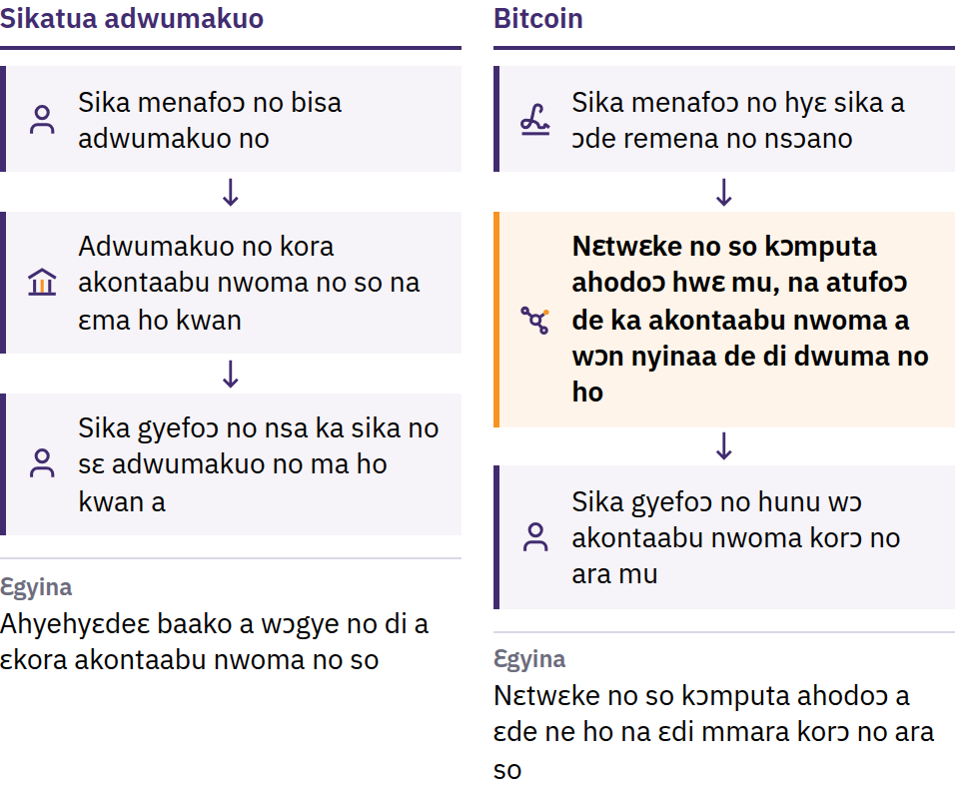
Sika Koro a Wɔde Tua Ka Mprenu Ho Ɔhaw
31 Ahinime 2008: Satoshi Nakamoto tintim Bitcoin: Ɛlɛtrɔnik Sika Ho Nhyehyɛe a Nnipa De Sika Kɔma Wɔn Ho Tee. Ɔpɛpɔn 2009: ntwamutam no hyɛ aseɛ.
Bitcoin Ho Nnianim · Dɛn ne Bitcoin?
Notes:
Ansa na Bitcoin reba no, na sika a wɔde fa intanɛt so mena no gyina ahyehyɛdeɛ bi a wɔwɔ mu ahotosoɔ so bere nyinaa: sikakorabea anaa sikatua adwumakuo a ɛhwɛ sikasɛm ho nwoma so, ɛpene akonta so, na ɛtumi to sikatua bi twɛn, si ano kwan, anaa ɛdan no san akyi. Ɛnyɛ den sɛ wɔbɛyɛ dijitaal nsɛm ho mfonini foforɔ: sɛ wɔtumi de dijitaal sika baako tua ka mprenu a, anka ɛrentumi nyɛ adwuma sɛ sika. Yei ne ɔhaw a ɛfa sika korɔ no ara a wɔde tua ka mprenu ho. Satoshi Nakamoto yɛ obi anaa nnipa kuo bi a wɔde saa din no di dwuma.

Slide 24
Tumi a wɔakyekyɛ mu · Dodow a ɛwɔ ano hyeɛ · Obi ne ne
yɔnko ntam
Tumi nni beaeɛ baako: adwumayɛbea titire biara nni hɔ a ɛbue akonta, sesa sika dodoɔ a ɛwɔ akonta mu, anaa ɛma kwan ma obi bɛka ho
Ne dodoɔ wɔ ano: bitcoin dodoɔ remmoro ɔpepem 21 da
Onipa ne onipa ntam: momfa nkɔma obiara, wɔ baabiara, a monsrɛ tumi titire bi kwan
Adwumakuo biara ntumi nsi bitcoin a mo ankasa modi so no ano. Saa ahofadie no de asɛdeɛ nso ba: mpɛn pii no, wɔrentumi nnan sika nkitahodie a ɛdi mmara so no akyi, na ntwamutam no nni mmoa dwumadibea biara.
Bitcoin Ho Nnianim · Dɛn ne Bitcoin?
Notes:
Tumi a wɔakyekyɛ mu no nkyerɛ sɛ obiara wɔ nkɛntɛnsoɔ a ɛyɛ pɛ. Ɛkyerɛ sɛ wɔn a wɔde wɔn ho hyɛ mu no mu baako mpo ntumi nsesa akontaabuo nwoma no anaa sika ho mmara no mma obiara.

Slide 25
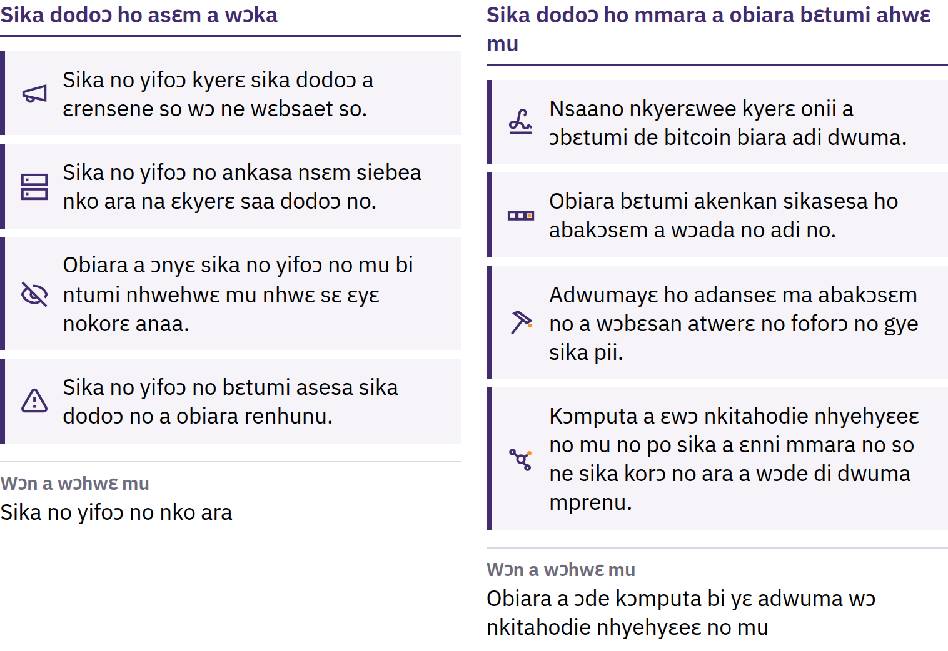
Anohyetoɔ a Obiara Betumi Ahwɛ Mu
Bitcoin Ho Nnianim · Dɛn ne Bitcoin?
Notes:
Wɔde bitcoin foforɔ ba sɛnea bere nhyehyɛe a obiara betumi ahu kyerɛ no, na kɔmputa ahorow a emu biara yɛ adwuma wɔ ne ho so, a wɔfrɛ no nodes no, pow blɔk biara a ɛbu saa mmara no so. Wobetumi de ho ato saa dodow ho hye no so efisɛ obiara betumi ahwɛ sɛ wɔredi so anaa. Ɛnyɛ abɔde mmara: ɛkɔ so yɛ adwuma efisɛ wɔn a wɔde wɔn ho hyɛ mu no kɔ so hwɛ ma wɔdi so. Bitcoin dodow a ano wɔ hye no nkyerɛ sɛ ne bo bɛkɔ soro ɔkwan biara so; ne bo gyina dodow a nkurɔfo pɛ sɛ wɔtɔ ne dodow a ɛwɔ hɔ nyinaa so.

Slide 26
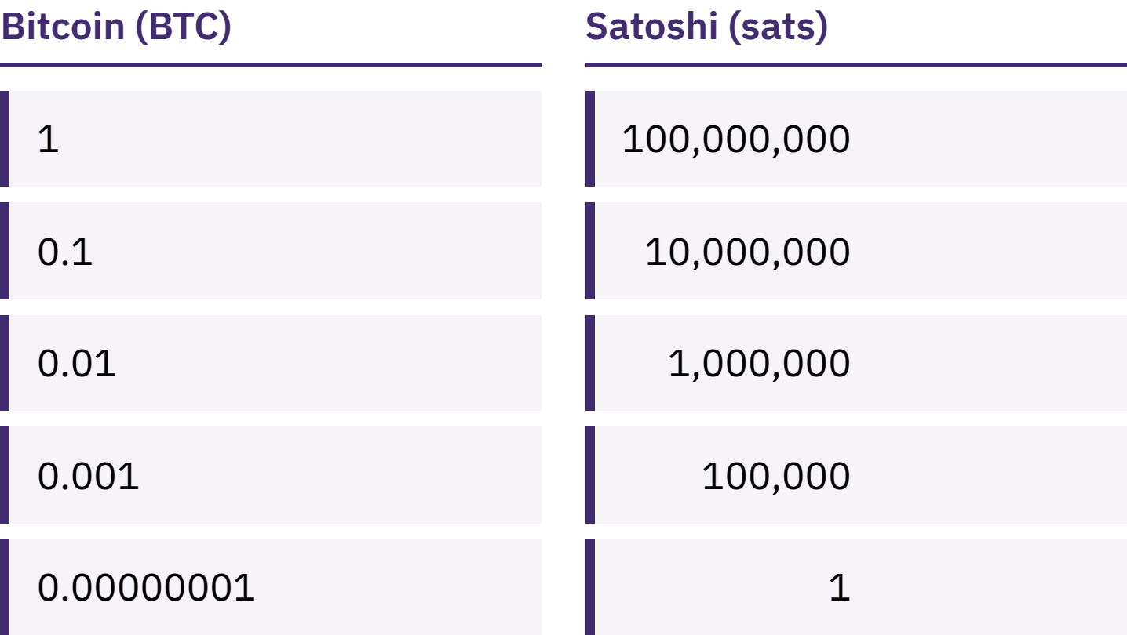
Ɛho Nhia Sɛ Mowɔ Bitcoin Mũ Baako
Wɔtumi kyɛ bitcoin baako mu afã nketewa 100,000,000 a wɔfrɛ no satoshis, anaa sats.
Bitcoin Ho Nnianim · Dɛn ne Bitcoin?
Notes:
Sɛ mowɔ 100,000 sats a, ɛne sɛ mowɔ 0.001 bitcoin no kyerɛ sika dodow koro no ara. Monteɛ adwene a ɛnteɛ a ɛne sɛ, esiane sɛ bitcoin baako bo yɛ den nti, obi ntumi ntɔ Bitcoin no.

Slide 27
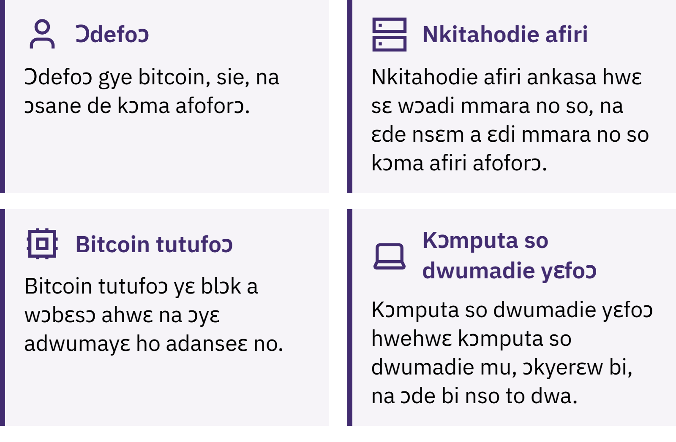
Hwan na ɔma Bitcoin kɔ so yɛ adwuma?
Bitcoin Ho Nnianim · Dɛn ne Bitcoin?
Notes:
Wɔn a wɔde bitcoin di dwuma no de mena, wɔgye, na wɔkora so; node ahodoɔ no hwɛ sɛ nkitahodie ne blɔk biara di mmara no so; wɔn a wɔtu bitcoin no si akan sɛ wɔde blɔk foforɔ bɛka abakɔsɛm a wɔakora so no ho bɛyɛ simma du biara. Saa abakɔsɛm a wɔakora so no, a wɔfrɛ no blɔkkyɛn no, obiara tumi hwɛ mu, na ɛho ka yɛ kɛseɛ paa sɛ wɔbɛsan atwerɛ no. Nkyerɛkyerɛmu fa atwerɛ ho: Bitcoin a wɔde B kɛseɛ na ɛhyɛ aseɛ no taa kyerɛ nkitahodie nhyehyɛeɛ no anaa nhyehyɛeɛ no nyinaa; bitcoin a wɔde b ketewa na ɛhyɛ aseɛ no kyerɛ sika no ankasa.

Slide 28

Hwan na ɔma Bitcoin kɔ so yɛ adwuma?
Bitcoin Ho Nnianim · Dɛn ne Bitcoin?
Notes:
Wɔn a wɔde bitcoin di dwuma no de mena, wɔgye, na wɔkora so; node ahodoɔ no hwɛ sɛ nkitahodie ne blɔk biara di mmara no so; wɔn a wɔtu bitcoin no si akan sɛ wɔde blɔk foforɔ bɛka abakɔsɛm a wɔakora so no ho bɛyɛ simma du biara. Saa abakɔsɛm a wɔakora so no, a wɔfrɛ no blɔkkyɛn no, obiara tumi hwɛ mu, na ɛho ka yɛ kɛseɛ paa sɛ wɔbɛsan atwerɛ no. Nkyerɛkyerɛmu fa atwerɛ ho: Bitcoin a wɔde B kɛseɛ na ɛhyɛ aseɛ no taa kyerɛ nkitahodie nhyehyɛeɛ no anaa nhyehyɛeɛ no nyinaa; bitcoin a wɔde b ketewa na ɛhyɛ aseɛ no kyerɛ sika no ankasa.

Slide 29
Bitcoin Wɔ Mfasoɔ ne Sintɔ
Ne boɔ tumi sesa ntɛmntɛm
Mpɛn pii no, wɔntumi nsiesie mfomsoɔ a wɔayɛ no bio
Mmeaeɛ bebree no, wɔda so ara nnye ntom kɛseɛ
Sɛ wɔde bedi dwuma ahobammɔ mu a, ɛhia sɛ wɔsua ho adeɛ kakra
Bitcoin de nneɛma mu a wɔhwehwɛ de si so dua ne obiara ankasa asɛdeɛ si ahotosoɔ a wɔwɔ wɔ ahyehyɛdeɛ mu no bi ananmu. Ɛnyi asiane mfiri hɔ.
Bitcoin Ho Nnianim · Dɛn ne Bitcoin?

Slide 30

Ɔkwan Bɛn So Na Wode Bitcoin Di
Dwuma?
Asɛmmisa a ɛdi kan fa sika kotoku biara ho: hwan na nsafoa no hyɛ ne nsa?

Slide 31
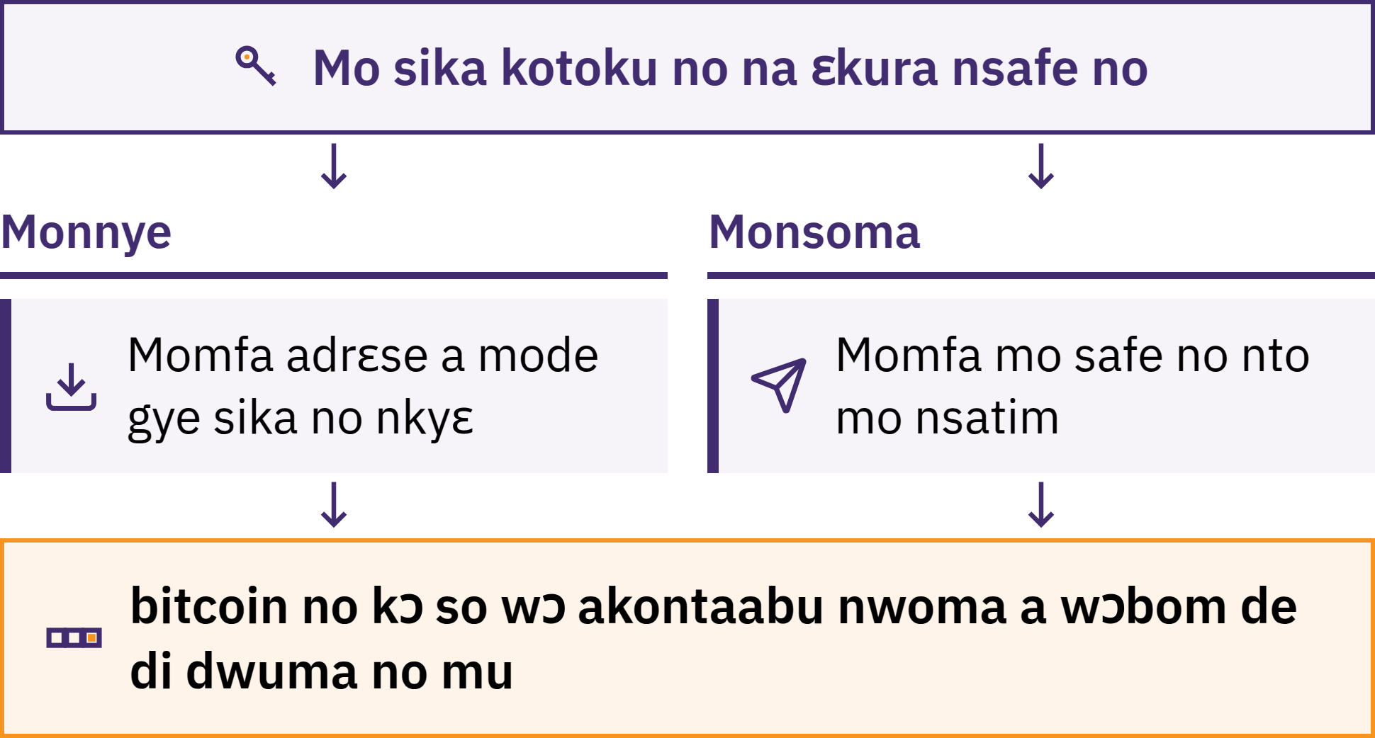
Sika Kotoku Hwɛ Nsafeɛ So
Bitcoin Ho Nnianim · Ɔkwan Bɛn So Na Wode Bitcoin Di Dwuma?
Notes:
Bitcoin sika kotoku yɛ adwinnadeɛ bi, a mpɛn pii no ɛyɛ app, a ɛma motumi gye bitcoin, hwɛ mo bitcoin sika dodoɔ, na mosoma bitcoin. Wɔnkora mo bitcoin wɔ mo telefon mu: wɔatwerɛ ho nsɛm wɔ blockchain no so. Sika kotoku no hwɛ safe ahodoɔ a ɛma motumi di adanseɛ sɛ bitcoin no yɛ mo dea na moma kwan ma wɔde tua sika no so.

Slide 32
Hwan na Nokorɛm Ɔkura Mo Bitcoin?
Mo ankasa na mokora so: mo na modi nsafeɛ no so
Obiara ntumi nnye mo bitcoin mma mo bio sɛ mohwere nsɛmfua a wɔde san nya sika kotoku no ne afidie no a
Ɔfoforɔ na ɔkora so: adwumakuo bi na ɛkura nsafeɛ no, te sɛ deɛ sikakorabea yɛ no ara
Mo sika dodoɔ a ɛda akonta no so no yɛ bɔ a adwumakuo no ahyɛ sɛ ɛbɛtua mo; ɛtumi to sika a mobɛtwe no ano hyeɛ, si akonta bi kwan, ma kɔmputa so nsɛmmɔnedifoɔ wura ne nhyehyɛeɛ mu, anaa ɛto mu
Sika sohwɛ kwan a mopaw no nyɛ mo boɔ a wɔsɔ hwɛ. Deɛ ɛho hia ne sɛ mobɛhunu ɔkwan ko a morefa so ne deɛ mode mo ho reto so.
Bitcoin Ho Nnianim · Ɔkwan Bɛn So Na Wode Bitcoin Di Dwuma?

Slide 33

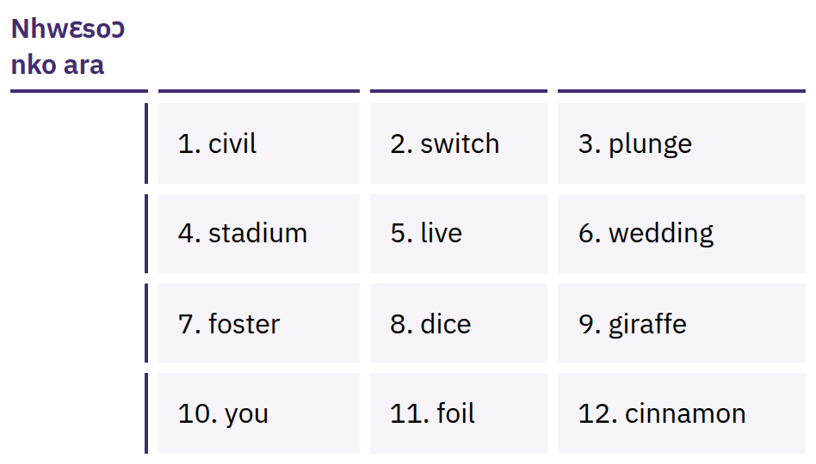
Mo Aba Nsɛmfua No Ma Mo
Biribiara Ho Kwan
Nsɛmfua a wɔahyehyɛ no nnidiso nnidiso, a ɛtaa yɛ 12 anaa 24, a wɔtumi de san yɛ mo safoa no bio. Obiara a ɔwɔ saa nsɛmfua yi tumi fa mo bitcoin.
Bitcoin Ho Nnianim · Ɔkwan Bɛn So Na Wode Bitcoin Di Dwuma?
Notes:
Nsɛmfua a wɔde san nya sika kotoku no nyɛ nea wɔde sie sɛ biribi sɛe a wɔde bɛsan anya kotoku no nko ara: ɛma obi tumi hyɛn kotoku no mu na ɔde emu biribiara yɛ nea ɔpɛ. Sɛ morebue sika kotoku no a, monkyerɛw nsɛmfua no pɛpɛɛpɛ wɔ krataa so; momfa nsie wɔ baabi a ɛnni intanɛt so, ɛhɔ yɛ kokoam, na ɛrenyera anaa ɛrensɛe. Monntwa ho mfonini da, mommfa email so nnsoma, mommfa nsie wɔ mununkum so nkyerɛwtohɔ mu, mommfa nkrasɛm mu nnsoma, na monnkyerɛw wɔ wɛbsaet biara so. Nsɛmfua a wɔakyerɛ no yɛ nhwɛsoɔ kɛkɛ; monnkyerɛ anaa monnboaboa nsɛmfua a wɔde san nya sika kotoku ankasa bi ano da.

Slide 34

Sɛ nsafe no nyɛ mo dea a, na sika
no nso nyɛ mo dea.
Bitcoin Ho Nnianim · Ɔkwan Bɛn So Na Wode Bitcoin Di Dwuma?

Slide 35

Ansa na mode sika kotoku biara
adi dwuma
Nsafe: hwan na ɔhwɛ so, mo anaa adwumakuo bi?
San nya: sɛ mo fon yera anaa adwumakuo no gu a, ɛbɛyɛ dɛn?
Baabi a ɛfiri: ɛfiri wɔn ankasa wɛbsaet anaa app gua so, na ɛnyɛ link bi a obi de abrɛ mo?
Kɔde: obiara tumi hwɛ kɔde no mu na wɔkɔ so hwɛ so yɛ no yie? (Yei nko ara nkyerɛ sɛ ahobanbɔ wɔ mu.)
Ɛho ka: sika bɛn na wɔgye wɔ sika a wɔde kɔma obi, wɔgye, anaa wɔyi ho?
Sikatua: wɔ blockchain no so, Lightning so, anaa mmienu no nyinaa so?
Bitcoin Ho Nnianim · Ɔkwan Bɛn So Na Wode Bitcoin Di Dwuma?
Notes:
My First Bitcoin nkamfo bitcoin sika kotoku pɔtee bi nkyerɛ. Nnwinnadeɛ, ɛka a wɔgye, ne wɔn a wɔyɛ ho wuranom sesa, na deɛ ɛfata mpɔtam bi no, ebia ɛrenfata mpɔtam foforɔ. Momfa asuafoɔ no nkɔkyerɛkyerɛfoɔ bi a ɔwɔ wɔn mpɔtam hɔ a wɔwɔ ne mu ahotosoɔ nkyɛn.

Slide 36
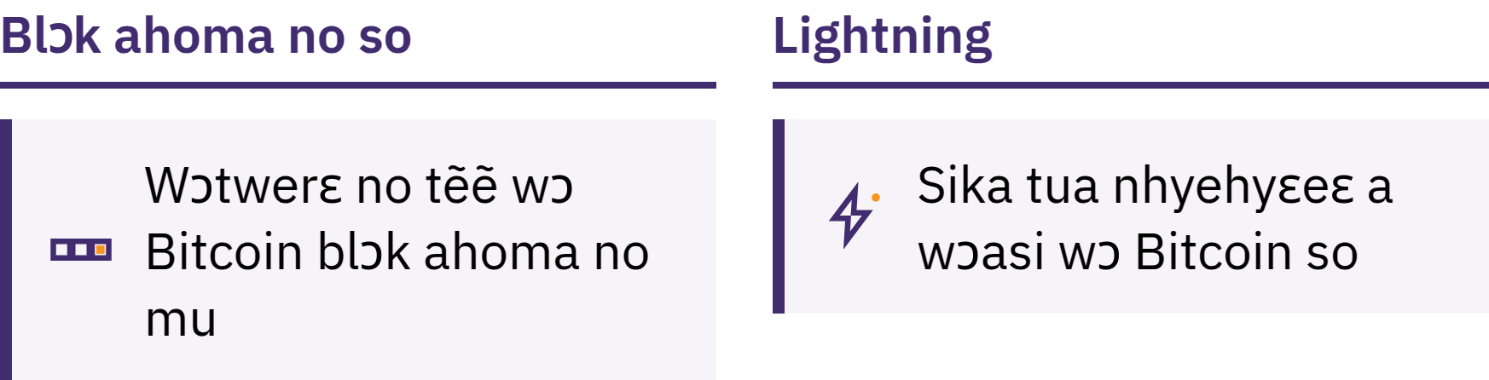
Blockchain So ne Lightning
Wɔ blɔk nkɔnsɔnkɔnsɔn no so: wɔkyerɛw gu blɔk nkɔnsɔnkɔnsɔn no mu tẽẽ
Lightning: sikatua ntam nkitahodie a wɔasi wɔ Bitcoin so ma sikatua nketenkete a wɔyɛ no ntɛmntɛm na ɛba mpɛn pii, te sɛ kɔfe a wɔtɔ
Lightning sika kotoku nso betumi ayɛ deɛ obi foforɔ hwɛ so anaa deɛ ne wura no ankasa hwɛ so
Bitcoin Ho Nnianim · Ɔkwan Bɛn So Na Wode Bitcoin Di Dwuma?

Slide 37
Mmara Mmiɛnsa Bere a Moresua Adeɛ
Monsua adeɛ kan. Mommma anigyeɛ, ehu anaa nhyɛsoɔ mma monnyɛ biribi.
Momfa kakra nhyɛ aseɛ. Momfa sika a sɛ mohwere a, ɛrenka mo asetena nni nnwinnadeɛ a monnim ho yie no ho sɔ nhwɛ.
Monnnya ahotoso kɛkɛ, monhwehwɛ mu nhwɛ. Monhwehwɛ onipa no, ɔkwan a wɔfa so tua sika no, adrɛse no ne sika dodoɔ no mu nhwɛ.
Momfa sika a mobɛgye ho nsɛm nkyɛ, nanso mommfa ahintasɛm nkyɛ da
Mobɛtumi de adrɛse anaa sika a wɔsrɛ sɛ wɔntua ho nsɛm akyɛ. Ɛnsɛ sɛ mode nsɛmfua a wɔde san nya sika kotoku no anaa kokoam safoa kyɛ da. Ɔkyerɛkyerɛfoɔ, sika kotoku adwumakuo anaa mmoa adwumayɛni a ɔyɛ adwuma wɔ nokorɛ mu biara remmisa mo saa nsɛm no da.
Bitcoin Ho Nnianim · Ɔkwan Bɛn So Na Wode Bitcoin Di Dwuma?

Slide 38

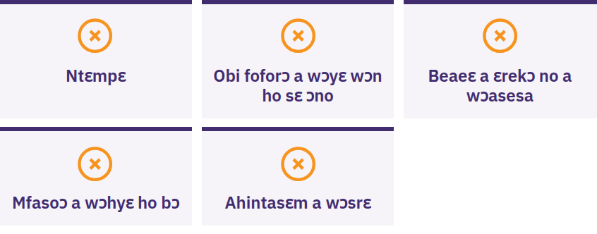
Mongyae, Monnkyɛ Biribiara,
Mommane Biribiara
Monnyae sɛ obi hyɛ mo sɛ monyɛ biribi ntɛm anaa monyɛ no kokoam, ɔbɔ mo awerɛhyem sɛ mubenya mfasoɔ, ɔka sɛ monni kan nsoma bitcoin, anaa ɔbisa mo nsɛmfua a mode san nya mo sika kotoku no ho kwan a. Montwɛn kakra. Mommfa biribiara mma obiara. Monnsoma biribiara. Afei momfa baabi a monim dedaw nhwehwɛ mu.
Bitcoin Ho Nnianim · Ɔkwan Bɛn So Na Wode Bitcoin Di Dwuma?

Slide 39

Ɛdeɛn na ɛdi hɔ?
Wei yɛ mfitiaseɛ ara kwa.

Slide 40
Asuadeɛ Anan
Sika gyina mmara ne ahotosoɔ so. Ahyehyɛdeɛ kakraa bi na ɛkyerɛ fiat sika dodoɔ a ɛwɔ hɔ ne ɛho mmara.
Bitcoin de mmara a ɛsono emu biara ba. Sika dodoɔ a ɛda adi, wɔahyɛ ano hyeɛ, na obiara tumi de di dwuma, a wɔbɛtumi ahwɛ ahunu sɛ ɛyɛ nokorɛ sen sɛ wɔbɛgye adi kɛkɛ.
Ahobanbɔ na ɛdi kan. Monsua adeɛ ansa, momfa kakraa bi nhyɛ aseɛ, monhwɛ biribiara mu nhu sɛ ɛyɛ nokorɛ, na monnkyɛ nsɛmfua a mode san nya mo sika kotoku no mma obiara da.
Wei yɛ ahyɛaseɛ ara kwa. Anammɔn baako a ahobanbɔ wom a mobɛtu adi hɔ no ara dɔɔso.
Berɛ tiawa a mode bɛdwene ho
Monsan nkɔ nsɛmmisa nnum a ɛwɔ mfitiaseɛ no so. Mmuaeɛ bɛn na anka mobɛma seesei?
Bitcoin Ho Nnianim · Ɛdeɛn na ɛdi hɔ?

Slide 41

Bitcoin Abodin Krataa
Anammɔn a ɛdi hɔ. Ne adesua afa anan no de mo kɔ anim:
Sika ho nteaseɛ
Sɛdeɛ Bitcoin yɛ adwuma
Bitcoin a wɔde di dwuma wɔ ahobammɔ mu
Bitcoin wɔ mo mpɔtam
Monkɔ so mpɛ sɛ mohunu nneɛma, monkɔ so mmisa nsɛm, na monsua pii wɔ myfirstbitcoin.org.
Yɛrehwɛ kwan sɛ yɛbɛhunu mo wɔ yɛn adesuafoɔ kuo a ɛdi hɔ no mu.
Bitcoin Ho Nnianim · Ɛdeɛn na ɛdi hɔ?

Slide 42


