Slide 1

Kusindikwa 26.10
Intalisyo
ku Bitcoin
Nsololezyo Yabataliki

Slide 2

Nkaambo Nzi Mali Ngaayandika?
Tubelesya mali mazuba oonse, pele tulabuzya buyo ziindi zisyoonto kuti abeleka buti.
Notes:
Kuzwa ku: My First Bitcoin, Intalisyo ya Bitcoin, Lugwalo Lwabayanda Kutalika, lusandululo 26.10. Cakasandululwa kutobela layisensi ya Creative Commons Attribution-ShareAlike 4.0 International; zilaidi eezi zibelesya layisensi imwi eeyi. Zilaidi eezi ncakugwasya muyiisi mukuyiisya, cakazwide kumabbuzye ali musanu aalomwe aali mulugwalo. Amusandulule zikozyanyo, lubilo lwakuyiisya, alimwi anzila yakuyiisya kuti zyendelane abantu bamucilawo canu, pele amukwabilile bupanduluzi amabwi aakwabilila buponi. Taakwe ciindi cakalembedwa cakuti ciiyo ceele kutola.

Slide 3

Bantu banji tabayimi pe kuti
bayeeye kujatikizya mali
Kutali kubelekela kuijana, kutali kuibelesya kugula zintu, pele kuyeeya kuti ninzi alimwi kuti ibeleka buti.
Intalisyo ku Bitcoin · Nkaambo Nzi Mali Ngaayandika?
Notes:
Amutalike acifwanikiso: boonse batuzingulukide babelesya mali kakunyina kwiibuzya atala angawo. Amubuzye nkamu ciindi ncibakalekezya kuyeeya atala amali nkwazwa.

Slide 4

Mibuzyo Yosanwe Yakutalikila
Nkaambo nzi bantu bayandika mali?
Ncinzi cipanga kuti cintu cibe mali?
Nguni uukonzya kupanga naa kweendelezya mali ngamubelesya?
Nkaambo nzi mali ngamubelesya aajisi mushingo?
Sena mali aanu aagula zintu zyiingi mbubonya mbuli kaindi?
Bambani nsandulo zyanu
Lembani nsandulo iifwaafwi kumubuzyo uumwi auumwi. Muyakupiluka kulinzyo kumamanino.
Intalisyo ku Bitcoin · Nkaambo Nzi Mali Ngaayandika?
Notes:
Amupe basicikolo maminiti masyoonto kuti balembe. Amutakumbili muntu uuli woonse kuti aambe makani a mali zyakwe mwini. Iingulo eezi ziyoboneka alimwi a silayidi ya zintu zyakuyeeya iitegwa “Ncinzi Citobela?”

Slide 5

Masimpe na Muzeezo?
Cintu ncobeni: "Mali eeyi yapepa ilatambulwa mukulipila mitelo." Eeci cilakonzya kusinizigwa.
Muyeeyo: "Uuyu ngomusobo wamali uubotu kwiinda yoonse." Eeci ciyandika zyakulinganisizya amboni.
Lugwalo oolu ndwakwiiya buyo. Talupe lulayo kujatikizya mali, kubikka mali mumakwebo, milawo, naa mitelo, alimwi talumwaambii kuti muule, muuzye, naa mubambe cintu cili coonse.
Intalisyo ku Bitcoin · Nkaambo Nzi Mali Ngaayandika?
Notes:
Amubambe kwaanda uku muchiiyo coonse. Kuti kwaba kaambo kaambwa, amubuzye kuti: tulakonzya kukalingula na, naa kayandika zyeelelo abumboni?

Slide 6

Mali Ncinzi?
Mali ncibelesyo cakusinzyanya.

Slide 7

Kucincanya Zintu a Kuswaangana kwa Ziyandwa Kumbali
Zyobilo
Bantu bobilo beelede kuyanda ncajisi umwi, ciindi comwe akubuninji bweelede.
Intalisyo ku Bitcoin · Mali Ncinzi?
Notes:
Amubelesye cikozyanyo cili mubhuku lyabusolozi: mulalima mpunga alimwi muyanda nsapato, pele mupangi wansapato uyanda mafuta aakujikila, kutali mpunga. Basikwiiya makani aabuvwubi eeci baciita kuti nkuswaangana kwaziyandwa abantu bobilo.

Slide 8
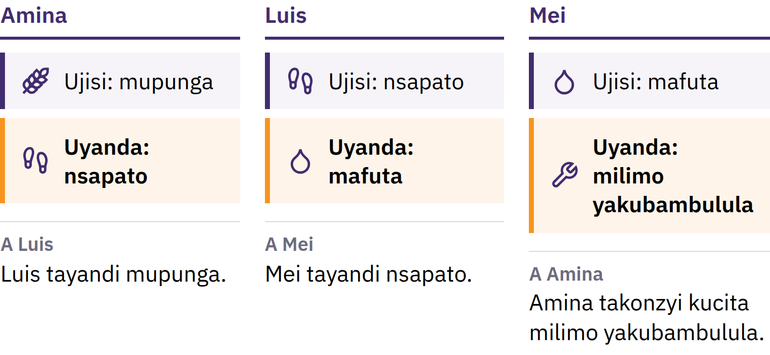
Kucincanya Zintu a Kuswaangana kwa Ziyandwa Kumbali
Zyobilo
Bantu bobilo beelede kuyanda ncajisi umwi munzabo, ciindi comwe alimwi mubungi bweelede.
Intalisyo ku Bitcoin · Mali Ncinzi?
Notes:
Amubelesye cikozyanyo cili mubhuku lyabusolozi: mulalima mpunga alimwi muyanda nsapato, pele mupangi wansapato uyanda mafuta aakujikila, kutali mpunga. Basikwiiya makani aabuvwubi eeci baciita kuti nkuswaangana kwaziyandwa abantu bobilo.

Slide 9

Mali Ncibelesyo ca Kucincana
Takwe muntu uuyanda mali akaambo kakuba mali buyo. Alagwasya nkaambo bamwi balaatambula, basyoma kuti bamwi bakayaatambule kumbele.
Intalisyo ku Bitcoin · Mali Ncinzi?
Notes:
Nooti yamali nchipapulo buyo. Mali ilamanizya penzi lyakucincanya zintu kwiinda mukwaandaanisya kusambala akugula: mulasambala mpunga wanu kumuntu omwe, eelyo mulagula nsapato kuli umwi muntu. Eezi nzizyaandaanisya mali akucincanya zintu.

Slide 10

Milimo Yotatwe ya Mali
Nzila yakucincanizya: bantu balaitambula pakubbadela
Cipimo cakubala: miulo ilatondezyegwa mulinjiyo
Cakukwabilila bulemu: cilaambukizya bulemu kuzwa sunu kuya kumbele
Takwe mali aakwabilila bulemu bwawo cakumaninina, pele misyobo imwi ilasweekelwa nguzu zyakugula kasyonto-kasyonto kwiinda imbi.
Intalisyo ku Bitcoin · Mali Ncinzi?

Slide 11

Kuzwa ku Zikamba Kuya ku
Mapepa
Zikwangwa, muunyu, bunkanda, banyama bakuŋanda, mukuba, siliva, ngolida
Nsimbi ziyandikana kapati: zilakatazya kujanika, zikala ciindi cilamfwu, zilatambulwa mumasena manji
Mapepa aapa nguzu zyakutambula bwinji bwansimbi bwakambwa
Milawo yangolida: cipimo ca mali ciyatanizyidwe kungolida kwiinda mumulawo
Milawo yakali kusiyana kweendelana abusena aciindi.
Intalisyo ku Bitcoin · Mali Ncinzi?

Slide 12
Ndalama Zyakazumizigwa Aboma
1971: United States yakalekesya kusandulwa kwamadola kuba ngolida kwazumizidwe kucitwa amaboma a kumasi aambi alimwi amabbanki mapati a zyisi
Mazuba aano mali manji a zyisi mali a fiat: alapangwa ansi panguzu zyabboma, taakonzya kusandulwa kuba ngolida na cintu cimbi ciyandika
Fiat ndijwi lya ciLatin lipandulula kuti "acicitike", kanji limvwigwa kuti "amulawo"
Alatambulwa nkaambo bantu, makwebo, mabbanki, alimwi amaboma alabelesya mali aayo; milawo ilaazumizya kubelesyegwa mukulipila alimwi ilalayilila kuti abelesyegwe mukulipila mitelo
Intalisyo ku Bitcoin · Mali Ncinzi?

Slide 13

Twakazwa kumali aajatikizyidwe
acintu, kuya kumali
aajatikizyidwe akusyoma muntu.
Intalisyo ku Bitcoin · Mali Ncinzi?

Slide 14

Ncinzi Citayendi Kabotu a Mali Eesu?
Bantu nobamvwa bbala lyakuti kukwela kwamiulo, kanji bayeeya kuti miulo ilakwela.

Slide 15
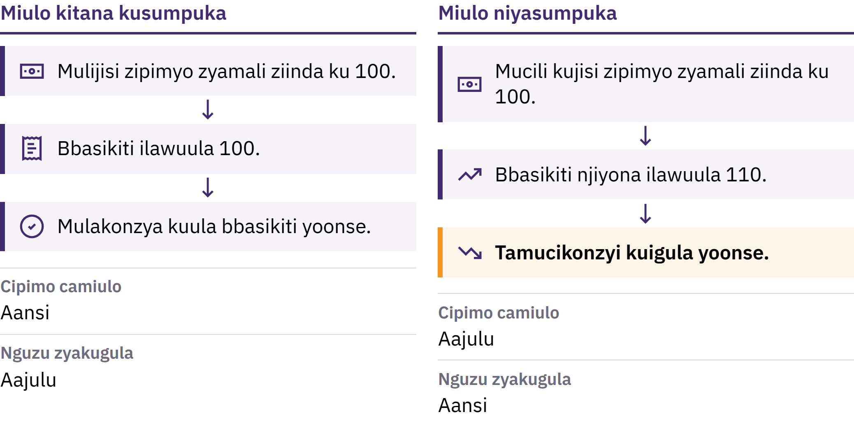
Kukwela kwamiulo a Nguzu Zyakugula
Intalisyo ku Bitcoin · Ncinzi Citayendi Kabotu a Mali Eesu?
Notes:
Kukwela kwamitengo nkuyungizika kuzumanana kwamitengo yazintu zyoonse. Lubazu lumbi lwako ndunguzu yakugula: bunji bwazintu nzyocikonzya kugula cibeela comwe camali. Ikuti mutengo wantanga yazintu ziyandika wakwela kuzwa kuzibeela zyamali 100 kuya ku 110, zibeela zyamali eezyo zili 100 tazicikonzyi kugula zintu zyoonse zili muntanga.

Slide 16

Kukwela kwamiulo a Nguzu Zyakugula
Intalisyo ku Bitcoin · Ncinzi Citayendi Kabotu a Mali Eesu?
Notes:
Kukwela kwamitengo nkuyungizika kuzumanana kwamitengo yazintu zyoonse. Lubazu lumbi lwako ndunguzu yakugula: bunji bwazintu nzyocikonzya kugula cibeela comwe camali. Ikuti mutengo wantanga yazintu ziyandika wakwela kuzwa kuzibeela zyamali 100 kuya ku 110, zibeela zyamali eezyo zili 100 tazicikonzyi kugula zintu zyoonse zili muntanga.

Slide 17

Milandu Minji, Kusala Komwe
Kuyungizigwa kwa mali ankongole
Kudodomana kwa kupegwa kwa zyintu akucinca kwa kuyandwa kwazyo
Mali iiceya nguzu, misonkho, mali yakupanga zyintu
Cimwi cileta eeci nkusala, kutali kucitika buyo: mundondomeko ya mali aa fiat, mabunga masyoonto alakonzya kuyungizya mali ankongole akucinca milawo yandondomeko eeyi.
Intalisyo ku Bitcoin · Ncinzi Citayendi Kabotu a Mali Eesu?
Notes:
Bazyabusongo bwamali balakazyanya kujatikizya mbocijisi nguzu cileenga cimwe acimwe. Amubikkile maano kucileenga comwe cili cakusala, kutali cakucitika buyo.

Slide 18
Kucepa a Bulemu
Cithuzithuzi ca Mona Lisa cakusaanguna cilijisi mutengo mupati kwiinda cikozyanyo cimbi cili coonse: ciliko comwe buyo
Kuceya kwacintu kulikke takucipi mutengo, pele bantu nibaciyanda, bungi bwaco bulayandikana
Bungi bwamali nibukomena cakufwamba kwiinda bungi bwazintu nzigukonzya kugula, cipanzi comwe-comwe camali kanjikanji cigula zintu ziceya
Intalisyo ku Bitcoin · Ncinzi Citayendi Kabotu a Mali Eesu?

Slide 19
Kukwela Kwamiulo Takukwati Boonse Munzila Iikozyenye
Mali aakujata amali aabambidwe alakonzya kusweekelwa nguzu zyakugula
Bamwini bazintu zikwela muulo balakonzya kukwabililwa mumbali imwi
Miholo amiulo zilacinja kubwangu bwiindene
Mali aali kubanki aaliindene amali aali mumanza aanu: ncisyomezyo cabanki cakuti ilamulipila. Cisyomezyo eeci kanji cilazuzikizigwa, pele cizembela kubanki akumilawo iilanganya banki eeyo.
Intalisyo ku Bitcoin · Ncinzi Citayendi Kabotu a Mali Eesu?

Slide 20
Amusoleke: Kusuzuma Nguzu Zyakugula
Amusale cintu comwe citumisyigwa mazuba oonse: cinkwa, kweenda, naa mali a kutumya fooni
Amulembe mutengo waciko sunu
Amubuzye muntu kuti mutengo waciko wakali buti myaka iisyoonto yainda, alimwi amulingule magwalo asyomeka kuti mwakonzya
Naa mali njibajana bantu aakomena mulubilo lumwi? Ncinzi cimbi cikonzya kupandulula kucinca ooku?
Intalisyo ku Bitcoin · Ncinzi Citayendi Kabotu a Mali Eesu?
Notes:
Eeci cilabeleka kakunyina cibelesyo na intaneti. Amweezyanisye nsandulo mucibunga, alimwi amuyeezye basikwiiya kuti mutengo omwe tauli muleezo woonse wakukomena kwemitengo.

Slide 21
Mali a Fiat Alabeleka, Pele Alijisi Ntenda
Kubbaadala kwakuleluka, ngongole iikonzya kusandulwa kweelana aakuyandikana, zyibelesyo zyakugwasya mubukkale bwamapenzi
Pele bunji bwayo amilawu yayo zilakonzya kusanduka, alimwi bantu baibelesya bajisi buyo nguzu zisyoonto zyakusala
Eeci ncecipanga kuti bantu bayande nzila zimwi, alimwi ncecipanga kuti Bitcoin ipangwe.
Intalisyo ku Bitcoin · Ncinzi Citayendi Kabotu a Mali Eesu?

Slide 22

Bitcoin ncinzi?
Mali a dijito aatajisi weendelezi omwe, aajisi mweelwe uupimidwe, alimwi aakonzya kutumwa kuzwa kumuntu kuya kumwi kakunyina kuzumizigwa abanki.

Slide 23
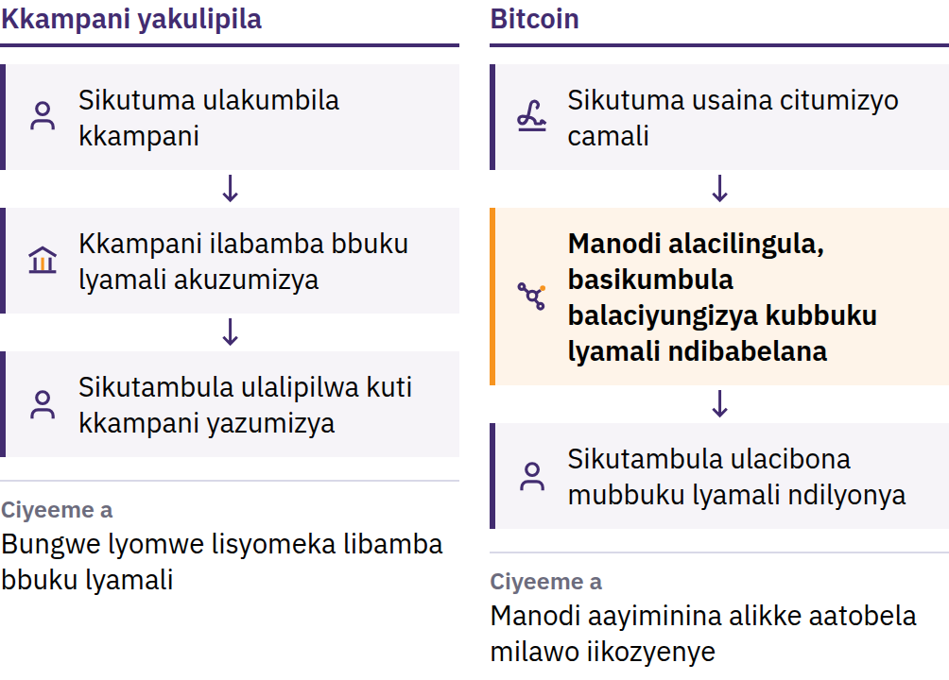
Penzi Lyakubelesya Mali Aamwi Ziindi Zyobilo
31 Oktoba 2008: Satoshi Nakamoto ulasampanya Bitcoin: Nzila Yamali Aamakompyuta Kuzwa Kumuntu Kuya Kumuntu. Janwali 2009: netiweki ilatandika.
Intalisyo ku Bitcoin · Bitcoin ncinzi?
Notes:
Bitcoin kaitanaba, kutumizya mali pa intaneti lyoonse kwakali kusyoma cibunga cisyomeka: bbanka naa kampani yakulipilana mali i yakali kubamba bbuku lyakulembela mali, kuzumizya maakaunti, alimwi yakali kukonzya kuceezya, kukasya, naa kubweza kulipila. Makani aamu kompyuta alavwuba kukopololwa: kuti koini yamu kompyuta yakali kukonzya kubelesyegwa kulipila ziindi zyobilo, tiiyakali kukonzya kubeleka mbuli mali. Ili ndilyo penzi lyakubelesya mali ngamo ziindi zyobilo. Satoshi Nakamoto ngumuntu naa nkamu yabantu ibelesya zina eelyo.

Slide 24
Taikweendelezegwi Abusena Bomwe · Mweelwe Uuli
Aamamanino · Muntu ku Muntu
Takwe bweendelezi bumwi: takwe ofesi iili aakati iijula maakawunti, iicinca mali aali mumaakawunti, na iizumizya kuti nguni unjila
Bungi buli aamamanino: takukabi bitcoin ziinda ku 21 miliyoni
Kuzwa kumuntu kuya kumwi: tumizyaanibe kuli uuli woonse, kuli koonse, kakunyina kulomba luzumizyo kubweendelezi buli aakati
Takwe kampani iikonzya kulesya kubelesya bitcoin njomweendelezya nobeni. Lwaanguluko oolu luzana ambungano yakulangania mali aanu: kutumizya mali kuzumizidwe kanji takukonzyi kujokelwa, alimwi takwe ofesi yakupa lugwasyo kumulongo ooyu.
Intalisyo ku Bitcoin · Bitcoin ncinzi?
Notes:
Kugawanya bweendelezi tacambi kuti boonse bajisi nguzu zikozyenye. Camba kuti taakwe umwi uutola lubazu uukonzya kucinca bbuku lyakulembela mali naa milawo yamali kubantu boonse.

Slide 25
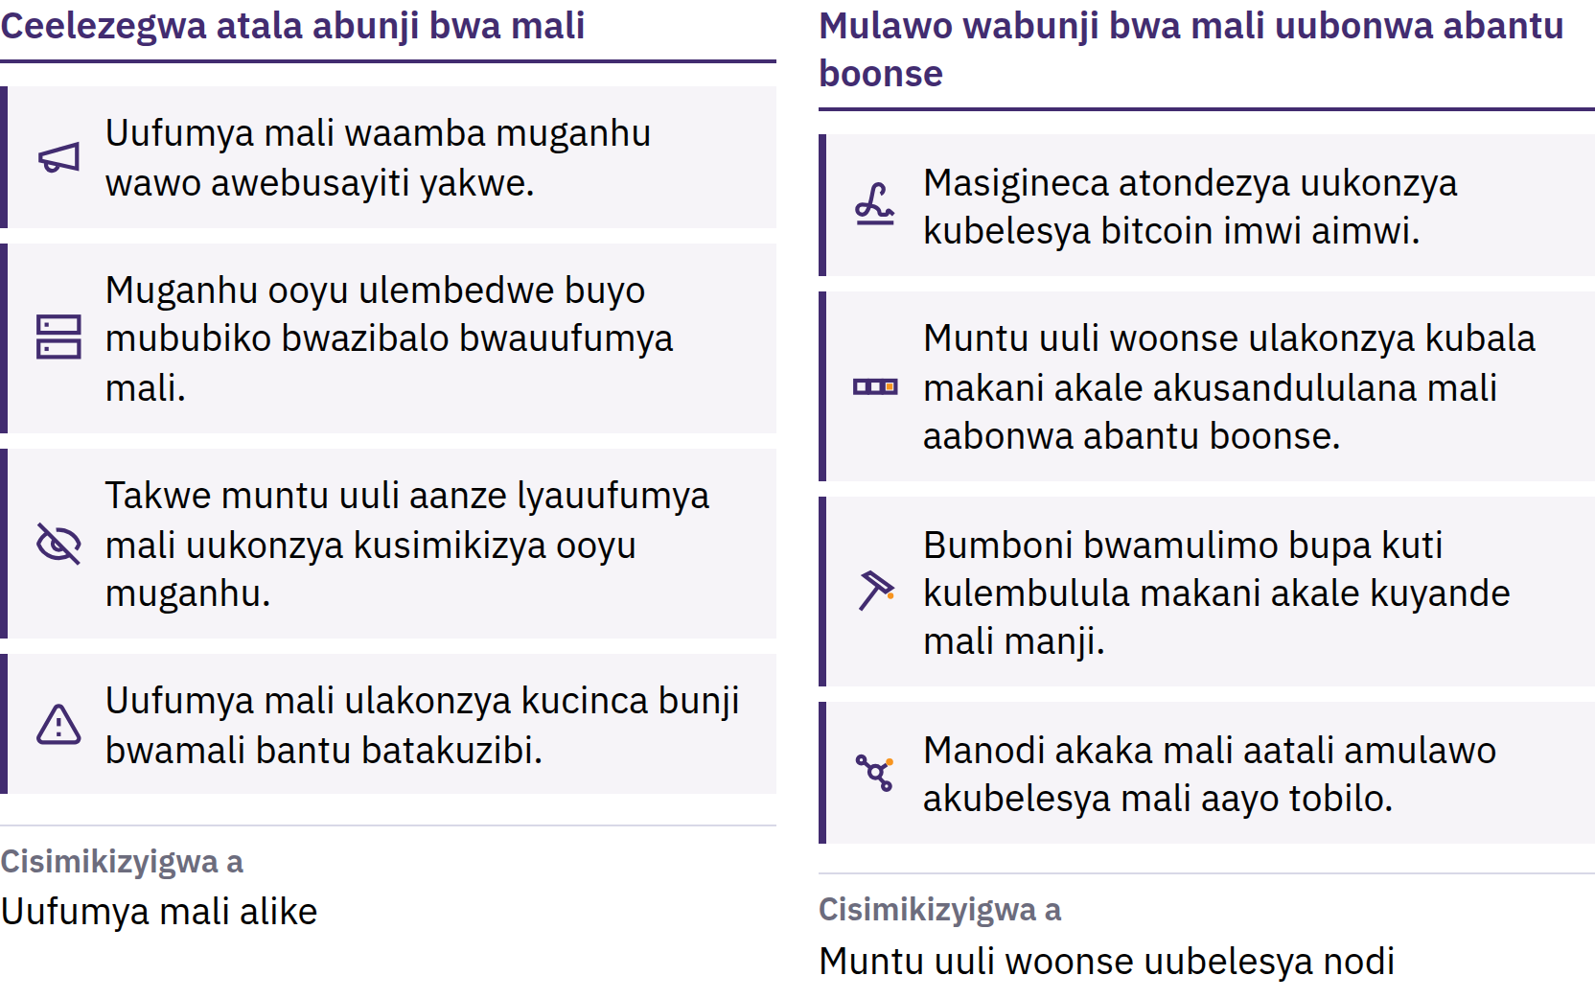
Mugano Uukonzya Kusinizyigwa a Muntu Uuli Woonse
Intalisyo ku Bitcoin · Bitcoin ncinzi?
Notes:
Bitcoin zipya zilagwisigwa kweendelana a ndandanda iizibidwe abantu boonse, alimwi makompyuta aayimelede alikke aaitwa kuti ma node alakana bbuloko lyoonse lityola mulawo ooyo. Mugano ooyu ulasyomeka nkaambo muntu uuli woonse ulakonzya kuulingula. Tauli mulawo wacilengedwe: ulazumanana kubeleka nkaambo abo batola lubazu bazumanana kuubamba. Kubikka mugano ku bunji bwa bitcoin takusinizyi kuti mutengo uyooyungizika; mutengo weendelana a bunji bwabantu bayanda kuzigula alimwi a bunji bwa bitcoin ziliwo.

Slide 26
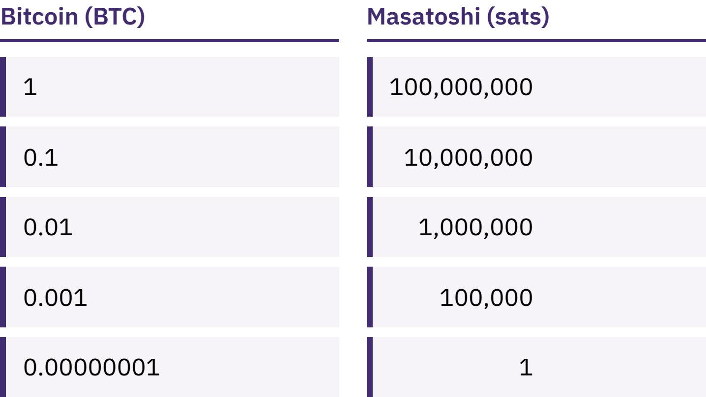
Tamweelede Kuba a Bitcoin Yoonse
bitcoin imwi ilaabanyizyigwa muzibeela zisyoonto zili 100,000,000 ziitwa kuti satoshis, naakuti sats.
Intalisyo ku Bitcoin · Bitcoin ncinzi?
Notes:
Kuba a 100,000 sats akuba a 0.001 bitcoin zyaamba mali aalingene. Amululamike muzeezo uutali kabotu wakuti Bitcoin tiikonzyi kugulwa nkaambo bitcoin yomwe iladula kapati.

Slide 27
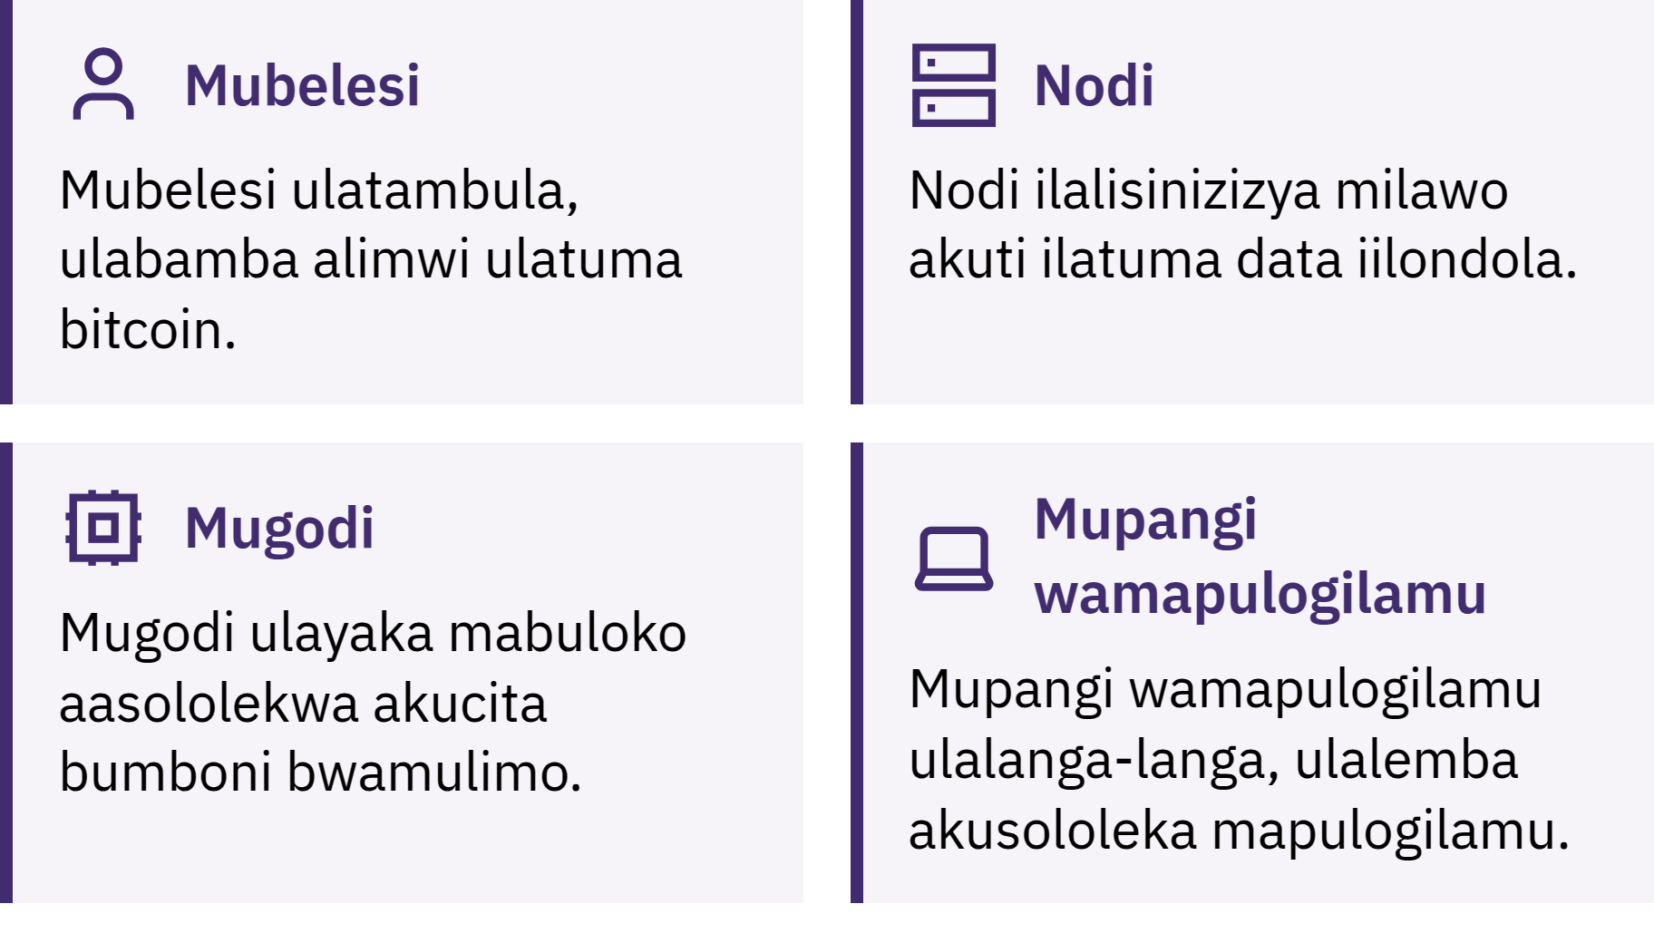
Nguni Ucita Kuti Bitcoin Izumanane Kubeleka?
Intalisyo ku Bitcoin · Bitcoin ncinzi?
Notes:
Babelesi batuma, batambula alimwi babamba bitcoin; manodi asuzuma kutumizya mali kulikonse a bbuloko lyoonse kuti zilatobela milawo; basicimba balizundana kuti bayungizye bbuloko lipya ku lugwalo lwazilembedwe ciindi cisika kumaminiti aali kkumi. Lugwalo oolo, blockchain, lulabonwa a bantu boonse alimwi kulemba lubo zilembedwe zyalwo kuladula kapati. Cakumanya kujatikizya maleembedwe: Bitcoin iilembedwe a B mupati kanji yaamba ntambo naa bubambe; bitcoin iilembedwe a b muniini yaamba mali aayo.

Slide 28

Nguni Ucita Kuti Bitcoin Izumanane Kubeleka?
Intalisyo ku Bitcoin · Bitcoin ncinzi?
Notes:
Babelesi batuma, batambula alimwi babamba bitcoin; manodi asuzuma kutumizya mali kulikonse a bbuloko lyoonse kuti zilatobela milawo; basicimba balizundana kuti bayungizye bbuloko lipya ku lugwalo lwazilembedwe ciindi cisika kumaminiti aali kkumi. Lugwalo oolo, blockchain, lulabonwa a bantu boonse alimwi kulemba lubo zilembedwe zyalwo kuladula kapati. Cakumanya kujatikizya maleembedwe: Bitcoin iilembedwe a B mupati kanji yaamba ntambo naa bubambe; bitcoin iilembedwe a b muniini yaamba mali aayo.

Slide 29
Bitcoin Ilijisi Bubotu Abubi
Mutengo wayo ulakonzya kucinca cakufwamba
Zilubizyo kanji tazikonzyi kululamikwa
Kutambulwa kwayo kucili kusyoonto mumasena manji
Kwiibelesya munzila iikwabilila kuyandika kwiiya zimwi zintu
Bitcoin ibikka kusinizya alimwi akulisungila kwamuntu mwini mubusena bwakusyoma mawunga kwakumwi. Tiigwisyi njozi.
Intalisyo ku Bitcoin · Bitcoin ncinzi?

Slide 30

Mubelesya Buti Bitcoin?
Mubuzyo wakusaanguna kujatikizya cikwama cili coonse: nguni uulanganya makiyi?

Slide 31
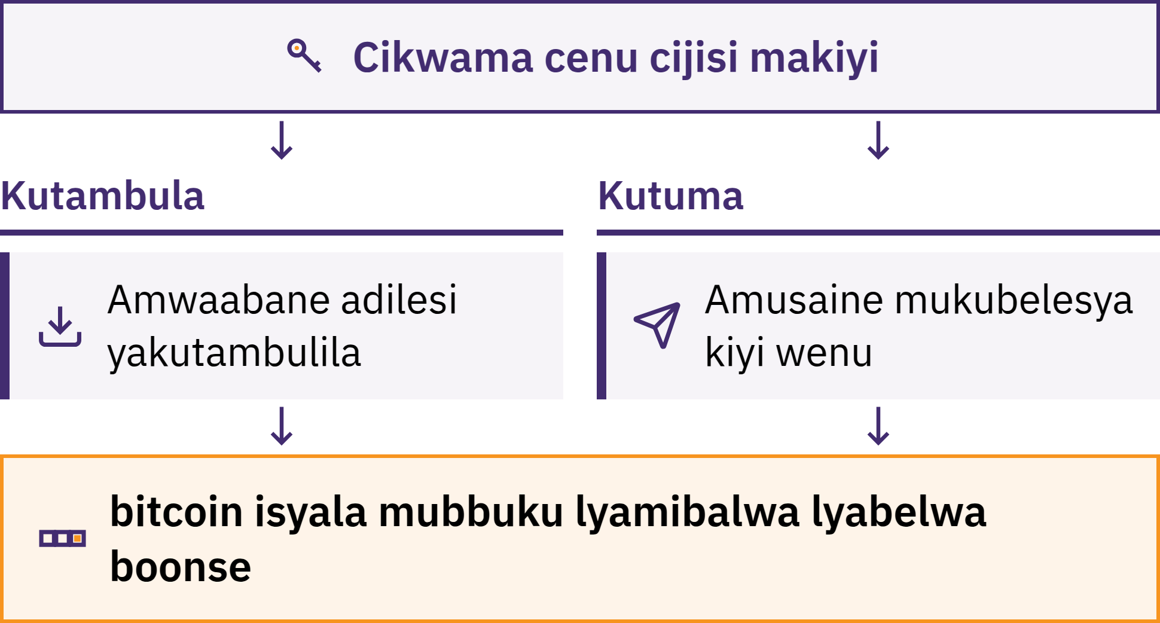
Cikwama Cilanganya Makiyi
Intalisyo ku Bitcoin · Mubelesya Buti Bitcoin?
Notes:
Cikwama ca Bitcoin ncibelesyo, kanji apulikesheni, cimuzumizya kutambula, kulanga, akutuma bitcoin. bitcoin yanu tiibikkwi mukati kafoni yanu: ilembedwe pa blockchain. Cikwama cilanganya makiyi amuzumizya kusinizya kuti bitcoin njenu akuzumizya kubbadela.

Slide 32
Nguni Uujisi Bitcoin Yanu Ncobeni?
Kulibambila: ndimwe mulalanganya makiyi
Taakwe uukonzya kumubweedezya bitcoin yanu kuti mwasweekelwa majwi aakubweedezya acibelesyo
Kubambilwa: kampani ilabamba makiyi, mbuli mbobacita kubanki
Mali iili muakaunti yanu ncisyomezyo cakampani cakumulipila; ilakonzya kubikka cigaminino kumali njomukonzya kugwisya, kukasya akaunti, kunjililwa mumakompyuta ayo cakutazumizigwa, na kujala
Kusala nzila yakubamba bitcoin taakuli kweezya bulemu bwanu. Ciyandika nkumanya nzila njomubelesya ancico ncomusyoma.
Intalisyo ku Bitcoin · Mubelesya Buti Bitcoin?

Slide 33

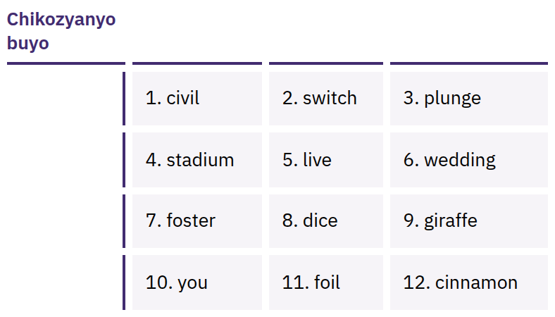
Mabala Aanu Aambuto Alapa
Busobozi Boonse Bwakunjila
Mulongo wamabala aabikkidwe munzila iilondene, kanji 12 naa 24, aakonzya kulenga alimwi makiyi aanu. Muntu uuli woonse uujisi mulongo ooyu ulakonzya kutola bitcoin yanu.
Intalisyo ku Bitcoin · Mubelesya Buti Bitcoin?
Notes:
Majwi aakubwezelezya cikwama taali nzila yakucibwezelezya buyo: alapa nguzu zyoonse zyakunjila akucibelesya. Mualembe kabotu apepa ciindi nomupanga cikwama; muayobole kakunyina intaneti, mubusisani, alimwi mubusena mobatakali kusweeka na kunyonyoonwa. Mutakaciti cifwanikiso caawo, kuatuma kwi-imeyili, kuayobola mumalembe aamu cloud, kuatuma mumulumbe, na kualemba awebusayiti. Majwi aatondezyedwe nchikozyanyo buyo; mutakatondezya na kubunganya majwi aakubwezelezya cikwama ncobeni.

Slide 34

Makiyi taali aanu, ndalama tazili
zyanu.
Intalisyo ku Bitcoin · Mubelesya Buti Bitcoin?

Slide 35

Mutanabelesya Cikwama Cili
Coonse
Makiyi: nguni uyalalanganya, ndinywe na nkampani?
Kubweza: ncinzi cicitika kuti foni yanu yazika na kampani yazimina?
Nkwazizwa: ku webusayiti yazumizyigwa na ku busena bwamaapu, kutali linki muntu njakamutumina?
Koodi: ilijulidwe kubantu boonse alimwi ilazumanana kulanganyizigwa? (Eeci aceeco tacisimikizyi kuti ilikwabilidwe.)
Malipilo: kuli malipilo akutuma, kutambula, na kugwisya mali?
Kulipila: pa blockchain, pa Lightning, na zyoonse zyobilo?
Intalisyo ku Bitcoin · Mubelesya Buti Bitcoin?
Notes:
My First Bitcoin taikulwaizyi kubelesya zikwama zimwi zyakasalidwe. Zibelesyo, mali aakulipila, abeenzinyina zilacinja, alimwi ceeco ceelela bantu bamucilawo comwe cilakonzya kutayeelela bantu bamucilawo cimbi. Amusololele basikwiiya kumuyiisi wakucilawo uusyomeka.

Slide 36
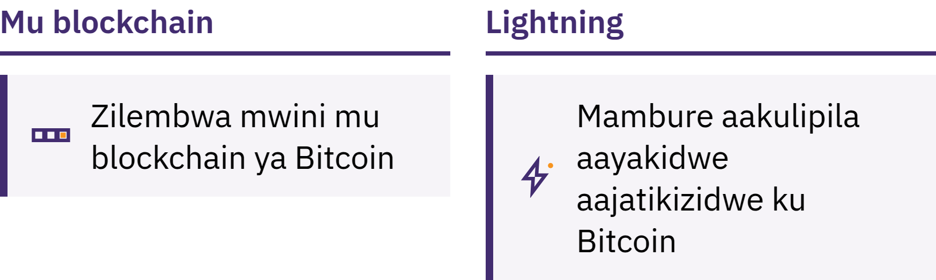
Pa Blockchain a Lightning
Muketani: kulembwa caantangalala muketani wamabbuuloko
Lightning: netiweeki yakulipila iyakilidwe atala a Bitcoin kuti kulipila tusimbi tuniini kucitike cakufwambaana alimwi kanji-kanji, mbuli kuula kofi
Cikwama ca Lightning cilakonzya alimwi kubambwa aumwi muntu naa kubambwa ndinywe nobeni
Intalisyo ku Bitcoin · Mubelesya Buti Bitcoin?

Slide 37
Milawo Yotatwe Ciindi Nomwiiya
Amusambilile cakusaanguna. Mutaciti cintu akaambo kakukondwa kapati, kuyoowa, naa kunyomezyegwa.
Amutalike azinini. Amusolole zibelesyo nzyomutazyi amali ngomunga mwakonzya kusweekelwa.
Mutasyomi Buyo, Amusinizye. Amulingule muntu, nzila yakubbaadala, adilesi, alimwi ambungano yamali.
Amwaabane makani aakutambwiila, kutali zyasisi
Adilesi naa cikumbizyo cakubbaadalwa cilakonzya kwaabanwa. Majwi aakuvwulusya cikwama naa kiyi yacisyese tazyeelede kwaabanwa pe. Kunyina muyiisyi uusyomeka, kampani yacikwama, naa mubeleki waluzyalo uuyoomulomba zintu eezi.
Intalisyo ku Bitcoin · Mubelesya Buti Bitcoin?

Slide 38

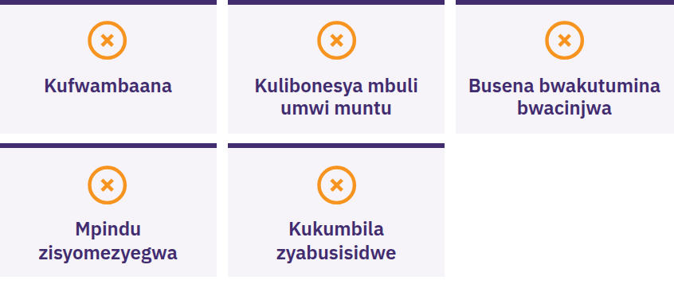
Amwiime, Mutaabani Cintu,
Mutatumizyi Cintu
Amwiime naa umwi wamukulwaizya kucita cintu cakufwambaana naa mubusisidwe, wamusyomezya mpindu iisinizidwe, wamulomba kuti mutume bitcoin kutanguna, naa wamulomba mazwi aakuvwuntulula cikwama canu. Amulindile. Mutapa pe cintu. Mutatumi pe cintu. Amane musinizye kwiinda kunsulo yamakani njimuzi kale.
Intalisyo ku Bitcoin · Mubelesya Buti Bitcoin?

Slide 39

Ncinzi Citobela?
Aaya ngamatalikilo buyo.

Slide 40
Zintu Zyone Zipati
Mali ayanzikide kumilawo akusyoma. Bunji bwa mali aa fiat amilawo yaayo zibambwa amabungwe masyoonto.
Bitcoin ijisi milawo iipusene. Bunji bwa mali buzibidwe kubantu boonse, bujisi mamanino, buzululidwe muntu uuli woonse, alimwi inga bwalolisisigwa kutali kubusyoma buyo.
Kukwabililwa kulatalika. Amwiiye kusaanguna, amutalike azisyoonto, amusinizye zyoonse, mutaambizigwi muntu mabala aakuvwununa cikwama canu.
Aaya ngu matalikilo buyo. Kutola ntaamu yomwe iikwabilidwe kulakkwana.
Kaciindi kakulanga-langa
Amujokele kumibuzyo iisanu yakumatalikilo. Munga mwaingula buti lino?
Intalisyo ku Bitcoin · Ncinzi Citobela?

Slide 41

Dipuloma ya Bitcoin
Intampu iitobela. Zipanzi zyayo zyone zilamutola kunembo:
Kumvwisya mali
Bitcoin mbwiibeleka
Kubelesya Bitcoin munzila iikwabilila
Bitcoin mucilawo canu
Amuzumanane kuyandisisya kuzyiba, amuzumanane kubuzya mibuzya, alimwi amwiiye zinji ku myfirstbitcoin.org.
Tulalangila kumubona mugulu lyesu litobela.
Intalisyo ku Bitcoin · Ncinzi Citobela?

Slide 42


