Slide 1
An Introduction to Galas
By Leanne Starkie (Gala Secretary) & Frani Horsburgh (Club Secretary)

Slide 2
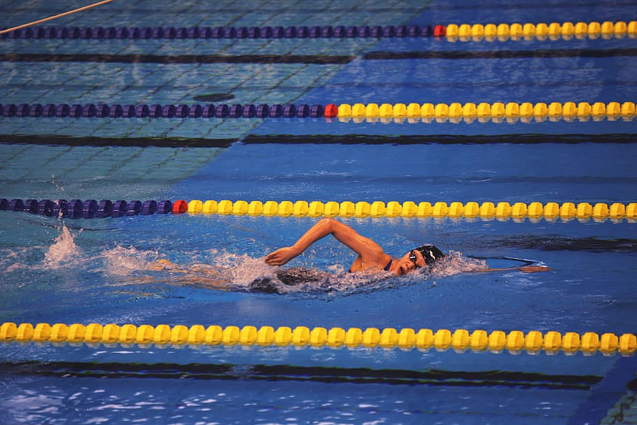
Types of Galas & Competitions
In house galas – Age Group Championships (May/June) & Club Championships (November)
Novice & Fife Leagues – Fife club events
Galas held by other Club – Level 1, Level 2 & Level 3
East District Age Group Championships (EDAGs) – qualifying times
Scottish Nationals Age Group Championships (SNAGS) – qualifying times
Notes:
Explain over sub, reserve on draft programme

Slide 3
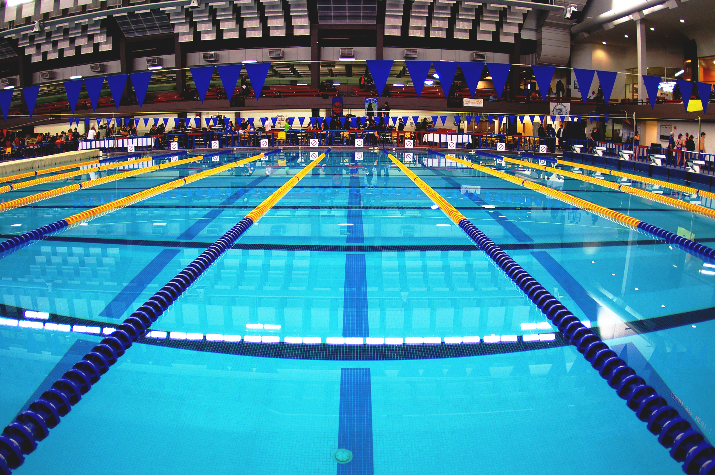
The Gala Entry Process
Coaches will decide which gala they think are suitable for each squad.
The information will then be sent to myself.
An email will be sent to relevant squads inviting them to attend the gala. The gala will then appear on the On Deck app.
All entries must be submitted before the deadline date.
A draft programme and billing report will be issued usually a couple of weeks before gala.
Payment will be deducted from your normal billing account 2 days before gala
Notes:
Explain over sub, reserve on draft programme

Slide 4
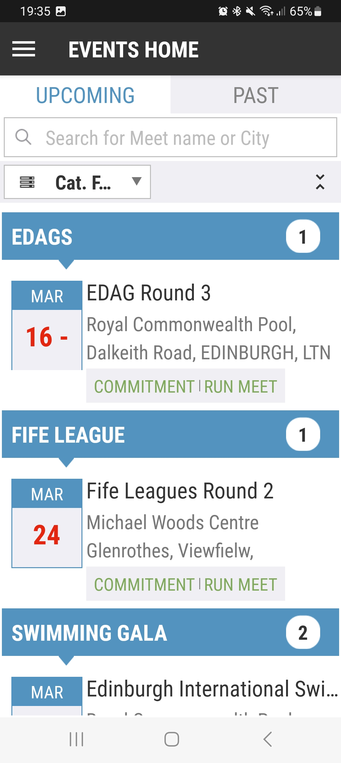
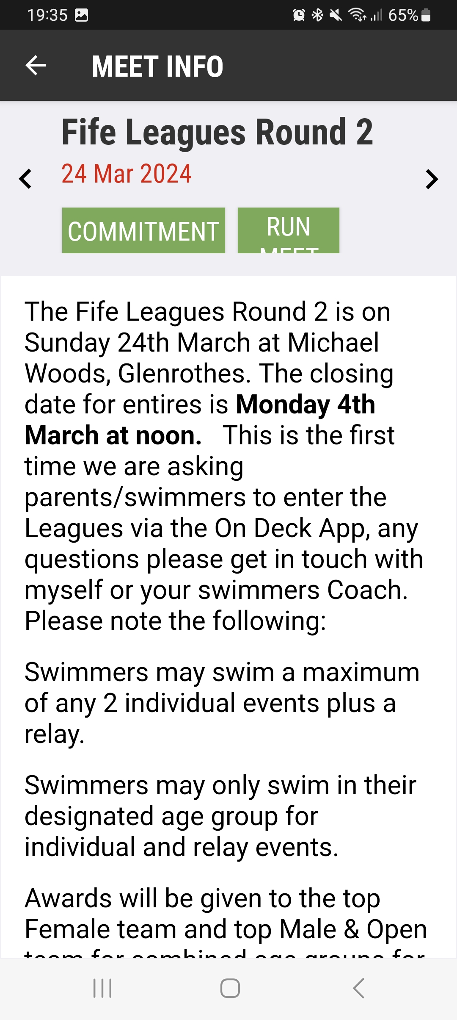
How to use the On Deck App
Click Commitment
Click Cat.Filter and ensure all green
Click Events
Click Events & Meet Entries
Select the event
Notes:
Log in with email and password used when registering swimmer.

Slide 5
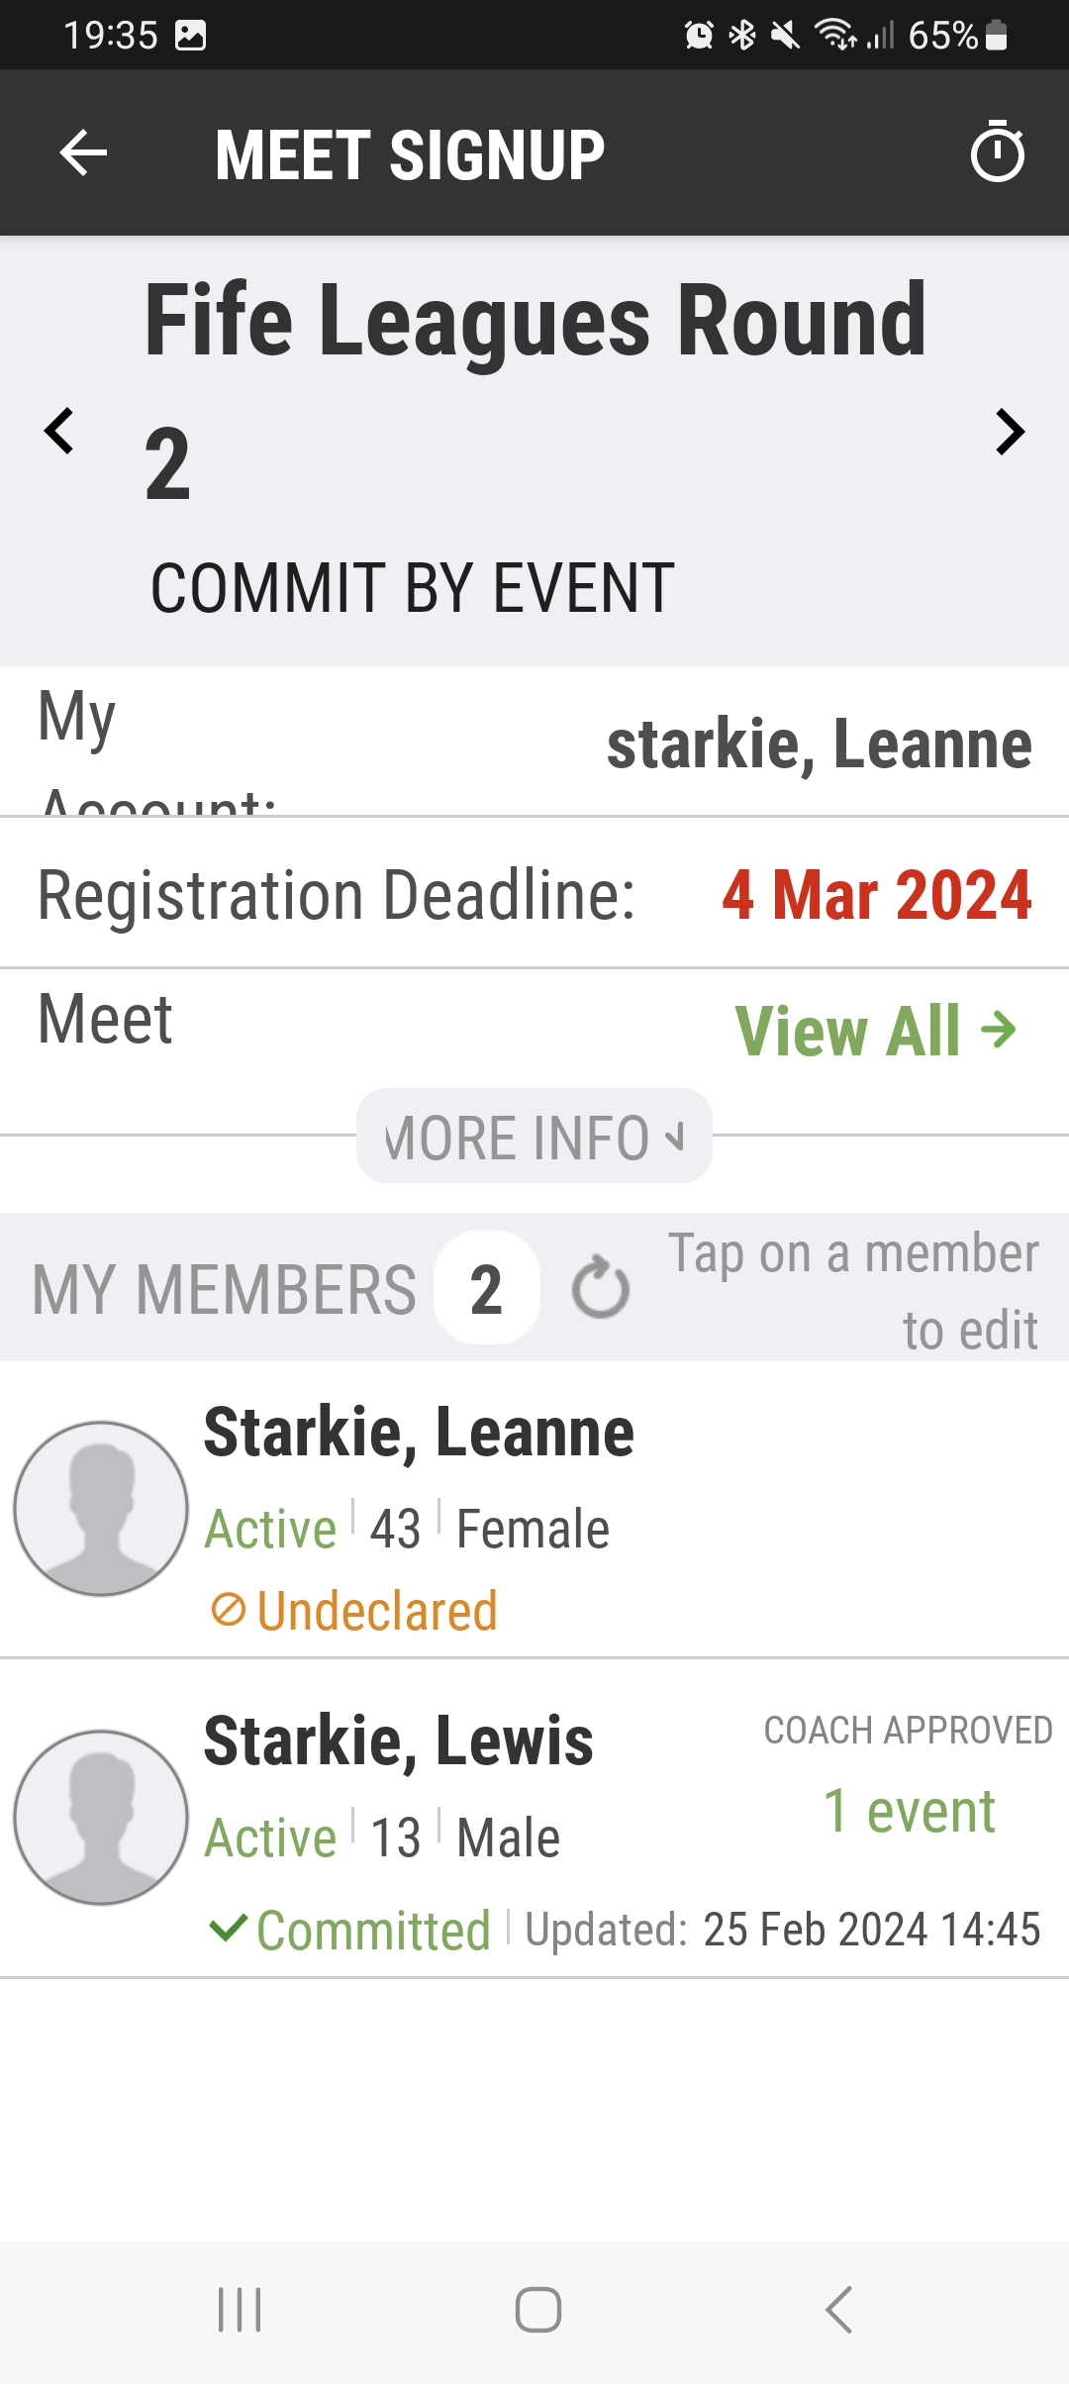
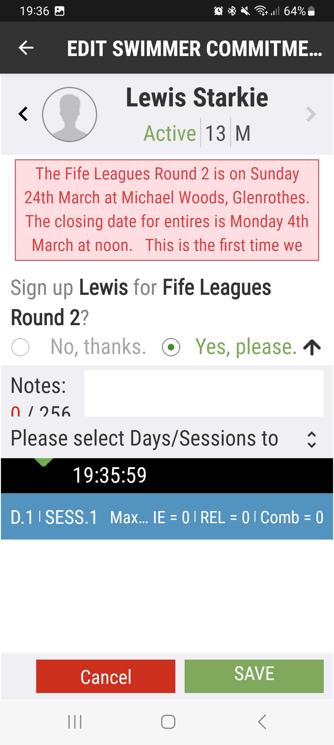
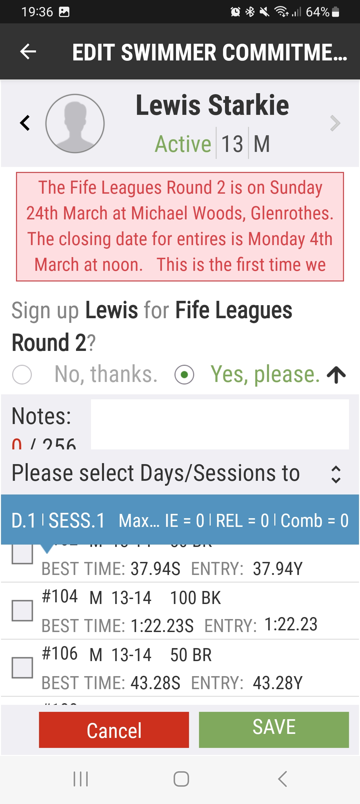
If you are unsure about what events to choose, please speak to coaches
Select Yes, please.
Click blue banner
Select your swimmer
Choose events your child would like to do
Click Save

Slide 6
Checklist for Galas
Spare Swimming costume/jammers
Spare goggles & cap
T-shirt for poolside
Towel for poolside
Healthy snacks
Water bottle
Something to keep swimmer occupied i.e. card game, colouring book etc

