Slide 1

P2P
Help helps, you are not alone!
We’re Here to Help

Slide 2
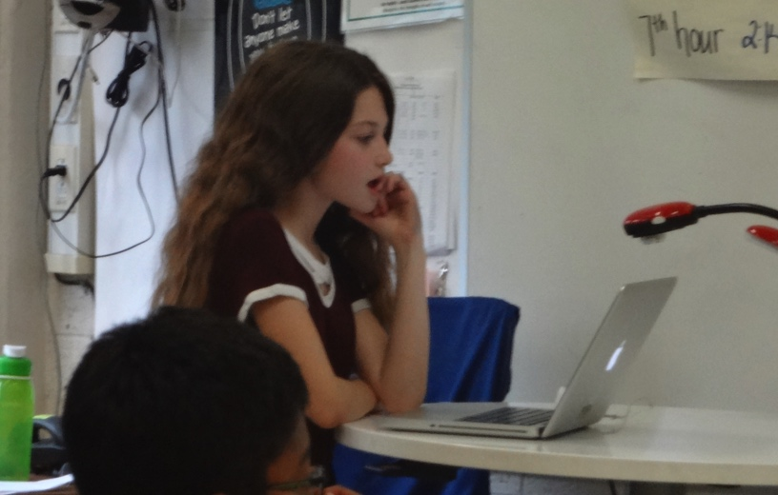
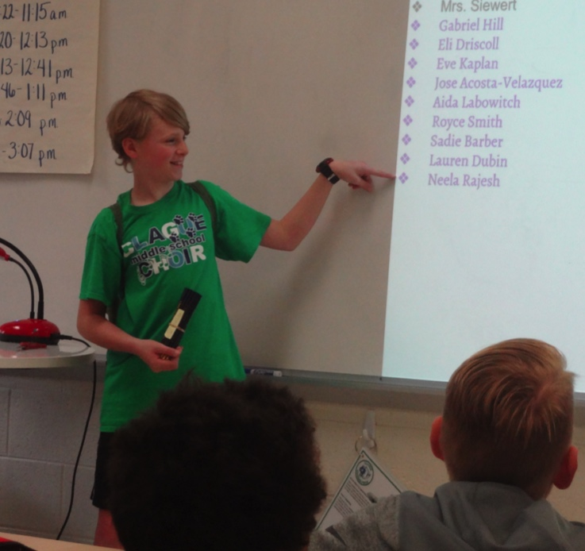
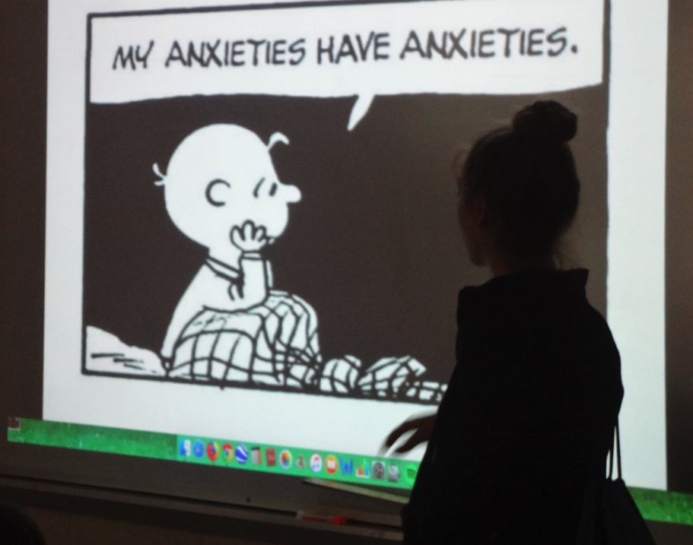
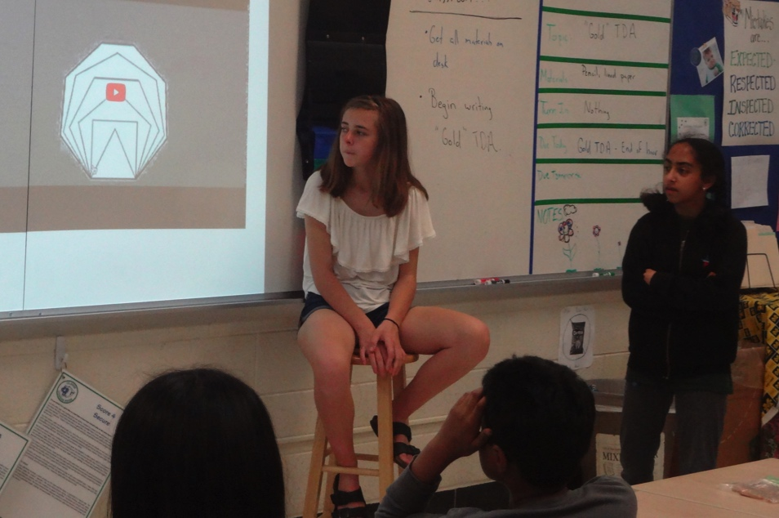

Slide 3
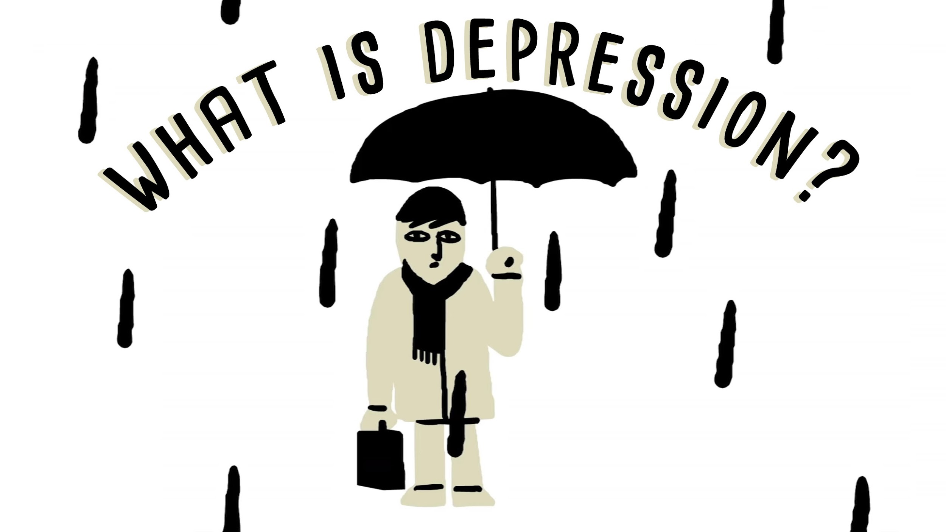

Slide 4
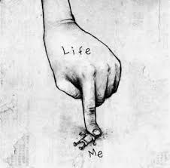
Depression Can Be:
Loss of interest or pleasure in activities once enjoyed
Feeling sad or having a dull mood
Changes in appetite — weight loss or gain unrelated to dieting
Trouble sleeping or sleeping too much
Loss of energy or increased fatigue
Increase in purposeless physical activity (e.g., hand-wringing or pacing) or slowed movements and speech (actions observable by others)
Feeling worthless or guilty
Difficulty thinking, concentrating or making decisions
Thoughts of death or suicide
Self harm
Feeling these ways for at least two weeks

Slide 5
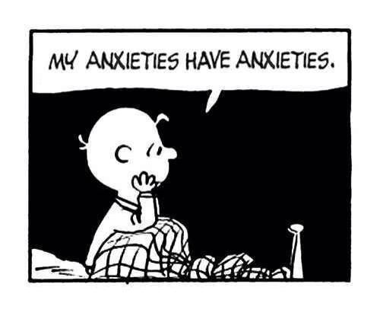

Slide 6

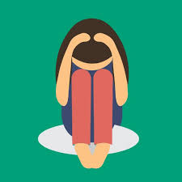
Anxiety Can Be:
a feeling of worry, nervousness, or unease, typically about an imminent event or something with an uncertain outcome.
Restlessness
Sweating
Excessive worry
Insomnia (Trouble sleeping)
Nausea (Feeling dizzy/sick)
Poor Concentration
Racing or Unwanted Thoughts
A feeling of panic — sometimes without a particular reason
These feelings impacting your daily life
Notes:
E

Slide 7

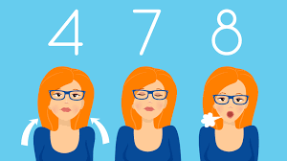
How about an activity
BOX BREATHING!
Box breathing can help you calm down in an anxious situation. Box breathing is a form of calming oneself down. This can help when you are anxious. Such as during a test. Take a chance to calm down. This video does really work. Please follow along with the video and relax.

Slide 8


Slide 9
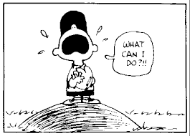

What Can I Do?
Having anxiety and depression is a hard thing to deal with. Here are some strategies to help get through it.
Professional Help (Counselor,
Therapist, etc.)
Talking to people who care about you (Close Friends, Family, etc.)

Slide 10
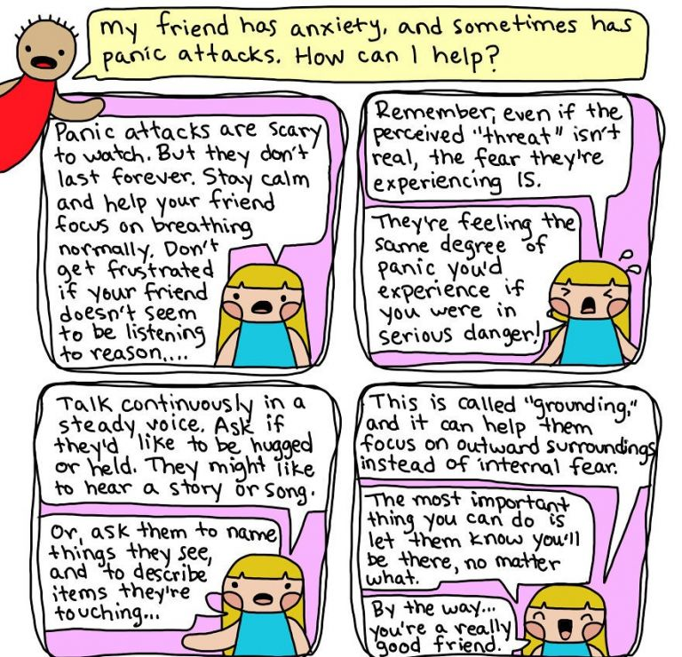
What Can Others Do?
Being a friend of someone who has depression or anxiety can be very hard to watch. You may feel bad for the friend. Here are some strategies that YOU can do to help.
Be positive
Do what your friends wants to do, don’t overdo it
Stay calm and help your friend keep calm.
Read this comic ---->

Slide 11
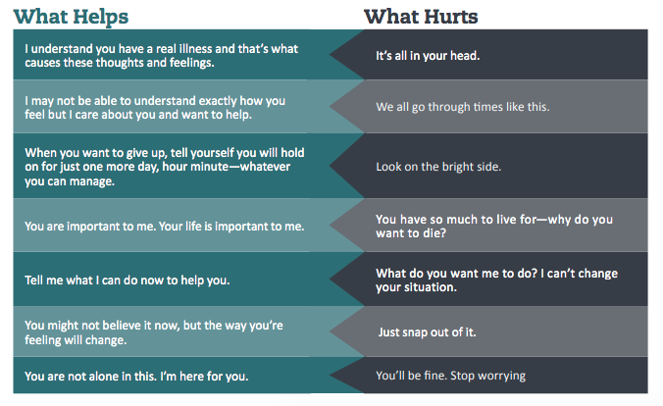

Slide 12


Erase
BY: Gabriel J. Hill 7th Grade

Slide 13
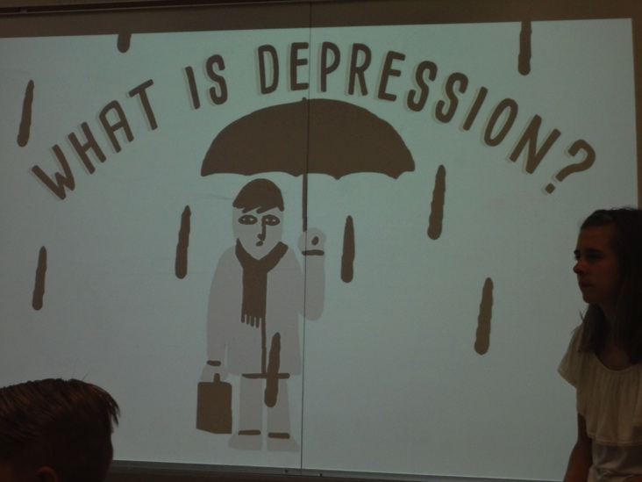
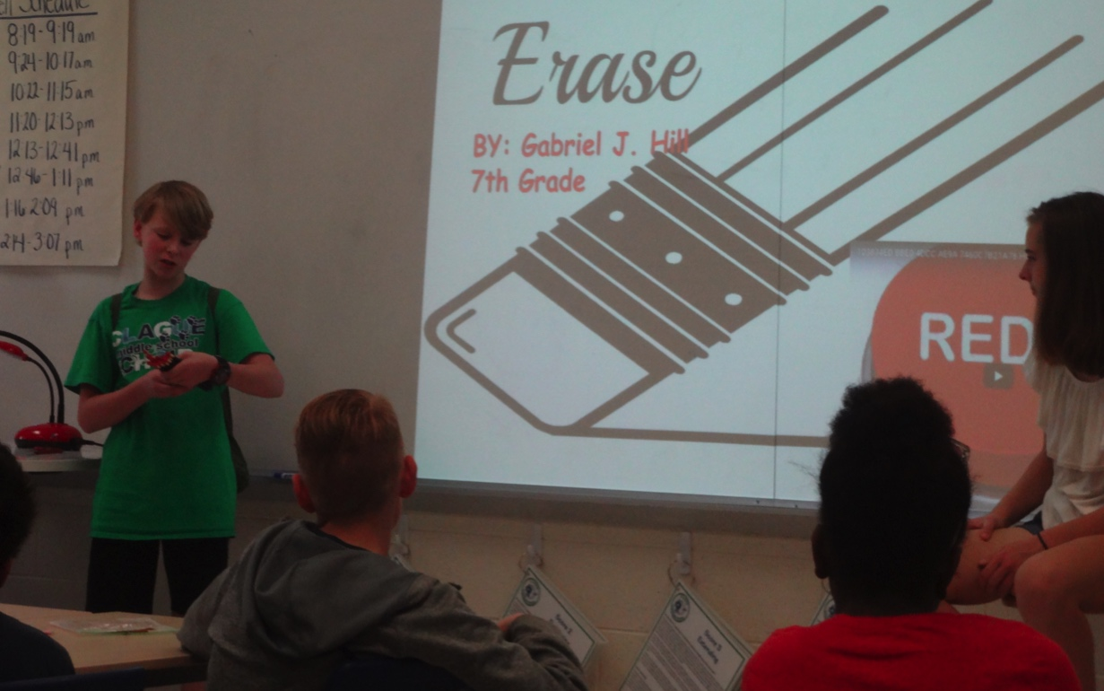


Slide 14
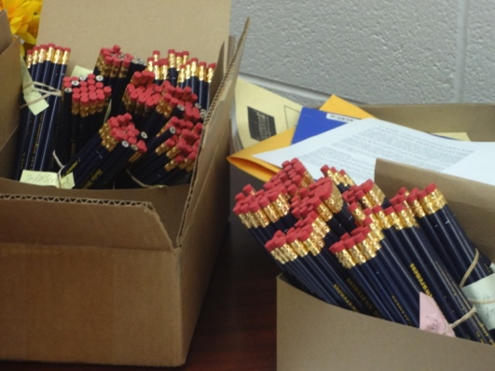

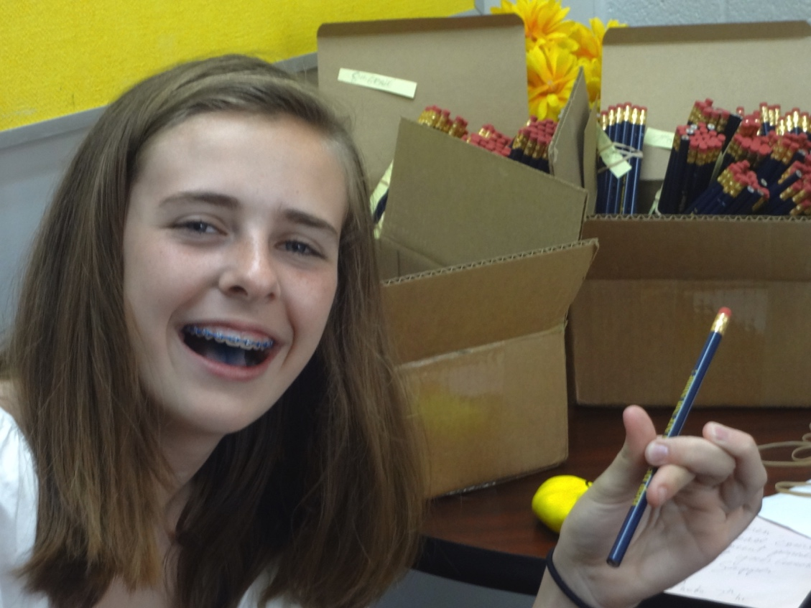

Slide 15


