Slide 1
P2P Forsythe
Raise awareness. Promote health seeking. End the stigma.
It’s okay to not be okay.

Slide 2
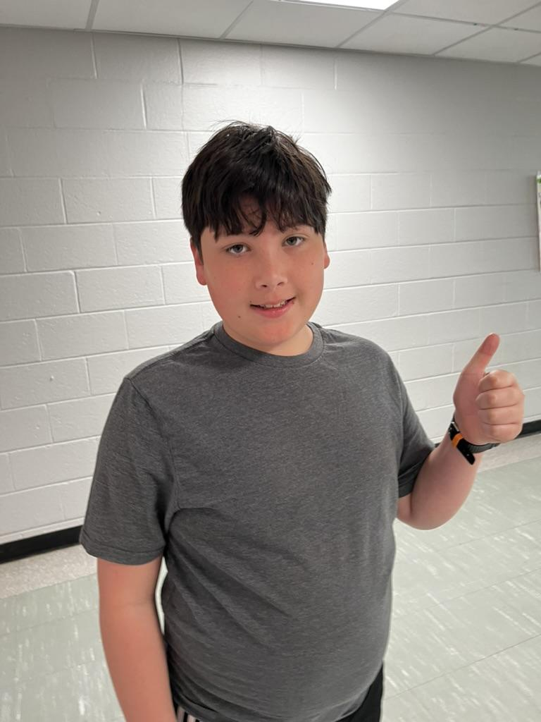
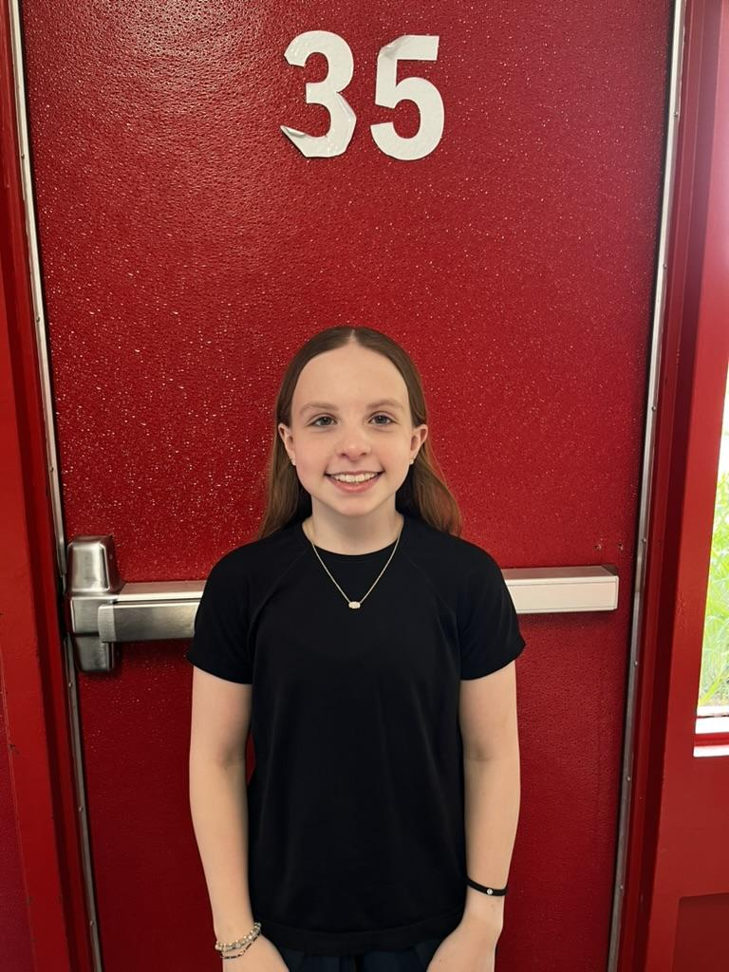
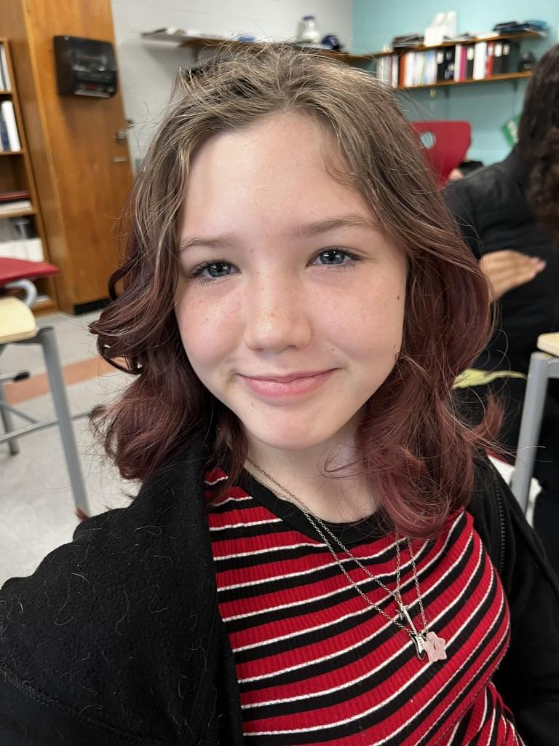
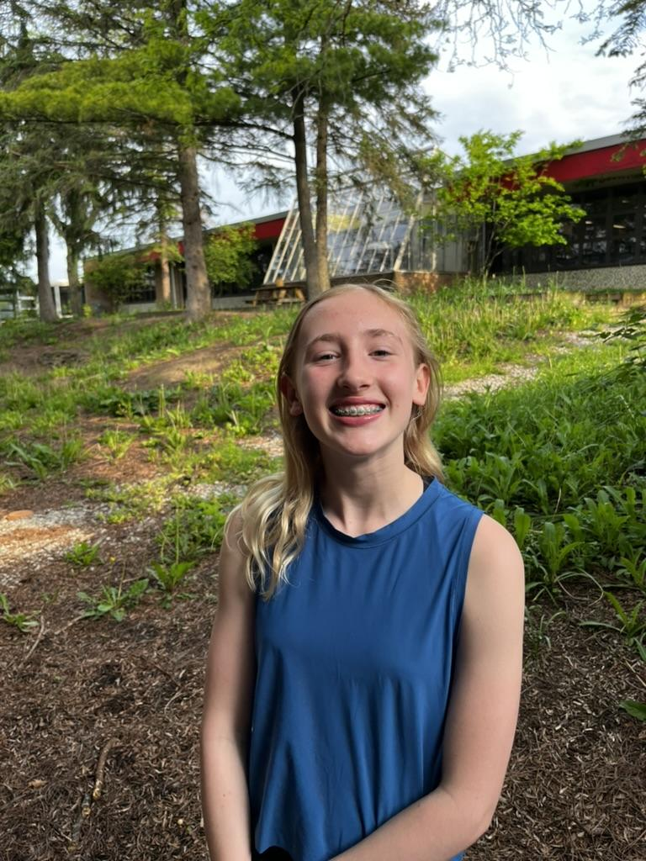
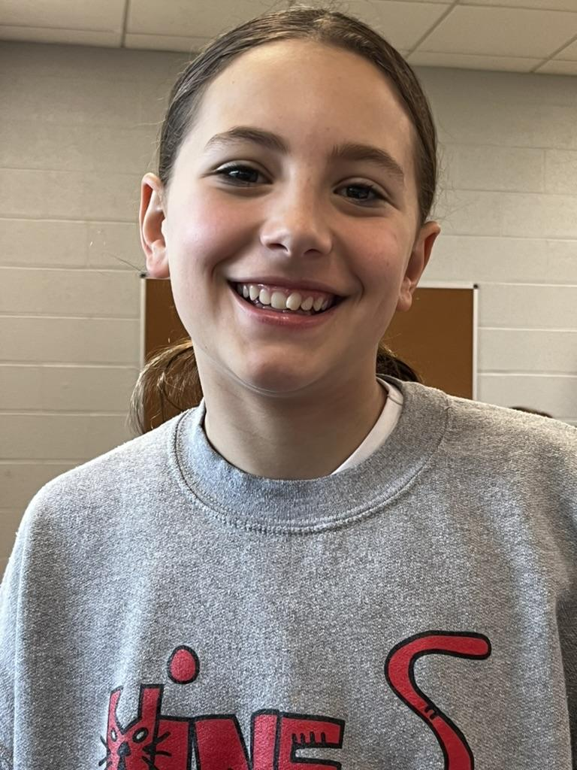
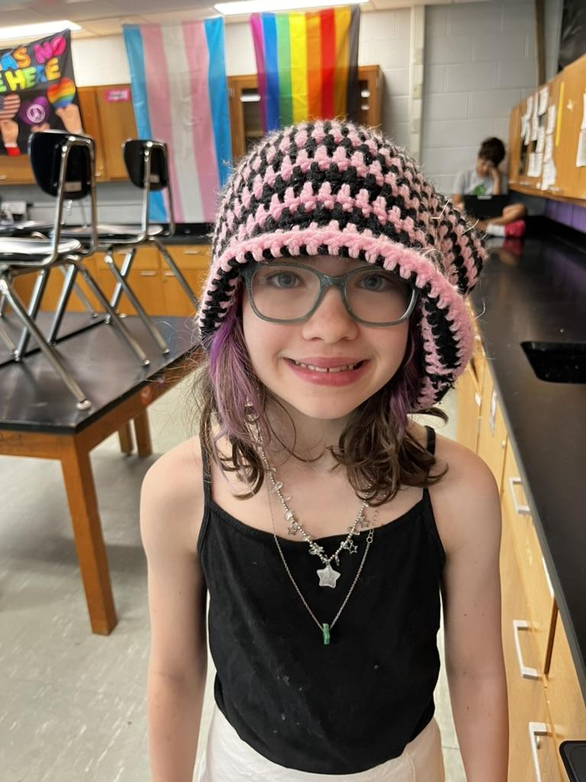
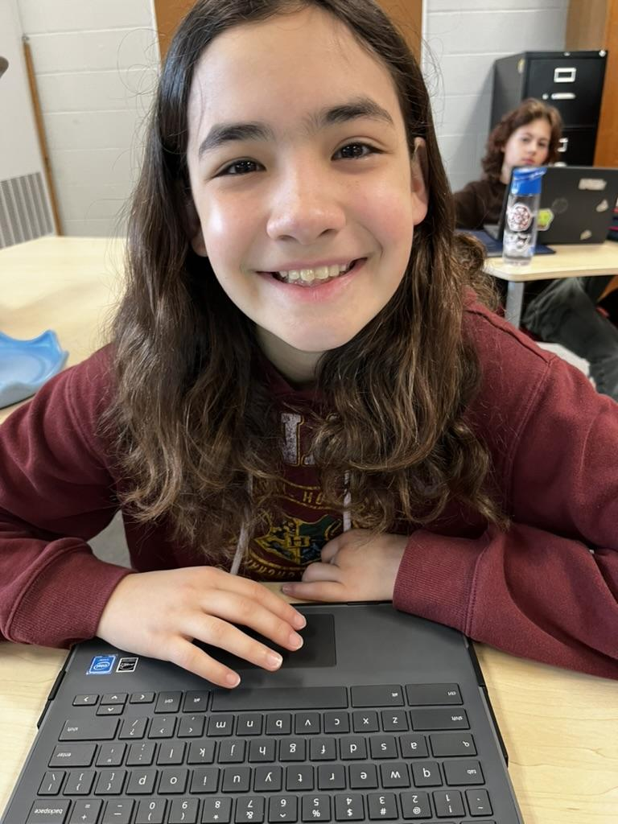
6th graders of P2P
N/A
Roman Salazar
Emma Hegwood
LilyBeth Sobczak
Ash Klus-Salisbury
Gable MacArthur
Margo Goldberg
Roxy Carlin
Annaliese Sams

Slide 3
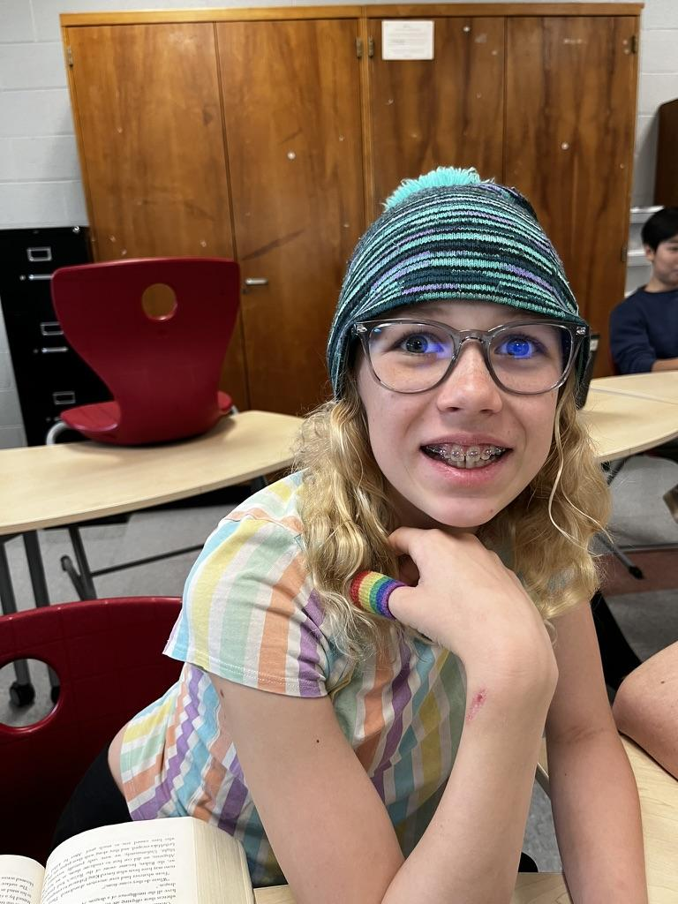
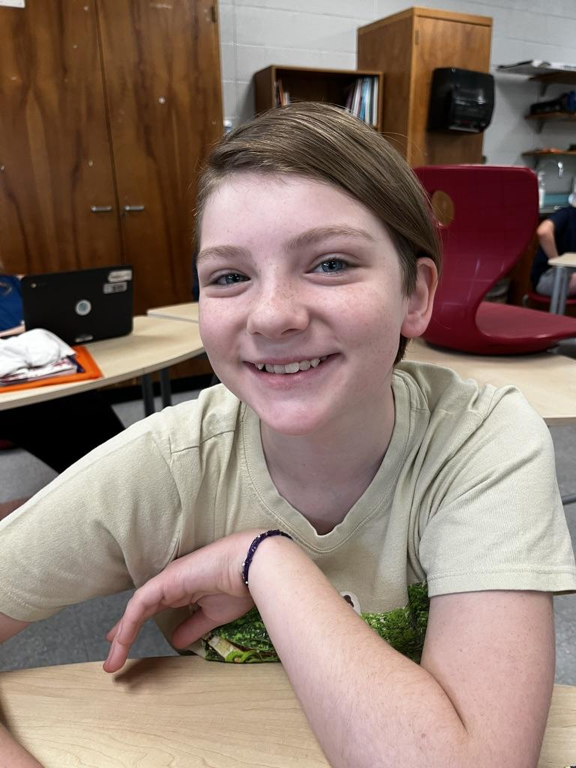
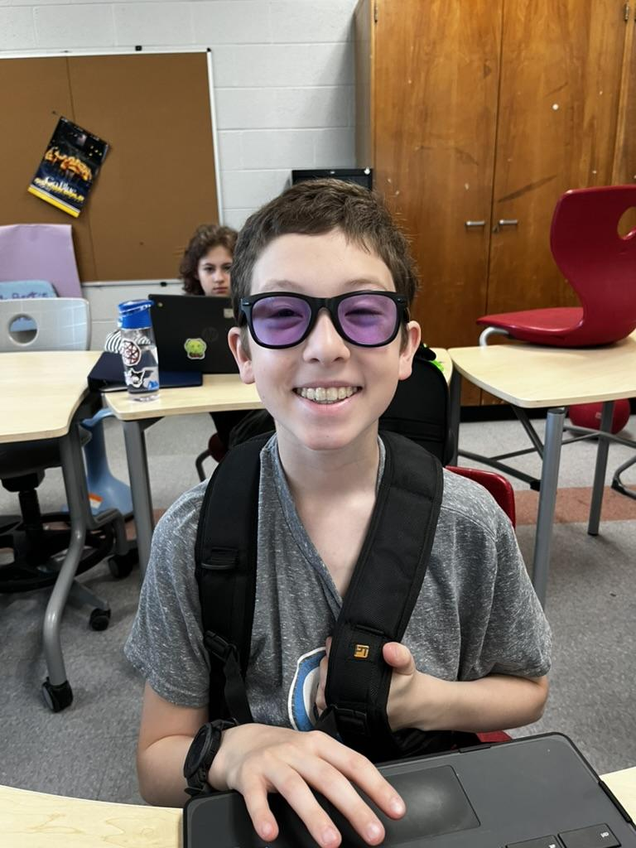
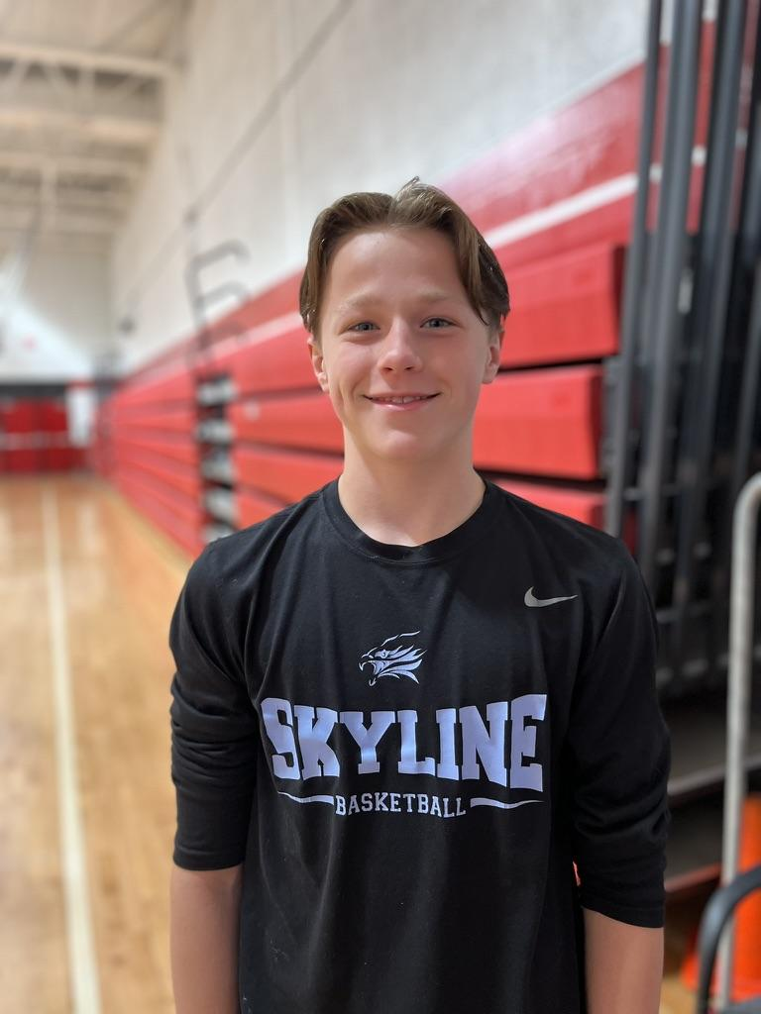
7th graders of P2P
Sophie Campbell
Violet Fournier
Woodrow Sams
Bryce Wall

Slide 4
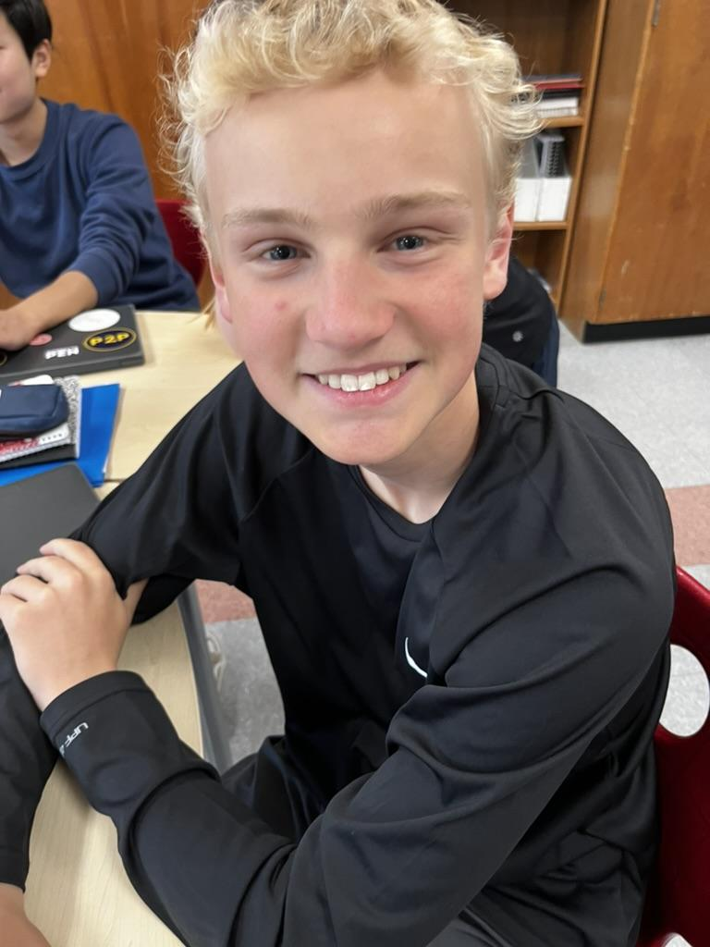
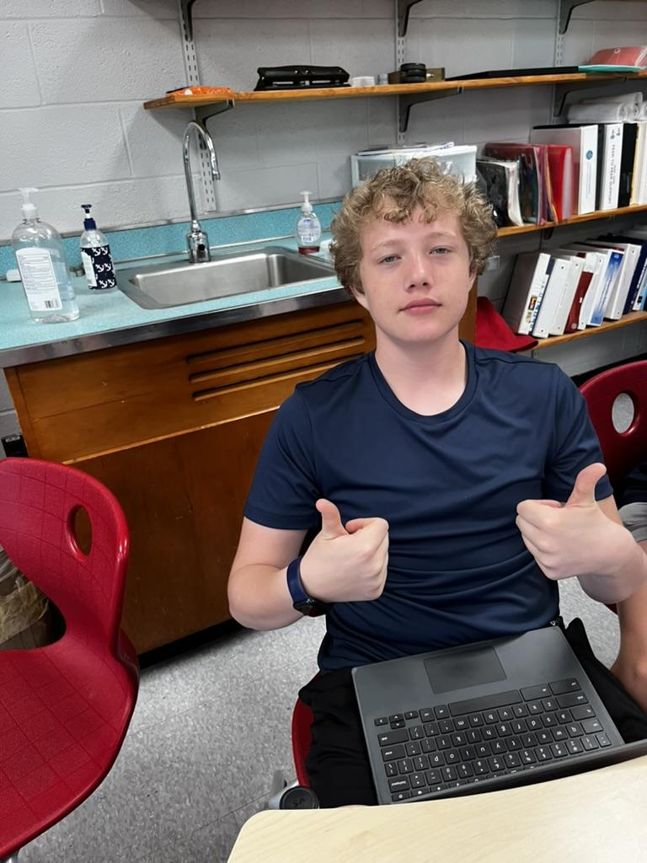
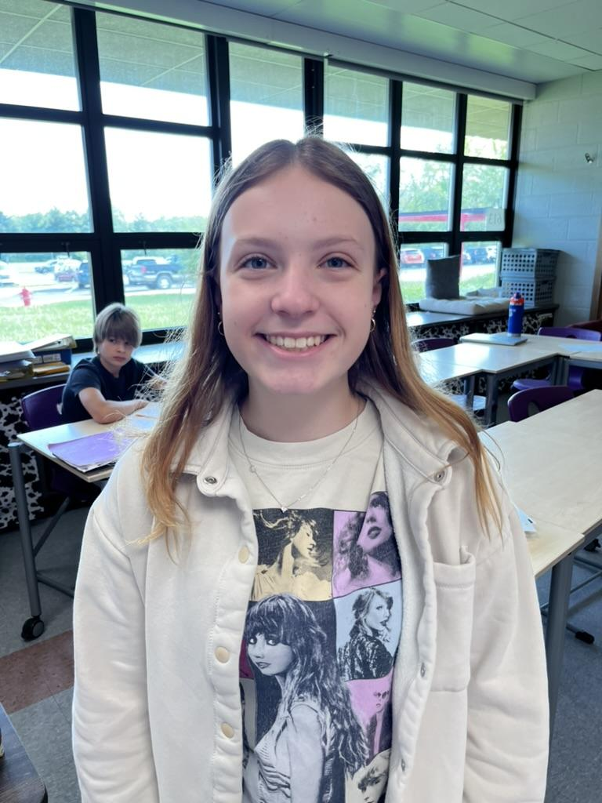
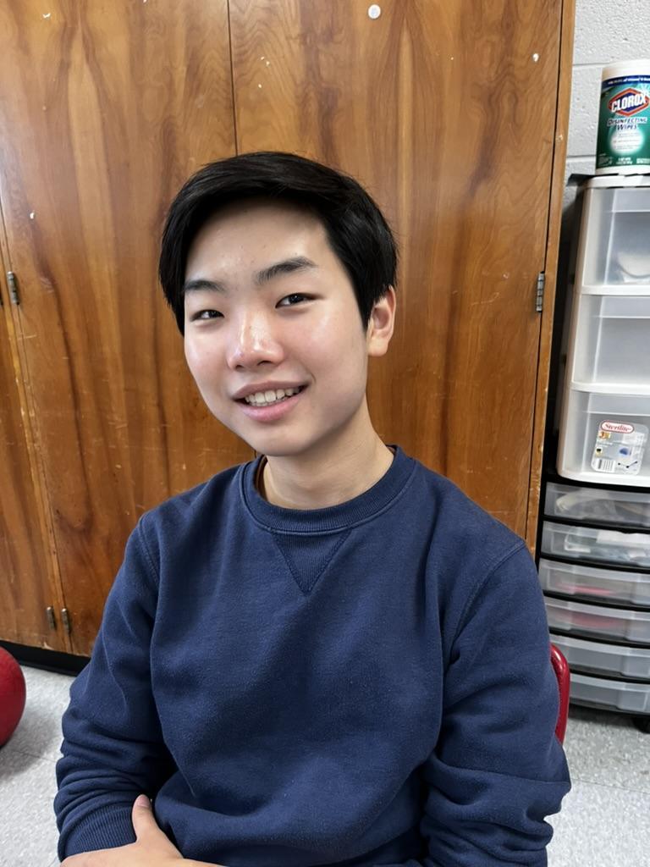
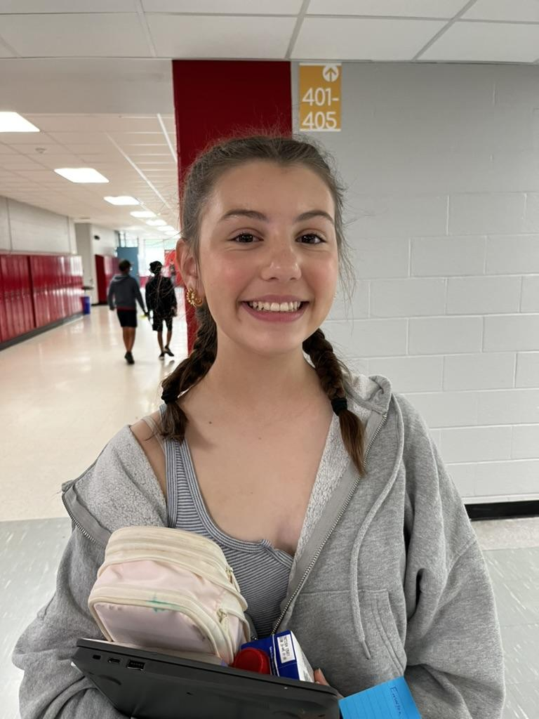
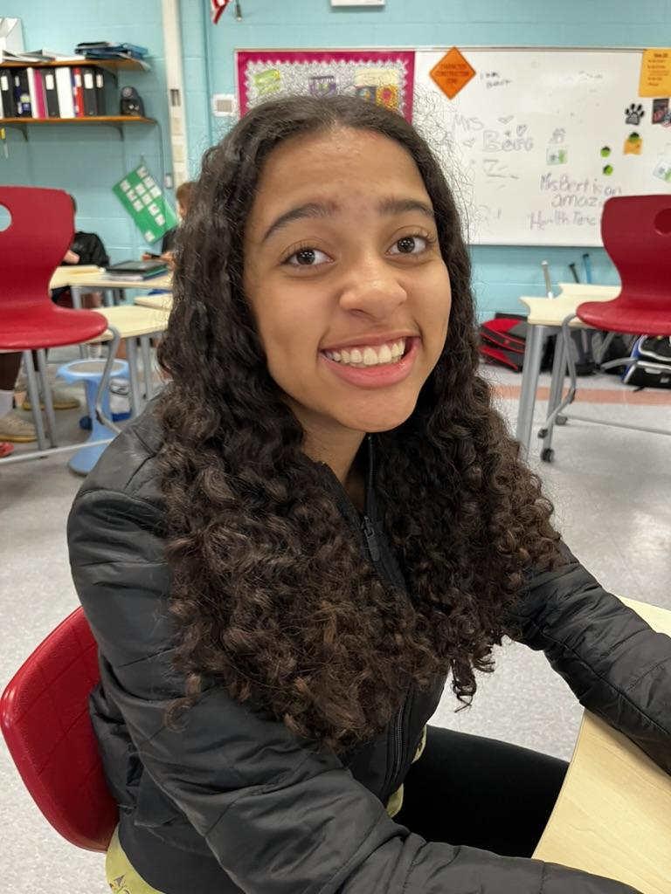
8th graders of P2P
William Duffy
Caleb Ellies
Claire Hegwood
Joowon Lee
Emerson Nalepa
Madison White

Slide 5
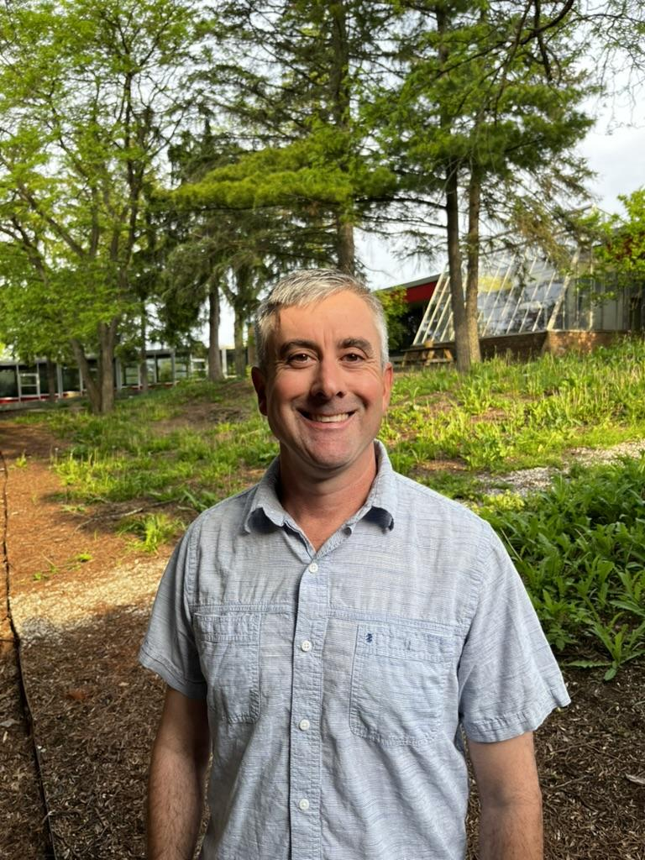
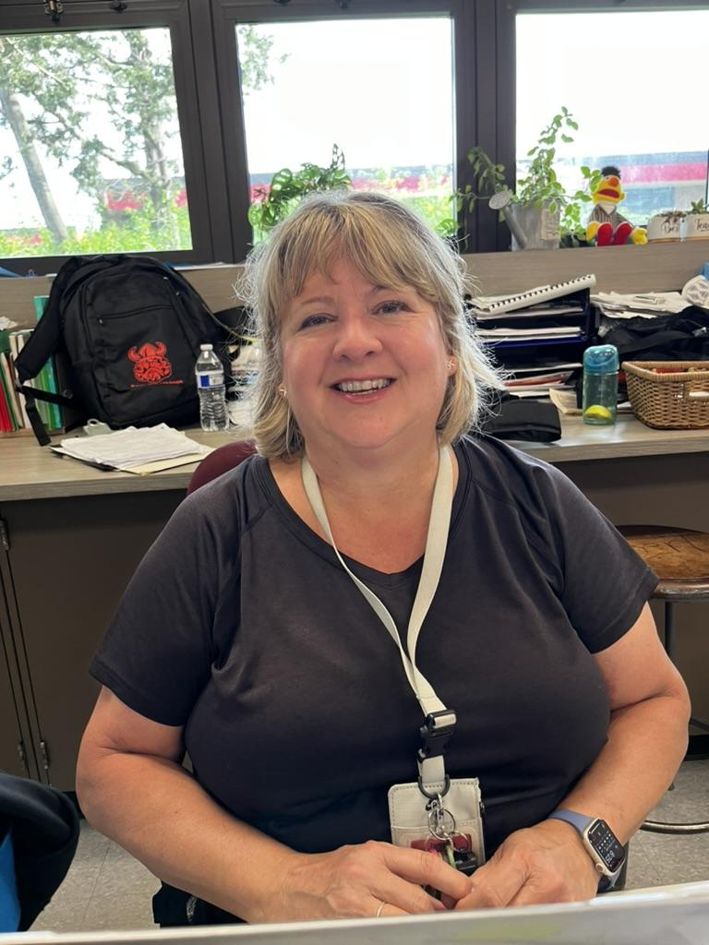
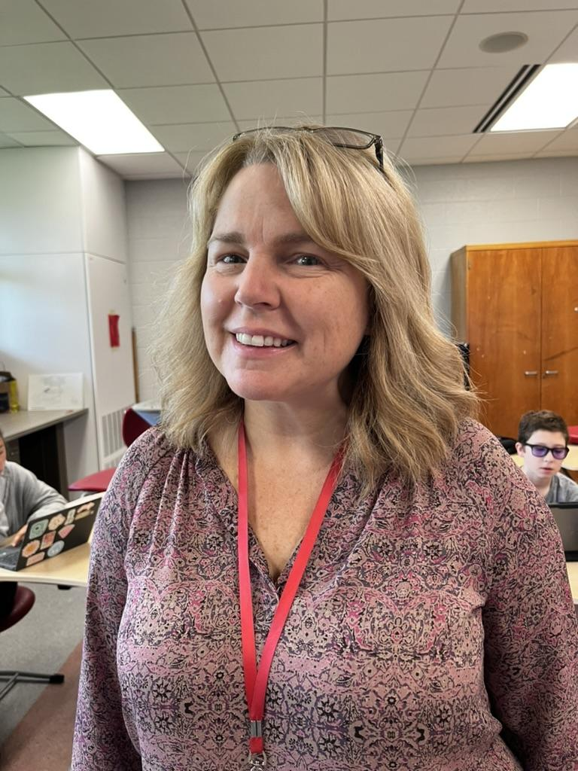
Peer to Peer Mentors
“It’s okay to ask for help. Find a trusted adult you feel comfortable talking to. Our doors are always open.”
Mr. Murphy
Ms. Klein
Ms. Bert

Slide 6

Adult resources at Forsythe
Counselors:
8th grade: Mrs. Hollis
(hollisam@aaps.k12.mi.us)
7th grade: Mrs. Morris
(morrisr@aaps.k12.mi.us)
6th grade: Mr. Murphy
(murphy@aaps.k12.mi.us )
“It’s okay to ask for help. Find a trusted adult you feel comfortable talking to. Our doors are always open.”

Slide 7
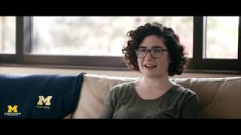
About Peer to Peer
Peer to Peer is an organization working to promote mental health, reduce the *stigma, and raise awareness around depression through schools. There is many different support systems that we promote to help anyone who needs it.
Stigma: A mark of disgrace

Slide 8
Numbers & hotlines
Cares Hotline: 734-544-3050
Suicide Lifeline: 800-273-8255
Mental health hotline: 988
Text HOME to 741741 to connect with a crisis counselor

Slide 9


Important resources
- Suicide prevention line link
-Washtenaw CARES link
-Counselor page

Slide 10
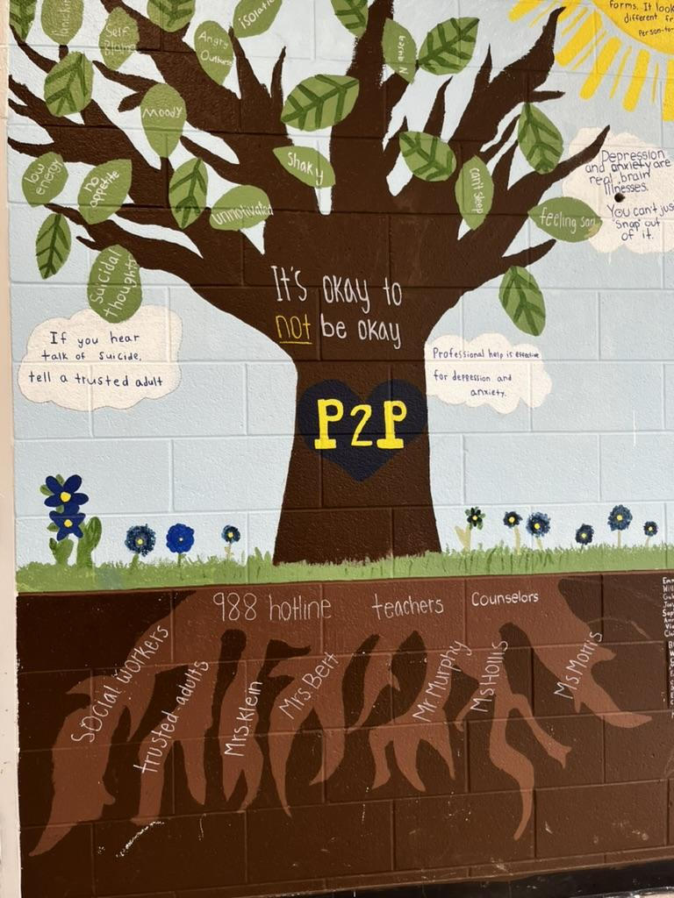
P2P Mural
Check it out in the cafeteria!

Slide 11


Where to reach us
@Peer2peerforsythe
@Peer2peerforsythe

Slide 12
Self Care Strategies
Helpful coping skills:
Talk with a friend or loved one
Go for a walk or run
Mediate!
Play with a pet
Read a book
Listen to your favorite music
Take brain breaks from socials
Do things to support yourself, and take that time to unwind

Slide 13
Depression and Anxiety Awareness Kahoot

Slide 14

Even if you don’t feel your best,
You got this.

