Slide 1
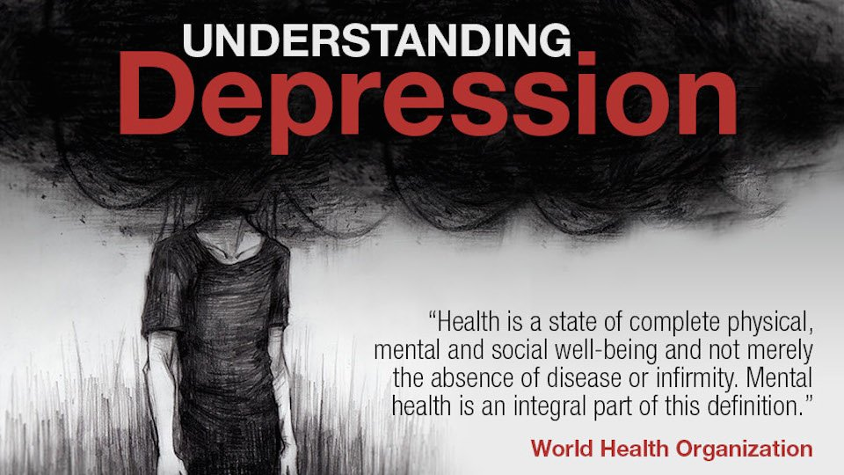
Depression Overview
Alejandro Rojas, LLMSW

Slide 2

Today’s Agenda
What is Depression
  And what Causes Depression
Symptoms of Depression
  thoughts, feelings, and behaviors
What are the myths about Depression
How we can help a friend with Depression
True or False game.

Slide 3
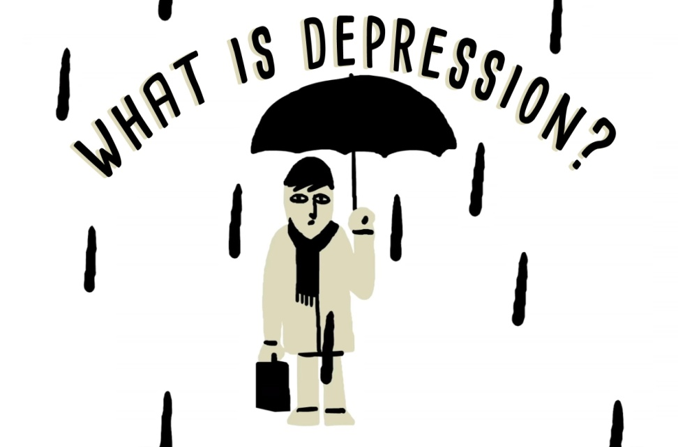
Common Symptoms
Low mood,
Loss of interest in things you’d normally enjoy, changes in appetite,
Feeling worthless or excessively guilty,
Sleeping either too much or too little,
Poor concentration, restlessness or slowness, loss of energy, and
Recurrent thoughts of harming yourself.
Depression is when normal feelings like being sad, down, grumpy, or irritable are very intense, go on too long and get in the way of normal life.

Slide 4
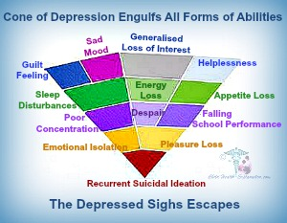
Causes of Depression:
Stress
Chronic illness
Chemicals in the brain (not working properly)
Stressful life events like
  death of a loved one,
Divorce
Moving to a new area
Breakup with a girlfriend or boyfriend

Slide 5
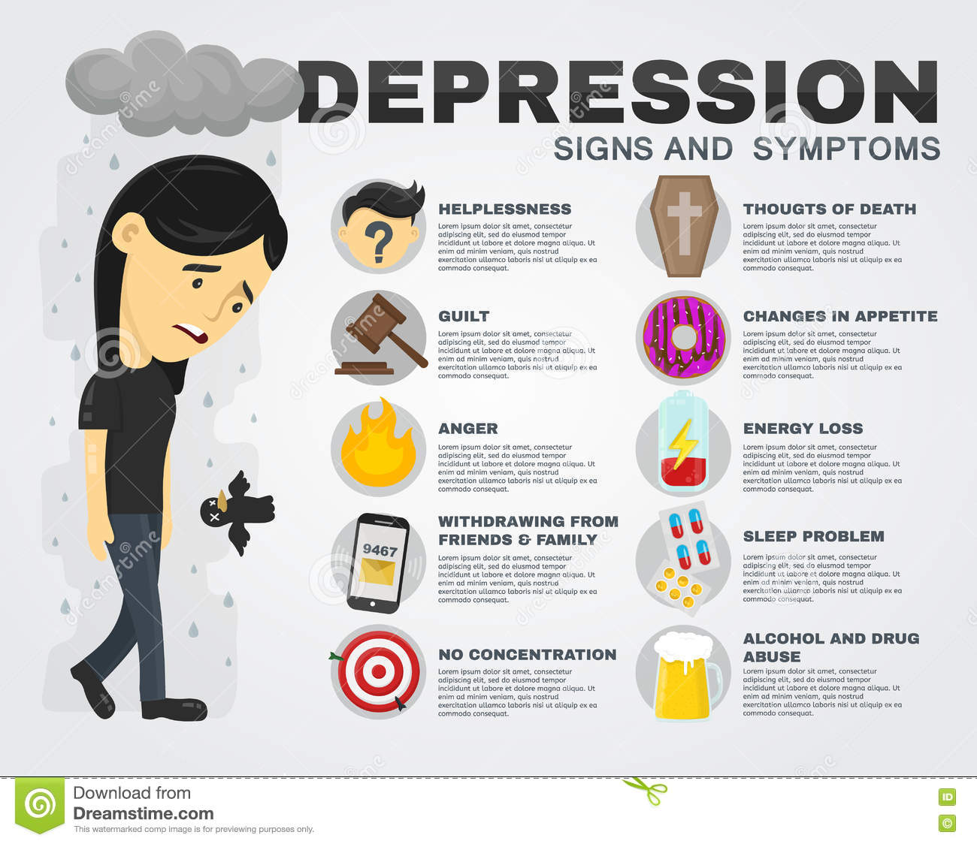
SYMPTOMS- Feelings
Sad mood, feelings of worthlessness or guilt, and despair
Irritability, anger, or hostility
No energy, bored
Extreme sensitivity to (and easily upset about) things
that happen
Difficulty concentrating
Physical aches and pains
such as headaches or stomachaches

Slide 6
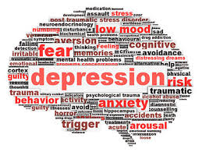
SYMPTOMS- Thoughts
Down on self, thoughts of not being worth anything, or not being lovable
Little or no interest in socializing with friends
People don’t like me or are not interested in me.
Thoughts of hopelessness- like things can never change or get better- nothing works..
Thinking it would be better to be dead, or thoughts of hurting oneself.

Slide 7

SYMPTOMS-Behaviors
Withdrawing, and Isolating from people.
Poor communication- fighting.
Crying about little things or crying lot.
Unintentionally losing or gaining weight/change in appetite.
Absences from school or a drop in school
Performance.
Talking about or trying to run away from home.
Alcohol or substance abuse
• Physical feelings of restlessness or being slow/sluggish
• Hurting self on purpose,

Slide 8
10 Common myths of Depression
Myth #1 Teens can’t become clinically depressed—they’re just moody
Myth #2 Adolescent depression looks like adult depression
Myth #3 Depressed kids are loners
Myth #4 You’re better off not discussing your depression
Myth #5 It is obvious as to who has depression.
Myth #6 People with depression can’t be happy or excited.
Myth #7 Parents will know if their teen is depressed.
Myth #8 Depressed teens will get better if they resume their normal routine.
Myth #9 Depression isn’t an inherited condition.
Myth #10 If a friend of mine is depressed, there isn’t much I can do.

Slide 9

How to Help a Friend
Get your friend to talk to you. ...
Know that your friend doesn't expect you to have the answers. ...
Encourage your friend to get help. ...
Stick with your friend through the hard times. ...
Speak up if your friend is suicidal.

Slide 10

Activity Time!
Grab a piece of paper and number it from 1 to 10
I will ask you 10 Questions and you answer True of False
Good Luck!

Slide 11


