Slide 1
Peer-2-peer is always here
PEER-2-peer

Slide 2
What is mental health?
Mental health is our well-being in the following areas:
emotional
psychological
social
It impacts how we feel
It impacts how we think.
It impacts how we act.
Our mental health can change throughout our lives.

Slide 3
Youth mental illness stats
32%
37%
15.1%
of 13-18 year olds have a diagnosable anxiety disorder (2017)
of students with depression/anxiety will receive mental health treatment
of adolescents aged 12-17 had a major depressive episode in 2018-2019
Notes:
Might be worthwhile to explain after the statistics that P2P focuses primarily on depression and anxiety because they are the most common mental health diagnoses that impact middle and high schoolers.

Slide 4
Depression symptoms
Depression is feeling very down or not wanting to do much for 2 weeks or more, and includes some of the following symptoms:
Eating less or eating a lot more than usual
Sleep problems/trouble falling/staying asleep or sleeping too much
Feeling tired or having little energy
Feeling easily annoyed or upset
Difficulty concentrating on things like schoolwork or watching a show
Trouble making decisions
Feeling very sad and crying easily
Thoughts of suicide
These symptoms get in the way of your daily functioning: doing your schoolwork, participating in chores or extracurricular activities, or getting along with other people.

Slide 5
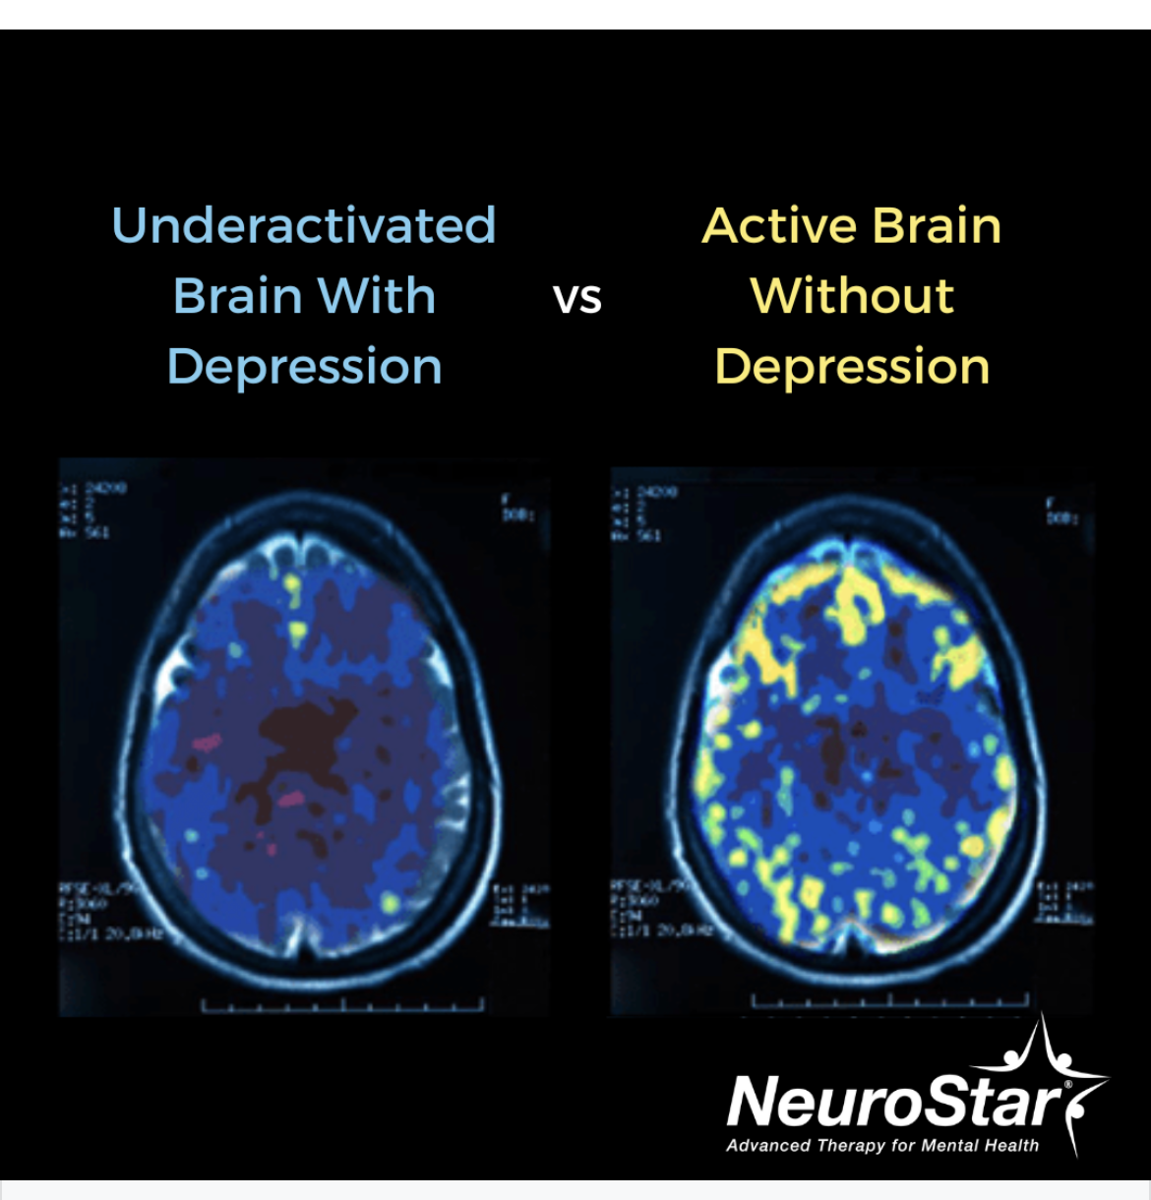

Changes in The brain
Through fMRI, we can “see” changes in the brain. Over time you can see that people with depression, have changes in their brain showing that this is a brain illness and you can't just snap out of it.

Slide 6


Stigma & Depression
Depression is
Depression is not
Genetic/Can run in families
Lasts 2 weeks or more
Gets in the way of our ability to live our everyday lives
A common and treatable medical illness
“The blues,” “being sad,” “stressed out,” or “upset”
A sign of personal weakness
Controlled through willpower
Caused by a bad day
Looking for attention

Slide 7
anxiety symptoms
Anxiety is excessive worrying that happens almost every day for 6+ months, and includes some of the following symptoms:
Feeling nervous/restless (you can’t sit still)
Not being able to control yourself
Being easily tired or worn out
Having tense or tight muscles
Having trouble relaxing
Difficulty concentrating or losing your thoughts
Being easy to annoy
Difficulty sleeping: trouble falling asleep or staying asleep
These symptoms get in the way of your daily functioning: doing your schoolwork, participating in chores or extracurricular activities, or get along with other people.

Slide 8
Be aware
Pay attention to unhealthy ways that some people cope with stressful situations, depression, and anxiety. The following behaviors can be dangerous:
Substance use =using alcohol, taking drugs or taking prescription drugs in a way that your doctor did not approve
Self-harm behaviors =intentionally causing physical pain to cope with negative emotions or relieve emotional numbness
Risk-taking behaviors could result in dangerous situations or serious injury,

Slide 9
Warning signs of suicide
Talking about suicide is a warning sign, in addition to:
Talking, writing, and drawing about death constantly
Giving away their things (ex-their favorite things/stuff at school)
Not spending time with friends and family and trying to be alone
Being more angry or showing aggressive behavior
Not taking care of their personal appearance
Running away from home
Engaging in risky behavior like dangerous activities
A change in personality (ex: very talkative and upbeat to quiet and alone)

Slide 10

Do NOT Hide Your Feelings
Hiding how you feel can lead to physical harm, substance abuse, and bad health. Instead of hiding your feelings, try talking to an adult. If you’re having a hard time, try asking your parent/guardian to schedule a time to see a professional that you can talk to.

Slide 11
People to go to for help:
Your Parent/Guardian
A family member
Your Teacher
Your School Counselor
Your Principal

Slide 12
Places to call for help include:
988 - Suicide and crisis lifeline (Provides 24/7 confidential support to people in suicidal crisis or mental health related to distress)
National Suicide Prevention Lifeline: 1-800-273-8255. Crisis intervention and free emotional support are available, which is helpful when you need confidential assistance during a time of emotional distress for you or a loved one.The helpline is open 24/7, and a live online chat is available as well.
911- last resort. In case of an emergency. If you are worried about them and you think someone might hurt themselves, and you don’t know what to do.

Slide 13
Peer-2-peer is always here
PEER-2-peer

Slide 14
Most of this Information was provided by:
The University of Michigan-Eisenberg Family Depression Center
Presented to you by Dubem Akabogu, Lily Cornett, Amelia Exume, Jonah Hoesel, Isaiah Hoffman, Dima Ismail, & Amaya Ly

Slide 15
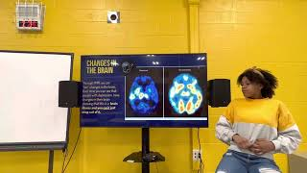
Peer
to
Peer
is Always Here

Slide 16

After Class…

Slide 17
Depression symptoms
Depression is feeling very down or not wanting to do much for 2 weeks or more, and includes some of the following symptoms:
Eating less or eating a lot more than usual
Sleep problems/trouble falling/staying asleep or sleeping too much
Feeling tired or having little energy
Feeling easily annoyed or upset
Difficulty concentrating on things like schoolwork or watching a show
Trouble making decisions
Feeling very sad and crying easily
Thoughts of suicide
These symptoms get in the way of your daily functioning: doing your schoolwork, participating in chores or extracurricular activities, or getting along with other people.

Slide 18
Changes in The brain
Through fMRI, we can “see” changes in the brain. Over time you can see that people with depression, have changes in their brain showing that this is a brain illness and you can't just snap out of it.

Slide 19
anxiety symptoms
Anxiety is excessive worrying that happens almost every day for 6+ months, and includes some of the following symptoms:
Feeling nervous/restless (you can’t sit still)
Not being able to control yourself
Being easily tired or worn out
Having tense or tight muscles
Having trouble relaxing
Difficulty concentrating or losing your thoughts
Being easy to annoy
Difficulty sleeping: trouble falling asleep or staying asleep
These symptoms get in the way of your daily functioning: doing your schoolwork, participating in chores or extracurricular activities, or get along with other people.

Slide 20
People to go to for help:
Your Parent/Guardian
A family member
Your Teacher
Your School Counselor
Your Principal

Slide 21
Places to call for help include:
988 - Suicide and crisis lifeline (Provides 24/7 confidential support to people in suicidal crisis or mental health related to distress)
National Suicide Prevention Lifeline: 1-800-273-8255. Crisis intervention and free emotional support are available, which is helpful when you need confidential assistance during a time of emotional distress for you or a loved one.The helpline is open 24/7, and a live online chat is available as well.
911- last resort. In case of an emergency. If you are worried about them and you think someone might hurt themselves, and you don’t know what to do.

Slide 22
Are These Questions True or False?
True/False -Depression is something that you can get over
Notes:
False

Slide 23
False-You can’t just get over depression, it’s not the “blues”

Slide 24
Are These Questions True or False?
True/False -Depression is not treatable
Notes:
False

Slide 25
False- Professional help and/or medication can help with depression

Slide 26
Are These Questions True or False?
True/False - A symptom of anxiety is being nervous or restless
Notes:
True

Slide 27
True- Those are all symptoms of anxiety

Slide 28
Are These Questions True or False?
True/False - Some people turn to drug use as a way to cope with depression/anxiety

Slide 29
True- Sometimes people use unhealthy coping (Non-Prescription drugs and substance use are an example of this)

Slide 30
Are These Questions True or False?
True/False - If you have a friend who has symptoms of anxiety/depression you should act as their therapist

Slide 31
False- If your friend is feeling this way, you should suggest professional help. (Such as, a hotline or a trusted adult.)

Slide 32
Thank you!
Any questions?
Share any coping skills that you have used….

Slide 33
Sensory Stickers

