Slide 1
Depression Awareness Campaign Week
April 16th - 20th

Slide 2
Monday, April 16th, 2018
Daily News!!!!!!!!!
We, the members of the peer to peer depression and anxiety awareness representatives for Scarlett Middle School took part in a training program to help bring information back to the student body. Our goal this week will be about spreading awareness throughout our school. But first, you should probably learn a little more about it. Our program was developed to help raise awareness of depressive illnesses, reduce the stigma of depression and increase the likelihood of early detection and encouraging students to seek help if needed.
Students who are wearing Michigan “P2P” shirts, created this week's campaign and can be a resource if you have any questions, comments, or concerns.

Slide 3
Greeting
Greet 2 people in the room and make a positive statement about them.
Example: Good morning Kayla, you have the best smile!!

Slide 4
Tuesday 17th “I am” statements:
***During lunch you will write a positive “I am” statement in the Scarlett Middle School bubble letters! This will be posted as a reminder of all the positive attributes that each and everyone of you bring to the table.
6th grade: Scarlett
7th grade: Middle
8th grade: School
So be thinking, some examples are: I am a great basketball player, I am a brilliant mathematician, I am great at doing nails, I am loved by my family and friends

Slide 5
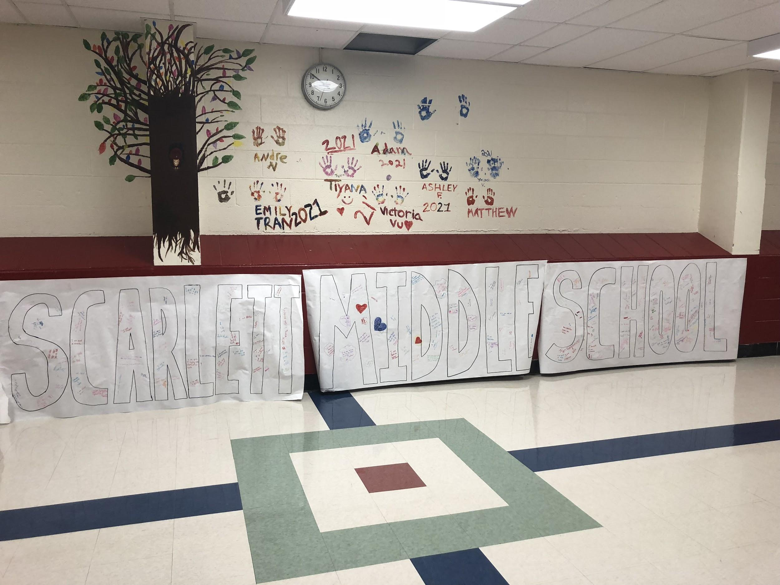
Positive “I am” posters

Slide 6
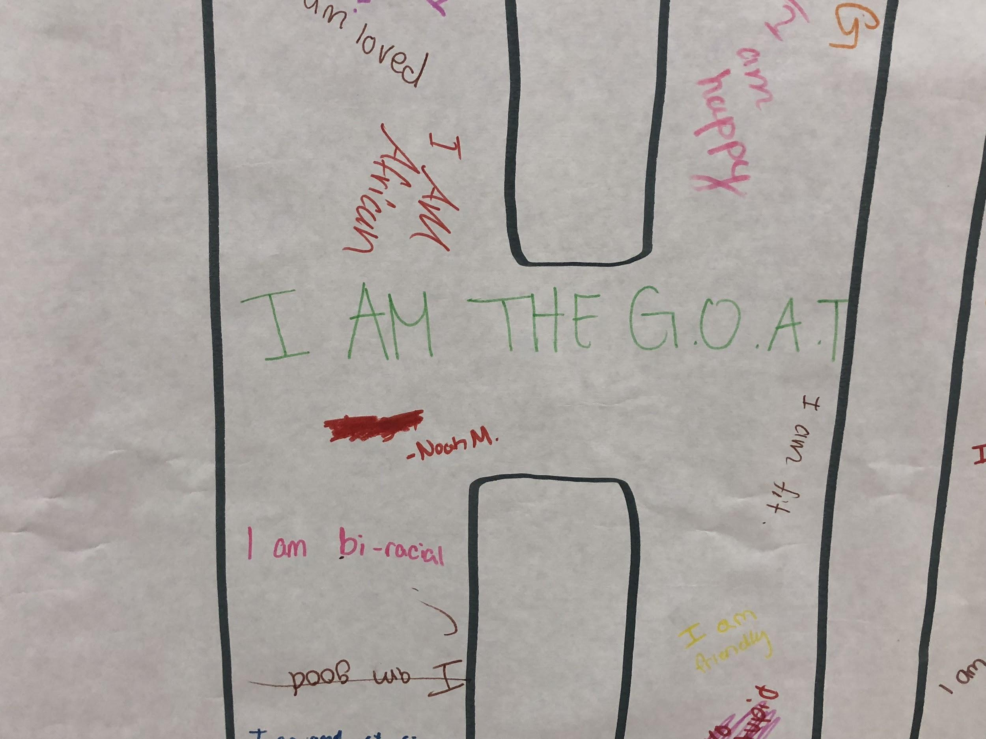
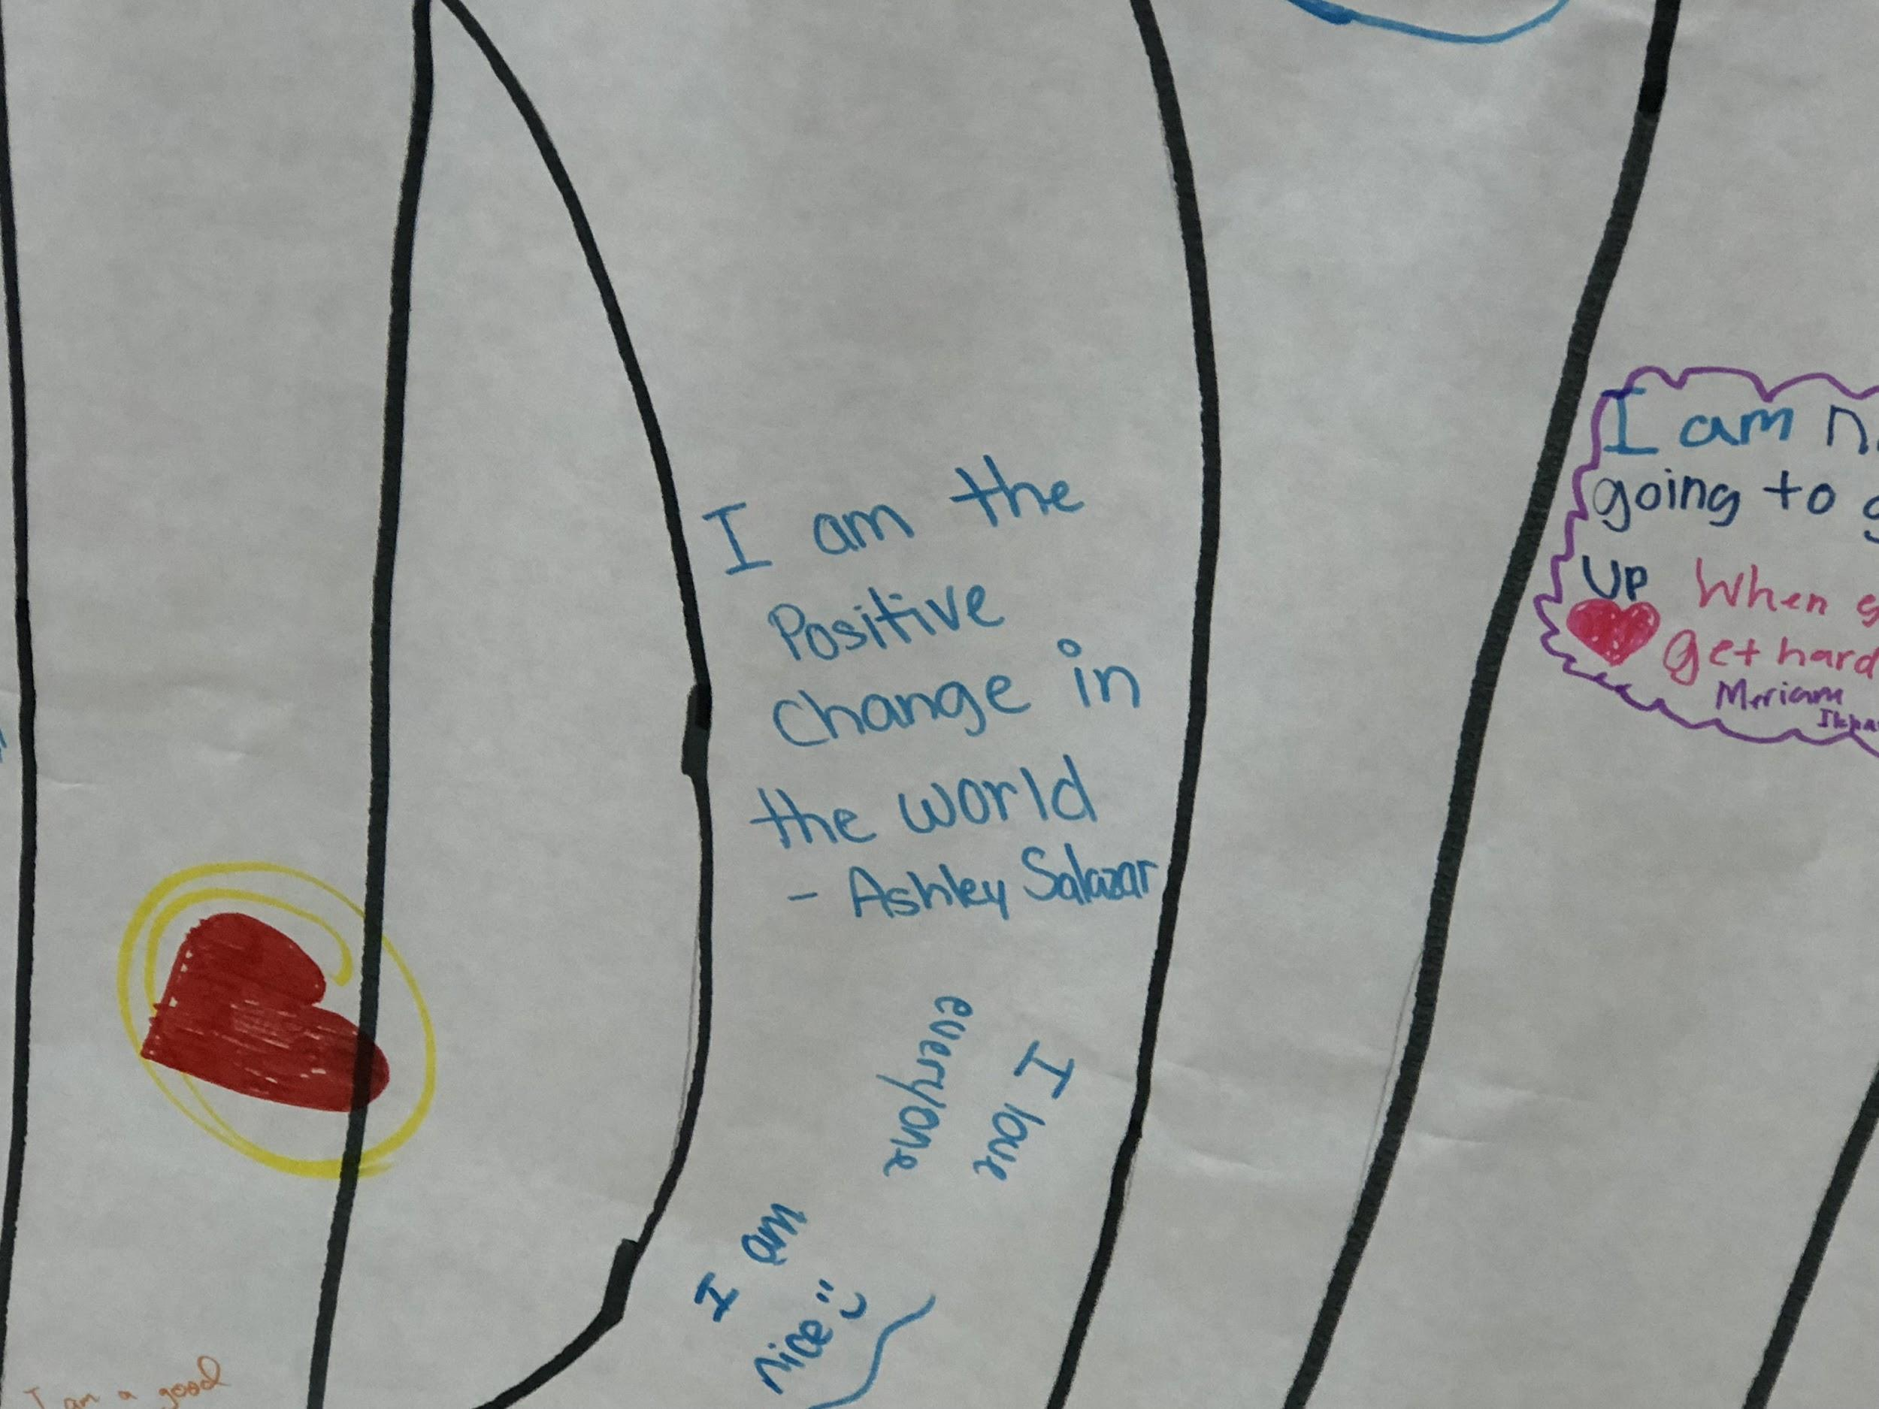
Individual “I am” statements

Slide 7
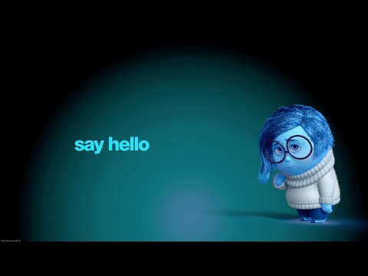
Wednesday 18th: Daily News
Depression is real and you can’t just “snap” out of it. Depression is a common but serious health condition- it is more than just feeling sad or “blue” for a few days.
If you have depression or anxiety disorder, professional help is available and effective. There is a lot of different ways to help you feel better. You don’t have to do it on your own. Asking for help is a sign of strength not weakness.
**Pass out the sheet with resources and go over it at the end of the lesson

Slide 8
Greeting/Sharing
Greet and discuss how you would help a friend who is upset.
How would you help and who are some people you could refer them to if they don’t seem to be getting better?

Slide 9
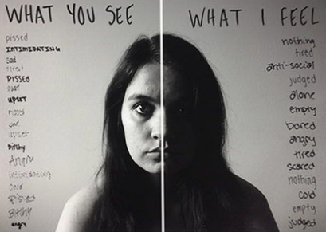
What is depression?
Most people feel sad or depressed at times. It’s a normal reaction to loss or life's struggles. But when intense sadness -- including feeling helpless, hopeless, and worthless -- lasts for many days to weeks and keeps you from living your life, it may be something more than sadness. You could have clinical depression -- a treatable medical condition.

Slide 10
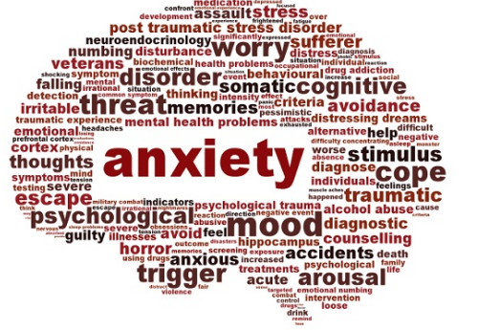
What is Anxiety?
Everyone feels anxious now and then. It’s a normal emotion. For example, you may feel nervous when faced with a problem, before taking a test, or before making an important decision. Anxiety disorders are different, though. They are a group of mental illnesses, and the distress they cause can keep you from carrying on with your life normally. For people who have one, worry and fear are constant and overwhelming, and can be disabling. But with treatment, many people can manage those feelings and get back to a fulfilling life.

Slide 11
Types of Disorders
Anxiety disorder is an umbrella term that includes different conditions:
Panic disorder. You feel terror that strikes at random. During a panic attack, you may also sweat, have chest pain, and feel palpitations (unusually strong or irregular heartbeats). Sometimes you may feel like you’re choking or having a heart attack.
Social anxiety disorder. Also called social phobia, this is when you feel overwhelming worry and self-consciousness about everyday social situations. You fixate about others judging you or on being embarrassed or ridiculed.
Specific phobias. You feel intense fear of a specific object or situation, such as heights or flying. The fear goes beyond what’s appropriate and may cause you to avoid ordinary situations.
Generalized anxiety disorder. You feel excessive, unrealistic worry and tension with little or no reason.

Slide 12
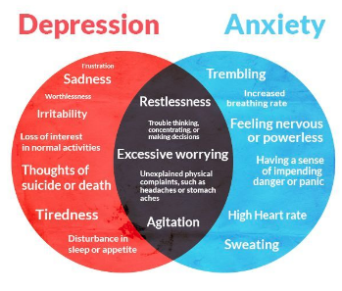

Slide 13
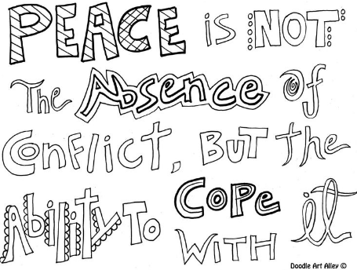

Thursday 19th
Daily News:
Box breathing is a technique used in taking slow, deep breaths. This technique can be beneficial to anyone, especially those who want to meditate or reduce stress.
Along with box breathing, research has found that coloring is now being used as a form of therapy to help reduce and/or relieve feelings of stress or anxiety.
Today you will have the opportunity to practice both techniques.
“Boxed Breathing”

Slide 14
Greeting/Sharing
Greet the person next to you and explain one way that you use to stay calm in a stressful situation.
Ask 2-3 people to share aloud

Slide 15
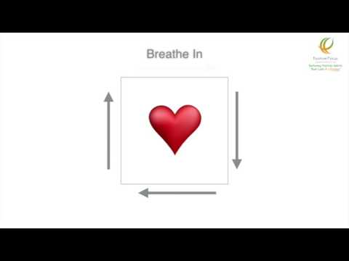
Activity
Show video that demonstrates the Box Breathing technique. After watching, have students practice this technique and discuss when they might use this.
If time, pass out a coloring sheet for each student. Let them know that there will be copies available in each classroom. If they are feeling stressed or anxious, they can help themselves to one of the copies.
P.S. Want to learn more? 6th grader Noah M. learned about this for his inquiry project: How does doodling help students learn?

Slide 16
Green Out/Black Out
Friday was a day for students to reflect on the weeks message. We covered the mirrors in the bathrooms, to send the message to the students that beauty comes from within.
We also encouraged students to wear green as that is the depression awareness color and we passed out green wristbands with the message “Breathe”, “You Got This”. This was to serve as a reminder that when they are stressed, just practice the box breathing technique from earlier in the week, and YOU GOT THIS!!!!

Slide 17
