Slide 1
Mill Creek P2P Team
Get Help, There Is Hope.

Slide 2
Members
Hannah Baldwin
Antonia Butka
Delaney Christy
Aaralyn Huhn
Ellie Manly
Laura Walton
Shelly Beach
Grace Byron
Audrey Hudson
Hayden Keeley
Niko Michos

Slide 3
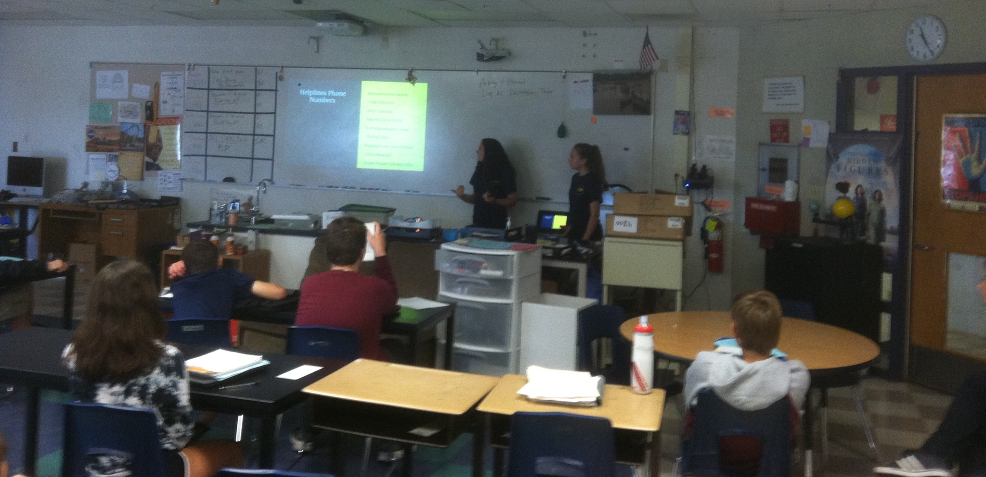
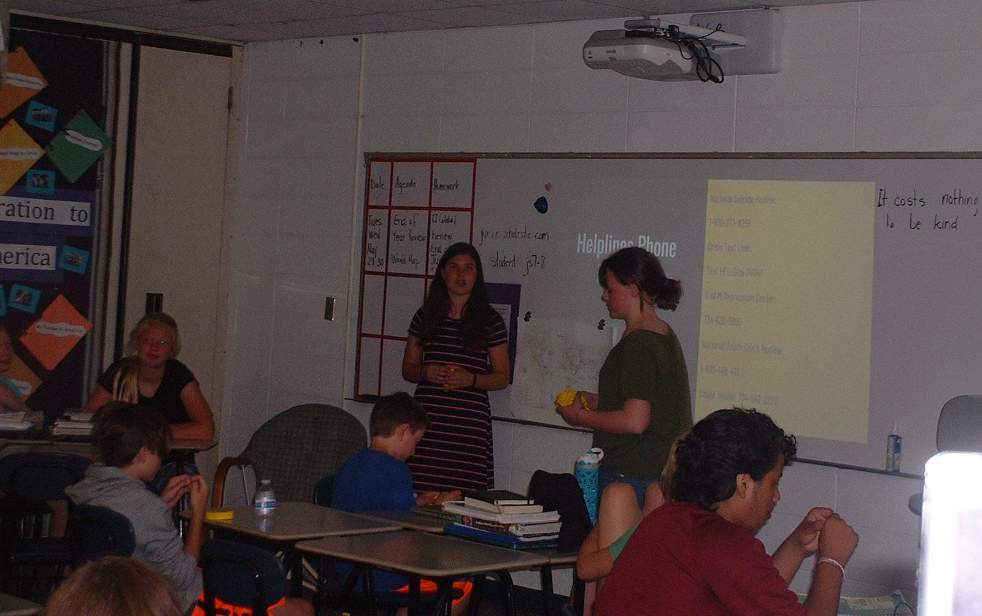
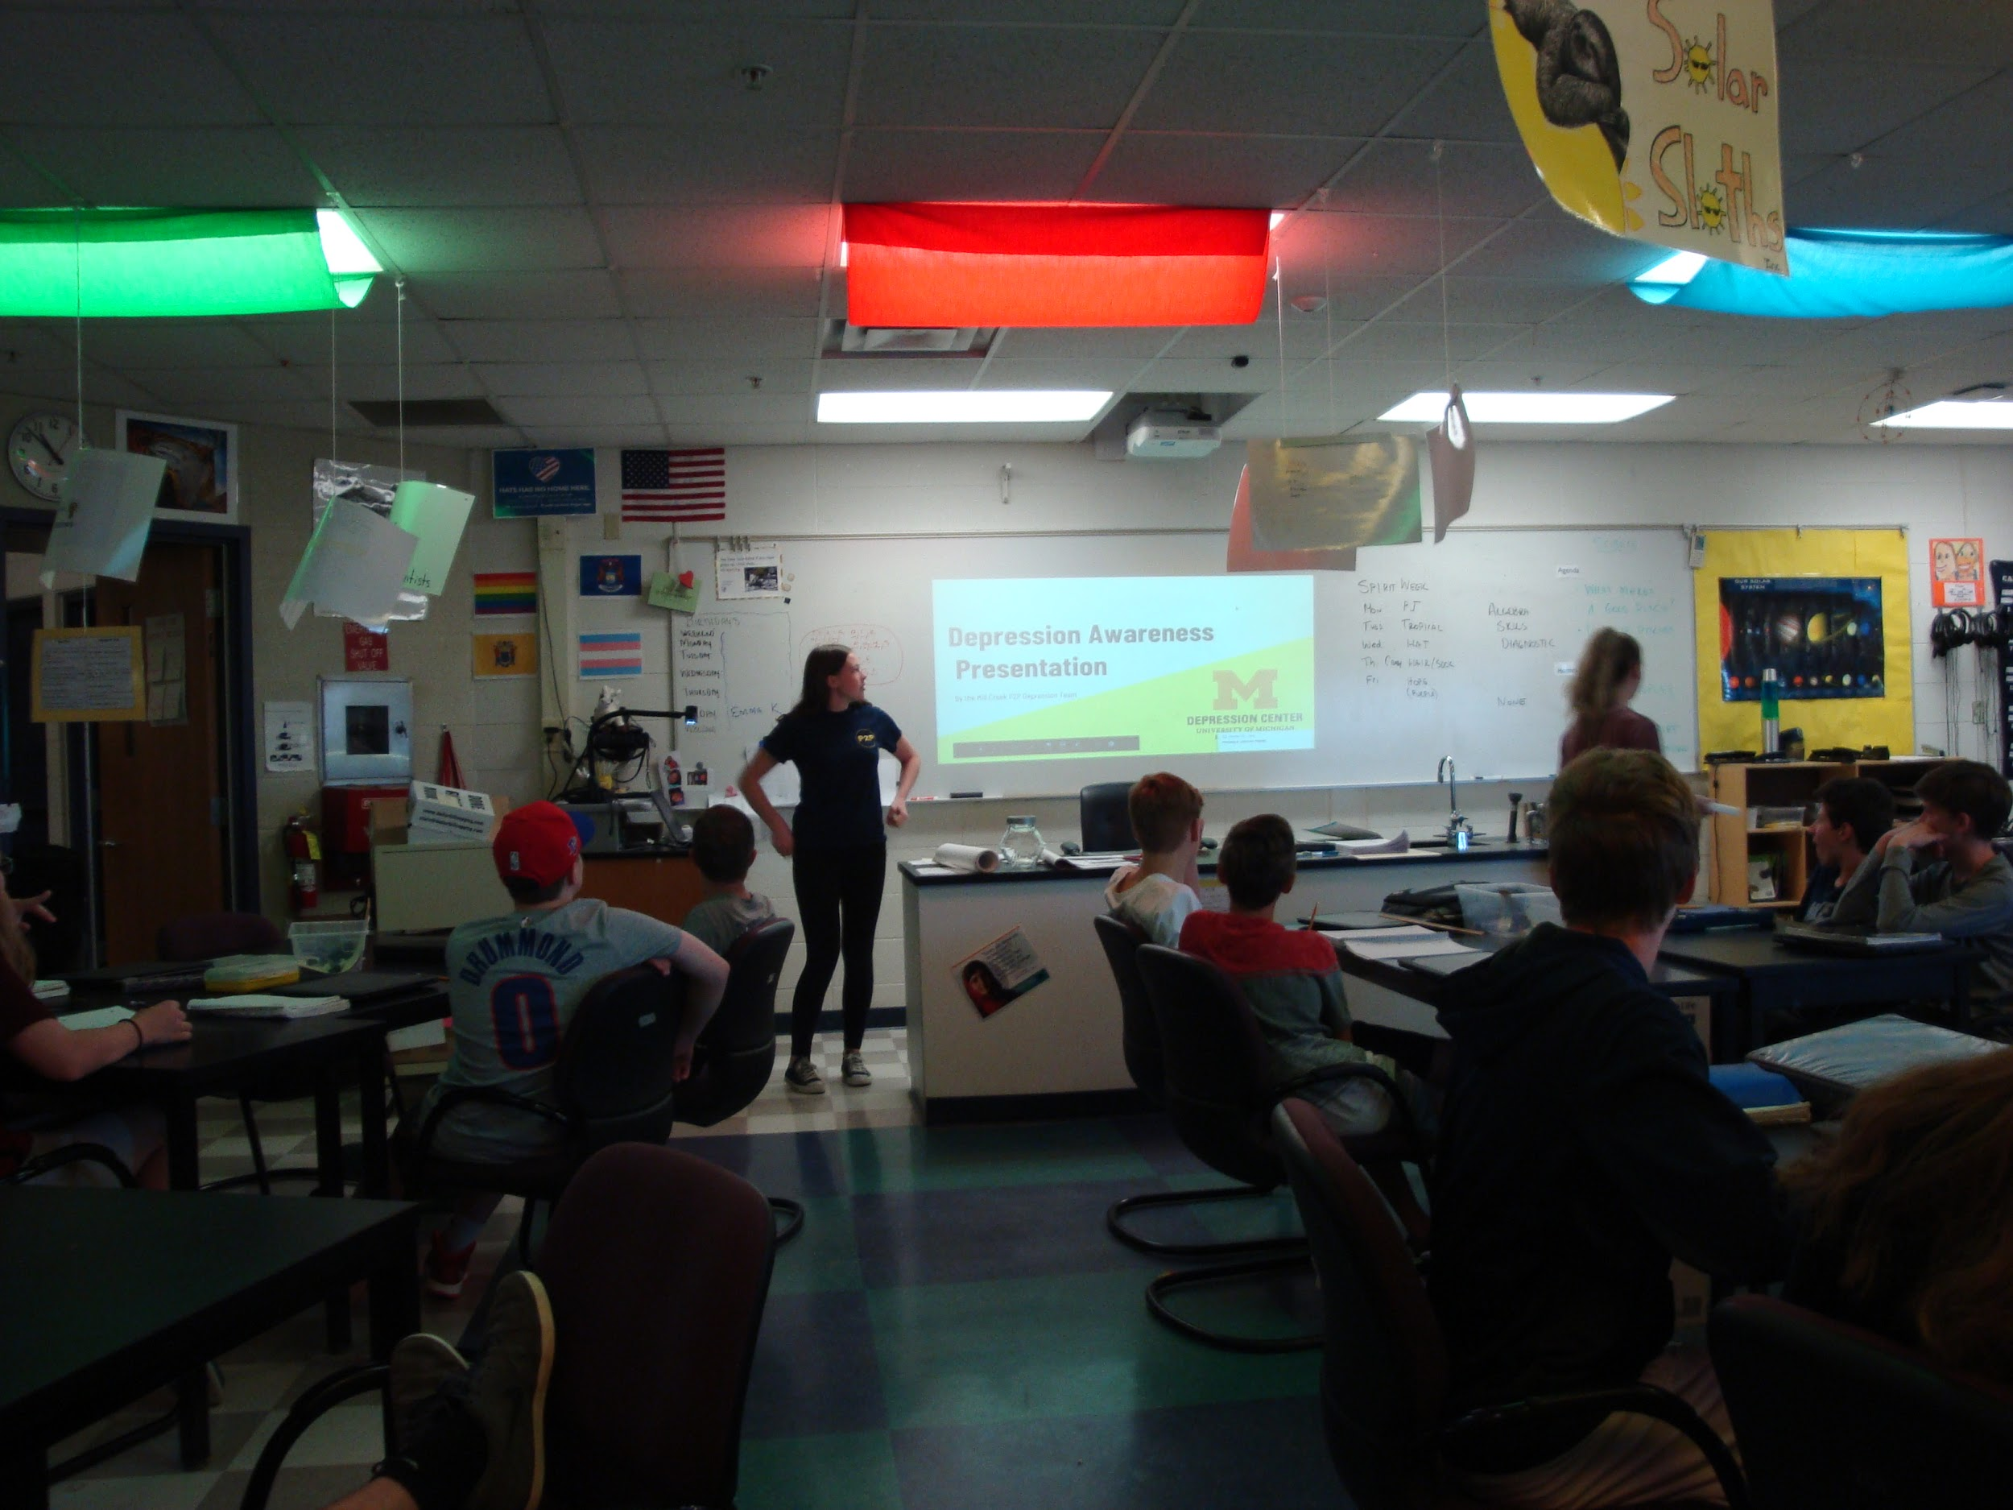
Presentation Pictures
Notes:
Do not Change

Slide 4
P2P Goals:
Give students a better understanding of depression through in-class presentations
Reduce stigma/ joking around depression
Encourage people to get help through presentations, keychains and posters

Slide 5

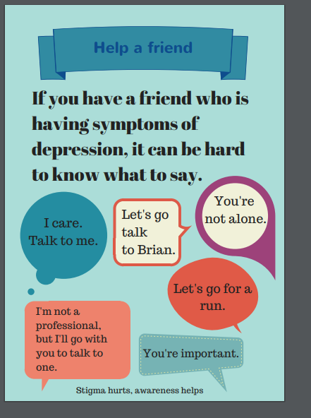

Slide 6
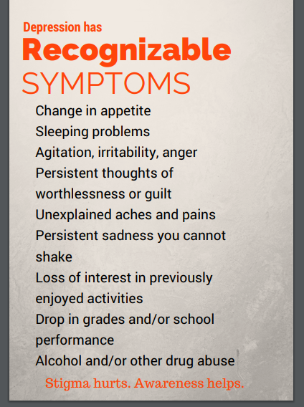


Slide 7
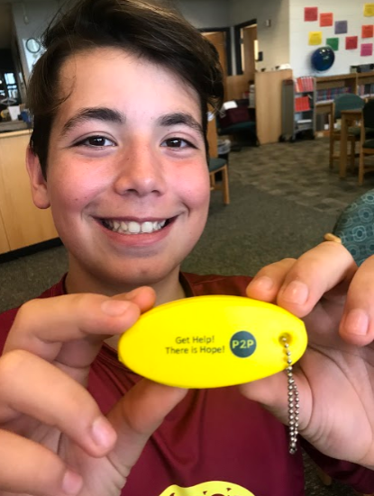
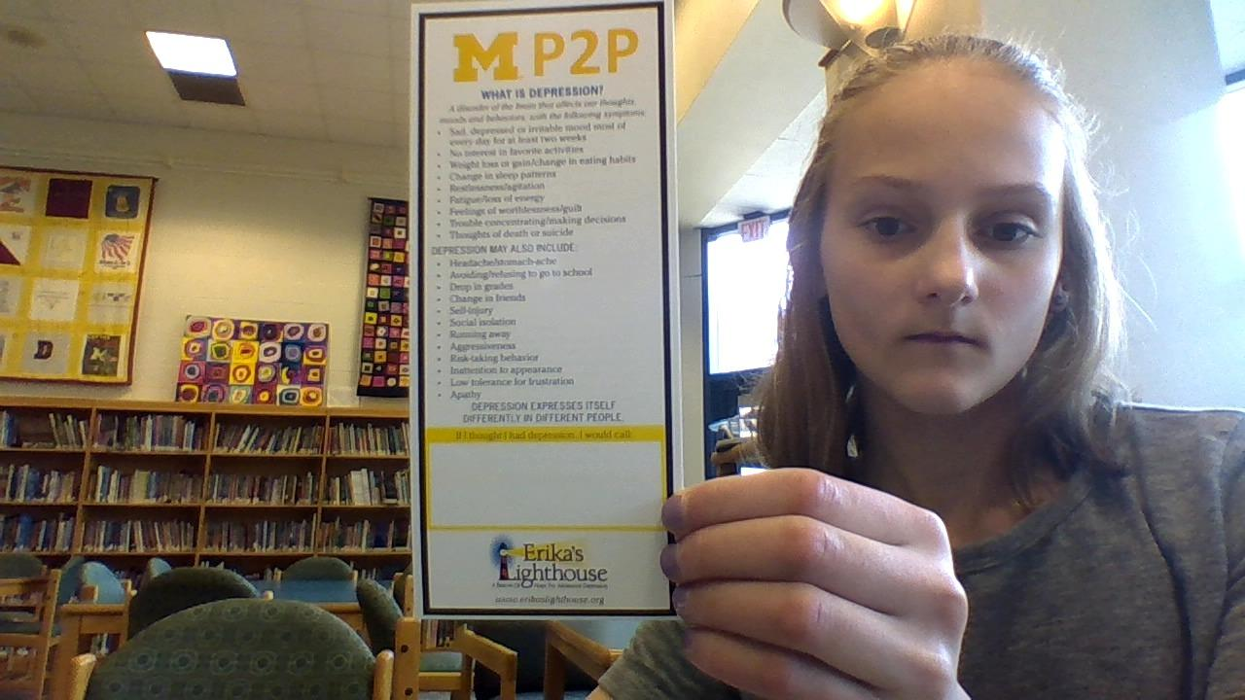
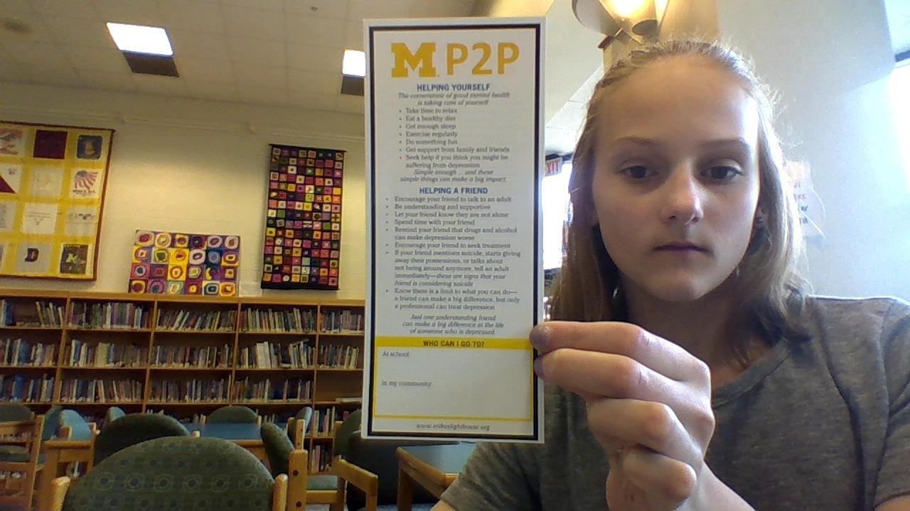
Keychains and Handouts
Stress ball keychains: Get Help! There is Hope!

Slide 8
In-Team Experience with Depression
Some members of Mill Creek’s P2P Team have direct experience with depression and, by including that into their presentations, greatly contributed to classroom conversations and education.

Slide 9
Impact
Many people left with a better understanding of depression and how to get help
Students definitely understood the importance of not joking about depression/ not creating stigma
  Changes could be seen directly after the presentation
  Keychains handed out reminded students to get help when they need it.
Notes:
This is where Delaney (or someone) will mention the thing when a student stopped another student from joking about depression after the presentation
Also where we can talk about other impacts seen

