Slide 1

Depression is real, so is help.
Peer to Peer Depression Awareness Campaign LMS
University of Michigan Depression Center
Lincoln Middle School
Peer to Peer
Ella, Allison, Cynthia, Andre, Lilith, Will, RAHS

Slide 2
Depression is real, so is help.
Peer to Peer Depression Awareness Campaign LMS
University of Michigan Depression Center
Announcement of the context for our P2P Campaign
Ella, Allison, Cynthia, Andre, Lilith, Will, RAHS

Slide 3
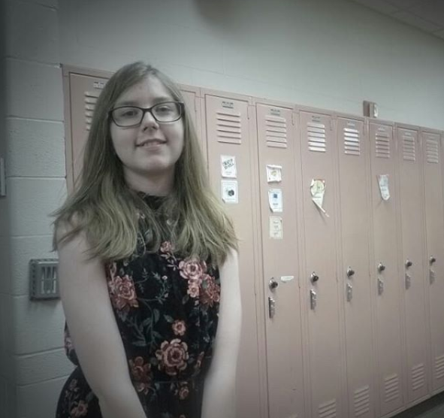
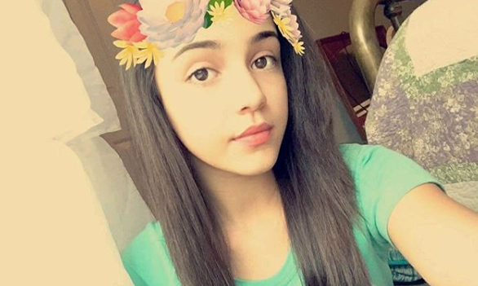
Depression is real, so is help.
Peer to Peer Depression Awareness Campaign LMS
University of Michigan Depression Center
Honoring recently deceased Lincoln Middle Schoolers: Kaylynn, Aubin, Taliah, Elizabeth
Elizabeth (Lizzy)
Kaylynn
Ella, Allison, Cynthia, Andre, Lilith, Will, RAHS

Slide 4

Depression is real, so is help.
Peer to Peer Depression Awareness Campaign LMS
University of Michigan Depression Center
If you think you have depression, please talk to someone. It will help!
734-714-9509 RAHS Clinic
Ella, Allison, Cynthia, Andre, Lilith, Will, RAHS

Slide 5
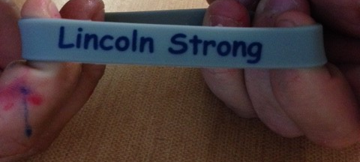
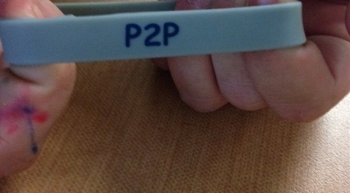

Slide 6


Myths Of Depression
Myth or Fact?
Peer to Peer Depression Awareness Campaign LMS
University of Michigan Depression Center
Ella, Allison, Cynthia, Andre, Lilith, Will, RAHS

Slide 7
Myths Of Depression
Myth or Fact of Depression:
Depression is your fault
Peer to Peer Depression Awareness Campaign LMS
University of Michigan Depression Center
Ella, Allison, Cynthia, Andre, Lilith, Will, RAHS

Slide 8
Myths Of Depression
Myth or Fact of Depression:
You should not talk to someone
Peer to Peer Depression Awareness Campaign LMS
University of Michigan Depression Center
Ella, Allison, Cynthia, Andre, Lilith, Will, RAHS

Slide 9
Myths Of Depression
Myth or Fact of Depression:
Depression is laziness
Peer to Peer Depression Awareness Campaign LMS
University of Michigan Depression Center
Ella, Allison, Cynthia, Andre, Lilith, Will, RAHS

Slide 10
Myths Of Depression
Myth or Fact of Depression:
People with depression often want help
and want to talk about their challenges but often don’t know where or how to start these conversations with a support person.
Peer to Peer Depression Awareness Campaign LMS
University of Michigan Depression Center
Ella, Allison, Cynthia, Andre, Lilith, Will, RAHS

Slide 11
Myths Of Depression
If you don’t get help you'll be fine
Peer to Peer Depression Awareness Campaign LMS
University of Michigan Depression Center
Ella, Allison, Cynthia, Andre, Lilith, Will, RAHS

Slide 12
Myths Of Depression
Depression is your fault
You should not talk to someone
Depression is laziness
You should hold it in
People with depression never look happy
People with depression never want help
If you don’t get help you'll be fine
Ask your RAHS Clinic or Counseling Office for support.
Peer to Peer Depression Awareness Campaign LMS
University of Michigan Depression Center
Ella, Allison, Cynthia, Andre, Lilith, Will, RAHS

Slide 13
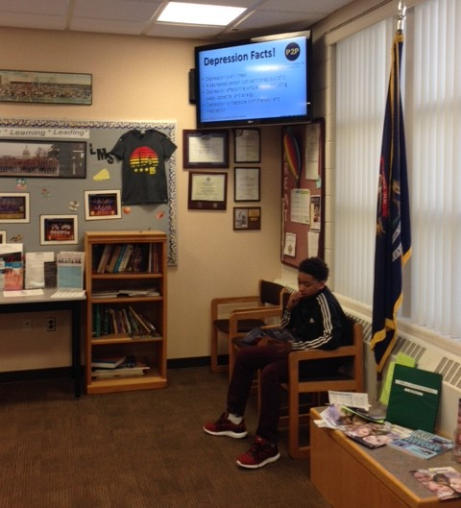

Slide 14
Depression Facts!!!!
Peer to Peer Depression Awareness Campaign LMS
University of Michigan Depression Center
Depression is an illness
A depressed person just can’t snap out of it
Depression affects the whole body including sleep, appetite, and energy
Depression is treatable with therapy and medication
Ask your RAHS Clinic or Counseling Office for support.
Ella, Allison, Cynthia, Andre, Lilith, Will, RAHS

Slide 15
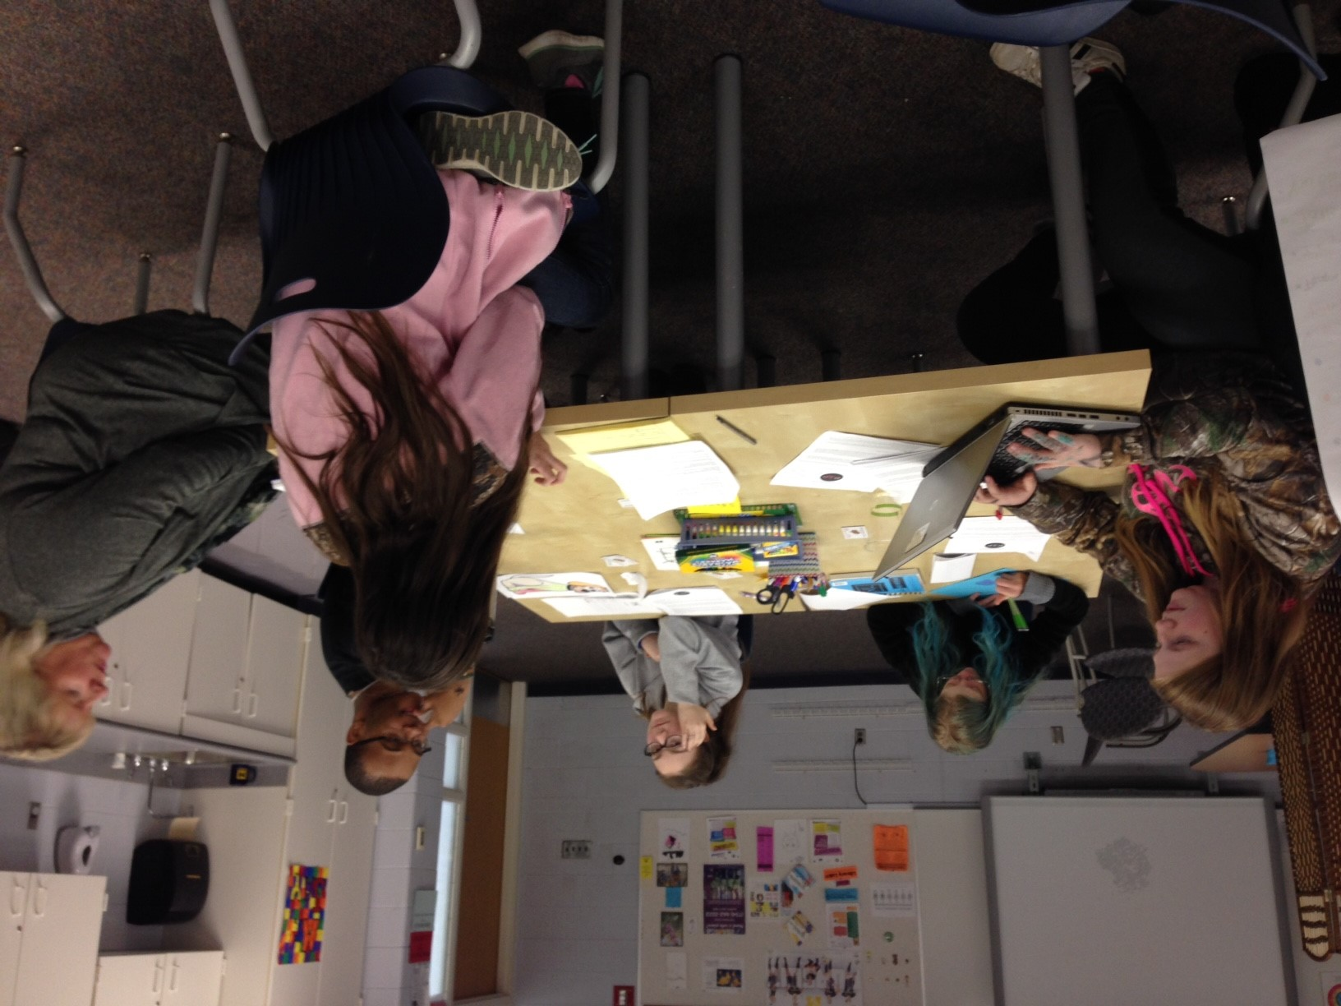

Slide 16
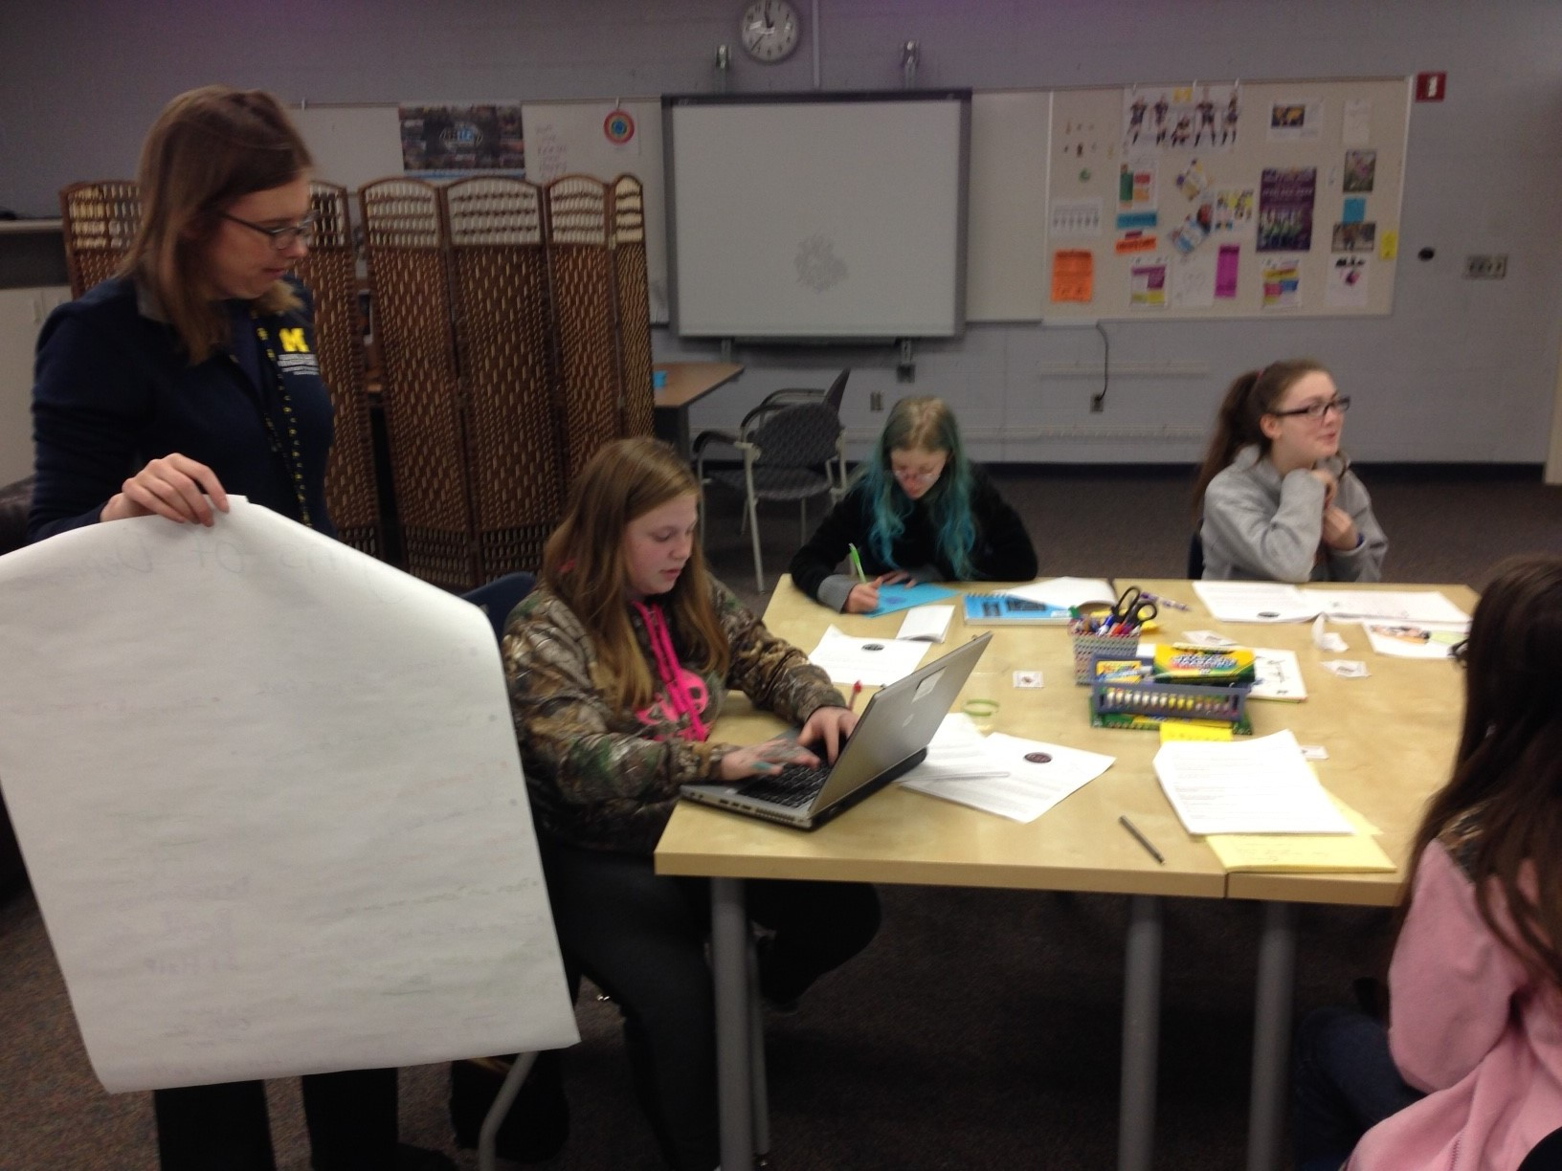

Slide 17
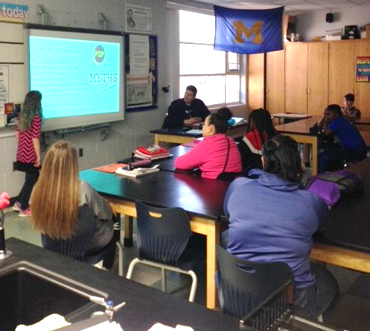

Slide 18
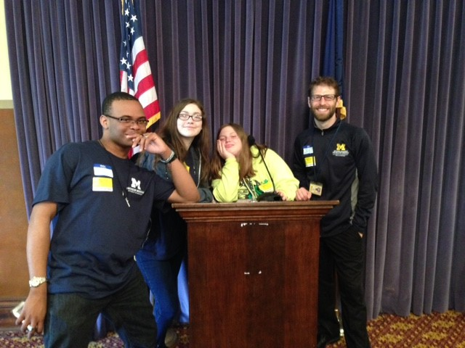

Slide 19
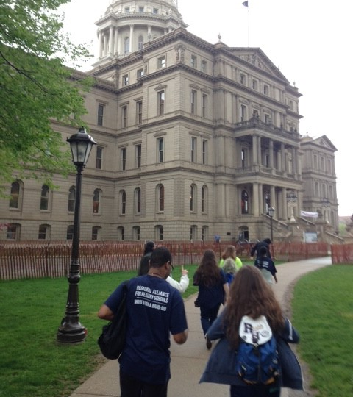

Slide 20
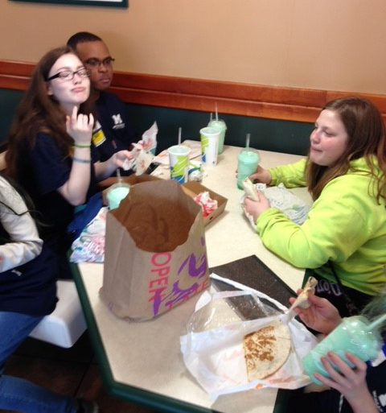

Slide 21
Thank you for your attention!

