Slide 1

P2P Mental health assembly
No One Should Be Left in the Dark

Slide 2
Why are we talking about mental health?
Notes:
Niloy - introduce
People suffering in silence
Can’t always see what’s going on with someone
SAD

Slide 3
According to the CDC (Center for Disease Control and Prevention):
42% of high school students felt so sad or hopeless almost every day for at least two weeks in a row that they stopped doing their usual activities
Nearly 1 in 3 high school students experienced poor mental health during the past 30 days
22% of high school students seriously considered attempting suicide during the past year
Notes:
Speaker = Maxine, Brooke, Avier

Slide 4
Teen Mental Health
School Resources:
Peer Counseling Lab -
Staffed every hour except 1st with Peers trained through the Peer Facilitating class and the UM Depression Center in Safe Talk, a suicide prevention model
School Counselors
Social Workers - Ms. Van Ee, Mr. Samaha, Ms. Floyd, Ms. Tooson
Community Resources:
Neutral Zone - (734) 214-9995
Ozone House & 24 hour crisis line - (734) 662-2222
National Suicide Prevention Lifeline - 988 (call or text)
Community Mental Health - (734) 544 3050
Corner Health Center - (734) 484-3600
Trevor Helpline (for LGBTQ Youth) - (866) 488-7386
Notes:
Ms Van Cleve
https://www.nccp.org/publication/adolescent-mental-health-in-the-united-states-facts-for-policymakers/#:~:text=Facts%20about%20Adolescent%20Mental%20Health,episode%20before%20they%20reach%20adulthood.

Slide 5
There’s no shame if you struggle with your mental health!
Sometimes we feel like we have to keep our struggles to ourselves.
This often isolates us from our loved ones and causes us to struggle in silence.
But don’t worry! The majority of students at Huron surveyed reported that they wouldn’t discriminate against their friends who struggle with mental health.
Don’t be afraid to reach out and lean on your community!
Check out this video on anti-stigma:
Break the Stigma video
Notes:
Speaker: Sofia

Slide 6
No One Should Be Left in the Dark video
We asked students and staff "what do you want Huron students to know about mental health?"
Follow us on Tik-Tok!
Huronpeerlab
Notes:
Lauren

Slide 7
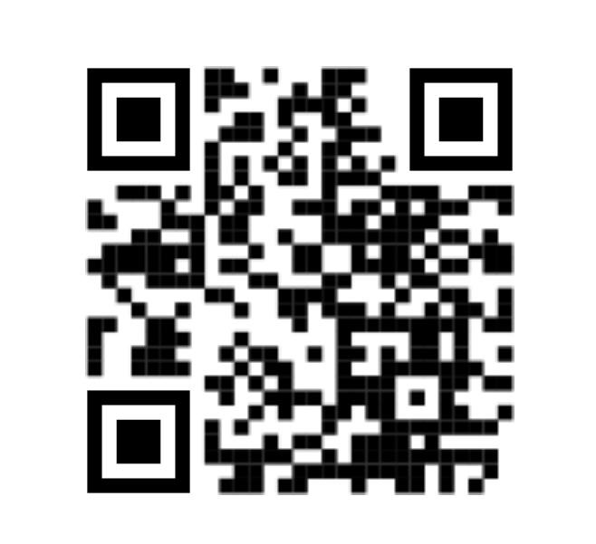
Andrea May (NAMI)
National Alliance on Mental Illness
NAMI Homepage
Notes:
Eliza introduces

Slide 8
Makenna Spieles
Huron Alum (2018)
Social Worker
Notes:
Jake introduces

Slide 9

How do you support your friends or classmates?
Listen to them actively - don’t interrupt and show them you are listening.
Encourage them to seek help
Do not add to their stress or drama
Know that you alone cannot make their depression or anxiety go away.
If you are concerned for their safety, tell an adult right away!
14% of Huron students surveyed said they would keep their friends suicidal thoughts a secret!
Turn on a “light” for your fellow River Rats!
Help them get the support they need.
Notes:
Dora Alicia

Slide 10
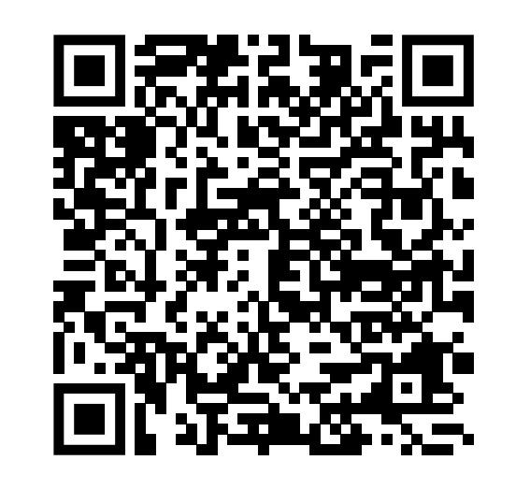
Mental Health Assembly Survey 2023

