Slide 1

ABN: 46135764876 ACNC
CRM: 001260561986
Schoolsforfuture@outlook.com
https://schoolsforfuture.wixsite.com/schoolsforfuture

Slide 2





SCHOOLS FOR FUTURE
https//schoolsforfuture.wixsite.com/schoolsforfuture
Accessibility to schooling for all
Inclusive & equitable quality education
Lifelong opportunity for all

Slide 3
Celebrating
Family Foundation
Mother’s Love & Nurture
1st May 2026

Slide 4
Family
“Family is the foundation of personal virtue and social order.” Confucius

Slide 5
Motherhood
Inherited with compassion and love, mother nurtures children with wisdom and courage. She is the world to her children even if the world sees her as a women.
Tuong Phan

Slide 6
SFF MAY 2026 EVENT
Makes tribute to motherhood in honour of resilient mothers, who have offered more than a century of love and care to their children, family and community

Slide 7
Mothers With a Century of Longevity by 2026
Mrs Mai Thi Nhanh, 106 yrs old
Mrs Loc Thi Nguyen, 104 yrs old
Mrs Nhan thi Nguyen, 103 yrs old
Mrs Beatriz Robles 103 yrs old
Mrs Dao Thi Tran, 102 yrs old
Mrs Dorothy Miller. 102 yrs old
Mrs Anh Diec, 100 yrs old
Mrs Van Thi Ngo, 100 yrs old
Mrs Rosa Patron, 100 yrs old
Mrs Thoi Thi Lam, 100 yrs old
Mrs Beatriz de Rivera 100 yrs old

Slide 8
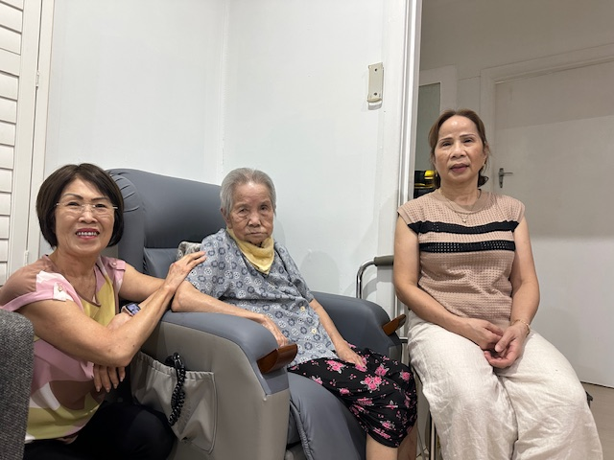
Mrs Mai Thi Nhanh 106 yrs
DOB: 01 January 1920
Origin: Vietnamese
35 years in Australia
Add: Fairfield NSW
Living with Son’s family
Carers: Daughters, Sons and extended family

Slide 9
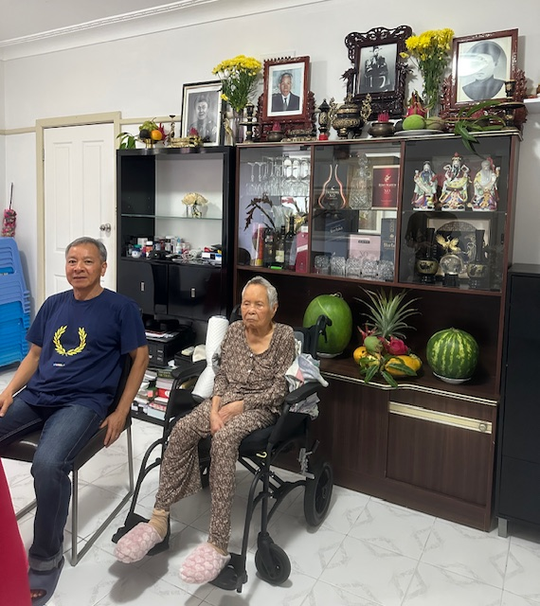
Mrs Loc Thi Nguyen104 yrs
DOB: 17 January 1922
Origin: Vietnamese
35 years in Australia
Add: Yagoona NSW
Living with Son’s family
Carers: Daughters, Sons and extended family

Slide 10
Mrs Nhien Thi Nguyen 103 yrs
DOB: 24 April 1923
Origin: Vietnamese
25 years in Australia
Add: Cabramatta NSW
Cared by: Arete Healthcare Lansdowne Aged Care, Cabramatta NSW
Carers: Sons

Slide 11
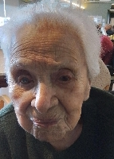
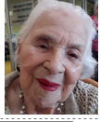
Mrs Beatriz Robles 103 yrs
DOB: 5 June 1922
Origin: Spanish
45 years in Australia
Cared by: Spanish Residential Gardens Rooty Hill NSW
Carers: Daughters, Sons and extended family

Slide 12
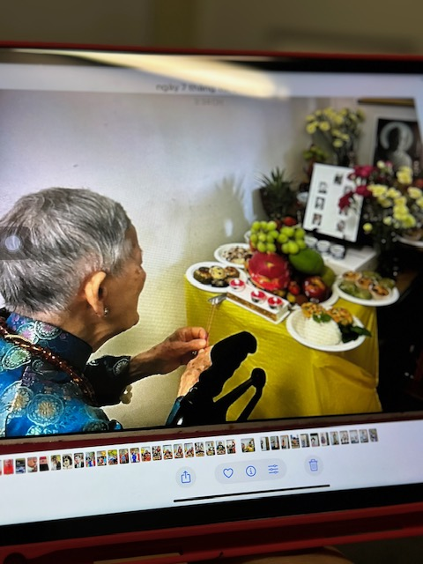
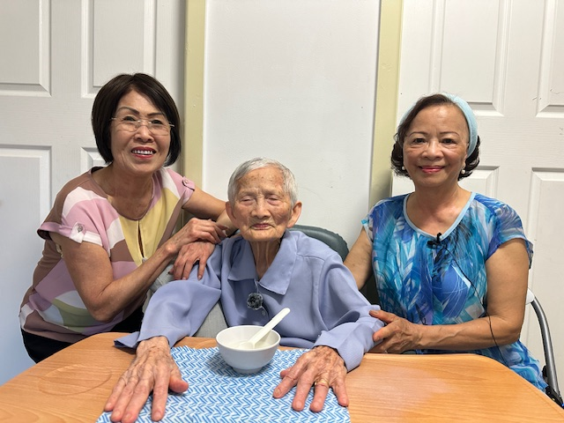
Mrs Dao Thi Tran 102 yrs
DOB: 24 Apri 1924
Origin: Vietnamese
35 years in Australia
Add: Fairfield NSW
Living with Daughter
Carers: Daughters, Sons and extended family

Slide 13
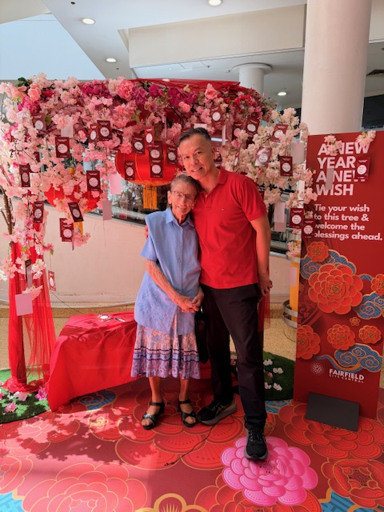
Mrs Dorothy Miller 102 yrs
DOB: 09 July 1924
Origin: Australia
50 years in Sydney
Add: Fairfield NSW
Living by herself
Carers: Sons, Daughters and extended family

Slide 14
Mrs Linh Tu Ly 100 yrs
DOB: 26 April 1925
Origin: Vietnamese
25 years in Australia
Add: Bankstown NSW
Cared by: Son’s Family NSW
Carers: Sons a Daughters and extended family

Slide 15
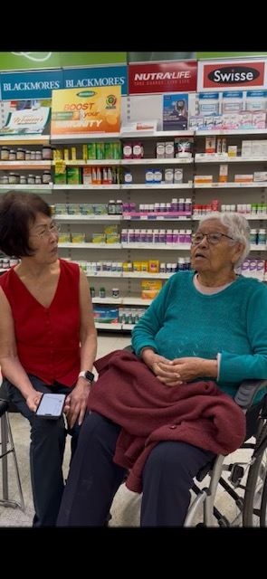
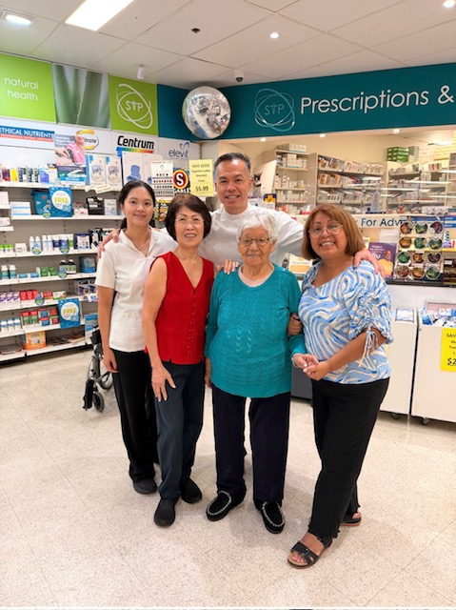
Mrs Beatriz de Rivera 100 yrs
DOB: 14 March 1926
Origin: Spanish
45 years in Australia
Home: Mt Pritchards NSW
Living by herself
Carers: Daughters, Sons and extended family

Slide 16
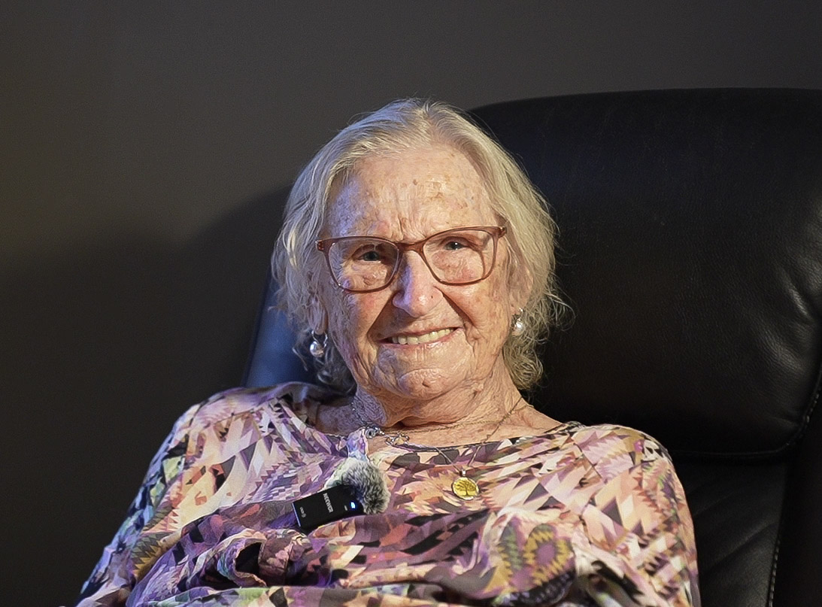
Mrs Rosa Patron 100 yrs
DOB: 25 June 1926
Origin: Spanish
45 years in Australia
Add: Aged Care, Chipping Norton, NSW
Carers: Sons and extended family

Slide 17
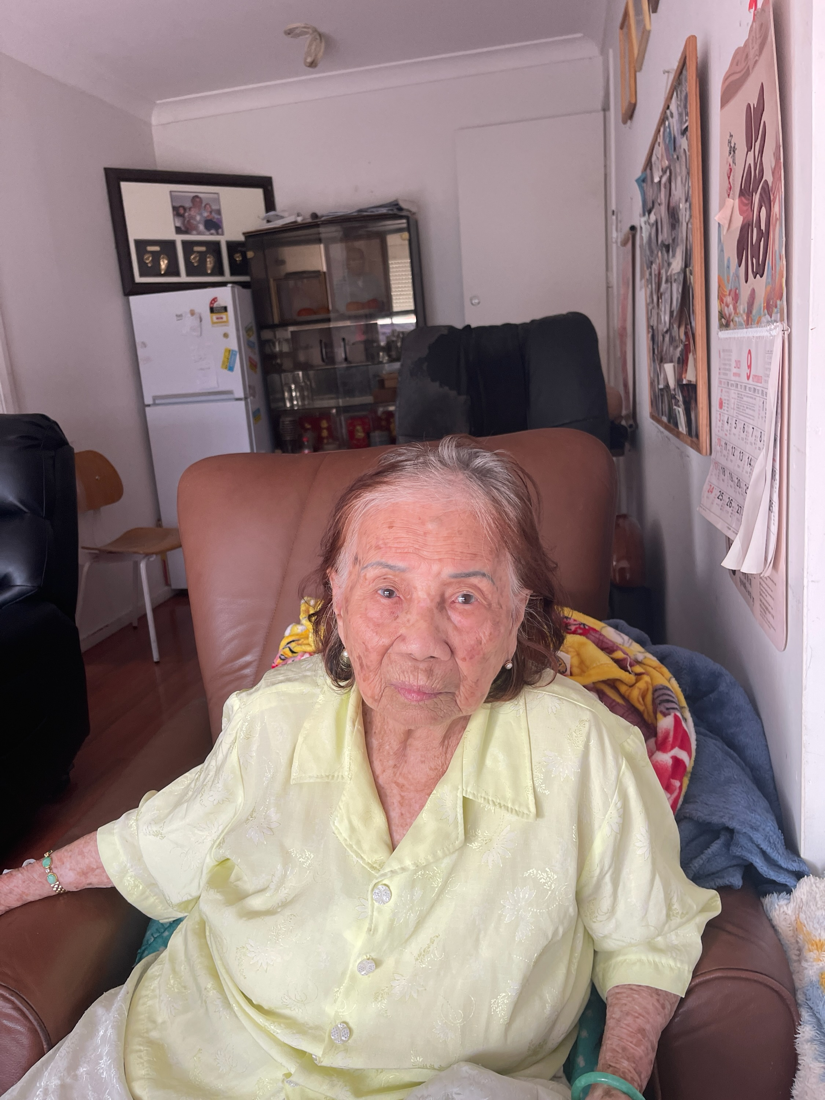
Mrs Lam Thi Thoi 100 yrs
DOB: 12 February 1926
Origin: Vietnamese
30 years in Sydney
Add: Edensor Park NSW
Living With Son’s Family
Carers: Sons, Daughters and extended family

Slide 18
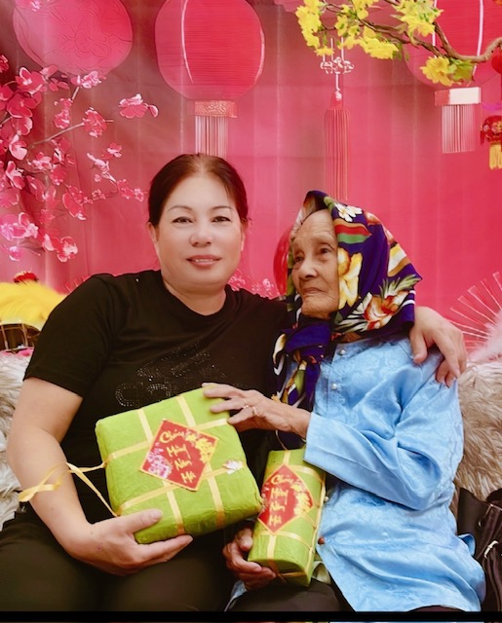
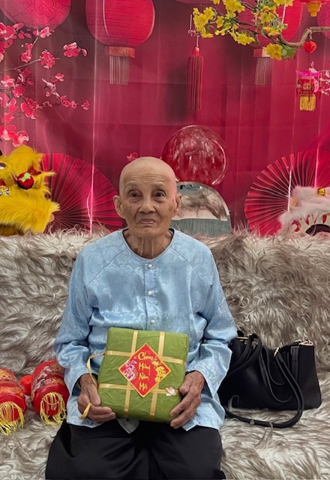
Mrs Van Thi Ngo 100 yrs
DOB: 01 January 1926
Origin: Vietnamese
25 years in Australia
Add: Canley Heights NSW
Living with Son’s family
Carers: Daughters, Sons and extended family

Slide 19
Living Values
learnt from these seniors
Education
Family love & harmony
Simple Living, Spend within means
Forgiveness
Hardworking

Slide 20
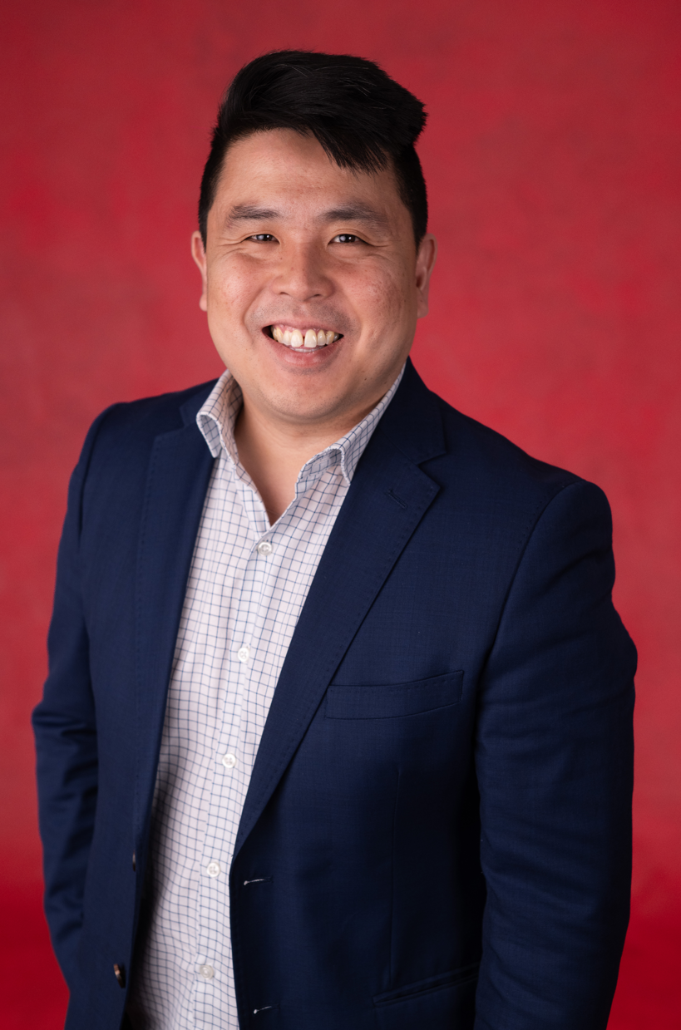
Keynote Speaker
Mr Zhi Soon
MP for Banks
Southwest Syd
Australia

Slide 21


Slide 22


Slide 23


Slide 24


Wishing You Happiness & Contentment
From all of us: SFF members, collaborators and children in need

