Slide 1
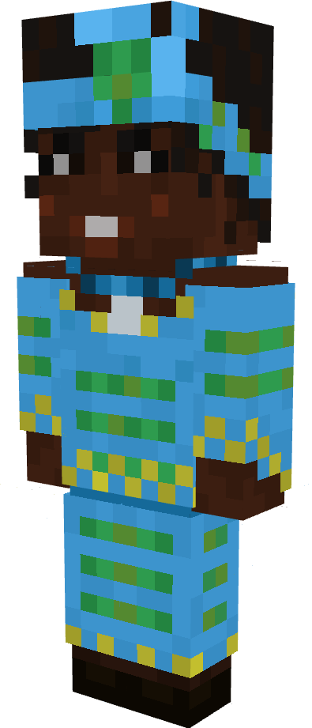
Wangari Maathai
University professor, environmental activist and Nobel Peace Prize laureate

Slide 3
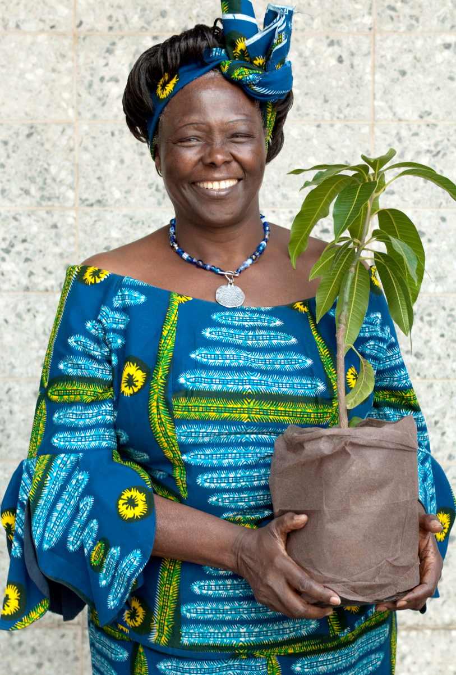
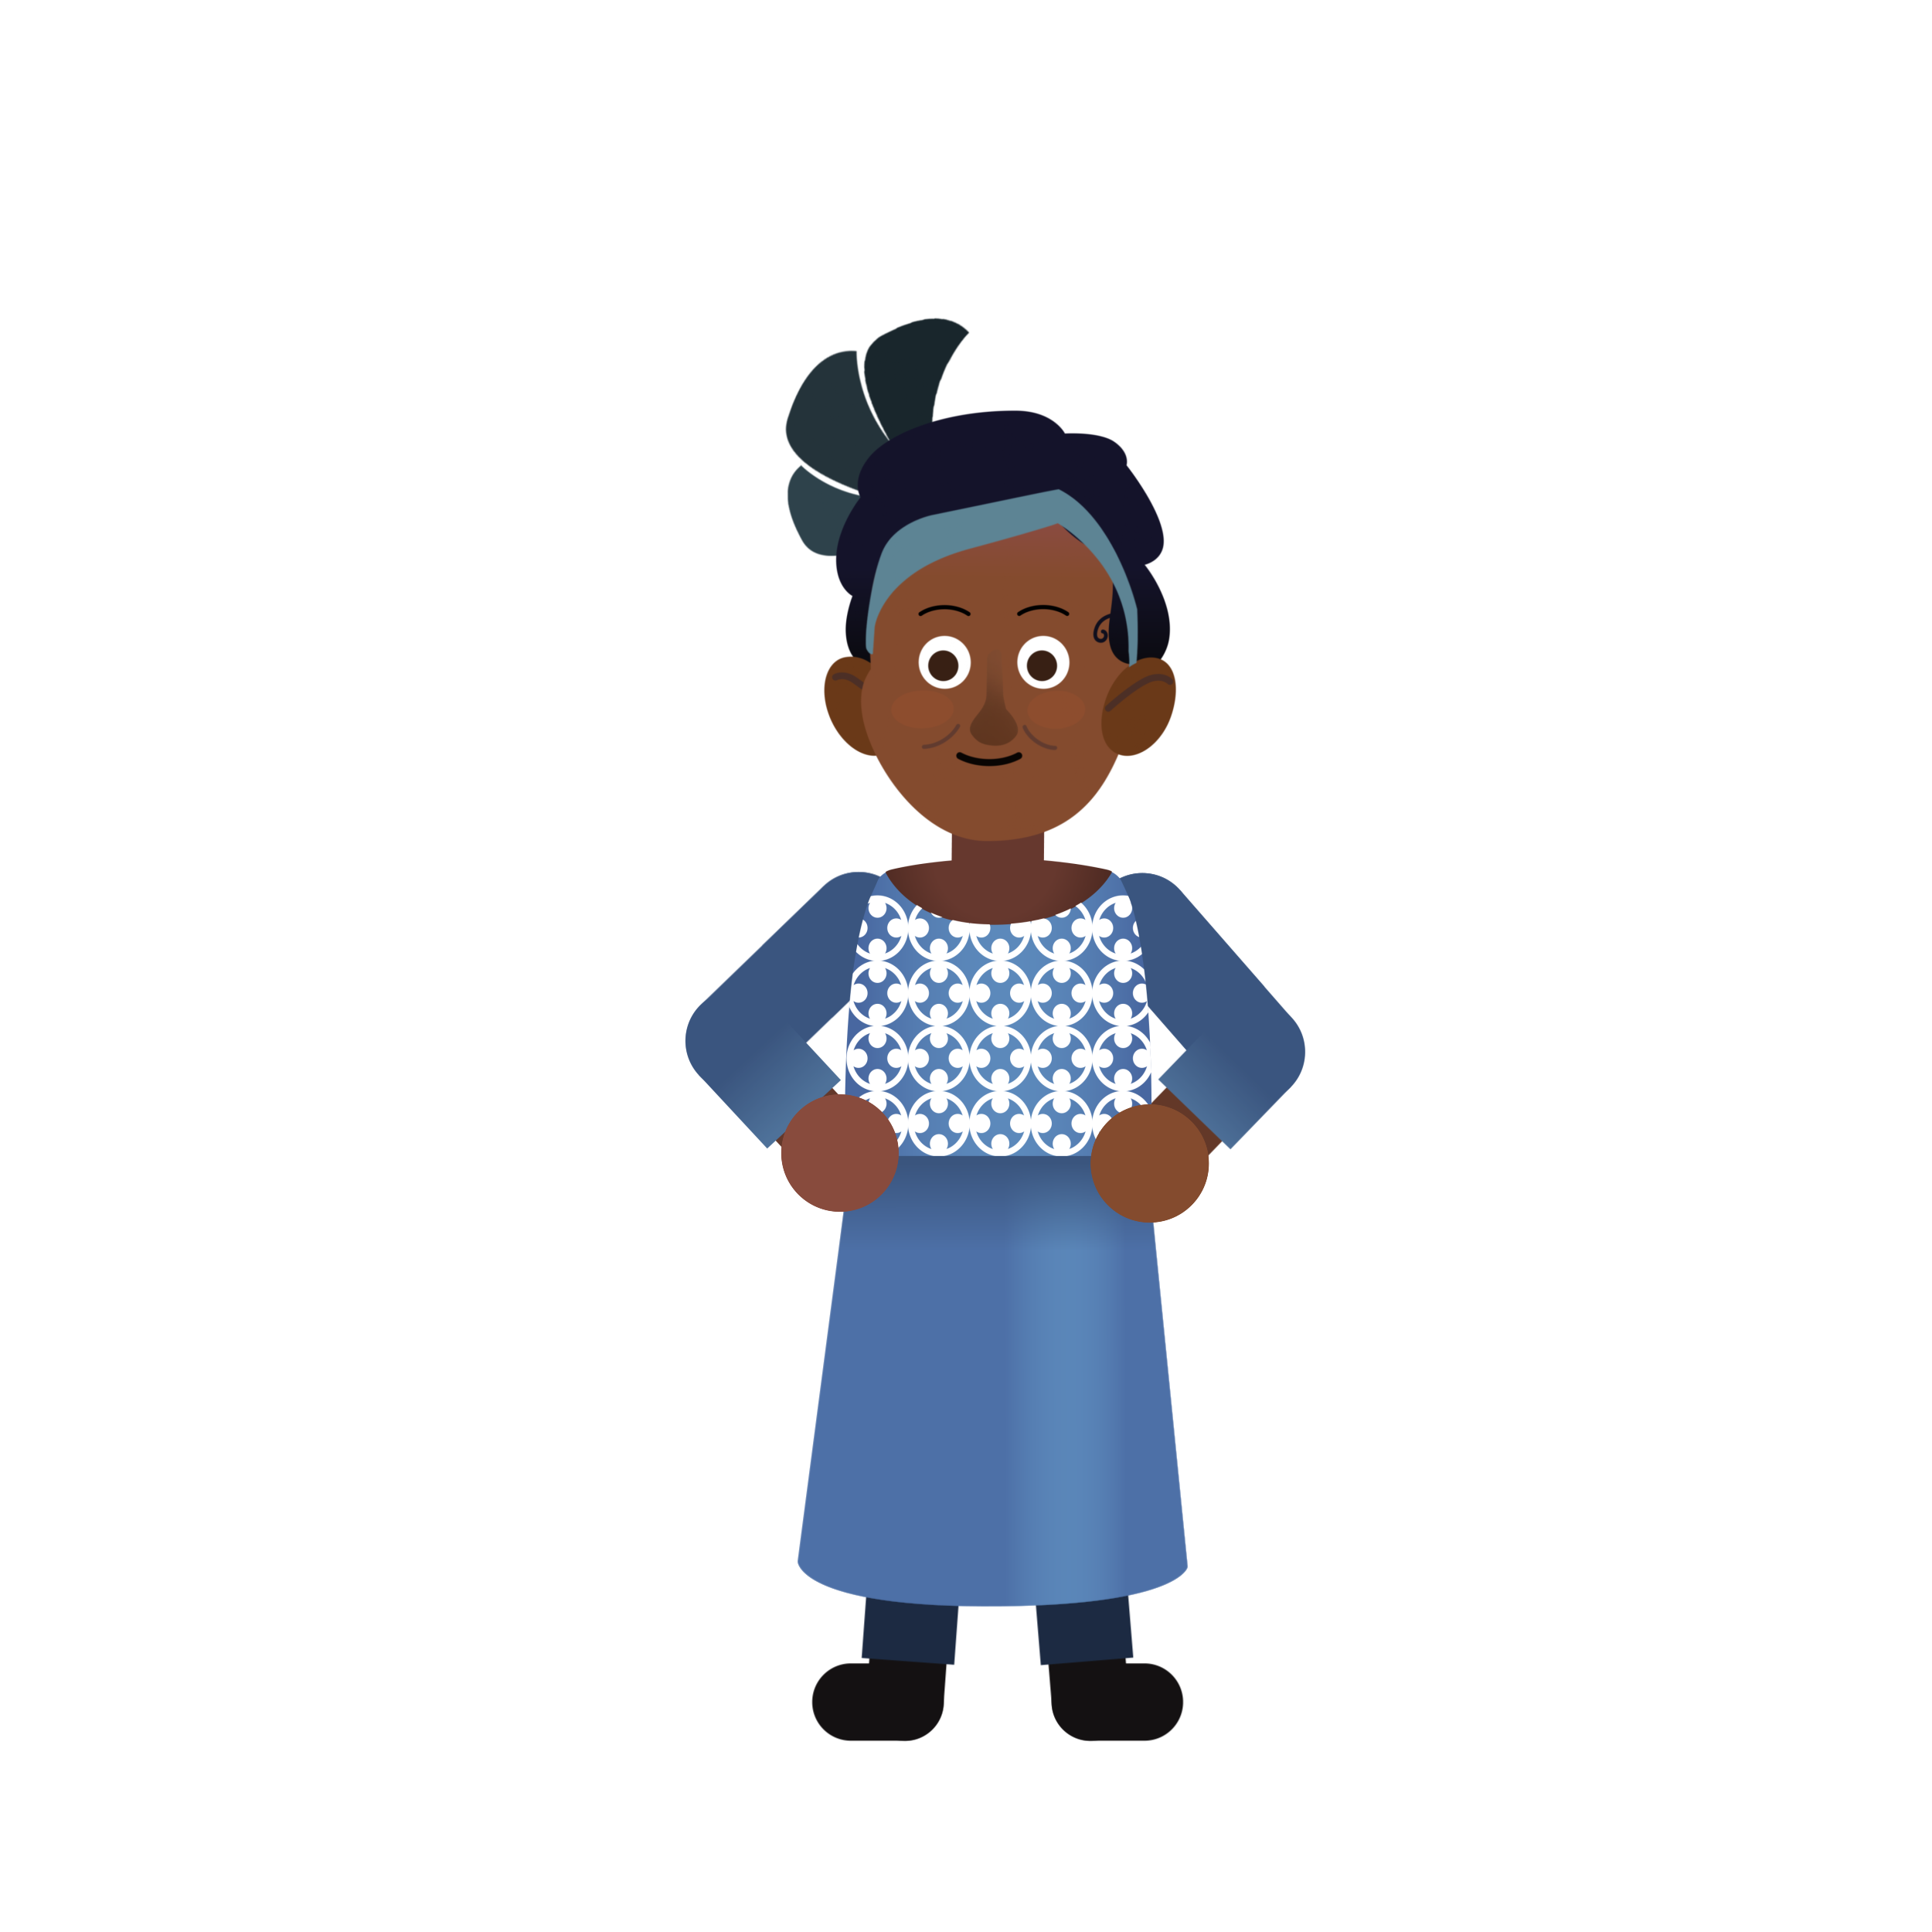
First Impressions
What did you think of Wangari Maathai?
Was there anything you didn’t understand?
Do you have any questions?
Notes:
Take a few minutes to ask students for feedback, comments, impressions and questions.

Slide 4
FIRST IMPRESSIONS
What did you think of Wangari Maathai?
Was there anything you didn’t understand?
Do you have any questions?
Notes:
Take a few minutes to ask students for feedback, comments, impressions and questions.

Slide 5
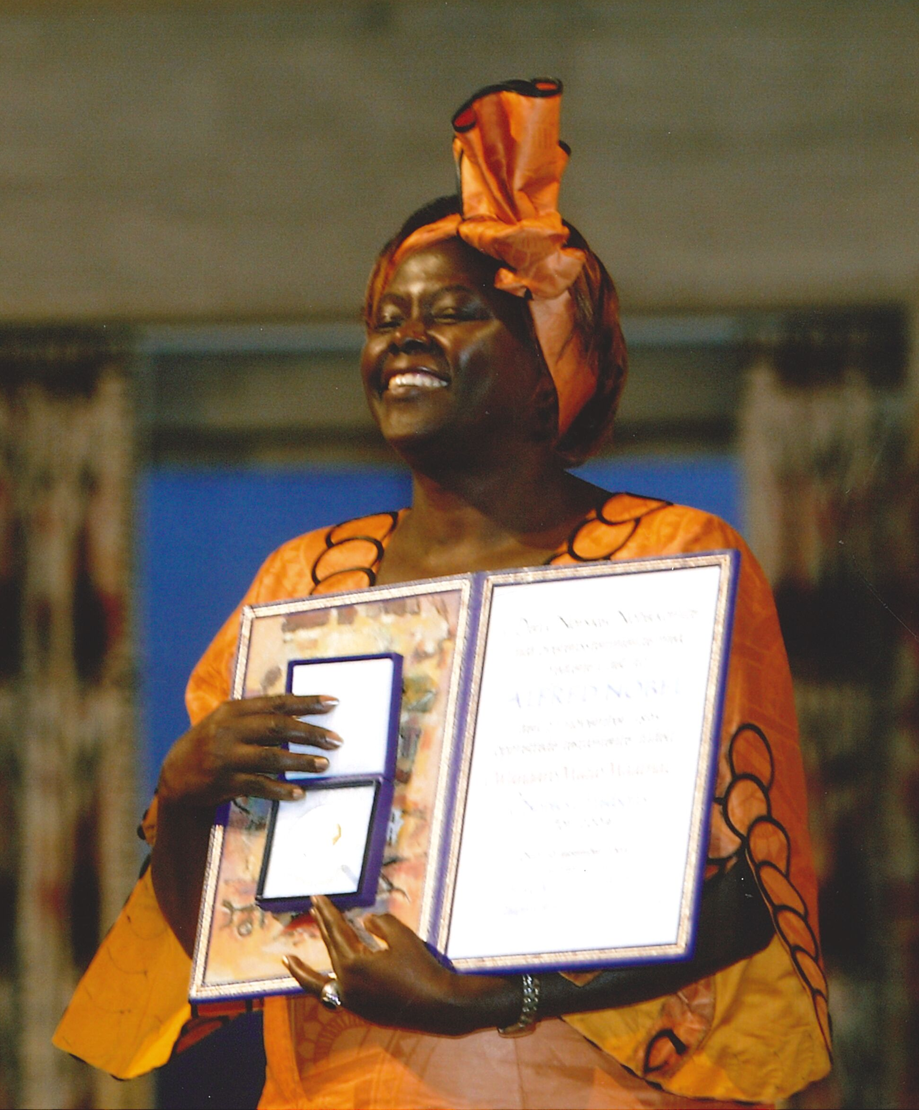
SUMMARY
1971 First woman in Eastern Africa to earn a PhD, doctorate in veterinary anatomy from the University of Nairobi
1976 First woman to become university professor in Kenya
1977 Wangari Maathai creates the Green Belt Movement.
2002 She is elected to Parliament.
2003 – 2005 She becomes Assistant Minister in the Ministry for Environment and Natural Resources.
2004 She receives the Nobel Peace Prize.
2006 She leads the United Nations Billion Tree Campaign.

Slide 6
What skills and/or tools did Wangari Maathai use to make a difference?
Notes:
The Dalai Lama promotes and follows values such as dialogue, compromise, non-violence, kindness. He's also ensured the democratization of the Tibetan administration. To adapt to a life in exile, he created a Tibetan educational system to make sure Tibetan children learn their language, culture and history and established cultural institutions to protect the Tibetan identity: the Tibetan Institute of Performing Arts (1959), the Central Institute of Higher Tibetan Studies (1967), the Library of Tibetan Works and Archives (1970).

Slide 7
Key Concepts
Grassroots: movement or organization using collective action on the local level to effect change at the local, regional, national or international level.
Green Belt Movement: grassroots, non-governmental organization based in Nairobi, Kenya. It aims at organizing women in rural Kenya to plant trees, combat deforestation, restore their main sources of fuel for cooking, generate income, and stop soil erosion. 30,000 women have been trained in forestry, food processing, beekeeping, and other trades that help them earn income while preserving their lands and resources.

Slide 8
Reflect & Discuss
“When we plant trees, we plant the seeds of peace and hope.” - Wangari Maathai What do you think she meant?
What does this mean to you?
Is this quote only about planting trees? Could its meaning extend beyond planting trees? If so, what is the larger message here?

Slide 9
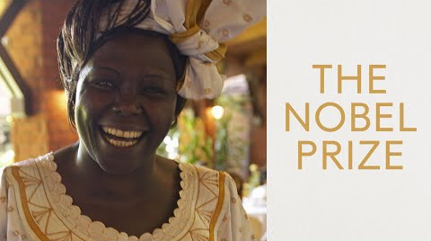
Wangari Maathai - Defender of the Earth, fighter for democracy

Slide 10
What is a “grassroots movement?”
Why was Wangari Maathai’s work creating The Green Belt Movement considered a “grassroots movement”?

Slide 11
Agree or Disagree?
“There are some big problems in the world today and if I take even one small action, it can make a difference.”

Slide 12
What is a “Likert Scale”?
Neither Agree or Disagree
Strongly Agree
Agree
Disagree
Strongly Disagree

Slide 13
Reflect and Share
What are 3 causes you care about (in our community, country, or the world?)
For each cause, can you think of one small action you can take to help address this cause?

Slide 14
COPYRIGHT DISCLAIMER
All original content by the Nobel Peace Center & Games For Change.
Animation video and illustrations: © Animaskin
Photos of Wangari Maathai :
© Green Belt Movement
© Knudsens fotosenter/Dextra Photo, Norsk Teknisk Museum

