Slide 1
Fridtjof Nansen
Polar explorer, scientist, diplomat
and Nobel Peace Prize laureate

Slide 2
PLACEHOLDER
Video: Fridtjof Nansen and the Nobel Peace Prize

Slide 3
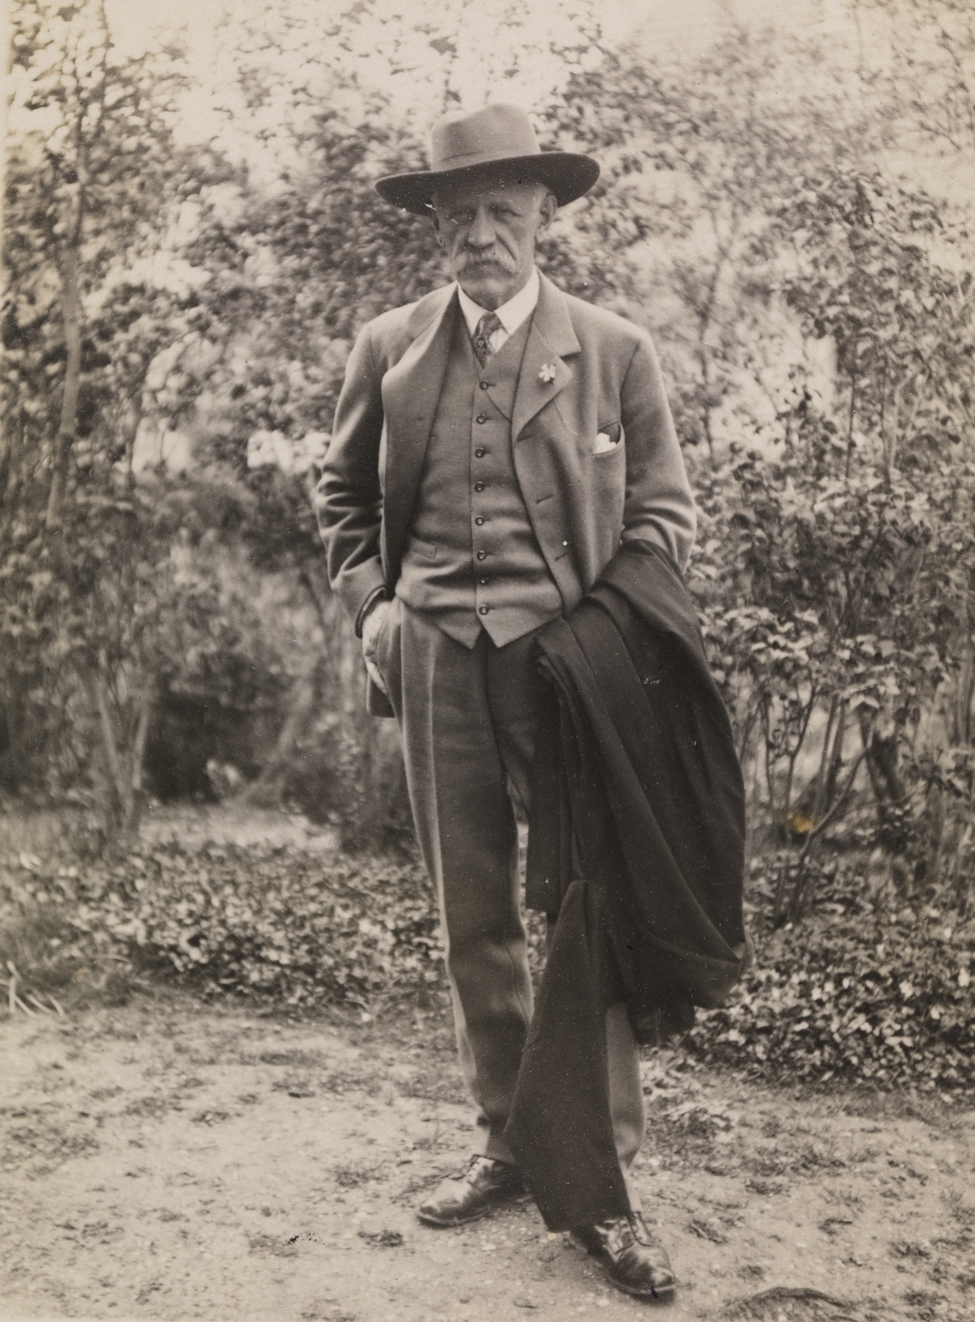
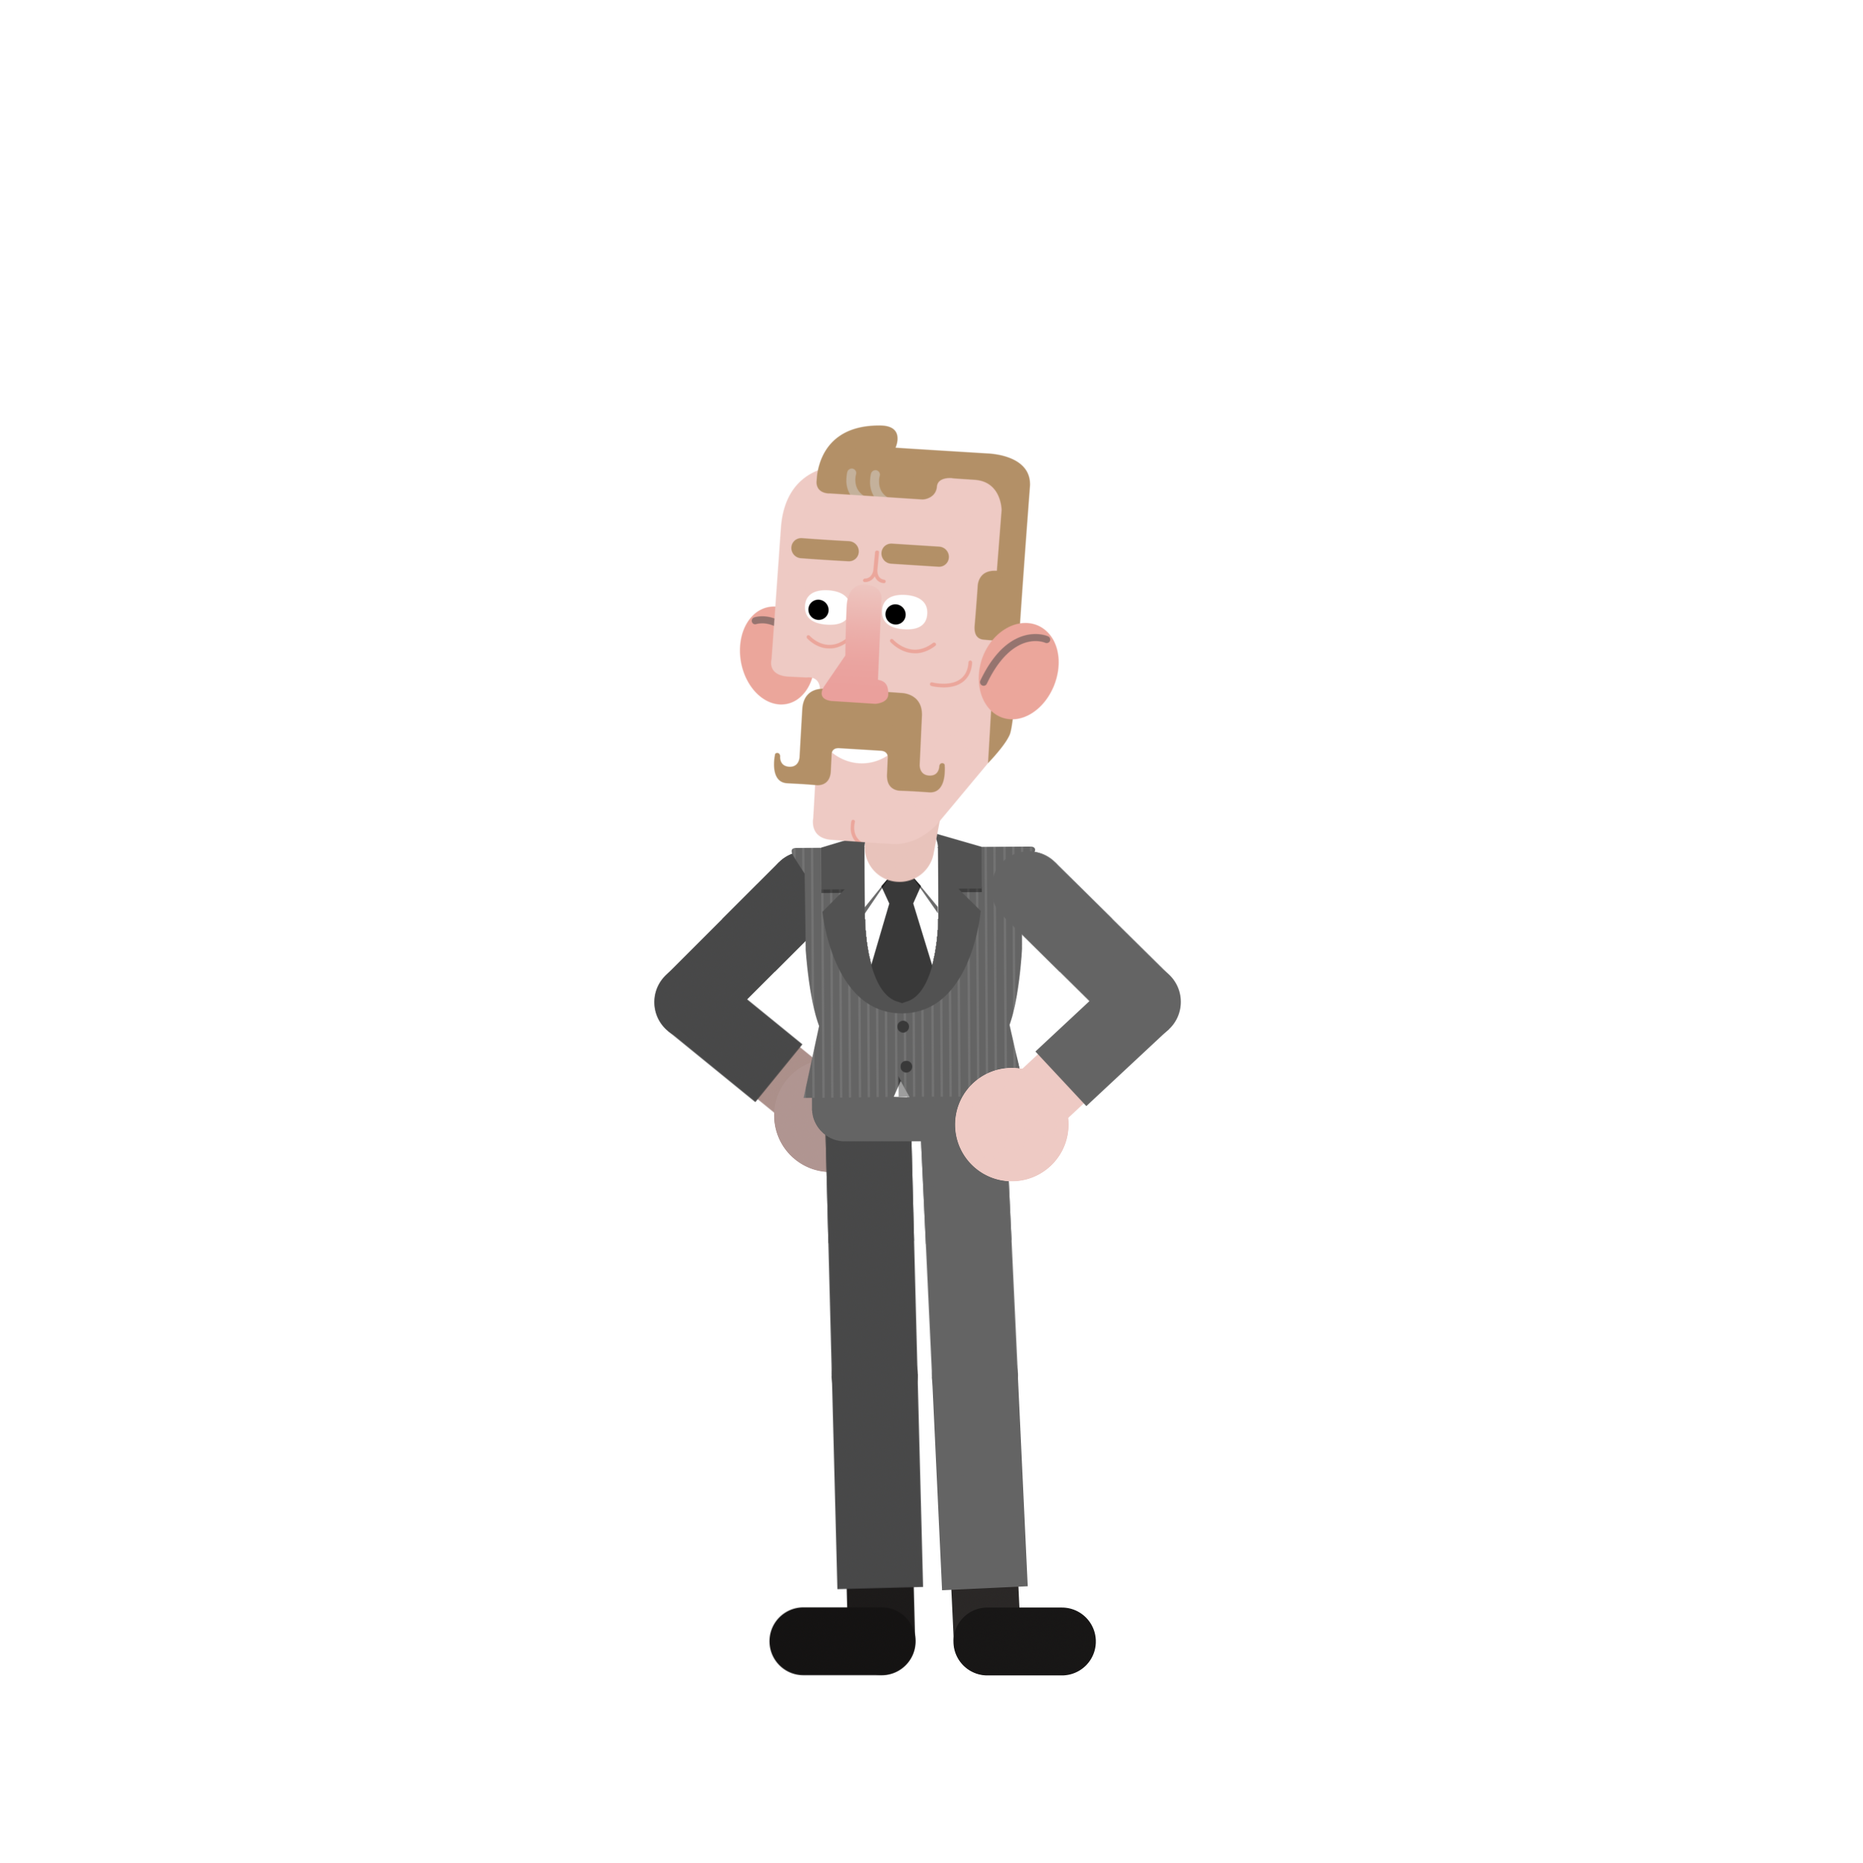
FIRST IMPRESSIONS
What did you think of Nansen?
Was there anything you didn’t understand?
Do you have any questions?
Notes:
Take a few minutes to ask students for feedback, comments, impressions and questions.

Slide 4
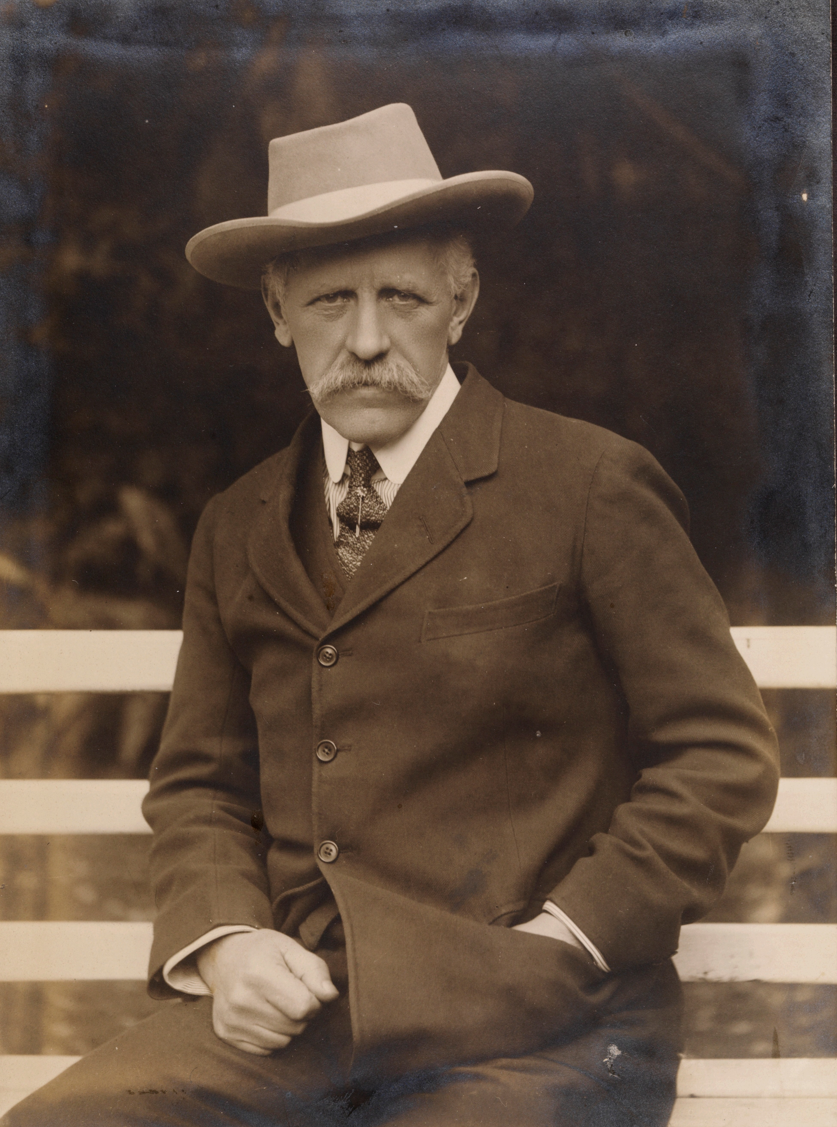
SUMMARY
1918 End of World War I
1919 Creation of the League of Nations
1920 Nansen becomes High Commissioner for Prisoners of War: he helps 430,000 prisoners of war return home.
1921 First High Commissioner for Refugees in history: he creates the Nansen Passport.
1921 Responsible for aid work for famine victims in Russia: he raises money for food and medicine.
1922 Nansen is awarded the Nobel Peace Prize.

Slide 5
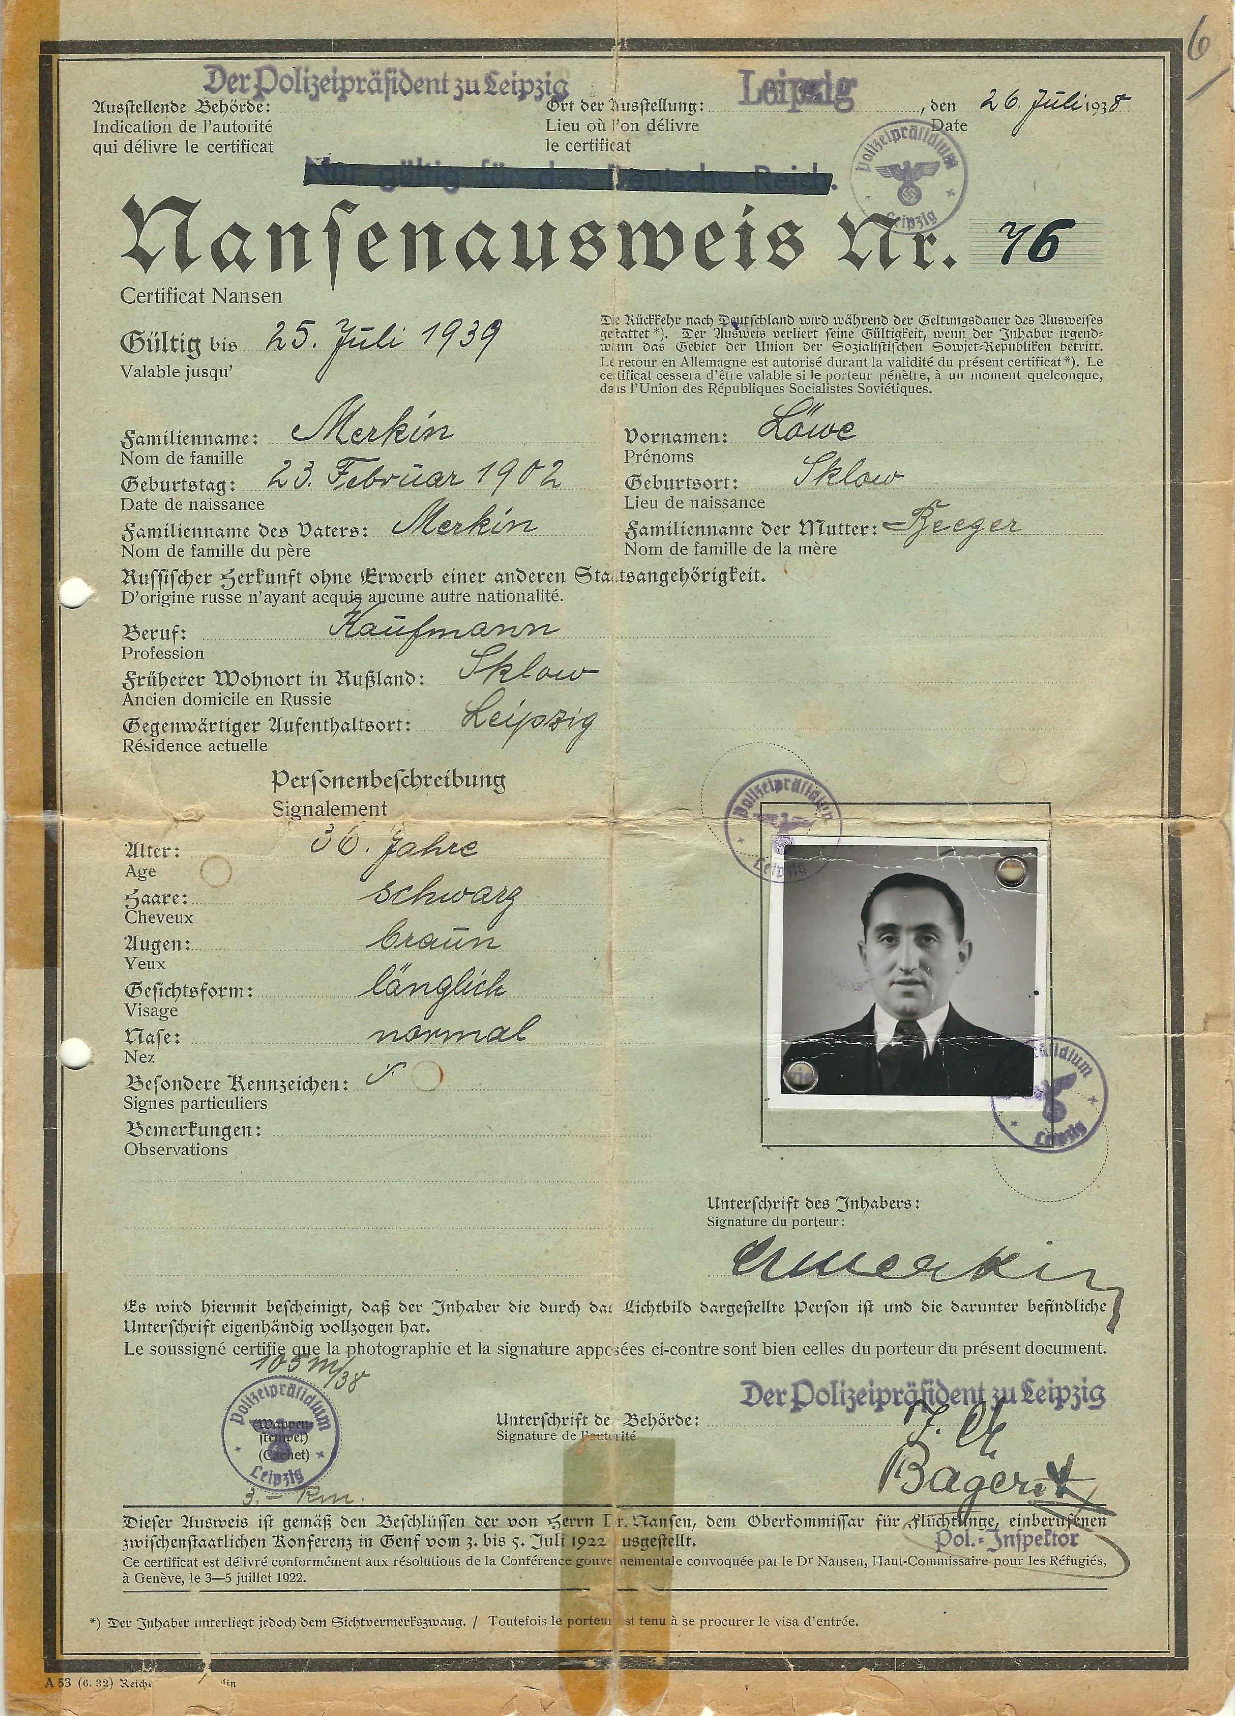
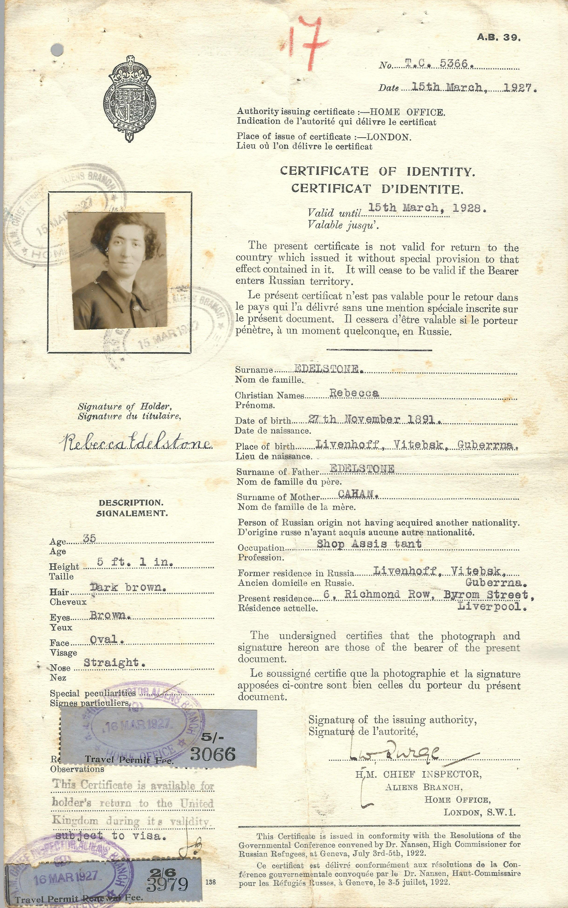
Notes:
These are two examples of Nansen Passports: one issued in Germany in 1938 (on the left) and one issued in the UK in 1927 (on the right).

Slide 6
What skills and/or tools did Nansen use to make a difference?
Notes:
The Dalai Lama promotes and follows values such as dialogue, compromise, non-violence, kindness. He's also ensured the democratization of the Tibetan administration. To adapt to a life in exile, he created a Tibetan educational system to make sure Tibetan children learn their language, culture and history and established cultural institutions to protect the Tibetan identity: the Tibetan Institute of Performing Arts (1959), the Central Institute of Higher Tibetan Studies (1967), the Library of Tibetan Works and Archives (1970).

Slide 7
What does it mean to be a refugee?

Slide 8
Key Concepts
How would you describe each of the following terms in your own words?
Migrant
Refugee
Asylum
Notes:
See definitions in the teacher's cheat sheet

Slide 9
Discuss
Where are there current refugee crises in the world today?
Who is being affected, why, and what is being done?

Slide 10
Imagine that a war breaks out here and we live in an area with heavy fighting. What would you do?
Notes:
Introduction to the 'four corners' exercise

Slide 11
Reflect
What is your greatest takeaway about Fritdjof Nansen and what he did for refugees?
What is one question you still have about Nansen or refugee rights today?

Slide 12
COPYRIGHT DISCLAIMER
All original content by the Nobel Peace Center & Games For Change.
Animation video and illustrations: © Animaskin
Photos of Fridtjof Nansen: © National Library of Norway
Nansen Passports: Public Domain

