Slide 1
How to understand conflicts?

Slide 2
What is conflict?

Slide 3
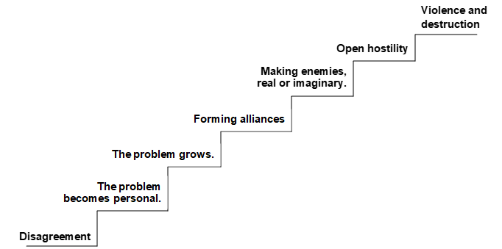
The conflict staircase

Slide 4
How can we prevent a conflict situation from escalating?
Write down your ideas and share with the rest of the class.

Slide 5
Conflict resolution
Participants define what they disagree on.
Participants discuss their disagreement, leaving aside negative feelings they have for each other.
Participants listen actively to each other’s needs and goals.
In their discussion, participants focus on the future, not the past.
Each participant tries to see the situation from the other’s point of view.
Participants seek help from a third party who functions as mediator.
Participants negotiate to find a solution.
Both sides decide to lower their demands.
Participants decide to be creative in order to find a solution that suits everyone’s interests.

Slide 7
Nobel Peace Prize​ and conflict resolution
Martin Luther King Jr. (USA) – Recieved the Nobel Peace Prize in 1964
Mairead Corrigan and Betty Williams (Northern Ireland) – Recieved the Nobel Peace Prize in 1976
Desmond Tutu (South-Africa) – Recieved the Nobel Peace Prize in 1984
Nelson Mandela and Fredrik Willem de Klerk (South-Africa) - Recieved the Nobel Peace Prize in 1993
John Hume and David Trimle (Northern Ireland) – Recieved the Nobel Peace Prize in 1998
Martti Athisaari (Finland) - Recieved the Nobel Peace Prize in 2008
Juan Manuel Santos (Colombia) - Recieved the Nobel Peace Prize in 2016

