Slide 1

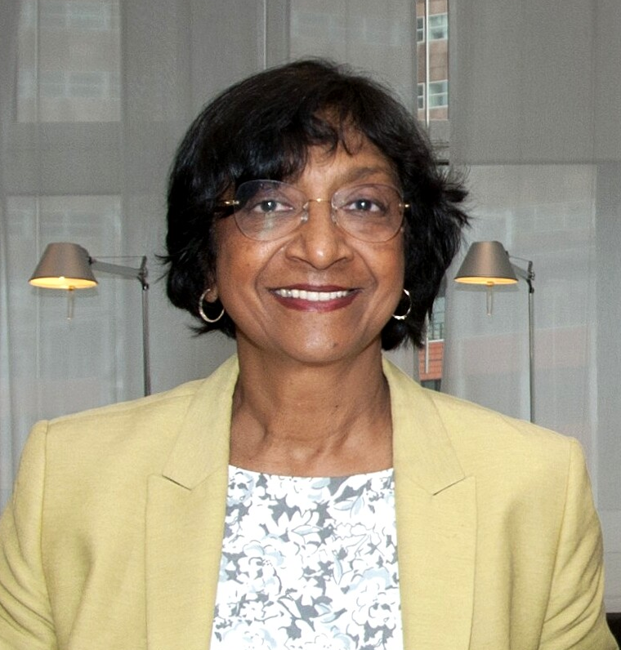
NOBEL PEACE PRIZE 2026
THE NOBEL PEACE LESSON
NAVI PILLAY

Slide 2
THE NOBEL PEACE LESSON
Which professions do you think of
when you think about
working for peace?
Notes:
Discuss as a class. There are many paths to peace.

Slide 3
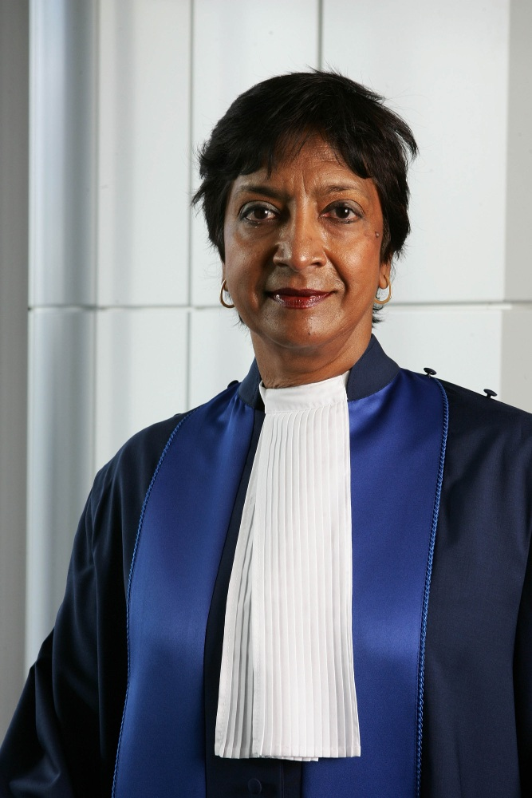
THE NOBEL PEACE LESSON
The Peace Prize went to a judge!
Navi Pillay was born in South Africa in 1941.
Until 1994, South Africa had apartheid.
It was a racist and brutal system with white people at the top, while everyone else faced repression.
Navi’s family is Tamil and originally from India.
They faced discrimination and lived in poverty.
Notes:
Navi Pillay grew up as one of eight children in a poor family in Durban during Apartheid in South Africa. Her father was a bus driver, and her mother was a homemaker. While many girls in the neighborhood were married off at an early age, her parents wanted their daughters to receive an education.

Slide 4
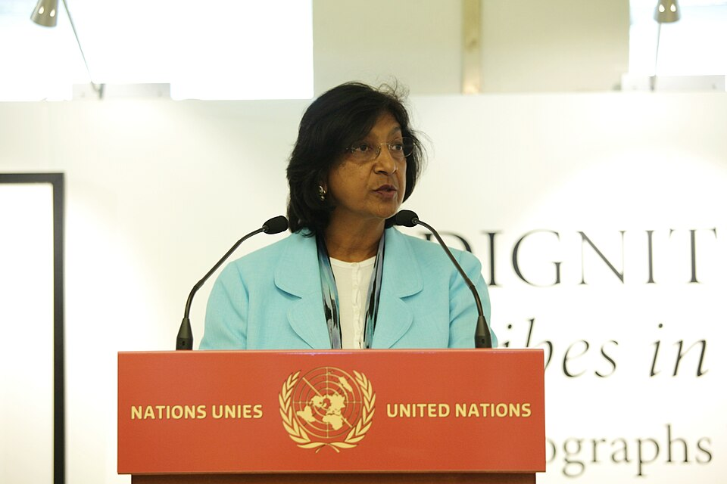
THE NOBEL PEACE LESSON
No peace without justice
Her community raised money so Navi could study law.
As a lawyer, she fought for the rights of South African political prisoners.
She has served as a judge in some of modern history’s most important international trials.
Notes:
Navi's commitment began early. At just 10 years old, she wrote a school essay about how non-white people received harsher sentences than white people in South African courts. The school principal recognized her talent and encouraged the local community to raise money so she could attend university.
After completing her education, she found that no law firms were willing to hire her. She was told that white secretaries could not work for a non-white lawyer. As a result, Navi decided to start her own law practice. She defended opponents of the apartheid regime and political prisoners. One of the most famous political prisoners in modern history was Nelson Mandela. He later received the Nobel Peace Prize and became South Africa’s first democratically elected president. In 1995, Navi Pillay was appointed as a judge of the High Court of South Africa under President Nelson Mandela.
Navi Pillay is best known for her work as a judge in the international legal system. Her first international judicial assignment was on the court that handled the trials following the genocide in Rwanda.

Slide 5
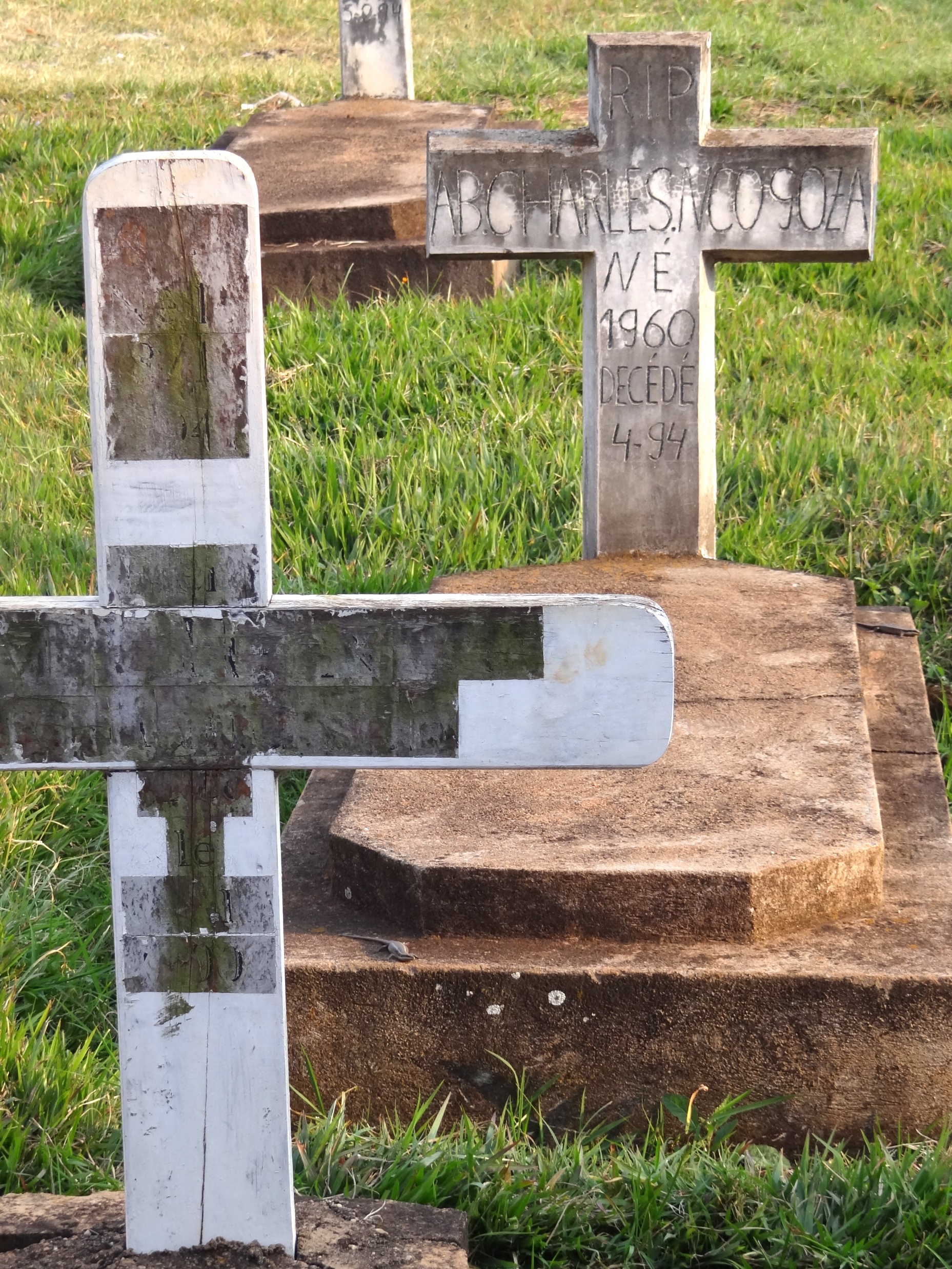
THE NOBEL PEACE LESSON
Justice after genocide
For one hundred days in 1994, extreme violence targeted the Tutsi people in Rwanda.
More than 800 000 were killed and several hundred thousand raped.
This was genocide, aimed at destroying the Tutsi people.
Newspapers and radio helped radicalise civilians to kill neighbours and take part in the genocide.
Genocide:
acts committed with intent to destroy, in whole or in part, a national, ethnic, racial or religious group
Notes:
Through the media, the Tutsi people were described as cockroaches and pests. This was done to dehumanize them, and it worked.
First, soldiers, police officers, and militias began killing people. Then they recruited ordinary citizens to kill neighbors, friends, and acquaintances who belonged to the Tutsi group.
This shows how words can lead to action. Propaganda can lead to genocide.

Slide 6
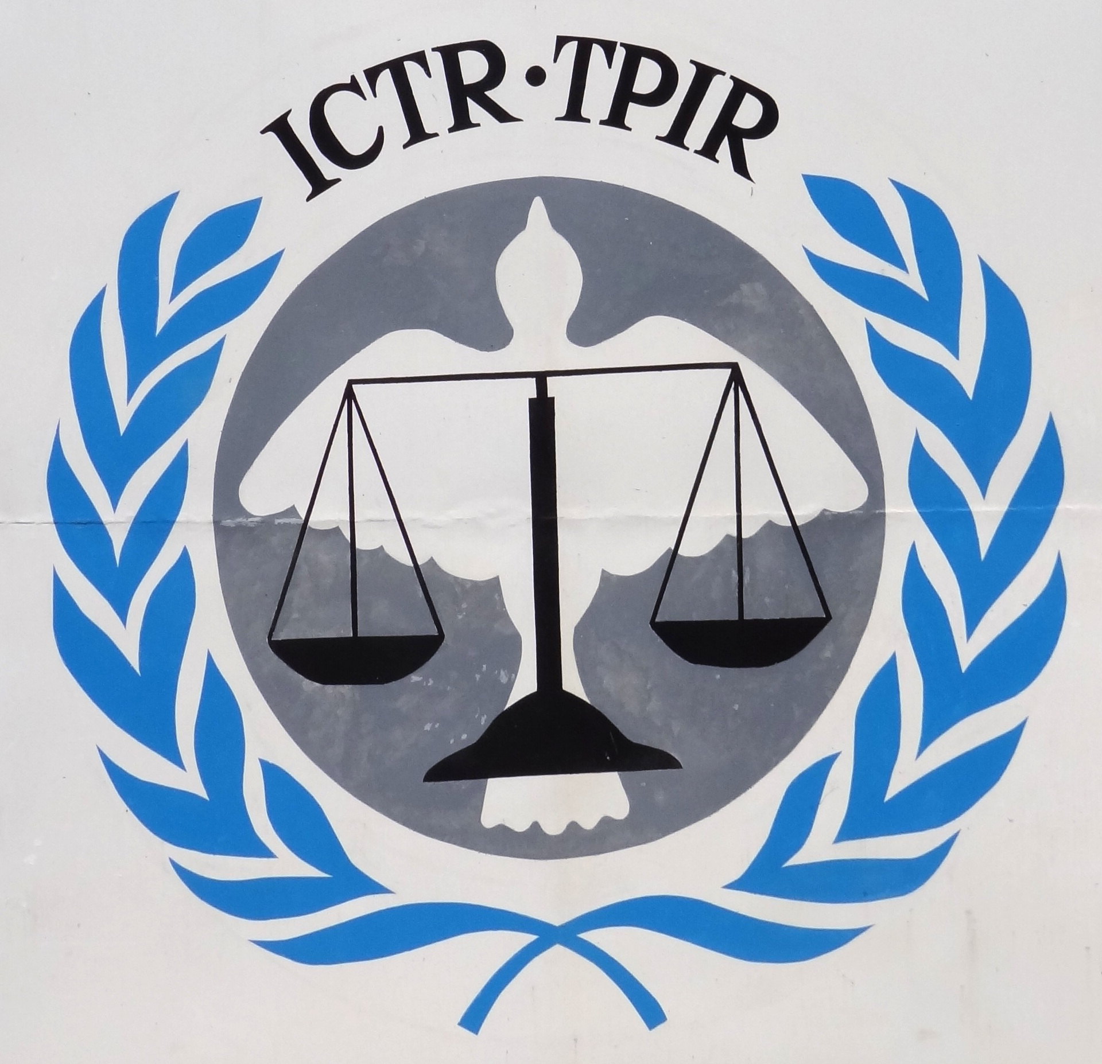
THE NOBEL PEACE LESSON
The trials
After the genocide, the UN established a tribunal to hold those responsible to account.
Navi Pillay was asked to serve as a judge. The judges established, among other things, that:
- Rape can constitute genocide and crimes against humanity.
- Media had contributed to the genocide through propaganda and calls for violence.
International Criminal Tribunal for Rwanda
Notes:
The Holocaust and other large-scale atrocities during World War II were crucial in prompting the international community to develop new international rules on human rights and genocide.
The trials following the genocide in Rwanda marked the first time that the legal framework established after World War II was put into practice. Navi Pillay played a crucial role in interpreting the law and developing international law. Her work helped define sexual violence as a crime.
Previously, sexual violence had been viewed as an unfortunate side effect of war. In Rwanda, several hundred thousand women were raped during the genocide. With Navi’s leadership, systematic sexual violence was prosecuted as crimes against humanity and recognized as a part of the genocide.
Navi also played a key role in convicting the leaders of newspapers and one radio station that had dehumanized the Tutsi people and encouraged violence and murder.

Slide 7
THE NOBEL PEACE LESSON
Discuss:
Who should be held responsible
for a war crime?
Someone who kills civilians
Someone who orders civilians killed
Someone who urges others to kill civilians
Notes:
Discuss as a class.

Slide 8
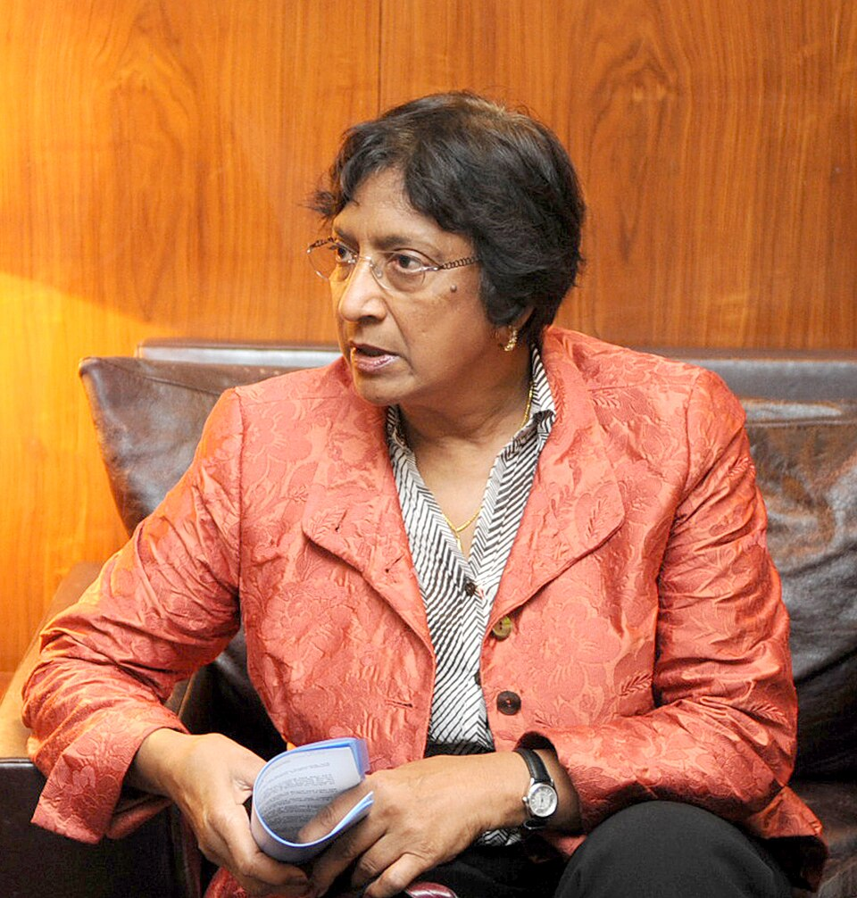
THE NOBEL PEACE LESSON
A life devoted to accountability
Throughout her long career, Navi Pillay has worked to hold those who break the law accountable.
States can be held responsible for breaches of international law.
Leaders can be tried for serious international crimes.
Pillay has served as a judge in several courts, including the International Criminal Court - the ICC.
Notes:
International law consists of the laws and rules that apply between states. It can cover everything from trade, maritime law, and diplomacy to war crimes, human rights violations, and genocide.
The international community has established several international courts that resolve disputes between states or prosecute individuals accused of serious violations of international law.

Slide 9
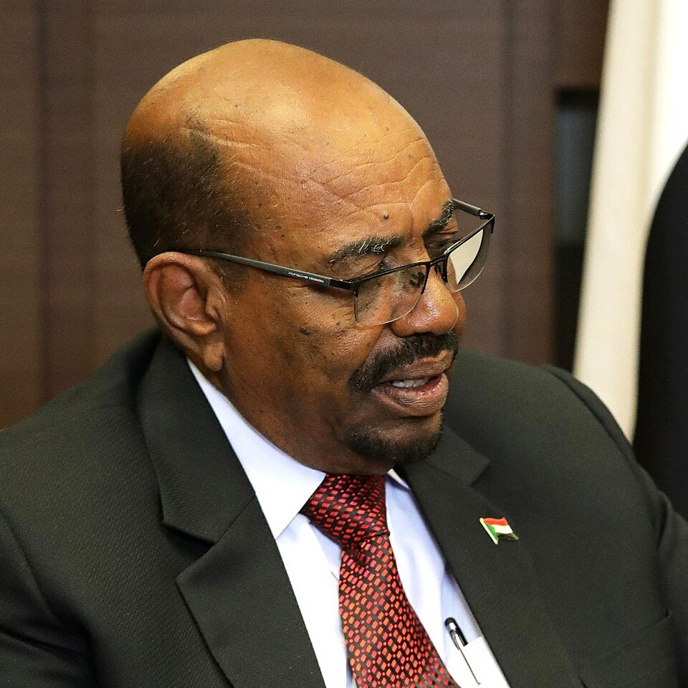
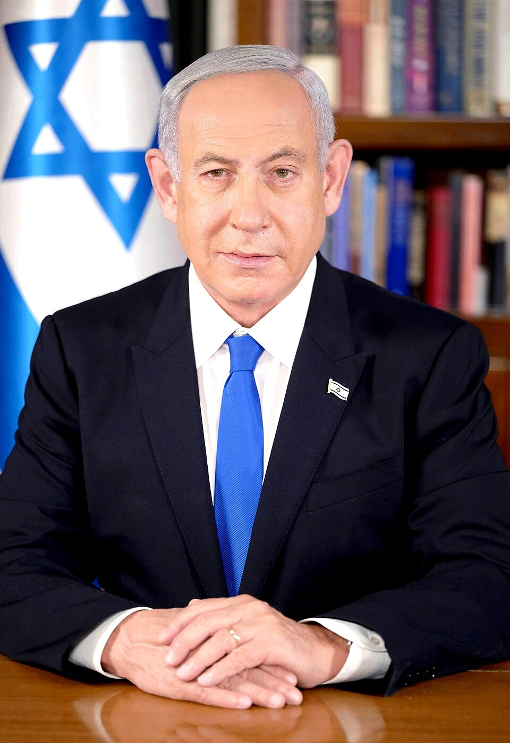
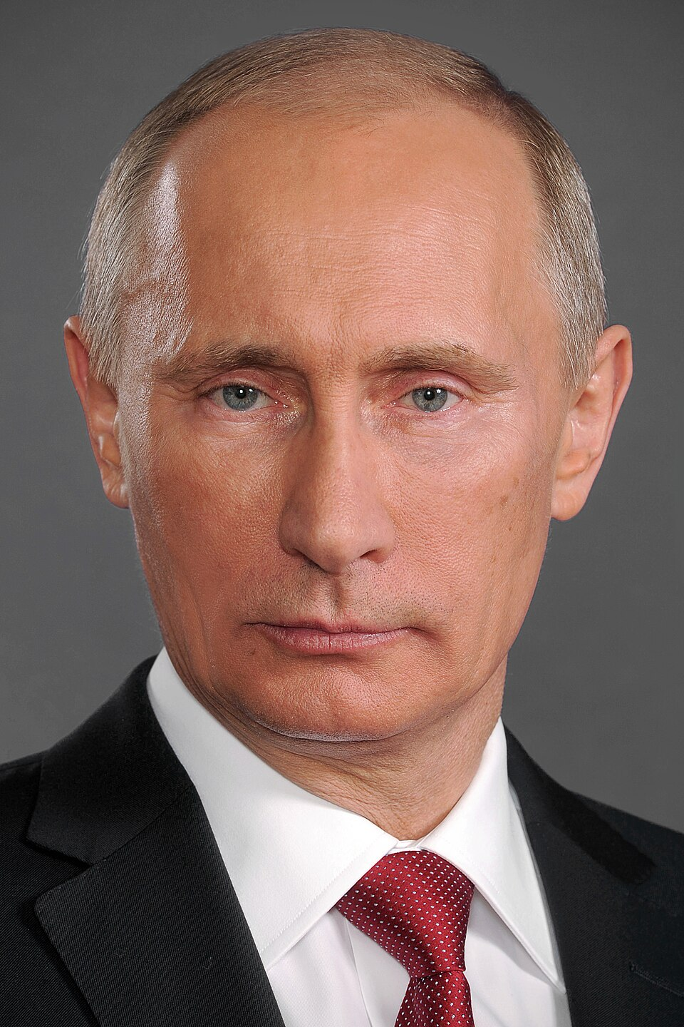
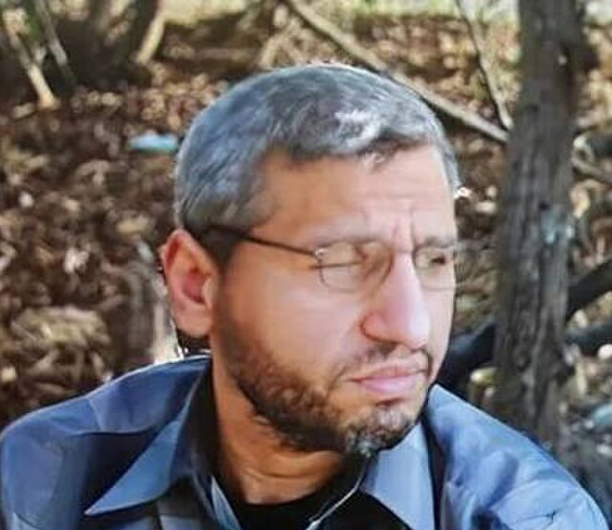
THE NOBEL PEACE LESSON
What do these people have in common?
Vladimir Putin
President of Russia
Mohammed Deif
A Hamas military leader
Omar al-Bashir
Sudan’s 4th president
Benjamin Netanyahu
Prime Minister of Israel
Notes:
Look at the next slide for answers.

Slide 10
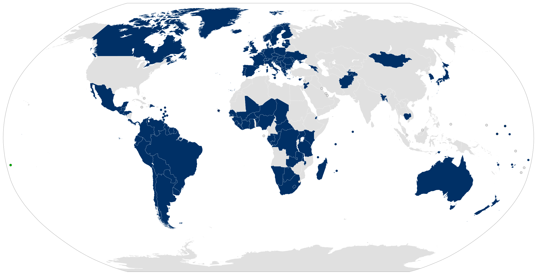
THE NOBEL PEACE LESSON
All have been wanted by the ICC!
125 countries have joined an agreement creating a court called the ICC.
It can prosecute people accused of the
most serious crimes.
The 125 countries
are committed to arresting
and surrendering suspects, whoever they are.
Notes:
The four individuals on the previous slide are all wanted by the International Criminal Court (ICC), and arrest warrants have been issued for them. Three of the cases are still ongoing, but the case against Mohammed Deif was closed after his death was confirmed in 2025.
This means that if Israeli Prime Minister Benjamin Netanyahu travels to Norway, or to any of the 125 countries that are members of the ICC (marked in blue), the authorities in those countries would be obligated to arrest him and transfer him to the court.
The United States has not ratified the Rome Statute and is therefore not a member of the ICC. As a result, Benjamin Netanyahu was able to travel to the United Nations headquarters in New York on 24 September 2026 to address the UN General Assembly, even though the ICC has issued an arrest warrant for him.
The ICC is an international court, but its premises are located in The Hague, Netherlands.
ICC handles cases involving genocide, crimes against humanity, war crimes, and crimes of aggression. Unlike the ICJ, which judges states, the ICC prosecutes individuals.
The court has 18 international judges. Several major countries have chosen not to recognize the ICC. Burundi became the first country to withdraw from the court in 2017. The Philippines became the second country to withdraw in 2019.

Slide 11
THE NOBEL PEACE LESSON
Why do you think some countries
do not want to join?
They do not want to spend time on a new organisation
They think their own laws and rules are more than enough
They do not want outsiders deciding what happens to their citizens
Their leaders fear someone will come and arrest them
Notes:
Discuss

Slide 12
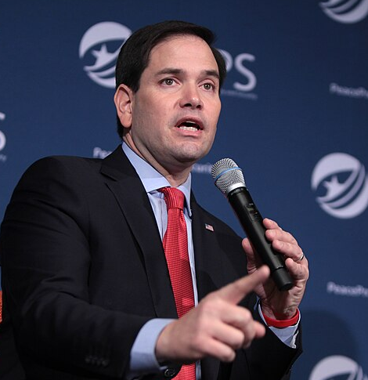
THE NOBEL PEACE LESSON
Political pressure
Many have interpreted Navi’s Peace Prize as support for the ICC.
Less than a day after Navi received the Peace Prize, the US imposed sanctions
on the ICC.
“The ICC is a political body that poses a deadly threat to law-abiding democracies everywhere and to the very idea of national sovereignty.”
Benjamin Netanyahu
Prime Minister of Israel
(…) Either the ICC ends its threats, or we end the ICC (…)
Marco Rubio
US Secretary of State
Notes:
Both the rules are being violated, and the ICC is being undermined.
The Nobel Committee wants to highlight Navi and others who work to ensure that conflicts are resolved through cooperation, laws, and rules.
A world in which rules are not respected is more dangerous for everyone.
Peace must be built on genuine justice.

Slide 13
THE NOBEL PEACE LESSON
Discuss:
Why is it important for peace
to hold criminals accountable for
what they have done?
What does it mean to the survivors?
In what way can it help deter new crimes?
Notes:
For example, students can spend one minute writing individually, discuss in groups and then discuss as a whole class.
For the survivors: War crimes and genocide should not go unpunished. Victims of serious crimes deserve to see those responsible held accountable.
Deterrence: Fear of being extradited and punished may discourage leaders from violating international law and encourage them to respect the international rules that apply during war.

Slide 14
THE NOBEL PEACE LESSON
Discuss: Is there any point if many heads of state are not surrendered?
Yes, because they may be surrendered and punished later if the country gets a new leader
Yes, because other countries can impose sanctions on countries that violate international law
Yes, because many citizens may wake up and work against what is happening
Notes:
It is easy to lose hope when political leaders or others under investigation are not extradited. But it can still make a difference.
In the former Yugoslavia, those responsible were convicted of genocide after new political leaders ratified the Rome Statute and extradited those responsible for the genocide.
When there is suspicion of an ongoing genocide, all countries have a responsibility to try to stop it. For example, they can impose sanctions, halt arms deliveries, or introduce boycotts. International pressure can create change.
A political leader who becomes the subject of an arrest warrant may lose popularity among voters and be removed from power in the next election.

Slide 15
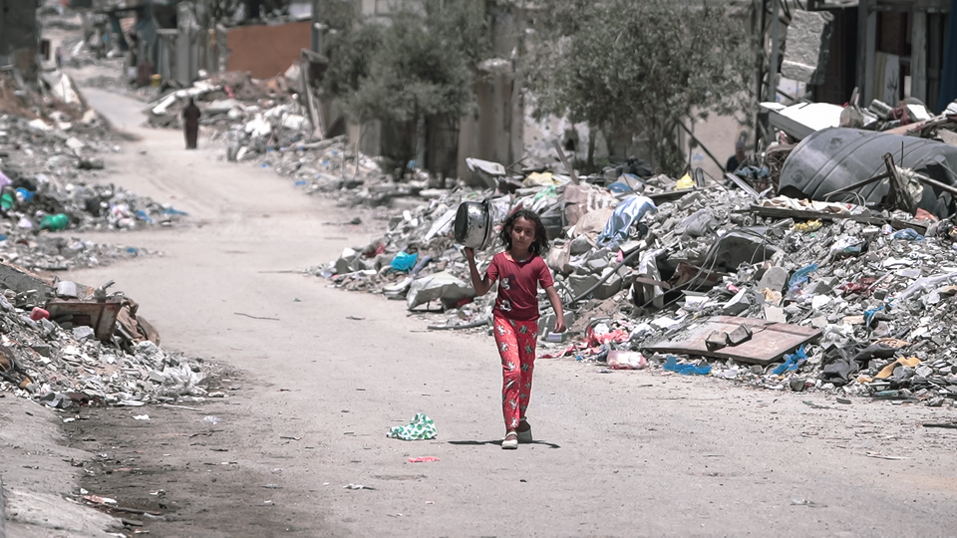
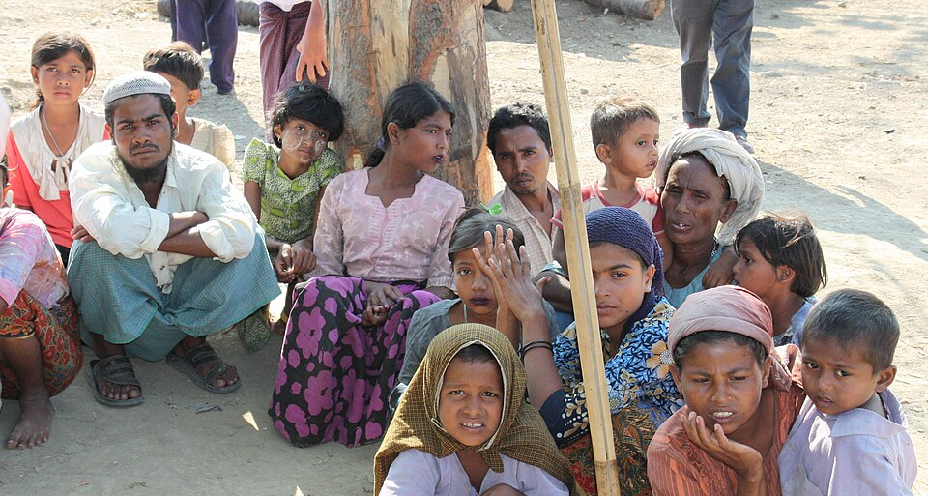
THE NOBEL PEACE LESSON
What is Navi working
on now?
Until 2025, Navi Pillay led an independent commission investigating possible violations of international law in Palestine.
The commission’s conclusion:
Israel had committed genocide in Gaza.
The case is now being processed by the international court of justice, the ICJ.
Since 2019, she has also served as a judge in the case accusing Myanmar of genocide against the Rohingya.
Notes:
The commission concluded that a genocide is taking place in Gaza because a very large number of civilians have been killed, hospitals, schools, and neighborhoods have been destroyed, large parts of the population are being starved, and Israel has prevented humanitarian aid from entering.
In addition, Defense Minister Yoav Gallant referred to Palestinians as "human animals," and President Isaac Herzog stated that he holds the entire Palestinian population responsible for Hamas's terrorist attack on 7 October.
The commission also concluded that Hamas has committed war crimes against Israel.
Israel has not been convicted of genocide. The case is currently being processed by the International Court of Justice.

Slide 16
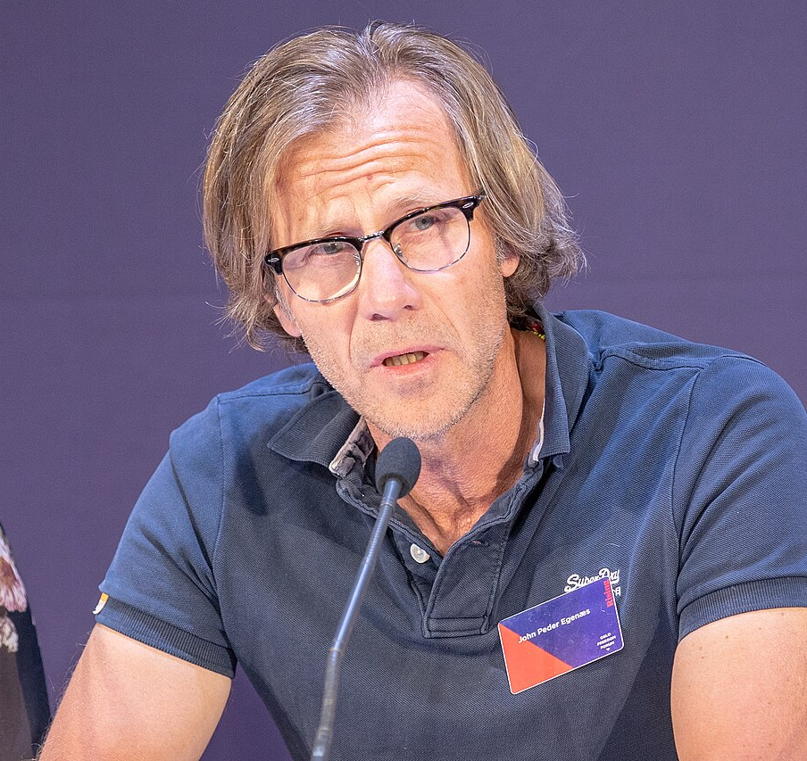
THE NOBEL PEACE LESSON
What can we learn from Navi?
She has shown that the law must also reach those in power.
International law is not a menu for great powers to pick from.
It must apply to everyone.
John Peder Egenæs
Secretary General, Amnesty Norway

Slide 17
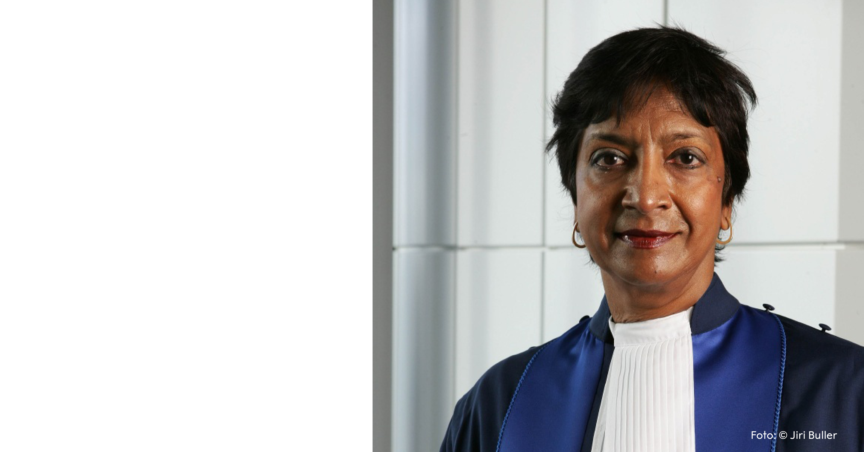
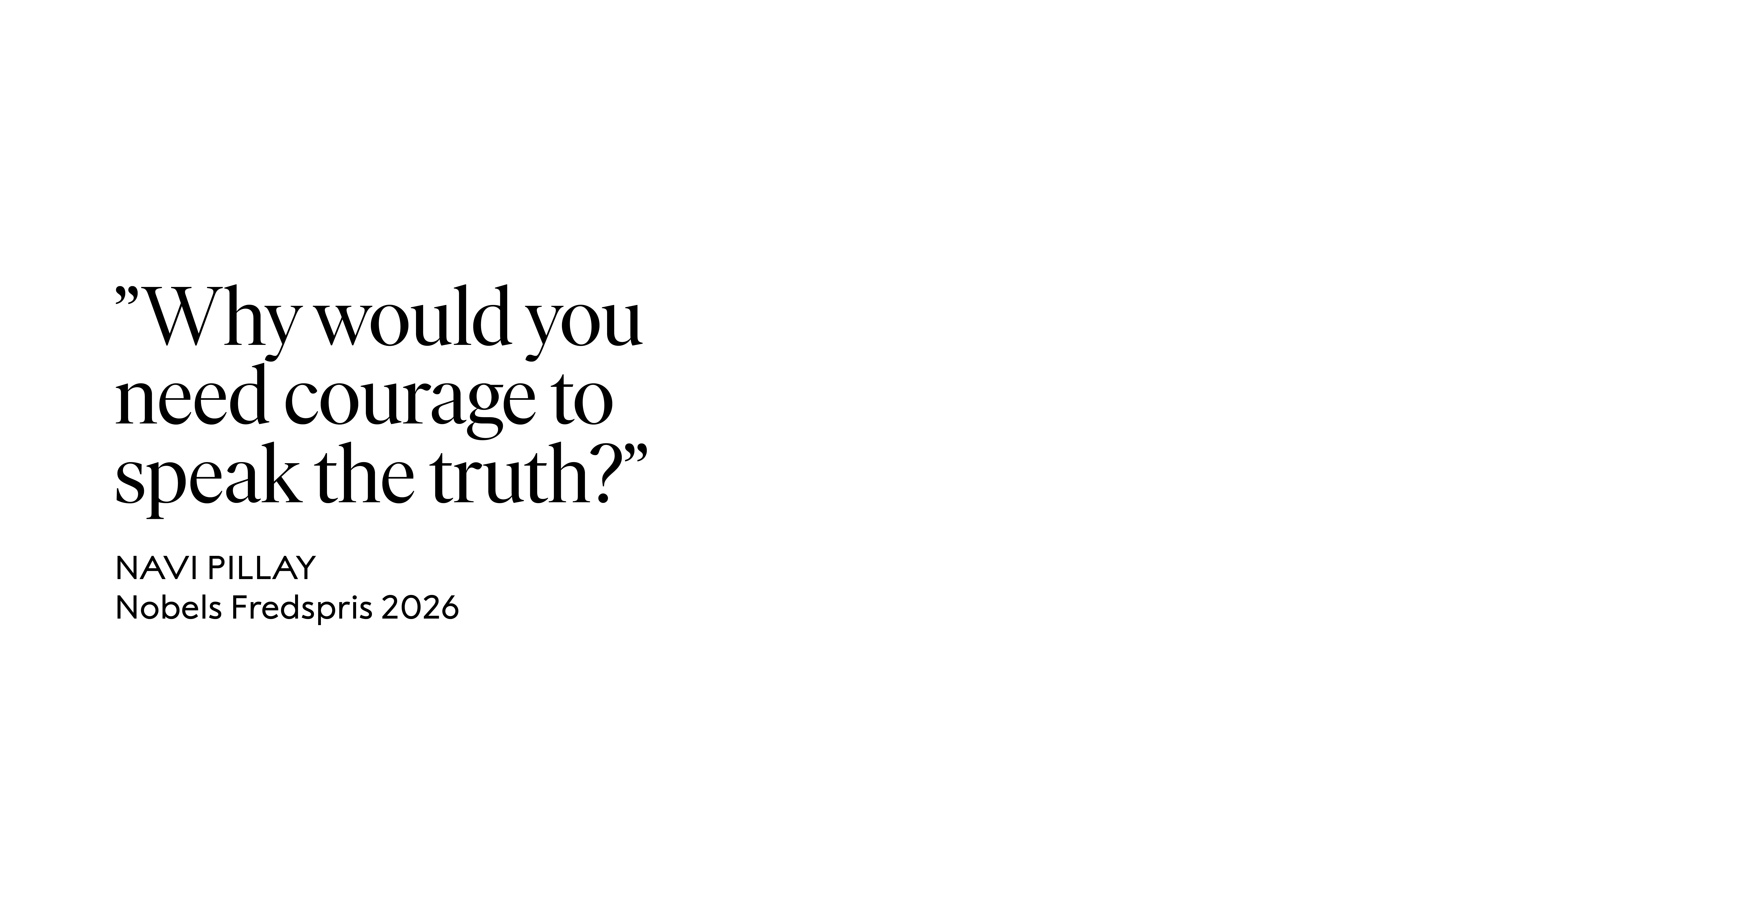
THE NOBEL PEACE LESSON
Notes:
What does Navi mean by this? Reflect as a class.
Navi’s role as a judge is to assess evidence in light of international law. She has carried out her work with great professional integrity and is among the world's most respected legal scholars.
She has also stated: "To do nothing is not neutrality. It is complicity."
Do you agree with her?

