Slide 1
Malala Yousafzai
Advocate for education and children's rights and the youngest Nobel laureate in history

Slide 2
What does “freedom of speech” mean? Why is it important?
Can you think of individuals, present or past, who have used their voice or their words to contribute something important to society or help change the world for the better? Who comes to mind, and how did they use their voice or words to create change?

Slide 3
What do we know about Malala Yousafzai?
What do you already know about Malala?
What are you unsure about?
What would you like to learn about her?

Slide 5
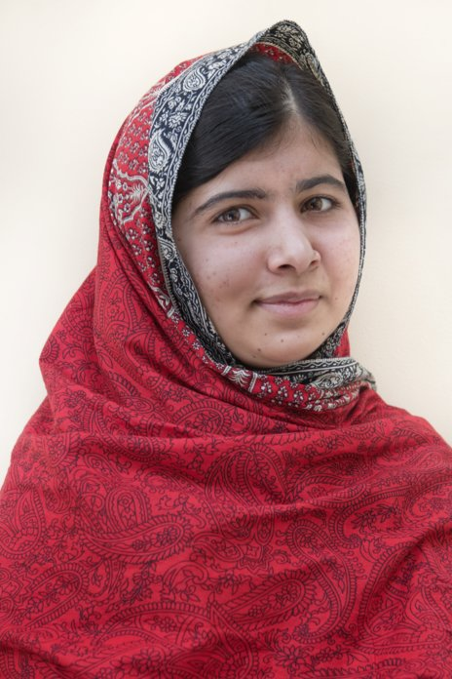
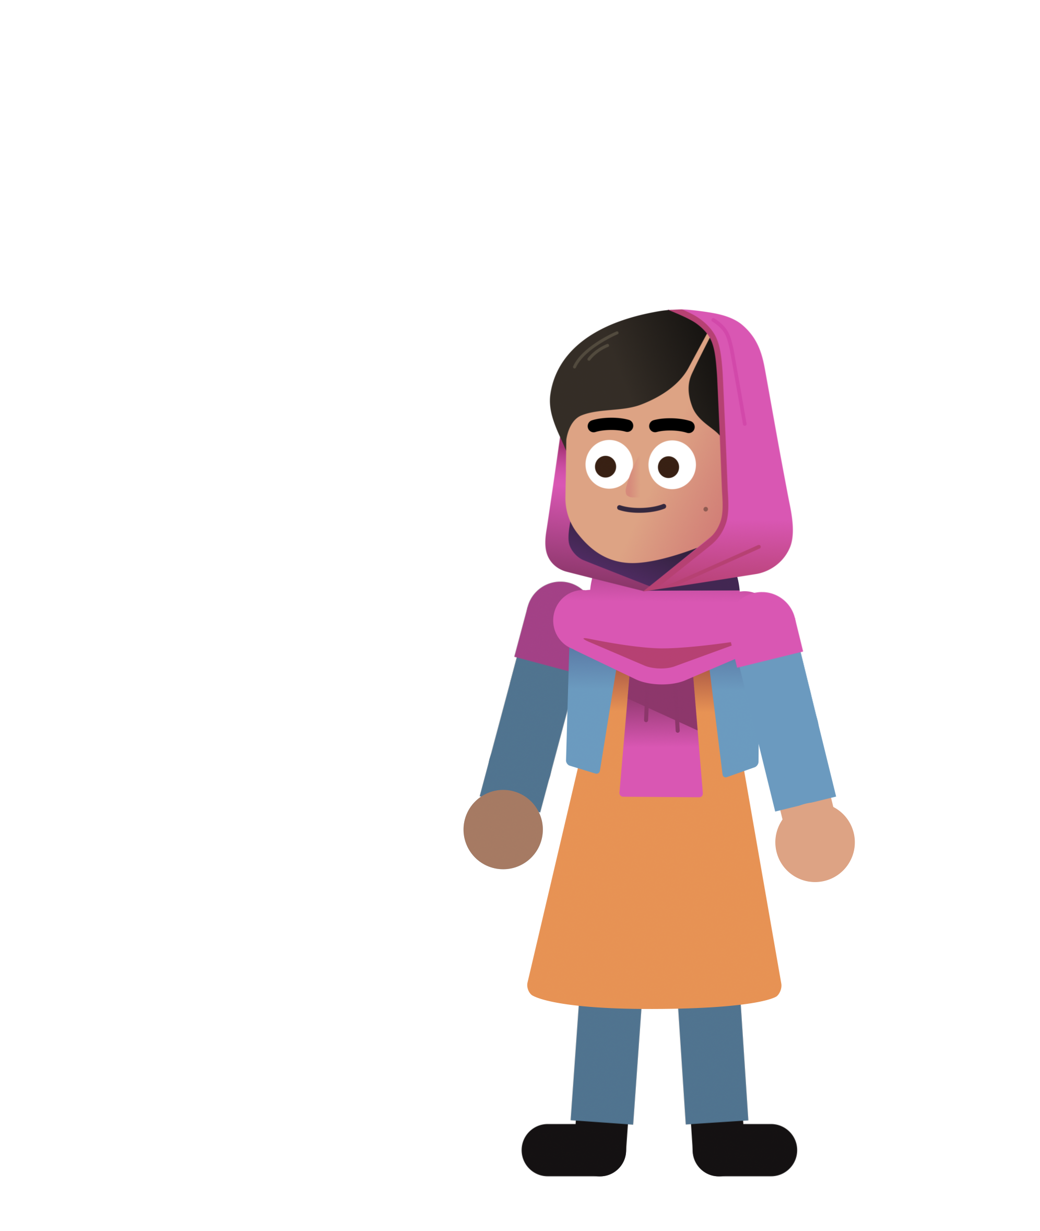
FIRST IMPRESSIONS
What did you think of Malala?
Was there anything you didn’t understand?
Do you have any questions?
Notes:
Take a few minutes to ask students for feedback, comments, impressions and questions.

Slide 6
SUMMARY
2009 Malala (11 years old) starts to blog anonymously for the BBC. She gains more and more attention and by the end of the year, she decides to reveal her identity and give interviews.
2010 – 2012 She becomes known throughout Pakistan for her campaign to give all Pakistani girls access to free quality education.
October 9th, 2012: Malala (15 years old) is shot by the Taliban.
March 2013 Malala is able to attend school in Birmingham (UK).
July 2013 On her 16th birthday, Malala speaks at the United Nations.
2014 Malala becomes the youngest Nobel laureate at the age of 17.
2021 Malala graduates from Oxford University.

Slide 7
What skills and/or tools did Malala use to make a difference?
Notes:
The Dalai Lama promotes and follows values such as dialogue, compromise, non-violence, kindness. He's also ensured the democratization of the Tibetan administration. To adapt to a life in exile, he created a Tibetan educational system to make sure Tibetan children learn their language, culture and history and established cultural institutions to protect the Tibetan identity: the Tibetan Institute of Performing Arts (1959), the Central Institute of Higher Tibetan Studies (1967), the Library of Tibetan Works and Archives (1970).

Slide 8
“I tell my story, not because it is unique, but because it is not.
It is the story of many girls. (…)
I am those 66 million girls who are deprived of education. And today I am not raising my voice, it is the voice of those 66 million girls.”
Malala Yousafzai

Slide 9
Greta Thunburg
Who is Greta Thunburg?
What do Greta and Malala have in common?
Let’s explore Greta Thunburg’s Twitter feed.

Slide 10
Let’s play a game!
In this card game you’ll take turns judging which types of social medium might work best to address a specific social cause.
Social Medium: a tool, website, or application (for example, Instagram, YouTube, a podcast, etc.) that can serve as a powerful form of communication and change-making in a social movement.

Slide 11
If you could send one Tweet about a cause that is important to you that everyone in the world would read, what would it be?
Optional challenge: A Tweet is limited to 280 characters (letters, punctuation, and spaces included). Can you write down your message in the form of a Tweet of 280 characters or less?

Slide 12
COPYRIGHT DISCLAIMER
All original content by the Nobel Peace Center & Games For Change.
Photos of Malala Yousafzai:
© The Nobel Foundation
© Johannes Granseth / Nobel Peace Center

