Slide 1
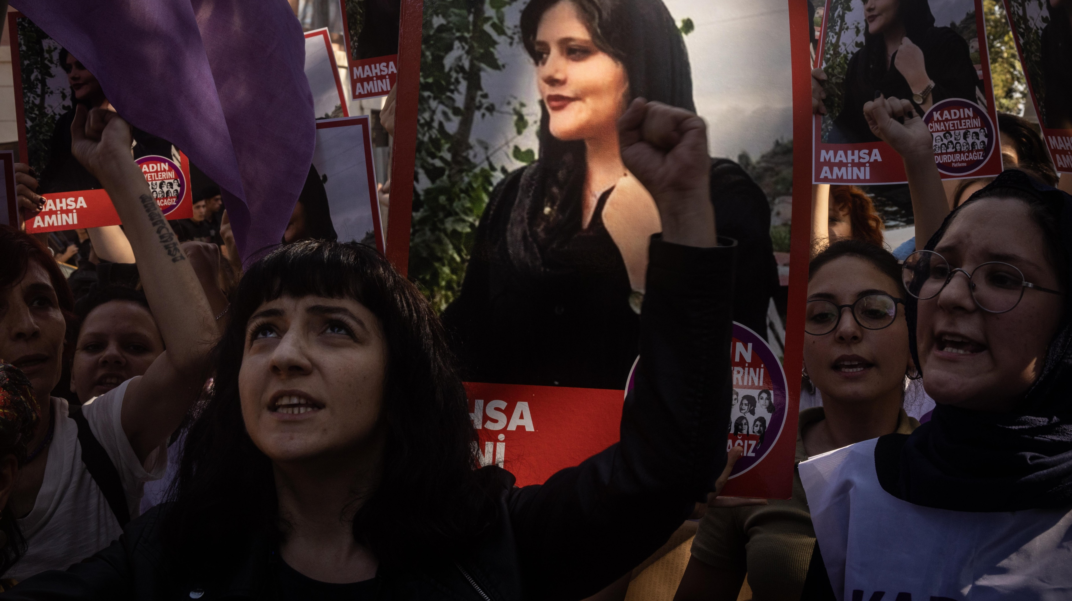
Notes:
Masha Amini and the 2022 protests
Photo: Chris McGrath, Getty
What do you see in this picture?
What do you think is going on?
Have you seen the woman on the poster before

Slide 2
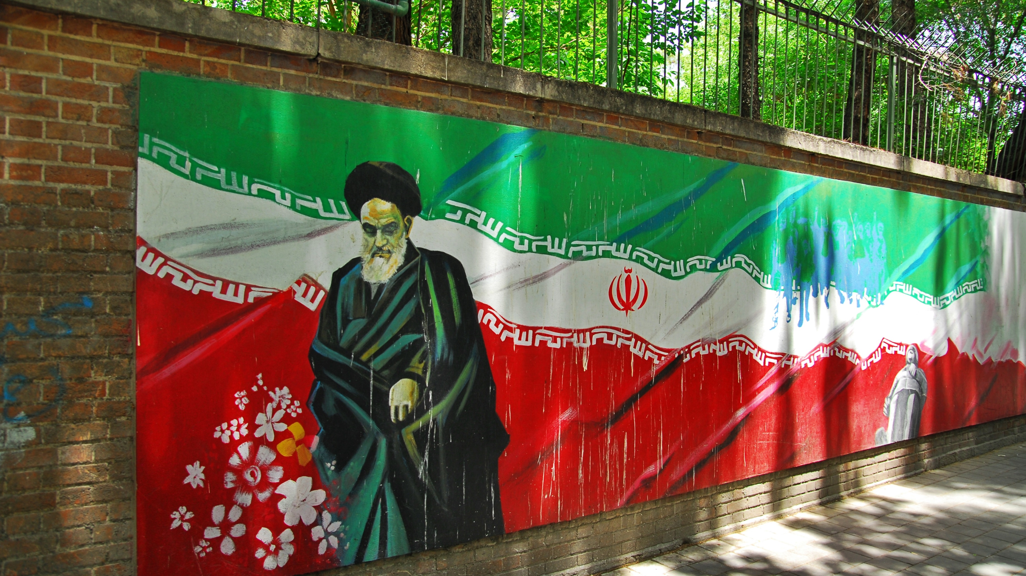
Notes:
A mural outside the American embassy in Tehran, Wikimedia
Photo: Pawel Ry, cc
What do you see in this picture?
Do you recognize the flag?
What do you think about the person on the flag? (What is he wearing? Who can he be?)

Slide 3
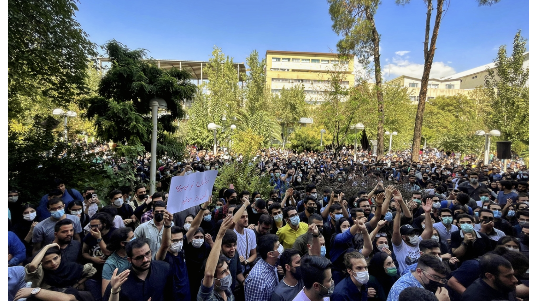
Notes:
"Women, Life, Freedom" protests at Amir Kabir University in Tehran, September 20, 2022. Photo: Darafsh, cc
What do you see in this picture?
Have you seen anything like this before?
Have you participated yourself?
What is the purpose of demonstrations such as this?

