Slide 1


Nobel Peace Prize 2025
FREDSPRISLEKSJONEN
Part 2

Slide 2
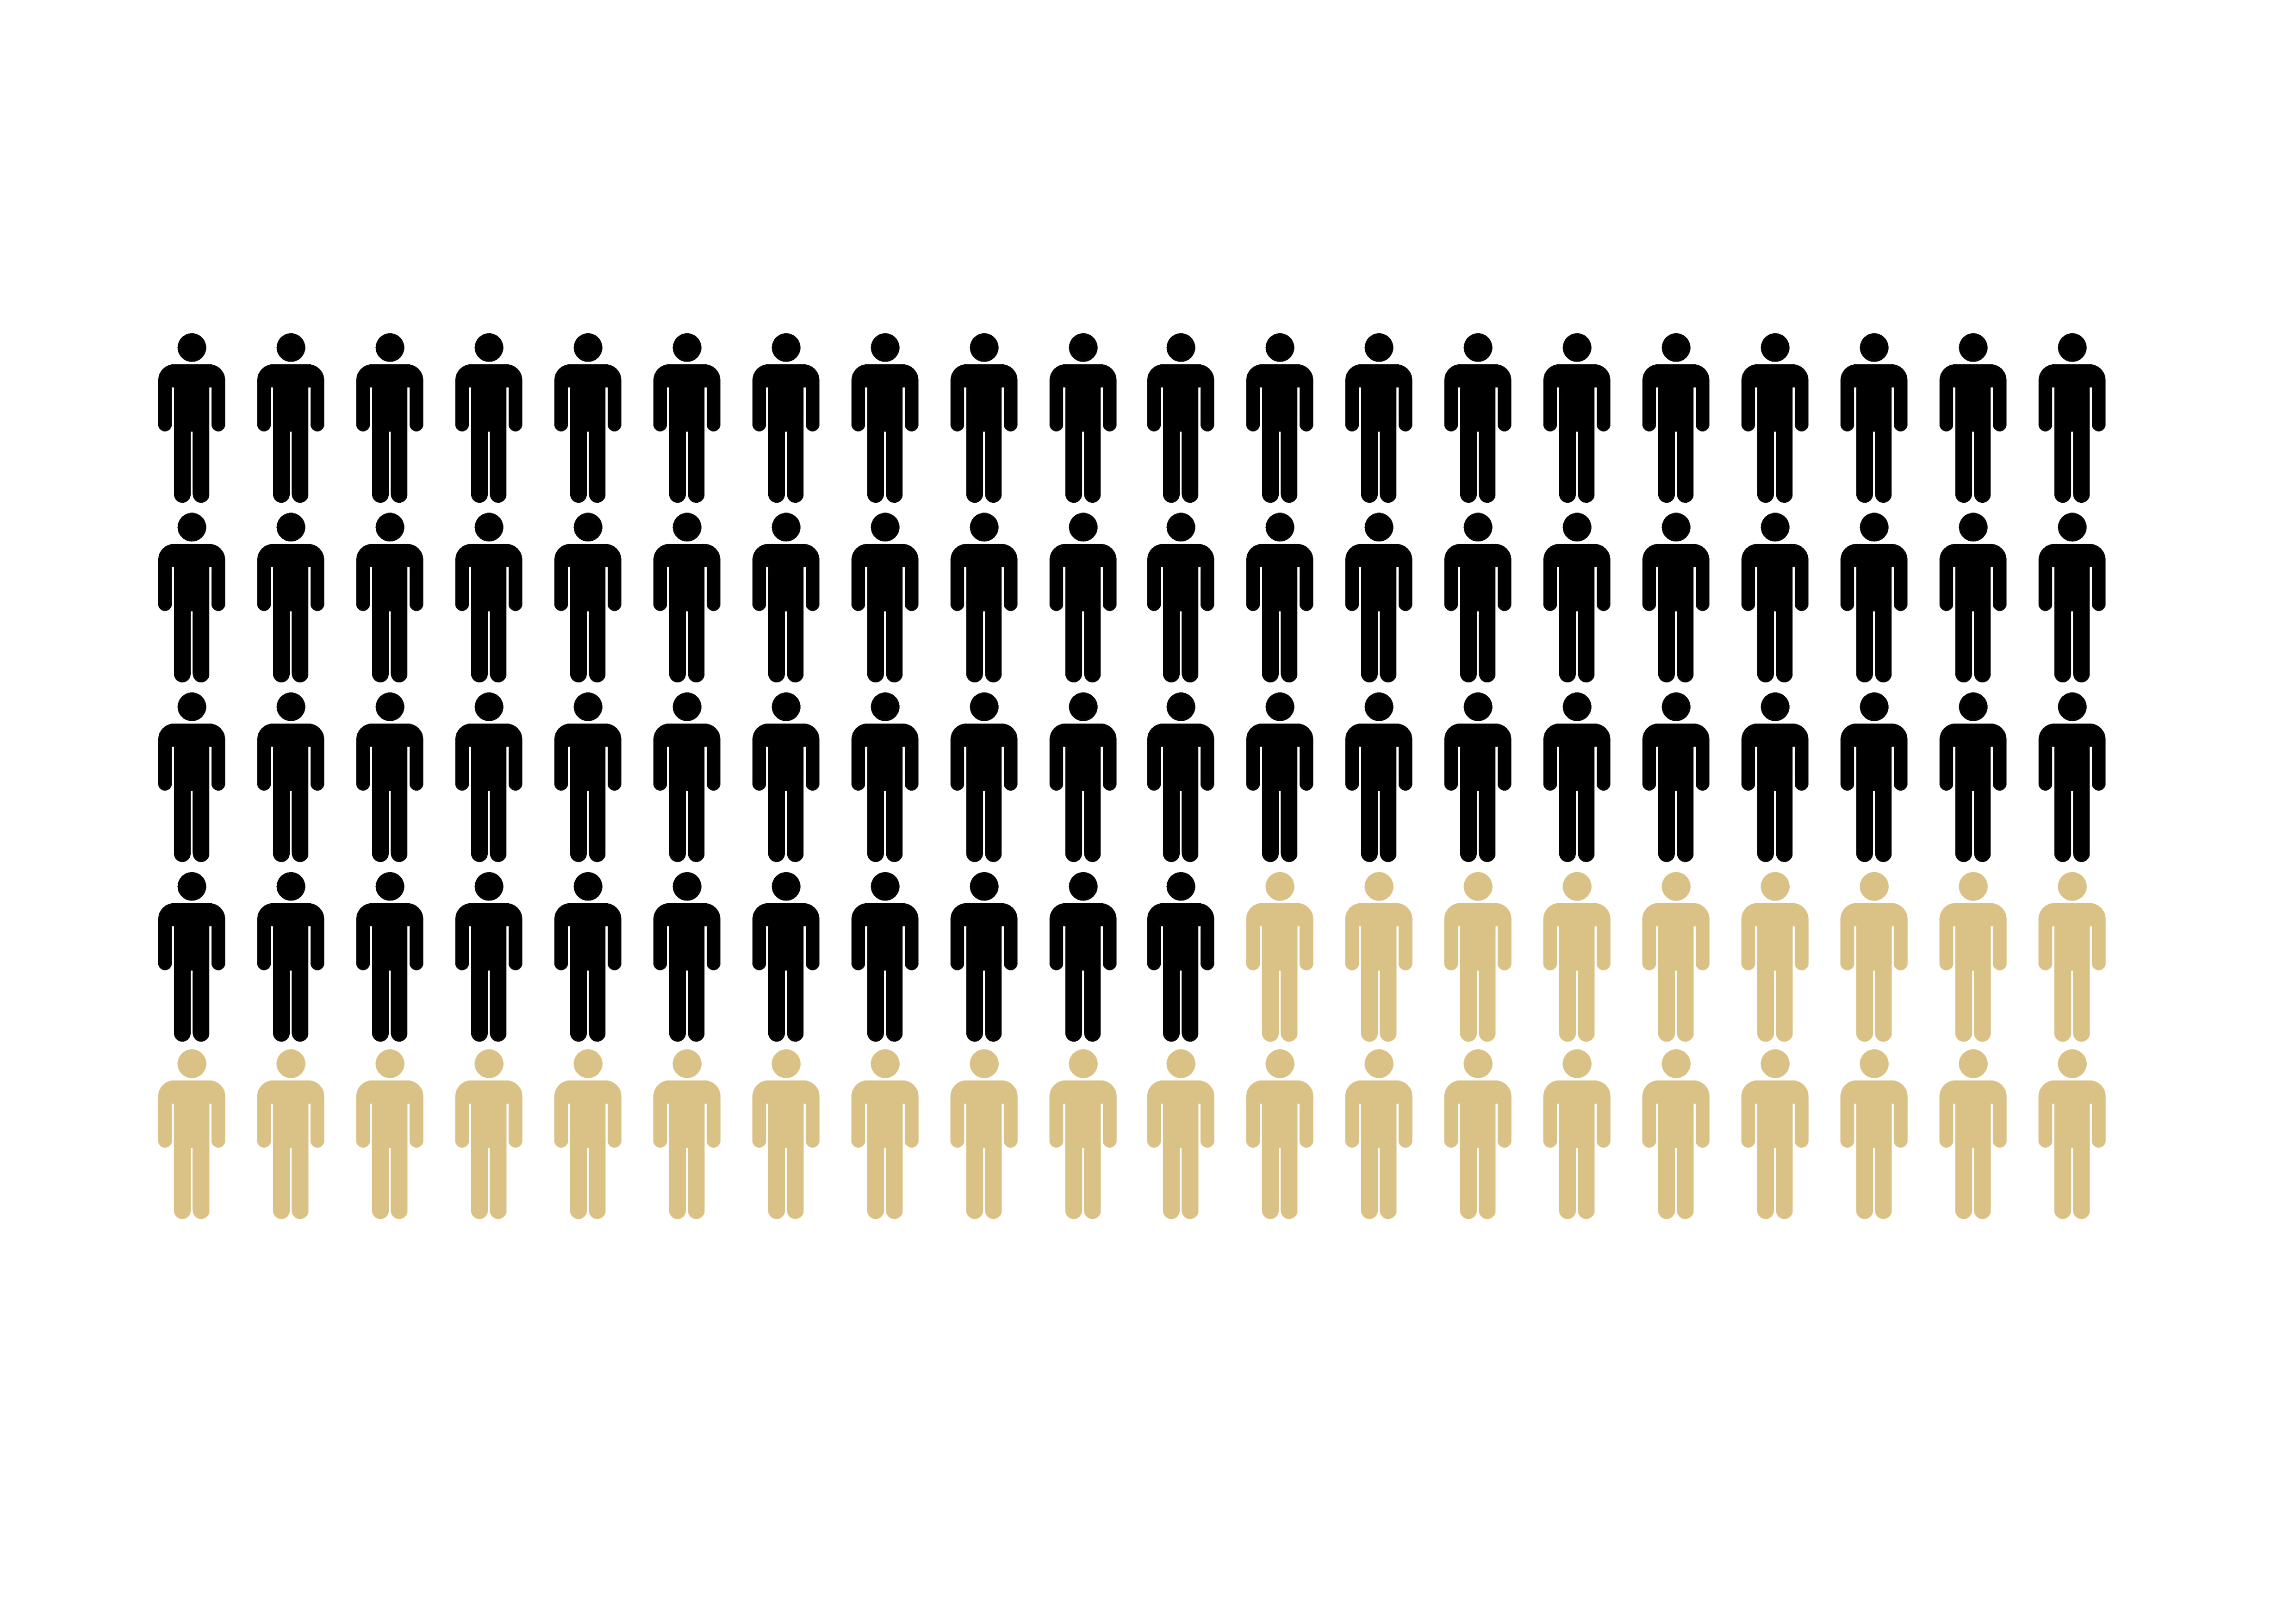
FREDSPRISLEKSJONEN
71% lives in autocracies
29% lives in democracies
Notes:
What do these numbers mean? Let the students guess. In 2022, 71% of the world’s population lived under autocracies – a system of government where power is concentrated in the hands of one person or a small group, who have full control over the state without real influence from the people.
29% lived in a democracy, where power is distributed and the people have a say through, among other things, free elections.
Today, unfortunately, democracy as a form of government is in decline.
For the most part, democracies are not destroyed by coups and wars. They are destroyed from within.
It happens gradually and it can be hard to notice. But that’s what we’re going to practice now.
Source: https://ourworldindata.org/

Slide 3

FREDSPRISLEKSJONEN
Group exercise:
The Democracy Thermometer: When do the warning lights flash?
You will now be presented with several scenarios
Rank the scenarios on the democracy thermometer:
Compatible with a democracy = low temperature
Seems suspiciously like a dictatorshio = high temperature
Notes:
Explain the task and preferably go through an example with the students so everyone understands. Remember to go through the examples in the order it is listed below.

Slide 4

FREDSPRISLEKSJONEN
Sorting exercise:
What are these scenarious really about?
Choose the category you think best fits each event.
There may be more than one correct answer, but agree within your group on what you think fits best.
Notes:
Now the students will try to categorize the scenarios. Several answers may be correct, but ask the students to place the scenario in the category they believe is most appropriate. Hand out the sheets with the categories. Go through the terms together with the class if needed. Explanations are on the next slide.
Finish with a group review. Highlight examples where students have categorized differently.

Slide 5
EXPLANATIONS
FREDSPRISLEKSJONEN
Separation of powers: Power in the state is divided between legislative, executive, and judicial branches to prevent abuse of power.
Freedom of speech: The right to express one’s opinions without being punished.
Freedom of assembly and association: The right to form associations and participate in meetings or demonstrations.
Free and fair elections: Elections where everyone has equal opportunity to vote and run for office.
Freedom of information: The right to access and share information, and to have insight into what the authorities are doing.
Civil disobedience: A non-violent breach of the law done to protest something perceived as unjust.
Minority protection: The idea that minority groups are entitled to special protection.
Rule of law: Everyone is equal before the law and entitled to a fair trial.
Trust in institutions: People accept decisions and elections because they trust the system is fair.
Democratic culture: Attitudes, values, and habits that support democracy.

Slide 6
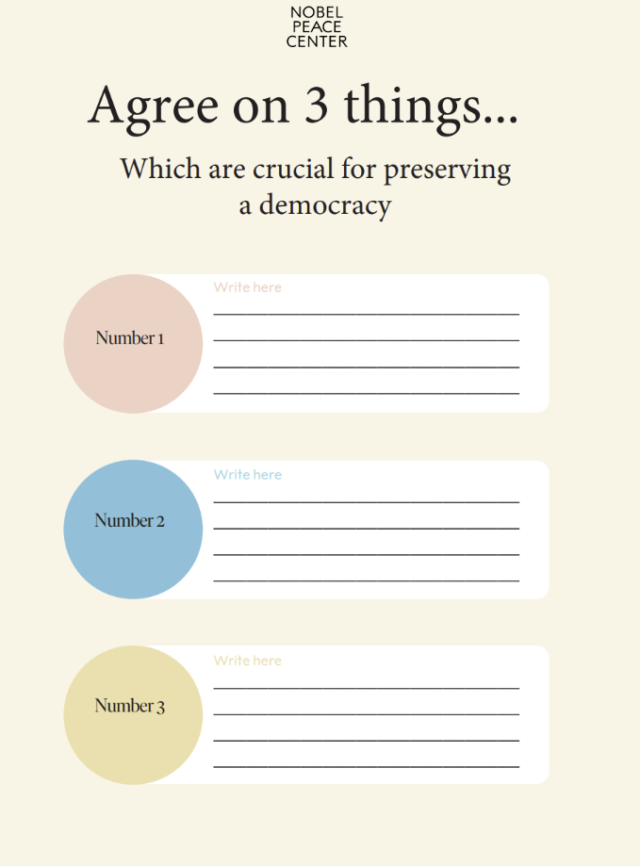
FREDSPRISLEKSJONEN
Notes:
Democracy cannot be taken for granted. It must be protected every single day. What can we do?
In pairs/groups: Students agree on 3 things they believe are crucial for preserving democracy.

