Slide 1

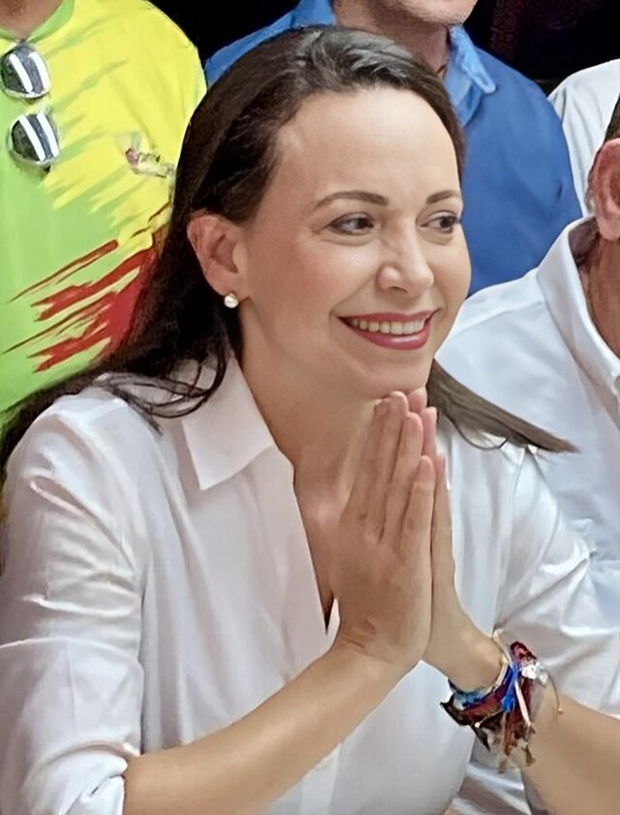

Nobel Peace Prize 2025
FREDSPRISLEKSJONEN
MARIA CORINA MACHADO
Notes:
On Friday, the Peace Prize for 2025 was awarded in Oslo. Has anyone heard about this? Who received it? Where is she from? What is the Nobel Peace Prize?
Maria Corina Machado from Venezuela in South America has been awarded the Nobel Peace Prize. The Peace Prize is given to individuals or organizations that have made important contributions to peace, for example human rights or democracy.

Slide 2
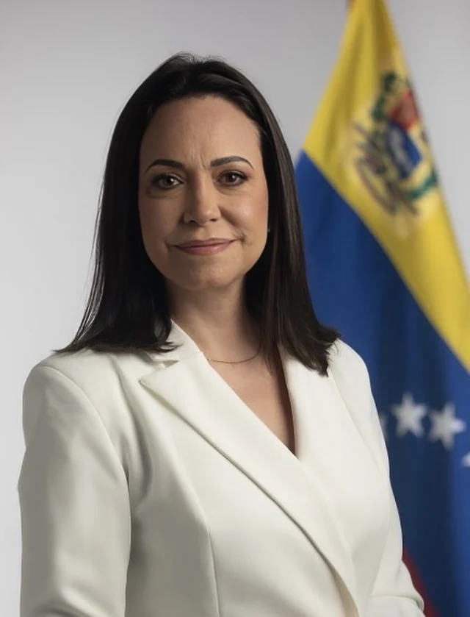
FREDSPRISLEKSJONEN
«(…) for her tireless work promoting democratic rights for the people of Venezuela and for her struggle to achieve a just and peaceful transition from dictatorship to democracy.”- The Norwegian Nobel Committee
Notes:
Ask: What do you think it means to fight for democratic rights?
Now, we’re going to watch a video from NRK that explains who she is, and what she is fighting for.

Slide 3

FREDSPRISLEKSJONEN
Watch the NRK video here

Slide 4

FREDSPRISLEKSJONEN
Questions for the video:
Why will Maria Corina be awarded the Nobel Peace Prize?
Why do you think the authorities in Venezuela wanted to prevent her from running for election?
What has Maria Corina specifically done to fight for democracy?
What does Jørgen Watne Frydnes believe is important to do to preserve democracy in Norway?
Notes:
Work individually or in groups. You may choose to review the results together at the end.
After the review: Now we’ve gotten to know Maria Corina Machado and her fight for democratic rights in Venezuela. We’ve seen how many people in the country live in deep poverty, are oppressed by the regime, and how many have chosen to flee because they no longer see a future there.
But how did it come to this? Now we’re going to do an activity where we explore the history behind it.

Slide 5
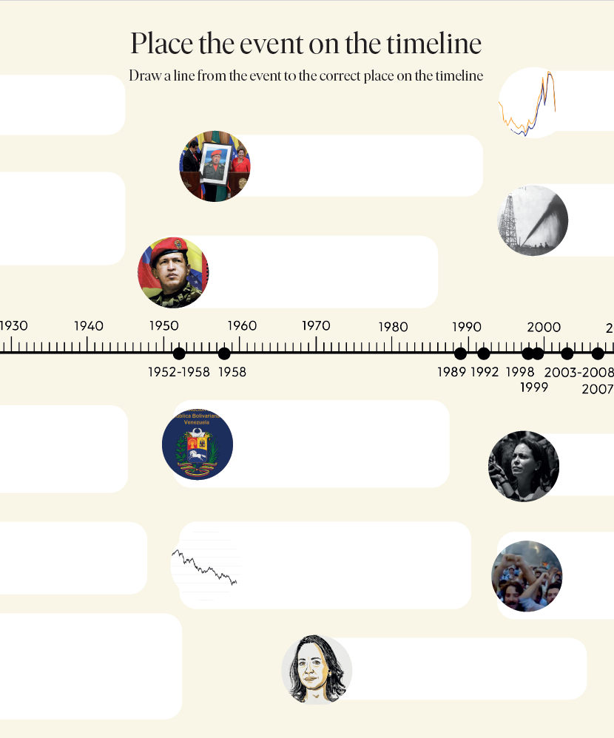
Group activity ​- Timeline
The History of Venezuela – 100
Years in 14 Events
1) Get your timeline sheet.
2) Draw a line from the events to the correct places on the timeline.
Notes:
Venezuela has gone from being one of Latin America's richest countries to a nation marked by crisis and authoritarian rule. In this activity, you will match key events with the correct year – and gain an overview of how the country ended up where it is today.
Practical instructions: Divide the students into pairs or small groups and hand out the timeline activity sheet along with a pen or marker, preferably in a bright color. We recommend allowing students to use digital tools to help complete the task.
Wrap up the session with a summary of the historical events. Overview: 1910–30: The oil industry is established in Venezuela; the country quickly becomes the world’s largest oil exporter and becomes highly dependent on oil.
1952–1958: The dictator Marcos Pérez Jiménez rules the country with an iron fist. He is eventually overthrown by the people.
1958: The first democratically elected government. The period brings growth and stability but also creates frustration over inequality and poor governance.
1989: Large protests against price increases are brutally suppressed by the authorities. The event weakens trust in democracy and paves the way for Hugo Chávez.
1992: The radical officer Hugo Chávez leads a failed coup attempt. He is imprisoned and becomes a symbol of resistance against the elite.
1998: Hugo Chávez is elected president. During the campaign, he promised to fight corruption and promote social justice.
1999: Venezuela adopts a new constitution that gives the president more power. Democracy gradually weakens through increased control over media, courts, and other institutions.
2003–2008: Chávez allows the state to take over many businesses. This leads to lower production, more corruption, and the beginning of an economic decline.
2007: María Corina Machado emerges as a key opposition leader and strong critic of the regime.
2013: Hugo Chávez dies, and Nicolás Maduro takes over. He continues Chávez’s policies but enjoys less popular support.
2014–2018: Oil prices fall sharply. The country is hit by economic crisis, food shortages, and international pressure.
2024: Widespread electoral fraud is reported after a new presidential election. María Corina Machado leads an independent citizens’ movement of election observers criticizing the vote.
Oct 1, 2025: After accusations of corruption and electoral fraud, Maduro decides to move Christmas forward. From now on, Christmas will start on October 1. This is celebrated with fireworks from the city’s infamous prison and torture chamber, El Helicoide.
Oct 10, 2025: María Corina Machado is awarded the Nobel Peace Prize for her fight for democracy in Venezuela.

