Slide 1

Lesson 4
Responsible Use of AI
techfutures.org.au

Slide 2
Learning objectives
By the end of this lesson, you will:
Understand how AI is changing the way we work and live
Understand the impact of cognitive offloading when using AI
Learn about AI and creativity and how artists, musicians and writers are responding to Generative AI
Reflect on how you can use AI responsibly
Understand what obligations AI companies have to behave responsibly
Learn about AI Responsible Use policies

Slide 3
Recap of Lesson 3: Types of False Information
Drag each example box into the matching type of false information.
AI EXAMPLES
TYPES OF FALSE INFORMATION
Misinformation
Chatbot makes up a statistic
Reposts an AI flood image
Fake account makes a deepfake
Disinformation
AI bots post fake reviews
Notes:
This is a quick recap of the types of false information.
Students should drag each example box into the matching type box.
Answers:
Chatbot makes up a statistic - Misinformation
Reposts an AI flood image - Misinformation
Fake account makes a deepfake - Disinformation
AI bots post fake reviews - Disinformation
Remind students to think about intent: was it a mistake, or was someone trying to trick people?

Slide 4
Recap of Lesson 3: Privacy and AI
Drag each example box into SAFE TO SHARE or NOT SAFE TO SHARE.
AI EXAMPLES
SAFE TO SHARE?
Safe to share
Made-up character name
Real name, school and suburb
General homework question
Password or login code
Not safe to share
Photo or voice clip before checking
Friend's name and problem
Notes:
The aim of this exercise is to review what is safe to share with AI.
Students should drag each example box into SAFE TO SHARE or NOT SAFE TO SHARE.
Answers:
Made-up character name - SAFE
Real name, school and suburb - NOT SAFE
General homework question - SAFE
Password or login code - NOT SAFE
Photo or voice clip before checking - NOT SAFE
Friend's name and problem - NOT SAFE

Slide 5
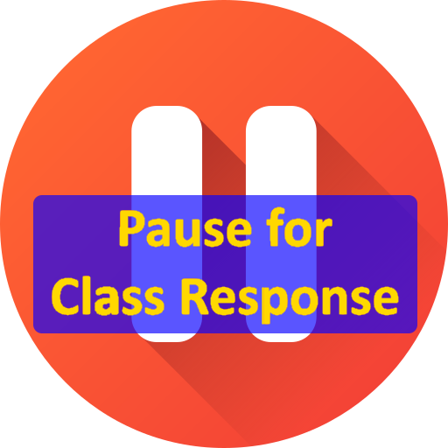
What do people use AI for?
Brainstorm some known uses:
Do you or your family use it?
What have they used it for?
Notes:
The aim of this slide is to get students thinking about what people use AI for. Brainstorm with the students all the applications for AI they can think of.

Slide 6
How are people actually using ChatGPT
Last September, OpenAI released the results of studying over 1.5 million conversations on how people are using chatGPT. They broke it down into these categories:
🙋 Asking (49%) - The most common use. People treat ChatGPT like a personal advisor, asking for information, opinions, and guidance rather than just getting it to do things for them.
✅ Doing (40%) - Getting ChatGPT to complete actual tasks like drafting text, planning, and coding. About a third of this is work-related.
💭 Expressing (11%) - The smallest category. This is where people are just sharing ideas with ChatGPT and reflecting or exploring.
See here for more details: https://openai.com/index/how-people-are-using-chatgpt/.
Notes:
A surprising result of this study is that 11% of usage is basically people just sharing with ChatGPT. Ask the students if they find this surprising.

Slide 7
How are people actually using ChatGPT
Interestingly, about 70% of the conversations were for personal reasons and not work-related.
Over 700 million people use ChatGPT every week, which is almost 10% of the world's adult population
It's replacing Google for some. Using ChatGPT to search for information grew from 14% to nearly 25% of all conversations in just one year.
When ChatGPT launched, over 80% of users had typically male names. By 2025, more than half of active users are women.
These survey results show that AI chatbots have really become integrated into people’s daily lives even outside of work.
Notes:
Another interesting result is that so many people are using chatbots outside of work: 70% is for personal reasons. That means people are using AI for things like study help, planning, writing messages, brainstorming ideas, asking health or lifestyle questions, making travel plans, or just exploring topics they are curious about.
The scale is also important. It is amazing how many people are using it, almost 10% of the world.
Another interesting point is that Google Search is being replaced; it is a real change in how we use the internet. It’s almost AI first rather than Google search first now.

Slide 8

Brainstorming
AI is great as an ideas generator. It can instantly suggests loads of ideas to help you get started on your project.
"Give me 10 unusual angles for a school project on climate change that most students wouldn't think of."
When you’re stuck, AI can help you get “unstuck”.
"I'm writing a story and my character just arrived at an abandoned house. I have no idea what happens next. Give me 5 unexpected directions the plot could go."
AI can look at a topic from many different points of view to help you see the bigger picture.
"Explain the pros and cons of social media from the perspective of a teenager, a parent, a psychologist, and a tech CEO."
Photo by Alessandro Bianchi on Unsplash
Notes:
The aim of this slide is for students to see all the different ways AI can be used for brainstorming. It can do other things than just come up with a list of ideas.

Slide 9
More Brainstorming
AI is good at suggesting “what-if” questions to help you be more creative.
"I'm doing a project on the Roman Empire. Give me 10 'what if' questions that could make my essay more interesting and original."
Once you have a nearly finished solution, AI is good at fine-tuning to take your work to the next level.
"Here is my conclusion paragraph for my history essay: [paste text]. Make it more powerful without changing my main argument or making it sound like an adult wrote it."
Photo by Alessandro Bianchi on Unsplash

Slide 10
Activity 4.01: Using AI for Brainstorming
Complete the activity on the platform
Download the worksheet here.

Slide 11
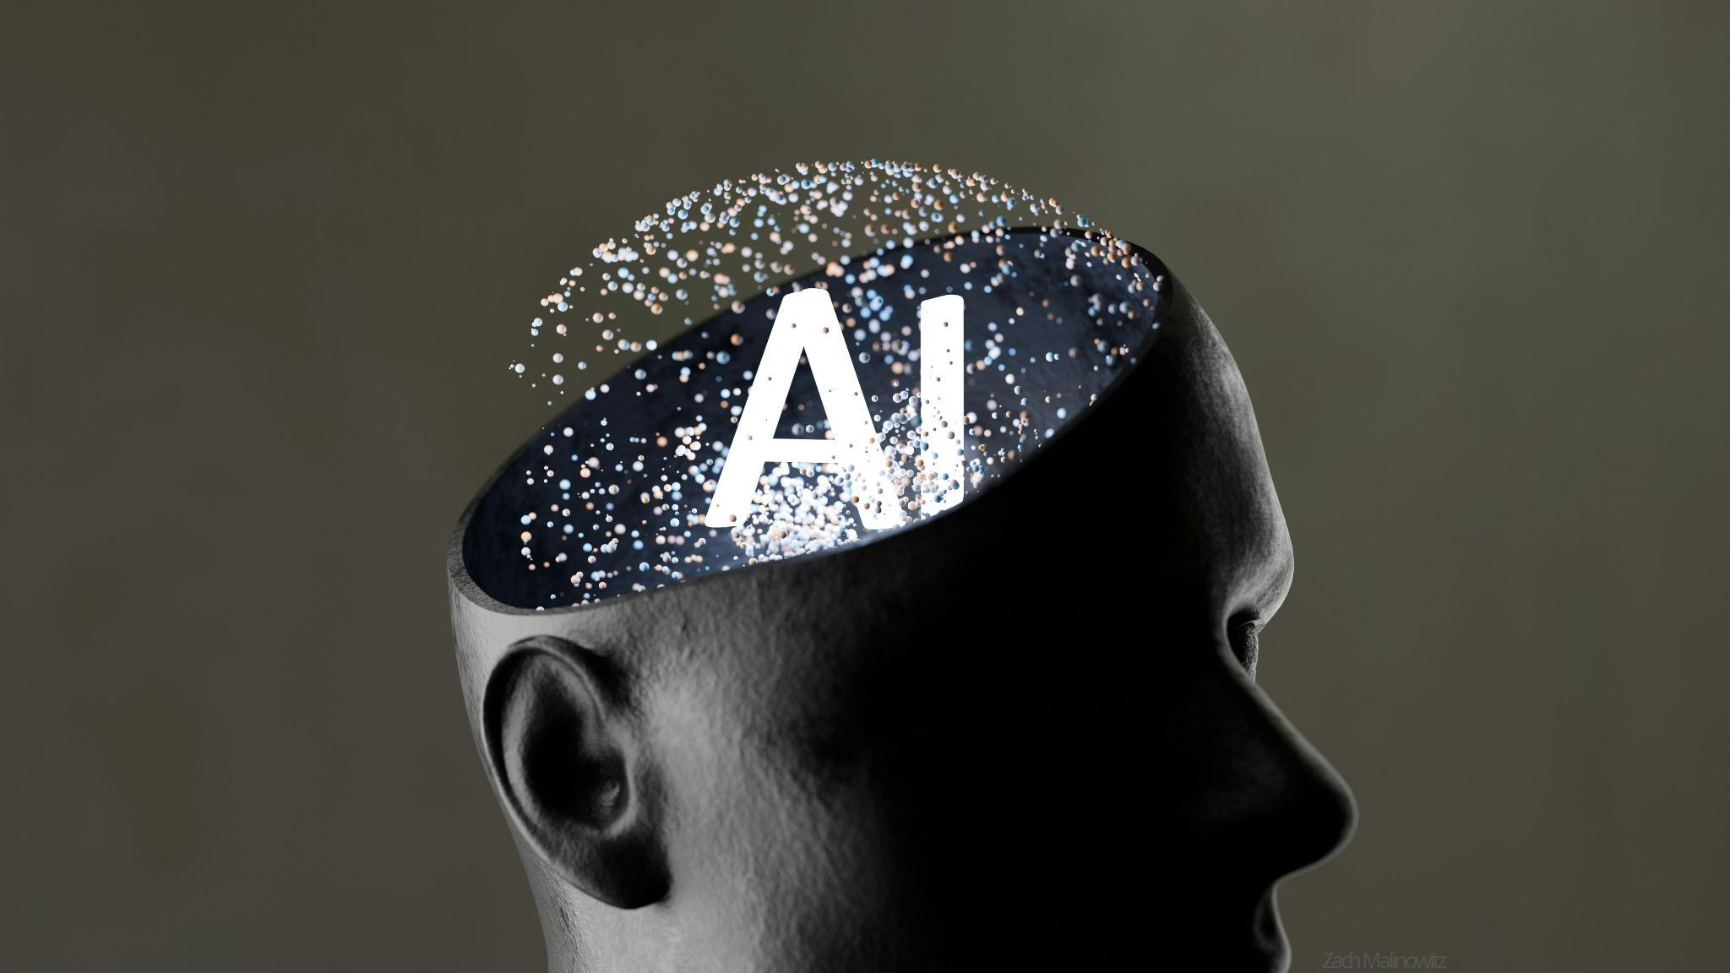
Feedback
LLMs can be used to quickly get detailed feedback on your writing, ideas and designs.
Unlike a teacher who can usually only review your work once or twice, an LLM lets you revise as many times as you want. And there is no judgement.
The feedback can be very specific and the LLM will suggest exactly how to fix errors.
Good use of AI feedback means reading the suggestions carefully and deciding what to accept or reject which will build your thinking skills.
Photo by Zach M on Unsplash
Notes:
This slide introduces students to one of the most practical and immediately useful applications of LLMs in their school life: getting feedback on their own work.
The key message here is that AI feedback is a supplement to teacher feedback, not a replacement. Encourage students to use it in the drafting stage,before they submit work, rather than as a way to avoid the revision process altogether.
The "judgement-free" aspect is worth discussing openly. Research suggests many students are reluctant to show unfinished or imperfect work to teachers or peers. LLMs remove that social anxiety, which can actually encourage students to draft and revise more willingly.
The final dot point is the most important one for critical thinking. Students should be reminded that LLMs can be wrong, overly cautious, or miss the point of a creative choice the student made deliberately. Accepting every suggestion without thinking is just as problematic as not revising at all.

Slide 12
Activity 4.02: Using AI for Feedback
Complete the activity on the platform.
Download the worksheet here.

Slide 13

Research
LLMs can quickly give you an overview of a topic and suggest areas worth exploring.
They are great at summarising information in plain language helping you understand a topic before you dive into the real sources.
As you saw in Lesson 3, LLMs can make up citations that look completely real. Always use Trusted Sources to verify information.
A good approach is to use AI to build your understanding first and then use the real sources to write it in your own words.
Photo by Windows on Unsplash
Notes:
This slide builds directly on the fake citations activity from Lesson 3, so it's worth explicitly linking back to that experience before moving through the points. Ask students "what did we learn about trusting AI-generated sources?" to activate prior knowledge.
Key points to emphasise:
The distinction between using AI as a thinking tool versus a source is the critical message here. Students often don't see the difference. They find information via an LLM and assume it's verified. Reinforce that an LLM is more like a knowledgeable friend who sometimes makes things up convincingly than an encyclopaedia you can cite.
The summarising function is genuinely useful and worth validating. Students who struggle with dense academic or news articles can use LLMs as a "translator" to help them access content they might otherwise give up on. Frame this as a legitimate study skill.
A good discussion question: "If an LLM gives you a great summary of a topic but you can't find the original source — should you use it?" This tends to generate strong opinions and reinforces the Trusted Sources framework from earlier lessons.

Slide 14
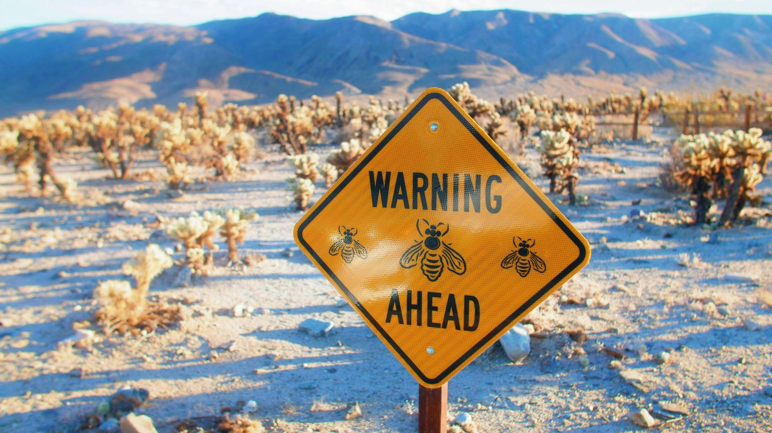
Research cautions
A researcher fed Microsoft Copilot a dataset about expressing emotions where the responses from US and UK participants were completely identical, word for word, the same data.
When asked to find differences between the two groups, Copilot confidently produced a detailed summary claiming Americans and British people expressed emotions differently in tone and wording style.
Copilot invented differences between them based on stereotypes it had learnt during training.
The AI doesn’t always tell you when it has nothing real to say, so always verify summaries against a trusted source.
Photo by Crystal Kay on Unsplash
Notes:
The key detail here is that the training data was identical: word for word the same. The AI had literally nothing real to find. Yet it still produced a detailed, confident, plausible-sounding summary of cultural differences. Ask students: "If you had submitted this AI summary as part of a research project, what could have happened?"
The AI when asked to compare the two groups drew on all its learned associations rather than the actual data in front of it. It essentially saw what it expected to see rather than what was there.
A Good Discussion Question: "Can you think of situations where an AI producing stereotyped summaries like this could cause real harm?" Students often suggest examples like job recruitment, medical decisions, or news reporting. These are all areas where AI is already being used.

Slide 15
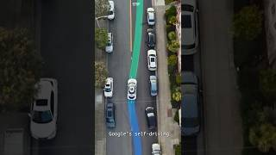
Self-driving cars: changing the way we get around
This Self-Driving Taxi Has NO DRIVER Inside! - Nexttech Aircraft Source: YouTube
Notes:
The purpose of this slide is to show how much daily life is changing and it is a glimpse of the future.
AI uses cameras, radar and sensors to detect pedestrians, cyclists and obstacles in real time faster than any human reaction time. 94% of serious crashes involve human errors. Self-driving AI never gets tired distracted or looks at its phone.
AI does struggle in unusual conditions like heavy snow or unexpected roadworks. A human driver is still required in most places.
However, Waymo is operating in all these cities: San Francisco Bay Area, Phoenix, Los Angeles, Miami, Nashville, Orlando, Dallas, Houston, San Antonio.

Slide 16

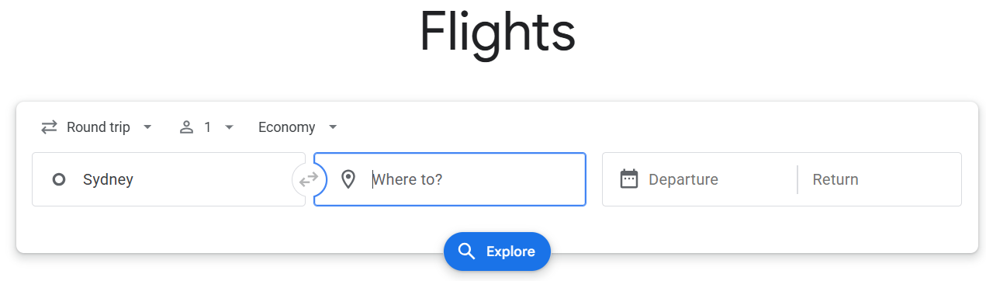

How AI has changed Travel?
Safer skies: modern aircraft use AI to detect faults, predict maintenance needs and assist pilots, reducing the risk of accidents. In 2024, Qantas adopted an AI system to predict failures before they occur.
Photo by Hao Zhang on Unsplash
Smarter pricing: AI apps like Google Flights analyse millions of variables to set flight and hotel prices in real time.
Faster border control: AI-powered passport scanners and facial recognition like at Sydney airport can make it quicker to go through security although you have to share your private information.
Photo by Nicole Geri on Unsplash
Notes:
This slide uses aviation and travel as a relatable, real-world context to show students that AI is already embedded in systems they or their families interact with, making it a great hook for discussion.
The aircraft example is here to show that AI is more than chatbots. It is used in high-stakes situations where reliability really matters. A good discussion question: "If AI is helping keep planes safe, does that make you more or less comfortable flying — and why?" This naturally leads into conversations about trust, accountability, and what happens when AI gets it wrong.
With Smarter Pricing, students may not realise that the price they see on Google Flights changes depending on when they search, what device they use, and their browsing history. Ask students: "Is it fair that two people searching for the same flight at the same time might be shown different prices?"
With the Faster Border control example, acknowledge the convenience benefit but push students to think about the trade-off: speed versus privacy. Key questions to raise: "Who stores your facial recognition data? How long do they keep it? Could it be misused?" Link this back to the privacy points covered earlier in the unit.

Slide 17

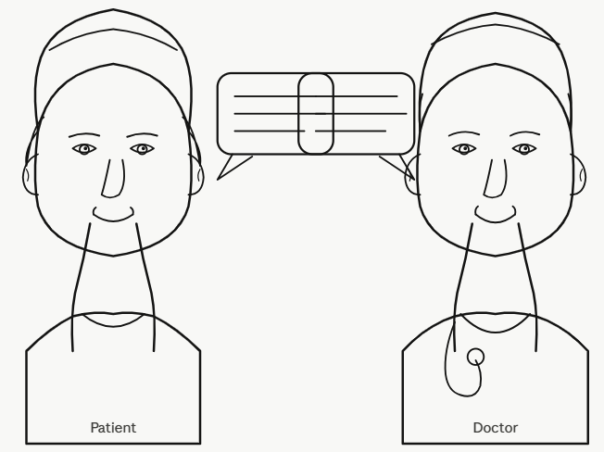
No translators required
Real-time translation: Google Translate and DeepL now handle over 100 languages instantly. You just point your phone camera at a foreign sign and can read it in your own language
Live spoken translation: AI can translate speech from one language to another in real-time allowing two people with no common language to communicate without a human translator.
Image generated by ChatGPT 5.5
Saving lives in hospitals: AI tools help doctors communicate with patients who speak rare languages making treatment quicker.
Image generated by Claude AI
Sonnet 4.6
Notes:
This slide shows the impact AI is already having all over the world.
Most students will have used Google Translate at some point, but many won't know about the camera function. Consider doing a quick live demo in class. Point a phone camera at text in another language to make the technology tangible. The Dutch road sign example from earlier in this unit works well here. DeepL is worth mentioning as a lesser-known but often more accurate alternative for European languages.
Live Spoken Translation is where the technology becomes genuinely impressive. You can relate this back to the story in the bible of Babel if that’s relevant for your context. The idea that two people with no common language can have a real conversation via a phone would have seemed like science fiction 10 years ago. Microsoft Translator is the strongest classroom example here as it supports multi-device conversations, making it particularly suited to face-to-face situations. A good discussion question: "Could you ever fully trust a machine to translate an important conversation — like a legal or medical discussion?"
Ask students to imagine being seriously ill in a hospital and not being able to explain your symptoms. It also naturally raises a counter-question worth discussing: "If AI translation is available, does that reduce the need for human interpreters — and is that a good thing?"

Slide 18
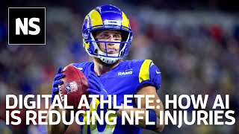
AI Keeping Athletes Safe
How the NFL's Digital Athlete uses AI to reduce concussions in American Football - New Scientist.
Source: YouTube
Notes:
This is another example of how AI is helping improve the quality of life for people. AI can detect concussion early and can also predict other injuries before they happen to athletes. They can review behaviour that may cause future injuries and they can help make fairer decisions with automated referee systems.

Slide 19
Activity 4.03: How AI is changing work and life
Complete the activity on the platform.
Download worksheet here
Notes:
Sample answer from Lumen:

Slide 20

Cognitive offloading
Cognitive offloading is when you use a tool to do your thinking for you instead of doing it yourself. For example, using Lumen to do your brainstorming instead of doing it yourself first, like you did earlier.
With generative AI, you can “offload”
almost any thinking task from writing an essay
to solving a problem with a simple prompt.
The problem is that struggling through a task is
actually how your brain learns and remembers. If AI does the hard part for you, you get the answer but miss the mental workout that builds the skill.
Photo by Steve A Johnson on Unsplash

Slide 21

Cognitive offloading research
Research conducted by Natilya Kosmyna at MIT’s Media Lab in June 2025, still under review, found that students using AI might think less for themselves.
54 students in the study were split into 3 groups: ChatGPT, Google Search, and No tech and asked to write essays.
Their brain activity was measured while doing the writing using EEG headsets.
Photo by Mindfield Biosystems on Unsplash
Notes:
For those who are interested here are some related research articles:
https://www.ndtv.com/feature/heavy-ai-use-could-be-making-you-stupider-mit-research-11389115
https://arxiv.org/pdf/2506.08872
https://www.mdpi.com/2075-4698/15/1/6 (Gerlich)

Slide 22
What the research found
The students using ChatGPT showed the lowest brain activity. Over time they used it more and more, often just copying what it produced. Their essays were noticeably similar to each other and short on original thinking.
The students using No tech showed the highest brain activity. They were more creative, more curious, and seemed to get more satisfaction from the work, feeling a genuine sense of pride in what they had written.
The students using Google Search also showed high brain activity and enjoyed the task. This shows using AI to search is very different from having it write for you.
Adapted from Day of AI, MIT RAISE (Responsible AI for Social Empowerment and Education). [The Cognitive Card Game], [2025]. dayofai.org. Licensed under CC BY-NC-SA 4.0.
Notes:
This slide gives students concrete, scientific evidence for something they may have already sensed intuitively, that taking shortcuts with AI might be making them less capable over time, not more.
The ChatGPT Group: Ask students: "If everyone in the class uses ChatGPT to write their essay, what happens to original thinking? What happens to your individual voice as a writer?" The pattern of students using it more and more over time is also worth highlighting. This is the cognitive debt concept from earlier in the unit playing out in a real experiment. The tool becomes a crutch rather than a support.
The No Tech Group: The fact that these students reported the most satisfaction and pride in their work is a really important human point that goes beyond academic performance. Link this to the broader idea that struggle and effort are actually part of what makes achievement meaningful. A good question: "Has there been a time you worked really hard on something and felt genuinely proud of it? Would it have felt the same if a machine had done it for you?"
The Google Search Group: This challenges the assumption that all technology use is equal: searching for information and evaluating sources is an active, cognitively demanding task that keeps the brain engaged. Using AI to write for you is fundamentally different. This is a great opportunity to reinforce the earlier message about using AI as a finishing tool rather than a starting one.
Some students may push back and argue that ChatGPT is just a more advanced version of Google Search. The brain activity data is your strongest counter to this. The cognitive demands of the two tasks are measurably different.
A Good Closing Question: "Based on what you've just seen, how would you personally choose to use AI in your schoolwork and has this changed how you were thinking about it before today?" This works well as a reflective journal prompt or an exit ticket to close the lesson.

Slide 23
Cognitive debt and cognitive effort
❌ Students who used ChatGPT first couldn't remember their own essays when asked to rewrite them without it.
✅ Students who wrote independently first then used ChatGPT performed much better.
This suggests AI works best as a finishing tool, not a starting one.
cognitive debt is when the AI does the thinking for you. You are missing the workout that builds your thinking skills and that “debt” quietly builds up.
cognitive effort is when you do the thinking for yourself
Adapted from Day of AI, MIT RAISE (Responsible AI for Social Empowerment and Education). [The Cognitive Card Game], [2025]. dayofai.org. Licensed under CC BY-NC-SA 4.0. Licensed under CC BY-NC-SA 4.0.
Notes:
This slide introduces the concepts of cognitive debt and cognitive effort. These are really good terms for students to be thinking of every time they use AI.
Ask students: "Why do you think that students forgot their essay when they used ChatGPT first?" Guide them toward the insight that if you haven't done the thinking yourself, there is nothing for your brain to actually hold onto. The essay was never really yours. You were essentially a copy-paste operator.
The finding that students who thought independently first and then used ChatGPT performed better is an important and hopeful message. It shows AI isn't the enemy of good work, it's about when in the process you bring it in.
Cognitive Debt: Emphasise the word "quietly". This is what makes it dangerous. Students don't notice cognitive debt building up because in the short term, using AI feels efficient and the results look fine. It is only over time that the gap between what they can produce with AI and what they can produce independently grows wider. Ask students: "Can you think of another area of life where taking shortcuts regularly might cost you something later?"
Cognitive Effort:. Cognitive effort is not about making school harder for the sake of it. It is about the fact that thinking is literally a workout for your brain, and like any workout, the struggle is where the growth happens. The students who wrote independently reported more pride and satisfaction in their work. Effort and reward are connected.
A Good Discussion Question: "If you used AI for every assignment for the next two years, what do you think would happen to your ability to write and think without it?" This tends to generate honest and sometimes uncomfortable answers that make the concept of cognitive debt feel very real.

Slide 24
Examples of cognitive debt and cognitive effort
You ask a chatbot to write a draft essay for your English assignment and then you do a quick edit and submit it.
You use a chatbot to search for project ideas for your history assignment and then you choose one of these ideas and write your assignment yourself.
DEBT❎
EFFORT ☑️
Notes:
The key point here is that it is OK to use AI to help you as long as you are doing the important thinking.

Slide 25
Activity 4.04: Categorising cognitive debt vs effort
Complete the activity on the platform
Download the worksheet here
This activity is from Day of AI, MIT RAISE (Responsible AI for Social Empowerment and Education). [The Cognitive Card Game], [2025]. dayofai.org. Licensed under CC BY-NC-SA 4.0.
Notes:
The intent of this activity is to get students to think about what is cognitive effort vs debt

Slide 26

AI in creative fields
AI (particularly Generative AI) have been used in a variety of ways in different creative fields.
AI can be used to quickly create a variety of media and these can be useful in lots of creative works.
Restoring old songs: producers use AI to restore degraded recordings including restoring John Lennon’s voice from an old demo to release an unheard Beatles song
Film and TV: AI is used to remove wires, clean up backgrounds and generate crowd scenes much quicker than ever before
Crowd scene, generated using Google Veo
Notes:
This part of the lesson is about the application of AI in creative fields (such as music, fiction writing and movies) and some of the issues around copyright and fair use of AI.
Some students might have have strong views about the use of AI in these creative areas and fears about what this might mean for their futures as artists. Although it is hard to predict exactly what will happen with creative fields, it seems very likely that there always be a need for human creativity and AI will not replace humans completely. One point you can emphasis is that AI tools can help creatives speed up their work and help them create more.
There is an activity where students can discuss these issues and other opportunities where you let students share their perspectives throughout this part of the lesson if you would like to encourage this discussion.

Slide 27

AI in creative fields
Visual Art and Design: designers use AI to quickly mock up designs speeding up the time taken
Writing and Publishing: Authors use AI for brainstorming and publishers use it to do administrative tasks freeing themselves up for editing
Expanding Gaming: AI is being used to generate vast dynamic game worlds that respond to player’s choices in real time. Small game developers with tiny budgets can create games that previously required hundreds of people
Source: Budka Damdinsuren (Unsplash)
Notes:
If you have time and/or students interested in design, you might want to show them examples of how tools like Figma and Canva have AI features that can be used to generate designs quickly. Similarly, presentation tools like Google Slides and Microsoft PowerPoint have features that can be used to quickly change the design of slides. There will also be more examples of how designers and developers can create mockup designs quickly, when students learn about vibe coding.

Slide 28

Copyright
Whenever someone creates a novel or a poem, Copyright is the law that says it belongs to them.
Other people are not allowed to just copy chunks of their book or poem and publish it on the internet without paying them or getting permission. If they do, they can get sued.
This is true for all types of media such as photos, video and audio and it’s why you have to pay to use many images on the internet.
Purpose is to protect authors who create original works.
Copyright icon, generated using NanoBanana

Slide 29
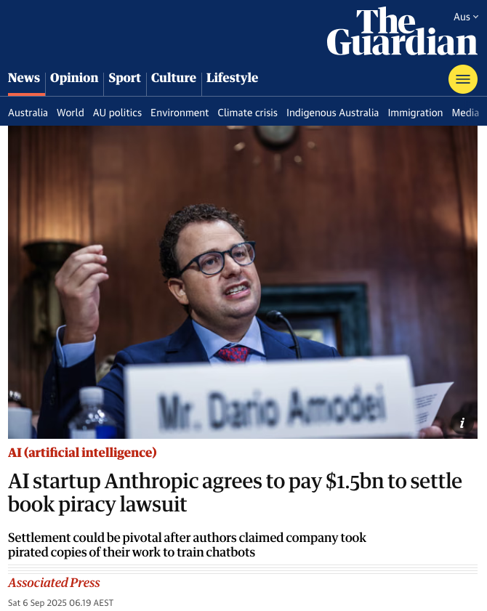
Copyright and AI
However, LLMs have been trained on most of the internet and sometimes the model developers have not had the right permissions for the training data they have used.
Many content creators (including song writers, photographers and authors) argue that AI LLM developers have “breached” copyright and stolen their material without permission.
A recent court case ended with Anthrophic (developers of the Claude LLM models) paying authors for pirating books used in their training. But that does not mean that LLM developers can’t use books in their training!
Source: The Guardian
Notes:
Anthropic paid to settle a lawsuit, because they had been found to have used pirated books (downloaded for free on the internet) as part of their training data. If they had paid for the books they downloaded, they would have been able to use them for training their models (including the Claude LLMs).
Copyright law is different in different countries and it’s important to note that a lot of the big AI companies run in the US, where there are generally less strict copyright laws, compared to Australia.
Teachers may want to challenge students to find other lawsuits against AI companies similar to this Anthropic one. There are plenty around!

Slide 30
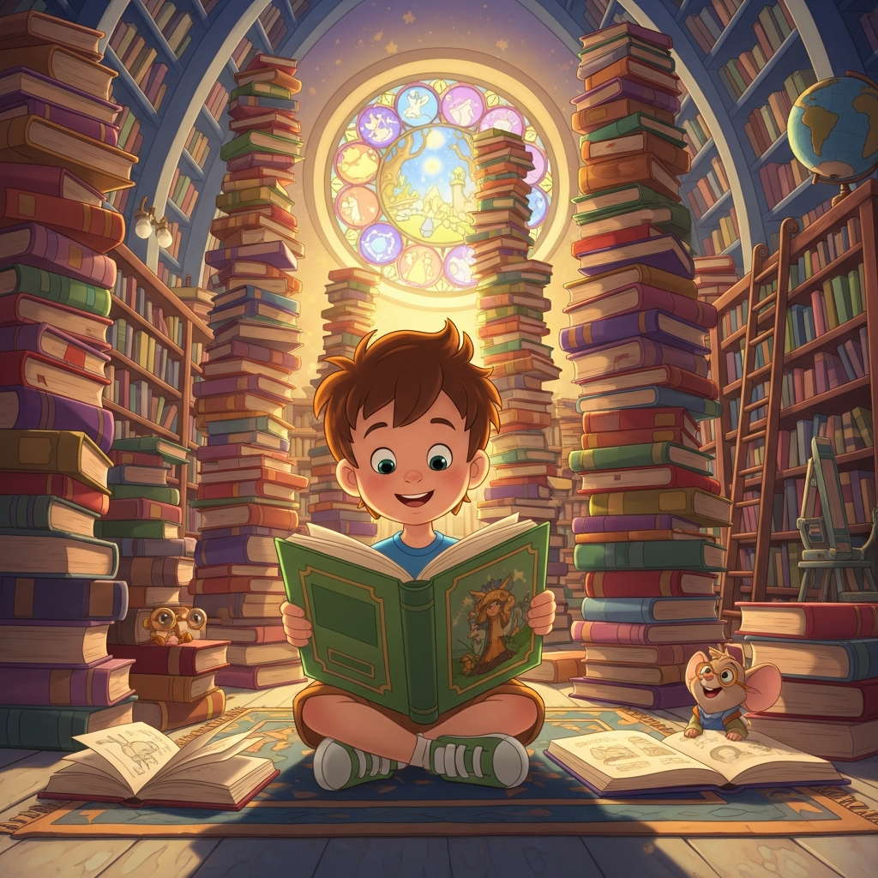
Fair use and fair dealing
Copyright law in the US has an exception called fair use.
Fair use allows people to use copyrighted material in limited ways without permission, including in news reporting, education or research.
AI companies argue that training on text is similar. They say they are not copying the books to resell them, they're learning patterns from them, the same way a human reader might.
In Australia, we have fair dealing, which is more strict than fair use.
A cartoon kid reading a book, generated using ImageGen 4.0 Generate
Notes:
It’s important to note that fair use is more relevant for the big AI companies (for example, OpenAI and Anthrophic) than fair dealing because they mostly operate in the US.
If you would like to know more about the differences between fair use and fair dealing, this page on the University of Newcastle website explains the differences: https://www.newcastle.edu.au/library/teaching-and-research-support/copyright/copyright-basics/copyright-basics/fair-dealing-vs.-fair-use
However, you may want to only mention fair dealing briefly and focus on the idea of fair use in court cases in the US for this lesson.

Slide 31
Fair use in US court cases
There have been several court cases in the US where AI model developers have defended their training on copyrighted materials is ok because of fair use.
Courts are still deciding who is right. In 2025, in a case between Anthropic and a collection of authors, a US judge ruled that training on legally obtained books was acceptable.
But downloading pirated copies of books to train Claude was not.
Anthropic agreed to pay $1.5 billion to settle the lawsuit.
There are many other examples of creative artists suing AI companies.
Notes:
This slide refers back to the Anthrophic court case mentioned on a previous slide. The key point of this slide and the preceding slides is that AI developers (in the US) are able to claim that training on copyrighted materials is fair use because the AI are learning from them like a human would and are not directly reproducing them. However, authors.
This is a topic where there is a lot of grey area (not black and white) and complexity because of differences in copyright laws across different countries. This makes it a good topic for discussion.
Another reference for the Anthropic case: https://apnews.com/article/anthropic-copyright-authors-settlement-training-f294266bc79a16ec90d2ddccdf435164

Slide 32
Activity 4.05: Copyright discussion
In groups of 3-4 classmates, discuss the statement:
“AI companies are stealing from human creators by training on their work without permission”
Come up with at least two arguments for and against this statement.
The activity is on the platform here. Complete the worksheet here.
Notes:
The intent of this activity is to get students to actively think and reflect on copyright issues, as they relate to Generative AI. Students discuss these these issues in small groups at first and then you can open up the discussion to the whole class.
We suggest you run the activity in the following way:
Split students into small groups of 3-4, away from their laptops/computers
Give students 10-15 minutes to discuss points for and against the statement and write them down
Move around the room to check in with students and offer examples if they are stuck
After all (or most) groups have at least 2 arguments for both for and against and have voted on which they agree with most, ask each group to share their thoughts
If the students are are engaged in the discussion as a class, spend some time discussing it as a whole group. Otherwise, you can wrap up the activity and move onto the next part of the lesson.
If the students are getting stuck thinking of arguments for and against the statements, you can use the worksheet solutions as examples. Or if the solutions include arguments that students don’t raise, you could discuss these as a group before moving onto the next part of the lesson.
Some students could have strong views about how AI can generate responses that included copyrighted materials and the impact this could have on authors and other creators. Some students might be indifferent to, or unaware of, these issues and not see them as potential problems.

Slide 33

Authors vs AI
There is currently another group of authors, including George RR Martin (Game of Thrones) suing OpenAI alleging that books were downloaded from pirate ebook websites and copied into ChatGPT. This lawsuit is still ongoing.
AI-generated fake books are appearing on Amazon using real authors' names — sometimes with deliberate misspellings like "Savana Gathrie" instead of Savannah Guthrie — tricking readers into buying them. AI has made producing these copycat books "so much easier and faster".
Fake book cover generated using ImageGen 4.0 Generate
Notes:
Fake AI books flooding Amazon under real authors' names
This is a particularly vivid example for students:
AI-generated fake books are appearing on Amazon using real authors' names - sometimes with deliberate misspellings like "Savana Gathrie" instead of Savannah Guthrie - tricking readers into buying them. The Authors Guild
Author Jane Friedman found six books bearing her name on Amazon that she never wrote. "As soon as I saw these books, I knew they were likely AI-generated… it was exactly the kind of generic, vague, not very good writing I would expect," she said. The Authors Guild
One author described the experience of removing fake books as "like whack-a-mole": take them down, and more appear weeks later. The Authors Guild
The Authors Guild CEO noted that AI has made producing these copycat books "so much easier and faster" and that they crowd out the real book before it even comes out. Variety
📰 NPR — Authors push back on AI scam books on Amazon
📰 Bloomberg Law — Fake Books on Amazon Drive Authors to Shield Their Names
The Empty Book (2026)
Following the silent album, 10,000 writers published a book together called Don't Steal This Book — which was completely empty, as a protest against AI firms using authors' work without permission. Soundplate
The Big Lawsuit — household name authors vs. OpenAI
In 2023, the Authors Guild filed a class action lawsuit against OpenAI, with named plaintiffs including John Grisham, George R.R. Martin, Jodi Picoult, Jonathan Franzen and David Baldacci — some of the best-selling authors in the world. TechCrunch
The lawsuit alleged that books were downloaded from pirate ebook repositories and copied into the fabric of ChatGPT, which OpenAI expects to earn many billions from. The authors argued that without their work, OpenAI "would have a vastly different commercial product." NPR
The lawsuit also cited attempts to use AI to generate volumes 6 and 7 of George R.R. Martin's Game of Thrones series — books he hasn't written yet — as an example of how AI exploits authors' creative identities. NPR
📰 CNN — George R.R. Martin, Jodi Picoult and other famous writers sue OpenAI
📰 Authors Guild — full details of the lawsuit

Slide 34
Musicians vs AI
In 2024, over 200 musicians signed an open letter warning about the unfair use of AI in music.
Artists including Billie Eilish, Nicki Minaj, Katy Perry, Stevie Wonder, Beyoncé and others raised concerns.
Their main worry was that AI could be used to copy voices, styles, lyrics, or performances without permission.
They argued that AI should not be used to replace human artists or profit from their work without consent.
Australian music has also been illegally copied and they have written their own open letter to the Australian government.
Notes:
200+ musicians signed an open letter (2024)
Over 200 artists including Billie Eilish, Nicki Minaj, Katy Perry, Stevie Wonder and Beyoncé signed an open letter warning against the "predatory use of AI" in the music industry, calling on tech companies to pledge they would not use AI to replace or exploit human artists. AI Pro
📰 CNBC — Billie Eilish, Nicki Minaj and 200 artists sign letter against AI music
Taylor Swift – copyrighted her voice and image
The Tennessee ELVIS Act (2024)
Tennessee became the first US state to pass a law specifically protecting musicians from having their voices cloned by AI without consent. The law can be criminally enforced. It was named after Elvis Presley, who was from Tennessee, which was a nod to how long artists have needed protection from people exploiting their identity. Medium
https://medium.com/ai-music/the-voice-in-the-machine-why-ai-cloning-is-rewriting-musics-rulebook-369da38e77c3

Slide 35
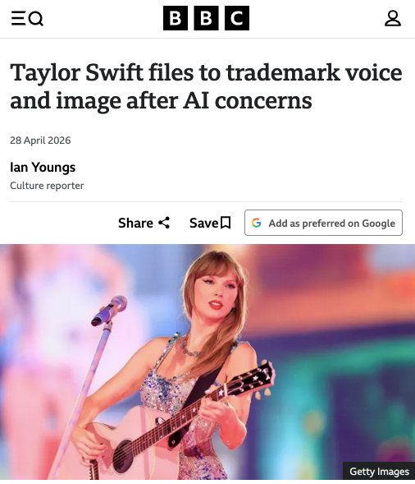
Artists’ responses
Taylor Swift has copyrighted her voice and image after Donald Trump posted images of her supposedly supporting him that were untrue.
Other artists are taking steps to protect their voice, image, and identity from being copied by AI.
In 2024, Tennessee passed the ELVIS Act, a law designed to stop AI voice cloning without permission.
It shows that governments are starting to treat AI copying as a serious copyright and identity issue.
Source: BBC
Notes:
For an extra activity, the teacher may wish to bring up the source article and ask students a couple of question about it like: Which image is Taylor Swift trademarking? What does she say in the audio clips she is trademarking?
A Good Discussion Question: "If an AI company trained its model on Taylor Swift's voice without her permission and then used that to generate new songs, who has been wronged and how should they be compensated?" This tends to generate strong opinions and naturally surfaces questions about consent, ownership, and fairness that sit at the heart of AI copyright debates.

Slide 36

The Silent Album
When the UK Government proposed allowing AI companies to use copyrighted works for free, over 1,000 UK musicians released a protest album made entirely of silence.
The album featured eerie recordings from empty studios and performance spaces, representing what those spaces would become if AI replaced human artists.
The silent album reached number 38 on the UK charts.
The campaign worked! The UK Government backed down from its proposal in March 2025.
Source: isthiswhatwewant.com
Notes:
The Silent Album: UK musicians protest with a blank record (2025)
When the UK Government proposed allowing AI companies to use copyrighted works for free, over 1,000 UK musicians released a protest album that was made entirely of silence. The album featured eerie recordings from empty studios and performance spaces, representing what those spaces would become if AI replaced human artists. Soundplate
The silent album reached number 38 on the UK charts, and featured artists including Kate Bush, Paul McCartney and Hans Zimmer. Soundplate
The campaign worked. The UK Government backed down from its proposal in March 2025. Soundplate
📰 Copyright Alliance — How Creators Are Pushing Back Against AI Theft

Slide 37
Actors striking about AI
In 2023, Hollywood actors and writers went on strike, mainly protesting about AI.
Studios wanted to scan background performers' images, pay them for half a day, then use those digital replicas however they liked, including to train AI systems without the performers' consent.
The resulting contract required studios to get actors' consent before using their digital likenesses for AI, though many actors felt the protections didn't go far enough.
Other actors like Matthew McConaughey have trademarked their voice and Scarlett Johannson is currently suing OpenAI for cloning her voice.
Notes:
In 2023, Hollywood actors and writers went on strike, which was the longest actors' strike in history. A central issue was AI: studios wanted to scan background performers' images, pay them for half a day, then use those digital replicas however they liked, including to train AI systems without the performers' consent. CNBC
The resulting contract required studios to get actors' consent before using their digital likenesses for AI, though many actors felt the protections didn't go far enough. The Observatory
📰 Wikipedia — 2023 SAG-AFTRA Strike
https://www.bbc.com/news/articles/cp87z6vexl3o Matthew McConaughey trademarked his voice and phrase as well

Slide 38

Guard rails
‘Guard rails’ are features in AI tools that try to stop people generating inappropriate content and reproducing copyrighted material.
Named because they try and stop people going “off-road”, like guard rails on a road.
You can see this on Lumen, try to generate images of Disney characters yourself, on either:
The Guard rails on Lumen page on the platform
On Lumen site, from Image Generation > Guard rails
Guardrails on a road
Source: Naomi August (Unsplash)
Notes:
At this point, you can get students to try generating pictures of different disney characters on the Lumen, either through the platform page titled “Guard rails on Lumen” or on the Lumen site itself.
Note that different models and different AI tools have different levels of guardrails. If students use tools like ChatGPT and Gemini, the developers of those (OpenAI and Google, respectively) build in a lot of guardrails, most likely because these tools are widely used and, consequently, come under more scrutiny that less-used tools. Some models will allow some copyrighted characters to be generated or their guardrails may be easy to circumvent. The key point here is that, like guard rails on a road, the guard rails can reduce the risk of going “off-road” but that the responsibility will often lie with the AI user to take care in how they use its outputs.

Slide 39
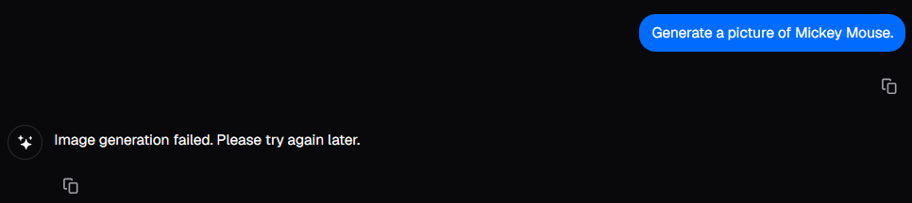
Guard rails on Lumen
When you try to generate pictures of a Disney character (such as Mickey Mouse), you’ll get a message like the one below. There are guard rails in place in the Nano Banana model, which prevent images of some copyrighted characters.
However, guard rails don’t always work. Sometimes people will break through them - accidentally and on purpose.
Notes:
The example screenshot from Lumen shows an example of a guard rail that is built into the model being prompted (Nano Banana in this case). We have asked for a picture of Mickey Mouse but due to copyright restrictions, the model just sends an empty response back.

Slide 40
Guard rails and copyright
Some AI tools (like ChatGPT) will have lots of guard rails to prevent copyrighted characters being shown.
However, AI models are trained on a lot of copyrighted materials and so, through the randomness of AI algorithms, copyrighted characters could appear in the response.
For example, including “iconic cartoon character” in a prompt to an image model could result in Mickey Mouse appearing in the image, even if his name is not mentioned directly.
Researchers found that one of Meta’s LLM could recall 42 percent of the first Harry Potter book word for word, through some clever prompts (Arstechnica)
Notes:
The ArsTechnica article that explains how the researchers were able to reproduce part sof the first Harry Potter book is here: https://arstechnica.com/features/2025/06/study-metas-llama-3-1-can-recall-42-percent-of-the-first-harry-potter-book/ The article is quite technical, so may be of interest to advanced students. However, the key takeaway is that, despite these tools having guard rails, copyrighted material can still be reproduced.
Accidentally reproducing copyrighted material is ok and it could happen to students. The main issue is where someone does this on purpose and then seeks to profit from the copyrighted material they have reproduced.

Slide 41
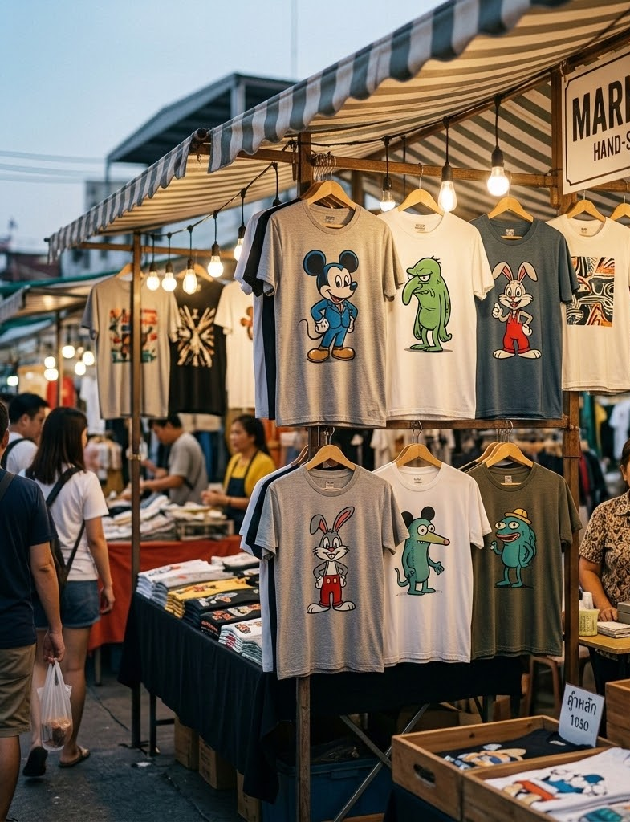
Copyright issues
One of the main issues with copyrighted materials comes when people profit (make money) by using a creator’s work without paying them.
For example:
Creating an ad for a product with a celebrity deepfake, where that celebrity is endorsing the product
Creating a design that includes a copyrighted character, printing it on a shirt and selling it
Generated with NanoBanana
Notes:
The image is an example of where an AI response seems to have reproduced copyrighted characters (or at least characters that resemble copyrighted characters). The prompt used included “iconic cartoon characters” but did not mention any specific characters.
Some students might make the point here that the examples could be seen as equivalent to what AI companies do. AI companies sell subscriptions and some users could purposely use those subscriptions to reproduce copyrighted materials. However, AI companies do have a responsibility to put in guard rails and prevent copyrighted material being reproduced (which is discussed further when talking about developers’ responsibilities later in the lesson).

Slide 42
Using AI responsibly
Think about what you have learned about AI so far.
What are some ways that you can use AI tools responsibly?
Notes:
This is an opportunity for students to reflect on what they have learned so far through the lessons and how they can use the knowledge and skills they’ve learned to be more responsible and purposeful in their use of AI.
Some ways that students could use AI responsibly, which you can suggest if students are stuck, are:
Check the accuracy of information that they’re given, rather than just take it as fact (including checking information with trusted sources)
Be careful in how much information they put in prompts (don’t overshare with personal information)
Don’t purposely prompt to generate responses that include copyrighted materials or inappropriate content
Aim to not offload everything to AI, otherwise there is a risk of too much cognitive debt (and not enough effort)
Be aware of bias in AI responses and how that might influence the responses that they get from AI

Slide 43
Using AI responsibly
Think about what you have learned about AI so far.
What are some ways that you can use AI tools responsibly?
Notes:
This is an opportunity for students to reflect on what they have learned so far through the lessons and how they can use the knowledge and skills they’ve learned to be more responsible and purposeful in their use of AI.
Some ways that students could use AI responsibly, which you can suggest if students are stuck, are:
Check the accuracy of information that they’re given, rather than just take it as fact (including checking information with trusted sources)
Be careful in how much information they put in prompts (don’t overshare with personal information)
Don’t purposely prompt to generate responses that include copyrighted materials or inappropriate content
Aim to not offload everything to AI, otherwise there is a risk of too much cognitive debt (and not enough effort)
Be aware of bias in AI responses and how that might influence the responses that they get from AI
Extension Activity: This is a great short video on How to use AI Ethically (2.07mins) It requires you to introduce the concept of Ethics beforehand though and relate it to Responsible use. You can say something like Ethics is the big picture version of Responsible Use. It’s about the moral questions surrounding how AI is built rather than how AI is used everyday. Think of it like cars: automotive ethics covers big questions like whether self-driving cars should be allowed on roads. Driving responsibly is about whether YOU check your mirrors and put your phone away. Same technology, very different level of responsibility.

Slide 44
Acknowledging AI use
One part of using AI responsibly is acknowledging when and where you have used AI in your work.
In these lessons, there are images that have been generated with AI. Each one has an acknowledges with the model used to generate it (like this one →)
When you have used AI, you can use statements like: “I used Claude to brainstorm ideas and organise the structure” to acknowledge this use.
Copyright icon, generated using NanoBanana

Slide 45

Journaling and drafting
When you work on projects or assignments over days or weeks, it’s a good idea to keep a journal or log.
This can include how you used AI, what prompts you used, and why you used AI.
It’s also useful to keep draft copies, which show your progress throughout your assignment work.
Shows your process and progress, not just your product.
Unknown person writing,
Source: Marcos Paulo Prado (Unsplash)
Notes:
You may have assignments where students are required to submit a journal/log along with their project/assignment. This is just a reminder to students that it is also beneficial for them to do this for their own learning and not just as part of the assignment requirement.
This could be related back to the idea of cognitive effort and cognitive debt. It is more effort to write journals and keep drafts like this, but it will likely help the student remember parts of their project better than if they do not it. Ultimately, a student should be able to explain their project/report without AI and the journaling will help with this.
If you have students who are experienced with tools like Google Docs and Microsoft Word, you could show them the features that show version history of documents (or help them set this up). These features help keep track of how documents change over time, which is easier than keeping separate draft copies of documents.

Slide 46
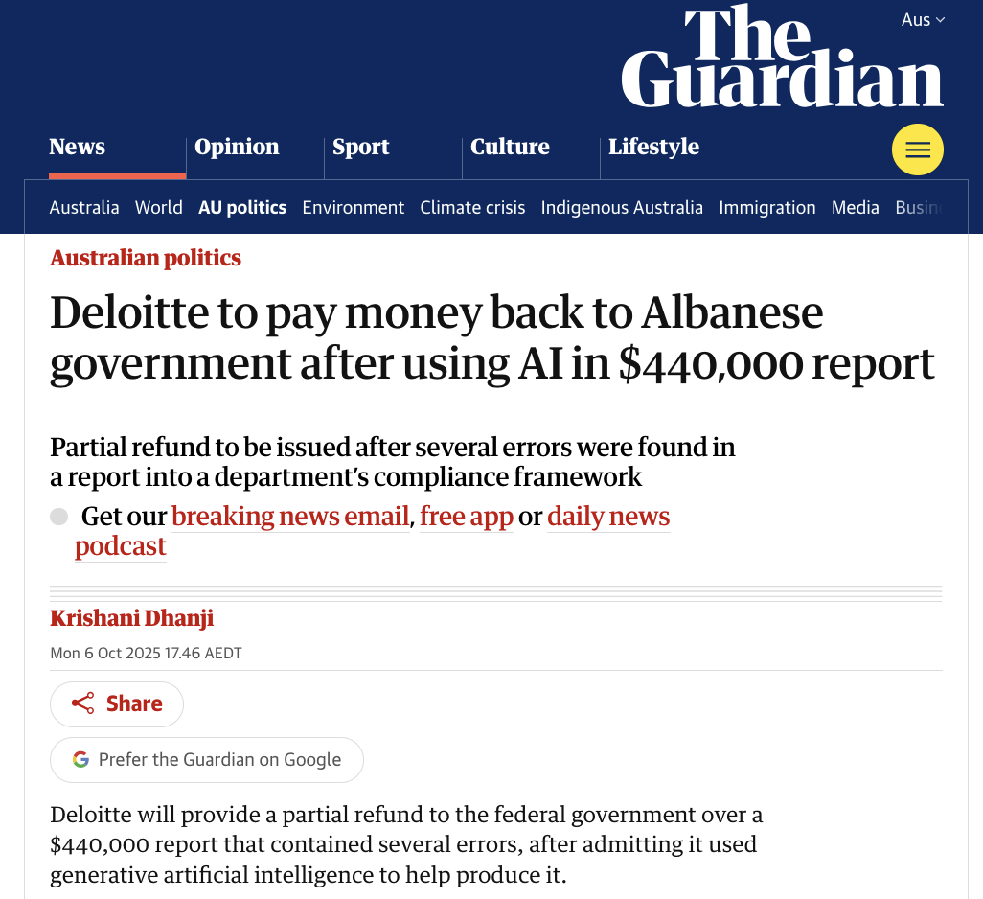
Checking sources
We looked at hallucinations in text responses in Lesson 3. A common type of text hallucinations recently have been hallucinated sources
When we write a report or essay, we often include references to sources (such as books and articles where we found information).
Sometimes LLM responses will include made-up (hallucinated) sources in their responses. Real companies are already getting into trouble for not checking their sources like the Australian company Deloitte.
Source: The Guardian
Notes:
The Guardian article is about a Deloitte report that included hallucinated sources. This is a relatively recent case where Deloitte had included made-up academic articles in their reference list and inaccurate quotes from articles in a report for the federal government’s Department of Employment and Workplace Relations. A few academics from Australian universities read the report and saw that there were articles attributed to them that they had never written.
There have been other examples of this happening, in Australia and in other countries, and not just for reports written by working professionals. For example, some students in the US have been disqualified from science fair competitions because they have used hallucinated sources in their work.
The key point in this slide and the slides that follow about checking sources is that it is ultimately the responsibility of the student/author to check whether the sources they use are hallucinated. While many AI tools do search for sources now and there has been improvements in how they reference sources (with some tools including links to the cited documents/websites), that does not guarantee those articles exist or that they contain the quotes/points the AI claims they do.

Slide 47

Checking sources demo
Let’s look at some ways of checking if sources are real. Let’s pretend we’re marking an assignment for a student who’s written an assignment on Albatrosses in Australia.
They cite these sources:
Barwell, G. (2013). Albatross. Reaktion Books.
Vance, R. T., & Holloway, G. D. (2024). Winds of the Southern Ocean: The conservation biology of Australian albatrosses. CSIRO Publishing.
How can we check these sources are real?
Albatrosses are a type of seabird with large wings.
Source: Paul Carroll (Unsplash)
Notes:
We recommend that you do the checking of these sources as a demonstration. The next two slides will walk you through this.
Typically, if a book is real, it will show up in Google search results, towards the top of the first page on websites like Wikipedia, Amazon or Goodreads. You can also search for books (or other sources) on those websites, rather than using a search engine (like Google).

Slide 48
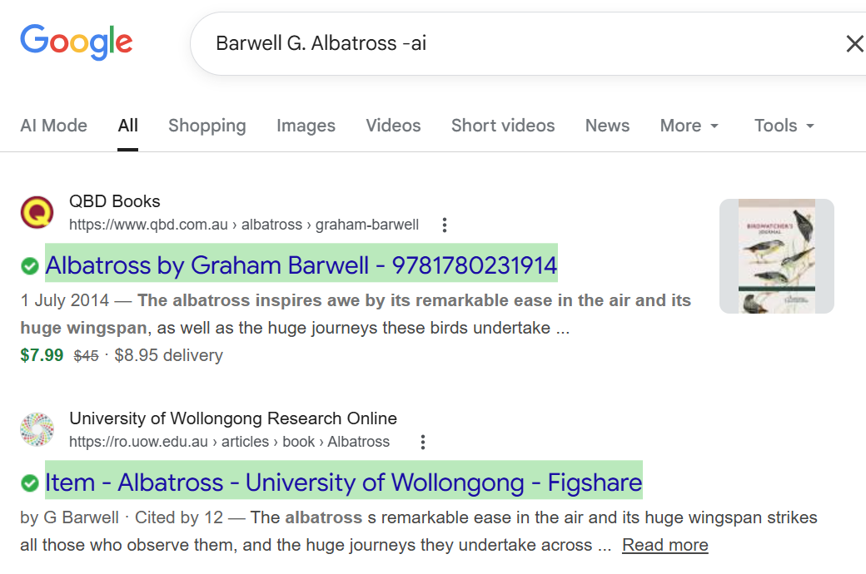
Checking sources demo
TRUE SOURCE ☑️
Notes:
Demonstrate this to your students live.
There are a few ways to check if these sources are real. We suggest searching for them by their title and authors on Google.
You can put -ai on the end of your search query on Google and it will not show the AI summary.
The first book is a real one and appears in the search results. This is a true source.
Sometimes the AI summary talks about fake sources as if they are real which confuses students even more. This is why it is a good idea to include “-ai” in your search.
Here is an interesting article about entrants in a famous International Science Fair competition who were disqualified for using fake sources.

Slide 49
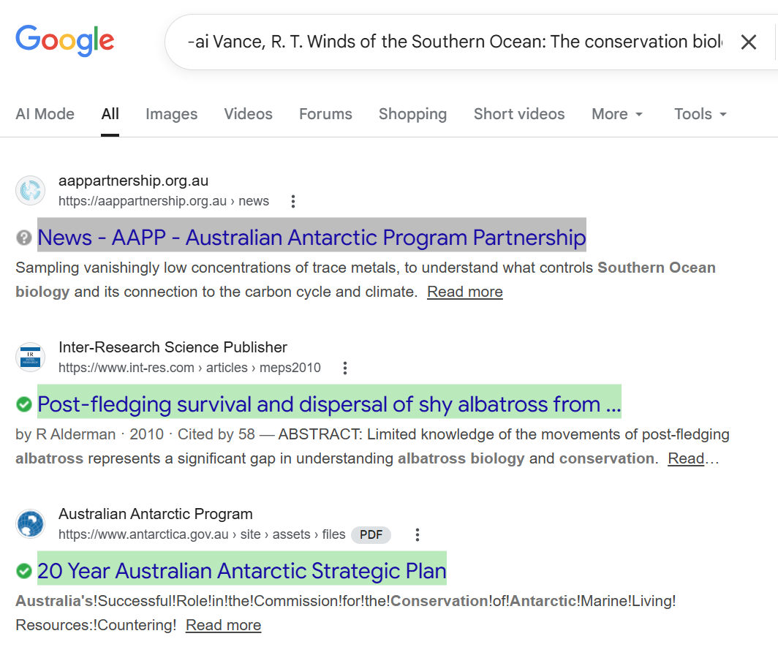
Checking sources demo
FAKE SOURCE
☑️
Notes:
The second book is a made-up book and none of the search results show a book as the answer to the search. We have included the first few results here.
Demonstrate this to your students live.

Slide 50
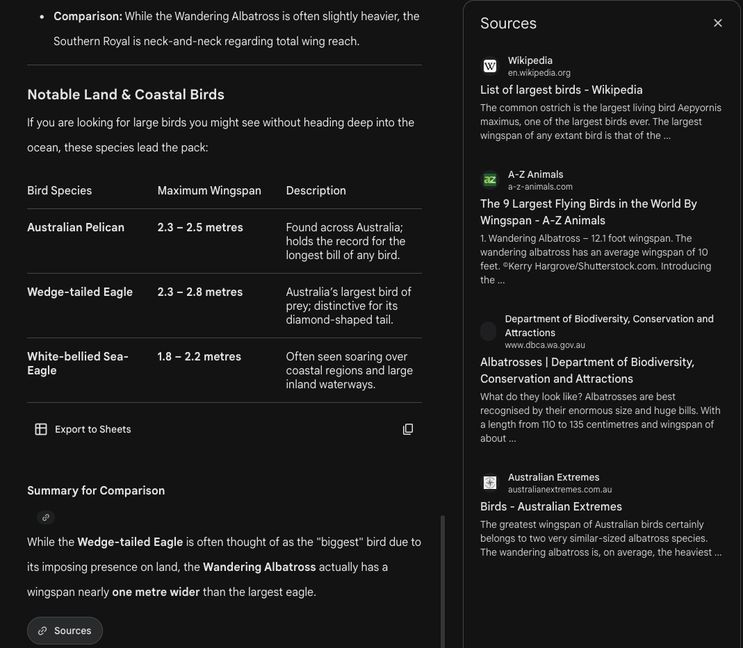
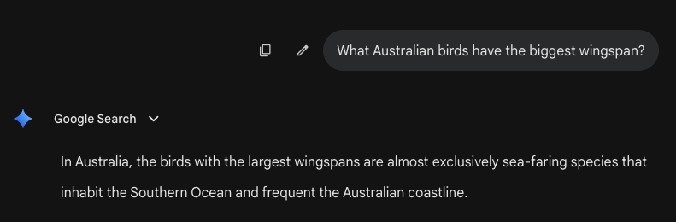
Checking sources
AI tools (like ChatGPT and Gemini) have also introduced features where they search for sources as part of their responses.
You can also upload files and ask questions.
Hallucinations can still happen!
Notes:
AI tools, particularly Chatbots and LLMs, have started to include sources in their responses, which show where information in them has come from. This is possible through a technology called Retrieval-Augmented Generation, which allows AI to search for external sources outside of its training data. This will be covered in more depth in future lessons.
You may have seen examples of RAG, where you can upload a document (for example, a job contract) to a chatbot app and then ask questions about that document.
The key point here is that even though chatbots have RAG and can use external sources and documents, there can still be inaccuracies in the responses.
In the next activity, students will read through a simulated chatbot response, which uses a “source” document (a contract) and check if the response is correct or incorrect about what is actually in that document.

Slide 51
Activity 4.06: Checking sources
Complete the activity on the platform
Download the worksheet here

Slide 52

AI developers’ responsibilities
AI companies have responsibilities to develop safe AI tools.
When Microsoft launched one of the first AI chatbots, Tay, in 2016 it was manipulated by users into posting racist and sexist content within 16 hours. It was shut down and Microsoft and other AI companies worked much harder to make future chatbots safer.
This is why AI companies build filters and guardrails to block harmful requests and prevent their tools from generating dangerous and inappropriate responses.
Microsoft Tay. Source: Wikipedia
Notes:
This slide shifts the responsibility conversation away from individual users and onto the companies that build AI tools.
Microsoft Tay was shut down within 16 hours of launch. It's worth emphasising to students that this wasn't a fringe or obscure experiment; it was Microsoft, one of the world's largest technology companies, getting it badly wrong in a very public way. The key teaching point is that good intentions are not enough. AI tools need to be tested, safeguarded, and monitored before they are released to the public.
Microsoft’s immediate response was to shut Tay down and apologise publicly. The longer-term response was the launch of a much more restricted replacement chatbot called Zo in December 2016, and a gradual evolution of their AI ethics framework over the years that followed.
Filters and Guardrails: A useful analogy here is a bouncer at a door, guardrails don't stop the AI from being powerful, they just decide what gets through and what doesn't. You might ask students: "Can you think of a time an AI tool refused to answer something? Why do you think it did that?" Most students will have encountered this and it makes the concept immediately concrete.
A Good Discussion Question: "If an AI company builds a tool that causes harm, should they be legally responsible — even if a user misused it?" This connects well to the broader unit themes around accountability and responsibility in AI.

Slide 53
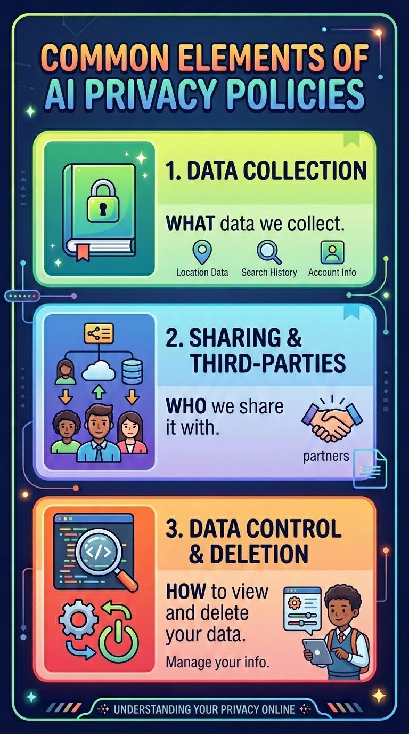
AI developers’ responsibilities
AI Companies also have a responsibility to protect users’ privacy
They have to abide by the privacy laws of the country where the tools are being used. These are stricter in places like Europe and Australia than the US for example.
They must tell users what data they are collecting and how long they are keeping that data.
Children’s data gets extra protection under laws around the world.
Generated with NanoBanana
Notes:
This slide connects AI ethics directly to privacy law.
Privacy Laws Across Different Countries: The contrast between Australia/Europe and the US is worth unpacking briefly. Australia's Privacy Act 1988 and Europe's GDPR (General Data Protection Regulation) give users significantly stronger rights than US federal law, including the right to request their data be deleted. A good way to make this tangible for students is to point out that when they agree to terms and conditions on an AI tool, the protections they have depend heavily on where the company is based and where they are located. Most students have never thought about this.
Data Collection and Transparency: This is a good opportunity to do a quick show of hands. "Has anyone actually read the privacy policy of an AI tool they use?" The answer is almost always no. This isn't laziness, privacy policies are deliberately long and complex. The teaching point is that companies are technically complying with the law by publishing these policies, but genuine transparency is a much higher standard than burying information in fine print.
Children's Data: This is directly relevant to your students' own lives. Under Australian law, and in many other jurisdictions, data collected from minors is subject to stricter rules around consent, retention, and use. A powerful question to raise: "When you signed up for an AI tool, did it ask your age? What do you think happened to that data?"
Students sometimes assume that because something is free to use, no data is being collected. This is worth explicitly challenging. If a product is free, the data users provide is often part of the business model.

Slide 54
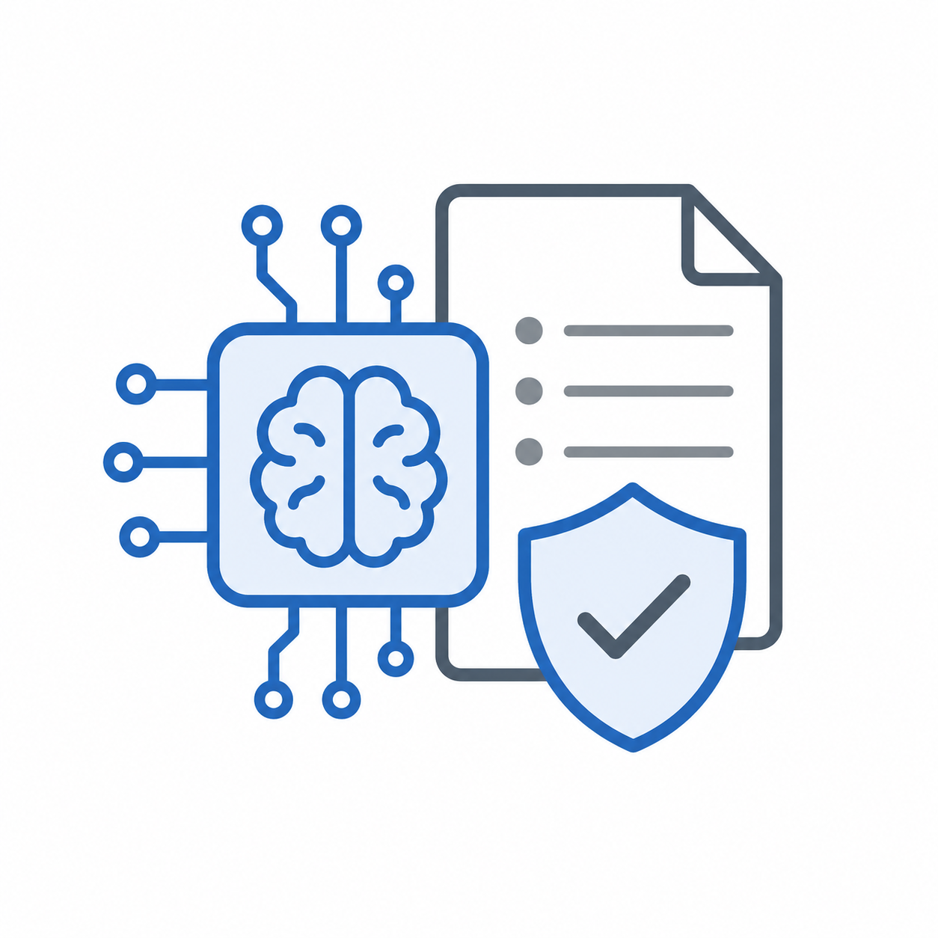
AI policies
Since AI is so powerful and easy to misuse most schools and organisations will have an AI policy to guide students and staff in using it fairly, safely and responsibly. These are sometimes called Responsible Use Policies.
An AI policy is simply a document containing a list of rules for how AI should be used.
Generated by ChatGPT 5.5
Notes:
This slide is about what an AI policy is. The key point is that it is just a list of rules that people should follow. Some examples are presented in the next slides.

Slide 55
Example company AI policy
Amazon Web Services has a Responsible AI Policy relating to how people use their AI/Machine Learning services. Here is an extract:
You may not use, or facilitate or allow others to use, the AI/ML Services:
for intentional disinformation or deception;
to violate the privacy rights of others, including unlawful tracking, monitoring, and identification;
to depict a person’s voice or likeness without their consent or other appropriate rights, including unauthorized impersonation and non-consensual sexual imagery;
for harm or abuse of a minor, including grooming and child sexual exploitation;
to harass, harm, or encourage the harm of individuals or specific groups;
to intentionally circumvent safety filters and functionality or prompt models to act in a manner that violates our Policies;
to perform a lethal function in a weapon without human authorization or control.
Why might these rules be necessary?
Notes:
The point of this slide is to show that companies have a responsibility to lay out rules that users of their products must follow.

Slide 56
Example school AI policy
In Georgia, USA the Taliaferro County Schools has an AI Use Policy for Students
Here are some of the rules in this policy:
Ethical Conduct:
Students are expected to use AI technologies ethically, respecting copyright laws, privacy norms, and the intellectual property rights of others. AI should not be used to engage in plagiarism, cheating, or any form of dishonesty in academic work. AI work must not be submitted in the place of student work.
Privacy and Data Protection:
Students must be cautious when interacting with AI tools that require personal information. Sharing sensitive or personal data without proper authorization or oversight is prohibited. Students should understand the risks and implications of data sharing and seek guidance from teachers when necessary.
Notes:
This is an example school AI policy in case the teacher’s school does not have their own policy. If they have their own policy it would be great to talk about that with their students.
In NSW, St Columbus Anglican School has rules for AI Use in their school which is not quite a policy but covers all the rules that would be in a policy.

Slide 57
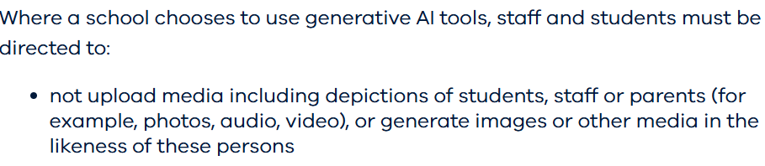
Requirements for Australian schools
There is an Australian Framework for Generative AI in Schools which guides the responsible and ethical use of generative AI tools in Australian schools.
Each state also has their own recommendations for AI policies. For example, here are some extracts from the Victorian Policy on Generative Artificial Intelligence for schools:
Notes:
NSW has developed its own school-safe AI tool called NSWEduChat, now available to all Year 5–12 students in NSW public schools. It uses eight content filtering systems and explicitly refuses to give direct answers. Instead it responds with guiding questions to encourage critical thinking. South Australia launched a similar tool called EdChat, rolled out to all public high schools from October 2025.

Slide 58
5 major issues to cover in an AI Policy
Privacy and security: be careful with yours and other people’s personal information
Misinformation: always fact-check before using AI responses in your work
Explainability: you should be able to explain your own work so don’t rely on AI too much.
Bias and Fairness: be careful of biased answers from AI and check for fairness before using AI responses.
Plagiarism: submitting AI-generated work as your own is dishonest.
This slide is adapted from the Day of AI, MIT RAISE (Responsible AI for Social Empowerment and Education). [Ethical Use of AI], [2025]. dayofai.org. Licensed under CC BY-NC-SA 4.0. Licensed under CC BY-NC-SA 4.0.
Notes:
This slide summarises the key responsible use principles students should carry with them beyond this unit.
Privacy and Security: Reinforce that this applies to other people's information as well as their own. Students often understand not to share their own details but don't think about the implications of typing someone else's name, address, or personal situation into an AI tool. A good prompt: "If you were asking AI for advice about a problem with a friend, what personal details would you need to leave out?"
Misinformation: Link explicitly back to the fake citations activity from Lesson 3 — this is the most concrete evidence students have encountered of AI getting things confidently wrong. Reinforce that fact-checking isn't optional:it's a non-negotiable step whenever AI is used for research or information gathering.
Explainability: This is the most important point on the slide for academic integrity. A useful rule of thumb to share with students: "If you couldn't answer a question about what you've submitted, you've probably relied on AI too much." This also connects back to the cognitive debt discussion: over-reliance on AI quietly erodes the thinking skills students are at school to develop.
Bias and Fairness: This is worth giving a concrete example to. AI tools trained predominantly on English-language Western data can produce answers that reflect those cultural assumptions. Ask students: "If you asked an AI about a historical event from a non-Western perspective, do you think the answer would be as detailed and accurate?" This tends to spark genuine curiosity.
Plagiarism:. Most students experimenting with AI aren't thinking of it as cheating. They're thinking of it as a shortcut. The key message is that their teachers are assessing their thinking and growth, not the output of a machine. It is also worth acknowledging that the line between using AI as a tool and submitting AI work as your own is genuinely blurry and that navigating that line thoughtfully is itself an important skill.
Overall: Consider ending the lesson by asking students to identify which of these five principles they think will be hardest for them personally to follow and why. It tends to generate honest and reflective responses that make for a strong close to the unit.

Slide 59
Activity 4.07: AI Rules poster
Download the worksheet here.

Slide 60

Understand how AI is changing the way we work and live
Understand the impact of cognitive offloading when using AI
Know about AI and creativity and how artists, musicians and writers are responding to Generative AI
Have reflected on how you can use AI responsibly
Understand what obligations AI companies have to behave responsibly
Know about AI Responsible Use policies
Summary
You should now be able to:

Slide 61
License Information
These Tech Futures Australia lessons plans, worksheets, and other materials were created by the Tech Futures Australia team. They are licensed under a Creative Commons Attribution-ShareAlike 4.0 International License.

