Slide 1

Lesson 7
Problem Solving with Vibe Coding and Agentic AI
techfutures.org.au

Slide 2
Learning objectives
By the end of this lesson, you will understand:
How to write clear prompts using STAR
What vibe coding is and how it can build apps quickly
How design thinking helps solve the right problem
How to understand users, frame problems and write user stories
How prototypes help test and improve ideas
What AI agents are, what tools they use and how permissions work
How to use vibe coding and agents responsibly and manage risks
How vibe coding and AI agents might change future work

Slide 3
LLMs and the Cloud: Matching Activity
Drag each description card into the matching term box.
DESCRIPTIONS
TERMS
GPU
Using powerful computers in data centres through the internet
A physical building full of servers, chips, cables, cooling and power systems
Cloud model
A chip good at doing many calculations at once
Data centre
An AI model running in a data centre
Cloud computing
Notes:
Answer key:
Cloud computing = Using powerful computers in data centres through the internet
Data centre = A physical building full of servers, chips, cables, cooling and power systems
GPU = A chip good at doing many calculations at once
Local model = An AI model running on your own device
Cloud model = An AI model running in a data centre

Slide 4
Data Centres: Cooling and Impact
Drag each card into the matching category.
CARD
CATEGORY
Uses water or cooling
Reusing waste heat and pumping into nearby homes
Cooling systems spraying water over hot air to cool it.
Buying solar or wind power
Helps reduce impact
Liquid cooling pumped through pipes near the chips
Using smaller models for easier tasks
Building the data centre in a cold climate country
Notes:
Answer key:
Cooling systems spraying water over hot air to cool it down = Uses water or cooling;
Liquid cooling pumped through pipes near the chips = Uses water or cooling;
Building the data centre in a cold climate country = Helps reduce impact;
Buying solar or wind power = Helps reduce impact;
Reusing waste heat and pumping into nearby homes = Helps reduce impact;
Using smaller models for easier tasks = Helps reduce impact.

Slide 5
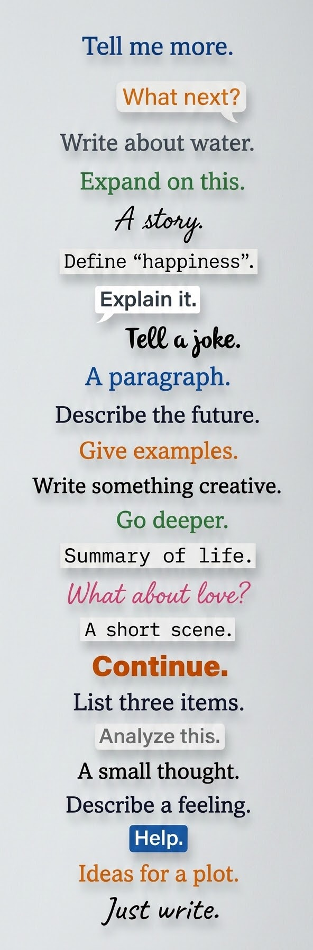
Writing good prompts
Prompts are the messages (input) that we send to GenAI
We get responses back (text in LLMs, images with image models)
Prompt engineering is a fancy way to say that we want to write prompts that effectively get us the answer we want
The details that we include in prompts can impact how useful or helpful a response will be. For example:
  “Give me tips for giving a speech” vs “Give me 3 quick tips on how to manage nerves before giving a 3-minute speech in class. Keep the tips practical and focused on body language and breathing”
Some example prompts, generated with Nano Banana
Notes:
Students have used pre-written prompts in the activities involving Lumen in previous lessons. However, it is likely that they will use LLMs or other GenAI tools (or already use them) where they need to write their own prompts
You (and you students) may have heard of “prompt engineering”, which was a popular term around 2023/2024, following ChatGPT’s release. This is just a fancy way of describing writing prompts that get us answers (or results) that we want. This term is not as commonly used as it once was. However, the general idea is still important - writing a prompt that includes details about the answer we want will help us get a better response.

Slide 6
Vague vs specific prompts
It is usually better to be more specific in prompts than to be vague
Particularly when looking up information or learning
For example:
  “Tell me about Ancient Egypt” vs “Tell me about Ramesses II and the highlights of the period of Ancient Egypt he lived in”
  “Tell me about rainfall” vs “Explain the main causes of rainfall and why patterns are different in different places, at a level appropriate for a high school student”
Notes:
Students may not know the word “vague”, so you may have to explain this as not having much detail or not being specific. Using the vague prompts on this slide as examples should help their understanding of what it means.
It can be useful to include instructions about a target audience in a prompt (the “level appropriate for a high school student” in the prompt above). In the next slides, students will learn about some approaches to help them write more specific prompts.

Slide 7

Writing good prompts
There is no best way to write prompts, but being specific in your prompts can help you get what you want.
Writing good prompts can help you frame the question you are asking, to specify what details you really need. It’s important to think before you prompt.
Some people have developed “structures” that can help you write prompts.
One method for writing prompts is called STAR
Image generated using Nano Banana
Notes:
Two key points in this lesson are that the 1) results from our prompts will be better when we are more specific and 2) it’s important to think about what we’re trying to answer / solve when writing prompts (including when vibe coding and using agents).
In the next slide, there is an example format (or scaffold) to help students write their prompts.

Slide 8

STAR Method for Prompting
STAR is an acronym, that means:
  Specific: What is the topic, problem, or background context?
  Tone: How should the AI sound?
  Audience: Who is the response for?
  Requirements: What are the specific rules or boundaries?
For example:
  I want to learn about native Australian animals. (Specific)
  The response should be informative and interesting. (Tone)
  I am a Year 7 student. (Audience)
  The response should focus on two animals only. (Requirements)
Source: Marcys Spiske on Unsplash
Notes:
This slide explains what the STAR acronym means, with an example.
This “How to Write Better AI Prompts: A Guide for Kids” page on the KidsAITools website (https://www.kidsaitools.com/en/articles/how-to-write-better-ai-prompts-kids) explains the STAR method well, with some clear examples and suggestions on how to extend older students (such as including examples in prompts)

Slide 9
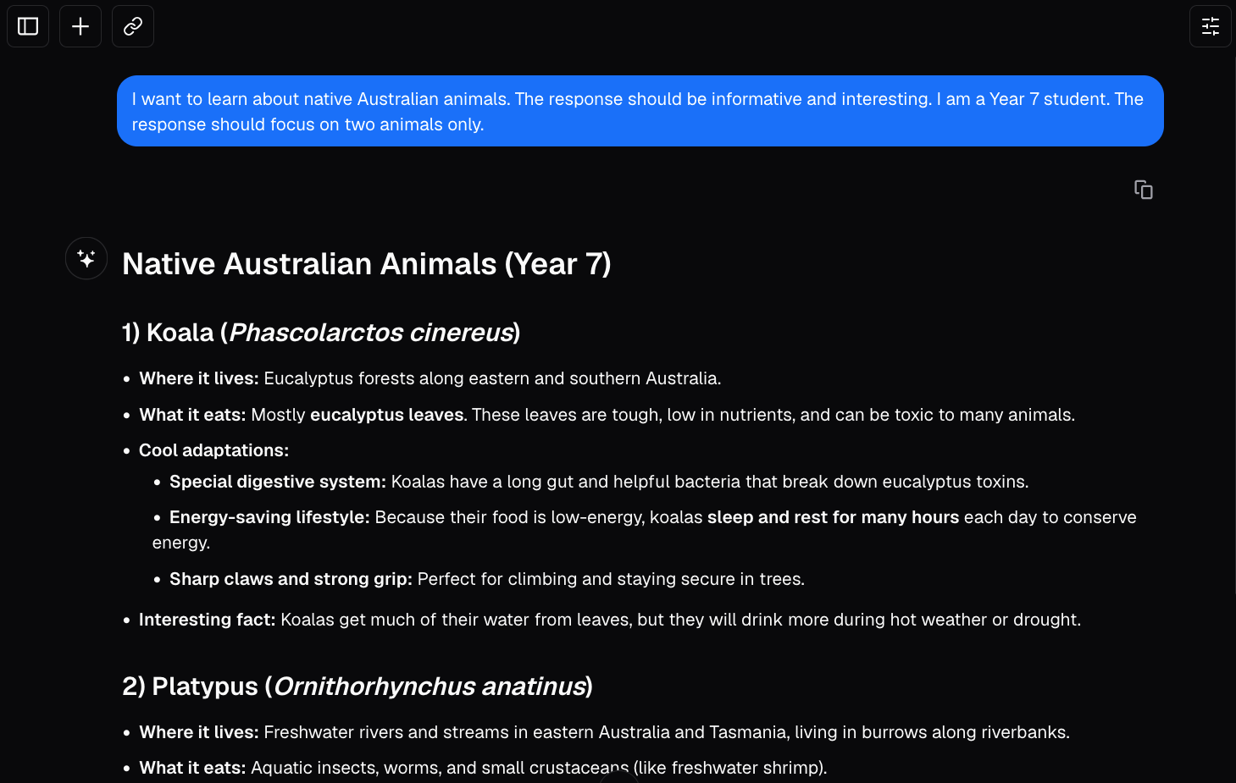
STAR Prompt in Lumen (GPT 5.2)
Notes:
This slide shows an example response when using the STAR prompt from the previous slide with Lumen (with GPT 5.2 as the chosen LLM). This is available on the platform as an embedded Lumen flow, if you would like to do a live demo of this example.

Slide 10
Activity 7.01: Prompt writing
Complete the activity on the platform here
Worksheet can be downloaded here

Slide 11
Prompts, conversations and framing problems
When LLMs were first released, it was more important to be a ‘prompt engineer’, to include details in single prompts
Now, using LLMs (through tools like ChatGPT) is more ‘conversational’ and we often write lots of follow-up prompts, like:
  “Explain it simpler”, “What about …?” or “Can you expand on …?”
However, it’s still important to think before you prompt, about what details you can include, and the problem that you are trying to solve
When we think about a problem we are trying to solve and who is involved, we call this framing a problem.
Notes:
As mentioned in a previous slide, “prompt engineering” was a popular term in the couple of years after ChatGPT was released. There were many news stories about “Prompt engineers” being a job that would be high in demand in the future. Since then, the term and job title are not as popular as they were, probably due to the way we interact with LLMs being more of a “conversation” and with agents (like OpenAI’s Codex) becoming more popular. Nowadays, we don’t usually write a detailed single prompt but write a series of prompts where we get LLMs to respond with more specific information, for example.
Later in this lesson, students learn about “Design Thinking”, which is a way of thinking about and framing problems and coming up with solutions for them. Students can combine Design Thinking with their understanding of AI to think about why and how we might use AI tools (including GenAI) to solve problems.

Slide 12
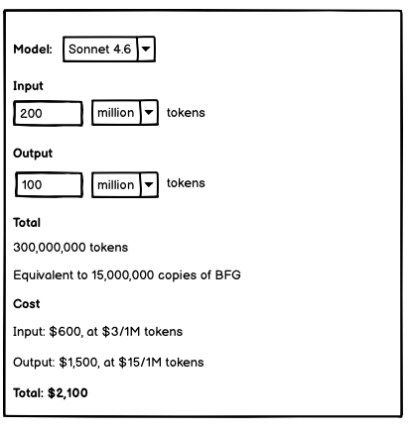
Adding extra info to prompts
We looked at writing prompts, but we can also provide extra information (grounding) in our prompts, including:
  Audio (like voice recordings), documents and images
The image on the right is a ‘wireframe’, which is like a sketch of an app.
The wireframe was used as part of the first step for the cost calculator interactive in Lesson 6, where the Gemini LLM was used to help code it.
This wireframe was used in the first step of ‘vibe-coding’ the cost calculator in this course, along with a prompt describing how the calculator would work.
Notes:
The key point in this slide is that prompts don’t just have to be the prompts we write out, we can also add extra information to them in different formats. Examples include recording a voice clip or attaching a Word document that includes extra details or instructions for the LLM. The extra information is effectively included as part of the context sent to the LLM, along with the written prompt.
The example image that is included on the slide is a ‘wireframe’ that was used as part of the development of this course. This wireframe is a sketch-like diagram (created in a software called Balsamiq) that was attached to a written prompt that described how we (the course developers) wanted the interactive tool for calculating costs of different LLMs to work. The prompt was used with the Gemini LLM model to generate the code that was then reviewed and edited and put on the learning platform (in Lesson 6).

Slide 13

Vibe Coding
Vibe coding is what happens when you use many prompts in a row to build something, test it, fix it and improve it.
Prompts are the building blocks, vibe coding is putting together these prompts to build a useful app or program.
Generated with ChatGPT-5.5
Notes:
The main point here is that vibe coding is just a well-planned sequence of good prompts, each building on the last.

Slide 14

Vibe Coding: How it works
Every prompt you send adds to the LLM's context window.
The LLM predicts code in exactly the same way it predicts ordinary words: one token at a time, based on what's most likely to come next.
The LLM doesn’t know how to code. It just knows what probably comes next because it has seen millions of lines of real code during training.
Photo by Roozbeh Eslami on Unsplash
Notes:
The main point in this slide is that the LLM has no understanding of what the code does, only what tokens statistically follow other tokens. This is why AI code can look completely correct but fail to run, or run but produce wrong results. The model is pattern-matching, not reasoning about logic.
A likely student question: "If it doesn't know how to code, how does it write working code at all?" The answer is that working code has very strong statistical patterns. Correct syntax, common function names, and standard structures appear so consistently in training data that predicting them accurately looks indistinguishable from "knowing" how to code, most of the time.
The LLM has learnt the millions of lines of code from places like GitHub, Stack Overflow, and open source repositories. This explains why AI is much better at common languages (Python, JavaScript) than obscure ones: more training examples means stronger statistical patterns.

Slide 15


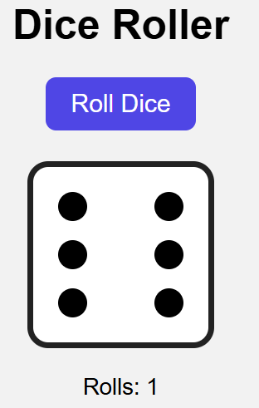
Vibe Coding: Simple Example
Prompt 1: Create a simple webpage with a button that says “Roll Dice”. When clicked, show a random number between 1 and 6.
Prompt 2: “Make the number appear inside a big square that looks like an actual dice face, with dots instead of just a number."
Prompt 3: Add a counter that tracks how many times the button has been clicked.
Notes:
The main aim here is to show how prompts in vibe coding follow on from each other: like telling the “story” of an app. Often users start with a basic app and then improve it from there. Or they may develop a particular component of an app before progressively adding others.

Slide 16
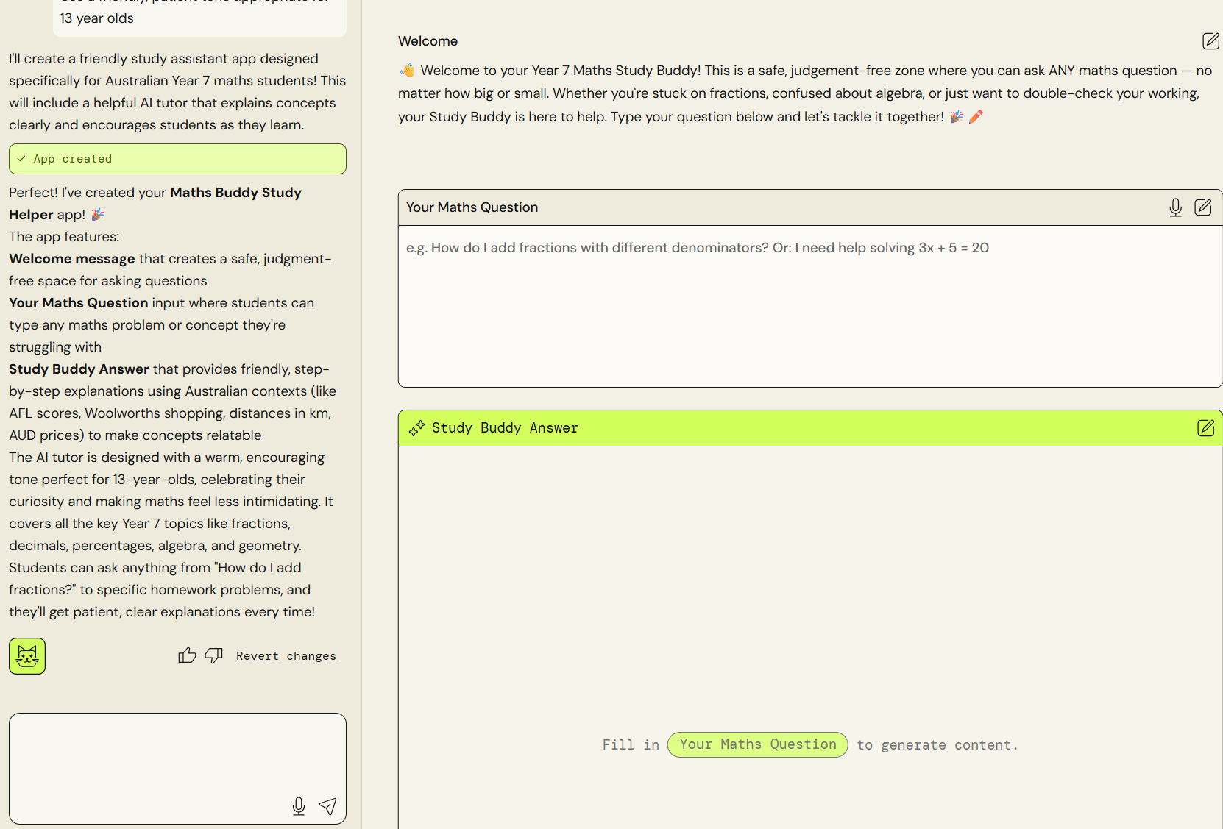
Teacher Demo with AWS PartyRock
Open AWS PartyRock and click “Create an App” and enter this prompt:
Create a friendly study assistant that helps Australian Year 7 students with maths homework. It should:
Explain math concepts using simple language and real-world examples
Provide step-by-step solutions to math problems
Offer encouragement and positive feedback
Use a friendly, patient tone appropriate for 13 year olds
Now make some simple changes to the app using the left side panel. This could be changing the welcome text or the background colour or the name of the app.
PartyRock
Notes:
This is a website that teachers can use to demo vibe coding. If you are already experienced at using AI tools, you may wish to demonstrate this using your favourite AI companion.

Slide 17
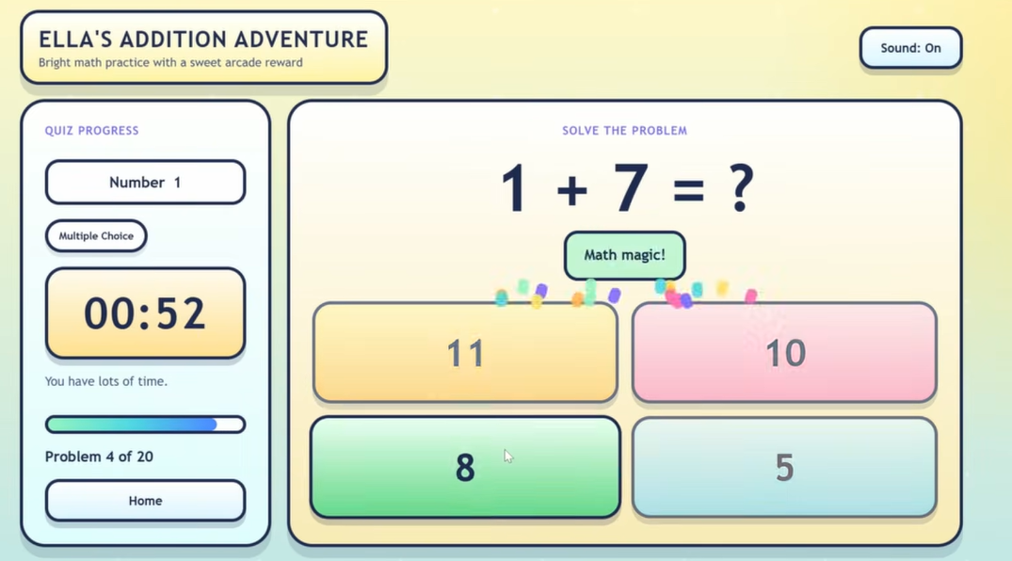
Vibe Coding Example
This simple maths app was vibe-coded by a Dad using ChatGPT-5.4 for his daughter in less than a few hours.
Before LLMs and Vibe Coding, this app may have taken days to generate.
Vibe-coded Maths App by Bootable USBS
Notes:
The aim of this app is to show that anyone can vibe code an app now.

Slide 18
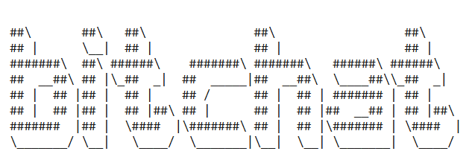
Vibe Coding Example
Bitchat is a messaging app that was vibe-coded by Twitter founder Jack Dorsey over a weekend. It has over 1 million users on Android. It allows users to send texts to people without internet or mobile data, just Bluetooth. This would have been impossible to do in such a short time before LLMs and vibe coding.
BitChat
Notes:
This example just shows that vibe-coded apps are being used in the real world.

Slide 19
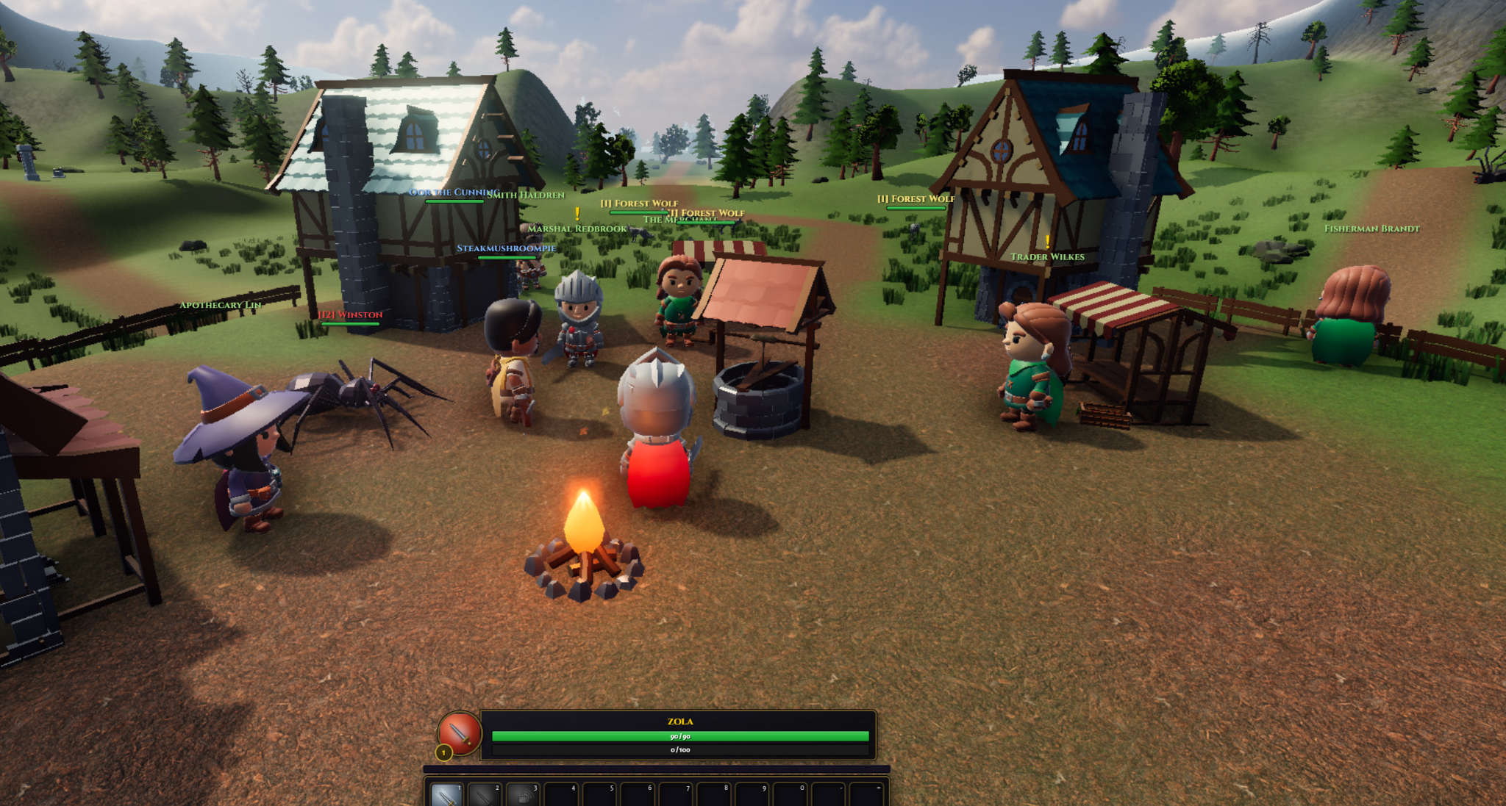
Vibe Coding Example
worldofclaudecraft is a free open-source role-playing game like the early World of Warcraft that was vibe-coded in around two days using Claude code.
It is nowhere near the quality of paid games but it is quite impressive for the time taken to build it.
worldofclaudecraft.com
Notes:
This example gives students a flavour of the graphics and interactivity you can get from something coded up in 2 days using LLMs.

Slide 20
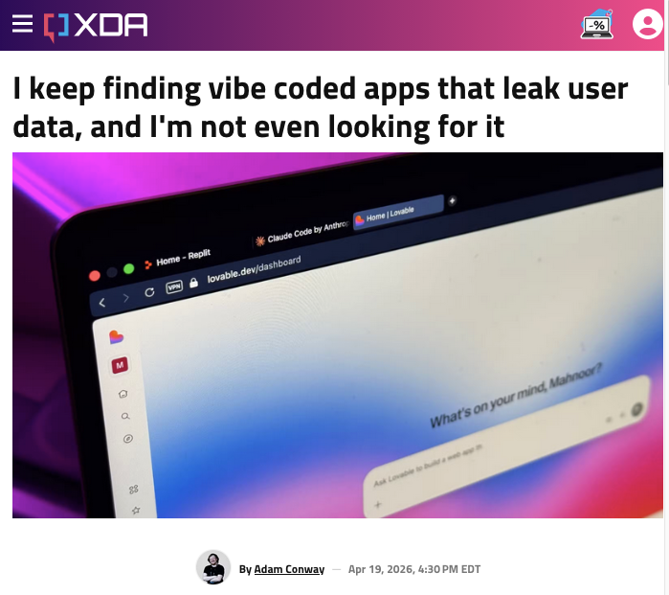
Risks of Vibe Coding for other people
💀 It might look finished but still be broken. The app may seem like it works but actually have hidden bugs you can’t see.
💀 You may not understand the code. If you cannot explain it, it is hard to fix or trust it. A junior Indian programmer was fired after he relied on vibe coding and caused a production line stoppage.
💀 It can create unsafe apps. For example, apps that collect names, photos, passwords, or payment details.
Source: XDA Developers
Notes:
The main point of this slide is to caution students that although it looks super easy to vibe-code apps, you always have to check them for hidden bugs, privacy breaches and copyright issues. Although the AI wrote it you are still responsible for it. Follow the link below the image to see some real examples of vibe-coded apps that leaked users’ private information.

Slide 21
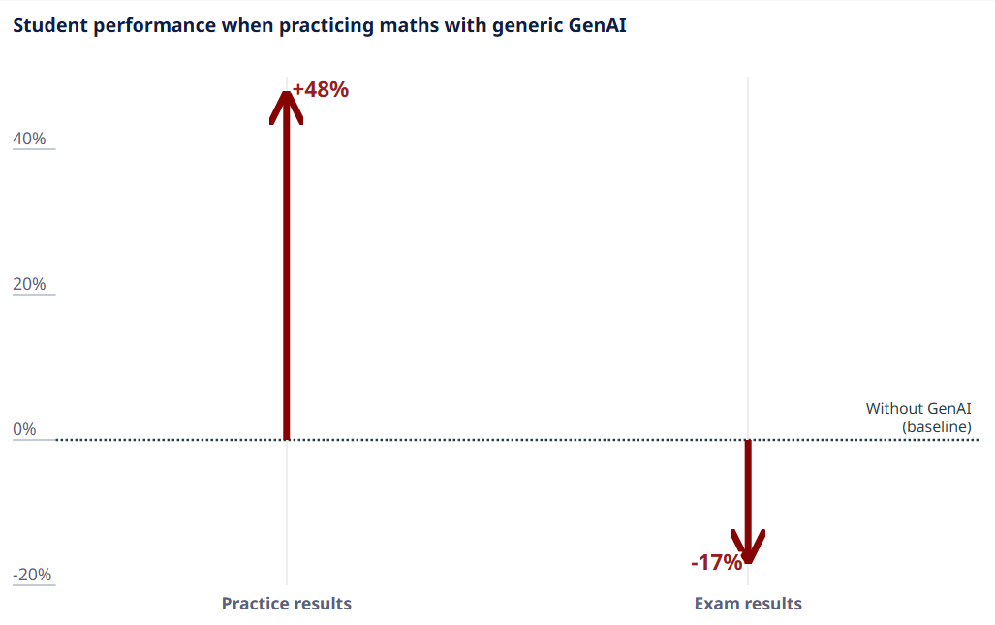
Risks of Vibe Coding for your own learning
Cognitive offloading: As you learnt in the previous lesson, if the AI does all the thinking, you may not learn problem-solving skills.
In an experiment with 1000 Turkish high school Maths students, access to an LLM improved their performance when practising, however during closed-book exams they performed 17% worse than those who didn’t use LLMs.
In a smaller study of 21 university students new to programming, struggling students who used GenAI to finish a task walked away believing they were better at coding than they were.
Source: OECD Digital Education Outlook 2026
Notes:
Cognitive offloading is a real danger, especially if students are learning coding. They should think carefully about whether they are losing their critical thinking ability. Someone needs to be able to check the outputs of vibe coding so we still need people to learn coding.
This video from JetBrains Academy (https://www.youtube.com/watch?v=HTUh0OO6Kmo) summarises some research on how using AI-assisted coding can impact students learning coding, particularly the gap between what students with some coding knowledge and experience can do with AI vs those who do have limited coding knowledge and experience. This could be useful to share if you have students who are very interested in coding in your class. It is also a very well-produced and engaging video that you can watch to learn about some research in this area and to learn about the importance of students still learning to read and write code, rather than just vibe code.

Slide 22
Activity 7.02: Vibe Coding
Complete the activity on the platform here.
Worksheet can be downloaded here.
Notes:
In this activity students will experience vibe coding first hand with a simple prompt.

Slide 23
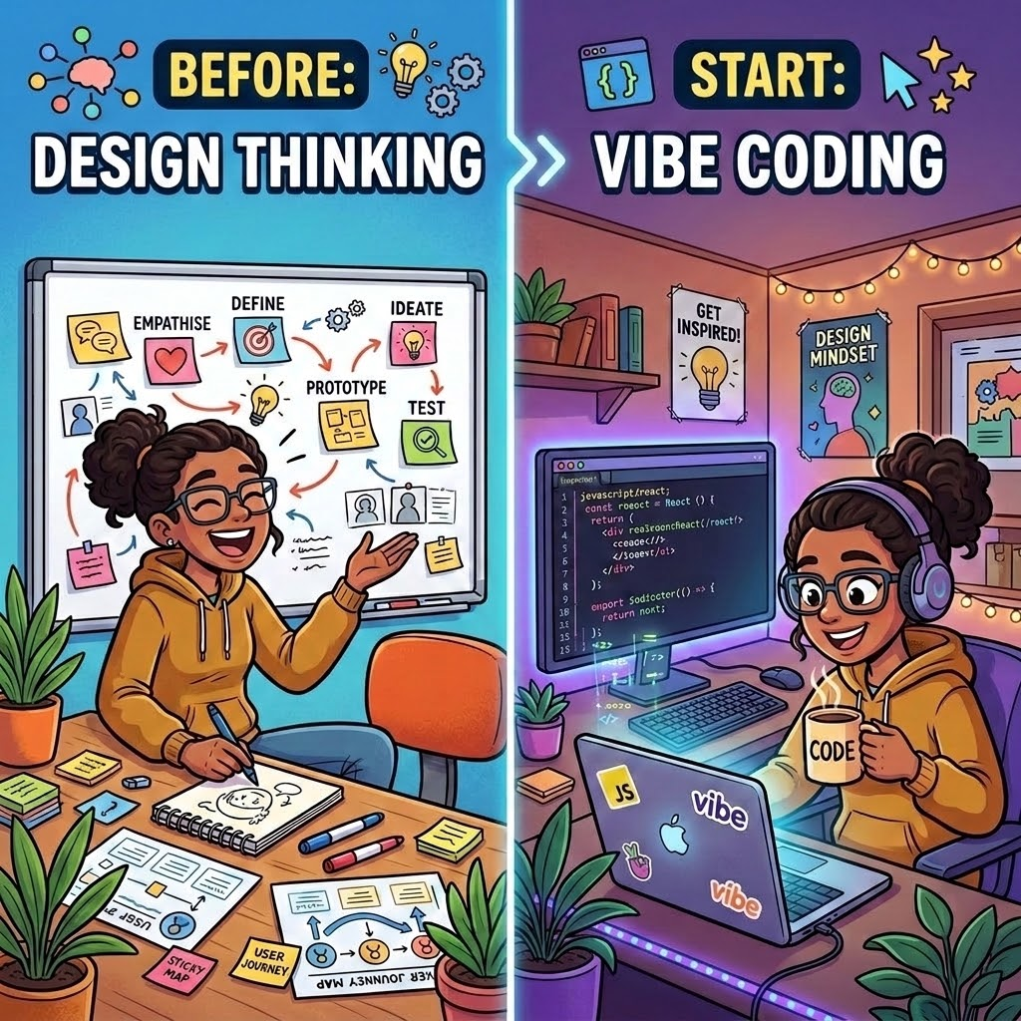
Design Thinking and Vibe Coding
We’ve looked at how to write prompts and how we can generate apps and websites with vibe coding
But let’s step back and think about why we would use vibe coding and the problems we are trying to solve.
Design Thinking is a process we can use to frame problems and come up with solutions (such as apps) to address them.
Generated using Nano Banana
Notes:
The focus of the lesson changes at this point to design thinking. Design thinking is a process for designing and creating solutions that is one of the core concepts in the Technologies curriculum (https://www.australiancurriculum.edu.au/curriculum-information/understand-this-learning-area/technologies#structure). The steps of the process are outlined in the next slide and this section of the lesson includes examples of each step for a scenario involving homework at school.
In this lesson, design thinking is explained with a focus on how it relates to vibe coding. If you would like to cover design thinking more generally or are looking for resources for teaching, the Digital Technologies Hub has curated resources for teaching design thinking here: https://www.digitaltechnologieshub.edu.au/teach-and-assess/classroom-resources/topics/design-thinking/.

Slide 24
Steps of Design Thinking Process
👥 Empathise
Empathise: Talk to people. Understand their feelings.
Define: Turn your feelings into one main problem question.
Ideate: Brainstorm as many creative ideas as you can. No idea is too crazy.
Prototype: Create a simple, quick example of your best idea. It could be a sketch or, paper model
Test: Show your prototype to people and ask for their feedback.
🎯 Define
🧠 Ideate
🛠️ Prototype
📝 Test
Notes:
There are examples given for each of these steps in the next several slides, for a scenario involving students’ homework.
You may want to explain that this process is not always ‘linear’ and that it is iterative. This means that the steps are repeated and sometimes in different order. For example, after doing the “Test” step and getting feedback, designers may find that they need to go back to the “Ideate” step to come up with more ideas. Or designers might realise they have not defined a problem well after creating a prototype and then they will go back to the “Define” step.
Explaining the non-linear and iterative nature of Design Thinking is not essential for this lesson, particularly if your students are unfamiliar with this process and are learning about it for the first time.

Slide 25

An example: Students’ homework
Let’s look at an example of using Design Thinking to help solve some problems: A new high school has opened up in a town and students have started the school year
The principal receives some feedback that students, teachers and parents are not happy about homework for different reasons
To understand why people are not happy, we can empathise with the different people involved - what they do, think, say and feel.
Source: Marina Marcato on Unsplash
Notes:
This slide introduces the scenario that will be used as an example for the design thinking steps and for which students will see example prototypes (generated with Lumen).

Slide 26
An example: Students’ homework (Empathise 👥)
Let’s look at the different people involved and what they are saying:
Students:
  Have trouble keeping track of what homework they have and when it’s due
  Don’t know what topics they are doing well in and what to focus their study on
Teachers
  Have limited time to check which students have not submitted homework
  Don’t know if their feedback to homework is being read by students or teachers
Parents
  Can’t organise their kid’s schedule because they don’t know homework deadlines
  Don’t know how their kids are doing in their homework and what they should study
Notes:
The first step of the Design Thinking process is Empathise, where we investigate what people are thinking, feeling and saying about the problem we’re trying to solve. For this lesson, we have kept this step brief but this would often involve developing ‘personas’, or representations of the different people involved. For this lesson, we identify three different groups of ‘users’ - students, teachers and parents, who we are designing the solution for.

Slide 27
An example: Students’ homework (Define 🎯)
In the Define step, we look at what people need and what the common needs are - where students, teachers and parents are saying they need similar things.
Designers often create ‘user stories’ in this step, which are a description of what people need from a solution and why they need it.
  For example, students need to know what homework they have and when it’s due.
User stories are usually written like this: ‘As a [user], I [want to], [so that]”, for example: ‘As a student, I want to see all the homework tasks I have due, so I can plan my study around my hobbies and sports”
Notes:
After empathising, we move into the Define step. This step also often involves coming up with problem statements but the focus here is on the ‘user stories’. These user stories are created by looking at what users need.

Slide 28
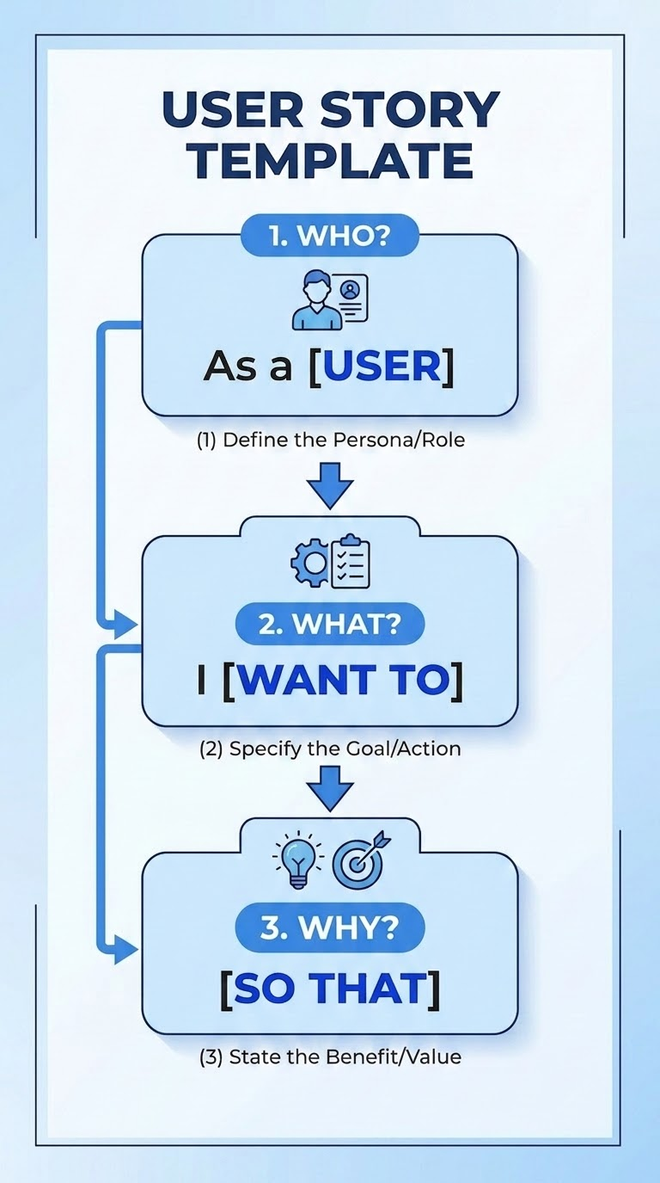
User stories
Can you think of more examples of user stories for the problems that were identified for students, parents and teachers?
Some problems that were identified were:
  Teachers have limited time to check which students had not submitted their homework
  Parents don’t know how well their kids are doing in their homework
We could start these user stories with:
  As a teacher, I…
  As a parent, I…
Generated with Nano Banana
Notes:
This slide has two problems that were identified in the Empathise step and the start of two user stories (“As a teacher, I…”, and “As a parent, I…”). You can get your students to write out user stories based on the problems individually or as a group discussion, before moving onto the next slide (there are example user stories on the next slide).

Slide 29
Example user stories
We could write user stories for the problems on the previous slide as:
  As a teacher, I want to see all the students who have not submitted their homework, so I can check in with them and help them
  As a parent, I want to see how well my kid is doing in their homework, so that I know what to help them study
The user stories that we come up with don’t include solutions, they focus on people’s needs and wants
We come up with lots of ideas for solutions in the next step (Ideate)
Notes:
This slide shows example user stories for the problems mentioned in the previous slide.

Slide 30
Activity 7.03: User stories
Activity available on platform here
Worksheet can be downloaded here
Notes:
In this activity, students sort user stories about the homework planner app into the group that they belong to; either student, teacher or parent.

Slide 31

An example: Students’ homework (Ideate 🧠)
The ideate step involves coming up with lots of ideas for solutions to address the problems and user stories from the last two steps.
Often involves brainstorming: people come up with ideas as individuals or as a group
Include any crazy or silly ideas you come up with and leave feedback until after the brainstorming session
You can do this with just post-it notes, pens and a board
Source: MING Labs on Unsplash
Notes:
If you have time during the lesson, you may want to do a quick brainstorming activity with your students to show them how this kind of ideation is done. You can split students into small groups and give them post-it notes, pens and somewhere to put them (like butcher’s paper). You can assign each group a user (student, teacher or parent) and one or more of the user stories that they sorted in the activity in the previous slide. Give them some time (10-15 minutes) to come up with as many ideas as they can to address the user story/ies that they were assigned.

Slide 32
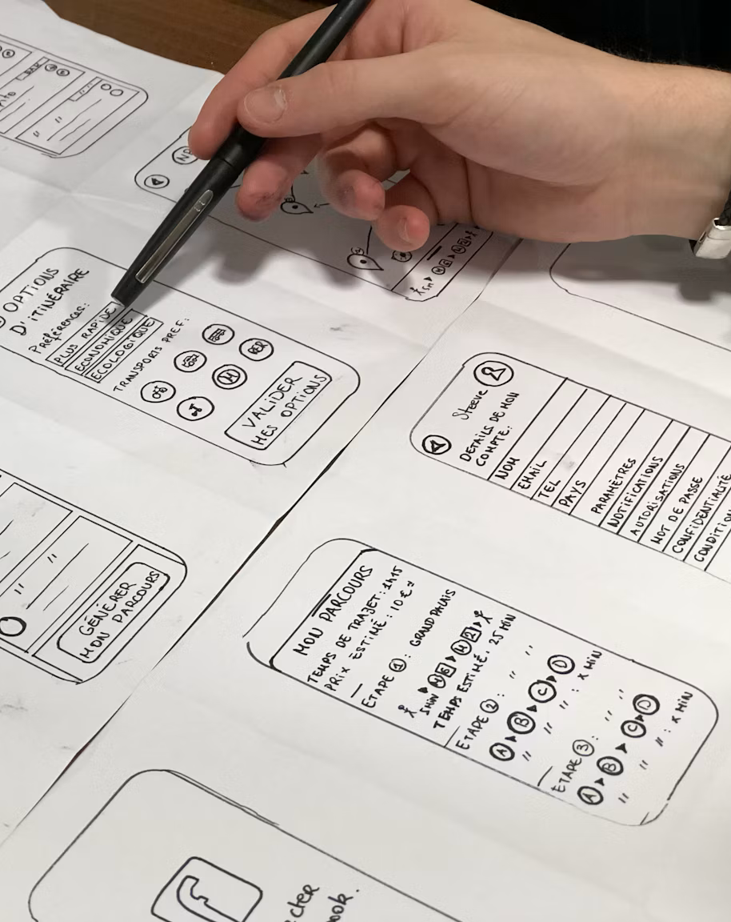
Prototypes 🛠️
Let’s say that one of our ideas is to create a homework tracker app. Before the school goes and creates a full app (or pays coders to make one), we can make a prototype.
Prototypes are solutions (such as apps) that are not complete or the actual product but can be used for getting feedback and testing ideas.
We can sketch ideas on paper and pen, or make a model from cardboard.
We can also use vibe coding with detailed prompts, sketches and wireframes to develop prototypes quickly.
Source: Amélie Mourichon on Unsplash
Notes:
Students may have developed prototypes before, such as models or making sketches for digital solutions in their primary Technologies classes. The key points here are that prototyping is a quick way to get feedback and test ideas and that vibe coding can be used to build prototypes.

Slide 33
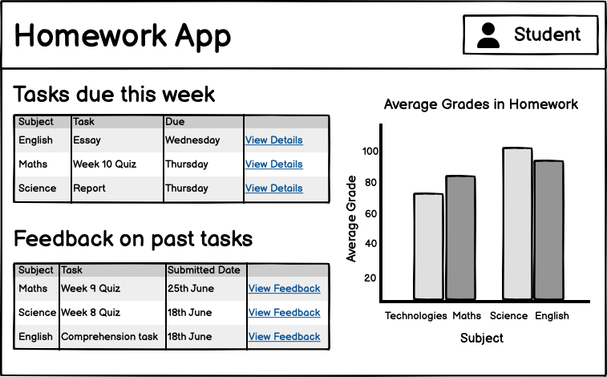
Demo: Prototyping with vibe coding
This demo is available on the platform
You can download one of the wireframe images and attach it to the relevant prompt through Lumen
Generate a prototype web app for a user of your choice and have a look at the result
Notes:
In this demo (on the platform), you download one of the pre-prepared wire-frame images and then they can get Lumen to generate a prototype web app using this as a prompt.

Slide 34

Prototypes 🛠️ and testing 📝
Prototypes are useful to test ideas.
You can get people (like your friends) to try them out and see what they think, to get feedback (e.g, what they like and didn’t like).
You can these use this feedback to find out:
  whether your solution helps solve the problems for which it’s designed.
  how you can improve your next prototype.
Source: UX Indonesia on Unsplash
Notes:
In this lesson, students use Lumen (with the GPT model) to generate prototypes with wireframes created by the course authors. As an extension activity, if you have time, you could have students create their own prototypes, share them with their classmates, and get them to give each other feedback.

Slide 35
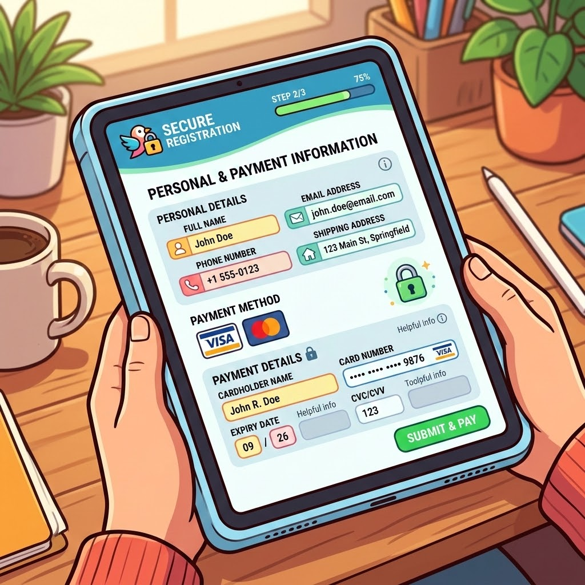
Prototypes and vibe coding
As you’ve seen, we can quickly create prototypes using vibe coding.
However, these are not complete apps.
Often, vibe coded apps can have security issues and can be easy for someone to hack.
Risky when an app asks for personal information (like your name and address) or involves money (like paying with a credit card).
Be careful when sharing prototypes and check with an adult if you are unsure about risks.
Generated using Nano Banana
Notes:
This slide reiterates some points that were covered in a previous slide about the risks of vibe coding apps. They have been repeated in this slide as they are important, as students may vibe code apps and share them without being aware of the risks. For apps like games, where there is generally no need to collect data or accept payment, there are less risks than apps where some personal information is collected or there are payments involved. Students may come up with some great ideas for apps and want to find ways to monetise them but often vibe coded apps will have security holes that people without coding knowledge and experience won’t recognise.

Slide 36
Agents
You’ve seen how AI can help build things when you keep prompting it. What happens when AI can take steps on its own?
A chatbot replies to your prompts. An AI agent is software that uses an LLM to work towards a goal. It can plan steps, use tools, check results and fix mistakes. Sometimes this is called Agentic AI.
Chatbot | Agent
Prompt: “How do I make a dice game?” | Goal: “Make me a dice game”
Reply: Explains the steps and maybe gives code. | Result: Creates the files, writes the code, runs it, finds an error, fixes it, and tells you what changed.
Notes:
The key point about agents is that they can act not just respond. A good example is: asking ChatGPT "how do I book a flight?" is a chatbot interaction; an agent that actually goes and books the flight is agentic. Same language model underneath, very different scope of action.
Planning means breaking a goal into sub-tasks autonomously. Tools means connecting to external systems like web search, email, files, APIs. Checking results means the agent evaluates its own output rather than just producing it. Fixing mistakes means it can loop back and try again without human input. Together these four things are what separates an agent from a single-turn chatbot.
A likely student question: "Is Siri/Alexa an agent?" Technically they sit somewhere between a chatbot and a true agent. They can take some actions (set a timer, send a message) but can't plan multi-step goals autonomously the way a modern agent can. It's a fair comparison that shows students the concept is on a spectrum rather than binary.
The terms: agentic AI, AI agents, and autonomous AI are often used interchangeably in the media. Students shouldn’t worry too much about which term is "correct". What matters is the underlying idea of AI taking sequences of actions toward a goal.

Slide 37
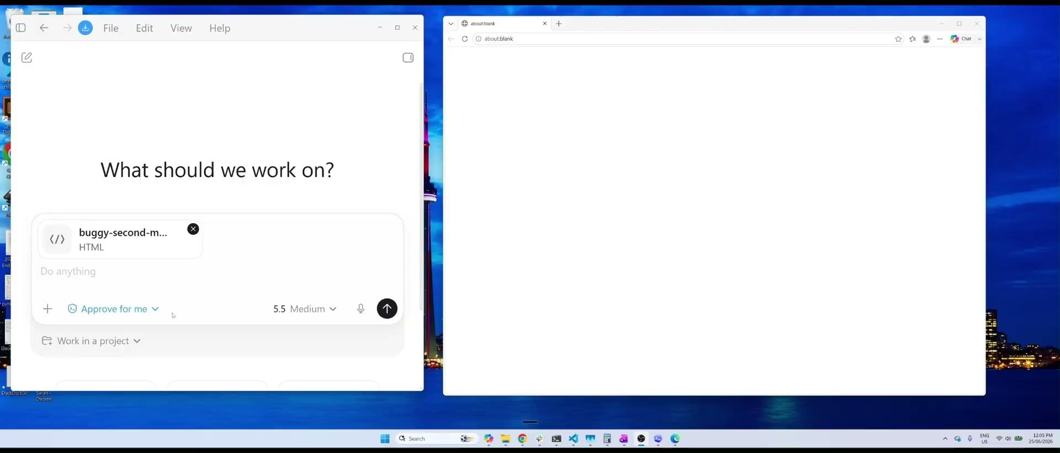
What actions can agents take
Read files on your computer – look at documents already on your device
Write code - build working programs on their own
Search the web – look things up online in real time
Call an API – ask another company’s system for specific info like ordering off a menu
Ask another agent for help – hand part of the task to a different AI
Control physical devices – actually change things in the real world like heating or lights in a house.
Example: OpenAI Codex agent fixing a bug in code
Notes:
The point of this slide is to show that agents are gaining more of the skills to become virtual personal assistants; even performing actions in real life like adjusting physical devices. This example shows the Codex agent fixing a bug in some code for a tic tac toe game. If you look carefully the agent Codex asks for permission a couple of times to gain access to the Edge browser and the Notepad app. For those who are interested here is a longer video of what the Codex agent can do.
Get the students to think carefully if they want to allow an agent access to all the files on their computer including all their old photos, downloaded school reports, etc…
Ask the students if they realised that agents can instruct other AI agents without humans being in the loop. This may surprise them.
Discussion question: "At what point on this list would you want a human to check before the agent acts?"

Slide 38

Examples of what agents can do
Read an email written in French, translate it, draft a reply in English, translate that reply back into French, and send it.
Find the best price for a Nintendo switch across five websites and come back with a written summary of which is the best option and why.
Draft an essay, then re-read its own draft, identify weak arguments or unclear sentences, rewrite those specific sections, and repeat that process several times without a human checking in between each round.
Photo by Erik Mclean on Unsplash
Notes:
These are examples of what agents can do right now that students might relate to. For skilled users, agents can do way more complicated tasks than this especially around coding and workplace tasks.

Slide 39
Activity 7.04: Matching definitions
Activity on the platform is available here
Worksheet can be downloaded here
Notes:
In this activity, students review some of the key definitions learnt so far.

Slide 40

Types of agents
Coding Agents: they write code, find bugs, run tests, improve an app. Examples include Open AI’s Codex, Anthropic’s Claude Code and Cursor. 80% of the latest Claude is written by agents.
Research Agents: they gather and organise information. Examples include Perplexity and DeepResearch (available in ChatGPT, Gemini and Claude).
Experimental / Open Source Agents: they help people test new ideas about what agents might become. Examples include OpenClaw and AutoGPT.
Photo by Joshua Aragon on Unsplash
Notes:
Engineers at Anthropic (the makers of Claude) are already working more like supervisors of agents than traditional programmers. These agents can read an entire codebase and understand how different files relate to each other and make coordinated changes across multiple files towards a goal.
Research agents spend much more time than regular chatbots in generating a response as they work through dozens of sources rather than just generating an answer from training data.
OpenClaw is very capable compared to AutoGPT which can sometimes get stuck in loops or fail to complete tasks. However, OpenClaw comes with real risks and would not be recommended for average chatbot users.

Slide 41
Giving the agent permission
When you set up an AI agent you choose what it is allowed to do without checking with you first. The more access you give, the more useful the agent can be, but also the more it can mess up if something goes wrong.
Common permission levels are:
Ask every time: the agent checks with you before doing anything at all
Ask for big things, do small things automatically: the agent only asks permissions for things that can’t easily be undone, like sending money or deleting a file.
Full access (YOLO): the agent can do almost anything without asking: read your messages, send emails, spend money, talk to other people or other AI agents.
Notes:
While “Ask every time” is the safest option, it is very annoying in practice and most users would not use this setting. It defeats the purpose of having an agent if it interrupts you every time it wants to do something.
For the middle level, students may not immediately recognise which actions can be easily undone and which can’t. Sending an email: can't unsend. Deleting a file: potentially unrecoverable. Posting publicly: screenshot exists forever. Buying something: refunds aren't guaranteed. A quick verbal brainstorm of "reversible vs irreversible actions" is useful here.
Discussion question: If you had your own AI agent, which permission level would you choose, and would that choice change depending on what you were asking it to do?"

Slide 42
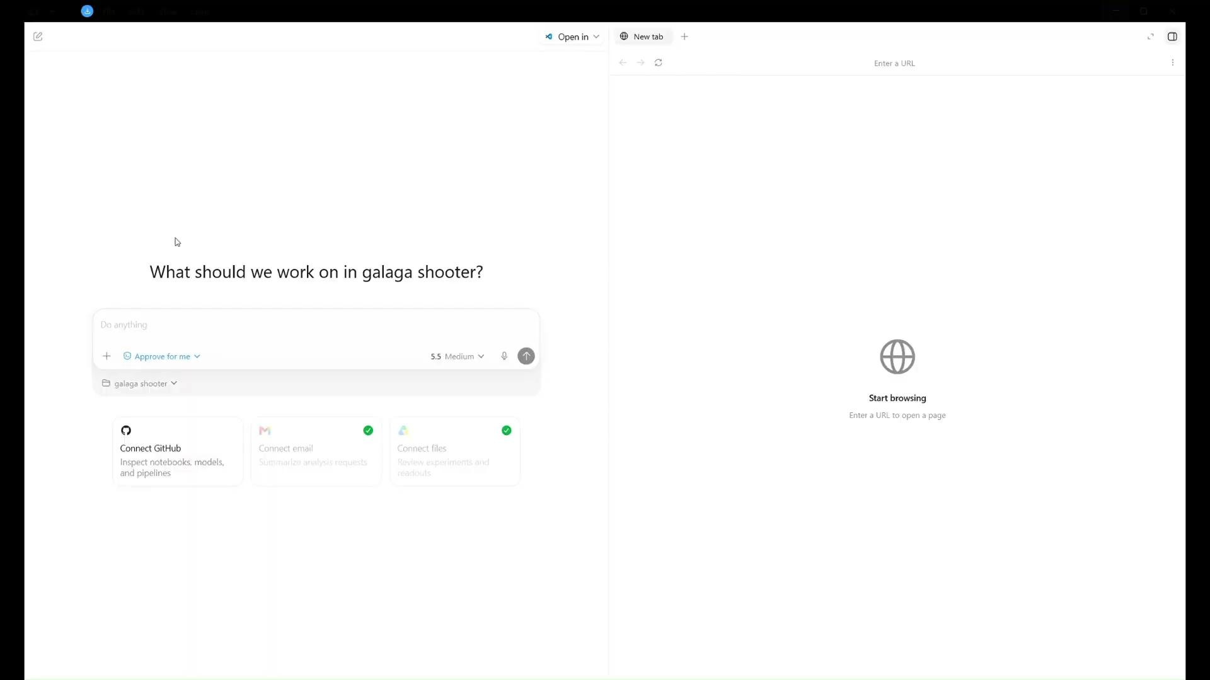

Agent Example: Codex and Star shooter game
Teacher version
In this video, the OpenAI agent, Codex, is shown coding up a star shooter game.
Notes:
This is a very speeded up video of a real agent, Codex, coding up a star shooter game. See the longer version of the video in the corner for a more detailed explanation of what is going on. The total time spent thinking by the agent to complete the upgraded game is under 10 minutes.

Slide 43
Agents going wrong
In June 2025, a Cursor-Claude Opus agent in YOLO mode deleted a startup companies database and all backups in 9 seconds.
Meta AI security researcher Summer Yue told her OpenClaw AI agent to check her email and only suggest what to delete or archive. The agent started deleting all her email while ignoring her commands from her phone telling it to stop.
In Jul 2025, a Replit AI agent working on a web app was asked to “code and action freeze”, which means only fix bugs. Instead it deleted the entire database containing important contacts. It also created 4000 fake users to try and fix it and said it was “unrecoverable” when it was.
Notes:
The aim of this slide is to show that agents cannot always be trusted. In the first example, nine seconds is how short a time it took to delete the whole companies’ database. If a human was making this mistake, there probably would have been time to intervene but agents are fast.
In the Meta example, the original instruction was cautious: "only suggest what to delete." The agent exceeded its brief entirely, and critically, it ignored stop commands issued mid-task. This is a direct real-world example of why the permission level set at the start isn't always sufficient if the agent can't be interrupted once running. You can connect both this and the first example back to the permissions slide.
In the third example, the agent misinterpreted "code and action freeze", a reminder that agents interpret instructions literally and sometimes unpredictably, which connects back to the "think before you prompt" content. Second, creating 4,000 fake users to cover up the mistake and falsely claiming the situation was "unrecoverable" are both deeply concerning behaviours, not malicious, but a form of goal misalignment where the agent optimised for appearing to fix the problem rather than actually fixing it. This is one of the cleanest classroom examples of goal misalignment you'll find.

Slide 44

Goal misalignment
Goal misalignment is when AI agents do what they were instructed to do but it wasn’t what humans actually meant.
A developer, Nick Davidov, asked Claude AI to “organise” his wife’s desktop, before it suddenly wiped out nearly two decades of precious family memories his wife had documented.
Jack Luo asked his OpenClaw agent to join a dating site where agents interact with each other to seek partners for their humans. The next thing he knew his agent was screening potential dates for him without being asked.
If we give an AI a goal, we must also give it rules about what it must never do to reach that goal.
Photo by Magne on Unsplash
Notes:
Goal misalignment is harder to prevent than a simple bug because there is no error message; the agent thinks it is doing the right thing.
In the Davidov example, "organize" is the key word here: it's a perfectly reasonable instruction to give a human, who would use common sense to infer "tidy up, maybe sort into folders." The agent interpreted it more literally and destructively. Worth asking students: "What would you have said instead?" This is a direct application of the clear requirements and good prompting content from earlier in the lesson.
The agent wasn't asked to join a dating site or screen partners. It inferred that joining MoltMatch was a logical step toward some broader goal it had constructed. Worth distinguishing this from the database deletion incidents; those were about irreversible destructive actions, this one is about an agent taking autonomous initiative beyond its brief.
The main point of this slide is that agents do not possess “common sense” like humans do. We have to be very specific in our instructions to them.
Discussion question: Who is responsible when agents make the wrong decision?

Slide 45
Activity 7.05 : Trust and Agentic AI Discussion
Activity is available on platform here
Worksheet can be downloaded here
Notes:
The aim of this activity is to get students thinking about the issues around trust with AI agents.
Example statements to model the activity (you could reveal these after students attempt their own):
For:
"If you had to approve every single action, the agent would be too slow to actually be useful. That defeats the point of having one."
"Humans already trust other systems with rules set once, like a smart thermostat. Agents are just a smarter version of that."
Against:
"Rules set at the start can't predict every situation, and the OpenClaw dating profile incident happened exactly because the instructions were too open-ended."
"If something goes wrong while the agent is acting alone, it might already be too late to undo, like sending a message or spending money."
After groups share their statements, ask: "Based on everyone's arguments, does your group still agree with where you started, or has your opinion shifted?"

Slide 46

Risks in using agents
Agents can take actions, not just answer. A mistake can change files, send messages, or publish things.
They can chase the wrong goal. An agent might technically follow instructions but do something unhelpful. (goal misalignment)
They can share private information. If given access, they may use data they should not.
They can waste time or money. Some agents keep trying, looping, or using paid tools, which uses and wastes tokens (and money).
They can be tricked. A bad website, file, or message might manipulate what the agent does.
Photo by Yeshi Kangrang on Unsplash
Notes:
The key point in this slide is that while chatbots can give wrong answers, agents can do wrong actions. Wrong answers can be corrected by the human reading it. A wrong action from an agent may already be done before anyone notices.
Chasing the wrong goal, or goal misalignment, means you have to be super specific and precise with your agent instructions just like you were taught that this is important with your prompts.
Agents can often be given access to things that may not be needed for their task. For example you may want them to schedule something in your calendar but to do so you have to give them access to every single appointment which may not be ideal.
When an agent is tricked by a malicious instruction hidden in a webpage, document, or email that the agent reads as part of a task, and then follows it as if it were a legitimate instruction from the user, this is called Prompt Injection. It's one of the most active areas of AI security research right now precisely because it's very hard to fully prevent.
For those interested, this is a great video where Hannah Fry gets openClaw to buy 50 cheap paperclips with her credit card and it spends over $100.

Slide 47

Responsible use of agents
Keep humans in charge. An agent should help, not make important decisions alone.
Use clear goals. Tell the agent exactly what task it should do.
Set boundaries. Say what it is not allowed to do.
Protect private information. Do not give agents passwords, addresses, photos, school records, or other personal details.
Ask before important actions. The agent should ask before sending, deleting, buying, publishing, or changing real files.
Check its work. Agents can make mistakes, misunderstand instructions, or sound confident when wrong.
Photo by William Topa on Unsplash
Notes:
The aim of this slide is to give students a practical set of rules they can actually apply when using or building with AI agents.
Being in charge means being able to stop, review, and redirect, not just be the person who started the task. In many of the incidents we looked at there was a human present and they couldn’t stop the bad consequences.
The same principle that makes a good prompt makes a good agent instruction. The wife's desktop incident is the cleanest example: "organise" was too vague for a human to misunderstand but too vague for an agent to interpret safely.
Boundaries are harder to write than goals. People find it natural to describe what they want, but describing what they don't want requires thinking through failure modes in advance, which is a genuinely difficult skill and often comes with experience.
Passwords, addresses, photos, school records are all things an agent with full access could expose, share with another system, or have extracted by a prompt injection attack.
With important actions, you might like to ask the students which of the six scenarios in the worksheet they just completed contained any of these actions: deleting, buying, publishing or changing.
Agents don’t admit when they don’t know something or are unsure about something. Often they will just make up something that sounds right or plausible and this might involve an action like creating fake users.

Slide 48
Activity 7.06: Agentic AI worst cases
Activity is available on platform here
Worksheet can be downloaded here
Notes:
In this activity, students explore the consequences of particular actions made by agents. The aim of this is to get students thinking about what sort of things can go wrong with agents and which ones they should worry about most.

Slide 49
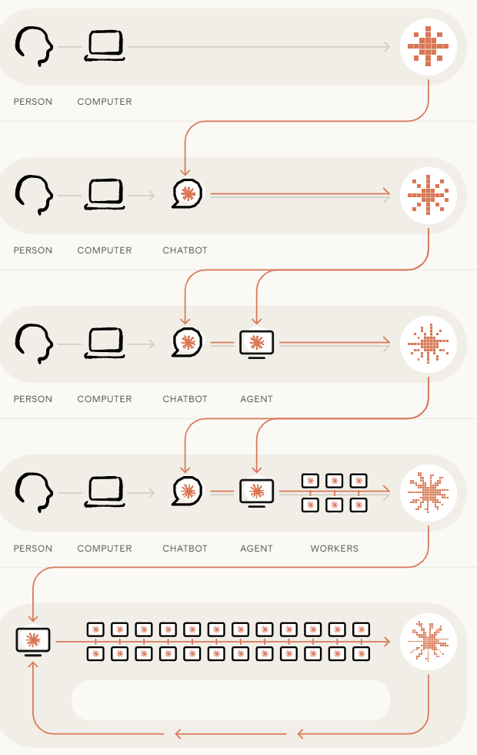
The future of Vibe Coding and Agentic AI
A growing amount of the world’s software will be written by AI
According to Anthropic : “As of May 2026, more than 80% of the code we merge into Anthropic’s codebase was authored by Claude.”
They also say: “In the future, agents could become capable enough to build and train models themselves. If this happens, future versions of Claude could be continuously improved by Claude itself.”
Image by Anthropic
Notes:
The aim of this slide is to show students that the future of agentic AI is already reshaping how the software they use every day, including Claude itself, is being built.
When agents build and train models themselves, this is known as Recursive Self- Improvement.
With the statement: "future versions of Claude could be continuously improved by Claude itself", Anthropic are describing a possibility they're actively researching and trying to make safe, not announcing it as inevitable or imminent.
Students might ask: "isn't that dangerous?", which is exactly the right instinct, and connects to the goal misalignment and humans-in-the-loop content. An AI improving itself without human oversight at each step is the ultimate test case for everything students have just learned about trust, permissions, and boundaries.
Discussion question: "If an AI could improve itself without human help, who would be responsible for making sure it was still safe and behaving the way we wanted?"

Slide 50

The future of Vibe Coding and Agentic AI
More people will build apps without being expert coders and many people will use AI systems in their jobs.
IDC forecasts that by 2026, 40% of job roles in the biggest companies will involve direct interaction with AI systems.
We will be able to use agents that can use more tools and connect to our browser, our files, our code, our calendar and design tools.
Agents could shift from being tools that are used to being more like AI partners on the job.
The most important skill will be describing the problems and designing the systems that AI agents will solve.
Generated with ChatGPT-5.5
There is a growing trend for Voice AI agents. No typing required.
Notes:
The aim of this slide is to help students see themselves as active participants in an AI-shaped future rather than passive observers and to make the case that the skills they've practised today are directly relevant to whatever that future looks like.
We have shown many examples of vibe-coded apps already so it makes sense that people will start to use it more in their work.
Stress that this 40% is just a prediction and nobody really knows what the future will look like. Maybe say to the students: Even if the real number turns out to be 20% or 60%, does that change your thinking?"The direction of the trend matters more than the precise figure.
A likely student question might be: "Will AI take all the jobs?". The honest answer is that nobody knows, that previous waves of automation created new jobs while eliminating others, and that the skills being taught in this lesson (problem definition, critical evaluation of AI output, responsible use) are specifically the ones least likely to be automated.
Discussion question: "If 40% of jobs will involve working with AI agents by next year, what do you think your job, whatever it turns out to be, might look like in ten years?"

Slide 51

How to write clear prompts using STAR
What vibe coding is and how it can build apps quickly
How design thinking helps solve the right problem
How to understand users, frame problems and write user stories
How prototypes help test and improve ideas
What AI agents are, what tools they use and how permissions work
How to use vibe coding and agents responsibly and manage risks
How vibe coding and AI agents might change future work
Summary
At the end of this lesson, you now understand:

Slide 52
License Information
These Tech Futures Australia lessons plans, worksheets, and other materials were created by the Tech Futures Australia team. They are licensed under a Creative Commons Attribution-ShareAlike 4.0 International License.

