Slide 1
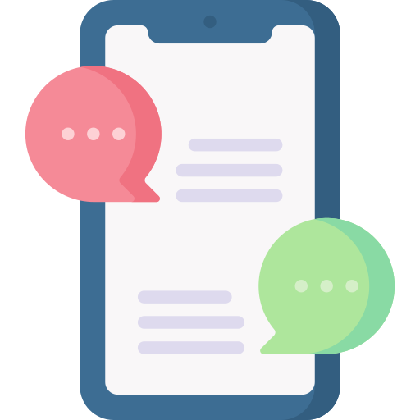
Lesson 8
The Future of AI
tfa.org.au

Slide 2
Learning objectives
By the end of this lesson, you will learn about:
What AI will look like in the future in many different areas of life
What AGI and superintelligence are and opinions on when and how they might be achieved
How humans will be impacted by AI: through augmentation and automation of their jobs
Risks of AI in the future
Notes:
The aim of this lesson is to give students a glimpse of the future with AI and help them realise that nobody knows what will happen in the future and to be sceptical of future predictions.

Slide 3
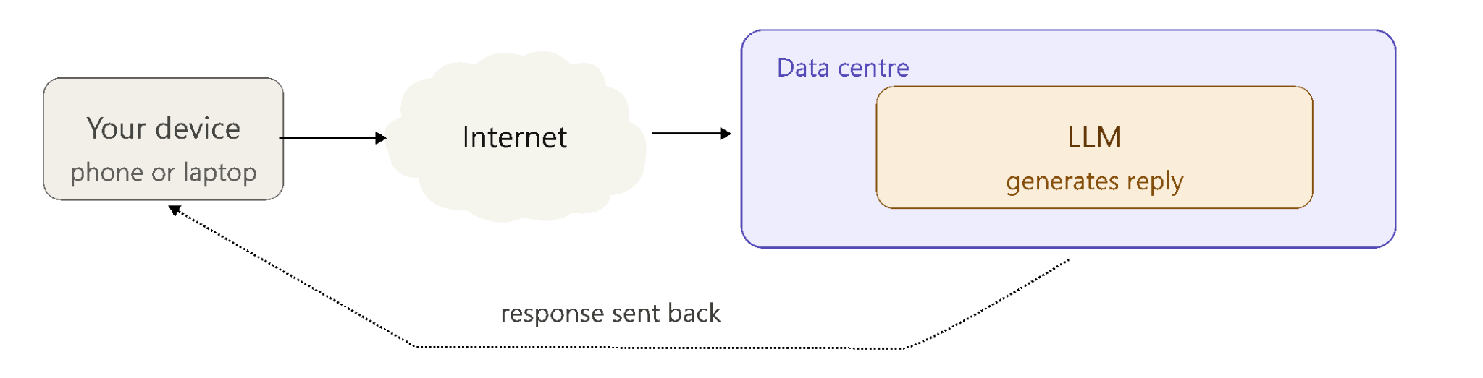
What you’ve learnt about how AI works
AI is very good at finding patterns in data
It can be used for classification, prediction or generation
Generative AI can make text, images, audio, video and code
The LLMs in generative AI are token predictors. They do not understand text like humans.
GPUs and data centres power the large LLMs that most people use today.
Notes:
This slide aims to partly summarise what students have learnt in the course.

Slide 4
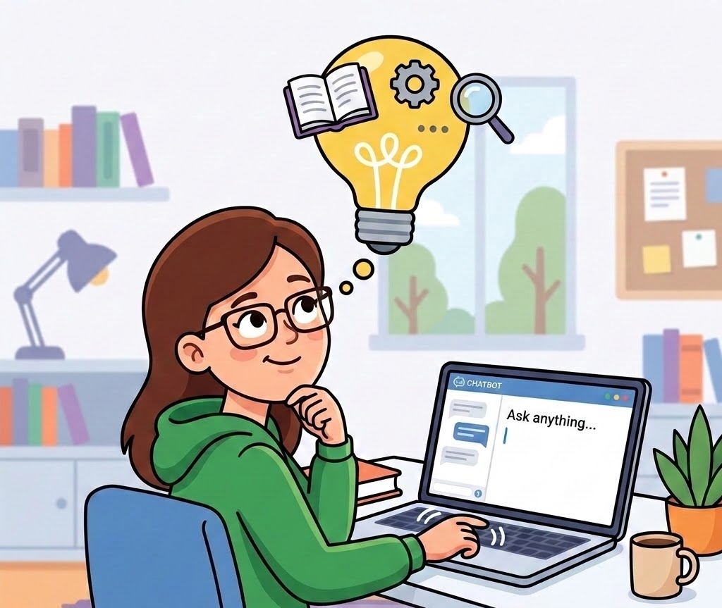
What you’ve learnt about using AI well
Clear, specific prompts with good context lead to better results
You should always fact-check with trusted sources
Avoid cognitive offloading: keep thinking for yourself
Keep humans in charge of important decisions
Use Design Thinking in tandem with AI to create better solutions
Prototypes should always be tested when vibe-coding or using agents
Image generated using Nano Banana
Notes:
This is a continuation summary slide.

Slide 5
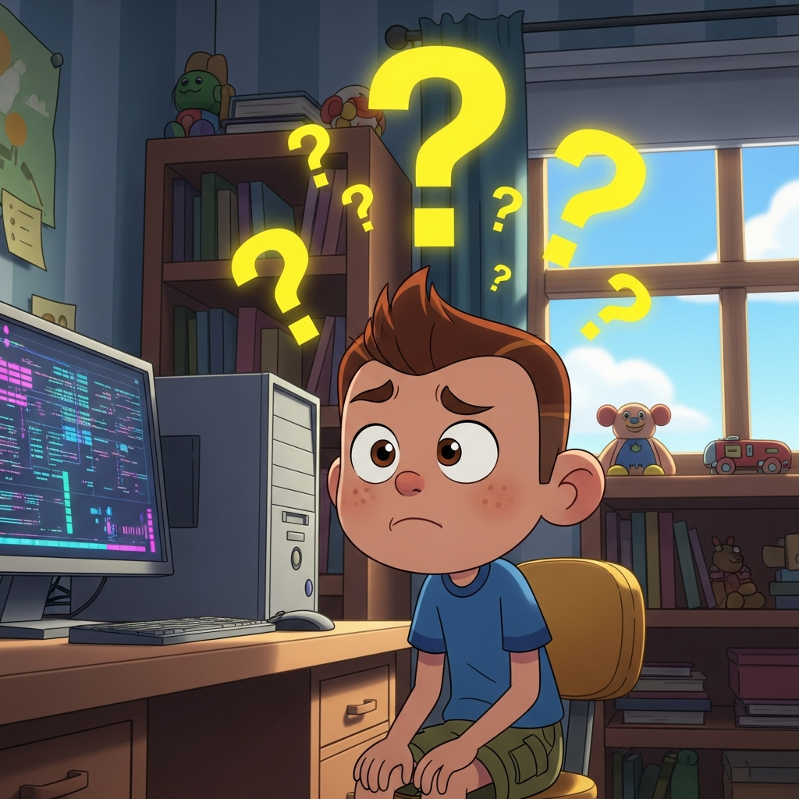
What you’ve learnt about the risks of AI
Hallucinations can sound confident but be wrong
Deepfake video, audio and images are becoming very hard to detect and you have to be on the lookout for scams.
Many of the popular LLMs contain bias as they weren’t trained on data that represented everybody.
Copyright can be unclear when AI copies or remixes work and many artists are struggling in this environment.
Private data can be stored or shared. It’s important to avoid entering personal information into AI tools
Generated with Imagen 4.0 Generate
Notes:
And the final summary slide of what they’ve learnt in the course so far.

Slide 6
Activity: Matching terms and definitions
Complete this activity on the platform
Notes:
This is a matching activity consolidating the learnings from earlier in the course.

Slide 7
AI in 2035: prediction scale
Drag the coloured circle for each statement from very unlikely to very likely.
Very unlikely
Very likely
Most students will have an AI tutor.
Some people will have AI friends or companions.
Most coding will be done by AI agents.
Schools will still need human teachers.
AI will make fake videos impossible to detect.
Humanoid robots will be common in homes.
Notes:
Teacher note: In edit mode, drag each coloured circle along the scale to show the class prediction. Leave the circles near the middle before discussion, or move them during class as students vote.
The aim of this activity is get students discussing what they think the future with AI will look like. There is no wrong or right answers.

Slide 8
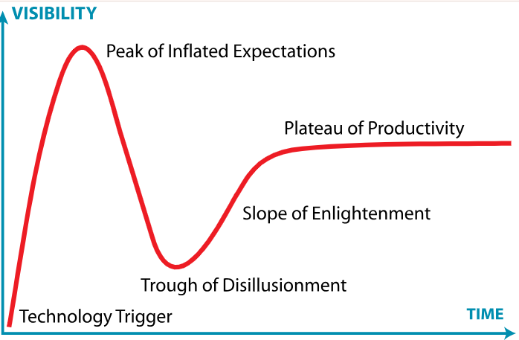
The future of AI
Predicting the future is hard: no one really knows what will happen
New technologies are always over-hyped early.
The Gartner Hype Cycle shows a common pattern: hype → inflated expectations → disappointment → slower, realistic progress
Past predictions have been wrong and experts disagree a lot.
The Gartner Hype Cycle by Jeremykemp at English Wikipedia, CC BY-SA 3.0, via Wikimedia Commons
Notes:
This slide shows the Gartner Hype Cycle. The “cycle” (which is not really a cycle) is a way of visualising a pattern of how new technologies can be adopted by people. The pattern doesn’t always look like this and the cycle itself is not backed up by scientific research. However, it can be useful to help us think about what could happen with new AI technologies (like LLMs and agentic AI) in the future.
The five main main steps can be explained in plain English as:
Technology Trigger: A new technology is released (e.g, think Virtual Reality or Smart watches)
Peak of inflated expectations: People hype up the new technology and claim that it will be widely used and solve many problems
Trough of disillusionment: The technology is not as widely used as expected and/or is not able to solve as many problems as claimed
Slope of enlightenment: People find appropriate uses for the technology and its adopted by many people as part of their usual life/work
Plateau of productivity: The technology becomes a normal, everyday tool. It’s no longer hyped up, it’s just useful.

Slide 9
Activity: Predicting the future
Download the worksheet
Notes:
In this activity students look at past predictions made by famous people and state if they think they are either a hit/near miss or a flop. The aim is for them to understand how hard it is to make accurate predictions, while at the same time be amazed by those predictions that came true.
Follow-up discussion question: "Why do you think some predictions came true fast, some came true slowly, and some never happened at all?"

Slide 10
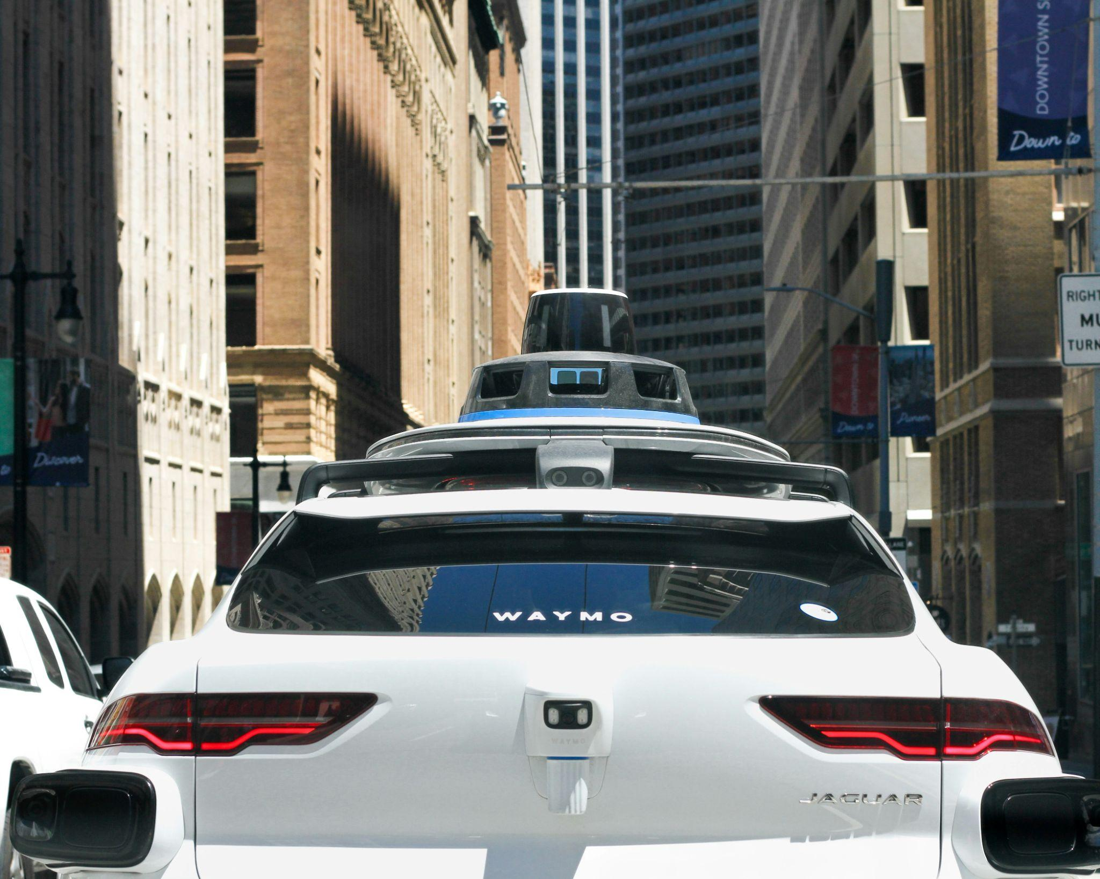
The near future
It’s easier to make predictions about the near future (1-2 years), compared to 5-10 years from now.
The further into the future a prediction goes, the more guesses it depends on, and any one of those guesses could turn out wrong.
Experts are often good at spotting what will change, but bad at predicting when. Self-driving cars are a classic example. They were confidently predicted for "a few years away" for over a decade).
Waymo by gibblesmash asdf on Unsplash
Notes:
The aim of this slide is to get students to focus on the near future and realise that it is much easier to predict closer ahead in time.
Students may not know that Waymo (the US self-driving taxi service) now gives about 500,000 driverless rides a week across roughly 14 US cities, up from just 50,000 a week in 2024 according to IndexBox. It's aiming for 1 million rides a week by end of 2026, but that still leaves it far behind Uber, which completed around 13.5 billion trips in 2025. It is not perfect though: regulators are investigating robotaxi behaviour around school buses, and San Francisco officials have raised concerns about how Waymo handles broken-down vehicles.

Slide 11
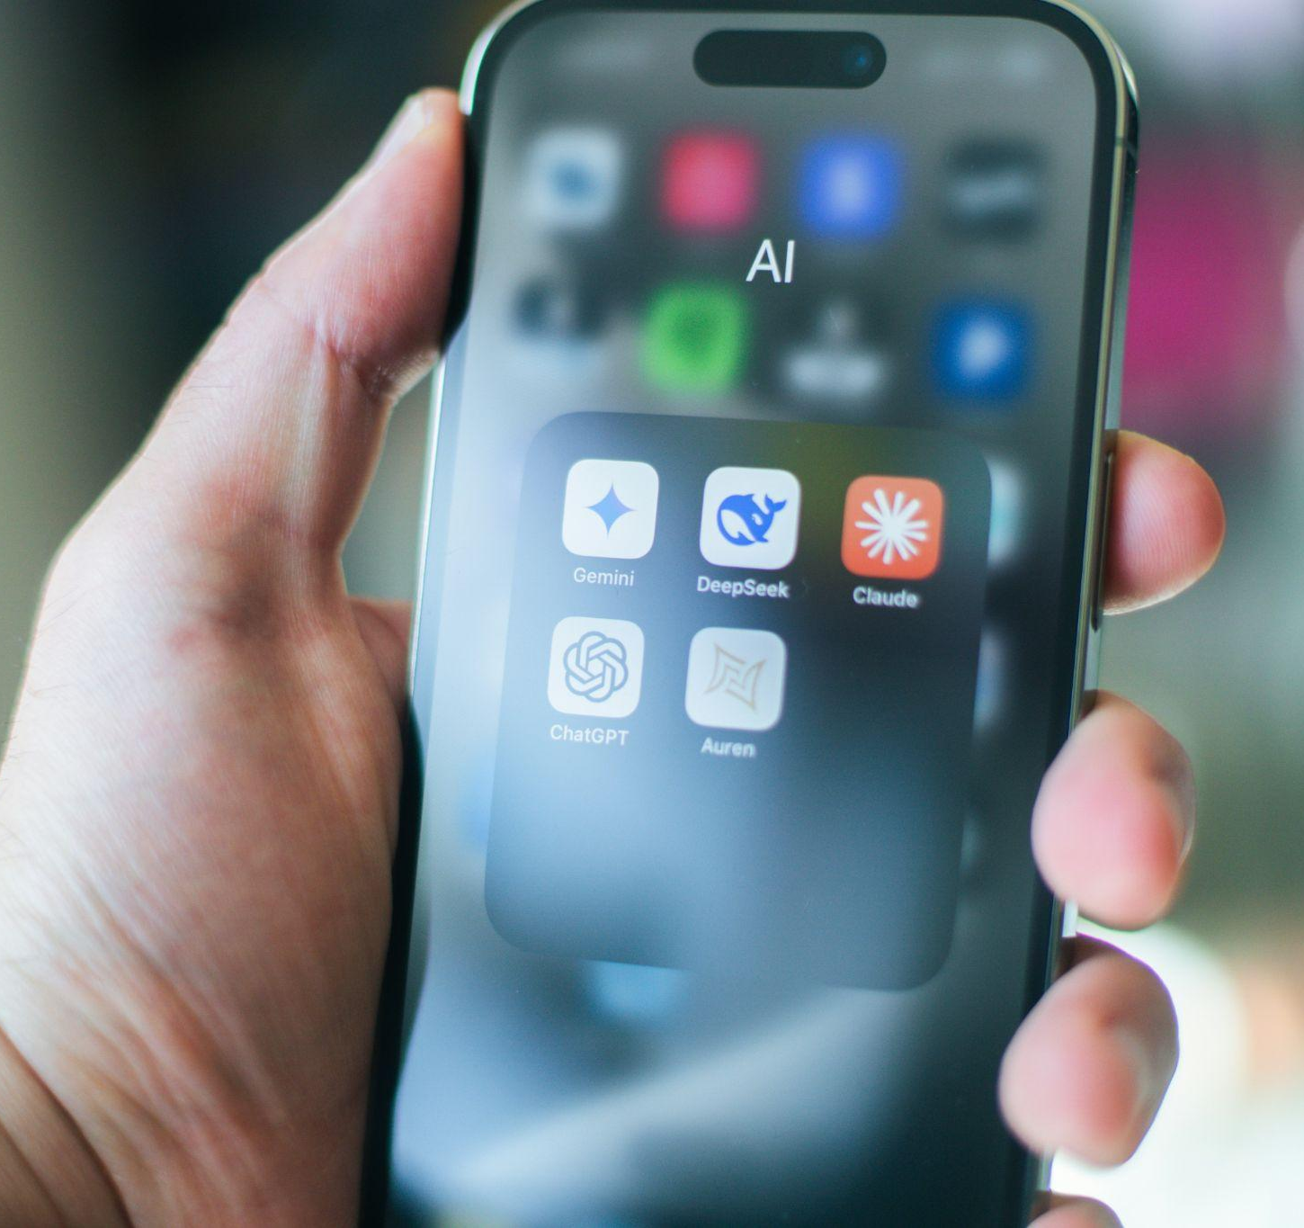
The near future: LLMs in 1 - 2 years
More agents, less chat. Models take actions, not just answer questions
Multimodal by default. Seeing, hearing, and talking become standard, not special features
Smaller, faster models. More AI running directly on phones and laptops, not just in data centres
Live information. More models connected to real-time search, less reliant on outdated training data
Better reasoning, not just bigger. Models trained to "think it through," not just scale up
Photo by Aerps.com on Unsplash
Notes:
This slide focuses on LLMs in the near future. It’s hard to predict further than this as things are changing so quickly. A new AI model is released, on average, roughly every 2 days according to an AI model release tracker, based on the past 90 days in July 2026. In just one week in July 2026, seven notable new AI models were released by five different companies.

Slide 12

The near future: More open models
Free, open-weight AI models (ones you can download and run but you can’t access their training data) are getting almost as good as the ones you pay for.
Moonshot’s Kimi K3 model topped the leaderboard on one benchmark test and equalled the latest OpenAI model on another one.
In the future, we'll probably see both kinds of models: paid, closed models for performance and support, and open-weight models for anyone who wants more control over their own AI.
Photo by Finn Hackshaw on Unsplash
Notes:
Discussion prompt: Ask students why a government or company might choose an open-weight model even if it's slightly weaker, with reasons like privacy and tunability as possible answers.
Source for the Kimi K3 model, on benchmarks against Anthropic and OpenAI models: https://www.tomshardware.com/tech-industry/artificial-intelligence/moonshot-releases-2-8-trillion-parameter-kimi-k3

Slide 13
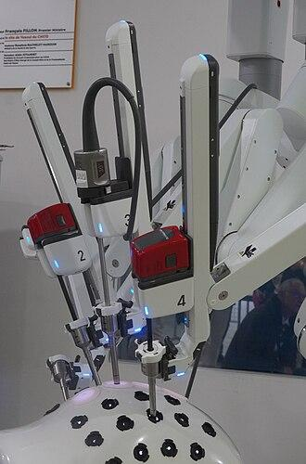
The near future: medical applications
Diagnosis: AI is increasingly helping doctors spot patterns in scans, test results, and symptoms faster.
Record keeping: tools like the Australian Heidi Health listen in on a doctor's appointment and automatically write up the clinical notes, freeing doctors to actually focus on the patient instead of typing.
Curing "incurable" diseases: MIT scientists used AI to scan millions of chemicals in days instead of years. They found new antibiotics that could fight dangerous superbugs.
Surgical robots: robots like the Da Vinci system already assist surgeons with extremely precise, steady movements no human hand could match alone and Remedy Robotics, an Australian company, has successfully trialed a completely remote operation.
Da Vinci robot by A.BourgeoisP CC BY-SA 4.0 via Wikimedia Commons
Notes:
The aim of this slide is to show the future directions of AI in Health. There are already some really cool things happening.
Another amazing example is Brain2Qwerty: an experimental Meta AI project that reads brain wave activity and converts it directly into typed text, aimed at eventually helping people who can't speak or type communicate. This video briefly explains the project: https://www.youtube.com/shorts/p9SJ186PCEU

Slide 14
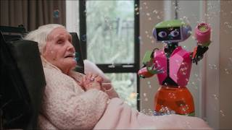
The near future: Abi the robot
Meet Abi | A best friend out of the box from Andromeda Robotics
Source: YouTube
Notes:
Abi is an Australian-made social robot designed to create an empathetic experience for nursing home residents, using sensors, motors and AI-driven software, and can recall details from past interactions, making conversations feel more personal.
Sadly up to 40% of aged care residents in Australia never receive a visitor, and Abi was built specifically to address loneliness rather than for efficiency or productivity.
Discussion prompt: Brown says residents often describe Abi as "a best friend or even a grandchild," which raises a genuine ethical question worth putting to students: is it okay for someone to feel that way about a robot, especially if it eases real loneliness? Is there a difference between companionship and the appearance of companionship?
Privacy angle: Abi uses end-to-end encryption and stores data locally by default, with cloud sync only under user consent, a nice concrete example for discussing data privacy in AI products aimed at vulnerable people.

Slide 15
The near future: Embodied AI
At home: robot assistants that don't just answer questions but can unpack groceries, remind an elderly person to take medication, or call for help if someone falls.
At work: a single AI agent could run dozens of robot bodies across a warehouse, construction site, or hospital at once.
In dangerous places: agents in robots could handle bushfire fighting, deep sea repair, or nuclear clean-up with minimal human involvement.
At school: a robot agent that notices a student is stuck, sits beside them, explains the concept a different way, and flags to the teacher that three students in the corner have been confused about the same thing for 20 minutes.
Notes:
The aim of this slide is to show where technology is heading, not existing products just yet. Watch this video and this one to see how close robots in the home are getting.
There is a lot of research going into robots in the workplace with a single model controlling many physical robots.
Robots are currently used for bomb disposal, deep-sea and nuclear site inspection. However, most current systems are still human-operated or supervised rather than autonomous.
Discussion prompt: Is a robot that flags struggling students to a teacher helpful support, or does it feel like being watched? For example, check out this creepy robot that is coming to a school in the US soon.

Slide 16
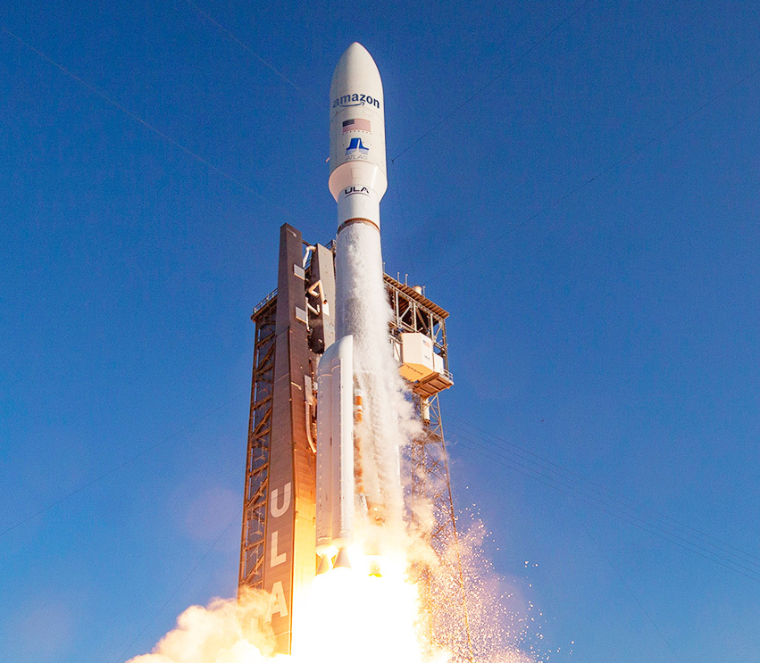
The near future: AI in space
AI is being used in developing space technologies already and its use is likely to expand in the near future.
SpaceX filed plans for a constellation of up to one million satellites to act as an orbital AI data centre.
Blue Origin has filed plans for its own satellite data centre network, called Project Sunrise, aiming for 51,000+ satellites.
Germany's LeLaR project has already shown a satellite using AI to reorient itself in orbit with no human input.
Amazon satellite launch

Slide 17

The near future: what have you seen?
Have you seen any predictions about AI in the next 1-2 years?
What do you think about those predictions?
Notes:
This is a good point to take a quick pause from the content in the slides and ask students to share predictions they have seen about AI. They may heard some interesting predictions or heard about some interesting ways AI has been used in the news.
At the time of writing these slides (July 2026), there were stories that Artificial General Intelligence (AGI) was just around the corner (AGI is also discussed later in the lesson). There was also a lot of stories about the impact of AI on employment and business productivity.
After this slide, the lesson will then transition to a focus on AI and jobs, and how AI has been used to automate parts of their job.

Slide 18
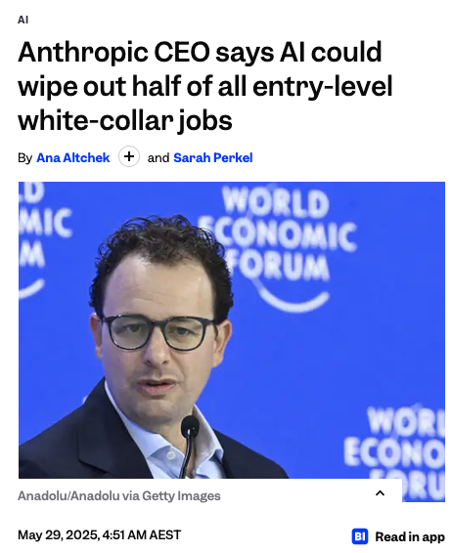
AI and the future of work
There have been lots of predictions about how AI will impact jobs.
Like other predictions, it’s hard to know what will happen.
It’s likely that some tasks in different jobs will be able to completed independently by AI (or rules-based software).
We call this automation: when a robot, software or AI carries out tasks without a human doing anything. For example, a robot making a coffee for a customer at a cafe.
Source: Business Insider
Notes:
Students may need to be told that white-collar jobs are jobs where people generally work in offices and in roles that are not focused on physical labour.
At the time of writing these slides (July 2026), there were stories about AI not having as much impact on jobs as predicted - with the CEO of Anthropic (the developers of Claude) taking back some of his comments about AI’s impact on the job market.
As mentioned in this slide and the previous slides, it’s difficult to make accurate predictions for the future but it is clear that AI (specifically LLMs and image/video/audio generation) is having an impact on how people work and will continue to do so in the future.

Slide 19
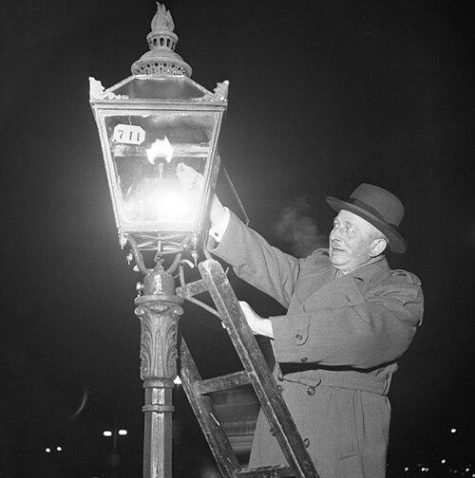
Automation
Jobs have disappeared before, lamplighters (who lit street gas lamps by hand) and knocker-uppers (who woke people up for work before alarm clocks) vanished once new technology took over.
Many jobs still haven’t been automated despite advancements in technologies.
Physical tasks like cooking and cleaning can be challenging to automate because collecting training data can be hard and because of Moravec’s paradox.
Photo by Gunnar Lanz at Wikimedia Commons
Notes:
This slide notes how automation has impacted workers in the past. At one point, people were employed to light gas lamps and to wake people up for work, but electric lights and alarm clocks made these jobs unnecessary.
Many jobs have been impacted in some way by automation but the technology has not worked as effectively as humans, or there are needs for human judgment or accountability. For example, there is software (AI and non-AI) to transcribe and translate audio from one language to another. But often the transcriptions and translations are not as accurate as humans’ or (in the case of translations) the meaning of the original text is not properly captured.
Students learned about Moravec’s paradox in Lesson 2. This paradox means that there are things it’s easy for humans to do (like fold laundry and wash dishes) but hard for robots and AI to do. Conversely, there are things humans can find hard (like playing chess) that robots and AI can do easily. In the next slide, there is a video that shows a way that AI developers have recently tried to collect data to train robots and AI to do physical tasks, like folding laundry and washing dishes.

Slide 20
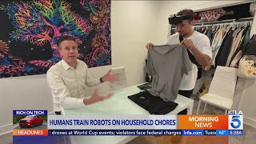
Data Collection for Automation
People are getting paid to teach robots - Rich On Tech
Source: YouTube
Notes:
This video shows how AI companies are collecting data to help train AI for carrying out physical tasks, such as washing dishes, folding clothes and sweeping floors. These data are used to train current technologies (like household robots) and it’s likely that this will continue to be a way of training them in the future.

Slide 21
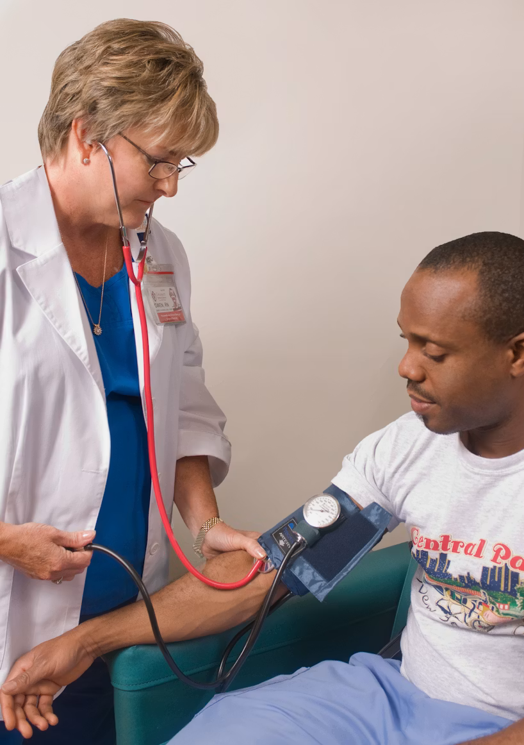
Augmentation and work
Most jobs are made up of many smaller tasks, AI is more likely to automate some of those tasks, not the entire job.
For example, a doctor's job includes diagnosing, explaining, comforting, and deciding on treatment. Comforting a worried patient still needs a human.
This is called augmentation, AI handling the repetitive or data-heavy parts of a job, freeing up humans to focus on judgement, creativity, and human connection.
Blood pressure measurement by CDC (Unsplash)
Notes:
This idea is central to the book The Future of the Professions (Susskind & Susskind), which argues professional work (like law, medicine, teaching) will be broken down into parts, some automatable, some not.

Slide 22
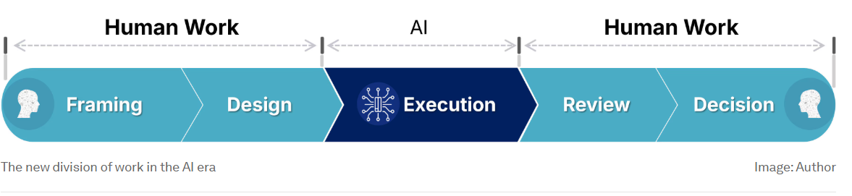
Humans and AI in the future
The World Economic Forum wrote an article with predictions on how AI will be used in future work. They also predict AI will be used to augment jobs in the future.
They predict AI will be used for more of the “doing’ or ‘executing’ while humans will be framing problems, designing solutions and reviewing outputs - like we have done throughout this course.
Source: World Economic Forum
Notes:
This slide makes similar points to the previous one - in the future it’s likely that jobs will continue to be augmented by AI but that humans will have responsibility for parts of the process.
Throughout the course, students have learned about the importance of framing problems (for example, when writing prompts) and how design thinking can be used to help solve problems with AI. Students have also reviewed and decided when they completed the activities (particularly those involving Lumen or when looking at simulated AI outputs) in previous lessons.

Slide 23
Human review and AI Execution
Let’s look at an example of how these steps could work for a website designer.
The designer talks to their customer about the website they need. They draw sketches of website designs.
An AI tool is used to generate the website code for 2-3 different designs based on the sketches.
The designer reviews and chooses their favourite designs and adjusts the code to show the customer the result.

Slide 24
Activity: Augmentation
Complete the activity on the platform
Download the worksheet here

Slide 25
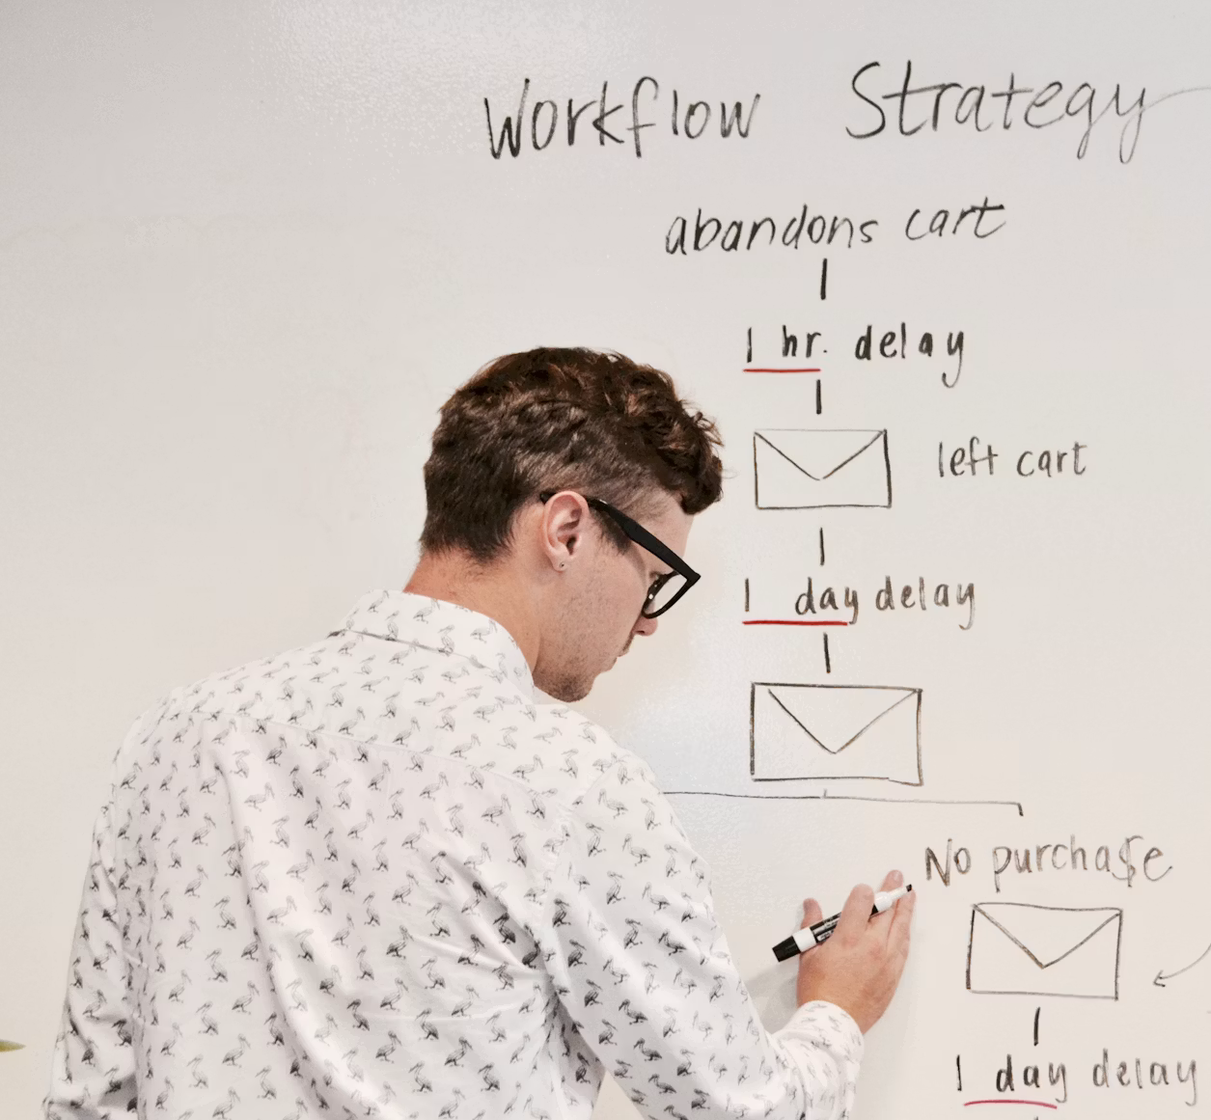
New AI Jobs
As well as jobs changing with augmentation, new types of jobs and industries could also be created
Some examples of AI jobs that have recently become more common are:
  AI Engineer/Developer: work on creating and improving new AI tools and models, such as LLMs
  AI Automation Engineer: find ways to use AI to automate and augment tasks for different jobs
  AI Trainer: Judge the responses from different AI tools and write training data examples to help train new AI models and improve AI tools
Source: Campaign Creators (Unsplash)

Slide 26
Activity: Hire Human or AI
Download the worksheet here.
Notes:
In this activity, students choose a job role and evaluate both a human and an advanced AI system for the role. The aim is to get the students thinking about what humans are well suited to and what AI systems do best.
Some suggested wrap-up discussion questions are:
Which jobs still need a human to be responsible for the final decision?
Does sounding understanding mean that an AI genuinely understands feelings?
Are there tasks that AI should never be allowed to complete alone?
What skills could people develop now, in 2026, to remain valuable in a 2035 workplace?
Was your decision based only on performance, or also on trust, fairness and responsibility?
This activity could be modified/expanded to include group presentations by each of the groups at the end of the activity

Slide 27
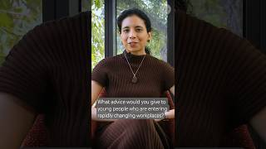
Advice for entering the workplace
What advice would you give young people entering a rapidly changing workplaces? | Dr Anima Anandkumar | Source: YouTube
Notes:
In this video Dr Anima Andankumar (a professor in Computing from the USA, who has led research in AI and held positions at NVIDIA and Amazon Web Services), gives some helpful advice to young people about adopting AI and thinking critically about outputs from LLMs and other generative AI technologies.
After this slide, the focus of the lesson changes to AGI and Superintelligence.

Slide 28
Artificial General Intelligence (AGI)
AGI (Artificial General Intelligence) is when an AI can understand, learn and perform any thinking task a human mind can.
Unlike today's AI, which is good at one job (translating, recognising images, playing chess), AGI would be flexible across many different tasks and areas.
It could take what it learns in one area and apply it somewhere completely different, the same way a person who learns to play chess can use that same strategic thinking to get better at a card game like poker.
AGI doesn’t exist yet. It’s a goal many AI labs are working towards not a current technology. It’s also very hard concept to define.

Slide 29
When will AGI happen?
Nobody knows when AGI will happen but CEOs of major AI companies are most hopeful about it arriving soon.
DeepMind’s CEO, Demis Hassabis, and OpenAI’s Sam Altman believe it will come by 2030.
Anthropic’s CEO, Dario Amodei believes AGI-level systems will come sometime around 2027-2028
However, experts don’t fully agree how to define or measure AGI..

Slide 30
Will LLMs ever reach AGI? : The No case
People are divided over whether LLMs will ever reach AGI. Reasons why not include:
They predict text based on patterns and critics argue that’s fundamentally different from reasoning, planning or truly understanding a problem.
They only learn from text/images, not real-world experience, touch and movement.
They struggle with genuinely new situations that don’t match anything in the training data
Making models bigger and adding more data might not be enough. We could run out of quality data and predicting the next word, no matter how much power is behind it, might not lead to true reasoning or understanding.

Slide 31

Will LLMs ever reach AGI? : The Yes case
Arguments for LLMs being able to reach AGI include:
LLMs already show abilities they weren't directly trained for. In 2025, Google's AI system found new, faster ways to do matrix multiplication, a core maths operation behind all AI.
Newer systems combine LLMs with memory, tool use, and real-world sensors, so "just text prediction" may not be the full picture going forward.
AGI timelines have kept shrinking, not stretching, as progress consistently beats expert predictions.
Photo by Anastasiya Badun on Unsplash

Slide 32
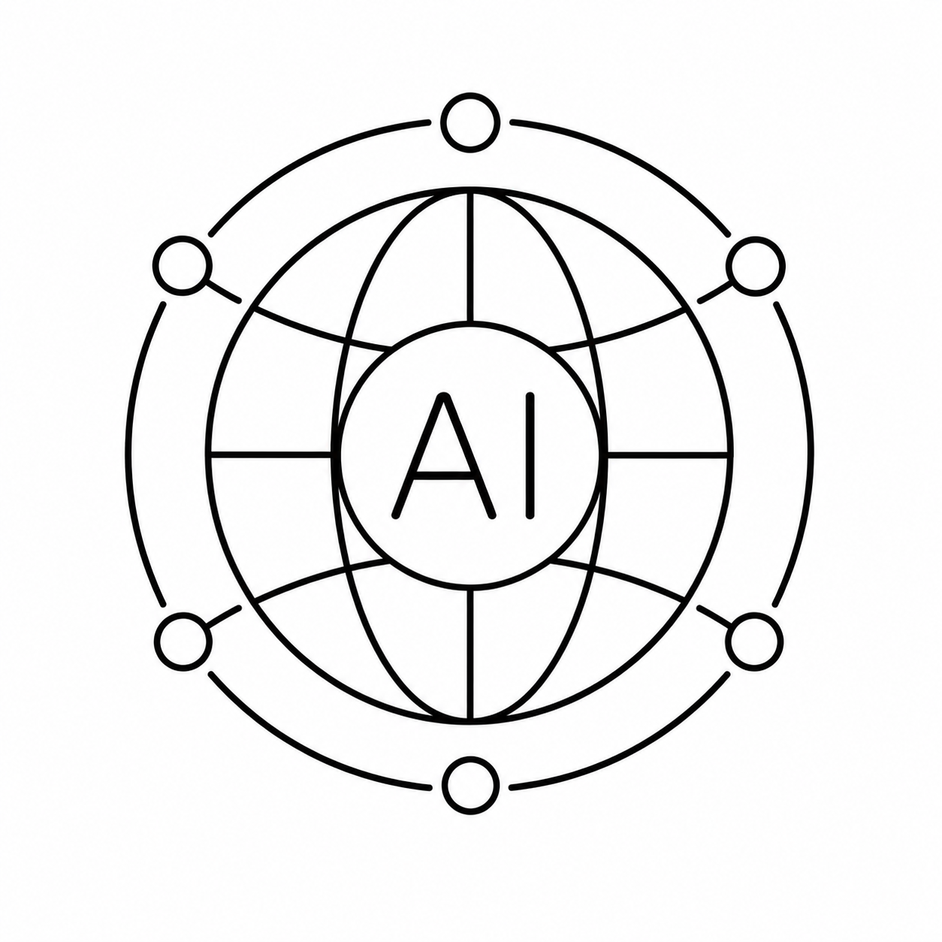
Other ways to reach AGI (Beyond bigger LLMs)
World models are different to LLMs. Instead of text, they learn to predict what happens next in the physical world, like how objects move.
They learn from video images and simulated environments instead of text.
Meta's Chief AI Scientist, Yann LeCun, left to create a world model startup (AMI Labs) raising $1.03 billion, similarly, World Labs (Fei-Fei Li) raised roughly $1.2 billion total.
LLM companies are still much bigger overall, with OpenAI valued around $300 billion.
Generated by Chat GPT-5.5
Notes:
World models Yan Le Cun

Slide 33

Genie 3: a world model
Genie 3: Creating dynamic worlds that you can navigate in real-time | Google DeepMind | Source: YouTube

Slide 34
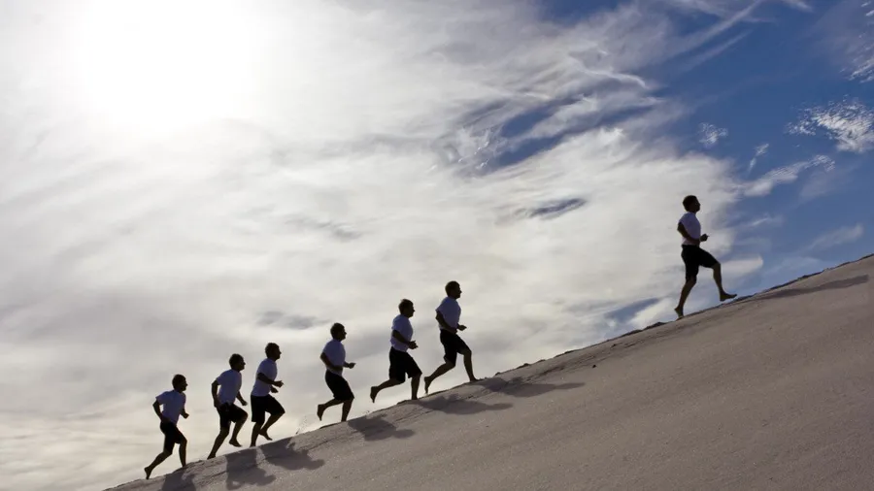
Superintelligence
The next step after AGI is Superintelligence. This is when a computer goes beyond human intelligence and is smarter than the best human experts in every field including science, creativity and problem-solving.
If AGI is hard to define, ‘superintelligence’ is even trickier
AGI and superintelligence are closely linked in most experts' thinking: many believe that once AGI is reached, it could improve itself and progress to superintelligence quickly, sometimes called a "takeoff"
Man leading others up a hill by zwan6714

Slide 35
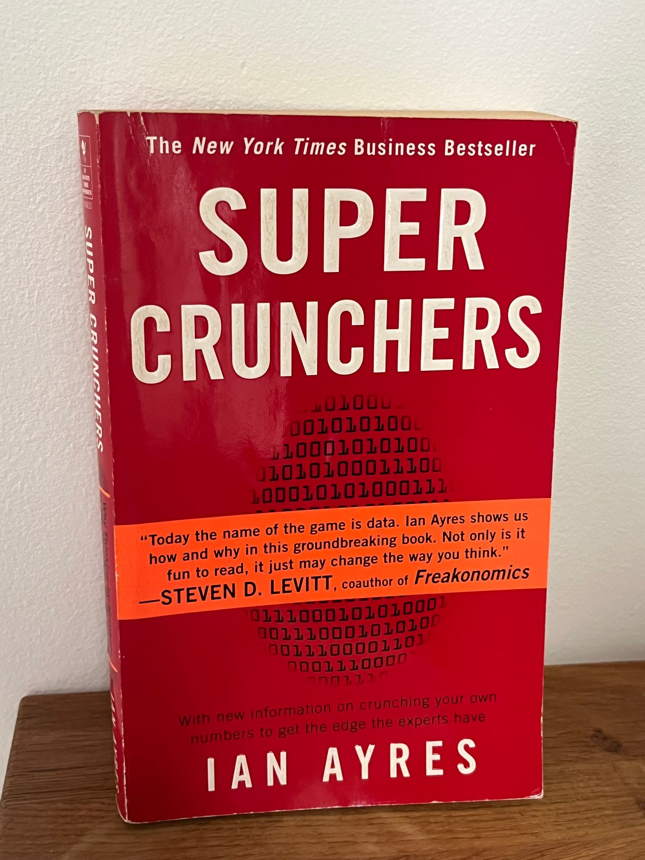
Will superintelligence really happen?
People have been predicting "superintelligent" computers for decades.
Books like Super Crunchers (2007) predicted data and algorithms would soon out-think humans at almost everything.
Some predictions came true. Many didn't; or not on the timeline promised.
Being excited about AI doesn't mean believing every claim

Slide 36
Activity: Prediction Postcard
Download the worksheet here

Slide 37
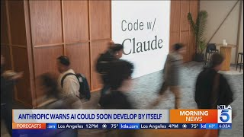
Risks of Future AI
Anthropic co-founder warns AI could soon train itself without humans | KTLA 5 | Source: YouTube
Notes:
Job Losses. Recent reports suggest AI is contributing to layoffs and slower hiring, especially in tech and entry-level roles, however the CEO of AWS for example believes that junior engineers will still be needed. In Australia, 13% of jobs could be automated by 2050

Slide 38
Activity: Futures Thinking Discussion
Download the worksheet here.
Notes:
Discussion prompts: What's one thing your group agreed on easily, and one thing you disagreed about?
Did thinking about the worst case change how you feel about the best case?
What's one thing that could easily tip this area toward the worst case instead?

Slide 39
Risks of Future AI
Job disruption: automating tasks across many industries
Misinformation: harder to tell real from AI-generated content
Bias: AI can inherit unfairness from the data it learns from
Privacy: relies on huge amounts of personal data
Overreliance: leaning on AI too much can weaken our own skills
Concentration of power: few companies/countries control the most powerful AI and may train on proprietary data in future
Equity and Access: who benefits from future AI, and who might be left out?
Notes:
Job Losses. Recent reports suggest AI is contributing to layoffs and slower hiring, especially in tech and entry-level roles, however the CEO of AWS for example believes that junior engineers will still be needed. In Australia, 13% of jobs could be automated by 2050

Slide 40
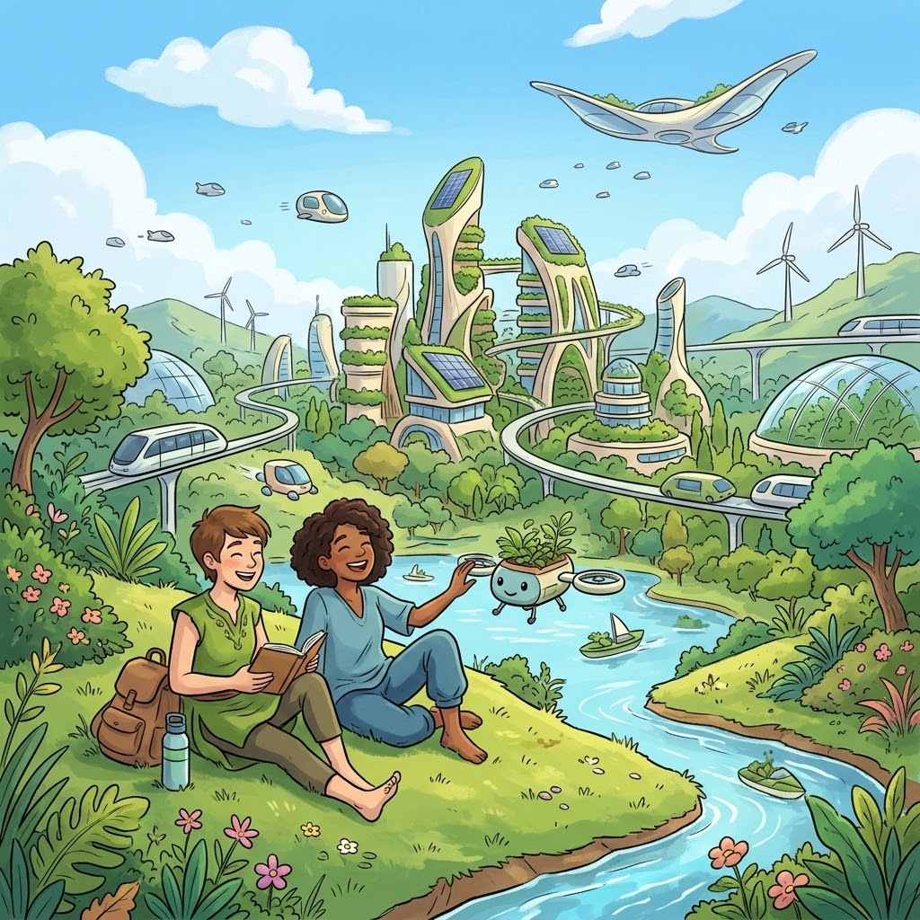
Preferred futures
A preferred future is someone’s idea about what they want the future to be like.
Different people will have different preferred futures
Part of any new technology development involves thinking about how the technology could impact the future and how we can reduce risks
We can decide and shape how AI is used and develop solutions to contribute to preferred futures
Generated using Nano Banana
Notes:
The optimistic case: AI as a tool that lifts everyone up
Advanced AI becomes a bunch of tools that massively improve productivity, entertainment and healthcare for everyone. By 2035, AI prediction tools, virtual nursing assistants and smart wearables help prevent health problems before they happen and reduce unnecessary hospital visits.
The "AI everywhere" case: agents and robots in daily life
Personalised chatbot software will soon be sophisticated enough to influence what people believe and how they vote, and once battery technology improves, LLMs will be downloaded into robotic bodies — meaning many families could have domestic robots within the next decade or so. By 2030, domain-specific AI agents are expected to be highly capable in business functions like finance, HR and legal work, with similar agentic capability spreading into daily personal life. NswTsirc
The unequal access case
The technology becomes too expensive and inaccessible for ordinary people, restricted instead to research by governments and a handful of private companies. This is a genuinely live concern — a sharp contrast to the optimistic "tools for everyone" scenario. Nsw
The "stuck in the middle" case
Not every forecast expects steady progress. One widely discussed roadmap predicts a plateau between 2030 and 2035, where AI agents keep expanding in use but capabilities stop meaningfully improving — leading to public debate over whether AI has hit a wall, sometimes described as an "AI winter." Pmc
The high-risk, fast-takeoff case
A reckless, runaway scenario where the technology "blows up in our faces" is one of the scenarios experts discuss — though it's treated as a tail-risk, not the likely outcome. Separately, the CEOs of OpenAI, Google DeepMind and Anthropic have all predicted that AGI could arrive within the next five years, which is part of why this scenario gets airtime even among serious researchers. NswFlag Color Codes
The "world models" case
Some researchers think the path forward isn't bigger language models at all, but systems that understand how the physical world works — concepts like gravity, cause and effect — learned from video and spatial data rather than text, which could eventually power genuinely capable robots and physical-world AI. Nsw
The governance case
By 2035, organisations may be required to provide transparent reports on how they use AI and will be held to high ethical standards, reflecting a future shaped as much by law and policy as by technology itself. Nsw

Slide 41
Activity: Matching AI problems to solutions - Privacy and Safety
Complete the activity on the platform

Slide 42
Activity: Matching AI problems to solutions - Human Impacts
Complete the activity on the platform

Slide 43
Who should make the rules for powerful AI?
Governments: set laws for safety, privacy, fairness, and accountability.
Companies: build safer systems, test for harms, and explain what their AI can and cannot do.
Schools: decide how AI should be used for learning, assessment, privacy, and academic honesty.
Users: use AI responsibly, check outputs, protect personal information, and report problems.
Communities: make sure rules include different voices, not just tech experts or powerful companies.
Shared responsibility: no single group should decide everything because AI affects everyone.

Slide 44
Activity: AI Future Tool Poster
Complete the activity on the platform.
Download the worksheet here.

Slide 45
Lesson Summary
At the end of this lesson, you now understand:
Future AI predictions are uncertain, especially long-term ones.
AI will probably automate some tasks, but humans still matter for judgement, care, creativity, and responsibility.
The future of AI depends on choices people make about safety, fairness, rules, and who benefits.

Slide 46
Course Summary
Across this course, you have learnt that:
AI uses patterns in data to classify, predict and generate.
Generative AI can create text, images, audio, video and code, but it does not think like a human.
AI can be useful, but it can also be wrong, biased, misleading or unsafe.
You should use AI wisely: prompt clearly, check facts, protect privacy, test results and keep thinking for yourself.
AI will change tasks and jobs, but human judgement, care, creativity and responsibility still matter.
AI’s future is uncertain. People’s choices and rules will help shape what happens next.

Slide 47
License Information
These Tech Futures Australia lessons plans, worksheets, and other materials were created by the Tech Futures Australia team. They are licensed under a Creative Commons Attribution-ShareAlike 4.0 International License.

