Slide 1

Lesson 6
Behind the scenes
techfutures.org.au

Slide 2
Learning objectives
By the end of this lesson, you will understand more of the ‘behind-the-scenes’ workings of AIs (including LLMs), such as:
The strengths and weaknesses of Central Processing Units (CPUs) and Graphics Processing Units (GPUs)
How prompts are sent to data centres via the Internet
Data centres and how much electricity and water they can use
Open source and open weight LLMs and what these terms mean
The difference between local and cloud AI models
Notes:
The aim of this lesson is to give students a solid understanding of how LLMS work ‘under the hood’. One of they key takeaways is that it is all just mathematics underneath. By representing words as numbers, language can be manipulated and new conversations can be generated.

Slide 3
Recap Lesson 5: Under the Hood of LLMs
Write numbers 1–6 next to each step to show the correct order in an interaction with a generative AI
A
The model picks the most likely next word and adds it to the input.
__
D
Connections are found between words in sentences.
__
B
Tokens are turned into lists of numbers that encode possible meanings.
__
E
Raw text is typed in by the user.
__
C
The text is broken into chunks, or tokens the computer can process.
__
F
A ranked list of likely next words is produced with probabilities.
__
Notes:
Answer is A-6,B-3,C-2,D-4,E-1,F-5,A-6. See next slide for nicely formatted answers.

Slide 4
Recap Lesson 5: The Transformer Architecture
1
Input
2
Tokenise
3
Embed
Raw text is typed in by the user.
The text is broken into chunks, or tokens the computer can process.
Tokens are turned into lists of numbers that encode possible meanings.
4
Transform
5
Output
6
Repeat
Connections are found between words in sentences.
A ranked list of likely next words is produced with probabilities.
The model picks the top word, adds it to the input, and starts again.

Slide 5
Recap Lesson 5: True or False?
True or False?
Delete the incorrect option for each statement.
1.
Tokens are always whole words.
T
F
2.
Two words with similar meanings have similar embeddings.
T
F
3.
The transformer processes words one at a time, in order.
T
F
4.
"Bank" in "river bank" and "bank account" have identical embeddings.
T
F
5.
A higher probability score means the model is more confident about the next word.
T
F
6.
Tokenisation happens after the transformer.
T
F
Notes:
Answers: 1-F, 2-T, 3-F, 4-F, 5-T, 6-F. See next slide for full explanations.

Slide 6
Recap Lesson 5: True or False?
FALSE
Tokens are always whole words.
Long or rare words get split: 'unbelievable' might become 3 tokens.
TRUE
Two words with similar meanings have similar embeddings.
Words that appear in similar contexts end up with similar number lists.
FALSE
The transformer processes words one at a time, in order.
All words are processed simultaneously. That's what makes it fast.
FALSE
"Bank" in "river bank" and "bank account" have identical embeddings.
Context changes the embedding. The same word can have different meaning => different numbers.
TRUE
A higher probability score means the model is more confident about the next word.
The output is a ranked list. The top score is the model's best guess.
FALSE
Tokenisation happens after the transformer.
Tokenisation is Step 1. The transformer can't run until tokens exist.
Notes:
For statement 4 (bank), link back to the context words activity and the 2D diagram.

Slide 7

What happens when you hit send?
You now know what happens inside an LLM — but where does that LLM actually live and what does it take to process your prompt?
Notes:
This is to prompt students to think about where the LLM actually lives. You could suggest:
your laptop
the internet
a data centre
inside Google
inside a robot brain
Tell them not to worry if they don’t know. That is what they are going to learn about in this lesson.

Slide 8
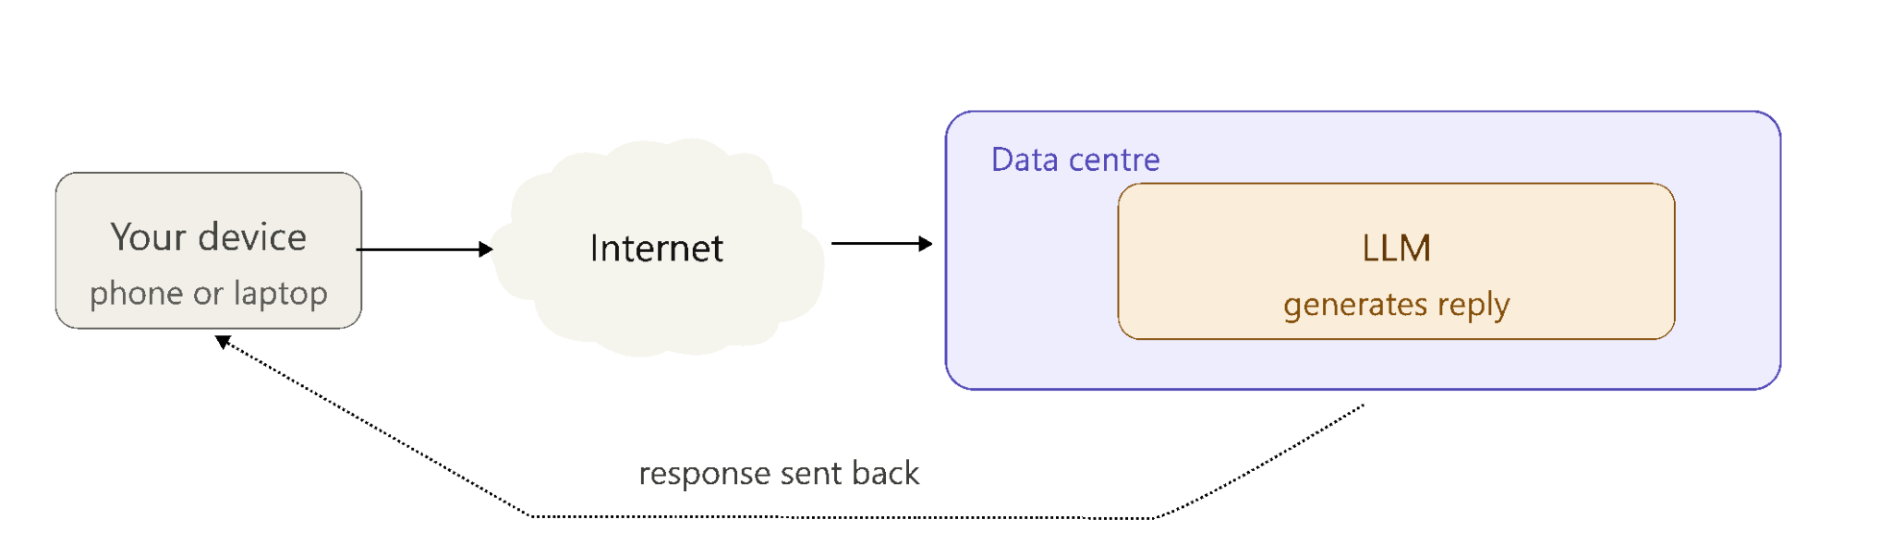
What happens when you hit send?
When you type a prompt into an AI chatbot, it travels from your device across the internet to a data centre where the LLM processes it. The response is then sent back one token at a time across the internet to your device, usually in a matter of milliseconds.
Notes:
In this lesson we will focus on the internet and data centre component of this diagram. We are looking at all the things “behind the scenes” of an LLM that users usually don’t think about.

Slide 9
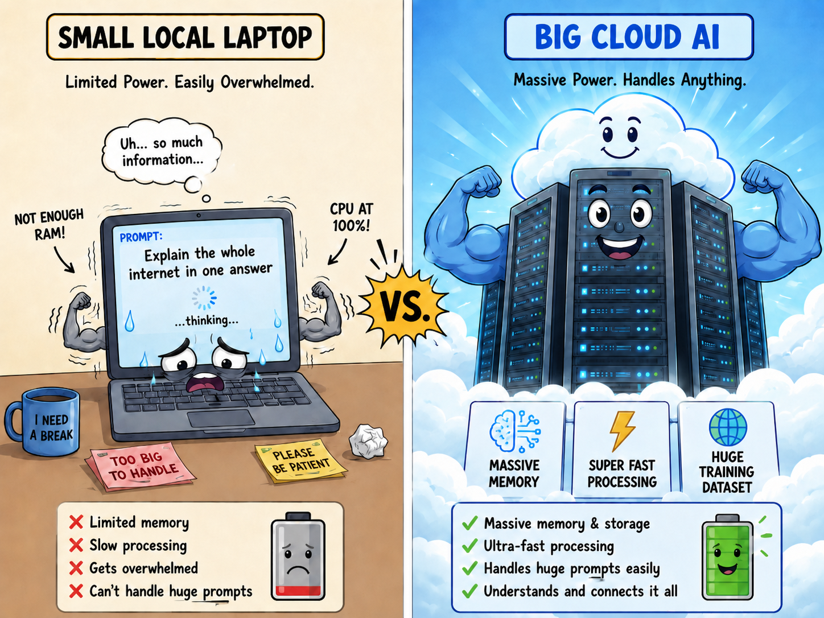
Why can’t the LLM just live on my laptop?
As you learned in the last lesson, LLMs have to do an enormous number of mathematical calculations at the same time to generate every single response.
That requires so much computing power that a regular laptop simply wouldn't be able to cope.
For example, GPT-4 has an estimated 1 trillion parameters. A single response requires billions of mathematical operations.
Your laptop CPU would take minutes to generate one reply. Data centres can do it in milliseconds!
Generated with ChatGPT 5.5
Notes:
The main point of this slide is that LLMs need lots of computer power and a particular type of computer power that means that millions of operations can all run at the same time. Laptops just don’t have enough grunt to do it!

Slide 10
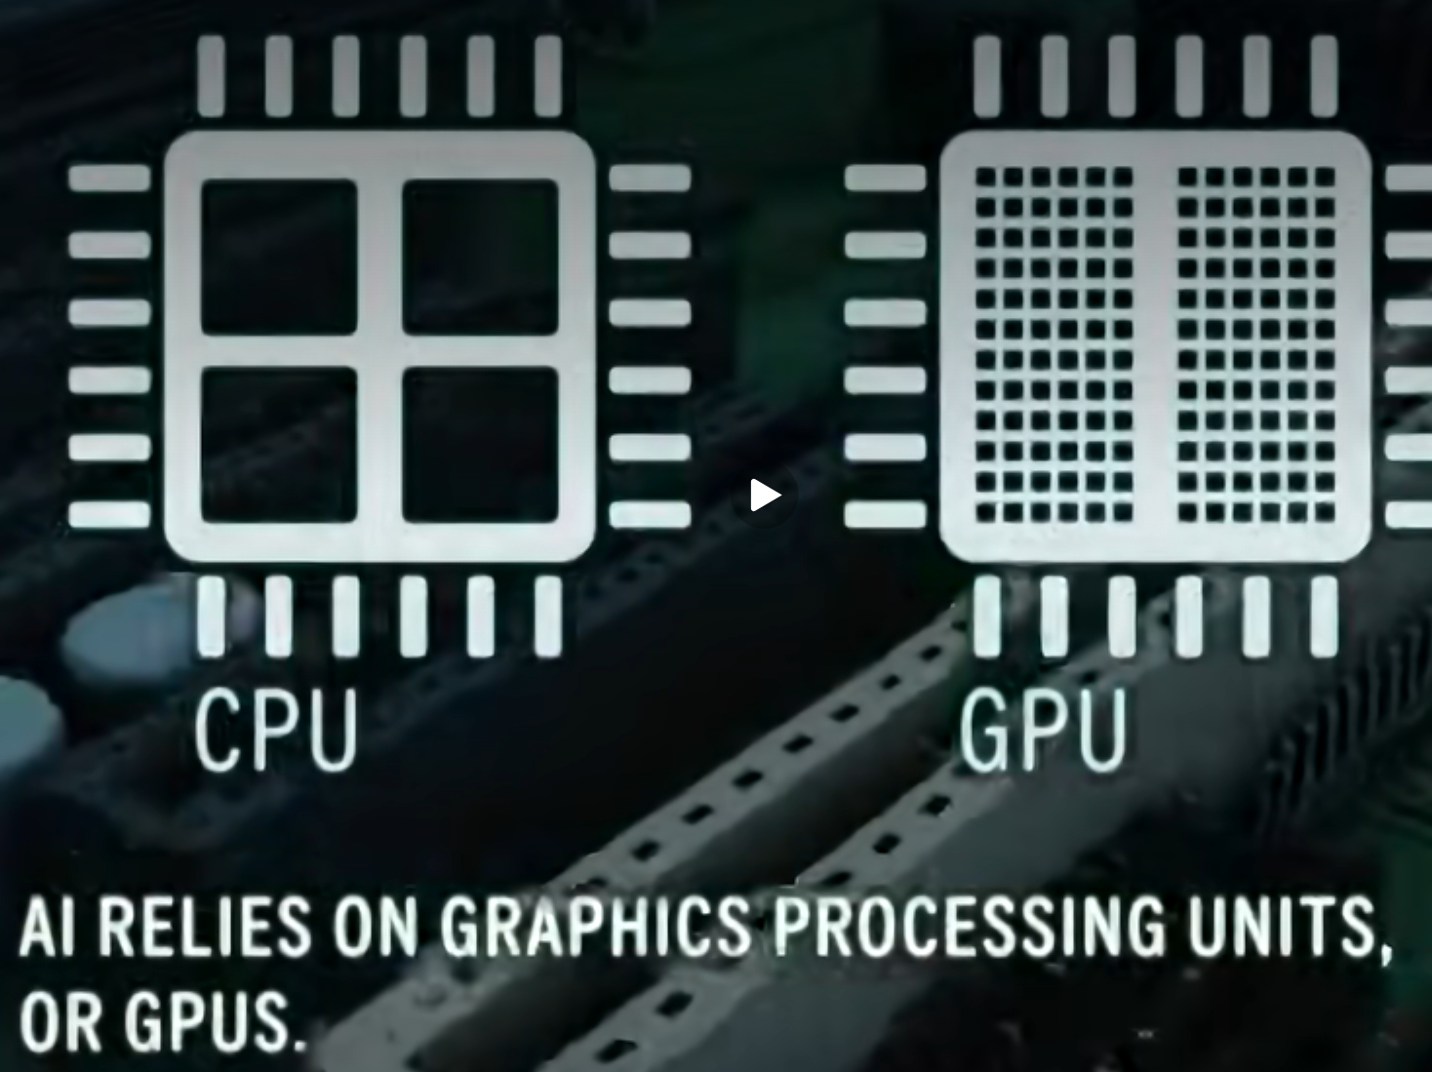
Special computing chips: GPUs
In order to run the millions of calculations at once required for LLMs, the AI computers in the data centres use a special computer chip, or processor, called a GPU.
Unlike the CPU (or brain) in your laptop, a GPU is designed to split a big problem into many smaller parts and work on them at the same time.
GPU stands for Graphics Processing Unit because they were first designed to process images and graphics. You have a smaller version of a GPU on your laptop.
Screenshot from Associated Press video
Notes:
Most modern laptops have an integrated GPU built into the processor, primarily for rendering the screen and running video. Some gaming laptops have a dedicated GPU that is genuinely powerful. However, the GPUs in data centres for running LLMs are way more powerful to cope with the millions of calculations required by LLMs.

Slide 11
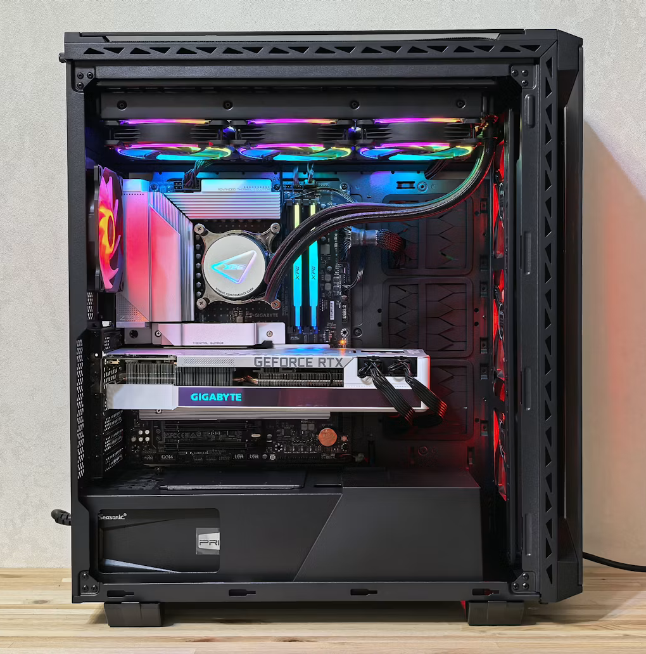
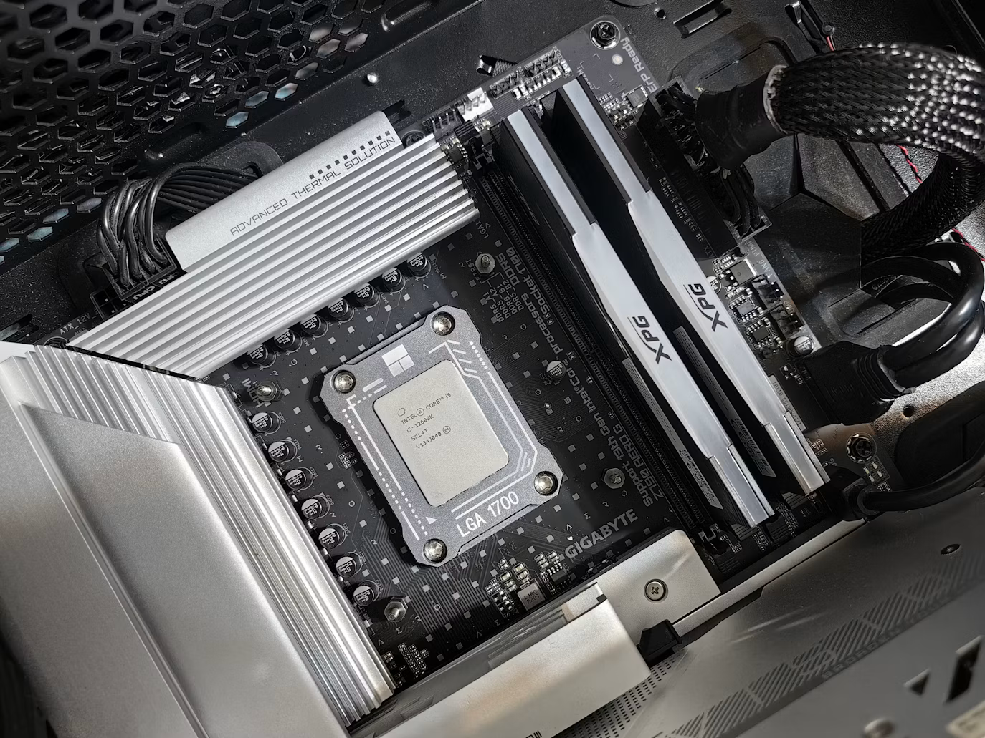
CPU and GPU in a desktop computer
Let’s look at a desktop computer with the case open to see a GPU and CPU.
We remove the fan and zoom in on the CPU
The CPU is covered by a fan to keep it cool.
The graphics card (GPU)
Photos source: Andrey Matveev via Unsplash
Notes:
This slide can help students see how CPUs and GPUs are separate components in computers and see what they actually look like in a desktop computer. It is generally easier to show students these different parts in a desktop computer like this, compared to laptops or phones, where these parts are much smaller (and in some cases, very close together).
The computer shown would be a typical “gaming desktop computer” where there is a separate graphics card (GPU) that is connected to the motherboard. Not all desktop computers will have a separate graphics card and some will have a GPU that is “integrated”, which means it sits inside the motherboard or CPU. The pictured computer has a separate graphics card because it is most likely used for gaming or video editing (or perhaps even AI), where having a powerful GPU is important for running software smoothly.
CPUs in desktop computers like this will have a fan on top of them because they can get very hot and if they are not cooled down, the computer will shut down to prevent any damage to the CPU (like parts melting). If we take off the fan (like the picture above) we can see the top of actual CPU chip. It is hard to see in the photo on the left but graphics cards also have fans on them to cool them down for the same reason.

Slide 12
GPUs vs CPUs
CPUs are better for jobs when the computer has to make lots of different decisions in order, while GPUs are better when the same type of calculation needs to happen many times at once.
Best for CPU:
Simple coding tasks: can follow instructions in order
Running a spreadsheet with formulas: the formulas usually depend on each other
Best for GPU:
video editing: can process multiple frames at once,
3D animation: can render many scenes in parallel
Training and Running LLMs: the transformer layers can happen all at the same time
Screenshot from Associated Press video
Notes:
The main point of this slide is that CPUs are better suited to tasks that are processed in sequence and GPUs are only really powerful for tasks that can be broken down into chunks that can all be run at the same time like graphics processing and training LLMs.

Slide 13
Activity 6.01: GPU vs CPU
Complete the activity on the platform here.
Worksheet can be downloaded here.
Notes:
The aim of this activity is to get students thinking about which tasks are better suited to GPUs and which are better suited to CPUs.

Slide 14

Data Centres
This video is part of the Amazon future engineer Career Tour, available on Kahoot.com
Notes:
In this video, data centres are introduced in the context of streaming videos.
This was downloaded from the Kahoot course: https://create.kahoot.it/details/7e6c2502-7225-4578-9361-daa15529b7ef?drawer=

Slide 15
Question
Is Dr Nashlie in the cloud right now?
Notes:
The answer is in the next video but let the students make their guess before moving on.

Slide 16

Cloud Computing
This video is part of the Amazon future engineer Career Tour, available on Kahoot.com
Notes:
This video introduces the term cloud computing and clearly shows that it is situated in the data centre.
This was downloaded from the Kahoot course: https://create.kahoot.it/details/7e6c2502-7225-4578-9361-daa15529b7ef?drawer=

Slide 17

Data Centres and Cloud Computing
Cloud computing means using powerful computers in data centres through the internet.
When you save a file to Google Drive, stream a video, or ask a chatbot a question, your laptop is often sending information to a data centre. The data centre does the hard work, stores the information, or sends back the result.
“The cloud” is not really floating in the sky. It is made of physical buildings filled with real computers with powerful computer chips.
Photo by engin akyurt on Unsplash
Notes:
Data centres have been around for a long time. Ask any students if they have gmail accounts. If they do, they have been using the cloud all this time and they may not realise. Data centres are not just for LLMs as many common applications live “in the cloud” like Gmail, Netflix, Spotify etc… but increasingly new data centres are being built dedicated to only LLMs.
As an extra activity you can do a virtual tour of a Microsoft data centre here.

Slide 18

AWS Career Video Amina
This video is part of the Amazon future engineer Career Tour, available on Kahoot.com
Notes:
This is a video about an AWS employee who works in a data center.
This was downloaded from the Kahoot course: https://create.kahoot.it/details/7e6c2502-7225-4578-9361-daa15529b7ef?drawer=

Slide 19
Activity 6.02: Local vs Cloud Computing
Complete the activity on the platform here.
Worksheet can be downloaded here.
Notes:
In this activity students will distinguish between tasks that are happening in the cloud vs tasks that happen locally.

Slide 20
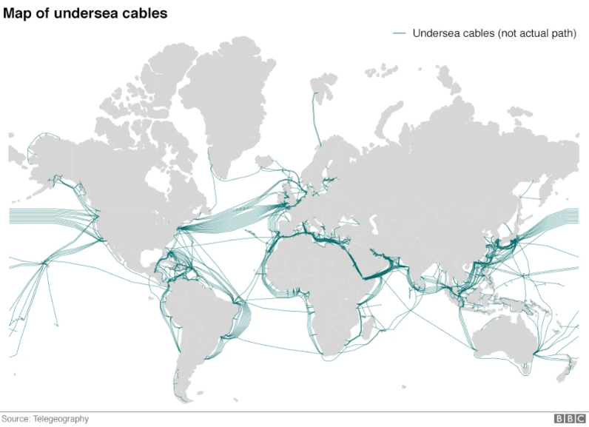
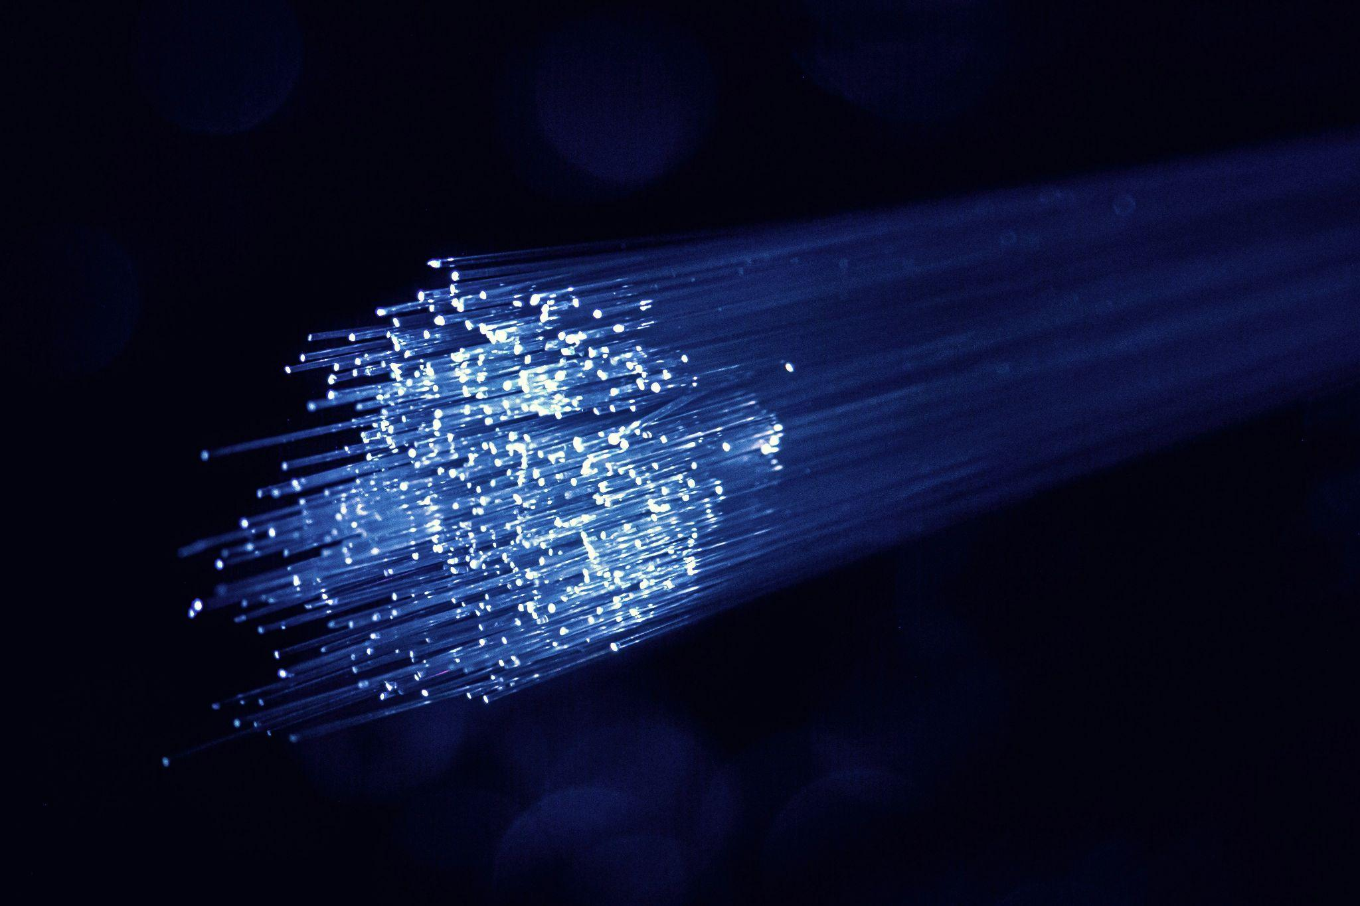
How do the LLM prompts get to the Data Centre?
Your prompt is converted into pulses of light and fired through a fibre optic cable.
This is a cable thinner than human hair that carries data as flashes of light rather than electricity, making it incredibly fast.
These cables run along the ocean floor, connecting countries at incredible speed.
They come ashore at buildings called landing stations before travelling underground to reach a data centre.
Fibre Optic Cable by Denny Müller
Notes:
The main point of this slide is to educate students about how their prompt gets to the data centre. A common misconception is that it travels through the air up into the clouds. It actually goes underground and undersea and is transmitted as light pulses which is pretty cool. You might remind them that light travels really fast.
An interesting fact: The total distance of all these underwater cables is about 800,000 miles. That's enough cable to wrap around the Earth's equator over 32 times!

Slide 21

The internet is in the ocean
Video source: Vox Almanac
Notes:
Teachers, this video may be missed if you are pressed for time.
For interested students, you can show them the submarine cable map here, which is an interactive map that shows the cables that connect different countries. You can click on the cables to see where which cities in different countries they are connected to. For example, you could click the cable that goes from Adelaide (Sydney-Melbourne-Adelaide-Perth (SMAP)) to highlight it and see that it is connected to different Australian cities. You can also search for cable names on the website and highlight the cable. For example, you could search for “Southern Cross NEXT” and see the cable that connects Australia with the United States (and to Fiji, Kiribati, New Zealand and Tokelau along the way).

Slide 22
What is inside a data centre?
Part | What it does
Servers | Powerful computers that store information and run apps, websites, and LLMs.
GPUs and CPUs | Computer chips that do calculations. GPUs are especially useful for AI.
Storage drives | Save huge amounts of data, like files, videos, websites, and backups.
Network cables | Move data in and out of the data centre at very high speed.
Cooling systems | Stop the computers from overheating.
Power systems | Keep everything running, often with backup generators and batteries.
Security Systems | Protect the building and the data inside it.
Everything needed to keep the data centre running is called the infrastructure.
Notes:
This is just a list and many of these will be elaborated on In the following slides. The students will see pictures of most of these things in later videos. You can tell them to look out for them.

Slide 23
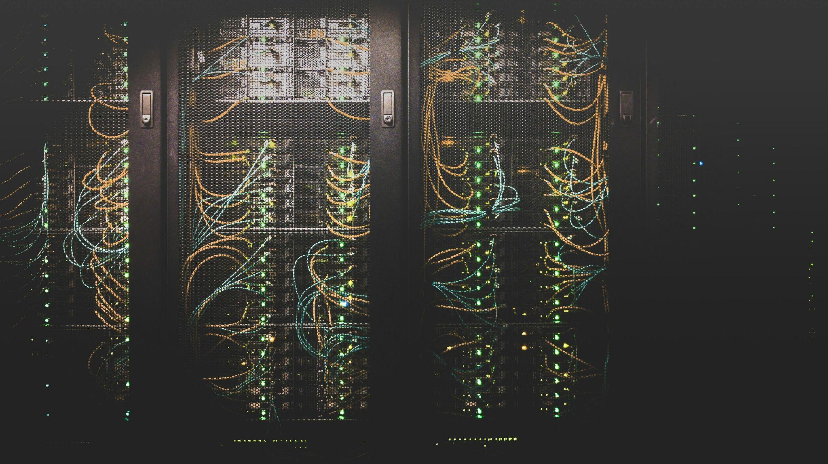
AI Data Centres
As AI grows, new data centres are being built specifically for AI workloads. These AI data centres often use thousands of GPUs to train and run large AI models, including LLMs.
The GPUs which are designed to do many calculations at the same time use a lot more electricity and heat just like when your computer heats up when you are playing an intense video game.
AI Data centres therefore need more advanced cooling systems to stop the equipment from overheating and to keep the systems running safely and reliably.
Photo by Taylor Vick on Unsplash
Notes:
The main point of this slide is that the huge demand for LLMs is driving the growth of new data centres devoted just to them.
On this webpage you can find some interesting statistics about predictions of future AI data centres.

Slide 24
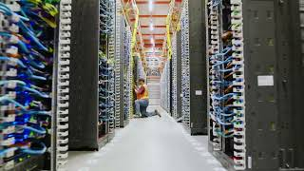
What does a Data Centre look like?
Video source: Amazon News
Notes:
This is a really short video (0:29) to show some real footage inside a Data Centre.

Slide 25
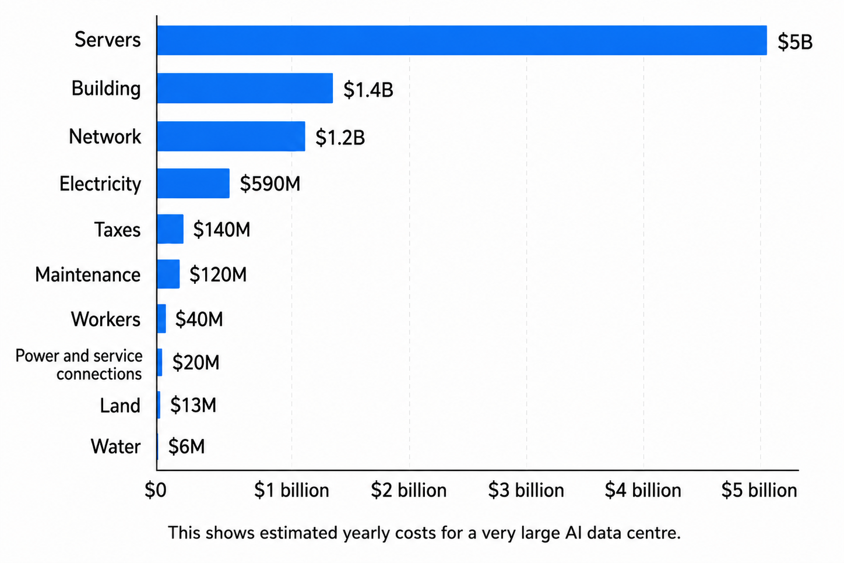
Annual Cost of building and running a data centre
This graph shows the modelled costs for a typical one-gigawatt (large) AI data centre. This graph is adapted from Epoch AI.
The main cost is the servers, primarily the thousands of special GPU chips.
Notes:
The main point of this slide is to show that it is the GPU chips that form most of the cost. Although they use a lot of energy, that is not the main cost of running a data centre.

Slide 26
Future spend plans for Data Centres
Big AI companies are planning to spend massive amounts of money on the computers, chips, electricity, and data centres needed to run powerful AI.
Company / group | What they have said they may spend on AI
OpenAI | Could be part of a huge AI building plan worth up to $500 billion over several years.
Anthropic | Announced a $35 billion plan to build more AI computer power.
xAI | Has already spent billions building a giant AI computer system, and may need much more in the future.
Amazon | May spend around $200 billion in one year, with a lot going toward AI data centres.
Microsoft | May spend more than $100 billion a year on AI data centres and computer equipment.
Google / Alphabet | May spend more than $100 billion a year to build AI systems and data centres.
Meta | May spend over $100 billion to build AI computers and train future AI models.
Source: YahooFinance
Notes:
The main point of this slide is to make students aware of what an impact AI is having on world economies. These are really big amounts of money!

Slide 27
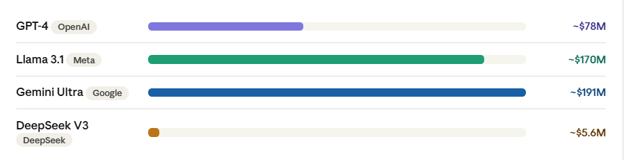
Costs of model training in the Data Centre
Training a model can take weeks or months. Epoch estimates it took 3 months to train GPT-4. Above are estimated costs for the electricity and hardware to run the model training, not including the teams of engineers, data collection or years of research. (From Stanford AI Index 2025 and Epoch AI).
Notes:
The main point of this slide is to emphasis that training is a significant factor in how often new AI models get released. There is a lot involved and it is not just like releasing a new version of software. These numbers do not include engineering salaries, data licensing, failed training runs, and years of prior research. Anthropic's CEO has publicly stated that next-generation models could cost $10–100 billion all-in.
Discussion prompt: "If it costs this much just to train a model once, why do companies keep releasing new versions every year?" The answer (models go out of date, competitors improve, fine-tuning is cheaper than retraining) opens up an interesting conversation about the economics of AI.

Slide 28
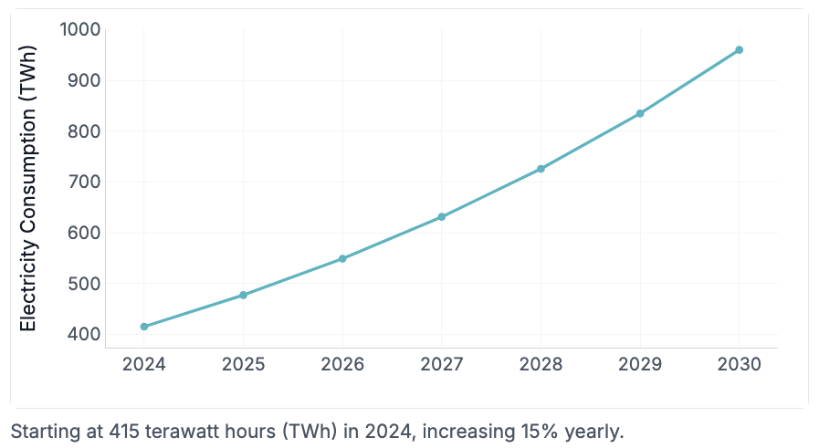
Energy consumption in Data Centres
Data centres are responsible for about 1.5% of the world’s total yearly electricity consumption in 2024.
Electricity consumption by data centres have grown 12% every year from 2020-2024 according to the International Energy Agency and it is estimated to grow by 15% each year from 2025-2030.
Source:
International Energy Agency: Energy demand from AI report
Notes:
More details can be found in this video here by the IEA.
Another interesting video on environmental impacts of data centres: https://www.youtube.com/watch?v=8eKnbjnKwHE
The graph on the right shows the estimated electricity demand from data centres, growing by 15% each year, until 2030.
Water consumption is a separate and significant issue not captured by electricity figures. Large data centres can use millions of litres per day for cooling.
Some students assume that because 1.5% sounds small, it isn't a problem. It's worth noting that global electricity consumption is enormous. 1.5% of world electricity is roughly equivalent to the entire electricity consumption of the United Kingdom.

Slide 29
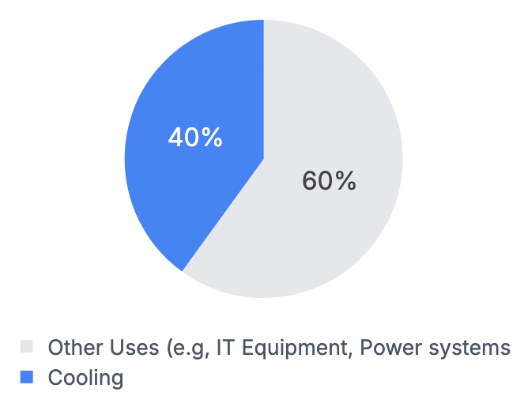
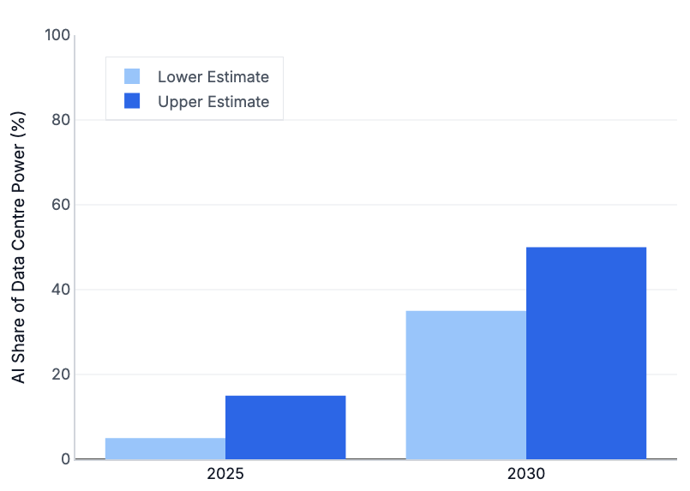
Energy and water consumption in Data Centres
AI could use 35–50% of data centre power by 2030, up from 5-15% in 2025. (CarbonBrief)
40% of an average data centre’s power is used just for cooling. (ADP Consulting)
Notes:
A useful way to make this concrete: If a data centre uses 100 units of electricity, 40 go straight to cooling before a single AI query is processed.
Connecting to prior learning: This slide links directly to the GPU heat content. The reason cooling costs so much is exactly what students learned about chips converting electrical energy into heat as a by-product.

Slide 30


Energy and water consumption in Data Centres
A large data centre can consume the equivalent energy of 50,000 homes (ADP Consulting)
Cooling the rows and racks of powerful computers also requires up to 19 million litres of water a day – a similar quantity of water to that consumed by a small city of 50,000 people. (ADP Consulting)
Images on this slide were generated with Nano Banana
Notes:
These figures reinforce that the electricity and water needed for data centres are on the scale of that needed for a city.
Students sometimes assume the water is polluted or destroyed. Most of it evaporates. It isn't returned to the water supply. In drought-affected regions like parts of Australia, losing that water to evaporation is a genuine concern even if it isn't toxic.

Slide 31
Who should decide?
Notes:
Stop and think: AI data centres use enormous amounts of electricity and water. Who do you think should decide where they get built? The companies, local governments, or local communities? And should there be limits on how much energy they can use?

Slide 32
Breakdown of Costs of model training
What the money actually pays for:
GPUs
Thousands of specialised AI chips running 24/7 for months - each costing $25,000+
Electricity
Running and cooling all those chips uses as much power as a small town.
Engineers
Teams of researchers and engineers, often for years, before training even begins.
Data
Collecting, cleaning, and licensing the billions of pages of text used for training.
Notes:
Stop and think: If training the next generation of LLMs costs $10 billion, which organisations in the world could actually afford to do it? What does that mean for who gets to control AI?.

Slide 33
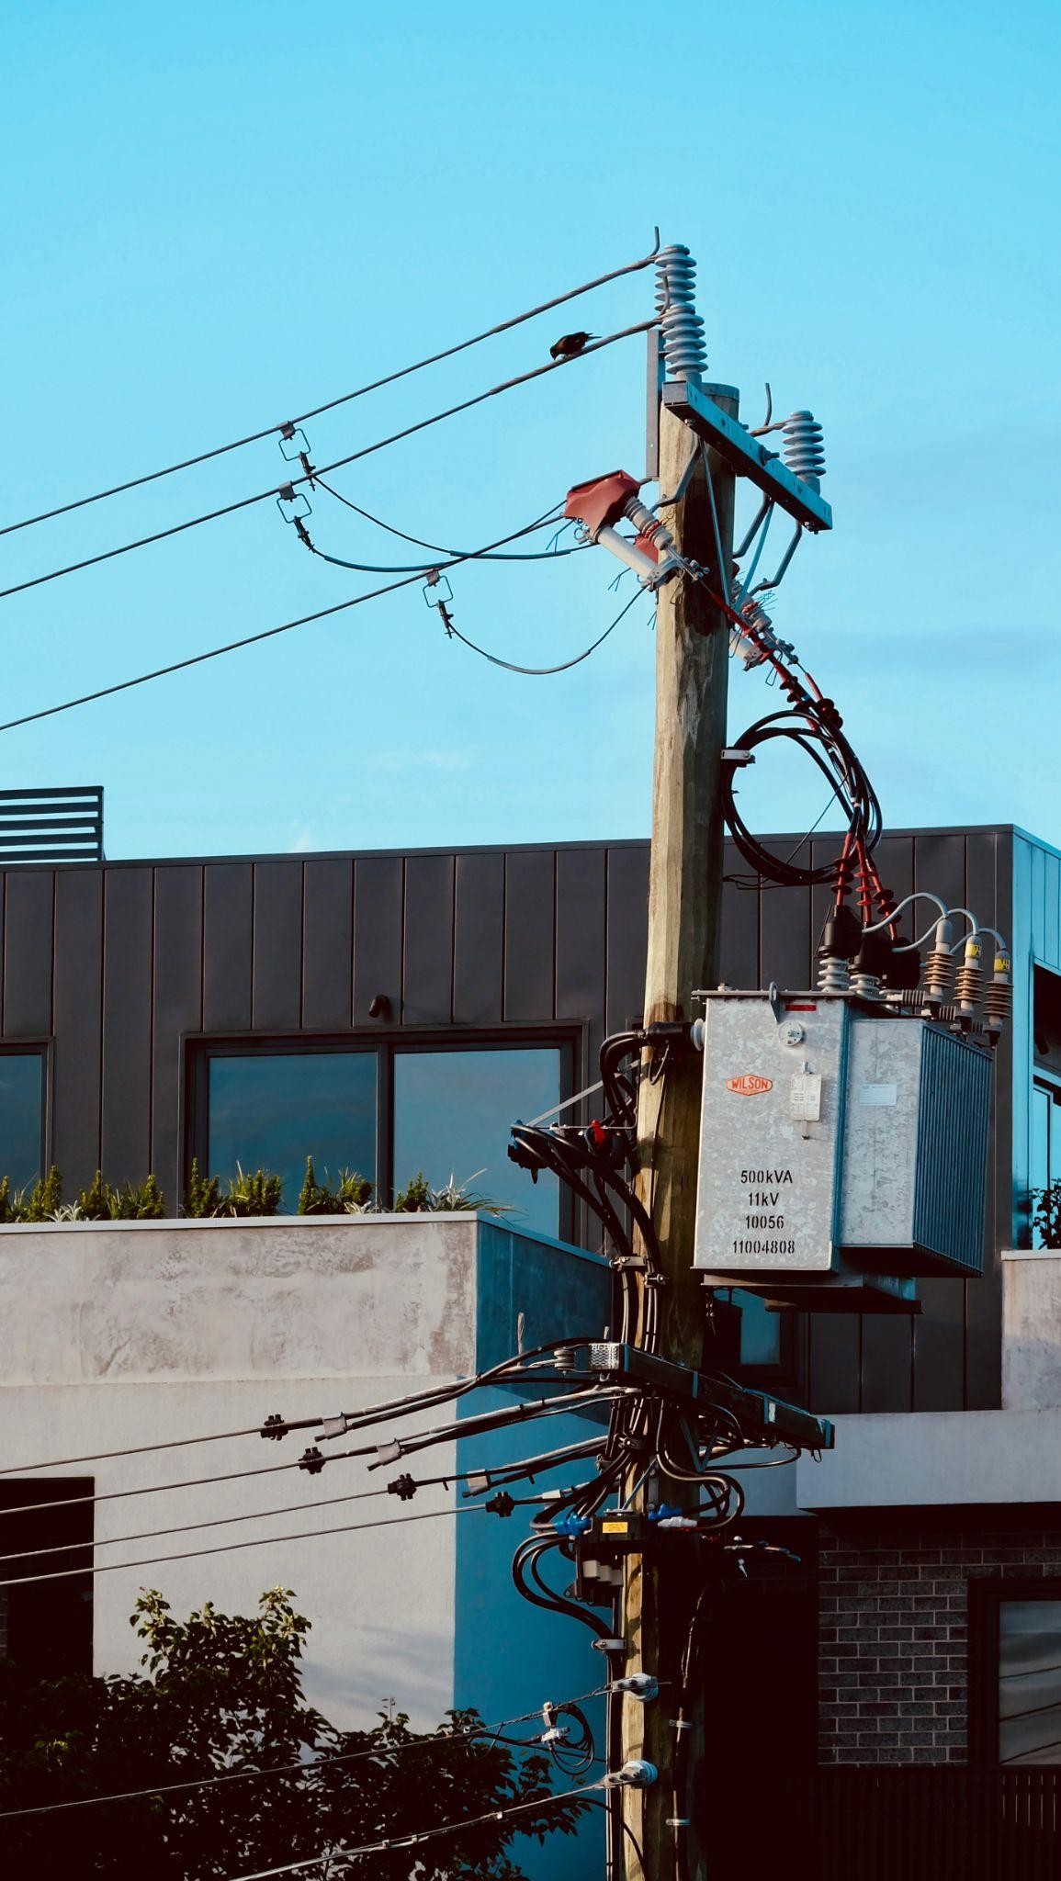
Rules governing Data Centres in Australia
In Australia, companies building AI data centres can't just plug into the existing power grid and expect everyone else to cover the cost.
The Australian Government expects them to bring their own clean energy, but it's not a legal requirement yet.
Companies that do this get priority approval for their projects, and most already offset about 70% of their energy with renewables. (Australian Govt)
Photo by Max Smith on Unsplash
Notes:
The point of this slide is for students to know what the Australian government is doing about companies wanting to build data centres in Australia.
The Australian Government's expectations document is guidance, not legislation. Companies that ignore it don't face legal penalties, but they do risk slower approvals and reputational damage. The word "yet" is worth discussing with students. Policy often starts as expectation before becoming law.

Slide 34
Rules governing Data Centres in Australia
Data centre owners have to cover their share of the costs of transmitting and distributing the energy they need.
Since they use a lot of water for cooling, they are expected to use “innovative, efficient and sustainable solutions to minimise water use”. (Australian Govt)
They are also expected to help build a “pipeline of skllled workers to support the construction and operation of data centres”. (Australian Govt)
Photo by Max Smith on Unsplash
Notes:
A useful discussion prompt: "If it's not a legal requirement, why would a company bother bringing their own clean energy?" The answers (faster approvals, public image, investor pressure, anticipating future regulation) open up an interesting conversation about how policy and business incentives interact

Slide 35
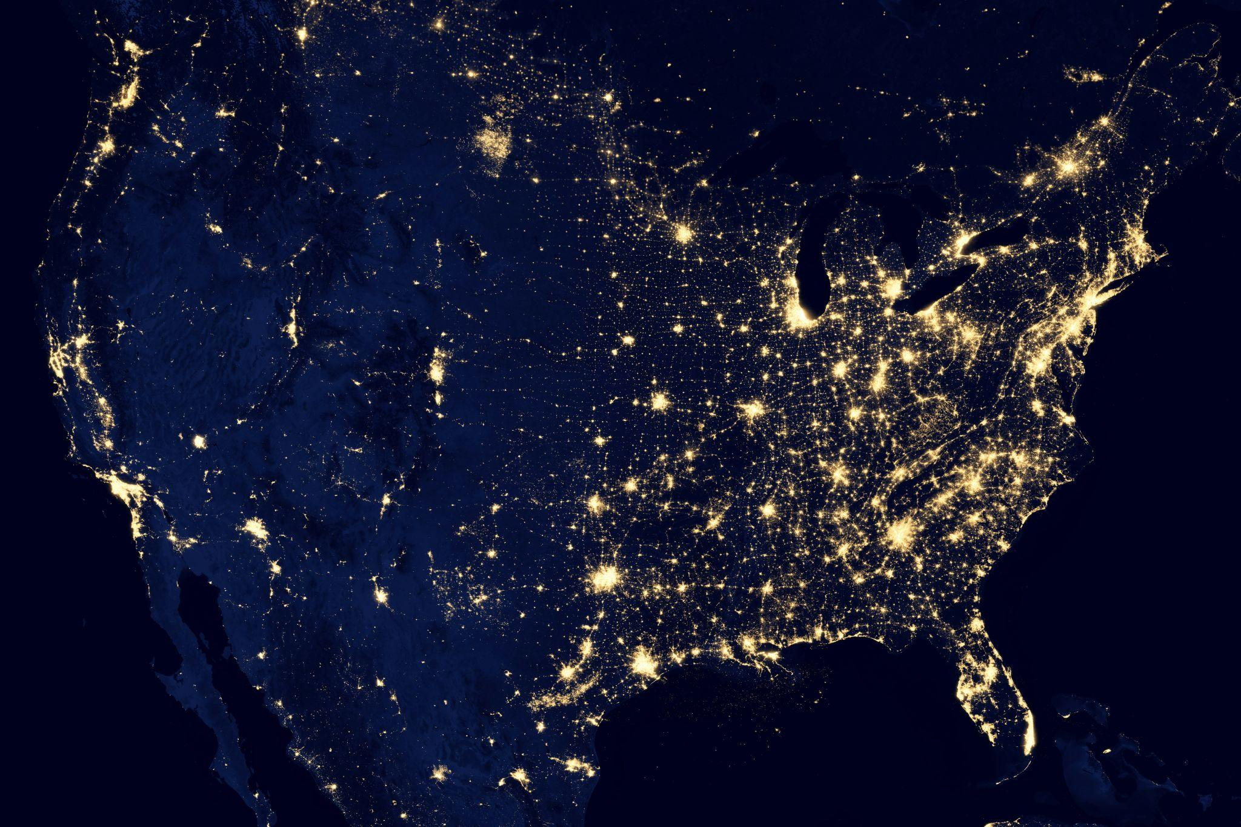
Rules governing Data Centres in the US
The United States has no single national rule. Each state does its own thing, and many have no protections at all.
When a tech company builds a data centre and needs new power infrastructure, the cost often gets added to everyone's electricity bills nearby.
Some states are introducing new laws to fix this, and Congress has proposed the federal SHIELD Act to stop families paying for big tech's energy costs but no national solution has passed yet.
Photo by NASA on Unsplash
Notes:
The main point of this slide is to compare what is happening in Australia with what happened in the US. The key contrast is that Australia moved proactively while the US is still passing state-by-state legislation after bills have already risen.
The “SHIELD Act” (Stopping Hikes In Electricity from Large Load Demands) was introduced in the U.S. House of Representatives by Mike Levin and Kathy Castor, in late 2025, to prevent data centers from increasing residential electricity costs.

Slide 36

How much energy for a typical text prompt?
According to a recent study released by Google last August, a typical text prompt run by their chatbot Gemini, uses 0.24 watt-hours of electricity, which is about the same as running a microwave for 1 second or a TV for about 9 seconds.
It also uses about 0.26 millilitres of water, roughly 5 drops, and creates about 0.03 grams of CO₂.
This may not sound like a lot but given there are roughly 2.5 billion prompts per day on ChatGPT alone this can add up.
Generating video takes a lot more energy but there are no official numbers available on this.
Photo by Simone Secci on Unsplash
Notes:
The main aim of this slide is that running queries on AI uses energy and water and across the world it all adds up.
Source for statistics on ChatGPT is here https://www.demandsage.com/chatgpt-statistics/
There is no data provided by the major AI companies on how much energy it takes to generate images or videos. Some experts say it takes much more energy while others say it is about the same as some longer text prompts.

Slide 37
Activity 6.03: Benefits and Costs of AI
Complete the activity on the platform here.
Worksheet can be downloaded here.
Notes:
In this activity, students read simple statements about AI energy use, then sort them into “Benefit,” “Cost,” and “Depends who you ask.”

Slide 38
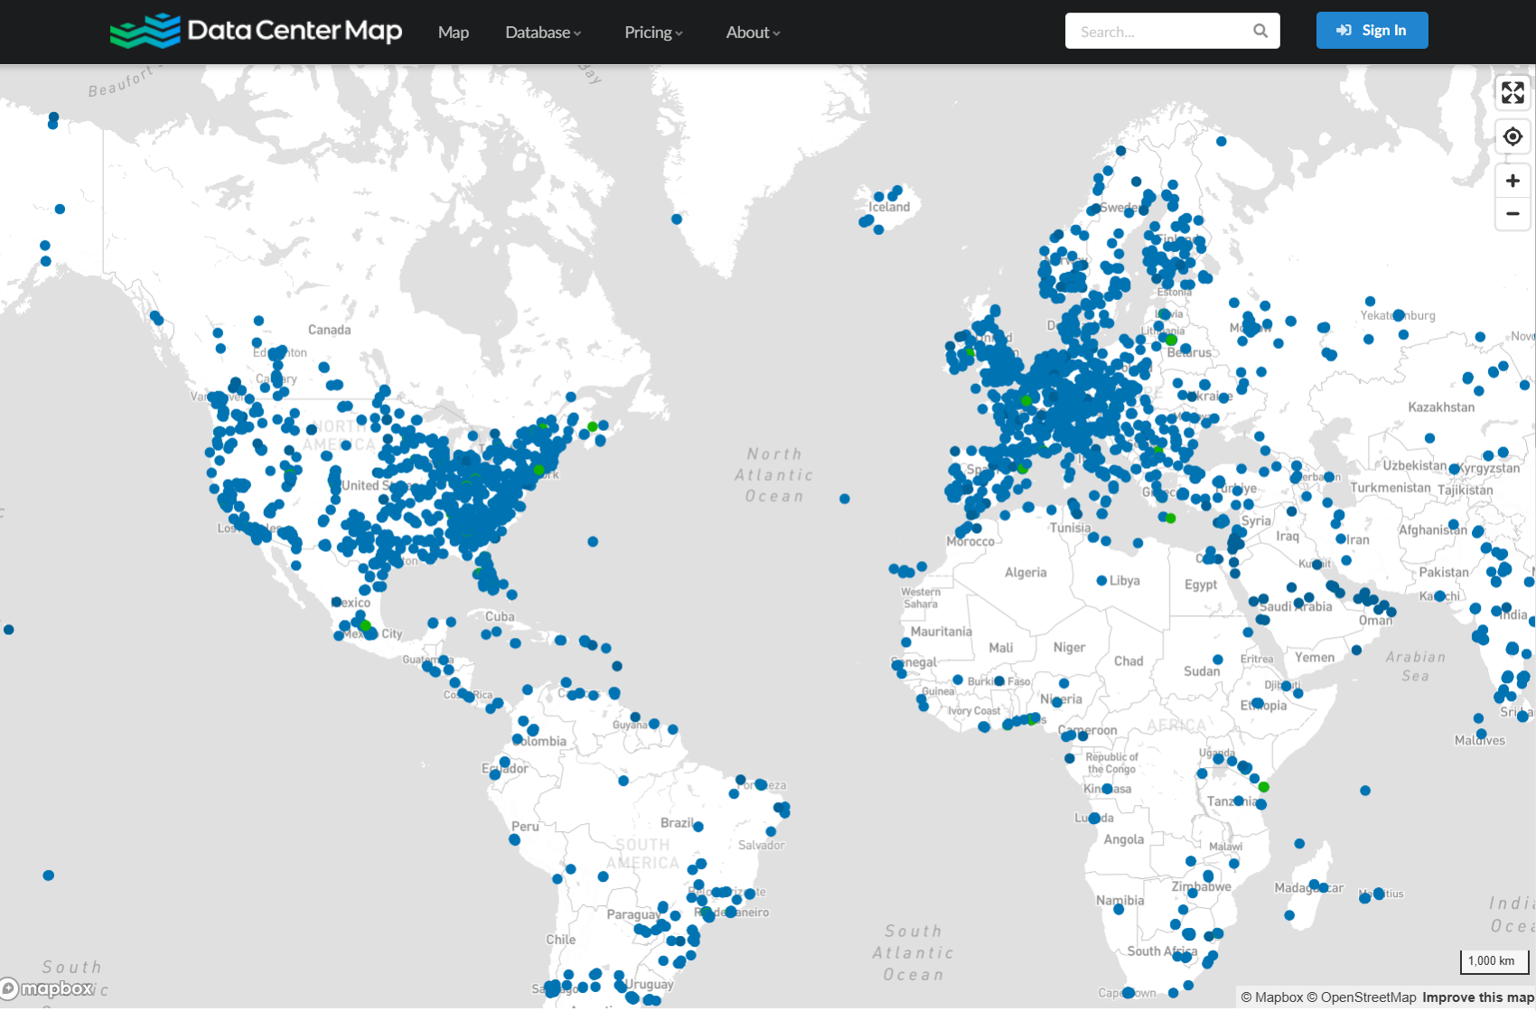
Where are all the data centers
According to datacentermap.com, as of June 2026:
there are roughly about 11,500 data centres worldwide across 179 countries.
The US has nearly 4,500 or almost 40% of the world’s data centres.
Europe has about 3,500 data centres.
Australia has about 300 data centres. The majority are concentrated in NSW and Victoria.
Source: datacentermap.com
Notes:
The aim of this slide is to give students an idea of where data centres are spread around the world. You might like to open the website datacentermap.com and show them the map live. In the next activity they will explore Australia on the platform.

Slide 39
Why does location matter?
Data centres need massive electricity.
If they’re built near renewable energy sources like wind, solar or hydro they can use clean energy which helps fight climate change.
Data centres in cold countries can use outside air for cooling which saves energy and money.
Data centres use millions of litres of water for cooling so in dry places this can compete with farmers and homes. In wet places, there is less impact on water supplies.
Data centres are often placed near big cities to make more people’s internet faster.
Notes:
The main point of this slide is to explain the reasons for choice of location of data centres. ‘
Proximity to renewable energy is a major factor now as more governments like Australia are making this a priority for approval. Microsoft, Google and Amazon all publish data on their renewable energy matching by region. Iceland and Norway are popular precisely because of abundant hydro and geothermal power. Australia's renewable energy zones in regional NSW and Queensland are attracting data centre interest for the same reason.

Slide 40
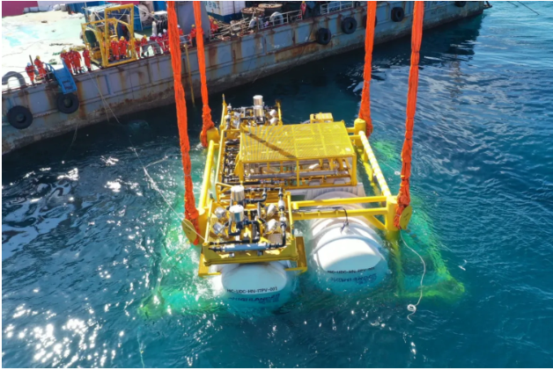
Submerged data centres
One solution for the cooling problem in data centres is to locate the whole data centre underwater. This can reduce the cost by about 90%.
This is a picture of the first serious undersea Data Centre developed by the Chinese and located off the Shanghai coast.
Source: Wired
Notes:
Here is a video too long to watch but very interesting for extension: https://www.youtube.com/watch?v=1LKD6zAQ2KQ&t=3s

Slide 41
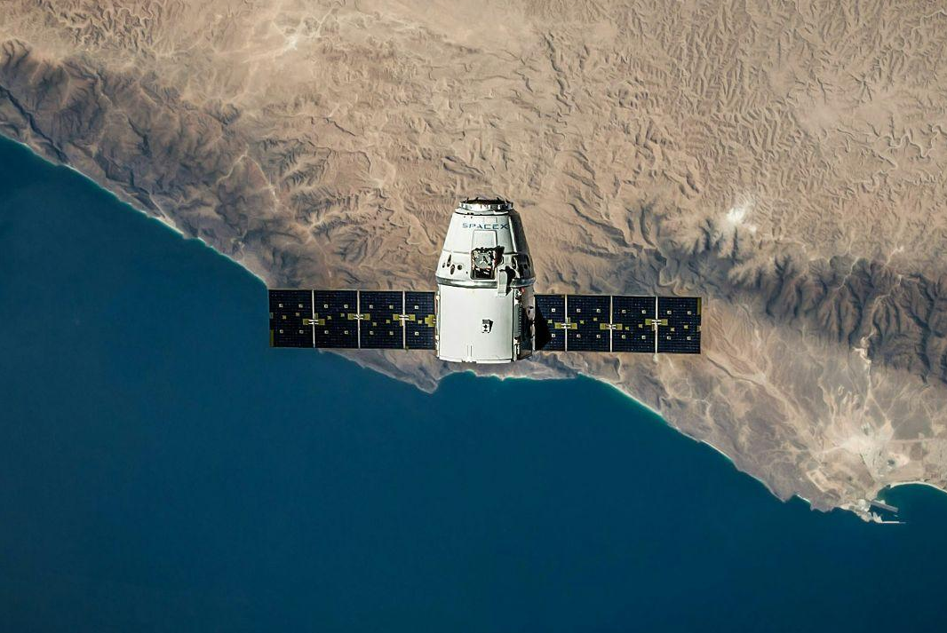
Data centres in space?
Some of the world's biggest tech companies, including Elon Musk's SpaceX, are planning to put data centres in space. 🛰️
Jeff Bezos’ Blue Origin and AWS have announced similar plans and China has already launched its first space computing satellites.
Why?
Free solar power: it’s always sunny with no clouds
Natural cooling: no cooling is needed as the heat just gets cast into space
No land needed: can have millions of satellites floating in space.
Photo by SpaceX on Unsplash
Notes:
This is still mostly a plan, not a reality. Analysts estimate space data centres won't reach cost parity with Earth-based ones until around 2040. Musk is famous for ambitious timelines that take longer than expected. That doesn't mean it won't happen but it's worth treating it with some scepticism.
Discussion prompt: Should one company be allowed to launch a million satellites and run AI data centres in space with no international oversight? Who should make the rules about what happens in orbit?
More info can be found here: https://www.cnbc.com/2026/05/20/bezos-blue-origin-space-data-centers.html and https://diginomica.com/boldly-rocketing-agentic-future-how-blue-origin-plans-build-lunar-colonies-built-ai-and-aws

Slide 42
Activity 6.04: Data Centre Locations
Complete the activity on the platform here.
Worksheet can be downloaded here.
Notes:
The map that students can use for this activity is available through the platform (link is in the slide above).
The data set used for this map is not completely up to date (as of June 2026) and is missing some of the data centres that are currently operational. Estimates at this time were around 160 operational data centres in Australia, whereas this map contains 122 data centres. The data was sourced from OpenStreetMap, which allows people to download and use its data (as long as there is an attribution)
You (and your students) may be aware of data centres that are not on the map (or there may be newer ones that are operational after June 2026). When completing the activity, students can write down data centres that are close to them but are not on the map (although we recommend verifying the location of the data centres with a search engine like Google or DuckDuckGo).

Slide 43
AI and Sustainability
Real progress is being made to make data centres use less electricity and power to reduce climate change effects including:
Smarter cooling: new liquid cooling systems pipe coolant directly to the chips instead of blasting cold air at entire rooms
Renewable energy deals: companies are signing long-term contracts to buy solar and wind power or building their own solar farms
Reusing waste heat: some companies are pumping their waste heat into nearby homes, offices or swimming pools to heat them for free
More efficient chips: AI chip makers are designing new processors that do the same calculations using less electricity.
Notes:
The main point of this slide is to show that AI companies are trying to make data centre more sustainable. Liquid cooling systems and more efficient GPU chips are the making the biggest difference at the moment. However, none of these improvements offset the rate at which AI energy demand is growing.
Discussion prompt: If a company makes its data centre 30% more efficient but then builds three more data centres to keep up with demand, have they actually helped the environment? What would "genuinely sustainable AI" actually look like?

Slide 44

Smaller models
Not every LLM task needs the most powerful model and smaller models use a fraction of the energy of large ones.
Running a big cloud model can be hundreds of times more energy intensive than a smaller one doing the same job.
Companies are now building families of models at different sizes and trying to match the task to the right-sized model automatically; only reaching for the big one when it's actually needed.
Photo by Igor Kyryliuk & Tetiana Kravchenko on Unsplash
Notes:
It is much more common now for AI companies to publish families of models at different sizes. For example, Anthropic has Claude Haiku/Claude Sonnet and Claude Opus. OpenAI has GPT-5.5 and GPT-4o mini.
Choosing the best sized model is called Model routing and it is like choosing between sending a letter by standard post or express courier. You don't send everything express just because express exists. Using the right service for the job saves money and resources without sacrificing the outcome
Discussion prompt: If using a smaller LLM gives you a good enough answer and uses ten times less energy, should developers be required to use the most efficient model rather than the most powerful one? Who should decide?

Slide 45
Activity 6.05 AI and Sustainability Video
Complete the activity on the platform here.
Worksheet can be downloaded here.
Notes:
In this activity students watch a video about AI and sustainability by a data centre company Equinix and answer questions about it.
The aim is to get students to appreciate the pros and cons of data centres in terms of sustainability.
Some extra discussion questions are:
In 50 years, do you think we will look back at today's AI energy use the way we now look back at early factories pumping smoke into the air?
Should AI companies be legally required to publish how much energy and water their models use?
If an AI data centre is built in your town and causes everyone's electricity bills to go up, is that fair? Who should you complain to?
Should people in poorer countries, who use far less AI, have to deal with the environmental consequences of data centres built to serve wealthy countries?
Is it fair that a few big tech companies get to make decisions that affect the electricity grid and water supply of entire regions?
Here is another video about AI and sustainability focused on Singapore ( by the National Library Board Singapore).

Slide 46
Who makes the LLMs?
There are hundreds of LLMs now but a handful of companies are responsible for the most powerful and widely used ones:
OpenAI: started with ChatGPT in 2022. Now backed by Microsoft.
Anthropic: was founded by ex OpenAI researchers who wanted to focus on AI Safety. They make Claude.
Meta: who also own Facebook and Instagram. Their Llama models are open-source and they are very popular for running local AI.
xAI: is owned by Elon Musk. Grok is built into X (formerly Twitter) and is known for having fewer guardrails or protections.
Google DeepMind: Gemini is built into Google Search, Gmail, and Android. Google has more data than almost anyone on the planet.
Microsoft: Copilot is built into Microsoft tools like Word, PowerPoint, Excel, Teams, Edge and Windows. It uses OpenAI’s models but is packaged for work, school and productivity tasks.
Notes:
Most students would have heard of many of these but they may not know the company that the model is connected to or vice-versa.

Slide 47

Open source LLMs
Some LLMs are locked away and you can only use them through an app or website, like ChatGPT. These are called proprietary (or closed source).
Others release their code publicly so anyone can download, modify, and run them. These are called open source models because they are “open” to anyone to use.
We could compare these to recipes:
Proprietary recipes are like the recipe for Coca-Cola, kept secret to a small group of people
Open source recipes are like OpenCola, a recipe that is available online for anyone to download and follow
Generated using Nano Banana
Notes:
This is not so relevant for students as they probably won’t be running their own models but it is good for them to know that open source models exist. Open source isn't just about reading the code, it's about being able to actually run it yourself. You can run Llama on your laptop precisely because Meta released the model files publicly.

Slide 48

Open source and open weight
Meta’s Llama is the best known “open source” model and many people download it and use it on their own computer.
However, Llama is not fully open source - Meta does not share the training data used for training the model. We call models like this open weight models (DeepSeek and Google Gemma are other examples).
There are some developers that make fully open source models, which also include the training data used for training them.
Proprietary models tend to be more powerful, but open source and open weight models give people more control and privacy and they are free to run.
Llama by Sébastien Goldberg on Unsplash
Notes:
The purpose of this slide is to explain some terminology, open-source vs open-weight, which is useful for the next activity (a discussion around the advantages and disadvantages of making LLMs open-source, including training data). Often, Llama is referred to as an open source model, although it is technically not completely open source because Meta do not provide the training data or details about how the training process is done. There are some completely open source LLMs that include training data used and details about the training, such as: https://github.com/multimodal-art-projection/MAP-NEO. However, the technical details of this goes beyond the scope of the course and you may only want to share this with interested students.

Slide 49
Activity 6.06: Open source LLMs Discussion
Complete the activity on the platform here.
Worksheet can be downloaded here.
Notes:
Students discuss/debate the advantages and disadvantages of open source vs proprietary LLMs. In groups of 3-4 classmates, they discuss the statement: “AI models should be open source, including training data.” They come up with at least two arguments for and against the statement.
This activity could be changed into a whole class debate if preferred.

Slide 50

Cost of Using Proprietary Models
Most big AI companies offer a free version with limitations. When you hit the free limit you either have to wait for it to reset or switch to a smaller model automatically.
For example, with ChatGPT-5.5, free users can send up to ~10 messages every 5 hours on the Thinking model, then they are switched to the smaller version of the model until the limit resets.
Both Claude and ChatGPT cost roughly $A30/month for the personal paid plan or around $300/month for serious or business users.
Photo by Alexander Grey on Unsplash
Notes:
Many students will ask whether there is a student discount. Neither Anthropic nor OpenAI currently offer one for individual students, though some schools access AI through institutional education agreements at different price points. Lumen, which students are using in class is completely free.
Discussion prompt: "Why do you think companies give away a free version at all?" The answers (hook users, collect data, build brand loyalty, hope free users upgrade) connect nicely to a broader conversation about how tech business models work.

Slide 51
Cost for Developers Using Proprietary Models
For developers building apps, their programs send requests to the LLM and get a response back (called API calls)
The cost is per 1 million (M) tokens input (what you write) and output (what the model writes back), not per month.
These prices can change when companies release new models or make their systems cheaper to run.
Model | Input Price | Output price
Fable 5 | $10 | $50
Opus 4.8 | $5 | $25
Sonnet 4.6 | $3 | $15
Haiku 4.5 | $1 | $5
Source: Claude API Docs - Pricing (June 2026)
Price is per 1 million tokens and price is in USD (US Dollars)
Models are in order from largest and most powerful (Fable), to the smallest and fastest (Haiku).
Notes:
Per-token pricing vs per-month is the key point of this slide.
API stands for Application Programming Interface. This is essentially a standardised way for one piece of software to talk to another. Students don't need the full definition here, but if they ask, a useful analogy is a waiter in a restaurant: your app places an order (the request), the kitchen (the LLM) prepares it, and the waiter brings it back (the response). The app never goes into the kitchen directly.
A developer building a school app used by 500 students could rack up significant costs very quickly if they use a large model for every request which connects directly back to the model routing slide. Choosing the right-sized model isn't just about sustainability, it's about keeping costs manageable.

Slide 52

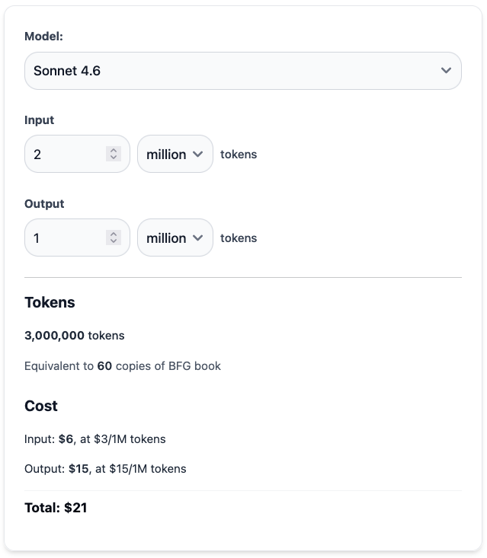
API Cost Calculator
The costs of using LLMs for developers is based on the number of tokens in the messages sent to and from the LLM.
You can calculate costs for different numbers on the platform with the cost calculator interactive on the platform.
BFG by Roald Dahl (pictured to the right) is a short novel that is roughly 50,000 tokens in length. 20 copies of this book would be around 1 million tokens. Most LLMs’ pricing is in $/per 1 million tokens (like the last slide).
The calculator includes a “Copies of BFG book” to help you think about how much information you would be able to get for your money.
Notes:
The aim of this slide is to introduce the API cost calculator which you can try out on the platform.

Slide 53

Local AI Models
When you use an AI like Lumen or ChatGPT, your question travels to a massive data centre on the other side of the world.
There is another way to run LLMs right on your own device. These are called local models.
To run a model locally you need to be able to download it. This is why all local models are also open weight.
Not all open source models are local; you can run an open weight model on a cloud server.
LLama, is the most famous local LLM but there is also Gemma by Google, Phi by Microsoft and Mistral and DeepSeek.
Photo by Priscilla Du Preez 🇨🇦 on Unsplash
Notes:
The aim of this slide is to introduce the concept of a local model and some well known local models that the students may not have heard of. Llama is developed by Meta who also own Facebook and Instagram.

Slide 54
When would you use local models?
You would use local models if:
you're working with sensitive or private information; e.g. medical notes, personal diaries, confidential business documents.
you need it to work without internet, like on a plane or in a remote area.
you don't want your conversations stored by a company
A good example where you might use a local LLM is a doctor using AI to help write up patient notes. Patient records are private by law, and sending them to a cloud server could be a serious data breach.
Notes:
Local models are more private but less powerful. Cloud models are more capable but your data leaves your device. There is no universally "better" option. It depends entirely on what you are doing and how sensitive your information is.
Stop and think: If you were building an AI app for a school that wanted to keep student data private, which would you choose: local or cloud? What problems might each option cause?

Slide 55
Activity 6.07: Local or Cloud models
Complete the activity on the platform here.
Worksheet can be downloaded here.
Notes:
In this activity students choose which scenarios would be good for local models.

Slide 56

How do we know if an AI is getting better?
When a new AI model comes out, companies need a fair way to compare it against older models and against other companies' models. This is where benchmarks come in.
A benchmark is a big set of questions or tasks that every AI is given so you can compare scores fairly, sort of like Naplan for AI.
MMLU (Massive Multitask Language Understanding) is one of the most common benchmarks that all the big AI companies use. It is a test with 57 subjects (like maths, science, history, medicine) from elementary school to university level.
Photo by Aliaksei Ramanouski on Unsplash
Notes:
The aim of this slide is to give students a flavour of how AI models are assessed and compared to each other using specific tasks.
Here is an article if you want further information about benchmarks used by AI companies. https://labelstud.io/learningcenter/what-are-the-most-reliable-ai-benchmarks-used-in-industry/
Some of the benchmarks are really interesting. For example, in the HellaSwag benchmark, which is related to commonsense, one of the tasks is to work out the best ending to this sentence fragment: She opened the fridge and looked inside. It was almost empty. She grabbed the last yoghurt and... Using Lumen these were the responses:
Grok 4.1: She grabbed the last yoghurt and ate it straight from the pot, savoring the tangy burst as her only meal of the day.
Llama 3.2B: She grabbed the last yoghurt and took a few handfuls of the remaining milk, which she poured into a bowl and began to make a simple breakfast of scrambled eggs and toast.
GPT 3.5 Turbo: She grabbed the last yoghurt and took a few handfuls of the remaining milk, which she poured into a bowl and began to make a simple breakfast of scrambled eggs and toast.

Slide 57
Activity 6.08: Lumen Benchmarks
Complete the activity on the platform here.
Worksheet can be downloaded here.
Notes:
The aim of this activity is to give students a flavour of how AI models are assessed and compared to each other using specific tasks. Students will run 3 benchmark tasks on Lumen LLM (chatbot) appropriate for a Year 7 student and evaluate 3 different models on these tasks. They will score each model on each task out of 5 and add up the totals across all tasks and see which model “won” the benchmark.

Slide 58

The strengths and weaknesses of Central Processing Units (CPUs) and Graphics Processing Units (GPUs)
How prompts are sent to data centres via the Internet
Data centres and how much electricity and water they can use
Open source and open weight LLMs and what these terms mean
The difference between local and cloud AI models
Summary
You should now have a better understanding of:
Notes:
The aim of this lesson is to give students a solid understanding of how LLMS work ‘under the hood’. One of they key takeaways is that it is all just mathematics underneath. By representing words as numbers, language can be manipulated and new conversations can be generated.

Slide 59
License Information
These Tech Futures Australia lessons plans, worksheets, and other materials were created by the Tech Futures Australia team. They are licensed under a Creative Commons Attribution-ShareAlike 4.0 International License.

