Slide 1

Lesson 2
Different types of AI
techfutures.org.au

Slide 2
Learning objectives
By the end of this lesson, you should
Understand some different types of AI: predictive, classification and generative
Learn to recognise AI-generated images, audio and video
Understand embodied AI: how robots use vision and action in the real world, and why some simple human tasks are still hard for them
See how AI-generated content is used across sport, entertainment, business and health

Slide 3
Quick recap on Lesson 1..
What is Lumen? Is it an LLM?
What are some differences in a text prediction model on a phone and an LLM?
Notes:
Answers
No, Lumen is not an LLM. It is a chatbot that allows you to choose different LLMs to send prompts to (as well as allowing you to generate images with image generation models). Examples of LLMs include Antthropic’s Claude model, OpenAI GPT models and Google’s Gemini models.
A text prediction model are usually trained on less data and use a small amount of storage space than LLMs. LLMs are usually trained and run using powerful computers (typically in data centres)

Slide 4
Different Types of AI
It can be useful to think about different types of AI, which perform different tasks and are useful for different purposes.
Classification AI: sorting some data into different categories - like whether an email is Spam or Not Spam
Predictive AI: gives a prediction (usually a number) by learning from past data - like predicting tomorrow's average temperature
Generative AI: generates new data - an LLM producing a poem or story. Our focus in this lesson.
Notes:
The intent of this slide is to get students to think about different types of AI and how different AI can give us different types of responses. Note that there are different ways of categorising AI (e.g, Narrow AI, General AI) but we use these simpler categories here because there is an activity at the end of the lesson where students will look at examples of how these different types of AI are used in different contexts (entertainment, sport, health and business).
In this lesson, the focus is on Generative AI and the generation of new content (text, images, audio and video). However, students should be aware that Generative AI is not always the most appropriate type of AI to use for certain problems. For example, if an AI is being used to screen patients' x-rays for a disease, we don't need this to be generative. We just want the AI to categorise the x-ray as having the disease present or not.

Slide 5
Activity 2.01: Categorise AI Examples
Complete the activity on the platform
Download the worksheet here
Notes:
The activity is intended to be completed on the platform, where students can drag and drop the examples of AI into the areas for the three different types of AI. However, the examples in the platform are also included in the worksheet, so you can also download the worksheet and complete this off the platform as an ‘unplugged’ activity.
Students are encouraged to think about some other examples of AI for the different categories. If they are not sure about more examples, you can ask them to look some ideas online and/or share some examples from the worksheet solutions.

Slide 6
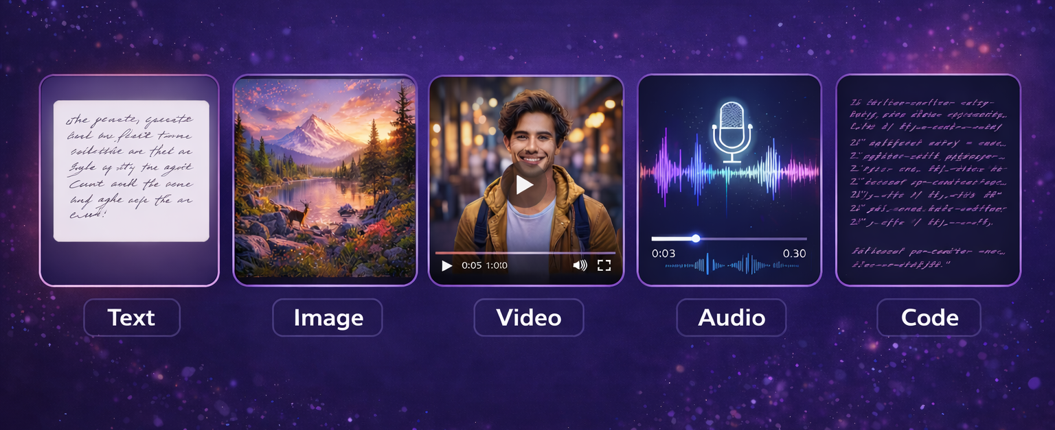
Different Types of Generative AI
Generated by ChatGPT
Generative AI can create a wide range of content—these are the main types and are known as AI modes. For example text-mode AI involves generating text such as stories and poems.
Notes:
Students are probably all familiar with chatbots but may not be so familiar with some of the other types of generative AI.

Slide 7

Generative AI for text
Creates text from your instructions (stories, answers, emails)
Used in apps you already use (chatbots, search, text prediction on your phone)
Can change writing style (simple, creative, formal, persuasive)
Helps with schoolwork (brainstorming, explaining, editing, summarising, researching)
Photo by Sanket Mishra on Unsplash
Notes:
You might want to ask students which of these they have already experienced. Or do their parents use AI at home or at work?

Slide 8

Generative AI for images
Generates an image given a description; e.g. “A cat surfing on the moon”
Trained on millions of images.
It doesn’t copy existing images. It creates something new based on patterns it learned. It learns what “cat”, “surfing” and “moon” look like
Tools: DALL-E, Midjourney, Adobe Firefly, Canva AI, Stable Diffusion
Generated by ChatGPT
Notes:
In the past most AI chatbots like chatGPT couldn’t generate images but now they can. The important point here is that the AI is not finding images on the internet or copying other images: it is generating brand new images from scratch.

Slide 9

Improvements in image generation
Generated with older image generation model
Generated by ChatGPT
Notes:
The point of this slide is to illustrate the huge improvements that have made over the last few years for image generation. Although the image from an older model was generated quickly with a less powerful model than what is available through ChatGPT, it would have been considered state-of-the-art at one point (and is quite amazing technology, even though the result is not fantastic).

Slide 10
Activity 2.02: AI Image or Real?
Complete the activity on the platform
Download the worksheet here
Notes:
This activity is intended to be completed on the platform. The aim of this activity is for students to get a feel for how “good” ai-generated images are and how it is really hard to spot the fakes.

Slide 11

Generative AI for video
Generative AI for video can:
generate a video clip from a prompt description
turn a still photo into a moving scene; e.g. waves crashing
generate a video with human-like avatars
remove objects, change backgrounds and swap faces in existing videos automatically
dub a video in another language and make it look realistic
Photo by Jakob Owens on Unsplash
Tools: OpenAI Sora, Google Veo, Runway, Luma Dream Machine
Notes:
The key point here is how powerful AI-generated video is and the range of things that can be done with it.

Slide 12
Activity 2.03: Gen AI videos
Complete the activity on the platform
Download the worksheet here
Notes:
This activity is intended to be completed on the platform. The aim of this activity is to show how realistic ai-generated video is today.

Slide 13
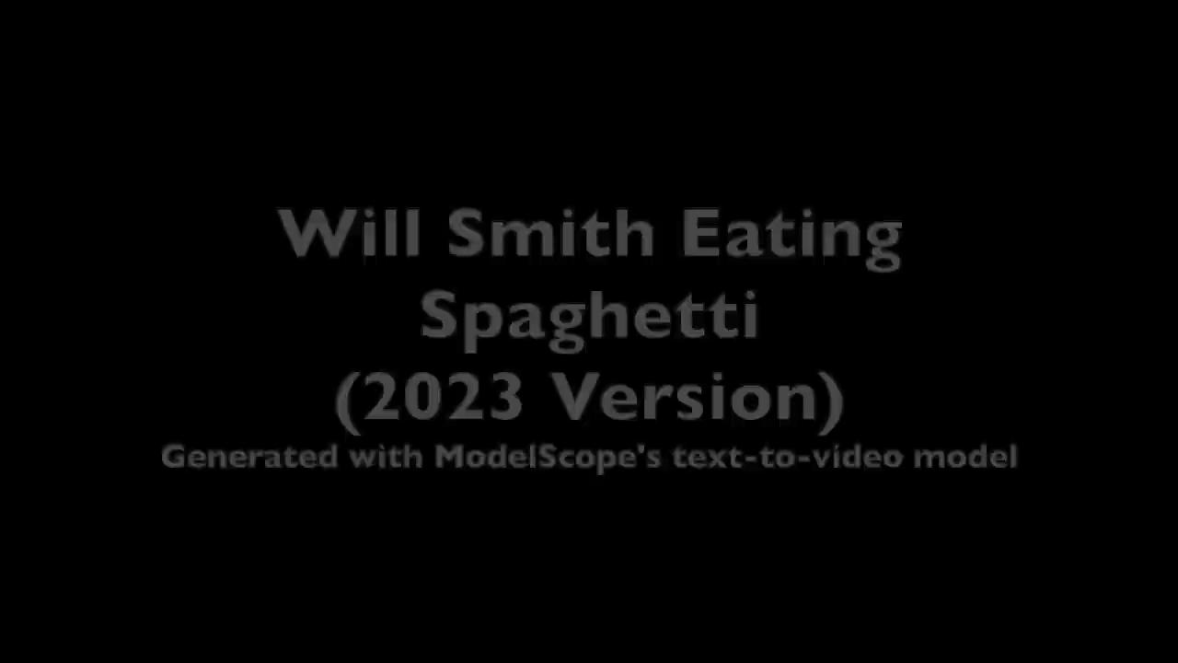
Progress of AI Video Generation
There have been huge improvements in AI video generation recently, just like there has been for image generation.
The Will Smith eating spaghetti test: video generation models can be judged on how realistic a video of the actor Will Smith eating spaghetti looks.
In 2023, a user of the website Reddit posted videos of Will Smith eating spaghetti generated using a video model tools called ModelScope. The video was shared across social media and this started a trend where model developers tested their new models by generating their own versions of the video.
2023 Video source: Wikimedia Commons
2025 Video source: Wikimedia Commons
Notes:
The video in the slide shows examples from the original post in 2023 and a more recent generated video from 2025 using Google's Veo 3 video model. There are huge differences in how realistic the videos are, even after only two years.
In 2026, Forbes magazine reported that the Seedance 2.0 model had passed the Will Smith eating spaghetti test, meaning it was realistic enough to pass as real video. You can learn more about this test on Wikipedia.
Some reasons for the improvement of video generation include an increase in computing power, more training data and smarter approaches to generation that improve realism.

Slide 14

Generative AI for audio
Text-to-speech: reads any text aloud in a natural voice
Voice Cloning: can copy someone’s voice from just a few seconds of audio
Real-time-translation: listens in one language and speaks back instantly in another
Music Generation: composes a full song in seconds, and can remix existing music
Photo by Pawel Czerwinski on Unsplash
Tools: ElevenLabs, Murf, Google Wavenet, Suno, Udio, GoogleMusicLM
Notes:
AI recognising human speech and AI generating human speech (Text-to-speech) were two early research areas in AI. They were achievable long before AI-generated images and chatbots came about. Audio generation and Video generation have traditionally been two separate processes. In most current AI video tools, the visuals and audio are generated separately and then combined.

Slide 15
Activity 2.04: AI audio or real?
Complete the activity on the platform
Download the worksheet here
Notes:
In this activity students must distinguish between real and AI-generated audio.There are 6 audio samples of 2 seconds each. Three of them are real and three of them are AI generated. The learning intention is for students to gain an understanding of the quality of AI-generated audio and how to detect if audio is fake or real. They are also prompted to think of possible uses of AI-generated audio and the risks involved.

Slide 16
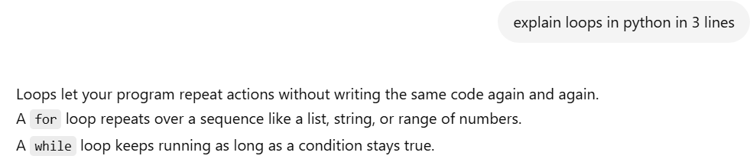
Generative AI for code
Generative AI for code can:
generate code given a prompt, e.g. “Make a noughts-and-crosses game”
generate code in many languages: e.g. Python, Java, HTML/CSS, Scratch
explain existing code
help students learn new coding concepts
Using ChatGPT to help us understand loops in Python code. Generated by ChatGPT
Notes:
Stress here that AI-generated code is not simply copying code from somewhere else: it is generating new code from patterns it has seen.
You (and your students) may have heard of “vibe coding”, where people write what they want AI to code and create and let the AI do all the coding. Although vibe coding easy to do and can have some great results, it’s important that people understand what the code they’re creating is doing and the potential risks. Vibe coding and AI assisted coding will be explored in more depth in a later lesson.

Slide 17
Activity: Generating code
Complete the activity on the platform.
Notes:
In this activity, students use Lumen to generate some simple code and then run the generated code in the Code for Schools (TFA) environment. They are prompted to think about what else they could generate with AI tools. This is an area we will touch on in a later lesson when we talk a bit about “Vibe Coding”. Vibe coding is when you tell an AI what you want a program to do, and it writes the code. You can tell them they have essentially just “vibe-coded”

Slide 18
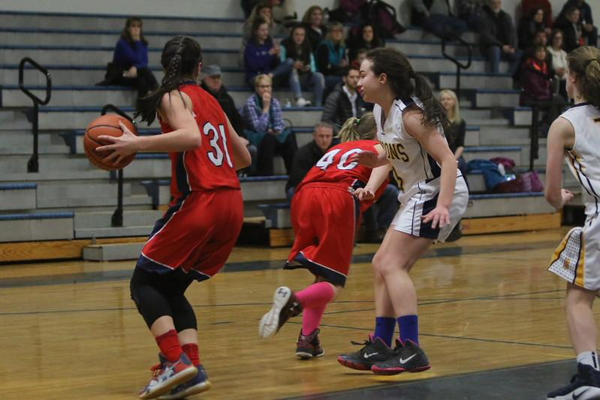
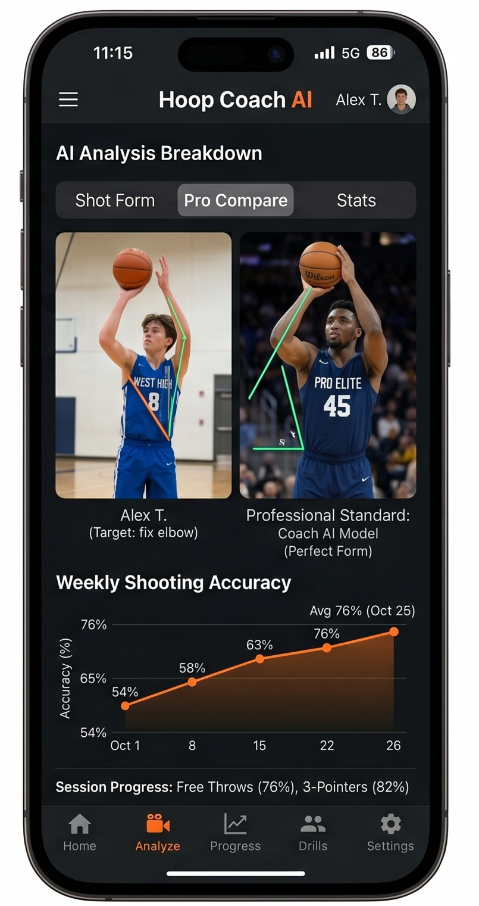
Multimodal AI
AI can use many modes at once (multimodal). Imagine an app that helps a teenager improve at basketball:
Video: The student films a shot and the AI analyses arm angle, jump height, and release point.
Images: It compares key frames to photos of professional players.
Audio: The student asks, “How can I fix my shooting form?” and the AI understands.
Code: It generates a small graph showing accuracy over time.
Output video: It creates an overlay video with arrows showing mistakes and a side‑by‑side comparison with a pro.
CC by 2.0 by flickr
A screenshot of a basketball app, generated using Gemini
Notes:
The aim of this slide it to bring the last few slides together and show how powerful AI can be when it is combined in different modes. The teacher may have to remind the students that the “mode” is the way you use it.

Slide 19
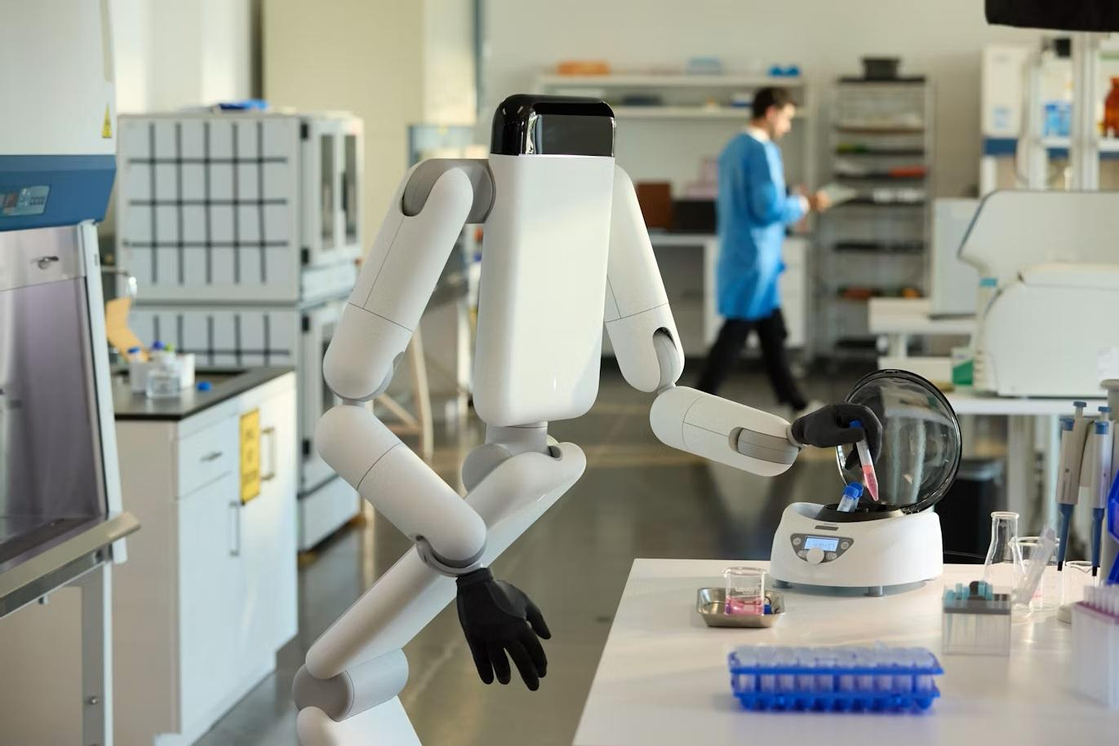
Embodied AI
Embodied AI (or Physical AI) is AI that lives in robots, drones or other devices with bodies so it can see, move and act in the real world.
AI changes traditional robots from following fixed rules, like assembling cars in a factory, to being able to learn from experience and adapt to new situations.
Most embodied AI today uses computer vision and AI models trained for specific tasks not LLMs.
Photo by Genesis AI
Notes:
The key point here is that Embodied AI means AI isn’t stuck on a screen. It’s built into something with a physical body (robot, drone, device) so it can sense and act in the real world. The combination of AI and traditional robots means robots can reason more about their environment but they still struggle in messy real-world situations where humans have no trouble at all.
Possible discussion prompt: "Why might a robot that works perfectly on a factory line struggle if you moved it into a school or a home?"

Slide 20
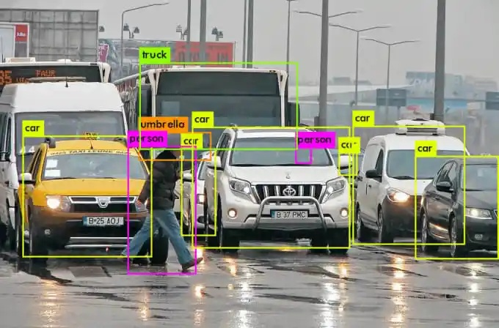
How does a robot see?
A robot’s camera captures an image as a grid of tiny coloured dots called pixels. On its own, a robot has no idea what those pixels mean.
Computer vision analyses patterns across those pixels, such as colours, edges and shapes, to identify objects and understand what is happening in an image.
It learns these patterns by training on large numbers of labelled images.
This allows it to recognise similar objects in images it has never seen before, helping self-driving cars detect pedestrians and warehouse robots avoid obstacles.
Source: viso.ai
Notes:
The main point of this slide is to explain how computer vision works and it is all about pattern matching. It doesn’t really “understand” what is in the image. Computer vision learns the same way other AI models do: from training on huge numbers of labelled examples.
Possible discussion prompt: "What might confuse a computer vision system that wouldn't confuse a human, e.g. a stop sign covered in stickers, or a shadow shaped like a person?"

Slide 21
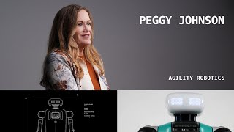
Embodied AI Example Video
AWS Startup Stories: Agility Robotics, source: YouTube
Notes:
In this video, students see a state of the art robot, Digit, and how it is currently used in manufacturing and logistics. The video stresses the importance of training data and how the cloud is used for performing much of its daily work. The narrator stresses that it will be humans plus machine, not humans vs machine.

Slide 22
Activity: Categorising AI as Embodied or not
Complete the activity on the platform
Notes:
In this activity, students categorise AI as embodied or not.
Discussion prompt: “Why is physical-world AI harder than text AI?”
Expected answers:
-Mistakes can physically hurt people
-The real world is messy
-Sensors can fail
-Weather, people and obstacles change
-Robots need motors, batteries and safety systems

Slide 23
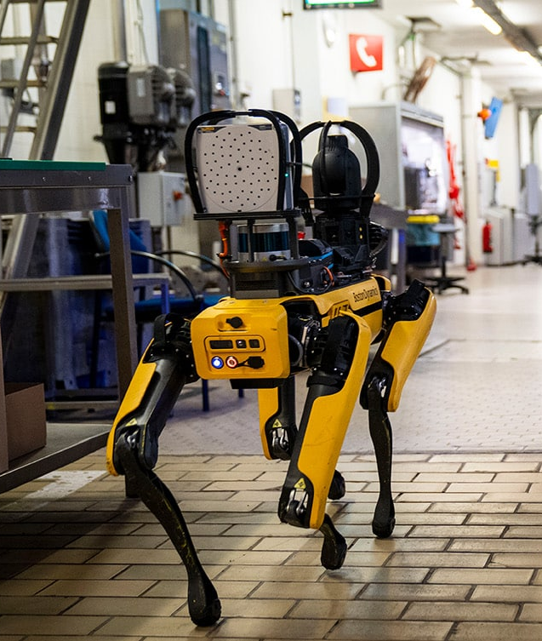
More examples of Embodied AI
Warehouses: Amazon's robots navigate shelves, identify objects, and hand off to humans for tricky tasks
Surgery: the Da Vinci robot assists surgeons with precision movements too fine for human hands
Disaster zones: robots enter collapsed buildings or nuclear sites where it's too dangerous for humans
Agriculture: robots identify and pick ripe fruit, or spray only the weeds instead of the whole field
Boston Dynamics' Spot: a dog-like robot that can open doors, climb stairs, and inspect construction sites
Spot from BostonDynamics
Notes:
These examples show embodied AI is already doing real jobs. Each one highlights a different reason robots are useful: precision, safety, scale, or access. However, most of these still have a “human in the loop” either supervising or working with them.
SwarmFarm are an Australian company with cool robotics for detecting and spraying only weeds. A couple more Australian examples are the Roo-ver, a lunar soil collector and ROVing, an AI powered submersible inspection drone.
Possible discussion prompt: "Which of these jobs would you least want to do yourself? Which do you think a robot could do best, and which still needs a human involved somewhere?"

Slide 24
What AI robots struggle with
Robots are still bad at many things humans find easy because humans are amazing at moving, touching, balancing, noticing, adjusting and using common sense. For example:
Picking up lots of different objects. They might pick up a box perfectly then struggle with a soft jumper, a slippery cup, tangled headphones or a half-open packet of chips,
Moving naturally like people do. They struggle in crowds, with stairs, uneven ground, wet surfaces and with people suddenly changing directions.
Common sense. They don’t naturally understand things like: “This room is messy but it does not mean everything is rubbish”. OR “Don’t put the wet towel on the laptop”.
Creative originality. AI can imitate styles, but humans are better at making work that feels meaningful, surprising or emotionally resonant.
Acting with incomplete information. Humans are better at making decisions with only partial information.
Humans are better at describing and interpreting social interactions in a moving scene. These are skills necessary for self-driving cars, assistive robots and other embodied AI.
Notes:
The key point of this slide is that there are many things that robots still find hard to do. Get students to think about why some of these things might be hard for robots. For example, if a robot can handle a box perfectly why is it hard for them to pick up a jumper (soft objects change shape). Common sense requires understanding a whole environment which requires a lot of world knowledge that robots often don’t have. And AI can imitate style convincingly but that’s different from originating something truly creative.
Contactile is an Australian company developing smart grippers with a human sense of touch. They can be used in manufacturing and assembly, food handling and packaging, pharmaceuticals and lab automation, and even healthcare and surgical robotics. Here is one of their example videos.
Possible discussion prompt: Pick one of these five weaknesses. What do you think would need to happen for robots to get better at it, more data, better sensors, or something else entirely?

Slide 25
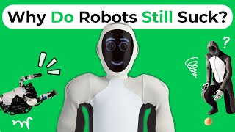
Easy for you, Hard for a Robot
Why Is It So Hard to Build Humanoid Robots? (Moravec's AI Paradox)
Source: YouTube
Notes:
The aim of this video is to explain Moravec’s Paradox, give examples of tasks that robots are no good at and discuss some of the other tasks they can’t do.

Slide 26
Activity 2.05: Easy for you, Hard for a Robot
Complete the activity on the platform
Download the worksheet here
Notes:
In this activity, students attempt to write rules for some hard tasks for a robot and then some rules for easy tasks for a robot. The idea is to get the students thinking about the fact that the reasons these tasks are hard is because you can’t easily write rules describing how to do them. They need lots and lots of training and smart AI to work this out.

Slide 27
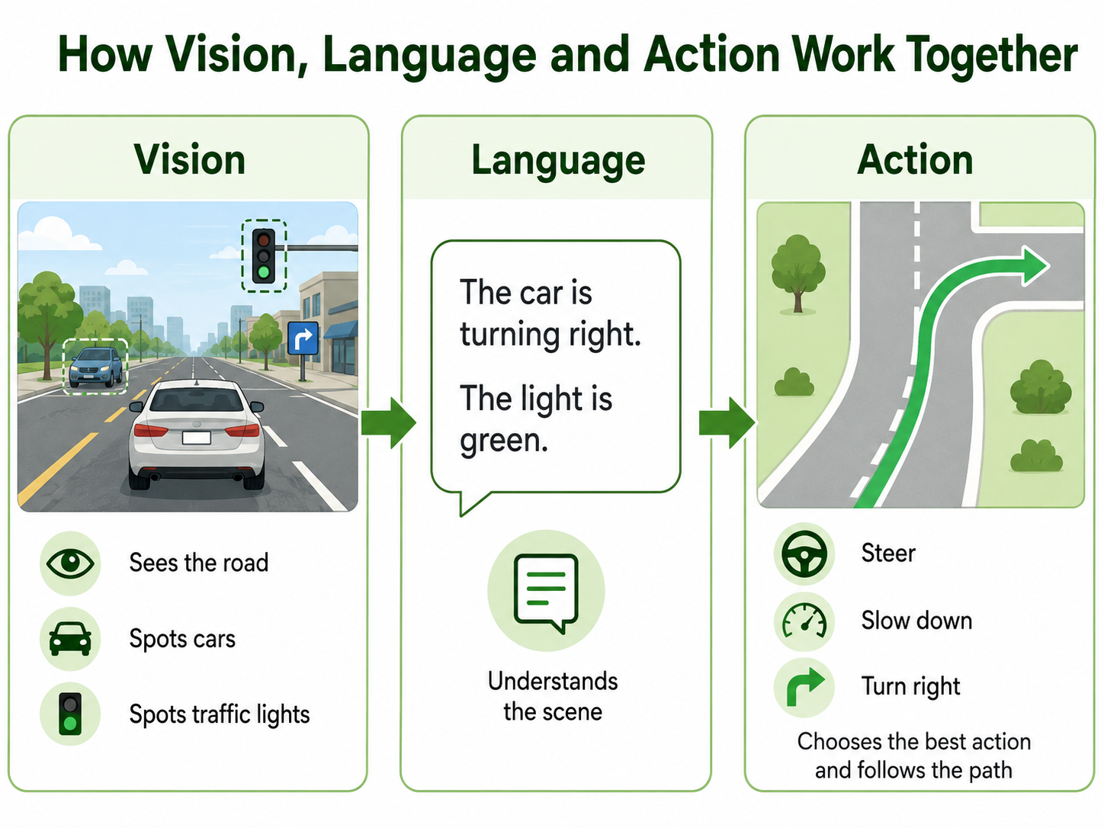
Vision Language Action Models
Most robots today don't use language models. They use computer vision and narrower AI trained for one job, like spotting objects or planning a path.
But researchers are now building robots that combine three things in one system: seeing (vision), understanding language, and acting.
These are called Vision-Language-Action models, or VLA models.
Instead of writing exact rules for every task, you can just tell the robot what to do: "pick up the red block" and it works out how.
They learn from huge amounts of examples (videos, images, instructions), and the robot can understand what you say, not just what it sees.
These are still early and they can still fail on simple tasks.
Generated by ChatGPT-5.5. Adapted from Labeller
Notes:
The key point of this slide is that this is the “next step up”. Most robots today are AI focused on specific tasks plus computer vision (no language understanding at all). VLA models are the latest thing combining vision, language, and action in a single system. Computer vision alone can identify a red block, but it can't understand the instruction "pick up the red block." VLA models close that gap. VLA models are at an early stage. These robots can still fail at tasks that look trivial to a human.
Possible discussion prompt: If a robot could understand any instruction you gave it, what's the first task you'd want it to do? What could go wrong if it misunderstands you?

Slide 28
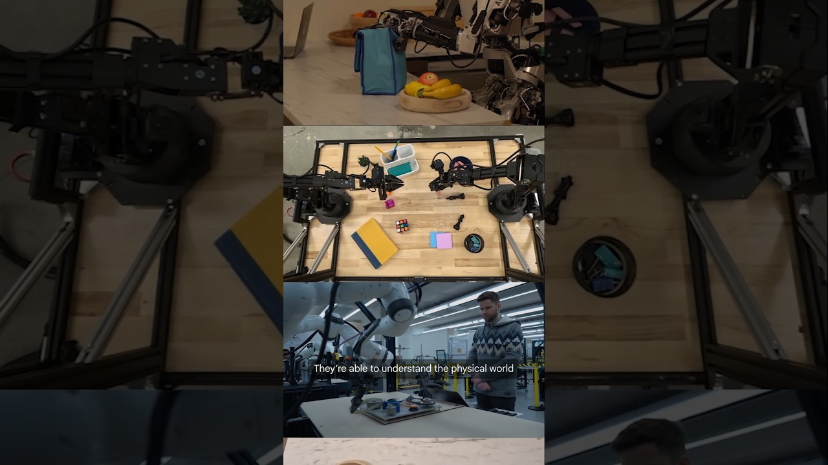
Gemini Robotics VLA Models Video
Introducing Gemini Robotics: two new AI models from Google DeepMind
Source: YouTube
Notes:
This video is a real demo of a VLA model by Gemini Robotics that combines vision, language and acti Ask students to spot the three ingredients as they watch: the robot seeing its environment, understanding a spoken instruction, and acting on it. This is from a research lab and is still emerging technology.
Possible discussion prompt: The robot in this video was told what to do in plain English. What could go wrong if the instruction was vague or ambiguous?

Slide 29

AI in the Real World
Today, AI is used everywhere, and you may be surprised the areas AI is used in!
Video: F1 accelerates race day storytelling with Track Pulse | Amazon Web Services (YouTube)

Slide 30

AI in the Real World: Entertainment
Music: Tools like Suno can write and produce full songs from text. Spotify analyses your listening to build you playlists.
Games: Game characters (NPCs) use AI to react dynamically. AI tools write game code.
Movies: Hollywood uses AI for de-ageing actors, dubbing films into new languages and generating digital crowds. Open AI’s Sora can generate entire video clips from text.
Recommendations: Netflix and Youtube use AI to pick what you see next based on your data to keep you watching as long as possible.
AI Art: Tools like Midjourney and DALL-E let anyone create art from text
AI art describing weather prediction by Google DeepMind on Unsplash
Notes:
There are lots of points of discussion here depending on student experience of AI.

Slide 31
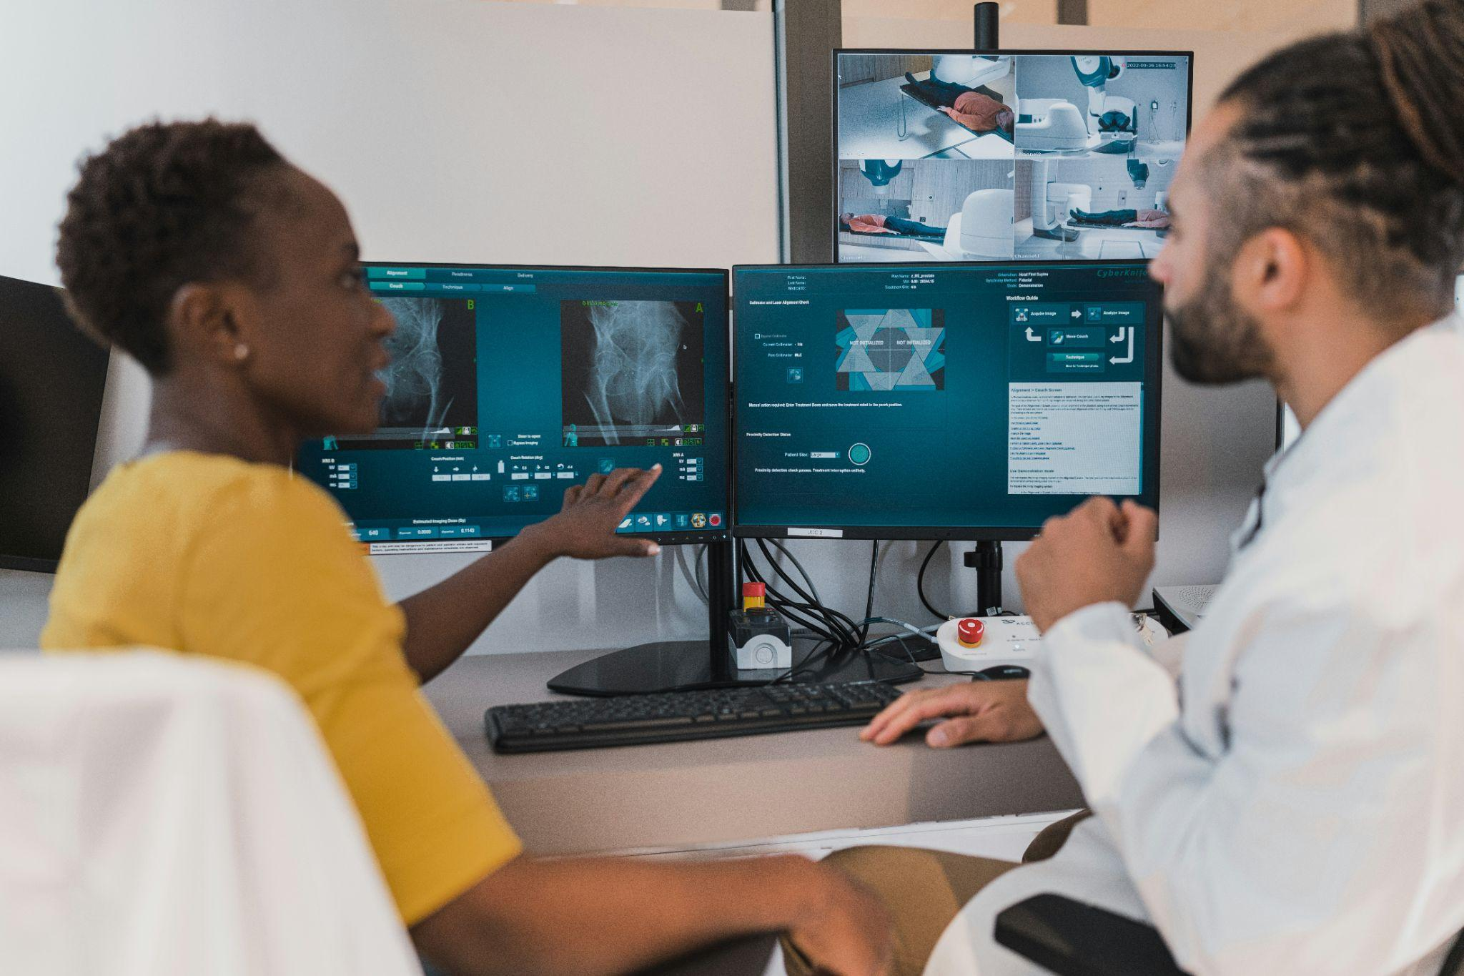
AI in the Real World: Health
Early Disease Detection: AI scans X-rays and MRIs faster than humans, catching cancer and eye disease earlier.
Drug Discovery: AI helped design COVID vaccines faster than ever before. It can model proteins and predict which drug compounds might work.
Personalised Treatment: AI analyses your medical history, genetics and lifestyle to help doctors choose the best treatment for you specifically.
Photo by Accuray on Unsplash

Slide 32

AI in the Real World: Sport
AI helps coaches predict player performance by looking at data like speed, heart rate and movement. It can also analyse game footage to spot strengths, weaknesses and identify better tactics.
Did you know?
Most major Australian NRL and AFL teams use AI tools to optimise their team performance.
NBA Inside the Game Powered by AWS. Source: YouTube
Notes:
The aim of this slide is for students to realise that there is a lot of AI “behind the scenes” that they might not know about.
Students may have heard of Amazon as "the shopping website." but Amazon is actually two businesses in one.
The one everyone knows: you buy stuff, it shows up at your door.
The other one, way bigger behind the scenes is AWS (Amazon Web Services). This is Amazon renting out computers.
Why would anyone rent a computer?
Think about Netflix. To stream a movie to millions of people at once, you need a huge amount of computer power, way more than a laptop or a school server could handle. Building all that yourself would cost a fortune and take years.
So instead, companies like Netflix just rent computer power from Amazon. Amazon already built giant warehouses full of computers (called data centres) to run its own shopping website. AWS is Amazon saying: "We've got spare computer power. Want to rent some?"
A simple way to put it:
"Amazon doesn't just sell you things anymore, it also sells other companies the computer power to run their apps and websites."

Slide 33
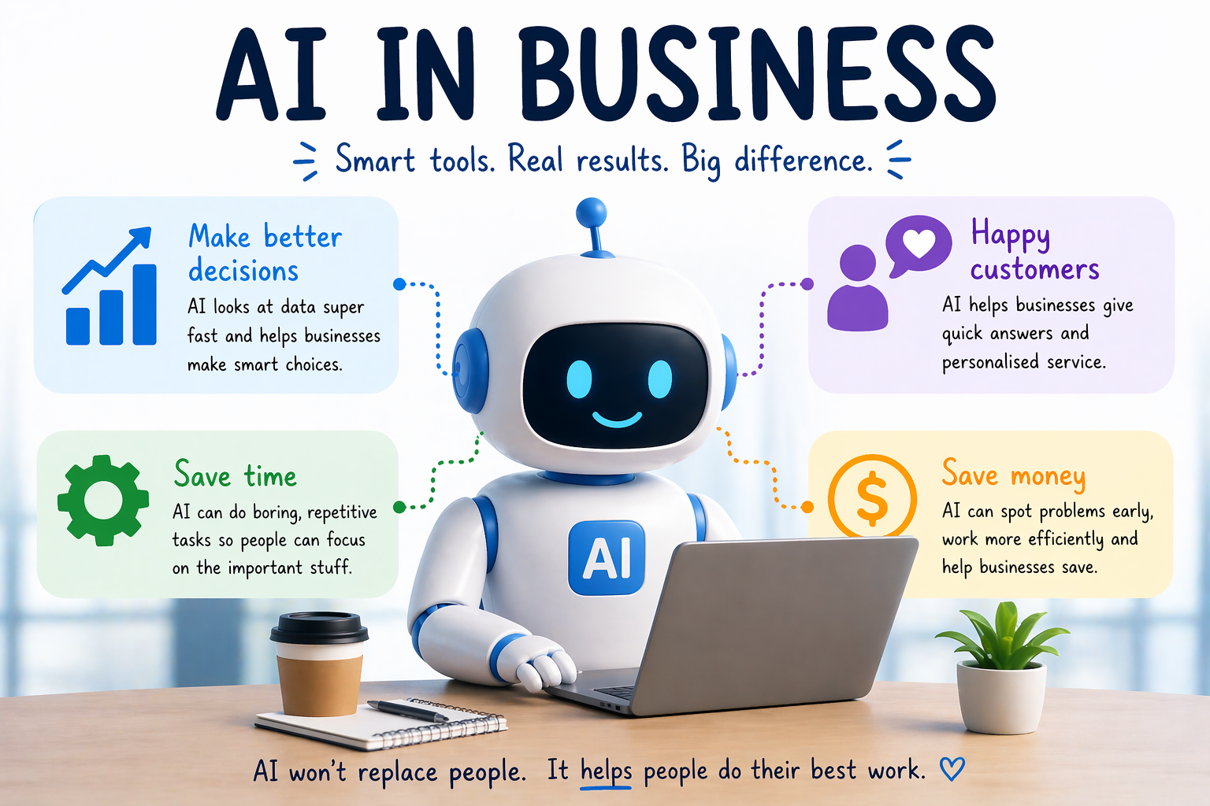
Generated by ChatGPT
Notes:
AI is widely used in business today and most students or their families will be using it.
You can have a discussion with students about how it is used and here are some examples:
Make better decisions: AI can look at huge amounts of data quickly to help managers make smart choices. For example, a supermarket can use predictive AI to figure out exactly how many apples they need to order each week so they don't run out or let them go to waste.
Happy customers: Businesses want to make sure their customers are satisfied. AI chatbots can be available 24/7 on a company's website to instantly answer questions or help a customer return an item.
Save time: AI can handle repetitive and boring tasks so workers can focus on more important things. For example, generative AI can help an office worker quickly write the first draft of a long email or summarise a long meeting into a few bullet points.
Save money: Because AI makes things faster and more efficient, it helps businesses lower their costs. For example, delivery companies use AI to figure out the fastest route for their drivers, which saves time and money on fuel.

Slide 34
Activity 2.06: Uses of AI
Complete the activity on the platform
Download the worksheet here
Notes:
In this activity, students use Lumen to research a particular type of AI (generative, predictive, classification) in a particular area (health, entertainment, sports or business). The learning intention here is to show students how you can use AI for research tasks while also learning about AI.

Slide 35

Be familiar with some different types of AI: predictive, classification and generative
Find it easier to recognise AI-generated images, audio and video
Understand embodied AI: how robots use vision and action in the real world, and why some simple human tasks are still hard for them
Be able to describe how AI-generated content is used across sport, entertainment, business and health
Summary
You should now be able to:

Slide 36
License Information
These Tech Futures Australia lessons plans, worksheets, and other materials were created by the Tech Futures Australia team. They are licensed under a Creative Commons Attribution-ShareAlike 4.0 International License.

