Slide 1

Lesson 1
What is AI?
techfutures.org.au

Slide 2
Learning objectives
By the end of this lesson, you should be able to:
Understand what AI is
Understand what Large Language Models (LLMs) are
Explore the outputs produced by LLMs
Understand how LLMs build on early AI techniques
Understand the relationship between LLMs and text prediction in phones

Slide 3

What are some examples of Artificial Intelligence (AI) ?
Notes:
Ask students what are some examples of AI they see around them.
Don’t say yes or no to any of them. Write them all up as a list either on the board or in this slide.
Make a list which you will come back to later at the end of the lesson

Slide 4
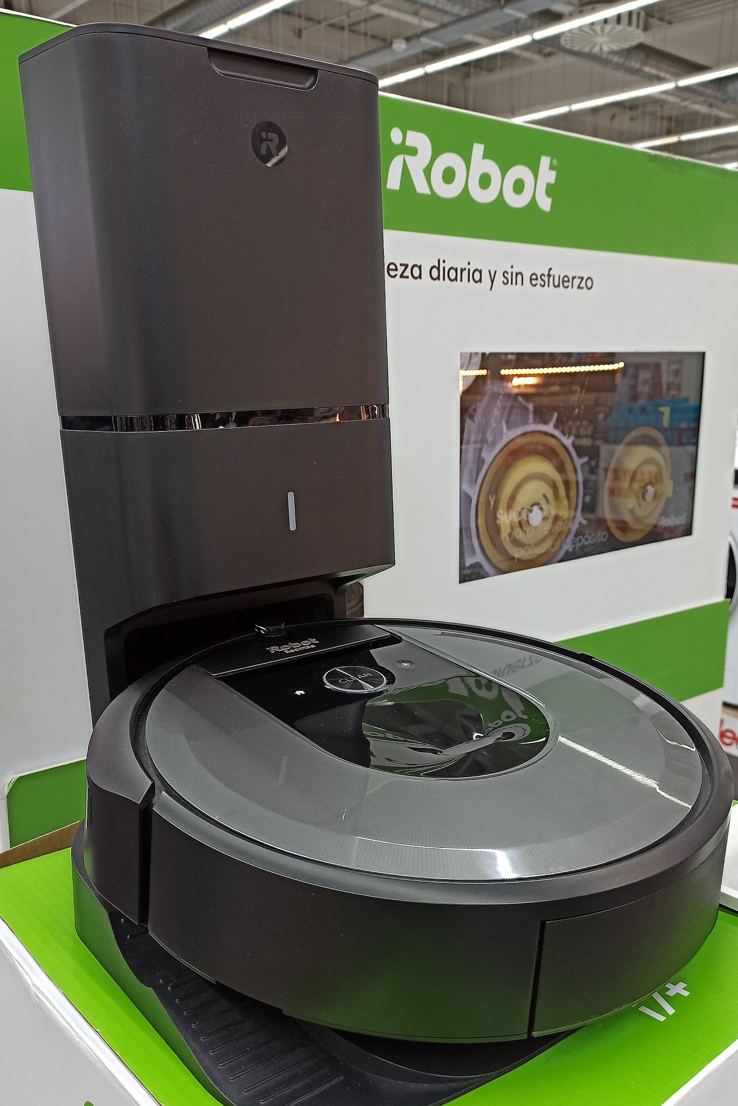
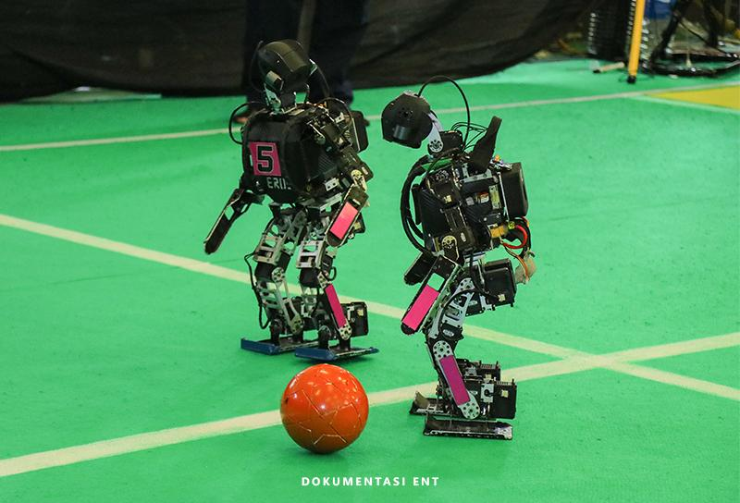
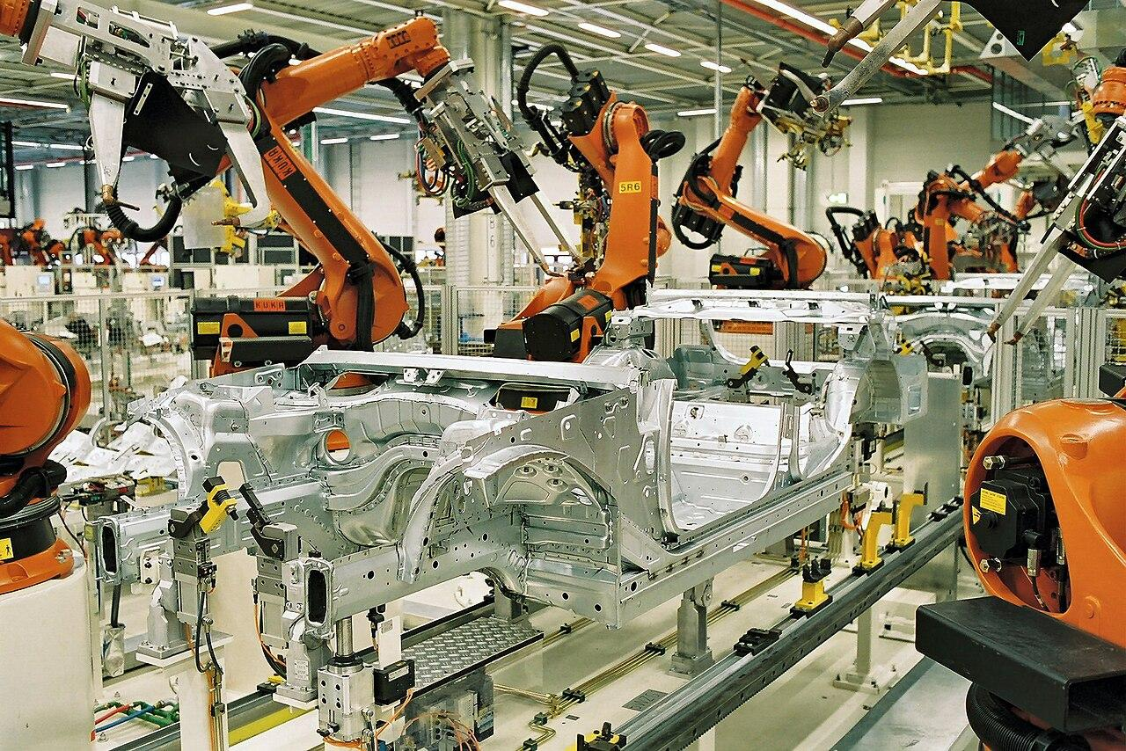
Examples of AI
Author: Politeknik Elektronika Negeri Surabaya, Source: Wikimedia Commons Licensed under the CC A-S A 4.0 International license.
Author: BMW Werk Leipzig, Source: Wikimedia Commons Licensed under the CC A-S A 2.0 Germany license.
Author: Politeknik Elektronika Negeri Surabaya, Source: Wikimedia Commons Licensed under the CC A-S A 4.0 International license.
Notes:
Ask the students if some of them thought of some of these examples of AI. Have any students got a robot vacuum at home?
Did students know that most cars are assembled by robots like in this BMW factory.
Did students know that robots can play soccer and researchers use robot competitions to improve their robots.

Slide 5
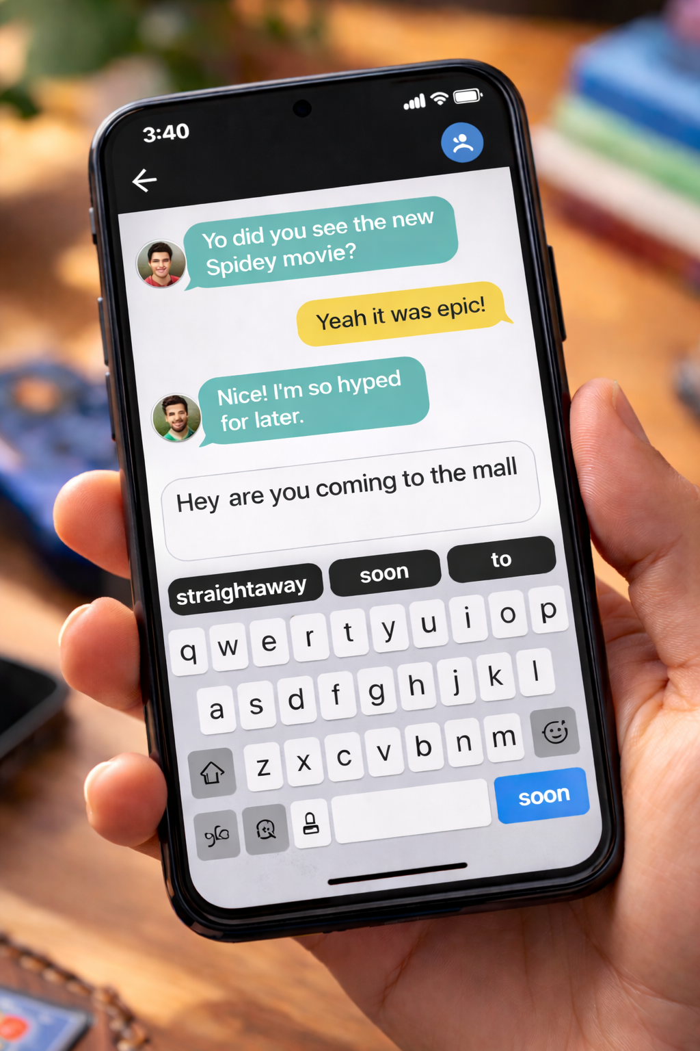
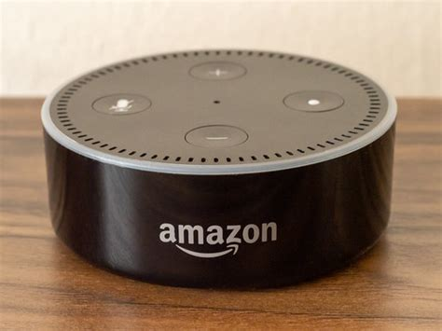

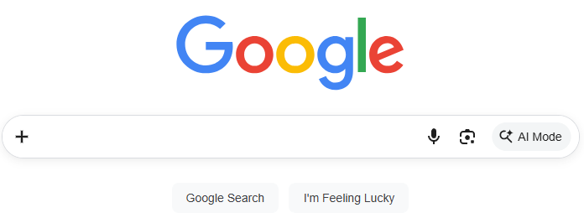
More examples of AI
Source: flickr.com
Source: Vecteezy
Generated using ChatGPT
Source: Vecteezy
Notes:
Say to your students that many of them may not know that they are using AI every day if they have interacted with any of these AI tools.
Youtube recommender systems use AI when they bring up the next video automatically. They know what you like!
Alexa remembers past conversations with you and your mobile phone can predict your next word.
Kids may also be familiar with Snapchat AI, which is a chatbot built into Snapchat.

Slide 6
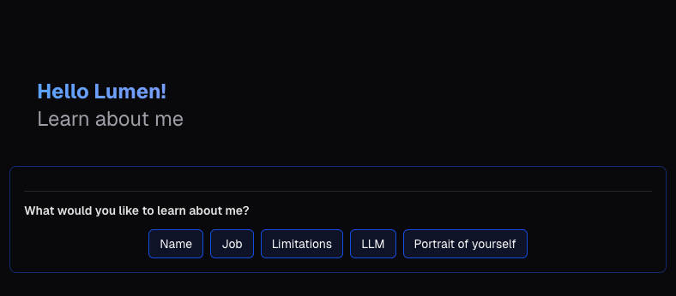
Meet Lumen
Lumen is a special AI chatbot
Notes:
Get students to follow on with you as you introduce them to Lumen on the Activity: Hello Lumen! page.
Get the students to select the “Name” option together as a group. The students will complete a worksheet (next slide) where they select the other prompts and answer questions about them.

Slide 7
Activity 1.01: Hello Lumen!
Complete the activity on platform
Download the worksheet here
Notes:
In this activity, students have their first interaction with Lumen. The goal of this activity is for students to become comfortable with Lumen, understand what it can do and what it’s limitations are. They should learn that it is a chatbot and that it can generate images.

Slide 8
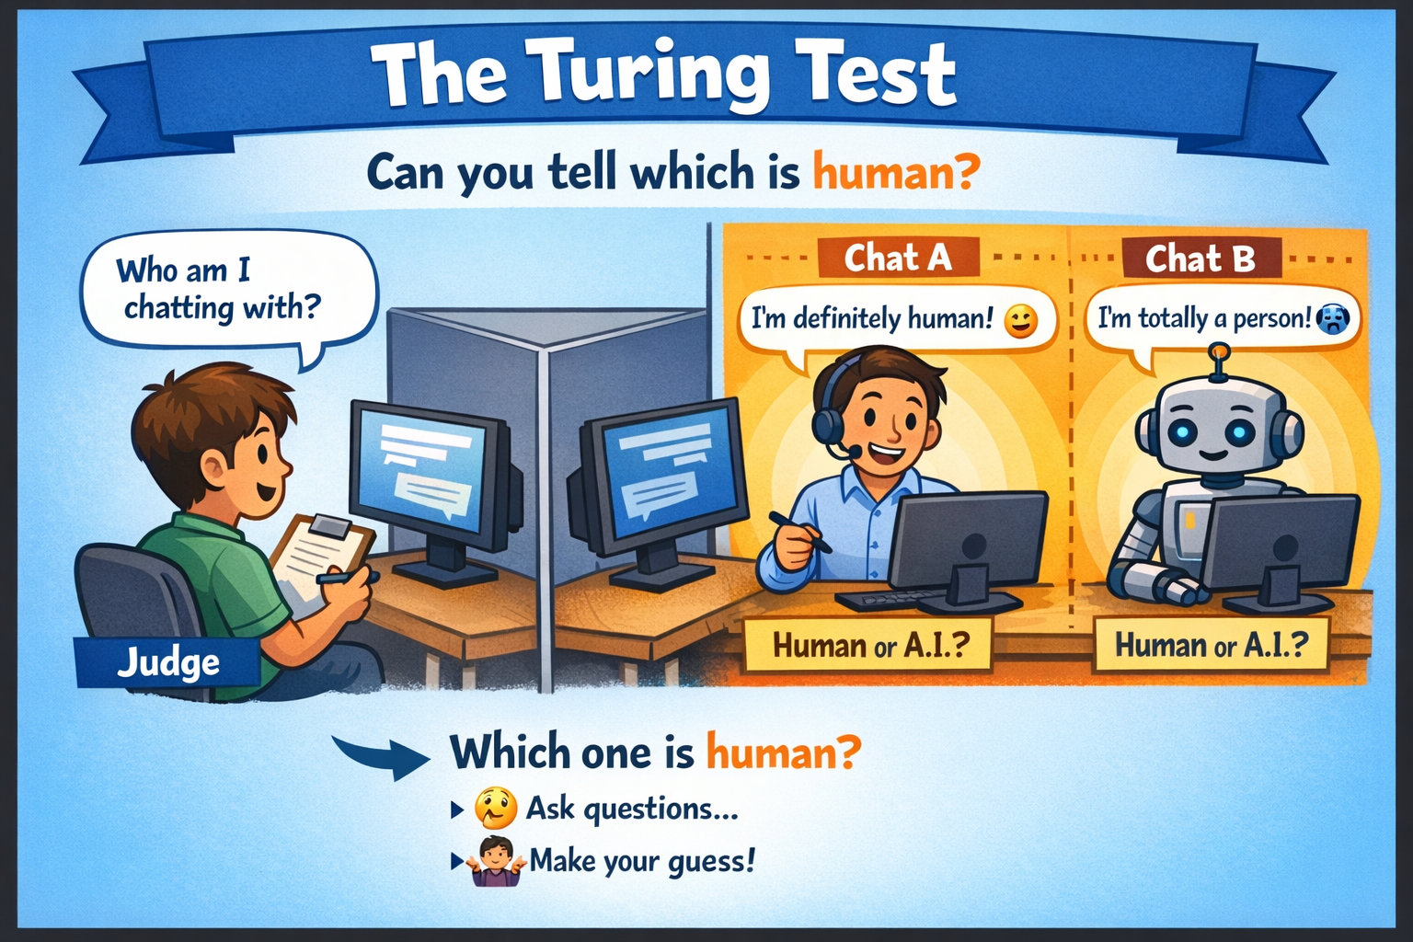
Early ideas of AI (1950s)
In 1949 Alan Turing proposed a thought experiment: “Can a machine think?”
The Turing Test: a human judge chats with two participants – one human, one machine.
If the judge can’t tell which is which, then the machine passes the test.
In 1956 the term Artificial Intelligence was used to describe intelligent machines.
Notes:
Explain to the students that a thought experiment means it was all just theory and there were no actual people or machines involved in the process at all. That came much later.

Slide 9
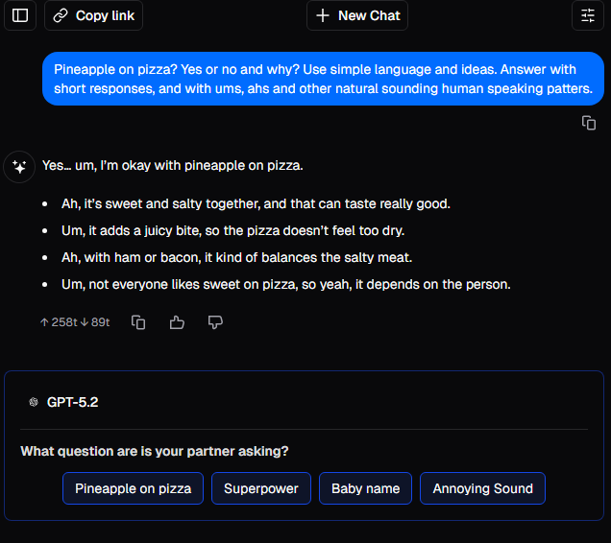
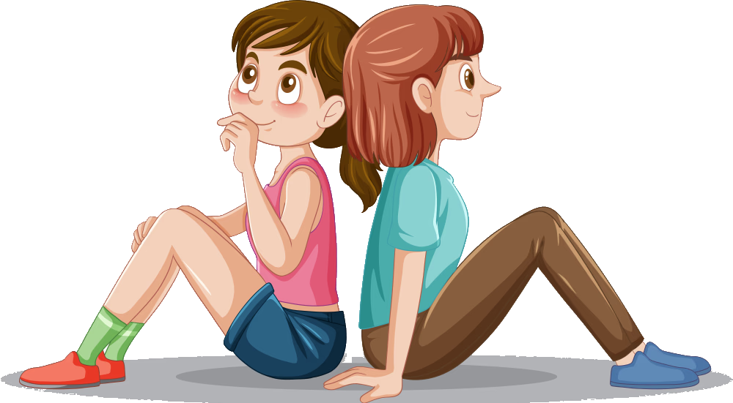


Activity 1.02: Turing Test
Remember: A computer passes the Turing Test if it can fool humans into thinking it is also human!
Complete the activity on the platform
Download the worksheet here
Notes:
In this activity, the students simulate the Turing Test using Lumen and a human partner. The learning intention is for students to understand the purpose of the Turing Test and use it to explore what “intelligence” might mean in humans vs AI systems.
It’s a good idea to demo this activity with a student up the front of the class to show them how it works.

Slide 10
Intelligent machines
Do you think being able to pass the Turing test means a machine is truly "intelligent"?
What other qualities do you think make a machine intelligent?

Slide 11
Intelligent machines
Some qualities that make machines intelligent include:
Reasoning and problem-solving: being able to solve new problems and make decisions based on information
Creativity: the ability to generate new ideas and solutions
Emotional Intelligence: recognising feelings and responding kindly
Ethical Thinking: understanding right and wrong and making ethical decisions
Learning and adaptability: being able to learn from experience and adapt to new situations
Notes:
Incorporate the students’ responses in your discussion here as well because they will probably come up with some other good ideas.

Slide 12
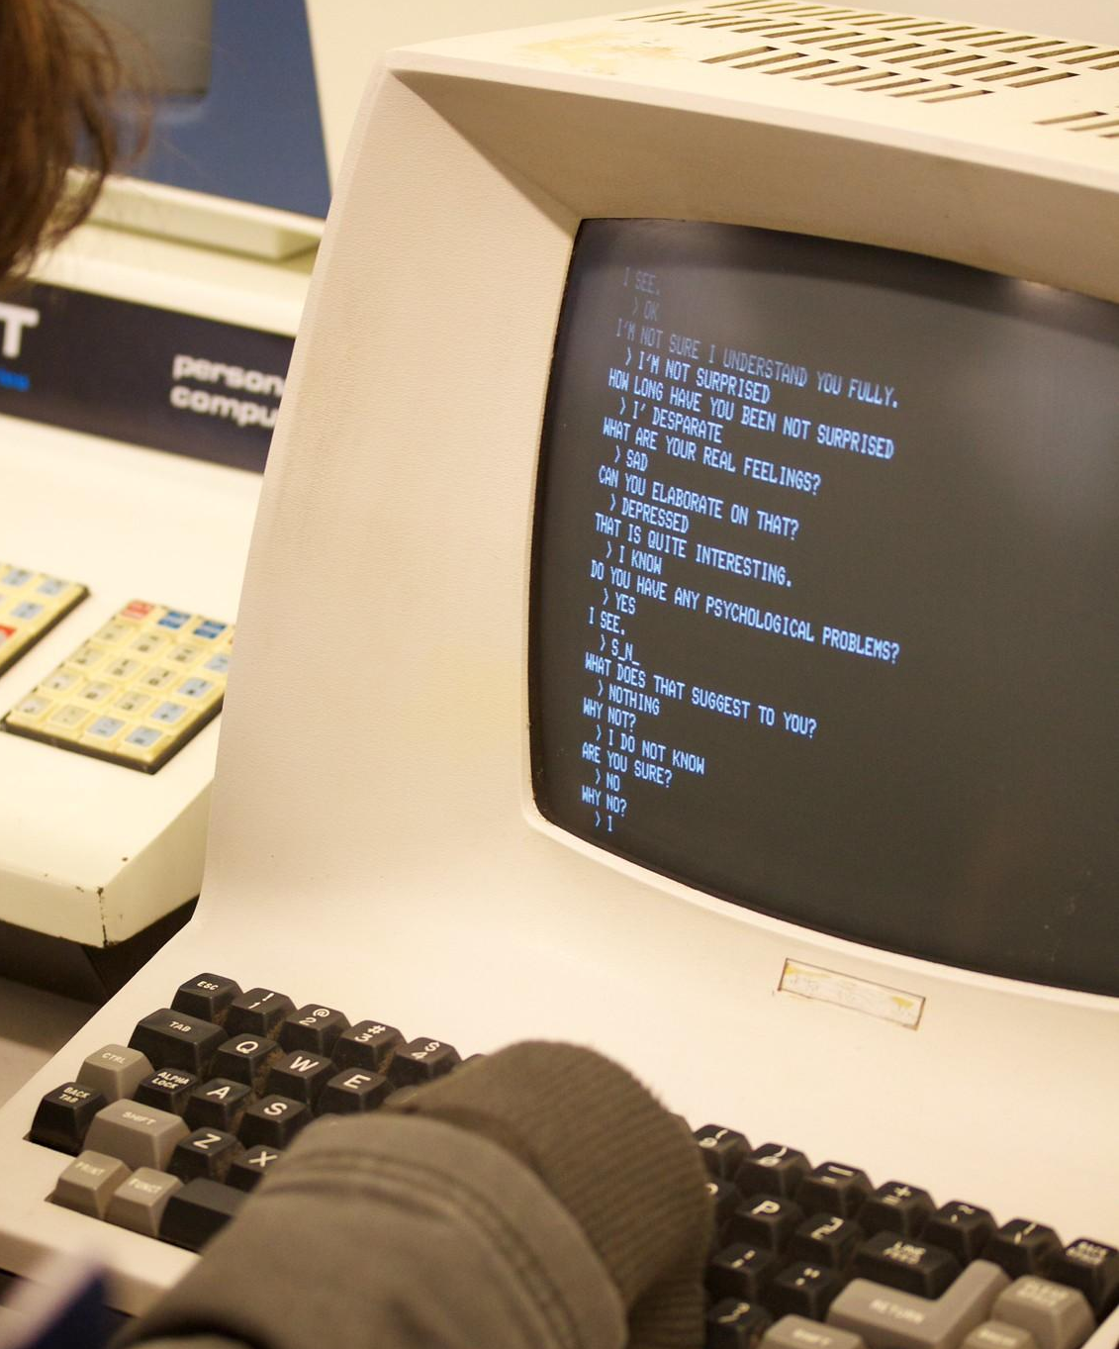
Rules Based AI
(1960s - 80s)
The first serious attempts at AI used rules to mimic human behaviour in conversation.
Eliza (1964 - 1967) was an early text chatbot that pretended to be a therapist and used a set of pattern‑matching rules written by its creator, Joseph Weizenbaum.
Source: flickr.com
Notes:
You can find more details about Eliza here

Slide 13
Activity 1.03: Investigate ELIZA
We will explore a recreated version of ELIZA ourselves.
Complete the activity on the platform
Download the worksheet here
Notes:
In this activity, students interact with the chatbot ELIZA. The learning intention is for students to appreciate that early chatbots were not intelligent – they simply followed fixed rules. When ELIZA couldn’t find a matching pattern, it used clever tricks like turning the user’s words into a question. This often led to strange or silly responses because ELIZA didn’t understand what the user was saying.
Here is an interesting video from an AWS technologist who was inspired by ELIZA to study technology.

Slide 14
Learning simple patterns (90s - 2010s)
In the 90s, AI started to learn patterns from data in a limited way.
This was called Machine Learning (ML).
For example, it might have data about house size and house prices. It would then guess a mathematical rule about the relationship between these and use this rule to predict a house’s price based on it’s size.
It then adjusted its guess based on data. This is known as predictive machine learning.
The computer didn’t “understand” the data – it just looked for patterns in the numbers.

Slide 15
Predictive Machine Learning (90s - 2010s)
Spam detection
Predicting whether an email was spam. Used word counts and patterns in emails.
Early recommender systems
Netflix and Amazon used predictive ML to work out what movies or products you might enjoy based on your past choices.
Demand forecasting
Retailers like Woolworths used ML to predict how many items they needed to stock each week.

Slide 16
Activity: Spam or Not?
Complete the activity on the platform

Slide 17
Learning complex patterns (2012 - 2020s)
This era introduced neural networks and deep learning which changed everything.
Neural networks are computer systems inspired by how the brain works. They learn by looking at lots of examples and adjusting tiny connections inside the network until they get better at the task.
Deep learning uses huge neural networks to learn much more complicated patterns.
This meant AI could now learn complex patterns like recognising faces, understanding speech or spotting objects in photos.
Notes:
These are very complicated concepts.
The main idea to get across is that the AI works by mimicking the way the brain and student’s are not expected to understand it in detail.
There are links to videos in the student portal for the students that are really interested in learning more details.

Slide 18

Deep neural networks (2012 - 2020s)
Voice Assistants (Siri, Alexa)
People could now tell Siri to “Call Mum”
Face unlock on phones
Phones learned to recognise your face using deep neural networks trained on millions of images
Lane detection in cars
Cars used deep neural networks to detect lanes, traffic lights and other cars

Slide 19
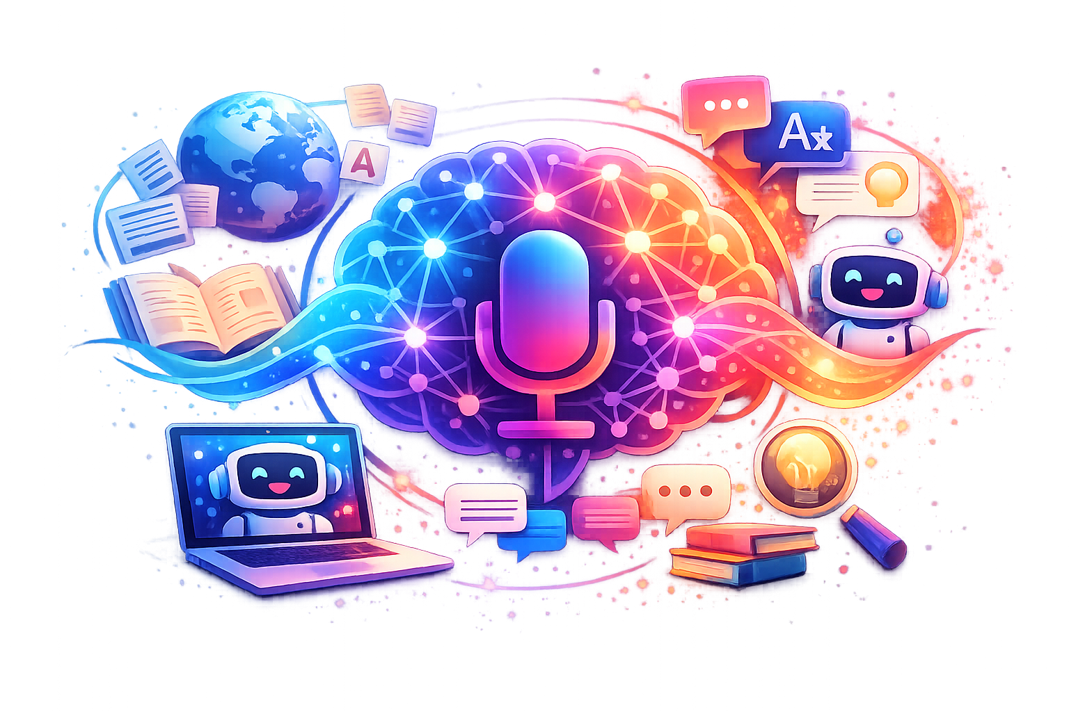
Modern AI: Large Language Models (2020 - now)
Became far more powerful and general. Use very large neural networks
Can understand and generate text
Learn from huge amounts of online information, books and different text sources
Can follow instructions, reason through problems, and hold long conversations
Powers tools like ChatGPT and modern translation systems
These are called Large Language Models (LLMs)

Slide 20

Chatbots and LLMs
How many chatbots have you used?
What’s the difference between chatbots and LLMs (if there is any?)
Notes:
The key point that will be made in the following slide is that chatbots like ChatGPT “Use” LLMs under the hood.
They can usually work with many different underlying models even within the same company’s chatbot.

Slide 21
Chatbots and LLMs
LLMs
How many do you know?
Notes:
In this series of slides we are trying to connect concepts and terms students may be familiar with or have heard of such as: chatbots, chatGPT, Claude, Anthropic, Grok and relate them to LLMs.

Slide 22

Chatbots and LLMs
LLMs
GPT-5.2
Notes:
GPT-5.2 is from the company OpenAI (run by Sam Altman). They might know GPT-5.2 as ChatGPT

Slide 23
Chatbots and LLMs
LLMs
GPT-5.2
Gemini 3.1 Pro
Notes:
Gemini is developed by Google

Slide 24
Chatbots and LLMs
LLMs
GPT-5.2
Gemini 3.1 Pro
Opus 4.6
Notes:
They might know Opus 4.6 as “Claude” which is developed by the company Anthropic

Slide 25
Chatbots and LLMs
LLMs
GPT-5.2
Gemini 3.1 Pro
Opus 4.6
Grok 4.20
Notes:
Grok 4.20 is developed by xAI (Elon Musk’s company)
The students may suggest other examples that aren’t on this slide. You can just refer to them and say “I couldn’t fit them all on here!”

Slide 26
Chatbots and LLMs
LLMs
GPT-5.2
GPT-3.5-Turbo
GPT-4o mini
o3

Slide 27
Chatbots and LLMs
The same provider (e.g. OpenAI) can also have many models… (different versions, reasoning capabilities, speed vs accuracy)
LLMs
GPT-5.2
GPT-3.5-Turbo
GPT-4o mini
o3

Slide 28
Chatbots and LLMs
Chatbot
LLMs
GPT-5.2
Gemini 3.1 Pro
Opus 4.6
Grok 4.20
Notes:
Now we will make the link explicit between a chatbot and the LLMs

Slide 29
Chatbots and LLMs
Chatbot
uses
LLMs
GPT-5.2
Gemini 3.1 Pro
Opus 4.6
Grok 4.20

Slide 30

Grok Chatbot
Notes:
This is an example of the Grok chatbot interface

Slide 31
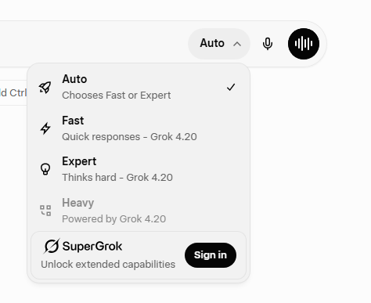
Grok Chatbot
The models (LLMs) it uses
Notes:
This is an example of the way you can select different LLMsin the Grok interface

Slide 32
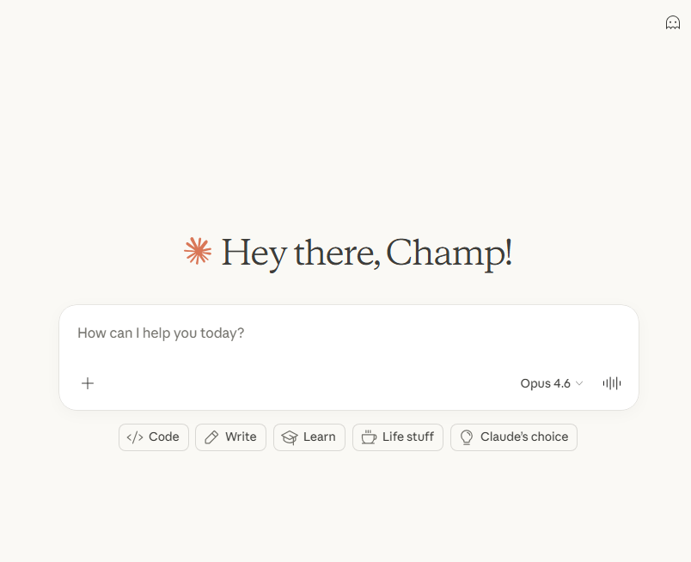
Claude chatbot
Notes:
An example of Anthropic’s Cluade chatbot

Slide 33
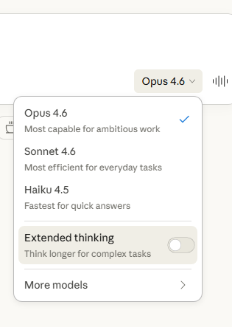
Claude chatbot
The models (LLMs) it uses
Notes:
And how you can select different LLMs in Claude

Slide 34

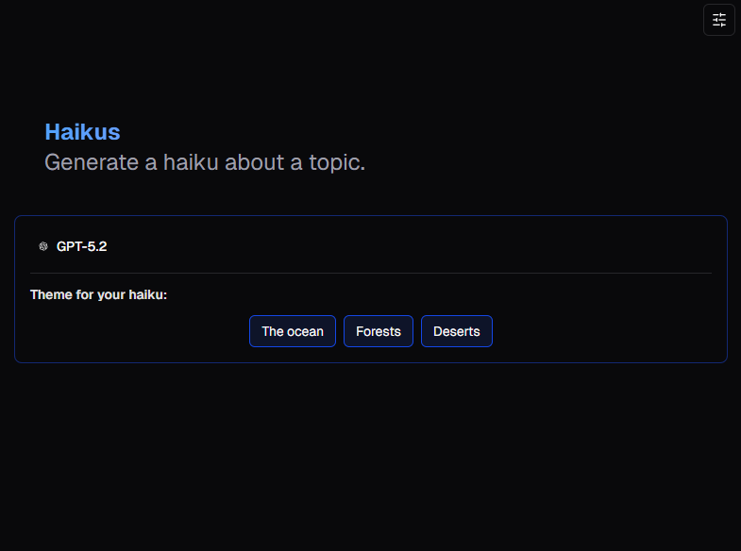
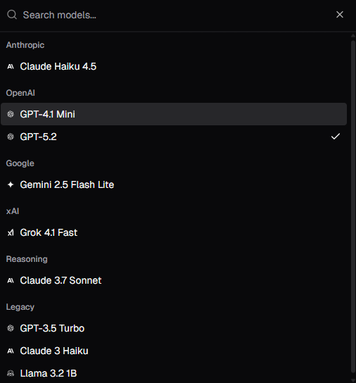
What about Lumen?
If you select a menu of models will appear.
How many models can it use?
Notes:
The teacher can go to the Haikus activity on the platform and demonstrate how to choose the different LLMS in Lumen.

Slide 35
Activity 1.04: Haikus
Complete the activity on the platform
Download the worksheet here
Notes:
In this activity, students use Lumen to generate haiku poems. The Learning intention is for students to appreciate that Lumen doesn’t know what a haiku is – it has simply seen many examples and learned the pattern. The different LLMs used by Lumen produce similar haiku because they were trained on similar examples.

Slide 36
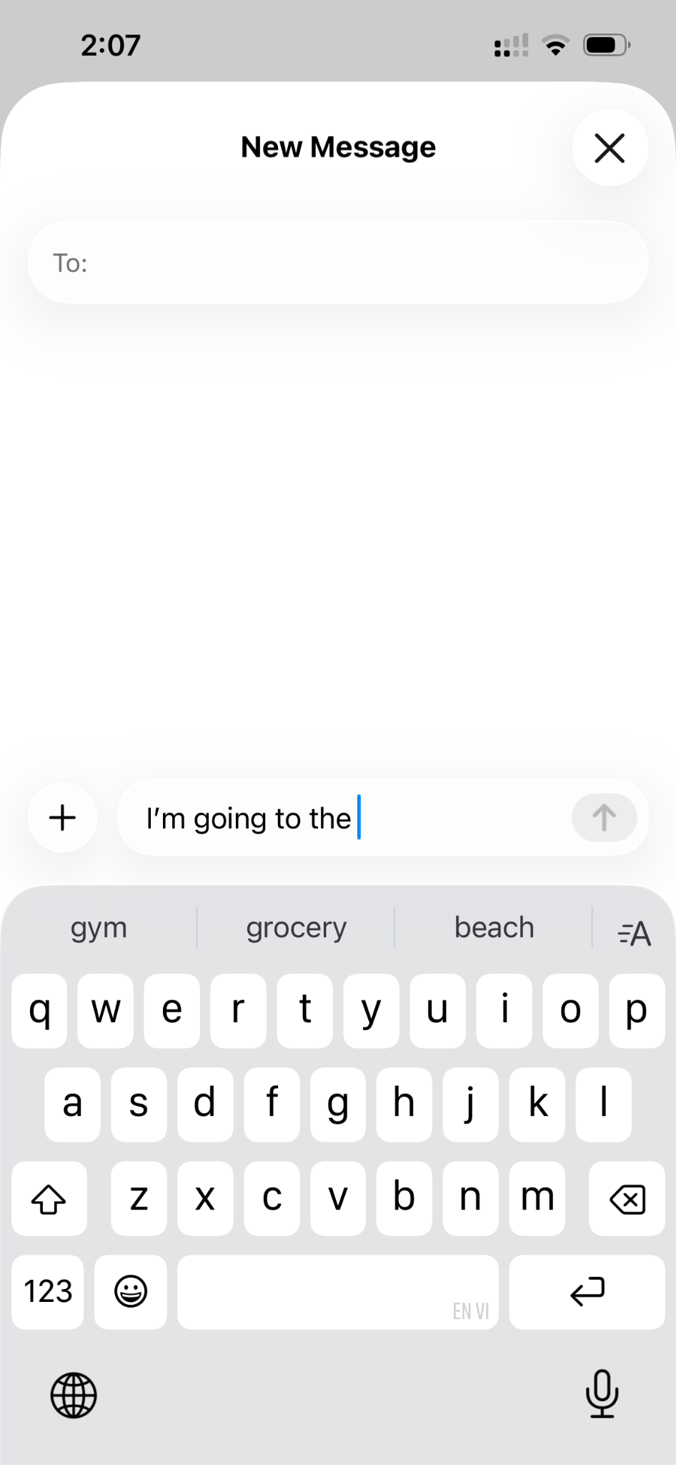
LLMs and text prediction
LLMs learn patterns from data to generate new text. LLMs are trained on a huge amount of text data (books, articles, websites and more).
LLMs predict the next word in a sentence, based on what word/s are likely to follow on from the current sentence.
Let’s look at how it works on a smaller scale: text prediction on your mobile phone.
Screenshot of text message from
iPhone 13, showing suggested next words (“gym”, “grocery”, “beach”).
Notes:
In this slide, we transition into the next focus of the lesson (an example of text prediction at a small scale).
The purpose of this example is to help students understand that LLMs work similarly to a text prediction on a mobile but at a much larger scale, with more training data and in a way that considers more context.
Point out to students that the text prediction in the screenshot is essentially trying to guess what you will say next, with some words (locations) that seem likely to follow from the phrase “I’m going to the…”.

Slide 37
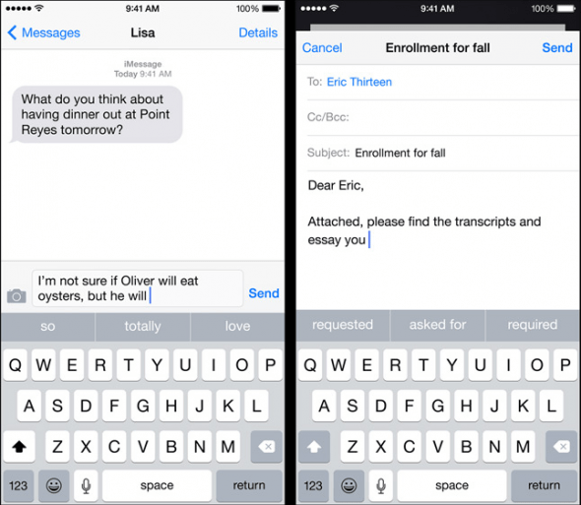
Text Prediction on your phones!
The text prediction feature on your phone is continually “learning” based on the types of messages and words that you type.
Notes:
Highlight to students that the phone “learns” from the text messages and other documents on the phone (like notes and emails) and finds patterns in how you write in these messages and documents.
The red circles show the suggested words that are likely to follow from the sentences in the messages app (left screenshot) and email app (right screenshot) on a phone.

Slide 38
Text Prediction on your phones!
for real bro it was like so embarrassing
he thought he ate that up for real
for real bro like how do you recover
no like actually for reals
he really thought he wasnt gonna die doing that like be for real
like bro he actually thought I was gonna go through with it like be for real
Let’s imagine you’ve typed the above types of messages…
Notes:
The text prediction model that is used in the example in the following slides has been “trained” with the sentences listed in the box (the training data).
This means that when we create sentences with the model, the resulting outputs will have the same words as the sentences in the training data but in different order (resulting in new sentences that are not in the training data).
In the next slide, we introduce “bigrams” (pairs of two words, where one word follows the other in the training data), which are used as part of the text prediction example.

Slide 39
Text Prediction on your phones!
for real bro it was like so embarrassing
he thought he ate that up for real
for real bro like how do you recover
no like actually for reals
he really thought he wasnt gonna die doing that like be for real
like bro he actually thought I was gonna go through with it like be for real
We’re going to look for pairs of words (bigrams)
Let’s start with pairs of words starting with the word “for”
Let’s imagine you’ve typed the above types of messages…
Notes:
The text prediction model uses bigrams to generate sentences from the training data.
Bigrams are pairs of words, where one word follows the other, in the sentences in the training data. For example, the bigrams in the first sentence are: (“for”, “real”), (“real”, “bro”), (“bro”, “it”), (“it”, “was”), (“was”, “like”), (“like”, “so”) and (“so”, “embarrassing”).
Students can be shown examples of these pairs (e.g., on a whiteboard) to help them understand what bigrams are.

Slide 40
Summarising the Bigrams…
Next word | Count
be | 2
so | 1
bro | 1
how | 1
actually | 1
Next word | Count
real | 5
reals | 1
Current word
like
Current word
for
Next word | Count
like | 1
it | 1
he | 1
Current word
bro
Next word | Count
wasnt | 1
actually | 1
thought | 1
really | 1
ate | 1
Current word
he
Current word
be
Next word | Count
for | 2
Notes:
This slide shows summaries of the “next words” for some of the words (for, bro, be, like and he) from the training data, and how often those next words follow the first word.
For example, “real” is the next word after “for” six times in the training data and “reals” is the next word after “for” once.
These summarises of the next words are used for the text prediction example in the next set of slides.

Slide 41
Text Prediction on your phones!
We’re now going to use our bigram counts to generate a brand new sentence
To start off, we’re going to select a word to start the sentence with: bro
Notes:
In the following slides, you can walk through how the example text prediction model can generate a sentence, using “bro” as the starting word.
There is a video available at <video link here> that steps through this example, which you can watch to help prepare you for demonstrating it with your class.
Alternatively, you can play the video to your class to demonstrate the example.

Slide 42
Text Prediction on your phones!
Current word
bro
Notes:
We start generating the sentence by choosing a word, which is “bro” in this example.

Slide 43
Text Prediction on your phones!
Current word
bro
Let’s now inspect the table of words with follow ‘bro’ in our bigrams tables
Notes:
We look at the table of words that follow “bro” from the training data.

Slide 44
Text Prediction on your phones!
Current word
bro
Next word | Count
it | 1
like | 1
he | 1
Notes:
These are the words that followed “bro” in the training data and how many times they followed “bro” (the count). The model will choose a word from these to add to the sentence.

Slide 45
Text Prediction on your phones!
Current word
bro
Next word | Count
it | 1
like | 1
he | 1
The idea is to pick the next word with the highest count.
However…
Notes:
This model could choose the next word with the highest count. In this case, all the counts are the same (1).

Slide 46
Text Prediction on your phones!
Current word
bro
Next word | Count
it | 1
like | 1
he | 1
When counts are equal, randomly pick a candidate
Notes:
As the counts are the same, the model chooses a next word at random.

Slide 47
Text Prediction on your phones!
Current word
bro
Next word | Count
it | 1
like | 1
he | 1
When counts are equal, randomly pick a candidate
Notes:
In this case, the word “like” is chosen randomly as the next word.

Slide 48
Text Prediction on your phones!
Current word
bro
Next word
like
Notes:
In this slide, we are highlighting that “like” is the chosen next word in the sentence.

Slide 49
Text Prediction on your phones!
Current word
bro
Next word
like
Let’s now lock in the first word.
And use the ‘next word’ as our current word.
Notes:
The first word (bro) in the sentence will be locked in (it won’t change).
And our “next word” (like) will be used as the current word, and we’ll add another word to the sentence.

Slide 50
Text Prediction on your phones!
Locked-in word
bro
Current word
like
Let’s now lock in the first word.
And use the ‘next word’ as our current word.
Notes:
As noted in the last slide, the “next word” (like) will be used as the current word, and we’ll add another word to the generated sentence.

Slide 51
Text Prediction on your phones!
Locked-in word
bro
Current word
like
Let’s now inspect the table of words with follow ‘like’ in our bigrams tables
Notes:
As we are using “like” as the current word now, we will look at the words that followed “like” in the training data and their counts.

Slide 52
Text Prediction on your phones!
Locked-in word
bro
Current word
like
Next word | Count
be | 2
so | 1
bro | 1
how | 1
actually | 1
Notes:
In this slide we have the possible next words for “like” and their count.

Slide 53
Text Prediction on your phones!
Locked-in word
bro
Current word
like
Next word | Count
be | 2
so | 1
bro | 1
how | 1
actually | 1
Pick the next word with the highest count.
Notes:
In this example, the model usually chooses the word that follows the current word the most (“be” in this case).

Slide 54
Text Prediction on your phones!
Locked-in word
bro
Current word
like
Next word
be
Notes:
This slide is used to remind students that we have locked-in “bro” as the start of the sentence and now we’ll lock in “like”.

Slide 55
Text Prediction on your phones!
Locked-in word
bro
Locked-in word
like
Current word
be
Notes:
We lock-in “like” as the second word in the generated sentence.

Slide 56
Text Prediction on your phones!
Locked-in word
bro
Locked-in word
like
Current word
be
Next word | Count
for | 2
Notes:
The current word is now “be” and the only possible word to follow it is “for”.
This is because there were two sentences in the training data with “be” in them, and both times “be” was followed by “for’:
- he really thought he wasnt gonna die doing that like be for real
- like bro he actually thought I was gonna go through with it like be for real

Slide 57
Text Prediction on your phones!
Locked-in word
bro
Locked-in word
like
Current word
be
Next word | Count
for | 2
Notes:
“for” is chosen as the next word, as it is the only options the model has.

Slide 58
Text Prediction on your phones!
Locked-in word
bro
Locked-in word
like
Current word
be
Next word
for
Notes:
This slide shows the generated sentence after adding “for”.

Slide 59
Text Prediction on your phones!
Locked-in word
bro
Locked-in word
like
Locked-in word
be
Current word
for
Notes:
“be” is locked in as the third word in this sentence and the model uses “for” as the current word, to select the next word in the sentence.

Slide 60
Text Prediction on your phones!
Locked-in word
bro
Locked-in word
like
Locked-in word
be
Current word
for
Next word | Count
real | 5
reals | 1
Notes:
In this slide we have the possible next words for “for” and their count: real and reals.

Slide 61
Text Prediction on your phones!
Locked-in word
bro
Locked-in word
like
Locked-in word
be
Current word
for
Next word | Count
real | 5
reals | 1
For variation in responses, don’t always pick the top counted word
Notes:
In this slide, we change the way the example model chooses words when generating the sentence, choosing the next word randomly (“reals”).
This way we have some more randomness in the sentences that are generated.
In text prediction models like this, the next word is often chosen randomly but words with high counts would be more likely to be chosen. For example, because “real” appears 5 times more often than “reals”, the model would be 5 times more likely to choose “real” as the next word.

Slide 62
Text Prediction on your phones!
Locked-in word
bro
Locked-in word
like
Locked-in word
be
Locked-in word
for
Current word
reals
Notes:
“reals” has been chosen as the next word, so our sentence becomes “bro like be for reals”.
We decide to end the sentence here and on the next slide we have all the words in the sentence locked-in.

Slide 63
Text Prediction on your phones!
Locked-in word
bro
Locked-in word
like
Locked-in word
be
Locked-in word
for
Locked-in word
reals
Notes:
All the words are locked in and we stop adding new words to our generated sentence: “bro like be for reals”.

Slide 64
Text Prediction on your phones!
Locked-in word
bro
Locked-in word
like
Locked-in word
be
Locked-in word
for
Locked-in word
reals
Final sentence fragment:
“bro like be for reals”
Notes:
This slide highlights the sentence that has been generated: “bro like be for reals”

Slide 65
Text Prediction on your phones!
for real bro it was like so embarrassing
he thought he ate that up for real
for real bro like how do you recover
no like actually for reals
he really thought he wasnt gonna die doing that like be for real
like bro he actually thought I was gonna go through with it like be for real
Final sentence fragment:
“bro like be for reals”
Notice how this sentence fragment is not anywhere to be found in the training data…
Notes:
Highlight to students that the generated sentence sounds similar to sentences in the training data but it’s not exactly the same as the training data sentences.

Slide 66
Text Prediction on your phones!
for real bro it was like so embarrassing
he thought he ate that up for real
for real bro like how do you recover
no like actually for reals
he really thought he wasnt gonna die doing that like be for real
like bro he actually thought I was gonna go through with it like be for real
Final sentence fragment:
“bro like be for reals”
Notice how this sentence fragment is not anywhere to be found in the training data…
Notes:
The model has essentially “learned” words that are commonly used and patterns in the training data messages (like using “be for” in sentences) and used them to create new sentences.

Slide 67
Text Prediction on your phones!
for real bro it was like so embarrassing
he thought he ate that up for real
for real bro like how do you recover
no like actually for reals
he really thought he wasnt gonna die doing that like be for real
like bro he actually thought I was gonna go through with it like be for real
Final sentence fragment:
“bro like be for reals”
It’s new! But generated “in the style of” the training data.
Notes:
This is a really key point: that LLMs generate “new stuff” but that they learn from their training data.
You can make the comparison to responses from Lumen AI, where the same prompt for creating haikus can result in different poems that follow a similar pattern.

Slide 68

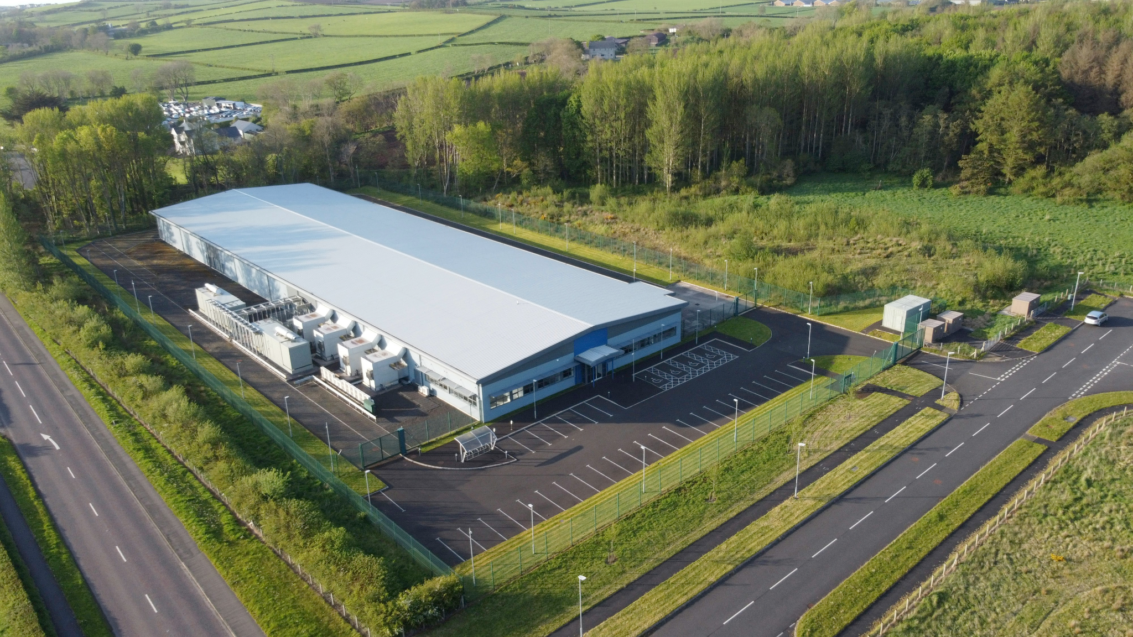
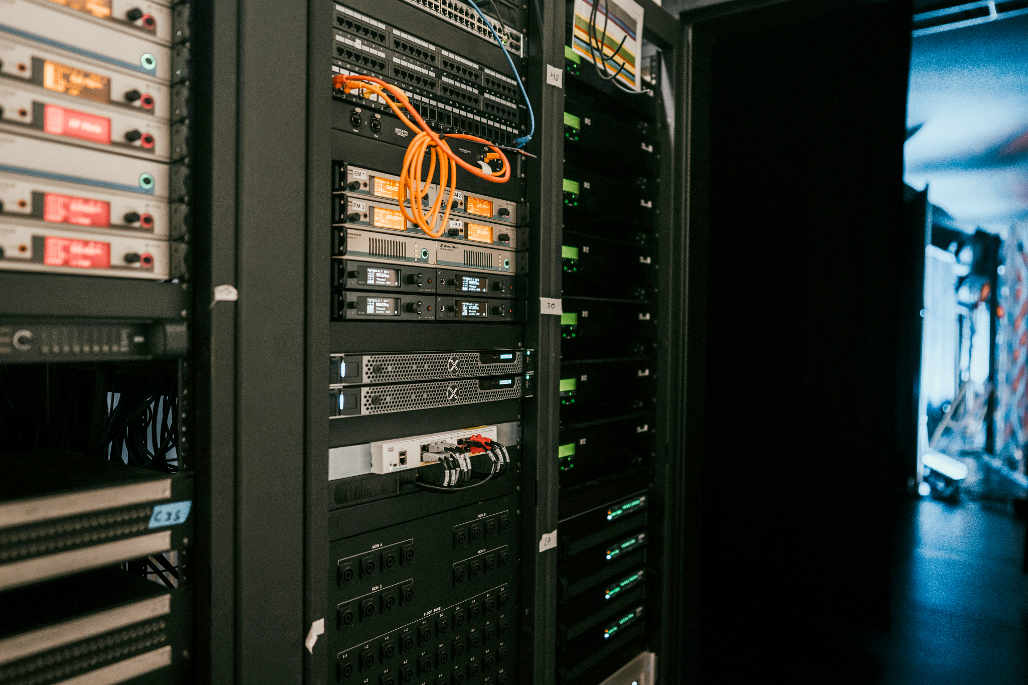
Scale of LLMs
Cable network by Taylor Vick
An aerial view of a large industrial building: Data Centre in Coleraine by Geoffrey Moffet
A rack of servers in a server room by Kevin Ache
Images’ source: Unsplash, under Unsplash licence
Notes:
The purpose of this slide is to highlight to students that LLMs are trained and run on very powerful and large computers, usually in data centres (like the data centre in Northern Island shown in the photo on the right).
You could compare the size and power of these computers to the students’ phones - there’s a huge difference in scale.
Students are encouraged to think about the large scale of computer power, energy and time that goes into training and running LLMs, compared to a small model (like the text prediction example on a phone).

Slide 69
Text Prediction vs LLMs
Text prediction on your phone | LLMs
Tiny model (a few megabytes). Looks at only 1-3 previous words. Optimised for speed and accuracy. Rarely invents new ideas. | Massive models built using deep learning (lots of neural networks). Understand full conversations and long context.
Looks at: 1-3 words | Looks at: many paragraphs or full conversations
Model size: a few megabyes | Model size: many gigabytes (stored on server computers, usually in data centres)
Runs locally on your phone; no internet needed | Runs on powerful server computers
Predicts the next word based on how common they appear in training data | Generates new ideas, explanations, reasoning, and creative text
Notes:
This table summarises some differences between a text prediction model (like the example shown in the previous slides) and LLMs (like GPT 5.4, Claude Sonnet 4.6 and Gemini 3.1).
Like the previous slide, they key point is that there is a huge difference in scale and capabilities of a simple text prediction model and LLMs, although there are some similarities.

Slide 70
Activity 1.05: Job Application
Complete the activity on the platform
Download the worksheet here
Notes:
In this activity students use Lumen to generate three different styles of job applications. The learning intention is for students to understand that Lumen doesn’t “know” what good writing is — it simply follows patterns it has learned. Students will see how clearly written prompts can change the style of the output, and why giving precise instructions matters when working with AI.

Slide 71

Examples of AI Revisited
Notes:
Go back to Slide 3 where students first gave examples of AI. Ask them if they think they are all correct and do they have many more examples now.

Slide 72

Summary
Understand what AI is
Understand what Large Language Models (LLMs) are
Be familiar with the outputs produced by LLMs
Know how LLMs build on early AI techniques
Understand the relationship between LLMs and text prediction in phones
You should now be able to:
Notes:
For an extension activity students can be directed to the short quiz on the platform here.

Slide 73
License Information
These Tech Futures Australia lessons plans, worksheets, and other materials were created by the Tech Futures Australia team. They are licensed under a Creative Commons Attribution-ShareAlike 4.0 International License.

