Slide 1
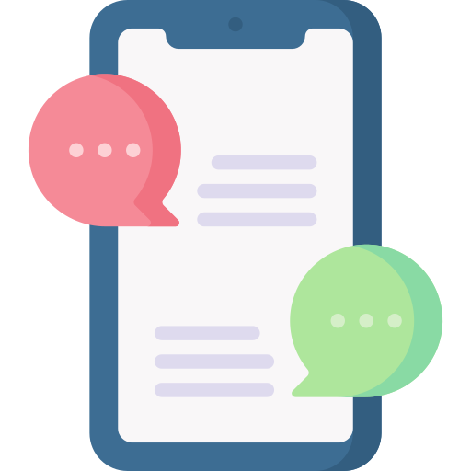
Lesson 3
Trust and AI
techfutures.org.au

Slide 2
Learning objectives
By the end of this lesson, you will:
Know why AI gets things wrong - and why it sounds so confident
Learn strategies to fact-check anything that AI tells you
Understand how AI is used to create and spread misinformation and disinformation
Recognise when AI output might be biased and why that happens
See how AI can be used in scams and deepfakes
Know how to protect your privacy when using AI

Slide 3
Recap of Lesson 2: Types of AI
Drag each example box into the matching type of AI box.
EXAMPLES
TYPES OF AI
Spam filter in your email
Classification AI
ChatGPT writes an essay
Netflix recommendations
Predictive AI
Face ID unlocks your phone
Weather forecast app
Generative AI
DALL-E makes an image
Notes:
This is a quick activity to recap Lesson 2. Teachers can ask students to drag each example box into the matching type of AI box.
Solutions:
Classification AI
• Spam filter in your email
• Face ID unlocks your phone
Predictive AI
• Weather forecast app
• Netflix recommendation
Generative AI
• ChatGPT writes an essay
• DALL-E makes an image

Slide 4
Recap of Lesson 2: Modes of Generative AI
Drag each example box into the matching generative AI mode box.
EXAMPLES
MODES OF GENERATIVE AI
Claude writes a poem
Text
Midjourney creates a painting
Image
Sora generates a short film
ElevenLabs clones a voice
Video
Udio composes a song
GitHub Copilot writes a function
Audio
Code
Notes:
This is a quick activity to recap Lesson 2. Teachers can ask students to drag each example box into the matching generative AI mode box.
Solutions:
Text
- Claude writes a poem
Image
- Midjourney creates a painting
Video
- Sora generates a short film
Audio
- ElevenLabs clones a voice
- Udio composes a song
Code
- GitHub Copilot writes a function

Slide 5
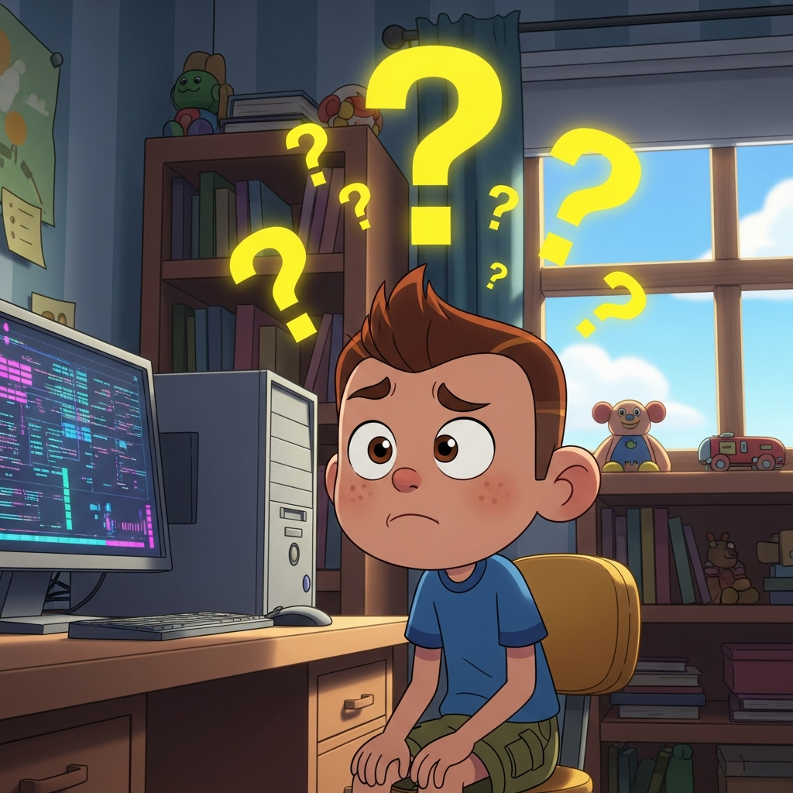
Can AI be wrong?
Have you noticed an AI (like Lumen) say something that is not true?
Sometimes AIs will make up information and we call these hallucinations
Other times the training data might be out of date or contain patterns that lead to biased answers
It’s important to understand AI does not ‘think’ like a human does and doesn’t always check when it is unsure
Generated with Imagen 4.0 Generate
Notes:
The point of this slide is to make students realise that AI can be wrong and there is more than one reason that AI gets things wrong. They’ve probably heard of hallucinations but they may not be aware of bias or that the data AI is trained from is not always up to date or complete.

Slide 6
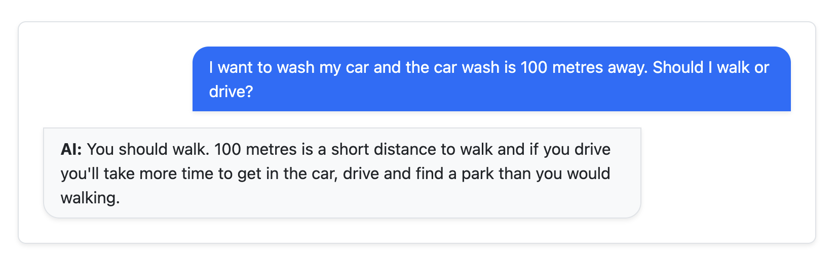
Hallucinations: Text
LLMs learn from huge amounts of data but that doesn’t mean they’re always right!
LLMs can answer incorrectly to questions that might seem simple to us.
What’s wrong with the AI’s response above?
Notes:
This example, where an LLM has given a response that doesn’t make sense when you think it through, is based off real responses from popular LLMs (like OpenAI’s ChatGPT) from 2026. There are people who try a variety of different prompts to “trick” LLMs into hallucinations like this, including when AI providers release new models. There are ways for AI providers to reduce hallucinations, some of which are discussed in this lesson, but it is unlikely that LLMs (with the current technology and approach) will ever be 100% “hallucination-proof”.
The core point of this lesson is that students should be aware that AI can produce false information and that they should verify their responses, particularly where there are risks involved in using that information (just like any other information they receive, whether it’s from TV, movies, their friends or so on).

Slide 7
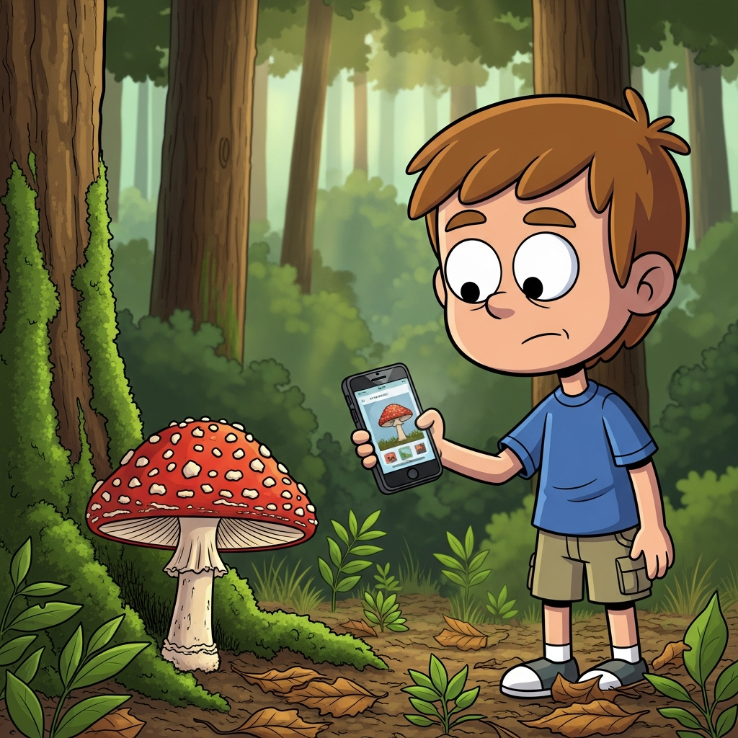
Hallucinations: Risks
Hallucinations can be funny and harmless.
But what are some situations where hallucinations could be risky?
When it is used for decision making or when asking advice, like asking an LLM if a mushroom is safe to eat
When we are given false information that gets shared with others, like a lie about someone being shared
Generated with Imagen 4.0 Generate
Notes:
There are many examples were an AI has “hallucinated”, giving false information to people that they recognised was not true. Sometimes these are funny and are clearly incorrect, such as Google’s AI that gave people advice to eat rocks every day for health (https://www.unsw.edu.au/newsroom/news/2024/05/eat-a-rock-a-day-put-glue-on-your-pizza-how-googles-ai-is-losing-touch-with-reality).
However, there have been cases where AI has given incorrect advice that could seem to be correct but that could cause harm (such as the Bunnings AI giving out advice to carry out electrical work that would be illegal, in December 2025: https://www.news.com.au/lifestyle/real-life/news-life/bunnings-responds-after-ai-tool-gave-out-illegal-advice/news-story/3cc477852899cb6d75302f99e0cf9193)
As mentioned in the last slide’s presenter notes, there are AI developers who are working to reduce hallucinations. However, some students may not be aware that taking AI responses at face-value can be risky and some students may think that because AIs, such as LLMs, are trained on so much knowledge that they cannot be wrong.

Slide 8
Hallucinations in different modes
Hallucinations don’t just happen in LLMs, with Text responses
Hallucinations happen in other modes:
Video
Audio
Images
Code
Sometimes hallucinations are easier to notice in those modes than they are in Text.
Notes:
Next, we transition into talking about hallucinations in other modes: videos, audio and images.

Slide 9
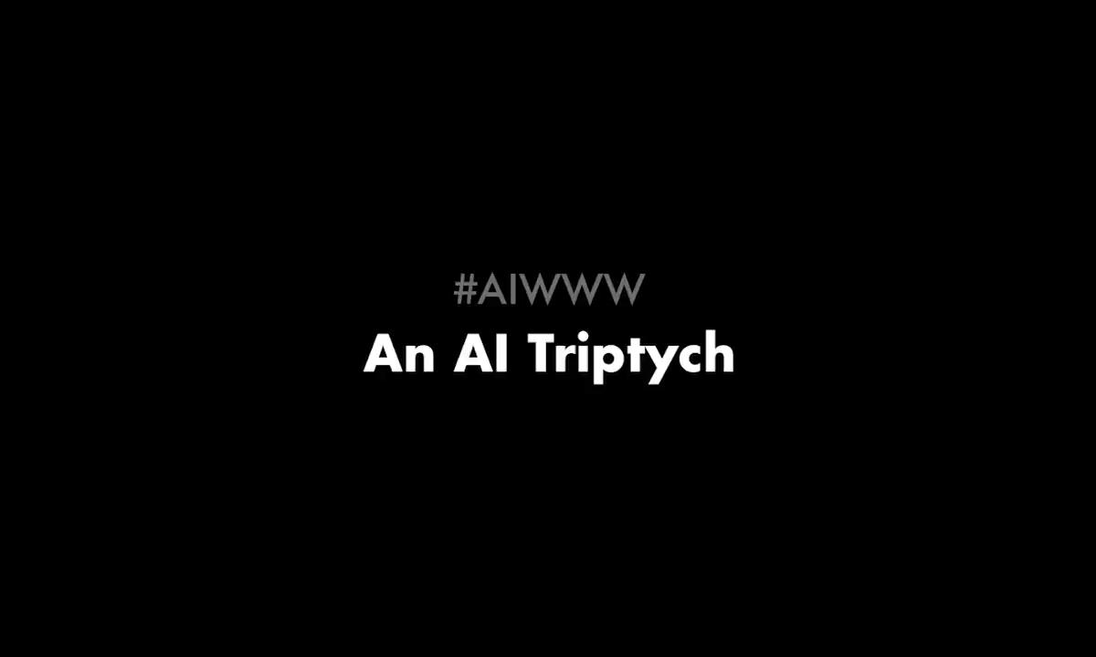
Hallucinations in videos
This video of cats has lots of hallucinations - what can you spot that looks wrong?
AI video has improved a lot and will likely get even better.
But, like other modes, hallucinations can happen!
Title: AIWWW: An AI Triptych
Source: Antonio Otalvaro (YouTube)
Notes:
A “triptych” is an old term for a work of art that has three parts. The embedded video is called a triptych because it consists of three short (ai-generated) videos combined together.
This video has been used as it shows some very clear hallucinations that are easy for students to spot. These include the cats morphing together and splitting into a larger number of cats, strange movement, yarn disappearing into the cats and the flying cat.
AI generated videos will often have hallucinations or errors that are more subtle. Students learned a bit about AI videos in the last lesson and they will learn more about AI videos (with a focus on deepfake videos) later in this lesson. Examples of where hallucinations could be more subtle are where shadows in AI-generated video don’t make sense or when something is out of place (for example, if there was a video generated for the prompt “A British town in the 1600s” where villagers are wearing watches.

Slide 10
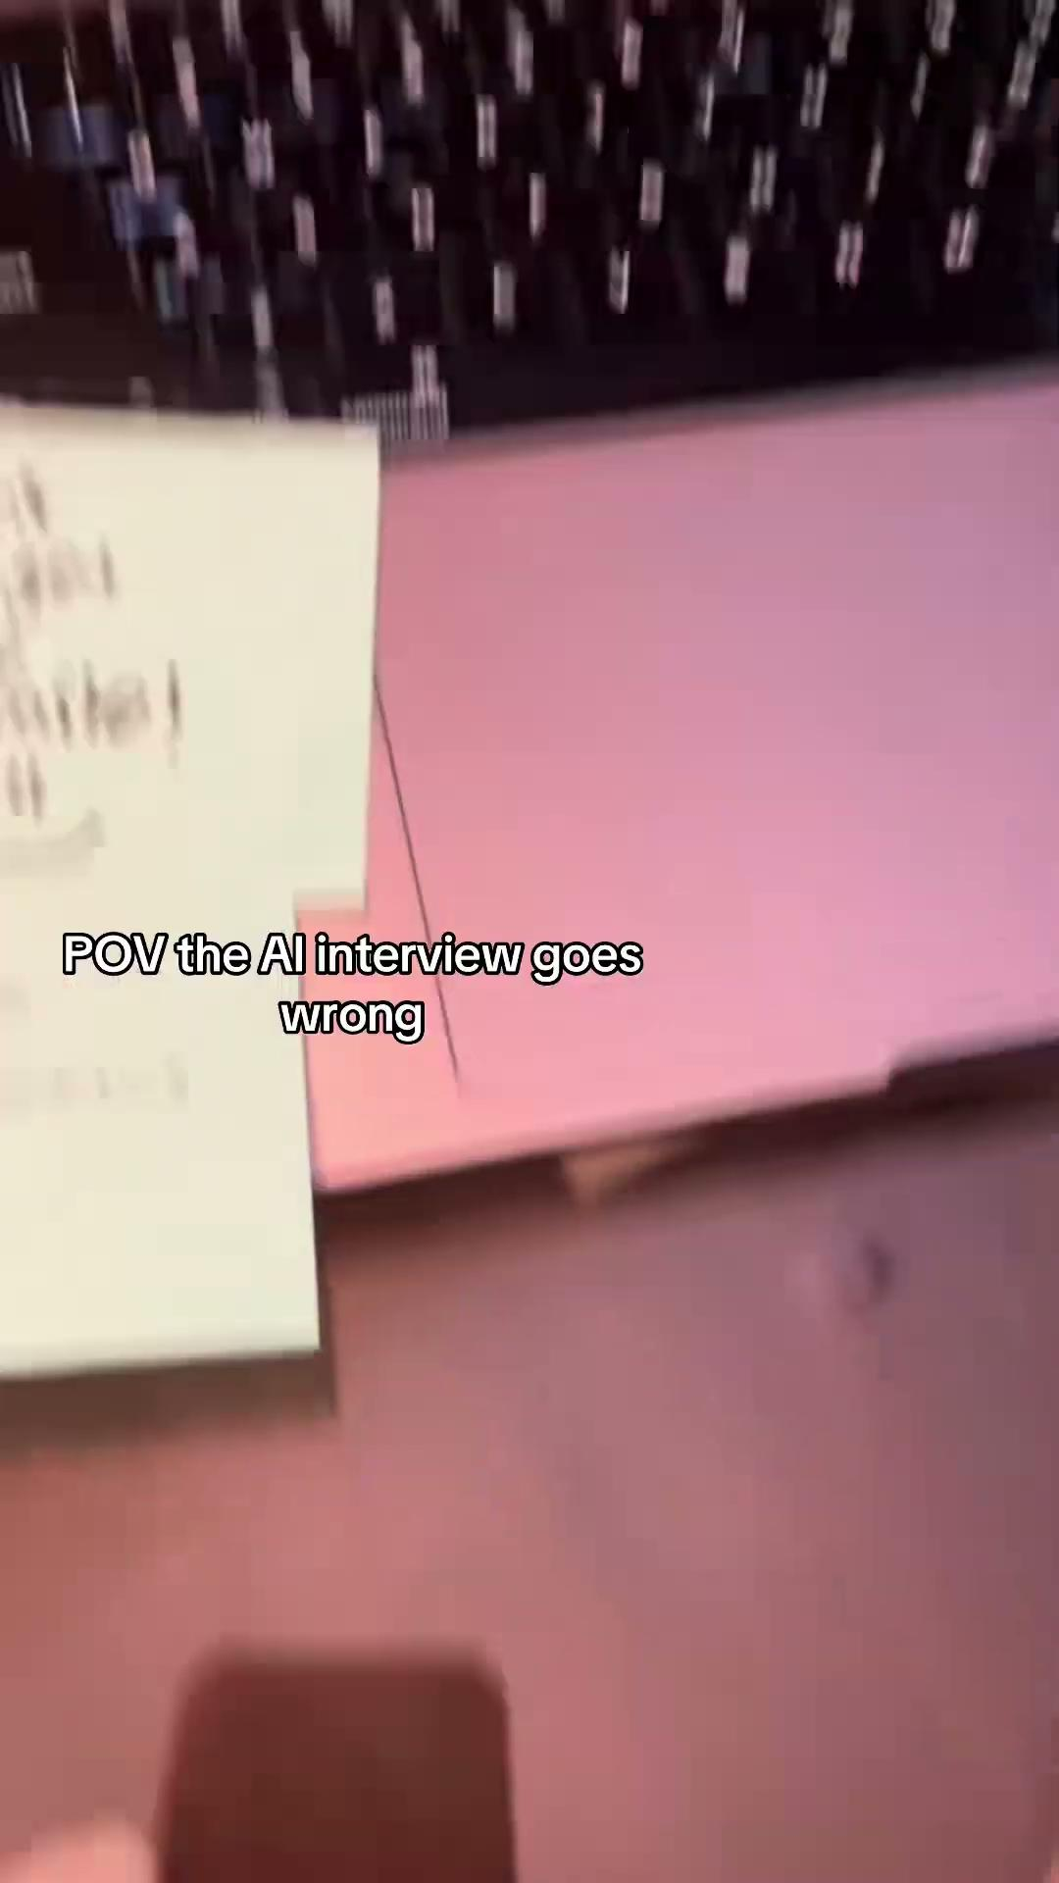
Hallucinations in audio
The video shows an interview where two generative AI “interviewers” talk to each other.
What mistakes/strange things do you hear?
AI audio has improved a lot recently too but hallucinations still do happen.
Title: POV the AI interview goes wrong
Source: @petobsessed (TikTok)
Notes:
The embedded video was created by @petobsessed, whose TikTok page is satirical and this is likely not a real interview. However, AI interviewers are being used and they can hallucinate in similar ways to the video.
Some mistakes/strange things in the video (and that commonly occur in AI-generated audio) include:
Repeating words and sentences over and over (‘Monday’)
Illogical phrases or nonsense (“Monday rhymes with book”)
Gibberish (words/sentences that don’t make sense), especially towards the end of the clip from the male voice
Unusual changes in speed of talking and volume
Another hallucination that often happens but that is not really present in this video is that AI voices will often change accents - e.g, going from American to Australian to British. Sometime AI voices will also pronounce words strangely and/or sound robotic.

Slide 11
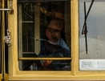
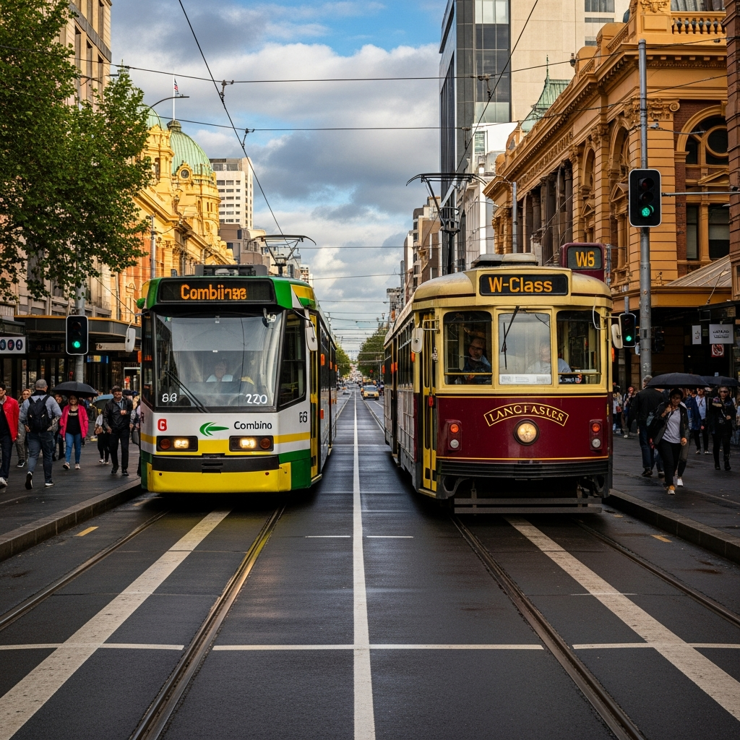
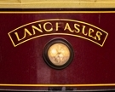
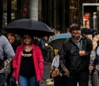
Hallucinations in images
Some hallucinations in this image include:
Distorted faces
Text that looks strange
Illogical:
  people with umbrellas up but no rain
  white line in the middle of the tram tracks
“Melbourne trams”, Generated with Imagen 4.0 Generate
Notes:
The generated image is of two trams in Melbourne next to each other. This image includes some hallucinations that are very common in generated images, which are noted on the slide. Although image generation (and generation of other modes) is always getting better and it can be hard to spot hallucinations like this in recent models, some images also do have a ‘quality’ that makes them look AI generated (this is discussed further when looking at deepfake videos).
In the next activity, students will generate images with Lumen and try and find hallucinations in them.

Slide 12
Activity 3.01: Traffic Crossing Image
Complete the activity on the platform
Download the worksheet here
Notes:
The purpose of this activity is to get students to generate an image where hallucinations in the image could be risky for people involved (in this case, students using a school kitchen) and for them to think critically about issues in generated images.
There are likely to be some errors or strange parts in the generated posters (for example, distorted text or objects that are not in the right place) for students to note down in the worksheet. However, if the generated posters do not have errors or mistakes, then you can gets students to look at the poster on the next slide (which was generated with ChatGPT), as that has several errors (detailed on the next slide).

Slide 13
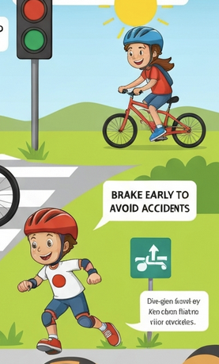
Why do these hallucinations happen?
Generated with Imagen 4.0 Generate
AI models don’t know what a hand or words are, like we know. They just learn patterns from their training data.
Issues with spelling or jumbled text can happen because models learn based on pixels and not letters.
Logical errors, like stoves that are turned on with nothing on them, can be caused by stoves being turned on in training images.
Randomness: the model is “guessing” what the image should look like and sometimes gets it wrong.
“Bike safety”, Generated with Imagen 4.0 Fast Generate
Notes:
The core points of this slide is that hallucinations happen because AI doesn’t think the same way we do, it learns from its training data and there is randomness involved in outputs. The image on the slide has a few errors: the area above the pedals on the bike at the top is distorted, the green sign symbol is nonsensical and the text bubble (coming from the kid’s shoe for some reason) contains gibberish text.
Some more detailed explanations for the cause of hallucinations and examples are below:
Text in images:
Common causes for errors in text:
Image generation is based on pixels, not letters. They learning text-shaped squiggles instead of actual letters, and can often get letters mixed up: "RFSTRAUNT" instead of "RESTAURANT"
Images are more forgiving than text. A generated image of a tree that is slightly bent out of shape still passes for a tree. But if "COFFEE" comes out as "COFFEF," the error is immediately obvious.
Hands and fingers:
Common causes for errors in text:
Similar to letters and text, the image AI learns patterns not rules. It doesn’t “know” that a hand has 4 fingers and a thumb with restrictions on how fingers bend etc.
Hands are even more difficult than letters, because unlike the capital letter ‘A’, hands can be posed in many more different 3D angles and lighting.

Slide 14
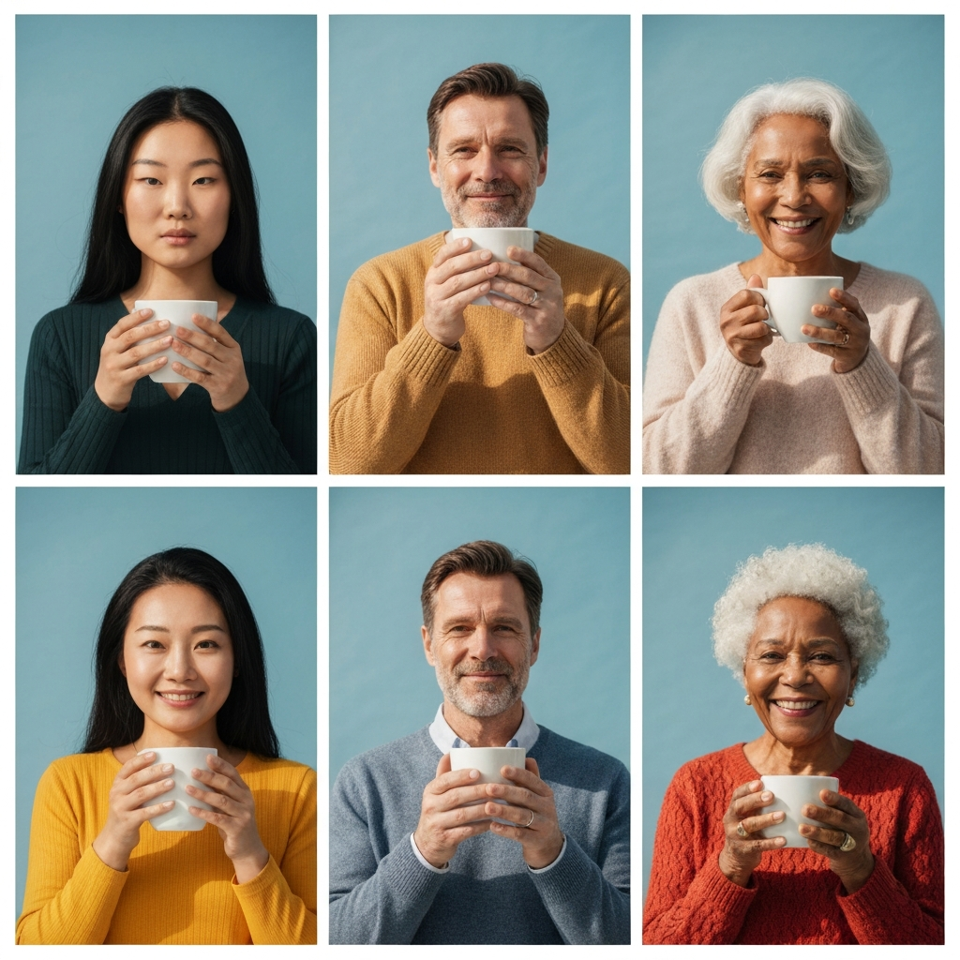
Reducing hallucinations
AI model developers use a variety of ways to reduce hallucinations in responses (including images and videos):
More and better training data
Models that combine different ‘modules’
  Modules specialise in generating different parts of the response (e.g, hands and texts)
  Results from modules are merged together by the model, as part of the generation
Models that integrate real-world physics and structures better (like models of human anatomy)
Generated with Imagen 4.0 Fast Generate
Current models do a good job of producing accurate-looking hands and fingers.
Notes:
There have been lots of recent improvements in generation of images, video and audio to reduce common hallucinations. For example, hands in AI generated images often had extra fingers or were posed in strange ways. However, AI model developers have found ways to integrate real-world physics and human anatomy in their models that improve the accuracy of these a lot. Most models that students are likely to use will generate images with realistic looking hands and fingers (like those in the included image on the slide).
Similarly, there’s been improvements in text in image generation, which are very noticeable in recent versions of chatbots like ChatGPT and Gemini. One of the ways this has been improved is by having “layers” (networks in the AI, mentioned in Lesson 1) that “specialise” in different parts of image generation. Like most improvements in generative AI, this requires more training and more deliberate choice of training data.

Slide 15
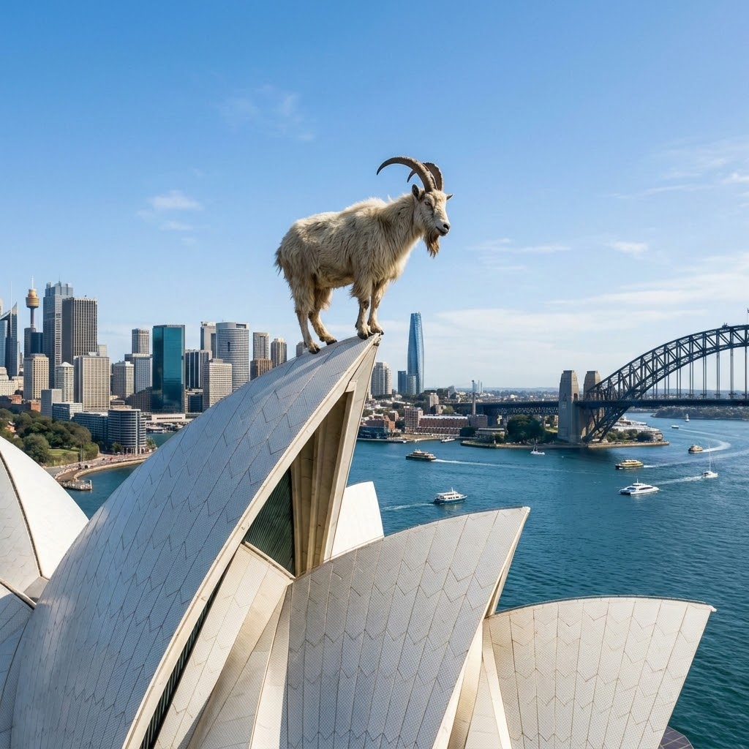
Misleading AI - Unintentional and intentional
We have seen examples of where AI can be wrong
We call these errors ‘hallucinations’
Hallucinations are unintentional - errors that we do not want
However, people can intentionally (on purpose) use and share AI responses and media that contain false information
Sometimes this can cause harm
Generated with Nano Banana
Did you hear about the mountain goat that climbed to the top of the Sydney Opera house?
Notes:
This slide links hallucinations which are accidental errors from the point of view of an AI to how people can use AI responses and media (including images and video) for either intentional or unintentional spreading of false information.
The image on this slide isn’t a hallucination but is an example of where an AI-generated image could be shared to spread false information. For example, if a student shared this image around told their classmates a goat was on the top of the Sydney Opera House last weekend, would their classmates believe them? This image is pretty harmless, but the next slides go through some examples of where AI-generated information could cause harm, intentionally or unintentionally.

Slide 16
How AI can spread false information
Fake videos: AI can make videos of people appearing to say or do things they never did.
Fake news stories: AI can write detailed articles that sound real but are completely false.
AI bots: Automated accounts can spread the same false information very quickly online.
Personalised misinformation: AI can target people with false content based on what they like, watch, or believe.
Notes:
This slide moves from accidental hallucinations to deliberate misuse. It’s worth pausing to make sure students understand the distinction. The previous slide covered errors the AI makes unintentionally; this is about humans choosing to weaponise those same capabilities.
A few points to draw out in discussion:
Fake videos (deepfakes) are increasingly hard to detect. You might ask students if they've seen any examples, or show a brief clip. Emphasise that even public figures and people they know could be faked.
Fake news stories produced by AI are harder to spot than ever because they mimic the tone and structure of real journalism. Ask students: what would they check before sharing a story?
AI bots amplify the problem. It's not just that false content exists, but that it can spread faster and wider than any human network could manage.
Personalised misinformation is the most subtle point and worth spending time on. Link back to the personalisation slides. The same systems that make AI feel helpful can be used to target people with content designed to confirm their existing beliefs.
A good closing question for discussion: "If you couldn't tell whether a video or article was made by AI, how would you decide whether to trust it?"

Slide 17
Misinformation and Disinformation
There are two types of false information: misinformation and disinformation
Misinformation is false or misleading information that people share without meaning to deceive others. The person sharing it may think it is true. For example your friend shares a fake photo because they think it is real.
Disinformation is false information that is shared on purpose to trick people. For example, someone creates an embarrassing fake photo of another student to deliberately fool people.
Notes:
The focus of this slide is on the terminology of misinformation and disinformation and making the students aware that sometimes it is accidental and sometimes it is on purpose. Further slides will provide many examples of both.

Slide 18
Misinformation Examples
Type of Misinformation | Description
Fake AI image | Someone reposts an AI image of a bushfire saying it happened yesterday believing it is true
Chatbot gives a wrong fact | A student asks a science question and AI gives the wrong answer
False health advice | An AI chatbot gives incorrect medical information when asked about an illness such as cancer.
Fake AI video | A fake emergency alert video appears online, claiming there’s a dangerous chemical spill in the city and telling everyone to stay indoors.
Notes:
This is now getting into detailed scenarios of how misinformation can occur and who might be responsible.

Slide 19
Disinformation Examples
Type of Disinformation | Description
Deepfake video | A video appears online showing a famous person saying something shocking but it was AI-generated and false
Fake screenshot | Someone creates or edits a screenshot of a message, post or headline to fool others into thinking it is real
Fake Review | Companies post fake reviews to make their product sound better than it is
AI Bots spreading posts | AI‑powered accounts repost the same false message hundreds of times to make it seem popular. These can often be made with the aim of convincing people of certain political views.
Notes:
This is now getting into detailed scenarios of how disinformation can occur and who might be responsible.

Slide 20
Activity 3.02: Misinformation or Disinformation?
Complete the activity on the platform
Download the worksheet here
Notes:
In this activity students get an opportunity to categorise scenarios as either misinformation or disinformation.

Slide 21
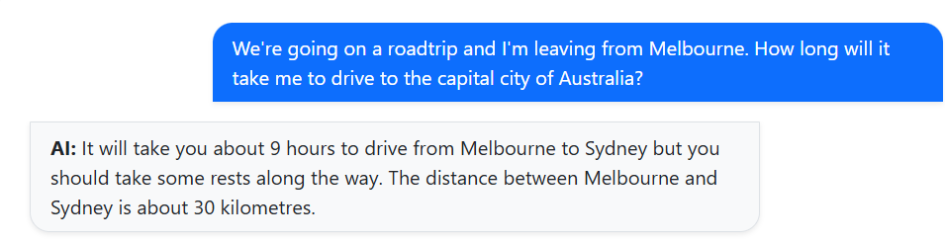
Fact checking
AIs can make mistakes in their responses and that is why it's important to fact-check them.
What is wrong with this response?
Is this misinformation or disinformation?
Notes:
This slide is prompting students to really question the results of AI interactions. The AI is not always right! See the next slide for a quiz question about this.

Slide 22
Quiz: Fact Checking AI
Does the AI response above contain hallucinations? There is only one correct answer.
⭕No, the response is all correct.
⭕Yes, the AI is wrong about the distance between Melbourne and Sydney.
⭕Yes, the AI has said Sydney is the capital city of Australia (but it's Canberra).
⭕Yes, the AI is wrong about the distance between Melbourne and Sydney AND the AI has said Sydney is the capital city of Australia (but it's Canberra).
Notes:
The correct answer is D. There are two pieces of incorrect information in the response - the wrong capital city and the wrong distance between Sydney and Melbourne.

Slide 23
How do I know it is true?
Some ways to fact-check AI responses:
Ask someone with expertise in the topic about the response.
Look for parts of images that do not make sense, such as people with six fingers or extra arms and legs.
Check generated code or maths solutions yourself, and compare your result with the AI’s answer.
Check the source of the information, especially if the AI provides links in its response.
Look up the information using another source you trust, such as checking distances between cities on Google Maps.
Notes:
These are practical ways students can fact-check AI responses.

Slide 24
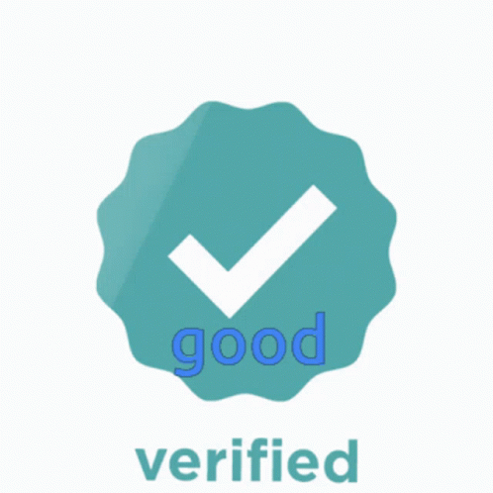
Trusted Sources
Because AI makes false information much easier to create and spread, it is important to check sources everyone trusts like ABC News, World Health Organisation, or government websites like the Australian Bureau of Statistics. We call these Trusted Sources
Trusted Sources:
Show where their information comes from - they list evidence or data so you can check for yourself.
Are updated and current - they show when they were published like health.gov.au
Usually have a recognisable domain name like .gov or .edu
Avoid bias and try to be fair - they present facts clearly
Often have a blue tick to show they are verified and trustworthy.
Notes:
Students should know where to go to fact-check AI.
Students often trust everything they read online, so teach them the difference between website domains:
✔️ .edu = Education & Universities (Reliable!)
✔️ .gov = Government Websites (Reliable!)
✔️ .org = Nonprofit Organizations (Usually reliable, but check for bias!)
⚠️ .com = Commercial Websites (May be reliable but often sell products!)
⚠️ .net = Networks (Use caution!)
One source isn’t enough. Tell students they should check more than one source.

Slide 25
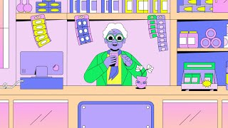
Before you tap “Share” hit pause
Source: Hit Pause (Youtube)
Notes:
This video is a quick reminder for kids to be careful what they share. This will be followed up in the next slide.

Slide 26
Fact check before you share
Who posted it? Can you trust them?
Is it backed up? Are there facts, evidence, or other trusted sources?
How is it making you feel? If it makes you angry, scared, or shocked, be careful.
What does it want from you? Is it trying to change your mind or get a reaction?
What’s the motive? Is it pushing an idea, product, or cause?
Who could it hurt? Could sharing it harm someone or spread false information?
These questions are based on those found at https://commonslibrary.org/disinformation-in-the-digital-age/
Notes:
This is a list of questions that students to use before they share. They should make share they are not the source of the misinformation or disinformation.

Slide 27
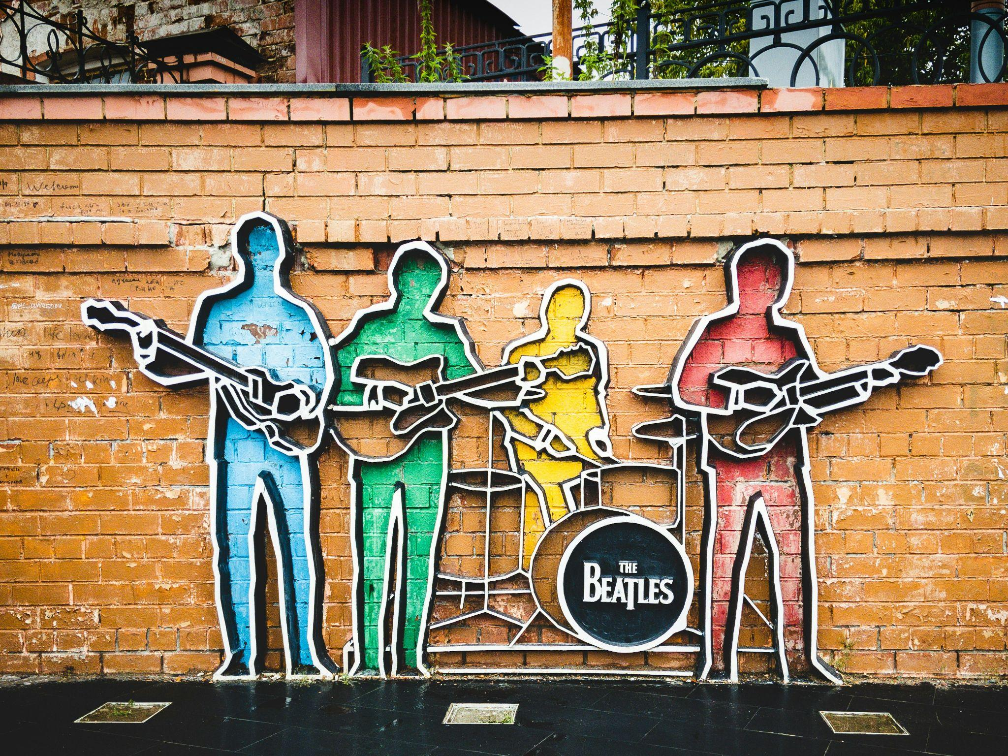
Fact Check Example: Is this true?
BEATLES RELEASE FIRST NEW SONG IN 25 YEARS — WITH HELP FROM AI
Google search results reveal the following sources confirming this story:
Sky News Australia (Australian online news agency)
News.com.au (Australian online newspaper
The Guardian (a UK newspaper)
More than one reputable source confirms the story so we would conclude that this is TRUE.
Photo by Fedor on Unsplash
Notes:
The two key points are to find reliable sources and more than one. Maybe discuss with students what other websites might be reliable. Suggest newspapers, government sites and the ABC.

Slide 28
Activity 3.03: Fact checking
Complete the activity on the platform
Download the worksheet here
Notes:
In this activity, students are asked to fact-check several scenarios and try and work out which ones are real and which are AI-generated. Teachers remind students to not check AI with the AI-generated answer that often comes up first. Go to a real website!

Slide 29
Bias
We’ve mentioned that bias is one of the reasons AI gets things wrong.
What is bias?
Notes:
These slides act as a bridge. Use the student discussion to surface their existing understanding of bias before the next slides unpack it properly. Don't correct or over-explain yet; just gather their ideas and tell them you're going to explore it together. The discussion question gives you a natural handoff into the bias slides.

Slide 30
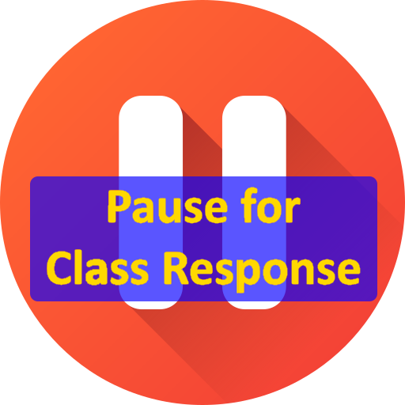
Bias
We’ve mentioned that bias is one of the reasons AI gets things wrong.
What is bias?
Notes:
These slides act as a bridge. Use the student discussion to surface their existing understanding of bias before the next slides unpack it properly. Don't correct or over-explain yet; just gather their ideas and tell them you're going to explore it together. The discussion question gives you a natural handoff into the bias slides.

Slide 31
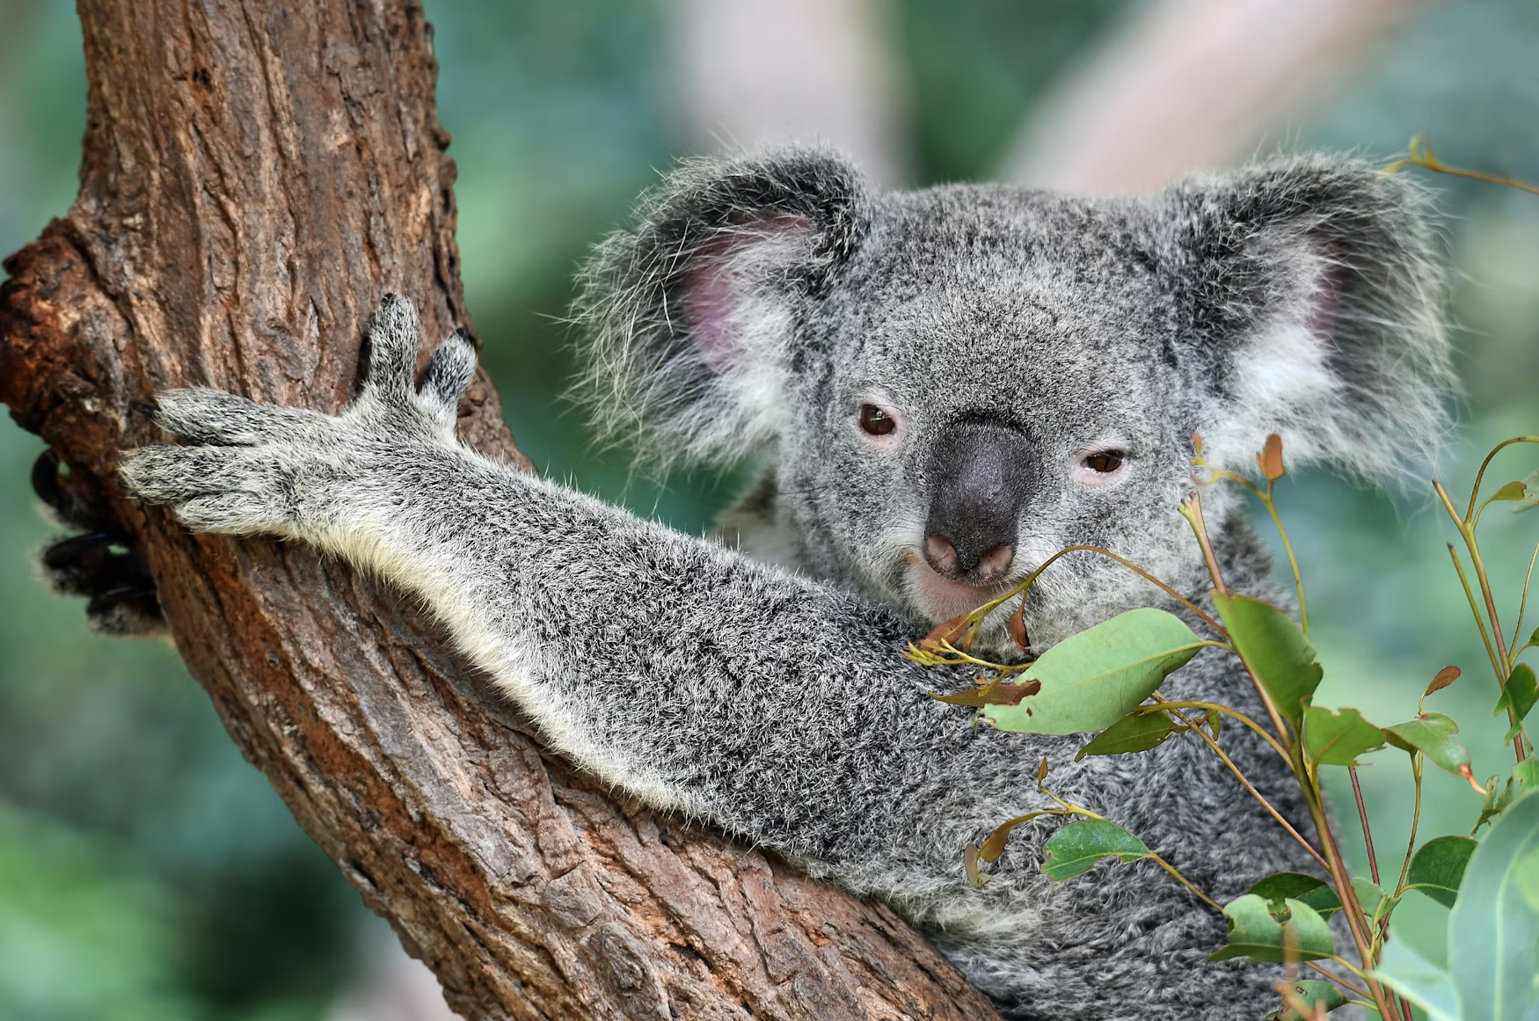
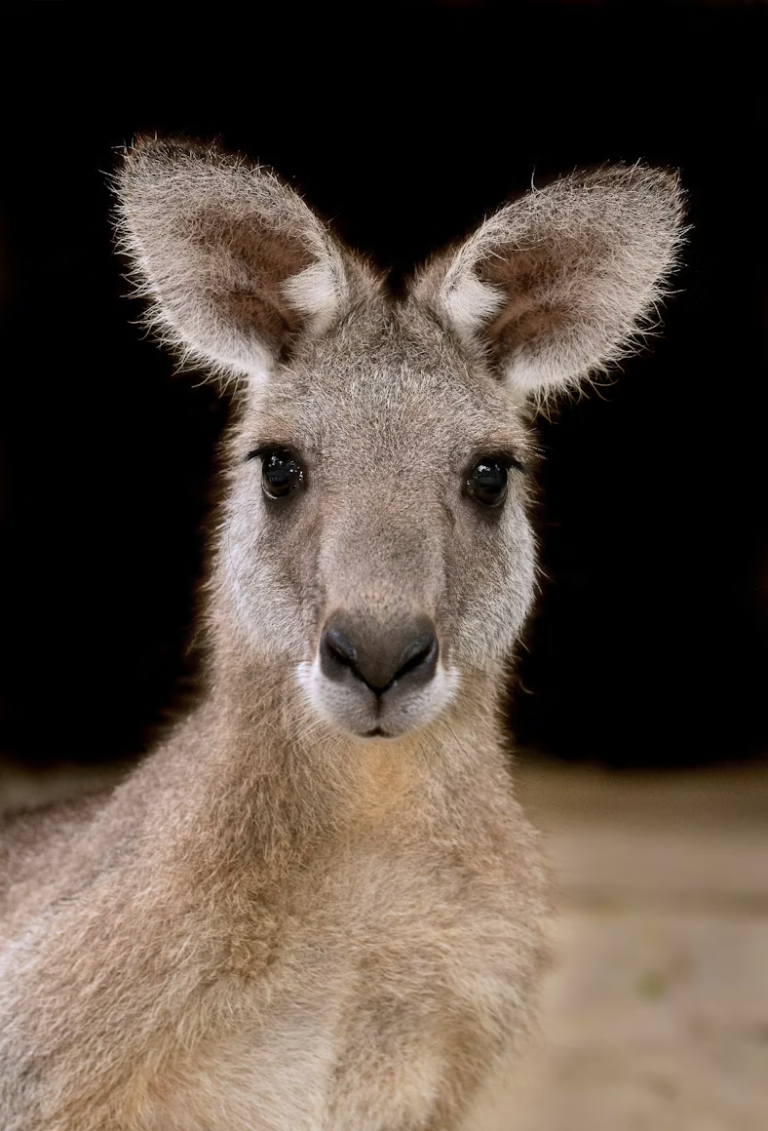
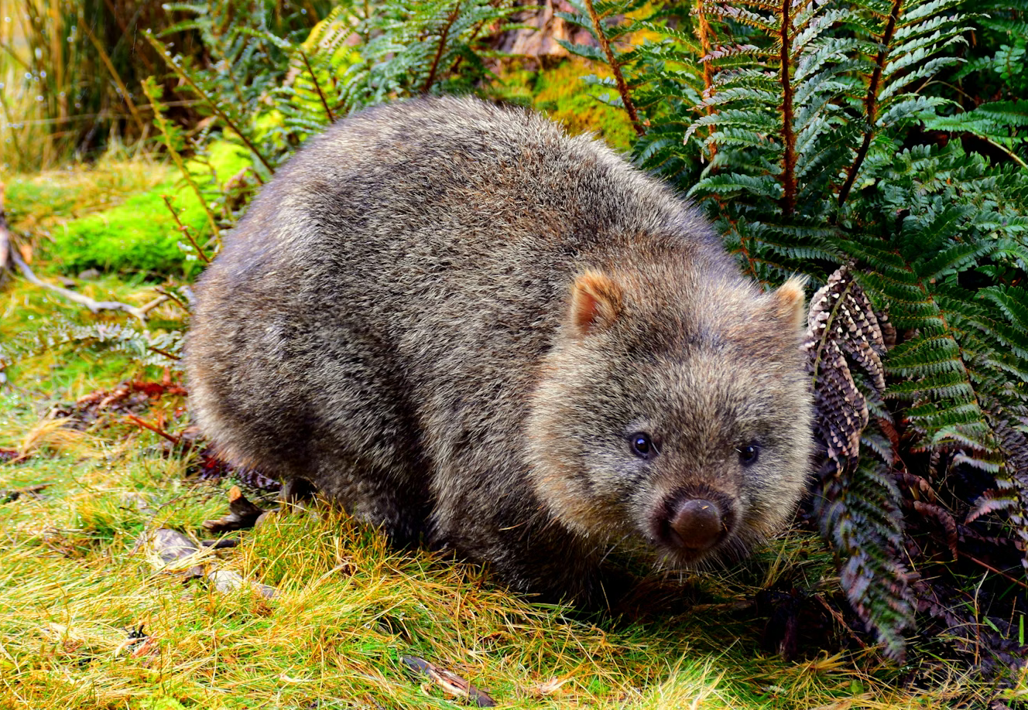
Bias
Bias is when one or more groups is favoured over others, which can result in unfair outcomes.
Let’s say you ask a class of Australian students what their favourite animal is. Then you present these animals as the world’s favourite animals: Koala, Kangaroo and Wombat
What makes this wrong or unfair?
Images source: Unsplash - Michael Jerrard (Wombat), David Clode (Kangaroo), David Clode (Koala)
Notes:
The example is biased because information from one group (a class of Australian students) has been used to claim something that is true for the whole world. Their views have been favoured over others.
Students are likely to have a variety of different levels of understanding of what bias is. The key points for this lesson is that students understand that there is bias in AI tools they interact with, that the biases often reflect biases/stereotypes in media (like TV and movies), and that AI model developers use several ways to address these biases and negate them as much as possible.
This lesson uses a few examples from Generative AI (e.g, biased images) and Classification AI (e.g, the cats and dogs activity in later slides) but there are many examples of bias in AI (and computing more broadly) that you could discuss if your students are working at a high level and/or they are interested in the societal impact of bias in AI. Bias issues can be quite complex and controversial, such as algorithmic bias in healthcare (https://learn.hms.harvard.edu/insights/all-insights/confronting-mirror-reflecting-our-biases-through-ai-health-care), so you may not want to go too deep into bias in this lesson and keep to the slide contents.

Slide 32

Bias
There is a lot of bias in the world and this is reflected in AI models.
When we prompt an image generation model (ImageGen 4.0) with “Professor”, this is what we get:
What do you notice about these images of professors?
G
What do you notice about the images?
Generated with ImageGen 4.0 Generate
Notes:
One of the easiest ways to demonstrate bias in AI is to generate images with prompts that are associated with stereotypes. In this slide, we’ve used “Professor” as the generated images from ImageGen 4.0 Generate demonstrate bias very well - the professors in the image reflect what we’d often see in movies and TV - mostly white older men with beards wearing blazers, ties and glasses surrounded by lots of books. In reality, there are professors of all genders, ages, and ethnicities.
AI models that are focused on image generation (for example, the ImageGen 4.0 Generate) are more likely to show biased images (like those above) than if you were to use a multimodal AI chatbot (like ChatGPT or Gemini). A lot of the multimodal AI chatbots will have been trained or set up such that they will attempt to reduce biased results (there’s more details about this in later slides).
Although it’s easiest to show bias in AI in a visual way, one of the key points to get across to students is that this bias impacts all modes of AI - including text. If you have marked 20+ essays where students have used generative AI to answer the same question, you will notice the same points made, the same (or similar) sources cited and similar structures used. It’s likely that those essays will reflect particular viewpoints, which is not good if you want more diversity of thought.

Slide 33
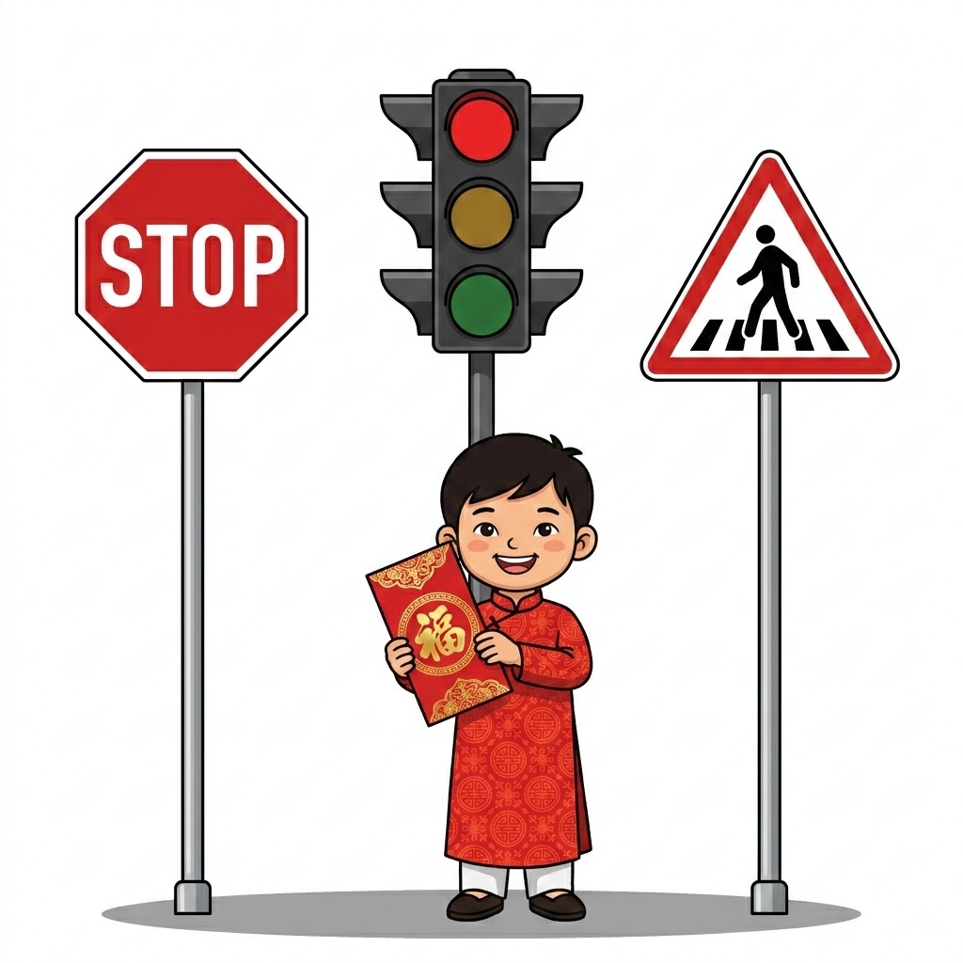
Why is there bias in AI responses?
Much of the data that AI is trained on comes from media (books, online articles, movies, TV shows) from the US, UK, Australia (and other Western countries):
Stereotypes are in those media (like the professors)
Reflect common ideas and traditions in Western cultures but there are different perspectives in different cultures
Historical biases, for example:
CEOs in the past were mostly men, so generated images of CEO are more likely to be men (even if it’s not true now)
Generated with Nano Banana
An example of cultural differences. In Western countries (like Australia): the colour red is often associated with danger, warnings or errors. In Asian countries, red is often associated with luck and wealth.
Notes:
This slide includes a couple of points on why AI responses can be biased. One of the main reasons is simply that the data used for training contains biases towards certain groups (for example, on the next slide the generated CEOs are mostly male). Another reason is that Western ideas are likely to be dominant in the data that is used for training, because the main AI companies are US-based and lot of media originates from the US.
The image is included as an example of cultural differences, where there are different perspectives on something (the colour red, in this case). If you were to ask an LLM about what the colour ‘red’ means, it might give an answer that it denotes “danger” or “urgency” or it might be a more thorough and say that it has different meanings in different countries. Some AI models will have been trained in a way that they seem “aware” of these differences, but there are likely to be more subtle differences.

Slide 34


More bias
You can see more examples of bias for the prompts “Nurse” and “CEO” in these images. What do you notice about them?
Although we have focused on images here, there’s bias in the other AI modes too: text, video, audio and code.
“Nurse”, generated with Imagen 4.0 Generate
“CEO”, generated with Imagen 4.0 Generate
Notes:
The purpose of this slide is to show more examples of bias in images and reinforce the point that bias is not just in image generation, but other AI modes (because they are trained on data that is often biased as well).
The example images can be related back to points in the previous slide - nurses are stereotypically women in media (like TV and movies) and there has been a historical bias towards CEOs being men and from Western origin.

Slide 35
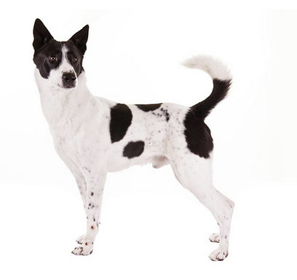
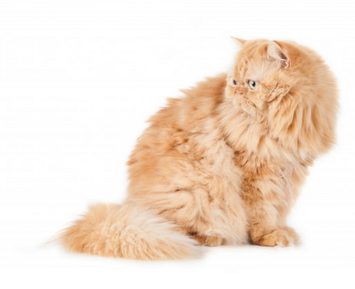
Bias in training data
Let’s look at an example of training our own model, which will be an AI that categorises a picture as either a cat or dog (an example of classification AI).
We are going to be training a model, testing it and improving it.
Complete the activity on the platform
Download the worksheet here
This activity has been adapted from the resource: “An Ethics of Artificial Intelligence Curriculum for Middle School Students”, which was created by Blakeley H. Payne with support from the MIT Media Lab Personal Robots Group, directed by Cynthia Breazeal.
Notes:
This activity involves training a simple classification AI model through a web-based tool on the platform. The AI will “look” at an image and determine whether it is a picture of a dog or a cat. Students will first label images for training, which involves them clicking a button to indicate whether the image is a Cat or Dog. The tool actually uses the training data from the students’ labelling, so if students do not label the images correctly, the model will not effectively identify the images as Cats or Dogs.
The tool on the platform does provide guidance and instructions for each step of the activity but you may want to use the following slides to step through each part of the process, before getting students to try it themselves.
This activity has been adapted from the resource: “An Ethics of Artificial Intelligence Curriculum for Middle School Students”, which was created by Blakeley H. Payne with support from the MIT Media Lab Personal Robots Group, directed by Cynthia Breazeal. That activity involves using the Teachable Machine website (https://teachablemachine.withgoogle.com/) and uploading pictures of the cats and dogs and training a model this way. This activity is similar but it simplifies part of the process, as students do not need to upload the images themselves.

Slide 36
Steps for training and testing our model
Step 1
Label our images
Step 2
Train the model
Step 3
Test the model
Cat: 🐈 Dog: 🐕
🤖
📋 ❌ ✅️
Step 4
Label more images
Step 5
Retrain the model
Step 6
Compare model results
Cat: 🐈 Dog: 🐕
🤖
📊
Notes:
You may want to share this diagram and talk through the steps in the process for this activity with students. However, the tool on the platform also provides the instructions and guidance for students to step through these themselves.
The steps for this activity are as follows:
Step 1: Label the images as “Cat” or “Dog” by clicking the buttons in the tool
Step 2: Train the model with our labelled images - this is Version 1 (the speed at which this training finishes will depend on students’ computers)
Step 3: See how well the model identified our test images as “Cat” or “Dog”
Step 4: Label some more images as “Cat” or “Dog” (this is our extra training data)
Step 5: Retrain the model with the original images and added ones - this is Version 2 (the speed at which this training finishes will depend on students’ computers)
Step 6: Compare how well the re-trained model (Version 2) identified test images as “Cat” or “Dog” with the first model (Version 1)

Slide 37
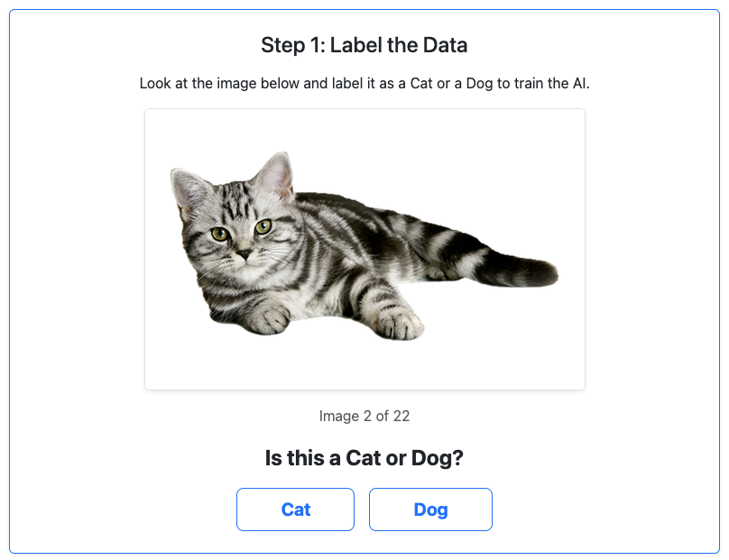
Steps for training our model: Step 1
Step 1: Label our images as “Cat” or “Dog”
For each of the images, click the Cat or Dog button to categorise them appropriately.
We call this part of the process labelling.
Notes:
Students start by labelling the images using the tool. This involves students clicking the appropriate button to categorise them as Cats or Dogs.
Students might notice at this point that there a lot of cats in the training data set. The result of this is a bias towards the images being classified as cats in Step 3 and Step 6.

Slide 38
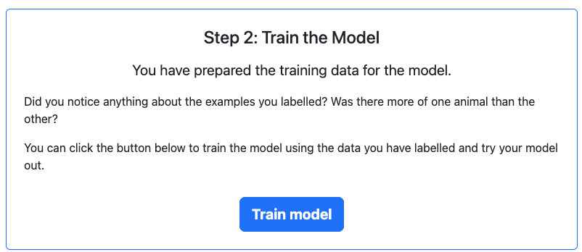
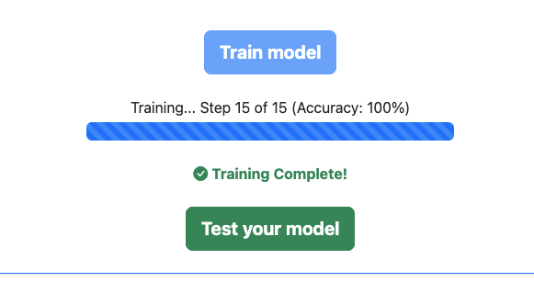
Steps for training our model: Step 2
Step 2: Train the model with our labelled images
Notes:
From the students’ perspective, this step just involves clicking the “Train model” button and waiting for it to complete. The speed at which this training finishes will depend on students’ computers. If the student/s have a powerful desktop computer, it will take less time than student/s on a less powerful laptop, for example. Once the training is complete, they can test it by clicking the “Test your model” button.

Slide 39
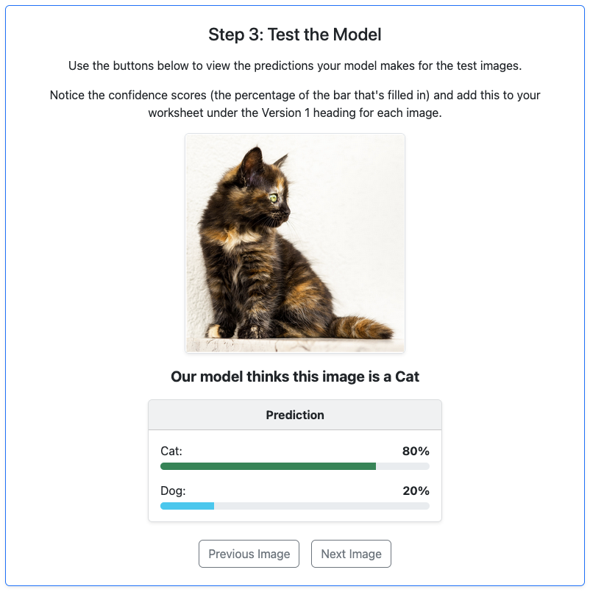
Steps for training our model: Step 3
Step 3: Test how well the model identified our test images as “Cat” or “Dog”.
In this step, you can see how well your model categories images.
The % shown for Cat and Dog, are the confidence the model has for that label, which will add up to 100%
Notes:
In this step, students can look through several test images, to see how well the model performs (how accurate it is at identifying images are cats or dogs). Students should write down the results in the activity worksheet. Note that this is for Version 1 of the model.

Slide 40
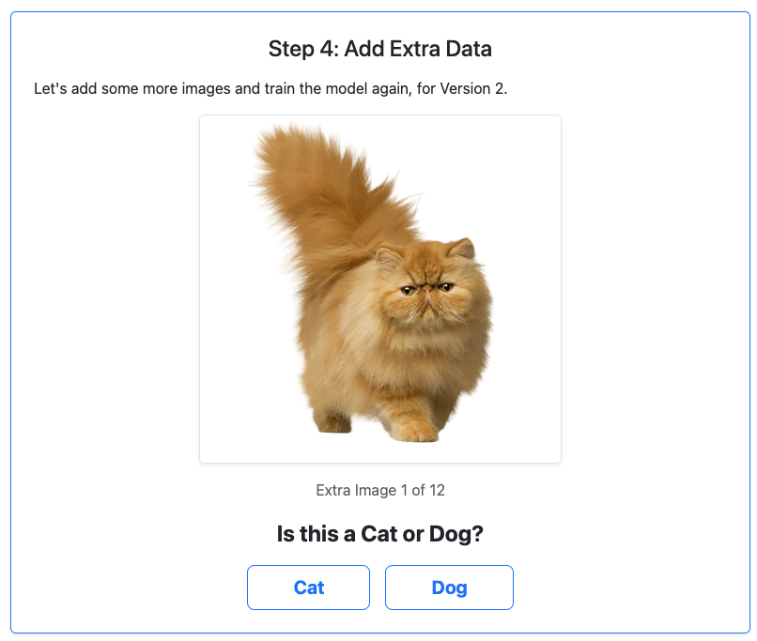
Steps for training our model: Step 4
Step 4: Label some more images as “Cat” or “Dog” as extra training data
For each of the images, click the Cat or Dog button to categorise them appropriately.
In this step, we are labelling again.
Notes:
In this step, students do more labelling of extra images for “Version 2” of the model. This is the same as Step 1 but with less images to label. These images, along with the images labelled in Step 1, are used for training Version 2 of the model.

Slide 41
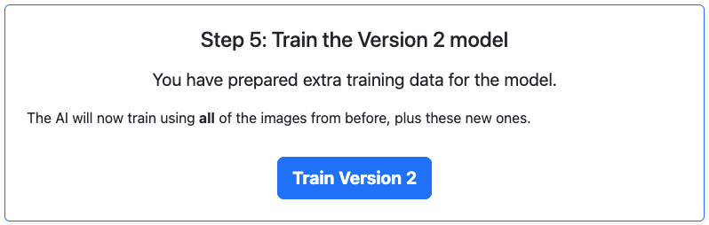
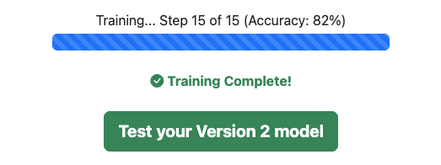
Steps for training our model: Step 5
Step 5: Retrain the model with the original images and extra images
Notes:
From the students’ perspective, this step just involves clicking the “Train Version 2” button and waiting for it to complete. The speed at which this training finishes will depend on students’ computers. If the student/s have a powerful desktop computer, it will take less time than student/s on a less powerful laptop, for example. Once the training is complete, they can test it by clicking the “Test your Version 2 model” button.

Slide 42
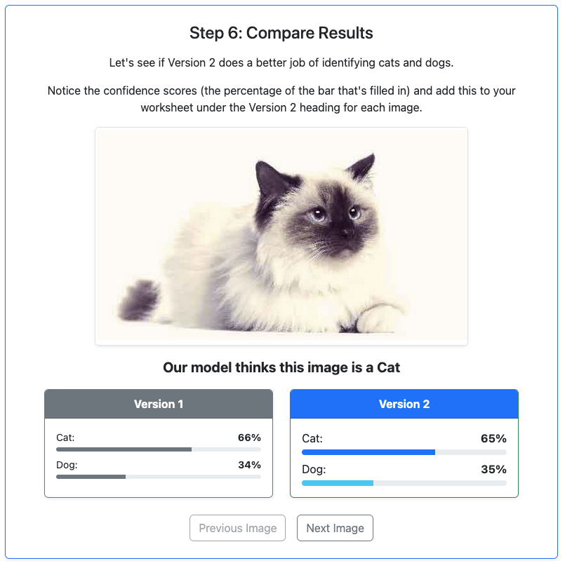
Steps for training our model: Step 6
Step 6: Compare how well the re-trained model (Version 2) classifies test images as “Cat” or “Dog”
Add these results to your worksheet. Does Version 2 do a better job of categorising the images?
Has more data helped? What could help improve the model for a Version 3?
Notes:
In the last step in the tool, students compare the results from the Version 1 and Version 2 models and write them down on their worksheets. Students are likely to find that the model is more accurate when categorising cats and that it tends to categorise some of the images of dogs (particularly the small ones) as cats. That is mostly because there is a bias towards cats in the dataset. Having more even representation of cats and dogs could result in more accurate classifications.

Slide 43
Activity 3.04: Training a model
Complete the activity on the platform
Download the worksheet here
Notes:
The purpose of this activity is to give students a hands-on experience of training a simple AI and to help them see how biased training data can impact the results from AI models.
The training data that is used is for this activity is biased towards cats. Students will likely see that the AI model does a better job at identifying images as cats when they are cats.
If students complete the activity quickly, you can extend them by getting them to do the training again but asking them to train the AI model wrong (by doing incorrect labels) and seeing how the results are different. Additionally, you could get students who need more extension to try the Teachable Machine website (linked below) and train their own model (potentially with a more even number of cats and dogs in the training data).
This activity has been adapted from the resource: “An Ethics of Artificial Intelligence Curriculum for Middle School Students”, which was created by Blakeley H. Payne with support from the MIT Media Lab Personal Robots Group, directed by Cynthia Breazeal. That activity involves using the Teachable Machine website (https://teachablemachine.withgoogle.com/) and uploading pictures of the cats and dogs and training a model this way. This activity is similar but it simplifies part of the process, as students do not need to upload the images themselves.

Slide 44
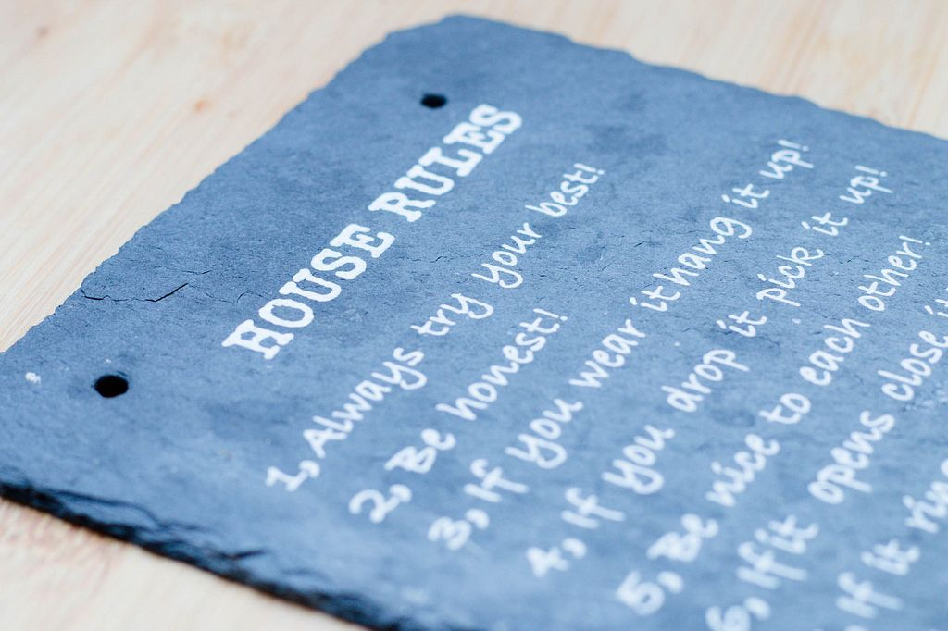
How do AI developers address bias?
One key technique is Reinforcement Learning from Human Feedback (RLHF). Humans rate the AI's responses, and the model is adjusted to produce fairer answers over time.
Developers also use system prompts: hidden instructions that run before every conversation, telling the model to be balanced, safe, and avoid harmful responses.
Think of it like house rules the AI must follow before it even reads your message. You never see them, but they're always there.
Even so, bias can't be fully eliminated, which is why thinking critically about AI responses matters.
House Rules Sign by Marco Verch CC 2.0
Notes:
This slide gives students a concrete sense that bias isn't ignored. Developers actively work to address it. The key is helping them understand both how that works and why it isn't a perfect fix.
A few points to draw out:
RLHF can be tricky to explain. The simplest framing is that humans act like judges, scoring the AI's answers, and the model learns to produce responses more like the highly-rated ones. You might ask: "Who do you think those human reviewers are, and could they have their own biases?" This is a good critical thinking moment. The humans doing the rating aren't neutral either.
System prompts are something students often don't realise exist. Emphasise that every time they use a chatbot, there are hidden instructions already shaping the response before they've typed a word. You could link back to the personalisation slides . System prompts are one way developers try to counteract bias that personalisation might otherwise reinforce.
The house rules analogy tends to land well. You might extend it by asking: "What if the person who wrote the house rules had their own biases?"
The closing point, that bias can't be fully eliminated, is important not to rush. Students should leave this slide understanding that these are genuine, ongoing challenges, not solved problems. That's what makes critical thinking about AI responses a real skill, not just a disclaimer.
Good closing question: "If you knew a chatbot had hidden instructions, would that change how much you trusted its answers?"

Slide 45
“Leaked” system prompts
AI companies keep system prompts secret but here are some past examples of “leaked” system prompts that people have discovered:
Claude should be wary of producing humor or creative content that is based on stereotypes, including of stereotypes of majority groups
If Claude suspects it may be talking with a minor, it always keeps its conversation friendly, age-appropriate, and avoids any content that would be inappropriate for young people.
Source: leaked system prompts - jujumilk3 (GitHub)
Notes:
For students who want to go further, here is an article describing leaked system prompts containing more technical details about where these leaked system prompts were found.
There is a “repository” (a collection of code and documents) with “leaked” system prompts available from https://github.com/jujumilk3/leaked-system-prompts. We have not been able to verify these are the actual prompts but they provide good examples of what these prompts look like. Advanced students could be encouraged to look at these examples.

Slide 46
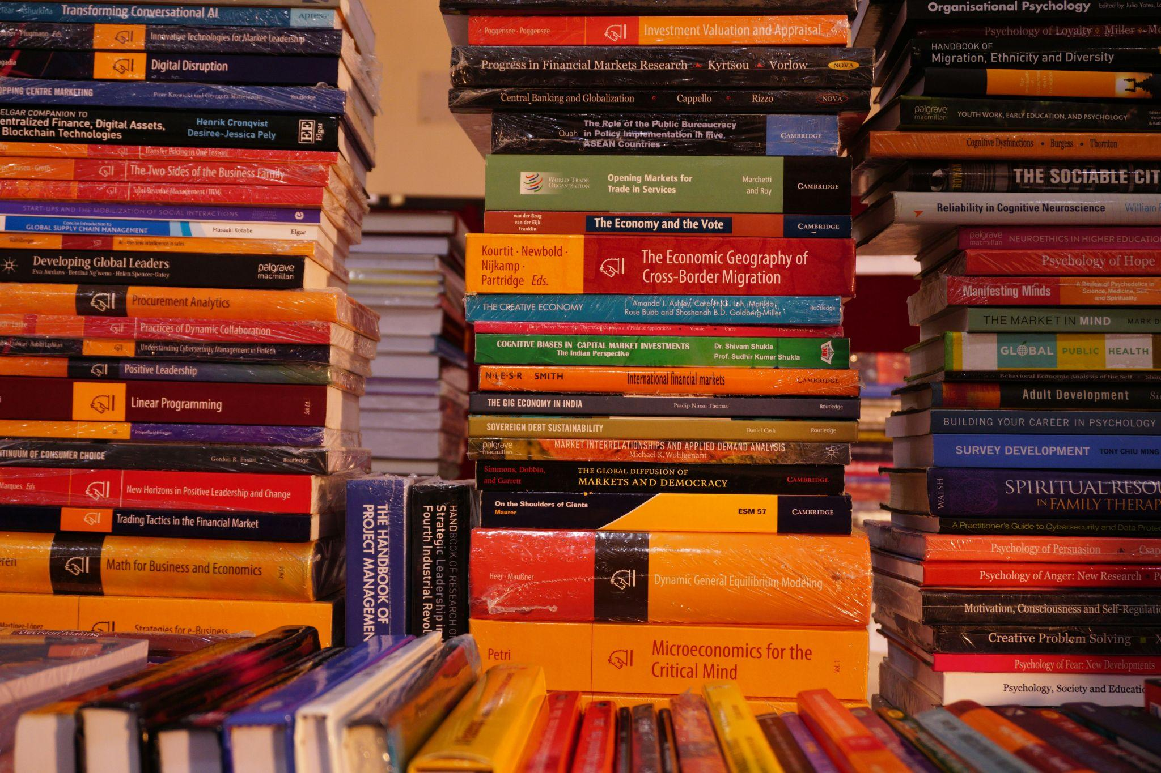
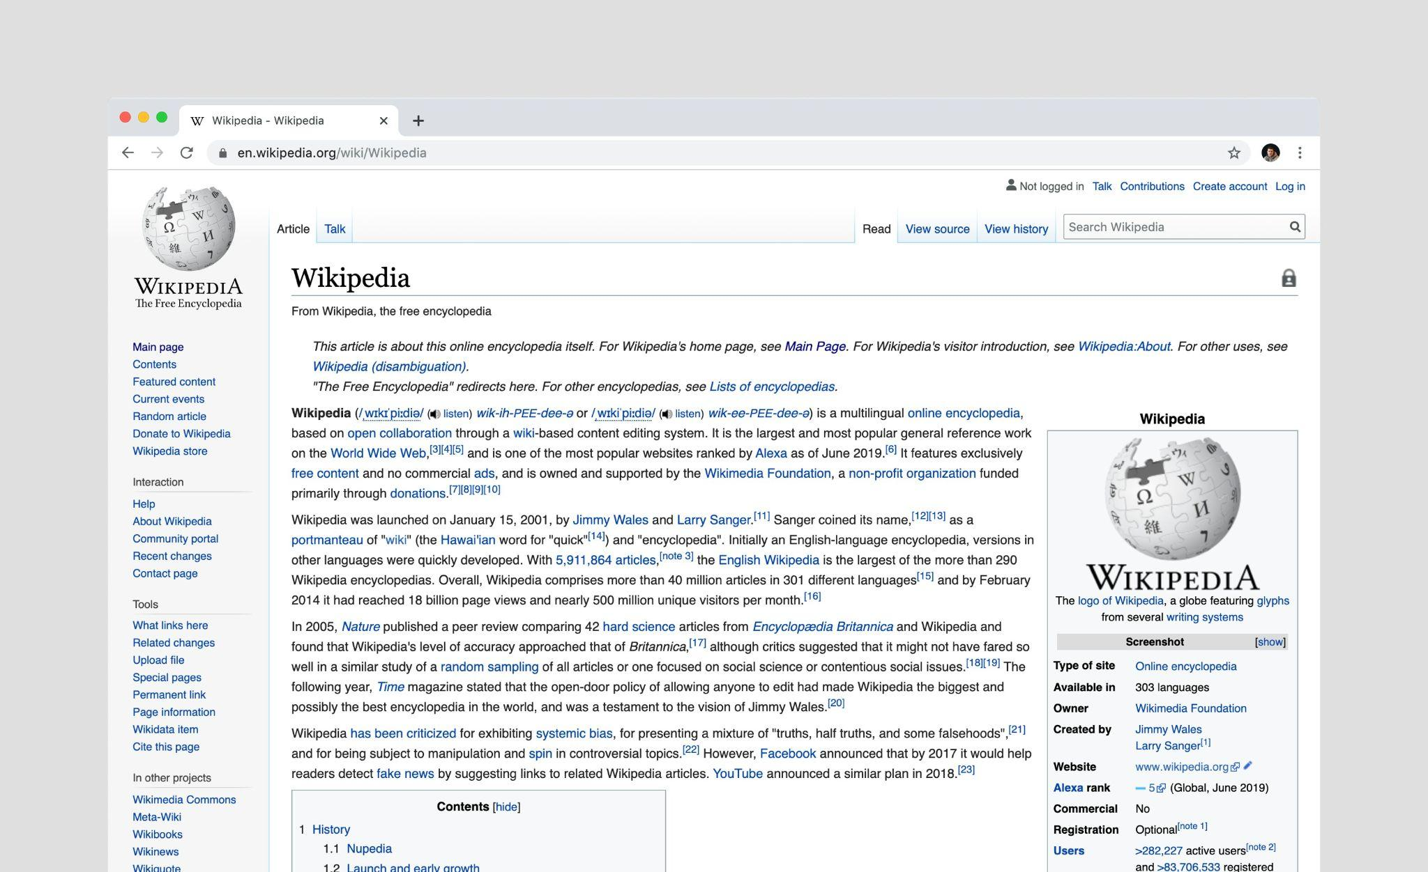
Training data: baked in before you arrive
Just like our cats and dogs model, the models we use through chatbots like Lumen are trained on data – except we're talking hundreds of gigabytes of text and not 30 pictures of cats and dogs.
Training is a massive, expensive process taking months and millions of dollars. It's not running quietly in the background while you chat.
This is what the "P" in GPT means: Pre-trained. The knowledge is baked in before you arrive, and your conversations don't change or update it.
Notes:
The key point to emphasis here is that the training of the model is largely done. Conversations don’t necessarily add to the model knowledge. Once trained, the model's core knowledge is essentially frozen. Your conversations don't necessarily update it or teach it new things.

Slide 47
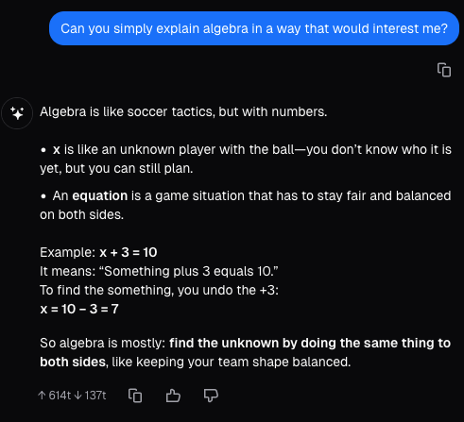
Personalisation vs Training
So if training is fixed, how does a chatbot feel like it "knows" you? That's personalisation and it's completely separate.
When you share your name, interests, or reading level, the chatbot uses that to shape its replies in the moment.
Some apps remember you across sessions (like ChatGPT's memory feature), but this isn't the AI "learning" in any deep sense, think of it like a teacher reading your student file before class. It helps them tailor their approach, but it doesn't change what they know.
A response from Lumen that explains algebra using a student’s interest (soccer) that a student talked about earlier in the chat.
Notes:
The key point here is that Personalisation is distinct from Training. Personalisation will be explored in more detail in the following slides.
The example screenshot shows a way that LLMs can use personalisation. You could try this in the AI tool/s you use with a similar prompt and see what you get. The response may surprise you, as it is likely to use a mix of topics from your previous conversations.

Slide 48
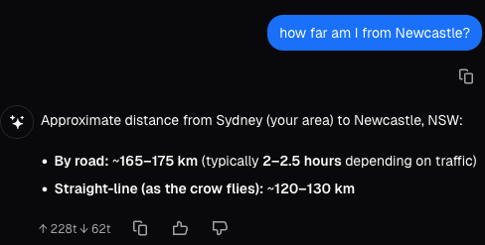
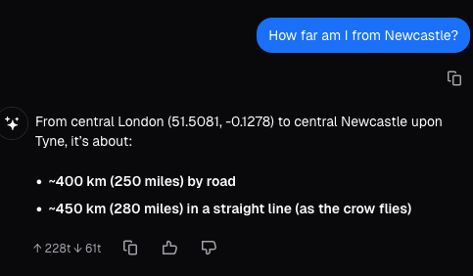
So what does the chatbot know about you?
When using Lumen from Sydney, Australia
Chatbots can pick up two types of information to personalise your experience: your metadata and your past messages.
Metadata is background detail the app can detect, like your approximate location from your IP address (city or country).
Past messages are more direct. If you've been asking about soccer, the chatbot might weave in soccer examples without you asking.
Worth knowing: Lumen doesn't remember you between separate conversations, but it does remember context within the same session.
When using Lumen from London, England:
Notes:
Students often don't realise how much context a chatbot is picking up without them explicitly providing it. The goal is to make that visible.
A few points to draw out:
Metadata is the less obvious one. Students may not know what an IP address is or that it reveals their location. It's worth a brief explanation: every device connecting to the internet has one, and it gives apps a rough sense of where you are without you ever typing it. Ask: "Did you realise apps could know your location without you telling them?"
Past messages are more intuitive but still worth highlighting. The soccer example is a good one because it shows personalisation happening invisibly. You might ask students: "Has a chatbot ever responded in a way that felt weirdly tailored to you? How did that feel?"
The Lumen point is practically important and worth emphasising. Students may assume Lumen is tracking them across sessions. Clarifying the difference between within-session memory and cross-session memory helps set accurate expectations, and is a good moment to contrast with tools like ChatGPT that do offer persistent memory.
Good discussion question: "What information do you think you've already shared with a chatbot without realising it?"
The example screenshots show the same prompt “How far am I from Newcastle” and the different responses that come back from Lumen when we’re in Sydney vs London. The location is used as part of the prompt that goes to the LLM (OpenAI’s GPT in this case) and so the LLM has inferred that we mean the city of Newcastle in NSW in the first screenshot, and the city of Newcastle Upon Tyne (in England) in the second screenshot, based on the location. In these examples, it’s just the city and distances that are different but personalisation based on location could be more subtle. For example, if you asked about laws or policies in your prompt while in Australia, the laws and policies are likely to be those that apply in Australia.

Slide 49
Is personalisation a good thing?
Personalisation can work in your favour. More relevant answers, examples that make sense to you, responses that match your level.
But if the chatbot has picked up incorrect details, it might confidently give you wrong information; e.g., mixing up details about you with someone else you've asked questions about.
There's another risk too: if it's always tailoring to what you want to hear, it’s like only ever hearing one side of the story.
Like any tool, knowing how it works helps you spot when personalisation is helping and when it might be leading you astray.
Notes:
This slide is about developing healthy scepticism, not putting students off AI, but helping them engage with it more thoughtfully. The benefits are real, but so are the risks, and both deserve honest discussion.
A few points to draw out:
The benefits are worth affirming first. Personalisation genuinely does make AI more useful, and students will likely have experienced this. Starting positive helps them engage with the risks without feeling like the lesson is just warning them off technology.
The incorrect details risk is subtle but relatable. The example of a chatbot mixing up details about you with someone else you've asked questions about is a good one to linger on. You might share a real example if you have one, or ask: "Has an AI ever assumed something about you that was wrong? What did it get wrong?"
The filter bubble point is the most conceptually challenging and links well to media literacy topics students may have covered elsewhere. The key idea is that a chatbot optimising for what you want to hear is subtly different from one helping you think and students may not notice the difference in the moment. Ask: "Would you want an AI to tell you something you didn't want to hear, if it was true?"
The closing point is the takeaway for the whole personalisation section: knowing how a tool works is what makes you a better user of it. You might frame it as: these aren't reasons to avoid AI, they're reasons to stay switched on when using it.
Good discussion question: "Can you think of a situation where you'd want the AI to ignore what it knows about you and just give you a straight answer?"

Slide 50
How personalisation can be used to trick or harm
Scammers use AI personalisation techniques to generate fake but convincing emails, texts and messages (scams) targeted at you
Scammers can use AI voice cloning to impersonate family members, teachers or officials asking for money or information
Deepfake video calls can make a scammer look and sound like someone you know or trust
Fake AI-generated profiles build trust before asking for money or information
AI can scrape your social media to learn details about you making scams feel uncannily personal and believable
Notes:
Scams feel abstract until students realise how personalised and convincing they've become. The goal is to make them more alert without making them paranoid.
A few points to draw out:
The personalisation link is important to make explicit. This is the dark side of everything covered in the personalisation slides. The same techniques that make a chatbot feel helpful can be used to make a scam feel trustworthy. It's worth pausing on that connection: "We just talked about AI using your data to tailor responses. What happens when someone with bad intentions does the same thing?"
Voice cloning is often the detail that surprises students most. There are real cases of people receiving calls that sound exactly like a family member in distress asking for money. You might ask: "If you got a call from someone who sounded exactly like your mum or dad, how would you check if it was really them?" This is a practical safety conversation, not just a theoretical one.
Deepfake video calls take this further. Students may assume that seeing someone on a video call is proof of identity. It's worth challenging that assumption directly.
Social media scraping connects to students' own lives in a concrete way. Ask: "What could someone find out about you just from your social media? Your school, your friends, your interests, your location?" This often prompts a genuine moment of reflection.
Encourage students to think of a safe word or phrase they could agree on with family to verify identity in suspicious situations. This is practical advice they can actually use.
Good discussion question: "What would make you suspicious that a message, call or video wasn't really from who it claimed to be?"

Slide 51

Scams in real life
In a 2024 poll carried out by Deloitte, 25.9% of executives revealed that their organisations had experienced one or more deepfake incidents targeting financial and accounting data in the 12 months prior.
Deloitte’s Center for Financial Services predicts that GenAI could enable fraud losses to reach US$40 billion in the United States by 2027.
AI-powered videos posing as genuine footage of Elon Musk have been going viral online. In August 2024, The New York Times dubbed deepfake “Musk” “the Internet’s biggest scammer.
Steve Beauchamp, an 82-year-old retiree, told the New York Times that he drained his retirement fund and invested USD $690,000 in such a scam over the course of several weeks, convinced that a video he had seen of Musk was real. His money soon vanished without trace.
Photo by Nick Fewings on Unsplash

Slide 52
Scam red flags
Red flags are clues that AI-generated content is not real
Red flags to watch for include:
  Urgent requests for money, gift cards or personal details, even from someone you know
  You're asked to keep the conversation secret from parents or teachers
  An offer or prize that sounds too good to be true
  You feel unusually emotional. Scammers use AI to trigger fear, excitement or sympathy on purpose
Notes:
The goal of this slide is to give students concrete and practical tips they will remember and use.
A few points to draw out:
Urgency and secrecy are the two biggest red flags worth emphasising. Scammers rely on people acting fast before they think. Ask: "Why would a real family member or official need you to act immediately and tell no one?"
The emotional manipulation point links directly back to personalisation. AI can be used to identify what triggers a specific person and exploit it. If students feel a sudden rush of fear, excitement or sympathy in a message or call, that's exactly when to slow down, not speed up.
The "too good to be true" point is familiar but worth reframing. AI makes fake offers look far more polished and believable than the obvious scam emails of the past. The old spelling-mistake test no longer works.
Good discussion question: "If you received a voice message from a family member that felt urgent and emotional, what would you do before responding?"

Slide 53

What to do about scams
Slow down. Scams are designed to make you act fast before you think
Verify through a different channel. If a "family member" calls asking for help, hang up and call them directly
Tell a trusted adult. You won't get in trouble for being cautious
Report it. in Australia, scams can be reported to Scamwatch at scamwatch.gov.au
Source: scamwatch.gov.au
Notes:
While the focus on the previous slide was on detecting scams, the focus of this slide is what “action” students should take.

Slide 54
Activity 3.05: Scam Red flags
Complete this activity on the platform
Download the worksheet here
Notes:
In this activity students are asked to identify “red flags” in three scenarios and determine what action they should take in each case.

Slide 55
Deepfake images
AI can create realistic fake photos of real people doing things that never happened
They’re getting harder to spot and they are very easy to create
They’re used to spread misinformation, damage reputations and run scams
You’ve probably already seen one without knowing it
Your own photos could be used to create a deepfake without your consent
Sometimes you can spot them by looking at odd skin texture, mismatched lighting or background glitches.
Notes:
Reiterate the idea that students' own photos could be used without their consent. Maybe this has already happened to some of them.
A few points to draw out:
"You've probably already seen one" is a good hook to open with. Ask students if they've come across anything that felt off, or if they've seen deepfakes shared as real. This grounds the topic in their actual experience rather than making it feel hypothetical.
The ease of creation is worth emphasising. Deepfakes used to require significant technical skill. Now they can be made in minutes with free tools. That shift changes everything about how we should approach images and video online.
The consent point is important and may spark strong feelings, especially around images of themselves or people they know. You might ask: "What do you think should happen to someone who creates a deepfake of another person without their consent?"
The spotting tips are useful but need a caveat. These glitches are becoming rarer as the technology improves. Encourage students to treat visual detection as one tool, not a reliable one, and to focus more on source and context when evaluating content.
This slide links well back to the misinformation slides. Ddeepfakes are one of the most powerful tools for spreading false content at scale.
Good discussion question: "If you couldn't tell whether a photo or video was real, what else could you check to decide whether to trust it?"

Slide 56
Activity: Editing images
Complete the activity on the platform
Notes:
The aim of this activity is to show how easy it is to edit an image. Students can do this in minutes. There is no worksheet for this activity.

Slide 57
Deepfake videos: the next step
They move and talk. A deepfake video shows a real person speaking and moving, making them far more convincing than a fake image
Your brain trusts video more. We're wired to believe what we see moving; deepfakes exploit that instinct
Voice can be cloned too. Fake visuals combined with a cloned voice makes deepfake videos almost impossible to spot
They spread faster than the truth. A deepfake video can be shared millions of times before anyone fact-checks it
Notes:
This slide builds on the previous one. Deepfake images are unsettling, but video takes it to another level. The goal is to genuinely shift how students think about video as evidence.
A few points to draw out:
"Your brain trusts video more" is the key insight of the slide. We've grown up treating video as proof: if we saw it, it happened. Deepfakes exploit an instinct that made sense before this technology existed. Ask: "Can you think of a time you believed something because you saw a video of it? Would you still be so sure?"
The voice cloning combination is what makes deepfake video so hard to detect: it's not just visual anymore. Students may have assumed they could spot a fake by listening carefully. Challenge that assumption directly.
The spread point connects to media literacy more broadly. By the time a deepfake is debunked, the damage is often already done. Ask: "If you shared a video that turned out to be fake, does it matter that you didn't know? What's your responsibility?" This can prompt a genuinely rich discussion about sharing habits.
It's worth acknowledging that this can feel overwhelming. The honest message is that no single trick will protect them, but slowing down before sharing, checking sources, and maintaining scepticism about emotionally charged content are all genuinely useful habits.
Good discussion question: "If video can no longer be trusted as proof, what would you need to see before believing something important?"

Slide 58
Activity 3.06: Deepfake videos
Complete the activity on the platform.
Download the worksheet here
Notes:
In this activity students learn about deepfake videos and are asked to reflect on the repercussions of these videos and who should be held responsible for them.

Slide 59
Bad actors
People who make deepfakes are sometimes known as “Bad actors”. This doesn’t mean they can’t act! It means they are acting “badly”.
Who are Bad actors?
Scammers: AI voice clones of family members asking for money
Fraudsters: fake video calls impersonating a CEO or official to trick companies into transferring money
Bullies: putting someone’s face on inappropriate images to humiliate or threaten them
Foreign states: some governments use deepfakes as part of larger disinformation campaigns
Notes:
This slide humanises the threat by putting faces to who is actually behind deepfakes. A few points to draw out:
Scammers and fraudsters can be discussed together. Both are financially motivated and both exploit trust. The CEO fraud example is worth highlighting because it shows deepfakes aren't just a threat to individuals; companies and institutions are targeted too. Ask: "If your boss called you on video asking you to transfer money urgently, what would you do?"
Bullying is the most personally relevant category for this age group and may need careful handling. Some students may have direct experience of image-based abuse, either personally or through someone they know. Emphasise that creating or sharing this kind of content is not just cruel, in many places it's illegal.
Foreign states introduces a bigger picture that students may find surprising, that deepfakes are used as geopolitical tools, not just personal ones. You don't need to go deep here, but it's worth planting the idea that misinformation can be coordinated and deliberate at a national scale. One example you could mention is from the Russia–Ukraine war. In 2022, a deepfake video circulated of Ukrainian President Zelensky apparently telling his soldiers to surrender. It was fake but it was designed to cause panic and confusion at a critical moment in the war. Ukrainian officials had to quickly go public to deny it. See here for more details.
Good discussion question: "Which of these do you think causes the most harm and why?"

Slide 60
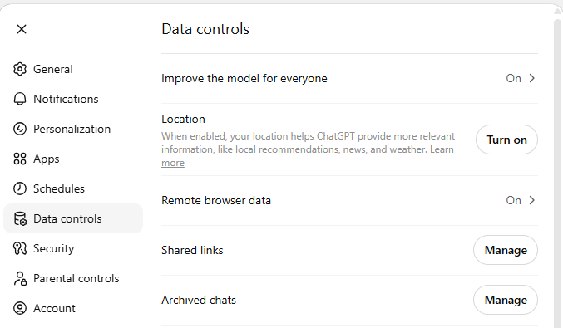
Privacy and AI
Every time you use AI, you're sharing data: what you type, and sometimes your location, voice or face and that's often what powers the personalisation we covered earlier.
That data can be used to train future AI models, target you with ads, or be sold to third parties.
ChatGPT-5.5 Data Controls Setting
In ChatGPT, sharing of your data for future training is on by default. “Improve the model for everyone” means chatGPT will use all your conversations to train its model.
Notes:
This slide is where the course comes full circle, connecting personalisation, training data, and privacy into a single picture.
A few points to draw out:
The opening connection is worth making explicit. Earlier slides covered personalisation as something that happens to your experience. This slide reveals that the data powering that personalisation doesn't just stay there. Ask: "Did you realise that what you type into a chatbot might be used to train future versions of it?"
The default settings point is practically important and often genuinely surprises people of all ages. "Improve the model for everyone" sounds positive and communal but students should understand what they're actually agreeing to. Ask: "Would you have noticed that setting? Would you have known what it meant?"
Third party data sharing may be a new concept for some students. It's worth explaining briefly that companies can sell anonymised user data to advertisers or other organisations, and that "anonymised" doesn't always mean truly private.
Good discussion question: "If an app told you clearly upfront: 'We will use your conversations to train our AI' Would you still use it? Does it change anything knowing it's the default?"

Slide 61
How to protect your Privacy with AI
Never share personal details: no real name, address, school, phone number or login details
Treat AI like a public space: anything you type could be stored or used to train future models; if you wouldn't say it on a bus, don't type it
Be cautious with photos and voice: AI can store all types of data; check what an app does with it before using it
Think before sharing someone else's details: a friend's name, photo or personal situation is their privacy too
In 2023, a ChatGPT glitch allowed some users to see titles of other users’ conversations and although this was fixed quickly it is a risk.
Notes:
This slide is the practical takeaway for the privacy section. Move through it as a checklist students can actually remember and apply, rather than a list of warnings to be anxious about.
A few points to draw out:
"Treat AI like a public space" is the most transferable idea on the slide and worth lingering on. Students instinctively understand what they would and wouldn't say on a bus. Applying that same instinct to typing is a concrete, memorable shift. Ask: "Has anyone ever typed something into a chatbot that they wouldn't want anyone else to read?"
Photos and voice may catch students off guard. Many will have used AI photo tools or voice features without thinking about what happens to that data. This is a good moment to ask: "What apps have you used that accessed your camera or microphone? Did you check what they do with it?"
Sharing someone else's details is an often-overlooked point that tends to resonate at this age. Students may not have considered that typing a friend's name, situation or photo into a chatbot is a privacy decision that isn't theirs to make. Handle this carefully as some students may have already done exactly this.
The overall tone to strike is agency, not anxiety. These are habits that make students smarter and safer users of technology they're going to keep using. Frame it as being in control, not being scared.
Good discussion question: "Have you ever typed something about someone else into an AI tool, such as a friend's name, a situation they told you about? Did you think of that as a privacy issue at the time?"

Slide 62
Activity: Safe to Share?
For each of these AI prompts discuss if they are: "Safe to type" OR "Risky to type" ?
"Help me write a birthday message for my friend Sarah"
"I go to Riverside Secondary College and am in Year 9. What subjects should I pick next year?"
"Can you write a message to my teacher Mr Henderson explaining why I missed the assignment?"
"My date of birth is 12 March 2011. Am I old enough to make an account on this app?"
"I feel really lonely lately and I don't have anyone to talk to"
"Here's a screenshot of a text argument I had with my best friend. Who do you think is in the wrong?"
"Here is a photo of my passport. Can you help me fill in this form?"
"My email is jake.morrison@gmail.com and my password keeps getting rejected. Can you help me?
Notes:
There is no worksheet for this activity.
Teachers ask students to get in pairs or groups to discuss whether the prompts are “safe” or “risky” to share.
Extension: How could you modify the prompts to reveal less of your information but still get the information you need?

Slide 63

Know why AI gets things wrong - and why it sounds so confident
Be equipped with strategies to fact-check anything that AI tells you
Understand how AI is used to create and spread misinformation and disinformation
Recognise when AI output might be biased and why that happens
Be aware of how AI can be used in scams and deepfakes
Know how to protect your privacy when using AI
Summary
You should now be able to:

Slide 64
License Information
These Tech Futures Australia lessons plans, worksheets, and other materials were created by the Tech Futures Australia team. They are licensed under a Creative Commons Attribution-ShareAlike 4.0 International License.

