Slide 1

Lesson 5
LLMs Under the Hood
techfutures.org.au

Slide 2
Learning objectives
By the end of this lesson, you will understand how LLMs work under the hood including:
Tokenisation and how words are converted to numbers
Transformer Architecture
Reinforcement Learning from Human Feedback
Context windows
Stateless AI
Grounding
Reasoning models
LLMs and Understanding
Notes:
The aim of this lesson is to give students a solid understanding of how LLMS work ‘under the hood’. One of they key takeaways is that it is all just mathematics underneath. By representing words as numbers, language can be manipulated and new conversations can be generated.

Slide 3
Recap of Lesson 4
Drag each description box into the matching term box.
DESCRIPTIONS
TERMS
Cognitive Overload
The mental work needed to think
Cognitive Effort
Too much information to handle
Cognitive Offloading
Letting a tool handle thinking tasks
Cognitive Debt
Relying on AI too much over time
Notes:
Answer Key:
The mental work needed to think - Cognitive Effort
Too much information to handle - Cognitive Overload
Letting a tool handle thinking tasks - Cognitive Offloading.
Relying on AI too much over time - Cognitive debt.

Slide 4
Recap of Lesson 4
Drag each description box into the matching term box.
DESCRIPTIONS
TERMS
Using copyrighted work without permission for a fair reason
Acknowledging AI Use
Rules that keep AI use safe
Copyright
Being honest about using AI
Fair Use
Creators own their work
Guard Rails
Notes:
Answer key:
Using copyrighted work without permission for a fair reason – Fair Use
Rules that keep AI use safe - Guard Rails
Being honest about using AI - Acknowledging AI Use
Creators own their work - Copyright

Slide 5
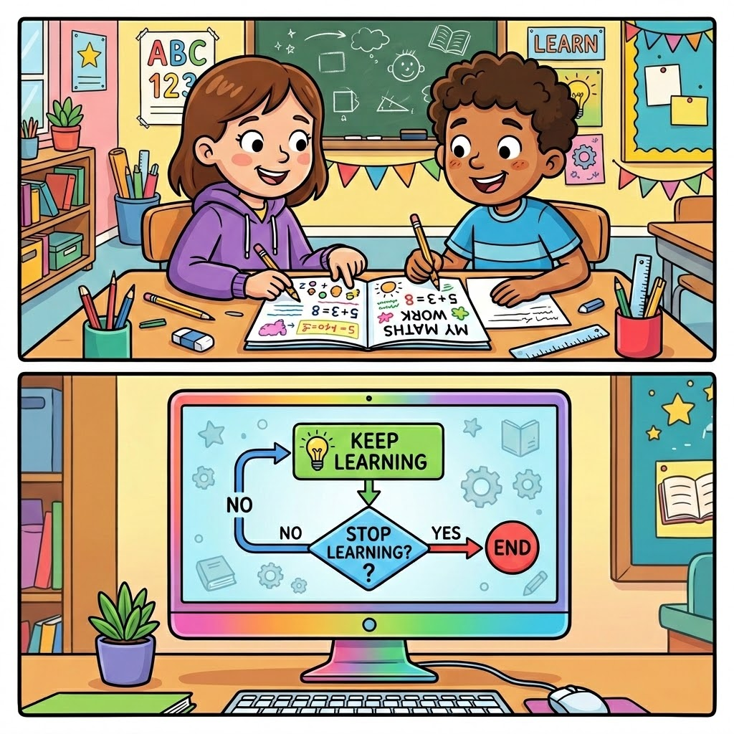
LLMs: Under the hood
In previous lessons, we discussed that LLMs are ‘trained’ on huge amounts of data and ‘learn’ from this data.
But this learning is not the same as how a human learns.
The approaches that LLM developers have used to get these models to ‘learn’:
are very clever
use a lot of computer power and maths.
Generated with NanoBanana
Notes:
In this lesson students learn about how LLMs work under the hood, without going too deep into these topics and minimising the maths that students need to do.
The key point that the lesson aims to get across is that LLMs work by converting words to numbers and that, under the hood, LLMs are just working with numbers (they do not have the same understanding about words humans do).
The diagram is intended to be a simple comparison of human learning vs LLM. Students learn through experience in the world and with their friends, peers, family, teachers and other adults, as well as through studying, reading books, watching movies and so on. LLMs learn through algorithms (step-by-step instructions) and don’t experience the world like humans do.

Slide 6
The main steps in training LLMs
Gathering training data
Converting to tokens
Converting to Numbers
Finding Connections
(Transformer)
These are the steps you will learn about in this lesson, which are used for training LLMs.
Reinforcement Learning from Human Feedback
Notes:
For this lesson, we have chosen these four steps to focus on to reduce the technical details and complexity in the lesson.

Slide 7
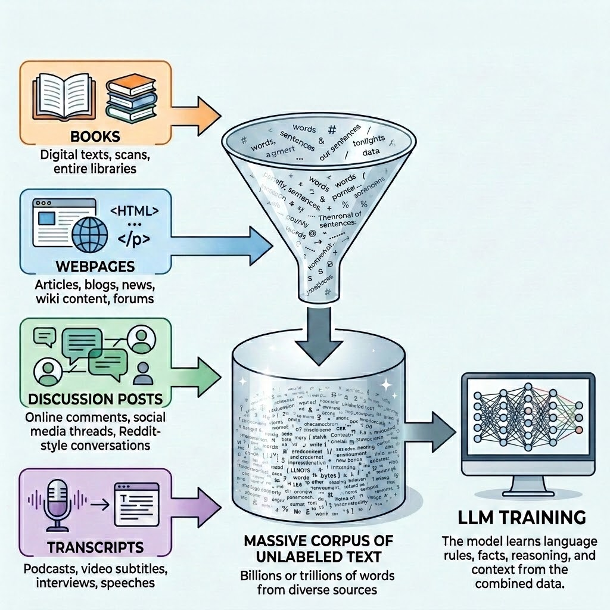
Gathering training data
The training data for LLMs is all in text form. Data comes from a variety of different sources: books, online articles, discussion posts on online forums and more.
In some cases, the data is digitised, like scanning printed books into digital form.
Some data can be non-text data that is turned into text, like a transcript from a YouTube video or podcast.
Generated with NanoBanana

Slide 8

Converting to tokens
The first step in training is taking our training data and “tokenising” it. Tokenisation is breaking down sentences, words, letters, numbers and punctuation marks into tokens.
There are different ways to tokenise sentences, such as separating spaces words by spaces in a sentence. For example, the sentence:
The uncharacteristically over-enthusiastic scientist waved hello.
could be split up by spaces:
Generated with NanoBanana
The
uncharacteristically
over-enthusiastic
scientist
waved
hello.
Notes:
The key points to get across from the section on tokenisation is that the algorithms used for training work with ‘tokens’, which are not always single words. They are sometimes sub-words. For example, “over” and “enthusiastic” would be sub-words within the word “over-enthusiastic”.
The sentence with these words has been chosen because it contains two words (“uncharacteristically” and “over-enthusiastic”) that get split into different tokens, rather than just splitting up the sentence into tokens by the space.

Slide 9
Tokenisation
Splitting up words by spaces and making these tokens is not the best approach. Especially when a LLM needs to support multiple languages. For example, when writing in Chinese language, there are no spaces between words.
新年快乐 translates to “happy new year” in Chinese.
When training LLMs, words often get broken into sub-words or - in some cases - just one letter, number or punctuation mark (like I, 2 or “).
There are different ways of tokenising and different LLMs will do this differently.
Tokenisation can save space/memory in the computer as it doesn’t need to store every whole word separately.
Notes:
This slide and the following slide do not go too deep into tokenisation, the key point is that the people who have developed tokenisers have had to figure out ways of tokenising words, including for different languages. The way that the data is tokenised impacts the “vocabulary” of models, with more words in a model’s vocabulary meaning it will take more time and power to train the model (but potentially more accurate results).
Multi-lingual students could be encouraged to try words and phrases that have similar meanings in the tokeniser tool that is linked in the next slide.
Some characters (e.g, emojis) will get split into other kinds of symbols but that is beyond the scope of this lesson.

Slide 10
OpenAI’s tokeniser
OpenAI (the makers of ChatGPT) have an online tokeniser. You can use this to see how their GPT models tokenise words and sentences.
https://platform.openai.com/tokenizer
The tokeniser used by GPT 5 models splits up the following sentence:
The uncharacteristically over-enthusiastic scientist waved hello.
into these tokens:
Generated with NanoBanana
The
un
character
istically
over
-
enthusiastic
scientist
waved
hello
.
Notes:
The tokens that this sentence gets split into by the tokeniser are shown on the slides but we also recommend showing the website that is linked in the slides, typing in the sentence and showing the result (the tokens are colour-coded on the website as well)
If you are multilingual and have students interested in different languages, you could demonstrate how different words and phrases in languages other than English are tokenised. Some phrases in non-English languages can actually end up being a much higher number of tokens when compared to English. The usage limits and pricing for LLMs are often based on the number of tokens and so non-English speakers can potentially end up reaching their usage limits quicker and LLM use can cost more for them.
A brief example of different languages where the token counts are likely to be larger (on average) than English is Vietnamese, where syllables are split by a space and a lot of words are made up of multiple syllables (e.g, cà phê means coffee). If we use the OpenAI tokeniser, “cà phê” is 4 tokens, whereas “coffee” is just one. When we have prompts and responses with more words and sentences in Vietnamese, this could be significantly more tokens that the equivalent prompts and responses in English.

Slide 11
Activity 5.01: Counting Tokens
In this activity you will guess how many tokens are in different words, using OpenAI’s tokeniser (which is used for ChatGPT).
Complete the activity on the platform here.
Worksheet can be downloaded here.
Notes:
In this activity, you don’t need to go into the details of how text is tokenised. The key point here is that while the tokens might not be the way we (humans) would split up words, it allows the maths behind LLMs to work with numbers (which is what they are good at).
Advanced students with strong coding experience could be directed to learn about byte-pair encoding, which is a technique that is used by LLM developers for tokenisation (this includes OpenAI and we have used their tokenisation tool for the examples in the platform).

Slide 12
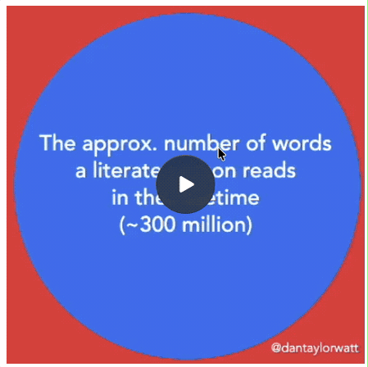
How much training data do LLMs learn from?
LLM developers do not usually share how big their training data is in number of words.
But we can estimate the number of words, when we understand how tokenising works. Each token is roughly ¾ an English word (according to OpenAI)
Meta (who own Instagram and Facebook) have their own LLM called LLama. Meta shared that their LLama 3.1 LLMs were trained on 15 trillion tokens, which is roughly 11 trillion words.
The animation compares the number of words humans read in their lifetime (300 million) to the words LLama LLMs read.
Source: Dan Taylor-Watt
Notes:
The slide is intended to help students see the scale of the training data used for training LLMs. As mentioned in the slide, LLM developers (like OpenAI and Google) are unlikely to share exactly how many tokens/words are used in their training but people have made estimates of more than 30 trillion tokens (more than the example in the slide).
The estimate from the article by Dan Taylor-Watt (the source of the animation on this slide), is calculated with the number of tokens used to train the Llama 3.1 models (15 trillion) multiplied by 0.75 (from the ¾ estimate given by OpenAI), which equals 11.25 (rounded to 11 trillion in this example).

Slide 13
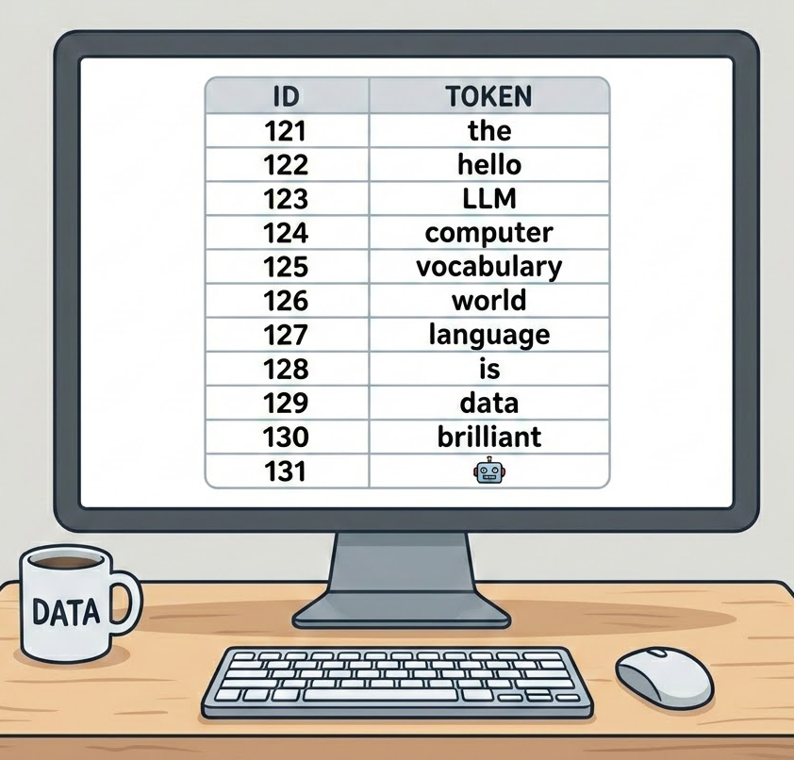
Vocabularies
Our vocabularies are the words that we know and understand.
For example, you probably know the words “apple”, “sentence” and “swim” and what they mean.
You can learn new words in lots of ways, for example, by reading books, talking with friends and in school.
LLMs’ vocabularies are learned during their training. Although they learn tokens and not words.
LLMs store the tokens as numbers and use them in their calculations, e.g, “the” could be stored as the number 121 like in the picture on the right.
Generated with NanoBanana
Notes:
The tokens that an LLM has in its tokeniser is referred to as its “vocabulary”. Similar to a human’s vocabulary, these are the words that LLMs “know” (although this is not just words, but sub-words, punctuation marks and other characters). The impact of different vocabulary sizes is quite complex and beyond the scope of this course. A larger vocabulary does not necessarily mean the model is better but the increase in vocabulary size has been one of the factors in improving recent models (and has helped support languages other than English).
A key point related to this slide, which is repeated through the lesson, is that LLMs don’t learn or know words the same way we do. For example, if you think of a food you love to eat (e.g, chocolate, a family recipe or meal from your favourite restaurant), you are likely to have some emotional association / feeling about that food (and it might also make you think of memories related to that food). However, LLMs just “see” these words as numbers and the patterns between them from their training data and do not experience them in the same way we do.

Slide 14
Token IDs
Token | ID
The | 976
un | 537
character | 38245
istically | 67862
over | 1072
- | 12
enth | 33774
usi | 9955
astic | 5620
Token | ID
scientist | 57204
waved | 135473
hello | 40167
. | 13
All the tokens in the tokenisation step become numbers. For example, IDs for the sentence “The uncharacteristically over-enthusiastic scientist waved hello.” are shown in the table.
These IDs have been generated using the OpenAI tokeniser.
You will learn more about how these Token IDs are used later in the lesson.
There are 200,000+ tokens in the tokeniser used in the OpenAI’s GPT 5 models (this is their vocabulary).
Notes:
This slide and the example IDs are shown on this slide to help communicate the huge number of tokens that LLMs can deal with. It’s important to note that the tokens won’t just be English words and sub-words. ChatGPT officially supports 59 languages (https://help.openai.com/en/articles/8357869-how-to-change-your-language-setting-in-chatgpt) and, therefore, the OpenAI tokeniser will have tokens from at least those 59 languages (and probably more).
You could get students to think about how many words they know. Estimates of the amount of words an “average” person knows is in the tens of thousands. Although it’s hard to make a direct comparison because we are comparing tokens and words, the scale of the LLMs’ vocabulary is so much larger than humans’ vocabulary (as was illustrated in the animation showing scale of training data in words).

Slide 15
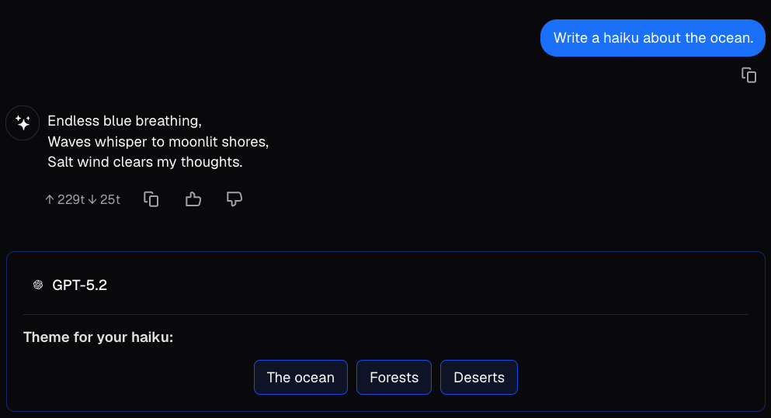


Tokens in Lumen
Have you noticed the token numbers shown in Lumen?
You can try this yourself on the platform or the Lumen site.
Tokens in Lumen page on platform
On Lumen site: Text Generation > Haikus
The orange box highlights the number of tokens sent to the LLM (GPT-5.2 in this example) and the number of tokens it sent back.
229 tokens sent to the LLM:
25 tokens sent back:
Notes:
Some students might notice that the number of tokens sent to the LLM is much more than you would expect from just the prompt “Write a haiku about the ocean” (or whichever prompt they choose to send). There is additional information that gets sent to the LLM (we call this the context window) that contributes to this number, which is discussed later in the lesson.

Slide 16

Understanding meanings of words
The tricky part with computers understanding language is that the same word can mean different things depending on the other words around it. For example:
“The bat flew away.” → “bat” is an animal.
“He swung the bat.” → “bat” is a cricket bat.
and:
“That joke was cool.” → “Cool” = good or impressive.
“The water is cool.” → “Cool” = a bit cold.
All the other words in the sentence help you decide which meaning is right. That “surrounding” part of the sentence is called the context.
Photo by Ishan @seefromthesky on Unsplash
Notes:
This slide establishes the core motivation for the transformer architecture in LLM models. The key idea is that meaning is not fixed. The meaning of a word depends on the words surrounding it and any system generating language must somehow handle this. That is precisely what the attention layer in a transformer does. You can return to this slide after introducing Attention in the transformer architecture and ask: "So which words do you think the model paid most attention to when processing the word 'bat'?"
Discussion prompts
Can you think of a sentence where the meaning of a word only makes sense because of the words around it?
How did you know which meaning of "bat" was correct in each sentence? Could you explain the rule you used?
If you covered up all the other words and only saw "bat", would you know what it meant?
Common misconception to address Students may assume computers handle language the way a spell-checker does by looking words up one at a time in a dictionary. This slide is a good moment to challenge that assumption: a dictionary gives you all possible meanings of "bat" but no way to choose between them without context.

Slide 17
Activity 5.02: Unplugged Context Activity
The activity is available on the platform here.
Download the worksheet here.
Notes:
The idea behind this activity is to get students to understand that as humans in order to detect the meanings of words in sentences, we use surrounding words in the sentence. These surrounding words are called context. For computers to be able to “understand” language, they will also need to be able to connect words in sentences to understand meanings. This activity is trying to “prime” the students to think about how they know what words in sentences mean.

Slide 18

Computers and maths
Computers are really good at maths. They can do billions of tiny calculations every second, much faster than any human.
People who build LLMs write special programs called algorithms that use huge numbers of these calculations to train the AI.
An algorithm is just a clear list of steps that a computer can follow, one after another, without getting confused.
Inside an LLM that works with language, every word gets turned into numbers so the computer can store it, compare it, and do maths with it.
Photo by Chris Liverani @chrisliverani on Unsplash
Notes:
The first key point here is that computers can do calculations very quickly and repetitively (over and over, without needing a break). For students, you could get them to think about how many maths problems (for example, using algebra to ‘solve for x’) they could do in a minute. Computers can do billions and billions of these problems in a second, without getting bored or tired.
The second key point here is that computers follow algorithms (step-by-step instructions). Students may have learned about algorithms in digital technologies, mathematics or other subjects and understand the term. However, some students may not be aware of this term and so this can be explained as a series of step-by-step instructions (like a recipe or a set of steps for tying shoelaces). In LLMs, these algorithms involve converting words and sentences into numbers, so that they can be worked with efficiently, as well as doing calculations.

Slide 19
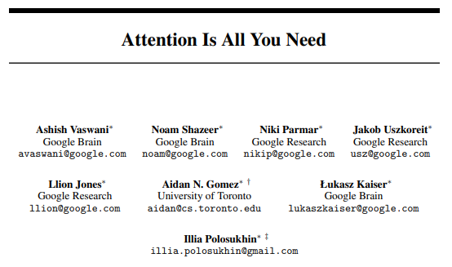
Transformer Architecture
Before the Transformer Architecture was introduced in a 2017 Google research paper: "Attention Is All You Need", machine learning models read words one at a time and could not remember relationships with words very far away in the sentence.
They had limited context.
The breakthrough was that Transformers could look at ALL the words at once and work out how each word relates to the others, even distant words.
The particular structure or architecture in the Transformers allowed for many different operations to happen all at the same time or “in parallel”.
Extract from Google research paper.
Notes:
This slide explains why the Transformer was a breakthrough by contrasting it with what came before. The two key ideas are: looking at all words simultaneously, and parallel processing.
Because operations happen in parallel, you can use thousands of computer chips simultaneously, which is what made it possible to train on billions of words and build models at the scale of GPT.
Discussion prompt Ask students: "Why might forgetting the beginning of a sentence cause problems?" Take a sentence like "The trophy didn't fit in the suitcase because it was too big" and ask what "it" refers to. A model that has forgotten "trophy" and "suitcase" by the time it reaches "it" has no way of answering correctly.

Slide 20
Simplified Transformer Architecture
Encoded lists of numbers
Predicted next word
Input Text
Tokens
Embed Meanings
Find word connections
Tokenise
Tokenise: the input text is tokenised
Embed Meanings: the tokens are turned into lists of numbers that encode their possible meanings
Find word connections: the transformer finds connections between the words represented as numbers using lots of thinking steps, stacked on top of each other all working at the same time.
Using those connections, the transformer then guesses which word is likely to come next.
Notes:
This slide is a very simplified version of what happens in the real transformer architecture which contains a lot more complexity in the Transformer block. If you wish to go into more detail you could say that the Transformer block is composed of many different layers of neural networks. Each layer has one part that checks which words are connected and another part that processes information.
Embedding is the starting point. Tokens arrive as meaningless ID numbers and embedding gives them an initial position in meaning-space. A useful analogy: it's like giving each word a postcode, a numerical address that roughly reflects where it "lives" relative to other words.
The key idea of the Transformer block is that it learns connections between words and this helps solidify meanings of words in their context.

Slide 21
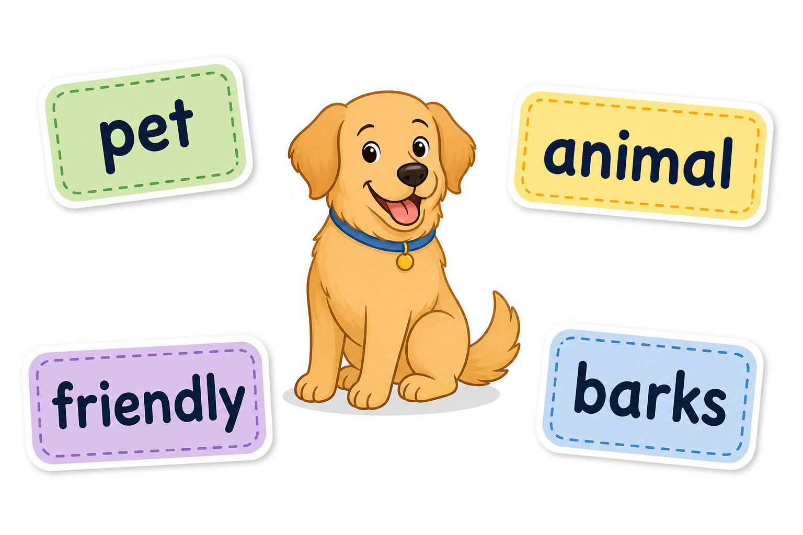
Embedding meanings
A token ID tells the computer which token it is looking at.
An embedding adds meaning clues, based on how that token was used in training.
Think of it like a library sticker: a sticker for “dog” might say pet, animal, friendly, barks.
Tokens with similar stickers means they are more related.
These meaning clues or embeddings are represented as lists of numbers so the computer can understand them and manipulate them.
Possible stickers for “dog” generated by ChatGPT-5.5
Notes:
This explanation is a simplification of what really happens. In the actual transformer model, these embeddings are represented by long lists of vectors (coordinates in multi-dimensional space). You can learn more about how it works here. Here, we avoid the vector concept and frame embeddings as meaning clues attached to tokens. Keep reminding students that the model is not understanding like a person. It is using patterns from training to decide which tokens are connected.

Slide 22
Activity 5.03: Human word map
The activity is available on the platform here.
Download the worksheet here
Notes:
In this activity, students rank some words according to two properties: living-ness and size. The idea is to get them to think about the different meanings that words can have. What they are effectively building is a tiny embedding space by hand. Each word's "sticker" was really just two numbers (living-ness, size). A real AI model does the exact same thing, except instead of 2 numbers, it uses hundreds, capturing far more clues than just "living" and "size."

Slide 23

Embeddings in real life
This is what embeddings look like in a real transformer: lists of 1000 numbers. They sometimes have 2000+.
That’s a lot of numbers - luckily computers are very good at working with them!
An animation showing 1,000 numbers in an embedding. Each token (200,000+ in GPT model) would have an embedding with 2,000+ numbers!
Notes:
Like the last slide, going into depth about the dimensions in LLMs is beyond the scope of this lesson. The slide is intended to illustrate the scale of LLMs again and why computers are so good at working with words as numbers.

Slide 24
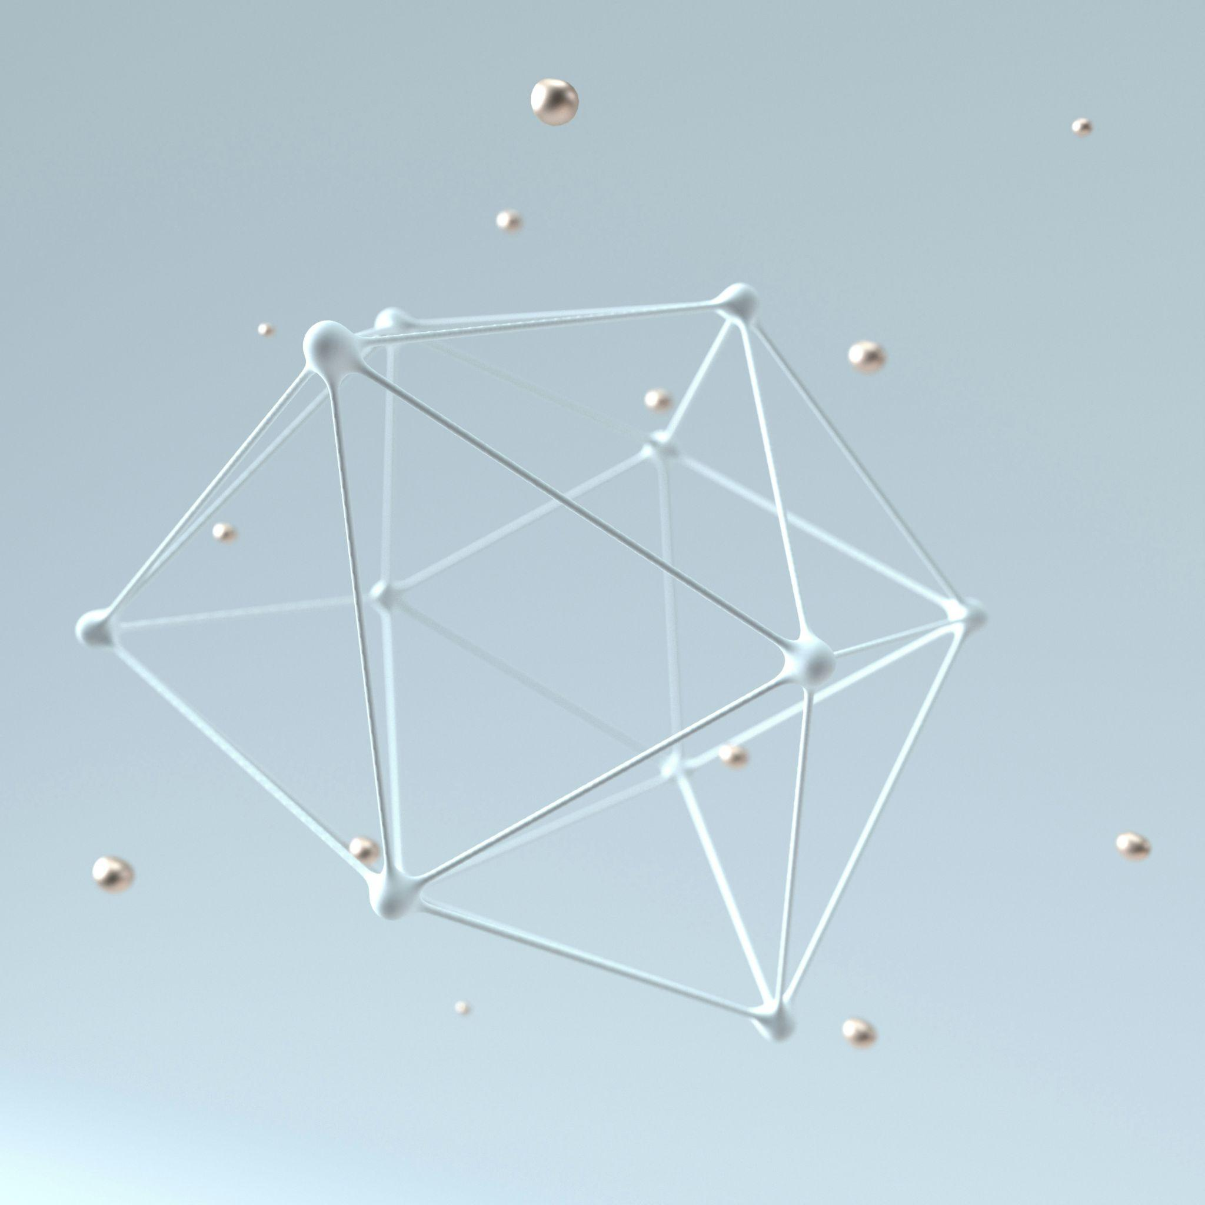
Finding word connections
In this step, each token looks at the other tokens around it in the sentence and works out which ones matter most for understanding its meaning here. This is called attention.
A word's sticker gives it a general meaning, but that meaning can change depending on the sentence. So the model checks nearby words for clues and updates the sticker on the spot.
"The bat flew out of the cave."
→ bat picks up clues from flew and cave → animal meaning
"He swung the bat at the ball."
→ bat picks up clues from swung and ball → sports equipment meaning
In a real transformer, this happens for every word in the sentence at the same time, not one at a time.
Photo by D koi on Unsplash
Notes:
Teacher note: This slide links embeddings to context. Students already saw ambiguous words earlier, so this makes the new idea feel connected to something they know.

Slide 25

Where does the training come in?
The model can only detect these connections between words like “bat” and “flew” because during training, it saw millions of sentences and adjusted its number‑lists so that words that often appear together ended up close to each other.
It doesn’t really understand that bats fly, like we humans do.
It’s not memorising single sentences; it’s memorising relationships between words.
Generated by ChatGPT 5.5
Notes:
The key point in this slide is the transformer does not understand language, it just works out which words are connected to each other by looking at millions of examples.

Slide 26

Predicting the next token
The model then predicts possible next tokens by giving every possible token (~ 50000) in its vocabulary a score. For example in: The dog chased the …
Possible next token | Probability
“cat” | 60%
“ball” | 25%
“rabbit” | 10%
“.” | 5%
…. | ….
Photo by Sasun Bughdaryan on Unsplash
There are over 50 000 rows here! And the sum of all probabilities must sum to 100%.
Notes:
This slide shows students that the model doesn't "choose" a word so much as produce a probability distribution across its entire vocabulary. That is, for each word in its vocabulary it has a probability that it should come next.
The 50,000 tokens point Every single token in the vocabulary gets a score every single time, even completely irrelevant ones like "Antarctica" or "photosynthesis." The model assigns them near-zero probability but they are still scored. This gives a sense of the scale of computation happening with every single response.
Probabilities summing to 1 A good moment to briefly connect to maths. This is a probability distribution, meaning all scores must add up to 100%. If cat gets 60%, that leaves only 40% for every other word in the vocabulary combined.
The sampling point Students will likely ask "so does it always pick cat?" The answer is no, and this is where temperature comes in. The model samples from the distribution, meaning lower probability tokens can still be chosen occasionally. This is what makes responses feel varied rather than robotic. We will look at Temperature in more detail in a later slide.
Discussion prompt "Why might it be a bad idea to always pick the highest probability token?" This leads naturally into a discussion of creativity, temperature, and why AI responses don't always sound the same.
Common misconception Students often assume the model "knows" the right answer and is choosing it. Reframe this as the model has no concept of correct, only of likely. Everything is probability.

Slide 27

AI Chatbots: software with settings
Although sometimes AI chatbots feel like magic, they are not.
They are just powerful software programs. And like any other software program, they contain many “settings” you can tweak to achieve different outputs.
One setting is the maximum number of tokens that can be generated in a single response. For ChatGPT 5.2, that maximum is roughly 128 000 tokens, which is roughly the size of the first Harry Potter book.
Generated by Claude Sonnet 4.6
Notes:
The aim of this slide is to teach students that AI is software with settings, not magic. This builds critical and analytical thinking about AI tools.
Temperature, max tokens, and context window size are all just settings. Framing them this way helps students see AI as something engineered and controllable rather than mysterious and autonomous.
You may want to ask: "Does 128,000 tokens sound like a lot? What could you fit in that space?"

Slide 28

Temperature
The ‘temperature’ setting of an LLM controls how creative or random the generated output of the LLM is. It varies between 0 and 2.
Remember that an LLM works by predicting the most likely next word. Every time it picks a word, it's actually looking at a list of thousands of possible next words, each with a probability score.
At low temperature, the LLM almost always picks the highest probability word. Every time you ask the same question you get very similar answers.
At high temperature, it gives the lower probability words a much better chance of being chosen. The results get more surprising, more creative and sometimes more nonsensical.
Photo by Immo Wegmann on Unsplash
Notes:
This slide connects the prediction mechanism students already understand to a concrete, tweakable parameter. However, it is worth pointing out that regular users of chatbots like ChatGPT will not be able to change the temperature. This is a setting only available to developers and users of Lumen.
The key point here is that Temperature doesn't change what the model knows. It changes how it samples from the probability distribution. The same vocabulary scores are produced either way; temperature just adjusts how strictly the model follows them.
Students will get to investigate themselves on Lumen in the next activity.
Discussion prompt Ask: "When would you actually want a low temperature?" and "When would high temperature be useful?" It leads in well to the next slide.
Common misconception Students may think high temperature means the model is "trying harder" or "being smarter." Clarify that it is simply being less conservative. It's not more intelligent, just more willing to take risks with lower-probability words.

Slide 29
Temperature Example
Possible next token | Probability
“cat” | 60%
“ball” | 25%
“rabbit” | 10%
“.” | 5%
…. | ….
The dog chased the …
“Low” temperature might always pick the highest probability token:
The dog chased the cat.
“Higher” temperatures will increase the range of tokens and might give:
The dog chased the rabbit.
Notes:
This slide connects the prediction mechanism students already understand to a concrete, tweakable parameter. However, it is worth pointing out that regular users of chatbots like ChatGPT will not be able to change the temperature. This is a setting only available to developers and users of Lumen.
The key point here is that Temperature doesn't change what the model knows. It changes how it samples from the probability distribution. The same vocabulary scores are produced either way; temperature just adjusts how strictly the model follows them.
Students will get to investigate themselves on Lumen in the next activity.
Discussion prompt Ask: "When would you actually want a low temperature?" and "When would high temperature be useful?" It leads in well to the next slide.
Common misconception Students may think high temperature means the model is "trying harder" or "being smarter." Clarify that it is simply being less conservative. It's not more intelligent, just more willing to take risks with lower-probability words.

Slide 30
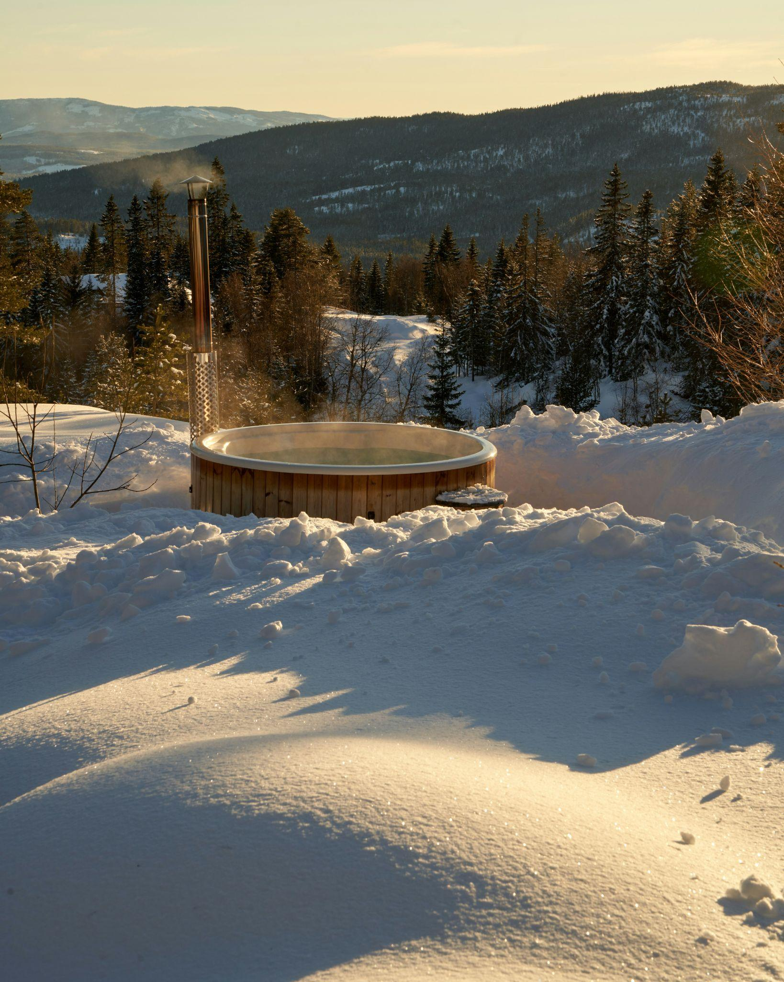
Changing Temperature
High temperature (creative, unpredictable)
Use when you want variety, originality, or playful output:
Writing a short story or poem
Brainstorming ideas for a product name
Generating jokes or creative slogans
Coming up with unusual solutions to a problem
Low temperature (precise, reliable)
Use when you need accuracy, consistency, or a single correct answer:
Answering a factual question
Summarising a document
Writing code
Giving step-by-step instructions
Photo by Barnabas Davoti on Unsplash
Notes:
The purpose of this slide is to clarify when to use high temperature and when to use low temperature.
The underlying principle is simple: if there are many good answers, temperature up. If there is one right answer, temperature down. Everything on this slide follows from that rule.
Discussion prompt Present some ambiguous cases and ask students to debate which temperature they'd use. “Write me a birthday message for my friend", "Explain how photosynthesis works", "Give me a catchy name for my YouTube channel." There are no perfectly right answers, which is the point.
Extension activity Ask students to add one example of their own to each column. This tests whether they have genuinely understood the principle or just memorised the examples on the slide.
Common misconception Students may assume low temperature is always "safer" or better. Emphasise that for creative tasks, low temperature actively produces worse outputs: predictable, bland, repetitive.

Slide 31
Activity 5.04: Changing Temperature
Complete the activity on the platform
Download the worksheet here.
Notes:
The aim of this activity is to show the effect of changing the temperature of the model.

Slide 32
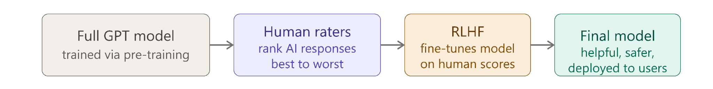
Reinforcement Learning from Human Feedback (RLHF)
This is where real humans raters rank responses to certain prompts and these rankings are ‘fed back’ into the Transformer to train it to improve the model output.
RLHF is a training process applied to the whole model after it has already been built and pre-trained.
Generated by Claude Sonnet 4.6
OpenAI’s breakthrough with the first ChatGPT in November 2022 was fine-tuning their massive pre-trained GPT model using real human feedback to train it to be more helpful and conversational, like a real assistant.
Notes:
This slide explains the key step that turned a raw next-token predictor into something that feels like a helpful assistant and grounds it in a moment students may have heard of.
It is worth emphasising that real people were paid to read model responses and rank them. AI improvement here was literally driven by human judgement, not just more data or bigger computers.
Many students will have heard of ChatGPT. This slide explains why it felt so different from anything that came before. The underlying model wasn't entirely new; what changed was RLHF shaping its behaviour.
Discussion prompt Ask: "What problems might come up if the human raters all share similar backgrounds or opinions?" This naturally leads into bias in AI, which connects well to earlier slides on critical thinking and hallucinations.

Slide 33
Activity 5.05: Rating Lumen
Complete the activity on the platform
Download the worksheet here.
Notes:
The aim of this activity is to give students a flavour of rating LLM responses themselves. This is not the same as real RLHF but it should prompt them to reflect about how the person who is rating the response has a bias and that the decisions they make may affect the contents of the final model.

Slide 34
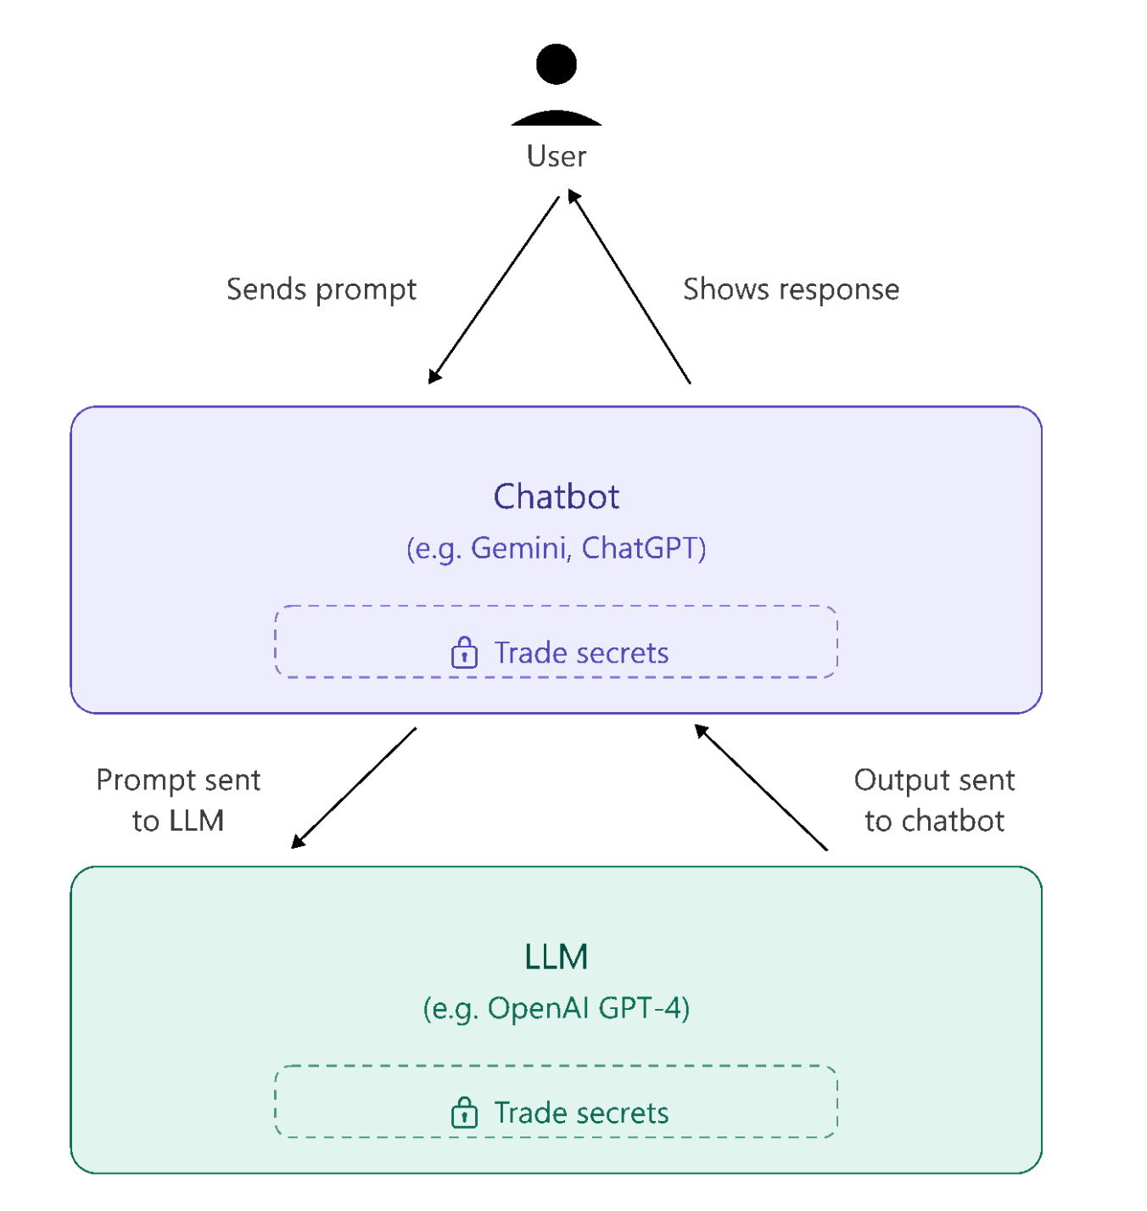
How are LLMs used?
Most people use LLMs by interacting with a chatbot or agent interface.
Although LLMs generally work the same way and we know how these algorithms work, different chatbots and LLMs have features that we don’t know about, which we call ‘trade secrets’.
Generated by Claude Sonnet 4.6
Notes:
Everything surrounding the LLM that allows people to use LLMs as chatbots is sometimes called the “Harness”.
This slide introduces the distinction between what we know about LLMs in general and what specific companies keep private, building critical awareness that not all AI systems are equal or fully transparent.
Examples of what companies keep secret include the exact composition of training data, how RLHF was conducted, safety filtering rules, and system prompt instructions. Students should understand that even experts cannot fully understand a commercial AI product.
The LLM itself is just the core engine, but what users actually interact with is a harness built around it: the chatbot interface, filtering layers, system prompts, routing logic, and safety guardrails. The harness is where most of the trade secrets live, and different companies build very different harnesses around similar underlying models.
Discussion prompt Ask: "Does it matter that we don't know exactly how a chatbot works? Should companies have to be more open about this?" This connects well to broader discussions about AI regulation, trust, and accountability.
Common misconception Students may assume that because we understand how transformers work in theory, we therefore understand any specific chatbot fully. This slide is the moment to challenge that assumption. Understanding the architecture is not the same as understanding the harness built on top of it.

Slide 35

‘Trade secrets’
AI companies keep some details about their products secret. This includes exactly what training data was used and how RLHF was done.
Chatbots also filter and ‘pre-process’ your prompt even before it reaches the LLM, checking it, modifying it and sometimes sending it to a completely different model.
For example, if we ask to generate an image using the Gemini chatbot, it will send our prompt to NanoBanana (an image generation model), instead of an LLM.
Chatbots can also add extra information to your prompt behind the scenes like instructions or safety guidelines that you never see but they shape your final response.
Screenshot of Google Gemini (with Nanobana generated banana)
Notes:
This slide makes the "harness" concept concrete, moving from the abstract idea that there are trade secrets to showing students exactly what kinds of hidden processing happen between typing a prompt and receiving a response.
A useful analogy: your prompt goes through security screening before it reaches the model, just like luggage at an airport. Things get checked, sometimes modified, and occasionally redirected entirely.
Chatbots route requests to whichever model is most appropriate, not just a single LLM.
Those hidden system prompt instructions are real tokens taking up real space in the context window, even though users never see them.
Discussion prompt Ask: "If a chatbot is modifying your prompt before sending it, does that change who is responsible for the output?" This opens up interesting discussion about accountability and transparency in AI products.
Common misconception Students often assume what they type is exactly what the model sees.

Slide 36
The Context Window
Context window
Our prompt
LLM’s responses in conversation
The Context window is everything the model can see at once: your messages, its replies and anything else in the conversation.
Metadata is extra background information like the date, your location (from your IP address) or instructions the developer has set in advance.
Metadata
LLM
Attachments
Previous prompts in conversation
Notes:
This slide lists examples of what's inside the context window and introduces metadata as a concrete example of hidden information students didn't know was being sent.
The location and IP address detail tends to surprise students and spark good discussion about privacy. Most students won't have considered that simply opening a chatbot reveals information about them before they've typed anything.
Discussion prompt Ask: "Does it bother you that the model knows your location before you've said anything?" This connects naturally to broader privacy and data literacy discussions.
Link to context window limits Remind students that all of this, including metadata, takes up tokens, leaving less room for the actual conversation.

Slide 37

The Context Window
Imagine you're having a long conversation with a friend, but every time you say something new, they forget a little bit of what was said earlier. What problems might that cause?
Notes:
This slide is an opportunity for students to stop and pause and think about how humans have conversations and how important remembering what was said is to having a meaningful conversation.

Slide 38
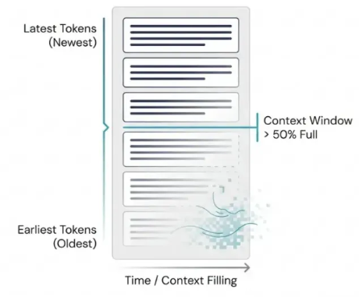
Context windows
Every model has a limit for its context window in terms of number of tokens. For example GPT-4 can hold around 128 000 tokens at once, roughly the length of a novel.
Limits have increased in size as LLMs have become more advanced and more people have started using them.
The longer you chat with an AI, the worse it tends to perform. This is called Context rot.This happens because as the context window fills up the model starts losing track of things.
Extracted From ProductTalk
Notes:
This slide connects the abstract concept of the context window to the practical limitation of AI responses getting worse in long conversations.
You can mention that the limit includes input and output tokens.
Discussion prompt Ask: "If you were building a chatbot to help students with homework, what would you prioritise putting in the context window?" This makes the trade-offs feel real and practical.
Common misconception Students may think a larger context window solves all problems. Clarify that even with a huge context window, the model's performance can still degrade as it fills up. More space delays the problem but doesn't eliminate it.
For the interested teachers, here is a link to the paper about Context Rot. In fact, when the context window is less than half full, the model tends to forget things in the middle; when it's more than half full, it starts losing the earliest parts of the conversation instead.

Slide 39

Grounding
By default, most LLMs only know what they learned during training which has a cutoff date and no knowledge of current events, private documents, or anything that happened after training ended.
Grounding is what fixes this by connecting the LLM to real, external information before it generates a response.
Some chatbots can use web search in real time to incorporate other information.
Another way is for users to upload PDFs, spreadsheets, or text files directly into a conversation. ChatGPT reads the document and grounds its responses in the actual content of that file rather than guessing from training data.
Photo by Fer Troulik on Unsplash
Notes:
This slide addresses one of the most common real-world limitations of LLMs, the training cutoff, and introduces grounding as the practical fix students can use right now.
The cutoff point Ask students: "What important things have happened in the world that an LLM trained two years ago wouldn't know about?" — makes the limitation feel concrete and relevant.
Uploading a PDF and asking questions about it is a genuinely useful study skill. Students will get to do that in the next activity.
Discussion prompt Ask: "If an LLM is connected to the web, does that make its answers more trustworthy?" The answer is not automatically yes, since web sources vary in quality, as was discussed in the earlier lesson about Trusted Sources.
Common misconception Students often assume LLMs have access to current information by default. This slide directly corrects that assumption and gives them a mental model for when to trust a response and when to verify it.

Slide 40
Activity 5.06 Grounding Activity
Link to activity on platform
Download the worksheet here.
Notes:
The aim of this activity is to show that students can add to the chatbots knowledge by uploading documents. There are also other ways chatbots increase their knowledge by using Web Search, other external tools like Weather services and sometimes external databases often in large business contexts.

Slide 41
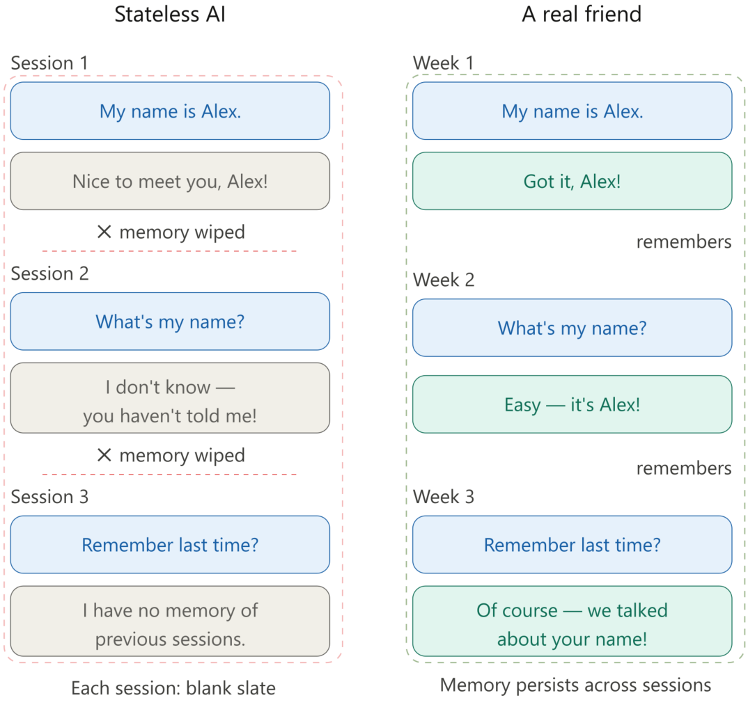
Stateless AI
Stateless AI describes the fact that In an LLM every conversation starts fresh. It has no memory of previous chats or sessions.
This is by design. Permanent memory could raise serious privacy and surveillance risks, so starting fresh after each session protects users.
As you chat with an AI like Lumen, the token count builds up as you go. When you reset the conversation, the token count starts back at zero.
Generated by Claude Sonnet 4.6
Notes:
This slide explains why AI doesn't remember you between sessions.
If AI remembered everything across all sessions, that data would need to be stored somewhere making it vulnerable to hacking. The stateless design is a deliberate trade-off between convenience and privacy.
As the conversation grows, the context window fills. Resetting clears it completely. This links stateless AI back to the context window concept and reinforces both ideas simultaneously.
Discussion prompts
"Would you want an AI to remember everything you've ever told it? What are the advantages and risks?"
"Can you think of situations where you would WANT the AI to remember you and situations where you would NOT?"
"How is this different from how Google remembers your search history?"
Common misconception Some students may confuse the model's training knowledge with memory. "It knows things so it must remember me." Clarify that knowing facts from training is completely different from remembering a specific user's previous conversations.

Slide 42
Activity 5.07: Stateless AI
Link to activity on platform
Download the worksheet here.
Notes:
In this activity students see first-hand the statelessness of Lumen, their AI chatbot.

Slide 43
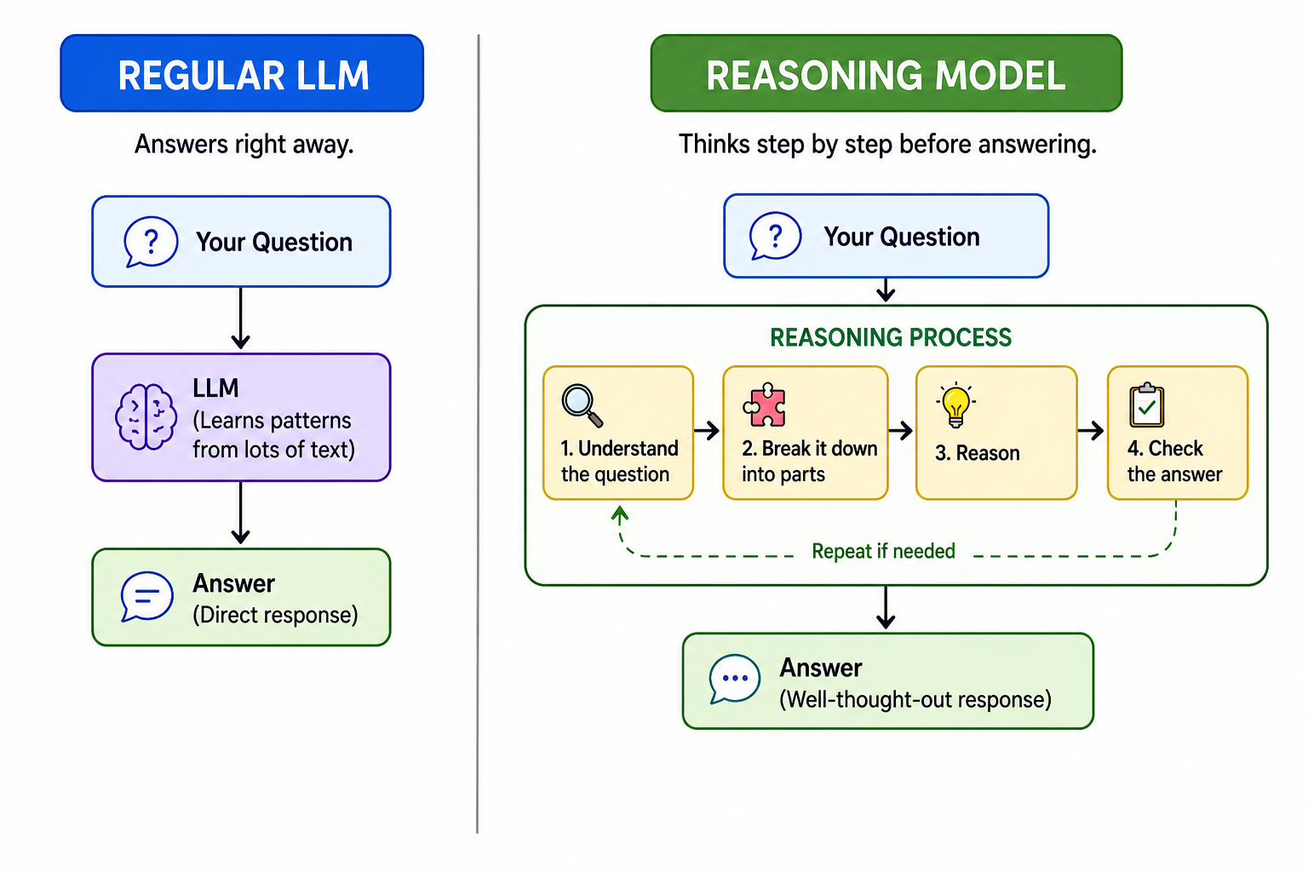
Reasoning models
A standard LLM generates one token at a time, in a single pass through the transformer.
It has no ability to pause, reconsider or check its own work.
A reasoning model adds a reasoning phase before the final response. It’s like a scratchpad where the model works through the problem step by step before committing to an answer.
They are usually used for tasks that require careful step-by-step thinking like complex coding or multi-step logic problems.
Generated by ChatGPT 5.5
Notes:
This slide introduces reasoning models as a natural extension of what students already know, the same transformer architecture, but with an added reasoning phase before committing to an answer.
It’s worth emphasising that the reasoning phase is real token generation. The model is literally producing text as it reasons, not running a hidden calculation. Students can often see this reasoning process in tools like ChatGPT o1.
Discussion prompt Ask: "Can you think of a question where thinking step by step would really matter versus one where a quick answer is fine?" Students quickly grasp that "what is the capital of France" doesn't need a reasoning model but "write me a proof" does.
Common misconception Students may assume reasoning models are always better. Clarify that they are slower and more expensive — for simple tasks a standard LLM is faster and perfectly adequate.

Slide 44

Training Reasoning models
On top of the standard LLM pre-training, reasoning models go through additional training steps:
Learning from examples: the model is shown extra examples which include the step-by-step reasoning involved.
Reinforcement Learning from Human Feedback: Human raters score the quality of the reasoning steps provided as well as the output.
Reward-based training: For tasks like maths and coding, the model's answers can be automatically checked; either the answer is right or it isn't. The model gets rewarded for correct answers and penalised for wrong ones, training it to develop better reasoning strategies over millions of attempts. This is a form of reinforcement learning.
Photo by Michael G on Unsplash
Notes:
This slide shows how reasoning models are trained differently from standard LLMs. This connects back to concepts students already know like RLHF and reinforcement learning.
The learning from examples is the same as pre-training students have learnt about except these use examples that explicitly include reasoning steps, teaching the model that thinking out loud is valuable.
Here human raters are evaluating the quality of the reasoning steps, not just whether the final answer felt helpful. The process is more demanding and more precise.
For maths and coding, you don't need human raters at all because correctness is automatically verifiable. It’s worth emphasising the scale: millions of attempts, each generating a reward or penalty signal, gradually pushing the model toward better reasoning strategies.
Nobody explicitly programmed the model to "think step by step". It discovered that strategy itself because careful reasoning kept getting rewarded. Students usually find this genuinely surprising.
Discussion prompt Ask: "Why can't we use automatic reward checking for every task?" This may lead into a discussion of tasks where there is no single right answer, like writing or advice, and why those still need human judgement.

Slide 45

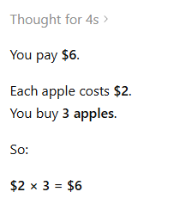
Reasoning models Example
ChatGPT5.5 in Thinking Mode is a reasoning model and when given this simple prompt, it replied with the steps it used to calculate the answer:
ChatGPT 5.5 Thinking
Notes:
Remind the students that while not all common chatbots are Reasoning models, most of them have a Reasoning model included, like ChatGPT and you can select it.
Also, just asking any LLM to “explain your thinking” usually gives you much more information about how the final answer was reached.

Slide 46
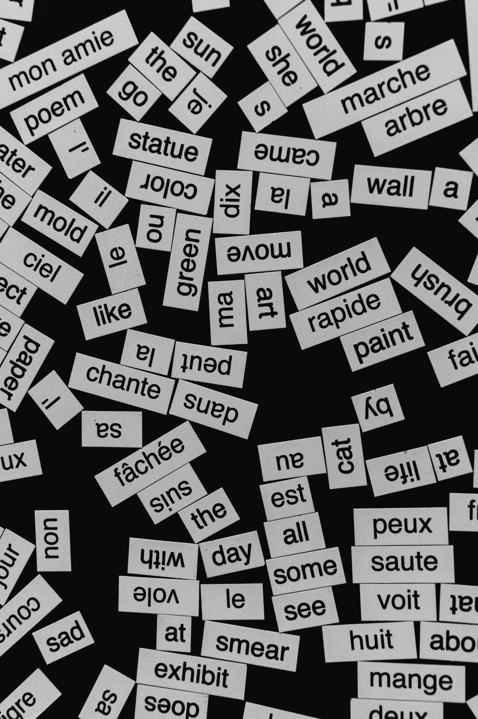
LLMs and Understanding
As you have learned, LLMs don’t really understand language the way humans do.
They build a mathematical picture of how words relate to each other and generate text by choosing the most likely next token.
Despite this, the results of LLM are very convincing and often correct.
This is because LLMs are trained on a huge amount of data and fine-tuned through RLHF.
Photo by Aedrian Salazar on Unsplash
Notes:
This slide addresses the fact that LLMs produce convincing, often correct output without genuine understanding. It's important students leave with this nuance rather than either over-trusting or dismissing AI.
Reinforce that the model has no concept of truth, meaning, or intention. It has learned statistical patterns across billions of examples. When it gets things right, it is because those patterns are reliable, not because it understands.
A useful analogy is: a parrot that has heard enough conversations might produce sentences that sound meaningful but we wouldn't say it understands language. LLMs are vastly more sophisticated, but the underlying principle is similar.
Discussion prompt Ask: "If an AI always gives you the correct answer, does it matter whether it truly understands?" This generates genuine debate and there is no clean answer, which is the point.
Common misconception Students often conflate accuracy with understanding. Separating these two ideas is one of the most important outcomes of the whole lesson.

Slide 47
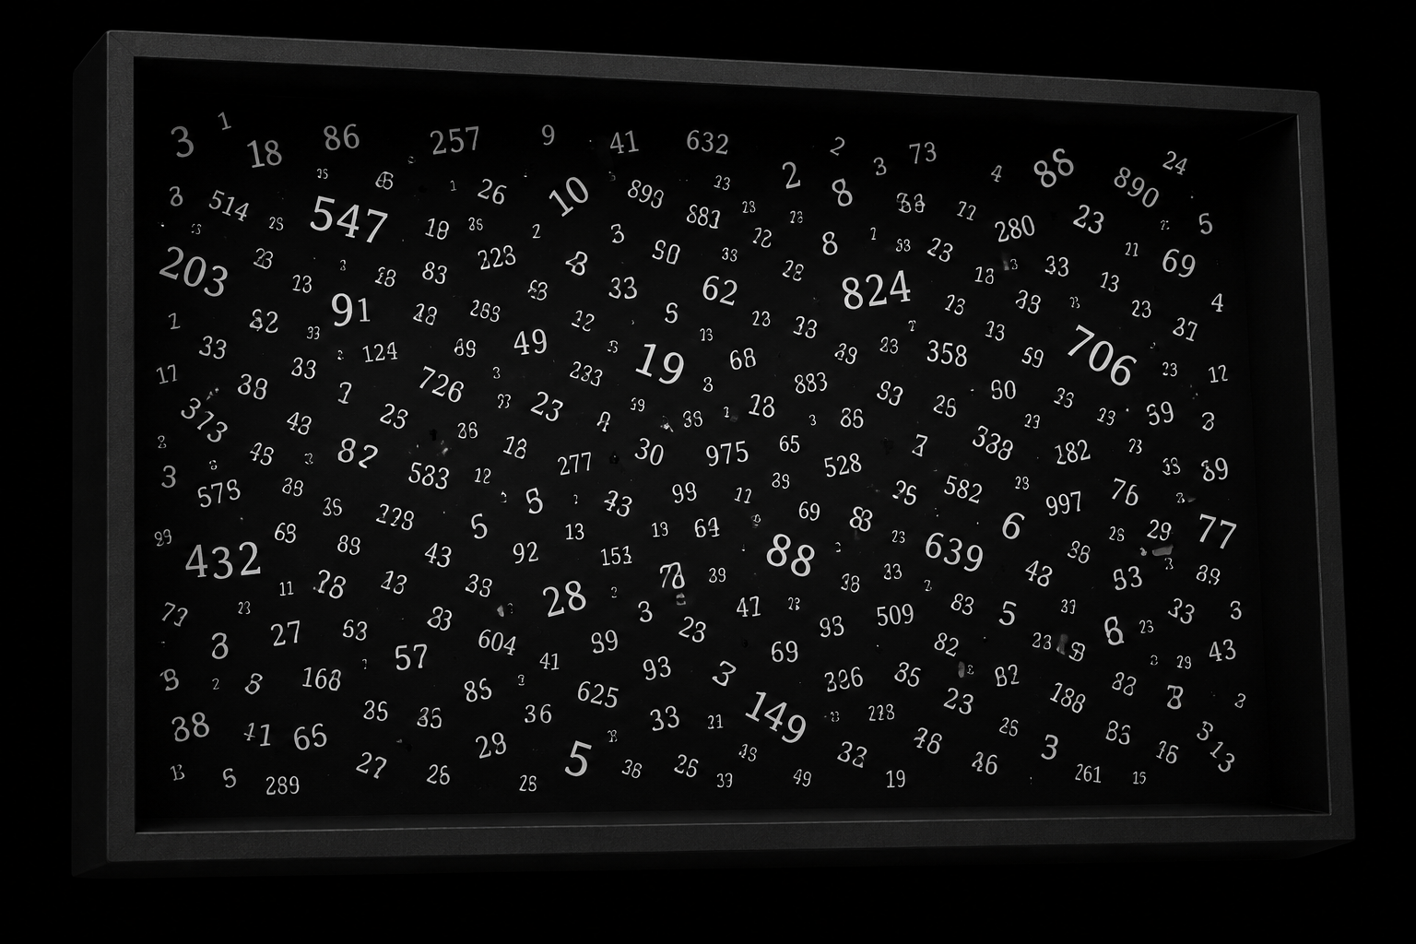
Humans understanding LLMs
Although humans have developed the algorithms (step-by-step instructions) to train LLMs and know how to build them, there are parts of how they work that we don’t understand.
Developers can’t really explain why an LLM has responded the way it did even though they understand the maths behind it. This is why we called it a black box earlier in the lesson.
If we try and look inside this black box then all we would see is numbers.
That’s why it’s important to think critically when using LLMs and consider how bias and hallucinations might impact the responses.
Black Box generated by ChatGPT 5.5
Notes:
This slide introduces the black box concept and uses it to motivate critical thinking. The fact that even experts can't fully explain LLM outputs is a strong argument for not taking responses at face value.
A useful analogy: Imagine a machine that always produces the right answer but you can never see inside it or understand why. Would you trust it completely? This is roughly the situation with LLMs. We understand the architecture but not the specific reasoning behind any given output.
The "we built it but don't fully understand it" point This genuinely surprises students and is worth dwelling on. Researchers are actively working on a field called interpretability, trying to understand what is happening inside these models. It remains one of the biggest open questions in AI.
The black box nature is precisely why bias and hallucinations are hard to detect and fix. If you can't see why the model said something, you can't easily identify where it went wrong.
Discussion prompt Ask: "Should we be allowed to use technology we don't fully understand?" This connects to broader discussions about AI regulation, accountability, and trust.
Common misconception Students may assume that because the maths is known, the behaviour is fully predictable. Clarify that knowing the rules of a system does not mean you can predict every output it produces.

Slide 48

LLMs vs Rules
LLMs are amazing technology but not always the best choice for solving problems.
Some problems are best solved with clear, fixed rules. Like calculating how much pocket money you get in a month, or counting how many times a word appears in a sentence.
LLMs are best when the task requires judgement, creativity or handling language in a flexible way: like summarising an essay, answering an open question, brainstorming product ideas or explaining a complex idea.
Rules-based systems are best for problems requiring precision and accuracy, like automatically flagging suspicious credit card transactions or calculating the fastest route based on live traffic data or alerting a nurse if a patient’s heart rate increases too quickly.
Photo by Jonny Gios on Unsplash
Notes:
This slide reminds students that knowing when to use an LLM versus a rules-based system is as important as knowing how LLMs work.
The credit card, traffic, and heart rate examples are intentionally high-stakes — they illustrate that in safety-critical situations, deterministic rules are not just preferable but essential. An LLM making a probabilistic guess about a patient's heart rate is dangerous.
Discussion prompt Present some cases and ask students to debate: "Is this a rules problem or an LLM problem?" Good examples include — "Is this essay plagiarised?", "Should this loan application be approved?", "What is the best treatment for this patient?"
Common misconception Students may assume that because LLMs can attempt any task, they are always the right tool. This slide directly challenges that assumption. The right tool depends entirely on the nature of the problem.

Slide 49
Rules-based Example
Here is a rules based AI which detects a cat or dog. BUT there is an error, can you spot it and fix it?
IF barks THEN DISPLAY "Animal is a cat!" ELSE IF purrs THEN DISPLAY "Animal is a dog!" ELSE DISPLAY "Unknown animal!"
Photo by Jonny Gios on Unsplash
Notes:
This is a simple example to show that we know how to fix mistakes in rules-based systems. By the way just swap the barks and purrs and you’ll get the correct version.

Slide 50

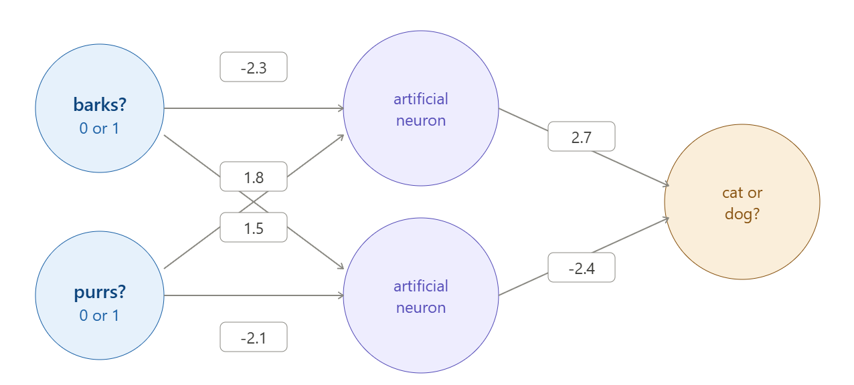
AI Example
Here is the LLM version with the same error. Can you fix it?
Photo by Steve A Johnson on Unsplash
made with Claude Opus 4.7
We can’t fix the LLM version in the same way as the rules-based AI version. We don’t know what the numbers represent the same way that we can ‘read’ and ‘understand’ the rules. We need to retrain and retest (which can take a lot more time).
Notes:
The aim of this example is to show how hard it is to understand how AI works. The answer is no by the way, you can’t fix it.

Slide 51
Activity 5.08: Categorisation Activity Rules vs LLM
Link to activity on platform
Download the worksheet here.
Notes:
The aim of this activity is to get the students thinking about when it might be appropriate to use Rules-based systems vs LLM based systems.

Slide 52

Tokenisation and how words are converted to numbers
Transformer Architecture
Reinforcement Learning from Human Feedback
Context windows
Stateless AI
Grounding
Reasoning models
LLMs and Understanding
Summary
You should now have a better understanding of:

Slide 53
License Information
These Tech Futures Australia lessons plans, worksheets, and other materials were created by the Tech Futures Australia team. They are licensed under a Creative Commons Attribution-ShareAlike 4.0 International License.

