Slide 1


LAB3: Risc-V RX and LPDDR4 Memory Controller
CertusPro-NX
MAS Educational Board
Ferrari Fabizio
fabrizio.ferrari@arrow.com
Cell: +39 348 711 33 52
Boschini Marco

Slide 2
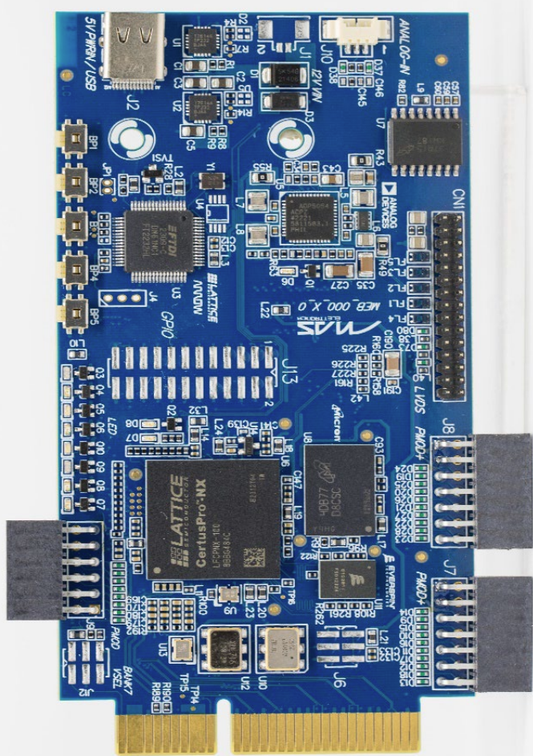
MAS ARROW Educational Board
https://maselettronica.com/prodotti-mas/mas-educational-board-certus-pro-nx/

Slide 3
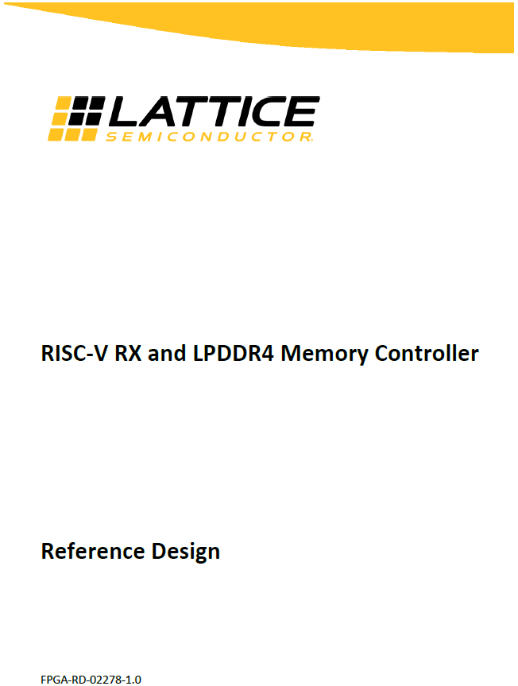
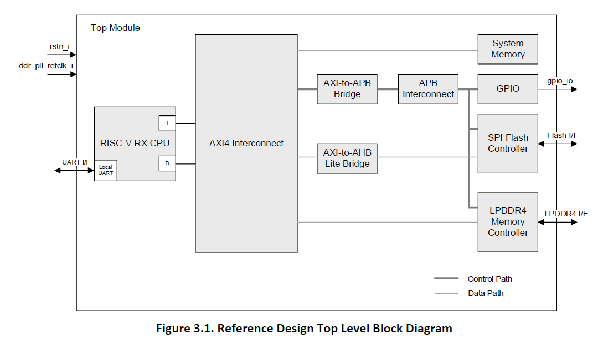
Lattice Reference Design FPGA-RD-02278-1.0

Slide 4
LAB3 AGENDA
Task 1: Create Propel Workspace and Import SOC Design Project
Task 2: Analyze SOC Design Project in PROPEL BUILDER
Task 3: Generate and Run RADIANT Project
Task 4: Generate basic “Hello World” and Debug it on internal RAM and external LPDDR4
Task 5: Analyze Boot up sequence of FPGA-RD-02278
Task 6: Import and Analyze Bootloader SW
Task 7: Import and Analyze FreeRTOS app and Deploy it
Task 8: Deploy FreeRTOS application on external Flash by Phyton
Task 9: Run again Bootloader in Debug mode
Task 10: Deploy Bootloader on internal RAM by ECO Editor tool

Slide 5
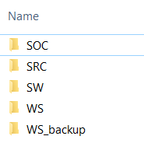
LAB3 Task1
Copy LAB3 folder to your laptop disk (i.e. C:\LAB3)
LAB3 contents:
SOC → SOC Design project
SRC → pinout file, main.C task???, ???
SW → #2 SW projects, Bootloader and FreeRTOS
WS → Empty workspace
WS_backup → Radiant already developed project

Slide 6
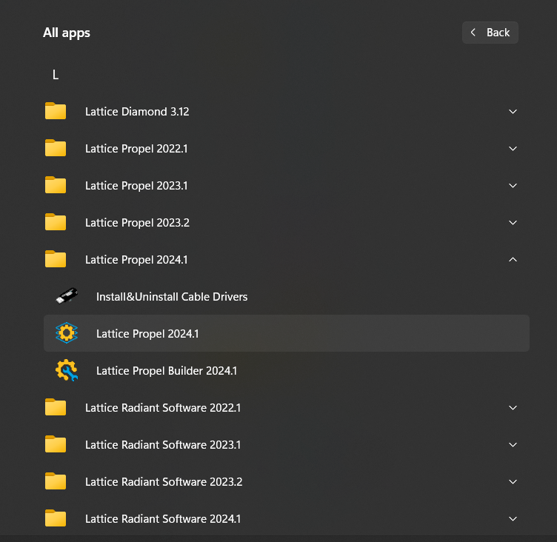
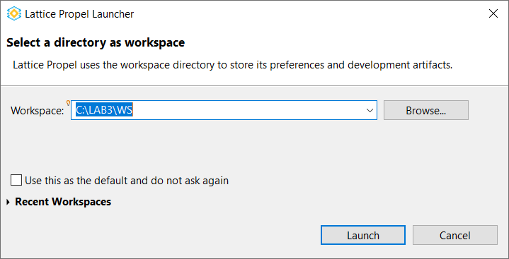
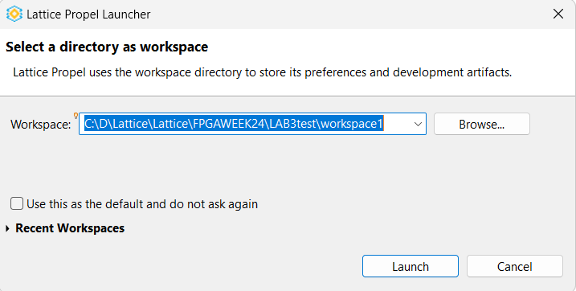
LAB3 Task1
1) Start → Lattice Propel 2024.1 → Lattice Propel 2024.1
2) Select folder WS in the main folder LAB3
(NOTE: it doesn’t matter the name, space char is not allowed)
3) Click on Launch
2
2
1
3

Slide 7
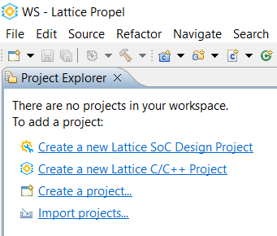
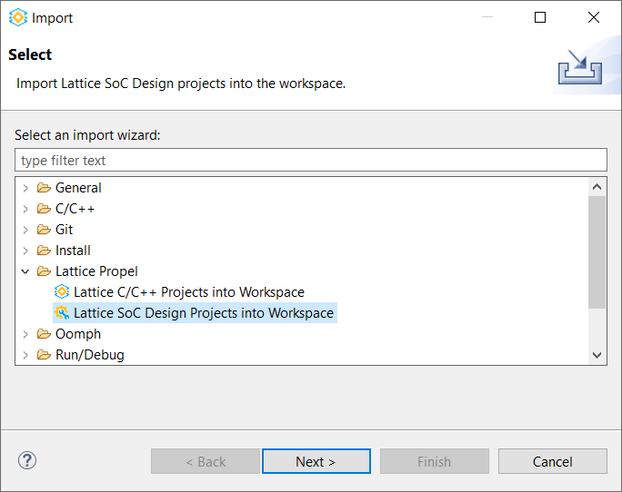
LAB3 Task1
Lattice PROPEL tool is launched
1) Click on "Import projects ..."
2) Select "Lattice SoC Design Projects into Workspace" then Next
2
1

Slide 8
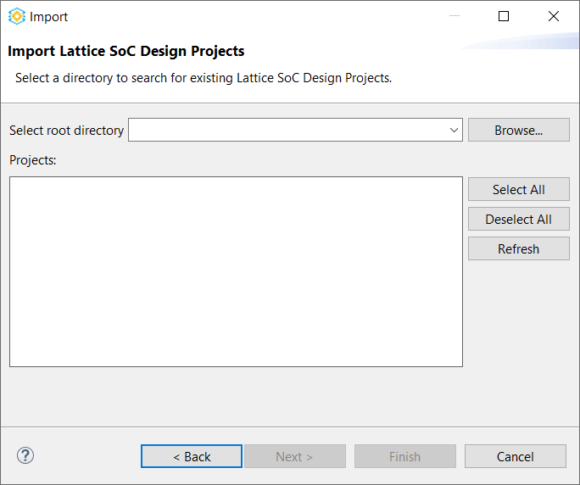
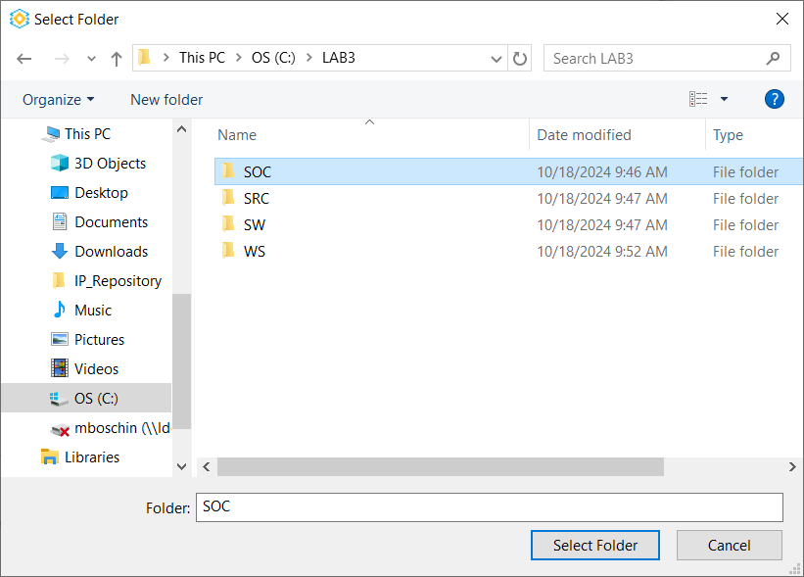
LAB3 Task1
Click on "Browse..."
Select folder SOC and then click on "Select Folder"
1
2

Slide 9
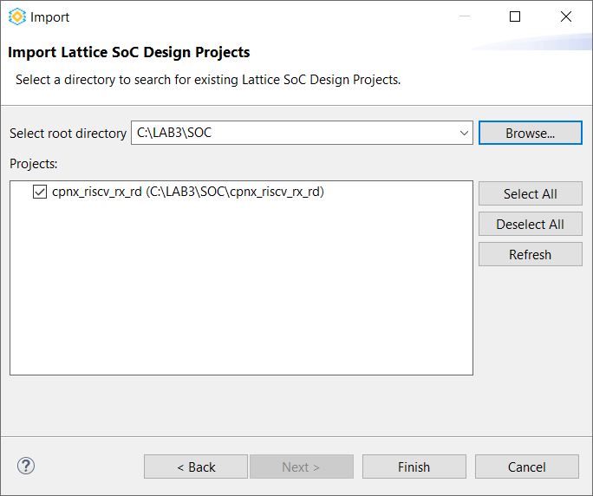
LAB3 Task1
Project section is auto-populated with the SOC Design project
Click on Finish to import the CPNX_RISCV_RX_RD design

Slide 10
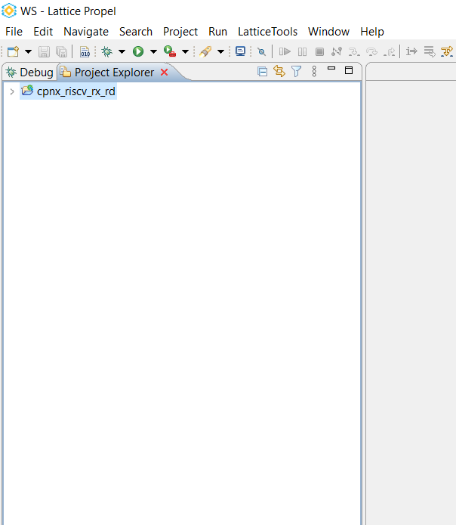
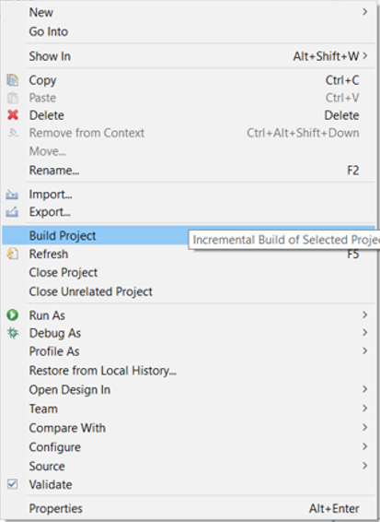
LAB3 Task1
Select CPNX_RISCV_RX_RD project
in Project Explorer and then
right click on Build Project

Slide 11
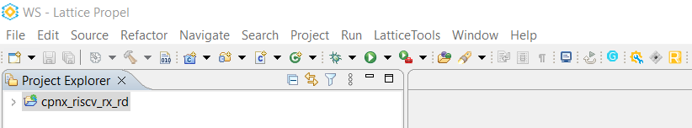
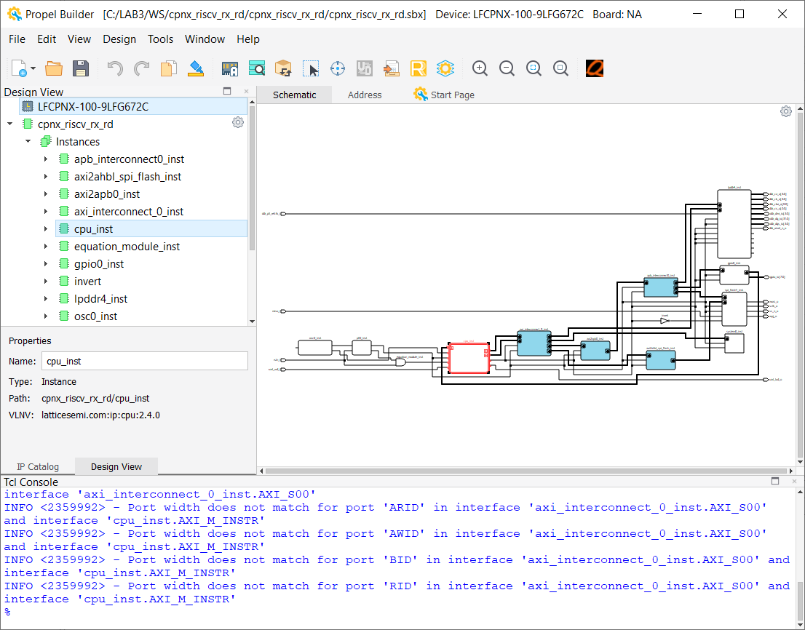
LAB3 Task1
Click on Propel Builder icon to open Propel Builder tool

Slide 12
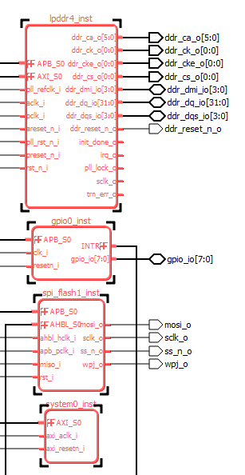
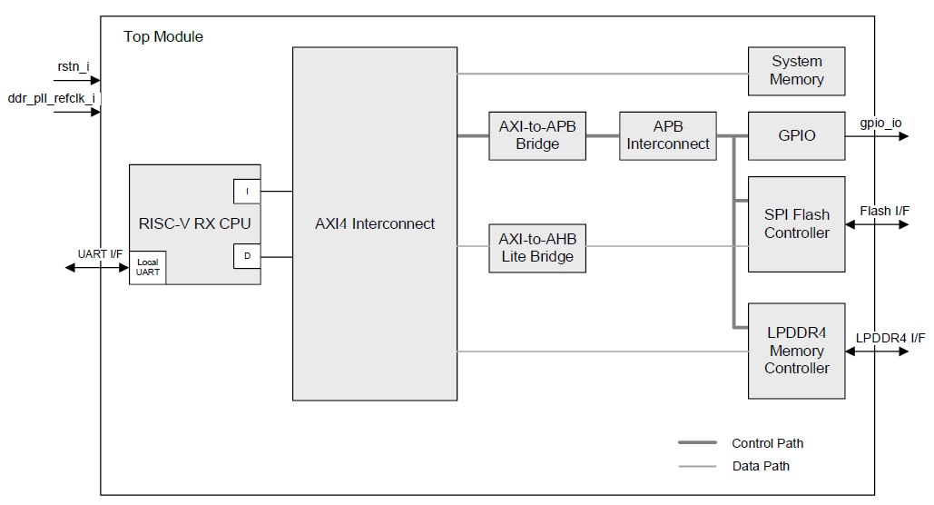


LAB3 Task2
CPNX_RISCV_RX_RD design analysis

Slide 13
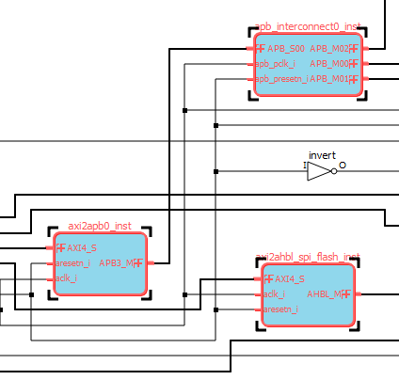
LAB3 Task2
CPNX_RISCV_RX_RD design analysis

Slide 14
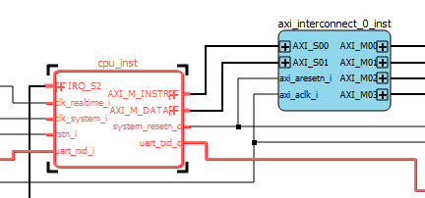
LAB3 Task2
CPNX_RISCV_RX_RD design analysis

Slide 15
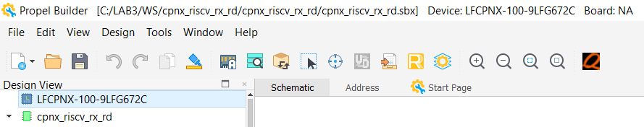
LAB3 Task2
Even if IP is not available do bot download from IP Server.
All design files are already available in CPNX_RISCV_RX_RD design
Click on icons
1) Auto Assign
2) Validate Design
3) Generate
4) Save
1
2
3
4

Slide 16
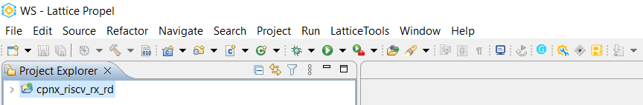
LAB3 Task2
Select the CPNX_RISCV_RX_RD design in PROPEL Project Explorer and then click on Radiant icon to Generate and open Radiant project
(or select LatticeTools → Generate and Open Radiant Project in file menu)

Slide 17
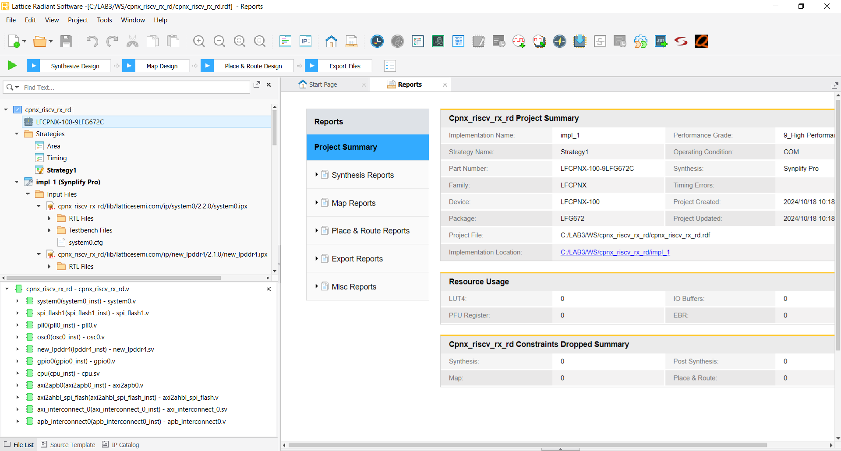
LAB3 Task3
Radiant project is automatically generated

Slide 18
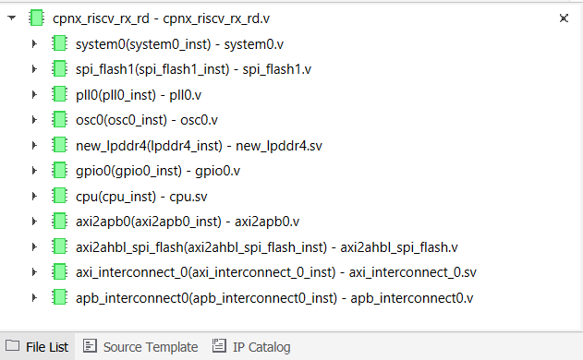
LAB3 Task3
Radiant project implements the CPNX_RISCV_RX_RD design

Slide 19
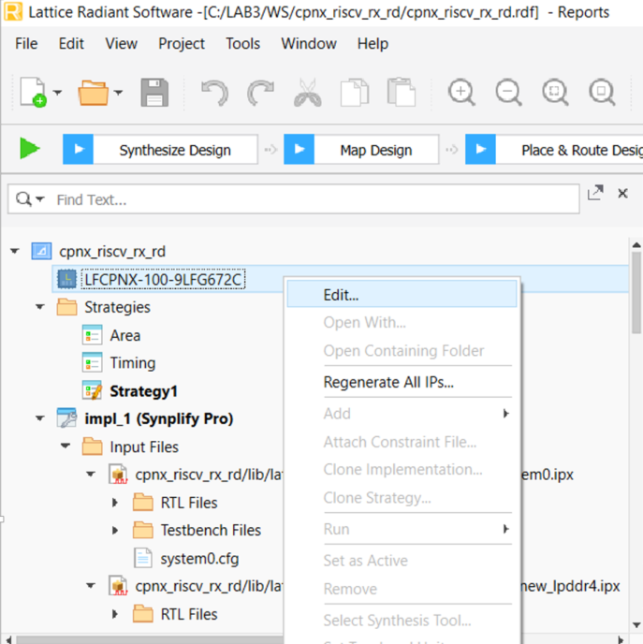
LAB3 Task3
Select the right part/OPN mounted on MAS ARRROW Edu. Board
Right click on part and then select Edit

Slide 20
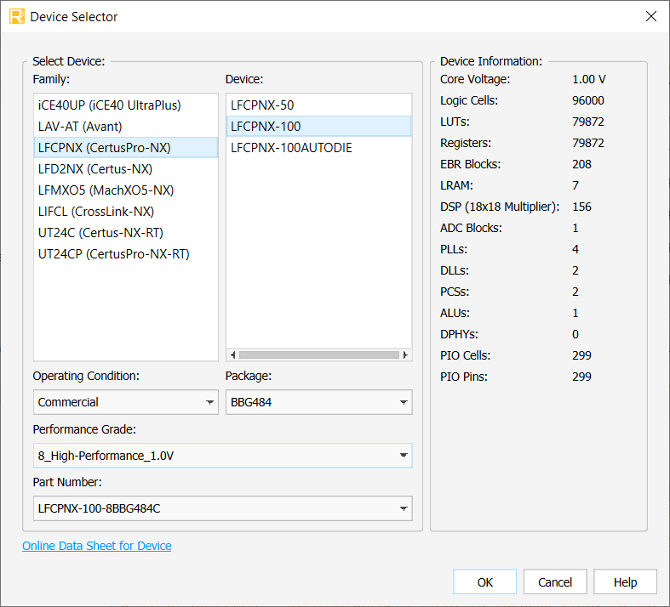
LAB3 Task3
Select and set the part as
Package BBG484
Performance Grade
8 High Perf. 1.0V

Slide 21
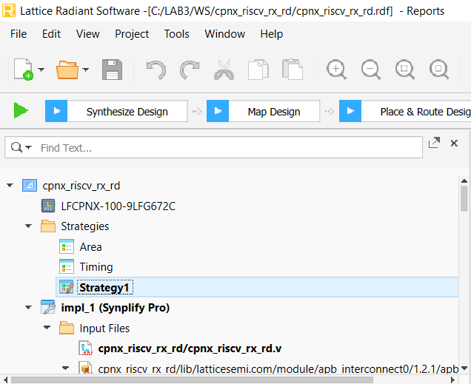
LAB3 Task3
Double click on Strategy

Slide 22
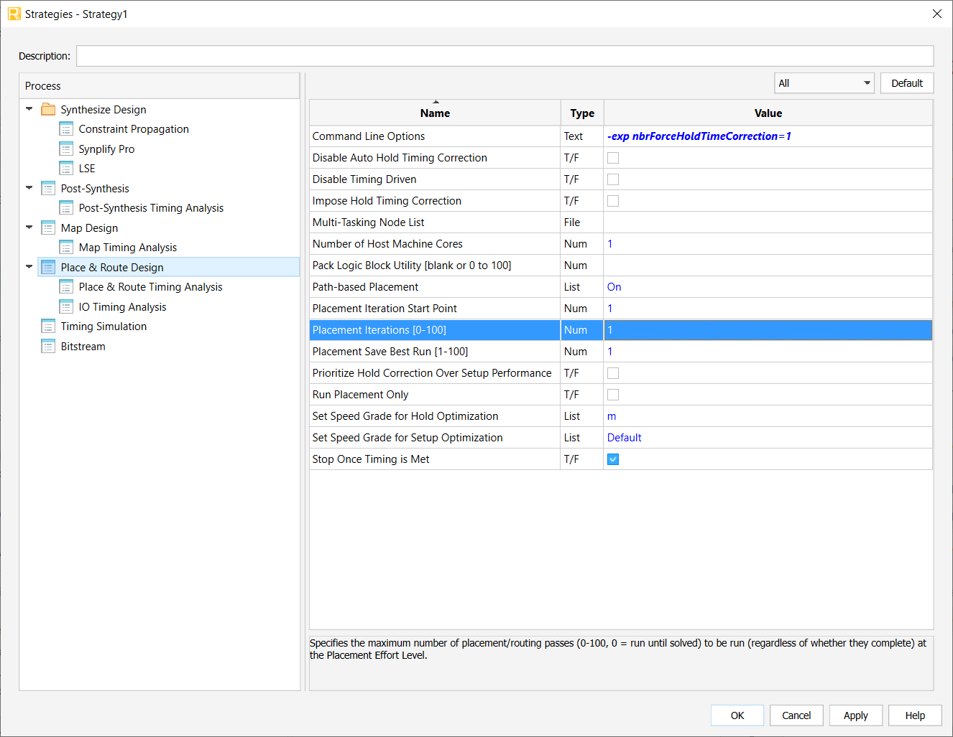
LAB3 Task3
NOTE
Default setting for
P&R → Placements Iterations
is #10 so #10 seeds are
going to be used for P&R
We can reduce it and set to #1

Slide 23
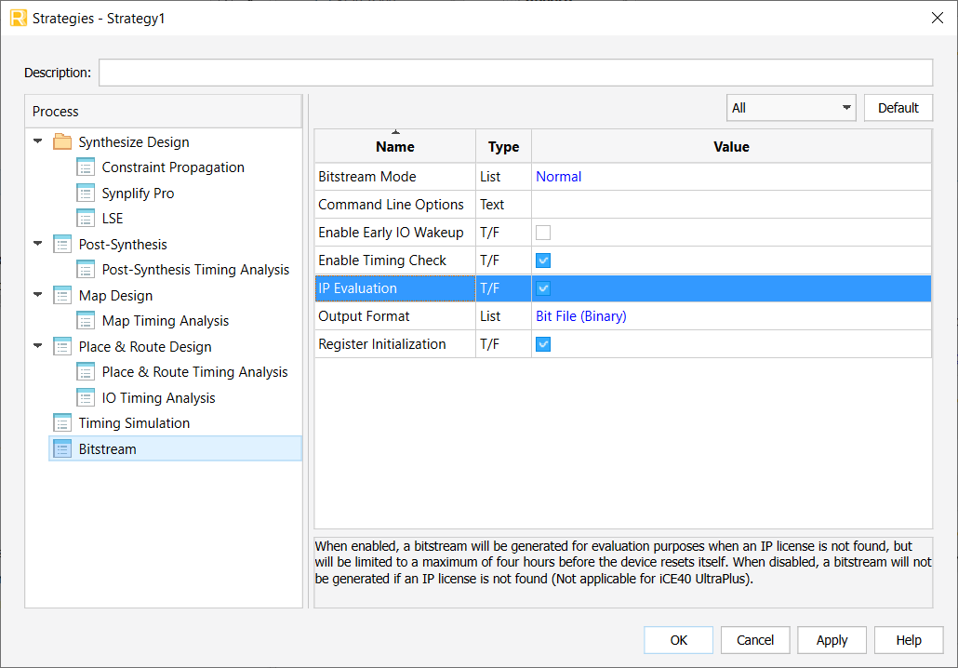
LAB3 Task3
CPNX_RISCV_RX_RD design is using the LPDDR4 macro/IP
and its usage is allowed as Evaluation mode.
Bitstream → IP Evaluation must be ticked

Slide 24
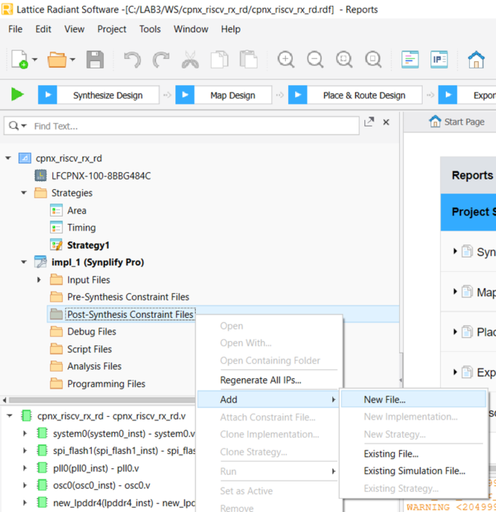
LAB3 Task3
Import pinout and design constraints
Right click on Post_Synth Constr. Files
and select Add → Existing File
2

Slide 25
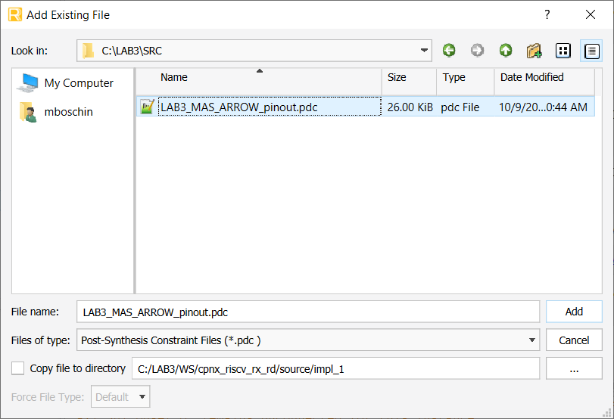
LAB3 Task3
Browse to folder SRC, select LAB3_MAS_ARROW_pinout.PDC file and
then click on Add

Slide 26
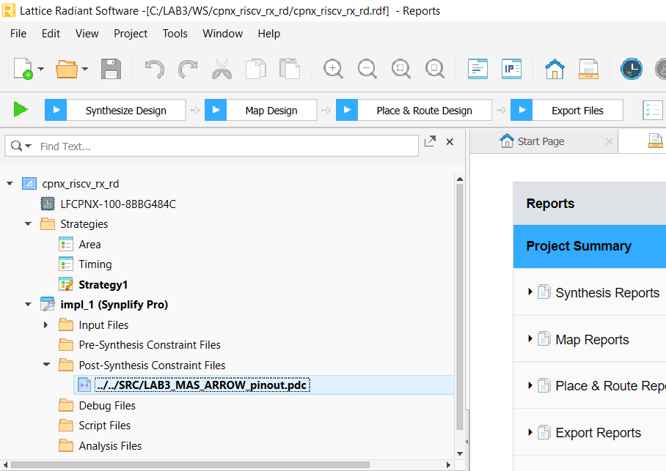
LAB3 Task3
LAB3_MAS_ARROW_pinout.PDC file is now available in Radiant project

Slide 27
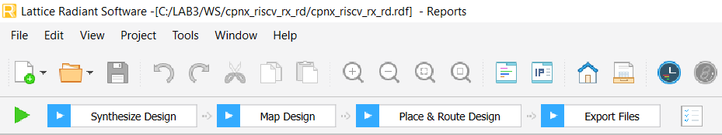
LAB3 Task3
Run Radiant bitstream generation by click on Export Files
This step takes 1h /1h 30min, so expected bistream has been provided in SRC folder to move forward with LAB3 training
Once completed, you will get this bitstream file

Slide 28
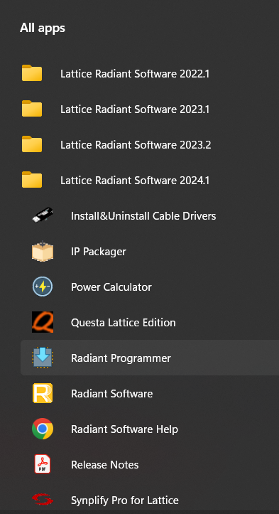
LAB3 Task3
Program CertusPRO-NX with bit_fastSPI_noMEM.bit in SRC folder
Run Lattice Radiant Programmer
available under Lattice Radiant SW 2024.1

Slide 29
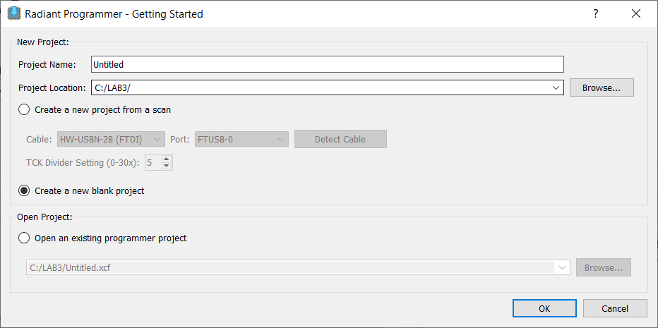
LAB3 Task3
Select "Create a new blank project" and then click OK

Slide 30
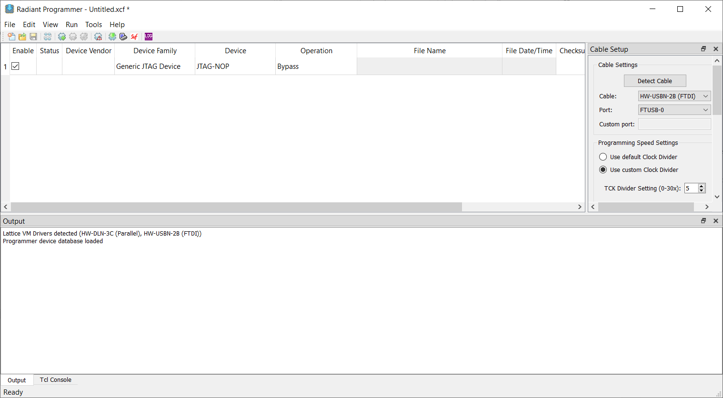
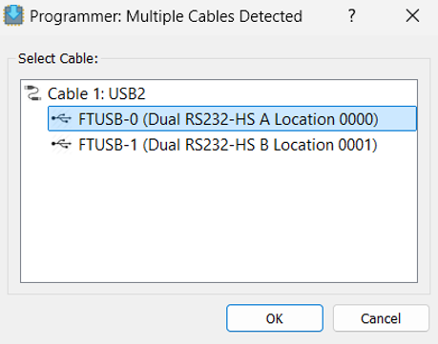
LAB3 Task3
Click on "detect cable". Cable and Port should be automatically set.
If Multiple Cables Detected window opens, then select location 0

Slide 31
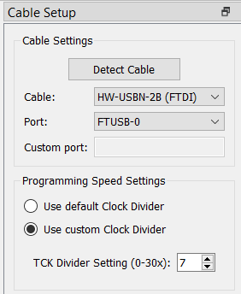
LAB3 Task3
NOTE:
if you have any FAIL,
check Port location
And
TCK clock speed (5 – 7)

Slide 32
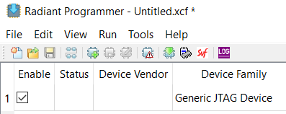
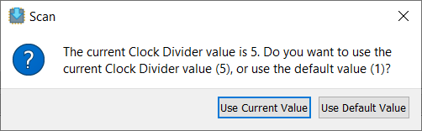
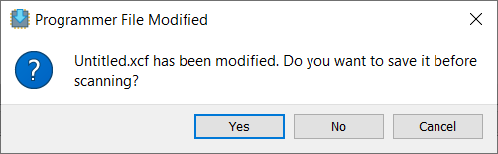
LAB3 Task3
Click on Scan Device icon
If TCK has been set, then select
Use Current Value when Scan
window opens
Select No when Progammer
asks for save Untitled.xcf file

Slide 33
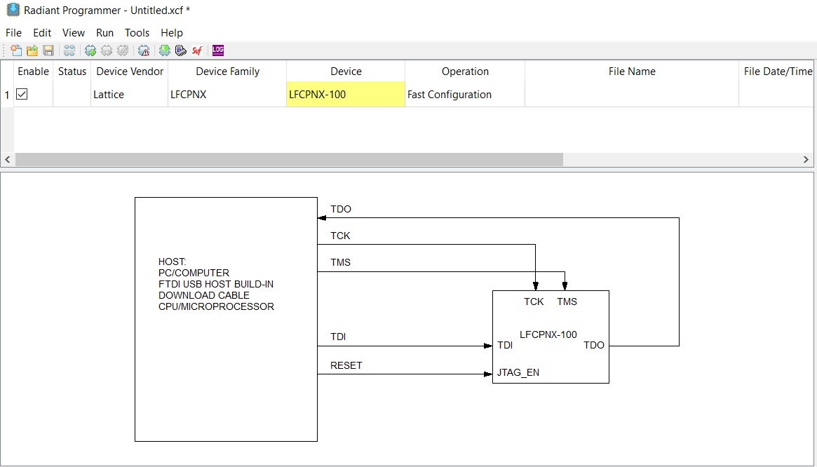
LAB3 Task3
Radiant PROGRAMMER provides the JTAG connection scheme
Click on Device entry to select LFCPNX-100

Slide 34
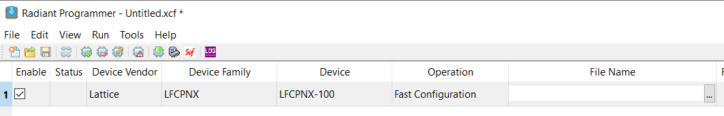
LAB3 Task3
File Name must be set with bistream file.
Click on ... in File Name entry
La catena appare come in figura.

Slide 35
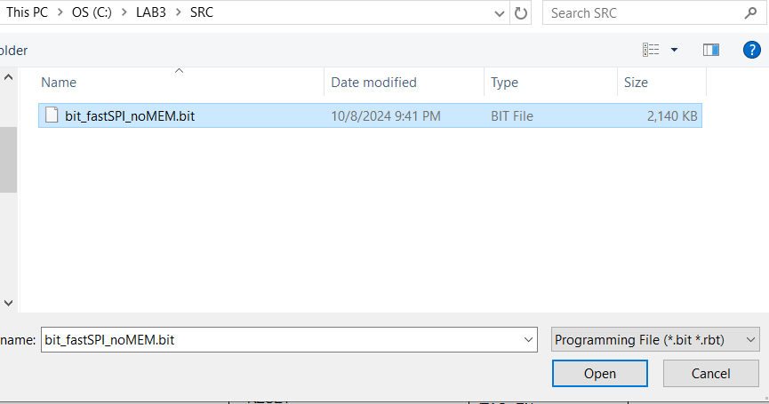
LAB3 Task3
Select bit_fastSPI_noMEM.bit in SRC folder and then click open

Slide 36
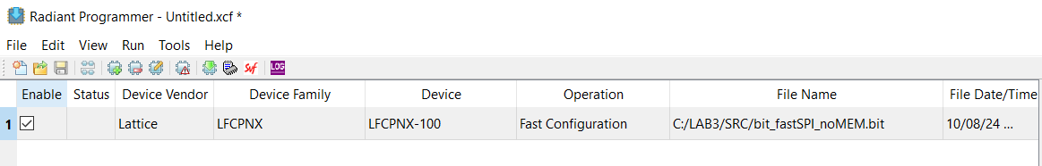
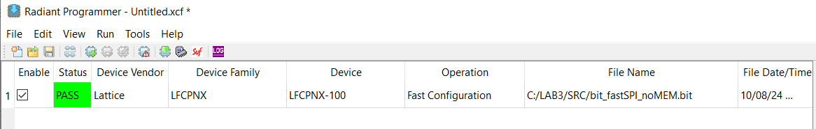
LAB3 Task3
Click on "Program Device" icon to program the LFCPNX part
with bit_fastSPI_noMEM.bit bitstream file
Successuful programming done, PASS status is the update

Slide 37
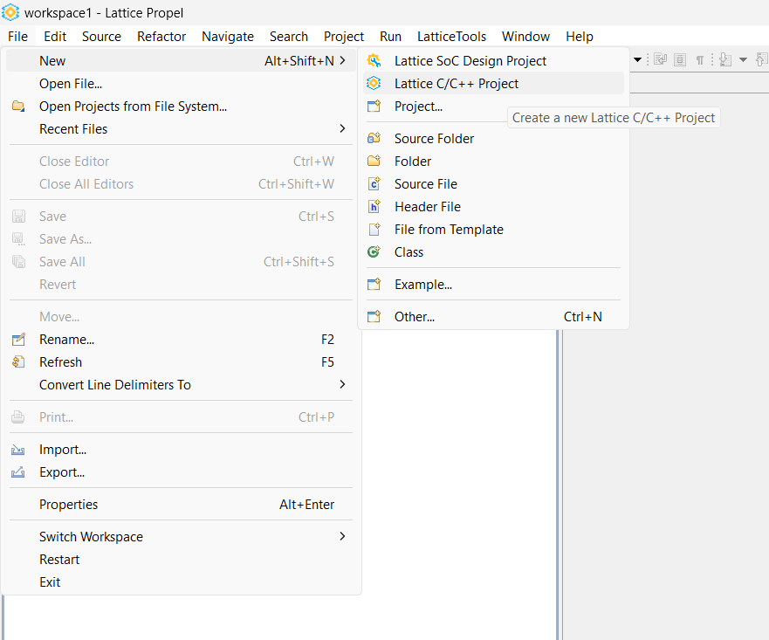
LAB3 Task4
Create a new basic "Hello Word" SW project
Back to Lattice PROPEL
Select
File→New→Lattice C/C++ Project

Slide 38
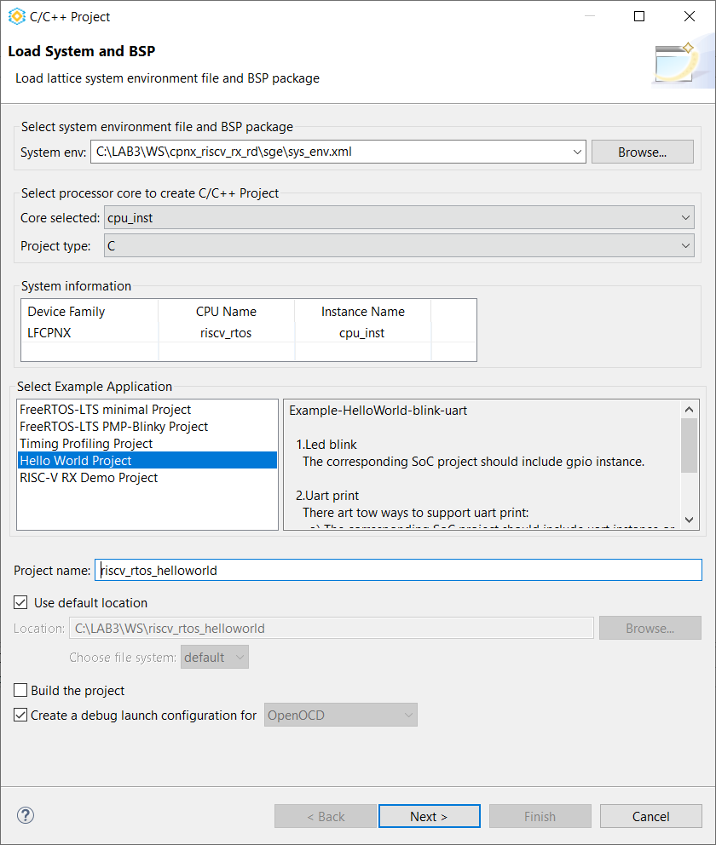
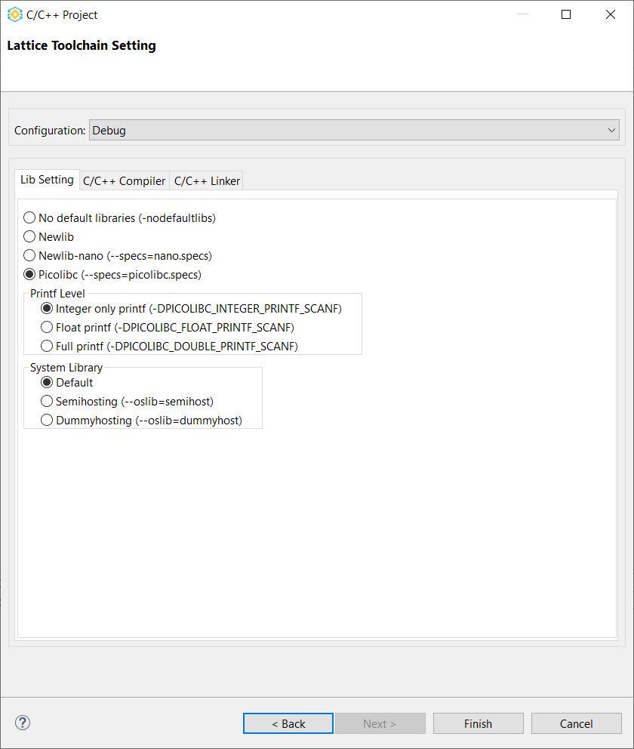
LAB3 Task4
Select Hello Word Project in C/C++ Project window then click Next and Finish
Poi NEXT e FINISH

Slide 39
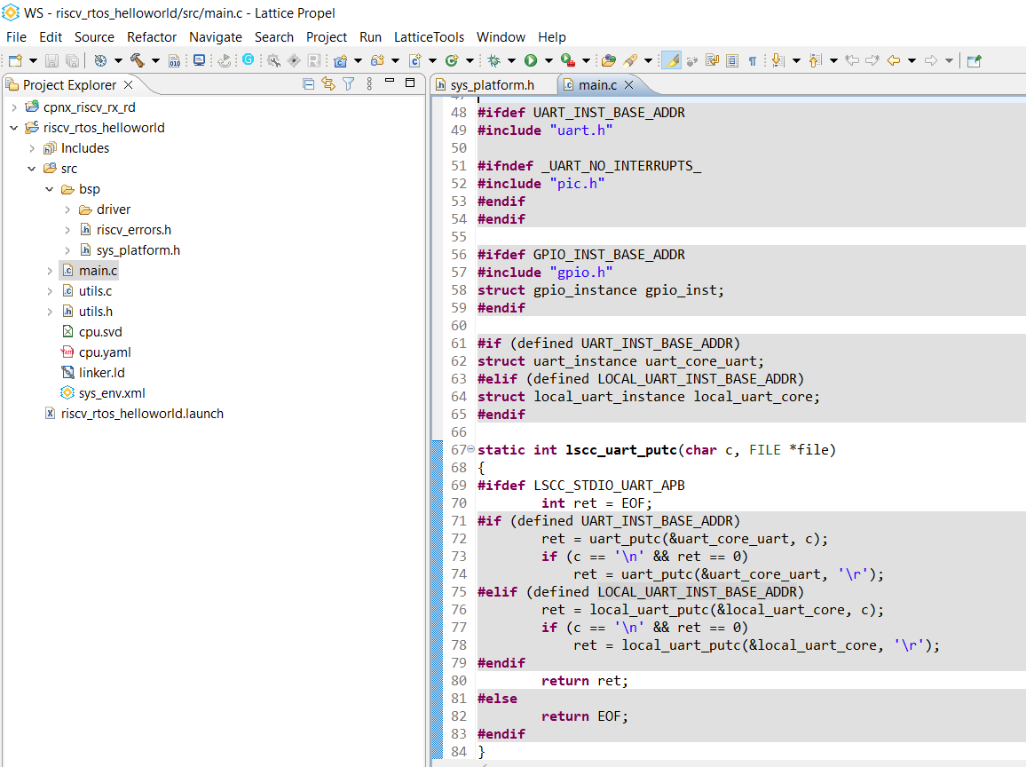
LAB3 Task4
Analyze main.C and see what is missing because not declared
…
GPIO_INST_BASE_ADDR
...

Slide 40

LAB3 Task4
Open sys_platform.H and check #define
…
#define GPIO0_INST_GPIO_MEM_MAP_BASE_ADDR 0x49008000

Slide 41
LAB3 Task4
We have to modify main.C as defined in sys_platform.H
#ifdef GPIO_INST_BASE_ADDR
#include "gpio.h"
struct gpio_instance gpio_inst;
#endif
#ifdef GPIO0_INST_GPIO_MEM_MAP_BASE_ADDR
#include "gpio.h"
struct gpio_instance gpio_inst;
#endif

Slide 42

LAB3 Task4
Copy main.C availble in LAB3\SRC and Paste to main.C

Slide 43


LAB3 Task4
Overwrite main.C
Right clik on SW project
and select
Build Project

Slide 44

LAB3 Task4
RISCV_RTOS_HELLO_WORLD SW project should be compiled with warnings and memory deployment done

Slide 45

LAB3 Task4
Select Run→Debug Configuration to start the Debug step

Slide 46

LAB3 Task4
Select RISCV_RTOS_HELLO_WORLD in GDB OpenOCD Debugging
All settings are already there so just click on Debug

Slide 47

LAB3 Task4
Click on Switch when "Confirm Perspective Switch" window appears

Slide 48

LAB3 Task4
Debug is active and it stops to first instruction of main.C (line 132)

Slide 49


LAB3 Task4
Select Terminal TAB and click on Open a Terminal icon
In Lauch Termnal, select Serial Terminal
and under Settings
Select the COM port (i.e COM4) with
Baud rate = 115200;
Data size = 8;
Parity = None;
Stop Bit = 1

Slide 50

LAB3 Task4
Select Step Over to move forward with debug

Slide 51

LAB3 Task4
COM4 shows the output
of printf

Slide 52


LAB3 Task4
Click on Resume to run debug
To stop and remove debug,
right click to select
Terminate and Remove

Slide 53

LAB3 Task4
Debug was run targeting system memory. Now we do the same but we are going to move debug from system memory to LPDDR4
Linker script must be modified with:
ddr (rwx) : org = 0x50000000, len = 0x80000000
system0_inst replaced with ddr

Slide 54

LAB3 Task4
Copy linker.LD in folder LAB3\SRC and then Paste to linkder.LD
of RISCV_RTOS_HELLO_WORLD SW project

Slide 55


LAB3 Task4
linker.LD file comparison: now target memory is LPDDR4

Slide 56


LAB3 Task4
Right on SW project and select Clean Project and then Build Project

Slide 57


LAB3 Task4
Copy ddr_download.cfg file in LAB3\SRC and Paste to RISCV_RTOS_HELLO_WORLD SW project

Slide 58

LAB3 Task4
Double click on to see its content
reset init
mww 0x4800A004 0x3
sleep 5

Slide 59

LAB3 Task4
Command is writing to the LPDDR4 memory controller register at offset 0x4 which is the Reset register
Writing value of 0x3 means to release the memory controller from reset. Then it will start the memory training sequence.

Slide 60
LAB3 Task4
Select Run→Debug Configuration to start the Debug step

Slide 61

LAB3 Task4
After selecting RISCV_RTOS_HELLOWORLD go to Debugger TAB
and add in Cogig Option -f ${ProjDirPath}\ddr_download.cfg

Slide 62

LAB3 Task4
Move to Startup TAB
Uncheck Initial Reset
Write 50000000
in Executable offset
field

Slide 63

LAB3 Task4
Again Startup TAB, uncheck Pre-run/Restart Reset
and then click first on Apply and last on Debug

Slide 64

LAB3 Task4
Now RISCV_RTOS_HELLO_WORLD SW project Debug is run in DDR
(address 0x50000fb6)

Slide 65

LAB3 Task4
Click on Resume to see same
Behavior of system memory debug
Right click and select
Terminate and Remove to stop Debug

Slide 66

LAB3 Task5

Slide 67
LAB3 Task5
Definitions
• Boot up – Process of starting the RISC-V RX CPU, loading SW into the LPDDR4 memory and executing the software
• Bootloader – SW that initializes, sets up and loads the application image into the LPDDR4 memory
• Application – SW that is loaded into the LPDDR4 memory and executed by the CPU at the end of boot up process
• SPI Flash – Extern non-volatile memory that store application software persistently
• Application image – Converted application software with extra information and is used to program into the flash

Slide 68
LAB3 Task5
Boot up sequence shown in Figure 6.1:
1. The application image (such as FreeRTOS) is pre-programed into flash before booting up
2. The system memory is pre-initialized with the bootloader (in bitstream file) during the FPGA configuration process
3. The RISC-V RX CPU executes the bootloader when reset is de-asserted
4. The bootloader initializes the LPDDR4 memory controller and copies the application image from SPI flash to LPDDR4 memory
5. The RISC-V RX CPU executes the application in the LPDDR4 memory when it is ready and this completes the boot up
process

Slide 69

LAB3 Task5

Slide 70

LAB3 Task5
The application image contains the application software binary and extra information appended as the header

Slide 71

LAB3 Task5
1. Build the application SW project in Lattice PROPEL. This creates the application binary file (.bin)
2. Run the make_image python script to append the image header on top of application binary

Slide 72

LAB3 Task6
In Lattice PROPEL, select File→Import...

Slide 73

LAB3 Task6
Select General→ Existing Projects into Workspace and then Next

Slide 74

LAB3 Task6
Select root directory must be LAB3\SW
In folder SW, both SW project are there,
Bootloader and Freertos application
Select Bootloader for this task
Check Copy projects into workspace
so we can modify what is needed
in the imported project and
folder SRC\SW is preserved
Last Finish

Slide 75


LAB3 Task6
Select Yes To All when window appears
BOOTLOADER_SW
has been imported

Slide 76

LAB3 Task6
Double click on main.C to analyze Bootloader SW

Slide 77


LAB3 Task6
Double click on linker.LD
to analyze linker script

Slide 78


LAB3 Task6
Select Bootloader SW,
Right click and then
Build Project

Slide 79

LAB3 Task6
Select
Run→Debug Configuration

Slide 80

LAB3 Task6
Select bootloader_sw in GDB OpenOCD Debugging
and then click on Debug→Debug Configuration

Slide 81

LAB3 Task6
Debug view is now populated with bootloader_sw Debugging and beakpoint appears at main.C line 57

Slide 82
LAB3 Task4
Select Terminal TAB and click on Open a Terminal icon
In Lauch Termnal, select Serial Terminal
and under Settings
Select the COM port (i.e COM4) with
Baud rate = 115200;
Data size = 8;
Parity = None;
Stop Bit = 1

Slide 83

LAB3 Task4
Bootloader SW works as expected
But FreeRTOS application has not been yet deployed and programmed into expternal SPI flash

Slide 84
LAB3 Task7
In Lattice PROPEL, select File→Import...

Slide 85
LAB3 Task7
Select General→ Existing Projects into Workspace and then Next

Slide 86

LAB3 Task7
Select root directory must be LAB3\SW
Select freertos_app_sw2 for this task
Check Copy projects into workspace
so we can modify what is needed
in the imported project and
folder SRC\SW is preserved
Last Finish

Slide 87


LAB3 Task7
Select Yes To All when window appears
FREERTOS_APP_SW2
has been imported

Slide 88


LAB3 Task7
Double click on linker.LD
to analyze linker script

Slide 89


LAB3 Task7
Select freertos_app_sw2,
right click and then
Build Project

Slide 90
LAB3 Task7
Run the make_image python script to append the image header on top of freertos_app_sw2 application binary (freertos_app_sw2.bin)

Slide 91
LAB3 Task7
If PHYTON.exe is not available,
folder LAB3\WS\freertos_app_sw2\Debug
contains pippo.BIN already created and imported with this latest task
If PHYTON is installed, following command generates the binary file external SPI flash
python.exe .\make_image.py bin_file_in bin_file_out
python.exe .\make_image.py freertos_app_sw2.bin lab3_spi_flash.bin

Slide 92

LAB3 Task7
Launch Windows PowerShell
Run following commands:
cd C:\LAB3\WS\freertos_app_sw2\Debug
python.exe .\make_image.py .\freertos_app_sw2.bin lab3_spi_flash.bin

Slide 93

LAB3 Task8
Back to Radiant Programmer and double click on Fast Configuration

Slide 94

LAB3 Task8
Do following settings:
Target Memory = External SPI Flash
(MICRON MT25QL512 16-pin SOP2)
Programming file =
C:\LAB3\WS\freertos_app_sw2\Debug
lab3_spi_flash.bin or pippo.bin
Click Load from File to update Data file size
Click OK

Slide 95

LAB3 Task8
Click on Program Device to start SPI Flash programming

Slide 96

LAB3 Task8
SPI Flash has been successfully programmed

Slide 97
LAB3 Task8
If there is any issue with external SPI Flash programming,
unplug and then reconnect USB cable
After SPI Flash programming, CertusPRO-NX must be programmed again as done at the end of Task3 (SRAM Fast Configuration)

Slide 98
LAB3 Task9
Select bootloader_sw in GDB OpenOCD Debugging
and then click on Debug→Debug Configuration

Slide 99
LAB3 Task9
Debug view is now populated with bootloader_sw Debugging and beakpoint appears at main.C line 57

Slide 100
LAB3 Task9
Select Terminal TAB and click on Open a Terminal icon
In Lauch Termnal, select Serial Terminal
and under Settings
Select the COM port (i.e COM4) with
Baud rate = 115200;
Data size = 8;
Parity = None;
Stop Bit = 1

Slide 101

LAB3 Task9
Now SPI flash contains
the freertos_app_sw2 binary
modified by phyton script

Slide 102


LAB3 Task10
Folder LAB3\WS_backup contains a complete Radiant project
Copy folder cpnx_riscv_rx_rd and rename as cpnx_riscv_rx_rd_ECO
Then run RADIANT tool
and open cpnx_riscv_rx_rd.RDF
project available in that folder

Slide 103


LAB3 Task10
Click on ECO Editor icon to run ECO Editor tool
Select Memory Initialization TAB

Slide 104
LAB3 Task10
Click on Choose File in Memory Initialization row

Slide 105


LAB3 Task10
Select Hexadecimal
as File Format
Click on ... of Memory File and select bootloader_sw.mem

Slide 106


LAB3 Task10
Click OK to update the ECO Editor tool Memory Initialization row

Slide 107

LAB3 Task10
Click on Design Rule Check to validate the memory content

Slide 108


LAB3 Task10
Click Save icon to update design with new memory content
Then click Save

Slide 109

LAB3 Task10
RADIANT keeps all run processes apart bitstream generation taht must be run after syste memory initialization
Click Export Files to get the new bitstream

Slide 110

LAB3 Task10
Back to RADIANT PROGRAMMER, select the latest generated bitstream and program CertusPRO-NX by Fast Configuration mode

Slide 111

LAB3 Task10
Now system memory contains the Bootloader, the SPI flash was laready programmed with Freertos_app_sw2, so now after reset we have the complete application as described in Task5

