Slide 1
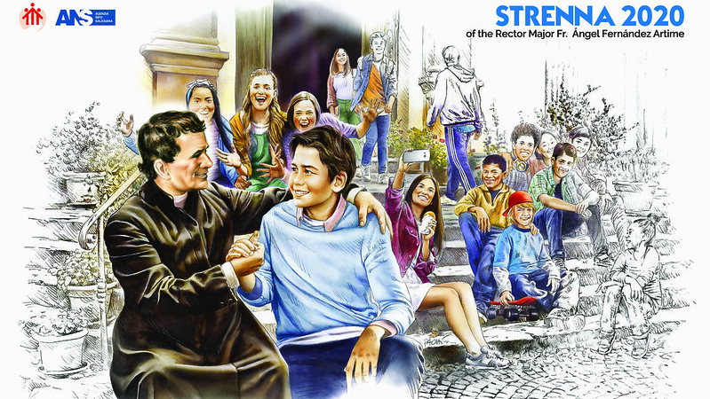
“GOOD CHRISTIANS AND UPRIGHT CITIZENS”

Slide 2
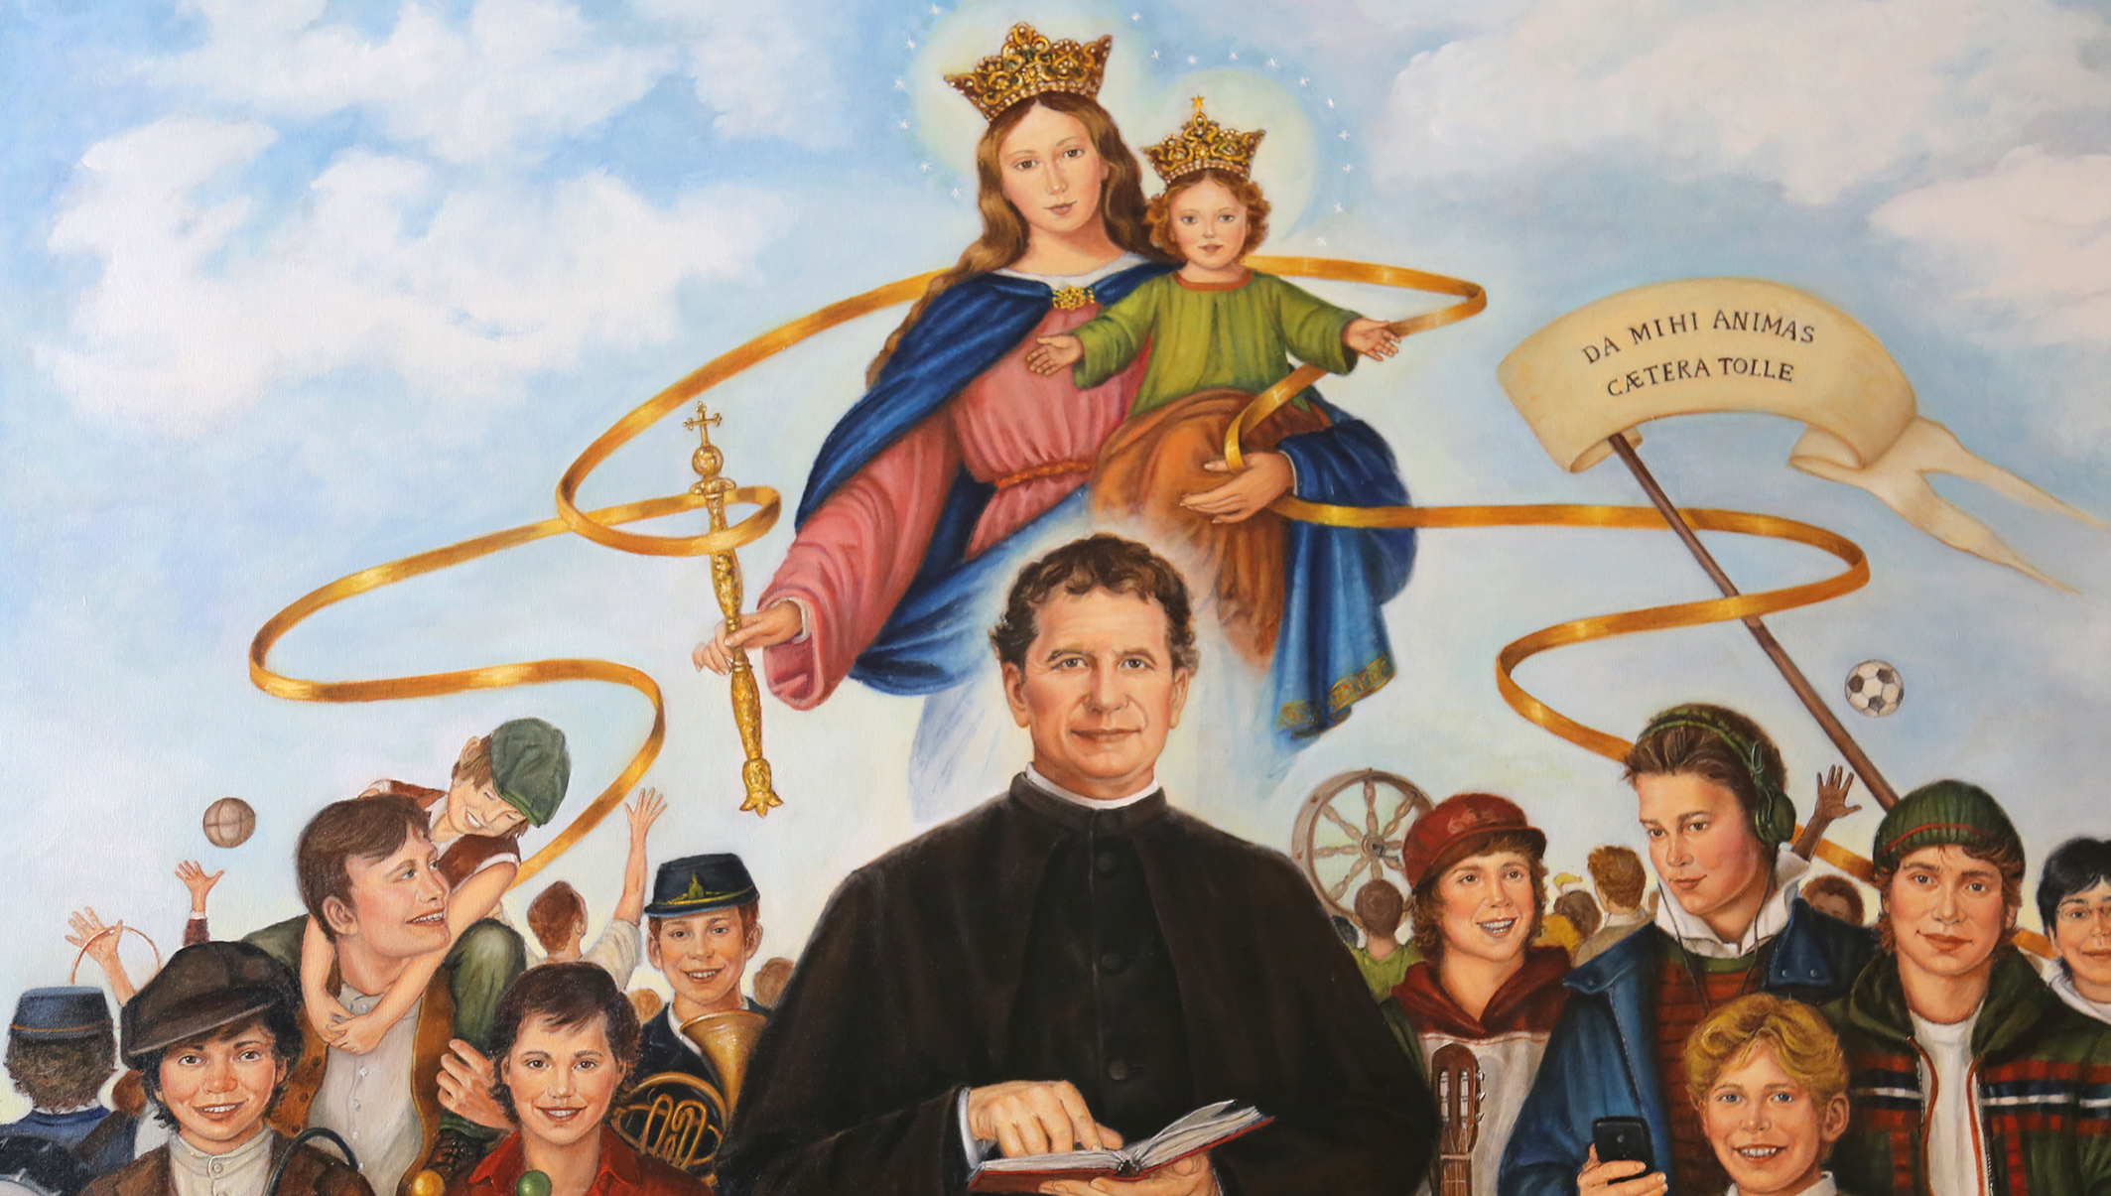
GOOD
CHRISTIANS

Slide 3
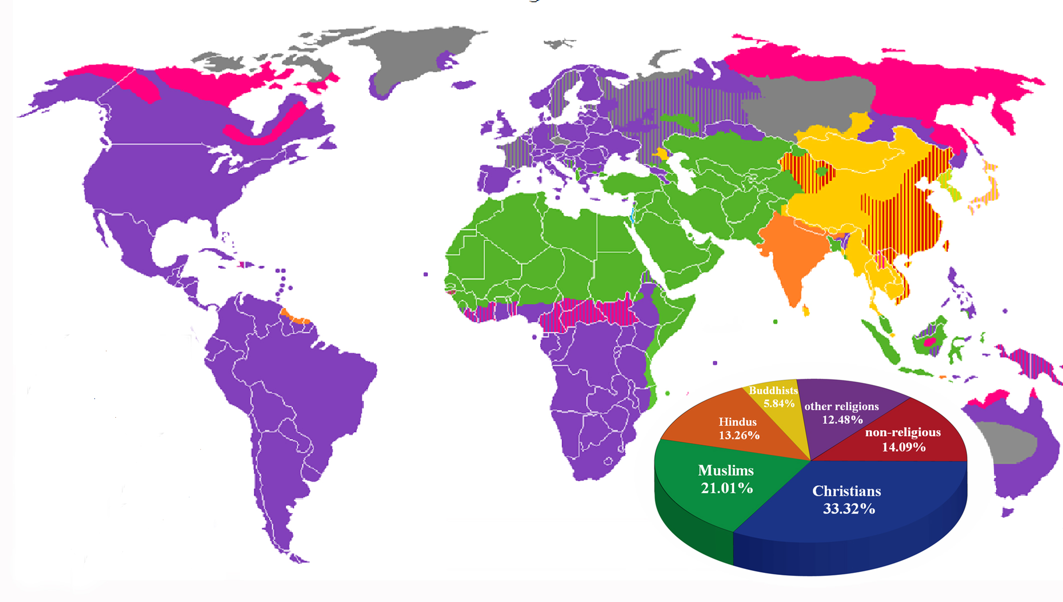
The religions in the world

Slide 4
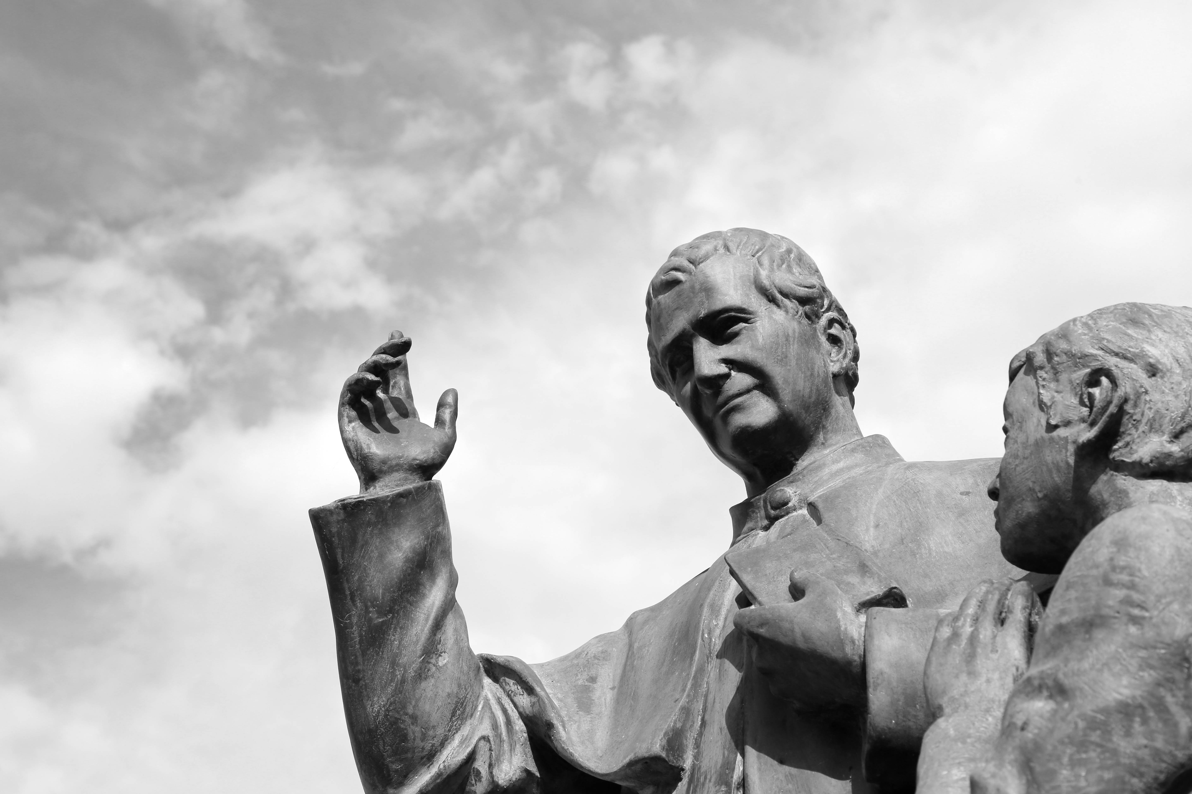
Don Bosco expressed this same motto in many forms
“Good Christians and Upright citizens”

Slide 5
“Wherever you are, always show that you are good Christians and honest men”

Slide 6
“Making them good Christians and useful citizens”

Slide 7
“giving to civil society useful members, to the Church virtuous Catholics, to heaven fortunate inhabitants”

Slide 8
“How many good sons, how many Christian and upright fathers, how many more better citizens might we not give to families, to the Church and to society?”

Slide 9
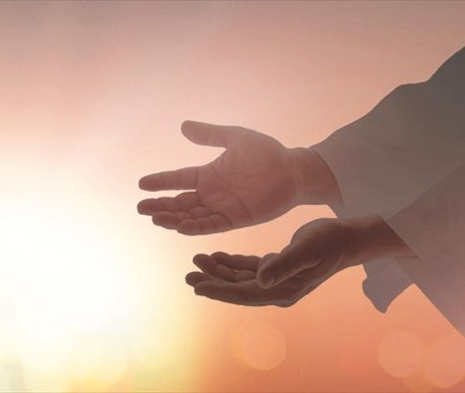
1.1 GOOD CHRISTIANS Living with faith in the Lord and under the guidance of the Spirit ...
“Living the faith" is nowadays the most precious gift we can share together, whatever might be our state of life, our age, our vocation and also our religion

Slide 10
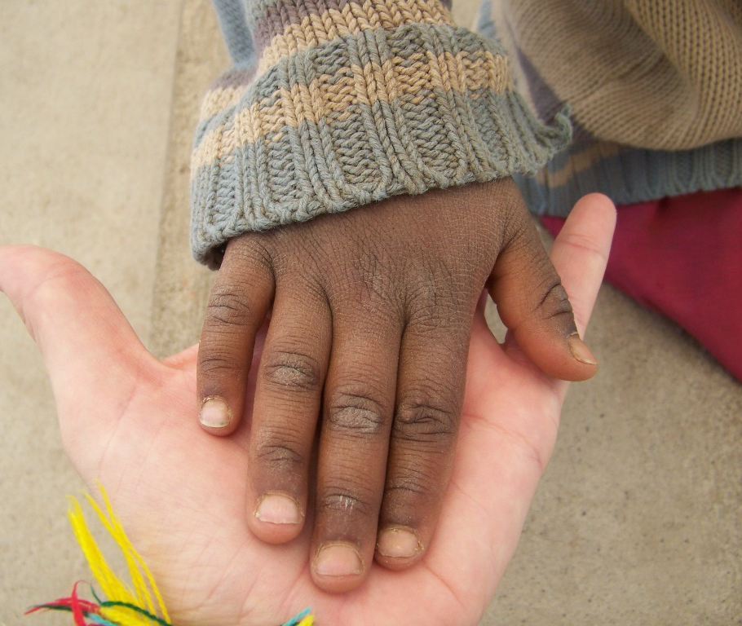
1.2. GOOD CHRISTIANS
living attentive to the God who speaks
Listening to God who speaks to usn eeds to be practised every day, as an artist or an athlete does in their area of specialised excellence

Slide 11
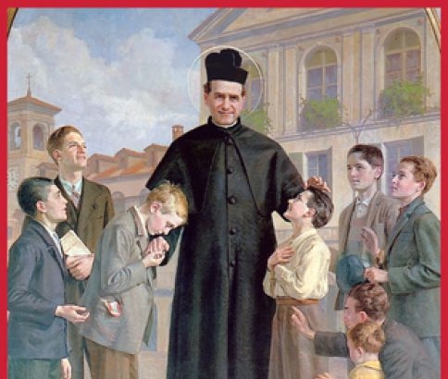
1.3. GOOD CHRISTIANS with the NEED to evangelize and to offer the first proclamation and catechesis, "This society’s origins are found in the simple catechetical instructions."
(MB IX, 61).
He took no step, he said no word word,he took up no task that was not directed to the saving of the young ... Truly the only concern of his heart was for souls."
With this heart we will know how to be and to remain among the young and the families who practise other religions or who claim to be agnostics or atheists

Slide 12
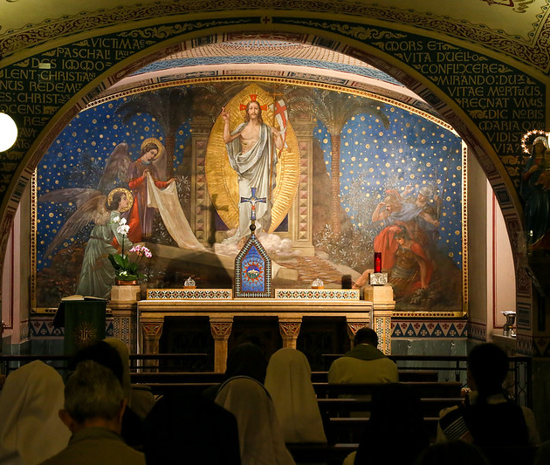
1.4. GOOD CHRISTIANS living a TRUE
Salesian
spirituality
I hope that you will be serious enough about yourselves to make an effort to grow spiritually (Pope Francis)

Slide 13
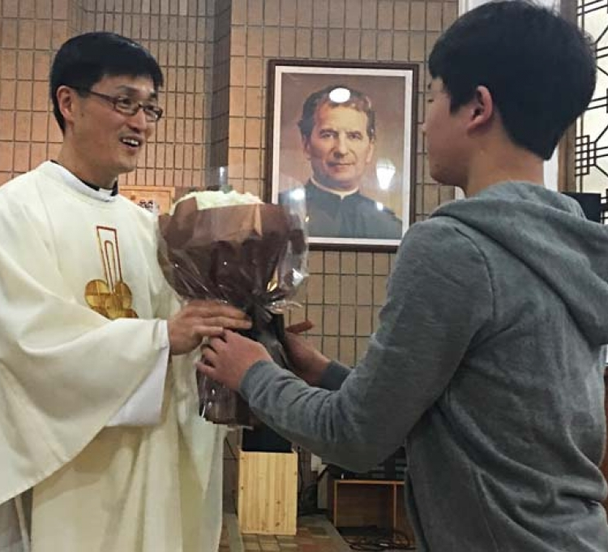
1.5. GOOD CHRISTIANS in the face of the the challenge of ENVIRONMENTS that are non-Christian, post-believing or post-Christian
We are all sent by the Lord and it is the Salesian mission that acts as a guide for us all.

Slide 14
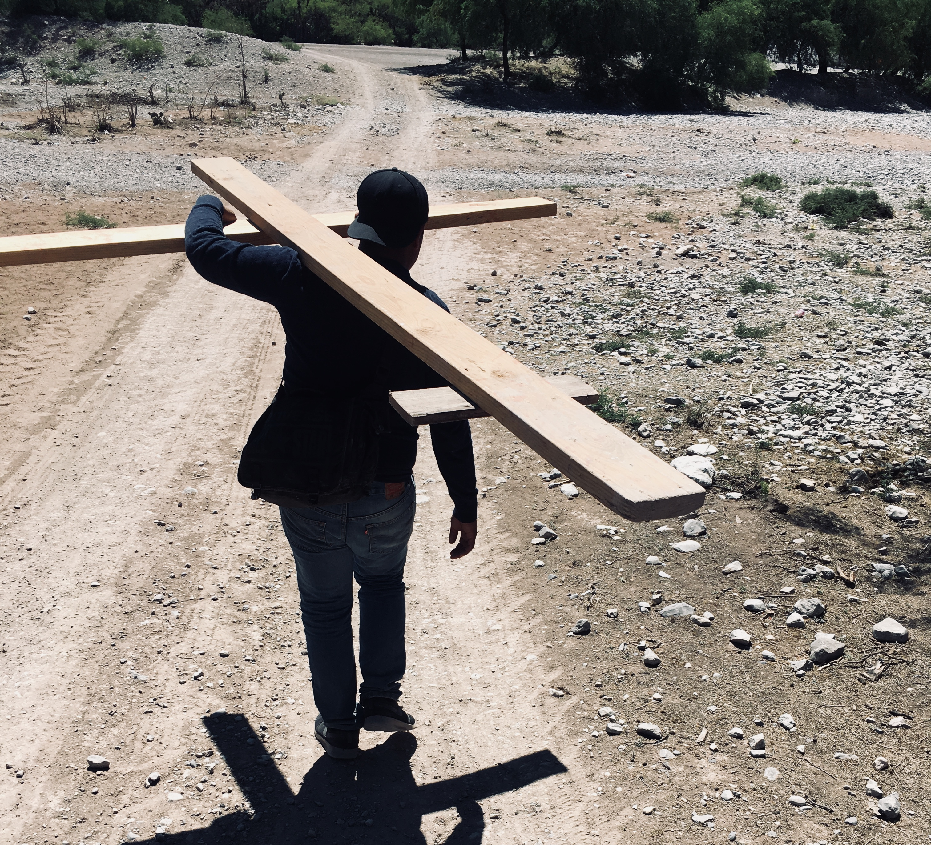
1.6. GOOD CHRISTIANS
detached from themselves
I AM a mission on this earth; THAT IS THE REASON WHY I AM HERE.

Slide 15
UPRIGHT CITIZENS

Slide 16
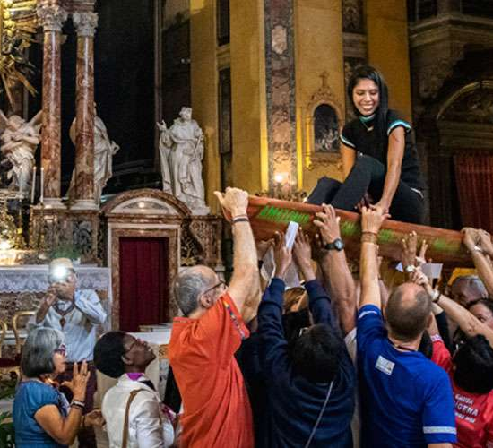
2.1. Young people are waiting for us in the 'house of Life'
In the Our Father we can find the "politics" of fraternity and of justice, solidarity, reconciliation, respect, equality and the protection of the most weakest.

Slide 17
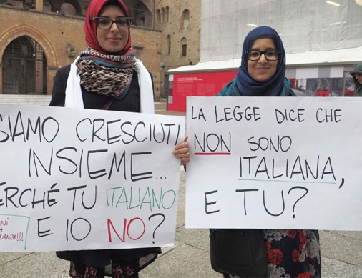
2.2. UPRIGHT CITIZENS educating our young people for Citizenship
and social commitment
fight for the common good, serve the poor, be protagonists of the revolution of charity and service, capable of resisting the pathologies of consumerist and superficial individualism.

Slide 18
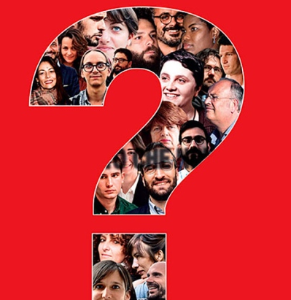
2.3. UPRIGHT CITIZENS educating our young people to commitment in political service
We want to be and continue to be on the side of the "politically incorrect" because we choose to be on the side of those who have no voice.

Slide 19

2.4. UPRIGHT CITIZENS educating our young people to integrity and legality
Corruption is a "process of death" that has become normal in so many societies, and is certainly a real evil and a grave sin.

Slide 20
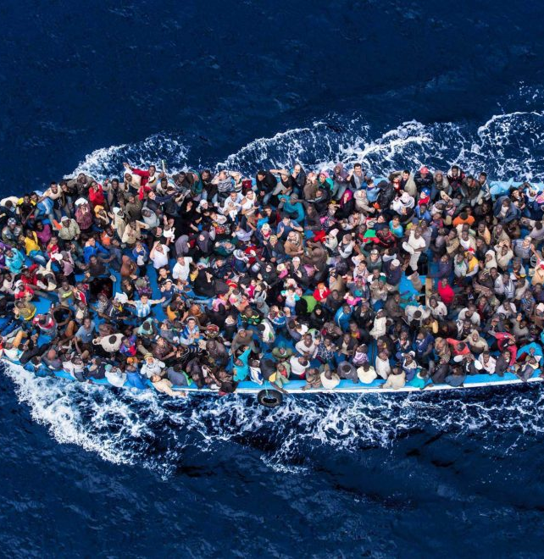
2.5. UPRIGHT CITIZENS, Sensible and co-responsible, in a world on the move and in migration
We are sons and daughters of an emigrant, who welcomed emigrants and who sent his sons as missionaries to take care of migrants.
What characterizes our interventions is the educative "presence" that arouses hope.

Slide 21
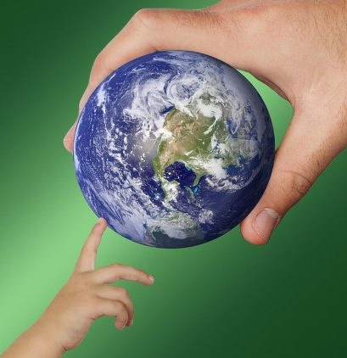
2.6. UPRIGHT CITIZENS who take care of our common home as young people ask us to
Everyone has to move on from consumption to sacrifice, from avarice to generosity, from waste to the ability to share, from ‘what I want’ to ‘what the God’s world needs’.

Slide 22
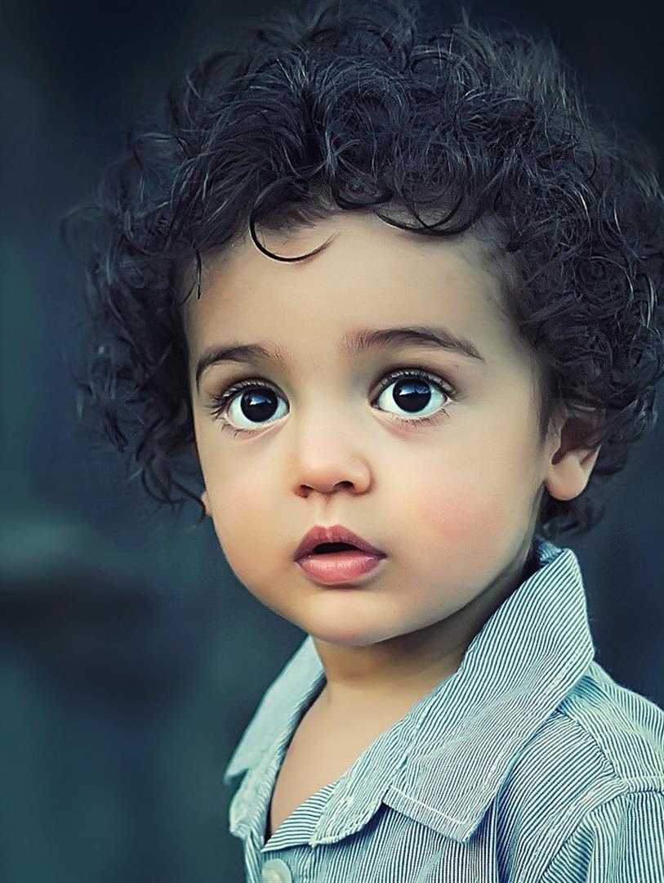
2.7 Upright citizens, in the defence of human rights and especially of the rights of minors
The purpose for which we have been raised up by the Holy Spirit in Don Bosco as the Salesian Family is that of giving our whole lives to minors, to youngsters, to the boys and girls of the world.
For this reason we have to be experts in the field of the defence of all human rights, especially those of minors, and asking for forgiveness even with tears should anyone not have acted in this way.

