Slide 1
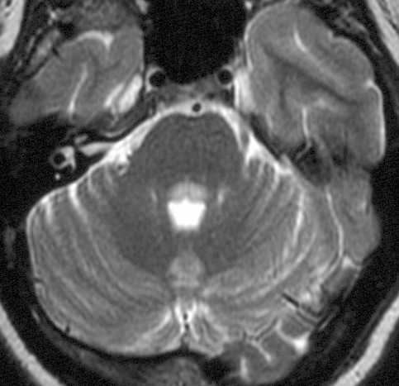
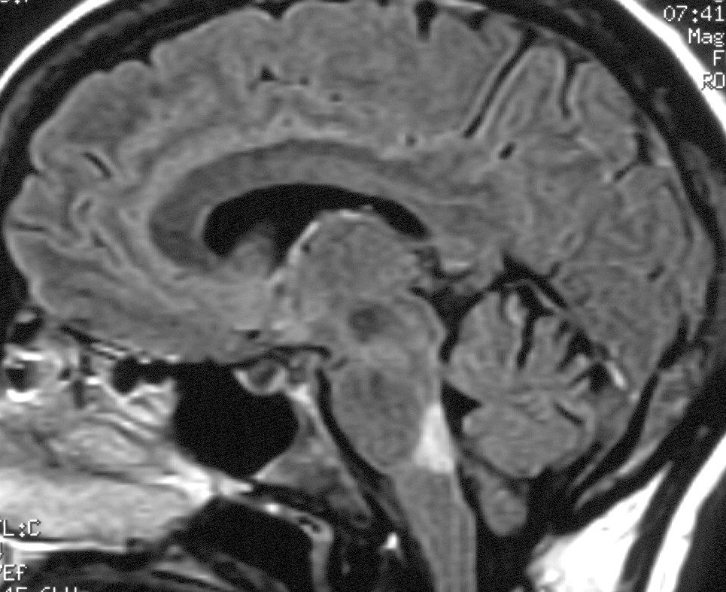

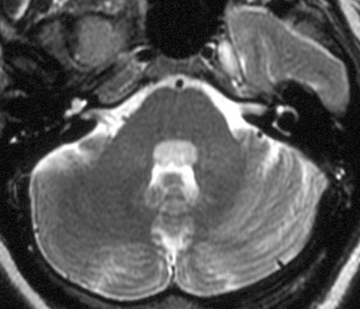
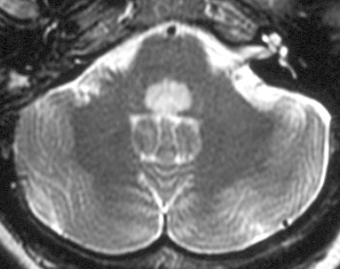
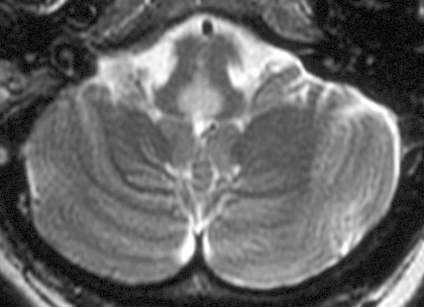
Notes:
These images are from a 39 year old woman assessed for possible MS who presented initially with diplopia and vomiting, the later being generally positional. Note the wedge shaped high signal intensity lesion (arrows) on the midline sagittal FLAIR (left hand image) and T2-weighted axial (right hand slices in the medulla and low pons just below the 4th ventricle). The location of the lesion should raise the suspicion of neuromyelitis optica and warrant a search for the presence of antibodies directed against aquaporin 4.

Slide 2
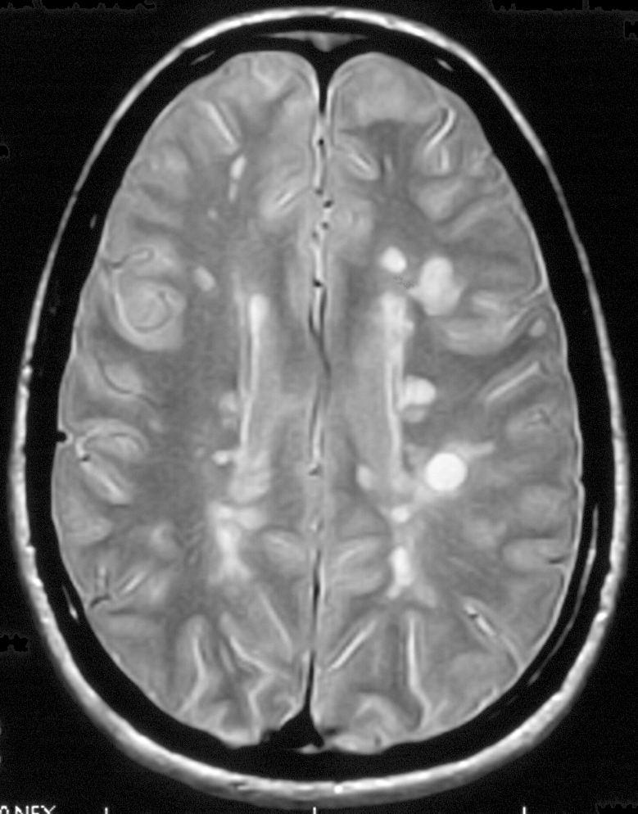
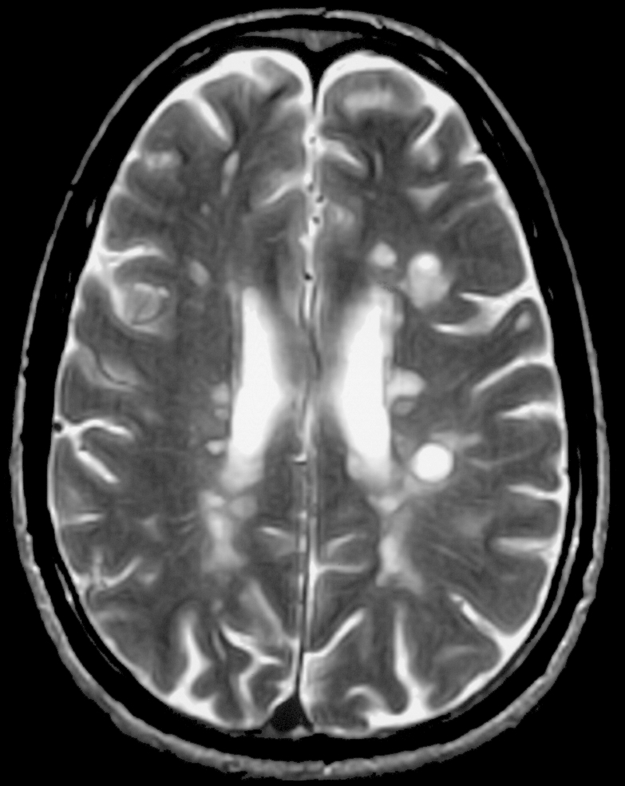
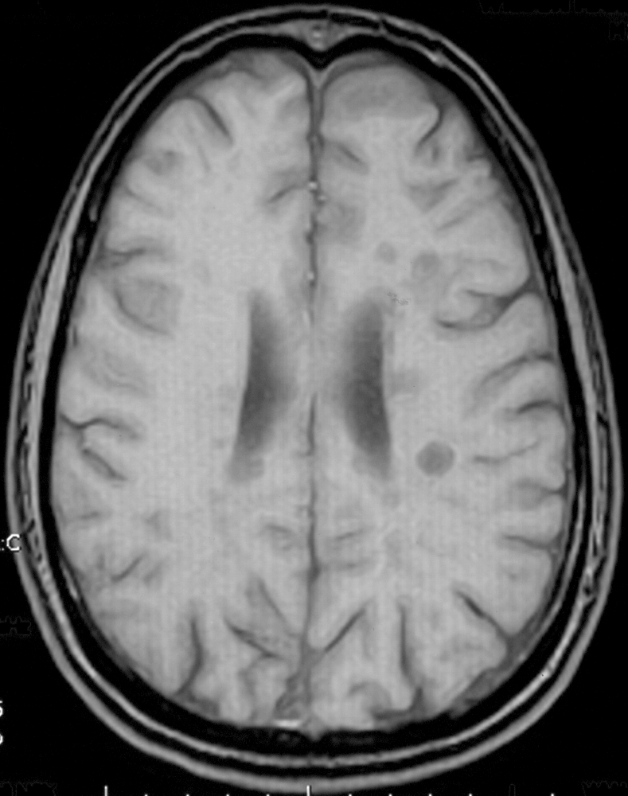
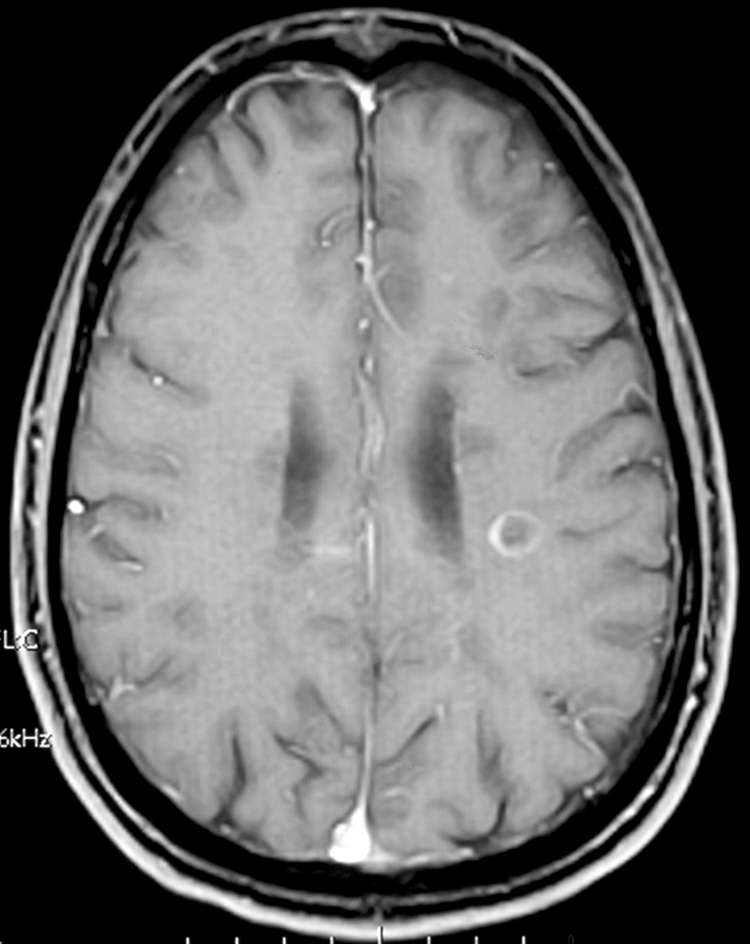
spin density
T2
T1 pre Gd
T1 post Gd
Notes:
These images are from a 41 year old male with known MS at the time of imaging. They illustrate several aspects of lesion appearance and topography that are useful in considering the diagnosis of MS by MRI. The upper panel images illustrate the high signal found on dual echo (spin density and T2-weighted scans). In the upper left panel, the three arrows point to typical periventricular lesions that have a rather perpendicular orientation to the lateral ventricles, suggesting the classical appearance of ‘Dawson’s fingers’ as defined on pathological specimens. The arrow in the upper right panel points to a subcortical or juxtacortical lesion lying just below the cortical ribbon. In the panels below, T1-weighted images before (left hand lower panel) and after (right hand lower panel) the administration of a gadolinium-based contract agent define several low signal intensity lesions or ‘black holes’ one of which in the white matter has ring enhancement following the injection of contract (arrows). Not that this enhanced lesion is also evident in the panels above as well. This pattern of periventricular, juxtacortical and distinct white matter lesions (meets dissemination in space diagnostic criteria), only some of which show enhancement (meets dissemination in time diagnostic criteria), is quite compatible with MS.

Slide 3
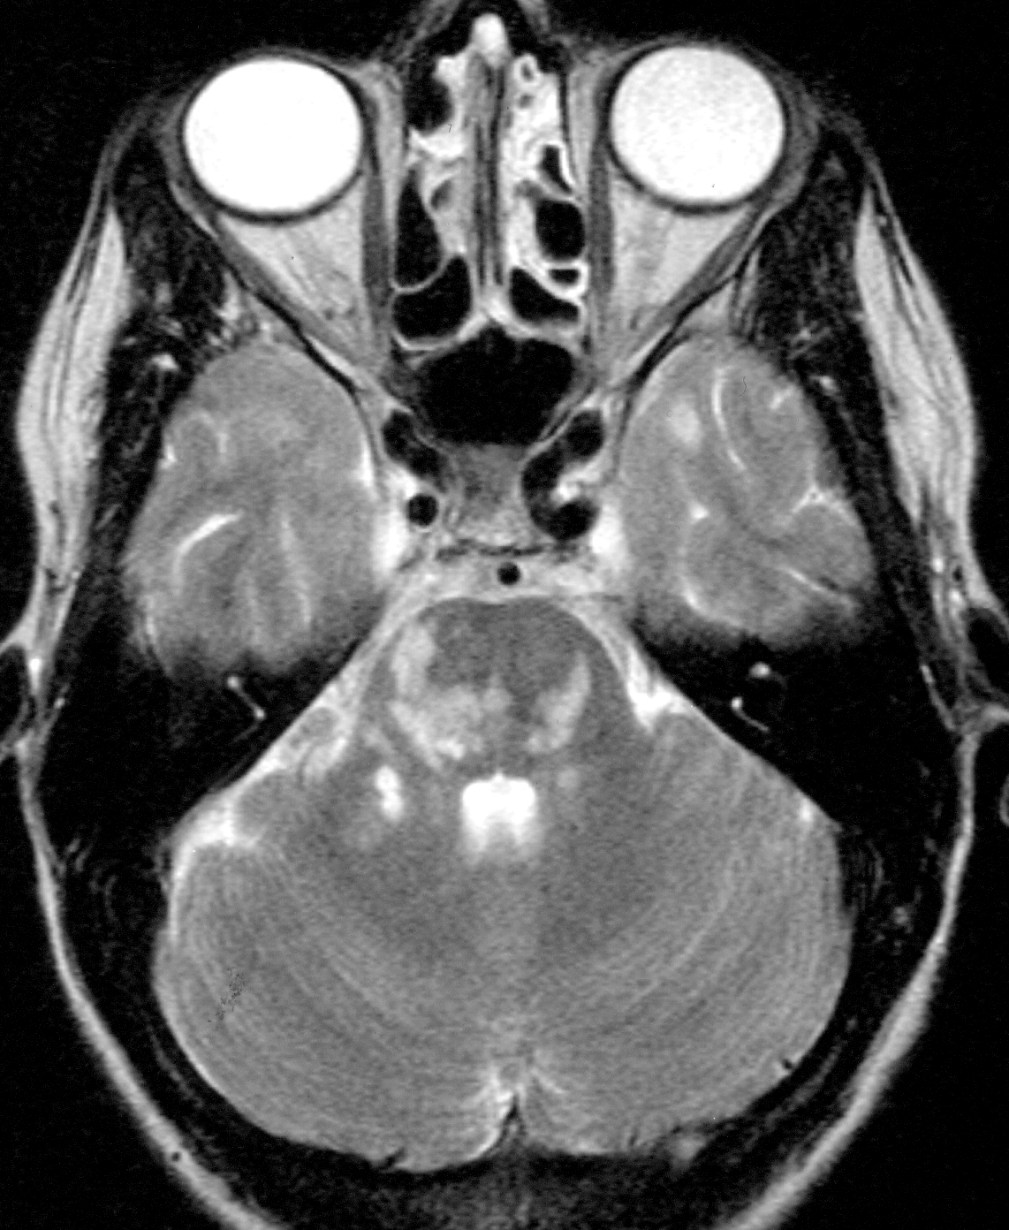
Notes:
Multiple ‘T2 lesions’ are seen in this T2-weighted axial image that includes portions of the cerebellum, pons and temporal lobes. A subcortical lesion is seen in the left temporal lobe (upper arrow), and multiple lesions are seen in the pons (lower arrow).

Slide 4
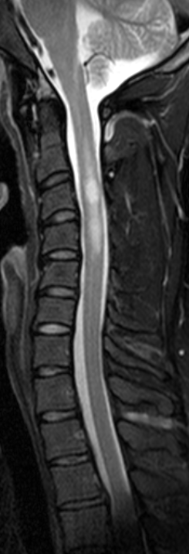
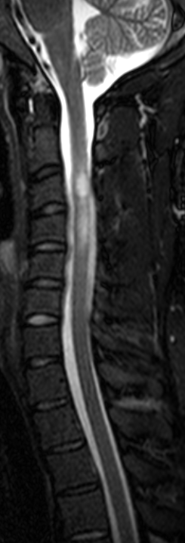
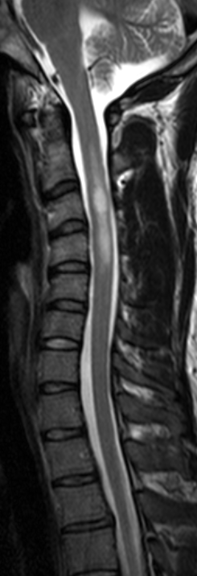
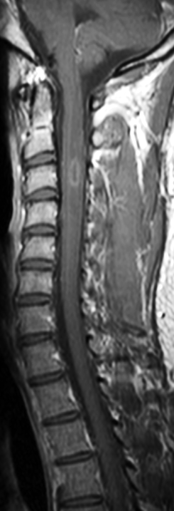
T2
STIR
T2 TSE
T1 Gd
Notes:
These cervical cord images of a 26 year old woman with transverse myelitis as an early presentation of her MS disclose two distinct lesions, one centered at the C3 and another at the C4 levels of the cord. The higher cord lesion shows ring enhancement following the administration of contrast (arrow). The four sagittal images shown were acquired using different imaging sequences (T2 = T2-weighted, STIR = short TI inversion recovery, T2 TSE = T2-weighted turbo spin echo, T1 Gd = post gadolinium T1-weighted) with provide somewhat different conspicuity of the lesions and the T1 Gd provides information on blood brain barrier permeability in this instance consistent with active inflammation and recent new lesion formation.

Slide 5
A
B
C
Notes:
These images from a 42 year old woman with relapsing remitting MS illustrate the importance of understanding the true three dimensional character of lesions for appropriate lesion classification. A. post gadolinium T1-weighted spin echo image in the coronal plane shows a juxtacortical enhancement. B. The same lesion is seen in this transaxial FLAIR image (had the enhancement been viewed only in the same transaxial plan, it might well have been incorrectly assumed to be a ring enhanced lesion in the occipital-parietal white matter. C. A new T2 lesion was found near the trigone of the left lateral ventricle on this transaxial T2-weighted image that did not enhance following gadolinium administration that was not seen on comparison with a prior, well registered image set from the patient’s last MRI.

Slide 6
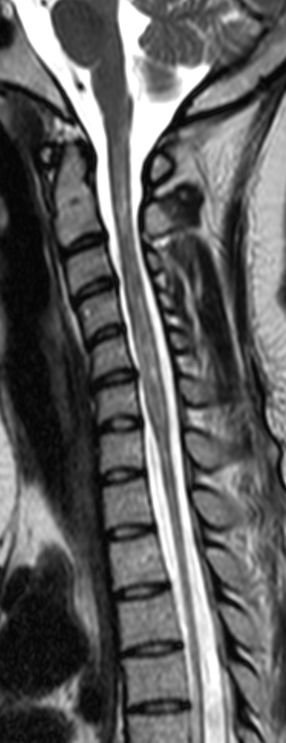
T2
Notes:
This sagittal image of the cervical cord is from a 20 year old African-American female with systemic lupus erythematosis and recurrent episodes of transverse myelitis with severe paraplegia and quadriparesis. Note the extensive cervical lesions along the extent of the entire cervical cord severe thoracic cord atrophy below the cervical level. The patient proved to be NMO antibody positive.

Slide 7
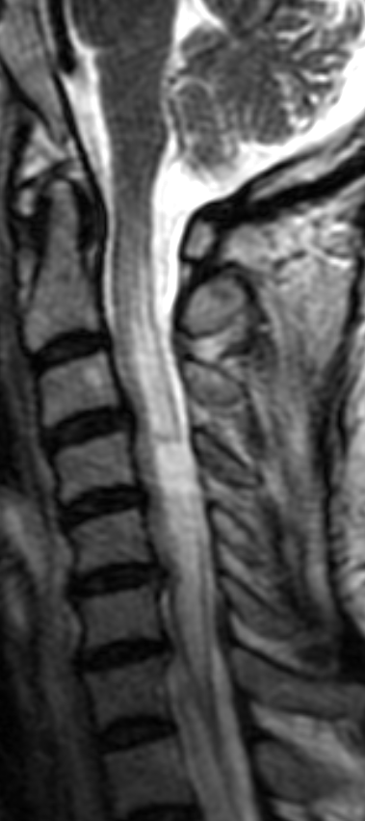
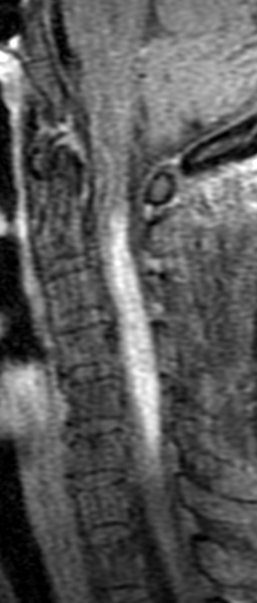
STIR
T1 Gd
Notes:
This 69 year old Asian-American woman was in active relapse at the time of imaging for recurrent myelitis (first episode of optic neuritis 20 years prior). Despite the presence of oligoclonal bands in her cerebrospinal fluid and a negative NMO serology, her background and the longitudinally extensive nature of her lesion make NMO more likely that MS.

