Slide 1


The CME program will start on the hour.
Multiple Sclerosis Disease Modifying Therapies: Infection Risks and Mitigation Strategies

Slide 2
Your feedback is important to us!
At the conclusion of the webinar, please complete the program survey in TMS or TRAIN. This must be completed within 15 days of the live program for CME/CEU credit.

Slide 3

Dr. Anza Memon is the Interim Director of the Multiple Sclerosis Center of Excellence East and the Director of the MS Regional Specialty Program at the Detroit VA Medical Center. She is an Associate Professor of Neurology at Wayne State University School of Medicine, with dual fellowship training in Multiple Sclerosis and Clinical Neurophysiology/EMG.
Dr. Memon is a dedicated clinician, educator, and researcher, with a focus on advancing MS care.

Slide 4

Multiple Sclerosis Disease Modifying Therapies: Infection Risks and Mitigation Strategies
Anza B. Memon, M.D. FAAN
Interim Director Multiple Sclerosis Center of Excellence East
Director Multiple Sclerosis Regional Specialty Program, Neurophysiology Lab, John D. Dingell, VAMC, Detroit
Associate Professor of Neurology, Wayne State University, SOM, Detroit

Slide 5
Conflicts of Interests
Research Funding- NIH
Consultation- inlightened

Slide 6

Outline
Understanding the risks of infections associated with MS and DMTs
Common Infections in MS
Disease Pathogenesis
Intro to DMTs and understanding of MOA
How DMTs affect susceptibility to infections
Identifying MS patients at higher risk of infections
Clinical guidelines and vaccination strategies

Slide 7





The Role of Infections in MS
1990s
2010s-2020s
Studies exploring the impact of other infectious agents, such as human herpesvirus 6, Helicobacter pylori, Chlamydia pneumonia on MS risk and progression.
Ongoing research examining the complex interplay between the immune system, infections, and the development of MS.
2000s
1950s
Advancements in molecular techniques enabling more detailed analysis of the connections between infections and MS.
Initial observations linking viral infections to the development of multiple sclerosis.
1970s-1980s
Investigations into the potential role of Epstein-Barr virus in triggering or exacerbating MS.
Bjornevik et al, Science2022
Aloisi F et al, Lancet Neurol. 2023

Slide 8
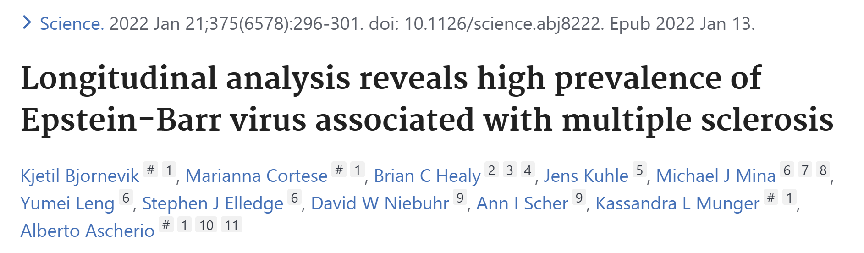
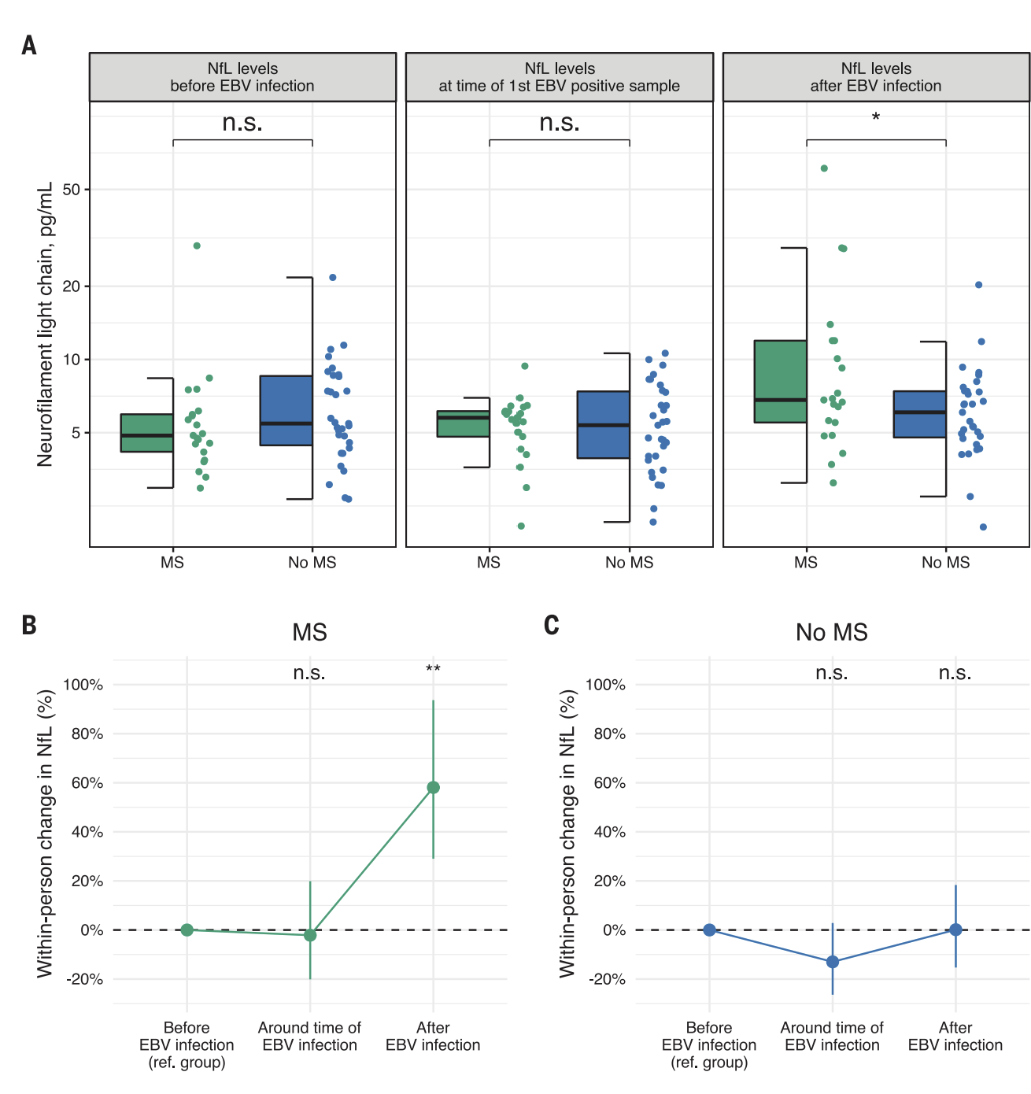
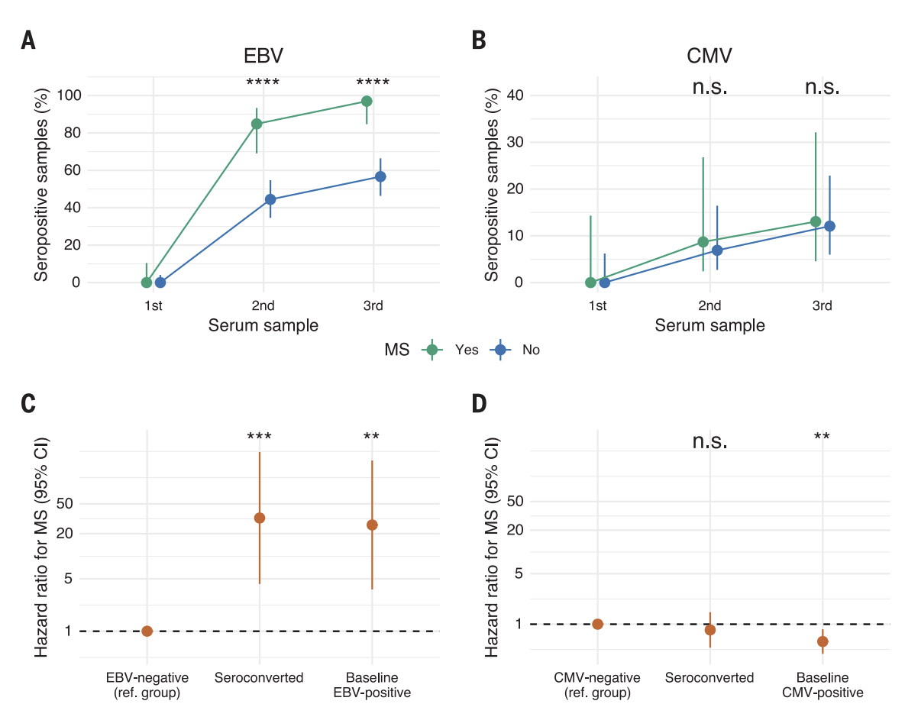
Epstein-Barr Virus (EBV) hypothesized as a potential cause of MS.
Study included over 10 million young adults in the US military, with 955 diagnosed with MS during service.
Risk of MS increased 32-fold after EBV infection ((95% CI: 4.3 to 245.3, P < 0.001)
No increased risk after infection with other viruses (e.g., cytomegalovirus).
97% of individuals who developed MS during the follow-up period seroconverted to EBV-positive status, compared to only 57% of those who did not develop MS.
Serum Neurofilament light chain (sNfL) levels, a marker of neuroaxonal degeneration, increased only after EBV seroconversion.
Findings suggest EBV as the leading cause of MS, not explained by known MS risk factors.

Slide 9
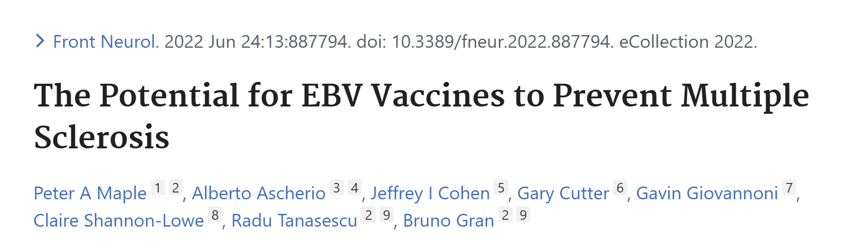
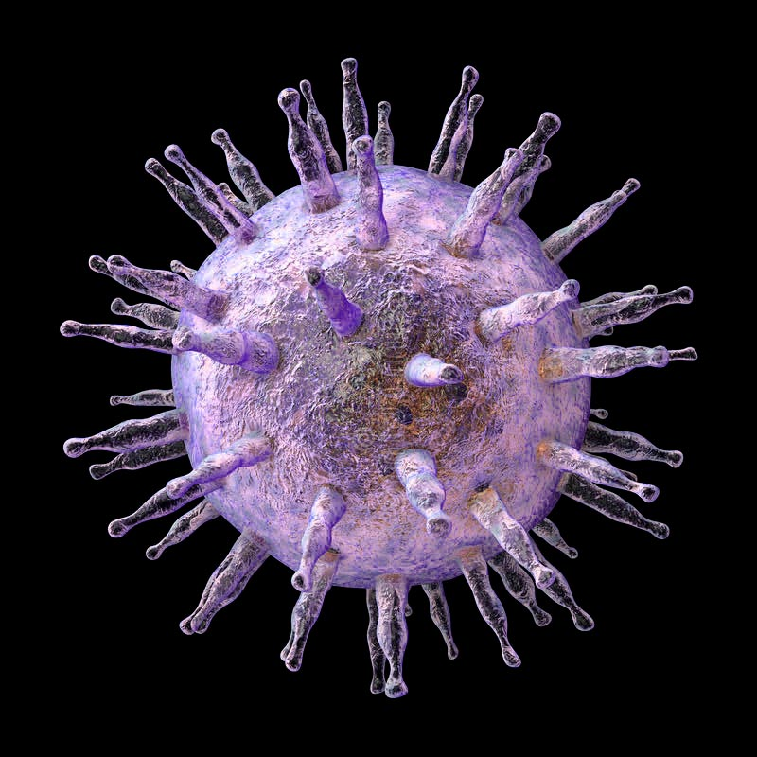
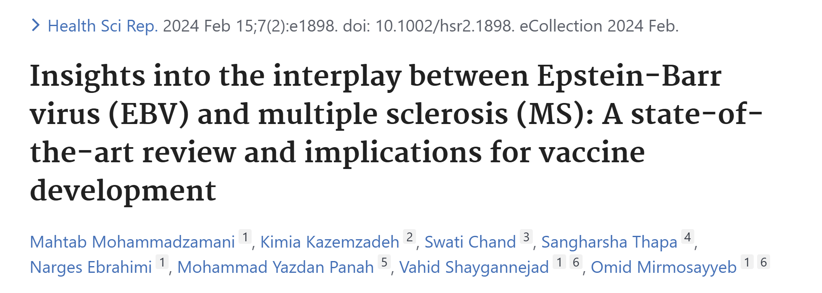
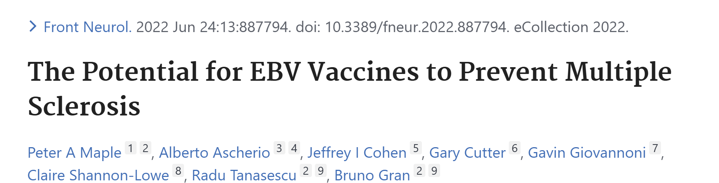

Slide 10
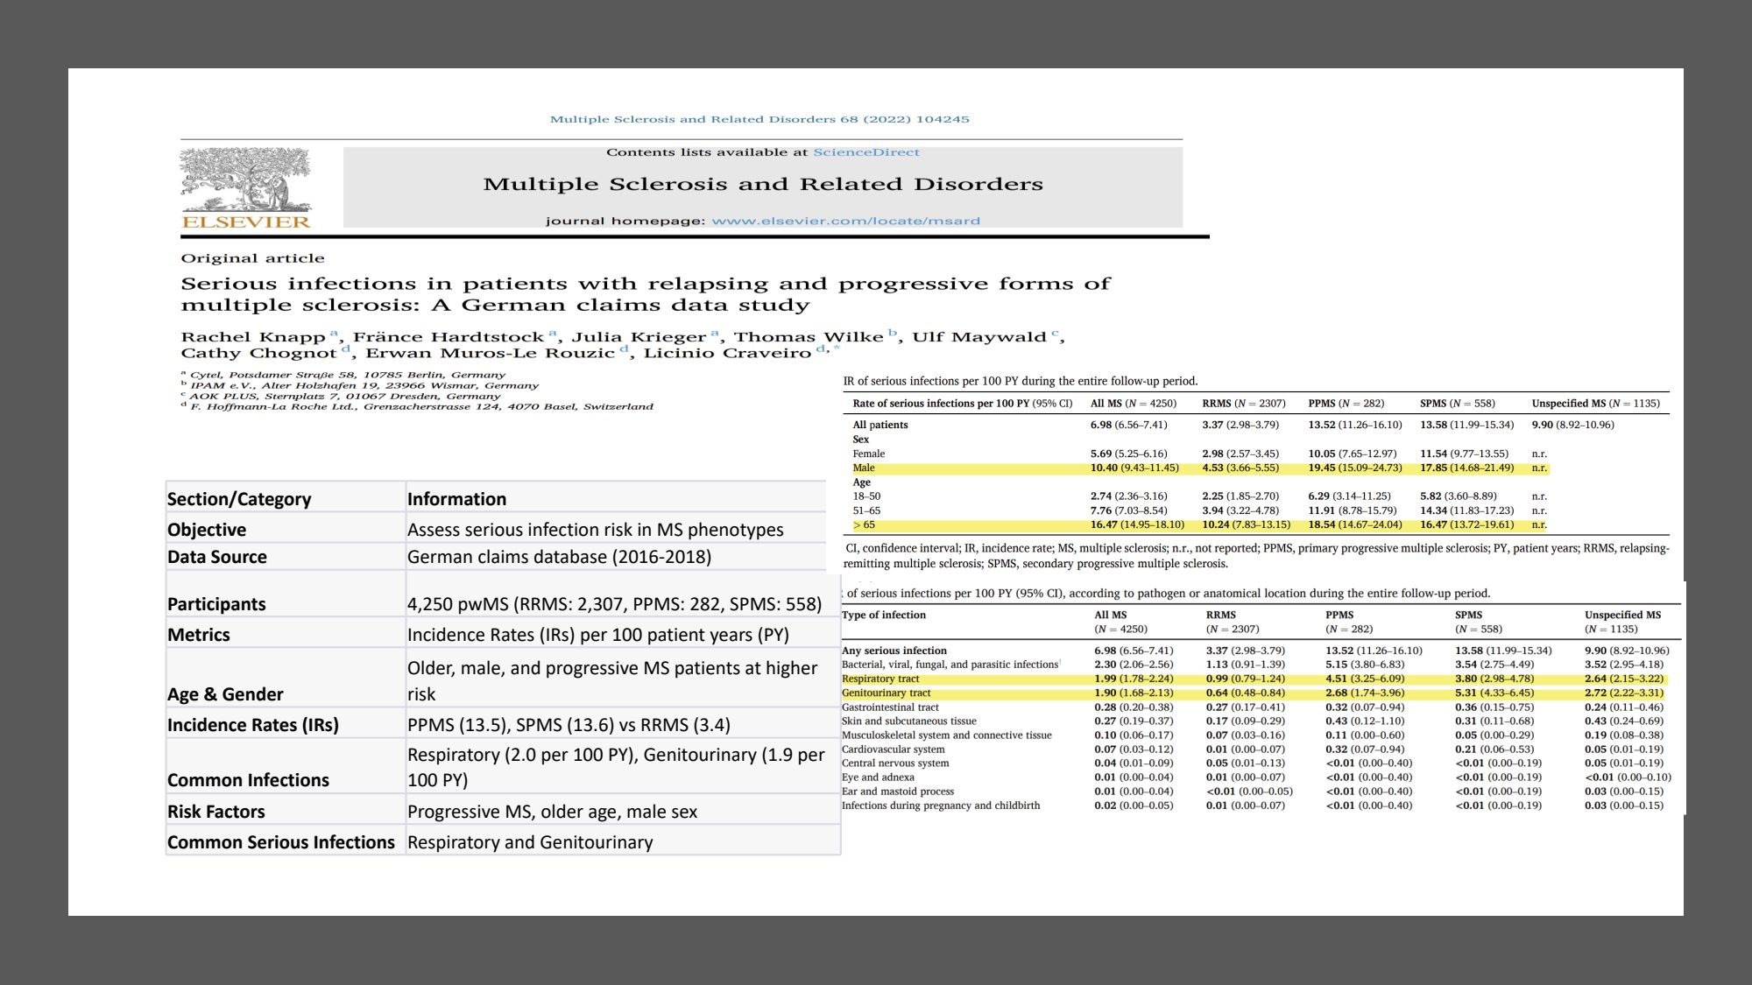

Slide 11







Immune Tolerance & Its Role in Multiple Sclerosis Pathogenesis: T cells
Central Tolerance
Disease Pathogenesis​
Interplay between genetic & environmental factors​
Affects autoreactive cells​
Occurs in thymus (T cells) & bone marrow (B cells)
Deletes CNS autoreactive immune cells
Peripheral Tolerance
Main T cell Subsets​
CD8+ T cells​
CD4+ TH1 & TH17 cells​
Prevents escaped autoreactive cells from causing disease
Failures due to impaired Treg function or resistance of autoreactive cells suppression.
Cytokines in MS​
IFN gamma, IL-17, GM-CSF​
Contribute to MS pathogenesis​
MS DMTs Efficacy​
Partially Shift T cell differentiation (TH1 and TH17) to less inflammatory TH2​
Dendrou CA, Fugger L, Friese MA. Immunopathology of multiple sclerosis. Nat Rev Immunol 2015

Slide 12



Immune Tolerance & Its Role in Multiple Sclerosis Pathogenesis: B cells
B cells in MS
Gaining attention in MS pathophysiology
Produce CSF-specific oligoclonal IgG bands
Infiltrates in CNS meninges
Correlate with lesions & disability
Epstein-Barr virus reservoir
Antigen presentation to T cells & toxic to oligodendrocytes
B-cell Cytokines
Proinflammatory: lymphotoxin-α, IL-6, TNF-α, GM-CSF
Anti-inflammatory impaired in MS (IL-10, IL-35, and TGF β1)
B-cell Depletion
Reduces proinflammatory activity in T cells
Comi G, Bar-Or A, Lassmann H, et al. Role of B cells in multiple sclerosis and related disorders. Ann Neurol 2021

Slide 13
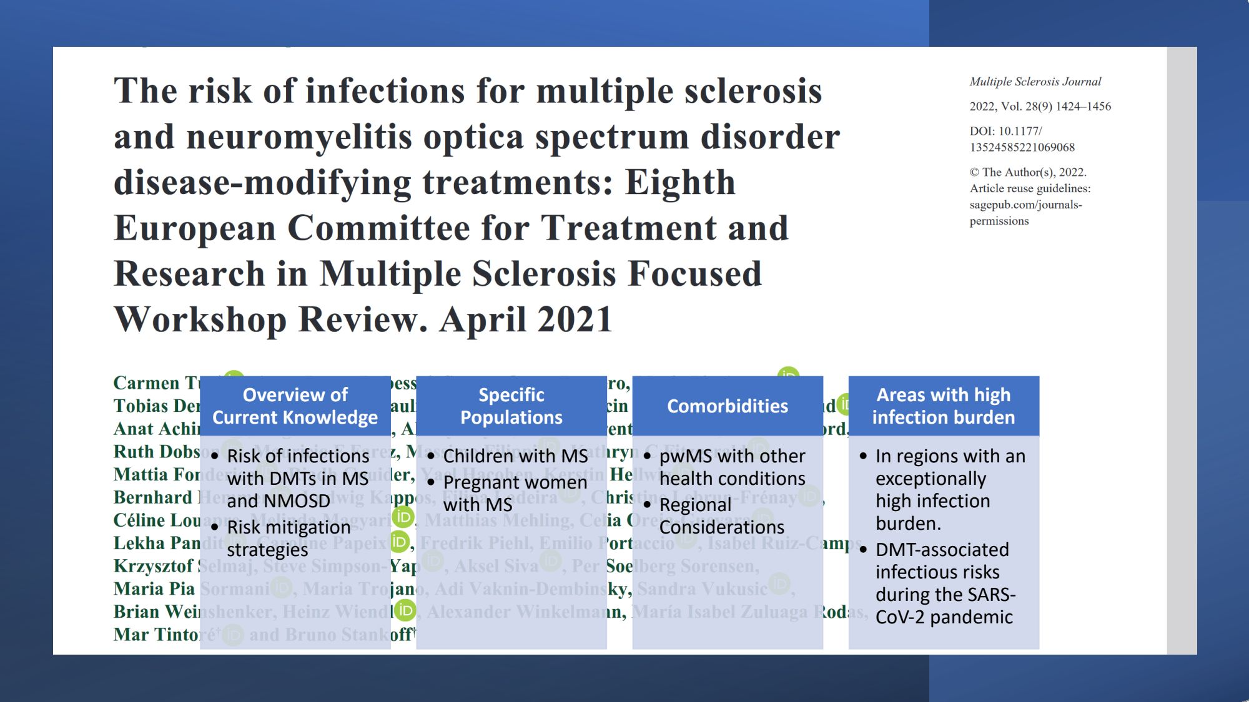

Slide 14











FDA approved DMTs for treatment of MS (N=38)
Injectables (10), Oral (11), and Infusions (17)
Immune Modulators
Immune Suppressants
Monoclonal Antibodies
S1P Receptor Modulators
Other Mechanisms
Interferon Beta-1a
Mitoxantrone
Natalizumab
Fingolimod
Dimethyl Fumarate
Interferon Beta-1b
Cladribine
Ocrelizumab
Siponimod
Bafiertam
Peginterferon Beta-1a
Ublituximab
Ponesimod
Diroximel Fumarate
Glatiramer Acetate
Ofatumumab
Ozanimod
Teriflunomide
Alemtuzumab

Slide 15



Efficacy Classification for DMTs
DMTs for MS are also classified by their efficacy in reducing relapses, MRI activity, and disability progression
Efficacy Level
DMTs
Low Efficacy
Interferon beta (Avonex®, Rebif®, Betaseron®), Glatiramer acetate (Copaxone®, Glatopa®), Teriflunomide (Aubagio®)
Moderate Efficacy
Dimethyl fumarate (Tecfidera®), Diroximel fumarate (Vumerity®), Fingolimod (Gilenya®), Siponimod (Mayzent®), Ponisomod (Ponvory®)
High Efficacy
Natalizumab (Tysabri®), Alemtuzumab (Lemtrada®), Ocrelizumab (Ocrevus®), Ofatumumab (Kesimpta®), Rituximab (Rituxan®), ublituximab-xiiy (Briumvi ®), Cladribine (Mavenclad®)
To achieve No Evidence of Disease Activity (NEDA) and delay Progression Independent of Relapse Activity (PIRA)

Slide 16
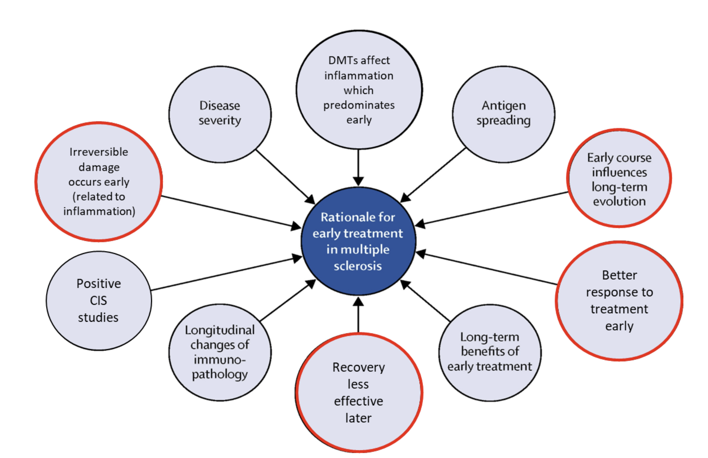
Rationale for early treatment in MS - Figure from Comi et al Lancet 2017

Slide 17
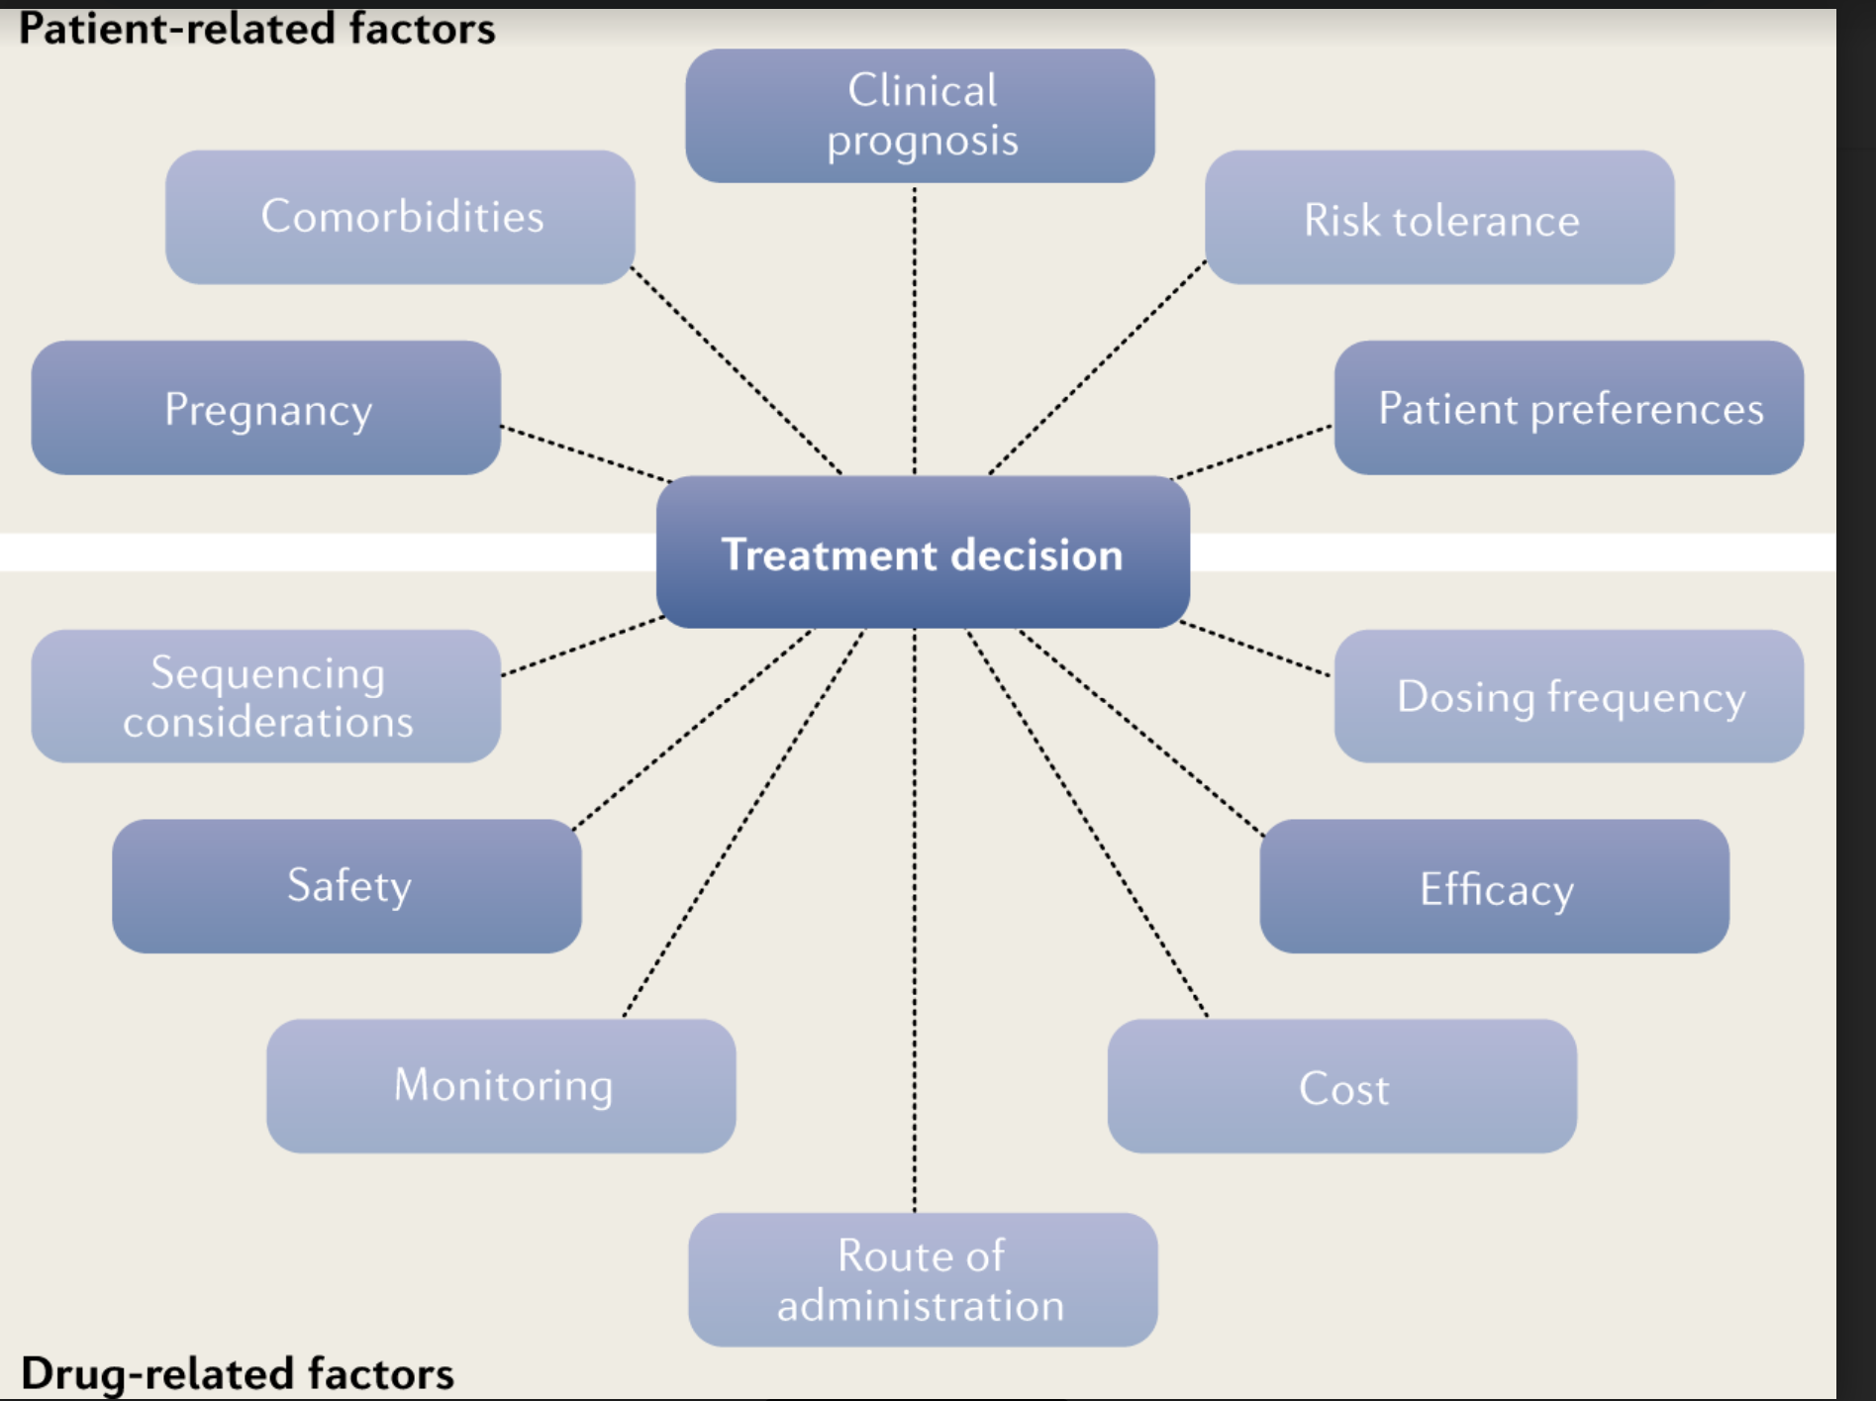
Factors that influence DMT decisions – Rotstein, D., Montalban, X. Nat Rev Neurol 15, 287–300 (2019)

Slide 18








Immune Suppressants- Cladribine
Mitoxantrone: Not discussed- risk of cardiotoxicity and AML
Impact on Immune Cells
Limited Innate Immune Effect
CLARITY Phase III Trial Findings
Cladribine Basics
Chlorinated deoxyadenosine analogue
Strong effect on B-cells; 6-month recovery
Rare occurrences of neutropenia and pancytopenia
Increased VZV infection linked to severe lymphopenia
Inhibits DNA synthesis in lymphocytes
Lesser, persistent impact on CD4+ T-cells
Latent tuberculosis reactivation in pancytopenia cases
Leads to apoptosis in B- and T-cells
Mainly causes lymphopenia in early months post-dose
No increased risk of other severe infections

Slide 19

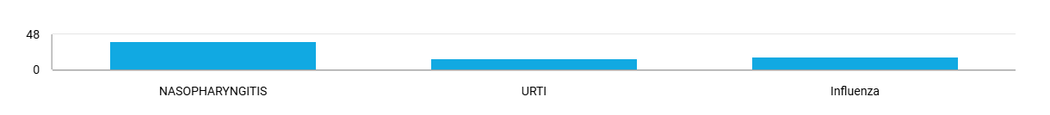
Monoclonal Antibodies- Natalizumab First monoclonal antibody to be approved
Against α4 integrins- Blocks inflammatory cells from entering the brain - (% patients affected in active arm)
AFFIRM TRIAL -RCT-NTZ VS PLACEBO
SENTINAL TRIAL- RCT-NTZ + IFNb-1a VS IFNb-1a- No Increased risk with respect to control arm except for JCV PML cases
JCV-related PML- 2 CASES (1 during and 1 after trial)

Slide 20
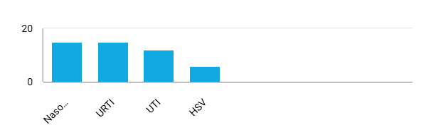
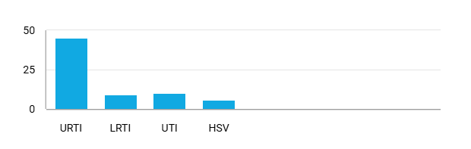
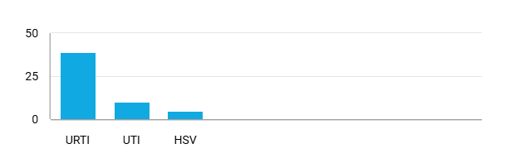
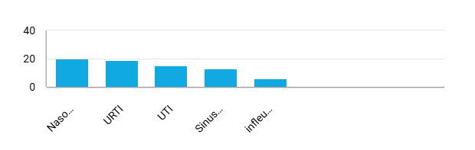
Anti-CD20 Therapies Infection Risk
Eliminates B-cells up to the plasma cell stage, leading to prolonged B-cell lymphopenia and potential hypogammaglobulinemia (low IgG/IgM), which increases infection risk- (% patients affected in active arm)
Ocrelizumab: OPERA I and OPERA II: RCT-OCR VS IFNb-1a
Ublituximab: ULTIMATE I and II: UBL VS teriflunomide
Ofatumumab: ASCLEPIOS I and II -RCT- OFA VS teriflunomide
RTX: HERMES (RRMS), OLYMPUS (PPMS: RCT-RTX VS PLACEBO)

Slide 21
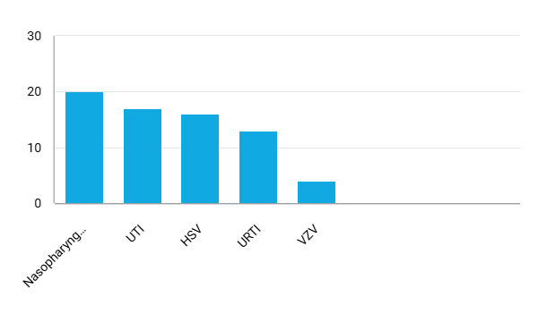
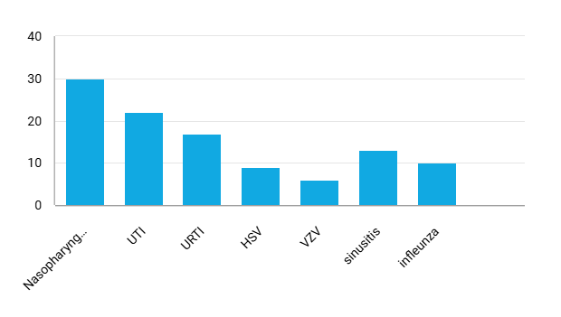



Alemtuzumab-CD52 lymphodepleting therapy Infection Risk
B-cells recover in 3-6 months, T-cells take at least 1 year to reach LLN, with an increase in CD4+ Treg subtype post-treatment- (% patients affected in active arm)
CARE MS -I: RCT- ALZ VS IFNb-1a
CARE MS -II: RCT-ALZ VS IFNb-1a:
1 case of disseminated TB
Acalculous cholecystitis -Uncommon but severe
•Common infections with alemtuzumab: Herpetic (HSV, cytomegalovirus) and bacterial (Listeria, Mycobacterium) due to T-cell suppression.

Slide 22
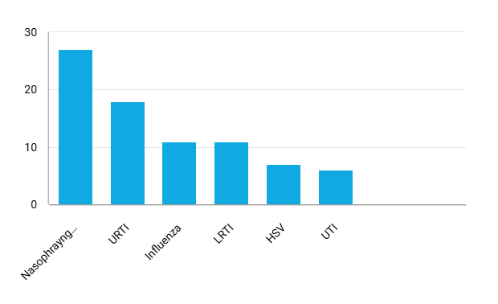
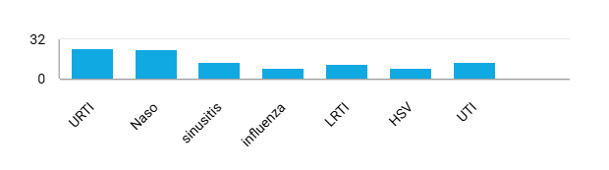
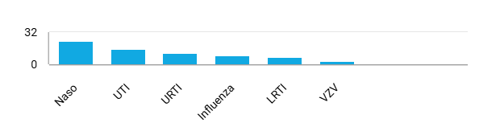
S1P Receptor Modulators-Infection Risk
Fingolimod-First Oral DMT
Traps white blood cells in lymphoid organs- % patients affected in active arm
Fingolimod: FREEDOMS-FTY VS IFNb-1a
Fingolimod: FREEDOMS II-FTY VS PLACEBO
Fingolimod- INFORMS: PPMS -FTY VS PLACEBO

Slide 23
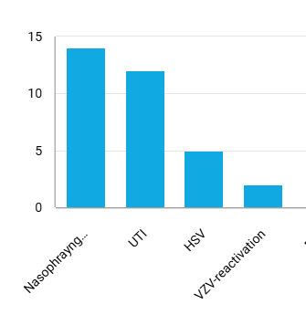
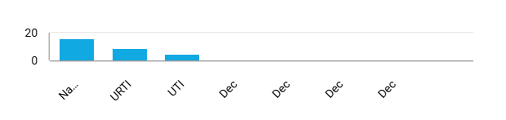

S1P Receptor Modulators-Infection Risk
Siponimod, Ozanimod, Ponesimod
Traps white blood cells in lymphoid organs- % patients affected in active arm
Siponimod- EXPAND TRIAL-RCT-SIP vs Placebo
Ozanimod-SUNBEAM AND RADIANCE TRIALS-
OZA Vs Interferon beta-1a
Ponesimod: OPTIMUM TRIAL-PON vs TER

Slide 24
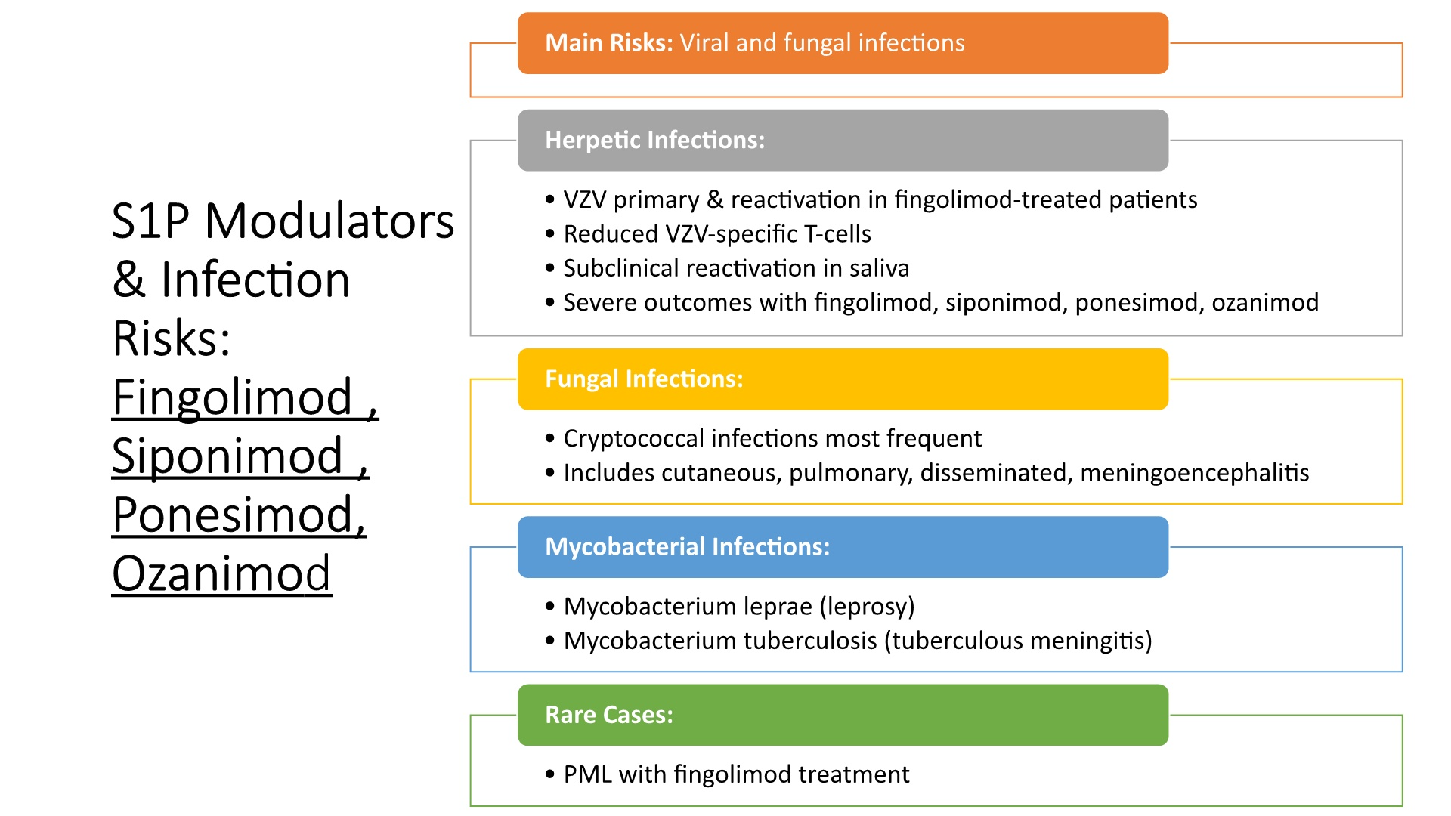

Slide 25
Dimethyl Fumarate (DMF): Activates Anti-oxidative and Anti-inflammatory Pathways
CONFIRM, DEFINE and ENDORSE Study (9 year follow up)
Mechanism of Action
Lymphopenia
DMF activates the Nrf2 pathway, a critical cellular antioxidant and anti-inflammatory response regulator.
DMF-related lymphopenia occurs in 37% of patients, with severe lymphopenia (lymphocyte count <200/mm3) in 8% of them.
Infection Risks
PML
Prolonged periods of severe lymphopenia due to DMF treatment are associated with an increased risk of serious and opportunistic infections, including VZV, HSV, CMV, Cryptosporidium, Mycobacterium tuberculosis, and Candida species.
Nine cases of PML have been reported, mainly in the context of persistent (for more than six months) moderate–severe lymphopenia.
PML-Progressive Multifocal Leukoencephalopathy

Slide 26



Teriflunomide: Infection Risk
Inhibits pyrimidine synthesis, reducing T and B cell activation
TEMSO Trial
TENERE Trial
TOWER Trial
Nasopharyngitis 12.7% Urinary tract infection (UTI) 8.9% Influenza 7.0%
Nasopharyngitis (23%) TB (1 case, <1%)
Nasopharyngitis (12%) URTI (9%) UTI (8%)

Slide 27




DMT Associated PML
PML Risk with DMTs
DMTs Linked to PML
Monitoring and Precautions
Progressive Multifocal Leukoencephalopathy (PML) is a rare, serious brain infection caused by the JC virus. Certain disease-modifying therapies (DMTs) for multiple sclerosis (MS) have been associated with an increased risk of developing PML.
Natalizumab, Fingolimod, and Ocrelizumab are some of the DMTs that have been linked to PML in patients with MS. The risk varies depending on the specific DMT and individual patient factors.
Patients on DMTs for MS need regular monitoring and vigilance for early signs of PML. Healthcare providers should follow recommended guidelines for screening, monitoring, and managing PML risk.
Importance of Informed Consent
Patients should be made aware of the PML risk associated with their DMT and the importance of reporting any new or worsening symptoms promptly. Informed consent is crucial for managing PML risk.
Understanding the PML risk associated with different DMTs for MS is essential for healthcare providers and patients to make informed treatment decisions and effectively manage this rare but serious complication.

Slide 28

Drug
Frequency and Risk
Notable Cases and Risk Factors
Risk factors: prior immunosuppressant use, long-term use, high JCV antibody index (>1.5). Cumulative risk ~27 per 1000 for JCV+ patients after 72 infusions with prior immunosuppressant use
Highest risk among DMTs. Incidence in years 5-8 of treatment: 3.6-6.2 per 1000
Natalizumab
188 suspected cases of PML
37 cases solely associated with fingolimod. Risk factors: age >45, treatment duration >24 months
Fingolimod
Estimated incidence: 0.069 per 1,000 patients.
Nine cases reported. Risk factors: persistent lymphopenia (ALC <800), age >54, prior natalizumab use
Dimethyl fumarate
Estimated incidence: 0.02 per 1000 patients.
11 cases attributed to prior DMT use. Other factors: age-related immunosenescence, lymphopenia
15 cases reported
Ocrelizumab
One case reported
31-year-old woman, 14 months after first cycle, 2 months after second cycle
Alemtuzumab
Ozanimod
One case reported
46-year-old woman after ~4 years of treatment
No cases in MS, but reported in other indications
Cladribine
Risk factor: prolonged CD4+ T-cell suppression
Teriflunomide, Siponimod, Ponesimod, Ofatumumab, Ublituximab
No cases reported in MS patients
N/A

Slide 29

Lymphopenia is Important, but Context-Specific
WHO Lymphopenia Classification
Grade 0 (normal): >1,000/mm3
Grade 1 (Mild): 800 – 999/mm3
Temporal Profile
Grade 2 (Moderate): 500 – 799/mm3
Grade 3 (Severe): 200 – 499/mm3
The patient’s age – people experience a drop in T-cell receptor diversity around the age of 60
Grade 4 (Very Severe): <200/mm3
Comorbidities
Qualitative Changes
The patient’s age – people experience a drop in T-cell receptor diversity around the age of 60
Any Co-morbidities
Qualitative changes in CD4 and CD8- The temporal profile, or how counts change over time in response to therapy
Duration of treatment
Any comorbidities
Age
Qualitative changes in CD4 and CD8
The temporal profile, or how counts change over time in response to therapy
Duration on treatment

Slide 30
Implications for Clinical Practice
Infection Risk and DMTs
Assess infection risks and closely monitor MS patients when selecting or adjusting DMTs with immunosuppressive effects
Vaccination Strategies
Encourage timely vaccinations of MS patients before starting DMTs.
https://www.nationalmssociety.org/managing-ms/living-with-ms/diet-exercise-and-healthy-behaviors/vaccination
Monitoring for Infections
Closely monitor MS patients for signs and symptoms of infection, including opportunistic infections. Promptly investigate and treat any suspected infections.
Multidisciplinary Collaboration
Individualized Treatment Approach
Shared Decision-Making:
Engage patients in discussions about their treatment options by considering their unique clinical characteristics, treatment history, and immune status. This approach ensures that DMT and infection management decisions align with each patient's values, preferences, and lifestyle.
Engage in multidisciplinary collaboration with neurologists, infectious disease specialists, and other healthcare providers to optimize the management of infections and disease-modifying therapies in MS patients.

Slide 31


Risk Mitigation Strategies before starting DMTs
All DMTs
Vaccination/Screening
Recommendations
Influenza
Annual vaccination
Measles, rubella, mumps
Ab screening; vaccination if negative IgG
HIV
Antigen p24 detection: referral to specialized unit if positive
Streptococcus pneumoniae
Consider vaccination with conjugate vaccine PCV13 and/or polysaccharide PPSV23 pneumococcal vaccine, especially if immunosuppression is planned
Clostridium tetani
Vaccination (tetanus, generally with Diphtheria (dT) or with Diphtheria and Bordetella pertussis (dTpa)
*Multiple Sclerosis International Federation (MSIF) - Disease Modifying Therapies for MS

Slide 32
Risk Mitigation Strategies: S1P Receptor Modulators: Fingolimod, Siponimod, Ozanimod, and Ponesimod
JCV Monitoring
HSV Prophylaxis
VZV Screening and Vaccination
Screen for anti-JCV IgG and index if previously on natalizumab due to risk of JCV seroconversion. Increase MRI monitoring for the first 6-12 months.
Provide acyclovir 200 mg twice daily for grade IV lymphopenia.
Screen for VZV antibodies and vaccinate if IgG negative. recombinant zoster vaccine (Shingrix ®)- two doses, typically 2-6 months apart.
Monitor lymphopenia.
HPV Screening
SARS-CoV-2 Vaccination
Opportunistic Infections
Perform regular Pap smear screening. Provide vaccination and referral if positive.
Recommend COVID-19 vaccine or booster. Patients on fingolimod may show reduced vaccine response.
Monitor for cryptococcus (low threshold for detection in patients >50 years), candidiasis, and tuberculosis.

Slide 33


Risk Mitigation Strategies-Teriflunomide and DMF
TER
DMF
SARS-CoV-2 -COVID-19 vaccine
JCV-PML-Screening anti-JCV IgG and index (not mandatory)
Tuberculosis -Tuberculin skin test or TB Quant
SARS-CoV-2 -COVID-19 vaccine
Thorax X-ray in patients with positive results; TB treatment if positive
Cryptococcus – Low threshold of suspicion when finding meningeal signs Consider Cryptococcus especially if age >50 years and prolonged treatment Monitoring of lymphopenia
TB-TB Quant/ PPD

Slide 34
Risk Mitigation Strategies - Cladribine
Prophylaxis with Acyclovir
Administer acyclovir 200 mg twice daily if grade IV lymphopenia to prevent HSV infection.
VZV Antibody Screening
Screen for VZV antibodies and vaccinate if patient is negative for VZV IgG.
Lymphopenia Monitoring
Closely monitor the patient's lymphocyte count during treatment with cladribine.
COVID-19 Vaccination
Administer COVID-19 vaccine or booster shot, preferably after immune reconstitution, as cladribine can reduce the cellular response to the vaccine.
Tuberculosis Screening
Perform tuberculin skin test or TB Quant, and chest X-ray for patients with positive results, followed by TB treatment if necessary.
Do not take MAVENCLAD- If HIV positive and / or have active infections, including tuberculosis (TB), hepatitis B or C- MAVENCLAD® (cladribine) Medication Guide

Slide 35


Risk Mitigation Strategies - Natalizumab
Risk Mitigation Strategies
Description
Screening anti-JCV IgG and index
Baseline Screening for antibodies to the JC virus (JCV) to assess the risk of PML
Increased MRI surveillance
Increased frequency of MRI scans to monitor for early signs of PML in patients on natalizumab- 6-12 months
Monitoring of anti-JCV antibodies and index
Regular monitoring of anti-JCV antibody levels and index to detect changes in PML risk- every 6 months
Extended dosage (6 weeks for natalizumab)
Extending the dosing interval of natalizumab from 4 weeks to 6 weeks to potentially reduce PML risk
Switch to a low-PML risk drug if high JCV stratify index ≥ 1.5
Switching from natalizumab to a different disease-modifying therapy with a lower risk of PML
*Tur, C., Dubessy, A.-L., et al. (2022). Risk minimization strategies for infections in patients with multiple sclerosis receiving disease-modifying therapies. Multiple Sclerosis Journal, 28(9), 1431-1443.

Slide 36
Risk Mitigation Strategies - Natalizumab
VZV Antibody Screening
Screen for varicella-zoster virus (VZV) antibodies before starting treatment and vaccinate if negative IgG
COVID-19 Vaccination
Recommend COVID-19 vaccine before or during treatment, and booster shots when indicated
Lymphopenia Monitoring
Monitor for lymphopenia during treatment, as it may increase risk of opportunistic infections
Cryptococcus Awareness
Maintain a low threshold of suspicion for Cryptococcus, especially in older patients on prolonged treatment
Candidiasis Monitoring
Monitor for mucocutaneous candidiasis and manage lymphopenia if present
Tur, C., Dubessy, A.-L., et al. (2022). Risk minimization strategies for infections in patients with multiple sclerosis receiving disease-modifying therapies. Multiple Sclerosis Journal, 28(9), 1431-1443

Slide 37
Risk Mitigation Strategies - Alemtuzumab
Infection Screening and Prophylaxis:
Screen for TB, hepatitis B/ C, and HIV before initiating treatment.
Begin herpes prophylaxis (e.g., acyclovir 200 mg bid) during and for 2 months post-infusion or until lymphocyte counts recover.
HPV screening (Pap smear)
Monitoring for Opportunistic Infections
Educate patients on signs of PML (Progressive Multifocal Leukoencephalopathy), listeriosis, candida, nocardia.
Advise patients to avoid high-risk foods for listeria (e.g., unpasteurized dairy, deli meats) for one-month post-infusion.
Vaccination:
Ensure vaccinations are up-to-date prior to treatment, especially varicella for VZV-negative patient and HPV for high-risk patients.
https://www.accessdata.fda.gov/drugsatfda_docs/label/2001

Slide 38



Risk Mitigation Strategies - Anti-CD20 Therapies
Rituximab, Ocrelizumab, Ofatumumab and Ublituximab
JCV-PML Screening
VZV Monitoring
COVID-19 Mitigation
Screen for anti-JCV IgG and index to assess PML risk (not mandatory)
Screen for VZV antibodies and vaccinate if negative. Monitor for VZV reactivation.
Administer COVID-19 vaccine or booster, ideally 6 months after last anti-CD20 infusion and 4 weeks before next infusion.
Infection Monitoring
Hepatitis Screening
HSV Prophylaxis
Monitor for mucocutaneous candidiasis and lymphopenia.
Screen for HAV, HBV, and HCV. Vaccinate against HAV and HBV if seronegative. Refer to a specialist if hepatitis is positive.
Provide acyclovir 200 mg twice daily prophylaxis if grade IV lymphopenia occurs
Tur, C., Dubessy, A.-L., et al. (2022). Risk minimization strategies for infections in patients with multiple sclerosis receiving disease-modifying therapies. Multiple Sclerosis Journal, 28(9), 1431-1443

Slide 39



Anti-CD20 Therapies and Hypogammaglobulinemia
Check IgG/M/A before each infusion
Consider extended dosage, with caution in NMOSD
Monitor immunoglobulin levels to ensure adequate immune function during anti-CD20 therapy.
Extending the dosing interval may be beneficial, but exercise caution in neuromyelitis optica spectrum disorder (NMOSD) patients due to the risk of severe attacks.
Consider IVIG if hypogammaglobulinemia exists
If immunoglobulin levels are low, intravenous immunoglobulin (IVIG) may be necessary to maintain immune function.
Careful management of immunoglobulin levels and dosing is crucial when using anti-CD20 therapies to ensure optimal treatment outcomes while minimizing the risk of complications.

Slide 40
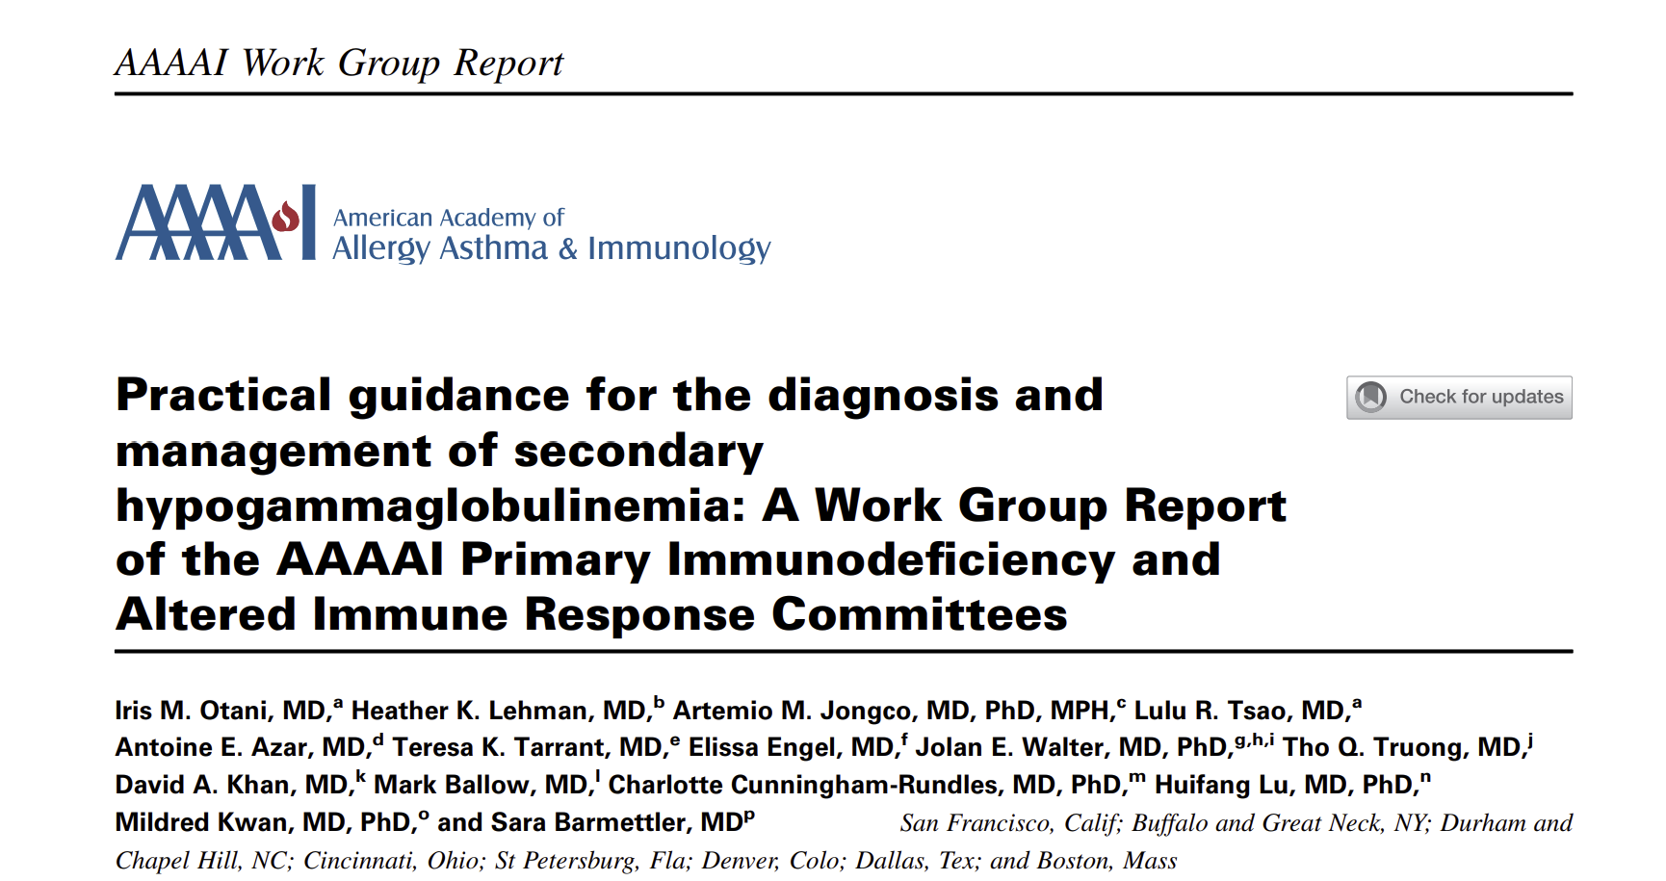

Indications for IVIG:
Severe Hypogammaglobulinemia:
IgG levels ≤150 mg/dL: Consider IVIG therapy.
Recurrent Infections:
Frequent/severe bacterial infections: IVIG may be needed even with IgG levels 150-600 mg/dL.
Low IgG with Impaired Antibody Response:
IgG levels 150-600 mg/dL: Assess antibody responses to vaccines (tetanus, diphtheria, strep pneumonia) before IVIG therapy.

Slide 41
IVIG for Sec Hypogammaglobulinemia
Dosing and administration
Alternative Options:
Initial dose – 400-600 mg/ kg/ month
Aim to maintain IgG trough levels >400-500 ml /dl
Usually administered every 4 wks. but can be individualized based on clinical response.
SCIg is an effective alternative for IVIG
Some guidelines suggest considering a trial of prophylactic antibiotics before initiating immunoglobulin replacement therapy.
Monitoring and Adjustment
Regular monitoring of IgG- 3-6 mths.
Adjust dosage to maintain adequate trough level
Clinical response is the key factor for Rx
Campagno et al- Immunoglobulin Replacement Therapy in Secondary Hypogammaglobulinemia. Front Immunol. 2014 Dec
Campagno et al- Subcutaneous immunoglobulin in lymphoproliferative disorders and rituximab-related secondary hypogammaglobulinemia: a single-center experience in 61 patients. Hematologica June, 2014
Otani et al-Practical guidance for the diagnosis and management of secondary hypogammaglobulinemia: A Work Group Report of the AAAAI Primary Immunodeficiency and Altered Immune Response Committees. J ALLERGY CLIN IMMUNOL. May 2022
Notes:
Py. C 400-

Slide 42
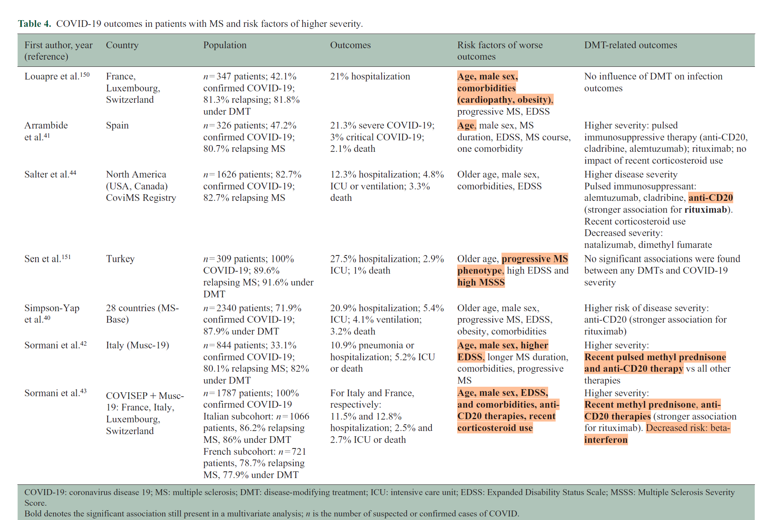

Slide 43
COVID-19 Risk for People With MS
Having MS alone doesn't increase your risk of contracting COVID-19 or experiencing severe illness
Elevated Risk Factors for Severe COVID-19 in MS Patients:
Black race
Male sex
Obesity (body mass index of 30 or higher)
Older age
Other chronic health conditions in addition to MS, like diabetes or heart disease
Progressive MS
Taking steroid medications
Taking certain disease-modifying therapies (DMTs) called anti-CD20 monoclonal antibodies/B cell depleting therapies (Ocrelizumab, Ublituximab, ofatumumab, rituximab and biosimilars)
Using a mobility device or a wheelchair
https://www.nationalmssociety.org/managing-ms/living-with-ms/diet-exercise-and-healthy-behaviors/vaccination/covid

Slide 44
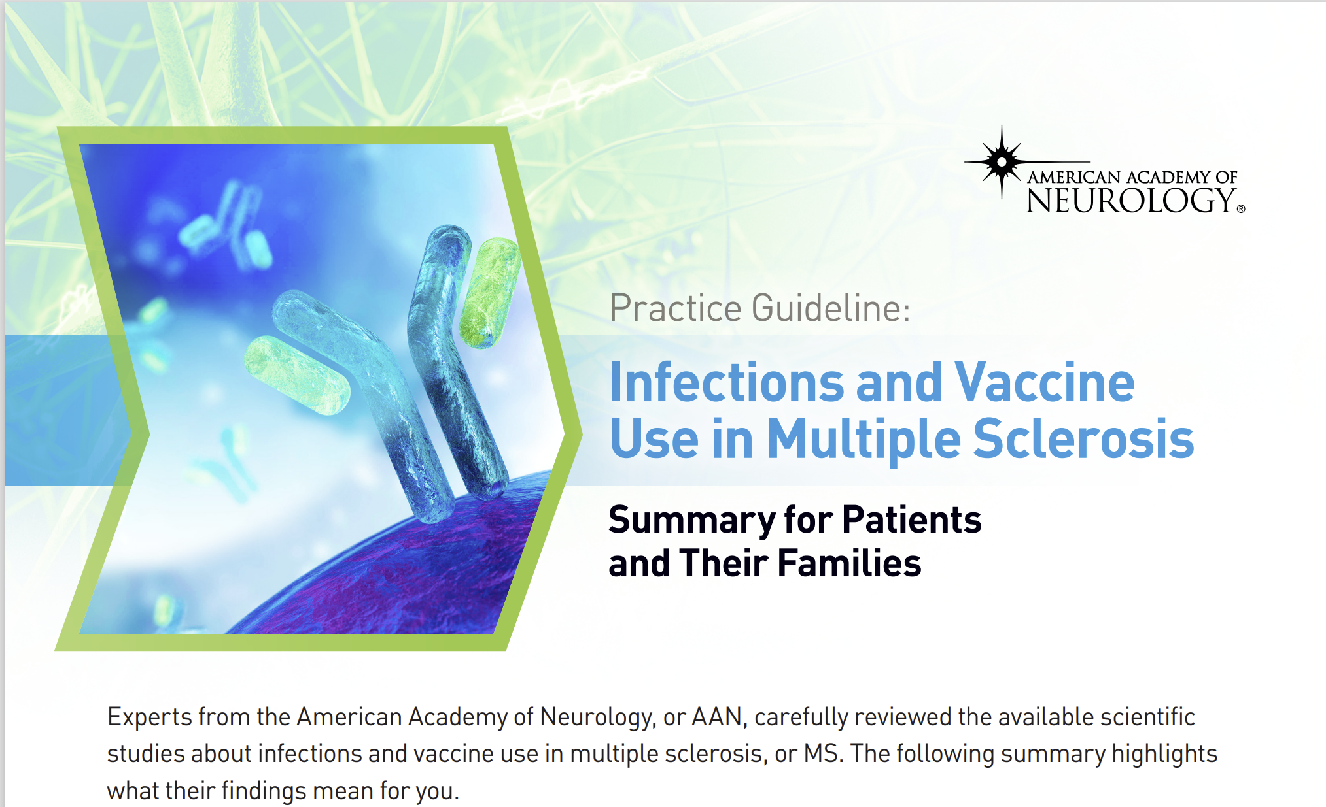
Timing Vaccines with DMTs
Beta interferons, Glatiramer acetates, Teriflunomide,Fumarates, Natalizumab: Do not delay starting these medications.
S1P receptor modulators: Get an updated COVID-19 vaccine 2 weeks before starting, or as soon as possible if already on treatment.
Alemtuzumab: Vaccinate 4 weeks before starting or 24+ weeks after your last dose.
Cladribine: Vaccinate 2 weeks before starting or resume treatment 2-4 weeks post-vaccine.
Ublituximab, Ocrelizumab, Rituximab: Vaccinate 4 weeks before next dose or 3+ months after last dose for better antibody response.
Ofatumumab: Vaccinate 2 weeks before starting or as soon as possible if already on treatment.
Steroids: Consider vaccinating 3-5 days after the last steroid dose.
https://www.nationalmssociety.org/managing-ms/living-with-ms/diet-exercise-and-healthy-behaviors/vaccination/covid

Slide 45
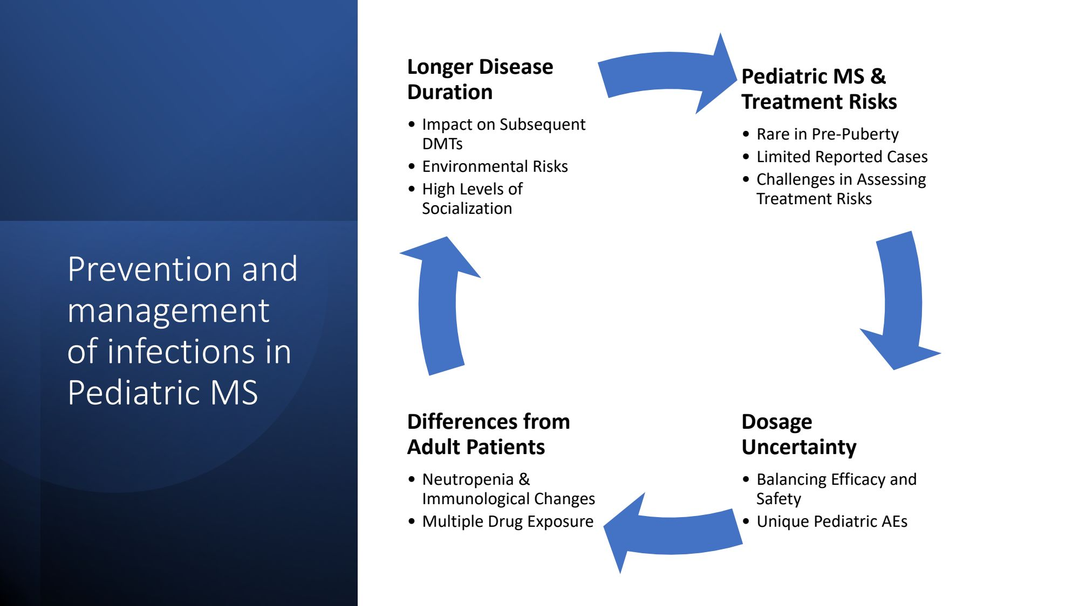

Slide 46
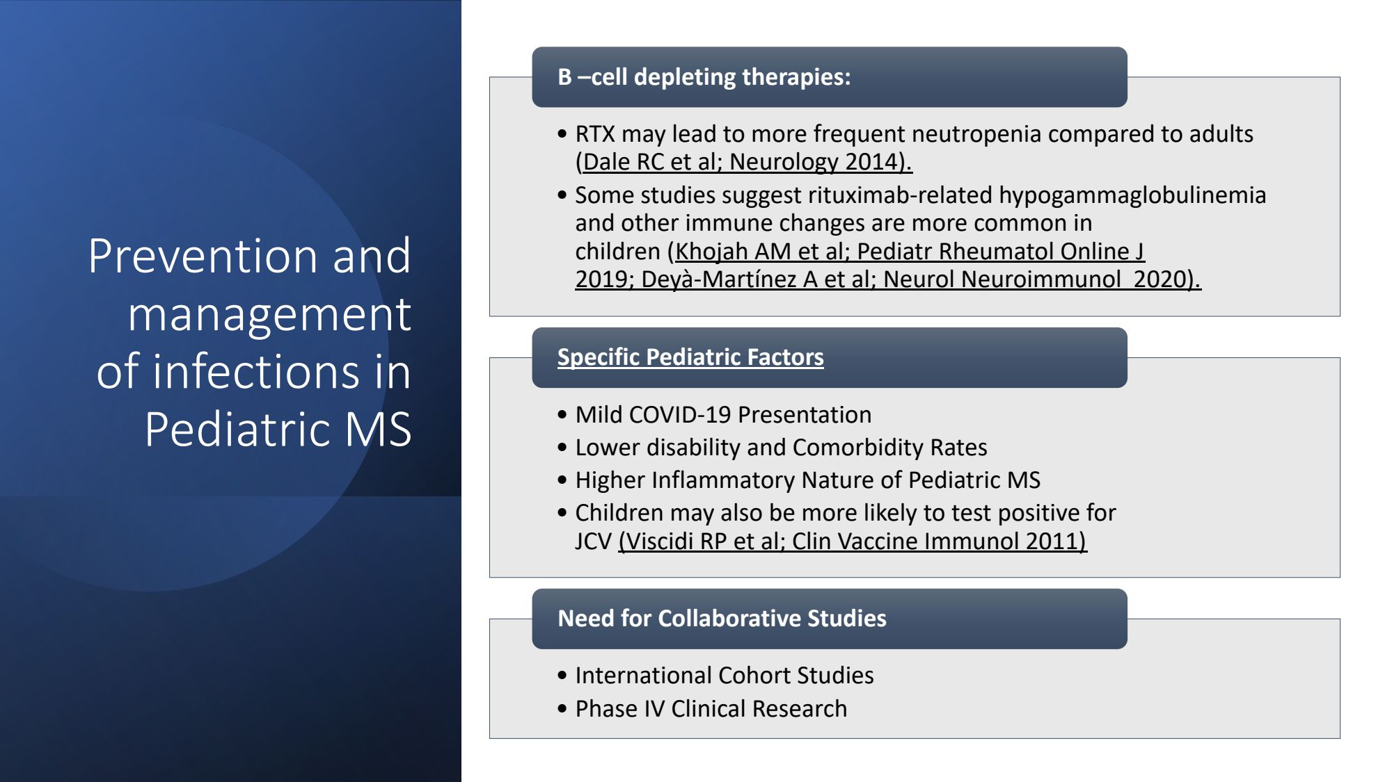

Slide 47
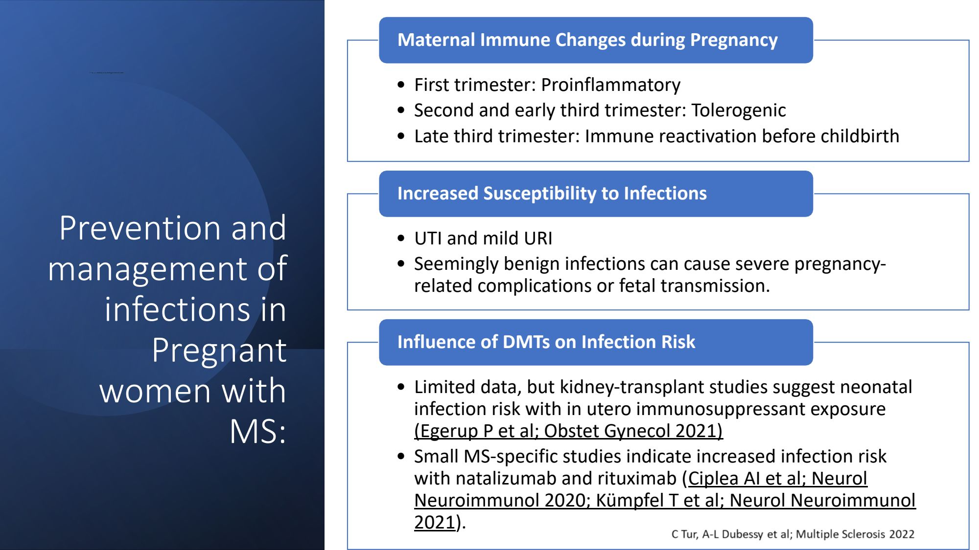

Slide 48
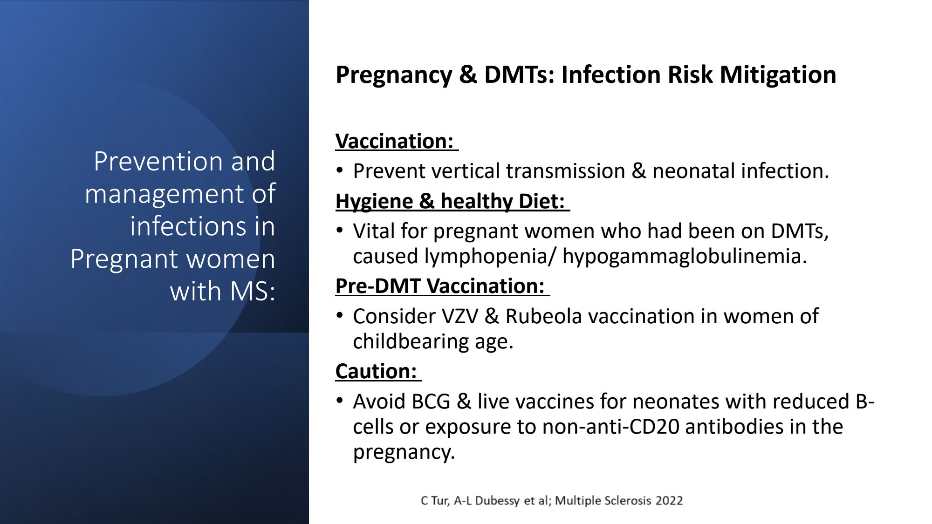

Slide 49
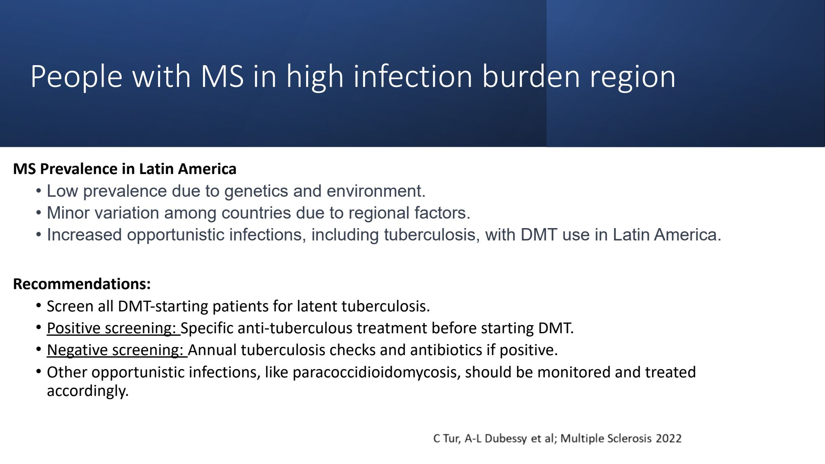

Slide 50
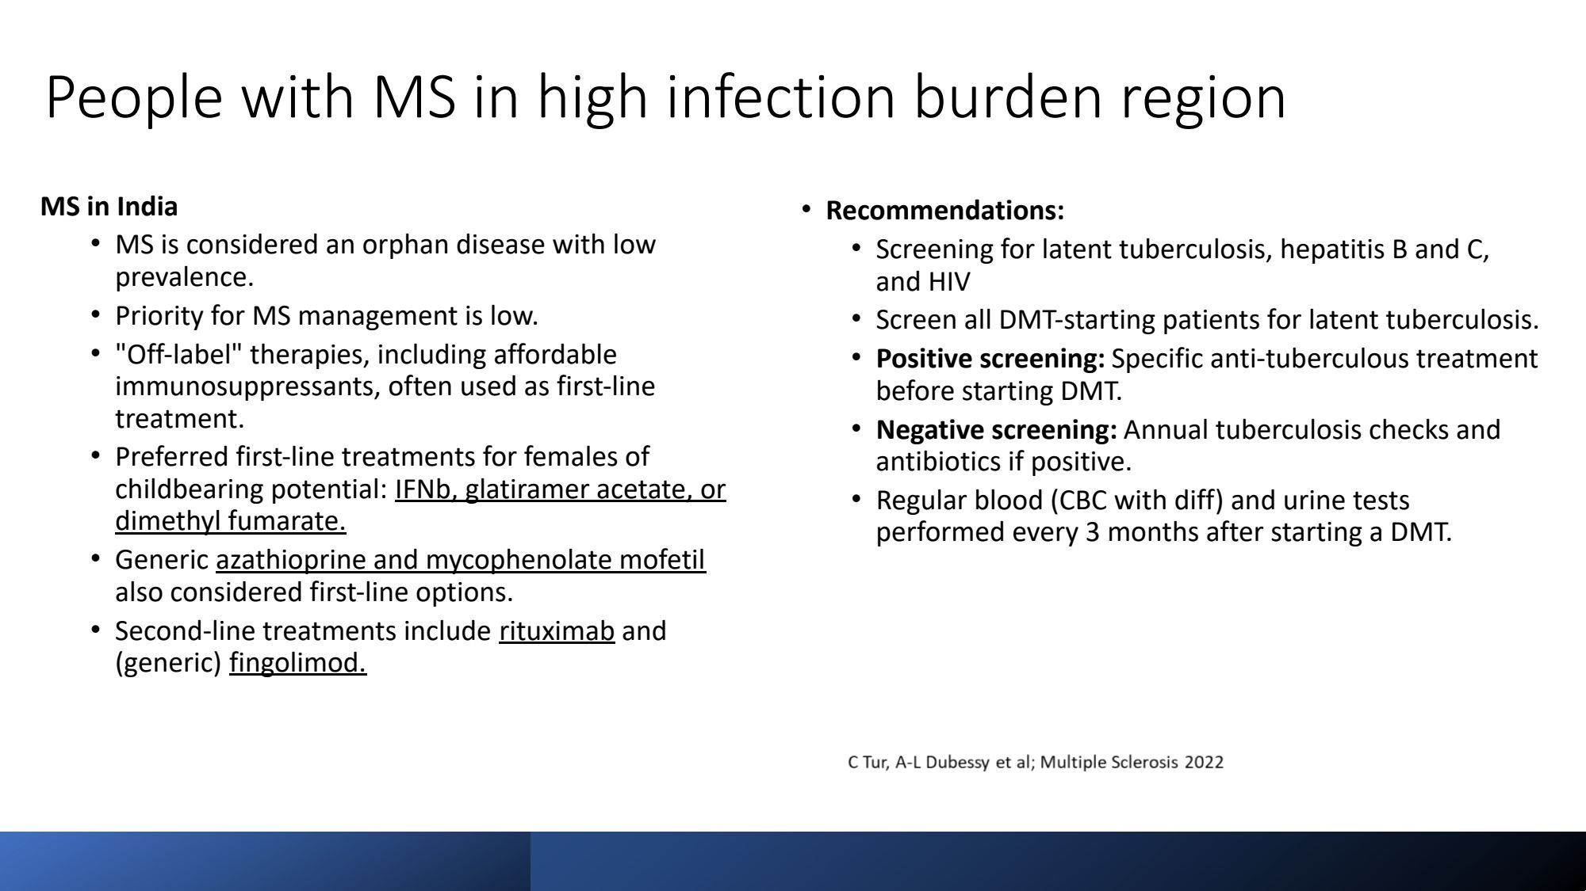

Slide 51
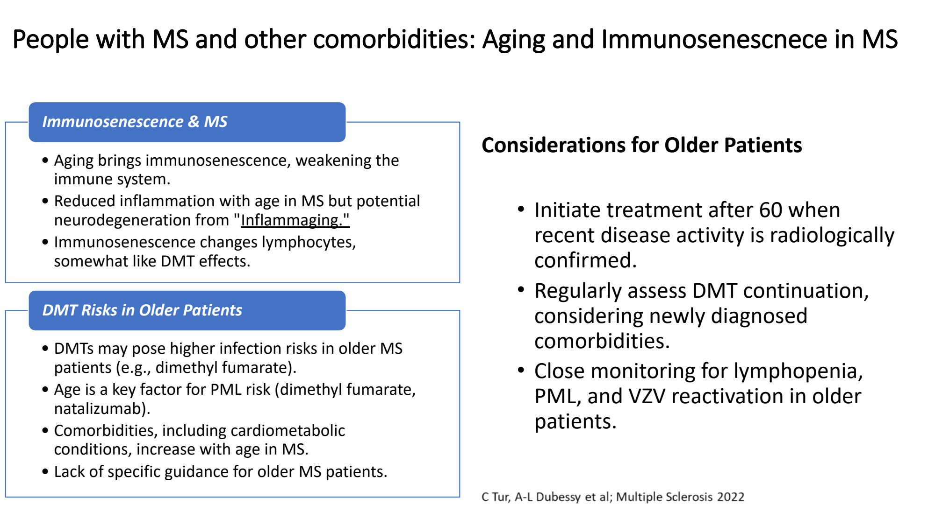

Slide 52
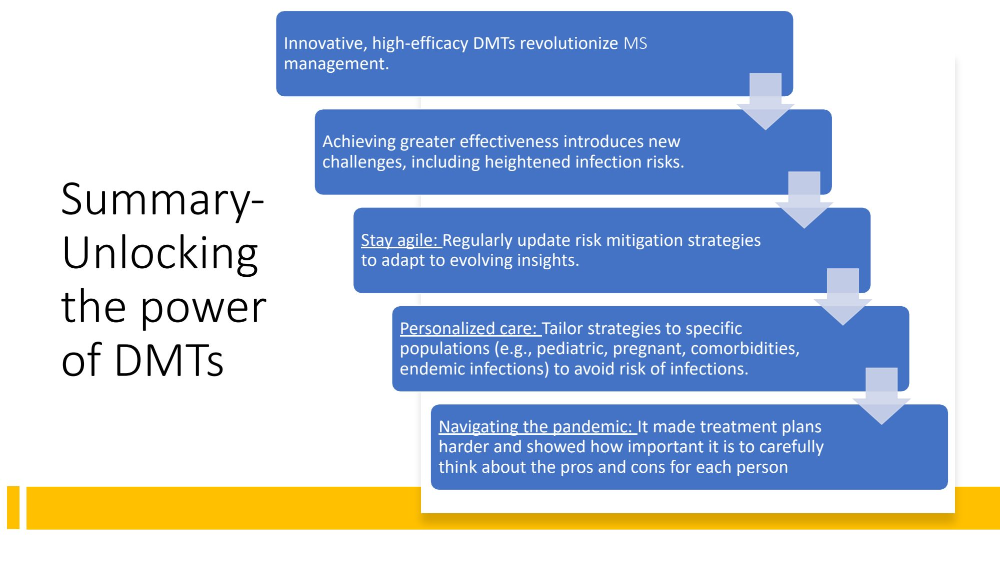

Slide 53
"An Ounce of Prevention Is Worth a Pound of Cure"
BENJAMIN FRANKLIN

Slide 54

Survey Reminder
Please complete the webinar survey in the TRAIN or TMS websites within 15 days. This will give you access to your CME/CE certificate.

Slide 55

What’s On Your Mind?
Please type your question into the Chat area in the lower right corner of your screen.
Notes:
Live questions

Slide 56
VA MS Centers of Excellence
National MS Society
Website: www.va.gov/MS
Remote clinical consults within VA
Clinical and DMT guidelines
Educational opportunities
Healthcare Professional
Monthly clinical e-newsletter
Monthly webinars
Conference presentations
Annual network meetings
Veteran
Monthly podcast
Quarterly e-newsletter
Webinars
Website: www.nationalmssociety.org
Professional Resource Center
Support
MS Navigator
Self-help groups
MSFriends
Educational Opportunities
Healthcare Professional
Webinars
National and local e-newsletters
Fellowships and mentoring
Patient
Ask an MS Expert series
Virtual Programs

Slide 57
Thank you and please SAVE THE DATES for our FY25 webinars!
Feb 5, 2025: Complementary & Alternative Medicine – Suma Shah, MD
May 7, 2025: Health Disparities – Lilyana Amezcua, MD
Aug 12, 2025: Sexual Intimacy – Nina Davis, MD
www.nationalMSsociety.org/currenttopics www.va.gov/MS/RESOURCES/CME_Webinar_index.asp
Notes:
Thank you for your participation today and special thanks to Dr. Casperson for the great presentation. This webinar is recorded and I will posting the recording and the slides on the webpage listed on the screen. Don’t forget, there’s another Current Topics webinar on September 16 on Medical Marijuana for MS Symptom Management presented by Dr. Michelle Cameron. You can register online for this webinar on our website noted on the screen. Thank you all for attending today and have a great rest of your day.

