Slide 1


The CME program will start on the hour.
Dietary Interventions in Multiple Sclerosis

Slide 2
Diversity,
Equity & Inclusion Statement
The National Multiple Sclerosis Society is a movement by and for all people affected by MS. Our voices and actions reflect diversity, equity and inclusion.
We welcome and value diverse perspectives.
We actively seek out and embrace differences.
We want everyone to feel respected and be empowered to bring their whole selves to ensure we make the best decisions to achieve our mission.

Slide 3
Vision & Mission Statements
​​Our Vision:
A World Free of MS.
Our Mission:
We will cure MS while empowering people affected by MS to live their best lives.

Slide 4

VA MS Centers of Excellence Mission
Improve the quality and consistency of health care services delivered to Veterans with MS across the US.
Expand care coordination between VA medical facilities through the development of a national network of MS providers within the Veterans Health Administration.

Slide 5
Your feedback is important to us!
At the conclusion of the webinar, please complete the program survey. This must be completed within 15 days of the live program.

Slide 6

Dr. Yadav is a Neurologist and Clinician-Scientist with joint appointments as a Professor of Neurology at Oregon Health & Science University (OHSU) and a VA Merit Grant Awardee at the VA Portland HCS. She is Director of the OHSU MS Center, a Staff Neurologist at the VA Portland HCS and Assistant Director of Clinical Care at the VA MS Center of Excellence-West. Dr. Yadav also serves as the Fellowship Training Director of the joint MS and Neuroimmunology program at OHSU and the VA Portland HCS. Dr. Yadav holds Endowed Professorship by the Tykeson Family Foundation in Wellness Research since 2015.
Dr. Yadav’s interest and research in Complementary and Alternative therapies for MS has been recognized nationally and internationally. She has published several peer reviewed journal articles and regularly presents her research at national and international meetings.

Slide 7

Dietary interventions in MS
Vijayshree Yadav, MD, MCR, FANA, FAAN
Professor, Neurology, Oregon Health & Science Univ (OHSU)
Tykeson Family Term Professor in Wellness Research
Director, OHSU Multiple Sclerosis Center
Staff Neurologist and Scientist, Portland VA Medical Center
Assistant Director Clinical Care, VA MSCoE West
Portland, OR
NMSS/MSCoE Webinar for Health Care Professionals
02/01/2023

Slide 8
Disclosures
Current Grant/Support from:
  Merit Awards, Department of Veterans Affairs
  Tykeson Family Term Professorship in Wellness Research
  National MS Society
  National Institute of Health
  Helius Medical Technology
Advisory board: BMS Foundation

Slide 9
Learning Objectives
Diets in MS – an overview
Plausible mechanisms by which diet may influence MS
Our clinical experience and recommendations

Slide 10
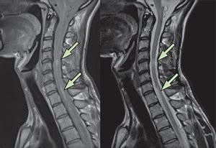
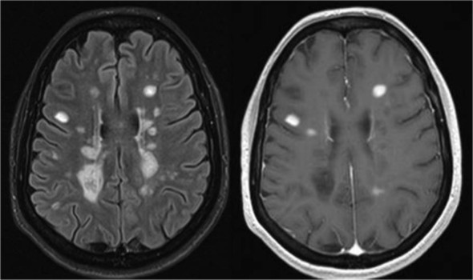
MS is an autoimmune - inflammatory disease

Slide 11
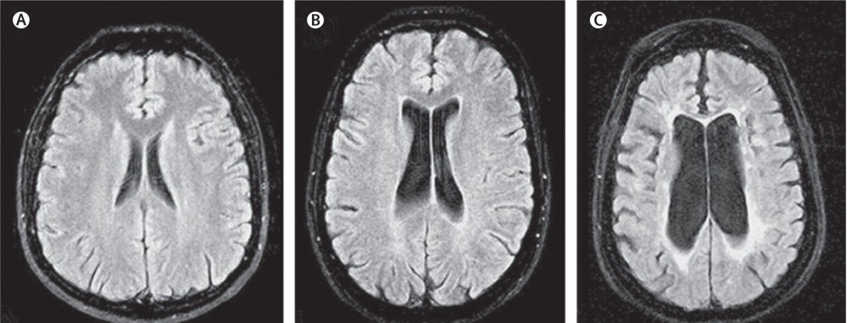
MS is a Neurodegenerative Disease
31 yo non-MS
36 yo RRMS
43 yo SPMS
Trapp and Stys, Lancet Neuro 8: 280–91, 2009

Slide 12
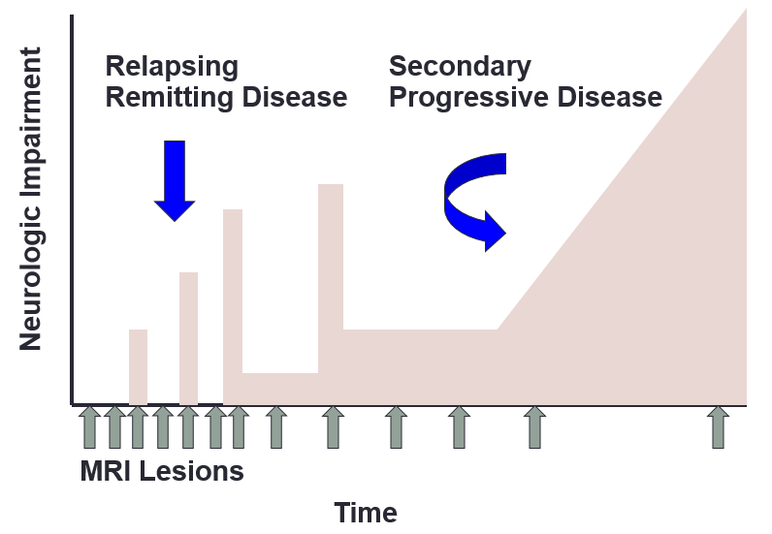
Clinical Course of MS

Slide 13
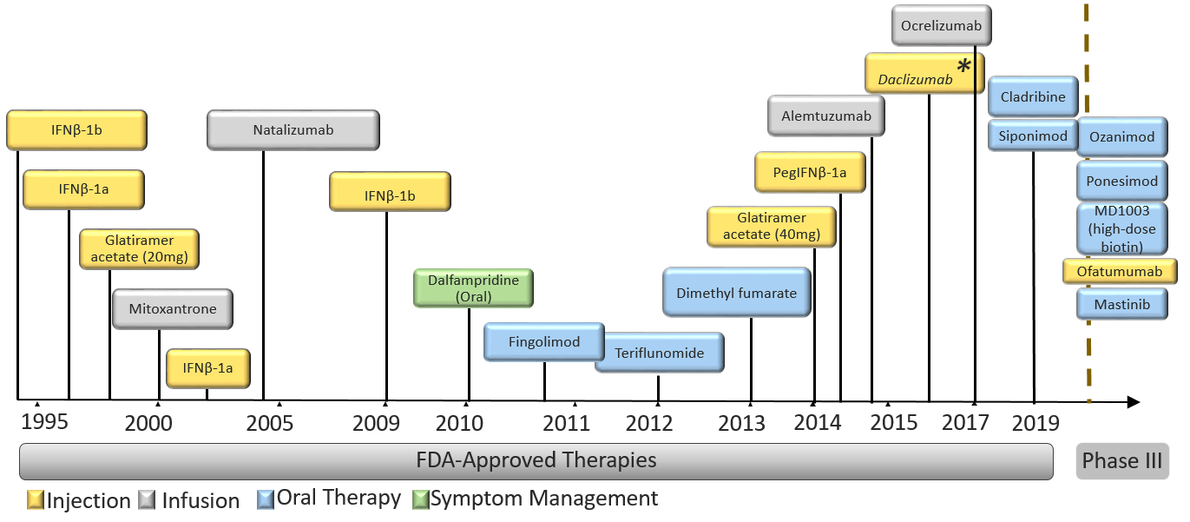
MS Treatment Landscape

Slide 14
Risks of MS drug therapies
Injection site/Infusion related reactions
Leucopenia
GI side effects/Liver dysfunction
Risk of opportunistic infections such as progressive multifocal leukoencephalopathy (PML), Herpes, other viral/bacterial/fungal infections
Other autoimmune diseases

Slide 15
MS Symptoms
Motor weakness, Imbalance, Incoordination, Tremors, Gait difficulty
Spasticity related symptoms – stiffness, spasms, pain
Abnormal sensation – numbness, tingling, painful sensations
Visual dysfunction – loss, double vision, nystagmus
Speech/swallowing difficulties
Bladder and Bowel dysfunction
Cognitive difficulties
Sleep, mood problems and Fatigue

Slide 16
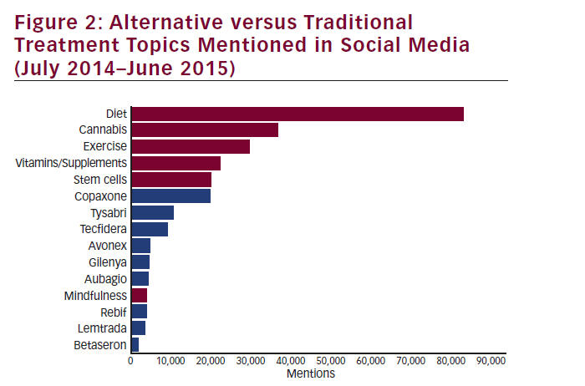
Notes:
Trends and Topics in the Multiple Sclerosis Community
Social Listening
Social listening, which is primarily utilized as a marketing and public relations tool, is the process of identifying and assessing what is
being said about a topic, company, individual, or brand on the Internet. Billions of conversations occurring daily—on blogs, message boards,
forums, social networks, wikis, microblogs, video sites, online news sources, and more—produce massive amounts of unstructured data.
Listening and analytics platforms use keywords to provide structure to the unstructured social data through the use of “smart algorithms.”
Essentially, the software transposes specific words or phrases in unstructured data into numerical values that are linked to structured
data in a database. The structured data can then be analyzed with traditional data-mining techniques.
Website Traffic
The Society’s website, nationalMSsociety.org, is an online resource for people living with and affected by MS and healthcare professionals. The
site is updated regularly based on research, best practices, and visitor feedback. With more than 16,000 pages of content, the site averages
approximately 450,000 monthly visitors, 80 % of whom have MS or have a loved one with MS. Recent usability tests revealed that treating MS,
understanding or managing symptoms, and fulfilling financial needs are the top priorities for website visitors.
Call Center Interactions
The Society’s IRC is made up of a team of human services professionals providing intake and assessment as well as information and referral
services to people living with MS. The goal for of the IRC is to help each person affected by MS to get timely, accurate information and counsel
to manage the disease and maintain and enhance independence and quality of life. In 2014, the IRC received approximately 171,000 calls and
11,500 emails. The most frequent requests include resources for emotional support and wellness, referrals to healthcare professionals with knowledge and experience in MS, and solutions to address the financial impact of MS.

Slide 17



Diet and MS: is there a relationship?
Notes:
There are multiple diets that have been proposed to help with MS and general inflammation

Slide 18
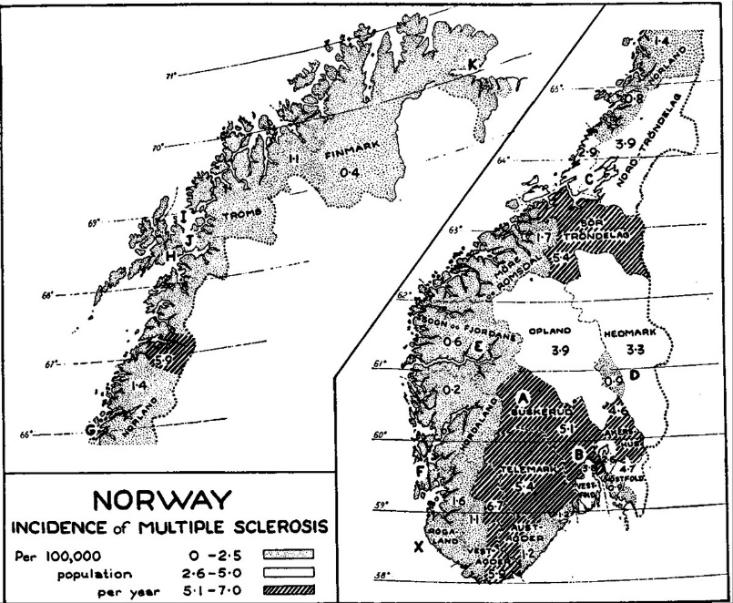
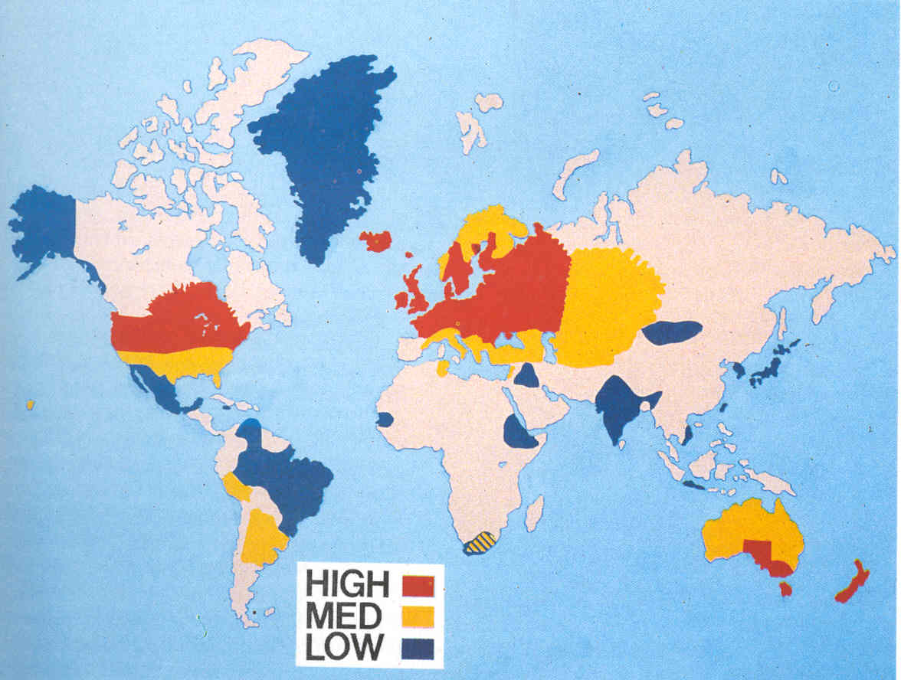
Geographic Influences on Risk of MS
Notes:
An association was first suspected based on the observation that inland farming communities in Norway had a higher incidence of MS than areas near the coastline. It was discovered that the diets of the farmers were much higher in animal and dairy products than the diets of the coastal dwellers, whose diet was enriched by cold-water fish.²²²⁰ Additional studies have since correlated consumption of animal fat, animal protein, and meat from non-marine mammals with the risk for MS.
This was the basis to support the Swank diet

Slide 19

The Swank Diet
One of the oldest dietary interventions in MS
Roy Swank started utilizing low-fat diet supplemented with cod liver oil in 1948
Notes:
Low-fat diet supplemented with cod liver oil is based on epidemiologic studies that found a decreased incidence of MS in populations that had a low consumption of animal fats with a high consumption of cold-water fish.

Slide 20
Dr Swank’s work
  “Good dieters” (n=70)
  Followed a low-fat diet (Consuming less than 20 g/d of fat )
34 years later: 23 deaths
In year 2000: 15 survivors
13/15 were still ambulatory and otherwise healthy
  “Bad dieters” (n=74):
  Consumed more than 20 g/d of fat
34 years later: 58 deaths
In year 2000: no survivors
Swank, R.L. and B.B. Dugan, Effect of low saturated fat diet in early and late cases of multiple sclerosis. Lancet, 1990. 336(8706): p. 37-9.
Swank, R.L. and J. Goodwin, Review of MS patient survival on a Swank low saturated fat diet. Nutrition, 2003. 19(2): p. 161-2.
Notes:
20 gm fat per day – ½ a Big Mac, 10 oreos
Not well accepted as not a well controlled study. The greatest benefit was seen in those with minimum disability at the start of the trial; in this group, when those who died from non-MS diseases were excluded from the analysis, 95% survived and remained physically active.
In 1990, Dr. Swank published a 50-year study assessing the effects of his Swank low saturated fat diet in MS. The study provided follow-up information for 144 MS patients and demonstrated their survival. The patients were divided into two groups: “good dieters” and “bad dieters.” The good dieters contained 70 subjects that strictly remained on a low-fat diet by consuming less than 20 g/d of fat, and bad dieters contained 74 subjects who consumed more than 20 g/d of fat. Thirty-four years later, there were 23 deaths in the good dieters group as compared to 58 deaths in the bad dieters group. Over the next 15 years subjects were not followed. In the year 2000 investigators contacted the subjects again and found that there were 15 survivors, all of which were from the good dieters group and who had followed the low-fat diet. Most of these patients (13 of 15) were still ambulatory and found to be otherwise healthy MS patients. From this study Dr. Swank gathered that the consumption of saturated animal fat is somehow related as a cause of MS. The patients who followed the Swank low-saturated-fat diet may have longer survival rates and decreased disability [4]. Although this study is a distinctive and promising long-term follow-up of an intervention of MS, the study lacked a control group for comparison. This makes it difficult to generalize the findings [37].

Slide 21
Limitations of Swank study
Quality of the evidence base - insufficient
  Compliance of the participants with the diet
  Control group
  Self-reports determined the classification into good or poor dieters
Hempel S, Fu, N, Estrada E, Chen A, Miake-Lye I, Beroes J, Miles JNV, Shanman R, Shekelle P. Risk Factors for Multiple Sclerosis Progression: A Systematic Review. VA ESP Project #05-226; 2015.

Slide 22
A Randomized-Controlled Study of Very Low Fat Diet, Plant based diet in MS
61 people with RRMS participated
29 - control group; 32 - McDougall low fat vegan diet
Trained (10 days in-house) in McDougall Diet and followed diet for one year
Age – 41; Females – 90-97%; EDSS 2.22-2.72
Disease duration – 5.3 yrs
No of relapses in the previous 2 yrs – 1.4-1.7
Primary Outcome: MRI brain – new T2 lesion formation
Secondary Outcomes: relapses, disability, fatigue, metabolic biomarkers
Primary Outcome: No changes on the brain MRI outcomes at one year
Yadav V, et al. Mult Scler Relat Disord. 2016 Sep;9:80-90
Notes:
In 2008, we started a pilot study looking at effects of a low fat plant based diet in MS. Our goal was to study if low fat plant based diet is safe in MS, can subjects be compliant for one year, can it cause biological effects on MS including biomarkers, does it change MS symptoms and if there is any hint of efficacy on disease activity.
This was a one-year long randomized control blinded study where we randomized 61 subjects into 2 groups. One group was taught the low fat diet intervention with a initial 10 day intense training program and then then followed with dietician guidance throughout the study and the control group

Slide 23
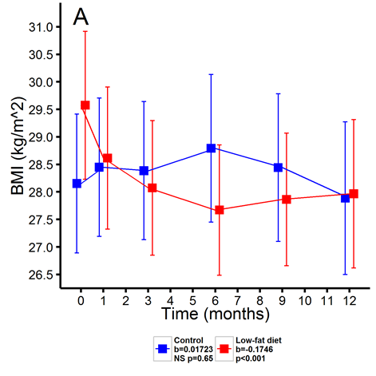
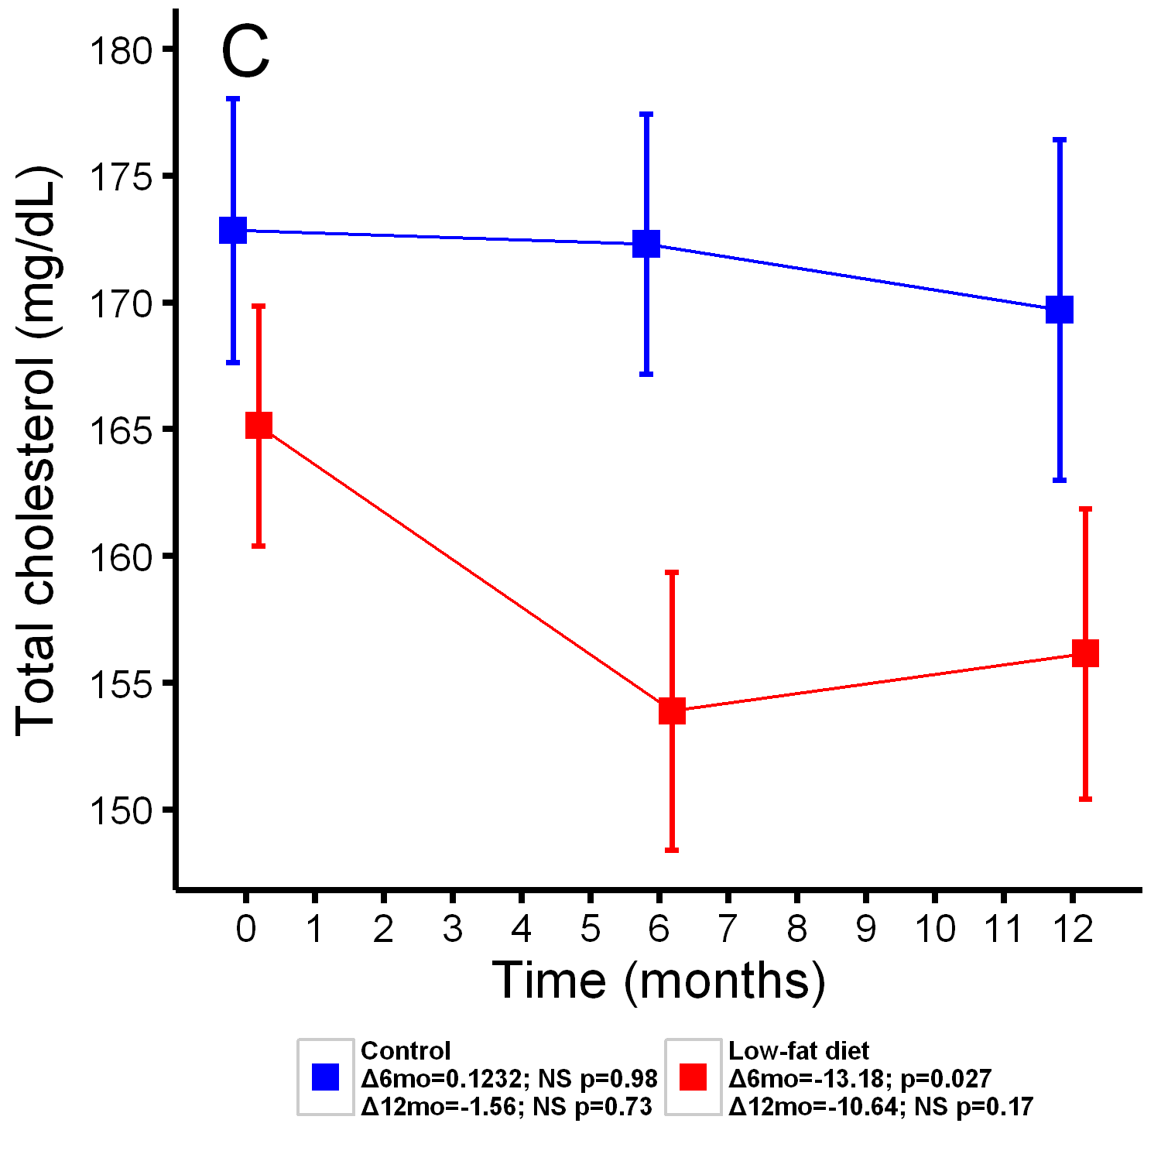
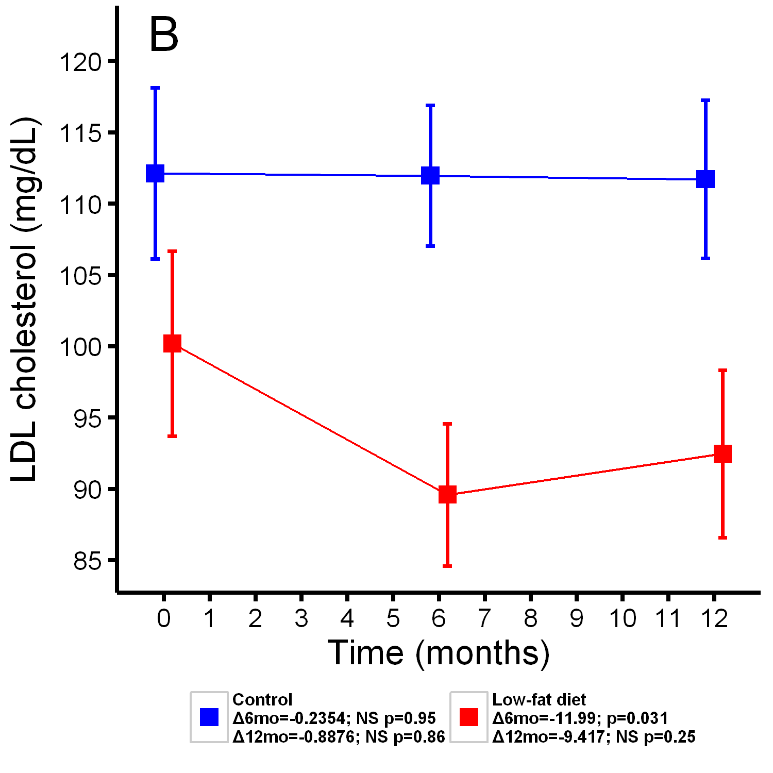
Changes in BMI and Blood lipids during 1-year trial
Yadav V, et al. Mult Scler Relat Disord. 2016 Sep;9:80-90
Notes:
Changes in weight, serum marker of inflammation and lipid metabolism
Diet group subjects showed a significant drop in their weight over the course of the 12 months of the study. On average, the diet group saw a 1.13 pound/month reduction, with the majority of the weight lost during the first six months of the diet (Figure 3A). The weight loss was both significantly greater than zero in its own right (t=-3.97; p<0.001) as well as significantly greater than the 0.1 pound/month gain observed in the control subjects (t=-3.64; p<0.001).
Several changes in serum biomarker levels were seen in the diet group after 6 months of the intervention (Figure 3). These included reductions in low density lipoprotein (LDL) cholesterol (t=-2.19; p=0.031, Fig 3B), total plasma lipids (t=-2.38; p=0.027; Fig 3C) and insulin (t=-2.77; p=0.0068; Fig 3D).

Slide 24
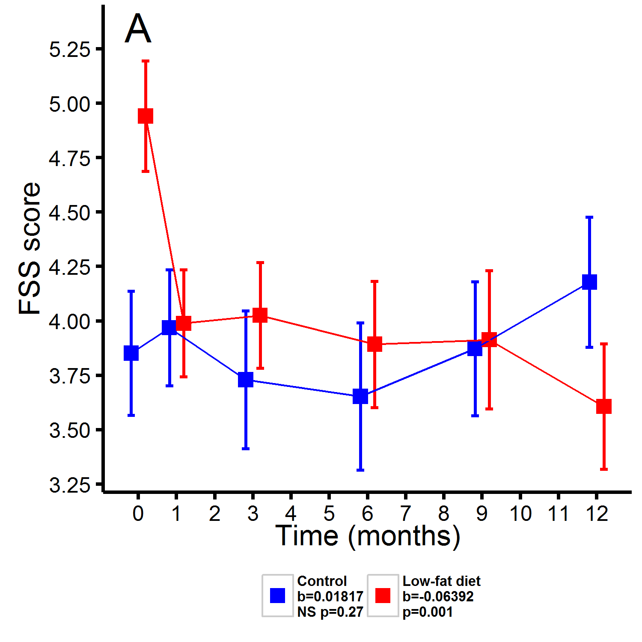
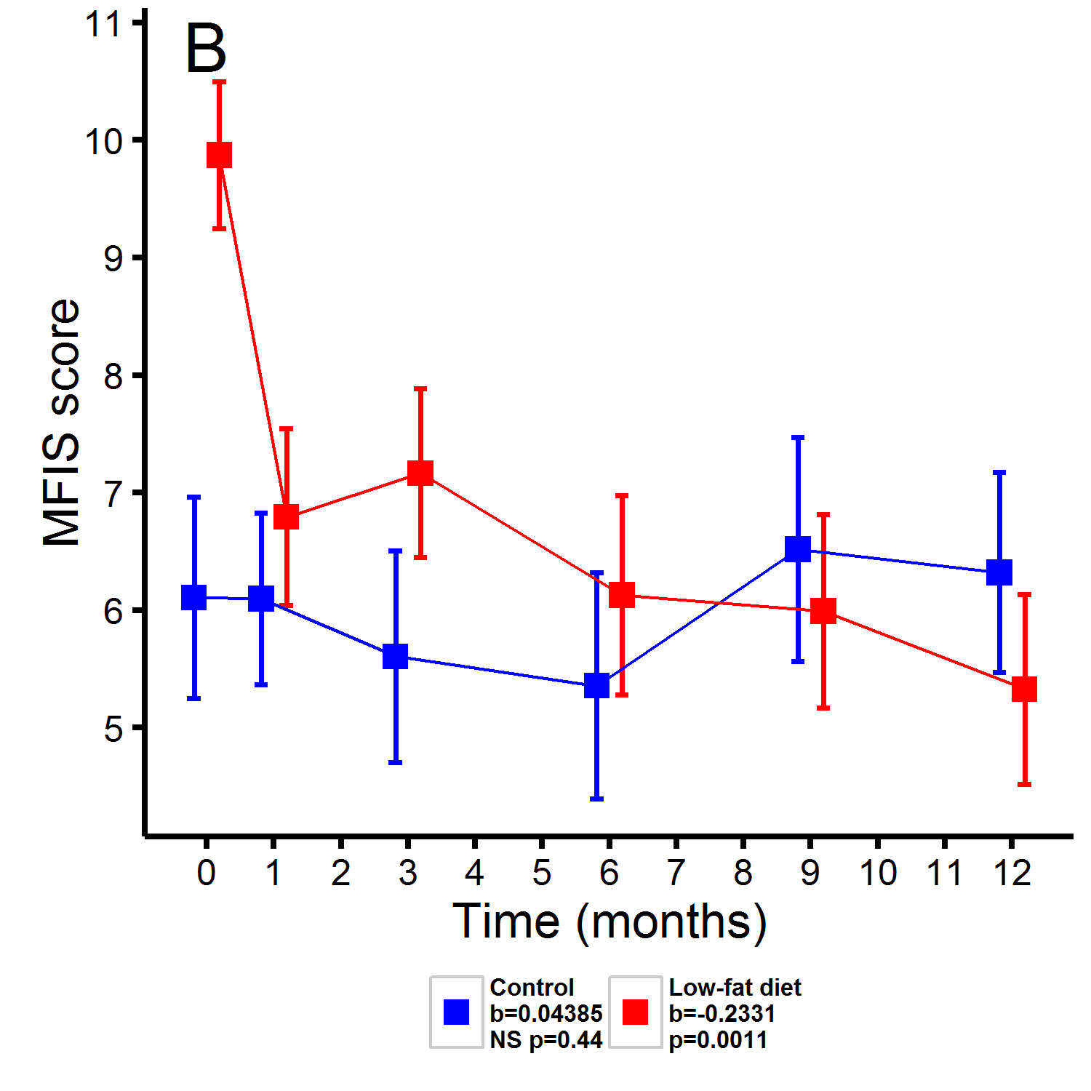
Improved Fatigue in Low Fat Diet Group
FSS: Fatigue Severity Scale; MFIS: Modified Fatigue Impact Scale
Yadav V, et al. Mult Scler Relat Disord. 2016 Sep;9:80-90
Notes:
MFIS Scoring (5-item version)
The Modified Fatigue Impact Scale-5 item version (MFIS-5) consists of the 5 MFIS
items correlating the most strongly with the total MFIS score. The following items from the MFIS constitute the MFIS-5: Items 1, 9, 10,
17, and 19. Thus, items from all three subscales are represented. The MFIS-5 total score consists of the sum of the raw scores on these 5 items, and thus, can range from 0-20.
Minimal Detectable Change (MDC) - Not Established
Minimally Clinically Important Difference (MCID) - Multiple Sclerosis: (Rietberg, 2010; n= 43; ambulatory patients with MS (mean age 48.7 years; SD 7 years; 30 women; median Expanded Disability Status Scale score 3.5)
•Smallest Detectable Change (SDC) = 16.2
•Minimal Detectable Change (MDC) % = 19.3%
Cut-Off Scores - Not Established
Normative Data - Multiple Sclerosis: (Tellez et al, 2005; 231 MS patients and 123 healthy controls, 164 patients with relapsing-remitting, 47 with secondary progressive, 12 with primary progressive)
•Median MFIS score= 33.0 (range 0-82)
FSS: 0-7
Healthy Population: (Grace et al, 2006; n = 16, mean age = 69.94 years)
•Mean (SD) FSS scores for healthy individuals; 2.3 (0.7)
Multiple Sclerosis and Systemic Lupus Erythematosus: (Krupp et al, 1989; n = 74, mean age = 40.2 years)
•The cut-off score is 36 where a score > 36 may indicate severe fatigue or need for further evaluation. ( when score 0-63)

Slide 25
OHSU Low Fat Diet study – Completed 2021
To design and test a more practical low-fat diet for people with MS (PwMS)
To determine if a less restrictive, 16-week low-fat diet is effective at ameliorating fatigue in PwMS [MFIS]
Randomized controlled trial - low-fat diet group compared to a wait-list control group
Hypothesis: low-fat study diet subjects will demonstrate a significant reduction in fatigue after 16 weeks compared to wait-list controls
Young et al, …. Yadav et al, ECTRIMS, ANA 2022 poster

Slide 26
STUDY DIET
Total daily calories from fat not to exceed 20%
Caloric breakdown: approximately 20% fat (saturated fat not to exceed 7% of daily caloric intake), 20% protein and 60% carbohydrate
Diet:
  Allowed: Primarily plant-based; Lean sources of animal protein, such as chicken, fish, and egg whites
  Not allowed: Dairy products, such as cow or goat milk, cheese, yogurt, or mayonnaise
Young et al, …. Yadav et al, ECTRIMS, ANA 2022 poster

Slide 27
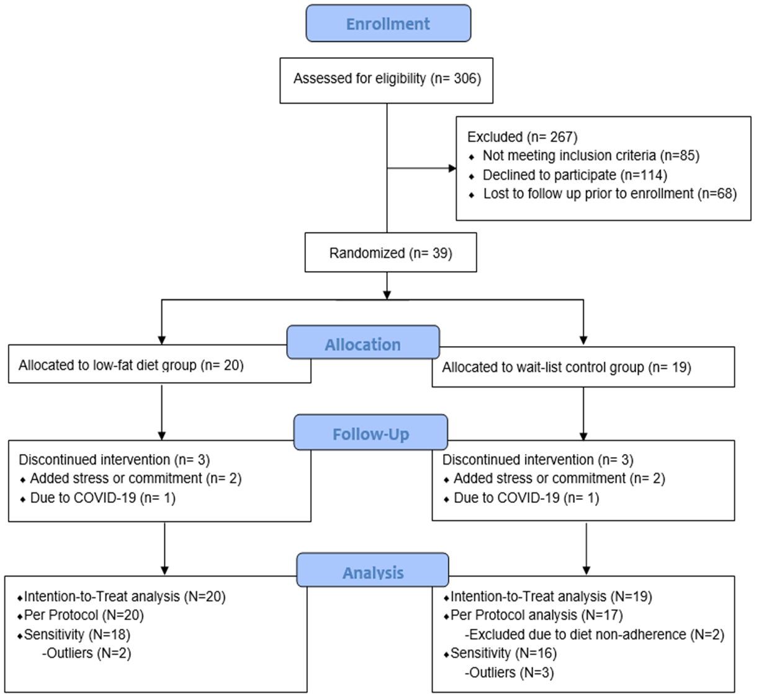
Study Subject Disposition
Young et al, …. Yadav et al, ECTRIMS, ANA 2022 poster

Slide 28
Inclusion/exclusion criteria
Included: Subjects 18 and 70 yrs, had physician confirmed MS diagnosis and any MS subtype; Expanded Disability Status Scale (EDSS) ≤ 7.5, and MFIS ≥ 38.
Excluded: Significant depression (Beck Depression Inventory Score (BDI) >28), Diabetes or significant medical problems, Pregnant or breast-feeding, Clinically significant MS exacerbation or received IV steroids within 30 days of screening visit.
Excluded: subjects with dietary fat content of <30% [(Food Frequency Questionnaire (FFQ)] at screening visit, or used fish oil or flax seed oil supplementation within 30 days of screening visit.
Young et al, …. Yadav et al, ECTRIMS, ANA 2022 poster

Slide 29

Background - METHODS
EDSS: Expanded disability status scale, MFIS: modified fatigue impact scale, FSS: fatigue severity scale, FFQ: food frequency questionnaire, QOL: quality of life
Young et al, …. Yadav et al, ECTRIMS, ANA 2022 poster

Slide 30
Results: Baseline characteristics
MS Characteristics | Totalª (N=39) | Low-fat dietª (active) (N=20) | Controlª (wait-list) (N=19) | p
Disease subtype |  |  |  | 1.00^{b}
RRMS | 36 (92.31%) | 18 (90.00%) | 18 (94.74%)
SPMS | 1 (2.56%) | 1 (5.00%) | 0 (0.0%)
PPMS | 2 (5.13%) | 1 (5.00%) | 1 (5.26%)
Disease Modifying Therapies |  |  |  | 0.72^{b}
None | 8 (20.51%) | 6 (30.00%) | 2 (10.53%)
Platform therapies | 7 (17.95%) | 3 (15.00%) | 4 (21.05%)
- Interferon | 4 (57.14%) | 2 (66.67%) | 2 (50.00%)
- Glatiramer | 3 (42.86%) | 1 (33.33%) | 2 (50.00%)
Oral Therapy | 14 (35.90%) | 6 (30.00%) | 8 (42.11%)
Anti CD 20 Therapy | 8 (20.51%) | 4 (20.00%) | 4 (21.05%)
Tysabri | 2 (5.13%) | 1 (5.00%) | 1 (5.26%)
Characteristic | Totalª (N=39) | Low-fat diet (active)ª (N=20) | Control (wait-list)ª (N=19) | p
Age (years) | 49.74 (11.68) | 52.2 (10.36) | 47.16 (12.69) | 0.18
Time since onset (years)^{c} | 17.05 (9.26) | 16.42 (6.98) | 17.72 (11.36) | 0.68
Time since dx (years) | 12.62 (8.72) | 13.00 (7.71) | 12.21 (9.87) | 0.78
Female sex | 32 (82.1%) | 16 (80.0%) | 16 (84.2%) | 1.00^{b}
Body mass index (kg/m²)^{c} | 31.75 (7.49) | 31.25 (7.24) | 32.24 (7.89) | 0.69
Expanded disability status score | 3.78 (1.38) | 4.15 (1.31) | 3.38 (1.38) | 0.08
ªMean(SD) or N(%); ^{b}Fisher’s exact test; ^{c}1 missing weight, BMI, 2 missing time since onset
ªMean(SD) or N(%); ^{b}Fisher’s exact test
Young et al, …. Yadav et al, ECTRIMS, ANA 2022 poster

Slide 31
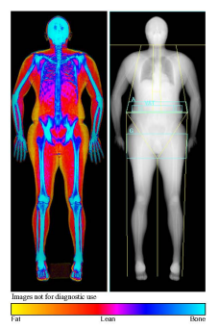
Results: Other outcomes, mean (SE) (per-protocol analysis)
 | Low-fat diet (active) (N=20) |  |  | Control (wait-list) (N=17) |  |  | BG change (95% CI)^{b}
 | Baseline | Week 16 | WG Changeª | Baseline | Week 16 | WG Changeª
Fat mass (g) | 38154.3 (2971.3) | 35286.4 (2982.5) | -2867.9** | 37114.1 (3220.5) | 36585.7 (3233.7) | -528.4 | -2339.5** (-3977.0, -702.1)
Lean mass (g) | 46372.3 (2192.8) | 46199.7 (2201.5) | -172.6 | 45967.1 (2376.7) | 44669.8 (2386.9) | -1297.3** | 1124.7 (-114.6, 2364.0)
Weight (Kg) | 87.7 (4.0) | 85.2 (4.0) | -2.4** | 84.8 (4.4) | 83.4 (4.4) | -1.4** | -1.1 (-3.3, 1.1)
BMI^{c} | 31.2 (1.4) | 30.4 (1.4) | -0.9** | 30.2 (1.6) | 29.7 (1.6) | -0.5 | -0.3 (-1.1, 0.4)
HbA1c | 5.4 (0.1) | 5.3 (0.1) | -0.1* | 5.5 (0.1) | 5.4 (0.1) | -0.1 | 0.0 (-0.2, 0.2)
Total Cholesterol | 182.1 (8.1) | 169.2 (8.3) | -12.9* | 207.3 (8.7) | 215.8 (9.2) | 8.5 | -21.5** (-36.7, -6.3)
LDL Cholesterol | 103.9 (7.2) | 91.7 (7.4) | -12.2** | 127.1 (7.8) | 135.2 (8.1) | 8.0 | -20.2** (-32.8, -7.7)
HDL Cholesterol | 58.7 (3.0) | 55.5 (4.0) | -3.2 | 57.4 (3.2) | 58.2 (3.4) | 0.8 | -4.0 (-10.5, 2.4)
Triglycerides | 98.0 (11.0) | 109.7 (11.0) | 11.7 | 114.1 (11.5) | 111.5 (12.2) | -2.6 | 14.3 (-9.5, 38.1)
LDL: Low density lipoprotein; HDL: High Density Lipoprotein
ªSE: Standard Error; WG: Within Group; WG change (week 16 – baseline); ^{b}BG: Between-Group; BG change (active WG change – control WG change); *p<0.05; **p<0.01
Young et al, …. Yadav et al, ECTRIMS, ANA 2022 poster

Slide 32
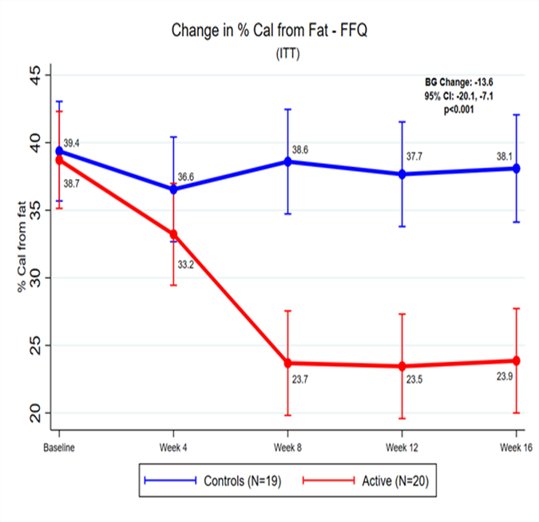
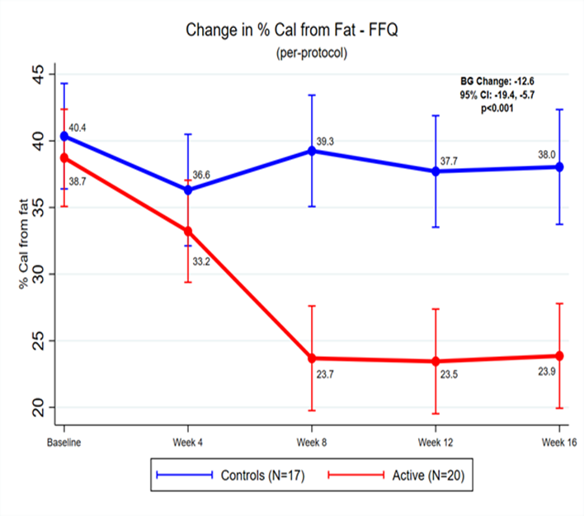
Results: Changes in fat calories (Food Freq Quest)
Young et al, …. Yadav et al, ECTRIMS, ANA 2022 poster

Slide 33
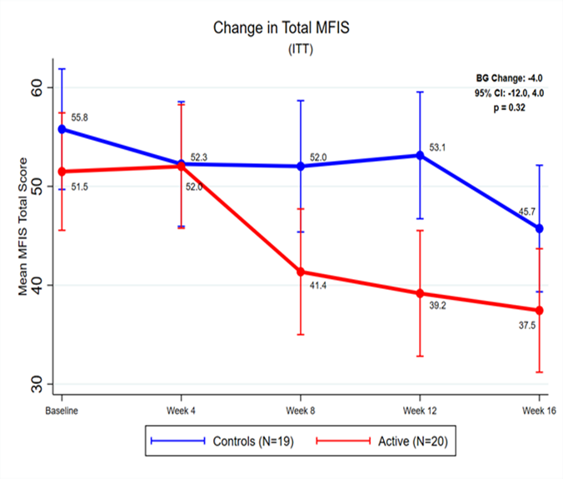
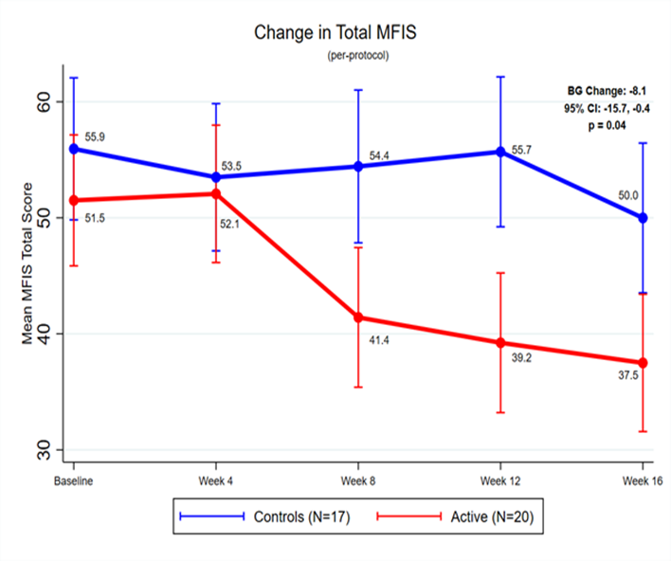
Results: Changes in Fatigue
Young et al, …. Yadav et al, ECTRIMS, ANA 2022 poster

Slide 34
Next steps
EDSS: Expanded disability status scale, MFIS: modified fatigue impact scale, FSS: fatigue severity scale, FFQ: food frequency questionnaire, QOL: quality of life
Young et al, …. Yadav et al, ECTRIMS, ANA 2022 poster

Slide 35
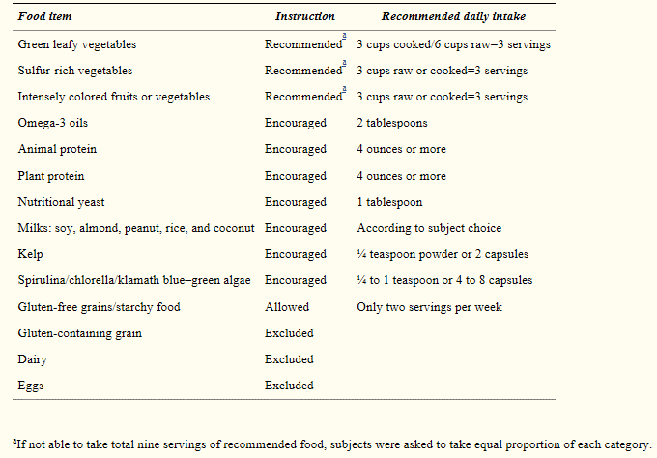
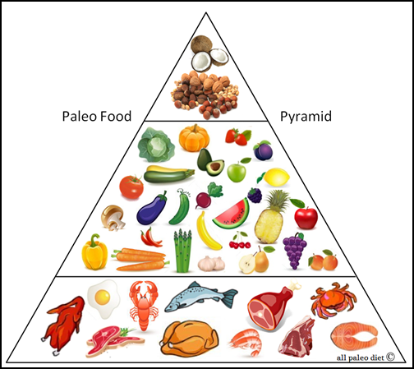
Modified Paleo diet (Wahl’s protocol)
Bisht et all. AAN, J Altern Complement Med. 2014 May;20(5):347-55
Notes:
Bisht B¹, Darling WG, Grossmann RE, Shivapour ET, Lutgendorf SK, Snetselaar LG, Hall MJ, Zimmerman MB, Wahls TL.
¹1 Department of Health and Human Physiology, University of Iowa College of Liberal Arts and Sciences , University of Iowa, Iowa City, IA.
While there is some variability regarding allowable foods, Paleolithic diets generally emphasize consumption of lean
meats including organ meats, fish, vegetables, and fruits and typically do not permit consumption of dairy or grain products

Slide 36
Modified Paleo diet with multimodal intervention in progressive MS
12-month multimodal intervention; One-arm, open-label feasibility trial, progressive MS, 26 eligible but 21 started the main study, 19 completed the study, mean age 51 yo, 74% females, mean dx duration – 14 yrs
Outcomes: Mood, cognitive, executive function at baseline and 3, 6, 9, and 12 months.
Home-based multimodal intervention, including (1) modified Paleolithic diet; (2) exercise program (stretching and strengthening of the trunk and lower limb muscles); (3) neuromuscular electrical stimulation (EStim) of trunk and lower limb muscles; and (4) stress management (meditation and self-massage)
  Anxiety, depression, cognitive function and executive function ( self reported) improved higher with higher individual participation
  Anxiety and depression changes - evident in just a few months
  Mood and cognitive function changes from baseline to 12 months were significantly associated with fatigue improvements
Lee et al, Am Coll Nutr, 2017 Mar, A multimodal, non pharmacological intervention improves mood and cognitive function in people with MS
Bisht et all. AAN, J Altern Complement Med. 2014 May;20(5):347-55
Notes:
Of the 67 people assessed for eligibility, 41 were eligible for participation in the run-in phase, and 26 were eligible for the main study. Five people were ineligible prior to the main study (N = 21 to start the main study), and 2 were excluded thereafter: one had clinically significant cognitive decline by 6 months, and one dropped out for unknown reasons before 3 months, thus only completing the baseline assessments), leaving 19 people in the analyses.
12-month multimodal intervention, One-arm, open-label feasibility trial, progressive MS
Outcomes: Mood (Beck Anxiety and Depression Inventories) and cognitive (Cognitive Stability Index, Cognitive Screening Test, Delis-Kaplan Executive Function System) and executive function (Wechsler Adult Intelligence Scale) at baseline and 3, 6, 9, and 12 months after the start of the intervention. Dosage of the multimodal intervention was assessed at 3, 6, 9, and 12 months.
Home-based multimodal intervention, including (1) a modified Paleolithic diet; (2) an exercise program (stretching and strengthening of the trunk and lower limb muscles); (3) neuromuscular electrical stimulation (EStim) of trunk and lower limb muscles; and (4) stress management (meditation and self-massage).
Higher individual participation yielded greater improvements on self-report measures of anxiety, depression, cognitive function and executive function
Mood and cognitive improvements were more closely related to a higher intake of the modified Paleolithic diet than to exercise and stress management dosage.
Anxiety and depression changes were evident after just a few months, whereas changes in cognitive function were generally not observed until later in the intervention period.
Mood and cognitive function changes from baseline to 12 months were significantly associated with fatigue improvements (ps = <0.0001 to 0.03).
Another study
J Altern Complement Med. 2014 May;20(5):347-55. doi: 10.1089/acm.2013.0188. Epub 2014 Jan 29.
A multimodal intervention for patients with secondary progressive multiple sclerosis: feasibility and effect on fatigue.
Bisht B¹, Darling WG, Grossmann RE, Shivapour ET, Lutgendorf SK, Snetselaar LG, Hall MJ, Zimmerman MB, Wahls TL.
Author information
Abstract
BACKGROUND:
Multiple sclerosis is an autoimmune disease influenced by environmental factors.
OBJECTIVES:
The feasibility of a multimodal intervention and its effect on perceived fatigue in patients with secondary progressive multiple sclerosis were assessed.
DESIGN/SETTING:
This was a single-arm, open-label intervention study in an outpatient setting.
INTERVENTIONS:
A multimodal intervention including a modified paleolithic diet with supplements, stretching, strengthening exercises with electrical stimulation of trunk and lower limb muscles, meditation, and massage was used.
OUTCOME MEASURES:
Adherence to each component of the intervention was calculated using daily logs. Side-effects were assessed from a monthly questionnaire and blood analyses. Fatigue was assessed using the Fatigue Severity Scale (FSS). Data were collected at baseline and months 1, 2, 3, 6, 9, and 12.
RESULTS:
Ten (10) of 13 subjects who were enrolled in a 2-week run-in phase were eligible to continue in the 12-month main study. Of those 10 subjects, 8 completed the study and 6 subjects fully adhered to the study intervention for 12 months. Over a 12-month period, average adherence to diet exceeded 90% of days, and to exercise/muscle stimulation exceeded 75% of days. Nutritional supplements intake varied among and within subjects. Group daily average duration of meditation was 13.3 minutes and of massage was 7.2 minutes. No adverse side-effects were reported. Group average FSS scores decreased from 5.7 at baseline to 3.32 (p=0.0008) at 12 months.
CONCLUSIONS:
In this small, uncontrolled pilot study, there was a significant improvement in fatigue in those who completed the study. Given the small sample size and completer rate, further evaluation of this multimodal therapy is warranted.
:

Slide 37
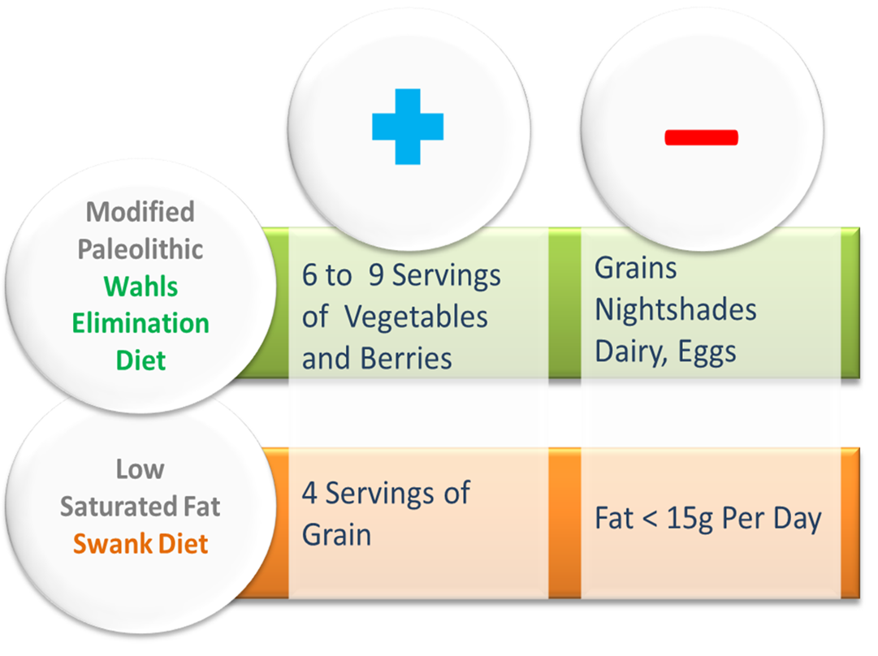
Wahls Elimination versus Swank Dietary Patterns
Effect on MS Related Fatigue, Quality of Life, Processing Speed, and Walking Distance
Grant funding: National MS Society
Primary objective: Determine impact of the Wahls and Swank diets on perceived fatigue within each diet group and between diet groups
Main hypothesis: Wahls diet group would experience a greater mean reduction in fatigue as measured by the FSS than the Swank diet group
Secondary outcomes: MFIS, MS Quality of Life-54 Physical/Mental Health (MSQoL-54 PH/MH), 6Minute Walk Test (6MWT [feet walked]), Symbol Digit Modalities Test-Oral (SDMT-O)
T. Wahls, MD; W. Darling, PhD; K. Hoth, PhD; J. Kamholz, MD, PhD; L. Rubenstein, PhD; P. Ten Eyck, PhD; B. Bisht, PhD, PT; T. Titcomb, PhD, RD; L. Snetselaar, PhD, RD, University of Iowa, Iowa City, Iowa, USA, ACTRIMS, September 12, 2020; Abstract 482

Slide 38
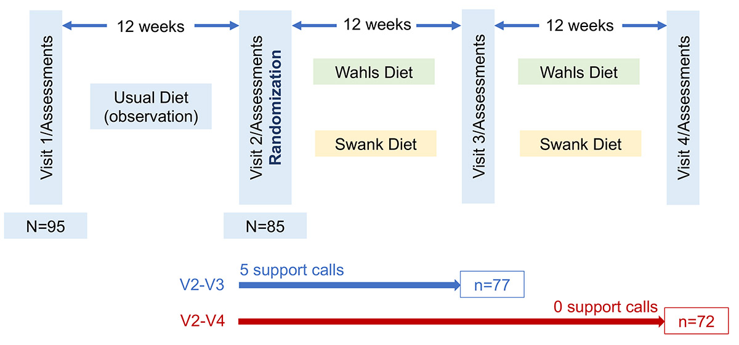
Study Design
Parallel group, randomized, blinded principal investigator, assessor, and statistician
Adult RRMS with clinically significant fatigue (FSS ≥4)
Three 12-week periods
Training on assigned diet and 5 telephone support calls by a registered dietitian during V2-V3; no scheduled support calls during final period
T. Wahls, MD; W. Darling, PhD; K. Hoth, PhD; J. Kamholz, MD, PhD; L. Rubenstein, PhD; P. Ten Eyck, PhD; B. Bisht, PhD, PT; T. Titcomb, PhD, RD; L. Snetselaar, PhD, RD, University of Iowa, Iowa City, Iowa, USA, ACTRIMS, September 12, 2020; Abstract 482
Slides Courtesy Dr Terry Wahls

Slide 39
Demographics
No differences in baseline demographic or clinical characteristics between diet groups
Demographics
Variable | Wahls | Swank
Mean age | 46 | 47
Female | 32 | 35
Never smoked | 23 | 26
Prior or current smoker | 16 | 9
Moderate alcohol | 29 | 29
Mean BMI | 20.8 | 19.4
On DMTs | 31 | 28
Mean vitamin D | 50.9 ng/mL | 47.9 ng/mL
T. Wahls, MD; W. Darling, PhD; K. Hoth, PhD; J. Kamholz, MD, PhD; L. Rubenstein, PhD; P. Ten Eyck, PhD; B. Bisht, PhD, PT; T. Titcomb, PhD, RD; L. Snetselaar, PhD, RD, University of Iowa, Iowa City, Iowa, USA, ACTRIMS, September 12, 2020; Abstract 482
Slides Courtesy Dr Terry Wahls

Slide 40
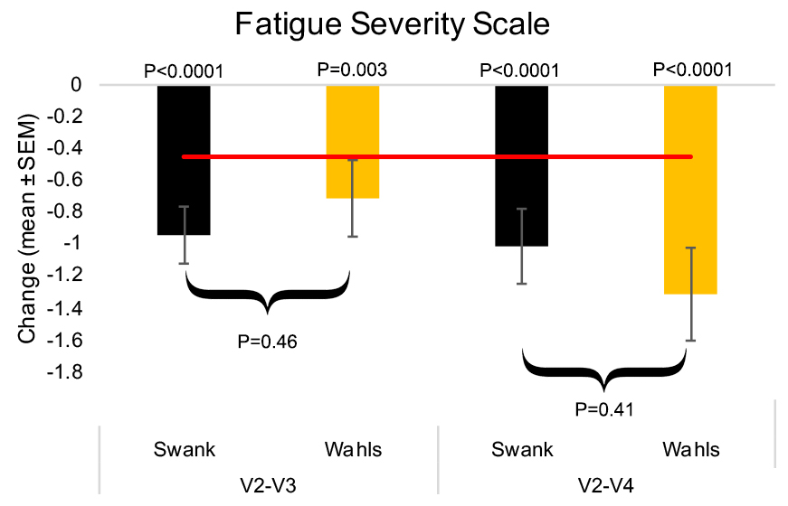
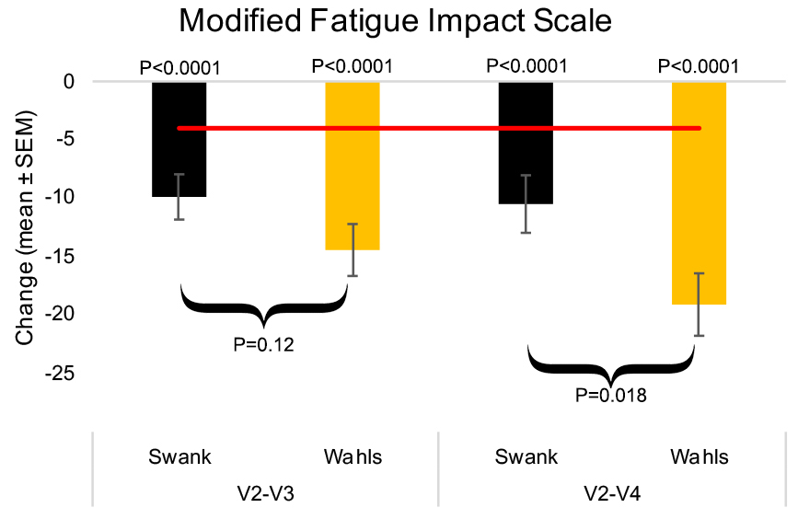
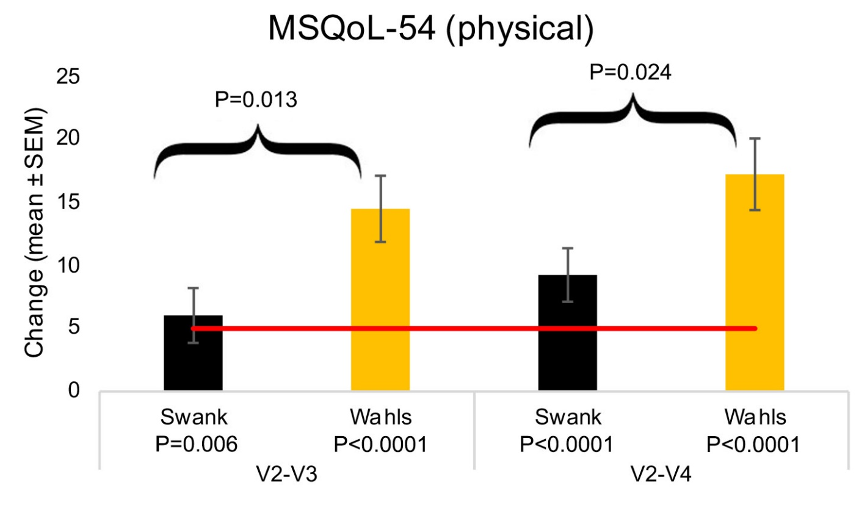
Results
Both groups had similar significant improvements in mean FSS at V3 and V4; no statistical differences between diet groups
Wahls diet group had significantly greater improvements at V4 for MFIS (p=0.018) and at V3 and V4 MSQoL54-PH (p=0.013, p=0.024)
red line indicates clinical significance levels for each measure
T. Wahls, MD; W. Darling, PhD; K. Hoth, PhD; J. Kamholz, MD, PhD; L. Rubenstein, PhD; P. Ten Eyck, PhD; B. Bisht, PhD, PT; T. Titcomb, PhD, RD; L. Snetselaar, PhD, RD, University of Iowa, Iowa City, Iowa, USA, ACTRIMS, September 12, 2020; Abstract 482
Slides Courtesy Dr Terry Wahls

Slide 41

Modified Mediterranean dietary program in MS
Aim: Feasibility (meeting target enrollment within the specified time frame, adherence, and study completion). Exploratory endpoints.
Single center, Women with MS, 36 people, randomized, 6 month duration
Self-reported adherence - excellent (90.3%)
Overall study completion rate of 94.4%.
Decline in Neurological Fatigue Index-MS scores (p = 0.01)
Trend toward reduced Multiple Sclerosis Impact Scale-29 scores; became significant after outlier removal (p = 0.12; p = 0.023), and a reduction in Expanded Disability Status Scale (p = 0.01) over time as compared to the non-intervention group.
Fatigue - Significant improvement (MFIS, physical and mental components of MSQoL-54
Mult Scler Relat Disord. 2019 Nov; 36:101403. Randomized-controlled trial of a modified Mediterranean dietary program for multiple sclerosis: A pilot study. Ilana Katz Sand ¹, Emma K T Benn ², Michelle Fabian ³, Kathryn C Fitzgerald ⁴, Elise Digga ³, Richa Deshpande ², Aaron Miller ³, Samantha Gallo ⁵, Lenore Arab ⁶
Notes:
We randomly assigned women with MS to follow/not follow the prescribed modified Mediterranean dietary intervention for 6 months, delivered through educational sessions. The diet encouraged the intake of fish and other foods high in poly- and monounsaturated fats, fresh fruits, vegetables, and whole grains and eliminated meat, dairy, and most processed foods and limited salt intake to <2 g/day. Primary endpoints related to meeting target enrollment within the specified time frame, adherence, and study completion. Clinical endpoints were evaluated in an exploratory fashion.

Slide 42
Ketogenic diet (high-fat, low-carbohydrate) in RRMS
Safety and tolerability of a modified Atkins diet (KD^{MAD})
20 subjects, relapsing MS, 6-month, single-arm, open-label study
Adherence (daily urine ketone testing); Fatigue, depression, fasting adipokines at baseline and on diet. Brain MRI was obtained at baseline and 6 months
No subject experienced worsening disease on diet
95% adhered to KD^{MAD} for 3 months and 75% adhered for 6 months
Decreased body mass index and total fat mass (p < 0.0001)
Improvement in Fatigue (p = 0.002) and depression scores (p = 0.003)
Serum leptin was significantly lower at 3 months (p < 0.0001) on diet
Neurol Neuroimmunol Neuroinflamm Jul 2019, 6 (4) e565. Pilot study of a ketogenic diet in relapsing-remitting MS
J. Nicholas Brenton, Brenda Banwell, A.G. Christina Bergqvist, Diana Lehner, Gulotta, Lauren Gampper, Emily Leytham, Rachael Coleman, Myla D. Goldman
Notes:
Intention to treat was used for primary data analysis, and a per-protocol approach was used for secondary analysis.
Ketogenic diets (KDs) mimic a fasting state. KDs create a metabolic shift from glycolytic energy production toward oxidative phosphorylation energetics by using fatty acids as a primary source of energy. As these fatty acids undergo beta-oxidation, ketones are produced. This increase in oxidative phosphorylation coupled with ketone production modifies the tricarboxylic acid cycle to limit reactive oxygen species generation. In addition, ketone bodies transported across the blood-brain barrier upregulate antioxidant pathway genes (particularly via the Nrf2 pathway) and boost energy production in brain tissue.^{4,–,7} Most importantly, KDs have been shown in multiple, recent animal and human studies to attenuate biomarkers of inflammation within the blood and CSF.^{8,–,12} One mechanism for its anti-inflammatory effects is via production of beta-hydroxybutyrate (BHB), a ketone body that blocks the NLRP3 inflammasome and reduces proinflammatory cytokine production (notably, IL-1β) by human monocytes.^{8,9,13,–,15} Preclinical studies have assessed the benefits of the KD in the experimental autoimmune encephalitis (EAE) mouse model of MS. EAE mice fed a KD experienced several positive effects including reversed motor disability, improved spatial learning and memory, increased hippocampal volumes, and remyelination of periventricular lesions. These benefits were associated with suppressed production of inflammatory cytokines and enhanced neuronal repair.¹⁰

Slide 43
Modified anti-inflammatory diet in MS
Aim: Effects on fatigue, quality of life, and inflammatory markers
Study design: RRMS, N=100, RCT, 12-week long, anti-inflammatory diet vs control (healthy diet recommendations).
Diet - 55% of energy from carbohydrates, 15% from proteins, and 30% from fat
MFIS and Multiple Sclerosis Quality of Life (MSQoL-54)
Anthropometric measures, inflammatory biomarkers (IL-17, IL-4, and hs-CRP), assessed at baseline and end of the study.
Diet group showed significant improvement in MFIS, physical and mental components of MSQoL-54 (p = 0.001, p = 0.015, and p = 0.003, respectively) vs control.
Significant increase in IL-4 level (p = 0.022). However, no significant changes were detected in IL-17 and hs-CRP levels
Int J Neurosci. 2021 Jul;131(7):657-665. The effects of modified anti-inflammatory diet on fatigue, quality of life, and inflammatory biomarkers in relapsing-remitting multiple sclerosis patients: a randomized clinical trial. Zahra Mousavi-Shirazi-Fard, Zohreh Mazloom, Sadegh Izadi, Mohammad Fararouei
Notes:
In the diet group, a diet was designed for each patient based on the anti-inflammatory diet [23]. In this regard, Harris-Benedict equation with the activity factor of 1.2–1.3 was used to calculate energy requirement [24]. Approximately 55% of energy was from carbohydrates, 15% from proteins, and 30% from fat. It should be noted that the diet was prescribed for weight maintenance. Abundant amounts of vegetables and fruits were included in the diet. Patients were advised to substitute white rice with brown rice, white bread with whole wheat bread, and high fat dairy products with probiotic low fat products. Legumes such as lentils, mung beans, pinto beans, chickpeas, and kidney beans, and soy products such as soybeans, soy milk, and soy protein were recommended, as well. Healthy fats, such as olive oil (extra-virgin olive oil) and canola, were also included in the diet for cooking or salad dressing. Besides, nuts such as walnut and almond and seeds like flax, pumpkin, and sesame seeds were advised and replaced for butter and cream. Spices such as ginger, cinnamon, and turmeric were also recommended in great amounts. White or green tea and moderate amounts of dark chocolate were recommended, as well. Protein sources such as lean poultry and fish were, too, considered in the diet. However, the consumption of lean red meat and eggs were limited to one to two times a week. Refined carbohydrates and sucrose-containing products such as pastries, cookies, cakes, and table sugar, processed food, fast food, fried food, and animal fat were not recommended, as well.
In the control group, the patients received healthy diet recommendations based on the World Health Organization’s (WHO) healthy diet [25]. Each patient was followed up by telephone every two weeks and was visited every month. To assess adherence to the diet, three-day dietary records were obtained in each visit.

Slide 44
Challenges of Dietary Intervention Studies
Outcome selection
  Disease activity/Disability; MRI outcomes; Symptom modification – fatigue, QOL, pain, mood, bowel dysfunction
Duration of diet intervention and expected impact on outcome – short term vs long term
Sample size
Adherence and its measurement
  controlled feeding versus advice-based
Confounders
  Use of DMT and its effect on the outcomes

Slide 45
Diet Quality and Association with MS Disability and Symptom Severity
Self-reported data, questionnaire (North American Research Committee on MS, registry); N= 6,989
Healthy diet quantified, in quintiles:
(1) more fruits, vegetables, legumes (fifth quintile = most)
(2) more whole grains (fifth quintile = most)
(3) less sugar from desserts and beverages (fifth quintile = least)
(4) less red and processed meats (fifth quintile = least)
Those in highest quintile for diet quality (sum of quintiles across the 4 food categories) vs lowest quintile were at 20% lower risk for severe vs mild self-reported physical disability (controlling for age, disease duration, body mass index, income, smoking).
Higher intake of whole grains was the only component of the diet score reliably linked to lower disability.
Fitzgerald KC, Tyry T, Salter A, Cofield SS, Cutter G, Fox R, Marrie RA. Neurology. 2018 Jan 2;90(1)
Notes:
Overall Dietary Quality
Two studies have leveraged existing MS registries to evaluate potential associations between overall diet quality and MS related disability and symptomatology.
6989 participants in the North American Research Committee on MS (NARCOMS) Registry, as described above, completed a dietary screener questionnaire (DSQ) in
addition to providing information on recent relapses, progression, and disability [95••]. Participants in the top quintile of diet quality score were at 20% lower odds of higher disability
scores compared to those in the bottom quintile. Higher diet quality was also linked to decreased odds of more severe depressive symptoms, after adjusting for disability status.
Within the HOLISM (Health Outcomes in a Sample of people with MS) study, as described above, 2047 patients with confirmed MS completed the Diet Habits Questionnaire (DHQ) as part of a comprehensive survey including information on relapse rate, disability status, and quality of life [94•]. The study noted that every 10-point increase on the DHQ (overall score ranging from 0 to 50, higher scores indicating higher quality diet) was associated with a 30% less likelihood of higher disability level. Higher DHQ scores were also significantly associated with better
physical and mental health-related quality of life (HRQOL).

Slide 46
Dietary intake and relapse rate in early pediatric MS
Multicenter study, 11 US pediatric MS centers
Patients with relapsing-remitting MS or clinically isolated syndrome
Disease onset: before 18 yr and duration < 4 years
Dietary intake during the week before enrolment assessed with validated Block Kids Food Screener
Study outcome: Time from enrolment to the next relapse
Out of 219 children, 93 experienced a relapse event over the course of ~ 2 years
Results
Each 10% increase in energy intake from fat increased the hazard of relapse by 56% (adjusted HR 1.56)
Each 10% increase in saturated fat tripled this hazard (adjusted HR: 3.37, 95% CI 1.34 to 8.43, p=0.009).
Each additional one cup equivalent of vegetable decreased the hazard of relapse by 50% (adjusted HR: 0.50, 95% CI 0.27 to 0.91, p=0.024).
Azary S, et al. J Neurol Neurosurg Psychiatry 2017
Notes:
More recently, a prospective study in pediatric MS with rigorously collected disease information from 219 participants followed for a median of nearly 2 years noted an association between energy intake from fat and relapse rate (adjusted hazard ratio for 10% increase in energy intake from fat 1.56, p =0.027) [68••]. Notably, the same increase in energy intake from saturated fat tripled this risk (adjusted hazard ratio for 10% increase in energy intake from saturated fat 3.37, p = 0.009).
These associations remained after adjustment for potential confounders including age, gender, ethnicity, socioeconomic status, disease duration, use of MS disease-modifying therapy, total energy intake, and BMI.

Slide 47
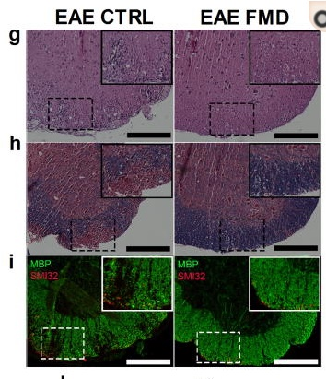
Caloric restriction reduces MS severity in mice
Fasting Mimicking Diet cycles
  Reduced clinical severity in all mice, completely reversed symptoms in 20%
  Increased corticosterone levels and T_{reg} cell number, reduced levels of pro-inflammatory cytokines, T_{H}1 and T_{H}17 cells, and antigen presenting cells (APCs)
  Promoted oligodendrocyte precursor cell regeneration and remyelination in axons
Cell Rep. 2016 Jun 7;15(10):2136-2146. A Diet Mimicking Fasting Promotes Regeneration and Reduces Autoimmunity and Multiple Sclerosis Symptoms. Choi, Piccio, Cross, Longo et al
Notes:
FMD promoted oligodendrocyte precursor cell regeneration and remyelination in axons in response to both EAE and cuprizone MS models, supporting its effects on both suppression of autoimmunity and remyelination.
The FMD cycles reduce infiltration of immune cells in the spinal cord
To investigate the capacity of FMD cycles to reduce potential autoimmune T-cells, we measured circulating white blood cells (WBCs), lymphocytes, monocytes and granulocytes of the naive, EAE CTRL, EAE FMD and EAE FMD:RF (measured 4 days after returning to a standard ad lib diet) groups after 3 cycles of the FMD regimen
effects of 3 cycles of a very-low-calorie and low-protein FMD lasting 3 days every 7 days or a KD continued for 30 days in EAE-induced by active immunization with myelin oligodendrocyte glycoprotein 35–55 (MOG35–55)
FMD cycles decrease disease severity of the MOG₃₅₋₅₅-induced EAE model(mean ± S.E.M, * p < 0.05, ** p<0.01; *** p < 0.001; t test, 1-way or 2-way ANOVA & Bonferroni Post Test; Scale bar represents 200 μm).
a. Diagram displaying the time course of the immunization and the diet interventions.
b. The EAE severity scoresof the Control Diet (EAE CTRL; n=23), ketogenic diet (EAE KD); n=13, semi-therapeutic FMD cycles (EAE FMD(S); n=7) or therapeutic FMD cycles (FMD(T); n = 23).
c. Incidence rate of the EAE CTRL and EAE FMD (S) (n=7–23).
d. EAE severity score of the EAE FMD(T) mice that completely reversed the EAE severity and scored 0, no observable disease (n=5).
e. EAE severity score of the best-performing control mice (n=12) and the FMD(T) mice (n=12).
f. EAE severity score of the EAE CTRL mice that treated with FMD upon chronic EAE development(EAE CTRL-FMD) (n=6).
g–m. Spinal cord of the EAE CTRL and the EAE FMD (T) mice with quantification of (g) H&E staining, (h) solochrome cyanine staining, and (i) MBP (Myelin Basic Protein) and SMI32 staining of spinal cord sections isolated at day 14.

Slide 48
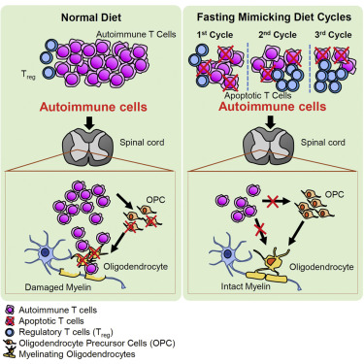
Cell Rep. 2016 Jun 7;15(10):2136-2146. A Diet Mimicking Fasting Promotes Regeneration and Reduces Autoimmunity and Multiple Sclerosis Symptoms. Choi, Piccio, Cross, Longo et al
Notes:
A simplified model of FMD-mediated effects on glucocorticoid, immune suppression & oligodendrocyte regeneration and differentiation in MS
The FMD treatment promotes endogenous glucocorticoid production, increases T_{reg} cell numbers, blocks T-cell activation and promotes T-cell death. In the lesion area. FMD treatment reduces autoimmune T-cell and microglia infiltration, promotes oligodendrocyte precursor dependent regeneration and the differentiation of myelinating oligodendrocyte which engage with demyelinated axons to promote the formation of myelin sheaths.

Slide 49
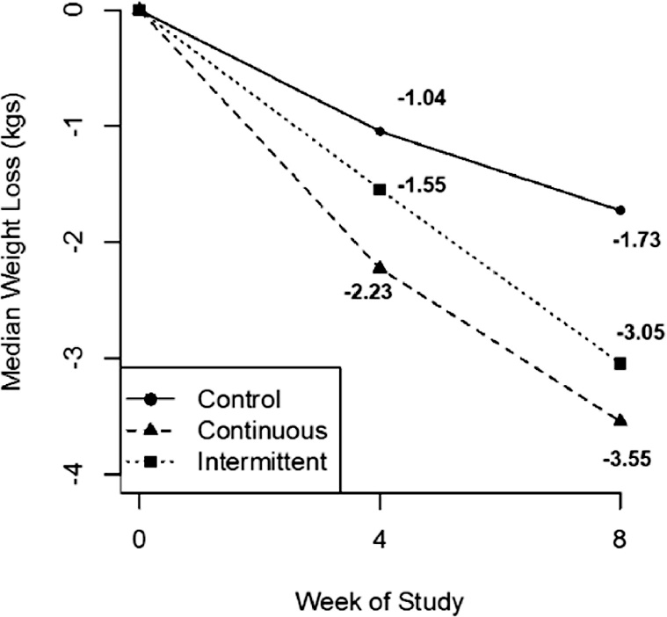
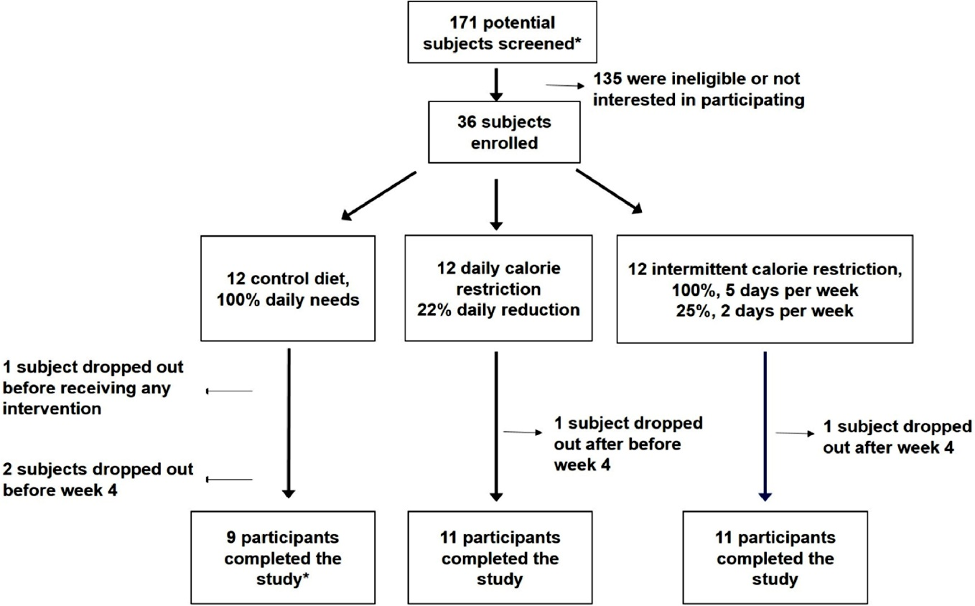
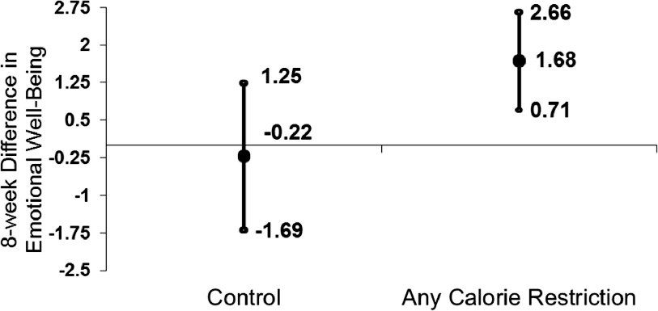
Intermittent Calorie Restriction in MS-Pilot study
Safety, feasibility of different types of calorie restriction (CR) diets; Effects on weight and patient reported outcomes
31 (86%) completed the trial; no significant AE
CR diets subjects lost a median 3.4 kg
Mult Scler Relat Disord. 2018 Jul;23:33-39. doi: Effect of intermittent vs. daily calorie restriction on changes in weight and patient-reported outcomes in people with multiple sclerosis. Fitzgerald KC¹, Mowry EM³ et al
Notes:
Other: Diet Diet, standardized to the 50th percentile for macronutrients, will be provided at varied calorie levels as described
Johns Hopkins; Ellen Mowry is PI
Mult Scler Relat Disord. 2018 Jul;23:33-39. doi: 10.1016/j.msard.2018.05.002. Epub 2018 May 5.
Effect of intermittent vs. daily calorie restriction on changes in weight and patient-reported outcomes in people with multiple sclerosis.
Fitzgerald KC¹, Vizthum D², Henry-Barron B², Schweitzer A², Cassard SD³, Kossoff E⁴, Hartman AL⁴, Kapogiannis D⁵, Sullivan P⁶, Baer DJ⁶, Mattson MP⁵, Appel LJ⁷, Mowry EM³.
Author information
1Division of Neuroimmunology and Neurological Infections, Department of Neurology, Johns Hopkins School of Medicine, Baltimore, MD, United States. Electronic address: fitzgerald@jhmi.edu.2Research Nutrition, Institute for Clinical and Translational Research, Johns Hopkins School of Medicine, Baltimore, MD, United States.3Division of Neuroimmunology and Neurological Infections, Department of Neurology, Johns Hopkins School of Medicine, Baltimore, MD, United States.4Departments of Neurology and Pediatrics, Johns Hopkins School of Medicine, Baltimore, MD, United States.5Department of Cellular and Molecular Neuroscience, National Institute on Aging, Baltimore, MD, United States.6Beltsville Human Nutrition Research Center, United States Department of Agriculture, Beltsville, MD, United States.7Welch Center for Prevention, Epidemiology and Clinical Research, Johns Hopkins Bloomberg School of Public Health, Baltimore, MD, United States; Department of Medicine, Johns Hopkins School of Medicine, Baltimore, MD, United States.
Abstract
An intermittent fasting or calorie restriction diet has favorable effects in the mouse forms of multiple sclerosis (MS) and may provide additional anti-inflammatory and neuroprotective advantages beyond benefits obtained from weight loss alone. We conducted a pilot randomized controlled feeding study in 36 people with MS to assess safety and feasibility of different types of calorie restriction (CR) diets and assess their effects on weight and patient reported outcomes in people with MS. Patients were randomized to receive 1 of 3 diets for 8 weeks: daily CR diet (22% daily reduction in energy needs), intermittent CR diet (75% reduction in energy needs, 2 days/week; 0% reduction, 5 days/week), or a weight-stable diet (0% reduction in energy needs, 7 days/week). Of the 36 patients enrolled, 31 (86%) completed the trial; no significant adverse events occurred. Participants randomized to CR diets lost a median 3.4 kg (interquartile range [IQR]: -2.4, -4.0). Changes in weight did not differ significantly by type of CR diet, although participants randomized to daily CR tended to have greater weight loss (daily CR: -3.6 kg [IQR: -3.0, -4.1] vs. intermittent CR: -3.0 kg [IQR: -1.95, -4.1]; P = 0.15). Adherence to study diets differed significantly between intermittent CR vs. daily CR, with lesser adherence observed for intermittent CR (P = 0.002). Randomization to either CR diet was associated with significant improvements in emotional well-being/depression scores relative to control, with an average 8-week increase of 1.69 points (95% CI: 0.72, 2.66). CR diets are a safe/feasible way to achieve weight loss in people with MS and may be associated with improved emotional health.

Slide 50

Functional Outcomes from Diets in MS (FOOD for MS)
UAB
Brooks Wingo, PhD, PI, John Rinker, MD, Co-I, Amy Goss, PhD, RD Co-I, Stacey Cofield, PhD, Co-I, Kathryn Green, RD- Project Coordinator, Jennifer Adams, MA, Consumer Consultant
Washington University
Laura Piccio, MD, PhD- site PI, Claudia Cantoni, PhD, Co-I, Cyrus Raji, MD, PhD, Co-I, Gregory Wu, MD, PhD, Co-I, Laura Ghezzi, MD, Co-I, Courtney Dula: Project Coordinator
Slides Courtesy Dr Brooks Wingo

Slide 51
Study Overview
Table 3: Overview of study measures
Measure
Clinical outcomes (MSFC*, BICAMS)
Patient-report outcomes (mood, anxiety, fatigue, pain, sleep, behavior theory constructs)
Cardiometabolic risks (Glucose, Insulin, Lipids, Blood pressure)
Inflammatory biomarkers (TNF-α, IL-6, IL-17, Adiponectin, Leptin)
Immune cell phenotyping (Tregs, Th17)
Anthropometrics, total body composition (height, weight, waist circumference, DXA)
MRI (adipose deposition and neuroimaging)
Resting energy expenditure
Gut Microbiome
Participant characteristics (demographics, type of MS, age at diagnosis, medications, medical history, physical activity)
*Primary Outcome is Timed 25-foot Walk within the MSFC MSFC: Multiple Sclerosis Composite Score
Purpose: Study efficacy of two dietary interventions, glycemic load and calorie restriction, for improving physical function, pain, fatigue, mood, and anxiety in adults with RRMS/ SPMS. 16 week long study
Specific Aims
Aim 1: To assess the efficacy of improved diet quality, with and without CR, for improving physical function in adults with MS.
Hypothesis: eucaloric low GL diet will improve physical function (timed 25-ft walk test (T25FW, primary outcome) portion of the Multiple Sclerosis Functional Composite (MSFC), compared with a eucaloric standard GL diet after 16 weeks (Phase 1).
CR low GL diet will improve physical function (T25FW, compared with a CR standard GL diet over an additional 16 weeks (Phase 2).
Aim 2: Assess efficacy of improved diet quality, with and without CR, for improving PROs in adults with MS.
Hypothesis: Eucaloric low GL diet will improve PROs (pain, fatigue, anxiety, mood) compared with a eucaloric standard GL diet after 16 weeks (Phase 1).
CR low GL diet will lead to significantly greater total improvements in PROs (pain, fatigue, anxiety, mood) compared with a CR standard GL diet over an additional 16 weeks (Phase 2).
Slides Courtesy Dr Brooks Wingo

Slide 52
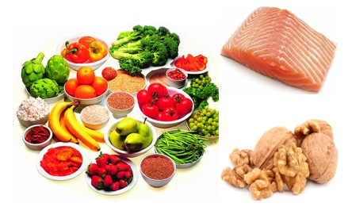
How does diet affect MS pathophysiology?
Attenuate vascular risk factors
Modification of immuno-biology
  Promotes or inhibits inflammation, BBB permeability
  Gut microbiome
  Role on oxidative stress

Slide 53
Vascular Comorbidity and MS Disability Progression
More than 50% (4745) of NARCOMS survey responders had at least one vascular comorbidity at the time of their MS diagnosis
  Hypercholesterolemia - 3,237 (37%)
  Hypertension - 2,664 (30%)
  Heart Disease - 606 (~7%)
  Diabetes - 532 (6%)
  Peripheral vascular disease - 209 (2%)
~ 16% (1,435) had 2 vascular comorbidities
~ 4% (397) had 3 vascular comorbidities
The mean (SD) ages at diagnosis for these comorbidities:
  47.3 (11.8) years for hypertension
  48.7 (10.3) years for hypercholesterolemia
  48.8 (12.4) years for diabetes
  50.4 (13.7) years for heart disease
  51.7 (14.1) years for peripheral vascular disease
A dose-response relationship between vascular comorbidity and MS disability with:
  Presence of a single vascular comorbidity increased the risk of early gait disability by 51%
  Presence of 2 of these conditions increasing the risk to 228%
Marrie R et al. Neurology 2010;74:1041-1047

Slide 54
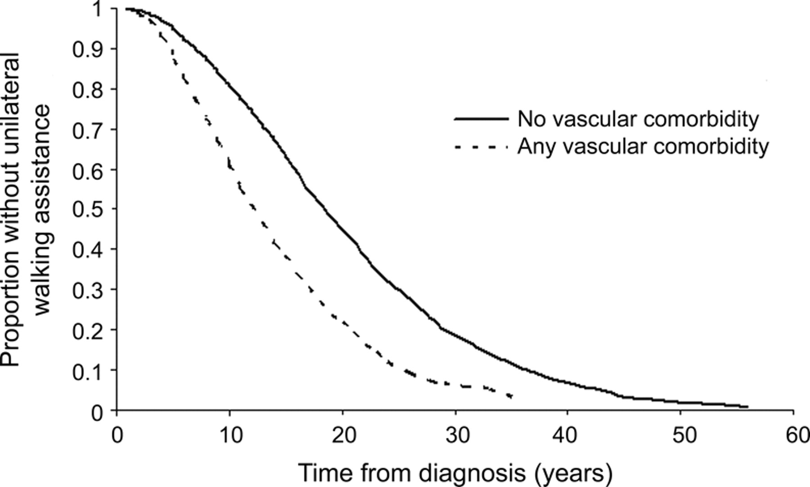
Vascular Comorbidity Increases Risk of MS Disability
19 years
13 years
No Vasc comorbidity
N = 2286
Vasc comorbidity
N = 572
Marrie R et al. Neurology 2010;74:1041-1047
Notes:
Figure Kaplan-Meier analysis Time from diagnosis of multiple sclerosis to needing unilateral assistance to walk in North American Research Committee on Multiple Sclerosis participants with (n = 572) and without (n = 2,286) vascular comorbidity at diagnosis. Any vascular comorbidity = any of diabetes, hypertension, heart disease, hypercholesterolemia, and peripheral vascular disease.
Neurology. 2010 Mar 30;74(13):1041-7.Vascular comorbidity is associated with more rapid disability progression in multiple sclerosis. Marrie RA, Rudick R, Horwitz R, Cutter G, Tyry T, Campagnolo D, Vollmer T. Health Sciences Center, Winnipeg, Canada. rmarrie@hsc.mb.ca
BACKGROUND: Vascular comorbidity adversely influences health outcomes in several chronic conditions. Vascular comorbidities are common in multiple sclerosis (MS), but their impact on disease severity is unknown. Vascular comorbidities may contribute to the poorly understood heterogeneity in MS disease severity. Treatment of vascular comorbidities may represent an avenue for treating MS.
METHODS: A total of 8,983 patients with MS enrolled in the North American Research Committee on Multiple Sclerosis Registry participated in this cohort study. Time from symptom onset or diagnosis until ambulatory disability was compared for patients with or without vascular comorbidities to determine their impact on MS severity. Multivariable proportional hazards models were adjusted for sex, race, age at symptom onset, year of symptom onset, socioeconomic status, and region of residence.
RESULTS: Participants reporting one or more vascular comorbidities at diagnosis had an increased risk of ambulatory disability, and risk increased with the number of vascular conditions reported (hazard ratio [HR]/condition for early gait disability 1.51; 95% confidence interval [CI] 1.41-1.61). Vascular comorbidity at any time during the disease course also increased the risk of ambulatory disability (adjusted HR for unilateral walking assistance 1.54; 95% CI 1.44-1.65). The median time between diagnosis and need for ambulatory assistance was 18.8 years in patients without and 12.8 years in patients with vascular comorbidities.
CONCLUSIONS: Vascular comorbidity, whether present at symptom onset, diagnosis, or later in the disease course, is associated with a substantially increased risk of disability progression in multiple sclerosis. The impact of treating vascular comorbidities on disease progression deserves investigation.

Slide 55
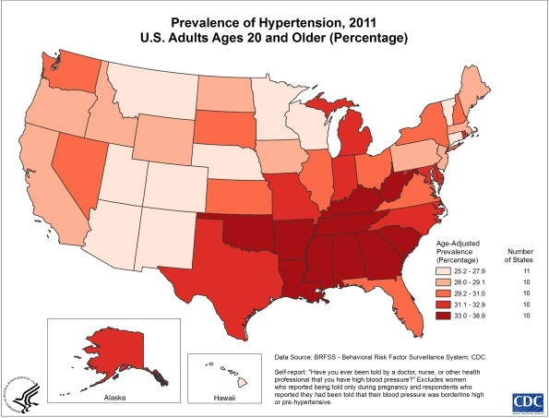
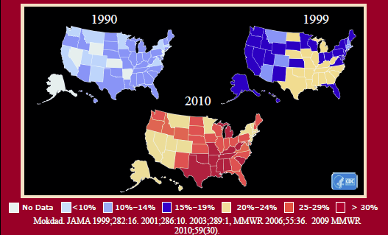
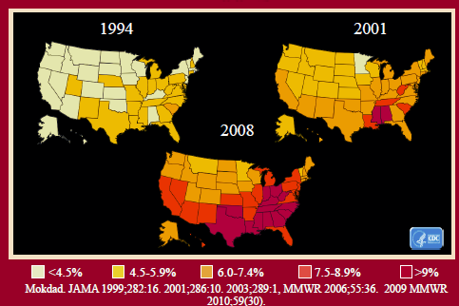
Obesity, Hypertension and Diabetes Trend Among US Adults
- ~ 45% of adults have HTN.
- More Black adults (54%) than White adults (46%) have HTN.
• > 11% of adults have high total cholesterol, ≥240 mg/dL
~ 11% of Americans have type 1 or type 2 diabetes
~ 35% of American adults have prediabetes, and people 65 years and older have the highest rate (48%) compared to other age groups
~ 74% of adults are overweight or have obesity
- Adults ages 40 to 59 have the highest rate of obesity (43%) of any age group
~ 40% of children and adolescents are overweight or have obesity; the rate of obesity increases throughout childhood and teen years

Slide 56
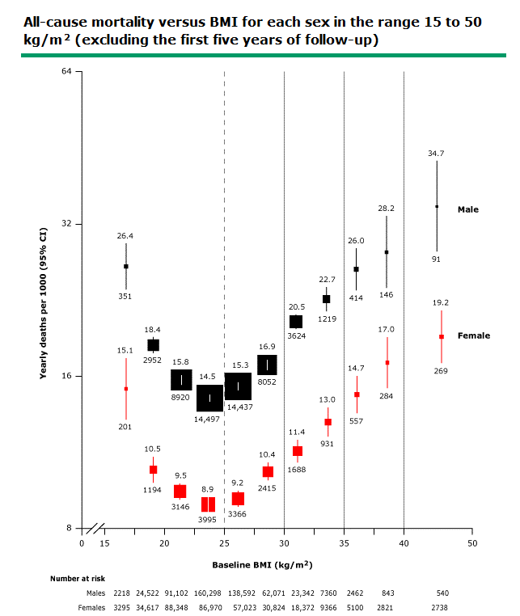
- Ages – 35-79 yr
- Above 25 kg/m², mortality was, on average, approx. 30 % higher for every 5 kg/m² higher BMI
Whitlock G et al Lancet 2009;373:1083
Notes:
Relative risks at age 35 to 89 years, adjusted for age at risk, smoking, and study, were multiplied by a common factor (ie, floated) to make the weighted average match the PSC mortality rate at ages 35 to 79 years. Floated mortality rates shown above each square and numbers of deaths below. Area of square is inversely proportional to the variance of the log risk. Boundaries of BMI groups are indicated by tick marks. 95% CIs for floated rates reflect uncertainty in the log risk for each single rate. Dotted vertical line indicates 25 kg/m² (boundary between upper and lower BMI ranges in this report). Above 25 kg/m², mortality was, on average, approximately 30 percent higher for every 5 kg/m² higher BMI.
BMI: body mass index; PSC: Prospective Studies Collaboration.

Slide 57
Obesity, Overweight and MS
  Highly prevalent in the MS population
  Affecting more than 50% of individuals
  Higher weight in youth is associated with:
    Greater risk of developing MS and
    Earlier age of onset
  As compared to normal body weight, obesity at 20 years of age is associated with a twofold increased risk of MS
Marrie RA, Horwitz RI. Emerging effects of comorbidities on multiple sclerosis. Lancet Neurol 2010; 9 (8): 820–828
Havak et al. Higher weight in adolescence and young adulthood is associated with an earlier age at multiple sclerosis onset. Mult Scler 2014
Munger KL et al. Childhood body mass index and multiple sclerosis risk: a long-term cohort study. Mult Scler 2013;19(10): 1323-1329
Hedstrom AK et al. High body mass index before age 20 is associated with increased risk for multiple sclerosis in both men and women. Mult Scler 2012; 18 (9): 1334–1336

Slide 58
Lipids and MS
Assess relationship between number of contrast enhancing MRI lesions and plasma levels of both Total and LDL Cholesterol (N=18, monthly MRIs)
Estimated increase in Total Cholesterol levels of about 4.4 mg/dl for each gadolinium enhancing lesion
Another study
Neurologic exam worsening with:
  Higher baseline LDL, Total cholesterol
Higher HDL levels associated with lower contrast-enhancing lesion volume
Higher total cholesterol - associated with trend for lower brain parenchymal fraction or brain atrophy (p = 0.033)
Giubilei F et al. Blood cholesterol and MRI activity in first clinical episode suggestive of multiple sclerosis. Acta Neurol Scand. 2002 Aug;106(2):109-12.
J Neuroinflammation. 2011 Oct 4;8:127. Serum lipid profiles are associated with disability and MRI outcomes in multiple sclerosis. Weinstock-Guttman B, et al.

Slide 59
Summary and Recommendations
Research supporting a healthy diet is becoming more available
Vascular disease risk factors including obesity and metabolic syndrome can be easy targets for diet/lifestyle modifications
Diet quality may be associated with disability and symptom severity in MS
There is no one single diet for MS yet
Diet and life style can have important implications on risk of MS, disease activity and possibly disease progression through complex mechanisms

Slide 60



Thank you!

Slide 61
Survey
Please complete the webinar survey in the
TRAIN or TMS websites within 15 days. This will give you access to your CME/CE certificate.
Non-VA: www.vha.train.org
VA: www.tms.va.gov

Slide 62

What’s On Your Mind?
Please type your question into the Chat
area in the lower right corner of your screen.
Notes:
Live questions

Slide 63
Thank you and please join us for the next webinar on March 1, 2023!
Role of Comorbidities in Healthcare Utilization
and Self-Management in Persons with MS
Elizabeth Gromisch, PhD, MSCS
Aaron Turner, PhD, ABPP (RP)
www.nationalMSsociety.org/currenttopics
www.va.gov/MS/products/CME_CEU_calls
Notes:
Thank you for your participation today and special thanks to Dr. Casperson for the great presentation. This webinar is recorded and I will posting the recording and the slides on the webpage listed on the screen. Don’t forget, there’s another Current Topics webinar on September 16 on Medical Marijuana for MS Symptom Management presented by Dr. Michelle Cameron. You can register online for this webinar on our website noted on the screen. Thank you all for attending today and have a great rest of your day.

