Slide 1


The CME program will start on the hour.
Biomarkers & Multiple Sclerosis

Slide 2

VA MS Centers of Excellence Mission
Improve the quality and consistency of health care services delivered to Veterans with MS across the US.
Expand care coordination between VA medical facilities through the development of a national network of MS providers within the Veterans Health Administration.

Slide 3
Vision & Mission Statements
​​Our Vision:
A World Free of MS.
Our Mission:
We will cure MS while empowering people affected by MS to live their best lives.

Slide 4
Diversity,
Equity & Inclusion Statement
The National Multiple Sclerosis Society is a movement by and for all people affected by MS. Our voices and actions reflect diversity, equity and inclusion.
We welcome and value diverse perspectives.
We actively seek out and embrace differences.
We want everyone to feel respected and be empowered to bring their whole selves to ensure we make the best decisions to achieve our mission.

Slide 5
Your feedback is important to us!
At the conclusion of the webinar, please complete the program survey. This must be completed within 15 days of the live program.

Slide 6

Dr. Graves is an Associate Professor of Neurosciences and Director of the Neuroimmunology Research Program at UC San Diego. She is a MS specialist at the San Diego VA Hospital. She is also Director of the Rady Children’s Pediatric MS Center and scientific member of the U.S. Network of Pediatric MS Centers. She completed an MD and PhD in Biophysics at the University of Texas Southwestern. She trained in neurology at the University of Pennsylvania receiving the Arthur K Asbury Award for Clinical Excellence. She completed two fellowships in Neuro-ophthalmology at the University of Pennsylvania and in MS and Clinical Research Methods at the UC San Francisco. She has received grant support from the NIH, the National MS Society, the Race to Erase MS and the Foundation for the CMSC. She is a collaborator in several national and international research efforts in MS and participates in multi-center clinical trials. At the start of the worldwide SARS-CoV-2 pandemic she launched the NeuCovid collaborative coordinating faculty across UC San Diego to study neurological effects of infection.

Slide 7

Biomarkers and MS
Jennifer Graves, MD, PhD, MAS
San Diego VA
Professor of Neurosciences
Director of Neuroimmunology Research at UCSD

Slide 8
Disclosures
Provisional patent on MSight device
No other disclosures directly related to slide content
Dr. Graves has received research support from NMSS, Octave, Biogen , EMD Serono, Novartis, ATARA Biotherapeutics, and ABM. She has served on advisory board for Bayer, Genentech, and TG therapeutics and pediatric clinical trial steering committee for Novartis. She has consulted for Google.
Notes:
Add – Elilie Rheas, David Vera, Covid 19 data,

Slide 9
Overview
Definition and validation of Biomarkers
Brief discussion of MRI, emphasis progressive MS
Established and emerging serum and CSF biomarkers
Visual system biomarkers
Biological aging biomarkers
Wearable sensing biomarkers
Notes:
Des Cartes view of binocular vision – “seat of imagination”

Slide 10

Biomarker Definition
Distinct from a clinical outcome; not a patient appreciated measure
Indicative of a normal biological process, a pathological process or a response to an exposure or intervention
Different types of biomarkers and modalities of biomarker measurement
Califf, RM. Experimental Biology and Medicine 2018; 243: 213–221

Slide 11


Classes of Biomarkers
Diagnostic
Disease monitoring
Prognostic
Predictive
Safety
Califf, RM. Experimental Biology and Medicine 2018; 243: 213–221

Slide 12
Regulatory considerations of Biomarker Development
Given confusing definitions and requirements FDA convened with NIH
DA-NIH Biomarker Working Group. BEST (Biomarkers, EndpointS, and other Tools) Resource. Silver Spring (MD): Food and Drug Administration (US); Bethesda (MD): National Institutes of Health (US), www.ncbi.nlm.nih.gov/books/NBK326791/

Slide 13
Biomarker vs Surrogate Marker
A biomarker can be a surrogate marker of a clinical outcome
But not all biomarkers are surrogates
Surrogate marker = marker that explains the change in clinical outcome
Surrogates markers have to show more than just correlation
Most biomarkers do not meet the standards of a surrogate
Califf, RM. Experimental Biology and Medicine 2018; 243: 213–221

Slide 14

Summary: Biomarkers
Not clinical outcomes
Measure normal biological or pathological processes
Blood, imaging or digital markers
FDA/NIH “BEST” validation
Diagnostic, monitoring, prognostic, predictive or safety
Most biomarkers are not surrogates

Slide 15
Imaging Biomarkers in MS

Slide 16
Prototypical MRI Biomarkers in Relapsing MS
Price, S Br Ir Orthopt J 2009
Notes:
wikipedia

Slide 17
Imaging Inactive Progressive MS
Global brain atrophy
  Not strongly associated with relapse history, may reflect neurodegenerative processes independent of inflammation
Regional brain atrophy
  E.g. cortical and deep gray matter
  May be more sensitive to change over time, requiring smaller sample size
Advanced Brain MRI techniques: MRS, diffusion methods, MTR, SWI
Cord Imaging
Moccia, M, et al, MSJ 2017, Ontaneda &Fox, Neurotherapeutics, 2017,
Notes:
wikipedia

Slide 18
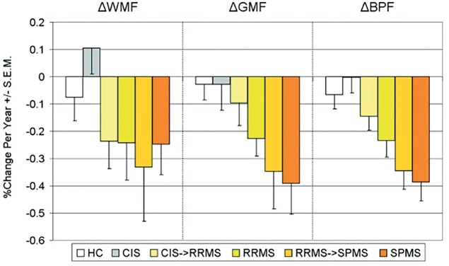
Global and Regional Brain Atrophy
Rocca, M.A. et al. Neurology 2017
Notes:
wikipedia

Slide 19
DTI, MTR in Progressive MS
Diffusion Tensor Imaging (DTI)
  Mean diffusivity and fractional anisotropy have been used in PMS clinical trials
Magnetization Transfer Ratio (MTR)
  MTR in normal appearing white matter is associated with 1 year progression in early PPMS
  MTR improved in response to natalizumab in PMS
SPRINTMS Ibudilast phase II trial used both DTI and MTR secondary outcomes
  DTI in descending pyramidal tracts – Endpoint was not met
  MTR of normal appearing brain tissue – Endpoint was met
Ontaneda & Fox, Neurotherapeutics, 2017, Moccia, M, et al, MSJ 2017, Khaleeli, Z. et al JNNP 2007, Christensen et al Neurology 2014
Notes:
wikipedia

Slide 20
Slowly expanding lesions and paramagnetic rim lesions:
SELs and PRLs
Calvi, Clarke and Barkhof, MSJ 2022
Notes:
The images show from left to right: SWI at baseline (the top left rectangle shows a magnification of the paramagnetic rim lesion), FLAIR with lesion mask countered in red, Jacobian map superimposed indicating that the PRL corresponds to a SEL. The images are from a 45-year-old person with a CIS and the MRI was performed 4 months after onset. At baseline the EDSS was 0 and last follow-up (~4 years) was 1.5. CIS: clinically isolated syndrome; EDSS: Expanded Disability Status Scale; PRL: paramagnetic rim lesion; FLAIR: fluid-attenuated inversion recovery; PRL: paramagnetic rim lesion; SWI: susceptibility-weighted imaging; SEL: slowly expanding lesion.

Slide 21
High cervical cord neurodegeneration:
Measured from cervical cord or brain imaging
Zurawski et al J Neurol Scences. 201; Taheri K et al MSJ-ETC 2022
Notes:
Cervical cord volumes assocaited with EDSS and QOL. Can measure from standard or more advanced sequences – rapid gradient echo. And can consider using brain images to calculate high cervical volumes – good correlation with cervical imaging volumes
Upper cervical cord area was assessed from C1-C3 on axial T1-weighted magnetization-prepared rapid gradient-echo brain sequence. An example tracing of the axial (A,B) (reconstructed) and sagittal (C) (native) images from a 44-year-old man with relapsing-remitting multiple sclerosis is shown.

Slide 22
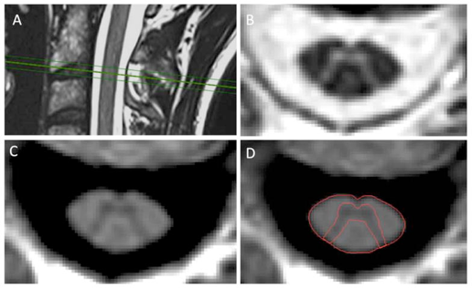
Advanced Imaging: PSIR cervical cord gray matter
3T phase-sensitive inversion recovery (PSIR) magnetic resonance imaging
PPMS showed smaller C2-3 GM and WM volumes than RRMS (p<0.004)
C2-3 GM volumes strongly correlated with EDSS
Schlaeger, R Annals Neurol. 2014
Notes:
C2-3
Planning of spectroscopy voxel and diffusion weighted image volume. Sagittal (A) and coronal (B) T₂-weighted images of the cervical cord with spectroscopy voxel centred on C2–3 intervertebral disc. Sagittal (C) and coronal (D) T₁-weighted image of the cervical cord showing diffusion weighted imaging volume coverage centred on the C2–3 disc.

Slide 23
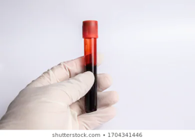

Serological and CSF Biomarkers
Notes:
wikipedia

Slide 24
Serological and CSF Biomarkers
CSF and serum neurofilament light chain (Nfl)
Serum glial fibrillary acid protein (s-GFAP)
Other CSF markers
Markers of somatic and reproductive aging
M. Mealy et al, J Neurol Sci. 2015 Aug 15; 355(0): 59–63., Christensen, JR, Mult Scler 2019
Notes:
wikipedia

Slide 25
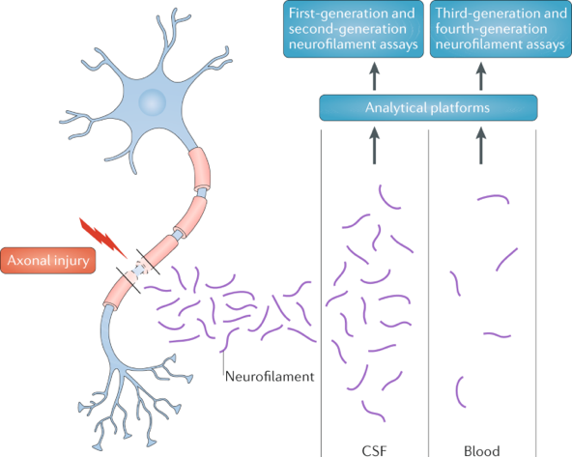
Neurofilament Light Chain (Nfl)
Khalil, M, et al, Nature Reviews Neurology, 2018
Notes:
wikipedia

Slide 26

Neurofilament Light Chain (Nfl)
Changes in Nfl levels in CSF or serum can be associated with acute inflammatory injury in MS
  Associated with relapses and Gad enhancing lesions
  Responsive to anti-inflammatory treatments in active PMS
  Very high baseline Nfl associated with progression in placebo group of ocrelizumab PPMS trial
  CSF Nfl primary outcome in the FUMAPMS Trial NCT02959658
  Secondary and tertiary outcome in several trials
Khalil, M, et al, Nature Reviews Neurology, 2018; Williams, T. Journal of Neurology 2020
Notes:
wikipedia

Slide 27
Neurofilament Light Chain (Nfl) in PMS
Nfl as a biomarker of neurodegeneration in PMS is more challenging
  Need to tease apart contributions from disease process of interest from impact of age, comorbid illness
In a systematic review of Nfl in PMS (n=17 studies, Williams, T et al 2020)
  Differences in NFL levels in RRMS vs. PMS explained by covariates like age
  Associations with current or future disability are inconsistent
  No evidence of Nfl being responsive to possible neuro-protective treatments
Khalil, M, et al, Nature Reviews Neurology, 2018; Williams, T. Journal of Neurology 2020
Notes:
wikipedia

Slide 28

Serum GFAP levels Progressive MS
  Type III intermediate filament found in CNS cells, including astrocytes and ependymal cells
  Ayrignac et al 2020 reported higher s-GFAP levels in PPMS vs RRMS
    - 130.3 ± 72.8 pg/ml vs 83.4 ± 41.1 pg/ml, p = 0.008
  Abdelhak et al 2018 also reported higher s-GFAP in PMS vs. RRMS
Ayrignac et al., Scientific Reports, 2020; Abdelhak, et al, Sci Reports 2018 natureresearch, RSCB Protein Data Bank
Notes:
wikipedia

Slide 29
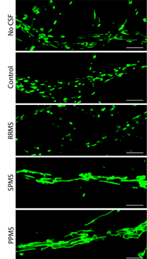
CSF Ceramide and Mitochondrial Dysfunction in Progressive MS
CSF from RRMS, SPMS and PPMS applied to cultured neurons
Live imaging with a mitochondrial tracer (green) demonstrated elongation of mitochondria with exposure to SPMS and PPMS CSF
Decreased activity in complex I, III, and IV
Enriching CSF with lipid ceramides replicated these effects
CSF ceramides impaired mitochondrial respiration but also decreased the bioavailability of glucose by increasing its uptake
Hypothesis: ‘virtual hypoglycosis’ induced by the CSF of progressive patients
Wentling, M et al. Brain, 2019
Notes:
sCD27 - TNF alpha family receptor, cleaved by metalloproteinases

Slide 30
Other CSF Biomarkers for Progressive MS
CSF Soluble CD27 receptor (sCD27) decreased in response to natalizumab and methylprednisolone in progressive MS trials
  sCD27 is shed by activated T cells in the CSF
  CSF sCD27 strongly correlated with CSF Nfl levels
Differential cytokine profiles have been reported
  Marastoni et al reported greater CCL2 and CCL15 in PPMS
CSF chitinase 3-like-1 (CHI3L1) levels are associated with disability level in early untreated PPMS patients with trend toward predicting future disability
M. Mealy et al, J Neurol Sci. 2015 Aug 15; 355(0): 59–63, Marastoni et al ECTRIMS 2018; Pérez-Miralles NN 2020, Christensen, J.R. et al., MSJ 2019, Mahler et al MSARD 2020
Notes:
sCD27 - TNF alpha family receptor, cleaved by metalloproteinases

Slide 31

Biological Aging Markers and
Progressive MS
Notes:
wikipedia

Slide 32
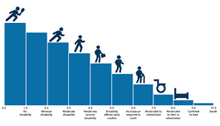
Disability accumulation as a function of age
Older age onset = shorter time to disability independent of disease duration
  MS starts age 10 → Walking dysfunction may occur in 20-30 years
  MS starts age 40 → Walking dysfunction may occur within 5-10 years
Confavreaux et al., Brain 2006;Trojano Ann Neurol 2002; Martinelli . Neurol Sci 2004; Scalfari Neurology 2011, Kalincik, T. et al., Brain 2013
Notes:
http://www.littleappliquefactory.com/1884-male-female-symbol-applique-design
Switch from relapsing to secondary progressive MS may be more related to changes in the host

Slide 33
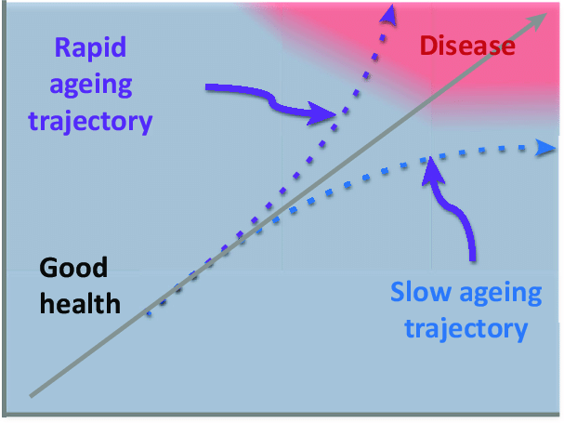
Biological aging:
A driver of progressive MS?
Geroscience Hypothesis:
Reversing aging processes will ameliorate diseases of aging
Timmons, J, Trends in Pharmacological Sciences

Slide 34
“Biological Age”
Aggressive immune suppression
Transitional:
Measurement of Biological Age
Less systemic immune suppression; Age Reversal
Specific targets
Jagust Nature Aging 2021
Notes:
http://www.littleappliquefactory.com/1884-male-female-symbol-applique-design

Slide 35
“Biological Age”
Birthdate isn’t everything!
Rate of physical aging vs # birthdays
Studies tell us that for a large group of 38 y/o’s their biological age can range from 25-60
Many factors could contribute to this variability
  Genetic, Level of exercise, Toxins like smoking
  Environmental and other forms of biological stress
Biological age relevant for prediction of mortality and chronic diseases like heart disease
Both somatic and reproductive aging
Notes:
http://www.littleappliquefactory.com/1884-male-female-symbol-applique-design

Slide 36

How can we measure Biological Age?
Notes:
We found that shorter telomere length, a marker of biological aging was associated with higher disability and lower brain volume. This supports the hypothesis that aging related processes may contribute to MS progression such as through oxidative stress, decline in remyelination capacity and altered immune function. Co-morbidities and lifestyle factors may also contribute. This suggests that targeting aging-related mechanisms may be a potential therapeutic strategy in MS given our limited ability to delay disability progression.

Slide 37
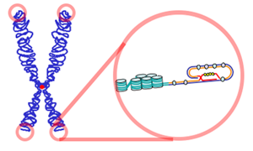
Telomeres
The ultimate biological clock
Telomeres are caps of proteins and genetic repeats that protect the ends of chromosomes and shorten when cells divide
Telomere shortening accelerated by oxidative stress and DNA damage
Shortened telomeres seen in:
  Cardiovascular disease
  Dementia
  Lupus, rheumatoid arthritis
  Progressive multiple sclerosis
World Biomedical Frontiers; shutterstock
Notes:
World Biomedical Frontiers
Telomeres contain proteins and nucleotide repeats (TTAGGG) at the end of chromosomes and shorten with each cell division, making telomere shortening a marker of cellular aging. Telomere shortening is accelerated by oxidative stress and DNA damage. Shortened telomeres are observed in chronic aging-related illnesses including cardiovascular disease²⁰ and dementia,²¹ and in autoimmune diseases such as systemic lupus erythematosus and rheumatoid arthritis.²² While telomere biology is not yet understood in MS, one prior study found that individuals with PPMS had shorter telomeres than controls. This was not seen for RR or SPMS

Slide 38
Telomere length and MS
Telomere loss explains 15% of variance of the effect of chronological age on disability
Shorter telomere length independent of MS disease duration and chronological age was is strongly associated with higher disability in MS
Aging-related processes may contribute to MS progression
  Oxidative stress, decline in remyelination capacity,
  Senesence of adaptive and innate immune system
Targeting aging-related processes may be a therapeutic strategy
Annals of Neurology 2019
Notes:
We found that shorter telomere length, a marker of biological aging was associated with higher disability and lower brain volume. This supports the hypothesis that aging related processes may contribute to MS progression such as through oxidative stress, decline in remyelination capacity and altered immune function. Co-morbidities and lifestyle factors may also contribute. This suggests that targeting aging-related mechanisms may be a potential therapeutic strategy in MS given our limited ability to delay disability progression.

Slide 39
Aging Model
Miner, A and Graves, JS, MSARD 2021
Notes:
We found that shorter telomere length, a marker of biological aging was associated with higher disability and lower brain volume. This supports the hypothesis that aging related processes may contribute to MS progression such as through oxidative stress, decline in remyelination capacity and altered immune function. Co-morbidities and lifestyle factors may also contribute. This suggests that targeting aging-related mechanisms may be a potential therapeutic strategy in MS given our limited ability to delay disability progression.

Slide 40
Epigenetic Biological Age
“DNA methylation” patterns change how our genes behave
Environment changes expression of our genes
DNA methylation Biological Age (DNAm) predicts mortality and aging related illness
DNAm is accelerated in MS patients compared to controls (especially in B cells)
3.6 year older DNAm Age in brain cells in MS
Early stage proof of principle studies on reversing Epigenetic Age
AE Field et al Molecular Cell 2018; Liu et al PLOS Medicine 2018, Horvath, S, Nat Rev Genet 2018; Levine ME et al Aging 2018; Theodoropoulou, E, Epigenomics 2019; Ciechomska, M, et al Cells 2019

Slide 41
Proof of Principle to Reverse Epigenetic Age
TRIIM: Thymus Regeneration, Immunorestoration, and Insulin Mitigation trial
Recombinant human growth hormone, DHEA and metformin
Fahy GM et al Aging Cell 2019
Notes:
Treatment‐induced changes in epigenetic age. EA, epigenetic age; A, chronological age; changes depicted relative to EA‐A before treatment [(EA‐A)₀]. (a) Decline in Horvath epigenetic age by 12 months of treatment. Overall, linear mixed‐model analyses (LMMAs) indicated a P value of .0009 over months 0–12 and .018 over months 0–18. (b) Decline in PhenoAge by 12 months of treatment. LMMA overall P values are .0064 for months 0–12 and .028 for months 0–18. (c) Decline in Hannum epigenetic age by 12 months, and continuing epigenetic age regression to 18 months. LMMA p = .012 for months 0–12 and p = .0092 for months 0–18. (d) Persistent decline in GrimAge age at 12–18 months. LMMA showed p = .0049 for months 0–12 and p = .0016 for months 0–18. (e) Mean of all four epigenetic aging clock results, indicating significant overall epigenetic aging regression at trial months 9–18. By LMMA, p = .0003 for 0–12 mo and .0016 for 0–18 mo. (f) Significant (p < .005) change in the rate of change of [(EA‐A)–(EA‐A)₀] between 0–9 months of treatment (plotted at 9 months) and 9–12 months of treatment (plotted at 12 months)

Slide 42
Measuring Biological Age in Clinic

Slide 43
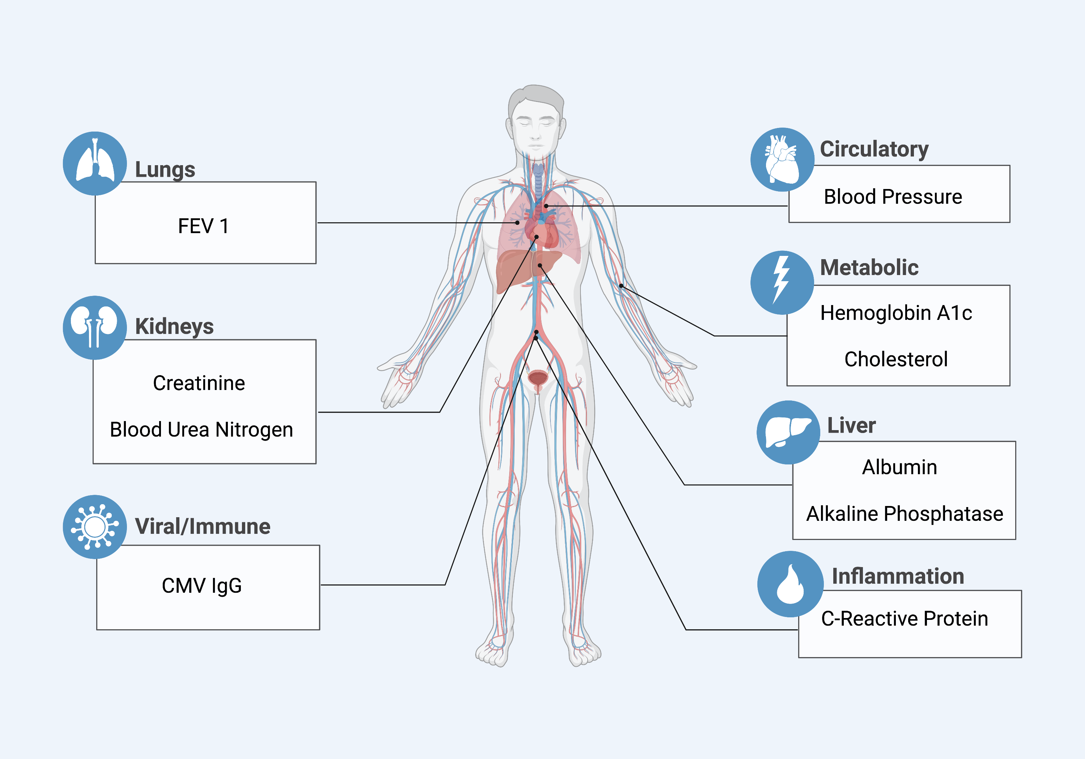
Multi-marker Index of Biological Age
Multi-marker indices of biological age are more reliable than single markers.
The NHANES Biological Age index (BAI) predicts the risk of aging-related diseases.
Miner, AE, Yang, J, Kinkel, R, and Graves, JS, MSARD 2023
Notes:
World Biomedical Frontiers
Telomeres contain proteins and nucleotide repeats (TTAGGG) at the end of chromosomes and shorten with each cell division, making telomere shortening a marker of cellular aging. Telomere shortening is accelerated by oxidative stress and DNA damage. Shortened telomeres are observed in chronic aging-related illnesses including cardiovascular disease²⁰ and dementia,²¹ and in autoimmune diseases such as systemic lupus erythematosus and rheumatoid arthritis.²² While telomere biology is not yet understood in MS, one prior study found that individuals with PPMS had shorter telomeres than controls. This was not seen for RR or SPMS

Slide 44
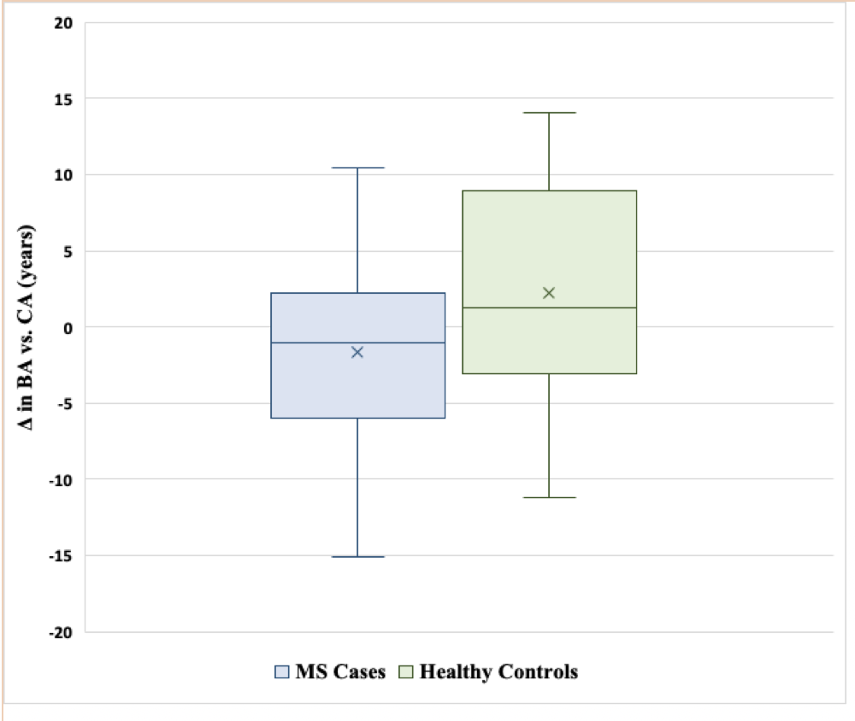
NHANES Biological Age index (BAI) in a pilot study of MS cases vs controls
Pilot study of n=51 relapsing and progressive MS participants and 38 healthy controls
Mean difference in Biological (BA) vs chronological (CA) age
  2.2 years younger controls
  1.4 years older MS patients
Extremes in both groups ranged 10-15 years
BAI correlated with walking speed (rho_{s} =0.31, p=0.045) and cognitive testing rho_{s}= 0.35, p=0.018).
Miner, AE, Yang, J, Kinkel, R, and Graves, JS, MSARD 2023
Notes:
World Biomedical Frontiers
Telomeres contain proteins and nucleotide repeats (TTAGGG) at the end of chromosomes and shorten with each cell division, making telomere shortening a marker of cellular aging. Telomere shortening is accelerated by oxidative stress and DNA damage. Shortened telomeres are observed in chronic aging-related illnesses including cardiovascular disease²⁰ and dementia,²¹ and in autoimmune diseases such as systemic lupus erythematosus and rheumatoid arthritis.²² While telomere biology is not yet understood in MS, one prior study found that individuals with PPMS had shorter telomeres than controls. This was not seen for RR or SPMS

Slide 45
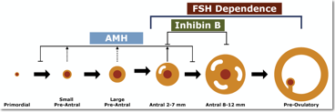
Reproductive Aging Biomarker and MS Progression in Women
Declines in Anti-Mullerian Hormone (AMH) , are associated with
  Disability accumulation (p<0.001)
  Gray matter atrophy
  Even after adjusting for age and disease duration
  Graves, J.S. et al, Neurology 2018
Notes:
wikipedia

Slide 46
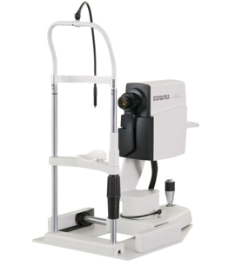
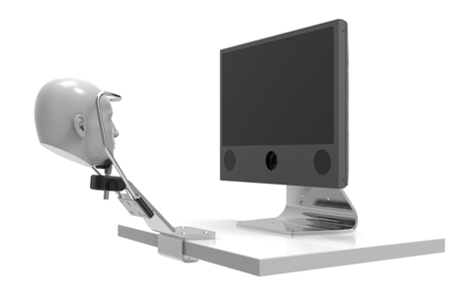
Visual System biomarkers IN MS
Notes:
wikipedia

Slide 47
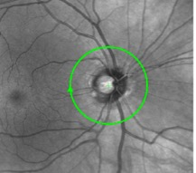

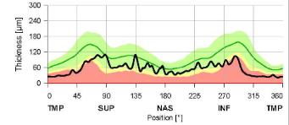
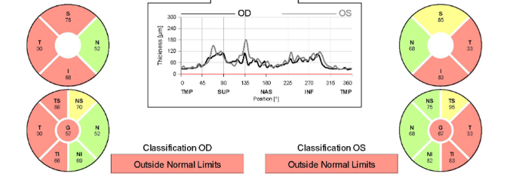
Optical Coherence tomography
peripapillary retinal nerve fiber layer (RNFL)
WHAT
A
B
Light based “ultrasound”
Thickness measurement of unmyelinated axons that become the optic nerve proximal to the optic disc
Temporal pattern of atrophy distinguishes MS from NMO and ischemic optic neuropathy
>5-6 μm assymmetry indicates prior optic neuritis
Correlates with visual function – low contrast acuity, visual QOL, visual fields
Correlates with brain atrophy
DiaGnosis
C
D
Correlates
Graves et al Neuroimmunology Neuroinflammmation 2022, Graves et al Seminars in neurology 2020, Nolan et al J Neuroophthalmol
. 2018 Dec;38(4):451-458, Waldman et al J Neuroophthalmol 2021 Dec 1;41(4):469-475

Slide 48
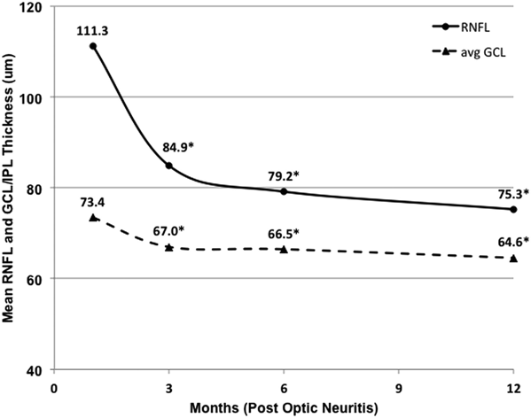
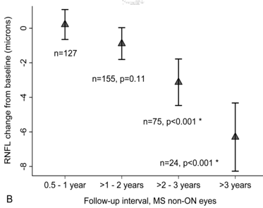
Optical Coherence tomography peripapillary RNFL changes over time
RNFL THICKNESS POST-ON
RNFL THICKNESS WITHOUT ON
Best time to record RNFL
From Costello F et al. 2015;86(12):1369-1373.
From Talman LS et al. Annals Neurol. 2011.
Frohman EM et al. Nat Clin Pract Neurol. 2008;4(12):664-675.  Graves JS et al. Neuroimmunology Neuroinflammm. 2022. 9(2).  Graves JS. Optical Coherence Tomography in Multiple Sclerosis. Semin Neurol. 2019;39(6):711-717.  Talman LS et al. Longitudinal study of vision and retinal nerve fiber layer thickness in multiple sclerosis. Annals Neurol. 2011.  Costello F et al. The temporal evolution of structural and functional measures after acute optic neuritis. J Neurol Neurosurgery Psychiatry. 2015;86(12):1369-1373.
Notes:
https://nn.neurology.org/content/9/2/e1126

Slide 49
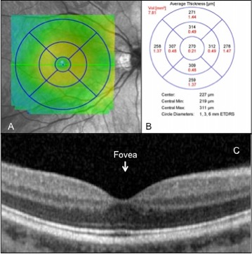
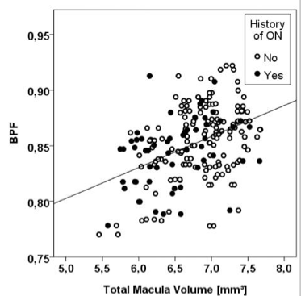
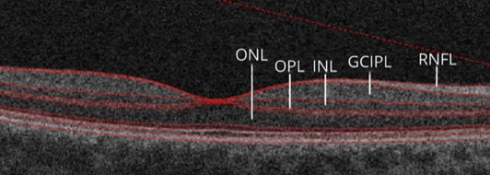
Optical Coherence tomography macular volume
CORRELATIONS
Ganglion cell layer (GCL) atrophy within 1 month of ON
Subclinical atrophy without ON
Even stronger correlation with gray matter atrophy
From Graves JS. Semin Neurol. 2019;39(6):711-717.
From Dörr J et al. PLoS One. 2011;6(4):e18132.
Graves JS et al. Neuroimmunology Neuroinflammm. 2022. 9(2).  Graves JS. Optical Coherence Tomography in Multiple Sclerosis. Semin Neurol. 2019;39(6):711-717.  Dörr J et al. Association of retinal and macular damage with brain atrophy in multiple sclerosis. PLoS One. 2011;6(4):e18132.

Slide 50
Optical Coherence tomography
Clinical Relevance
OCT can help gauge
Future Disability
Baseline thickness associated with future disability
Brain volume
GCL thickness: Correlates with GM atrophy Less expensive and taxing than MRI
Serological levels
Correlates with s-NfL levels
TREATMENT response
Patients on higher efficacy DMT have less retinal atrophy over time
Button J et al. Disease-modifying therapies modulate retinal atrophy in multiple sclerosis: A retrospective study. Neurology. 2017;88(6).  Saidha S et al. Optical coherence tomography reflects brain atrophy in multiple sclerosis: A four-year study. Ann Neurol. 2015;78(5):801-13.  Krajnc N et al. Association of cerebrospinal fluid parameters and neurofilament light chain with retinal nerve fiber layer thickness in multiple sclerosis. Front Neurol. 2022;13:814734.  Balcer LJ et al. The International Multiple Sclerosis Visual System Consortium: Advancing Visual System Research in Multiple Sclerosis. J Neuroophthalmol. 2018;38(4):494-501. Waldman AT, Benson L, Sollee JR, et al. Interocular Difference in Retinal Nerve Fiber Layer Thickness Predicts Optic Neuritis in Pediatric-Onset Multiple Sclerosis. J Neuroophthalmol. 2021;41(4):469-475.

Slide 51
Optical Coherence tomography
Clinical Relevance
Rates of GCIP loss between platform therapies and natalizumab
Study 1 – platform therapies vs natalizumab
402 patients with RRMS
At least 1 year adherence to a single DMT
Use of platform therapies resulted in faster rates of GCIP thinning compared to HET
Cohort | Rate of GCIP loss, μm/y | Differences compared to HC
Healthy controls | -0.14 | -
GA | -0.30 | -0.16
IFN_{SC} | -0.54 | -0.40
IFN_{IM} | -0.28 | -0.14
Natalizumab | -0.16 | -0.02
Study 2 – IFN-B vs ocrelizumab
Subanalysis of OPERA I and OPERA II trials
Ocrelizumab (n=112) vs IFN B-1a (n=95)
No meaningful change to RNFL thickness, GCL thickness, or macular volume were observed in the ocrelizumab group
Retinal atrophy in patients taking IFN-B or ocrelizumab
2.0
1.0
IFN-B
0.0
Oreclizumab
-1.0
P=0.0546
-2.0
Button J et al. Disease-modifying therapies modulate retinal atrophy in multiple sclerosis: A retrospective study. Neurology. 2017;88(6):525-532.

Slide 52
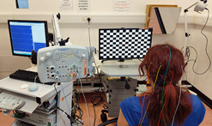
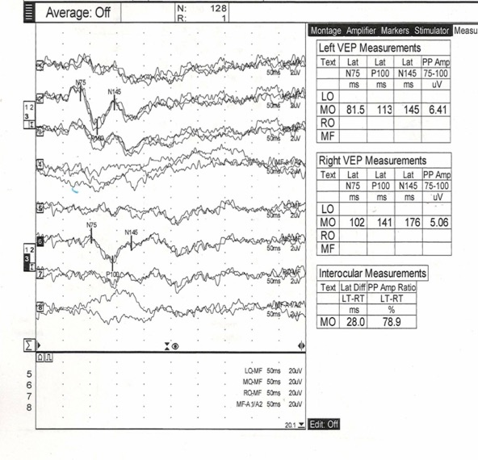
Visual evoked potential
WHAT
Measure of demyelination and remyelination
Outcome in remyelination trials
Used > 50 years
CLINICAL RELEVANCE
Delay of the P100 ms peak associated with demyelinating optic neuritis
Expect delay acutely in ON, with variable recovery over time
Graves JS et al. Neuroimmunology Neuroinflammm. 2022. 9(2).

Slide 53

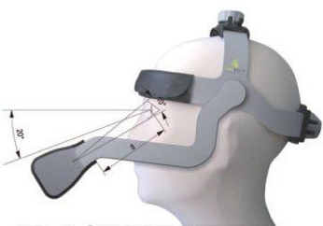
EYETRACKING in MS
Sensitive measure of brain dysfunction
Slow saccades are associated with MS diagnosis even in children and with worse disability scores in adults
Abnormal smooth pursuit movements, including saccadic pursuit movements are associated with the MS diagnosis and are present even early in disease course
Eyetracking captures subtle cerebellar dysfunction
Nygaard et al showed that saccadic initiation time is negatively correlated with the Symbol Digit Modalities Test (SDMT) testing for cognitive impairment in MS.
Complex tests of eye movements, like tests of antisaccades, are also associated with cognitive dysfunction in multiple sclerosis
Masaki, Miner, Jung, Graves, submitted
Rempe et al MSARD 2021, Derwenskus, Rucket et al. Ann N Y Acad Sci. 2005; Lisak N Front. Neurol. 2016; Jozefowicz-Korczynska Journal of Neurology 2011, Moroso et al Cerebellum 2017, Nygaard MSARD 2015, Fielding et al Cortex 2009, Fielding et al PLoS One 2012

Slide 54

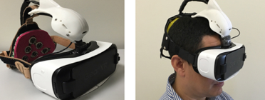
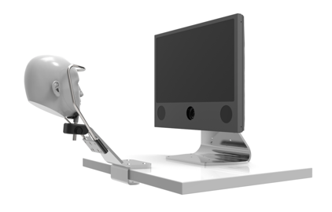


MSight: Afferent and efferent visual function captured on single mobile brain computer interface
Nakanishi, Miner, Jung, Graves, IEEE 2023
Notes:
Our strengths include that the MYO involves a short few minutes assessment that can be done by non-clinical personnel and can distinguish relapsing from progressive MS. Additionally, one device and algorithm can be used for both upper and lower limbs. The device can capture change in function over a short interval of 1 year. Our longitudinal algorithm adjusts for the variability in follow up time, which is important if using this device in real world practice. The device is also inexpensive, comfortable and unobtrusive to the neurologic exam and clinic flow.
Limitations of this study include the lack of a perfect or pathologic gold standard for MS subtype or change in disability over short intervals to compare our new metric with, making it difficult to evaluate whether the metric detects subtle progression. There was also a relatively small sample size of progressive MS patients, although the algorithm still performs well in distinguishing MS subtype.

Slide 55
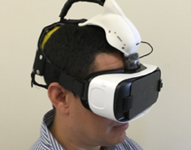
MSight: Afferent and efferent visual function captured on single mobile brain computer interface
Masaki, Miner, Jung, Graves, IEEE 2023

Slide 56
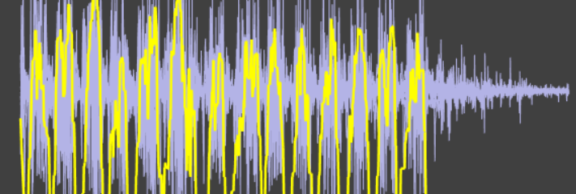
Next Generation Digital
Tools to Monitor MS
Notes:
http://i43.tower.com/images/mm100494284/multiple-sclerosis-having-baby-judy-graham-paperback-cover-art.jpg
Drivers of neuroimmunological disease expression and …

Slide 57
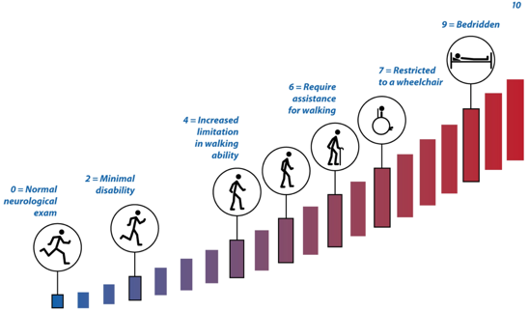
Background: Disability metrics in MS
Classification of MS subtype largely retrospective
Gold Standard Expanded Disability Status Scale (EDSS) is problematic
  Lack of sensitivity to short-term changes
  Dependence on ambulation
  Poor capture upper extremity
  Inter-rater variability
  Long assessments
  Specialty training
Kurtzke 1983
Bermel et al. 2014; Meyer-Moock et al. 2014
Notes:
Our primary disability outcome in MS, which depend heavily on the exam have several limitations.
These affect sensitivity to change over the short and limit our abiiity to detect progression in short time period trials.
Classification of MS subtype is largely a retrospective classification based on clinician impression, and partially related to worsening on the EDSS scale which is also the most commonly used MS disability scale in clinical trials. This is problematic given lack of sensitivity to short-term change in disability, strong dependence on ambulatory dysfunction at higher scores, inter-rater variability, and lengthy assessments.
since they are given by injection
Build up rationale behind current study in 1-2 background slides. Reference other studies and only display facts and figures if closely related. What has been done and why you did the study.

Slide 58
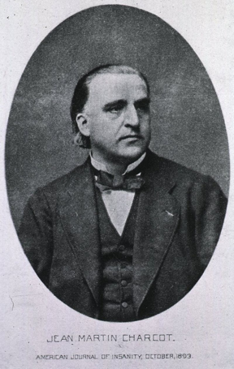
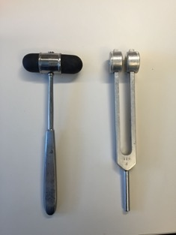
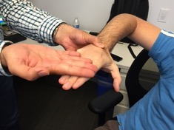
Next Generation Digital Tools
1888 1889
https://en.wikipedia.org/wiki/Neurology#/media/File:Charcot1893.jpg
Notes:
The neurological exam is arguably the most elegant in medicine but our tools remain rudimentary.
Medical Tricorder - Starfleet

Slide 59
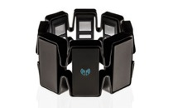
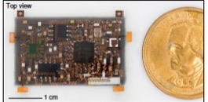
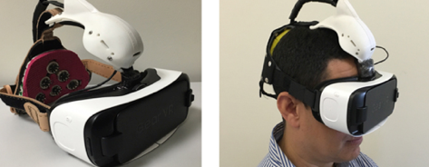

Next Generation Digital Tools
1888 1889
Krysko, K et al ACTN 2021, Nakanishi et al, IEEE 2023, Montalban et al 2021, Graves et al ECTRIMS 2022, Graves and Montalban MSJ 2021
Notes:
The neurological exam is arguably the most elegant in medicine but our tools remain rudimentary.
Medical Tricorder - Starfleet

Slide 60


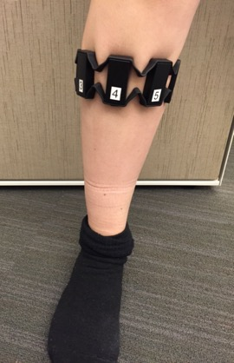
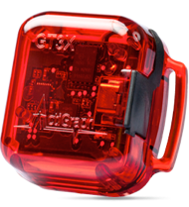
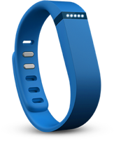
21st Century Neurological Exam: Biosensors
PURPOSE: Convert physiological information into electrical signals
Fitness trackers
(accelerometers, heart monitors)
Gyroscope
(balance and positional data)
SURFACE EMG
(real life electromyogram data)
Graves JS & Montalban X. Biosensors to monitor MS activity. Mult Scler J. 2020;26(5):605-608.  Yousef A et al. Biosensing in multiple sclerosis. Expert Rev Med Devices. 2017;14(11):901-912.  Block V et al. Comparison of Actigraph, Fitbit and Manual Step Count during a Two-Minute Walk Test in People with Multiple Sclerosis: A Pilot Study (2016 CMSC Annual Meeting). In: ; 2016. Accessed May 27, 2022. https://cmsc.confex.com/cmsc/2016/webprogram/Paper4160.html  Rudick RA et al. The Multiple Sclerosis Performance Test (MSPT): An iPad-Based Disability Assessment Tool. J Vis Exp. 2014;88(88):51318.  EyeLink II - The Best Head Mounted System - SR Research. Accessed May 27, 2022. https://www.sr-research.com/eyelink-ii/
Notes:
Make every patient count for research
Offer all patients opportunities – important for those who work, raise 5 kids or have disability other limitations to long research visits
Offer
Recent advances in sensor technology and the computer con-trol industry afford the MS specialist the opportunity to measure neurological function in exciting new ways that may enable the capture of subclinical pro
Visual system is not the only importatn axis for MS dysfunction…refined metrics
Not only do we need better methods to more wholistically approach risk factor evaluations –
BIG Numbers but with more phenotypic detail – an oxymoron that requires technology
What if instead of staring at fingers for 10 sec – you can this – the spherical coordinates of finger’s position and rhymicity – took only 30 sec and a bluetoothe connection in clinic. Rather than more – enhancing the clinic exam – during 25 foot walk – you had acceleration data, spherical coordinates on the leg paoition - incorporating data from patients – patient centered. What if these made your clinical practice better and not just your research.
We need to go from deeply phenotyped cohorts of hundreds to thouasands in pediatric and Adult MS
Makes the experience more patient centered, motivates them to participate in research
Clinic based and everyone who walks in the door counts
Patients – my visits to an MS clinic are the same as they were 20-30 years ago – and that’s not right – We are sruviving as clinicians under our changing pressures; patietns are doing their best with MS – Wer can do more

Slide 61
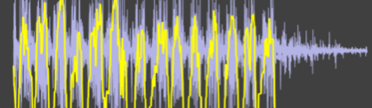

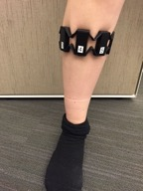



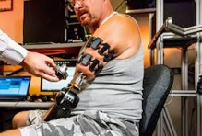
Wearable Sensing
Technology from gaming and computer control industry
Commercial Biosensors
  Accelerometers, gyroscopes
  Surface EMG, electrodermal sensors
Analyzing and using wearable sensor data in novel algorithms tailored to the disease state
  Traditional signal processing
  Artificial intelligence approaches
Graves, J, and Montalban, X. MSJ 2020, Carson and Drake, SMU, Yousef et al Expert Rev Med Devices. 2017, MYOband™, Actigraph™; Block, V., et al, CMSC 2016; Actigraphcorp.com; fitbit.com; Rudick, R et al, Cleveland Clinic, Multiple Sclerosis Performance Test; http://www.sr-research.com/eyelinkII.html ;
Notes:
Genetic risk factors do not distinguish
Switch from relapsing to secondary progressive MS may be more related to changes in the host

Slide 62
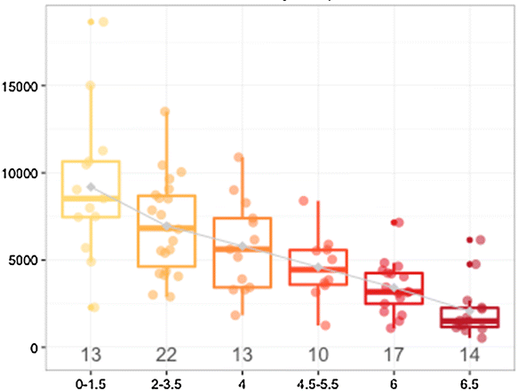
Biosensors in MS Accelerometer
Use in trials
>80% of MS biosensing studies focus on accelerometry
Current measure in several therapeutic trials (e.g., ofatumumab phase 3b, elezanumab phase 2)
Most common outcome: step count
Correlations
Commercial products (e.g., Fitbit) with long-term research accelerometers (Actigraph)
Step counts with disability (observational)
EDSS by Daily step count
Average daily step count
EDSS
Yousef A et al. Biosensing in multiple sclerosis. Expert Rev Med Devices. 2017;14(11):901-912.  Block V et al. J Neurol
. 2017 Feb;264(2):316-326
Notes:
wikipedia

Slide 63
Clinical utility of Accelerometry IN MS
Proposed roleS in practice:
Monitoring
  As a correlate of EDSS, physical activity and QOL
PRos
Correlate of physical activity Possible correlate of social function Associated with EDSS score Patients may already have it! (e.g., if they wear a Fitbit)
Cons
Does not capture upper extremity function well Does not perform well at high disability levels Can have wide range of physical activity for a given EDSS value
Bittner S et al. The potential of serum neurofilament as biomarker for multiple sclerosis. Brain. 2021;144(10):2954-2963.

Slide 64




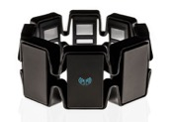



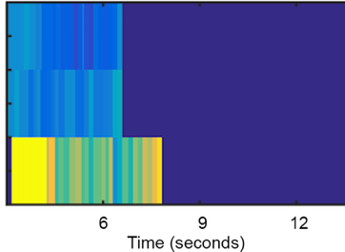
New MS Vital Sign: detection of disability with wearable multi-sensor
Foot Taps
Sensors and signal processing
Includes accelerometer, gyroscope, and surface EMG
Waveform feature extraction → Scalar metrics
Cross-sectional validation
117 participants with MS, 30 HC
ICCs for features ranged from 0.80 to 0.87
Foot and finger taps correlated strongly with EDSS and patient reported outcomes (P<0.0001)
right finger tap (PPMS)
Haralick energy heatmap
Longitudinal analysis
53 patients with relapsing and 15 with progressive MS
Finger and foot taps able to distinguish progressive from relapsing MS
Captured changes in limb function in 6-12 months
Akhbardeh A, et al. Novel MS vital sign: multi-sensor captures upper and lower limb dysfunction. Ann Clin Transl Neurol. 2020;7(3):288-295.  Krysko KM, et al. Biosensor vital sign detects multiple sclerosis progression. Ann Clin Transl Neurol. 2021;8(1):4-14. Zhao et al IEEE 2020

Slide 65



















Design/Methods
7 heatmaps/sensor/limb
Waveform features combined across visits with trapezoidal approach, normalized by follow up time
Limb specific metrics of limb performance over time
UE metric
LE metric
Notes:
Within Patient analysis
We next had to combine the various textural features, as well as the measurements across visits. In order to account for the variable timing of routine clinic visits, we used a trapezoidal method of integration for calculation of area under the curve. We then normalized by follow up time to account for the variable overall duration of follow up. This led to a limb specific metric of limb performance over time. The upper limbs were combined to obtain an UE metric and the lower limbs were combined to create a lower extremity metric. These metrics represent a change in limb function over time.

Slide 66
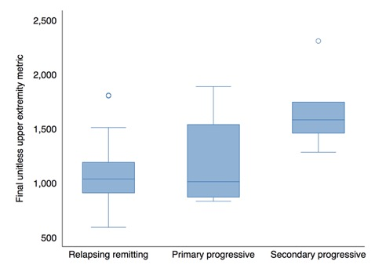
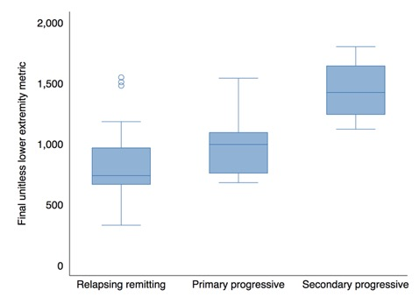
Multi-sensor Vital Sign: Distinguishing MS phenotype
UPPER EXTREMITY
Final summary scalar metrics differentiated relapsing from secondary progressive MS with AUROC UE 0.93 and LE 0.96.
The metrics were associated with baseline EDSS (UE P = 0.0003, LE P = 0.0007).
Little change in EDSS during the short 1 year follow-up.
But several participants had evidence of progression by the novel multi-sensor metrics.
p<0.001
LOWER EXTREMITY
p<0.001
Notes:
Within patient analysis
Comparison of the upper extremity metric values across MS subtypes is shown here. The subtypes are shown on the x axis with relapsing, primary progressive and secondary progressive. The y axis displays the unitless UE metric. As you can see those with progressive MS, particularly SPMS had higher values of the metric than relapsing patients.
Similarly, we see this also for the LE metric with higher scores in those with progressive MS.

Slide 67
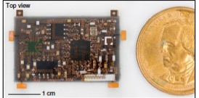
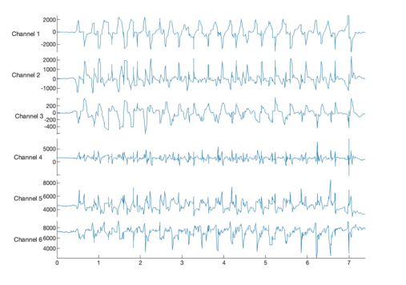
UCSD Center for Advanced Neurological Engineering: Next Generation Multisensor
TAPMS: Smaller multisensor wearable
Applying this now in a progressive MS clinical trial (NACPMS)
Development of self-contained acquisition and analysis device
Capturing changes over 12 months
Xiangjun Chen
Notes:
Our strengths include that the MYO involves a short few minutes assessment that can be done by non-clinical personnel and can distinguish relapsing from progressive MS. Additionally, one device and algorithm can be used for both upper and lower limbs. The device can capture change in function over a short interval of 1 year. Our longitudinal algorithm adjusts for the variability in follow up time, which is important if using this device in real world practice. The device is also inexpensive, comfortable and unobtrusive to the neurologic exam and clinic flow.
Limitations of this study include the lack of a perfect or pathologic gold standard for MS subtype or change in disability over short intervals to compare our new metric with, making it difficult to evaluate whether the metric detects subtle progression. There was also a relatively small sample size of progressive MS patients, although the algorithm still performs well in distinguishing MS subtype.

Slide 68
Mobile Device Apps Example: FloodLight
Midaglia et al J Med Internet Res 2019, Graves, J, Ganzetti, M et al, ACTN 2022; Montalban, J, Graves, J et al MSJ 2022

Slide 69
FloodLight Draw a Shape Test
Graves, J, Ganzetti, M et al, ACTN 2022; Montalban, J, Graves, J et al MSJ 2022

Slide 70
FloodLight Draw a Shape Test
Graves, J, Ganzetti, M et al, ACTN 2022; Montalban, J, Graves, J et al MSJ 2022

Slide 71
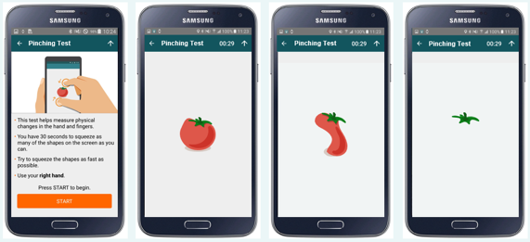
FloodLight Pinching Test
Graves, J, Ganzetti, M et al, ACTN 2022; Montalban, J, Graves, J et al MSJ 2022; Graves, J ECTRIMS 2022

Slide 72
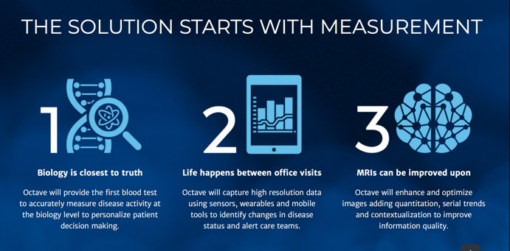

Other Digital Health Platform Examples
Octave
MS Paths

Slide 73
What’s Next?

Slide 74





What’s Next?
Multimodal assessments and cross validation
Create common language of extracted features
“Energy” in signals for irregularity of movement
Angular velocity
Platforms to collect, visualize and analyze multiple data forms in real time
Device approval and dissemination pathways

Slide 75

Self contained acquisition and analytical devices: Form and Function
Clinician or patient ready devices
Ownership and co-development of hardware and software

Slide 76





Future MS Monitoring
Home Waiting Room Vital Signs

Slide 77
Summary
Imaging biomarkers well established for RRMS. Next we need standardization for PMS imaging biomarkers
Serum and CSF biomarkers may capture aspects of pathology in RRMS and PMS, but are not yet well deployed in clinical practice
21st century neuro “vital signs” may aid clinical care and support more rapid trials of disease modifying agents in neurodegenerative diseases.
These tools are rater independent, quantitative measures of function and can allow us to rigorously capture single limb progression.
Application of new tools requires rigor and a systematic development approach to ensure highly reliable and sensitive outcomes with clinical meaning.

Slide 78



Acknowledgements
UCSD
Annalise Miner
Ashley Fair
Torge Rempe
Emilie Liu
Masaki Nakanishi
Tzyy-Ping Jung
Jennifer Yang
Revere Kinkel
Sheng Xu
Xiangjun Chen
UCSF
Emmanuelle Waubant
Jennifer Arjona
Kristen Krysko
UCSD Galvanizing Engineering in Medicine Award

Slide 79

Thank you!

Slide 80

Contact information:
jgraves@health.ucsd.edu

Slide 81
Survey
Please complete the webinar survey in the
TRAIN or TMS websites within 15 days. This will give you access to your CME/CE certificate.
Non-VA: www.vha.train.org
VA: www.tms.va.gov

Slide 82

What’s On Your Mind?
Please type your question into the Chat
area in the lower right corner of your screen.
Notes:
Live questions

Slide 83
VA MS Centers of Excellence
National MS Society
Website: www.va.gov/MS
Remote clinical consults within VA
VA specific MS care information
  Benefits, grants, adaptive equipment, referrals
  MS quality measures, MSSR, DMT use criteria
Educational opportunities
  Healthcare Professional
  Monthly clinical e-newsletter
  Monthly webinars
  Conference presentations
  Annual network meetings
  Veteran
  Monthly podcast
  Quarterly e-newsletter
  Webinars in collaboration with non-VA MS and Veteran service organizations
Website: www.nationalmssociety.org
Professional Resource Center
  Clinical publications
  Literature search
Support
  MS Navigator
  Self-help groups
  MSFriends
Educational Opportunities
  Healthcare Professional
  Webinars (ECHO, VA, Pediatric, Mental Health)
  National and local e-newsletters
  Fellowships and mentoring
  Patient
  Ask an MS Expert series
  Virtual Programs (New to MS, Black MS Experience, Hispanic/Latinx Experience, & more)

Slide 84
Thank you and please join us for the next webinar on November 1, 2023!
Helping People with MS Adjust to Disease Progression Using the Whole Health Model Terry Lee-Wilk, PhD & Moira Dux, PhD
www.nationalMSsociety.org/currenttopics
www.va.gov/MS/products/CME_CEU_calls
Notes:
Thank you for your participation today and special thanks to Dr. Casperson for the great presentation. This webinar is recorded and I will posting the recording and the slides on the webpage listed on the screen. Don’t forget, there’s another Current Topics webinar on September 16 on Medical Marijuana for MS Symptom Management presented by Dr. Michelle Cameron. You can register online for this webinar on our website noted on the screen. Thank you all for attending today and have a great rest of your day.

