Slide 1


The CME program will start on the hour.
Fostering Meaningful Interactions with Patients Living with MS: Importance of Motivational Interviewing and Shared-Decision Making

Slide 2
Your feedback is important to us!
At the conclusion of the webinar, please complete the program survey in TMS or TRAIN. This must be completed within 15 days of the live program for CME/CEU credit.

Slide 3
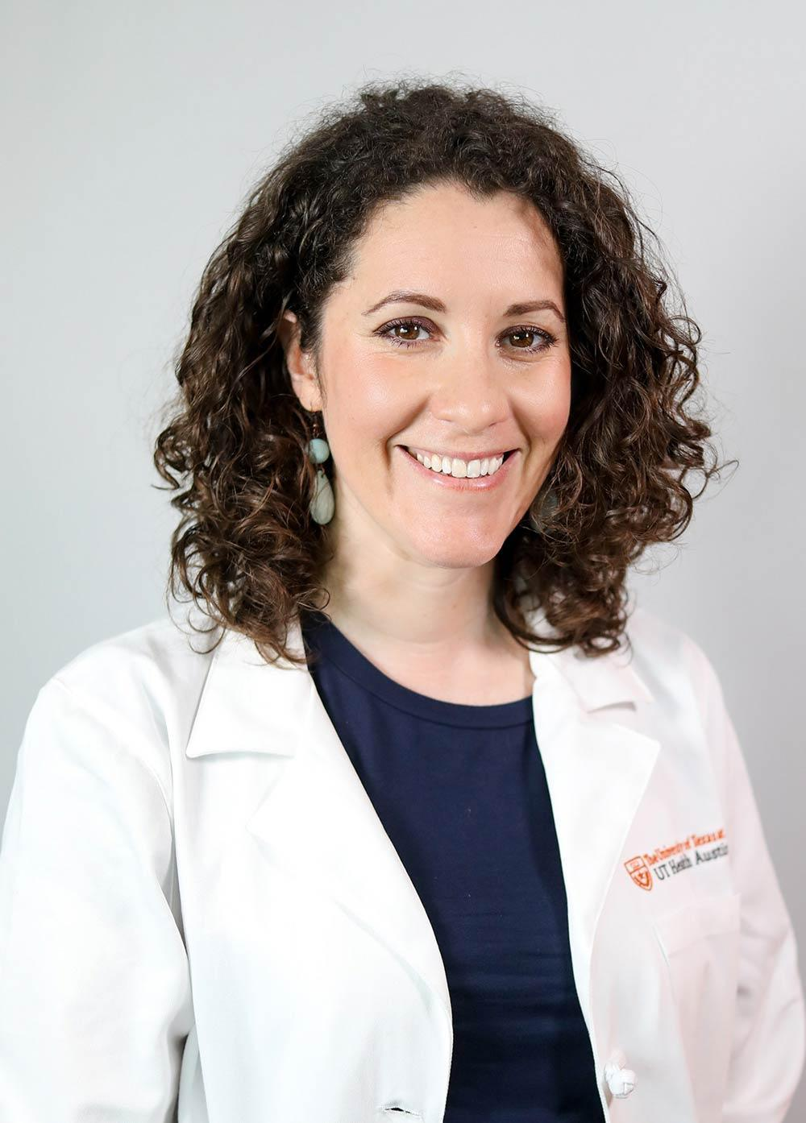
Dr. Leorah Freeman is the director of the Multiple Sclerosis and Neuroimmunology Center at Dell Medical School, The University of Texas at Austin. She also serves as director of the MS and Neuroimmunology fellowship program and of the MS Imaging and Outcomes Research Laboratory. Her research focuses on the development of data-driven approaches to predict and improve the long-term outcomes of people with MS. She is passionate about promoting equity in MS research and care. She is the founder of the Texas MS Consortium and routinely works with MS advocacy and community organizations to help people with MS thrive.

Slide 4

May 2024
Fostering meaningful interactions with patients living with MS: importance of motivational interviewing and shared-decision making.
Leorah freeman, md, phd
Medical Director, MS and Neuroimmunology Center, Dell Medical School, The University of Texas at Austin

Slide 5
Learning Objectives
Define motivational interviewing and shared decision-making.
Identify opportunities for motivational interviewing and shared decision making in clinical practice.
Apply fundamental principles of motivational interviewing and shared decision making, alone or in combination, to achieve person-centered care
Recognize practical tips for conducting motivational and shared decision-making conversations with patients, even when time is short.

Slide 6
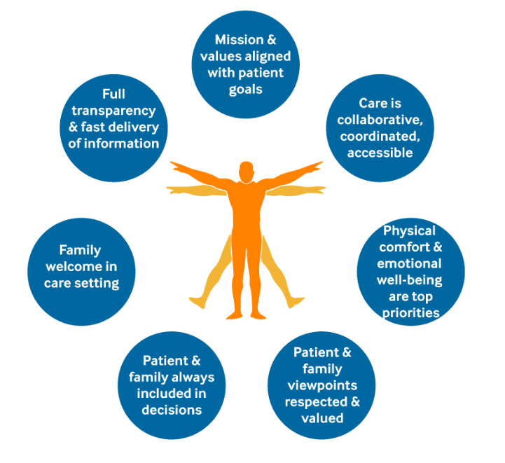
Person-centered care
Person- and family-centered care encourages the active collaboration between patients, families, and clinicians to design and manage a customized and comprehensive care plan.
Person-centered care benefits patients and clinicians.
It requires a cultural shift.
Notes:
Not only do patients benefit, but providers and health care systems benefit as well, through:
• Improved satisfaction scores among patients and their families.
• Enhanced reputation of providers among health care consumers.
• Better morale and productivity among clinicians and ancillary staff.
• Improved resource allocation.
• Reduced expenses and increased financial margins throughout the continuum of care.
https://catalyst.nejm.org/doi/full/10.1056/CAT.17.0559

Slide 7

Person-centered care is critical in MS
High variability of clinical presentations and outcomes
The last 30 years have seen the expansion of our therapeutic arsenal with 20+ DMTs currently available.
MS symptoms are debilitating: 90% of people with MS still report limitations due to MS (Teni et al., Eur J Neurol, 2023)
Image credit: WPAUMC.org

Slide 8

2 Communication Approaches
Shared decision making
The clinicians’ role is to help patients understand what the reasonable options are.
Then elicit, inform, and integrate patients’ informed preferences as they relate to the available options
Motivational interviewing
Person-centered approach to counseling
Helps guide behavior changes
Usually when a patient feels ambivalent
Clinicians must be able to identify situations where these methods are most appropriate and recognize that sometimes both methods may be required.
Elwyn et al., Ann Fam Med, 2014

Slide 9
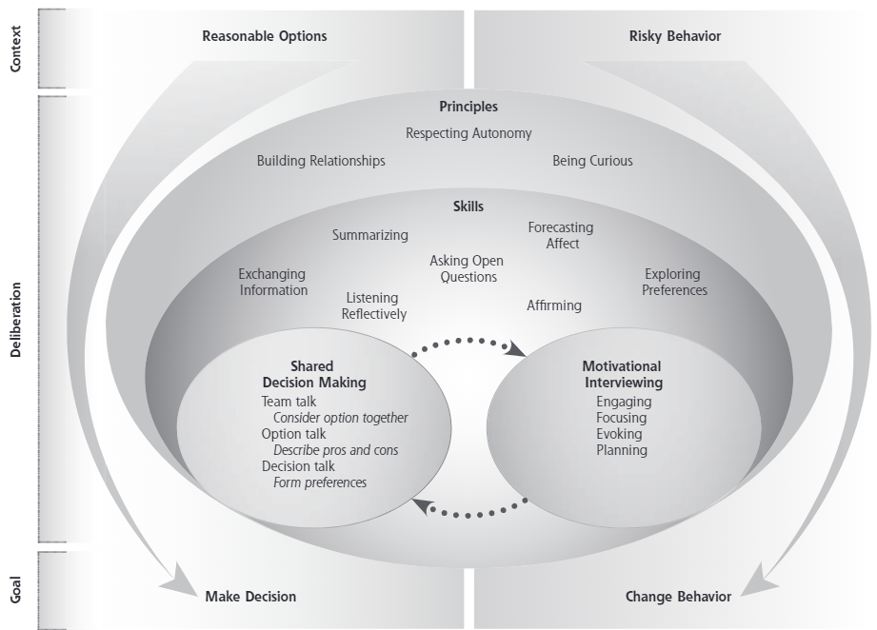
Relationship between SDM and MI
Elwyn et al., Ann Fam Med, 2014

Slide 10

Shared decision making
3 conditions for SDM
Access to evidence-based information about options
Guidance on how to balance the risks and benefits of different management options
An understanding by clinicians that facilitates patient engagement
Patient and Clinician as a team make decisions together based on best available evidence
Clinician’s role:
Help patients become well-informed
Help them develop their personal preferences for available options
Provide professional guidance where appropriate.
Elwyn et al., Ann Fam Med, 2014

Slide 11
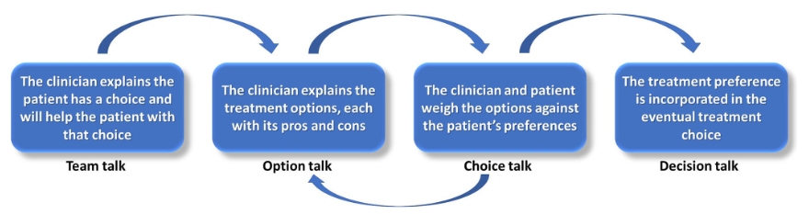
SDM in clinical practice
Initial Preferences
Informed Preferences
Ubbink et al., Frontiers Neuro, 2022; Elwyn et al., Ann Fam Med, 2014

Slide 12
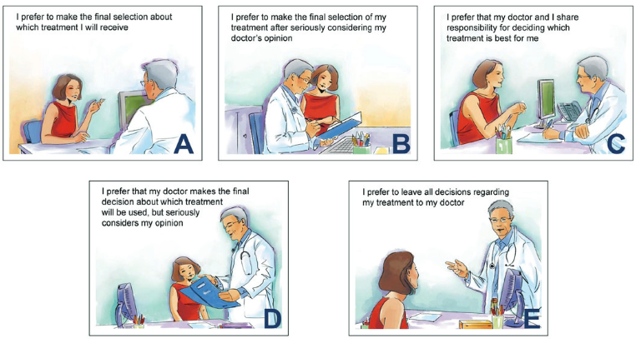
Care preferences in MS
Control Preference Scale
© Solari A, Giordano A, Kasper J, et al. Role preferences of people with multiplesclerosis: image-revised, computerized self-administered version of the Control Preference Scale. PLoS One.8(6):e66127
2017 study analyzed the care decision-making preferences of people with MS using the Control Preference Scale in the NARCOMS registry (n=7009 respondents)
Cofield et al., IJMSC, 2017

Slide 13
Care preferences in MS
9.2%
38.8%
42.8%
CPS selection was related to:
Age
Employment Status
PDDS
CPS not related to:
Insurance status
Relapse in last 6m
2.1%
7.1%
Most people with MS prefer to be highly involved in care decisions
Cofield et al., IJMSC, 2017

Slide 14
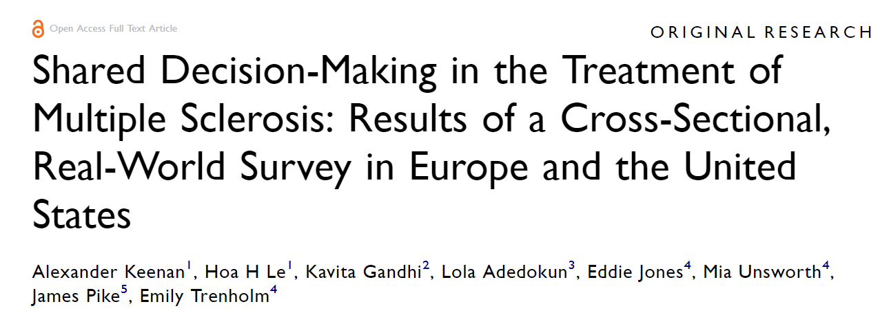
SDM in clinical practice: DMT decisions
Less than a third of patients were involved in decisions about their treatment
Patients involved in proactive decision-making reported benefit in several symptoms, including less fatigue and improved cognitive function, as well as better overall quality of life.
Cross-sectional survey of physicians (n=472) and their patients with MS (n=692), with retrospective data collection, conducted in six moderate-high income regions (France, Germany, Italy, Spain, UK, US) between December 2020 and July 2021

Slide 15
SDM in clinical practice: DMT decisions
Starting, stopping or switching DMTs are key decisions for people with MS for which SDM is critical.
People new to MS may have a limited understanding of MS treatments. Choosing a DMT can be overwhelming.
DMT decisions are complex in MS - Despite the expansion of DMT options over the past 30 years, there are still no explicit guidelines on which medicine to start nor how to transition to the next DMT or discontinue.
Great variability in patients’ priorities and values around DMT

Slide 16

SDM in clinical practice: First DMT
30-year-old woman
1 year prior, noticed intermittent numbness and tingling in bilateral feet. Symptoms lasted for 2 months and self-resolved. She didn’t seek care.
4 weeks prior: episode of myelitis treated in the hospital with IV steroids
near-complete recovery.
She was told she had MS in the hospital and was referred to our clinic.
Comes accompanied by her fiancé.

Slide 17
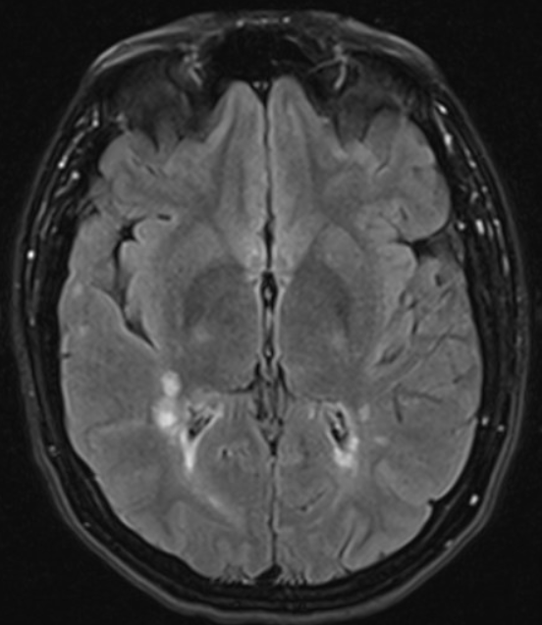
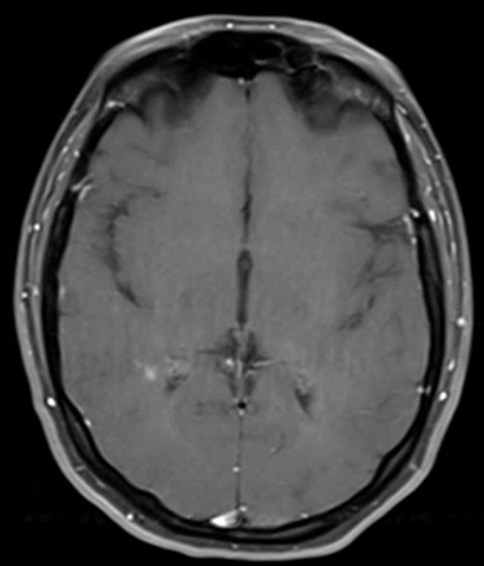
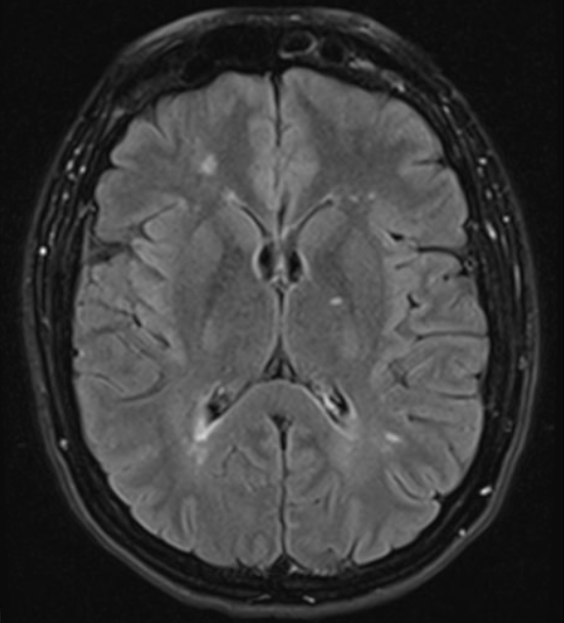
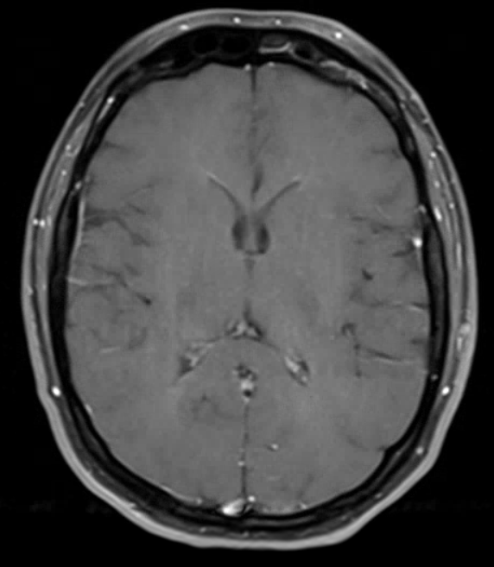
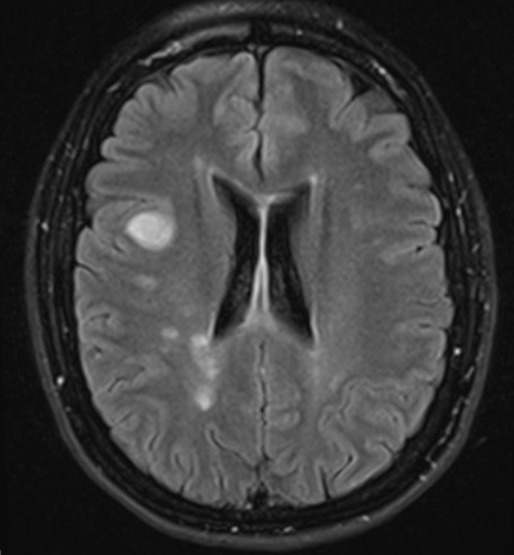
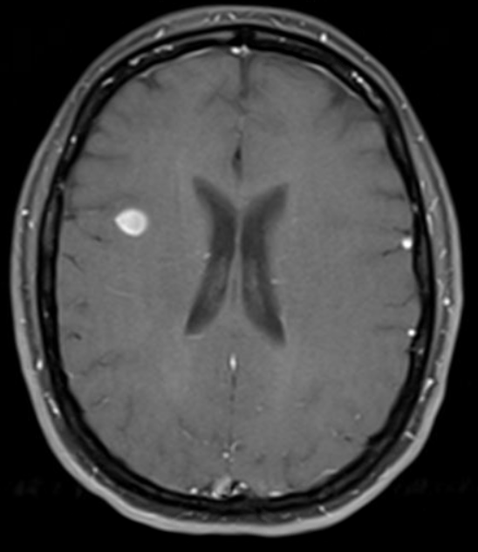
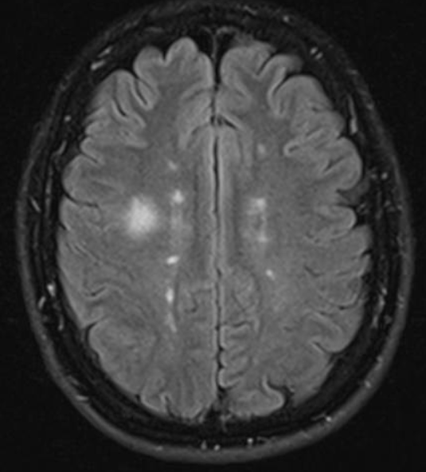
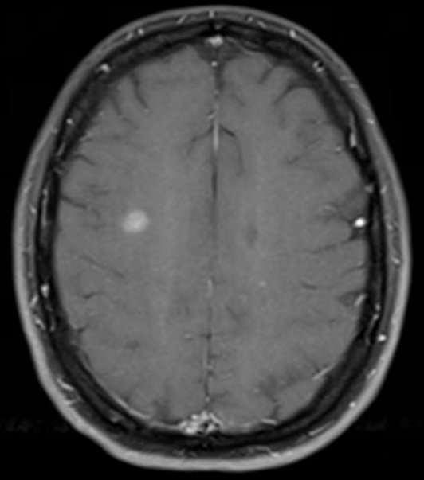
SDM in clinical practice: First DMT

Slide 18
SDM in clinical practice: First DMT
What is your understanding of MS and its treatment?
Identify misconceptions
Explain goals of MS management
Understand importance of:
Preventing future relapses or progression
Symptom management
Having least possible side effect
Treatment not impacting daily activities
What are your priorities and concerns when it comes to MS treatment?
Do you prefer infusions, injections, or daily pills?
Assess for possible needle phobia, transportation issues, difficulty remembering to take pills…
Consider treatment with minimal harm to patient and fetus
Consider potential for unplanned pregnancy in women of childbearing age
Are you planning to start a family?
Stoll et al. Neurol Ther, 2024

Slide 19
SDM in clinical practice: First DMT
What is your understanding of MS and its treatment?
I understand that MS treatments are dangerous, and I want to beat MS naturally!
What are your priorities and concerns when it comes to MS treatment?
My priorities are to not impact my wedding next month and to get rid of this awful fatigue.
Do you prefer infusions, injections, or daily pills?
We want a family but are not planning to start trying immediately
Are you planning to start a family
Stoll et al. Neurol Ther, 2024

Slide 20
SDM in clinical practice: Barriers
Misconceptions and Distrust:
Patient has overall distrust of traditional healthcare system viewed as “pushing medications”
Wants to be in control of decisions
Overestimation of DMT risks and of “natural treatment” effectiveness
Clinician bias
Easy to judge patients preferring “natural” options without trying to understand values
Clinicians may not be as invested as with other patients whose values align
Risk giving up on patient deemed “helpless”
Differences in Patient and Clinician’s goals
Clinician focused on tissue loss
Patient focused on short-term personal goals and quality of life
Time
Busy schedules don’t allow for complex conversation
Afraid to upset other patients

Slide 21
SDM in clinical practice: Overcoming barriers
Be curious
Aim to understand patient’s values and goals: make them feel seen and heard.
Ask questions about their healthy habits.
Affirm them in their choices to engage in positive lifestyle changes: they are beneficial!
Be cognizant of our own bias
Many patients have had negative experiences with health care providers in the past, and this can impact their perception and trust.
Change your narrative and language.
See strengths first!
Educate on treatment options for MS
Do not try to “oversell” or “scare them into using a medication”
Offer information they can review after their visits with their loved ones.
Schedule close follow up visit to further answer questions and build trust.
Manage your time
Use decision aids and external resources
Work with your team: MS nurse and APPs are wonderful partners in patient education and engagement!
Building trust is a marathon, not a sprint.

Slide 22
SDM in clinical practice: First visit
Understand her respective values and goals
Autonomy
Treatment should not interfere with lifestyle
She doesn’t want to feel sick or be reminded that she is “sick” by taking medications daily
Respectfully inquire about her “approach”
Avid exerciser, part of like-minded community
Interested in “stem cell” treatment [embryonic stem cell infusion/injections], read a lot about it.
30-year-old woman
New Diagnosis of MS
Hesitant about DMT
Prefers “natural” options
Important life event in the near future
Understand her timing
Wedding in less than a month.
Then has plans to travel internationally for stem cells.

Slide 23
SDM in clinical practice: First visit
Affirm her strengths
Healthy lifestyle is critical for people with MS and she is already there
She is actively seeking information about her condition
Explain my approach to care
DMT are part of a larger comprehensive plan
Discuss MRI findings and concerns
Explain relationship between inflammation and fatigue
Give her information she can review after her visit
30-year-old woman
New Diagnosis of MS
Hesitant about DMT
Prefers “natural” options
Important life event in the near future
Find a way forward and agree on a plan
Compromise
Clear plan with dates to reconvene

Slide 24
SDM in clinical practice: Timeline
4 wks
2 wks
3 months
4 wks
First visit
MRI: new contrast-enhancing lesions
Wedding
30-year-old woman
New Diagnosis of MS
Hesitant about DMT
Prefers “natural” options
Important life event in the near future
Planned Visit
Travel to the Ukraine for stem cell treatment
HE DMT start

Slide 25

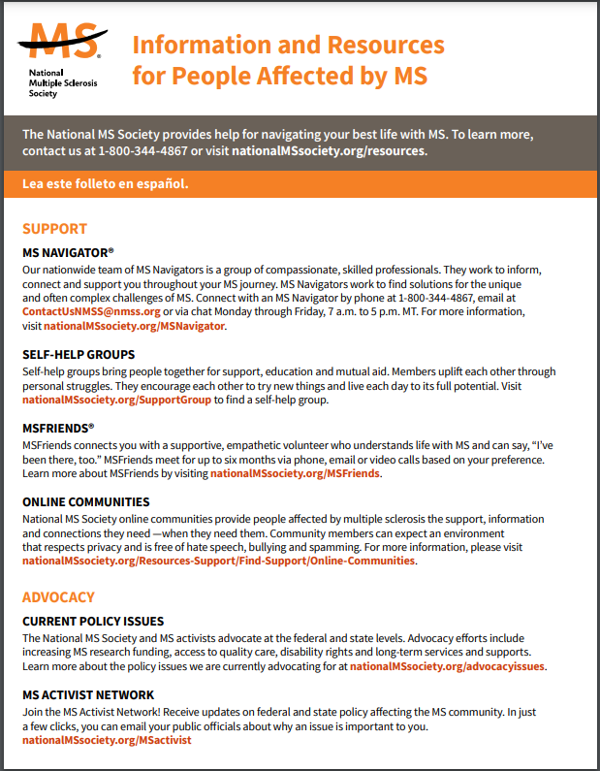
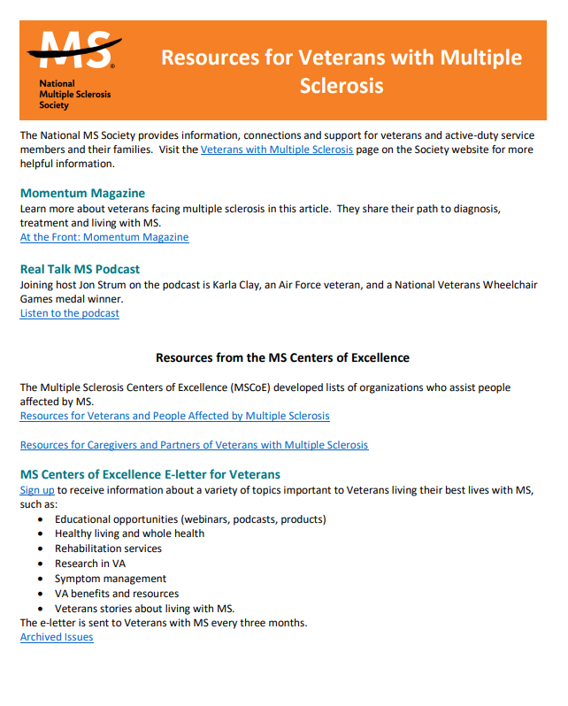
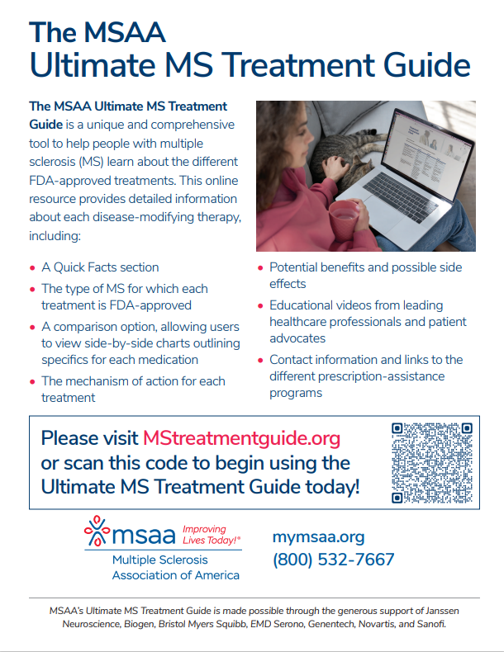
SDM in clinical practice: Decision Aids and Resources

Slide 26

SDM in clinical practice: DMT switch
45-year-old man
2008: episode of optic neuritis
2011: numbness of LUE
Started on platform therapy
2018: MRI showed 2 new lesions, stays on same platform medication
2024: transfers care due to neurologist retiring
Reports depressive symptoms in context of recent divorce

Slide 27
SDM in clinical practice: DMT Switch
What is your understanding of your MS? Your past MRI findings?
Identify understanding of own disease course
Tease out what previous discussions around DMT/ potential switch may have been.
Discussing and showing patients their MRI scans can help relieve anxiety and empower patients to participate in SDM.
Can I show you your recent MRI scans and explain what they tell us?
Patients who have been on the same medication for a long time may not be up-to-date with current medications, or afraid of a switch. Understanding their knowledge and concerns can help guide the conversation.
What do you know about other MS therapies? What are your concerns?
Would you like help with your mental health?
Psychological comorbidities may affect SDM.
Stoll et al. Neurol Ther, 2024

Slide 28
SDM in clinical practice: DMT Switch
I have been stable for the past 13 years. As far as I have been told, my MRIs looked fine. I’d like to understand what you are seeing and what it means.
What is your understanding of your MS? Your past MRI findings?
Can I show you your recent MRI scans and explain what they tell us?
I don’t know much about other medications. I certainly don’t love injecting myself. But I have bad insurance and I don’t think they would approve something else.
What do you know about other MS therapies? What are your concerns?
Yes, I think I need help. It’s hard to deal with everything, especially now that my MS is no longer stable.
Would you like help with your mental health?
Stoll et al. Neurol Ther, 2024

Slide 29
SDM in clinical practice: Barriers
Lack of knowledge about own MS course and available treatments
Patient either had not been told or didn’t understand his MRIs were previously abnormal
Patient has been on same treatment for 10+ years and doesn’t know what other treatments are available
Therapeutic inertia
Therapeutic inertia is prevalent in MS, and more frequent with patients who are clinically stable on DMT and have no/limited side effects from their current DMT (Rodrigues et al, MSARD, 2021)
Impacts long-term outcomes
Mental Health
Study shows that people with MS who have depression have a decreased sense of autonomy (Hanna et al., MSARD, 2020)
It is critical to address psychological comorbidities to promote DMT adherence
Insurance concerns
Processes associated with insurance approval is a concern for BOTH clinicians and patients
Clear communication of process and expectations is important

Slide 30
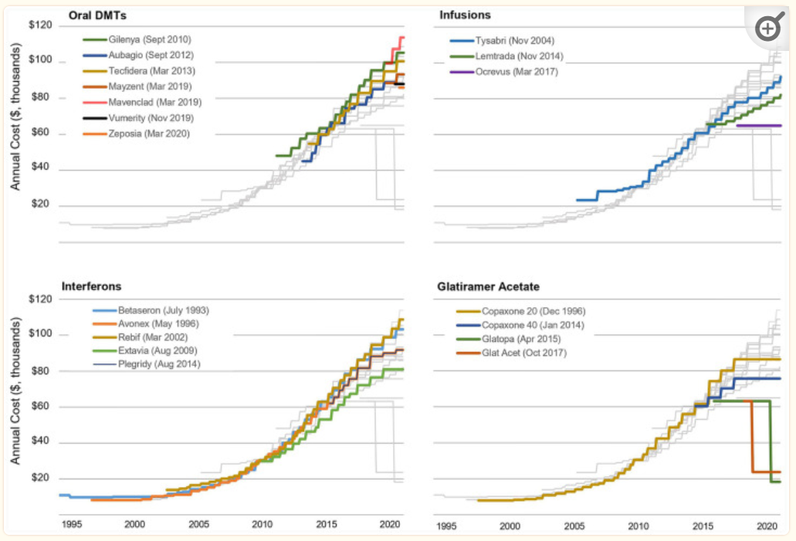
SDM in clinical practice: DMT cost
Trends in DMT costs
Spending on DMTs has risen because of increasing prices and introduction of new DMT
Escalating costs affect patients
Cost-related insurance exclusions and limitations create access barriers
In a recent survey, 1/3 of MS patients reported struggles in getting their DMT covered.
More than half were concerned about being able to afford their DMT in the future.
Hartung, Ther Adv Neurol Disord, 2021
Notes:
Prices for MS DMTs, which are among the costliest of all medications by disease category, have increased rapidly over the last several decades
The US healthcare system spent $18.8 billion on MS DMTs in 2018 – seventh highest by therapeutic class overall. Because the incidence of MS is highest among working age individuals, spending on MS DMTs ranks fifth by therapeutic class for employer-sponsored insurance programs.
Aggregate spending on DMTs has risen as a consequence of both increasing prices and the introduction of new DMTs
The escalating costs of MS DMTs can negatively affect patient care in multiple ways. First, cost-related insurance company exclusions and limitations often create significant access barriers for patients.
In a recent survey, more than one-third of patients with MS report struggles in getting their DMT covered because of insurance company restrictions
Further, nearly half of respondents noted that they have altered how they take their DMT (e.g., skipped doses, delayed treatment) and changed other lifestyle choices (e.g., spend less on entertainment) because of high DMT costs
More than half of respondents indicated they were very concerned about being able to afford their DMT in the near future.

Slide 31
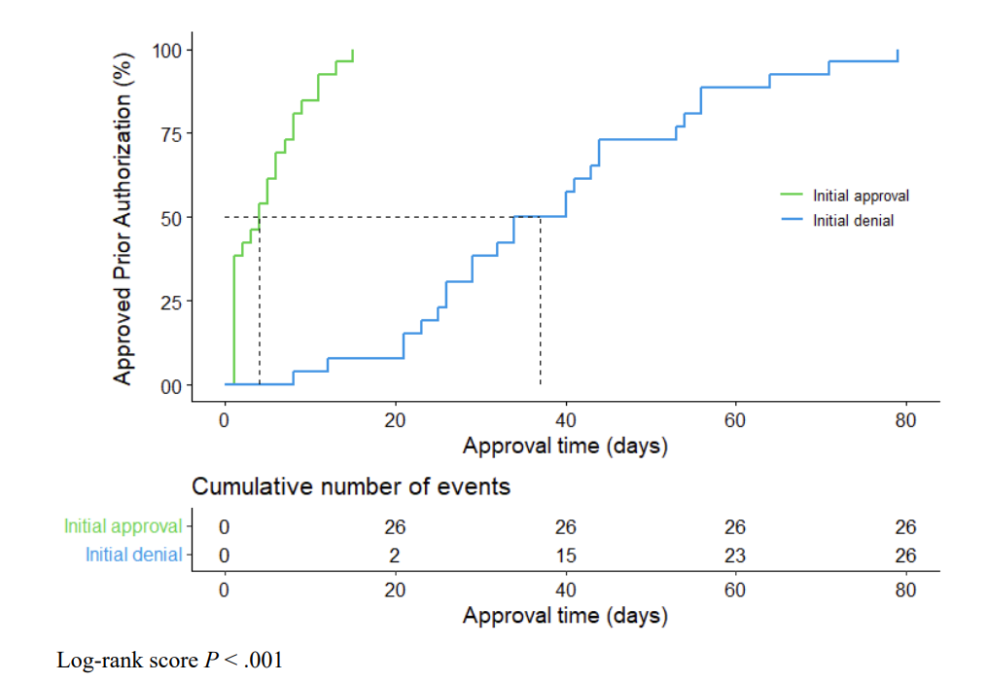
SDM in clinical practice: Impact of insurance restrictions
Retrospective cohort study (n=58)
The median time until approval was 4 days (range, 1-15 days) among those with an initial PA approval and 37 days (range, 8-79 days) among those with an initial PA denial
The odds of having PA initially denied were increased for oral medications and infusions compared with injections
Odds of having PA initially denied were increased for Medicaid
The odds of having disease activity increased if PA was initially denied
Mizell, IJMSC, 2024
Notes:
Of the 52 patients who required a PA, 26 were initially
approved and 26 were initially denied. The overall median
approval time was 14 days (range, 1-79 days). The median
time until approval was 4 days (range, 1-15 days) among
those with an initial PA approval and 37 days (range,
8-79 days) among those with an initial PA denial (P < .01)
the odds of having PA initially denied were
increased for oral medications (OR, 4.91; 95% CI, 1.33-21.52;
P = .02) and infusions (OR, 8.35; 95% CI, 1.10-88.77; P = .05)
compared with injections and holding payer type constant.
While holding type of medication constant, the odds of
having PA initially denied were increased for Medicaid (OR,
4.51; 95% CI, 1.13-22.01; P = .04) over commercial insurance
After
adjusting for potential confounding variables, the odds of
having disease activity increased if PA was initially denied
(OR, 6.18; 95% CI, 1.33-44.86; P = .03) compared with an ini-
tial approval

Slide 32
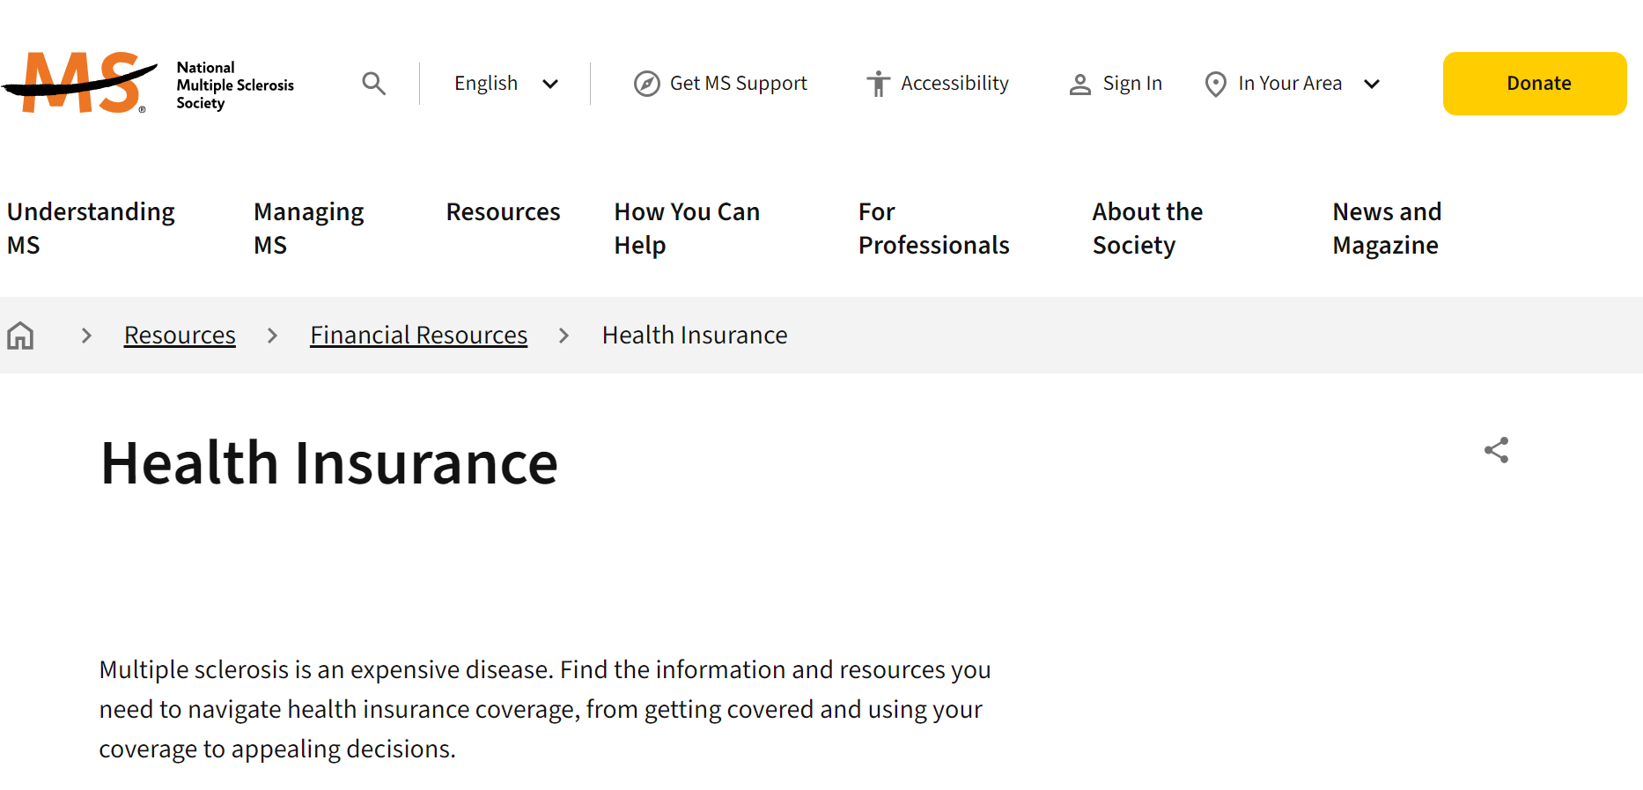
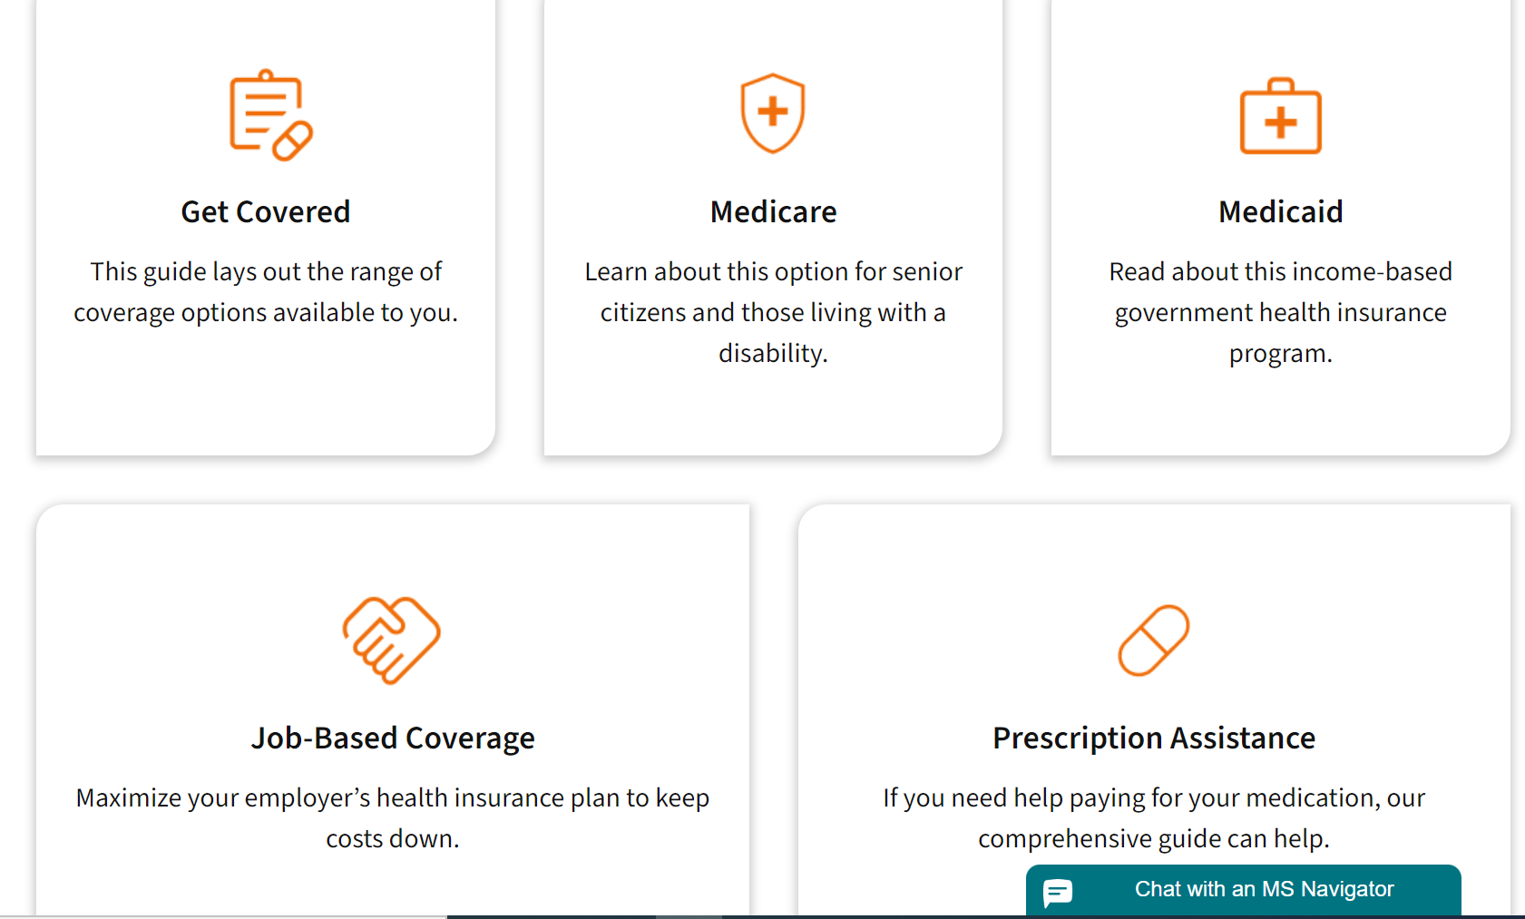
SDM in clinical practice: Overcoming barriers related to insurance and cost
Promote health insurance literacy
Poor health insurance literacy is associated with greater avoidance of both preventive and non-preventive services (Tipirneni et al. JAMA Open Network, 2018)
Importance of a common language about process
Utilize existing resources
Keep in mind that your patients may not know which question to ask - Anticipate
Provide overview of process at first visit
Engage patients in decisions in case of insurance denial
https://www.nationalmssociety.org/resources/financial-resources/health-insurance

Slide 33
SDM in clinical practice: First Visit
Share and Explain MRI findings
Past imaging findings concerning for active disease
Explained impact of silent disease activity on outcomes
Made plans with patient to reevaluate MRI asap
Address mental health issues
PROs useful to screen patients for mental health concerns
Asked respectful questions to understand urgency
Engaged patient with LCSW early
45-year-old man
15-year MS history
On platform therapy
Past evidence of disease activity
Concerns about costs and mental health
Form a clear plan
Discussed possibility of DMT switch at first visit to lay the groundwork for subsequent planning.
Used scenario approach: “If new MRI shows…”
Educated patient on insurance coverage process

Slide 34
SDM in clinical practice: Timeline
2 wks
4 wks
First visit
MRI: new contrast-enhancing lesions
LCSW touch point re: mental health and financial concerns
Visit with NP to review treatment options
45-year-old man
15-year MS history
On platform therapy
Concerns about costs and mental health
45-year-old man
15-year MS history
On platform therapy
Past evidence of disease activity
Concerns about costs and mental health
New DMT start
Continued counseling
Referral to support group

Slide 35
Relationship between SDM and MI
Elwyn et al., Ann Fam Med, 2014

Slide 36
Motivational interviewing (MI)
3 keys for MI
Understand that change is difficult, and ambivalence is normal
Work with people’s strengths, not their problems or deficits
Value connection fist
A collaborative, goal-oriented style of communication with particular attention to the language of change. It is designed to strengthen personal motivation for and commitment to a specific goal by eliciting and exploring the person’s own reasons for change within an atmosphere of acceptance and compassion.
Miller and Rollnick, 2013

Slide 37
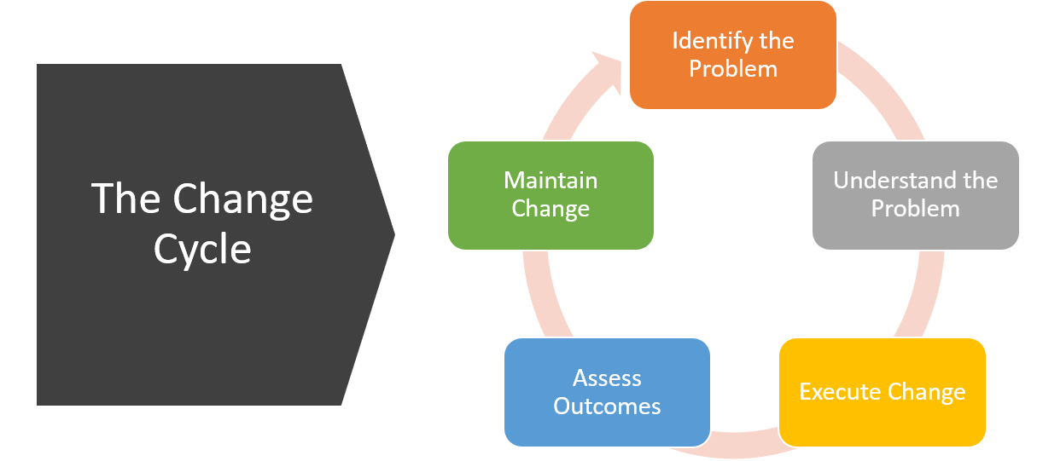
Motivational interviewing (MI)
Mary Ann Salerno and Lillie Brock, The Change Cycle: How People Can Survive and Thrive in Organizational Change. Berrett-Koehler Publishers, 2008.

Slide 38
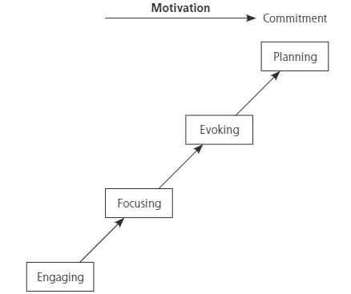
Motivational interviewing (MI)
Engaging refers to building a helpful working relationship
Focusing is a process during which a specific direction about change is developed
Evoking involves eliciting the patient’s own motivations for change; their ideas and feeling are recognized, elicited, explored, and reinforced.
Planning encompasses both developing com-mitment to change and formulating a concrete plan of action: it is a conversation about action, eliciting the patient’s own solutions and continuing to strengthen talk about change as a plan emerges.
Elwyn et al., Ann Fam Med, 2014

Slide 39
Motivational interviewing (MI)
Open Ended Questions
Cannot be answered by yes or no
Require elaboration
Ask “What” and “How” questions
E.g. “What have you already tried that has helped with your fatigue?”
Reflective listening
A reflection is your best guess of what the person means
Simple reflections stay close to what the person said, help stabilize the patient
More complex reflection can reframe content and say more than the person said but no more than what they meant.
Affirmations
Phrases that acknowledge strengths, effort and/or value
Decrease defensiveness
Build engagement
Notes:
How can I help you with ___?
Help me understand ___?
How would you like things to be different?
What are the good things about ___ and what are the less good things about it?
When would you be most likely to___?
What do you think you will lose if you give up ___?
What have you tried before to make a change?
What do you want to do next?
References:
https://www.homelesshub.ca/resource/motivational-interviewing-open-questions-affirmation-reflective-listening-and-summary

Slide 40
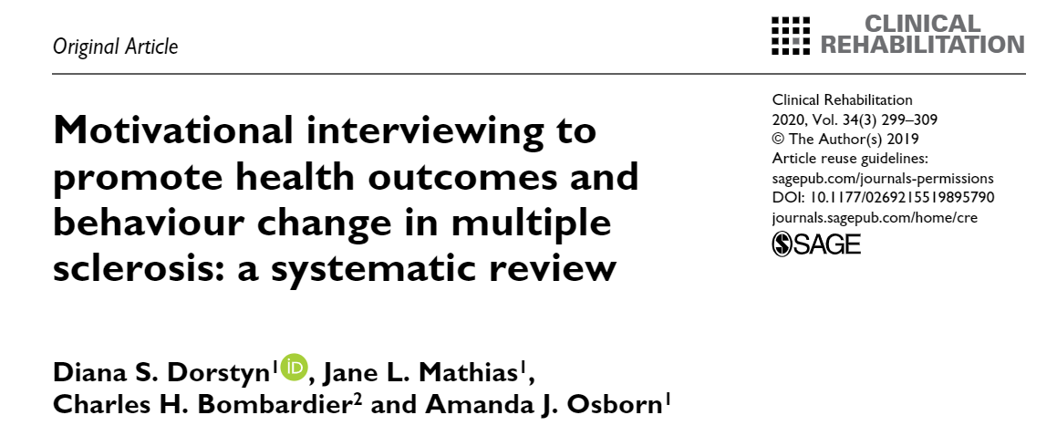
Motivational interviewing (MI): evidence
Ten randomized controlled trials, involving a pooled sample of 987 adults with RRMS or PMS and mild to moderate impairment, were identified.
Motivational interviewing, when used in conjunction with other counselling or rehabilitation techniques, resulted in significant immediate medium-to-very large improvements in multiple physical, psychological, social and behavioral outcomes Individual and group-based interventions, delivered in-person or by telephone, were all effective.
Dorstyn et al, Clinical Rehabilitation, 2020

Slide 41
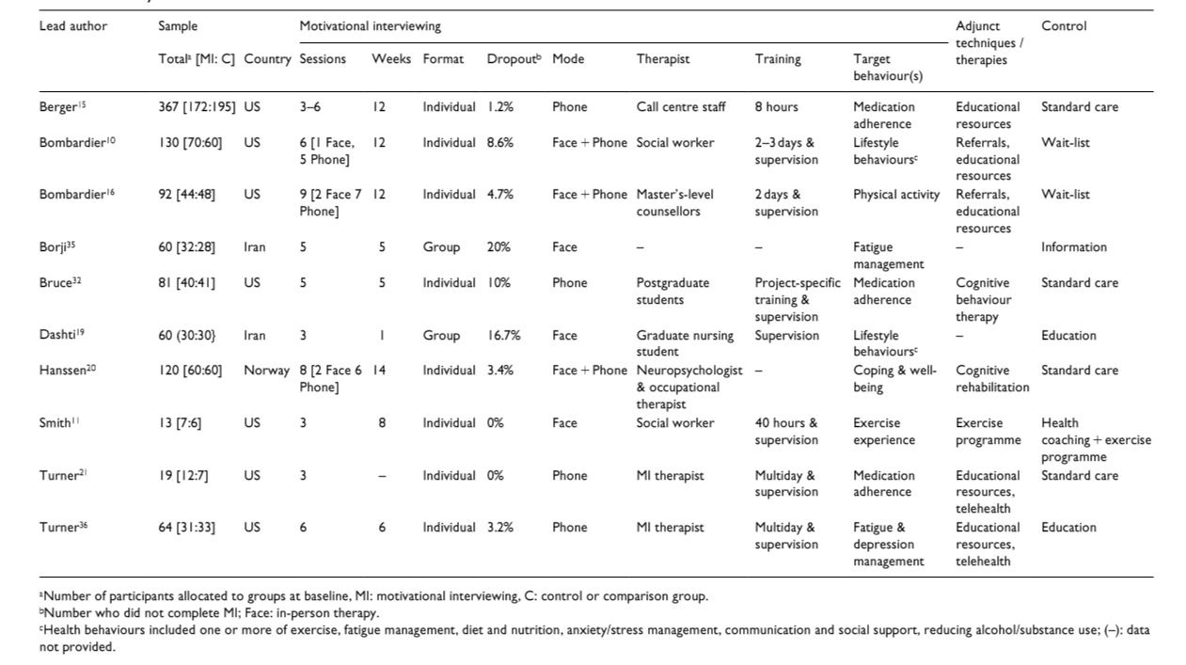
Motivational interviewing (MI): evidence
Dorstyn et al, Clinical Rehabilitation, 2020

Slide 42
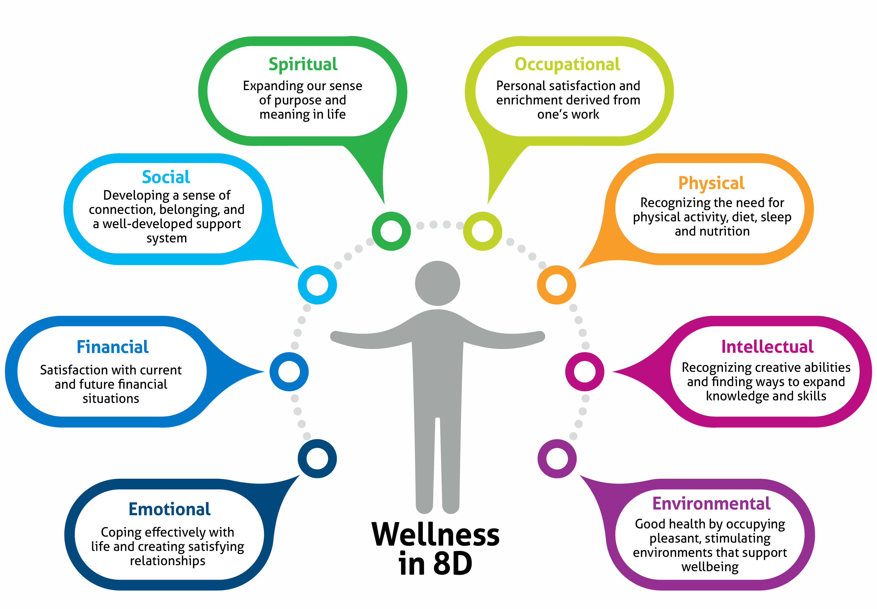
Motivational interviewing intervention: Lifestyle changes to improve overall wellness
The 8 dimensions of Wellness

Slide 43

Motivational interviewing intervention: Lifestyle modification to improve overall wellness
42-year-old woman
RRMS currently off DMT
Neurologist retired 1 year prior then lost insurance
No recent relapse but significant complaints:
Neuropathic pain in LE
Anxiety
Sleep difficulties
Fatigue
Admits to drinking 1.5 bottles of wine nightly to be able to sleep, poor self-care

Slide 44
SDM in clinical practice: timeline
First visit
Reinitiation of DMT
LCSW touch point
Counseling and Case Management
42-year-old woman
RRMS off DMT
Concerns for mental health and alcohol use
NP introduction
Symptom management
Psychiatry
referral
Treatment of depression with anxiety
Lifestyle medicine
referral
Coaching to address alcohol use and self-care

Slide 45

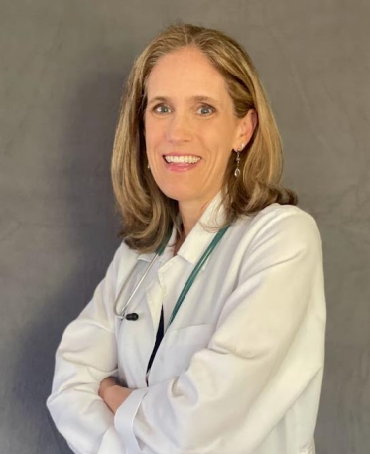
Motivational interviewing intervention: Lifestyle modification to improve overall wellness
Lifestyle medicine is a field of medicine that uses evidence-based strategies to promote health and to prevent, treat and sometimes reverse chronic disease through adopting healthy practices.
The six pillars of lifestyle medicine are:
A whole-food, plant-predominant eating pattern
Physical activity
Restorative sleep
Stress management
Avoidance of risky substances
Positive social connections
Dr. Lisa Doggett, Family and Lifestyle Medicine Specialist
MS and Neuroimmunology Center at UT Health Austin

Slide 46
Motivational interviewing intervention: Lifestyle modification to improve overall wellness
Create a safe space
Build trust and relationships
Shame-free environment
Use positive language and recognize suffering at root of lifestyle issues
Meet people where they are
Understand their “Why”
Affirm their strengths
Set SMART Goals
Specific
Measurable
Attainable
Relevant
Time-bound
Teamwork
Recognize that patient lost her medical support with retirement of neurologist and temporary loss of insurance
Lifestyle modification in MS is part of a comprehensive management plan
Provide education and resources

Slide 47



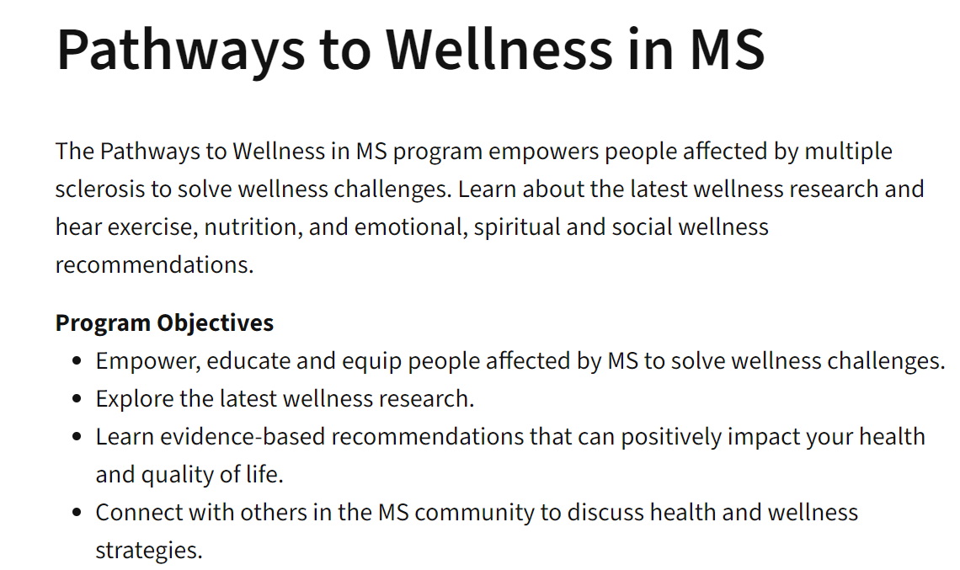
Resources for Patients

Slide 48
Conclusion
Person- and family-centered care encourages the active collaboration between patients, families, and clinicians to design and manage a customized and comprehensive care plan.
People with MS prefer to be highly involved in care decisions
Shared decision-making ensures that patients’ treatment matches their personal priorities and preferences in order to achieve optimal compliance and long-term disease outcomes
Motivational interviewing is a person-centered approach to counseling to help with behavior change and is particularly useful for the implementation of lifestyle modifications in MS

Slide 49
Thank you!

Slide 50

Survey Reminder
Please complete the webinar survey in the TRAIN or TMS websites within 15 days. This will give you access to your CME/CE certificate.

Slide 51

What’s On Your Mind?
Please type your question into the Chat area in the lower right corner of your screen.
Notes:
Live questions

Slide 52
VA MS Centers of Excellence
National MS Society
Website: www.va.gov/MS
Remote clinical consults within VA
VA specific MS care information
Benefits, grants, adaptive equipment, referrals
MS quality measures, MSSR, DMT use criteria
Educational opportunities
Healthcare Professional
Monthly clinical e-newsletter
Monthly webinars
Conference presentations
Annual network meetings
Veteran
Monthly podcast
Quarterly e-newsletter
Webinars in collaboration with non-VA MS and Veteran service organizations
Website: www.nationalmssociety.org
Professional Resource Center
Clinical publications
Literature search
Support
MS Navigator
Self-help groups
MSFriends
Educational Opportunities
Healthcare Professional
Webinars (ECHO, VA, Pediatric, Mental Health)
National and local e-newsletters
Fellowships and mentoring
Patient
Ask an MS Expert series
Virtual Programs (New to MS, Black MS Experience, Hispanic/Latinx Experience, & more)

Slide 53
Thank you and please join us for the next webinar on August 7, 2024!
Surveying Disease Modifying Therapies in MS: Green Light, Yellow Light, Red Light
John R. Rinker, III, MD
www.nationalMSsociety.org/currenttopics www.va.gov/MS/RESOURCES/CME_Webinar_index.asp
Notes:
Thank you for your participation today and special thanks to Dr. Casperson for the great presentation. This webinar is recorded and I will posting the recording and the slides on the webpage listed on the screen. Don’t forget, there’s another Current Topics webinar on September 16 on Medical Marijuana for MS Symptom Management presented by Dr. Michelle Cameron. You can register online for this webinar on our website noted on the screen. Thank you all for attending today and have a great rest of your day.

