Slide 1


The CME program will start on the hour.
Complementary and Alternative Medicine and Multiple Sclerosis

Slide 2
Your feedback is important to us!
At the conclusion of the webinar, please complete the program survey in TMS or TRAIN. This must be completed within 15 days of the live program for CME/CEU credit.

Slide 3
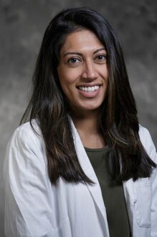
Suma Shah, MD, is an Associate Professor of Neurology at Duke University School of Medicine and cares for MS patients both at Duke Health and the Durham VA Hospital. In addition to her clinical practice, she holds several leadership roles including serving as the Program Director of the Neurology Residency Program at Duke and the Associate Director for Clinical Care for the VA MS Centers of Excellence.
Dr. Shah is actively involved in Duke Neurology's educational mission, teaching and mentoring multiple learners and trainees. Her research interests include the intersection of women's health and MS, MOG-antibody disease, as well as neurosarcoidosis.
She joined the faculty in 2018 after completing medical school at Upstate Medical University in Syracuse, NY, Neurology residency at Duke, and a fellowship in MS/Neuroimmunology at Duke.

Slide 4
Complementary and Alternative Medicine and MS
Suma Shah, MD

Slide 5
Veteran Story
“Hey doc, I don’t want to put any chemicals in my body. I have a couple buddies on a social media group who have told me about the benefits of curcumin, ashwagandha, and valerian root. What do you know about these things and can you tell me how much I should take”

Slide 6
Outline
Definitions
Ways to assess
Questions to consider
Treatments and interventions
Diets
Supplements
Evidenced based CAM symptomatic therapies
Resources

Slide 7
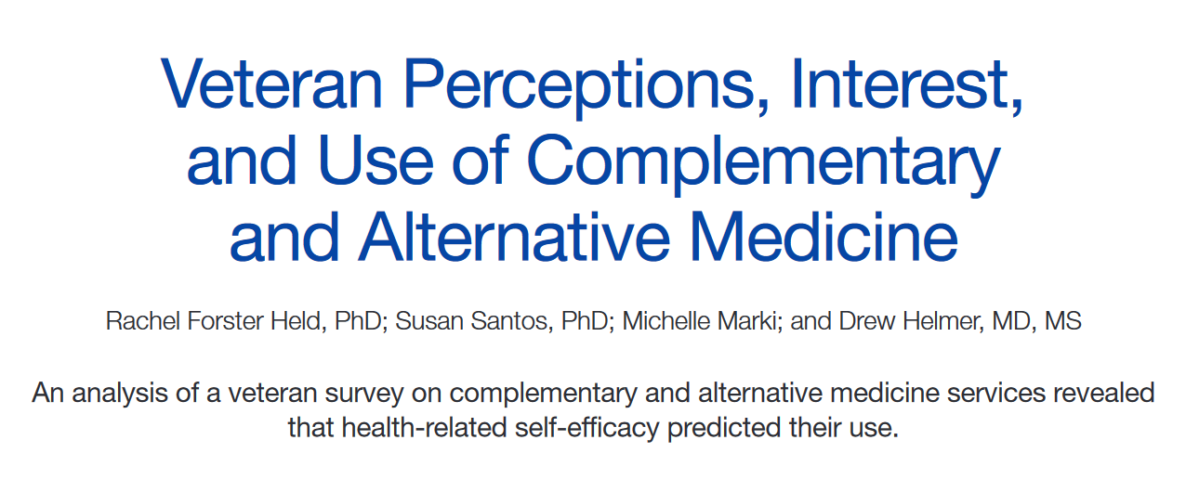

Slide 8
Key points
Of the 733 surveys distributed to veterans, 134 (18%) responses were received.
More than 60% of the respondents had tried a CAM technique, higher rates than reported by most other CAM utilization studies: U.S. prevalence studies range from 29% to 42% of respondents having tried some CAM technique, and studies of veterans or military personnel range from 37% to 50% having tried CAM
Many also reported interest in trying at least 1 practice (n = 73; 55%) or learning more about at least 1 practice (n = 71; 53%) either on their own or with an instructor.
More veterans indicated they would prefer to try the techniques with an instructor (n = 61; 46%) rather than on their own (n = 26; 19%)

Slide 9
Definitions
Complementary
When used in combination with conventional medicines, these interventions are “complementary”
Alternative
If used instead of traditional medicine, they can be referred to as alternative
Integrative medicine
An approach to medical care that recognizes the benefit of combining conventional (standard) therapies (such as drugs and surgery) with complementary therapies (such as acupuncture and yoga) that have been shown to be safe and effective.
Lifestyle medicine
The therapeutic use of lifestyle change as the foundation of health care.
Notes:
Many people have come to believe that western, or traditional, medicine isn’t necessarily the only way to address health and wellness issues. They’ve increasingly embraced “complementary and alternative” therapies – seeking to improve their health and well-being through:
diet
vitamins and nutritional supplements
lifestyle interventions
and exercise therapies

Slide 10
Complementary medicine
Complementary approaches can be classified by their primary therapeutic input (how the therapy is taken in or delivered), which may be:
Nutritional (e.g., special diets, dietary supplements, herbs, probiotics, and microbial-based therapies).
Psychological (e.g., meditation, hypnosis, music therapies, relaxation therapies).
Physical (e.g., acupuncture, massage, spinal manipulation).
Combinations such as psychological and physical (e.g., yoga, tai chi, dance therapies, some forms of art therapy) or psychological and nutritional (e.g., mindful eating).

Slide 11
Questions to consider
What does the treatment involve?
How and why is it supposed to work?
How effective is it?
What are the risks associated with its use?
How much does it cost or is it covered by your insurance plan?
Will it interact with your other therapies?
How reliable is your source information?

Slide 12
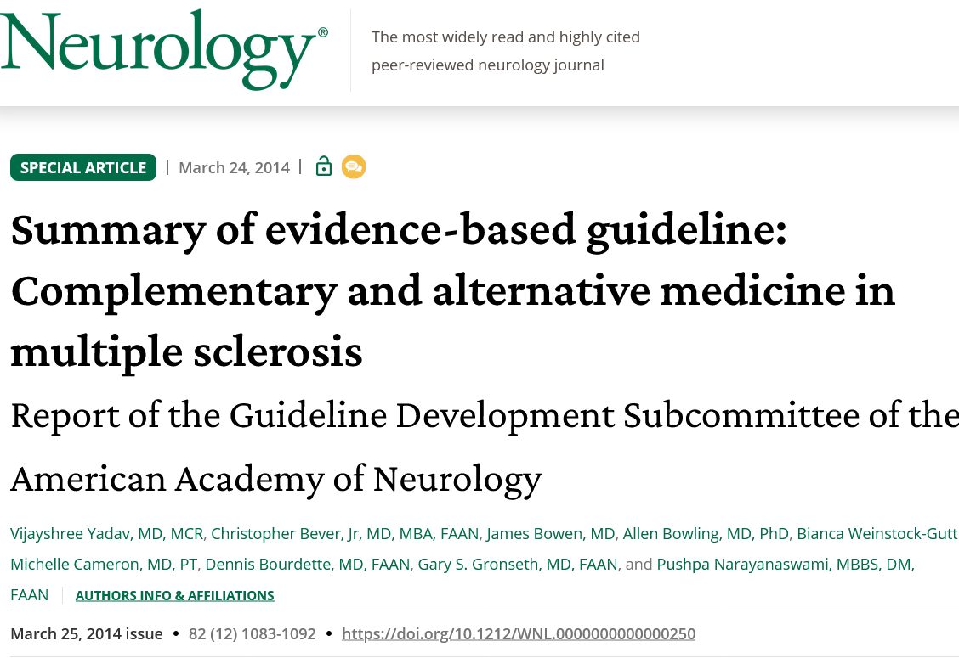
How do we assess efficacy?
Clinical Trials
*take the lack of data with a grain of salt
Assessing things like fatigue or cognition is fraught with challenges

Slide 13
Cultural awareness
What one may deem as “CAM” can be part of the deeply rooted cultural health beliefs and practices of certain groups (i.e. what may be perceived as alternative or complementary to some may be very much at the center of one’s health maintenance activities for others)
When providing care, we make sure we understand the variety of factors that may prompt someone to talk to their clinician about these complementary and alternative modalities, and it may be a part of one’s identity/culture/experience
Being culturally responsive is about understanding your patient and their cultural norms, their cultural background, and what all of that means in a clinical setting.

Slide 14
Treatments and interventions
Diets, supplements, symptomatic relief

Slide 15
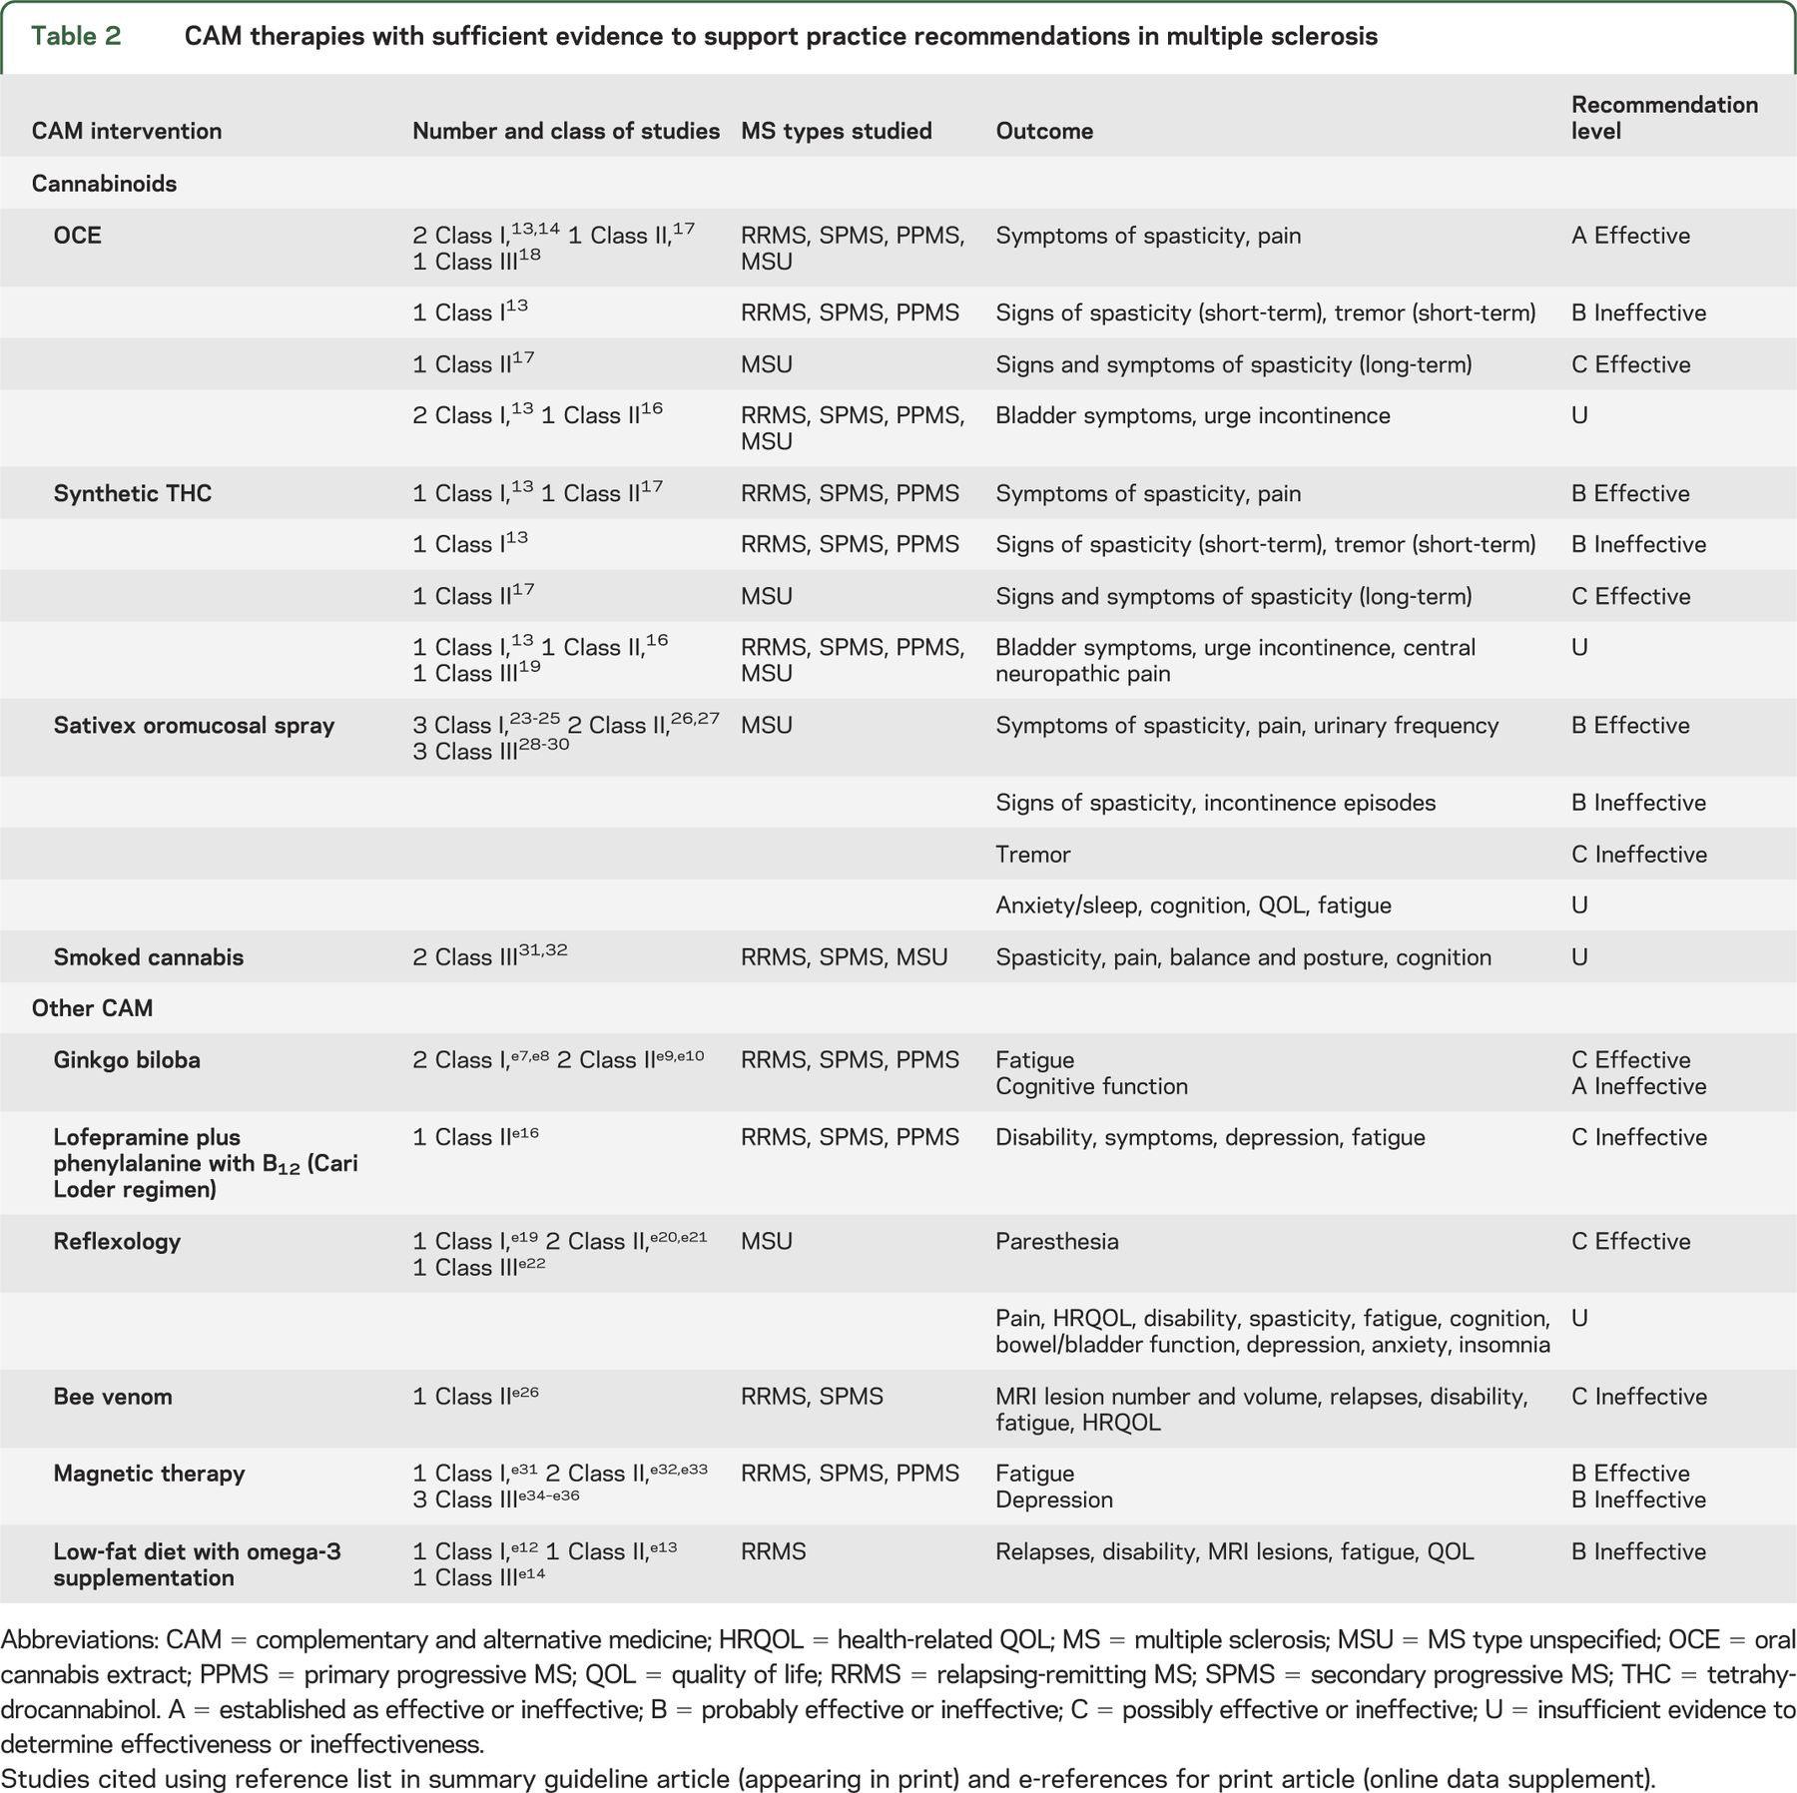
Evidence based approach in ms care

Slide 16
Diet
Swank
Wahl’s
Paleo
Whole30
Mediterranean*
Supplements?
No definitive diet that can change the course of MS.
The National MS Society has funded multiple research studies and hopes to offer more specific advice as they are completed.
While we do not yet know that a specific diet will treat your MS, a healthy diet is likely to improve your overall health and well-being. Most MS experts agree that a healthy diet is important to the long-term health of your nervous system. Experts offer the following recommendations for good health:
Prepare meals at home as much as possible.
Incorporate colorful fresh fruits and vegetables daily.
Choose lean proteins and healthy fats.
If you eat grains, choose whole grains over refined grains.
Consider adding herbs and spices to add flavor to meals.
Avoid or limit processed foods and added sugars as much as possible.

Slide 17
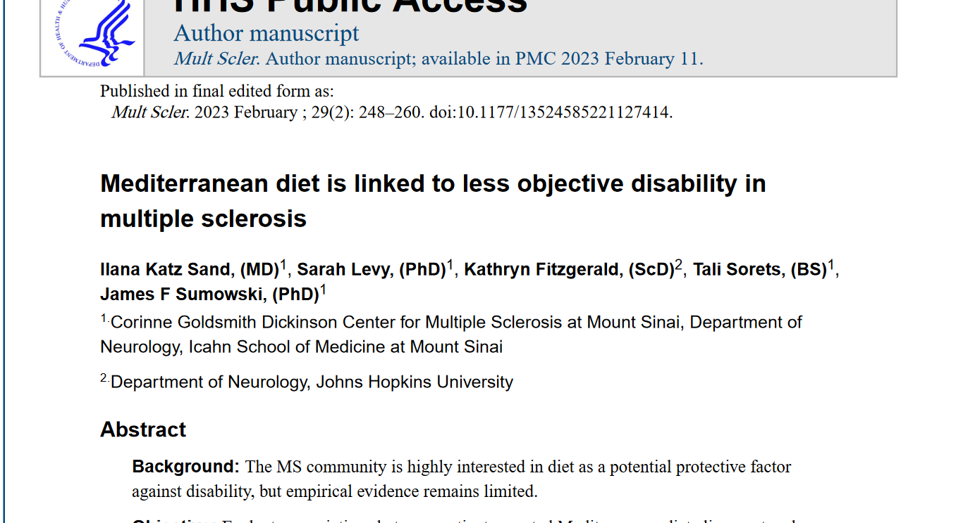
Diet
“higher Mediterranean diet alignment predicted lower objective and patient-reported disability. Findings lay the necessary groundwork for longitudinal and interventional studies to guide clinical recommendations in MS.”
*Whole health

Slide 18
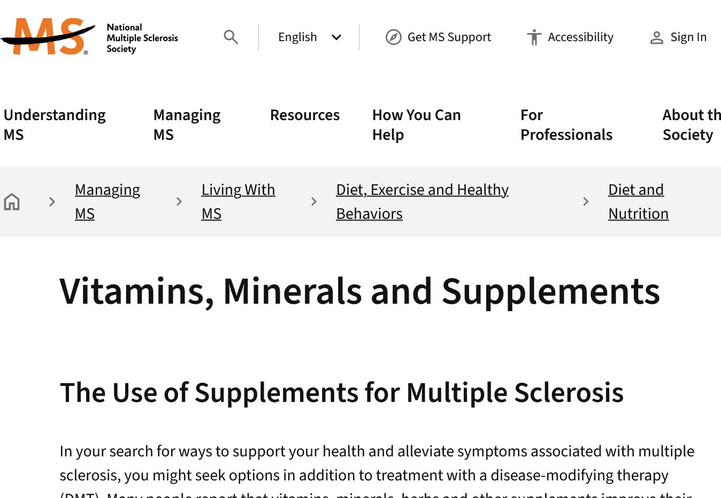
Dietary supplements
Vitamin D
Calcium
Vitamin B 12
Iron
Vitamins A, B1, C, E
Mega B complex
Notes:
https://www.nationalmssociety.org/managing-ms/living-with-ms/diet-exercise-and-healthy-behaviors/diet-nutrition/vitamin-mineral-and-supplements

Slide 19
Fatigue
Mindfulness based cognitive therapy (MBCT)
Cognitive behavioral therapy
Activity
PT
Exercise
Gingko biloba
Valerian root
Dandelion
Melatonin
CoQ10

Slide 20
Pain
Cannabinoids for spasticity, pain
Ginger
Massage
Acupuncture
Reflexology for paresthesias

Slide 21
Pain- evidence based management with cam

Slide 22
Cognition
Insufficient evidence
Look for treatable causes
Stay active
B12 supplementation
Treat depression

Slide 23
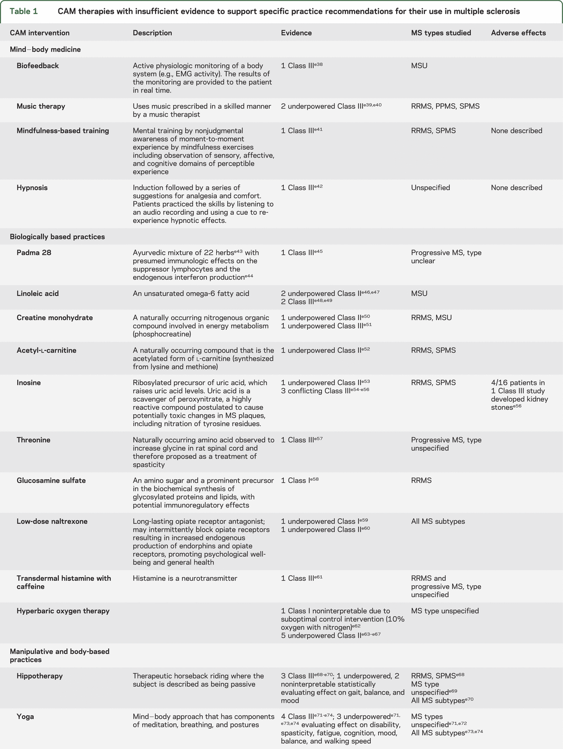
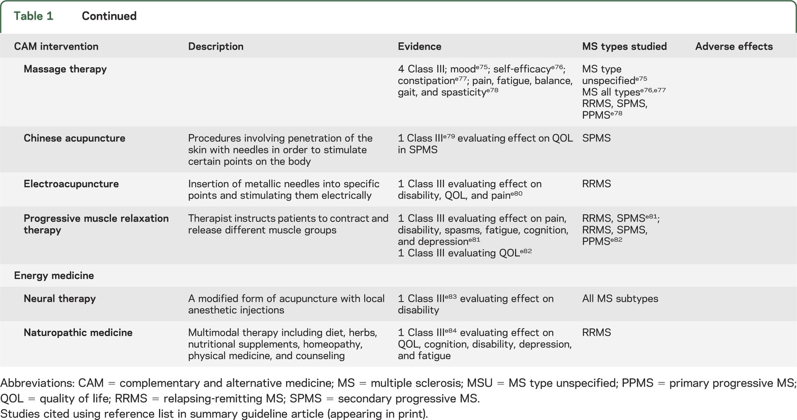
Supplements shown to not help
Bee Venom
Biofeedback
Music therapy
Hippotherapy
Hypnosis
Hyperbaric oxygen
Massage therapy

Slide 24
What is available through the VA
CITC Acupuncture
CITC Chiropractic care
Physical therapy for home exercise plan
Support group

Slide 25

Resources
The National Center for Complementary and Integrative Health (NCCIH)

Slide 26
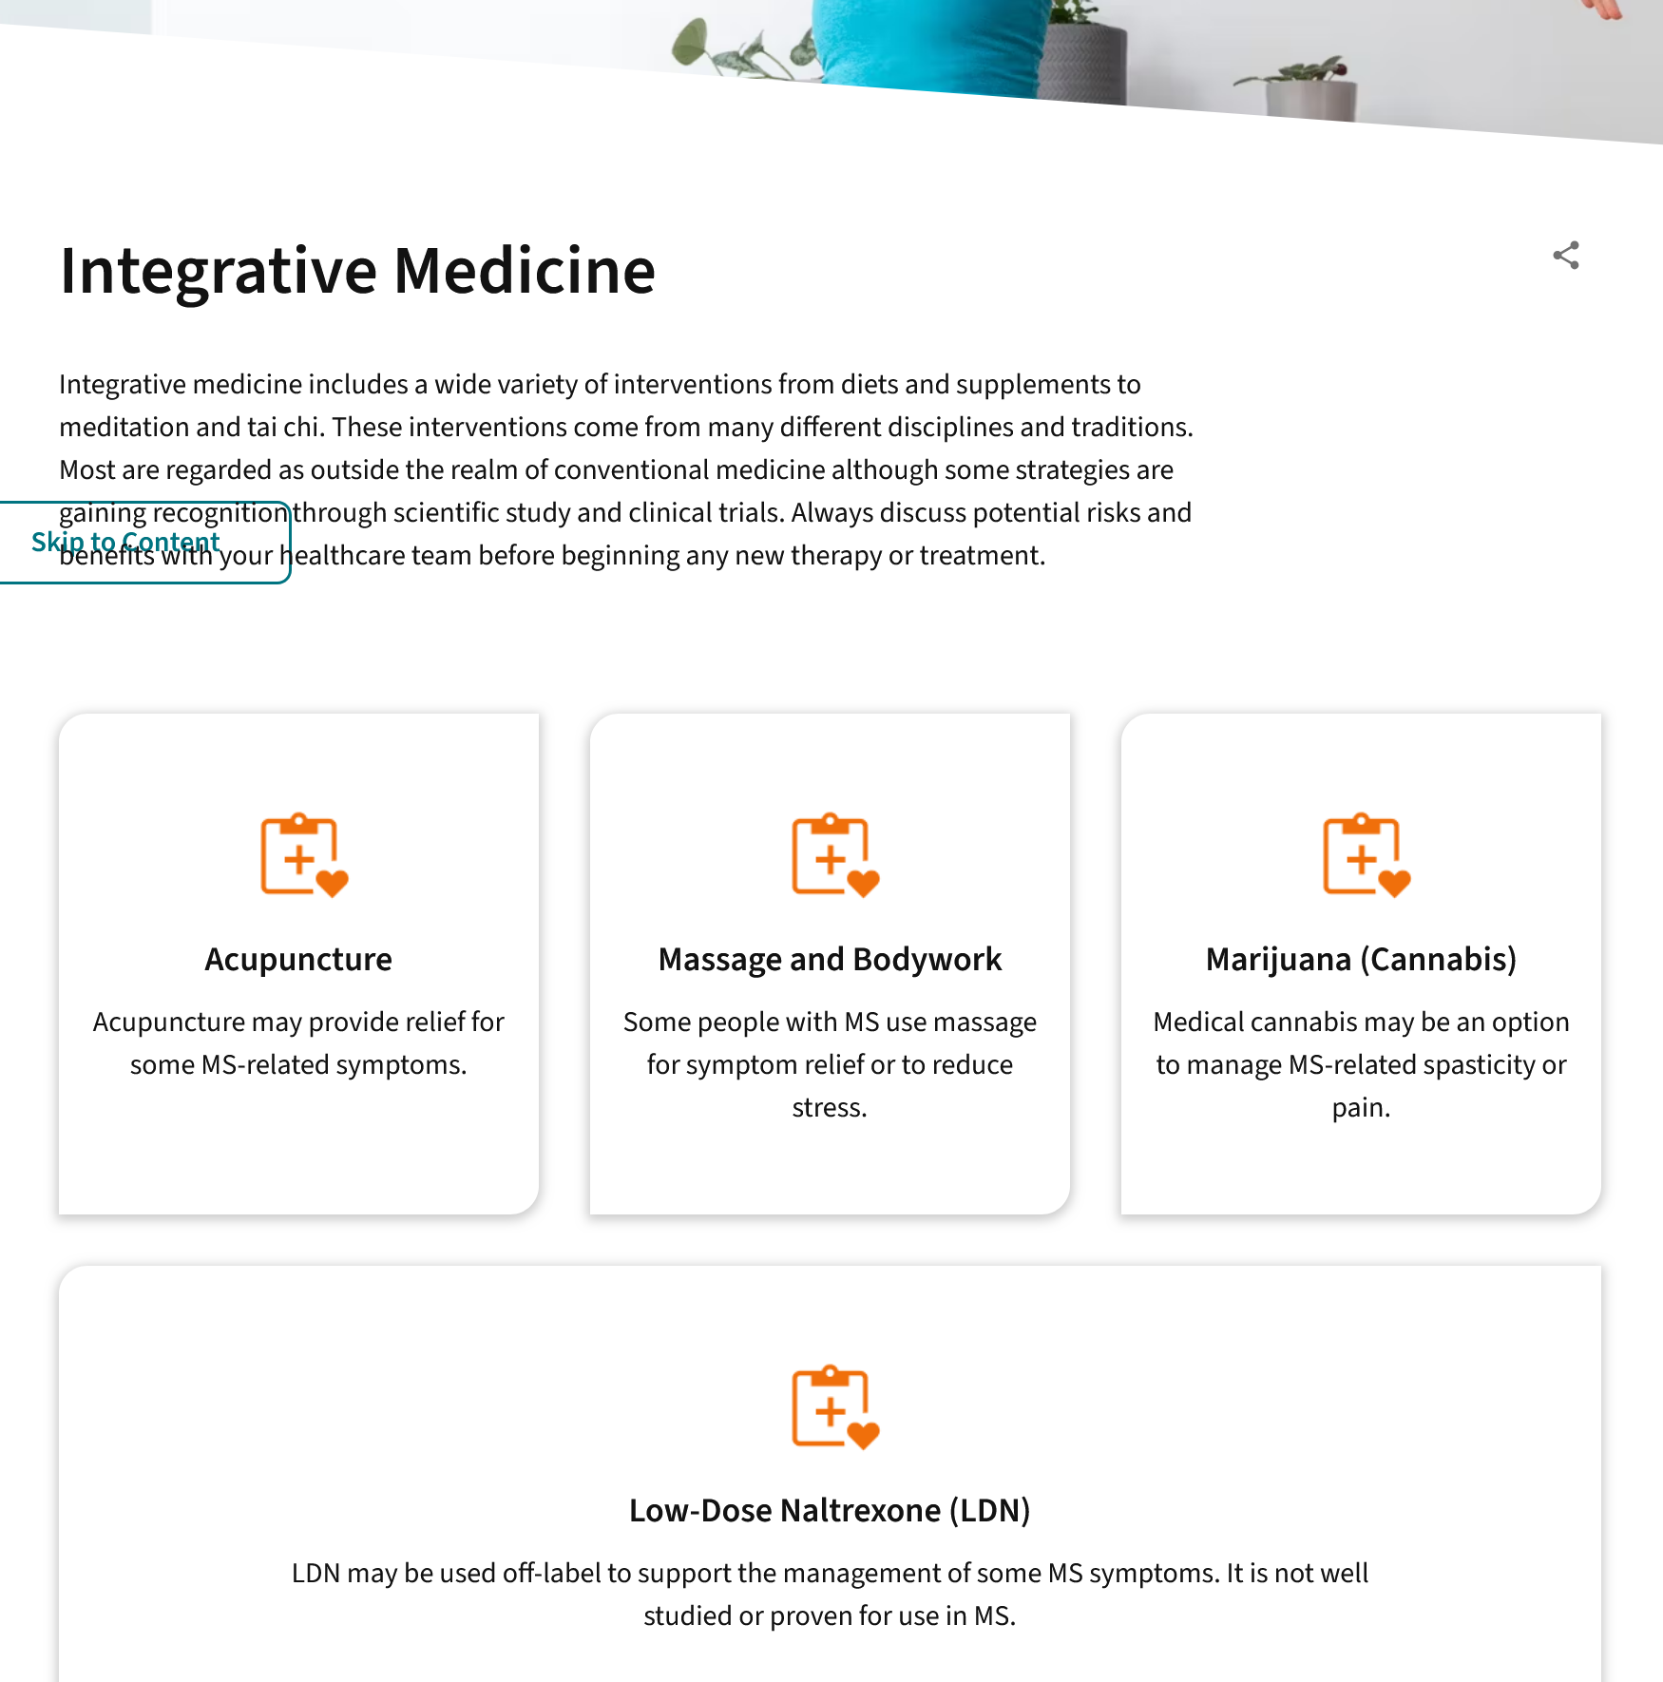
resources
NMSS Integrative medicine website

Slide 27
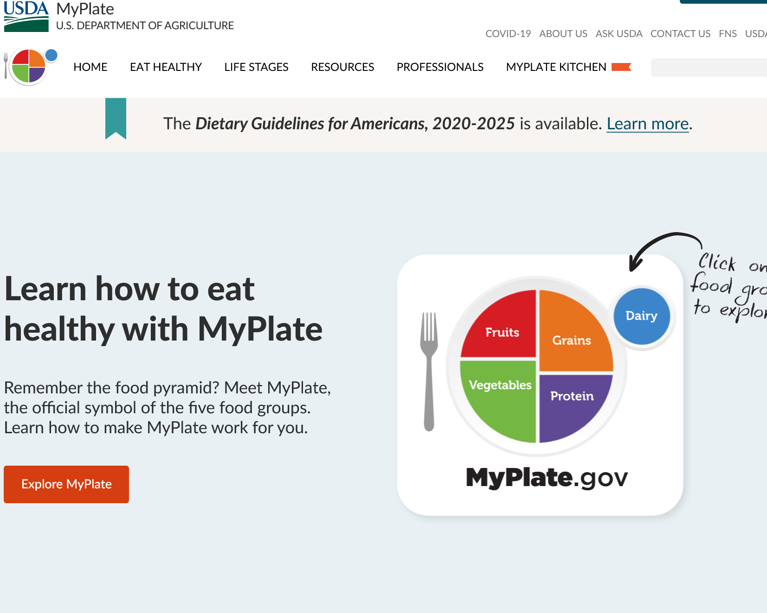
Veteran/patient facing resources
MyPlate
National MS Society Integrative Medicine website

Slide 28
Example discussion with a veteran
38
Diagnosed 2 years prior
Stable on treatment with every 6 month infusions
MRIs are unchanged
Main symptoms are:
Fatigue
heat sensitivity
Cognitive fog
Spasticity
depression

Slide 29
Takeaway Points
Encourage open communication about questions
Inquire about herbs and supplements at intake
Encourage symptom diary
Many supplements take several weeks for discernible efficacy

Slide 30

Survey Reminder
Please complete the webinar survey in the TRAIN or TMS websites within 15 days. This will give you access to your CME/CE certificate.

Slide 31

What’s On Your Mind?
Please type your question into the Chat area.
Notes:
Live questions

Slide 32
VA MS Centers of Excellence
National MS Society
Website: www.va.gov/MS
Remote clinical consults within VA
Clinical and DMT guidelines
Educational opportunities
Healthcare Professional
Monthly clinical e-newsletter
Monthly webinars
Conference presentations
Annual network meetings
Veteran
Monthly podcast
Quarterly e-newsletter
Webinars
Website: www.nationalmssociety.org
Professional Resource Center
Support
MS Navigator
Self-help groups
MSFriends
Educational Opportunities
Healthcare Professional
Webinars
National and local e-newsletters
Fellowships and mentoring
Patient
Ask an MS Expert series
Virtual Programs

Slide 33
Thank you and please SAVE THE DATES for our FY25 webinars!
May 7, 2025 (12 pm ET): Health Disparities – Lilyana Amezcua, MD
Aug 12, 2025 (2 pm ET): Sexual Intimacy – Nina Davis, MD
www.nationalMSsociety.org/currenttopics www.va.gov/MS/RESOURCES/CME_Webinar_index.asp
Notes:
Thank you for your participation today and special thanks to Dr. Casperson for the great presentation. This webinar is recorded and I will posting the recording and the slides on the webpage listed on the screen. Don’t forget, there’s another Current Topics webinar on September 16 on Medical Marijuana for MS Symptom Management presented by Dr. Michelle Cameron. You can register online for this webinar on our website noted on the screen. Thank you all for attending today and have a great rest of your day.

