Slide 1


The CME program will start on the hour.
Sexual Dysfunction and Multiple Sclerosis

Slide 2
Your feedback is important to us!
At the conclusion of the webinar, please complete the program survey in TMS or TRAIN. This must be completed within 15 days of the live program for CME/CEU credit.

Slide 3
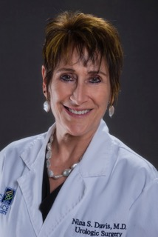
Dr. Nina Davis is a Pennsylvania native who went to Mt. Holyoke College for undergraduate study, majoring in Biochemistry and English Literature. She was accepted into the US Navy’s Health Professions Scholarship Program, completing medical school at the University of Rochester in upstate NY, and then paying back her Navy obligation as a flight surgeon. She left the Navy, returning to the University of Rochester for Urology Residency.
Dr. Davis has completed 2 fellowships – Male Infertility at The Cleveland Clinic and Female Urology and Voiding Dysfunction at Medical College of Pennsylvania, now Drexel University. Following training, she joined the faculty of the University of Cincinnati where she became Urology Residency Director and ascended to the rank of Associate Professor.
After a brief stint in a group practice in Washington State, she happily returned to academia, joining the faculty at Oregon Health and Science University and the Portland VA. Over the past 24 years she has been in Portland, Oregon where she has particularly enjoyed working closely with the VA’s MS Centers of Excellence and caring for patients with MS for which her strong Neurourology training at the University of Rochester prepared her well. It is a true privilege for her to be able to focus on our shared patient population and contribute substantially to their care.
And today, she is most grateful for the opportunity to share her knowledge and experience addressing the sexual dysfunction that is, sadly, so prevalent in our patients with MS.

Slide 4

Sexual Dysfunction and Multiple Sclerosis
Nina S. Davis, M.D., FACS Professor Urology/Urogynecology OHSU
August 12, 2025

Slide 5

Disclosures
Member of the Medical Education Speakers Network
Member, International Society for the Study of Women’s Sexual Health (ISSWSH). Slides used with permission.
I will be discussing off-label use of medications.

Slide 6
Objectives
To review the physiology of the male and female sexual response
To discuss the epidemiology, manifestations and evaluation of sexual dysfunction encountered in patients with MS (PwMS)
To provide interventions that neurologic practitioners can provide to their MS patients who are experiencing sexual dysfunction

Slide 7
Scope of the Problem
Prevalence of sexual dysfunction is HIGH in MS patients: (5X > than general population)
Women 40-80%
Men 50-90%
Multiple factors affect dysfunction
Neurologic*
Psychologic (body image)
Side effects of medication
Depression
Fatigue
Muscle weakness
Bahmani DS and Motl RW. 2021; 51:102878.

Slide 8
What about Diversity?
Though SD is common in the MS population, regarding literature exploring diversity in MS patients experiencing sexual dysfunction.
There is NONE!
In a recent systemic review (Zaloum SA et al. MSARD 2024;89:105767), 204 studies with 77,902 participants were reviewed. Only females and/or male subjects were studied.

Slide 9
MS-Related Correlates of SD
Disease severity
Perception of illness (more pronounced effect in patients with mild disability)
Depression/Anxiety
Fatigue
LACK OF CORRELATION :
No correlation with MRI findings
No correlation with DMT
Seyman E et al. Mult Scler J Exp Transl Clin 2022; 8:20552173221132170

Slide 10
General Diagnostic Evaluation
Screening tools including determination of interest in sexual information and management. Patients reticent, so need to address subject early on.
Detailed sexual history
Risk factors
Men: DM, PVD, CVD, HTN, smoking, meds, surgeries
Women: DM, meds, surgeries
Level of function/impairments
Relationship issues

Slide 11
Screening and Assessment Tools
QUESTIONNAIRES
SEA-MS-F (Sexual Dysfunction Management and Expectations Assessment in Multiple Sclerosis-Female
The first questionnaire specifically validated for this purpose in women with MS. The questionnaire explores patients' expectations about information, treatment, and overall management of sexual dysfunction, aiming to improve communication and treatment strategies.
Interest appears to decline after menopause
Interest also less in patients with EDSS > 6
Lack of interest only found in patients with progressive forms of MS
MSISQ-19 (Multiple Sclerosis Intimacy and Sexuality Questionnaire - 19)
Dual gender self-administered questionnaire
Intended to identify factors that may interfere with sexual activity or satisfaction
Problematic because levels of clinical significance have not been defined
FSFI (Female Sexual Function Index)
IIEF (International Index of Erectile Function)
Brouchet M et al. MS Rel Dis 2023; 79:104950.; Bisseriex H et al. J Sex Med 2014; 11:2955.; Schreiber-Bontemps A et al. Sex Med 2022; 10:100502.; Petracca M et al. Mult Scler Rel Dis 2023; 78:104907.

Slide 12
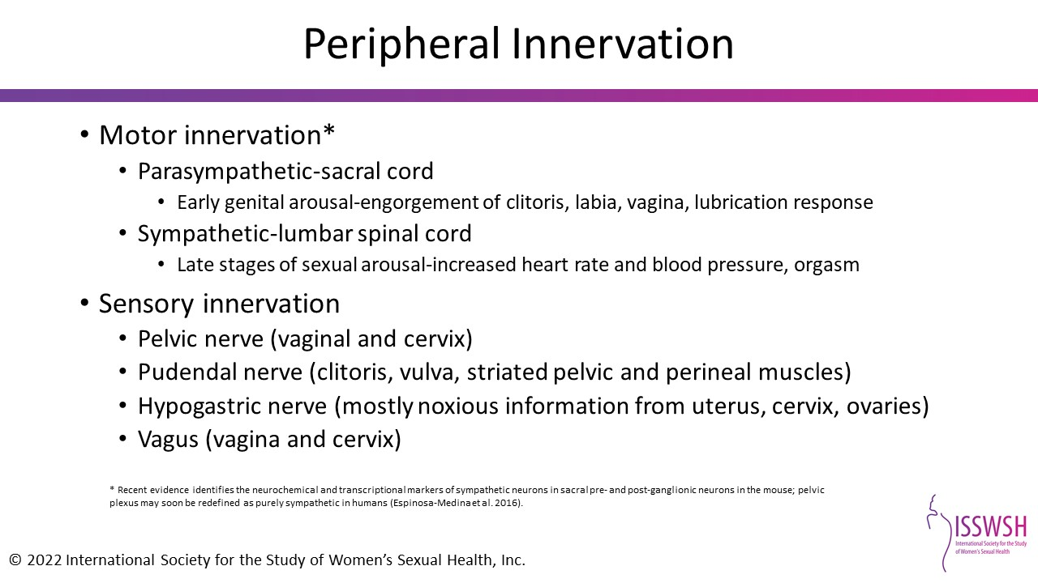

Female Sexual Function

Slide 13
Female Sexual Dysfunction*
Hypoactive Sexual Desire Disorder (HSDD)
lack of motivation for sexual activity; loss of desire to initiate or participate in sexual activity
Absent desire
Lack of response to erotic cues or stimulation
Inability to maintain interest through sexual activity
Female Sexual Arousal Disorder (FSAD)
Physical state arising from an interaction between genital response , CNS activity and information processing of sexual stimuli
Subjective and genital arousal may not match
Female Orgasmic Disorder
Diminished frequency, intensity, timing of orgasm
Anorgasmia/Muted orgasm/Delayed orgasm/anhedonic orgasm
Dyspareunia
Painful intercourse including painful penetration
Most often related to hypertonicity of the pelvic floor
All must be associated with PERSONAL DISTRESS
*These diagnoses do not correspond to the latest DSM-5 classification, but are more useful because descriptive information is inherent in the nomenclature.

Slide 14
Risk Factors for FSD in Patients with MS
“Female sexuality is multifaceted and MS can impact it at every level.”*
Damage to brain and SC can reduce desire, decrease vaginal sensation and lubrication, impair orgasm and contribute to pain with coitus.
Physical impairment such as bladder and bowel dysfunction, fatigue, weakness and spasticity can interfere with patients’ desire or ability to engage in intercourse.
Cognitive dysfunction or depression may reduce sexual interest.
The domains most affected by MS are desire, arousal and orgasm **
^{Decreased lubrication 32%}
^{Anorgasmia 29%}
^{Diminished libido 48%}
^{Arousal difficulties 40% ***}
*Krysko KM et al. Ther Adv Neurol Disord 2020; 13: 1756286420936166. doi: 10.1177/1756286420936166.
**Mahmoudi R et al. Prog Urol 2018; 11:530-535.
***Yazdani A et al. BMC Womens Health 2023; 23:352.

Slide 15
Evaluation of FSD
Patients are often too embarrassed to bring up, so need to ask. Making this a standard part of interaction will show interest and increase patient comfort.
Medical/surgical history
Sexual history
Incorporate questions about sexual activity with GU history-taking
Urine check for glucose or infection

Slide 16
Basic Treatments for FSD
Education about the normal sexual response and effects of aging, side effects of medication, etc.
Personal lubricants, “warm oils” and local hormone therapy for dryness/dyspareunia due to GSM
4% aqueous lidocaine solution on cotton ball to vestibule 5 minutes before coitus to reduce pain of intromission
Importance of foreplay, non-penetrative sexual activity, use of vibrators and other sex toys
Coaching regarding interpersonal communication with partner

Slide 17
A Holistic Option for Treatment of FSD
Multiple studies suggest that women with MS who have sexual dysfunction may benefit from the following form of physical therapy:
Pelvic floor muscle training with EMG + intravaginal neuromuscular electrostimulation
Improvement noted in arousal, lubrication and satisfaction as well as pelvic floor health
Lucio A et al. Mult Scler, 2014
Gopal A et al. Int J MS Care, 2021
Yavas I, Emuk Y, Kahraman T. MS Relat Disord , 2022

Slide 18
Hormonal Treatment of FSD
Estrogen replacement
*vaginal estrogen is considered essential in postmenopausal women with SD and voiding dysfunction
Estradiol cream qMWF; Vagifem® or Yuvafem® 10 mcg vaginal suppository 2X/week; Estring® every 3 months
Hx breast or GYN cancer is not a contraindication
Indicated for surgical or natural menopause
Decreases vaginal dryness, improves clitoral sensitivity, decreases pain with intercourse, ?increases libido
Oral: estrogen +/- progestin
Topical: skin gel, patch, oral

Slide 19
Hormonal Treatment of FSD
Role of TESTOSTERONE
Appears to be correlated with libido and well-being
Indications = ovarian failure, androgen deficiency, symptomatic menopausal deficiency, ?premenopausal low libido
Prasterone (Intrarosa®) in postmenopausal female
DHEA vaginal suppository: dehydroepiandosterone is a metabolically active steroid (precursor to T)
Eases vaginal dryness and decreases dyspareunia

Slide 20
Hormonal Treatment FSD
Testosterone (T) administration
No FDA-approved preparation for women
Usually oral or applied to the skin
Methyl testosterone + estrogen (Covaryx HS® or Covaryx®️)
contraindicated with amifampridine
taken once daily on demand
Topical testosterone 1-2%, 1-3X/week
many different preparations and regimens
Adverse effects = acne, hair growth, weight gain, clitoral enlargement, elevated cholesterol level
Supplement DHEA (weaker than testosterone)
fewer side effects

Slide 21
Medications for Premenopausal FSD
Flibanserin (Addyi®)
Daily medication to increase sex drive in premenopausal females (take at HS)
ADEs = hypotension, fatigue, dizziness, nausea, syncope
Bremelanotide (Vyleesi®)
Subcutaneous injection in abdomen or thigh self-administered before coitus
Indication is decreased sexual desire in premenopausal females
ADEs =N/V, H/A, flushing, skin reaction

Slide 22
Depression and FSD
Depression is commonly associated with FSD in general and SD due to MS
in desire disorders, must R/O depression
SNRIs or SSRIs can cause global FSD
offenders = paroxetine, fluoxetine, sertraline
substitutes = meds with fewest sexual ADEs are bupropion, mirtazapine, vilazodone, vortioxetine, duloxetine, desvenlafaxine, levomilnacipran
A referral to a mental health practitioner or sexual therapist may be necessary

Slide 23
Summary: Contributors to FSD in MS and Management Options
Contributing factors | Management options
Pain | Vaginal lubricant/moisturizers Low-dose vaginal estrogen Intra-vaginal DHEA Laser treatment for vaginal atrophy Pelvic floor physical therapy
Comorbid medical problems (e.g., diabetes, obesity) | Treatment of gynecologic disorders, bladder and bowel incontinence Diagnosis and management of sleep disorders Depression management Weight loss Systemic hormones for menopause, when appropriate
Medication side effects | Manage anti-depressant associated sexual dysfunction Behavioral (exercise, vibratory stimulation, scheduling sexual activity) Acupuncture Pharmacologic (bupropion, sildenafil, cyproheptadine) Modification of medications
Psychologic factors | Psychotherapy, CBT, individual/couples therapy Stress management
Hypoactive desire | Education Books: “Better Sex through Mindfulness” (Lori Brotto), “Mating in Captivity” (Esther Perel), “Come As You Are” (Emily Nagoski) Apps: Meet Rosy, OMGYes Sex therapy (may include behavioral, CBT, mindfulness therapy) CNS medications (flibanserin, bupropion†, buspirone†) Hormone therapy (transdermal testosterone†, ‡) Behavioral modifications (exercise, erotica, vibratory or clitoral vacuum stimulation)
†Limited evidence exists to support these treatment options; these medications are not FDA-approved for hypoactive sexual desire in women.
‡Safety is incompletely understood in this population so risks and benefits should be considered.

Slide 24

ERECTILE DYSFUNCTION
Definition of ED
The inability to obtain or maintain an erection sufficient for satisfactory intercourse
Prevalence is age-related
2-9% in men age 40-49
20-40% age 60-69
>70 yo, 50-100%

Slide 25
Types of Male Sexual Dysfunction in MS
Male MS patients
Erectile dysfunction (most frequent)
Diminished sensation
Fatigue/Diminished energy
Diminished libido
Orgasmic dysfunction
Ejaculatory dysfunction
Moussa M et al. Intractable Rare Dis Res. 2021; 10: 62.

Slide 26
Risk Factors for Erectile Dysfunction
Diabetes mellitus
Heart disease*
Peripheral vascular disease
Hypertension
Hypercholesterolemia
Smoking
Obesity
Depression

Slide 27
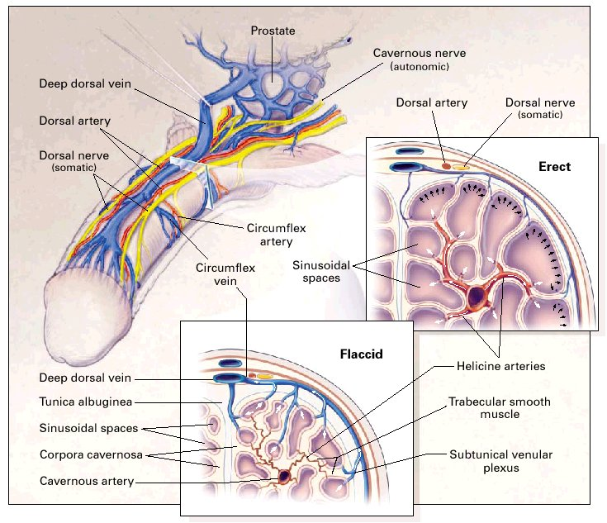
Penile Erection Anatomy and Mechanism
Lue T. New Eng. J. Med, 2000, 342:1802
Notes:
Penile Erection Anatomy and Mechanism
Peripherally, the balance between contractant and relaxant factors controls the degree of contraction of the smooth muscle of the corpora cavernosa and determines the functional state of the penis. Noradrenaline contracts both corpus cavernosum and penile vessels via stimulation of alpha(1)-adrenoceptors. Neurogenic NO is considered the most important factor for relaxation of penile vessels and corpus cavernosum. The role of other mediators released from nerves or endothelium has not been definitely established.
The caverous nerves (autonomic),which travel posterolaterally to the prostate,enter the corpora caverosa and corpus spongiosum to regulate penile blood flow during erection and detumescence.The dorsal nerves (somatic),which are branches of the pudendal nerves,are primarily responsible for penile sensation.The mechanisms of erection and flaccidity are shown in the upper and lower inserts, respectively. During erection,relaxation of the trabecular smooth muscle and vasodilatation of the arterioles results in a severalfold increase in blood flow,which expands the sinusoidal spaces to lengthen and enlarge the penis.The expansion of the sinusoids compresses the subtunical venular plexus against the tunica albuginea. In addition,stretching of the tunica compresses the emissary veins, thus reducing the outflow of blood to a minimum. In the flaccid state, inflow through the constricted and tortuous helicine arteries is minimal, and there is free outflow via the subtunical venular plexus.
From: Lue JAMA 2000:342:1802

Slide 28
Approach Toward the Patient with Erectile Dysfunction
Patient-centered approach
Evaluation is minimal
Routine evaluation with emphasis on medical history, comorbidities and medications
Testing is kept to a minimum
Goal is to get patient treated at time of diagnosis of erectile dysfunction
Because treatments are nonspecific, do not need to define the pathology

Slide 29
Evaluation of the Male with ED
It is beneficial to see patient and partner together
Sexual history
50% ejaculatory or orgasmic dysfunction
40-75% erectile dysfunction
12% premature ejaculation
Medical/surgical history
Physical examination
Urinalysis (glucosuria)
Testosterone panel
Blood draw about 8 am if possible
Toljan K and Briggs FBS. J Neurol 2024; 271:2169.
Adamec I et al. MS Rel Dis 2024; 85: 105531

Slide 30
Guidance for Male Patients
“If it is good for your heart, it is good for your penis.”
Interventions that promote normal erectile function
Eat a heart-healthy diet
Lose weight
Mulcahy: “one inch = 35 pounds”
Strict control blood sugar levels if diabetic
Reduce cholesterol levels
Stop smoking
Increase exercise

Slide 31
Interventions to Mitigate MS Effects on Sexual Function (Update)
Providing adaptive coping strategies to patients with negative illness perception
Treat depression
Exercise training
Scandurra et al. J Clin Med. 2023;12(6):2215.
Bahmani DS and Motl RW. 2021;51:102878.

Slide 32
Treatment Options for ED
Hormonal replacement +/-
PDE-5 inhibitors
The Vacuum Erection Device (VED)
Many models are available online without a Rx
Manual or battery-operated
Intracorporal injections
Penile implants

Slide 33
Testosterone Therapy
Treatment based on testosterone level
Testosterone replacement for LOW levels only
testosterone gel (Testim/Androgel/Vogelxo)
intramuscular injection every 2 weeks (T cypionate, T enanthate)
testosterone pellets
oral methyl testosterone approved by FDA, but not used
Only improves mild erectile dysfunction
Enables function of the PDE-5 inhibitors

Slide 34
Available PDE-5 Inhibitors
Viagra® = sildenafil (25, 50, 100 mg)
most sensitive to food: avoid fatty meals
one study found sildenafil ineffective in men with MS*
Levitra® = vardenafil (2.5,5, 10, 20 mg)
Cialis® = tadalafil (5, 10, 20 mg)
Stendra® = avanafil (50, 100, 200 mg)
only need to take 30 minutes before intercourse
Decision-making regarding dosing depends on duration and severity of ED
Tadalafil 5 mg daily (FDA-approved for LUTs) was found to improve erectile function.*
*Safarinejad MR J Urol, 2009.
*Francomano et al. J Endocrinol Invest, 2017.

Slide 35
Side Effects – PDE-5 Inhibitors
Headache
Visual changes: NAION!
(nonarterial anterior ischemic optic neuropathy)
Stomach upset
Flushing
Rhinitis
Muscle pain (tadalafil)
With NITRATES may cause life-threatening hypotension

Slide 36
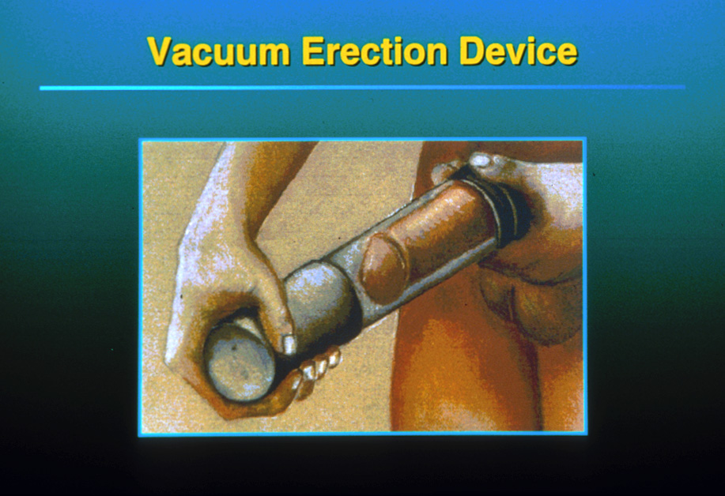

Slide 37
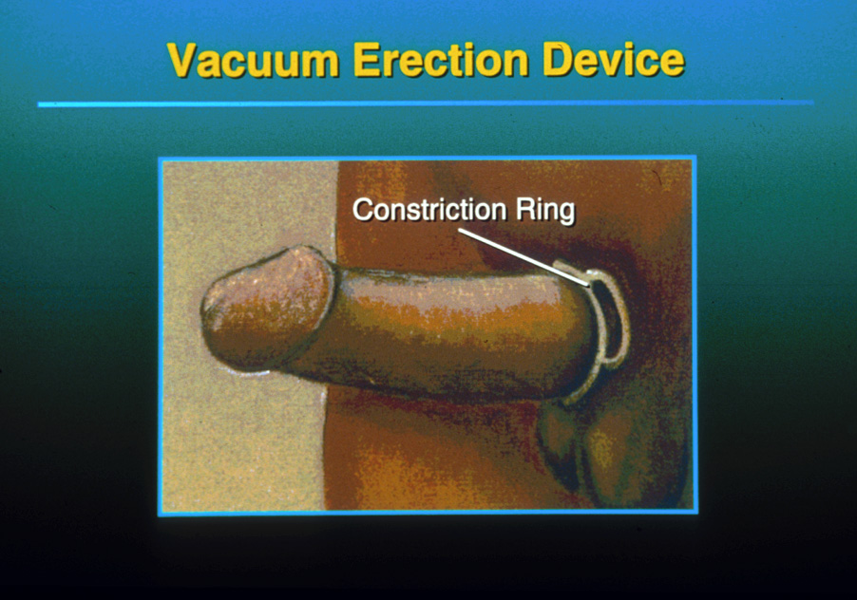

Slide 38
Problems with the VED
mechanical nature of the device
hairs catch in ring
tightness of ring causes pain
penis is blue and cold – not natural
petechiae can develop on the penis
unstable erection
BUT, no long-term complications if ring worn < 30 minutes
In MwMS, manual dexterity may be problematic

Slide 39
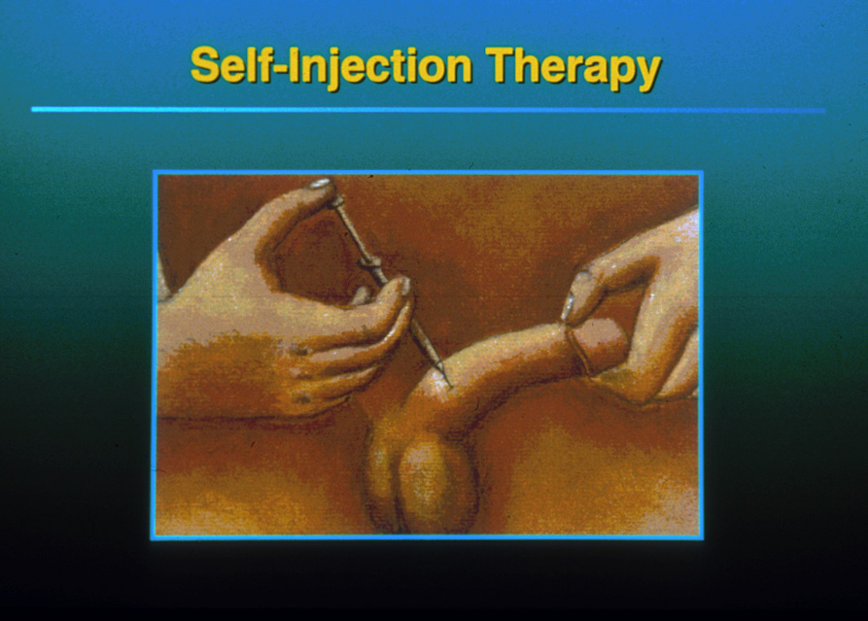

Slide 40
Prostaglandin E1 (Alprostadil)
Alprostadil is now only used for penile injection
May be compounded
papaverine
Phentolamine
Mechanism of Action
Secondary erectile pathway

Slide 41
Intracavernosal Injection - ADEs
Priapism (prolonged painful erection)
Penile pain at injection site
Diabetics
Men with history of radical prostatectomy
Hematoma
Urethral injury
Scarring/Fibrosis
In MwMS, manual dexterity may be problematic and partner may need to administer

Slide 42
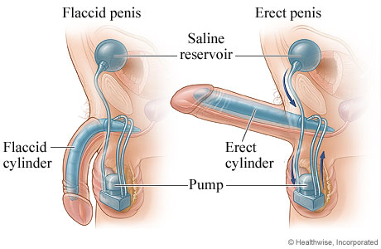
Implantable Penile Prosthesis
Two main types of implants
Malleable (best for MS patient)
Inflatable (2-piece or 3-piece)
Requires surgery and one night in the hospital
Recuperative period = 6 weeks

Slide 43
The Downside of Penile Implants
Requires surgery
Mechanical nature of device
Not natural
Inflatable device requires manual dexterity
Penile length and girth cannot be restored
Infection, early and late, especially in diabetics
Mechanical failure

Slide 44


Special Considerations
Romance and intimacy can take many forms
Each couple finds their
own way

Slide 45


Slide 46

Survey Reminder
Please complete the webinar survey in the TRAIN or TMS websites within 15 days. This will give you access to your CME/CE certificate.

Slide 47

What’s On Your Mind?
Please type your question into the chat area.
Notes:
Live questions

Slide 48
VA MS Centers of Excellence
National MS Society
Website: www.va.gov/MS
VA SharePoint: https://dvagov.sharepoint. com/sites/ VHANeurology/MS
Remote clinical consults within VA
Clinical and DMT guidelines
Educational opportunities
Healthcare Professional
E-newsletter
Webinars
Conference presentations
Veteran
E-newsletter
Webinars
Podcast
Website: www.nationalmssociety.org
Professional Resource Center
Support
MS Navigator
Self-help groups
MSFriends
Educational Opportunities
Healthcare Professional
Webinars
National and local e-newsletters
Fellowships and mentoring
Patient
Ask an MS Expert series
Virtual Programs

Slide 49
Thank you and please SAVE THE DATE for our FY26 webinars, topic and speaker information coming soon!
November 5, 2025 January 7, 2026 March 4, 2026 May 6, 2026 July 8, 2026 September 9, 2026
www.nationalMSsociety.org/currenttopics www.va.gov/MS/RESOURCES/CME_Webinar_index.asp
Notes:
Thank you for your participation today and special thanks to Dr. Casperson for the great presentation. This webinar is recorded and I will posting the recording and the slides on the webpage listed on the screen. Don’t forget, there’s another Current Topics webinar on September 16 on Medical Marijuana for MS Symptom Management presented by Dr. Michelle Cameron. You can register online for this webinar on our website noted on the screen. Thank you all for attending today and have a great rest of your day.

