Slide 1

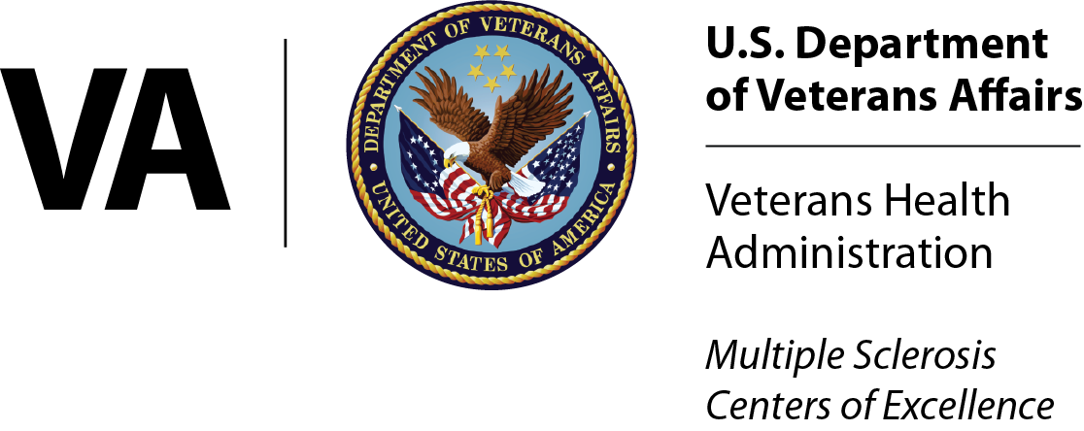
The CME program will start on the hour.
Care of Rural Veterans with
Multiple Sclerosis

Slide 2
Your feedback is important to us!
At the conclusion of the webinar, please complete the program survey in TMS or TRAIN. This must be completed within 15 days of the live program for CME/CEU credit.

Slide 3
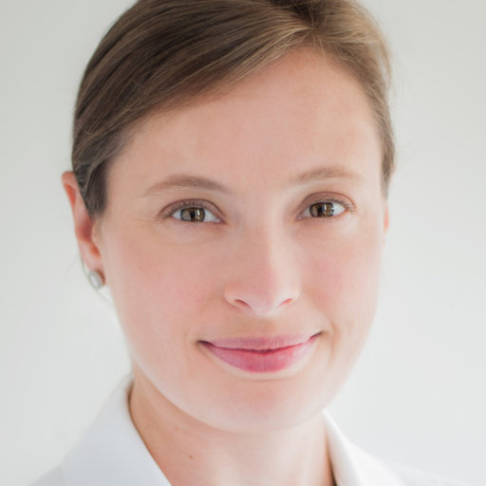
Dr. Carolyn Bevan, MD is Associate Director of Clinical Care for the VA’s MS Center of Excellence West and Director for the Chicago VA Medical Center’s MS Regional Specialty Program. She is Associate Director for Subspecialty Care for the VA National Tele-Neurology Program. In this role she works to expand access to subspecialty neurology care for Veterans living in rural and underserved areas. She maintains an academic affiliation with Northwestern University and University of Illinois Chicago.
She received her medical degree from Dartmouth Geisel School of Medicine, then completed her neurology residency at Columbia University followed by fellowship in MS and Clinical Neuroimmunology at the University of California San Francisco.

Slide 4

Care of Rural Veterans with Multiple Sclerosis
Carolyn J Bevan, MD
National Multiple Sclerosis Society
VA Multiple Sclerosis Centers of Excellence

Slide 5
Disclosures
Carolyn Bevan, MD has received compensation for participation in ad-boards from Genentech.
Disclosure will be made when a product is discussed for an unapproved use.

Slide 6
Learning Objectives
Understand gaps in neurology care, nationally and in VA
Define rural landscape in VA
Identify different models of extending care to Veterans in rural areas
Explore evidence base of treatment approaches in rural settings
Describe MS care resources available to patients and providers from VA MSCoE and NMSS

Slide 7
Overview
Part I: Case of a Rural Vet with MS
Part II: Landscape of Neurology Care in US
Part III: Rurality in the VA
Part IV: Virtual care models in VA
Part IV: Management in rural settings
Part V: Resources

Slide 8
Overview
Part I: Case of a Rural Vet with MS
Part II: Landscape of Neurology Care in US
Part III: Rurality in the VA
Part IV: Virtual care models in VA
Part IV: Management in rural settings
Part V: Resources

Slide 9
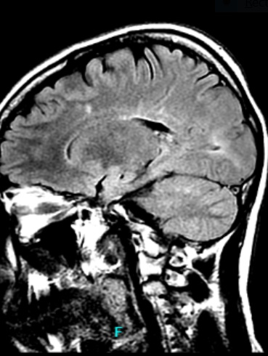
To start, a patient story
Maria*: 32yo woman with relapsing multiple sclerosis, living in a rural area
Year diagnosed: 2014
Presenting symptom: optic neuritis OS, numbness/tingling both hands
MRIs:
Brain: Enhancing and non-enhancing lesions, involving PV, JC, IT and optic nerve
C /T spine: No cord lesions
Serology: ACE normal, ANA 1:40 speckled, lyme negative, B12 337, HIV negative, HCV negative, JCV Ab indeterminate --> negative on reflex inhibition assay
CSF: WBC4, RBC 0, protein 34, glucose 55, IgG Index 0.6 (normal), zero oligoclonal bands in CSF
* Name has been changed

Slide 10
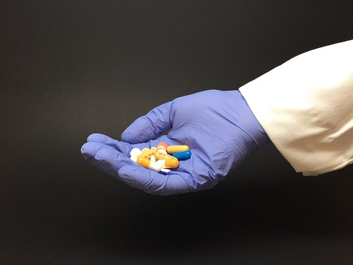
Treatment history
2014 – 2017: Fingolimod
Discontinued due to leukopenia and concern about PML risk
2017 x3 months: Glatiramer acetate
- Discontinued due to dysuria / hematuria
2017 x 2 months: Dimethyl fumarate x months
Discontinued due to side effects (not sure which)
Off DMT since ~2017
This Photo by Unknown Author is licensed under CC BY

Slide 11
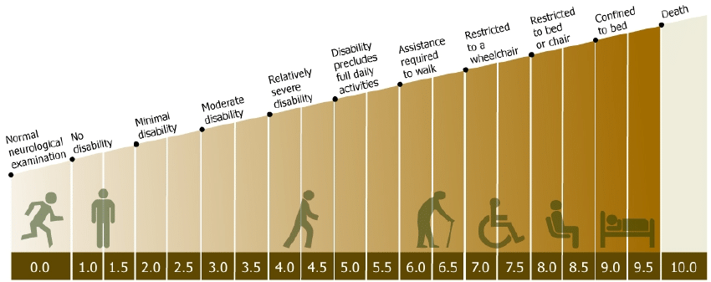
Subsequent Disease Course
2017: MR brain with new, active lesions
2018: MR brain with new, active lesions
2021: Multifocal relapse, post-partum
  Required a wheelchair at peak of symptoms but recovered well enough to be able to walk again over the ensuing months.
  Residual symptoms:
    Weakness of her right hand
    Urinary urgency and retention
    Concerns about her cognition
    Fatigue
    Abnormal gait
Current Estimated EDSS: 3.5 - 4.5
Image source: Buzzard, Katherine A., Simon A. Broadley, and Helmut Butzkueven. "What do effective treatments for multiple sclerosis tell us about the molecular mechanisms involved in pathogenesis?." International journal of molecular sciences 13.10 (2012): 12665-12709.

Slide 12
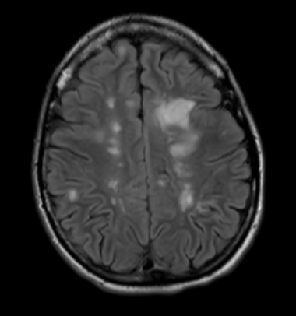
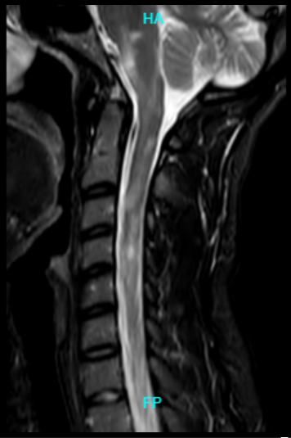
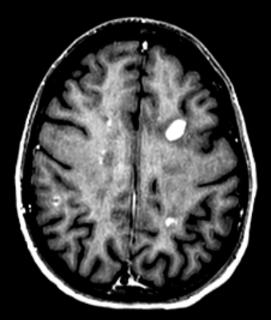
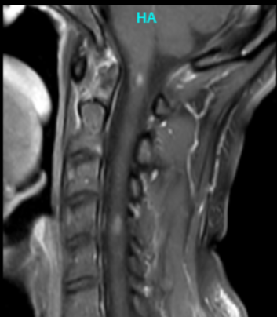
MRIs from 2021 relapse
Notes:
Ophtho exam 7/2023:
VA 20/20 +PH OU, no APD, temporal pallor OS
RNFL: Avg 90 OD, 80 OS with temporal predominant thinning OS.
HVF: mild residual central defect OU consistent with history of optic neuritis
Glaucoma suspect with cupping but normal IOPs

Slide 13
Overview
Part I: Case of a Rural Vet with MS
Part II: Landscape of Neurology Care in US
Part III: Rurality in the VA
Part IV: Virtual care models in VA
Part IV: Management in rural settings
Part V: Resources

Slide 14

Shortage of Neurologists in the United States
Total active neurologists: 13,853
  Patient Care: 11,684
  Teaching: 235
  Research: 622
  Other: 1,312
Number of people per active neurologist: 23,574
Source: Association of American Medical Colleges. Physician specialty data report. Physician Specialty Data Report | AAMC
Image Source: Mechanic Repairing Brain is a photograph by Ikon Ikon Images which was uploaded on September 18th, 2018. Mechanic Repairing Brain Photograph by Ikon Ikon Images - Fine Art America
Notes:
Active: Licensed MD or DO, working >20hrs / week
Population data per US Census beureau
Subcategories broken out by “Major Professional Activity”
Other: Physicians whose self-designated major professional activity was Administration / Not Classified / Other

Slide 15

Geographic Disparity In Neurology Care
15 – 20% of US population is classified as rural
Neurologists and neurology advanced practice providers, September 2021:
- 24,658 providers listed in NPI registry
- Of those, 776 neurologists (3.1%) had a primary practice location in a rural county
- Of 2,014 rural counties in the US, 337 (20%) had at least one neurologist
Owens, Micaela, Jasmine Owens, and Christopher Whiting. "Geographic distribution of neurologists in rural areas (S28. 008)." (2022).
Notes:
(Total active neurologists: 13,853)

Slide 16
Overview
Part I: Case of a Rural Vet with MS
Part II: Landscape of Neurology Care in US
Part III: Rurality in the VA
Part IV: Virtual care models in VA
Part IV: Management in rural settings
Part V: Resources

Slide 17
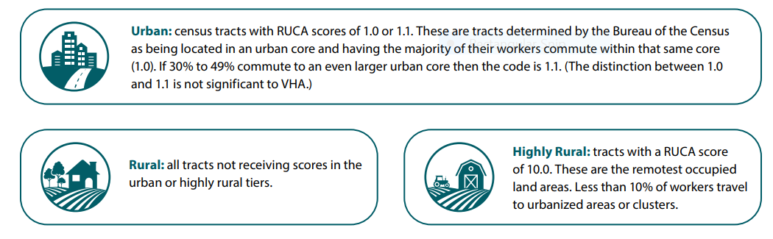
Defining Rurality in the VA: Veterans
Office of Rural Health (ORH) uses rural-urban commuting area (RUCA) codes
Developed by USDA and DHHS, based on how the US Census Bureau counts citizens
Considerations:
- Population density
- How closely a community is linked to a larger urban center
Source: https://www.ruralhealth.va.gov/docs/ORH_RuralityFactSheet_508.pdf
Notes:
1.0, 1.1 = urban
2 – 9, 10.1 – 10.3 = rural
10.0 = highly rural

Slide 18

Defining Rurality in the VA: VA Facilities
VA Site Tracking System (VAST) assigns level of rurality to VA facilities
Based on census tract location
  Two step process:
  1. Geocode precise coordinates of site street address
  2. Pace the coordinates on the rurality map layer
Based on proportion of Veterans served who are classified as rural
Rurality Calculator: Guide for ORH funding
Source: https://www.ruralhealth.va.gov/docs/ORH_RuralityFactSheet_508.pdf

Slide 19
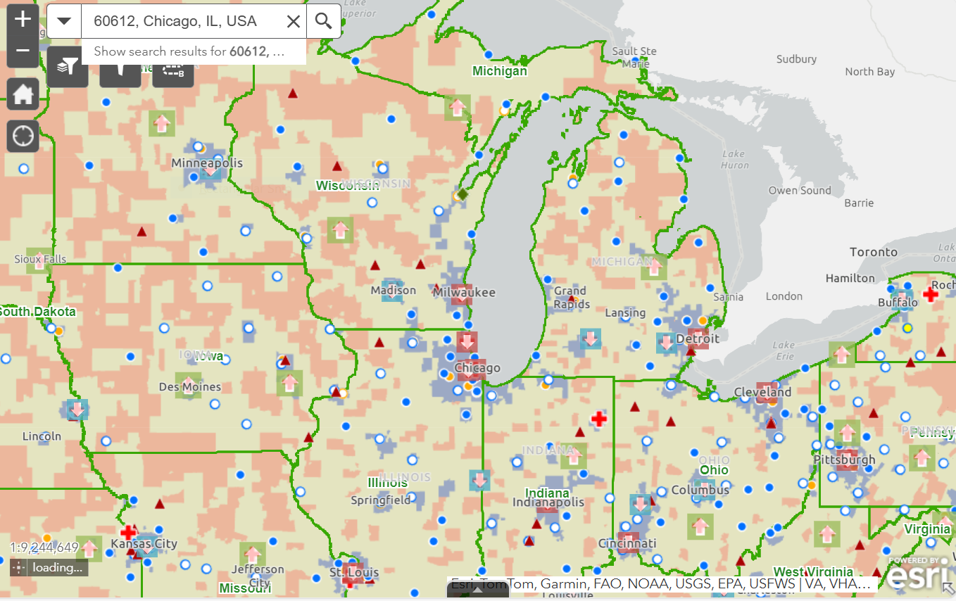
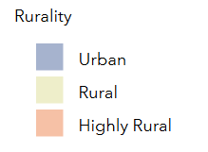
Demographics of Rural Veterans
Of 8.5 million Veterans enrolled in VHA:
2.7 million are rural / highly rural
- 54% are >/= 65yo
Data source: https://www.ruralhealth.va.gov/aboutus/ruralvets.asp
Map: https://dvagov.sharepoint.com/sites/VHARuralHealth/SitePages/Rurality.aspx
Notes:
(~30%)

Slide 20
Neurologists are in Shortage in VHA
OIG analysis of VHA facilities’ responses to OIG FY 2024 staffing survey:
20% of VHA facilities identified neurology as a severe shortage
Occupation: Clinical, Title 38 (excluding hybrid) | Number of facilities reporting severe shortage | % of facilities reporting severe shortage
Psychiatry | 66 | 47
Primary Care | 62 | 45
RN Staff Nurse – Inpatient | 52 | 37
Gastroenterology | 49 | 35
RN/Staff-Inpatient Community Living Center | 37 | 27
Anesthesiology | 31 | 22
Urology | 30 | 22
CM RN Staff-Critical Care | 29 | 21
Neurology | 28 | 20
Source: https://www.vaoig.gov/sites/default/files/reports/2024-08/vaoig-24-00803-222.pdf

Slide 21
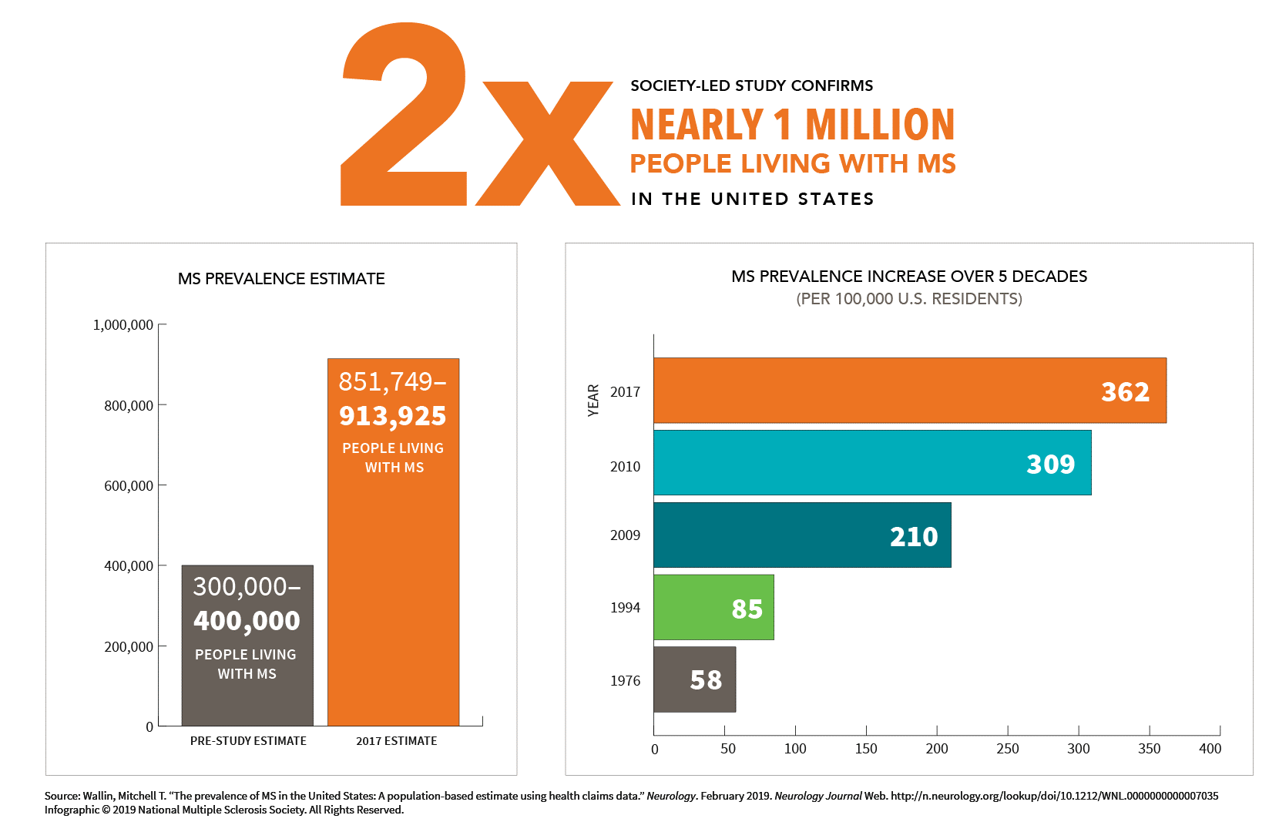
Multiple Sclerosis Is More Common than We Thought
Available: How Common is Multiple Sclerosis? | National MS Society
Notes:
Nearly 1million adults in the US living with MS, (data published 2019)
18-20k vets receive regular neurologic care for multiple sclerosis through the VA
From NMSS:
The Society funded a comprehensive study, published in the February 15, 2019, online issue of Neurology, to address a longstanding need to have a more accurate estimate of the number of people over the age of 18 with MS in the U.S. The study brought together some of the best experts in neurology, epidemiology and statistics.
The study estimates that up to 913,925 adults are living with MS in the U.S. This is two times the number previously reported in a 1975 national study and subsequent updates. In the general U.S. population, the risk of developing MS is about 1 in 333.
This breakthrough — a pivotal moment in the MS movement — helps us better understand the impact of the disease in the U.S.

Slide 22
Overview
Part I: Case of a Rural Vet with MS
Part II: Landscape of Neurology Care in US
Part III: Rurality in the VA
Part IV: Virtual care models in VA
Part IV: Management in rural settings
Part V: Resources

Slide 23
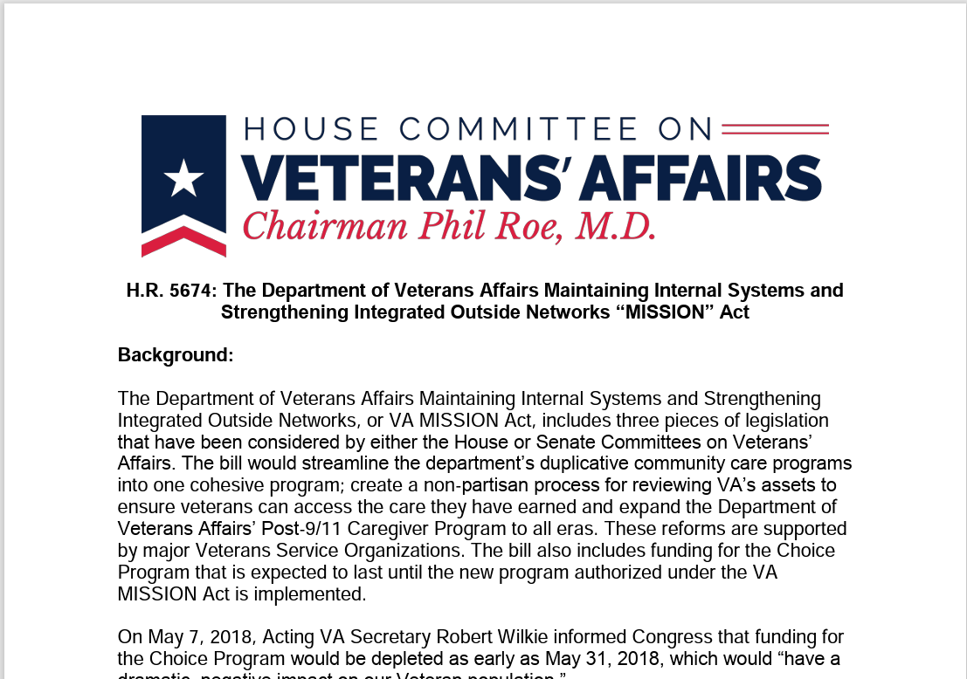
Solution: Community Care
MISSION Act: 2018
Community care for eligible Veterans
  Drive time >60min
  Wait time >28 days from date of appointment request
Source: va_mission_act_summary.pdf

Slide 24
Solution: Virtual Care
Mandates VHA to establish an “Anywhere to Anywhere” telehealth network.
Goal: By 2021, 100% of VHA providers in outpatient Mental Health and Primary Care service lines nationwide will be both capable and experienced with providing VVC to non-VA locations.
Source: va_mission_act_summary.pdf

Slide 25
VHA is the largest telehealth provider in the US
In FY 2023:
11.6 million virtual care encounters
>2.4 million unique Veterans (40% of all Veterans receiving care at VA)
9.4 million VVC visits
Source: VA Forges Ahead With Expanded Telehealth Access for Veterans - Patient Safety & Quality Healthcare

Slide 26
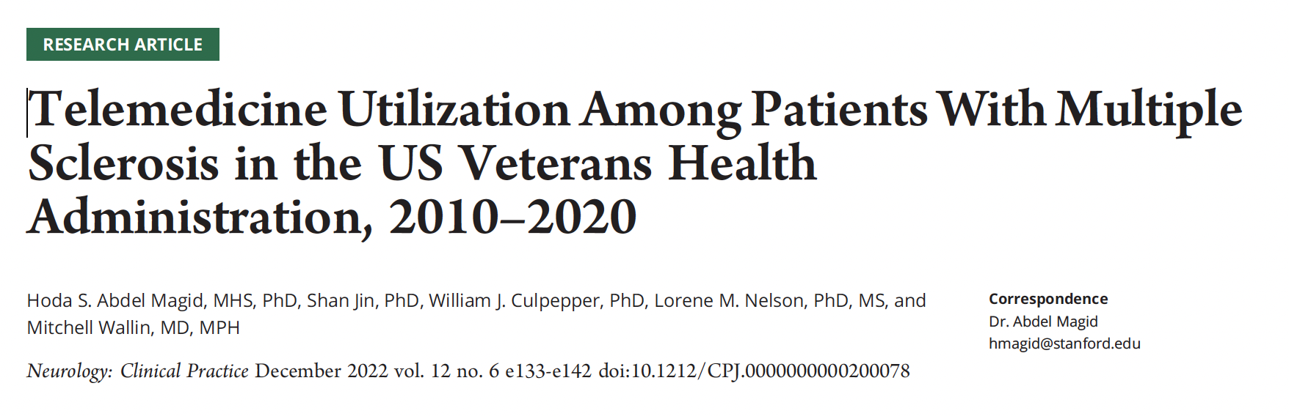
Veterans with MS use virtual care
Figure 3. Spatial Patterning of Number of Telemedicine Utilization Encounters by State Among Multiple Sclerosis Cases and Controls in the US Veterans Health Administration: 2010, 2016, 2020.
Abdel Magid, Hoda S., Shan Jin, William J. Culpepper, Lorene M. Nelson, and Mitchell Wallin. "Telemedicine utilization among patients with multiple sclerosis in the US veterans health administration, 2010–2020." Neurology: Clinical Practice 12, no. 6 (2022): e133-e142.

Slide 27
VHA Partners in National Telehealth
Office of Rural Health: Promotes and disseminates research and programs to benefit rural Veterans
Clinical Resource Hubs
NTNP
Office of Connected Care: Promotes access to health care for Veterans
My Health eVet
VA Apps: VA VVC, Annie App, Doximity
VA Telehealth
  At Home: Meet with VA care team virtually, securely send health data from home. Includes remote monitoring devices and tools such as VA Video Connect
  In the Clinic: CVT, store and forward
  In the Hospital: Virtual collaboration of inpatient providers

Slide 28

National Tele-Neurology Program (NTNP)
NTNP is funded by the Office of Rural Health to provide neurological care to rural Veterans utilizing Telehealth
Mission Statement​
Breaking down the walls of traditional neurological care to reduce disparities and giving all Veterans access to the highest quality, patient-centered, innovative neurologic care. ​
Vision Statement ​
Honor and serve Veterans by providing quality virtual neurological care​
Notes:
Funded by the Office of Rural Health starting in FY2020
Started at 12 VAMCs, starting with seven neurologists
Synchronous telehealth visits: either VVC or CVT

Slide 29
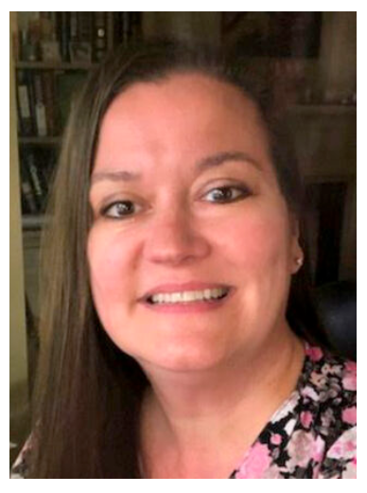
NTNP: A Virtual Neurology Clinic
Multidisciplinary Care
  Neurologists (20+)
  Nurses (working in Nurse-Physician dyads)
  Neurology Clinical Pharmacy Practitioner
  Social worker – liaison to spoke site teams
  Neuropsychologists
Education
  Nursing education consults for headache
  After visit summaries
  Development of suicide prevention processes
Integration of Technology
  Annie App: Headache, Epilepsy
  Personal Kinetograph (PKG) for remote PD monitoring
  Tele-ambulatory EEG
Services
Outpatient general neurology virtual clinic: Hub and spoke model
Consultations, as well as ongoing/follow care, routine care
CVT, VVC and E-consults
Providers document in spoke CPRS, write orders and manage patients
Work closely with any internal neurologists and primary care to ensure smooth, safe and efficient care coordination; become part of a virtual team; spoke visits possible
Jayne R Wilkinson, MD MSCE
Associate Professor of Neurology
Corporal Michael J Crescenz VA
Philadelphia, PA
Notes:
Outpatient general neurology care

Slide 30

A Step Further: Subspecialty Care eConsults
Neurology Expertise Telemedicine: NExT
Movement Disorders
Neuro-COVID
Multiple Sclerosis
Epilepsy
Sleep and Circadian Rhythm Disturbances
Cognitive Neurology
Neuromuscular
Headache
Neurosurgery
ALS
Stroke
Notes:
Number of Veterans referred to NEXT for MS consult FY24: 44

Slide 31
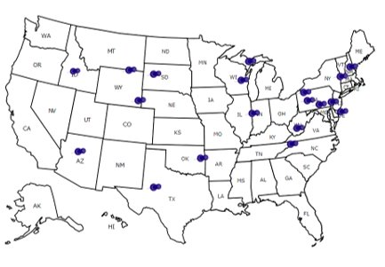
NTNP FY24
FY24:
- 2,524 new patient neurology consultations
- 8,340 total (new and follow-up) patient encounters
2,466 unique Veterans (66% rural)
18 VAMCs
VA TeleNeurology Program Helps Compensate for Shortage of Neurology Specialists
Map courtesy NTNP
Notes:
VA TeleNeurology Program Helps Compensate for Shortage of Neurology Specialists
Map courtesy NTNP

Slide 32
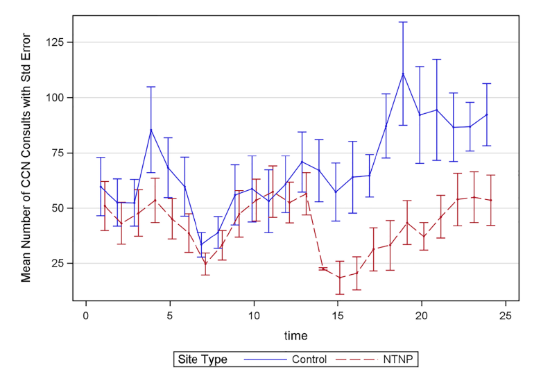
Week 14: First NTNP site active for one month
NTNP consult time:
To schedule:
NTNP site: 10.1 days
Control site: 29.0 days
To completion:
NTNP site: 44.0 days
Control site: 96.9 days
CCN volume:
Remained stable at NTNP sites
Accelerated at control sites
Veteran Satisfaction (N=259)
- Overall satisfaction score 6.3 (1.2) on a 7-point Likert Scale
Wilkinson, Jayne, et al. "The VA National Teleneurology Program (NTNP): implementing teleneurology to improve equitable access to outpatient neurology care." Journal of General Internal Medicine 38.Suppl 3 (2023): 887-893.
Notes:
CCN = community care neurology

Slide 33
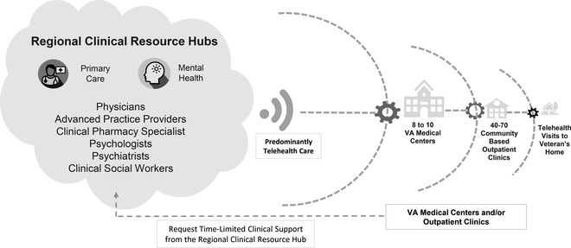
Clinical Resource Hubs
2018: One CRH established in every VISN
2019: Established CRH telemedicine initiative
Staffing:
  Primary care providers
  Registered nursing care managers
  Clinical pharmacists
  Behavioral health clinicians
  Other support staff
Burnett, Kedron, et al. "The Clinical Resource Hub initiative: first-year implementation of the veterans health administration regional telehealth contingency staffing program." The Journal of ambulatory care management 46.3 (2023): 228-239.

Slide 34
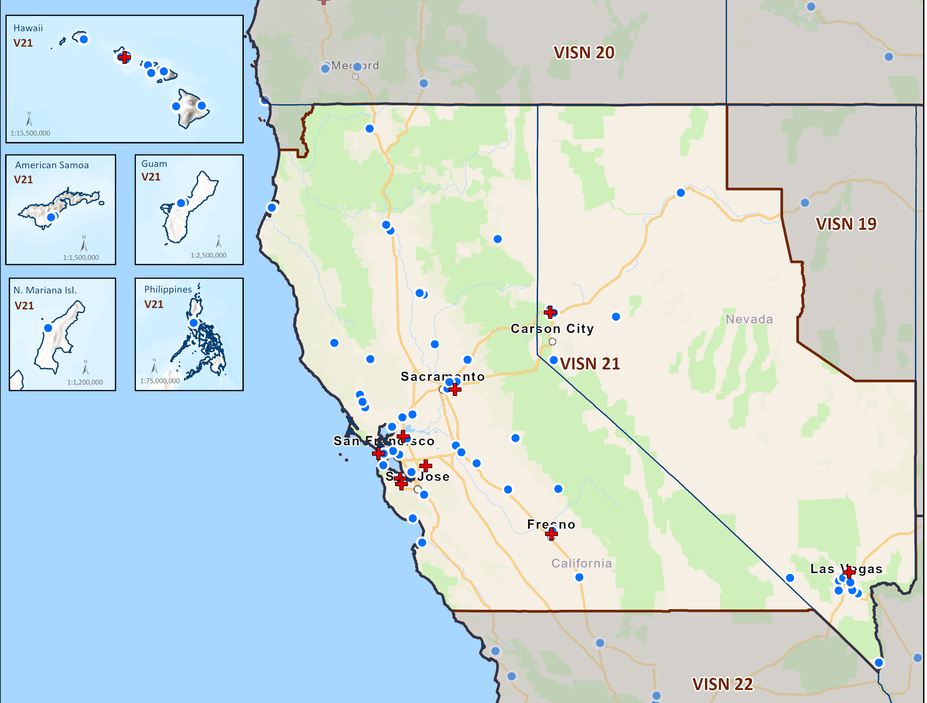
CRH Model: VA Sierra Pacific Network / VISN 21
Hub: San Francisco
Model: IFC+2 way TSA
Source: VISN 21 - Veterans Integrated Service Networks

Slide 35

CRH Model: VISN 21 Sierra Pacific Network
Director: Sarah Corbridge, MD
Three neurologists
Nurse, MSAs, Clinical Pharmacist
Telephone, VVC, starting CVT
Offering inpatient consults at Reno site
Interest from other VISNs
Notes:
Access through WEBVRAM, documents at both SF and spoke site, places orders at local site, follows up
Schedule is mixed from different sites
Sarah triages consults, meets with sites once a month to address concerns

Slide 36
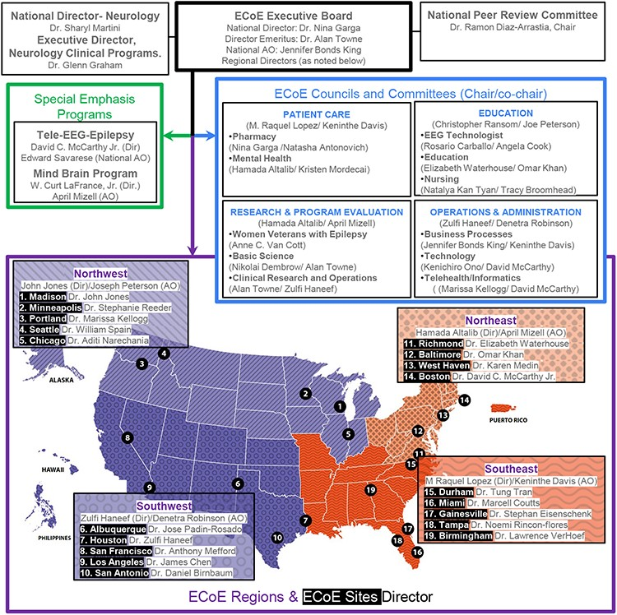
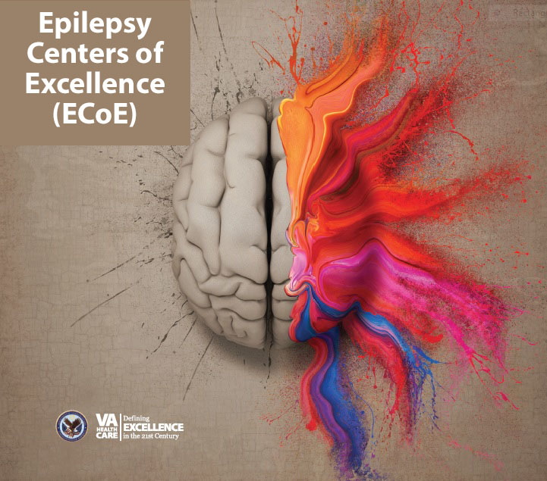

VA ECoE
Notes:
Figure 3. Organization of the ECoE. The ECoE Executive Board liaises with the National Neurology Directors and the National Peer Review Committee to coordinate the functioning of the ECoE regions/sites, the ECoE councils/committees, and the special emphasis programs. The U.S. map shows the 4 regions (Northeast, Southeast, Southwest, and Northwest) and the individual ECoE sites/site directors. Figure adapted from the FY23 ECoE annual report.16
Unless provided in the caption above, the following copyright applies to the content of this slide: Published by Oxford University Press on behalf of the Association of Military Surgeons of the United States 2024. This work is written by (a) US Government employee(s) and is in the public domain in the US.This work is written by (a) US Government employee(s) and is in the public domain in the US.

Slide 37
VA National Tele-EEG and Epilepsy Program
A Nationally Designated Telehealth Hub
Host Facility: VISN 1 Boston VAMC
Mission: To provide nationwide coverage of EEG service and expert epilepsy consultation to Veterans through a telehealth platform utilizing hub-spoke methodology and leveraging a central data repository framework.
Offers standalone consults, with option to reconsult if needed

Slide 38
VA National Tele-EEG and Epilepsy Program
A Nationally Designated Telehealth Hub
Host Facility: VISN 1 Boston VAMC
Mission: To provide nationwide coverage of EEG service and expert epilepsy consultation to Veterans through a telehealth platform utilizing hub-spoke methodology and leveraging a central data repository framework.
Offers standalone consults, with option to reconsult if needed
COMING SOON: MSCoE National eConsult Service

Slide 39
Overview
Part I: Case of a Rural Vet with MS
Part II: Landscape of Neurology Care in US
Part III: Rurality in the VA
Part IV: Virtual care models in VA
Part IV: Management in rural settings
Part V: Resources

Slide 40
Back to Maria…
February 27, 2023:
Established care with NTNP neurologist.
Chose to remain off DMT in favor of dietary approach.
July 28, 2023:
At NTNP follow-up visit, reported new left hemisensory symptoms, change in bowel / bladder function.
Went to local ED, received two doses of IVSM but the local ED had no other doses of IVSM due to local drug shortages, so she was discharged.
Discussed oral pulsed corticosteroid, starting ofatumumab.
The patient elected to pay out of pocket to see a neurologist in the community for a second opinion. (Notes never sent to VA)
NTNP neurologist requested subspecialty eConsult regarding MS management.
Notes:
Coordination of labs, imaging
Multiple messages, nursing communications updating regarding coordination of MRIs
Counseling regarding medication administration

Slide 41
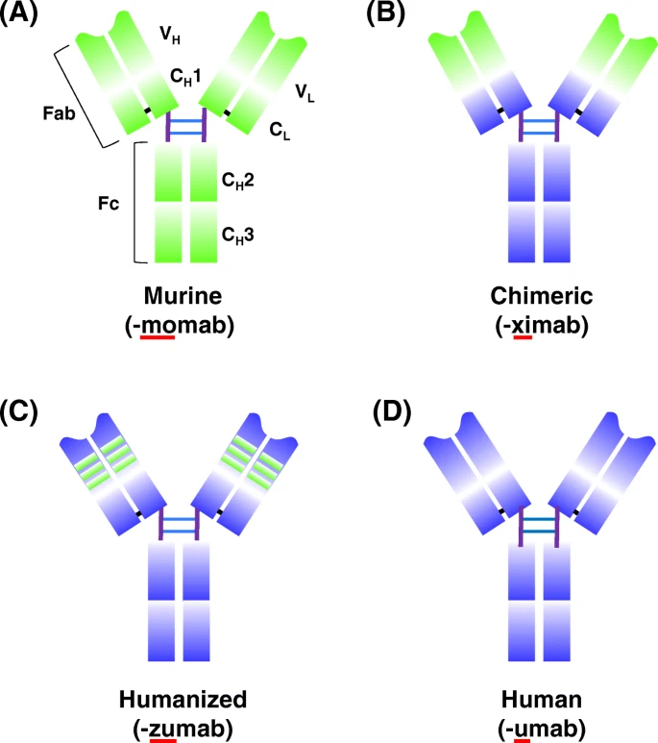
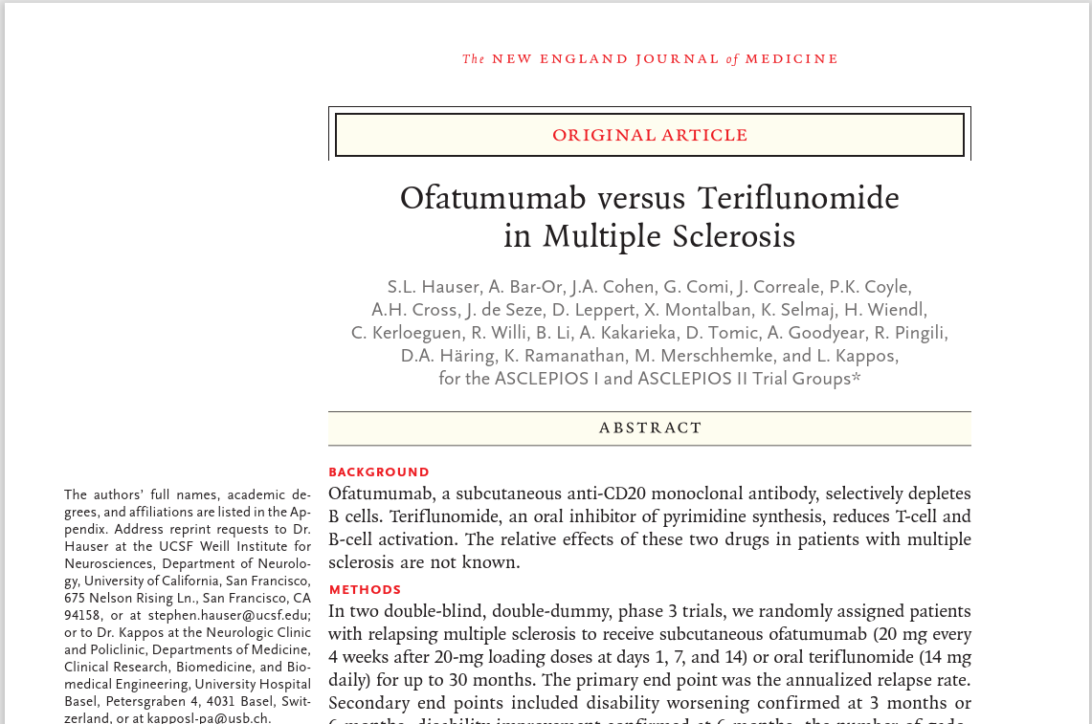

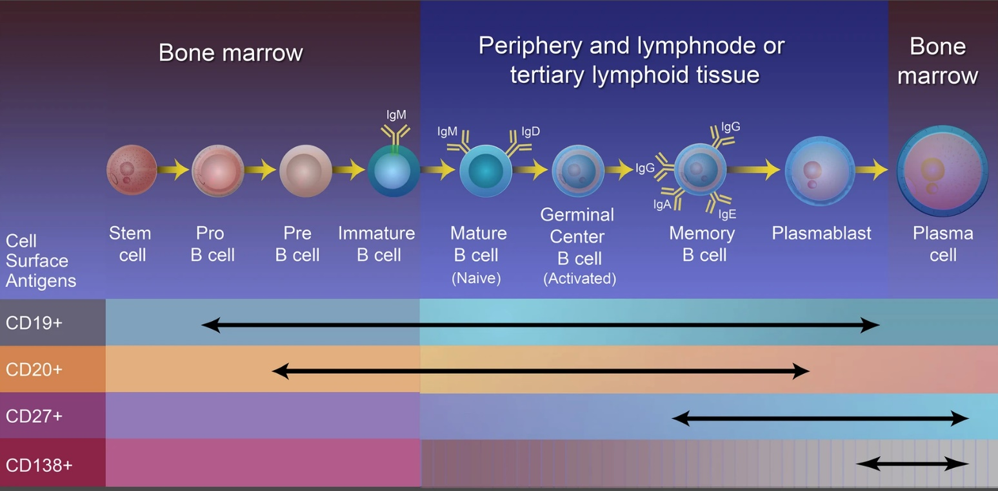
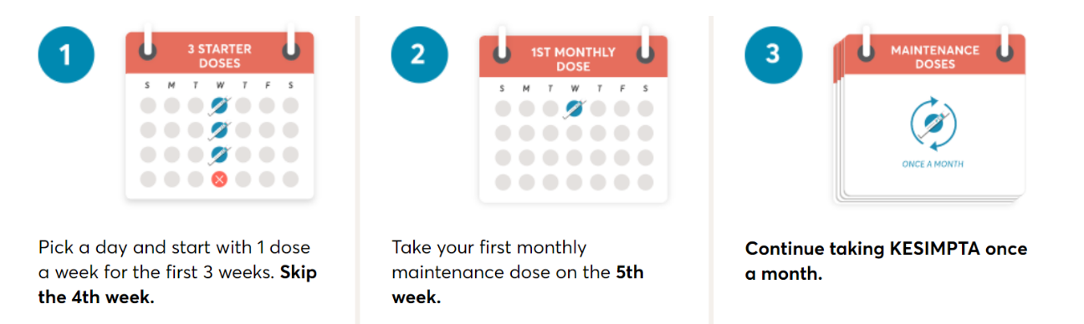
Ofatumumab in Relapsing Multiple Sclerosis
Hauser, Stephen L., et al. "Ofatumumab versus teriflunomide in multiple sclerosis." New England Journal of Medicine 383.6 (2020): 546-557.
Image sources: Lu, Ruei-Min, et al. "Development of therapeutic antibodies for the treatment of diseases." Journal of biomedical science 27.1 (2020): 1-30; kesimpta.com; Stathopoulos, Panos, and Marinos C. Dalakas. "Evolution of anti-B cell therapeutics in autoimmune neurological diseases." Neurotherapeutics 19.3 (2022): 691-710..
Notes:
Published 2020: Two phase 3 double-blind, double-dummy randomized controlled trials
Ofatumumab 20mg vs teriflunomide in relapsing multiple sclerosis
IgG
Variable domain / constant domains; heavy and light chains
CDR = Complimentary determining regions
Chimeric: variable regions are murine, otherwise human
Humanized: only hypervariable segments are murine, otherwise human
(Ocrelizumab in RRMS was compared to interferon beta-1a at a dose of 44 μg three times weekly)
(Ublituximab in RRMS was compared to teriflunomide)

Slide 42
Treatment: MS Relapse
ONTT (1992)
457 patients with ON
Double blind RCT (except IVSM group)
Intervention
IVSM 1g x3d (250mg q6hrs) + 11 day taper
Oral prednisone 1mg/kg/day x14 days
Placebo
Outcome
Faster recovery at 6 months in IVSM group
Oral dose → increased risk of subsequent episodes of ON
…. Followed for 15 years
OMEGA trial (2014)
Double blind RCT: 49 patients, MS relapses
1250mg prednisone x3d
Noninferior, similar rates of adverse events
COPOUSEP trial (2015)
Double blind RCT: 199 patients, MS relapses
1000mg oral methylprednisolone
Noninferior, similar rates of adverse events
Oral Steroids for ON (2018)
Single blind RCT: 45 patients: RMS, CIS, 1st demyelinating
prednisone 1250mg x3d
Non-inferior, similar rates of adverse events
Non-FDA approved use
Beck, Roy W., et al. "A randomized, controlled trial of corticosteroids in the treatment of acute optic neuritis." New England Journal of Medicine 326.9 (1992): 581-588.
Ramo-Tello, C., et al. "A randomized clinical trial of oral versus intravenous methylprednisolone for relapse of MS." Multiple Sclerosis Journal 20.6 (2014): 717-725.
Le Page, Emmanuelle, et al. "Oral versus intravenous high-dose methylprednisolone for treatment of relapses in patients with multiple sclerosis (COPOUSEP): a randomised, controlled, double-blind, non-inferiority trial." The Lancet 386.9997 (2015): 974-981.
Morrow, Sarah A., et al. "Effect of treating acute optic neuritis with bioequivalent oral vs intravenous corticosteroids: a randomized clinical trial." JAMA neurology 75.6 (2018): 690-696.
Notes:
(1250mg prednisone = 25 pills of pred 50mg)
ONTT: Beck et al
Oral corticosteroids for multiple sclerosis relapses
Alternative: Dexamethasone 160mg daily, +/- taper
Cautions:
Hyperglycemia
GI bleeding (PPIs not always needed): mechanism unclear but may be related to impact on tissue repair (not contact with stomach)
Short/long-term: Insomnia, mood, AVN, osteopenia/osteoporosis, hyperglycemia, gastritis/ulcer (esp w NSAIDS), wt gain, fluid retention
Chronic: Skin changes, increased infectious risk, cushingoid, menstrual irregularities, myopathy, cataracts, cardiovascular disease, glaucoma
Use valacyclovir in patients with fingolimod

Slide 43
Maria’s Treatment Plan
August 4, 2023:
Met with NTNP pharmacist to discuss ofatumumab start.
The patient requested serum JCV Ab, which needed to be drawn through community care.
NTNP nursing team coordinated with local lab.
August 31, 2023: Community Care lab JC virus Ab test result negative.
September 6, 2023:
Developed right arm and chest numbness and burning pain.
MRI obtained in community revealed new enhancing cord lesions.
Prescribed oral pulsed corticosteroids with taper.
September 18, 2023: Received first dose of ofatumumab.
Notes:
Coordination of labs, imaging
Multiple messages, nursing communications updating regarding coordination of MRIs
Counseling regarding medication administration

Slide 44
Overview
Part I: Case of a Rural Vet with MS
Part II: Landscape of Neurology Care in US
Part III: Rurality in the VA
Part IV: Virtual care models in VA
Part IV: Management in rural settings
Part V: Resources

Slide 45
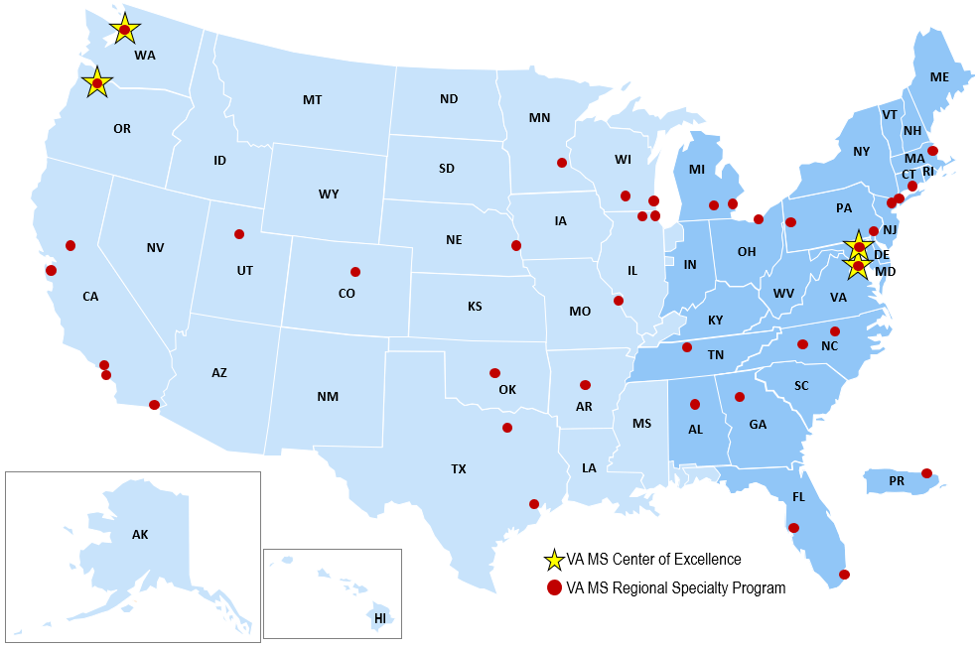
Resources: VA MS Centers of Excellence
National MSCoE Coordinating Centers:
MSCoE East: jointly located in Baltimore, MD and Washington, DC
MSCoE West: jointly located in Seattle, WA and Portland, OR
MS Regional Specialty Programs: 37
At least one in each VISN
Mission:
Improve the quality and consistency of health care services delivered to Veterans with MS across the country.
Expand care coordination between VA medical facilities through the development of a national network of MS providers within the VHA.
Provide resources to VA providers through a collaborative approach to clinical care, education, research, and informatics.
Source: https://dvagov.sharepoint.com/sites/VHANeurology/MS?spStartSource=spappbar

Slide 46


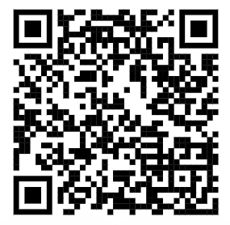
Resources for Patients
Understanding MS:
Great information for newly diagnosed patients
Managing MS:
Disease modifying therapies
Symptom management
Information for patients and care partners
Resources:
MS Navigator
Ask an MS Expert (General Program – weekly; Spanish Speaking – monthly; Veterans – quarterly)
Finding doctors and resources
Finding support groups and connection programs
Educational programs and library
For additional information or to talk with an MS Navigator via web chat:
  Phone: 1-800-344-4867
  Hours: 7:00AM – 5:00PM MT (M – F)
  Email: ContactUsNMSS@nmss.org
  Webchat: nmss.org
Notes:
MS Navigators are compassionate highly trained professionals who can provide information, resources, and support to individuals living with MS and their care partners. Patients can connect with an MS Navigator though the QR code provided here and the options listed below the QR code.

Slide 47
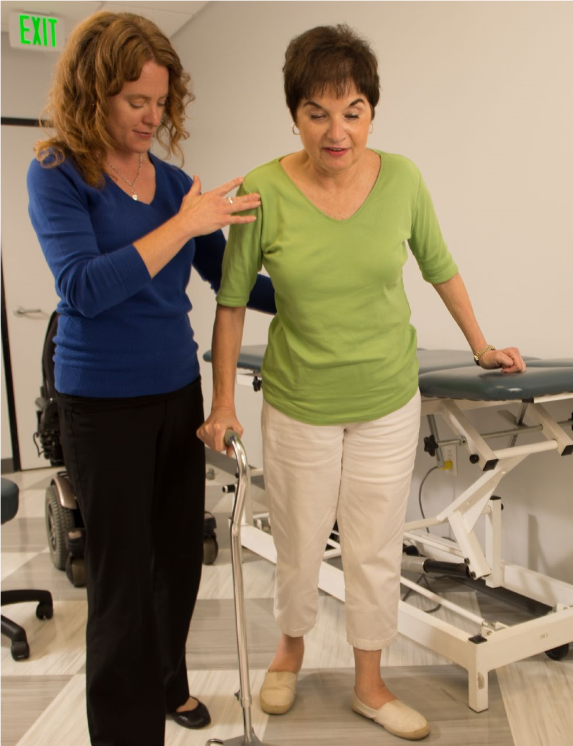
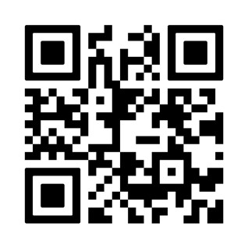
Resources for Healthcare Professionals
For Healthcare Professionals:
General information on MS
Diagnosing MS
Management and clinical practice tools
Professional education resources
Connect Your Patients Easily
Submit an MS Navigator online Healthcare Professionals referral form at
nationalMSsociety.org/referral
  Phone:1-800-344-4867
  7:00AM – 5:00PM MT (M – F)
  Email: ContactUsNMSS@nmss.org
Notes:
Additionally Healthcare Professionals who are working with patients with MS can scan this QR code and can access the online Healthcare Provider referral form. The referral will be securely sent to the MS Navigator team, and they will outreach the referred patients. The MS Navigator will send a case narrative to the clinician when the case is closed.

Slide 48
Learning Objectives
Understand gaps in neurology care, nationally and in VA
Define rural landscape in VA
Identify different models of extending care to Veterans in rural areas
Explore evidence base of treatment approaches in rural settings
Describe MS care resources available to patients and providers from VA MSCoE and NMSS

Slide 49

Thank you!

Slide 50

Survey Reminder
Please complete the webinar survey in the TRAIN or TMS websites within 15 days. This will give you access to your CME/CE certificate.

Slide 51

What’s On Your Mind?
Please type your question into the chat area.
Notes:
Live questions

Slide 52
VA MS Centers of Excellence
National MS Society
Website: www.va.gov/MS
VA SharePoint: https://dvagov.sharepoint. com/sites/ VHANeurology/MS
Remote clinical consults within VA
Clinical and DMT guidelines
Educational opportunities
  Healthcare Professional
  E-newsletter
  Webinars
  Conference presentations
  Veteran
  E-newsletter
  Webinars
  Podcast
Website: www.nationalmssociety.org
Professional Resource Center
Support
  MS Navigator
  Self-help groups
  MSFriends
Educational Opportunities
  Healthcare Professional
  Webinars
  National and local e-newsletters
  Fellowships and mentoring
  Patient
  Ask an MS Expert series
  Virtual Programs

Slide 53
Thank you and please SAVE THE DATE for our final FY25 webinar!
August 12, 2025 (2 pm ET)
Sexual Intimacy
Nina Davis, MD
www.nationalMSsociety.org/currenttopics
www.va.gov/MS/RESOURCES/CME_Webinar_index.asp
Notes:
Thank you for your participation today and special thanks to Dr. Casperson for the great presentation. This webinar is recorded and I will posting the recording and the slides on the webpage listed on the screen. Don’t forget, there’s another Current Topics webinar on September 16 on Medical Marijuana for MS Symptom Management presented by Dr. Michelle Cameron. You can register online for this webinar on our website noted on the screen. Thank you all for attending today and have a great rest of your day.

