Slide 1

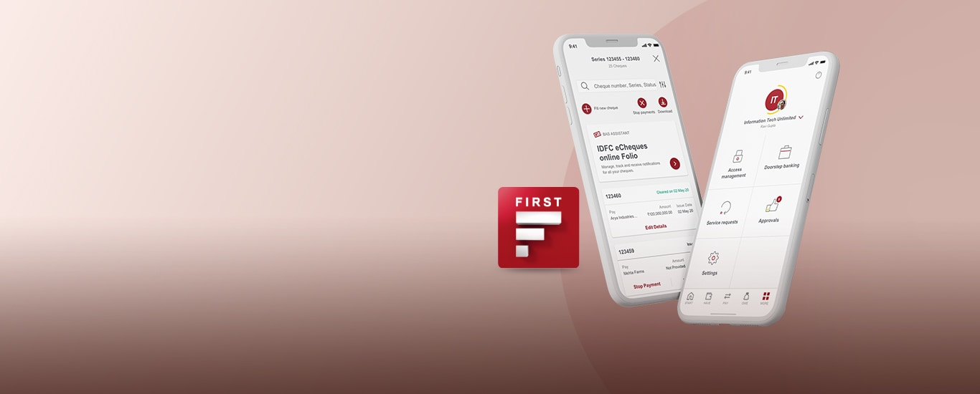



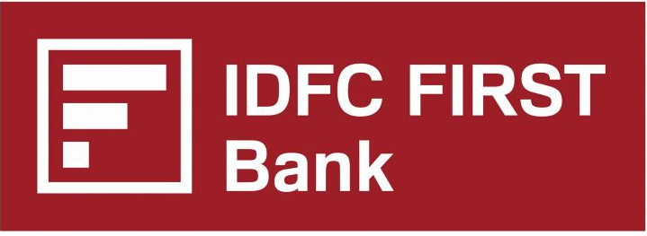
FAME 5.0:
Open Innovation Challenge
Problem Statement 1 :
Repositioning the IDFC First mobile app from a generic tool to a premium experience
Team: The Ambassadors of Quan
Kartik Sharma
Riya Arolkar
Vedang Poddar

Slide 2

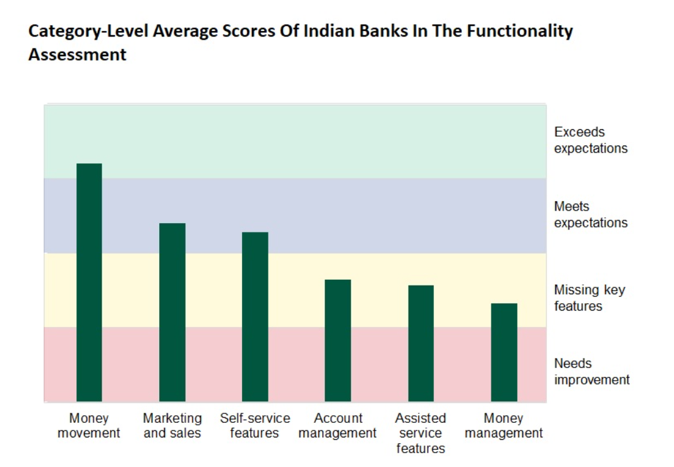
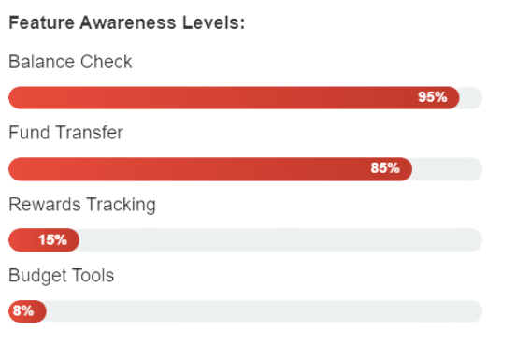





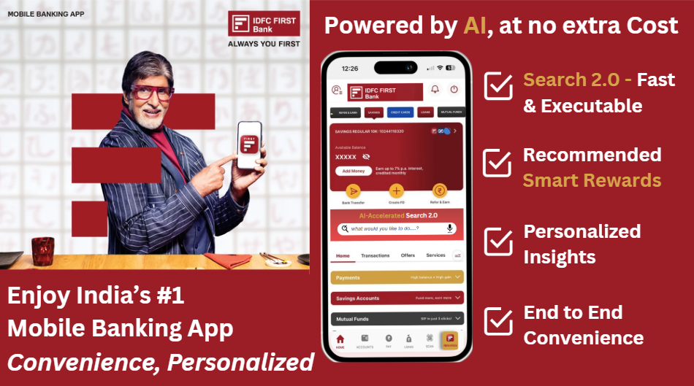




Slide 1: Research & Positioning
Slide 2: Gaps & Solution
Exhibit 1: Search 2.0
Exhibit 2: Smart Rewards
Exhibits 3: RAG/Costing/Feasibility
Premium today means an app that manages, advises, & rewards; handling every financial need in one place at no extra cost
Primary Research : Key Insights from Interviews (6) and Survey (34)
Secondary Research Insights
“Nearly 85% of our customers use the mobile app. Customers want more, an app that manages their finances”
Navigation of Feature Awareness Level
Category Level Average Score Of Banks In Functionality Assessment
87% of online Indian adults say they want to do all their banking via smartphone - the highest in the Asia-Pacific region. Forrester
“Many Indian banking apps still lack personalized financial tools like budgeting and spending analysis”
IDFC
Branch
Manager
Transactions
Money Movement
Exceeds Expectations
Marketing
& Sales
Self Service Features
Assisted service features
“I want my banking app to be a one-stop hub, it should act like a financial manager, not just payments app”
Raising Service Requests
Meets Expectations
“The app is smooth & easy to use but feels limited to transactions”
Account Mgmt.
Money Mgmt.
Rewards Redemption
Missing Key Features
CUSTOMERS
OTHER BANK CUSTOMERS
Budget Tools / Spend Analytics
Needs Improvement
Competitor Positioning w.r.t. app usage experience
Positioning Strategy
Core Value Proposition: “Personal Digital Banking Concierge"
Usage (depth + frequency)
Query-to-action conversion
Voucher Attach-rate
35%-40%
Quality of Experience (Basic Utility → Premium)
25%-30%
Satisfaction (personal + easy)
NPS
Reduction in service calls/ bank visits
Range of services & ecosystem integration (Low → High)
8-10 pts
HDFC
Premium feel but extremely limited functionality
ICICI
Strong integration, weaker on rewards/personalization
SBI (YONO)
Broad ecosystem, poor UI/UX & navigation.
Business growth
Kotak
Smooth UX, but limited advanced tools.
Cross-Sell via Search 2.0
New users who switch-in due to app functionality
Axis
Balanced app, lacks clear differentiation.
Market lacks a single app that unites premium UX, rewards, and financial management into one cohesive experience
The Ambassadors of Quan
Note: Primary Research Data is derived from Personal Interviews conducted with an IDFC BM,
Category Level Average Scores: Forrester Reviews And Scores Indian Mobile Banking Apps

Slide 3

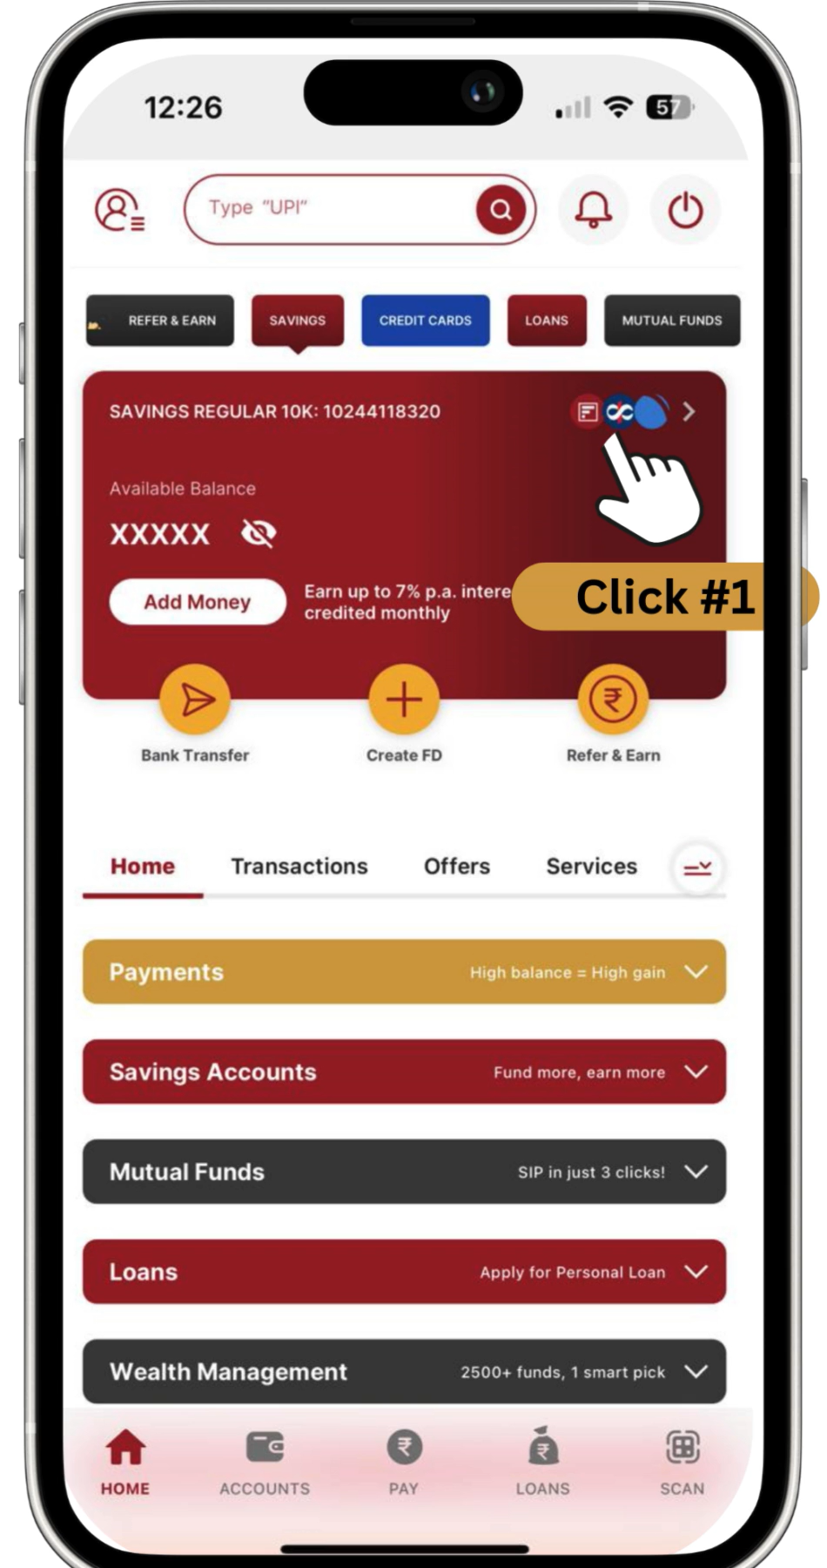


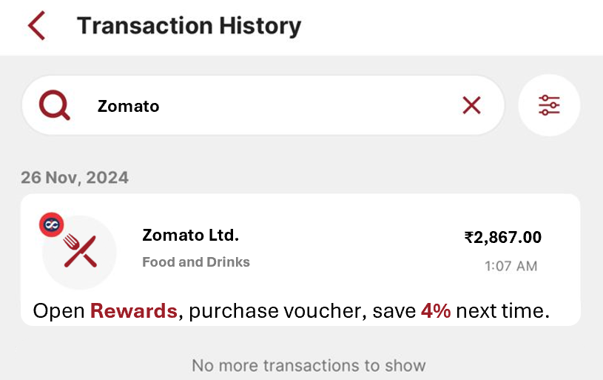








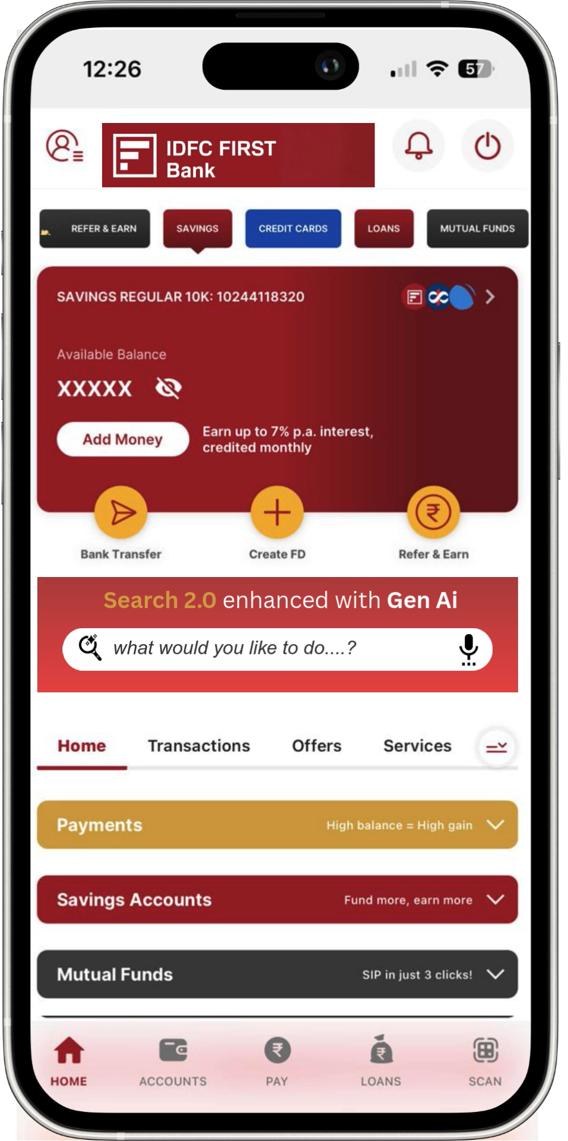
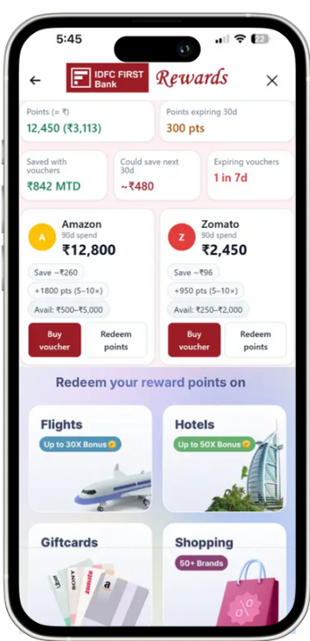

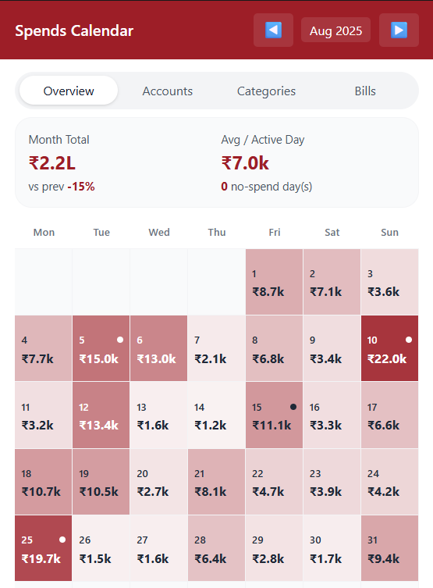


Slide 1: Research & Positioning
Slide 2: Gaps & Solution
Exhibit 1: Search 2.0
Exhibit 2 : Recommended Rewards
Exhibit 3 : RAG/Costing/Feasibility
Gap #1: Lack of Actionability in Existing Search Feature
Gap #2: A Broken Reward Redemption Journey
What It Takes to Complete a Simple Task Today
Revamp expense management and map relevant rewards
Task: Find all Zomato expenses from my HDFC account in the last 2 weeks.
Problems in the current spending analysis and rewards program experience
Click to Play
Too Many Clicks
Fragmented Journeys
Hard to find rewards
Un-Intuitive Spends Overview
Not matched to my spends
Long Customer Journey
Simple tasks take 6–7 taps to finish
Each task is buried in separate sections
Value buried across tabs/portals
No Calendar view to give a birds-eye view
Generic, low-relevance offers
Extra steps, logins, minimums/fees
Poor Visibility of Features
Lack of Executability
Move Rewards to the Homepage, improving visibility
Many users are unaware of features
Search behaves more like a guide, not like a concierge
REWARDS
Currently buried in the expanded menu
Search 2.0 – Query Based, Execution Oriented
Within transactions, nudge with a matching voucher of the same vendor
Increases engagement with the reward program and results in savings
clicks reduced to
Personalized insights
Contextual to customer’s data
Launch a compact Rewards Insight Hub, with personalized recommendations
Track user spends on top vendors and nudge to buy vouchers
Features discovery
Recommends relevant app features beyond the query
Query Examples
Wealth: “Show my FD maturities in 2025”
Expenses: “Top 5 spends in Food last month”
Payments: “Pay my Tata Power bill ₹2,500”
Loans: “What’s my total EMI this quarter?”
Others: “Show all salary credits in 2024”
Conversational queries
Natural language, intuitive input
Leverage the current spend analysis ability
Add a cashflow calendar highlighting major spend and upcoming bills/ CC payments
Enables a better tracking mechanism
Multilingual Support
Supports 6 Regional Languages
Click to Play
The Ambassadors of Quan
Note: Refer Exhibits 1 and Exhibit 2 for more information on the suggested strategic ideas

Slide 4
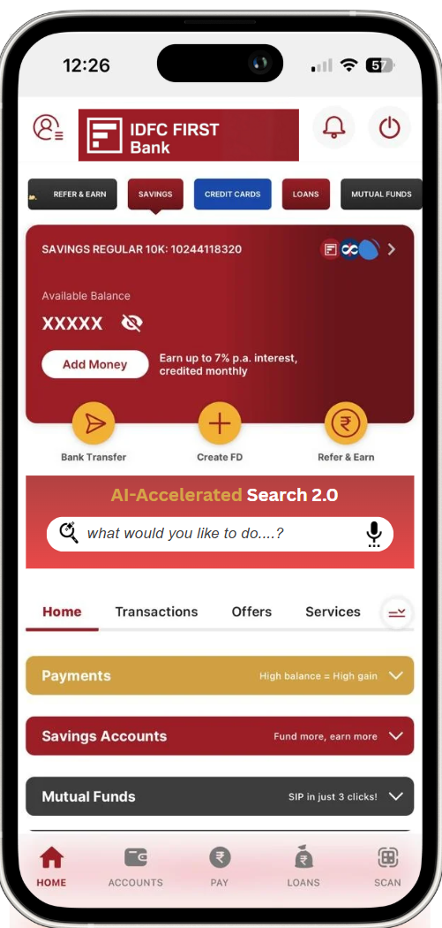
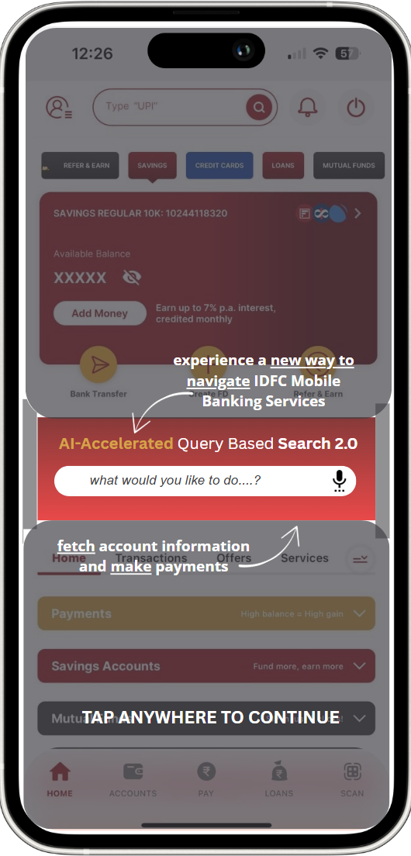
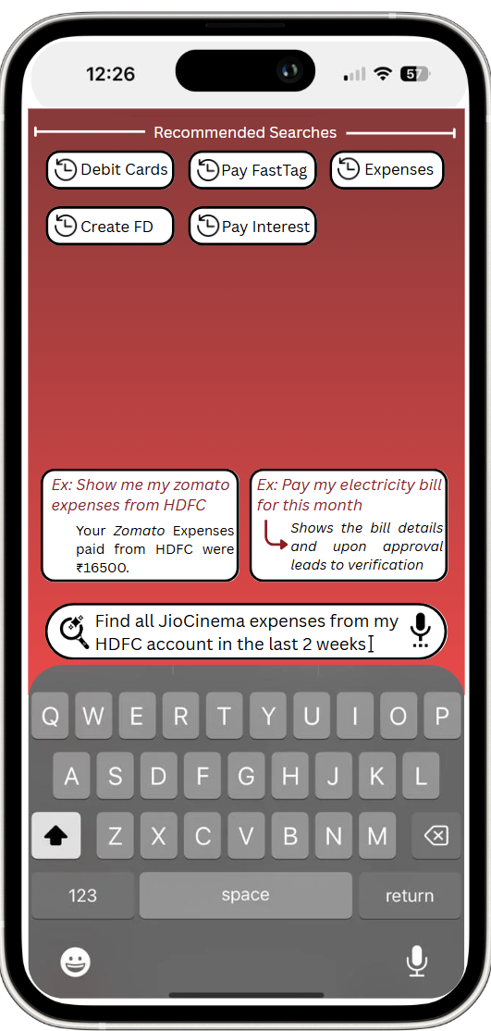
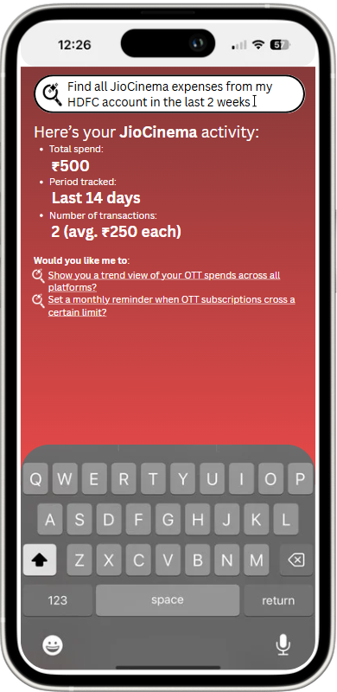
Slide 1: Research & Positioning
Slide 2: Gaps & Solution
Exhibit 1 : Search 2.0
Exhibit 2 : Recommended Rewards
Exhibit 3 : RAG/Costing/Feasibility
Exhibit 1: Expediated Customer Journey with Search 2.0
Current Search Bar gets replaced with the new & updated Search 2.0
The LLM fetches the data from the application and shows result
Recommended Searches are provided to those navigating normally
User becomes aware about the new bar once updating app
Query Examples and results are provided to explain functionality
Further recommendations are provided to educate the user further
User enters the query is casual textual format
REWARDS

Slide 5
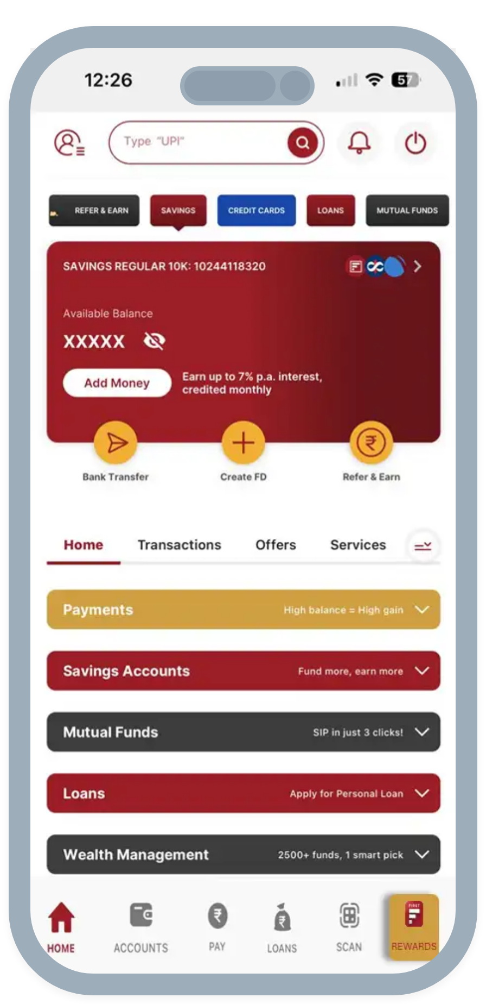
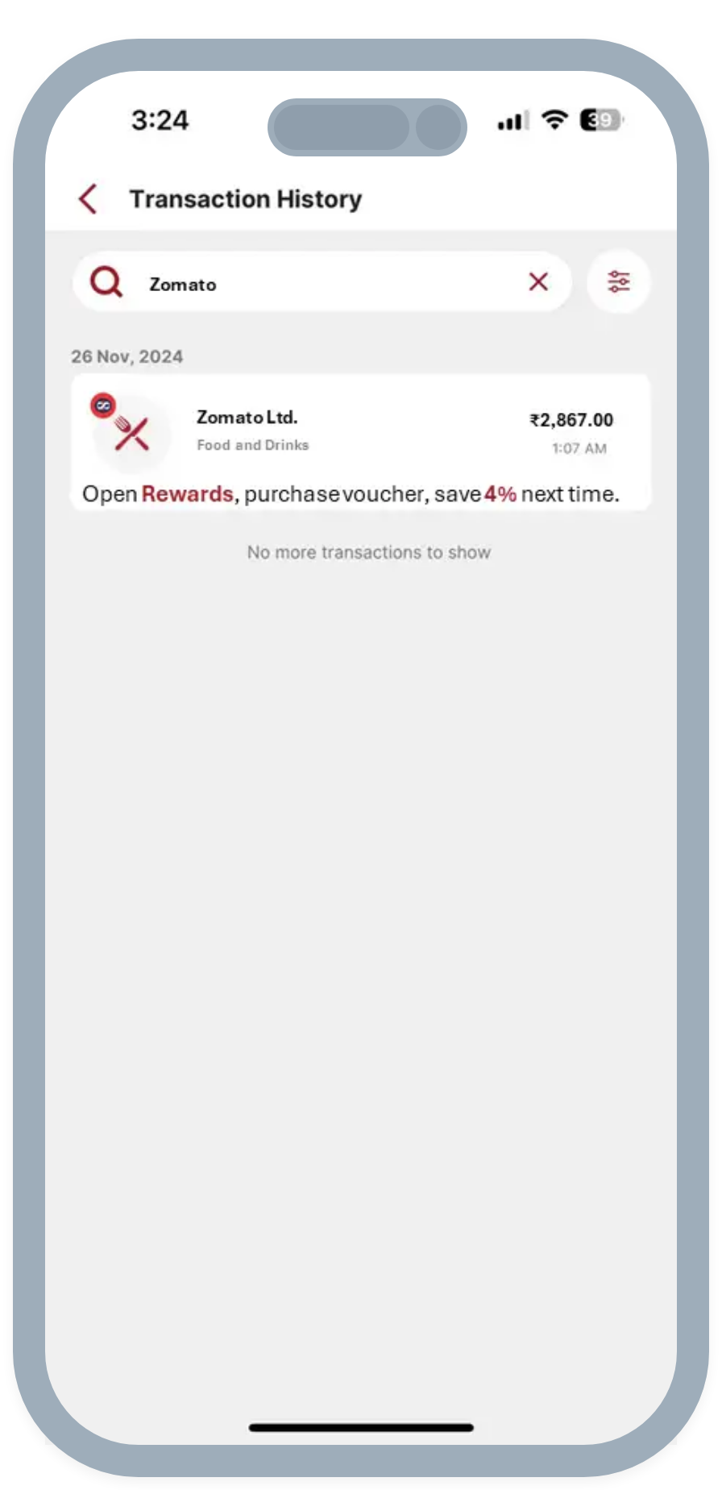
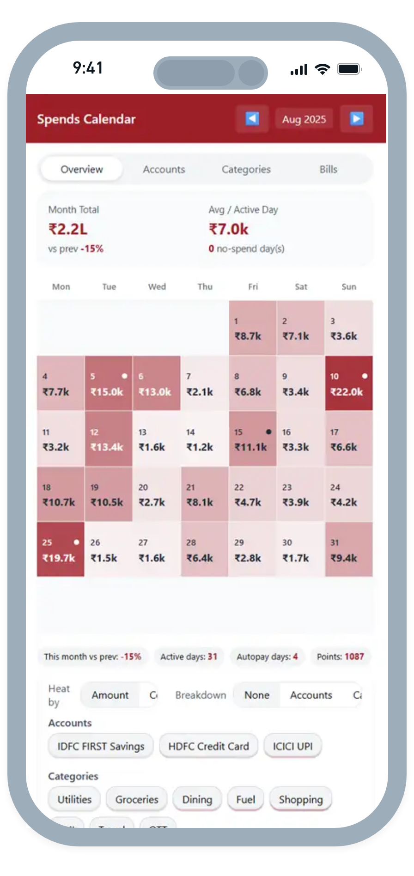
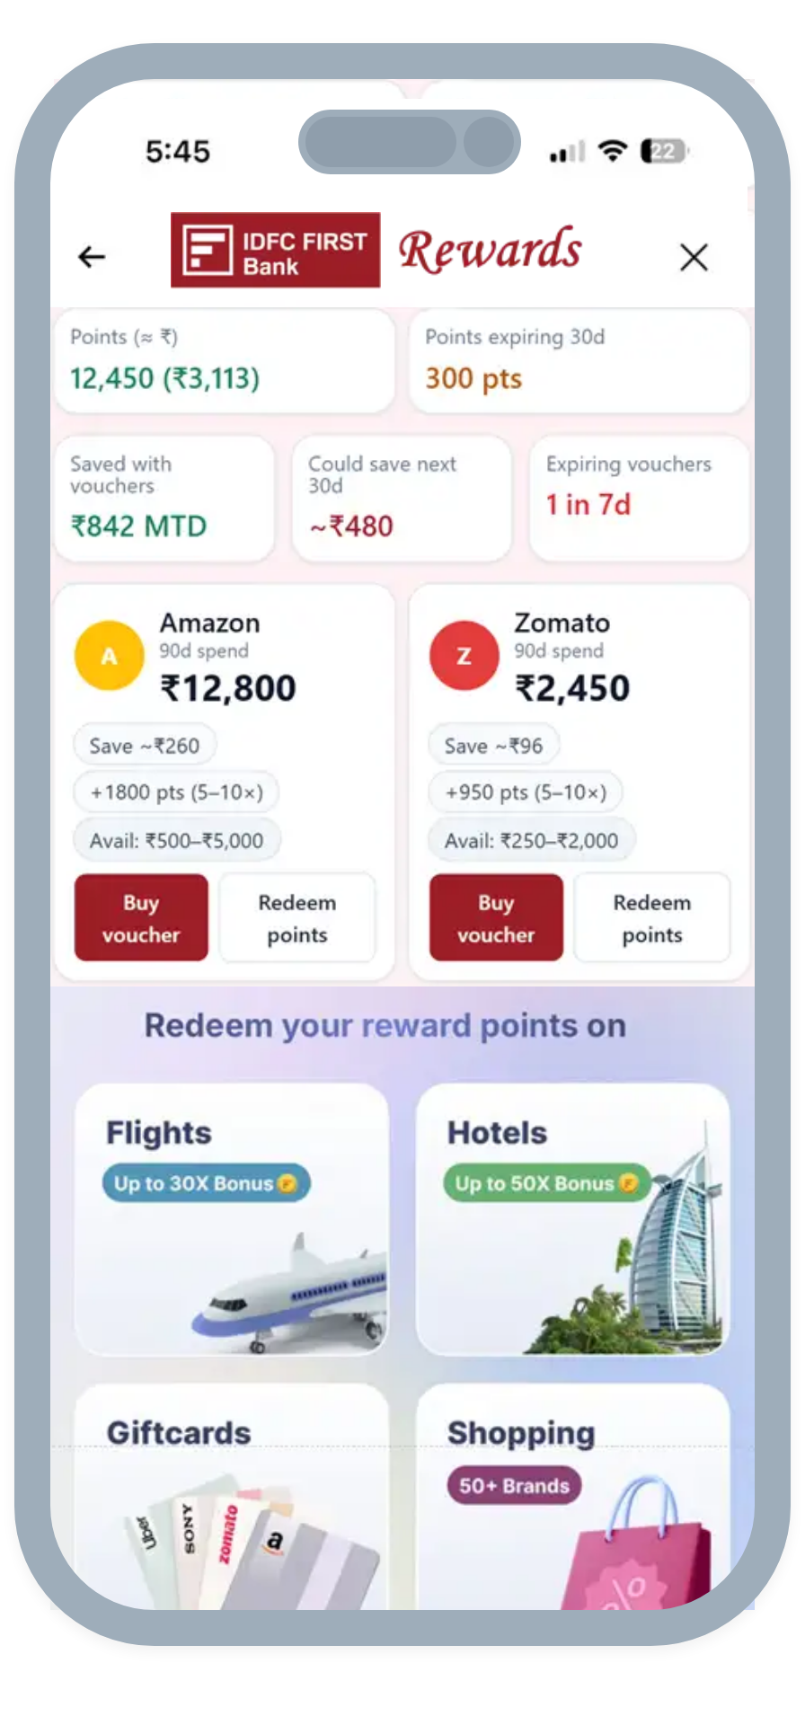
Slide 1: Research & Positioning
Slide 2: Gaps & Solution
Exhibit 1 : Search 2.0
Exhibit 2 : Recommended Rewards
Exhibit 3 : RAG/Costing/Feasability
Exhibit 2: Revamping Reward Redemption & Expense Management
A calendar overview for better tracking and intuitive visualization
A new dashboard with personalized recommendations
Match the vendors to available vouchers, and show the savings
Shift the Rewards tab to the Homepage for better visibility

Slide 6
Slide 1: Research & Positioning
Slide 2: Gaps & Solution
Exhibit 1 : Search 2.0
Exhibit 2 : Recommended Rewards
Exhibit 3 : RAG/Costing/Feasability
Behind the Scenes of On-Prem RAG LLM
Architecture
Infra & Cost
On-prem RAG stack
Target SLOs
P50 ≤ 2s, P95 ≤ 4s; 1–2k TPS at national scale; citations + safe-decline when uncertain.
7–13B LLM (bank-tuned) + vector search + SQL/API retrieval; chat + voice (vernacular) ASR/TTS; strict customer-scope filters before the LLM.
Pilot (3–6 mo)
Rollout (6–12 mo):
Unit economics
4–8 GPU servers (H100/L40S/A100 class), 2–3 index/API nodes, ~100 TB storage → 200–500 TPS.
15–30 GPU servers, 6–10 index/API nodes, 300–600 TB storage → 1–2k TPS.
Capex: US$1–3M (HW + licenses). Opex/yr: US$0.5–0.9M (power/cooling/support, 6–8 FTE).
Capex: US$10–25M. Opex/yr: US$2–4M (8–12 FTE).
8-GPU server ≈ US$150–450k (vendor/spec dependent); vector DB license/support if commercial.
Feasibility & Rollout
Phase 0 (8–10 wks)
Phase 1 (3–6 mo)
Phase 2 (6–12 mo)
Business KPIs
Data pipes, RBAC, POC on transactions + cards
Hindi/English voice.
Pilot to 1–5% users
All domains (loans/wealth/beneficiaries), multi-AZ HA
Call deflection 10–20%, task completion ↑
Hit P50 ≤2s and ≥95% grounded answers.
1–2k TPS steady state.
CSAT/NPS ↑, rewards redemption/attach-rate ↑.
Feasibility & Rollout
Hallucinations
PII/Access leakage
Latency
Model drift/compliance
Row-/doc-level AuthZ pre-retrieval, encryption in transit/at rest, output redaction, full audit.
Quantization/distillation, batching, caching, streaming ASR; autoscale within DC.
Monthly eval + fine-tune, live index refresh, allow/deny lists, human-handoff for high-risk intents.
RAG grounding, confidence thresholds, supervisor check; cite sources or decline.

