Slide 1
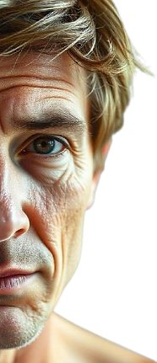

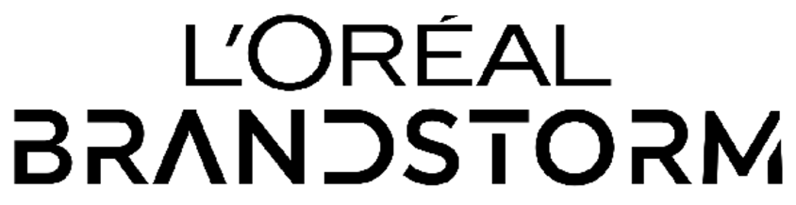



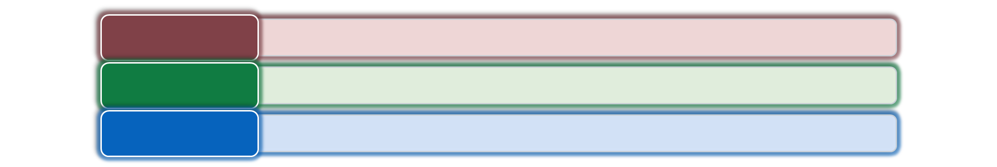
What if we told you that this is a picture of a 27-year-old male?
Shreyas Puri
Kanupriya Chhabra
Vedang Poddar
Summer Intern at PwC
Consulting
Summer Intern at HT Media
Marketing
Summer Intern at Cipla
Finance
What if we told you - your skin is much older than your biological age?
Team - L'Oréal ManStorm
Problem
Men’s beauty must go beyond products—creating awareness, ease, digital experiences, and measurable outcome to drive engagement
Solution
L’Oréal SmartSkinX –AI-powered ecosystem that addresses aging and skincare, simplifying men’s skincare routine with a smart roller, real-time tracking & habit-forming engagement
Approach
Tech-driven, omnichannel strategy combining AI-powered kiosks, gamified digital experiences, and e-commerce-first sales

Slide 2










Market Overview (1/2)
L'Oréal SmartSkinX
Marketing and Financials
Execution and Growth
Men are unaware of stress accelerating skin aging, —bridging science and convenience can unlock a €15.5bn high-growth SkinTech market
SECONDARY RESEARCH AND INDUSTRY ANALYSIS
Stress Work pressure, bad sleep, unhealthy diet
Skin Backlash Early Aging, acne and wrinkles
Inaction Men don’t notice - until it’s too late
28.7
€15.5bn
85% Extrinsic Factors
8.4%
Growth in gender-neutral skincare products, reflecting increasing male participation
TAM Men’s Skincare
Skin Aging
16.5
€978mn
15% Intrinsic Factors
SAM Premium SkinTech
The Silent
Stress-Ageing Loop
€103mn
67%
U.S. men use grooming products beyond hygiene, signaling evolving routines
2034 F
SOM
2025
Extrinsic aging from lifestyle outweighs intrinsic aging, making your skin likely to age faster than your biological age
(in €Bn)
2026
50%
Gen Z men (18-24) are open to facial makeup, expanding the male skincare market
CAGR 6.37%
We aim to capture ~11% of SkinTech Market in 2026 (SOM)
High-stress lifestyle can make you look up to 3.5 years older than your biological age
22Y
The approximate age at which loss of skin elasticity starts
Men’s interest in skincare far exceeds actual purchases, revealing a major untapped market
SCIENTIFIC LINK BETWEEN STRESS AND ACCELERATED AGING
Stressed Individual
Stress Activation (Trigger) → Extrinsic (UV/pollution) or Intrinsic (anxiety/work stress)
C-SAC (Cortisol-Skin Aging Cycle)
Ideal World: Cortisol level would normalize to the baseline when stress is resolved
Brain detects stress → Activates HPA → Skin senses stress via Cortisol Receptors
Real-World: Consistent stress keeps cortisol elevated, leading to collagen degradation, slow cell renewal, and premature aging
Hypothalamus (Command Centre) releases CRH → Activates Pituitary gland.
Pituitary Gland releases ACTH → ACTH stimulates adrenal glands → Releases Cortisol
High Cortisol signals HPA and pituitary gland to stop CRH & ACTH, restoring balance
Research shows that a consistent skincare routine can actively reduce cortisol levels by up to 83%, making skincare not just cosmetic but a science-backed tool to slow aging and protect skin health.
Chronic Stress disrupts feedback loop keeping Cortisol consistently high → Skin Aging

Slide 3



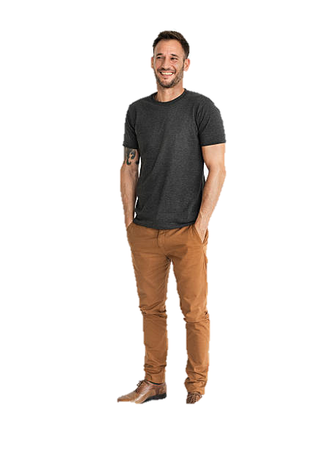
Decoding Consumers (2/2)
L'Oréal SmartSkinX
Marketing and Financials
Execution and Growth
Men perceive skincare as unnecessary and complex, yet they care about looking good and ageing well —bridging this gap requires a science-backed, effortless solution
PRIMARY RESEARCH (SAMPLE SIZE)
“Men don’t need skincare, right?”
105
RESPONSES
9
INTERVIEWS
2
FGDs
1
Dermatologist
💬 SAY
“I don’t want to touch something greasy.”
Laddering Analysis
Asking a series of "why" questions to
uncover the underlying motivations and values
WHAT OUR CUSTOMERS..
🧠 THINK
“I don’t need skincare; my skin is fine.”
“Skincare is too complicated”
OBSERVATION
Men don’t use skincare
❤️‍🔥 FEEL
“Does skincare even work?”
ISSUE
They think it’s unnecessary
“I can’t commit to a 5-step routine.”
DEEPER CONCERN
They do care about looking good & aging well
💡 DO
“Use minimal or no skincare”
“Choose convenience over complexity”
BREAKTHROUGH INSIGHT
If skincare is science backed and effortless, they might use it
CONSUMER BEHAVIOR
*
MEN’s SKINCARE AWARENESS
Anti-aging & reducing wrinkles
👔 Profession
IT Consultant
💰 Income
₹18 LPA ($22K)
👔 Profession
CEO, Startup
💰 Income
$120K/year
27%
Sun protection & preventing damage
18%
People aware about stress induced skin damage
Improving overall confidence
Pain Points
Pain Points
18%
Doesn't know what to buy, hates multi-step routines, seeks ease-of-use
Oily skin, breakouts, skeptical of beauty marketing, wants a quick-fix
Hydration & smooth skin
16%
Psychographic
Psychographic
Preventing acne & breakouts
Harry Barreto, 35 y/o Bangalore
Career-driven and time-conscious but unaware of skincare essentials routine
Larry Peter, 26 y/o New York
Trend-conscious, values self-care & tech-solutions. Overwhelmed by many choices
21%
Purchase Trigger
Purchase Trigger
With 74% of men unaware of stress-induced skin damage yet 27% prioritizing anti-aging in skincare, the gap between awareness and action is clear – SmartSkinX perfectly balances this need by combining tech-driven diagnostics and habit building
Needs simple skincare solutions, avoids complex routines, wants visible results
Notices aging signs, has social media influence, wants effective premium care
*Based on 105 responses, 9 interviews and 2 FGDs

Slide 4





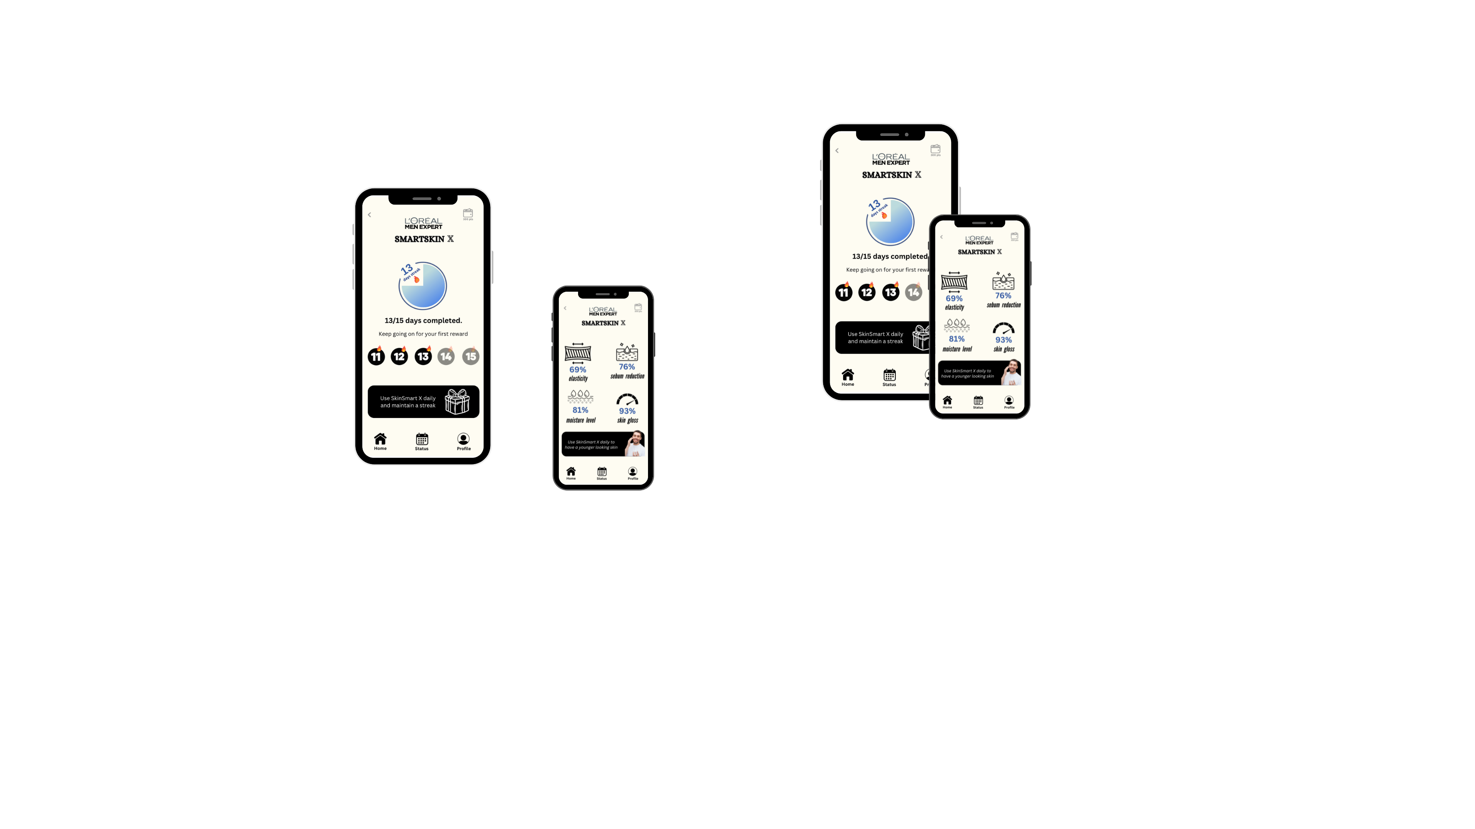
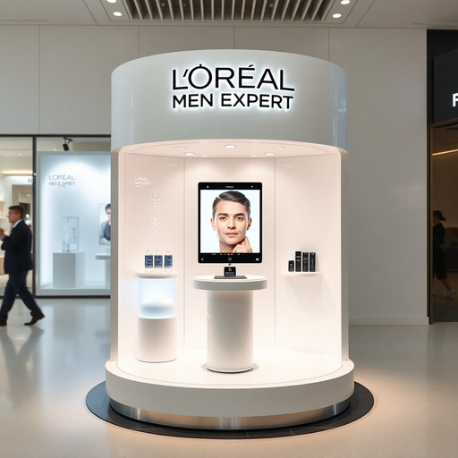
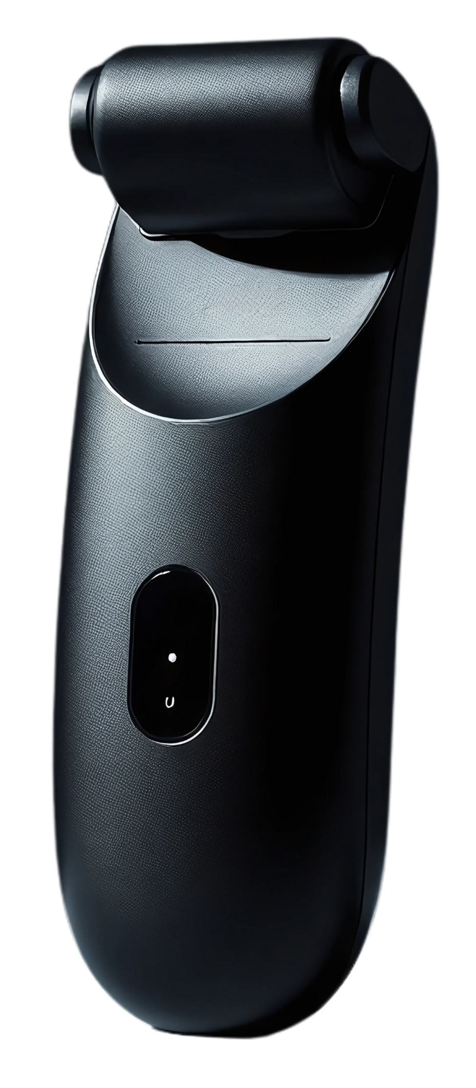
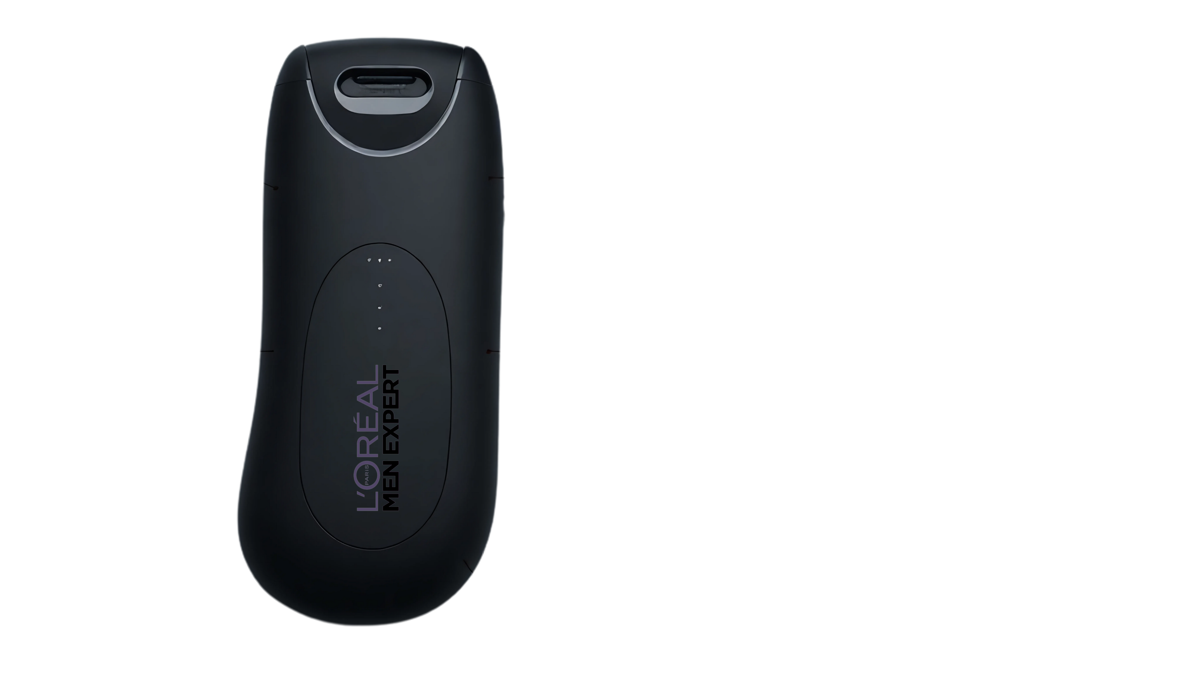

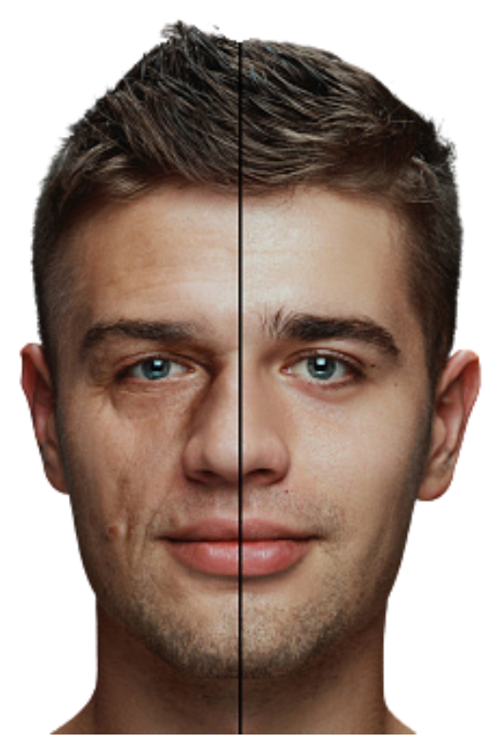

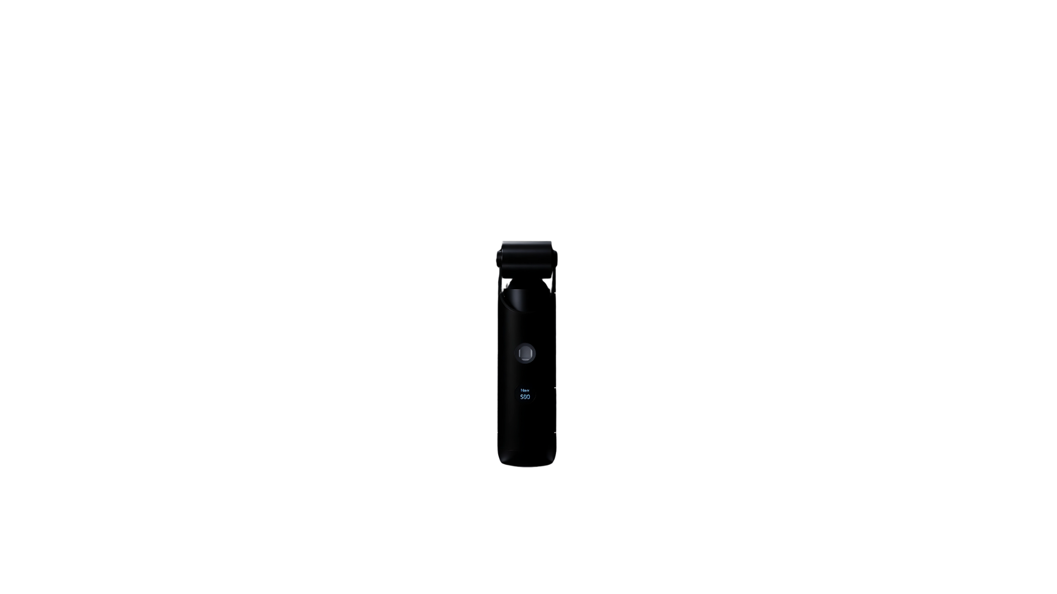
Market Overview
Transformation Journey (1/4)
Marketing and Financials
Execution and Growth
L’Oréal SmartX App
Track, Improve, Dominate
App-Driven Skincare that works like a fitness plan for your skin
AI powered Kiosk
Awakening the Need
Find Out Instantly! - Your Skin Age vs. Real Age
L’Oréal SmartSkinX Confidence, Delivered
One Device, One Minute, Zero Hassle
Aligned with L’Oréal’s “Never Alone” initiative, SmartSkinX recognizes the mental stress due to bad skin and promotes self-care
Integrated Roller
Automatic Cream Dispenser
Refillable Cream Cartridge
Better Skin
KNOW YOUR SKIN AGE
Commitment to Skincare
More
Confidence
Smart Skin Scanner
Your gym has trainer, your skin deserves one too!
Your digital skincare guide to analyse your skin daily, set milestones, & help you achieve results
3 problems 1 solution cause you’re worth it! A premium smart skincare device to give you a skincare routine in just 60 seconds
Reduced Stress
“Know Your Skin Age” kiosk;
where awareness sparks action
Interactive AI-Powered Kiosks at Malls and L’Oréal Partner Salons
Cross buys advanced anti-aging serums, SPF, night creams and eye care
Walks into a Mall Notices the Kiosk
Scans Skin to check skin age
Receives Skin Age analysis
SmartSkinX is Introduced
Sets Up SmartX App
Starts Routine - Apply, Scan & Track
Refill renewal & subscription

Slide 5
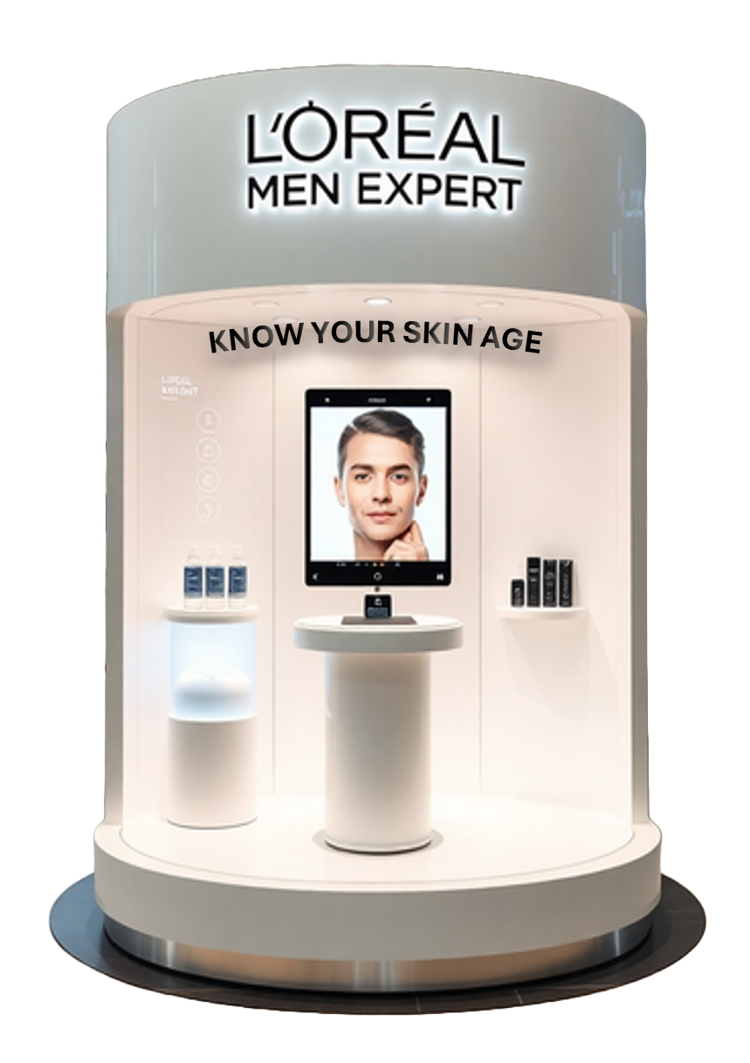
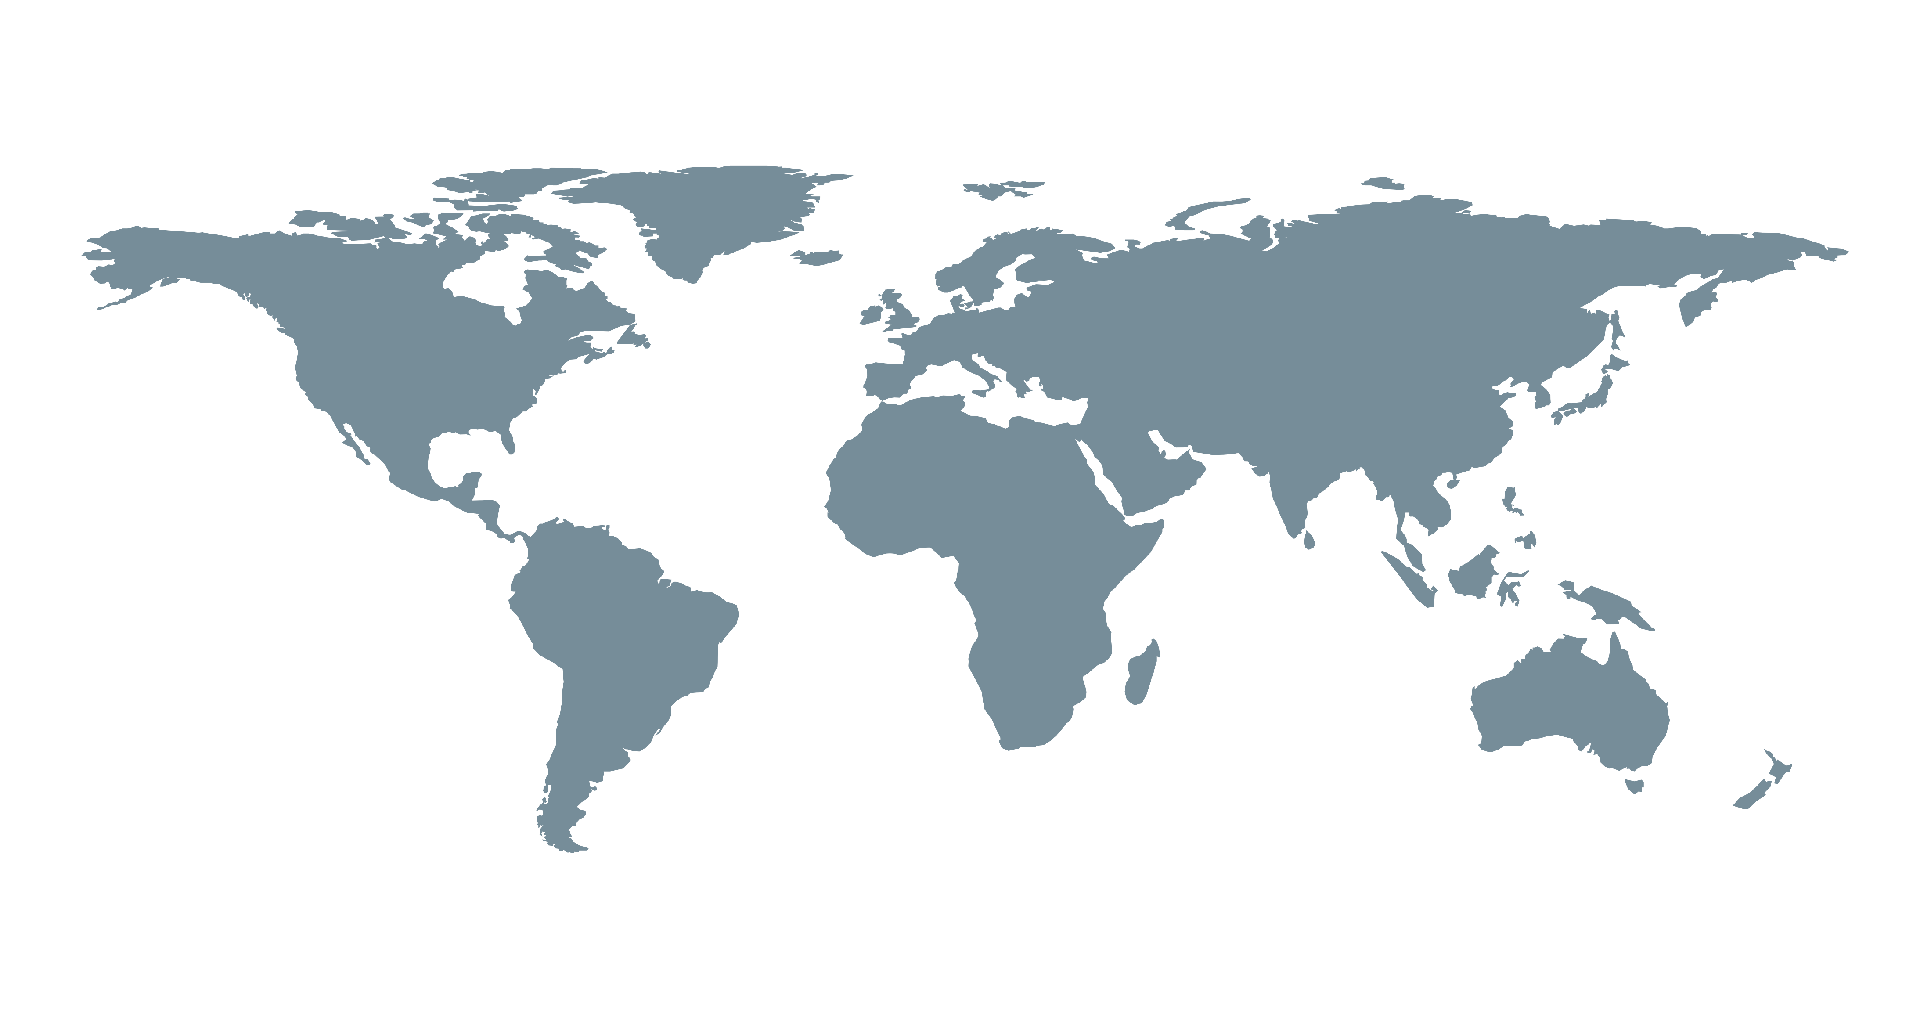
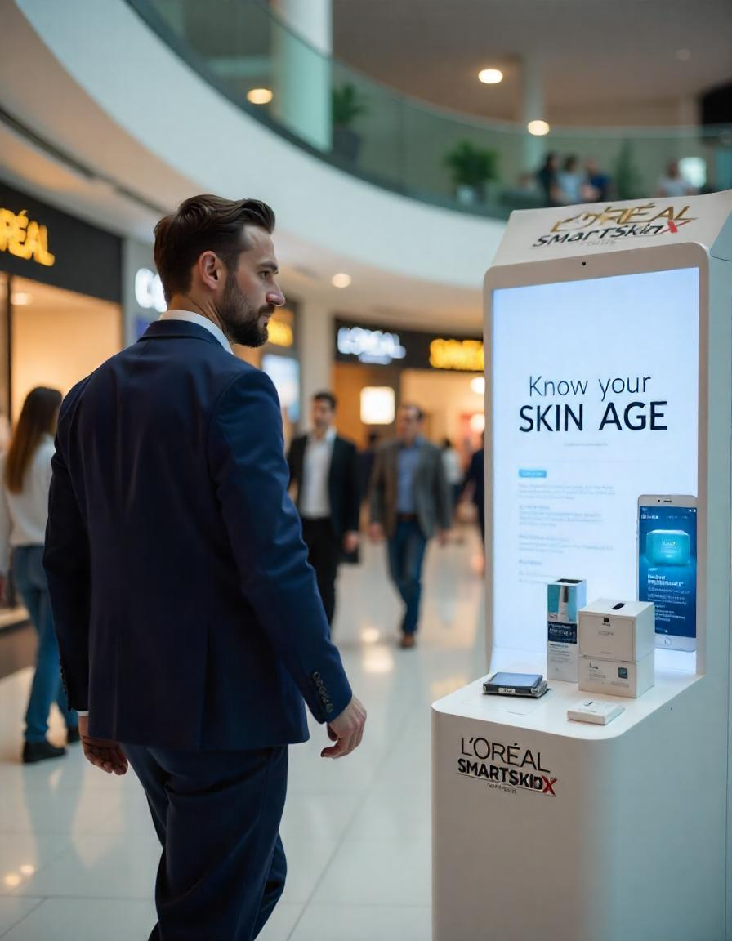
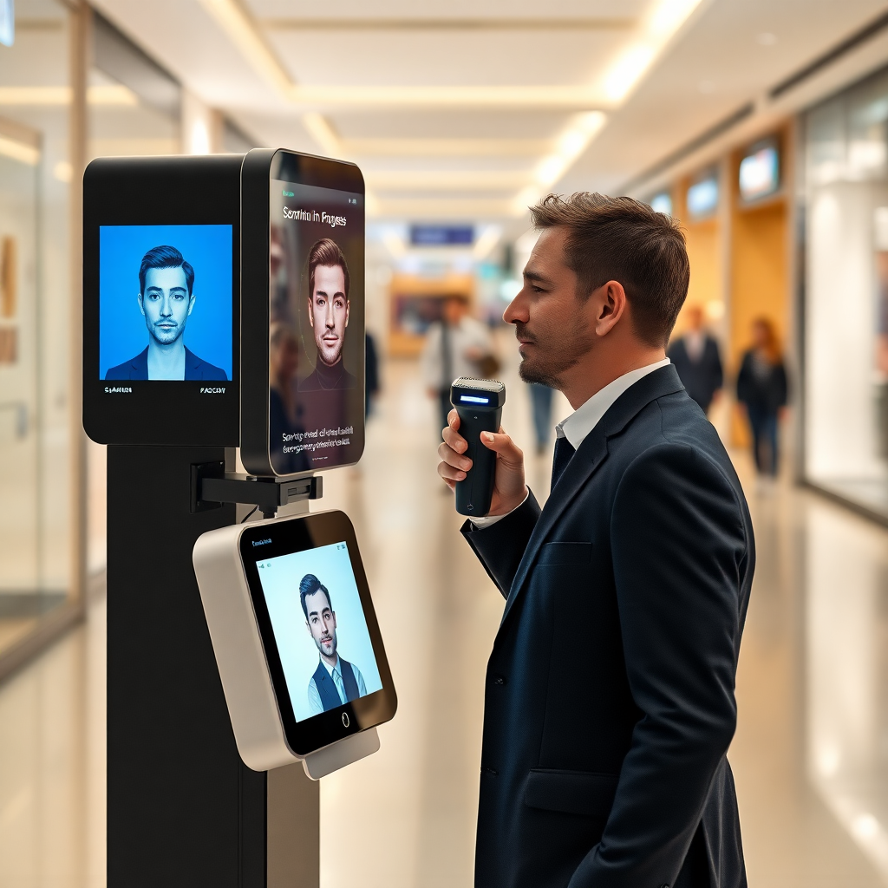
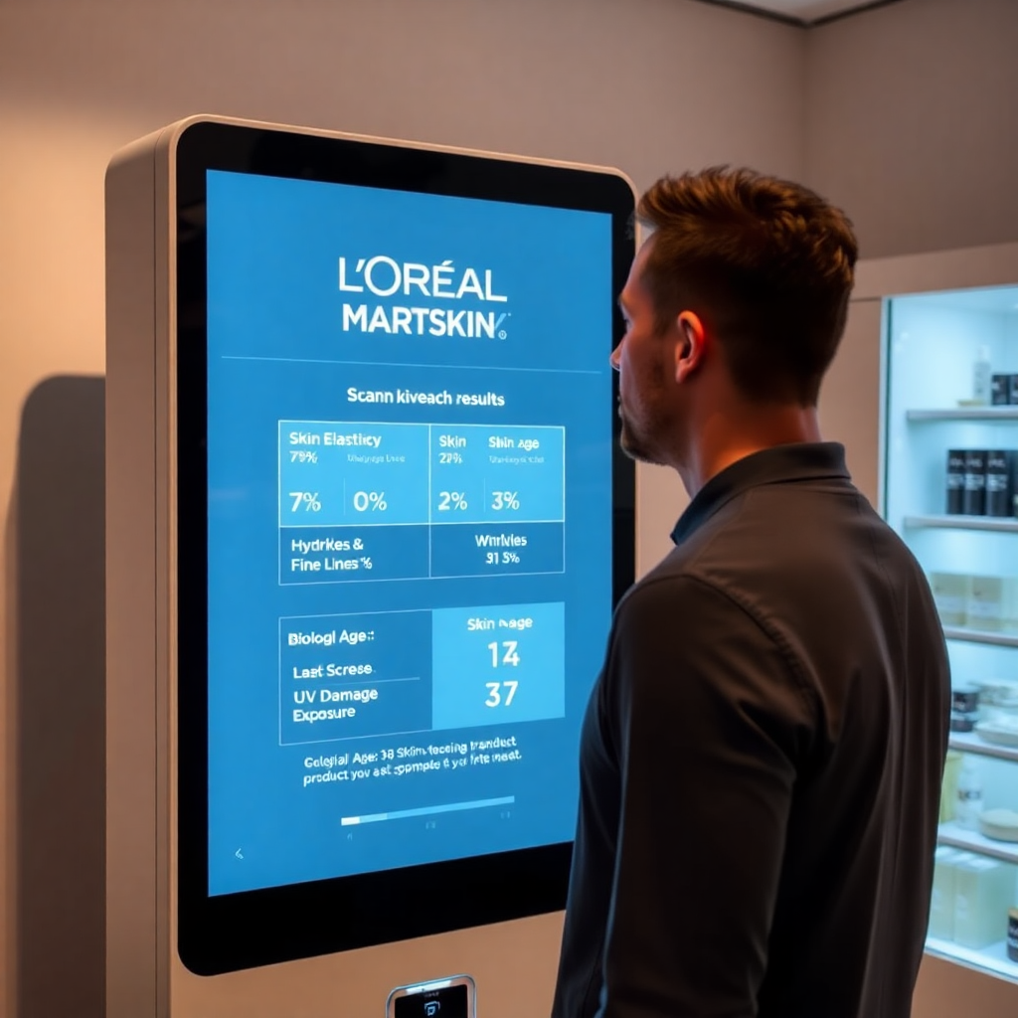
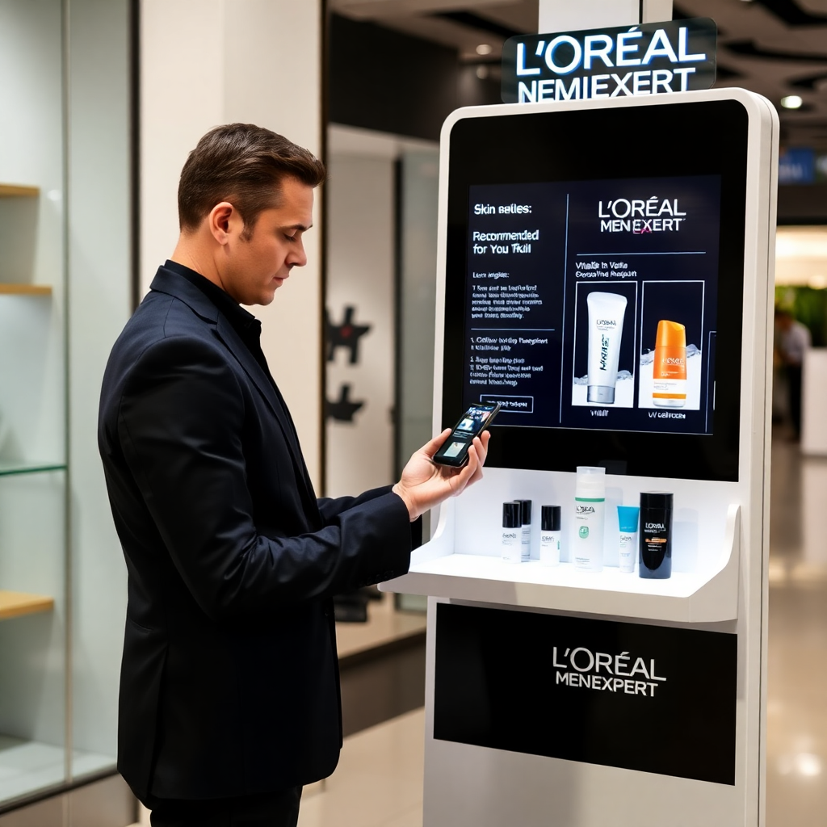












Market Overview
Initial Pull (2/4)
Marketing and Financials
Execution and Growth
A/B TESTING THE MESSAGE
Your Skin Age vs Biological Age
Concrete: “Your skin age is 3.5 years older than your biological age, implying skin elasticity has declined by 12% compared to optimal levels.”
- Sparking Action through Awareness
OR
Skin Analysis
via SmartSkinX
Abstract: “Your skin may be aging faster than you think. You might not know what’s happening beneath the surface.”
PHASE 1 ROLLOUT
(North America & Europe)
Tech-forward and concerned premium consumers
Body vs Skin Age Insights
89%
PHASE 2 ROLLOUT
(North Asia & Australia)
Grooming-conscious men open to high-tech beauty solutions
Favourable responses* to concrete messaging
SmartSkinX Purchase Enabler
*based on 73 responses
PHASE 3 ROLLOUT
(India, SE Asia, LATAM)
Emerging markets with growing beauty adoption in men
Upsell other products
Concrete messaging drives stronger engagement and behavior change, increasing kiosk interactions, app sign-ups, &SmartSkinX adoption.
KIOSK EXPERIENCE: FROM CURIOSITY TO CONVERSION
INSTALL IN HIGH FOOTFALL AREAS
25+ Airports
250+ Grooming Lounges
100+ Corporate Parks
150+ Shopping Malls
IMPACT METRICS
Kiosk Interaction rate
Trial to Purchase rate
Upsell Rate
Average
Transaction
Value (ATV)
Intrigued by the kiosk, he steps closer to scan
Analyse skin age through the scanner
The screen reveals shocking skin insights
These insights compel him to buy SmartSkinX

Slide 6

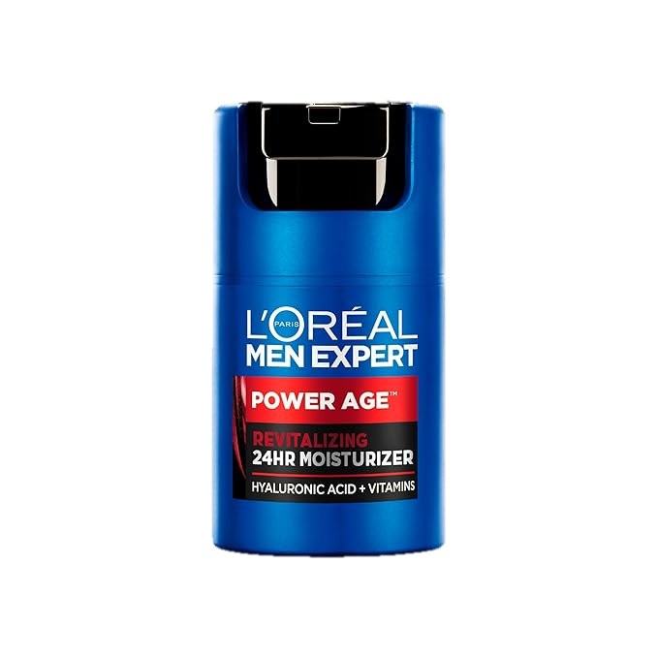
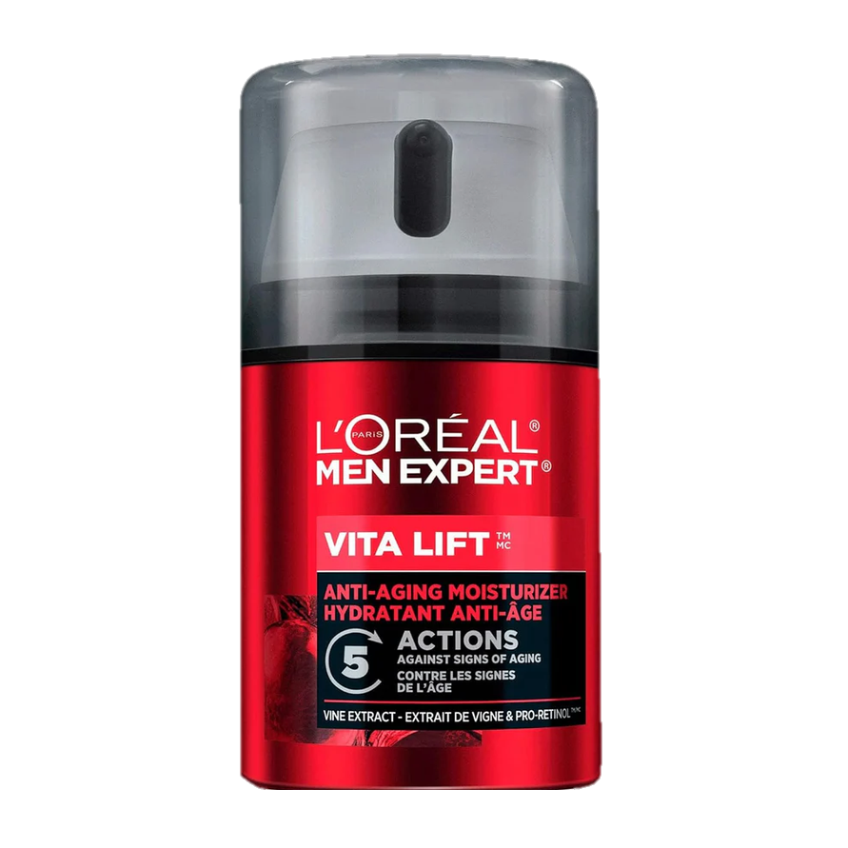
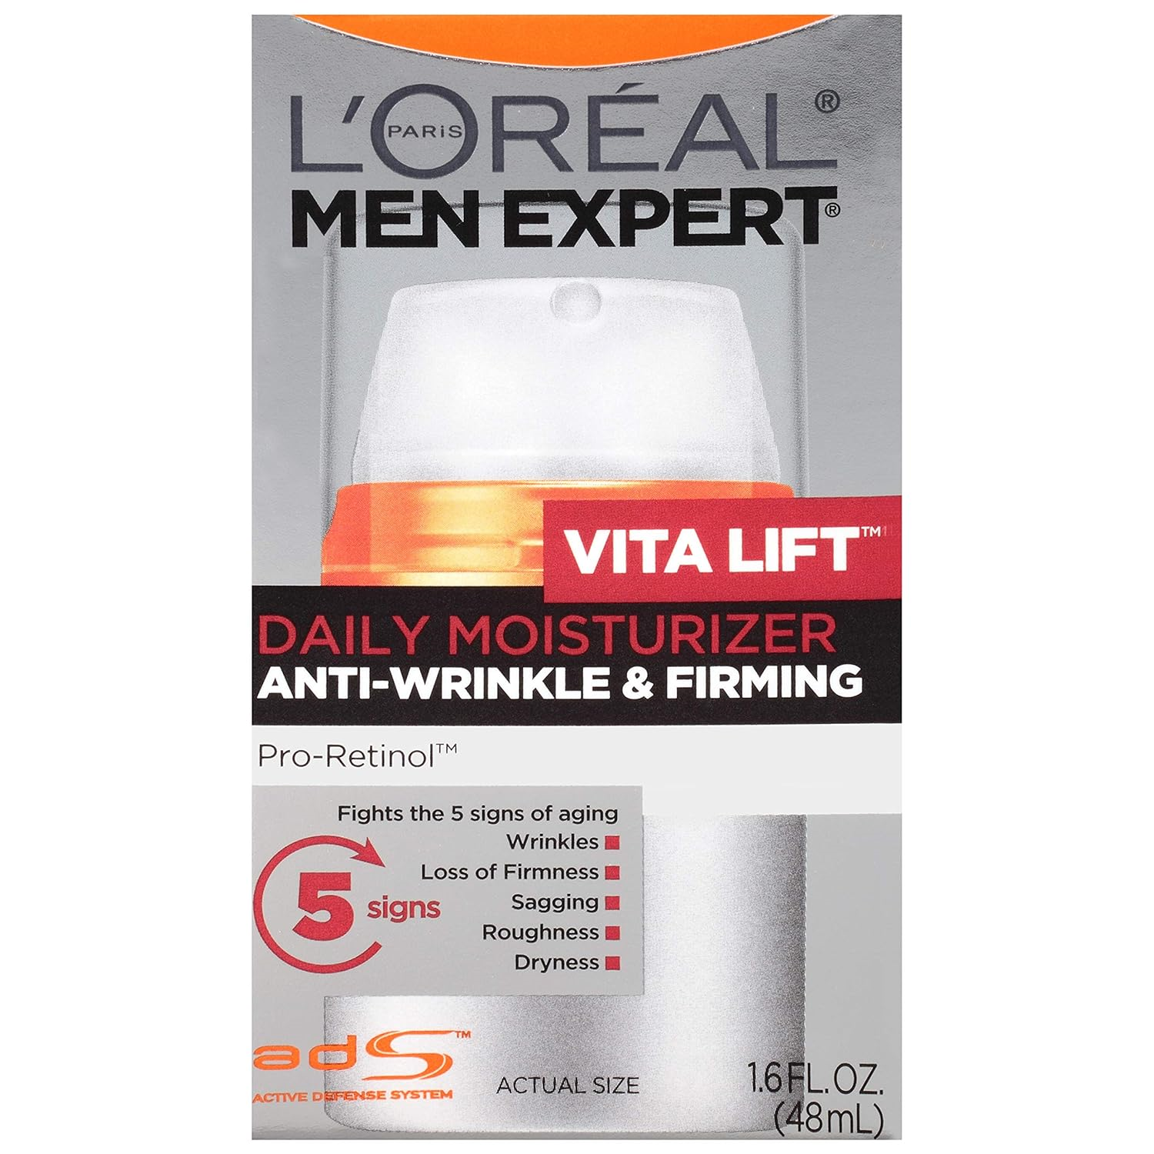
Market Overview
L'Oréal SmartSkinX (3/4)
Marketing and Financials
Execution and Growth
CUSTOMER PAIN POINTS
TECHNICAL FEASIBILITY
“Too many steps, too much effort – I just want something simple.”
“Skincare feels like a gimmick – I need real, science-backed proof.”
Skin Scanner Illuminates & Measures
3 Problems 1 Solution cause you’re worth it!
Targeted UV Light Exposure
A 395 nm LED emits UV light onto the skin, exciting biomolecules like Advanced Glycation Ends (AGEs).
Integrated Roller
Automatic Cream Dispenser
"I start but never stick to it – no visible progress, no motivation."
"I hate the greasy, sticky feeling – it makes me avoid skincare."
Fluorescence Emission
The excited AGEs re-emit light at longer wavelengths, indicating their concentration in the skin.
Refillable Cream Cartridge
SYNTHESIZED INSIGHTS
Optical Detection
A photodetector captures the emitted fluorescence, converting it into measurable data.
Men prioritize technology and proven results over beauty marketing
Cartridge System Locks-in & Dispenses
€5 - €10
Insert Snap the cartridge into place
Lock Twist or push to secure
Replace Swap with a new cartridge
€129
Cartridge cost
Blended Global Price
Smart Skin Scanner
Men require visible progress for motivation and consistency
Men don’t want 5-step routines or high-maintenance solutions
High-margin recurring revenue, driving profitability
Dispense the anti-ageing moisturiser
Hands-free application with roller
Scan to update your skin progress
Easy 3-step routine delivered in just 1 minute
Built for all skin types, L’Oréal SmartSkinX embraces inclusivity by offering skincare solutions tailored to individual needs
Tracking Your Skin’s Vital Signs
Current portfolio of Anti-Ageing Lotions
Sustainable Refillable cartridge versions of existing Vine and Retinol product-line for anti-ageing
Skin aging markers (AGEs)
Collagen degradation & elasticity loss
Hyperpigmentation & sun damage
Bacterial activity in acne-prone skin

Slide 7
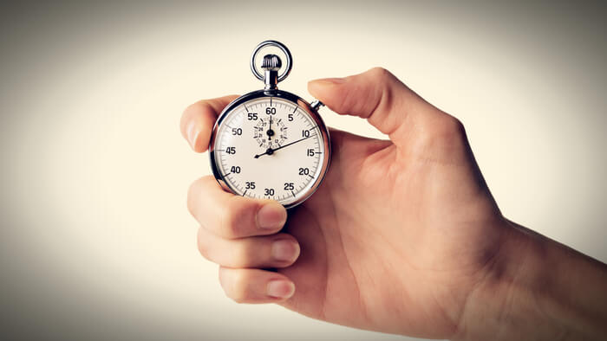

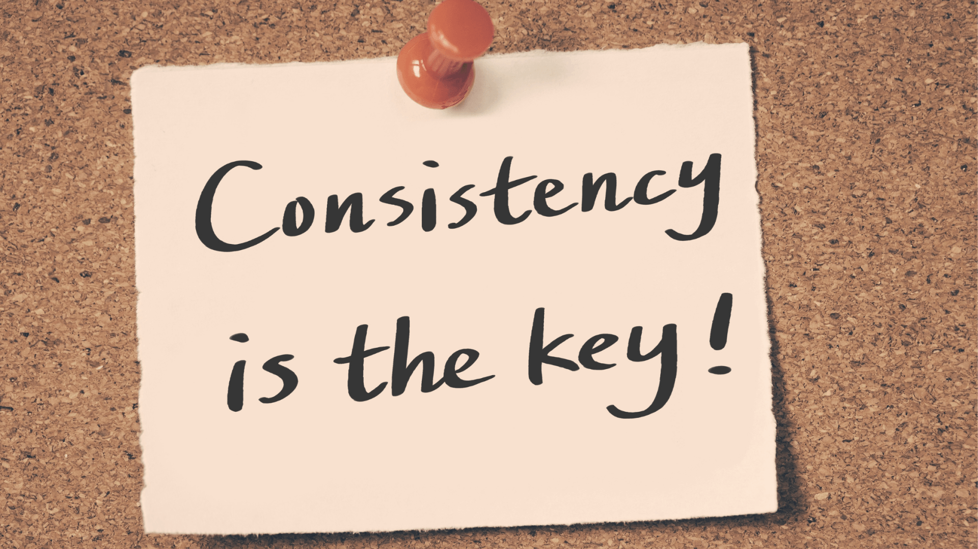

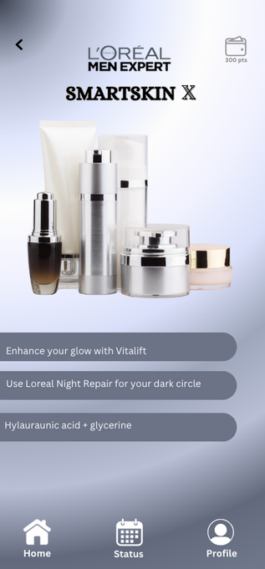
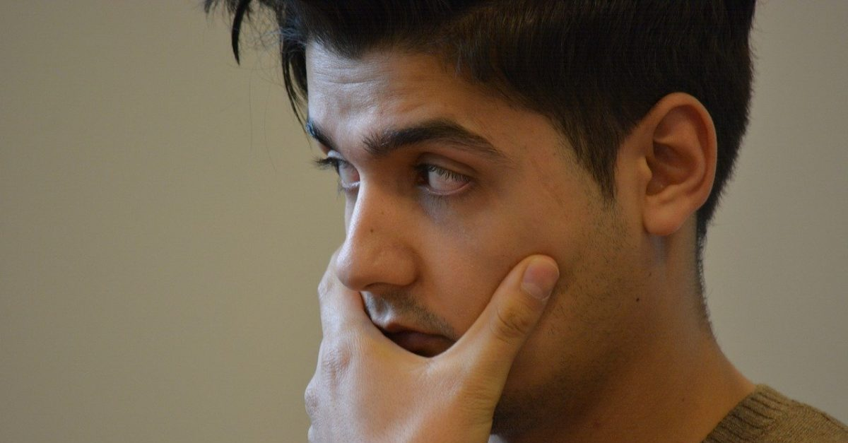
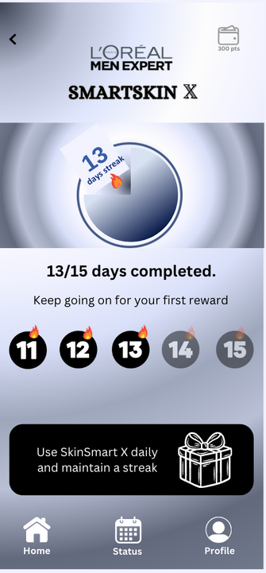
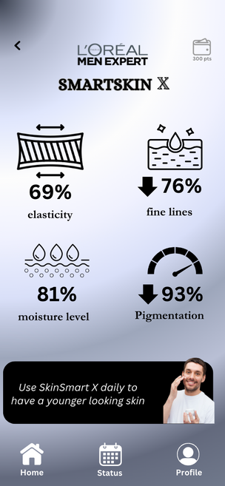





Market Overview
L'Oréal SmartX App (4/4)
Marketing and Financials
Execution and Growth
PAIN POINTS TO SMART SOLUTIONS
SCOPE FOR L'Oréal
Lack of Urgency?
Skin age vs biological age tracker
Fresh Start: More likely to adopt habits with a clear start
High-Margin Recurring Revenue
Your gym has trainer, your skin deserves one too!
“Users with skincare habits are 3X more likely to repurchase complementary products”
“Habit-building apps can increase product engagement by 40%+”
Behavioral Loyalty Triggers
What’s In It for L'Oréal?
Cross-Selling
Potential
Not Consistent?
Get streak reminders and rewards
Operant Conditioning improves habit consistency
Sceptical about results?
“See it to believe it” model
Goal Gradient: Visual progress increases engagement
Loyalty & Advocacy
Customer Data Goldmine
SMARTSKIN
X
1. Discovery & Onboarding
User finds the app via kiosk/product packaging
Installs & sets up profile
Syncs SmartSkinX with SmartX app
Tracking begins
3. Progress & Real-Time Insights
User tracks visible improvements such as:
Consistency
Elasticity and wrinkles
Hyperpigmentation
UV damage
2. Daily Routine & Habit Formation
App sends reminders
User scans & applies SmartSkinX
Streaks & milestone based rewards to promote and encourage consistency
4. AI-Powered Recommendations
Based on the progress, SmartX application suggests complementary products like:
Sunscreens
Acne Solutions
Serums
IMPACT METRICS
DAU
Streak Adherence
Session Duration
Push Notification Response Rate

Slide 8
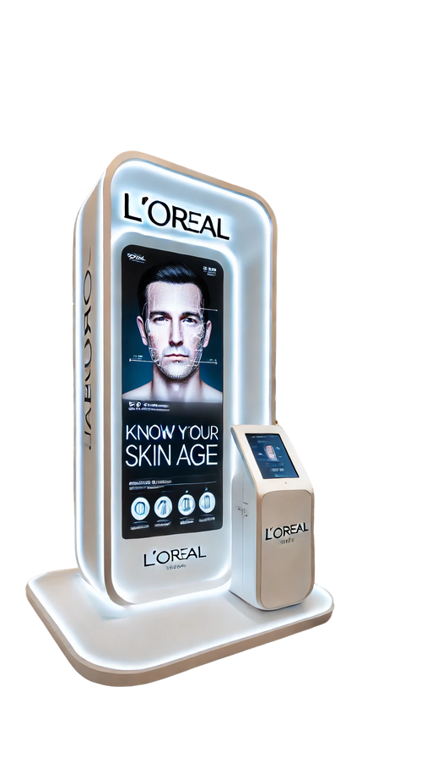
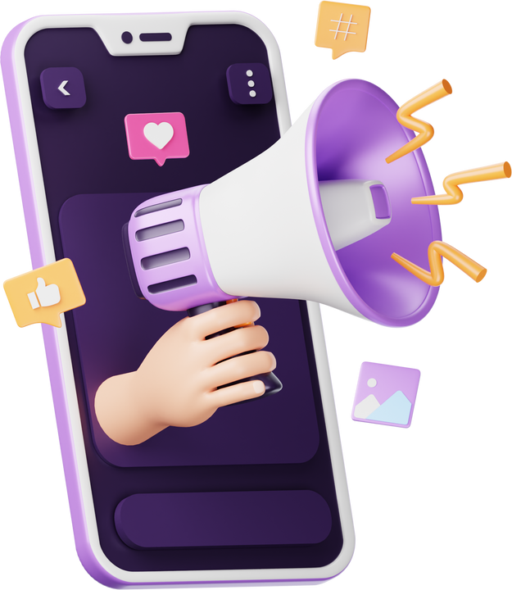
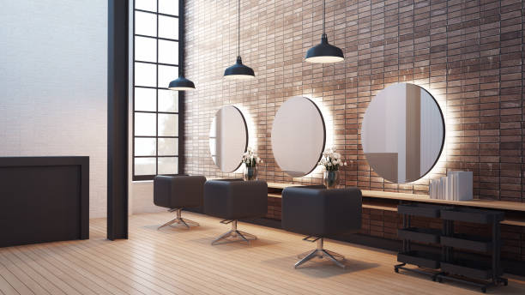
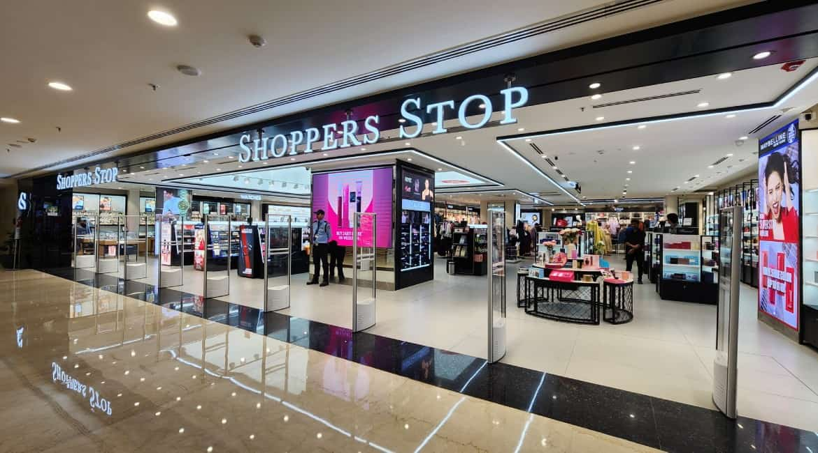







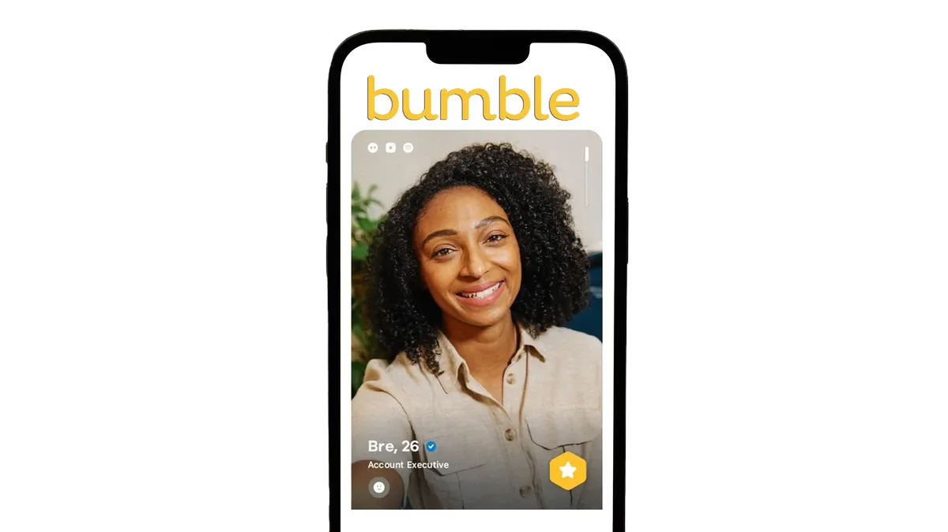

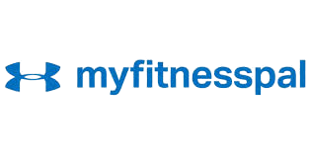



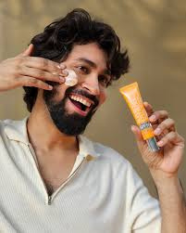

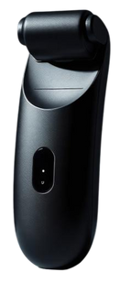
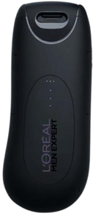



Market Overview
L'Oréal SmartSkinX
Distribution & Marketing (1/2)
Execution and Growth
A multi-touchpoint strategy—spanning retail, e-commerce, and quick commerce—ensures SmartSkinX is always within a consumer’s reach.
INTEGRATED MARKETING
DISTRIBUTION CHANNELS
INTEGRATED MARKETING
Social Influencer Marketing
Event-Based promotions such as Valentine’s
Fitness Apps “MyFitnesPal”
Dating app partnerships with Bumble & Hinge
Offline
Kiosk & QR Challenge (Mall, gym & wellness)
Corporate Wellness Programs
Couple-driven workshops for community building
Expert Endorsements to build credibility
Offline
Offline Channels
Online Channels
ONLINE
INTEGRATED MARKETING
L'Oréal partner salons, Kaya Clinics
Lifestyle, Shoppers Stop, etc
L'Oréal website, Amazon, Nykaa Man
Swiggy, Zepto, BlinkIt
OFFLINE
Salons and Dermatology clinics
Brick-and-Mortar Retail
Direct and e-Commerce
Instant Delivery & Quick Commerce
A reliable sources where professionals recommend grooming and skincare solutions
Easy to pick up skincare essentials while shopping for other necessities
Trusted platforms for easy product discovery and quick reordering
To leverage Impulse buying & last-minute purchases
MARKETING CAMPAIGNS
“Age gracefully with Ankush“
Campaign with Ankush
Placed between reels and stories, Ankush Bahuguna demonstrates the 1-min routine to age gracefully
“Glow Together “ Campaign with bumble
“Age gracefully with Ankush“
Campaign with Ankush
“Track Beyond Fitness" Campaign with MyFitnessPal
Position the campaign between swipe cards prompting user to buy SmartSkinX & age beautifully together
Placed between reels and stories, Ankush Bahuguna demonstrates the 1-min routine to age gracefully
Placed between meal logs/ workout tracking screens nudging user to track skin with SmartSkinX
Your fitness
has a tracker, your skin needs it too!
glow together
SmartSkinX
Brand Recall
Sales Spike
Social proof
Purchase Intent
Confidence, Delivered
One Device, One Minute, Zero Hassle
Awareness
Conversions
W SmartSkinX
Ankush Bahuga uses SmartSkinX to apply, track and scan his skin effortlessly in one minute. Try now!

Slide 9
Market Overview
L'Oréal SmartSkinX
Distribution & Marketing (1/2)
Execution and Growth
A multi-touchpoint strategy—spanning retail, e-commerce, and quick commerce—ensures SmartSkinX is always within a consumer’s reach.
INTEGRATED MARKETING
DISTRIBUTION CHANNELS
INTEGRATED MARKETING
Social Influencer Marketing
Event-Based promotions such as Valentine’s
In-App Engagement SmartX
Dating app partnerships with Bumble & Hinge
Offline
Online
Offline Channels
Kiosk & QR Challenge (Mall, gym & wellness)
Corporate Wellness Programs
Couple-driven workshops for community building
Expert Endorsements to build credibility
Offline
ONLINE
INTEGRATED MARKETING
L'Oréal partner salons, Kaya Clinics
Lifestyle, Shoppers Stop, etc
L'Oréal website, Amazon, Nykaa Man
Swiggy, Zepto, BlinkIt
OFFLINE
Salons and Dermatology clinics
Brick-and-Mortar Retail
Direct and e-Commerce
Instant Delivery & Quick Commerce
A reliable sources where professionals recommend grooming and skincare solutions
Easy to pick up skincare essentials while shopping for other necessities
Trusted platforms for easy product discovery and quick reordering
To leverage Impulse buying & last-minute purchases
MARKETING CAMPAIGNS
“Age gracefully with Ankush“
Campaign with Ankush
Placed between reels and stories, Ankush Bahuguna demonstrates the 1-min routine to age gracefully
“Glow Together “ Campaign with bumble
“Age gracefully with Ankush“
Campaign with Ankush
“Track Beyond Fitness" Campaign with MyFitnessPal
Position the campaign between swipe cards prompting user to buy SmartSkinX & age beautifully together
Placed between reels and stories, Ankush Bahuguna demonstrates the 1-min routine to age gracefully
Placed between meal logs/ workout tracking screens nudging user to track skin with SmartSkinX
Your fitness
has a tracker, your skin needs it too!
glow together
SmartSkinX
Brand Recall
Sales Spike
Social proof
Purchase Intent
Confidence, Delivered
One Device, One Minute, Zero Hassle
Awareness
Conversions
W SmartSkinX
Ankush Bahuga uses SmartSkinX to apply, track and scan his skin effortlessly in one minute. Try now!

Slide 10


Market Overview
L'Oréal SmartSkinX
Financial Feasibility (2/2)
Execution and Growth
A first-mover in the €1.7bn SkinTech market, SmartSkinX leverages a scalable model with 30% Revenue CAGR and 62% contribution margin, achieving breakeven by 2030.
SKIN-TECH MARKET SIZE
GEOGRAPHY BASED PRICING
FINANCIAL FEASIBILITY
From niche to necessity- SmartSkinX is redefining the men’s SkinTech market with scalable growth.
Optimizing Market Accessibility & Maximizing Profitability through Purchasing Power Parity (PPP) & Regional Demand Elasticity
From niche to necessity- SmartSkinX is redefining the men’s SkinTech market with scalable growth.
Initial Investment: <€50m
Total Skincare (2026) : €129bn
NA: €139m
EU: €149m
6Y Revenue CAGR: 30%
North Asia: €129m
Contribution Margin: 62%
Men’s Skincare: €15.5bn
Africa, ME, SE Asia: €69m
6Y Project IRR: ~20%
Men’s SkinTech: €0.8bn
LATAM: €79m
CLTV: €98 / CAC: €24 = 4:1 LTV:CAC Ratio
Cumulative BEP: SmartSkinX will return the initial capex by 2030, i.e. within 5 years of launch
At 10% penetration, L'Oréal can achieve ~€98mn revenue in 2026
Blended Price: €129
Future Market and Assumptions
Unit Economics and Device Breakdown
Market Penetration: 28%
Contribution Margin: €80
Market Growth: 9.5% CAGR
2031 Figures
SkinTech Market: €1.7bn
SmartSkinX Revenue: €0.4bn
Revenue: 30% CAGR
SAF Sensors: €16
Blended Price: €129
Housing and
Electronics: €11
Interchangeable
Cartridge: €9
2031 Target GP: 67%
2031 EBIT Margin: 22%
Rolling
Mechanism: €5
Variable Cost: €49

Slide 11






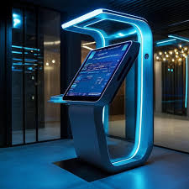

Market Overview
L'Oréal SmartSkinX
Marketing and Financials
Execution (1/2)
By aligning strategic execution with robust risk mitigation, SmartSkinX accelerates from prototype to global expansion—securing market leadership in SkinTech
Q1
Q2
Q3
Q4
Entry & Stabilize
Willingness-to-Pay Studies
Prototype Design & Testing
Manufacturing Partner Selection
Pilot Launch and Refinement
2025
Market Research & Consumer Insights
Material Sourcing
App Integration & Finalisation
Finalize Kiosk and Product MVP
Growth & Expansion
Launch SmartSkinX North America & EU
Expand retail presence
Launch on Amazon & D2C
Growth groundwork for China, Japan, & Korea
2026
100+ kiosks in malls, gyms airports in Tier-1 cities
Influencer & targeted digital campaigns
Corporate Wellness Programs in Fortune 500 Cos.
Future Goals
Global Expansion in Oceania, India, SE Asia & LATAM
First LTV Optimization Campaign: Maximize refill retention
2028
Develop SmartSkinX 2.0 with multi-cartridge dispensing
Ginseng-infused skincare (mental health focus)
2029
Launch Global Skin Health Index: Data-backed consumer insights
Sustainability Innovation: Exploring refillable solid skincare formats
2027
RISKS & MITIGATION
Market and Consumer
Regulations and Privacy
Technology and Product
Distribution and Execution
Scanner accuracy concerns
Price sensitivity
Conduct clinical validation
Region based pricing
Data Privacy concerns
Overpromising benefits
3-Factor Authentication
Clinically backed claims
Application fatigue
Copycat brands
Gamify experience
Secure Patent & trademark
High kiosk set-up costs
Risk in Global expansion
Phased Rollout
Start with flagship locations

Slide 12

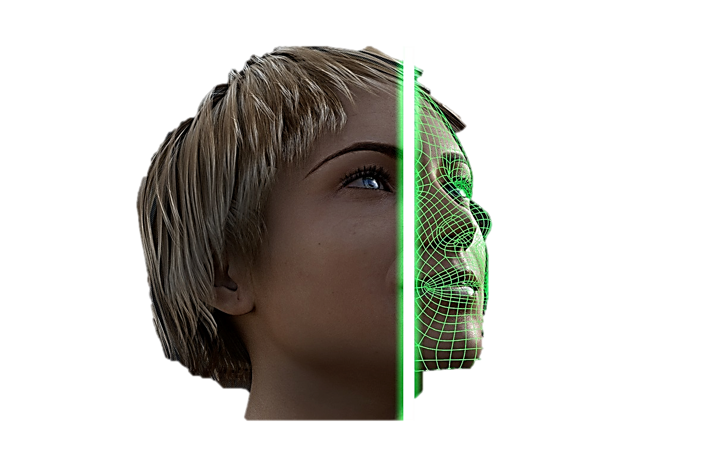
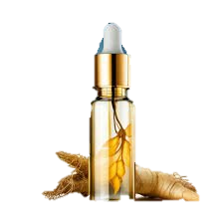
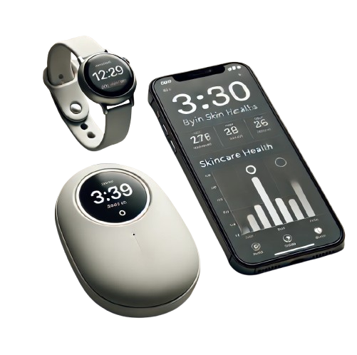
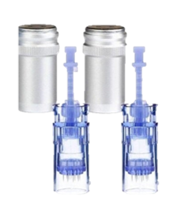






Market Overview
L'Oréal SmartSkinX
Marketing and Financials
Future Growth & Goals (2/2)
Beyond anti-aging—SmartSkinX will offer multi-cartridge personalization, neuro-cosmetic mental wellness, all while being inclusive and sustainable
The Future of SmartSkinX
Skincare meets cutting-edge innovation: SmartSkinX evolves beyond anti-aging into a tech-driven, personalized wellness ecosystem
Skin Twin Simulation
Leverage AI/ML to create a virtual twin of user’s skin, showing how their skin will age basis current habits vs how SmartSkinX can help
Skincare X Mental Care
Expand into the neuro-cosmetics segment by integrating skincare with mood-enhancers like Ginseng to further reduce the stress levels
SmartSkinX Ecosystem
Sync SmartSkinX with wearables and smart home devices, ensuring skin health tracking alongside fitness and wellness routines
Multi-Cartridge Expansion
Launch SmartSkinX 2.0 with multiple cartridges for different use cases such as sebum control, hydration, sun-protection etc
Future Growth
Future Growth
SmartSkinX & L'Oréal: Inclusive Innovation
SmartSkinX aligns with L'Oréal’s Sustainability Goals
"Your Skin, Your Story" spread diversity with 16 individuals of varying skin tones
L'Oréal’s Accessible Beauty Innovation for physical accessibility
Biodegradable PLA lines and 50% PCR plastic in cartridges
100% of plastic packaging recyclable, refillable, or bio-based by 2025
Accessibility-First
Ergonomic Design & voice enabled UX/UI in the app
Accessibility-First
Ergonomic Design & voice enabled UX/UI in the app
SmartSkinX uses 50% recycled ABS & bio-based polycarbonate
100% of plastic packaging from recycled or bio-based sources by 2030
Recyclable cartridges cut packaging waste by 30% per user
20% reduction in packaging intensity by 2030
SmartSkinX aligns with L'Oréal's mission of inclusivity by providing personalized skincare solutions for all skin types and tones.
L'Oréal can leverage its recent tri-party agreement with Evonik and Abolis to develop bio-based materials for SmartSkinX

Slide 13


Slide 14
Appendix
https://pmc.ncbi.nlm.nih.gov/articles/PMC5758347/#:~:text=Panax%20ginseng%20and%20ginsenosides%20have,unfermented%20red%20ginseng%20%5B105%5D
https://pmc.ncbi.nlm.nih.gov/articles/PMC5628357/#:~:text=Ginseng%20effectively%20regulates%20the%20immune,prevents%20stress%2Dassociated%20physiological%20diseases
https://healthcare.utah.edu/healthfeed/2024/01/stressed-out-skin-link-between-stress-and-skin-health
https://www.belogical.in/blogs/news/how-stress-is-driving-the-need-for-skincare-solutions?srsltid=AfmBOorl0ABASuO_Ea_u2bJj3GPpVq8PZaHBBkzh3F7-r-K3eP5ZANWd
https://pmc.ncbi.nlm.nih.gov/articles/PMC8480446/
https://www.apa.org/pi/health-equity/resources/stress-report.pdf
https://timesofindia.indiatimes.com/life-style/health-fitness/de-stress/the-surprising-link-between-stress-and-skin-problems/articleshow/73249819.cms
https://www.harpersbazaar.com/uk/beauty/skincare/a33008631/skincare-routine-reduce-stress/
https://www.inklingsnews.com/opinions/2021/11/24/stigma-around-mens-skincare-must-be-upended/?utm
https://www.forbes.com/sites/richardkestenbaum/2022/03/22/how-mens-attitude-towards-grooming-and-cosmetics-is-changing/?utm
https://www.mdpi.com/2079-9284/9/4/78?utm
https://straitsresearch.com/report/mens-skincare-products-market?utm
https://www.liquid-land.com/the-importance-of-skincare-in-mental-health/
https://www.forbes.com/sites/celiashatzman/2024/06/10/new-research-shows-the-surprising-link-between-skin-and-emotional-wellness/
https://www.cosmeticsandtoiletries.com/research/literature-data/article/21836451/the-ins-and-outs-of-aging-intrinsicextrinsic-factors-and-nutricosmetic-fixes?utm
https://pmc.ncbi.nlm.nih.gov/articles/PMC2613964/
https://www.precedenceresearch.com/men-skin-care-products-market/
https://wellconnected.murad.com/how-to-reverse-stress-induced-aging

