Slide 1
Transitioning to clean “inhaling”

Slide 2




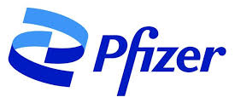




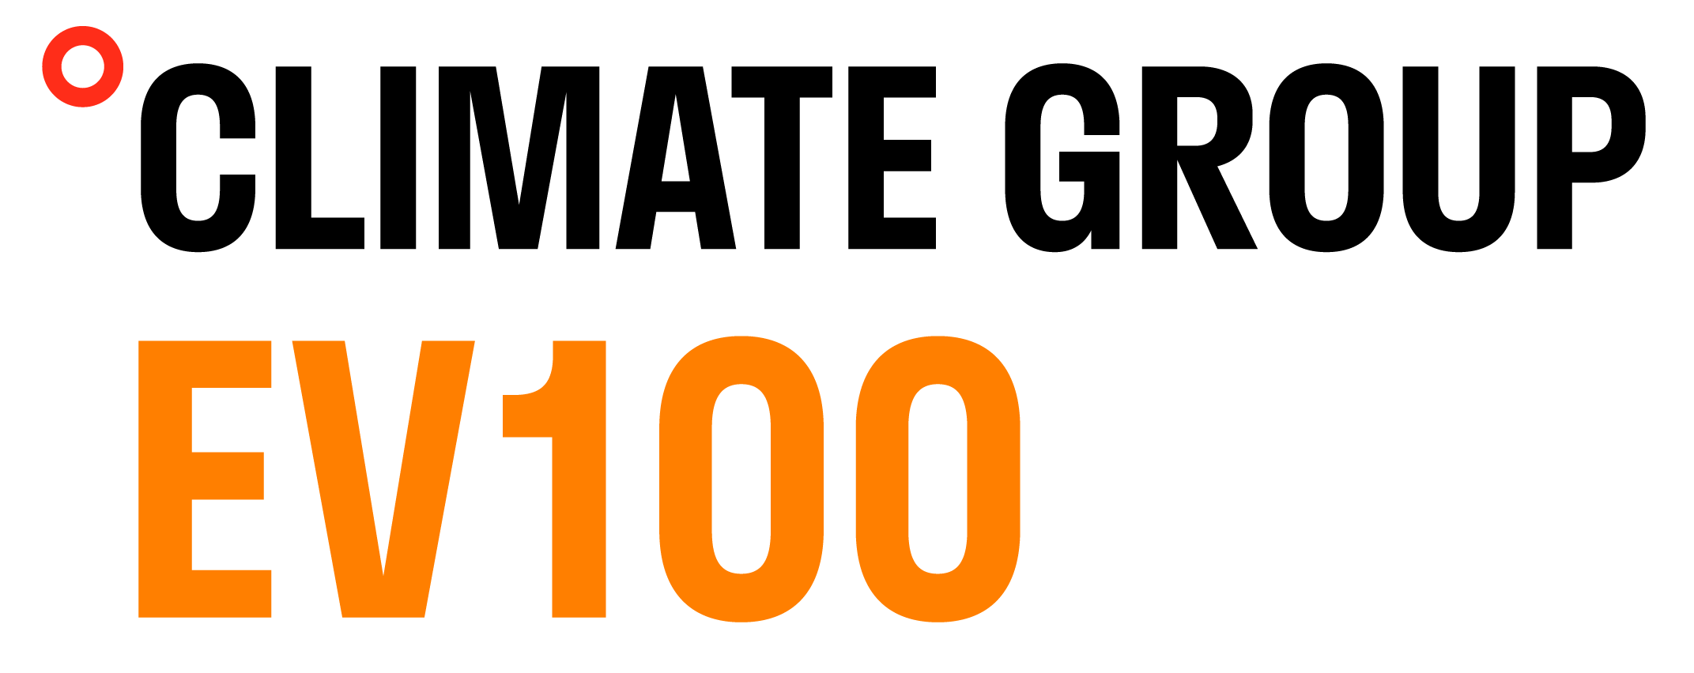
ESG overview of pharma companies
Cipla remains steadfast in achieving Carbon & water neutrality, zero waste to landfill by 2025
SBTi Targets | ✗ | ✓ | ✗ | ✓ | ✓ | ✓ | ✓
CRISIL ESG Score | 65 | 67 | 57 | 59 | 56 | 59 | 61
Renewable Mix | 29% | 48% | 45% | 6% | 10% | 53% | 83%
Water Recycling | 39% | 49% | NA | 44% | 12% | NA | NA
ZLD⁽¹⁾ Facilities | 15% | 65% | 35% | 40% | NA | NA | NA
Treatment of Discharged Water | <50% | 100% | 100% | 100%
Waste Recycling | 89% | 53% | 39% | 33% | 39% | 42% | 53%
26%
Stake acquired for ~₹43 Lakhs
Secured green energy access through inter-state transmission under a captive structure
36%
Fleet already electrified
Joined the EV100 initiative and aims to fully electrify global fleet by 2026
Water-positivity was achieved in FY23 which was set to be achieved by 2025
“Environment-friendly & multi-layered cold storage packaging which can be re-used post refurbished/re-qualification every use cycle”
“99% of the global hazardous waste are sent to cement industries and recyclers for co-processing and recycling”
Cipla can strengthen its ESG standing by focusing on increasing its renewable energy mix and enhancing water treatment process
ZLD: Zero Liquid Discharge.
Notes:
Hello everyone and thank you for allowing us to present today. I’m Asmita, and this is Vedang. We’re first-year MBA students at BITS School of Management, Mumbai.
We’re here to take you through the ESG landscape of global pharmaceutical companies and assess Cipla’s current position and We look forward to proposing a strategic initiative that could enhance Cipla's growth and long-term sustainability.
So, without further ado, let’s delve into the ESG pillars, starting with the environmental aspect. We compared Cipla with its domestic and global competitors on crucial factors such as renewable energy mix, water management, and waste management. These are the primary areas where most companies are concentrating their efforts. The three key takeaways from this benchmarking include:
Our renewable energy mix stands at 29%, which is significantly lower than our competitors. To increase this, We can adopt a similar approach as Dr. Reddy’s which recently acquired a stake in O2 Renewables to secure direct control over green power, rather than relying entirely on external sources
Another crucial finding is that, despite having similar initiatives as its domestic competitors like Sun Pharma and Lupin, Cipla treats less than 50% of its discharged water. Notably, Dr. Reddy's has also achieved water neutrality and even water positivity, two years ahead of its 2025 target
Last but not least, Cipla outperforms its competitors when it comes to waste management. This leadership position is a significant advantage, but to maintain it, we can learn from initiatives like Sun Pharma’s environment-friendly packaging for a key product, which can be reused after each cycle.

Slide 3

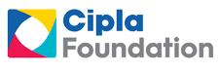







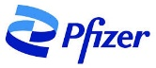


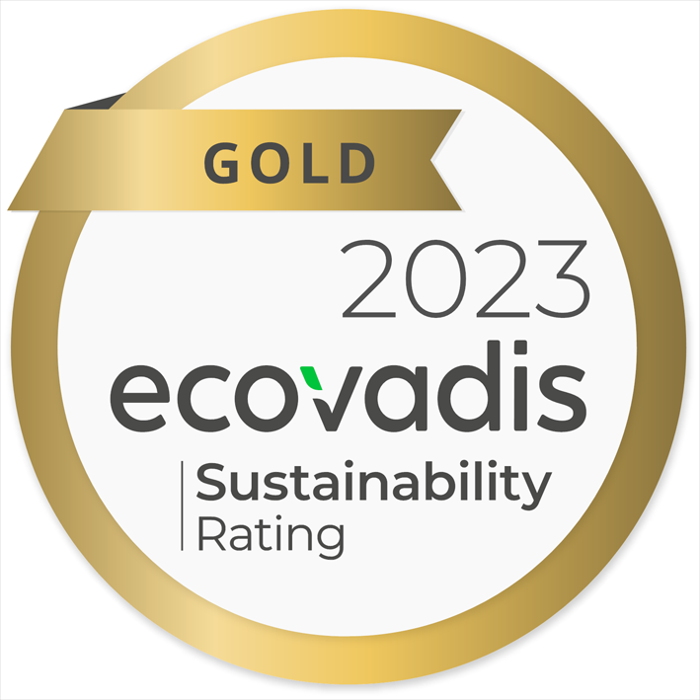
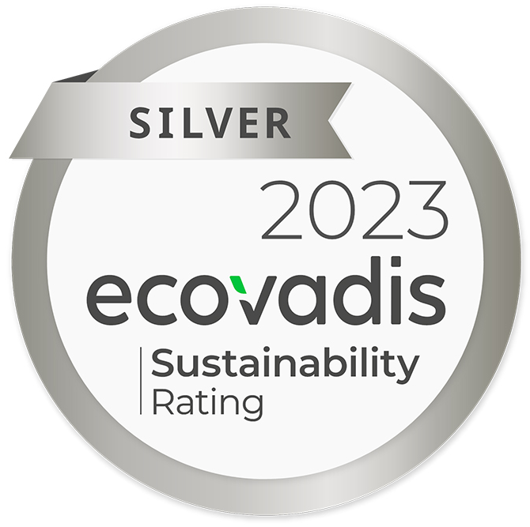
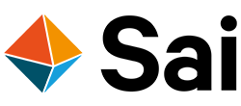




ESG overview OF pharma companies
Cipla aims to enhance inclusion & elevate governance
Social Responsibilities
Strong Governance
Global MNCs
Includes LGBTQ & Live-In partners under
Mediclaim policy
16.2%
Sustainability Council chaired by CTO
Only meets quarterly to oversee the sustainable performance
Chief Sustainability Officer
Focused leadership
Fosters sustainable culture & a sense of urgency
 | Launched a Self-Managed Team program to upskill & hire disadvantaged youth from rural areas | 30% contribution to ops. workforce
 | Launched “Lungs on Care” campaign to provides in-clinic services for Interstitial Lung Disease (ILD) | 300 clinics targeted by 2030
 | “Accord for a Healthier World” offers all its US & EU patented medicines and vaccines at no profit | 1.2bn people targeted in 45 countries
“There is a need for all Pharma companies to partner and unify the methodology of calculating supply-side Scope 3 emissions. A CSO will be the subject matter expert to negotiate & evaluate the partnerships
The Energize program
20 Global pharma partnered to decarbonize the pharmaceutical value chain
16/20 have CSOs or directors, entirely dedicated to fostering sustainability in business
Recognitions^{(x)}
100% of suppliers to comply with the chosen ESG framework by 2030
Cipla's strong social initiatives sets it apart, yet governance could benefit from a board-level leader dedicated to foster sustainability across business
Notes:
Now, let’s turn to the social front. Through its philanthropic arm, the Cipla Foundation, Cipla collaborates with various credible NGOs and government agencies to implement impactful community initiatives. Among its many noteworthy efforts, one that truly sets us apart and fills us with pride is our inclusion policy regarding the LGBTQ community. According to our research, Cipla is the only company among its key competitors in India that not only includes the LGBTQ community in its workforce but also provides medical coverage for them and their partners.
However, despite a profitable performance in FY 23, Cipla’s social expenditure decreased by 16%. Although we saw a 12% increase in the last financial year, it still falls short of FY 22 levels. Investing in social initiatives is crucial, as competitors are heavily investing in this area, boosting their recognition and credibility.
Finally, turning to governance, we have identified a notable practice. In contrast to Indian pharma companies, global players like Pfizer, AstraZeneca, and GSK have appointed Chief Sustainability Officers (CSOs) or similar roles at the board level to cultivate a strong sustainability culture throughout their organizations.
According to Deloitte, to capitalize on opportunities in environmental sustainability and ensure it remains a priority in every business decision, it is crucial to appoint dedicated leaders who can recognize risks and make bold decisions around sustainability.
These leaders are crucial for forming the partnerships necessary to address Scope 3 emissions, which are particularly challenging due to complex supply chains.
The recent Energize Program underscores the importance of such collaboration. In this initiative, 20 leading pharmaceutical companies have come together to decarbonize the pharmaceutical value chain. Committing to work with sustainability-focused suppliers, they are taking a significant step forward in tackling Scope 3 emissions.
Talking about suppliers and Scope 3 emissions, Dr. Reddy's, has set an ambitious target for 2030. They aim to ensure that 100% of their suppliers comply with their chosen ESG framework.

Slide 4








Macro backdrop of propellants
Inevitable shift due to upcoming regulations
Current scenario
Replacement of current propellants
78% of inhalers are pMDIs⁽¹⁾
Kigali Amendment to the Montreal Protocol restricted use of HFC
HFO⁽⁷⁾-1234ze and HFA⁽⁸⁾-152a to replace HFCs
F-Gas⁽⁴⁾ and REACH Regulation
Initiated a phase-out schedule starting in 2019
Current propellants
Observed no mechanical difference in the properties through a compatibility test in Aptar’s metering valve
384mm COPD⁽²⁾
Patients
339mm Asthma
Patients
An urgent CTA⁽⁵⁾ to strategize the shift to next-gen propellants (NGP)
California banned sale of HFCs⁽⁶⁾ starting 2030 in a 2022 Senate Bill
A more aggressive phasedown of HFC
use in EU
Multi-fold increase in manufacturing cost due to higher propellant cost
Device components currently in use are compatible with the new propellants
HFC 227ea - 2030
HFC 134 - 2032
10% of 2015 emissions allowed by 2027
HFC 227ea - 4x to $5.4
HFC 134a - 3x to $2.9
290KM equivalent emission impact of 1 inhaler
Global Warming Potential (GWP)
Regulated Use
Similar antimicrobial properties to current propellants, thus facilitating the reformulation of new pMDIs
NGP
Restricted F-gases use of 2019 baseline by 2030
15%
50% Scope-3 emissions from propellants⁽³⁾
(91%)
(99%)
Research exhibits negligible amount of TFA⁽⁹⁾ accumulation in the rainwater, suggesting no threat to human life and the ecosystem
Article 2 Parties (EU, Canada, US) baseline by 2030
30%
Restrictive regulations and rising raw material prices compel a transition to NGPs for building business resilience
pMDI: Pressurised Metered Dose Inhaler.
COPD: Chronic Obstructive Pulmonary Disease.
Per GSK.
F-Gas: Fluorinated Greenhouse Gases.
CTA: Call-to-Action.
HFC: Hydrofluorocarbon.
HFO: Hydrofluoroolefin.
HFA: Hydrofluoroalkane.
TFA: Trifluoroacetic Acid.
Notes:
Our primary proposal under the environmental vertical of ESG is a shift to green propellants which would decrease the scope 3 emissions by a huge margin. Lets break this down by first looking at how big is this problem and some context on the new regulations which are forcing this shift.
More than 700mn patients are affected by COPD and Asthma and GSK reported more than 50% of their scope 3 emissions result from the release of propellants during use – Even Cipla’s AR stated that propellants make up the largest share of scope 1- and scope 3 emissions.
Coming to the regulatory backdrop, the first transition of inhaler propellants happened in 1987 under the Montreal protocol and the entire world shifted from CFCs to HFCs to tackle ozone depletion. The issue of high global warming potential persisted even after this shift to HFCs and in 2016, signatories to the Kigali Amendment of montreal protocol committed to cut the consumption of HFCs by more than 80 percent over the next 30 years. As a result of these restrictions, even the manufacturing cost of inhalers using old propellants is expected to increase by 3-4x
Accordingly, multiple partnerships were announced to start formulating a composition which supported new green propellants such as HFO-1234ze and HFA-152a – Before moving to discussing these partnerships, lets look at why these gases are suitable for such a transition
Most importantly, the GWP of these gases is lower by 99% and 91% respectively.
To analyze the viability and ease of implementing such a transition, Aptar and Honeywell conducted a study and found no mechanical difference the 2 sets of propellants.
An Italian study in collaboration with OzUK concluded that the current devices are compatible with the new propellants
Essentially, we have established that pollution from propellants is a huge problem and to build business resilience, it is imperative to formulate a transition strategy right away!

Slide 5







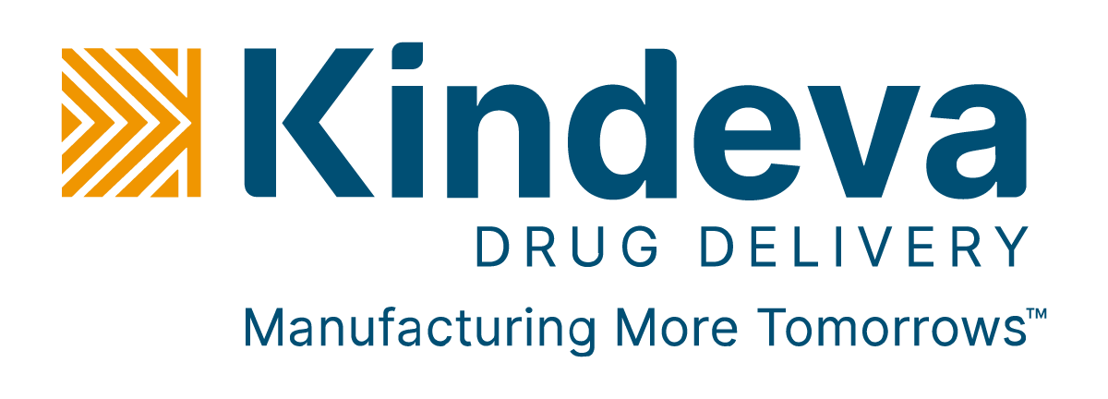

Implementing the transition
Leverage own capabilities and strategic partnerships
Cipla’s Strengths
CDMO⁽²⁾ Partnership
Propellant Technology Partnership
Manufacturing Prowess
Commercial Scale Filling Knowledge Transfer
Solstice Air
Zephex® 152a
Newly commissioned MDI⁽¹⁾ line in Massachusetts
New continuous manufacturing line in Goa
De-risking key respiratory pipeline products and capacity expansion in US
HFO-1234ze
Status: Ready
HFA-152a
Status: 2027E
1st to test medical viability of NGPs
HFO-1234ze In the PFAS⁽³⁾ list Status: Ready
HFA-152a
Not in the PFAS list, Flammable
Status: Phase III left
1st CDMO to manufacture
pMDI and NGPs
Key Partnerships
Development Timeline
Development Timeline
Laboratory facilities for development
2016
Laboratory scale feasibility studies
2016
Successful initial formulation trials
R&D Capabilities
Expanded Bespak’s filling lines at Holmes Chapel facility
2018
2019
Upgraded the in-house device laboratories to advance MDI
Approval in the clinical trials of the Inhaled Insulin
Fast-track development of Asthma and COPD product
2020
Clinical grade ready
2022
Clinical Grade
Early-phase discovery, formulation and scale-up
Commercial
facility
Commercial facility
2022
2023
Clinical and in-patient studies to advance the development
2024
Completed certain Phase III trails
2024
Begins Phase III trials with Chiesi
In 2024, Bespak announced a new high-speed commercial filling equipment
Multi-year partnerships have successfully concluded the validity of green propellants with active ingredients
AstraZeneca has already commenced phase III trials in India to assess the equivalence of BGF⁽³⁾ delivered by HFA vs. HFO in patients with COPD
MDI: Metered-Dose Inhaler.
CDMO: Contract Development and Manufacturing Organization.
PFAS: Perfluoroalkyl and Polyfluoroalkyl Substances.
BGF: Budesonide, Glycopyrronium & Formoterol.
Notes:
We can implement the transition to NGP Propellants through leveraging our own capabilities and taking cues from the past multi-year strategic partnerships
Talking about internal core competencies:
The newly commissioned MDI line in Massachusetts and the improved continuous manufacturing process in Goa will help in de-risking key respiratory pipeline products in the U.S. and other markets
Upgrades to the in-house device laboratories will help in advancing the viability studies of the new propellant.
Approval in clinical trials for Inhaled Insulin opens up a huge untapped market for Cipla and we can incorporate NGPs in these inhalers as well
We can breakdown the partnerships on the basis of manufacturing the actual inhaler device and the sourcing the propellant used within the inhaler.
On the manufacturing side:
Bespak is the first CDMO to manufacture pMDI using NGPs and are ready to commercially fill inhalers with HFO-1234ze
They partnered with industry leaders such as DH Industries and Oz UK who were at the forefront of implementing the first transition from CFCs to HFCs as well.
Notably, in 2024, they launched high-speed filling equipment and even committed to increasing the capacity underpinning a huge pent-up demand in the market
Coming to the propellant technology
We believe Honeywell is a pioneer in advancing the development of green propellants and was the first to test the medical viability of HFO-1234ze. From announcing laboratory scale feasibility studies in 2016, it took them 4 years to prove the clinical readiness of the propellant and they partnered with AstraZeneca for this. As of July, 2024 the composition of AstraZeneca’s active ingredient and Honeywell’s Solstice Air propellant has passed phase III trials and they are hopeful launch a commercial product in 2025 by employing Bespak as the CDMO
Development at Koura also followed a similar timeline but the key difference is that they developed the HFA-152a gas.
AstraZeneca is currently conducting a phase III trial of ~550 patients to monitor the efficacy of drugs delivered with HFA vs. HFO propellants signalling the onset of a global shift.

Slide 6









Cipla’s next step forward
Proposed Development Timeline
2024
2025
2026
2027
2028
2029
2030
 | Planned 50+ filings and 80+ launches globally in the next 5 years in the respiratory therapy is a testament to the manufacturing and R&D prowess Accelerated development and manufacturing schedule by building on previous advancements of other pharmaceutical companies
Breakdown of Key Initiatives | Further refine the process of preparing the green-propellant based composition highlighted in Cipla’s patent Honeywell’s manufacturing patent expires in 2026 |  | Submit prototypes for regulatory approval and compliance checks Leverage formulation and testing expertise |  | Start small scale manufacturing and clinical trials Start building commercial filing lines in-time for the largest scheduled restriction
Impact of Switching to NGP | By adopting HFO-1234ze, Cipla can save 16.7mm metric tonnes of CO² equivalent annual emissions into the atmosphere
CO² emissions from annual energy use in 2.0mm homes
Yearly greenhouse gas emissions from 3.6mm cars
CO2 emissions from burning 18.4bn pounds of coal
A word of caution: PFAS rules currently include HFO-1234ze as a restricted substance
Illustrated Supporting Initiatives
Specify sustainability targets during vendor onboarding to control emissions in the supply chain
Leverage AI-powered formulations to decrease costs and time from development to launch
Development of sustainable sourcing of lactose which is used as a carrier in inhalers
Deploy Grino’s low maintenance and energy efficient desalination systems to produce clean water
Eliminating Greenhouse Gas Emissions, One Breath at a Time
Notes:
Alright, now coming to the development timeline. Existing approvals and completed phase III trials would contribute in decreasing the product development cycle significantly.
Exactly a month ago, Cipla’s patent application comprising different compositions of green propellants and active ingredients was published in the World Intellectual Patent Organization. This publication underscores our technical expertise to build our own compositions. Notably, Honeywell’s patent on its manufacturing process of HFO-1234ze will be expiring in 2026 and this could help us in building further on their approach.
We can employ pioneers such as MEU and OzUK for their formulation and testing expertise and dedicate ~2 years to submit prototypes for regulatory approval before moving on to clinical trials.
By 2030, Cipla can aim to start building or partnering for commercial filling lines, just when the largest restrictions come into force.
Coming to the impact of such a transition, purely from a sense of environmental benefits, Honeywell estimated that we can save ~16.7mm metrc tonnes of Co2 equivalent emissions annually which is equal to energy consumption in 2 million homes or burning 18.4bn pounds of coal
A few other initiatives such as implementing sustainability targets during vendor onboarding, leveraging AI for drug formulation, and sustainably sourcing lactose could further enhance our overall thought leadership in ESG.
Before concluding the presentation, I want all of us look back at the year 2000, when Cipla was the first company across all companies in A5 countries to launch CFC free inhalers and I truly believe we can repeat this feat and start eliminating greenhouse gas emissions, one breath at a time.
Thanks You

Slide 7
Thank you

Slide 8
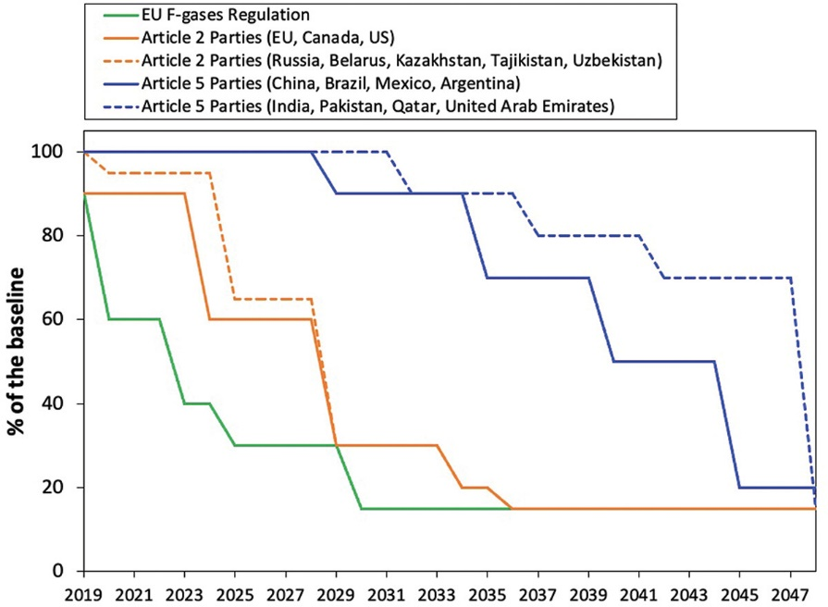
Appendix
Environment
GSK x DFE Pharma
Pfizer annual report
Cipla Annual Report
AstraZeneca x EV100
Dr. Reddy’s integrated report
Lupin annual report
Dr. Reddy x O2
Sun Pharma Annual Report
AstraZeneca sustainability report
CRISIL ESG Ratings
GSK ESG report
Sustainable, Governance, and Recognition
Deloitte x CSO
EcoVadis
Energize program
Macro Backdrop of Propellants
Share of pMDI
Kigali Amendments
HFC Mfg. Price Increase and other rules
Aptar Test
CODP and Asthma Patient Count
Share of emissions from propellants
California HFC Ban
AntiMicrobial Properties
Device Compatibility
Implementing the Transition
Cipla’s Next Step Forward
AstraZeneca Clinical Trials
Honeywell + AstraZeneca
Honeywell Patent
Cipla’s Patent
Honeywell’s Patent
Impact of Transition
H&T Presspart Partnership
Chiesi + Koura
Kindeva + Koura
Merck and IBM
Tata Motors
Cipla, 2000
Oz UK Partnership
Koura Facility
Bespak New Facility
DFE + GSK
MEU Partnership
Grino
AstraZeneca Trials in India

Slide 9
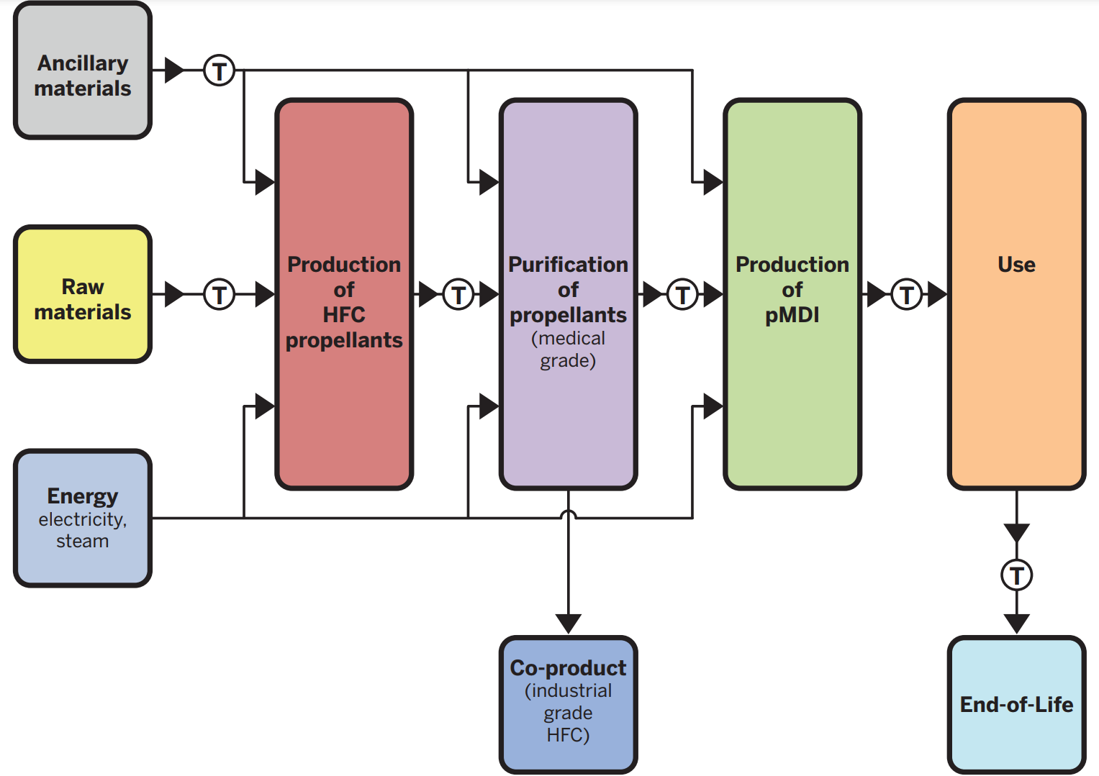
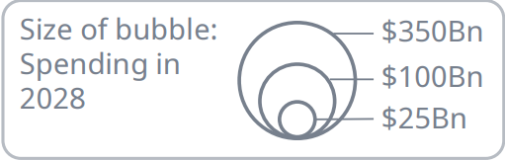
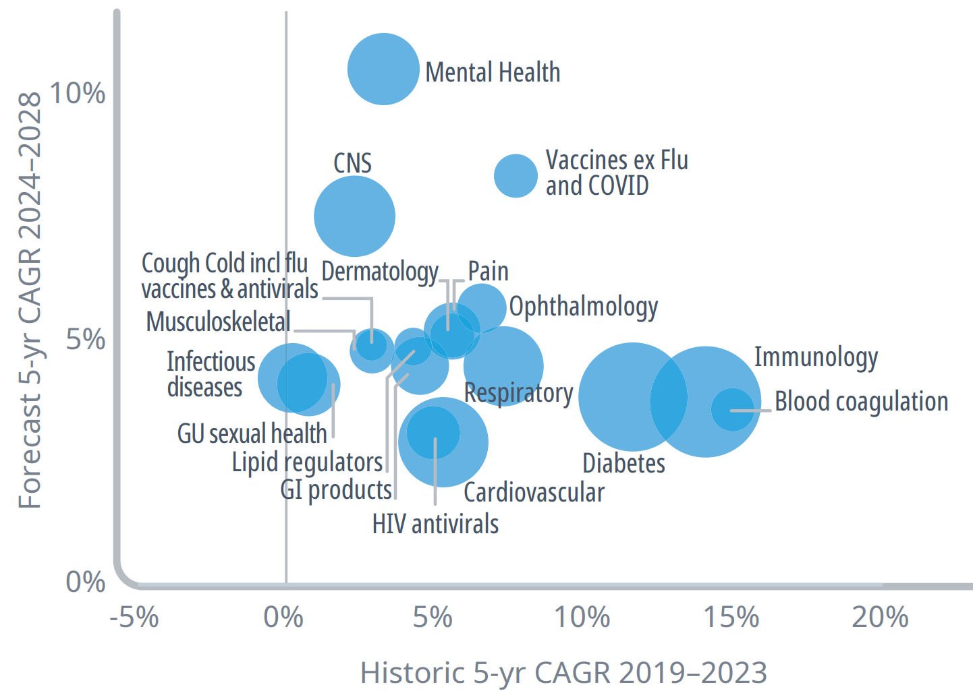
Appendix
Production cycle of pMDIs
Spending on Respiratory related health issues
3-6%
$99Bn
Respiratory
7.5%

