Slide 1


Slide 2



Vedang Poddar 6th June 2025
Marketing Spends Optimization

Slide 3



Executive Summary
Business Problem
Lack of real-time visibility into monthly marketing spends
No centralised view & cumbersome calculation for spends productivity
Understand the process; SAP -> Excel
Reconcile RCPA audit rates with NBR/NRV
Blueprint through Excel in PowerBI
Map productivity against spends in PBI
Datalake/SQL linking to fully automate
Analyze city/therapy specific spend patterns
Dynamic Spends Dashboard empowering real-time tracking with a >95% accuracy to PnL data
HQ-level marketing spend Productivity Dashboard with insights to lift sales
Improve budgeting decisions with real-time spends data
Save 50 hours/week across 4 employees
Eliminate discrepancies due to manual linkages
Centralized dashboard for the entire India Business
Geographical and Therapeutic insights
Identify leaks/opportunities to optimize spends

Slide 4
Insights from Field Engagement Analysis
Geographic Analysis: HQs, Cities, and Regions
43% of 867 HQs grew >10% y/y
All regions show similar performance
Field Eng. at 3% of sales in OIB
~60% of the cities that spent more than regional average on Field Eng. experienced >10% growth
A delta of ~2% between de-growing HQs and HQs with >10% growth, implying a INR15 Cr additional spend
Therapeutic Analysis: Mapped using maximum occurrence
Pain & Analgesics with the highest EAS spend at 7%
Pain/Cardiac/Respi have a 3% delta b/w Gr. & DeGr.
~70% of RBMs under Pain, Cancer, and Cardiac grew >10% y/y; vs. only 5% of Opthals RBMs
~25% of Cardiac and Vitamin RBMs grew with <2% EAS Spend; 27% Gynaec de-grew despite >5% EAS spend
*Excluding Institutions
*Only expenses initiated by the field

Slide 5


Way Forward
PBI Blueprint and SOP ready
Initiated Datalake/SQL linkages
Backtest the Dashboard
Build capabilities for trend analysis
4 Weeks
1 Week
1 Week
Productivity dashboard ready
Briefly analyzed HQ/Therapy level spend
1:1 with divisional heads to understand nuances
Identify spends leaks/sales lift opportunities
2 Weeks
3 Weeks
1 Week
Recommendations
Workflow Automation
Data Cleanup
LLM Integration
Create auto-alerts or generate custom insights
Zapier can trigger automatic updates to Master files
Standardize, clean, and match data from all sources
Query the data within PBI for custom insights
Sets the stage for data-led transformation with a granular marketing dashboard for Cipla

Slide 6
Key Learnings
“Excel”, Not Excel
Strive to know your unknowns
Change Management is tough
Explaining benefits reduces friction
Keep end-results at the forefront
Avoid getting lost in the process by having a north-star in mind
Curiosity improves problem solving
Asking “Why” can reveal the solution

Slide 7
Thank you!
Rupali Malke
Arjun Mehraul
Abhijeet Waghmare
Kushal Jhunjhunwala
Lokesh Tiwari
Akshay Bhuptani

Slide 8
1. Insert Date
Relative Date Option
Remove All Filters
2. Choose Cluster
3. Choose Division
Automatic insights based on filters
Divisional Totals, Utilization, and Proportion
Sub-Division Breakdown
Can even filter through sub-divisions

Slide 9
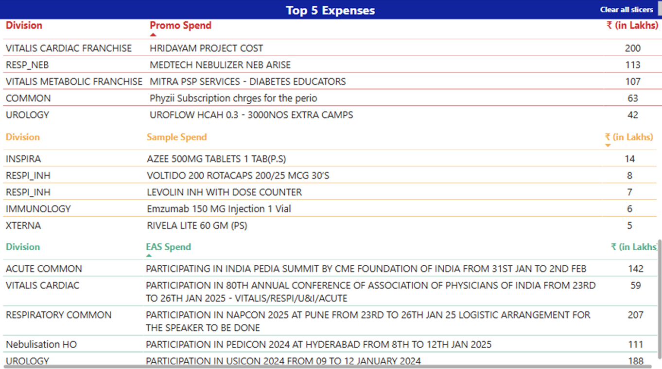
Linked to each filter level
Remove All Filters

Slide 10
Remove All Filters
Divisional filter
Sub-divisional and RBM HQ efficiency (filter as well)
Color-coded Efficiency city-wise data
Automatic Insights based on filters

