Slide 1
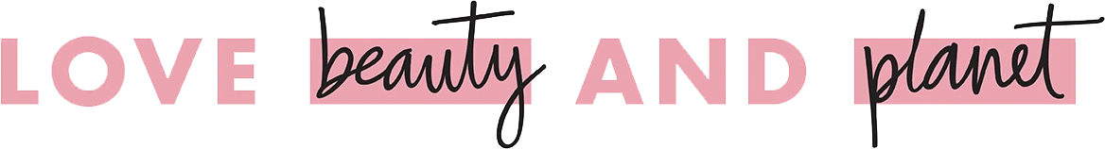
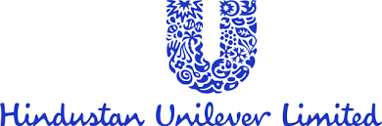
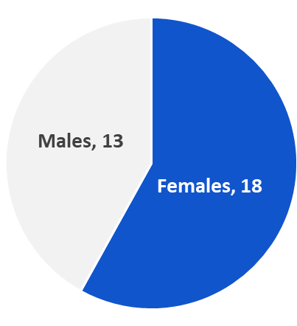
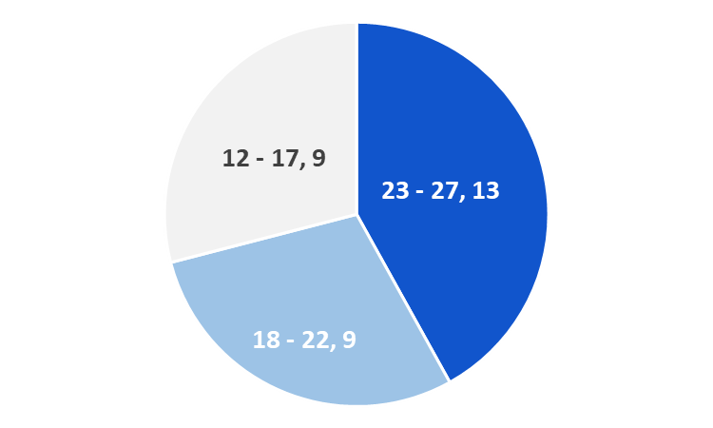
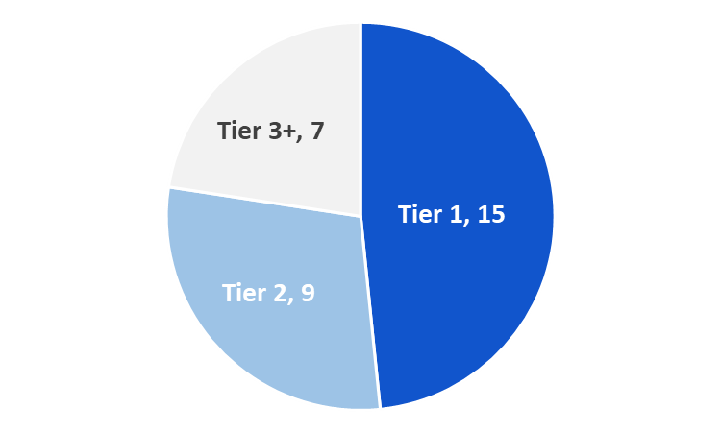
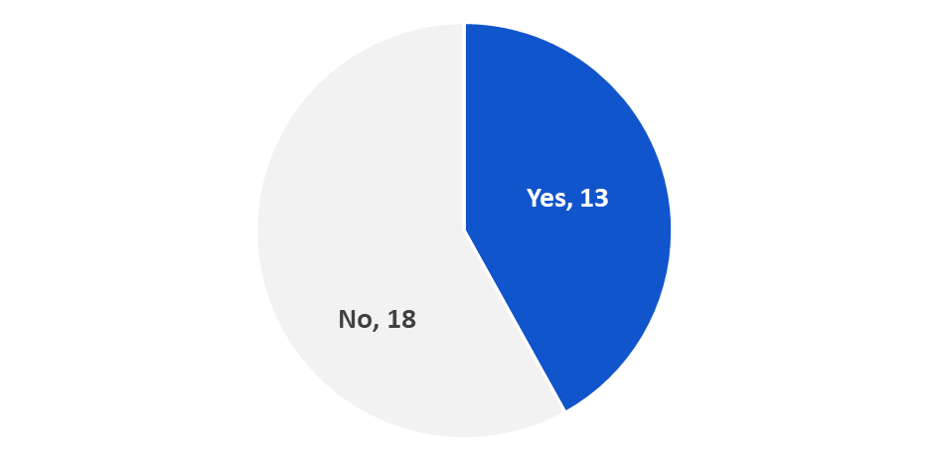
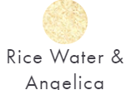
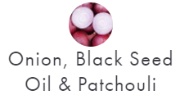

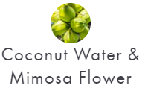
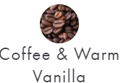

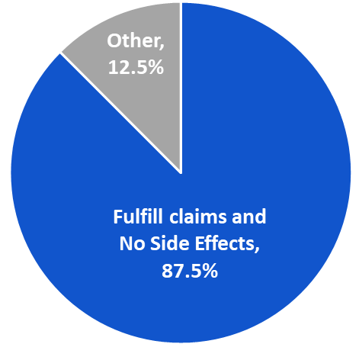
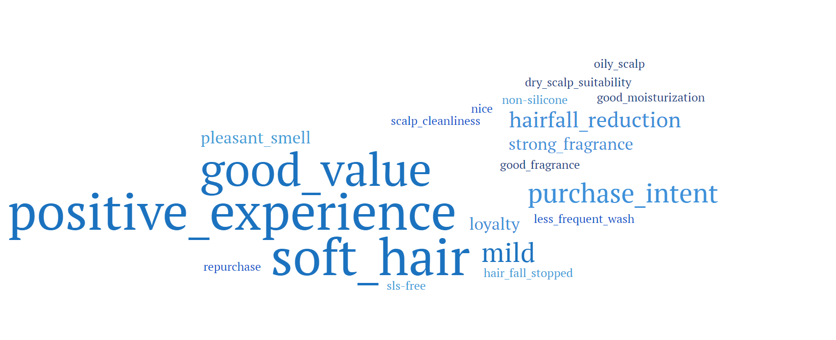
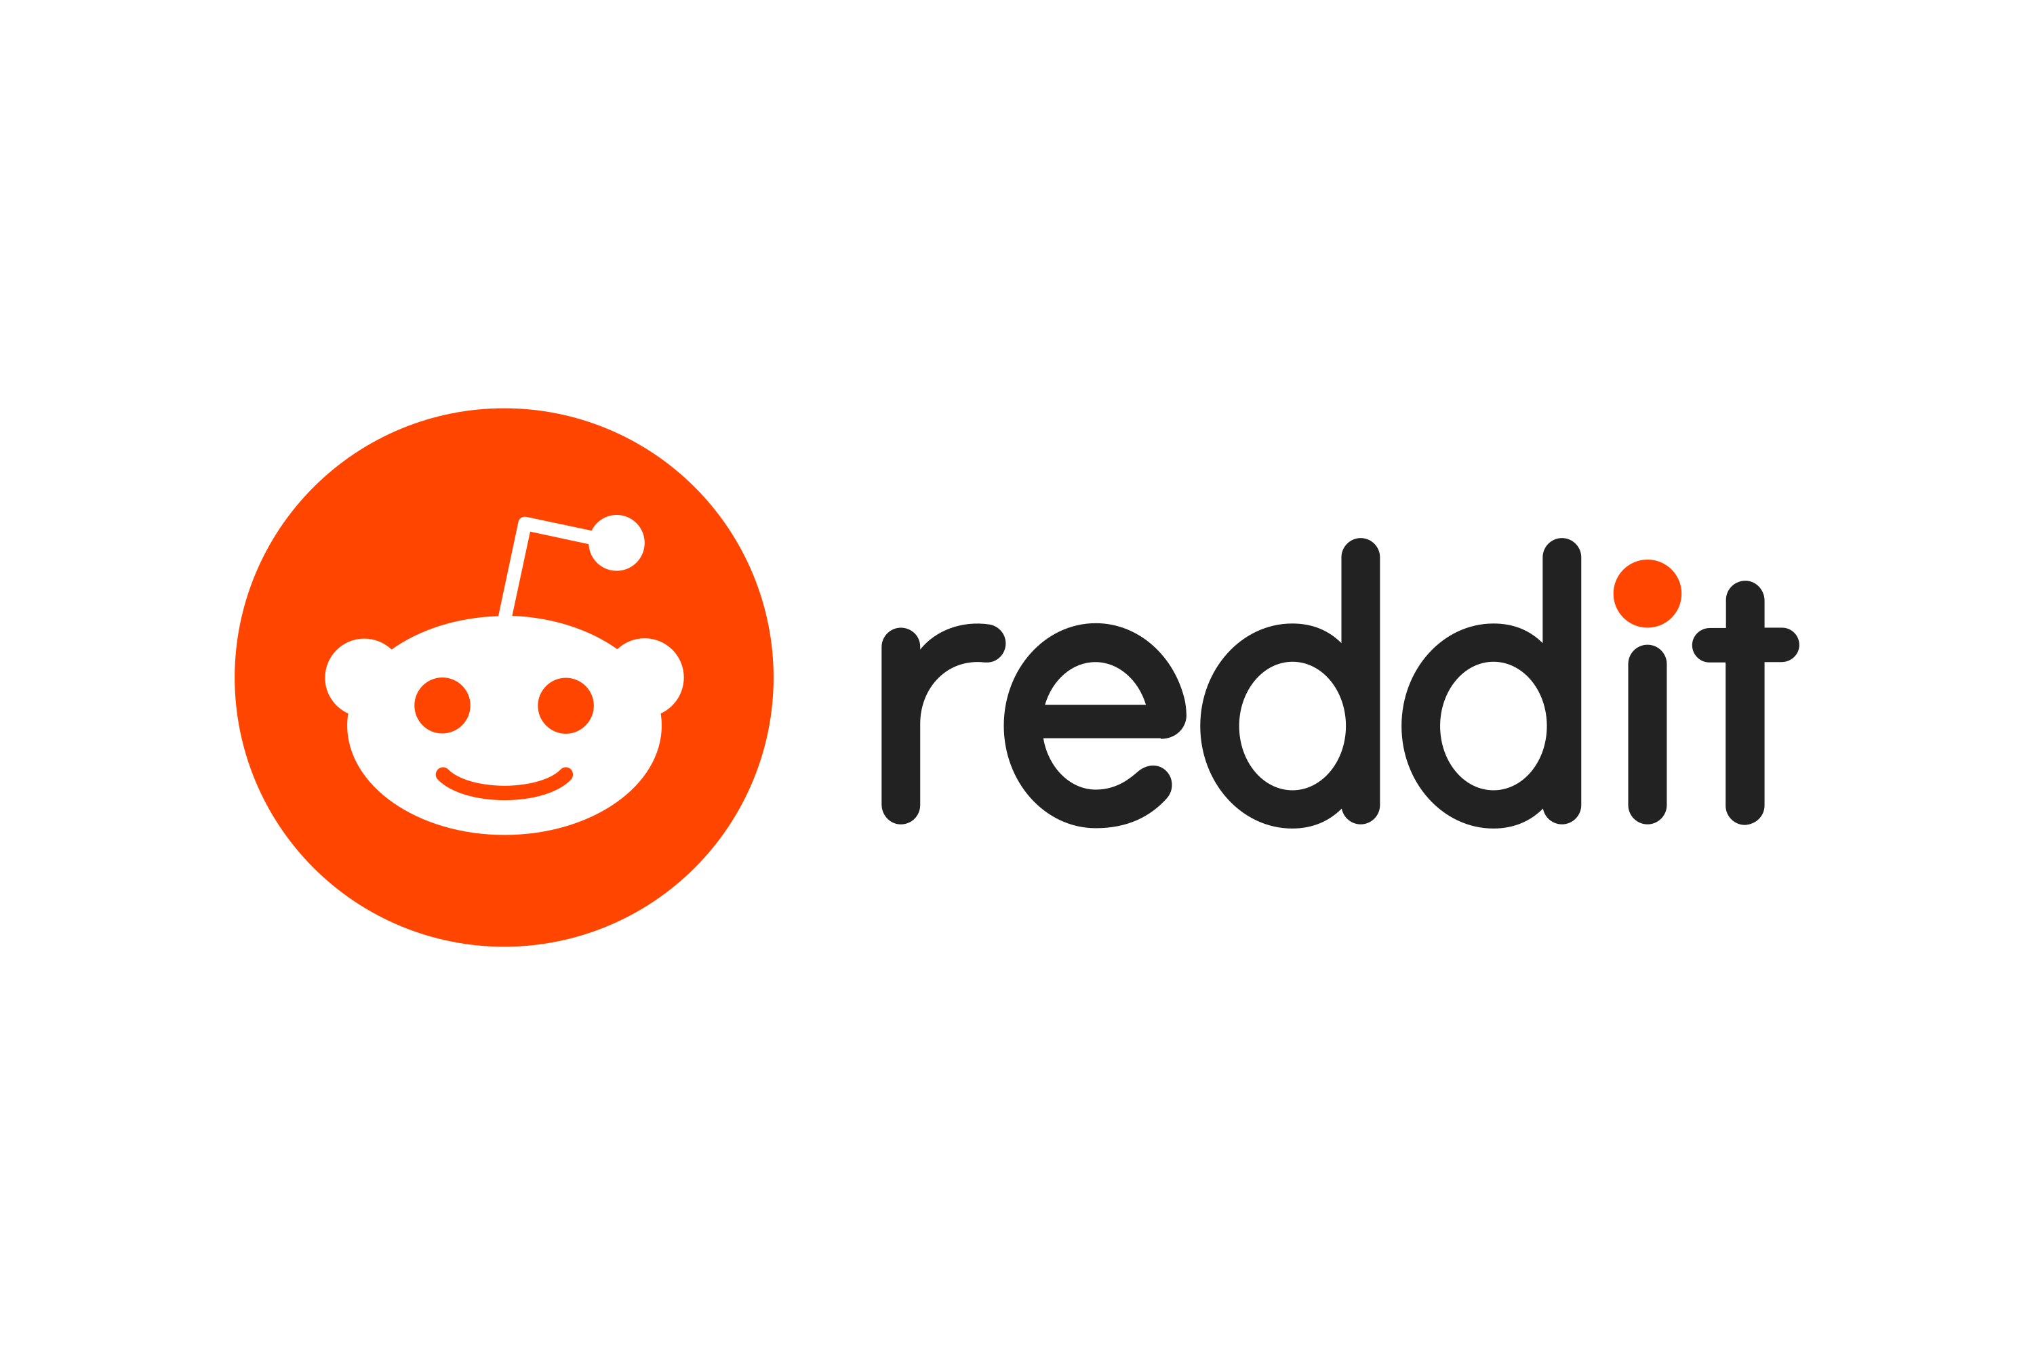

Hero Brand:
Top Consumer Trends:
31
“I trust a brand more when I recognize ingredients, especially if I’d find them at home”
“Quality is when a product does its job without causing other issues”
“I support brands that back up their eco-friendly claims with real results”
“Chemical-free is a big deal for me”
“I’m more likely to try something if a trusted person recommends it”
“I need to feel like I’m getting real value for my money”
Summary of Consumer immersions:
Respondents
Gender Split
Age Split
Geo Split
LBP Awareness
Data to support the Consumer Trends:
Super Consumer:
Primary Research
Shanaya, a college student aged 18-24, misses the homemade remedies her mother taught her. Living in a busy urban environment, she seeks easy, chemical-free solutions that protect her hair and body. She prefers sustainable options to feel guilt-free, but her hectic schedule is a barrier.
80%
attracted to brands that
use home ingredients
3/5
Relied on personal recommendations
90%
Focused on value for money
3/4
Influenced by data-backed ads
87%
Have used home remedies before
Communication Challenge:
Quality in hair-care/body-care?
Current Mindset
Desired Mindset
Ratings Survey
I question brands claiming to be 100% natural or sustainable. Homemade remedies are better, but they’re time-consuming
I trust LBP’s natural ingredients due to its transparency, & feel confident about going chemical-free & sustainable without hassle
Rating of 5: “Would influence you to try/buy it”
% of respondents who rated a 4 or 5
80%
“60mn plastic bottles reused to make product bottles”
56%
“Sulfate/Paraben free Natural Ingredients”
Current Behaviour
Desired Behaviour
I use home remedies sometimes because I don’t trust shampoos to meet my needs or their claims of being natural & sustainable
I use this brand as a reliable alternative to home remedies, for its transparency on natural ingredients & sustainability
Secondary Research
Social Listening
Scanned 120+ posts & 1,000+ comments
The singular most important point that I want to convince my Super Consumer with Love Beauty and Planet is “I’m going chemical-free with familiar natural ingredients, and it makes me feel good about being sustainable”

Slide 2

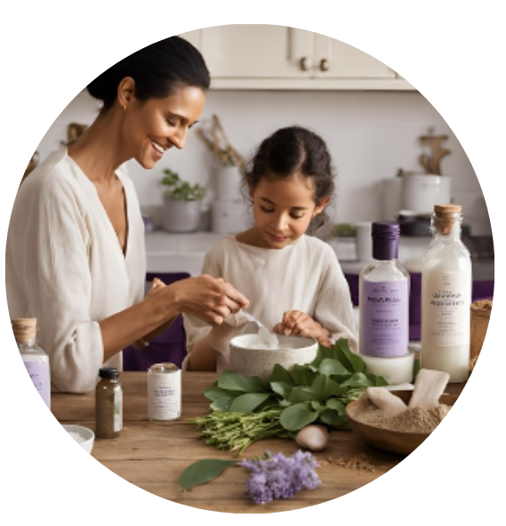
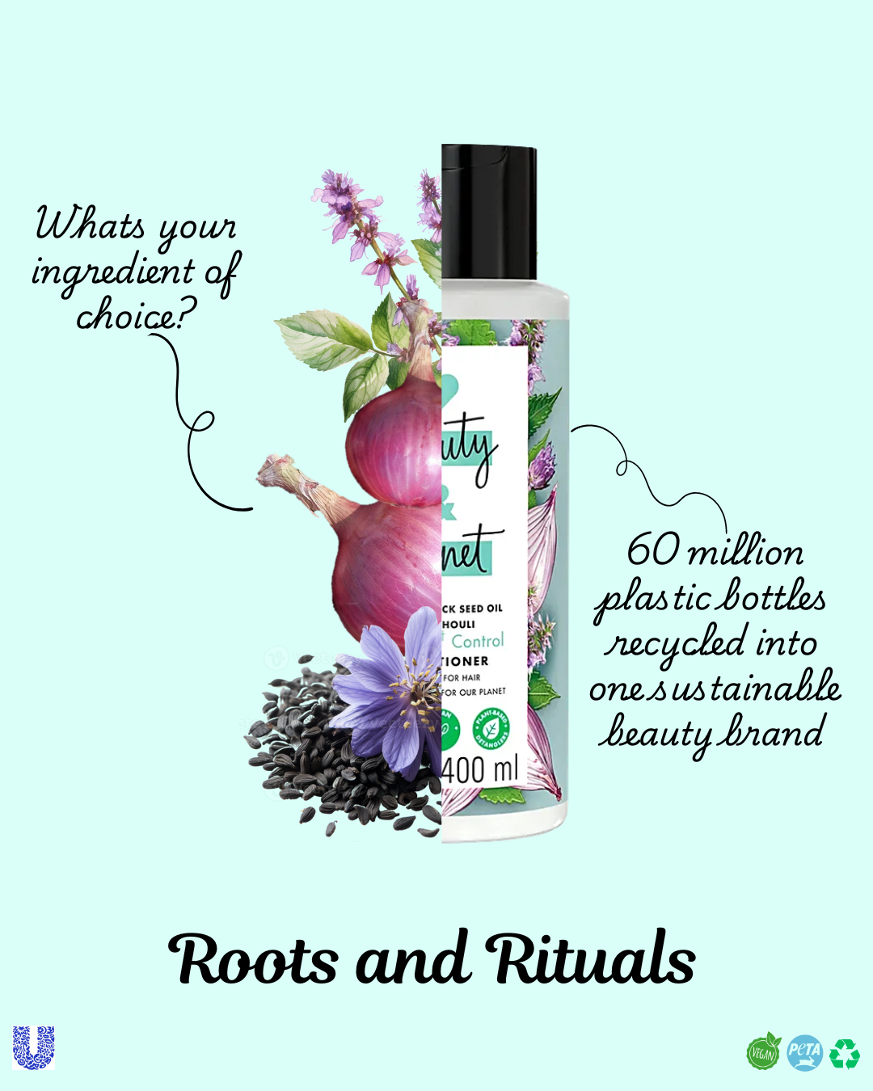
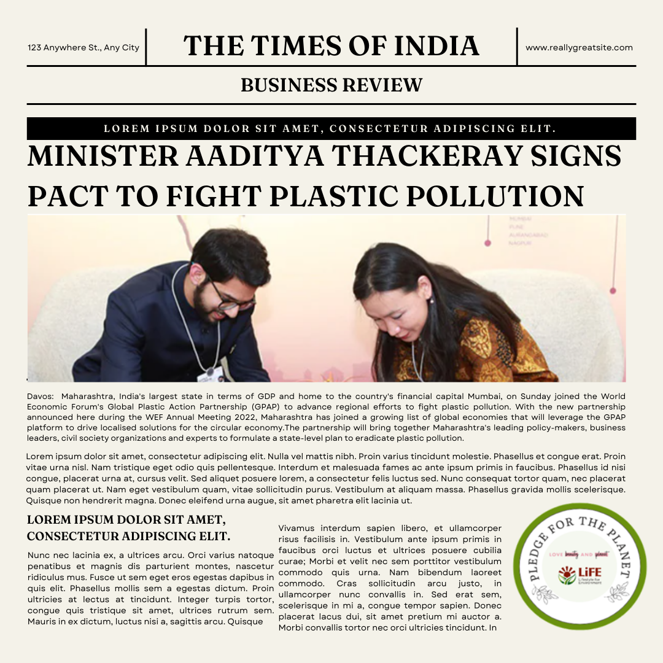
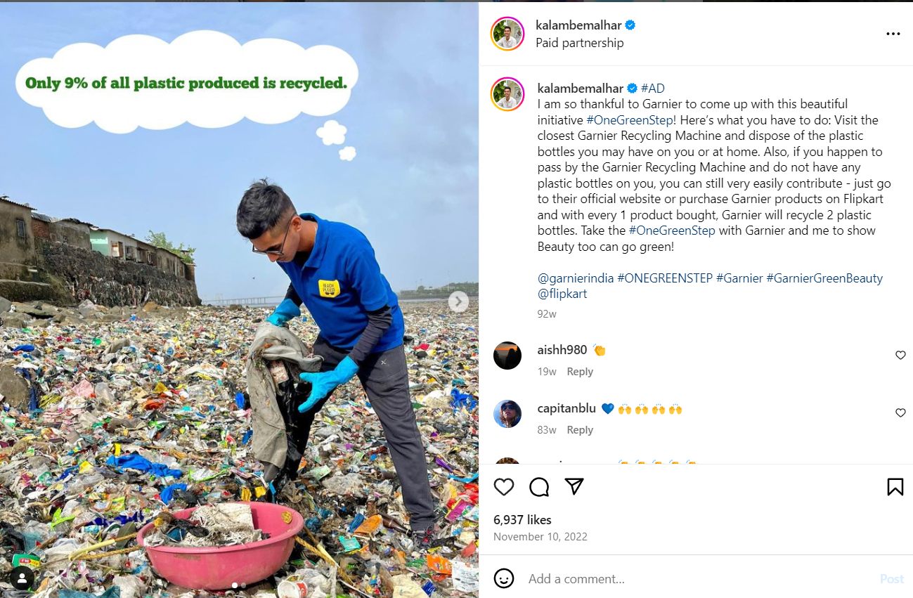

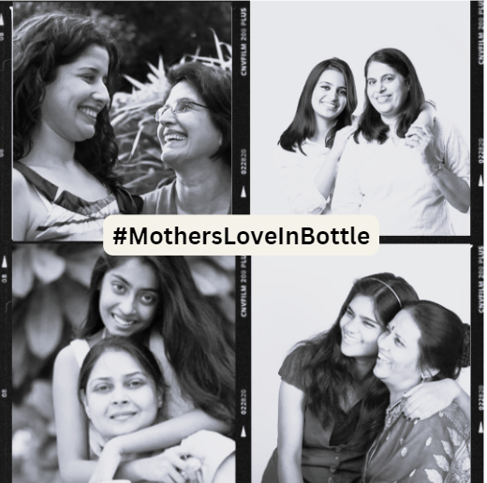







Consumer Insight
"I’ve always trusted home remedies, but life is too busy now to keep up with them. I want to believe in ‘natural’ products, but I’m always questioning if they’re truly chemical free. Honestly, I’m more concerned about avoiding side effects from whatever I use."
Static Creative:
Bring the Idea Alive
A memorable Instagram creative that drives consideration
Campaigns
#PledgeforPlanet
#MothersLoveInABottle
A platform where people pledge to choose recycled plastic packaging, linked to Government of India’s
Mission LiFE's Pro-Planet People with a pledge page offering rewards for social media shares
Consumers to share their personal stories of beauty rituals inherited from their mothers celebrating treasured traditions
Amplifications
Offer 'Mother’s Touch' care packages for sending curated products to loved ones.
TV Advertisement
Launching ‘Roots and Rituals’, series of timeless beauty tips from mothers, passed down through generations
Newspaper Ad
Partner with Eco-Influencers:
Vani Murthy & Afroz Shah
Outcomes
Broader reach
Targeted engagement
Enhanced Consumer Interaction
Credibility Boost
Community building
Emotional Brand Ties

