Slide 1


VaccineCo.
Building Africa’s Health Sovereignty
Team Ambassadors Of Quan
Assisted by:
Dr. Shehzala
(Associate Professor of Marketing)
The Baobab (Adansonia digitata)
Native to Africa, is celebrated as ‘Tree of Life’, Its a symbol of longevity, resilience, and sustenance for communities across the continent

Slide 2





VaccineCo.
Executive Summary
Current Scenario
Strategic Plan
Execution Roadmap
Envisioned Future
Turning Gaps into Growth: Our Sustainable Path to 2040 By Turning Shortfalls To Leadership
We Are VaccineCo.
“O”
CTC /
Heat Stable
Vaccines
“B”
DFI
Loans
“Our Mission is to enable the production of 1 out of 5 vaccines manufactured in Africa by 2040”
Microarray
Patches
Technology
AVMA
Grants
“A”
Freeze
Damage
Resistant
Formulations
Equity &
Strategic
Investors
BRICS/
Global Talent
Exchange
“Our Vision is to facilitate the development of a new public health order grounded in equity, resilience, & sovereignty for the people of Africa”
Measles
Rubella
(MR)
University
Collaborations &
Trainings
Programs
“A”
Pneumococcal
(PCV 13)
Blend Capital
Optimize Technology
Regional
Capability &
Capacity
Centers
Campaign F&F
For Outbreak
Diseases
Hepatitis B/
Pentavalent
“B”
Attract Talent
Offtake
Agreements
Adapt Portfolio
Tech Transfers
& Licensing
R&D For Novel/
Underserved
Diseased
Build Local
Boost Partnerships
“B”
Drug
Substance
Manufacturing
Donor & DFI
Collaborations
BAOBAB
Our Foundations
Infrastructure & Utilities
Strategic & Stable Southern Africa Hub
Regulatory Experience (SAHPRA/WHO)
GMP Compliance Know-How
Proven F&F Capability
Govt. Backing & Ownership
1
Team Ambassadors Of Quan
Sources: Author’s Research & Analysis (Primary & Secondary), Reports By PAVM, GAVI, AVMA, CEPI, Alonso, AUDA-NEPAD, Africa CDC, and UNICEF
/11

Slide 3


VaccineCo.
Executive Summary
Current Scenario
Strategic Plan
Execution Roadmap
Envisioned Future
From Vision to Action: Building Momentum Toward the BAOBAB Framework
Objective
To set the context on demand, challenges, and actions for Africa’s vaccine self-sufficiency framing Vaccine Co’s long-term manufacturing and investment strategy
Africa’s Vaccine Demand to Double by 2040
But Critical Gaps in End-to-End Manufacturing Severely Constrain Africa’s Path to Vaccine Self-Reliance
Projected Surge in Africa’s Vaccine Demand by 2040
Cholera
Hepatitis B
BCG
DTP
Hexavalent
Meningococcal
Rift Valley Fever
Measles/MR
Tetanus
Pneumococcal
Chikungunya
Rabies
Typhoid
Yellow Fever
Influenza
Rotavirus
Lassa Fever
Malaria
$5.0B
DT
GBS
HPV
Ebola
HIV
Covid-19
Medium and the upside scenarios show strong growth in vaccine demand with Africa’s market for existing products projected to more than double by 2040.
6.20%
CAGR
R&D
$2.1B
Current Capacity
DS
F&F
Source: https://wellcome.org/reports/scaling-african-vaccine-manufacturing-capacity
No. of Manufacturers
0
1
2
3
4
5+
Africa’s present vaccine capacity is concentrated in fill-and-finish, with only a handful of players in drug-substance manufacturing and limited in-continent R&D. This imbalance highlights the critical need to expand upstream capabilities to meet future demand and reduce import dependence.
Note: Figures are author-calculated based on Gavi – Expanding Sustainable Vaccine Manufacturing in Africa: Priorities & Support.
….Closing Africa’s Vaccine Demand–Supply Gap Needs Scaling, Technology Expansion and an Integrated Ecosystem by 2040
Top Five Priority Challenges Identified by African Vaccine Manufacturers
Enablers to Close Africa’s Vaccine Demand–Supply Gap
Strategic Pathways
Volume Maximization
Technology Coverage
Fully Integrated Ecosystem
We need to scale production, expand technology, and build an integrated vaccine ecosystem to meet Africa’s vaccine demand.
HOW TO WIN?
Info Source: https://wellcome.org/reports/scaling-african-vaccine-manufacturing-capacity
2
Team Ambassadors Of Quan
Sources: Author’s Research & Analysis (Primary & Secondary), Reports By PAVM, GAVI, AVMA, CEPI, Alonso, AUDA-NEPAD, Africa CDC, and UNICEF
/11

Slide 4

VaccineCo.
Executive Summary
Current Scenario
Strategic Plan
Execution Roadmap
Envisioned Future
Build Local, What Matters: Fill & Finish Is Our Foundation But Drug Substance Will Be Our Future
Objective
To demonstrate why VaccineCo. should pivot towards Drug Substance (DS) manufacturing — the true value pool in Africa’s vaccine ecosystem
Fill & Finish (F&F): Overcrowded and Oversupplied
Drug Substance (DS): Massive White Space to Capture (~90% gap)
1,675
821
#No. of Manufacturers*
1,600
728
1
3
1
800
810
1
1
1
1
3
1-2
Source: Partnerships for African Vaccine Manufacturing (PAVM) Framework for Action
Note: *These are the number of African manufacturers with either: Commercial DS production running, or Signed / planned facilities for that specific antigen’s drug substance. Source: Partnerships for African Vaccine Manufacturing (PAVM) Framework for Action
Africa requires 1.6B F&F doses by 2040, but already has >1.67B capacity planned, creating a 475mn oversupply risk in viral vector and non-live virus
More than 20 African players (post-COVID) are already investing in F&F, leading to fragmented competition.
F&F is at risk of becoming commoditized, with low margins and little strategic differentiation.
Competing in F&F will expose us to crowded, low-value markets. Strategic focus should remain on integrating DS where supply gaps and grant opportunities are clear.
Africa requires 821M DS doses by 2040, but only ~93M doses capacity exists/planned, leaving a 728M dose gap (~90%)
Most antigens (Pentavalent, PCV, MMR, Malaria, HIV) have zero local DS production today
Only Yellow Fever has meaningful DS capacity (Institute Pasteur Dakar/Tunis)
Africa will require at least 1–2 manufacturers per antigen by 2040 — underscoring both the manufacturing gap and the opportunity for early movers.
DS offers high value capture (~60% of vaccine value chain), is aligned with AVMA 2040 self-sufficiency goals, and secures import substitution incentives & grant unlocks
3
Team Ambassadors Of Quan
Sources: Author’s Research & Analysis (Primary & Secondary), Reports By PAVM, GAVI, AVMA, CEPI, Alonso, AUDA-NEPAD, Africa CDC, and UNICEF
/11

Slide 5
VaccineCo.
Executive Summary
Current Scenario
Strategic Plan
Execution Roadmap
Envisioned Future
Adapt Portfolio, Empower Africa: By Securing Routine Vaccines & Advancing Into Novel Future Proof Vaccines
Objective
To establish VaccineCo as Africa’s end-to-end producer of priority routine vaccines (DS+F&F), unlocking import substitution & AVMA incentives
VaccineCo Product Portfolio Map — Where to Integrate End-to-End (DS+F&F) by 2030
Our Portfolio In Action (Business Model)….…
High Priority Vaccine To Integrate & Scale
(DS + F&F)
1
Routine model: End-to-End domestic production (DS + F&F)
DS first R&D & Small Outbreak Model : Campaign F&F
Focused Vaccines For Fill & Finish In Short Term, With DS added when viable in longer term (2030-2040)
Impact in Medium Term (2030-40)
Impact in Long Term after 2040
2
3
Expand existing downstream F&F capacity to include end-to-end value chain production particularly for routine vaccines. This locks in import substitution at scale and captures AVMA incentives
Seeds future proof DS platforms (conjugation/protein subunit; mRNA/ viral-vector via partnerships) targeting novel/under-served diseases while keeping a nimble F&F line for campaign/outbreak products
High (5)
Market Attractiveness²
Low (0)
E2E Vaccines to focus on:
PCV 13, MR, Hepatitis B
R&D on Novel Drugs: Malaria, TB, HIV
Campaign F&F on: OCV, Rotavirus, IPV, Yellow fever, Ebola, BCG
Impact of Shortlisted E2E Vaccines (Figures are for year 2030)
x
Defer their local manufacturing, Instead Focus on R&D of emerging diseases
~50%
~$1-1.5 Bn.
$250 Mn.
(Phased)
Manufacturing Attractiveness¹
Import Substitution Potential Unlocked In Volume
AVMA Grants Unlocked (CAPEX Investment + Per Vial Incentives)
Low (0)
High (5)
Total Addressable Market (TAM) In Africa
¹Manufacturing Attractiveness is scored on DS feasibility, Manufacturing complexities, Tech transfer availability, Cost feasibility & Portfolio fit
²Market Attractiveness is scored on Demand Forecast by 2030, AVMA Priority List, Customers Offtake, Africa Whitespace & Innovation Edge
Refer to Appendix I & II for detailed scoring & justifications
Sources: Author’s Research & Analysis (Primary & Secondary), Reports By PAVM, GAVI, AVMA, CEPI, Alonso, AUDA-NEPAD, Africa CDC, and UNICEF
4
Team Ambassadors Of Quan
/11

Slide 6












VaccineCo.
Executive Summary
Current Scenario
Strategic Plan
Execution Roadmap
Envisioned Future
Optimize Technology, Improve Accessibility: Leveraging Formulations That Eliminates Cold-Chain Barriers
Objective
To leverage next-gen vaccine technologies and smart cold-chain systems to eliminate storage failures, cut wastage, and expand reliable vaccine access Pan-Africa
Aligning our vaccine portfolio with WHO-GAVI’s VIPS focused innovative vaccine tech
Priority Vaccine
Measles-Rubella
Hepatitis B
PCV 13 Valent
Benefits to the African Subcontinent
Technology
Needle-free, heat-stable and compact
Cuts reliance on skilled workers
x
Liquid form cannot be dried & layered in micro-projections
Multiple Array Patches (MAP)
Stable at +40°C for ≥3 days – help frontline workers
Reduces cold-chain logistics costs ($0.06 per vial)
x
CTC/Heat Stable Vaccines
Preserve potency, cut wastage
Near-zero added cost (<$0.001 per dose)
x
Freeze Damage Resistant
Freeze-dried form, not low temp sensitive
Providing AI-enabled Predictive Cold-Chain Maintenance to distribution partners in collaboration with Figorr (Nigerian, part of Gavi INFUSE 2024)
x
Frequent equipment failure- 50% wastage
AI Predicts failures in advance
Preventative maintenance auto-generated work orders
AIoT sensor tracking
Real-time alerts
Updated Dashboard
Partners see live updates
5
Team Ambassadors Of Quan
Sources: Author’s Research & Analysis (Primary & Secondary), Zenatix (India) - Predictive AI Cold Chain Technology, Figorr Website, VIPS Executive Summaries for Tech – MAPs, CTC, FDR
/11

Slide 7
VaccineCo.
Executive Summary
Current Scenario
Strategic Plan
Execution Roadmap
Envisioned Future
Blended Funding, Innovation First: Build a continent-scale DS backbone and new-gen vaccines that enable AU2040 vision
Objective
To outline the 15-year strategic roadmap, showing how a $500M investment builds a 140mn dose/year capacity, driving over $3bn in revenue
1
Phased Capital Deployment: Front-Loading DS Capabilities With WHO-PQ Focus And Next-Gen Vaccine Innovation
Timeline
2025
Short Term
2030
Medium Term
Long Term
15-year Vaccine Co. Cumulative
2035
2040
Investments
$215mn
Investment in $Mn
$100mn investment
in new-gen vaccines
Thermostable & needle-free vaccines; boost access
Investment
Required
$190mn
Vaccine
Technology
$95mn
$400mn investment in Drug Substance
Africa’s Drug Substance manufacturing backbone
Drug Substance
Manufacturing
# of Doses
40mn p.a.
60mn p.a.
40mn p.a.
Capacity of 140mn p.a doses by 2040,
bridging 20% of DS gap
2
Strategic Funding Architecture: Blended Finance Approach With Milestone-Based Unlocks And Risk Mitigation
AVM Accelerator
Potential Funding Sources
Managing the current PE Investor
High
Capital Fit Map
DFIs
Ticket
Past Investing History
By 2034, de-risked cash flows and
innovation lift multiples
Funding Strategy
Milestone Payment
Accelerator Payment
€30–75m | €75m loan for IP Dakar’s MADIBA facility
Eligibility:
DS is manufactured
on African soil
Eligibility:
AVMA Priority
Vaccine and DS
Donor Led
$10–50m | Up to $145m to BioNTech to invest in Kigali (2024)
Risk Appetite
1. PE continues
2. PE Divests
GP-led continuation or follow-on round
Target new institutions on our profile
$20mn x
3 Vaccine’s DS
$0.50/dose of DS
$0.30/ dose of F&F
Sovereign
$20–80m | BII $20m anchor into Summit Africa Fund II
Low
Valuation Scenario
Funding Unlocked
Strategic
$20–60m | Invested in Gqeberha sterile facility used for vaccines
$68mn
9x-11x
$612-$748
$200mn for DS | $50mn for F&F
Low
Concessions
High
EBITDA
Multiple
Enterprise Value
3
As DS comes online and formulations mature, volume translates into price discipline and yield gains—expanding gross margin, EBITDA, and free cash
Financial
Outcome
Timeline
2025
Short Term
2030
Medium Term
Long Term
15-year Vaccine Co. Cumulative
Financials
2035
2040
64%
Revenue
~$3.0bn | ~$1.0bn
Gross %
55%
60%
IRR
~18%-22% (Target: 20%)
Revenue (ARR Mn $)
CoC and Payback
~4.5x – 6.2x | 8-9 years
6
Team Ambassadors Of Quan
Note: Refer to Appendix III for detailed financial model
/11
Notes:
“Targeting ~$300–350m from the above buckets over 6–8 years through a blend of DFI loans/guarantees, donor grants, corporate JVs, and sovereign institutional equity, with concrete precedents

Slide 8





VaccineCo.
Executive Summary
Current Scenario
Strategic Plan
Execution Roadmap
Envisioned Future
Attract Talent, Amplify Impact: Develop An Inhouse Talent Pipeline Through RCCNs And R&D Partnerships
Objective
To build a continent-wide skilled workforce to close Africa’s vaccine-manufacturing talent gap and support long-term sustainable self-sufficiency by 2040
The Challenge: Africa's Vaccine Talent Crisis
BRAIN DRAIN
Current force
Current gap
Workforce Target by 2040
Academic Publications
CCC Graduate Achievement
Africa’s vaccine industry faces a critical talent shortfall that threatens the continent’s 2040 local-manufacturing vision. We envision a continent-wide talent push to build the skilled workforce needed for vaccine self-sufficiency.
2-3K
~10%
10,000+
12,500+
60+
35%
FTEs across continent
Current Talent Gap
Annual Loss Rate
Full-time employees across R&D, manufacturing, regulatory & quality
Target: 100+ per year long-term pre-clinical/clinical publications
Target: 100% workforce contribution by 2040
Key Challenges and Priority Support Areas related to Talent
Manufacturers’ ranking of key barriers
Degree breakdown for required vaccine manufacturing talent
100%
15%
Apprentice/ High school/ Industrial training
20%
Bachelors/
High school
56%
Masters/
Bachelors
8%
1%
Total Workforce (100 %)
PhD / Masters
PhD/ Medical Degree
The data highlight the need to build a much larger pool of highly qualified vaccine-manufacturing professionals in Africa. At the same time, manufacturers say weak local training pipelines and competition for skilled scientists drive brain-drain, making it difficult to staff the graduate- and PhD-level roles needed for long-term growth.
Strategic Pillars & Implementation
A
Build & Attract Talent
B
Develop & Retain Skills Pipeline
C
Enable Sustainable Ecosystem and Partnerships
Establish Regional Capability & Capacity Networks (RCCNs) to coordinate training centers, internships and on-the-job development across Africa.
5 CCC
6-12M
Innovation
Fully Operational Continental Capability Centers.
Skilled Specialists across key functions.
Active R&D Partnerships anchoring Pilot Manufacturing.
Collaborate with global vaccinology leaders (e.g., IVI, WHO Academy, Oxford VACFA) to embed international best practice while localizing training delivery.
Launch BRICS talent exchanges
Partner with leading African universities
Establish internship-to-employment pathways
7
Team Ambassadors Of Quan
Sources: Author’s Research & Analysis (Primary & Secondary), Reports By PAVM, GAVI, AVMA, CEPI, Alonso, AUDA-NEPAD, Africa CDC, and UNICEF
/11

Slide 9




VaccineCo.
Executive Summary
Current Scenario
Strategic Plan
Execution Roadmap
Envisioned Future
Boost Partnerships, Accelerate Growth: Uniting Public Institutions, Financiers, Innovators & Manufacturers
Objective
To collaborate with partners for value creation, mutual benefit and for a shared vision of a self reliant Africa
x
x
Leverages RCCNs, funders, and global R&D leaders to build Africa’s own pipeline for HIV, malaria, and TB
Secures DS capability for MR, HepB, and PCV13 through licensing and VIPS-aligned tech transfer, ensuring PQ-ready local production.
Refer to Appendix IV for detailed analysis & prioritization of partners for Tech Transfer
Financing Partners
Regulatory Bodies
Vaccine Technology
Licensing & Tech Transfer
x
SAHPRA (South African Health Products Regulatory Authority), African Medicines Agency (AMA), WHO
PATH - MAPs
WHO + BMGF – CTC
PATH - FDR
x
BMGF, IFC, Welcome Trust, NIH USA, MasterCard Foundation (TB, Malaria, HIV)
x
x
Pfizer – PCV13
Serum Institute – MR
Biological E. – Hep-B
End to End Hubs
Research & Development
DS Manufacturing & Vaccine Tech
Regulatory & Enablers
x
x
WHO PQ – global procurement
Local NRAs – national license
Africa CDC / AVAT – AU demand
African led-Regional Capability and Capacity Networks (RCCNs) ~ hubs of Universities Funders, manufacturers, Regulators
Distribution
Government Stakeholders
Storage providers
Third-Party logistics providers
x
Gavi-funded Cold Chain Equipment Optimization Platform (CCEOP), UNICEF Supply Division, PPP arrangements
x
Partner with Ministry of Health (selection), Ministry of Finance & Treasury (approval)
x
Private logistics (Bolloré, DHL, Imperial), Public fleets under EPI, provincial govt. fleets
x
Partners with AU, UNICEF, and logistics providers to deliver reliable, last-mile vaccine access across Africa
8
Team Ambassadors Of Quan
Sources: Author’s Research & Analysis (Primary & Secondary), RCNN source, Pfizer source, SII source, Biological E source, CCEOP source
/11

Slide 10

VaccineCo.
Executive Summary
Current Scenario
Strategic Plan
Execution Roadmap
Envisioned Future
Implementation Roadmap: From First Tech-Transfer to Full End-to-End Continental Leadership by 2040
Actions: Sustain E2E leadership (PCV, MR, Penta); prepare novel candidates malaria/HIV platforms; localize raw material suppliers; Run a GMP academy for steady talent supply
KPIs: ≥140M. Doses/yr capacity; >50% import substitution in our categories; on-time PQ renewals; EBITDA ~35%; visible contribution to AU 60% made-in-Africa goal
Actions: Add conjugation suite (+ valency upgrades) and DS Line-3 (~40M/y); set up regional JVs/ Subsidiaries across Africa for tariff benefits; scale CTC/FDR; MAPs launch
KPIs: ≥140Mn does/yr contracted sales; staff attrition <10%; EBITDA margins <30% >30
5
Become Continental Innovation Backbone
4
Extend Footprint Pan- Africa
2037 – 40
(Phase 3)
2034 – 36
(Phase 2)
2031 – 33
(Phase 2)
Actions: Start DS Line-2 (~60M/y); PCV PQ; launch CTC enabled MR/Penta; go digital (MES/eBR); dual-source critical inputs materials
KPIs: 3 PQs; 100–120M/y DS capacity; ≥100M/y under LTAs; right-first-time ≥98%
Actions: Sign Technology Transfers (PCV, MR, Penta); build DS Line-1 (~40M/y); stand up PQ-ready QMS; close blended finance (DFIs + AVMA); MoUs with UNICEF/Gavi & SA DoH; launch talent pipeline
KPIs: Line-1 mech. complete; 50 hires; ≥40Mn.Doses/yr MoUs; AVMA eligible
3
Scale with 3rd Approval (PCV)
Lay the foundation
(TT + Site + PQ-ready systems)
1
Actions: Run validation (PPQ); WHO PQ for MR & Pentavalent; pilot CTC/FDR/MAP versions ; convert MoUs to LTAs; receive AVMA milestone + per-dose funds
KPIs: 2 PQs; ≥40Mn. Doses/yr DS run-rate; ≥70Mn. Doses/yr contracted/ MoUs; Production effectiveness ≥75%.
2
Validate & Launch (MR/ HepB)
2028 - 30
(Phase 1)
2025 – 27
(Phase 1)
Note: CTC = heat-stable “Controlled Temperature Chain”; FDR = freeze-damage-resistant; MAP = microarray patch; PQ = WHO Prequalification; AVMA = African Vaccine Manufacturing Accelerator; DS = Drug Substance; LTA = long-term agreement; JV = joint venture
9
Team Ambassadors Of Quan
/11

Slide 11
VaccineCo.
Executive Summary
Current Scenario
Strategic Plan
Execution Roadmap
Envisioned Future
From Risk to Resilience: Executing a Strategic Plan To Mitigate Challenges For Our Africa Scale-Up
Objective
To demonstrate a proactive and prioritized plan for de-risking our Africa expansion, confirming our readiness to execute and achieve our strategic goals
Risks to African DS Scale-Up….
….Countermoves That Build Resilience
High
External Risk: Hedge & Adapt
Capital Constraints
DCVM Competition:
  “Out-position, not out-price”
Infrastructure Risk:
  “Resilience by Design”
Infrastructure Risk
CTC/MAP Differentiation
Regional Speed/Surge
Local Preference in Tenders
N+1 Power/WFI
Qualified Cold Rooms
Dual-Source SU/Vials
Skills Shortage
DCVM Competition
Strategic Priorities: Invest & Deliver
Skills Shortage:
  “Hire–Train–Keep”
Capital Constraint:
  “Hedged Funding”
Low Control, High Importance
High Control, High Importance
DS Fellowships
GMP Academy
ESOPs/Tech ladder
Blended Stack (Grant/DFI)
AMC/Volume Guarantees
SEZ Incentives
Strategic Importance (Impact on Success)
External Risk
Strategic Priorities
FX Volatility
Tech Delays
Partner Viability
Quick Wins: Optimize Operations
Partner Viability:
  “Program the Partnership”
Tech Delays:
  “Track and Think Ahead”
Global Health Policy
Stage-Gates + QbD
Parallel Standard Format
Commercial Clarity
Alliance Charter + RACI
KPI Scorecards
Price Corridor/
Indexation
Low
High Control, Low Importance
High Control, Low Importance
Monitor & Accept
Quick Wins
Monitor & Accept: Minimize Impact
Low
Strategic Control (Ability to Influence)
High
FX Volatility:
  “Keep costs predictable”
Global Policies:
  “Stay aligned and influence”
Strategic Importance¹ is scored on Impact if it hits (PQ/tenders, delay/cost) and Likelihood (next 24 months).
Strategic Control² is scored on Our control (people/process/capital), Time to mitigate, and external dependence.
Refer to Appendix III for detailed scoring & justifications
Natural hedges
(USD in/out)
Rolling hedges
(6–12m forwards)
FX clauses (indexation/
corridor)
Policy tracker (Gavi/WHO/UNICEF)
Advocacy blocs (PAVM/AVMI/AU)
Product flexibility
10
Team Ambassadors Of Quan
/11

Slide 12

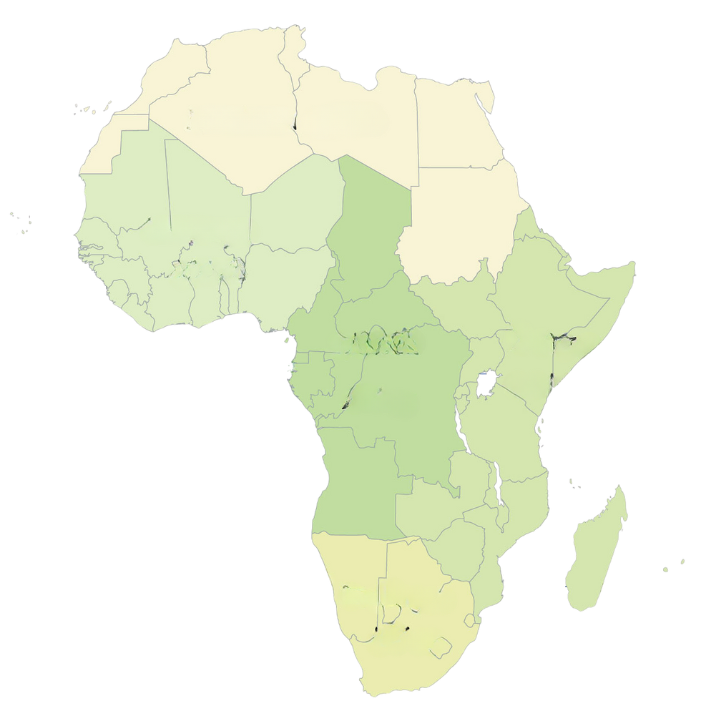
VaccineCo.
Executive Summary
Current Scenario
Strategic Plan
Execution Roadmap
Envisioned Future
Second Independence of Africa: Envisioning a new SDG-aligned public health order for the people of Africa
Autonomy
A4Africa
Agility
Four Anchors for a Resilient Future
Strengthened healthcare value chains through increased self-reliance
Vaccine stockpiles and flexible manufacturing lines pivot quickly to new threats
Skilled human labor ensures effective healthcare pathways and self-sufficient ecosystems
Bridge to MENA/EU
AMA and RCOREs enable fast-track approval pathways for emergency vaccines
Uninterrupted immunization for brighter and healthier lives
Communities receive vaccines within weeks, during pandemics and outbreaks
Demand Anchor
Innovation Hub
African universities become global centers of excellence, pioneering innovation in healthcare
Creating Resilience
One Africa, one system ensure that vaccines are distributed seamlessly across Africa’s borders
Young Africans see a career path in science and research without leaving the continent
Aligning policies with the global SDGs- SDG 3, SDG 10, SDG 17 (BRICS, WHO, GAVI, UNICEF)
HIV transmission is drastically reduced, TB is no longer a public health threat, and malaria deaths are rare
Shaping the global dialogue by leading with Vision 2040 & Agenda 2063
Production backbone
Advancement
Alignment
Source: Africa Analysis- Cornell EMI case
11
Team Ambassadors Of Quan
/11

Slide 13
Appendix I: Vaccine Prioritization Framework - Databank
Vaccine | Segment | 2030 Demand (Mn. Doses) | Mfg. Complexity (Brief) | TT Availability (Africa) | Cost Feasibility (Africa) | AVMA Priority | Cold-chain Innovations Feasibility (CTC / Freeze / MAP) | Africa TT/ Commercial (Status) | Recommendation For Vaccine Co | One-line Justification
Measles-Rubella (MR) | Routine | 204 | Live attenuated; lyo; viral QA | Medium (multiple originators; AVMA focus via MR) | Moderate price; high volume tenders | Yes | Lyo baseline; MAP late-stage; target CTC for campaigns | DS: 0; DP: limited | Make now (DS+F&F) | Highest routine volumes; fits our MR; DS feasible with TT; strong UNICEF demand.
Rotavirus | Routine | 119 | Medium; simpler than conjugates | Medium (paths exist; AVMA interest) | Good at scale; multi-supplier | Yes | Thermo options exist; aim CTC-like; freeze moderate | DS: 0 | Make now (DS+F&F) | Big/stable demand; first viral DS build; good learning curve.
Inactivated Polio (IPV) | Routine | 94 | Medium; Vero + inactivation; containment | Medium (Sabin IPV TT viable) | Medium-low DS economics; DP good | Yes | Freeze-sensitive; work on freeze-stable; CTC not yet | DP in SA (FF); DS: 0 | Make now (DP→DS); DS next | Durable demand post-OPV; strong fit; staged DP→DS path.
Pneumococcal (PCV) | Routine | 126 | High; multi-serotype conjugation + analytics | Low (today); DP→DS path | Capex heavy; strong value pool | Yes | 2–8 °C; explore lyophilized/thermo tweaks | DS: 0 | R&D now; DS in Phase-2 | Strategic anchor but complex; pursue after simpler DS wins.
Hexavalent (DTwP-Hib-HepB-IPV) | Routine | 46 | Medium; 6-in-1 testing burden | Low (originator-heavy) | Low-to-med margins; complex SC | Yes | Freeze-sensitive; improve freeze robustness | DS: 0 | R&D (post-IPV DS) | Attractive once IPV DS exists; not first build.
Meningococcal multivalent (MenA/C/W/Y/±X) | Routine (+ belt outbreaks) | 19 | High; polysaccharide + conjugation | Active TT (SA project in flight) | Higher unit price; funded | Yes | MenA had CTC; aim CTC for future liquid | TT underway; DS: 0 | R&D + partner; DS later | Regional strategic value; follow existing SA TT path.
Yellow fever (YF) | Routine (endemic) + Outbreak | 47 | Higher; egg-based live; egg supply mgmt | Partner/mentor path (Senegal) | Medium; campaign funding | Yes | Lyo; good heat; CTC label aspirational | Commercial DS in Senegal (1) | Partnered make (DS in SA if backed) | Health-security critical; consider co-dev/mentorship with Dakar.
Oral cholera (OCV) | Outbreak + Preventive | 32 | Medium; killed whole-cell fermentation | High TT momentum (multiple African projects) | Good COGS; donor stockpile | Yes | CTC-qualified (Shanchol); design for CTC | TT present (≥1 project); DS: 0 | Make now (DS+F&F) | Largest “whitespace”; chronic shortage; tech within reach.
Pentavalent (DTwP-HepB-Hib) | Routine | 330 | Lower per antigen; complex 5-in-1 | TT exists; cost leadership hard | Low margins; crowded | No | Freeze-sens.; improve freeze robustness | DS: 0 | Defer | Commodity tender; tough to win on price vs incumbents.
BCG | Routine | 120 | Low; live attenuated | Low (crowded legacy) | Very low price | No | 2–8 °C | Commercial in N. Africa (legacy) | Defer | Commodity; minimal business upside.
HepB (mono) | Routine | 80 | Medium; yeast recombinant (alum) | Widely TT-able | Commodity pricing | No | Freeze-sensitive; pursue freeze-stable | DS: 0 | R&D (freeze-stable line for Africa) | Useful for domestic/regional; compete on stability/quality.
Tetanus toxoid | Routine | 70 | Medium; toxoid | Widely TT-able | Low price | No | Freeze-sensitive; pursue freeze-stable | DS: 0 | R&D (process & freeze-stable) | Platform for future combos; reinforce our TT expertise.
HPV | Routine (adolescent) | 30 | High; VLP + complex QC | Scarce today | Medium value; dropping prices | No | HPV (Gardasil) has CTC; MAP in R&D | DS: 0 | R&D watch | Strategic later; originator dominated now.
Typhoid conjugate (TCV) | Routine (introductions) | — | Medium; single polysaccharide conjugate | Limited | Medium; growing uptake | No | 2–8 °C | DS: 0 | R&D (after conjugation skills) | Regional niche; follow after PCV skills.
Influenza (seasonal) | Non-Routine (private) | 8 | Medium; egg/cell; annual strain | Limited for Africa | Private/occupational niche | No | 2–8 °C; PFS | FF readiness in N. Africa (limited) | Defer | Small public market; revisit for private channel.
COVID-19 (routine) | Non-Routine | — | High; mRNA/viral vector | Platform TT ongoing (R&D) | Uncertain routine demand | No | −20 °C to 2–8 °C (platform-dep.) | Platform programs exist | Platform R&D (not product) | Keep platform optionality; low near-term tenders.
Polio – OPV/nOPV2 | Outbreak | — | Medium; live attenuated; BSL-3 | Possible (licensed consortia) | Stockpile-funded; sunset post-eradication | No | 2–8 °C | Planned line in Senegal (1) | R&D/partner (time-limited) | Useful until eradication; specialize only if funded.
Ebola (Zaire) | Outbreak | 0.25 | Medium; live vector; ultra-cold | Low | Small, episodic; stockpile-funded | No | −60 to −80 °C; lyo desirable | DS: 0 | Defer / FF pilot if funded | Not a volume play; pursue only with external financing.
Malaria (RTS,S / R21) | Non-Routine → Routine (growing) | 67 | High; recombinant + adjuvant; multi-dose | Low-to-med (longer-term) | Medium; donor backed | No | 2–8 °C; freeze-sens.; MAP future | DS: 0 | R&D strategic (5–10y) | Huge DALY impact; long game after DS muscle built.
Lassa / RVF / other VHF | Outbreak | — | High; early-stage platforms | None yet | Unknown | No | TBD | DS: 0 | Defer / monitor | R&D stage; not 0–5y manufacturing.
Rabies (human) | Non-Routine (PEP/PrEP) | — | Medium; inactivated cell culture | Possible | Public health niche | No | 2–8 °C | ≤1 historical in N. Africa | Defer (niche) | Regional niche; later add-on if demanded.
Japanese Encephalitis (JE) | Non-Routine (travel) | — | Medium; inactivated/attenuated | Limited | Minimal Africa demand | No | 2–8 °C | 0 | Defer | Not priority for Africa.

Slide 14
Appendix II: Vaccine Prioritization Framework - Scoring
X Axis (Manufacturing Attractiveness)
Y Axis (Market Attractiveness)
Vaccine | Segment | DS Feasibility (w=30%) | Manufacturing Complexity (w=25%) | TT Availability (w=20%) | Cost Feasibility (w=15%) | Portfolio Fit (w=10%) | Weighted Score (0–5) | Demand (w=50%) | AVMA Priority List (w=15%) | Customer Takeoff (w=15%) | Africa Whitespace (w=10%) | Innovation Edge (w=10%) | Weighted Score (0–5) | Recommendation
Measles-Rubella (MR) | Routine | 5.0 | 3.0 | 3.0 | 4.0 | 5.0 | 4.0 | 5.0 | 5.0 | 5.0 | 5.0 | 4.1 | 4.9 | Go now (E2E)
Pneumococcal conjugate (PCV) | Routine | 4.0 | 3.0 | 4.0 | 4.0 | 5.0 | 3.9 | 4.0 | 5.0 | 3.0 | 4.0 | 2.0 | 3.8 | Go now (E2E)
Pentavalent (DTwP-HepB-Hib) | Routine | 3.0 | 5.0 | 2.0 | 2.0 | 5.0 | 3.4 | 5.0 | 1.0 | 3.0 | 5.0 | 2.6 | 3.9 | Go now (E2E)
Inactivated Polio (IPV) | Routine | 3.0 | 3.0 | 3.0 | 3.0 | 4.0 | 3.1 | 3.0 | 5.0 | 3.0 | 2.0 | 3.8 | 3.3 | Build
Rotavirus | Routine | 5.0 | 3.0 | 3.0 | 3.0 | 3.0 | 3.6 | 3.0 | 5.0 | 3.0 | 2.0 | 2.0 | 3.1 | Build
Yellow fever (YF) | Routine+Outbreak | 3.0 | 1.0 | 2.0 | 3.0 | 3.0 | 2.3 | 2.0 | 5.0 | 5.0 | 3.0 | 3.5 | 3.2 | Watch
BCG | Routine | 2.0 | 5.0 | 2.0 | 1.0 | 2.0 | 2.6 | 4.0 | 1.0 | 3.0 | 3.0 | 2.0 | 3.1 | Watch
Hexavalent (DTwP-HepB-Hib-IPV) | Routine | 2.5 | 3.0 | 2.0 | 3.0 | 3.0 | 2.7 | 2.0 | 5.0 | 3.0 | 2.0 | 2.6 | 2.7 | Watch
Oral cholera (OCV) | Outbreak+Preventive | 5.0 | 3.0 | 5.0 | 4.0 | 3.0 | 4.2 | 1.0 | 5.0 | 5.0 | 2.0 | 3.5 | 2.6 | Watch
Meningococcal multivalent (MenA/C/W/Y/±X) | Routine | 3.0 | 1.0 | 5.0 | 4.0 | 3.0 | 3.1 | 1.0 | 5.0 | 5.0 | 2.0 | 3.5 | 2.6 | Watch
HepB (mono) | Routine | 3.0 | 3.0 | 3.0 | 1.0 | 5.0 | 2.9 | 3.0 | 1.0 | 2.0 | 2.0 | 2.6 | 2.4 | Watch
Malaria (RTS,S / R21) | Non-Routine→Routine | 2.5 | 1.0 | 2.0 | 4.0 | 3.0 | 2.3 | 2.0 | 1.0 | 5.0 | 5.0 | 2.2 | 2.6 | Defer
Polio – OPV/nOPV2 | Outbreak | 3.0 | 3.0 | 3.0 | 4.0 | 3.0 | 3.2 | 2.0 | 1.0 | 5.0 | 2.0 | 2.0 | 2.3 | Watch
Tetanus toxoid (TT) | Routine | 3.0 | 3.0 | 3.0 | 3.0 | 5.0 | 3.2 | 2.0 | 1.0 | 3.0 | 2.0 | 2.6 | 2.1 | Watch
Typhoid conjugate (TCV) | Routine | 3.0 | 3.0 | 3.0 | 3.0 | 3.0 | 3.0 | 2.0 | 1.0 | 3.0 | 2.0 | 2.0 | 2.0 | Watch
Lassa / RVF / JE | Outbreak/Non-Routine | 2.0 | 1.0 | 2.0 | 3.0 | 2.0 | 1.9 | 2.0 | 1.0 | 3.0 | 2.0 | 2.0 | 2.0 | Defer
Rabies (human) | Non-Routine (PEP/PrEP) | 2.5 | 3.0 | 3.0 | 3.0 | 2.0 | 2.8 | 2.0 | 1.0 | 2.0 | 2.0 | 2.0 | 1.9 | Watch
COVID-19 (routine) | Non-Routine | 2.5 | 1.0 | 2.0 | 3.0 | 3.0 | 2.2 | 2.0 | 1.0 | 2.0 | 2.0 | 2.0 | 1.9 | Defer
Ebola (Zaire) | Outbreak | 2.0 | 3.0 | 2.0 | 4.0 | 2.0 | 2.6 | 1.0 | 1.0 | 5.0 | 2.0 | 2.0 | 1.8 | Watch
HPV | Routine (adolescent) | 2.0 | 1.0 | 2.0 | 4.0 | 3.0 | 2.2 | 1.0 | 1.0 | 3.0 | 2.0 | 2.2 | 1.5 | Defer
Influenza (seasonal) | Non-Routine (private) | 2.5 | 3.0 | 2.0 | 2.0 | 2.0 | 2.4 | 1.0 | 1.0 | 2.0 | 2.0 | 2.0 | 1.4 | Defer

Slide 15
Appendix III: Investments, Funding Partners, and Company Financials
Investments
Phase | Years | Total Investment (US$ mn) | DS Investment (US$ mn) | Vaccine Investment (US$ mn) | Added Capacity (mn doses p.a.) | Cumulative (US$ mn) | Cumulative (mn doses p.a.)
Short Term | 2025 - 2030 | 215 | 180 | 35 | 40 | 215 | 40
Medium Term | 2030 - 2035 | 190 | 150 | 40 | 60 | 405 | 100
Long Term | 2035 - 2040 | 95 | 70 | 25 | 40 | 500 | 140
Total (15 years) | Cumulative | 500 | 400 | 100 | 140 | 500 | 140
Company Financials
Year | F&F revenue (USD m) | F&F GM% | F&F GP | DS volume (m doses) | DS price ($/dose) | DS COGS ($/dose) | DS revenue | DS COGS | DS GP | Total revenue | Total GP | Gross % | Base opex | Vaccine tech R&D | EBITDA | DS Capex | NWC change | Tax | Project cash flow
2025 | 40.8 | 40.5% | 16.5 | 0.0 | 2.1 | 1.1 | 0.0 | 0.0 | 0.0 | 40.8 | 16.5 | 40.5% | 16.0 | 7.0 | -6.5 | 30.0 | 0.0 | 0.0 | -36.5
2026 | 41.6 | 41.0% | 17.1 | 0.0 | 2.1 | 1.0 | 0.0 | 0.0 | 0.0 | 41.6 | 17.1 | 41.0% | 17.0 | 7.0 | -6.9 | 36.0 | 0.0 | 0.0 | -42.9
2027 | 42.4 | 41.5% | 17.6 | 0.0 | 2.1 | 1.0 | 0.0 | 0.0 | 0.0 | 42.4 | 17.6 | 41.5% | 18.0 | 7.0 | -7.4 | 36.0 | 0.0 | 0.0 | -43.4
2028 | 43.3 | 42.0% | 18.2 | 10.0 | 2.2 | 1.0 | 21.7 | 9.7 | 12.0 | 65.0 | 30.2 | 46.5% | 19.1 | 7.0 | 4.1 | 36.0 | 1.1 | 1.0 | -34.0
2029 | 44.2 | 42.5% | 18.8 | 30.0 | 2.2 | 0.9 | 65.7 | 28.2 | 37.5 | 109.8 | 56.3 | 51.2% | 20.2 | 7.0 | 29.1 | 36.0 | 2.2 | 7.3 | -16.4
2030 | 45.0 | 43.0% | 19.4 | 60.0 | 2.2 | 0.9 | 132.7 | 54.7 | 78.0 | 177.7 | 97.4 | 54.8% | 21.4 | 8.0 | 68.0 | 30.0 | 3.4 | 17.0 | 17.6
2031 | 45.9 | 43.5% | 20.0 | 90.0 | 2.2 | 0.9 | 201.0 | 79.5 | 121.5 | 246.9 | 141.5 | 57.3% | 22.7 | 8.0 | 110.8 | 30.0 | 3.5 | 27.7 | 49.6
2032 | 46.9 | 44.0% | 20.6 | 120.0 | 2.3 | 0.9 | 270.7 | 102.7 | 168.0 | 317.5 | 188.6 | 59.4% | 23.6 | 8.0 | 157.0 | 30.0 | 3.5 | 39.3 | 84.2
2033 | 47.8 | 44.5% | 21.3 | 135.0 | 2.3 | 0.8 | 307.5 | 111.8 | 195.8 | 355.3 | 217.0 | 61.1% | 24.5 | 8.0 | 184.5 | 30.0 | 1.9 | 46.1 | 106.5
2034 | 48.8 | 45.0% | 21.9 | 150.0 | 2.3 | 0.8 | 345.0 | 120.0 | 225.0 | 393.8 | 246.9 | 62.7% | 25.5 | 8.0 | 213.4 | 30.0 | 1.9 | 53.4 | 128.1
2035 | 49.7 | 45.0% | 22.4 | 150.0 | 2.3 | 0.8 | 345.0 | 120.0 | 225.0 | 394.7 | 247.4 | 62.7% | 26.6 | 5.0 | 215.8 | 14.0 | 0.0 | 54.0 | 147.8
2036 | 50.7 | 45.0% | 22.8 | 150.0 | 2.3 | 0.8 | 345.0 | 120.0 | 225.0 | 395.7 | 247.8 | 62.6% | 27.6 | 5.0 | 215.2 | 14.0 | 0.0 | 53.8 | 147.4
2037 | 51.7 | 45.0% | 23.3 | 150.0 | 2.3 | 0.8 | 345.0 | 120.0 | 225.0 | 396.7 | 248.3 | 62.6% | 28.7 | 5.0 | 214.6 | 14.0 | 0.1 | 53.6 | 146.9
2038 | 52.8 | 45.0% | 23.8 | 150.0 | 2.3 | 0.8 | 345.0 | 120.0 | 225.0 | 397.8 | 248.8 | 62.5% | 29.9 | 5.0 | 213.9 | 14.0 | 0.1 | 53.5 | 146.4
2039 | 53.8 | 45.0% | 24.2 | 150.0 | 2.3 | 0.8 | 345.0 | 120.0 | 225.0 | 398.8 | 249.2 | 62.5% | 31.1 | 5.0 | 213.2 | 14.0 | 0.1 | 53.3 | 145.8
Funding Partners
Funder | Category | Typical Instruments | Avg. Ticket Size | Risk Appetite | Concession | Notes
IFC | DFI | Debt, Equity | 45 | 3.20 | 4.20 | Project finance/equity; can co-lead with commercial lenders
DFC | DFI | Debt, Guarantees | 45 | 3.60 | 3.40 | Political-risk cover & guarantees common; supports health infra
EIB | DFI | Debt (blended) | 57.5 | 2.10 | 3.30 | EU-linked; often blends with grants for health manufacturing
AfDB | DFI | Debt, Guarantees (blended) | 52.5 | 3.10 | 3.60 | Regional development bank; syndicates with DFIs
CEPI | Donor | Grants, AMCs | 25 | 4.80 | 4.80 | R&D & manufacturing readiness; target diseases of epidemic potential
Gavi | Donor | Volume guarantees, AMCs | 65 | 3.00 | 3.00 | Demand commitments; price/volume top-ups
Aspen | Strategic | Equity/Capex JV | 40 | 3.30 | 1.40 | Co-invest in sterile/DS capacity; operational synergies
Strategic | Strategic | Equity/JV, Offtake | 100 | 2.40 | 4.50 | Tech transfer + offtake; commercial terms
BII | Sovereign Wealth | Equity (anchor) | 150 | 2.70 | 1.10 | Large tickets for strategic health/biotech plays
Temasek | Sovereign Wealth | Equity/Growth | 100 | 3.50 | 2.50 | Growth equity; healthtech exposure

Slide 16
Appendix IV: Prioritization of Partners For Tech Transfer
Vaccine
Scoring
Choice
Pneumococcal
Conjugate Vaccine
(PCV13)
Partner | Relevance to PCV13 | Supply Scale | Tech Transfer Record | Regulatory Standing | IP / Patent Position | Total
Pfizer | 5 – Originator, only true PCV13 | 5 – Dominant global supplier | 3 – Limited history | 5 – Strong PQ record | 5 – Owns key patents till ~2030 | 23
Serum Institute | 3 – Makes PCV10 (Pneumosil), not PCV13 | 4 – Large supplier | 4 – Proven LMIC transfers | 5 – PQ strong | 2 – No PCV13 rights | 18
SK Bioscience | 3 – Developing PCV candidate | 2 – Small share | 4 – Active in partnerships | 3 – In development | 3 – Partial wins vs Pfizer | 15
Pfizer
only route to PCV13 DS until patents expire.
Measles–Rubella
(MR)
Partner | Relevance to PCV13 | Supply Scale | Tech Transfer Record | Regulatory Standing | IP / Patent Position | Total
Serum Institute | 5 – Largest MR producer globally | 5 – Major UNICEF/Gavi supplier | 5 – Multiple LMIC transfers | 5 – Strong PQ | 4 – Few patent barriers | 24
Bio Farma | 4 – MR producer | 3 – Regional supplier | 3 – Limited | 4 – PQ’d | 3 – No unique IP | 17
Shantha Biotech | 4 – MR in portfolio | 3 – Smaller scale | 3 – Moderate | 4 – PQ’d | 3 – No unique IP | 17
Serum Institute
Scale, PQ, and proven openness to transfer
Pentavalent
(DTP–HepB–Hib)
Partner | Relevance to PCV13 | Supply Scale | Tech Transfer Record | Regulatory Standing | IP / Patent Position | Total
Biological E (BioE) | 5 – Top pentavalent producer | 5 – Supplies ~50% UNICEF demand | 4 – Open to partnerships | 5 – WHO PQ leader | 4 – Few IP barriers | 23
Serum Institute | 5 – Produces pentavalent | 4 – Large supplier | 4 – Transfer history | 5 – PQ strong | 4 – Few IP barriers | 22
Shantha Biotech | 4 – Pentavalent in portfolio | 3 – Smaller scale | 3 – Moderate | 4 – PQ’d | 3 – No IP edge | 17
Panacea Biotec | 3 – Pentavalent producer | 3 – Limited UNICEF share | 3 – Some partnerships | 3 – PQ’d, smaller | 3 – No edge | 15
Biological E
Most dominant, PQ’d, strong track record with UNICEF

Slide 17
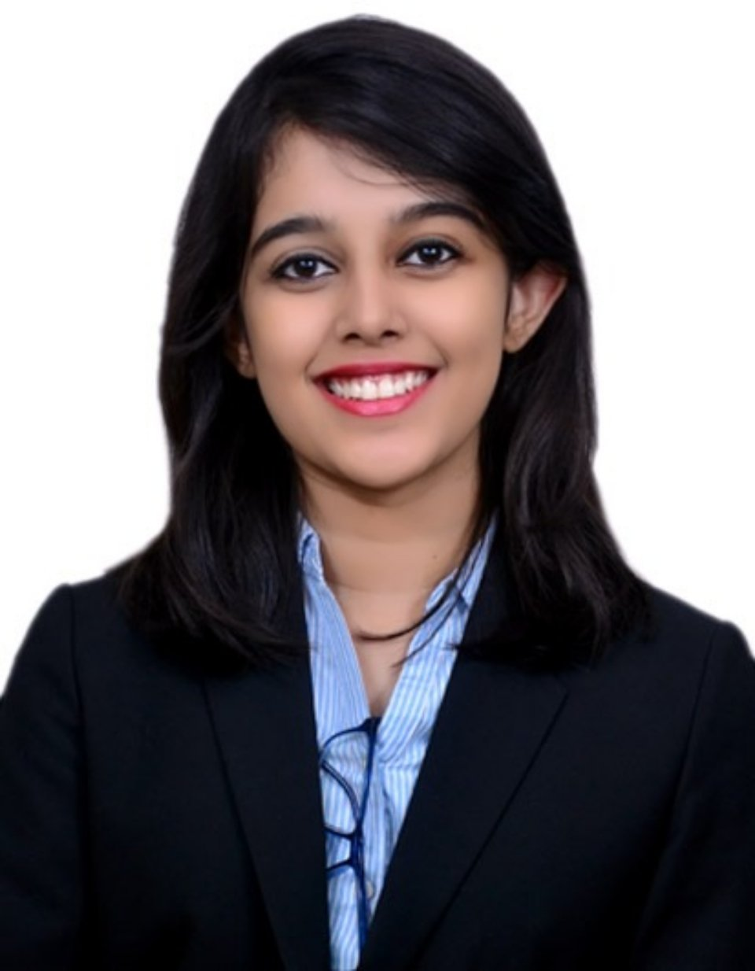
Appendix V: Primary Research
Interview with
Ms. Rai Sengupta
Q1. From your experience on the ground, what gaps stand out most in emerging markets’ health systems?
“One of the clearest gaps is consistency of service delivery. Facilities may exist, but resources, medicines, staff, equipment don’t always arrive when or where they’re needed.
Another is the shortage of skilled personnel. Even when infrastructure is in place, there often aren’t enough trained professionals to operate or manage it effectively.
And finally, data. Without timely, reliable data, it becomes very hard to identify bottlenecks or act quickly when things go wrong.”
Q2. What role have organizations like Gavi and UNICEF played in addressing these challenges?
“They’ve been central. Global institutions bring financing, procurement power, and logistical reach that most low- and middle-income countries couldn’t build on their own. UNICEF, for instance, has supply chains that can reach the most remote areas.
But the flip side is dependency. Heavy reliance on external actors can discourage local governments from strengthening their own systems, which makes sustainability difficult in the long run.”
Q3. Looking forward, what do you think emerging markets need most to achieve self-reliance in health?
“I would highlight three things. First, investing in local production and systems so countries are less vulnerable to global supply shocks.
Second, building regulatory and governance capacity, so that quality and safety are assured locally and not just externally validated.
And third, talent. Unless there are clear career pathways, young professionals will continue to migrate abroad, creating a cycle of brain drain. Retaining skilled people is just as important as building infrastructure.”
UNICEF- M&E
Ecory’s UK – Climate & Health Specialist, Tanzania and Nigeria
University of Oxford- MSc Evidence-Based Social Intervention and Policy Evaluation
Q4. From an evaluation perspective, how do you define success?
“Not just in terms of infrastructure built or funds disbursed. Success should be measured in outcomes: fewer service gaps, reduced wastage, higher coverage in underserved areas, and stronger systems that continue functioning long after donor support tapers off.”

