Slide 1
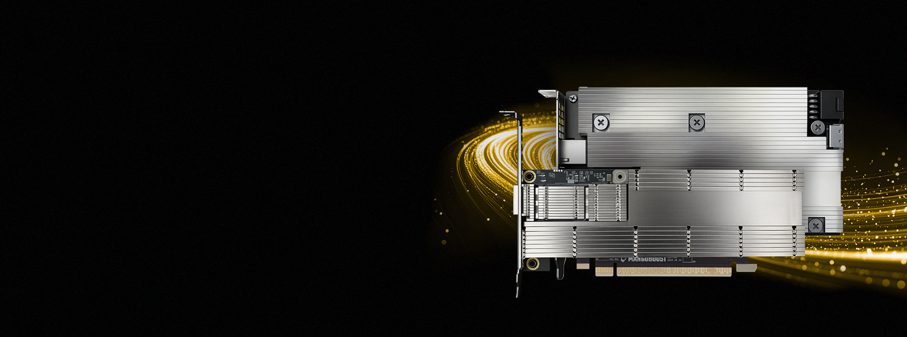



BOOST YOUR
DATACENTER
PRODUCT BRIEF
Mango BoostXTM
NRT (NVMe-oF RDMA Target)
Enabling Scalable Storage Systems
Overview
Specifications
Mango BoostX™ NVMe-over-Fabrics (NoF) Target Accelerator Card offloads NVMe/RoCEv2 data paths to dedicated hardware, delivering line-rate, zero-CPU performance for disaggregated storage. Built on an FPGA-based modular architecture, it enables low-power, low-latency, high-throughput communication and scalable deployment across Ethernet data centers, reducing TCO while matching local SSD performance.
Network Interface
1×200GbE (QSFP-DD)
Host Interface
PCIe Gen5x16 HHHL, <75W Power
Compliance
NVMe base specification 1.3 & 2.0
NVMe over Fabrics specification 1.0c
NVMe over Fabrics
Supports up to 32 hosts
32 entries per connection
Includes active-active and active-passive multipath support for redundancy and scalability
NVMe
Supports up to 26 NVMe SSDs and 26 subsystems
128 KiB maximum data transfer size (MDTS)
512-byte logical block sizes
Congestion Control
Explicit Congestion Notification (ECN)
Performance Summary
Key Highlights
JBOF-ready NVMe/RDMA Target
Headless NVMe/RDMA target accelerator for JBOF storage enclosures
NVMe-oF storage expansion enabled at low system power
Unparalleled Performance
Line-rate performance at 200GbE
Zero CPU consumption in NVMe-oF I/O path
Direct communication with NVMe SSDs without CPU intervention
Interoperability and Compatibility with Standards
Compatible with RoCEv2 standardized infrastructure
Certified NVMe-compliant solution by UNH-IOL
Zero-CPU I/O Path
Mango BoostX™ NVMe-oF Target is a zero-CPU solution that fully offloads the NVMe-oF I/O stack. Built on RoCEv2 network acceleration, BoostX™ efficiently converts network packets
CPU
CPU
CPU
CPU
from the NVMe-oF protocol to the NVMe protocol, allowing communication with NVMe SSDs. Our solution targets CPU- and DRAM-less JBOF systems. Therefore, our solution do not rely on CPU involvement entirely, enabling light storage servers and reducing total cost of ownership.
4KB (IOPS) | Random Read | 5.7M
 | Random Write | 5.7M
 | Random RW Mix | 8.3M
128KB (GB/s) | Sequential Read | 24.3
 | Sequential Write | 24.3
 | Sequential RW Mix | 44.4
CPU
CPU
CPU
CPU
CPU
Network Interface Card
NVMe
SSD
NVMe
SSD
NVMe
SSD
CPU
CPU
CPU
CPU
CPU
CPU
CPU
NVMe
SSD
Mango BoostX™
NVMe over Fabrics Target
NVMe
SSD
NVMe
SSD
© 2025 MangoBoost, Inc. All rights reserved.
© 2026 MangoBoost, Inc. All rights reserved.
Solution Brief: MANGO BOOSTX™ NVME OVER FABRICS TARGET CARD – DRIVING FORCE FOR DATACENTER ACCELERATION
‹#›
‹#›

Slide 2
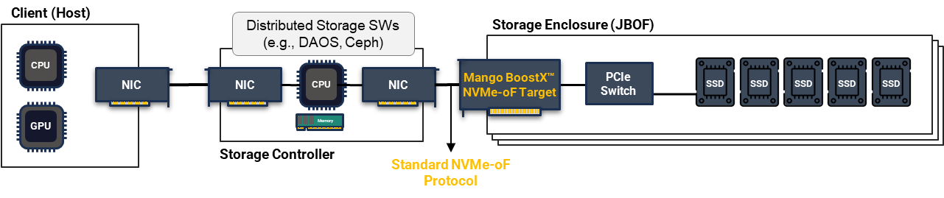
BOOST YOUR
DATACENTER
PRODUCT BRIEF
Key Benefits
Zero CPU Overhead | Full hardware offload of NVMe-RoCEv2 target processing eliminates the need for a host CPU, enabling power-efficient, headless JBOF storage systems.
Line-Rate Performance | Delivers sustained high throughput and low-latency response across a 200GbE interface, supporting multi-host access without performance degradation.
Seamless Integration | Operates as a standard NVMe-oF target device, requiring no changes to initiator drivers, applications, or storage management workflows for deployment.
Multi-Host Connectivity | Supports multiple concurrent host connections and queue pairs, enabling shared flash pools to scale across clusters and data center fabrics.
Efficient Resource Utilization | Reduces networking overhead and power usage—delivering cost-efficient, high-density disaggregated storage at scale.
Solutions & Use Cases
Disaggregated All-Flash Arrays
Enables high-density, network-attached flash storage pools accessible by multiple compute nodes at near-local performance
Fabric-Attached Bunch of Flash
Simplifies scaling of flash resources through Ethernet fabrics, improving flexibility and management
AI-Ready Shared Storage Systems
Delivers the throughput and consistency required for AI/ML pipelines and distributed model training
Enterprise & Cloud Storage Clusters
Reduces TCO by replacing proprietary SAN hardware with standards-based Ethernet solutions
Edge and Telco Deployments
Provides deterministic, low-latency performance with a small power footprint suitable for distributed edge nodes
Reference Storage System Design
This reference storage system demonstrates how Mango BoostXTM enables a standard JBOF architecture. By exposing storage through a standards-compliant NVMe-oF interface, it integrates seamlessly with distributed storage software running on controller nodes.
DISCLAIMERS
The performance claims in this document are based on the internal cluster environment. Actual performance may vary depending on the server configuration. Software and workloads used in performance tests may have been optimized for performance only on MangoBoost products. Performance results are based on testing as of dates shown in configurations and may not reflect all publicly available updates. Results that are based on pre-production systems and components as well as results that have been estimated or simulated using MangoBoost reference platform for informational purposes only. Results may vary based on future changes to any systems, components, specifications, or configurations. Statements in this document that refer to future plans or expectations are forward-looking statements. These statements are based on current expectations and involve many risks and uncertainties that could cause actual results to differ materially from those expressed or implied in such statements. MangoBoost does not guarantee any specific outcome. Nothing contained herein is, or shall be relied upon as, a promise or representation or warranty as to future performance of MangoBoost or any MangoBoost product. The information contained herein shall not be deemed to expand in any way the scope or effect of any representations or warranties contained in the definitive agreement for MangoBoost products. The information contained herein may not be reproduced in whole or in part without prior written consent of MangoBoost. The information presented in this document is for informational purposes only and may contain technical inaccuracies, omissions and typographical errors. The information contained herein is subject to change and may be rendered inaccurate for many reasons, including but not limited to product and roadmap changes, component and motherboard version changes, new model and/or product releases, product differences between differing manufacturers, software changes, BIOS flashes, firmware upgrades, or the like. MangoBoost assumes no obligation to update or otherwise correct or revise this information and MangoBoost reserves the right to make changes to the content hereof from time to time without any notice. Nothing contained herein is intended by MangoBoost, nor should it be relied upon, as a promise or a representation as to the future. MANGOBOOST MAKES NO REPRESENTATIONS OR WARRANTIES WITH RESPECT TO THE CONTENTS HEREOF AND ASSUMES NO RESPONSIBILITY FOR ANY INACCURACIES, ERRORS OR OMISSIONS THAT MAY APPEAR IN THIS INFORMATION. © 2025 MangoBoost, Inc. All rights reserved.
© 2025 MangoBoost, Inc. All rights reserved.
© 2025 MangoBoost, Inc. All rights reserved.
© 2026 MangoBoost, Inc. All rights reserved.
‹#›
‹#›
Solution Brief: MANGO BOOSTX™ NVME OVER FABRICS TARGET CARD – DRIVING FORCE FOR DATACENTER ACCELERATION
‹#›

