Slide 1
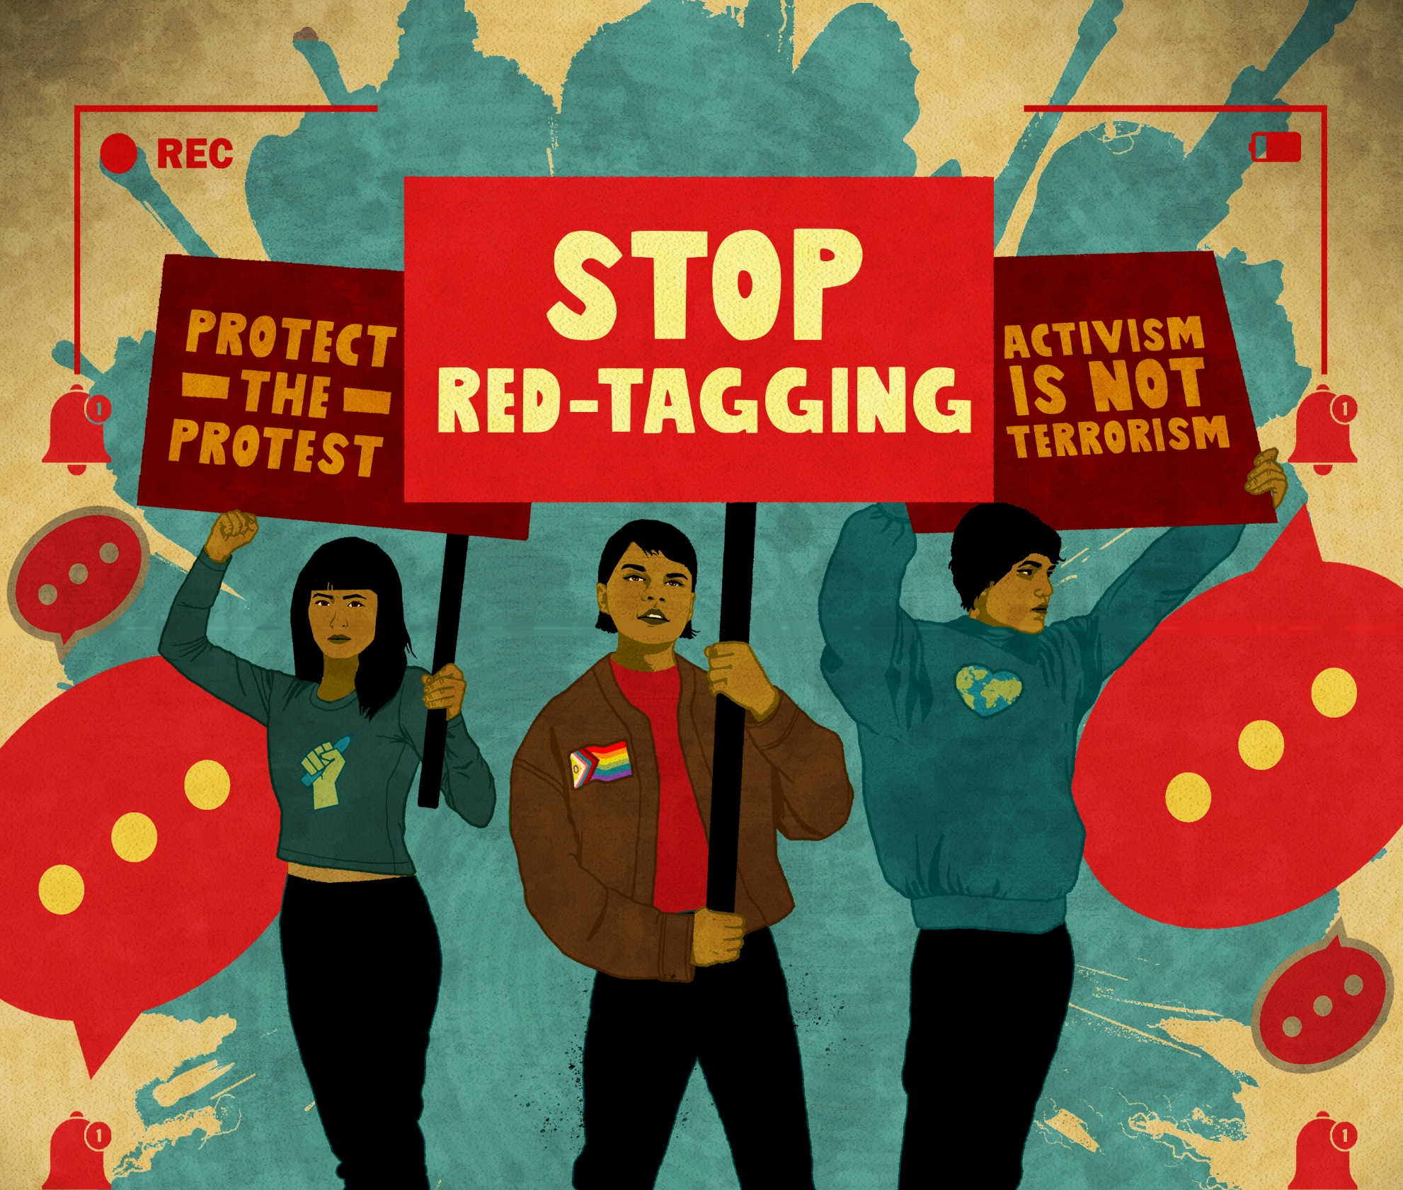
STOP RED TAGGING
“I turned my fear into courage”
Freedom Challenge 2025
Notes:
Freedom Challenge
Our annual youth leadership challenge where we ask our youth advocates to take on a real HR challenge we think they can particularly have an impact on
Always occurs around Int Youth Day – August 12 – as that date also works well for schools and uni groups
Focusing on the Philippines, and in particular a nasty practice of red tagging

Slide 2
What exactly is red tagging?
Notes:
Allows for the whole of state approach to targeting you – accusing you of being communists, being terrorist - police, military, govt officials, university and school authorities
But also can see your own friends and family turn on you
That can be even if you are a 13-year-old high school student, or a university student , a student journalist. Somebody who might have simply liked a social media post or attended a protest

Slide 3
The Philippines has a vocal civil society and long tradition of activism and protest.
Remains one of the most dangerous countries for human rights defenders in Asia.
Youth Human Rights Defenders (YHRDs) have for decades been at the forefront of protesting for rights
But they are also particularly at risk of state violence.
Notes:
This campaign highlights how vibrant Philippine civil society is , even despite the risks associated with that activism.

Slide 4
Protecting the rights to freedom of assembly and freedom of expression
Pushing back against restrictions of these rights
Legal
Political
Police or military intervention
Protecting human rights defenders standing up for these rights.
Notes:
Part of our global Protect the Protest campaign
Contributes to our national strategy which prioritises ensuring youth voices/actions are to the fore and that we grow and support youth engagement

Slide 5
State actors including leading political figures and authorities use red-tagging as a dog whistle to incite violence and discrimination against young advocates engaged in diverse human rights causes and against student journalists.
That violence and discrimination has seen young advocates
under surveillance and harassed by members of the security forces,
facing legal harassment, arbitrary arrests,
enforced disappearances
Death
Cyber attacks
10 minute video –featuring direct accounts from young human rights defenders https://www.youtube.com/watch?v=mKljCkir2qg
Notes:
Youth is no escape from being targeted or harassed.
And it’s tougher again when you come from a minority community - like disabled, ethnic minority, rainbow .
Youth voices are desperately needed in the media landscape, not only to ensure youth voices are heard but to ensure student journalists continue on in their media careers.
Standing up against such an onslaught requires huge courage and persistence.
The video highlights features 3 young women HRDs Louise, Kessha, Hailey talking about over-coming their fears to take action and the strength they draw from their communities

Slide 6
Education system as a battleground
Universities and student organisations are also red tagged
National Service Training Programme classes (originally designed to instil civic responsibility) used to label students and organisations as communist sympathisers
Since Jan 2021 – National Defence Forces can enter University campuses without prior notice, on unfounded allegations of “ongoing clandestine recruitment” for the NPA.
On and offline warnings not to join popular student organisations which are critical of the government
‘There’s that crippling feeling of “am I a target to the military?”’
Ana , 26-year-old community activist, Southern Luzon
Notes:
It’s not just individuals who are red tagged, but also unis and student orgs.
Not even universities are safe
Unis are accused of being hot beds of communist and terrorist activity harbouring students and staff who are anti-govt, which undermines academic freedoms and intimidates young people which suppresses youth activism

Slide 7
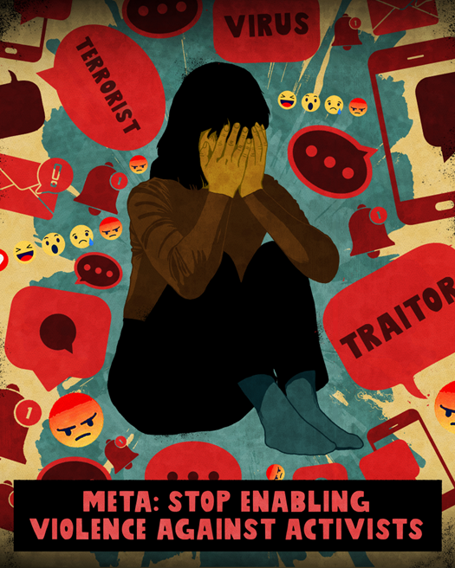
Online targeting of advocates
Facebook is the leading social media network
- 95% of social media users use this platform monthly.
State actors use Facebook to broadcast and amplify their red-tagging messages allowing them to incite violence against youth human rights defenders
Meta, the owner of Facebook, has:
allowed state officials and other platform users to harass, intimidate and threaten human rights defenders
provided Inadequate content moderation and ad approval mechanisms,
failed to track the effectiveness of its risk mitigation measures,
Notes:
Online targeting is rife and Meta/ Facebook has failed to address wide ranging concerns/targeting/harassment online.
Contrary to President Marcos’ attempts to portray his administration as more rights-respecting than Duterte’s government, red-tagging remains commonplace. The Anti-Red-Tagging Monitoring Project has counted more than 450 red-tagging incidents in the first half of 2024, 61% of which were attributed to government actors. These incidents have wide-ranging impact on the rights and well-being of each affiliated member, staff member or students of the civil society organisations, unions or educational institutions targeted.
Here in Aotearoa NZ we are hosting our own online safety campaign with the aim to urge the NZ govt to demand controls on social media providers in this country. Laws already exist in such countries like the UK and Australia. They need to exist here.
What it will allow is for us to upskill on the impact of both on and offline harm as it relates to youth activism, and provide resources and referral agencies to those facing online harm in Aotearoa NZ.

Slide 8
Laws and actions used as weapons against human rights defenders
Executive Order 70 establishing a “Whole-of-Nation approach in defeating the Local Communist Terrorist Groups.
A new presidential task force, the “National Task Force to End Local Communist Armed Conflict”, ( NTF-ELCAC) established.
2020
the Anti-Terrorism Act passes which further suppresses dissent and entrenches the targeting of human rights defenders
2021
the government tears up a 32-year-old agreement barring state forces from entering campuses of the University of the Philippines (UP) without prior approval from the university administration
“Those legal harassments are actually clearly baseless, and its purpose is to demoralise and to stop our advocacy work for human rights.”
May, 24-year-old activist, Southern Luzon
Notes:
Laws that should protect HRDs are actually used to persecute, harass and prosecute them. Some of those acts include the above.
2017 peace agreement between the Philippine government and the Communist Party of the Philippines (CPP), the political party of the NPA failed.
In response, President Duterte stepped up targeting of Communist or alleged Communist activity with a “Whole-of-Nation” approach introducing a series of acts and entities which suppressed dissent allowing for the targeting of HRDs.
Since 1989 the University of Philippines had an agreement barring military forces from coming on campus without prior approval,

Slide 9
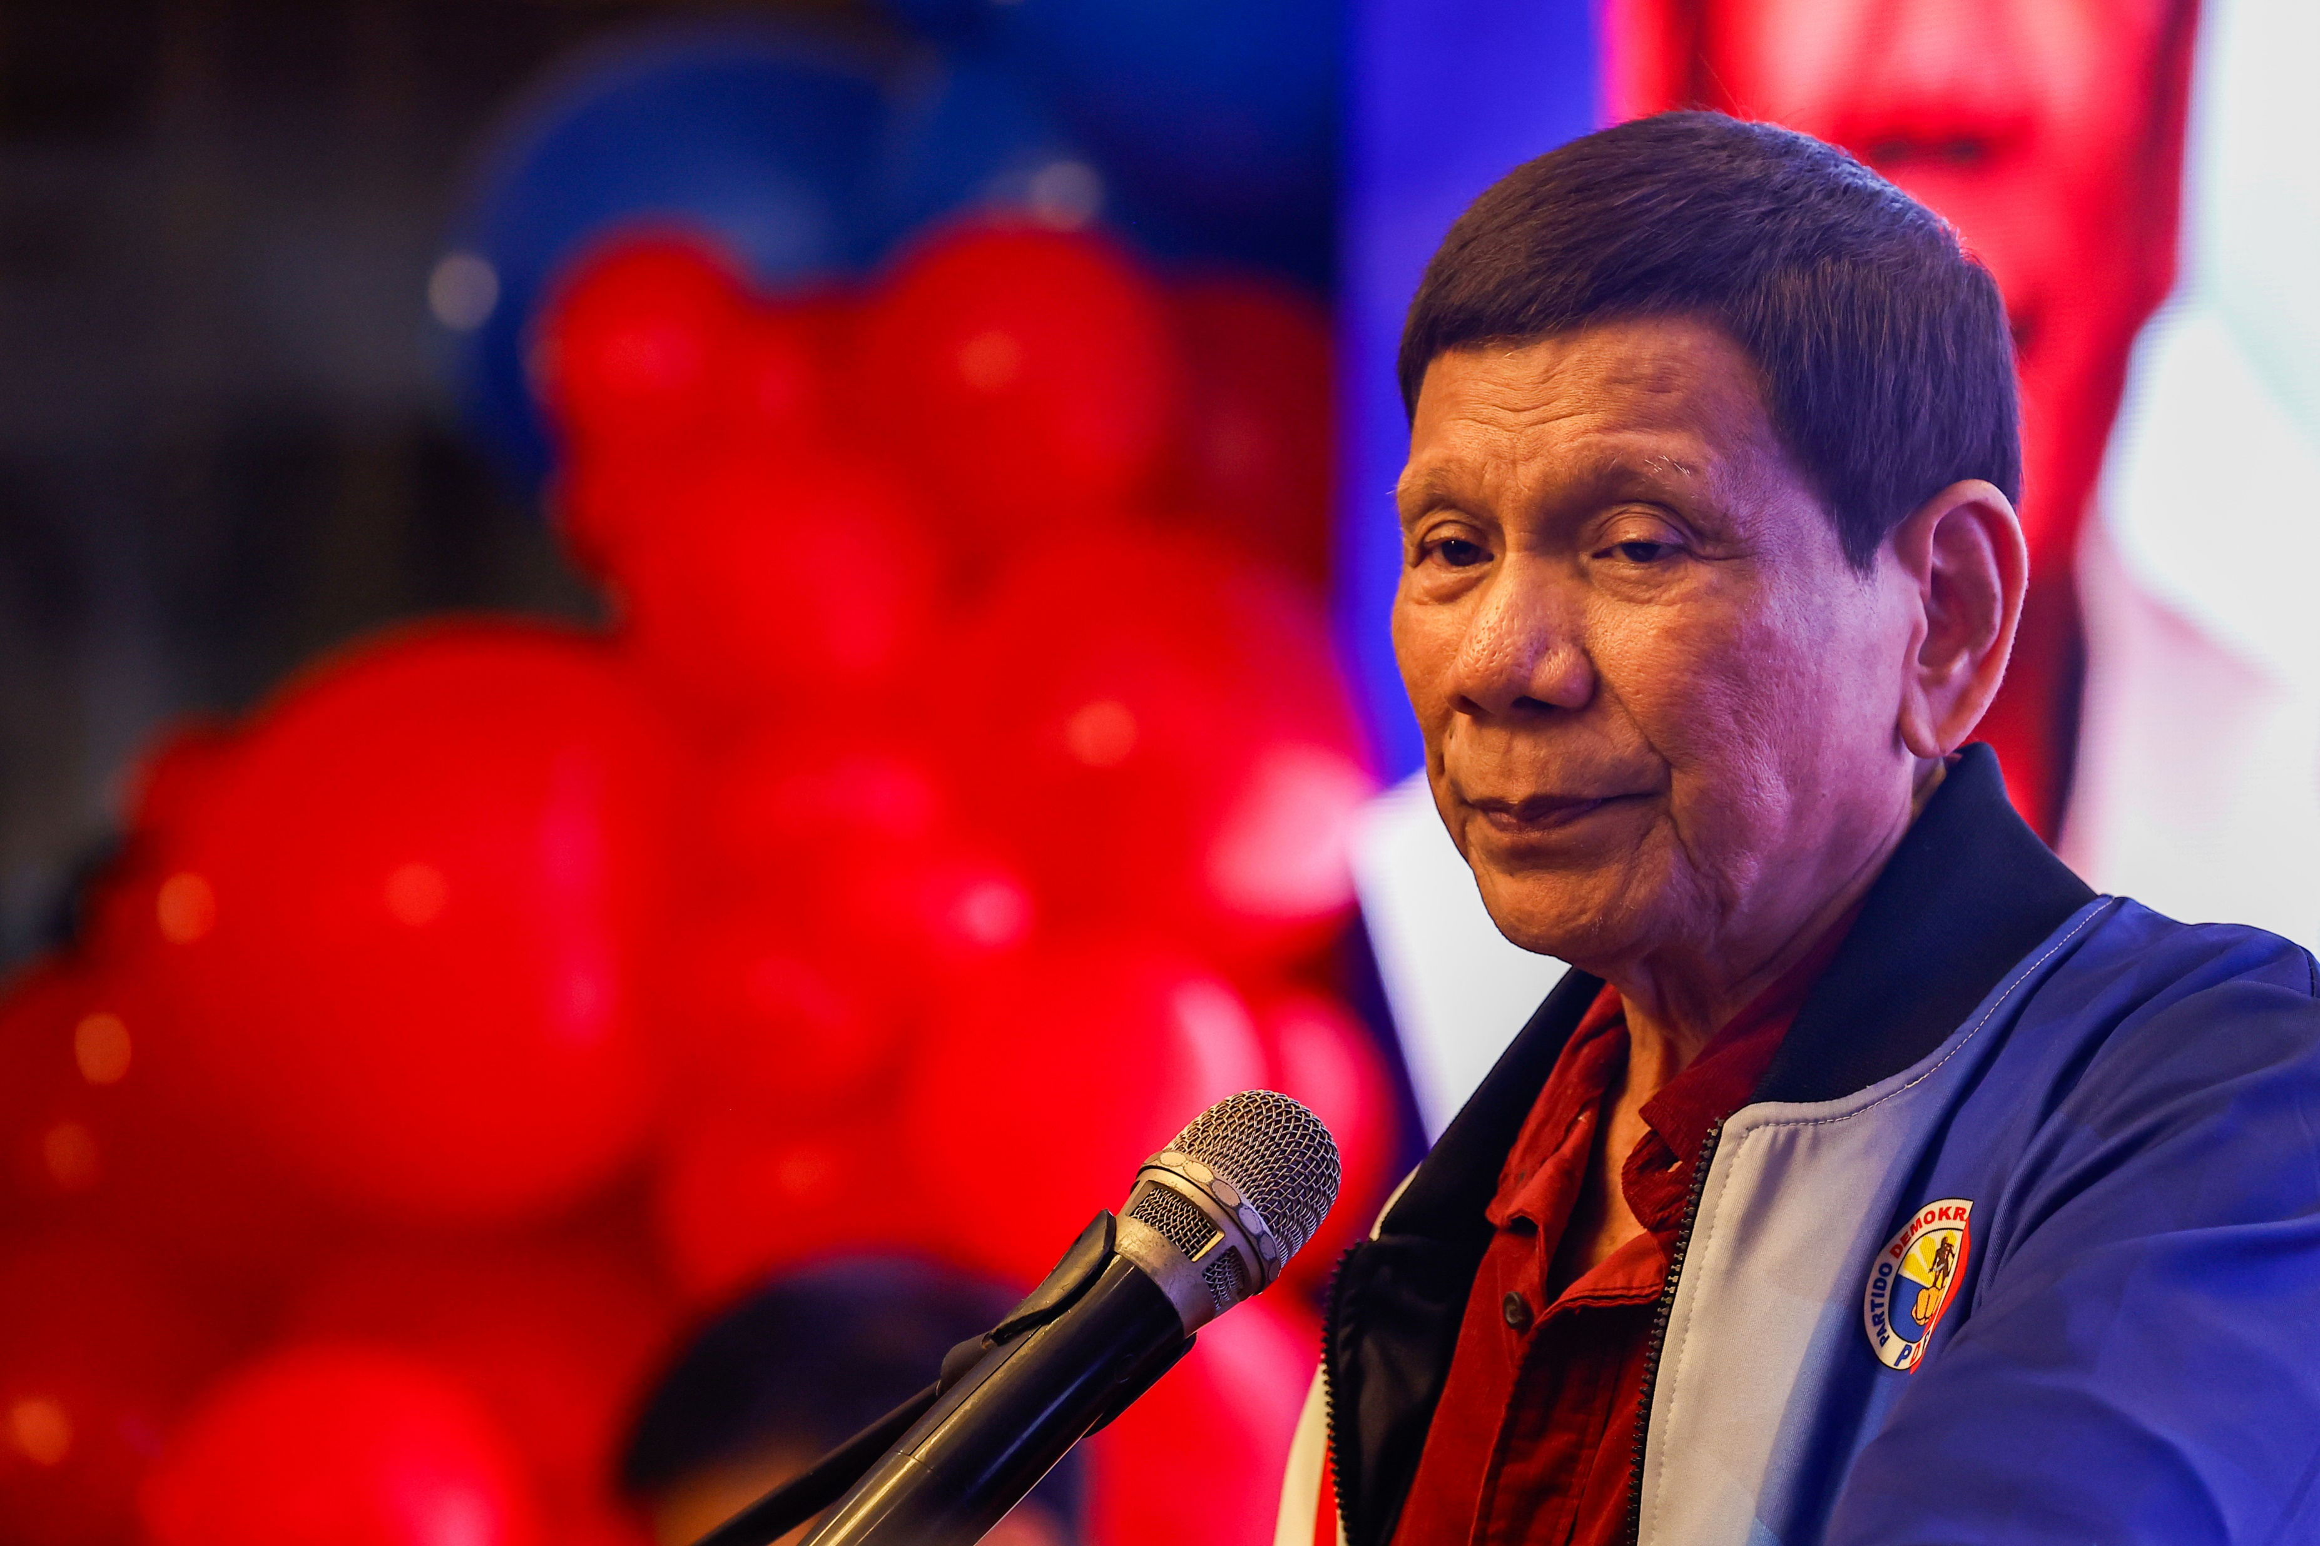
“
2012 landmark Anti-Enforced or Involuntary Disappearance Act passed which, bans state actors from abducting individuals, no person had been held accountable for the recorded disappearances of 183 people
2020 Report by the Philippine Commission on Human Rights argues that red-tagging is often an “open invitation” to commit further serious human rights violations against HRDs, including surveillance, false arrests and killings
2024 the Philippine Supreme Court recognised that “red-tagging, vilification, labelling, and guilt by association threaten a person’s right to life, liberty, or security”
2025 Former President Duterte surrendered to the International Criminal Court after being arrested on charges for the crimes against humanity of murder, torture and rape.
Notes:
Good laws do exist in the Philippines, they just need to be implemented like the Disappearance Act.
And the tide is turning with the Human Rights Commission and Supreme Court coming out against red tagging
Bad laws are increasingly being challenged, and perpetrators are being brought to justice. As this year’s surrender of former President Duterte to the ICC is evidence of. Nobody is above the law.

Slide 10
Within this year’s Freedom Challenge we highlight the urgent need for effective protections against the targeting of Young Human Rights Defenders in the Philippines.
We are calling for the Philippine government to
Abolish the NTF-ELCAC Task Force and investigate its operations.
Stop the use of red tagging
Repeal the Anti-Terrorism Act and investigate abuses in the use of this law
Pass the Human Rights Defenders (HRD) Protection Act
Review provisions of the Cybercrime Act
Notes:
It’s why withing this year’s Freedom Challenge we are calling on the Philippine govt to stop using red tagging and the Task Force, repeal or review existing laws, pass laws that will protect HRDs .
While our colleagues in the Philippine also focus on Meta/Facebook within their campaigning our focus is solely on the Philippine govt.

Slide 11
Solidarity with brave youth human rights defenders
Notes:
This campaign also offers the opportunity for a solidarity action. Anything we can do to let brave human rights defendes know they are not alone is a powerful act.

Slide 12
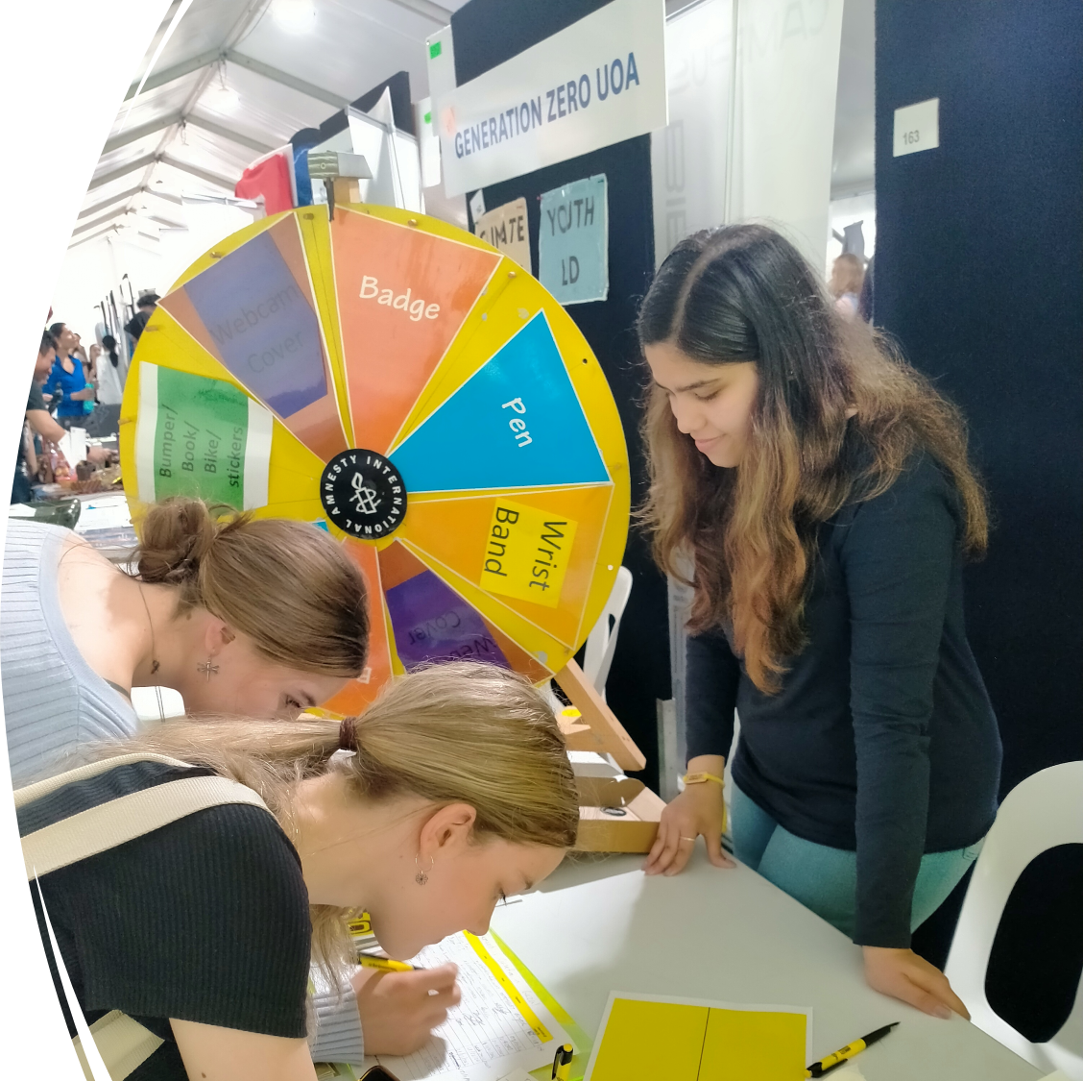
We ask our school and uni groups
& youth advocates to
Get informed
Raise awareness
Take action to have impact on a youth-
relevant human rights issue
Along the way they will engage in
Campaigning
Public speaking
Advocacy
Event management
Fundraising
Recruitment
HAVE FUN
Notes:
Offer prizes for the team & individual who contribute the most signatures and solidarity messages and the most funds to this campaign.

Slide 13
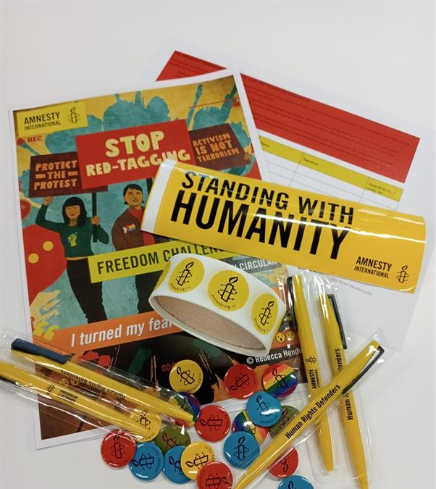
Resources and support
Freedom Challenge - 2025 website https://amnesty.org.nz/freedom-challenge/
An Action Circular with information and ideas
Downloadable & online petition
Register to receive resources - https://forms.office.com/r/Yvzg9WSjJp
We’re also offering prizes for the top action taking and fundraising individual or team.
Webinars and skillshares
Notes:
.
Amnesty merch for any raffles you offer as part of your fundraising package.
Badges, stickers and Standing with humanity resources to provide for action taking and/or a gold coin donation

Slide 14
Pātai?
Any questions?
Any suggestions??

