Slide 1
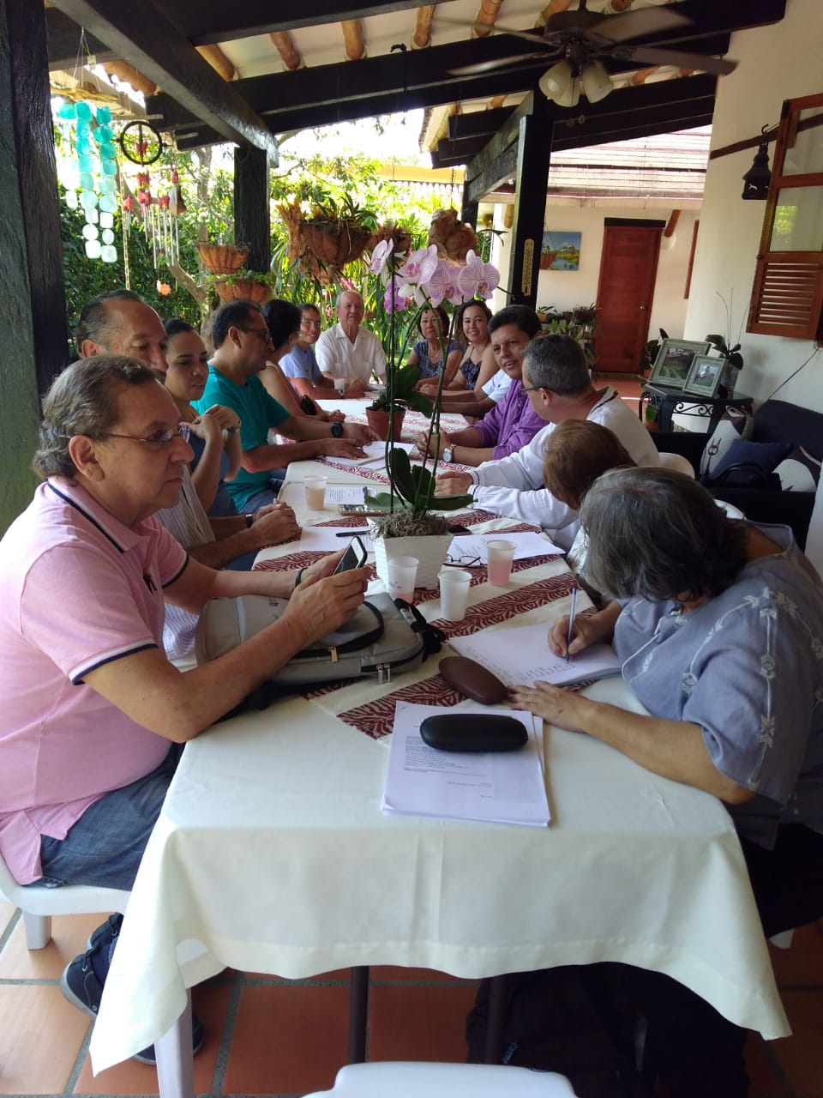
MENTAL HEALTH AND crises GROUP
REPORT ON CALI-COLOMBIA WORKSHOP
Place: JamundÍ´s Suburban area. House of Gabriel and Dorotea. The place was chosen to have a sort of retreat space, providing a green, calm and intimate environment.
Date: August 7, 2019 (A Colombian Holyday)
Participants: A total of 13 Helpers (6) Ladies and (7) men including helpers of Cali and Jamundí. Among them 2 National Helpers, 1 regional and local helpers of both groups. Plus 1 lady who is a regular member that was the host, and the three facilitators. Detailed List provided on the appendix
Facilitating Team: Sarita Martinez, Muchsin Silva and Ramona Ruiz

Slide 2
Expectations of participants
Participants come to the meeting with the following expectations:
To be informed about Mental Illness and Subud crises; especially to have a better criteria about how to asses, support and follow up in such cases.
To identify in the helper´s work, what needs to be done facing reality of member´s and ourselves as a Dewan.
To talk about how to do the follow-up with applicants especially concerning mental health background.

Slide 3
AGENDA
9:00 9:45 am ARRIVAL tea and cofee and snacks
9:45-10:00 am Presentation of Agenda and Background info concerning our group (Sarita, Ramona & Muchsin).
10: 00- 10:30 am Latihan (30 min.)
10:30- 11:10 am Opening with a group exercize concerning words and ideas associated with mental illness and crises in Subud.
11:10 am -12:30 pm Sharing and negotiation of ideas and workshop´s guidelines.
12:30-2:00 pm Lunch Break
2:00-3:00 pm Testing concerning discussed topics. Applicant´s meetings, attitudes towards members in need of support, God´s guidance and inner conection for approppiated attitudes.
3:00-5:00 pm Sharing of experience with the testing and more discussions concerning mental health in Subud
5:00 -6:30 pmMuchsin´s presentation of Matthew´s Power Point illustrated with his own experiences and practice
6:30 -7:00 pm Closures and agreements.
7:15 pm DEPARTURE

Slide 4
Presentation of Agenda and Background info concerning MICRG and the roles of Sarita, Ramona & Muchsin.
MCRG previous work in Subud
International Helpers Committed
Puebla and Freiburg Congresses´ Statements and working parties
Lack of confidence in LH and IH been reached to support unattended or concerning cases
Issues around confidentiality
Matthew´s workshops in Freiburg
Current work of our team
Mostly former IH and other MH professionals

Slide 5
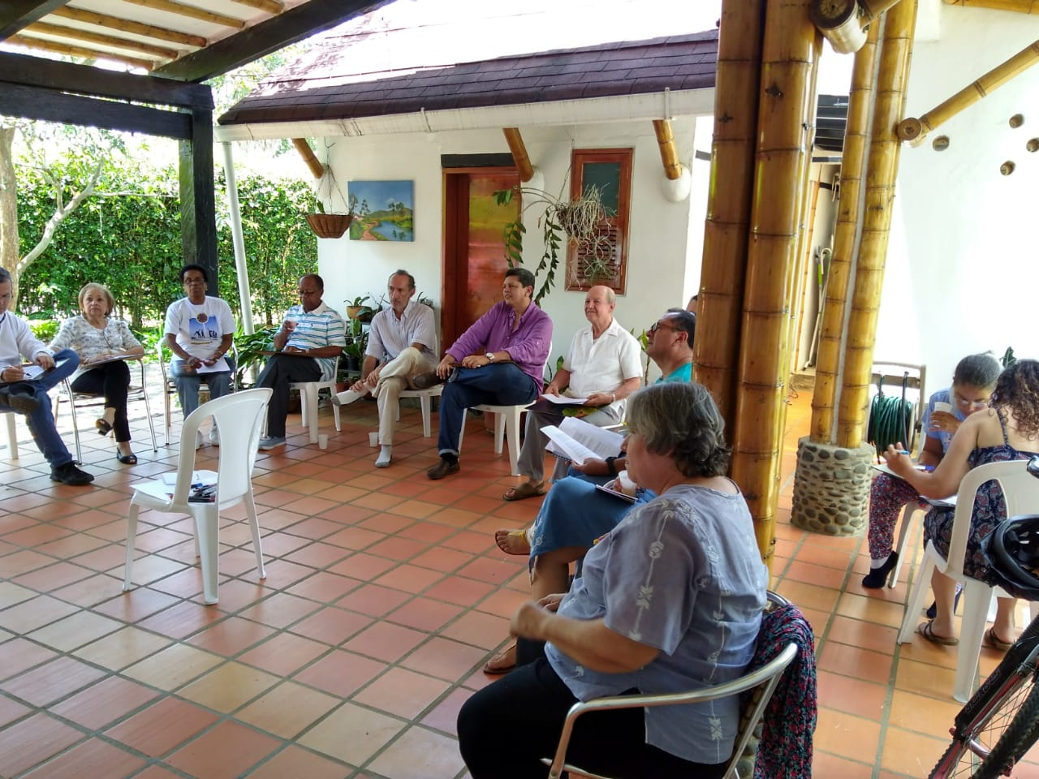
Group exercise concerning key ideas associated with mental illness and crises in Subud
After a Latihan, we started with a group exercise in witch each person listed key words associated to the names of “Mental illness” and “crises”. They were discussed in couples and then presented to the group.
Listing the key words and sharing opened a conversation concerning each helpers experience around these issues.
Here the list of ideas we discussed. (3 slides)

Slide 6
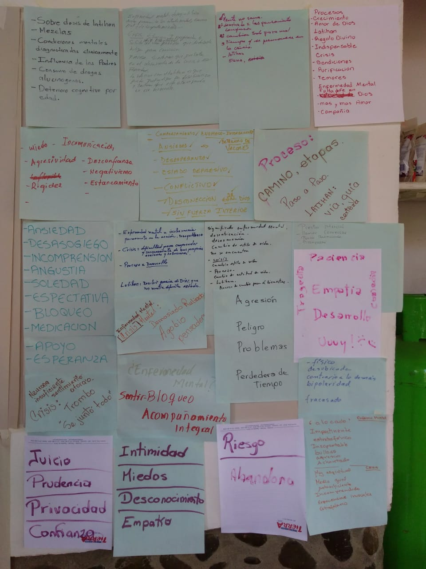
Group exercise concerning words and ideas associated with mental illness and crises in Subud.
Judging –Prudence-Privacy-Trust
Support-Hope
Crazy-impertinent-Difficult-Noisy-Aggressive-Flattened (Person with a Mental Illness)
Very spiritual-sort of a guru-self sufficient-Nobody understands him/her-Unusual experiences- bizarre (Person in crises)
To keep an eye on. To give attention, call and talk. Too much thinking. To stand by him or her and give company.
Danger, aggression, troubles, loosing of time, patience, Empathy, growth, tragedy, comedy. UUUYYY

Slide 7
Group exercise concerning words and ideas associated with mental illness and crises in Subud.
Failure, Looser, Disoriented, opposite to the others, Bipolarity
Anxiety, unrest, misunderstood, loneliness, anguish, To be blocked, Medicines
The neurone is not sufficient, the feelings are trapped, to much on the plate
Risk, abandon
Intimacy fear, empathy, the unknown
Integral support
Good´s gift, purification, fears, lack of faith, Company, fears,
Lack of communication, lack of trust, stagnant, Rigidity, negativity, aggressive

Slide 8
Words and ideas associated with mental illness and crises in Subud.
Latihan´s overdose
Paternal influence
Mental Condition diagnosed clinically
Consumption of Hallucinogenic Substances. (SPA)
Cognitive deterioration due to aging
Mixing
A mind that is not healthy
Dominated by confused thinking
Every thing changes for bad
Consider the timing and duration of crises

Slide 9
Workshop Group´s Agreements
As we develop our brainstorming concerning mental health and crises issues in Subud, a list of guideline agreements for the workshop was built´.
Here are the key points:
Ideas concerning empathy and compassion to speak about cases
Confidentiality. What we discuss today stays in the participants’ group.
Not personalizing in cases and keeping peoples privacy. Keep it general.
To be open towards the cases and situations we where about to discuss.
No to harm (Action with no harm)
To be sincere.
To be brief and concise.
Loving and caring attitude.
To be respectful
To be open and unafraid

Slide 10
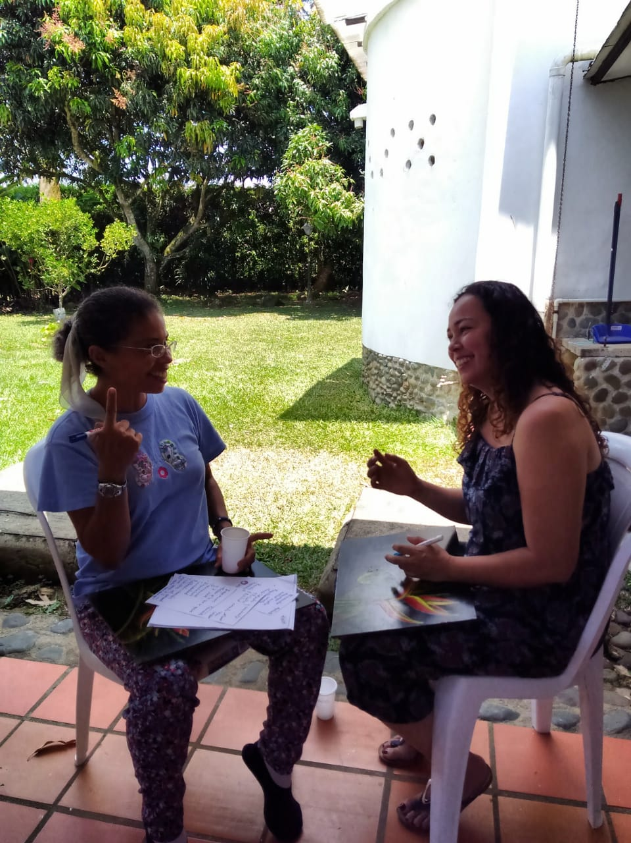
Role play- Listening and talking to applicants
One of the group concerns was the screening of applicants and the orientation concerning mental health and Subud crises, we may give during the application and the follow-up time.
Also, about helpers readiness concerning this topic.
It followed a role play exercise in couple in which this issue was explored.
The couples switched to try both sides of the game.

Slide 11
Role play- Listening and talking to applicants
How do we listen?
To what do we pay attention?
How much concerned are we with the “content “ of our conversation with applicants?
In sum, the group noticed to be:
Overly concern about what to keep in mind, and being a “good helper”.
Sometimes been even “sneaky and invasive with questions and comments”
Too much concerns about the wording of things been caught-up into their minds and feeling and not open and quiet enough, to feel the inner connection with the applicants.

Slide 12
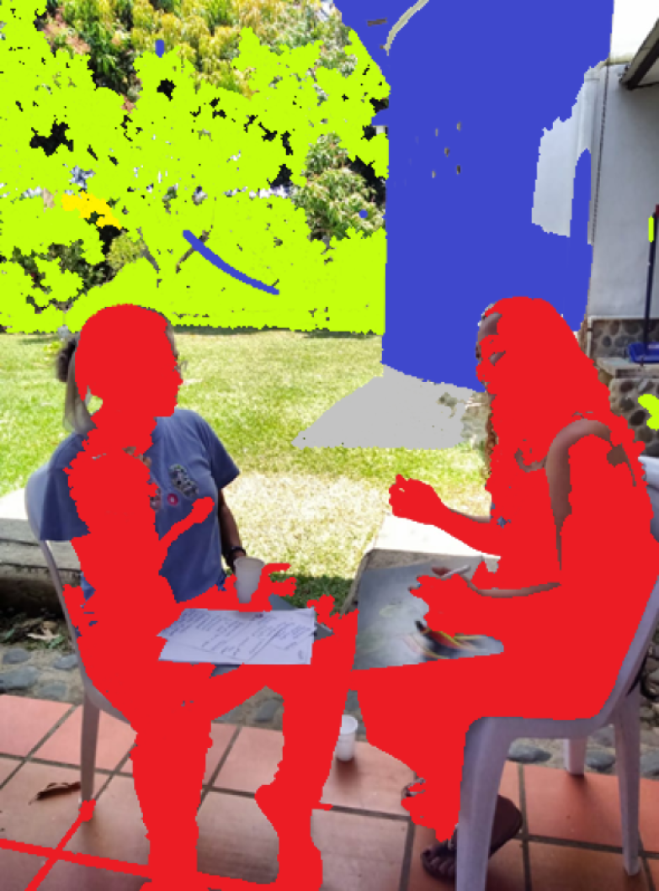
Role play- Listening and talking to applicants
To work in inner quietness
To be prepared for the applicants (fast or be on the right attitude when is the day to come to the applicants´ meeting)
To be openly curios about the applicants´ life story (family and work background, personal concerns, etc.)
Beware of helpers lack of harmony. Beware of power dynamics, specially among helpers.
Trust in Good´s guidance. Even though, sometimes we fail as helpers applicants' have their own experiences and receiving. Some people even experience their own Latihan before been open.
We need to maintain the good habit of checking our work as a helpers and if is right or not for each one of us to continue in her/his helpers role, and to asses, through testing, how we can improve our work as helpers.

Slide 13
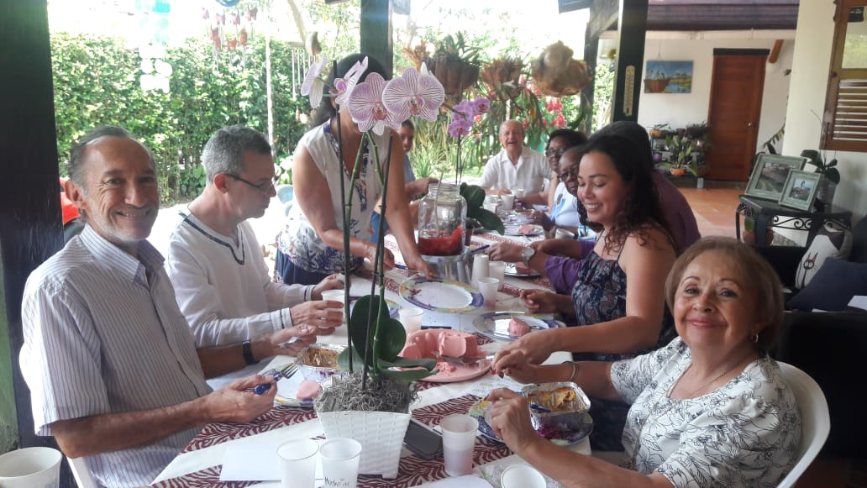
We had healthy snacks and a nice Lunch Break

Slide 14

Afternoon Latihan and testing
After a good lunch break we had more latihan and testing.
Women testing was about feeling their own budhi and sensing how to connect budhi to budhi, checking own receiving and awareness of God´s guidance as helpers.
Men testing was about feeling their actual state of mental health and how it should be accordingly with God´s will.
(Sorry there are not pictures of Latihan and testing available).

Slide 15
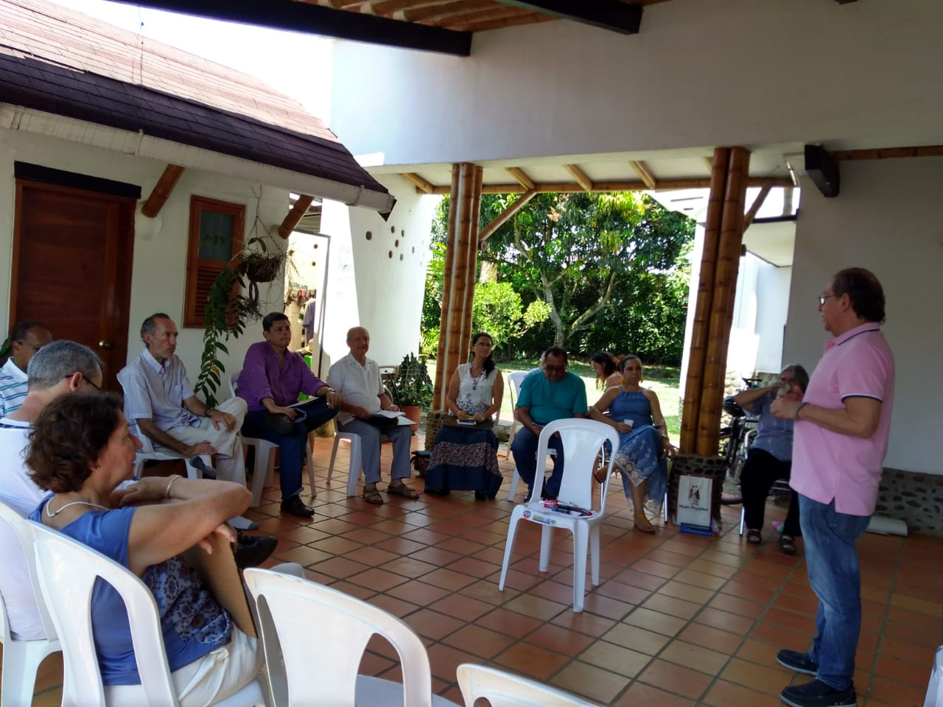
Muchsin´s presentation of Mathews´ article
Very alive and filled with his own experience as a psychiatrist
Presented main facts concerning mental health in the world.
To have a wide view of the continuum of Mental health issues and diversity of life spam crises v.s. Subud crises.
To consider the dynamics of people relating to each other and the token of mental health concerns.
To understand the importance to address mental health issues and to know how to handle them, specially suggesting people´s need to asses problems with support of doctors or psychologist.

Slide 16
CLOSURE & Agreements for Following-up
All agree that this is a very transformative, informative and training exercise.
Also, that we need to set apart more time for new workshops and further developments on this matter.
Noverber the 7th was set as our next date to work together in a similar setting

Slide 17
WhatsApp Ladies´ Comments. Key words: Companionship, good food, good work, tired but happy
Thanks. Congratulations for the attendance and the excellent work we accomplish today. (H)
Excellent work. Very productive day and integrative experience. Thousand of thanks for the sharing and companionship. The food was delicious, and the facilitators well organized. I am tired but very happy. (M)
Thanks to God because he allows us to enjoy a day with a lot of learning, and the companionship of this beautiful Subud Family, Good night and have a nice rest.(B)
Good night, thanks for the companionship, the workshop, the food. I arrived plenty, healthy, zero stress and a feeling of a great flowing.(F)

Slide 18
List of participants (Helpers from Cali)
Ladies
Men
Beatriz
Megan
Marcela
Farah
Honorata
Alma (KC)
Dorotea (Subud member)
Gabriel
Ricardo
Iskandar
Lambert
Reinaldo
Emanuel(Regional Helper)
Manuel (KC)

