Slide 1

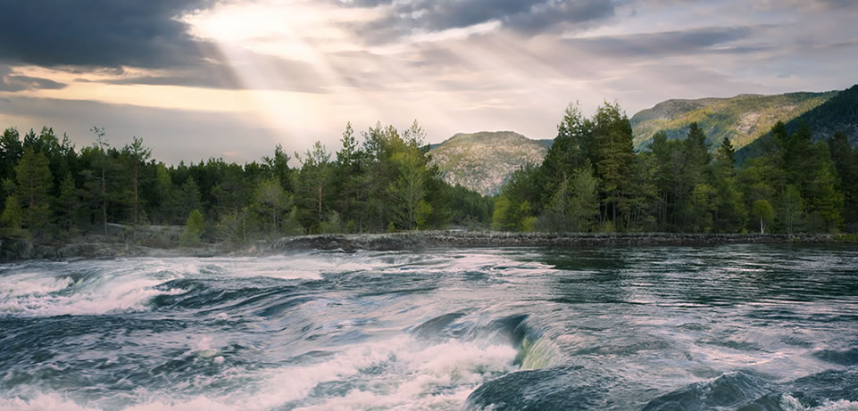
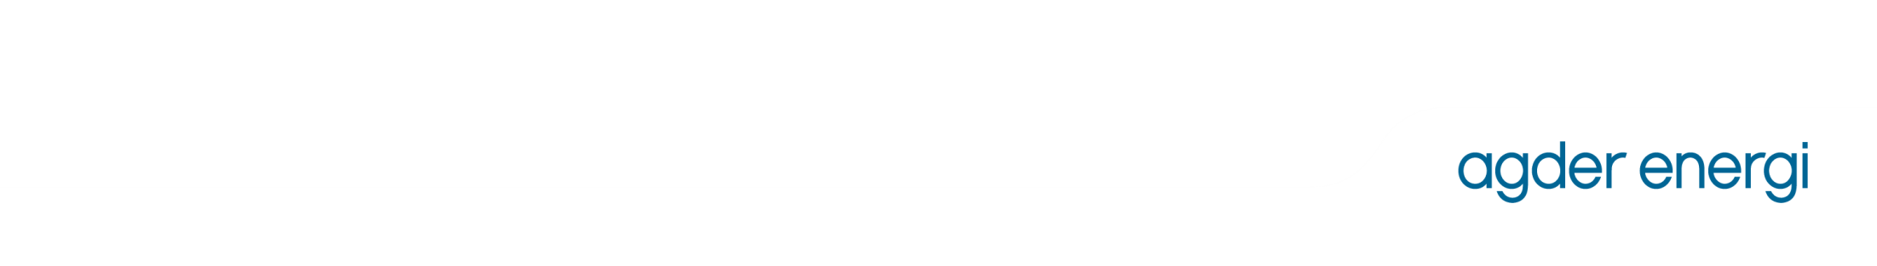
Investor presentation
Annual report 2015 April 29, 2016

Slide 2
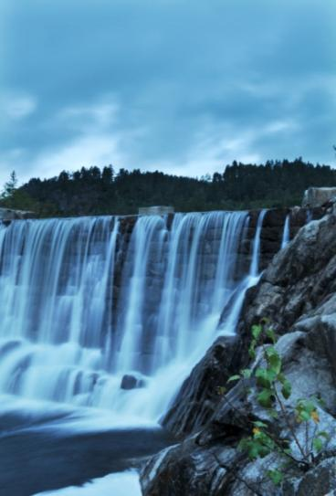
Agenda
Company overview
Strategy and investments
Financial info
Funding and liquidity

Slide 3
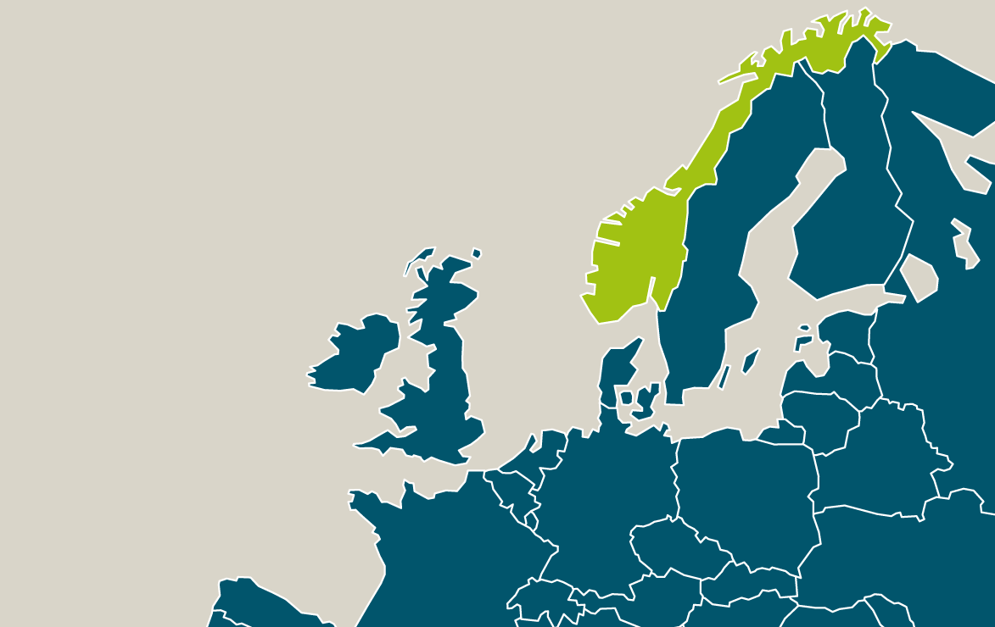
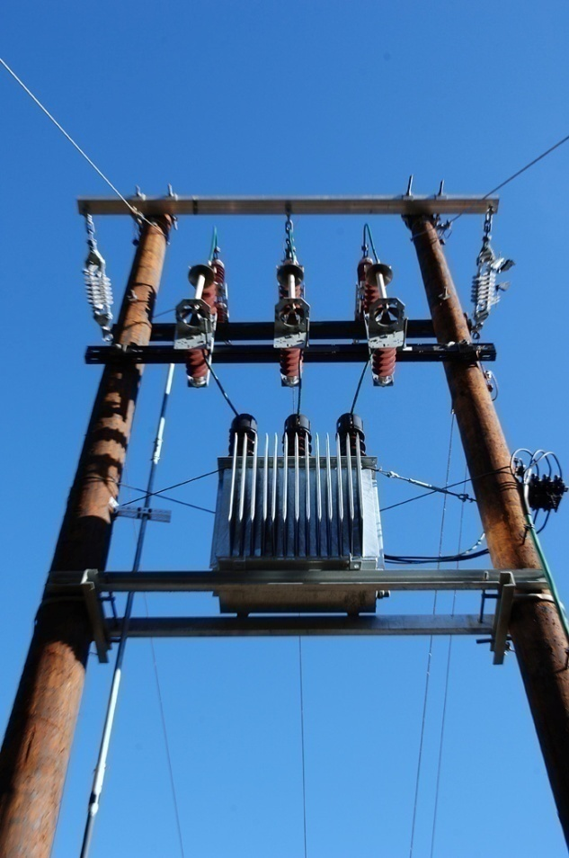
Our vision
A leading Norwegian renewable energy group

Slide 4
Facts about Agder Energi
Vertically integrated energy group, ca. 1 250 employees, sales ca. 8 bn. kr.
Fourth largest energy producer, mean production 7.9 TWh, 49 power stations.
Fourth largest network company, 190 000 customers.
Ca. 9 TWh enduser sales, largest in corporate segment.
45.5 % owned by Statkraft and 54.5 % Agder municipalities.

Slide 5
Organization
Group CEO
Finance and risk management
HR and shared services
Public affairs
Market/business development
Energy management
Hydro electric power
Network
LOS
Otera
AE Varme
AE Venture

Slide 6
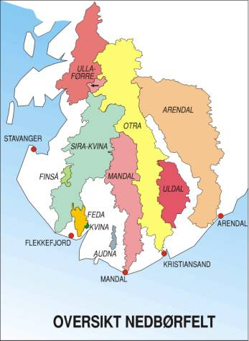
High production flexibility
Water course | Mean production TWh/year | Reservoir capacity TWh
Otra | 3.4 | 2.7
Mandal | 1.7 | 0.5
Arendal | 1.3 | 0.7
Sira-Kvina | 0.8 | 0.7
Ulla-Førre | 0.3 | 0.5
Other | 0.4 | 0.1
Total | 7.9 | 5.3
63 % of annual mean inflow may be stored in reservoirs.
Precipitation Areas

Slide 7
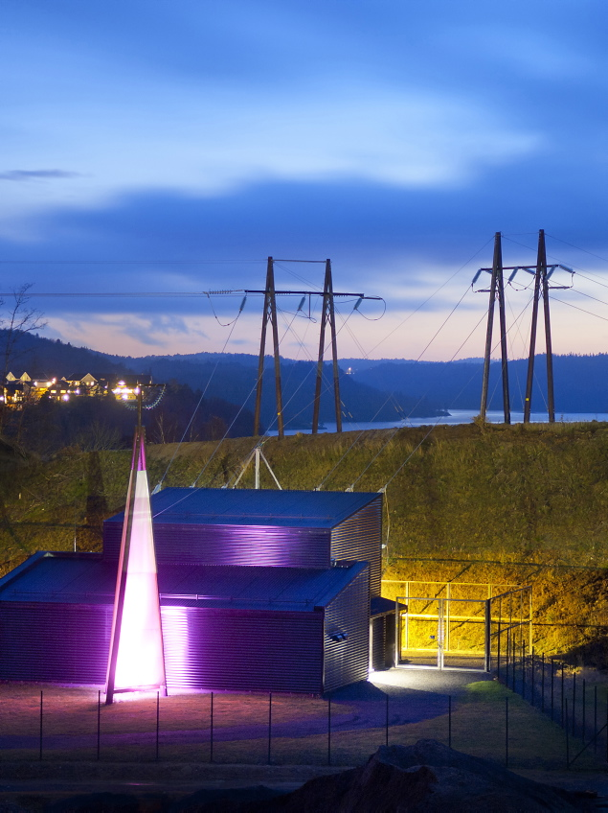
Network consolidated in Agder
Agder Energi Nett owns and operates the local and regional distribution networks in Aust- and Vest-Agder.
Stable and considerable cash flow.
Network capital 3 833 mill. kr.
Notes:
Grimstad Vest trafostasjon

Slide 8
Key credit factors
Strong market position
    Competitive low cost and flexible producer of hydro power.
    Monopoly on regional and local distribution network in the Agder counties.
Strong cash flow
    High level of el-price hedge next 3-5 years, robust hedge the following 10 years from long term power sales contracts.
    Stable and considerable cash flow contribution from monopoly business.
Investment flexibility
    Optionality in existing project portfolio.
Strong and stable ownership structure
    30 coordinated municipalities and Statkraft, which is 100% state owned (AAA).

Slide 9
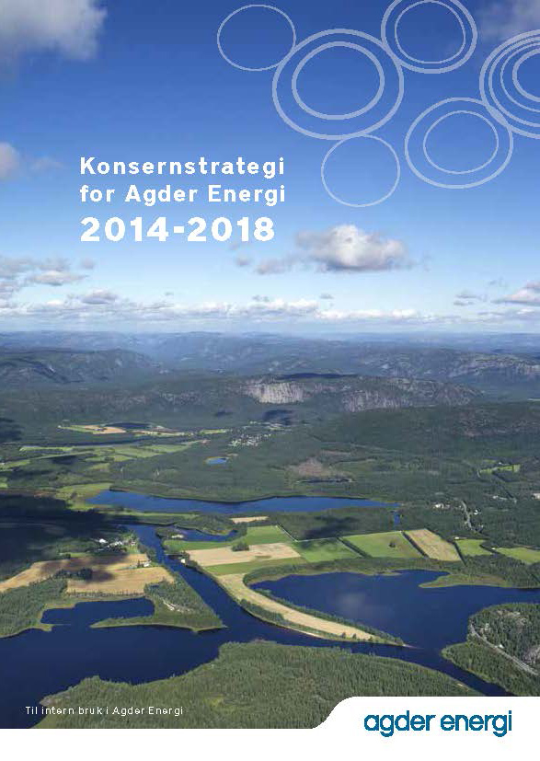
Agenda
Company overview
Strategy and investments
Financial info
Funding and liquidity

Slide 10
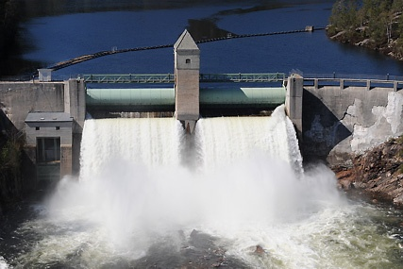
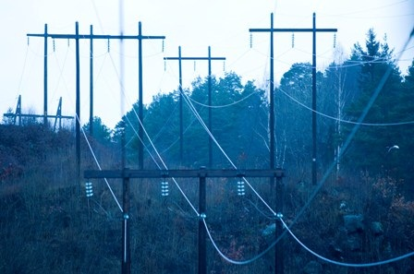
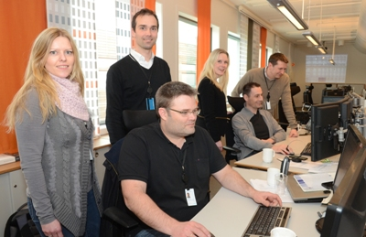
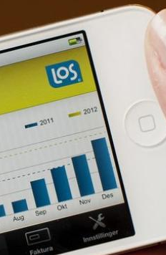
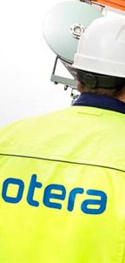
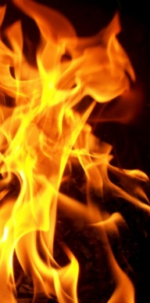
Core business activities
Hydro Power
Network
Build and operate hydro power stations
Build and operate distribution network
Energy Management
Market
Energy management and trading
Value creation of the portfolio
LOS – enduser sales
Otera – infrastructure contractor
Varme – district heating and cooling

Slide 11
Focus on core activities and reallocation of capital
Agder Energi has divested considerable business activities that do not support core business the latter years, recently the share holdings in Småkraft, Fosen Vind and Bjerkreim Vind.
Funds of approximately 1.3 bn. kr is reinvested within hydro power and network.

Slide 12
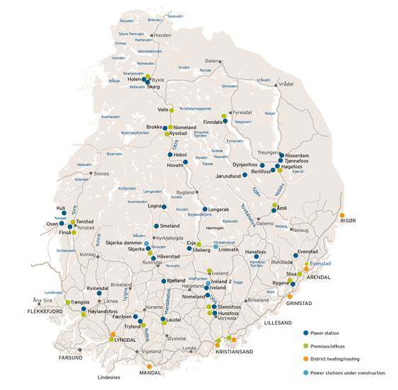
Expansion phase coming to an end
Main projects:
Brokke North and South, Skarg power station 175 GWh. Completed Q2 2014.
Åseral projects, potential of ca. 200 GWh. 2014-2018. Skjerka dam initiated Q3 2014.
Iveland II 150 GWh. In operation from Q1 2016.

Slide 13
Investments 2016-2020
More than 95 % hydro power and network.
Planned investments ca. 1 250 mill. kr per year througout 2018, thereafter down to level 800 mill. kr per year. Reinvestments within network included in the regulated tariffs.
Comitted and gvt. imposed 550 mill. kr on annual average in the 5 year period.
Investments within network include AMS, and Honna which will be taken over by Statnett in 2018.
Options within hydro power.
 | Largest projects
Network | AMS
Hydro power | Skjerka dam and generator
Hydro power | Iveland II

Slide 14
Focus on profit improvement
Organization – a more transparent group structure.
Focus on core business, several companies sold.
Efficiency, reduction of staff.
Continuously improving work processes.
Focus on realization of benefits and gains.
Ensure increased pace and ability to continuing restructuring.

Slide 15
Agenda
Company overview
Strategy and investments
Financial info
Funding and liquidity

Slide 16
Highlights 2015
Robust profit from operations.
  2 235 mill. kr (2 467 mill. kr) underlying EBITDA.
Sold share holdings in Småkraft and Fosen Vind.
High investment activity 1 367 mill. kr (1 200 mill. kr).
  Of which 90 mill. kr (100 mill. kr) of investments within network paid by customers.
All-time low sickness absence.

Slide 17
Key figures
(mill. kr) | 2015 | 2014 | 2013 | 2012 | 2011
Sales | 8 361 | 7 808 | 9 391 | 8 946 | 10 684
Underlying EBITDA | 2 235 | 2 467 | 2 304 | 1 957 | 1 924
Net income after taxes | 1 220 | 475 | 834 | 1 037 | 1 153
Equity ratio | 24.7 % | 22.9 % | 26.1 % | 25.6 % | 21.9 %
Net int. bearing debt | 8 560 | 8 257 | 7 647 | 7 155 | 6 976
FFO/Net debt* | 21.9 % | 25.1 % | 21.8 % | 20.0 % | 19.8 %
* FFO unadjusted, adjustments are made in rating process. Interest bearing debt on 4 quarter rolling basis.

Slide 18
Development in production

Slide 19
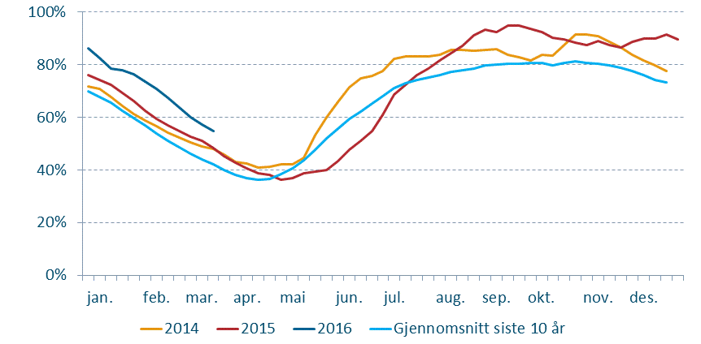
Reservoir levels NO2
10 Y average
Agder Energi’s reservoir levels were considerably higher than average at the and of 2015.

Slide 20
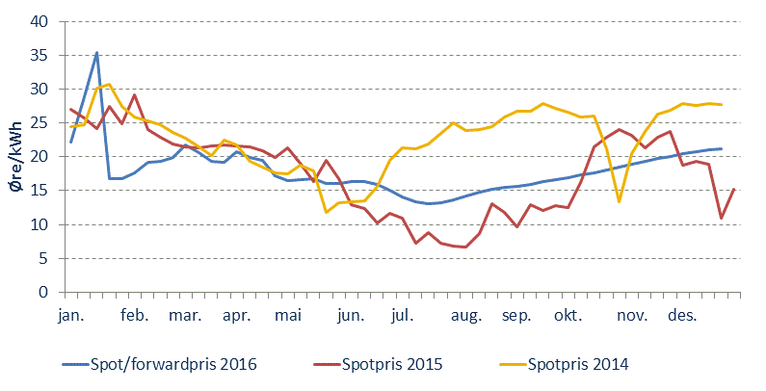
Price development Nord Pool
Average spot price (NO2) 17.7 øre/KWh in 2015, down 22 % from 2014.
Forward prices point to lower prices in 2016 than average spot price in 2015.

Slide 21
Cash flow
Strong cash flow and underlying EBITDA.
Gross investments 1 286 mill. kr. (1 136 mill. kr)
  Of which 90 mill. kr (100 mill. kr) investments within network paid by customers.
90% of investments within hydro power and network.

Slide 22
Development underlying EBITDA¹
¹Adjusted for unrealized value changes in power derivatives and significant
non-recurring items.

Slide 23
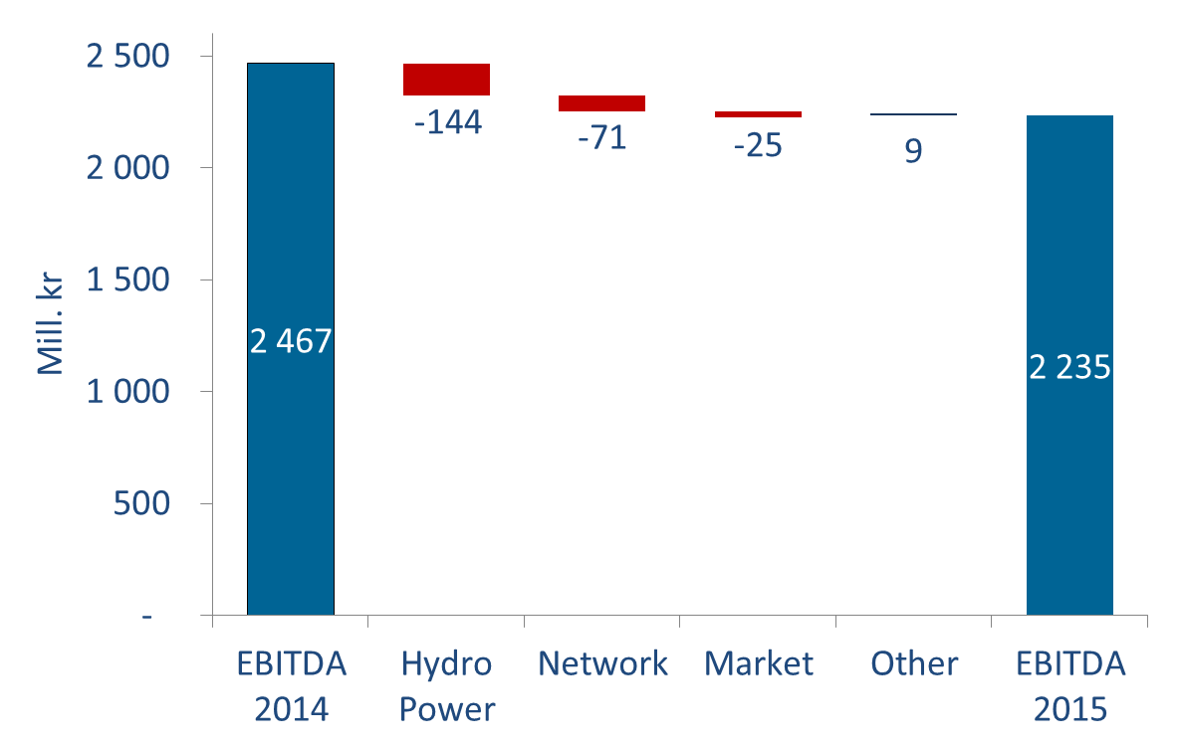
Change in underlying EBITDA¹
¹Adjusted for unrealized value changes in power derivatives and significant
non-recurring items.

Slide 24
EBITDA per profit center²
Distribution 2015 (mill. kr)
Development
²Profit centers are reported according to NGAAP.

Slide 25
Investment per profit center²
Distribution 2015 (mill. kr)
Development
²Profit centers are reported according to NGAAP.

Slide 26
Current dividend policy
Revised down to 400 mill. kr plus 60 % of excess profit.
Based on group income to majority according to NGAAP previous year.
Policy is rule of thumb, qualitative assessment annually.

Slide 27
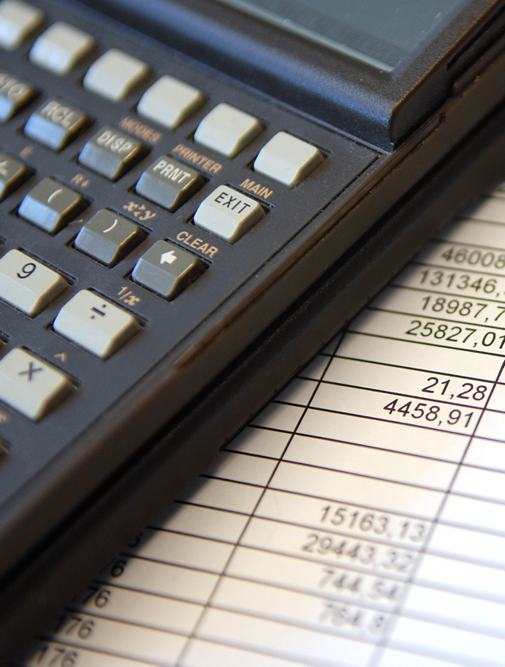
Agenda
Company overview
Strategy and investments
Financial info
Funding and liquidity

Slide 28
Robust funding structure
Funding sources
Maturity profile
Backstop 2 x 500 mill. kr unutilized.
*Including basis swaps from NOK to EUR.

Slide 29
Financial strength and rating
Long term objective shadow rating:
Minimum BBB+
Net interest bearing debt⁴ 8 522 mill. kr (7 935 mill. kr in 2014)
FFO 1 865 mill. kr (1 992 mill. kr in 2014)
³ Unadjusted, adjustments are made in shadow rating.
⁴ Interest bearing debt on 4 quarter rolling basis.

Slide 30
Funding overview
Funding is done at parent company level.
Flexibility by diversified funding sources and sufficient back stop facilities.
Funding need is decided by cash flow from operations and investment activites and dividend.
Maturity 790 mill. kr rest 2016.
Possible funding sources: Domestic bond and CP market, banks, private placement markets, etc.

